Slide 1
Transport Research and Analysis
Module 3: Transport Modeling and Simulation
Lecture 14: Scenario Analysis and Forecasting
Notes:
"Good morning, and welcome to Lecture 14. Today, we address one of the most challenging and crucial aspects of transport planning: dealing with the future. The decisions we make today—about new metro lines, highways, or transport policies—will shape our cities for decades to come. But the future is deeply uncertain. How do we make robust, multi-billion-dollar decisions when we don't know what the world will look like in 20, 30, or 50 years? The answer lies in the disciplined yet creative methodologies of Scenario Analysis and Forecasting. Over the next 45 minutes, we will explore the tools planners use to navigate this uncertainty and design transportation systems that are resilient, adaptable, and prepared for a range of possible futures."

Slide 3
Table of contents
Lecture 14: Scenario Analysis and Forecasting
03 Quantifying the Future……………….……..............20
3.0. What is Forecasting & Why Do We Use It?...........21
3.1. Common Forecasting Methods…….....……………22
3.2. Common Forecasting Methods…............…………23
3.3. Example: Forecasting Metro Ridership..................24
3.4. Limitations & Common Pitfalls of Forecasting...….25
04 Synthesis, Application, and Conclusion................26
4.0. The Integrated Approach……...…………………....27
4.1. Application Example……………............................28
4.2. Final Key Takeaways………………..……..……….29
4.3. References & Further Reading……………….........30
00: Introduction & Objectives……...................................3
0.0. Lecture Overview......................................................4
0.1. Connection to Previous Lecture................................5
0.2. Learning Objectives…………………………………....6
01 What is Scenario Analysis & Forecasting?...............7
1.0. What is Scenario Analysis & Forecasting?................8
1.1. Scenario Analysis vs. Forecasting….........................9
1.2. Why Are These Methods Important?.......................10
1.3. Defining the Planner's Toolkit…………....................11
1.4. The Planner's Toolkit………..…………....................12
02 The Scenario Planning Process…………….............13
2.0. The Purpose and Benefits of Scenario Analysis......14
2.1. The Scenario Planning Process………………..……15
2.2. Example Scenarios: Scenario 1……………......…...16
2.3. Example Scenarios: Scenario 2………..……...........17
2.4. Visualizing Future Mobility Scenarios……………….18
2.5. Group Activity: Brainstorming Key Drivers………....19

Slide 4
Section 00:
Introduction and Objectives

Slide 5

00. Introduction & Objectives
0.0. Lecture Overview.
Lecture Roadmap
The Challenge of an Uncertain Future: Why we need these methods.
Crafting Plausible Futures: The step-by-step process of scenario planning.
Quantifying the Future: An introduction to forecasting techniques.
Synthesis & Application: How scenarios and forecasting work together.
Notes:
"To guide us through this topic, we will follow a clear, four-part structure. We will begin by establishing the challenge of an uncertain future, defining the core problem that these methods are designed to solve.
Next, we will dive into the creative process of crafting plausible futures, providing a step-by-step guide to the art of scenario planning.
Then, we will shift from the qualitative to the quantitative, with an introduction to forecasting, where we'll look at the tools used to make numerical predictions.
Finally, we will bring it all together in our synthesis and application section, showing how these two approaches are combined to create robust, long-term strategies, and we'll conclude with the key takeaways. This structure will take us from the problem to the integrated solution."

Slide 6
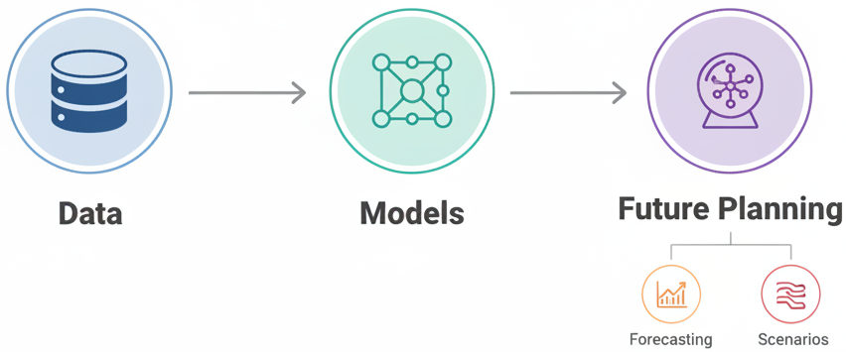
00. Introduction & Objectives
0.1. Connection to Previous Lecture.
Recap: From Data to Models
  In previous lectures, we learned how to collect, clean, and manage high-quality transport data.
  We then used that data to build models that represent and simulate real-world transport systems (e.g., Public Transport Modeling).
Today's Focus: Using Models to Plan for the Future
  Now that we can model the present, we will learn how to use these models to navigate the future.
  This lecture focuses on the two key methods for long-range planning: Forecasting (predicting outcomes) and Scenario Analysis (exploring possibilities).
Notes:
"Before we begin, let's connect today's topic to what we've already covered. In our preceding lectures, we built a strong foundation. We started with the fundamentals of collecting and cleaning data. We then moved on to modeling, learning how to use that data to create a digital representation—a 'digital twin'—of a real-world transport system.
So, we have these powerful, data-driven models that can accurately simulate how our transport network operates today. This brings us to the fundamental question that every planner must face: what now? How do we use these tools to make smart decisions for a future that is inherently uncertain?
That is the focus of our lecture today. We will explore the two primary methods that form the foundation of modern, long-range strategic planning. We will learn how to use our models to perform Forecasting—making quantitative predictions about what is most likely to happen. And we will learn the art of Scenario Analysis—creatively exploring the range of what could happen. Together, these tools allow us to use the models we've learned to build to design resilient and adaptable transport systems for the future."

Slide 7

00. Introduction & Objectives
0.2. Learning Objectives.
By the end of this lesson, you should be able to:
Explain why managing uncertainty is a central challenge in transport planning.
Distinguish between scenario analysis (exploring possibilities) and forecasting (predicting probabilities).
Outline the key steps in the scenario planning process.
Identify common forecasting methods and their primary limitations.
Describe how scenario analysis and forecasting are used together to support robust decision-making.
Notes:
"By the end of our 45 minutes together, you should be equipped with a solid foundational understanding of this topic. Specifically, you will be able to explain why uncertainty is such a critical issue in our field. You will be able to clearly distinguish between the qualitative art of scenario analysis and the quantitative science of forecasting. You will be able to outline the practical steps for how to actually build a scenario. You will be able to identify the major forecasting techniques and, just as importantly, understand their limitations. And finally, you will be able to describe how these two methods are integrated to create powerful, resilient long-term plans. With these goals in mind, let's begin."

Slide 8
Section 01:
What is Scenario Analysis & Forecasting?

Slide 9
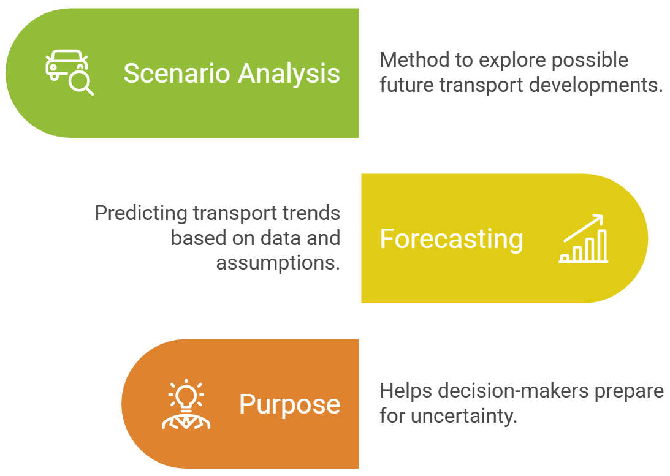
01. What is Scenario Analysis & Forecasting?
1.0. What is Scenario Analysis & Forecasting?
Forecasting
Notes:
"So, why are these methods so important? Because traditional planning, which often assumes the future will be a simple extrapolation of the past, is bound to fail. The world of transportation is defined by deep uncertainty.
We face major technological changes. Thirty years ago, no one was planning for the impacts of ride-sharing apps like Uber or the mass adoption of electric scooters. Today, we have to consider the potentially revolutionary impact of autonomous vehicles.
There are huge economic factors at play. Will oil prices rise dramatically, making public transport more attractive? Or will they fall, encouraging more driving?
Governments introduce new policy changes. A new carbon tax or a major subsidy for electric vehicles could completely change the landscape.
And we see profound social trends. The recent shift towards remote work, for example, has fundamentally altered commuting patterns in ways that few predicted.
Because we cannot know for sure how these drivers will play out, we cannot rely on a single prediction of the future. We must plan for multiple possibilities, and that is the core purpose of scenario analysis and forecasting."

Slide 10
01. What is Scenario Analysis & Forecasting?
1.1. Scenario Analysis vs. Forecasting: A Direct Comparison
Attribute | Scenario Analysis | Forecasting
Purpose | To explore possibilities & manage uncertainty | To predict outcomes & quantify trends
Question | "What could happen?" | "What is most likely to happen?"
Output | A set of plausible, narrative stories | A single quantitative number or range
Methodology | Qualitative & creative | Quantitative & analytical
Primary Use | Strategic thinking & resilience testing | Budgeting, engineering & operational planning
Notes:
"To make the distinction between these two critical tools absolutely clear, let's compare them directly across several key attributes.
Think of their purpose: Scenario Analysis is about exploring the range of what's possible to make our plans more resilient. Forecasting is about predicting a specific outcome to support detailed planning.
This leads to the question they answer. Scenarios ask, 'What could happen?' Forecasting asks, 'What is most likely to happen?'
Their output is also fundamentally different. The output of a scenario process is a set of stories—rich, qualitative narratives about different futures. The output of a forecast is a number—a specific prediction of future ridership or traffic volume.
This reflects their methodology: Scenarios are primarily qualitative and creative, while forecasting is quantitative and analytical.
And this determines their primary use. We use scenarios for high-level strategic thinking. We use forecasts for the hard, numerical work of budgeting, engineering, and operational planning. You cannot substitute one for the other; you need both."

Slide 11
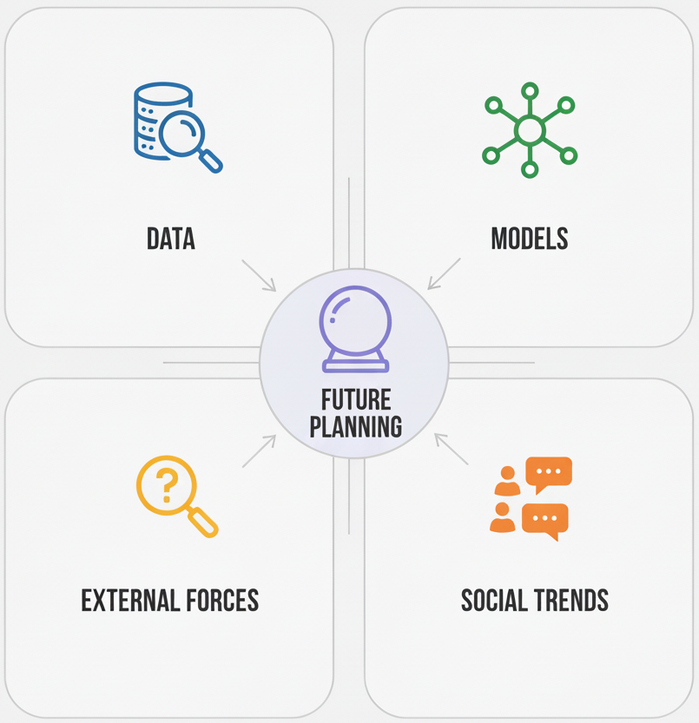
01. What is Scenario Analysis & Forecasting?
1.2. Why Are These Methods Important?
Long-term transport planning involves deep uncertainty. Plans can fail due to unexpected developments.
Key Uncertainties (Drivers of Change):
  Technological Changes: The rise of autonomous vehicles, shared mobility (e.g., Uber), and electric scooters.
  Economic Factors: Fluctuations in fuel prices, economic growth or recession.
  Policy Changes: New environmental regulations, government investment priorities, or land use plans.
  Social Trends: Shifts in population (urban growth), lifestyles (remote work).
Notes:
"So, why are these methods so important? Because traditional planning, which often assumes the future will be a simple extrapolation of the past, is bound to fail. The world of transportation is defined by deep uncertainty.
We face major technological changes. Thirty years ago, no one was planning for the impacts of ride-sharing apps like Uber or the mass adoption of electric scooters. Today, we have to consider the potentially revolutionary impact of autonomous vehicles.
There are huge economic factors at play. Will oil prices rise dramatically, making public transport more attractive? Or will they fall, encouraging more driving?
Governments introduce new policy changes. A new carbon tax or a major subsidy for electric vehicles could completely change the landscape.
And we see profound social trends. The recent shift towards remote work, for example, has fundamentally altered commuting patterns in ways that few predicted.
Because we cannot know for sure how these drivers will play out, we cannot rely on a single prediction of the future. We must plan for multiple possibilities, and that is the core purpose of scenario analysis and forecasting."

Slide 12
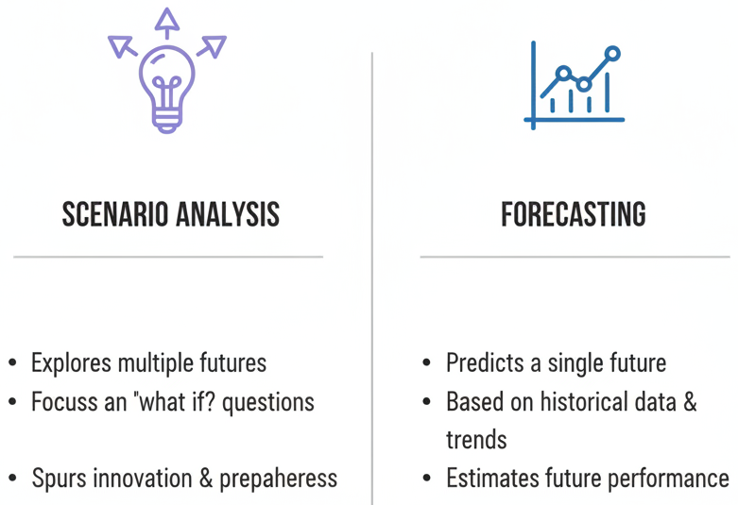
01. What is Scenario Analysis & Forecasting?
1.3. Defining the Planner's Toolkit
We use two distinct but complementary methods to navigate uncertainty:
Scenario Analysis (The Art of Perception)
  A qualitative method to explore several different, plausible possible futures.
  Answers the question: "What could happen?"
Forecasting (The Science of Prediction)
  A quantitative method to predict the outcome of a specific trend based on data and assumptions.
  Answers the question: "What is likely to happen, given a specific set of assumptions?"
Explores multiple futures
Focusses on “What if?” questions
Spurs innovation and preparedness
Predicts a single future
Based on historical data and trends
Estimates future performance
Notes:
"To navigate this uncertainty, planners use a two-part toolkit. It is absolutely critical to understand the difference between these two methods.
First, we have Scenario Analysis. I like to call this the 'art of perception.' It is a qualitative, creative process where we develop a handful of rich, narrative stories about different ways the future could unfold. We are not trying to predict what will happen. We are trying to broaden our perspective and explore the range of what is possible.
Second, we have Forecasting. This is the 'science of prediction.' It is a quantitative, data-driven process where we use statistical or mathematical models to predict a specific outcome, like future ridership or traffic volume. But—and this is key—every forecast is built on a specific set of assumptions.
The two methods work together. Scenario analysis helps us define the different sets of assumptions we need to test, and forecasting then gives us the hard numbers within each of those scenarios. We will explore scenarios first."

Slide 13
01. What is Scenario Analysis & Forecasting?
1.4. The Planner's Toolkit: Common Tools
Planners use a range of software and methods to conduct scenario analysis and forecasting.
For Scenario Planning (Qualitative):
  Workshops & Brainstorming: Facilitated sessions with experts and stakeholders.
  Expert Elicitation: Structured methods like the Delphi Method to build consensus.
  Narrative Development Tools: Visual frameworks for building and communicating scenario storylines.
For Forecasting (Quantitative):
  Spreadsheet Models: Excel for basic trend analysis and what-if simulations.
  Statistical Software: R or Python (with libraries like statsmodels) for advanced time-series and regression modeling.
  Traffic Simulation Software: SUMO, VISSIM, Aimsun for detailed network performance forecasting under different scenarios.
Notes:
"Before we move to our conclusion, let's briefly touch on the actual tools that planners use to do this work. The toolkit includes both qualitative methods and quantitative software.
For the qualitative work of Scenario Planning, the most important tools are often process-oriented. This includes running structured workshops with diverse groups of experts and community stakeholders. It involves formal expert elicitation techniques like the Delphi method, which we mentioned earlier, to gather and synthesize expert opinions.
For the quantitative work of Forecasting, we use a range of software. For simple models, spreadsheets like Excel can be surprisingly powerful. For more rigorous academic and professional work, we use statistical software like R or Python to build complex regression and time-series models. And finally, to forecast the detailed network impacts within our scenarios, we use the kind of traffic simulation software we saw in the SUMO example, which allows us to model the behavior of every vehicle and predict outcomes like travel time and emissions with high precision."

Slide 14
Section 02:
The Scenario Planning Process
Notes:
"This brings us to Section 2 of our lecture. Now that we understand why we need to consider multiple futures, we're going to focus on the practical process of how to actually create them. In this section, we will walk through the step-by-step methodology that planners use to develop rich, insightful, and useful scenarios."

Slide 15
02. The Scenario Planning Process
2.0. The Purpose and Benefits of Scenario Analysis
Scenario analysis is a tool for making more resilient and robust strategic decisions.
Key Benefits:
  Explore Multiple Futures: Avoids the "tunnel vision" of relying on a single prediction.
  Test Decisions: Allows you to evaluate the performance of a project (e.g., Metro vs. BRT) under different future conditions.
  Reduce Risk: Helps identify and mitigate risks, preventing costly investments in projects that might fail in a different future.
  Promote Long-Term Thinking: Encourages planners to think beyond short-term trends and consider long-term structural shifts.
Notes:
"So, why go to all the trouble of creating these stories about the future? Because scenario analysis provides immense strategic value.
First, it forces us to explore multiple futures. The single most dangerous mistake in long-range planning is to bet everything on one official prediction. Scenarios break us out of that tunnel vision and force us to consider a range of possibilities.
Second, it allows us to test our decisions. As the example from the original slides showed, we can take a proposed project, like a new Metro line, and test how it would perform in different scenarios. Would it still be a good investment in a future with low population growth? What about in a future where autonomous vehicles dominate?
This directly helps us reduce risk. By identifying the uncertainties that could cause a project to fail, we can design more resilient strategies or avoid making bad investments altogether.
And finally, the process encourages long-term thinking. It pushes us to look beyond the immediate trends and consider the larger, structural forces that could reshape our world over the next several decades."

Slide 16
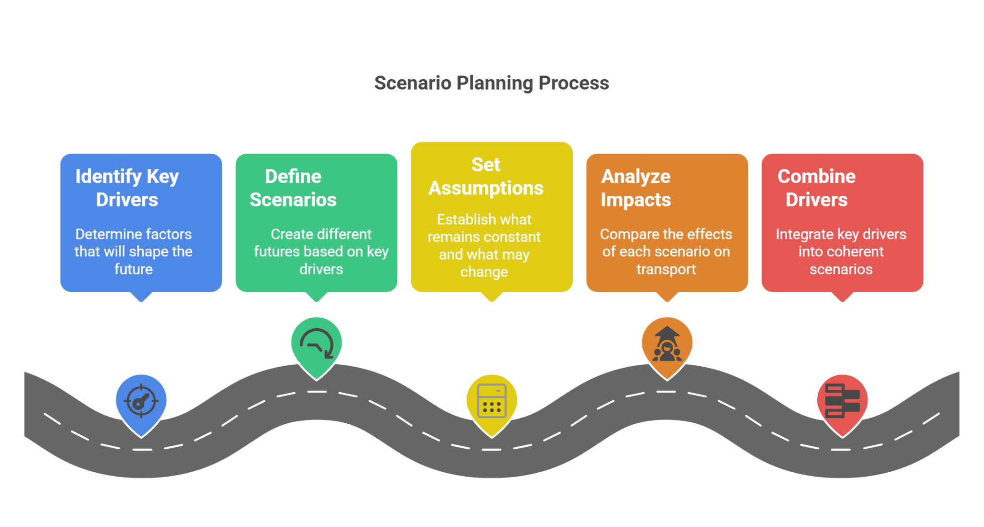
02. The Scenario Planning Process
2.1. The Scenario Planning Process.
A five-step process for developing coherent and useful scenarios:
Set Assumptions:
For each scenario, establish what remains constant and what changes
Notes:
"Creating good scenarios is a structured process, not just random brainstorming. It follows a clear, five-step workflow, as illustrated in this roadmap.
The first, and most important, step is to Identify the Key Drivers. These are the forces of change we talked about earlier—the big uncertainties like the future of technology, the economy, and policy.
Step two is to Define the Scenarios. Here, we choose a few key drivers and imagine different ways they could unfold. For example, we might define two scenarios based on the future of autonomous vehicles: one where they are adopted rapidly and one where they are not.
Step three is to Set Assumptions. For each scenario, we need to be very clear about what we are assuming. In our 'high AV adoption' scenario, what are we assuming about government policy and public acceptance?
Step four is to Analyze the Impacts. This is where we start to connect the scenarios to our transport system. What would the impact of 'high AV adoption' be on congestion, parking, and public transport?
Finally, step five is to bring it all together and Combine the Drivers into a rich, narrative story. A good scenario is not just a list of assumptions; it's a coherent story about a plausible future world."

Slide 17
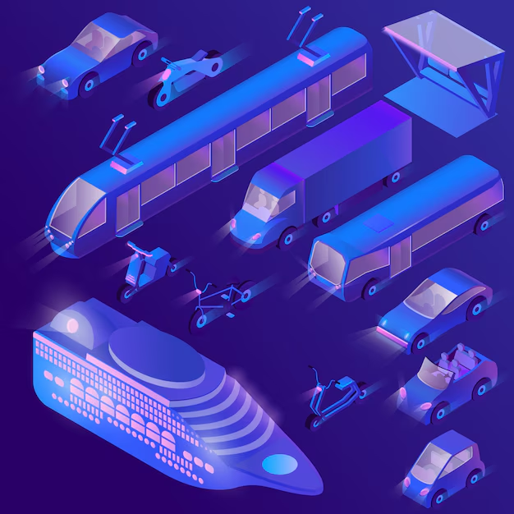
02. The Scenario Planning Process
2.2. Example Scenarios: Scenario 1
Scenario 1: The "High-Tech, Shared" Future
  Key Assumptions:
    Autonomous vehicles and shared mobility (e.g., Uber) are common.
    Private car ownership is low.
  Potential Impacts:
    Lower congestion, less need for parking.
    Public transport focuses on high-capacity, high-density corridors.
Notes:
"Let's make this concrete by looking at two classic, contrasting scenarios.
On one hand, we could imagine a 'High-Tech, Shared' Future. The key assumptions here are that technological trends like autonomous vehicles and shared mobility services become dominant. As a result, fewer people feel the need to own a private car. The potential impacts of such a future would be transformative: with fewer cars on the road, we might see lower congestion and a dramatically reduced need for parking, freeing up valuable urban land. In this world, the role of public transport might shift to focus on providing very high-capacity services on the busiest main corridors.
On the other hand, we could imagine a very different 'Car-Centric' Future. Here, the key assumptions are that governments continue to underinvest in public transport and that policies like fuel subsidies keep driving cheap. This encourages more urban sprawl and high levels of car ownership. The impacts of this scenario are also clear: ever-worsening traffic congestion, higher emissions, and significant equity challenges, as anyone without access to a car would have limited access to jobs and services.
As you can see, by changing just a few key assumptions, we arrive at two vastly different future worlds that would require completely different transportation plans."

Slide 18
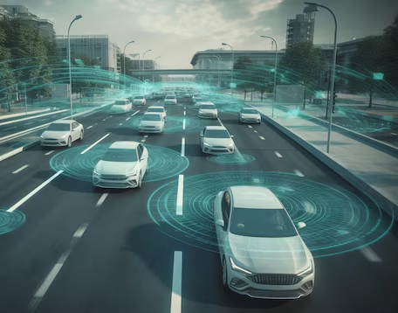
02. The Scenario Planning Process
2.3. Example Scenarios: Scenario 2
Scenario 2: The "Car-Centric" Future
  Key Assumptions:
    Continued weak investment in public transport.
    Cheap fuel and subsidies encourage car ownership and urban sprawl.
  Potential Impacts:
    More traffic congestion, higher emissions.
    Limited access to opportunities for those without a car.
Notes:
"Let's make this concrete by looking at two classic, contrasting scenarios.
On one hand, we could imagine a 'High-Tech, Shared' Future. The key assumptions here are that technological trends like autonomous vehicles and shared mobility services become dominant. As a result, fewer people feel the need to own a private car. The potential impacts of such a future would be transformative: with fewer cars on the road, we might see lower congestion and a dramatically reduced need for parking, freeing up valuable urban land. In this world, the role of public transport might shift to focus on providing very high-capacity services on the busiest main corridors.
On the other hand, we could imagine a very different 'Car-Centric' Future. Here, the key assumptions are that governments continue to underinvest in public transport and that policies like fuel subsidies keep driving cheap. This encourages more urban sprawl and high levels of car ownership. The impacts of this scenario are also clear: ever-worsening traffic congestion, higher emissions, and significant equity challenges, as anyone without access to a car would have limited access to jobs and services.
As you can see, by changing just a few key assumptions, we arrive at two vastly different future worlds that would require completely different transportation plans."

Slide 19
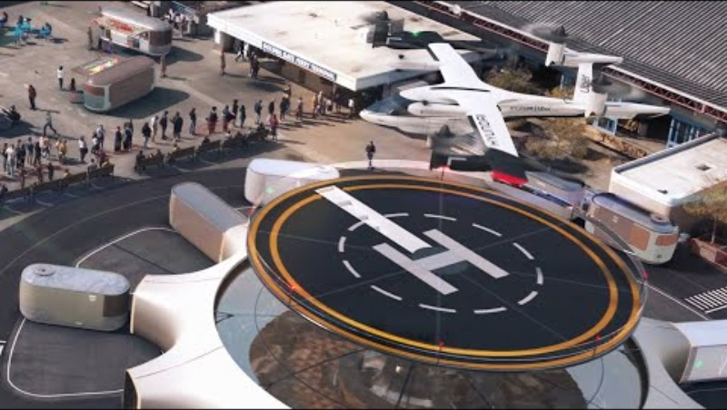
02. The Scenario Planning Process
2.4. Visualizing Future Mobility Scenarios
Notes:
"These descriptions are helpful, but to really understand the power of scenarios, it's best to see them visualized. We're going to watch a short video that brings two different potential futures for urban mobility to life.
As you watch, I want you to think like a scenario planner. Try to identify the underlying assumptions about technology, policy, and human behavior that lead to the different outcomes you see on screen. And pay close attention to how these changes in the transport system can affect the entire physical and social fabric of the city. This is the kind of powerful communication tool that scenario analysis can provide to decision-makers and the public."

Slide 20
02. The Scenario Planning Process
2.5. Group Activity: Brainstorming Key Drivers
Quick Activity (In Pairs):
Prompt:
  Name one key driver (e.g., a technological, economic, or social trend) that could drastically change the future of transport demand in your city.
Instructions:
  You have 1 minute to discuss with a partner.
  Be prepared to share your driver (e.g., telecommuting trends, new rail expansions, shifts in funding, e-commerce growth).
Notes:
"Alright, before we transition to the quantitative side of our topic, let's do a very quick, one-minute activity to apply this idea of 'key drivers.'
Please turn to the person next to you. The prompt is simple: I want you to name one key driver—a single trend or uncertainty—that you think could dramatically change the future of transportation demand in a city you know well.
This could be anything: a technological change like drone delivery, a social change like the widespread adoption of remote work, or a policy change like a major new investment in rail.
You have one minute. Be prepared to share your key driver with the class."
(Facilitate the activity, quickly gathering a few examples from the class to show a diversity of potential drivers. This reinforces the core concept that the future is shaped by multiple, complex forces.)

Slide 21
Section 03:
Quantifying the Future: An Introduction to Forecasting
Notes:
"Excellent. Those examples show you're already thinking about the key drivers that create an uncertain future.
That concludes our section on the qualitative art of scenario planning. We now shift our focus to the other half of our toolkit: forecasting. In this section, we will explore the quantitative science of making numerical predictions about the future. While scenarios help us imagine what could be, forecasting helps us estimate what is likely, given a specific set of assumptions. This is where we put hard numbers to our future visions."

Slide 22
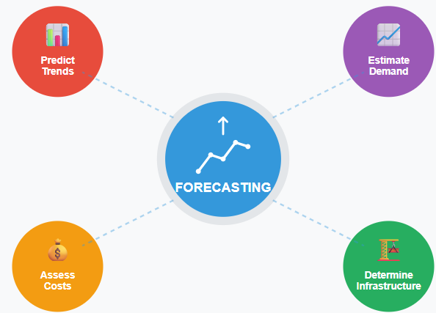
03. Quantifying the Future
3.0. What is Forecasting & Why Do We Use It?
What is Transport Forecasting?
The process of using historical data and statistical models to make quantitative predictions about future transport trends.
Primary Purposes:
Predicts Transport Trends: Identifies future transport patterns using historical data.
Estimates Future Demand: Forecasts demand for transport services and resources.
Assesses Costs: Evaluates potential costs for future transport projects.
Determines Infrastructure Needs: Identifies necessary infrastructure improvements for future demand.
Notes:
"So, what exactly is transport forecasting? It is the process of using historical data and analytical models to make specific, numerical predictions about the future.
Forecasting serves several crucial purposes, as illustrated in this diagram. It is the tool we use to predict future transport trends, such as the growth in electric vehicle adoption or the decline in commuter travel. This allows us to estimate future demand—how many people will want to use a new metro line, or how much traffic a new highway will carry.
Based on these demand estimates, we can then assess the costs of proposed projects. And by comparing the forecasted demand with our existing system's capacity, we can determine our future infrastructure needs.
In short, if scenario analysis gives us the storyline, forecasting provides the critical numbers—the demand, the costs, the capacity requirements—that are necessary for detailed planning and engineering."

Slide 23
03. Quantifying the Future
3.1. Common Forecasting Methods
Forecasting methods range from simple data extension to complex modeling.
Four Main Approaches:
  Trend Extrapolation: Extends current trends into the future, assuming past patterns will continue. (Simplest method).
  Regression Models: Uses historical relationships between variables (e.g., population growth and ridership) to predict future changes.
  Time-Series Analysis: Examines historical data patterns (e.g., seasonality, trends) over time to forecast future values.
  Expert Judgment: Uses insights from professionals and experts, often through structured methods like the Delphi Method, especially when historical data is limited.
Notes:
"There are many different forecasting methods, but they generally fall into one of these four main categories.
The simplest method is Trend Extrapolation. This is essentially drawing a line through your historical data and extending it into the future. It's a quick and easy method, but it dangerously assumes that the trends of the past will continue unchanged.
A more sophisticated approach is using Regression Models. Here, we look for stable, historical relationships between different variables. For example, if we have a model that shows a consistent relationship between population growth and transit ridership, we can use population forecasts to predict future ridership.
Time-Series Analysis is a set of statistical techniques that specifically look at data points collected over time. These models are very good at identifying and projecting patterns like long-term trends or seasonal variations, such as the increase in transit use during the school year.
Finally, when historical data is limited or we expect a major break from past trends, we must rely on Expert Judgment. This isn't just random guessing. It often involves highly structured techniques like the Delphi Method, where a group of experts provides anonymous feedback over several rounds to build a consensus forecast about an uncertain future, such as the adoption rate of a brand-new technology."

Slide 24
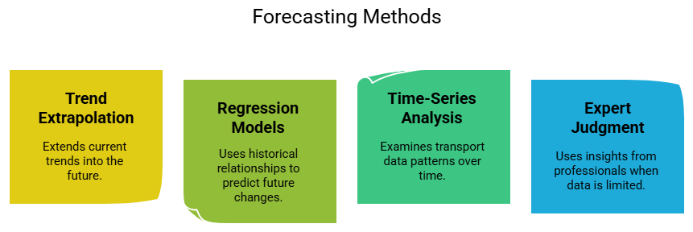
03. Quantifying the Future
3.2. Common Forecasting Methods
Notes:
"There are many different forecasting methods, but they generally fall into one of these four main categories.
The simplest method is Trend Extrapolation. This is essentially drawing a line through your historical data and extending it into the future. It's a quick and easy method, but it dangerously assumes that the trends of the past will continue unchanged.
A more sophisticated approach is using Regression Models. Here, we look for stable, historical relationships between different variables. For example, if we have a model that shows a consistent relationship between population growth and transit ridership, we can use population forecasts to predict future ridership.
Time-Series Analysis is a set of statistical techniques that specifically look at data points collected over time. These models are very good at identifying and projecting patterns like long-term trends or seasonal variations, such as the increase in transit use during the school year.
Finally, when historical data is limited or we expect a major break from past trends, we must rely on Expert Judgment. This isn't just random guessing. It often involves highly structured techniques like the Delphi Method, where a group of experts provides anonymous feedback over several rounds to build a consensus forecast about an uncertain future, such as the adoption rate of a brand-new technology."

Slide 25
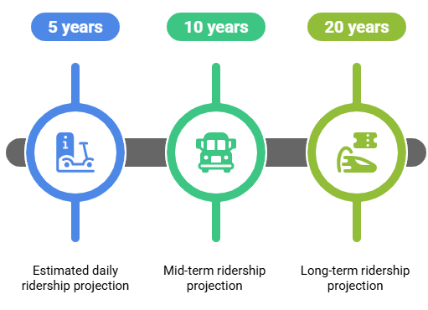
03. Quantifying the Future
3.3. Example: Forecasting Metro Ridership
Scenario: A city is planning a major metro line expansion and needs to forecast future ridership.
Method:
  A Time-Series Analysis model is built using 20 years of historical daily ridership data.
Factors Considered (Model Inputs):
  The model also incorporates external variables like projected population growth, planned new housing developments, and regional economic forecasts.
Output:
  The model produces estimated daily ridership projections for key planning horizons: 5, 10, and 20 years into the future.
Notes:
"Let's look at a classic, practical example of forecasting. A city wants to expand its metro system and needs a reliable forecast of future ridership to justify the investment and plan for the right capacity.
A common method for this is a time-series analysis. The planners would gather as much historical ridership data as they can—say, the last 20 years of daily station entries.
But a good model doesn't just look at past ridership. It also considers the key factors that drive ridership. So, the model would also be fed data on projected population growth in the areas the new line will serve, information about major new housing or commercial developments, and forecasts of regional economic growth.
The final output of the model would be a set of clear, quantitative projections of the estimated daily ridership at different points in the future. These numbers—the 5, 10, and 20-year forecasts—are the critical inputs that engineers use to design the stations, determine the number of train cars needed, and plan the service frequency."

Slide 26
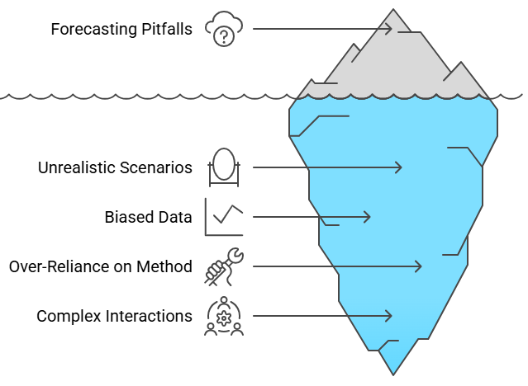
03. Quantifying the Future
3.4. Limitations & Common Pitfalls of Forecasting
All forecasts are wrong. Some are useful. It's critical to understand their limitations.
Common Pitfalls:
Unexpected Trends: Sudden shifts or "black swan" events (e.g., the COVID-19 pandemic's impact on travel) can render forecasts useless.
Technological Disruptions: New technologies (e.g., Uber, e-scooters) can emerge and disrupt established travel patterns in ways historical data cannot predict.
Biased or Incomplete Data: A forecast built on poor-quality historical data will produce a poor-quality forecast.
Over-Reliance on One Method: Relying solely on a simple trend extrapolation can overlook broader uncertainties.
Notes:
"It is absolutely essential to maintain a critical perspective on forecasting. There's a famous saying in statistics: 'All forecasts are wrong, but some are useful.' The goal is not to be perfectly correct, but to be thoughtful and aware of the limitations.
As this iceberg diagram illustrates, there are many hidden pitfalls. The most obvious is that forecasts can be completely derailed by unexpected trends or major global events. The COVID-19 pandemic is the ultimate example; it radically altered travel behavior in a way that no historical data could have predicted.
Similarly, technological disruptions constantly challenge our projections. The rise of ride-sharing services had a significant impact on taxi and public transport demand that was not visible in the data from the years before.
A more controllable pitfall is the use of biased or incomplete data. If your forecast is built on a faulty foundation, its predictions will be unreliable. This is why data cleaning is so important.
Finally, a major mistake is an over-reliance on a single, simplistic method. This is why we need to combine forecasting with the scenario planning process we discussed earlier. Forecasting tells us where the trend is heading, but scenario analysis reminds us that the trend itself could break."

Slide 27
Section 04:
Synthesis, Application, and Conclusion
Notes:
"That brings us to our final section. We have now covered the qualitative art of scenario planning and the quantitative science of forecasting. In this concluding section, we will synthesize these two approaches, look at a final application example, and summarize the key takeaways from our lecture. This is where we bring everything together."

Slide 28

04. Synthesis, Application, and Conclusion
4.0. The Integrated Approach: Scenarios + Forecasting
The most robust approach integrates both methods.
How They Work Together:
  Scenarios Define the Context: Scenario planning creates several plausible future worlds based on key uncertainties.
  Forecasting Quantifies the Outcomes: Forecasting models are then run within each scenario to calculate the specific, quantitative impacts.
Example:
  Scenario 1 ("High-Tech Future"): Forecast the impact on transit ridership.
  Scenario 2 ("Car-Centric Future"): Forecast the impact on transit ridership.
Result: This integrated approach supports resilient, well-informed decisions that are prepared for a range of futures.
Notes:
"So how do we reconcile the creative, qualitative nature of scenarios with the hard numbers of forecasting? The answer is that we integrate them. This is the gold standard for modern, long-range planning.
The process works like this. First, we use scenario planning to define the context. We create our handful of plausible future worlds—the 'High-Tech' future, the 'Car-Centric' future, and so on. These scenarios are our qualitative storylines.
Then, we use forecasting to quantify the outcomes within each of those scenarios. We take our 'High-Tech' scenario and run our forecasting models with assumptions that align with that world (e.g., high AV adoption, low car ownership). This might give us a forecast of a 10% increase in transit ridership. Then, we take our 'Car-Centric' scenario and run the same models but with a different set of assumptions (e.g., high car ownership, low transit investment). This might give us a forecast of a 20% decrease in ridership.
The result is not a single prediction. It is a range of quantitative forecasts, each one tied to a plausible future story. This integrated approach allows planners to develop strategies that are resilient and adaptable, no matter which future unfolds."

Slide 29

04. Synthesis, Application, and Conclusion
4.1. Application Example: Using SUMO for Scenarios
Bringing it all together with a simulation tool.
Scenario: A city is considering adding a new bus lane to a congested corridor.
The Integrated Process:
  Identify Need: Recognize congestion issues on a key corridor.
  Simulate Traffic Scenarios: Use a tool like SUMO to build a model of the corridor. Run two forecasts:
    A "Baseline" scenario (no bus lane).
    A "New Bus Lane" scenario.
  Analyze Simulation Results: Compare the quantitative outputs from the two scenarios (travel time, emissions, bus speeds).
  Decision to Implement: The simulation results show a significant potential reduction in travel time and emissions, providing the evidence needed to support the decision.
Notes:
"Let's look at a final, concrete example of this integrated process in action, using a simulation tool like the open-source platform SUMO.
The scenario is simple: a city wants to reduce congestion on a busy road by adding a dedicated bus lane.
The process follows these steps. First, the planners identify the need. They have data showing that the corridor suffers from heavy congestion and unreliable bus service.
Next, they simulate the traffic scenarios. They build a digital model of the corridor in SUMO. They run a forecast of the 'Baseline' scenario to see how bad the congestion is predicted to be in the future if they do nothing. Then, they run a forecast of the 'New Bus Lane' scenario, with all the same assumptions but with the new infrastructure added.
Then, they analyze the simulation results. They compare the quantitative outputs of the two forecasts. The model might show, for example, that in the 'New Bus Lane' scenario, average bus travel times decrease by 30% and overall vehicle emissions are reduced by 10%.
This quantitative comparison provides the evidence that allows the city to make an informed decision to implement the bus lane. This is a perfect, small-scale example of the integrated scenario analysis and forecasting process."

Slide 30
04. Synthesis, Application, and Conclusion
4.2. Final Key Takeaways
Three key lessons for planning under uncertainty:
  Embrace Uncertainty with Scenarios: Scenario analysis is the primary tool to reduce risk and avoid the trap of relying on a single, flawed prediction of the future.
  Quantify with Forecasting: Forecasting provides the essential, data-driven estimates of future needs and impacts that are required for detailed planning.
  Integrate for Resilience: The most robust and effective long-term strategies are created by using both methods together—combining qualitative stories with quantitative models.
Notes:
"That brings us to the end of our lecture. Let's summarize with three final key takeaways.
First, you must embrace uncertainty by using scenarios. The future is unknowable, and the only way to create resilient plans is to explore a range of plausible futures. Scenario analysis is your tool for doing this.
Second, you must quantify your assumptions with forecasting. While scenarios provide the narrative, forecasting provides the hard numbers needed for engineering, budgeting, and operational planning.
And finally, and most importantly, the best practice is to integrate these two methods for resilience. Use scenarios to define the plausible futures you need to test, and use forecasting to analyze the impacts within each of those futures. This integrated approach is what allows us to create long-term transportation strategies that are not brittle, but are robust, adaptable, and ready for whatever the future may hold. Thank you."

Slide 31
04. Synthesis, Application, and Conclusion
4.3. References & Further Reading
For further exploration of these topics, please consult the following resources:
On Scenario Planning:
  Schoemaker, P. J. (1995). Scenario Planning: A Tool for Strategic Thinking. Sloan Management Review, 36(2), 25-40.
  Godet, M., & Roubelat, F. (2000). Scenario Planning: An Open Future. Technological Forecasting and Social Change, 65(1), 1-2.
On Transport Forecasting:
  Ortúzar, J. de D., & Willumsen, L. G. (2011). Modeling Transport (4th ed.). John Wiley & Sons. (See chapters on forecasting).
On Transport Futures:
  Banister, D. (2008). The Sustainable Mobility Paradigm. Transport Policy, 15(2), 73-80.
Notes:
"For those of you who wish to delve deeper into these topics, these are some excellent academic resources. The work by Schoemaker is a classic, foundational paper on scenario planning from a strategic management perspective. The Ortúzar and Willumsen textbook, which we have mentioned before, has excellent chapters on transport forecasting methods. And David Banister's paper provides a thought-provoking look at the paradigm of sustainable mobility, which is often the goal of our future scenarios. I'm now happy to take any questions you may have."

Slide 32
Thank you for your attention!
Notes:
Thank You

