Slide 1
Transport Research and Analysis
Module 3: Transport Modeling and Simulation
Lab 7: Traffic Flow Simulation
Notes:
Hi everyone, and welcome to Lab 7 of our Transport Research and Analysis course. In this lab, we’ll explore traffic flow simulation using a powerful tool called VISSIM. Whether you’re new to simulation or have some experience, don’t worry—this session is designed for beginners and we’ll guide you step by step.

Slide 3
Table of contents
Traffic Flow Simulation
Section 1: Lab Overview and Required Tools .…………………………………………………………. 4
1.1 Objectives - Traffic Flow Simulation …….……………………………………………………… 5
1.2 Lab Activities and Time Allocation ...…….……………………………………………………… 6
1.3 Tools Used in This Lab …………………….……………………………………………………… 7
Section 2: Introduction and Install VISSIM …………….………………………………………………. 9
2.1 Introduction and System Requirements ….…………………………………………..………… 10
2.2 Download VISSIM Student Version & Install ………………………………………………….. 11
Section 3: Create and Run VISSIM Simulation ….………….......……………………………...……… 13
3.1 Setting Up a Basic Intersection …………….…………………………………………….……… 14
3.2 Running Simulations ………………………….…………………………………………………… 26
3.3 Observe Traffic Flow Patterns …………………………………………………….......………… 28
Section 4: Analyzing and Improving Traffic Flow …..………….……………………………...………. 29
4.1 What is a Bottleneck? …………………………………………………………………….……….. 30
4.2 Identify Bottlenecks and Queues ……………………………………………………….……….. 31
Notes:
The main goal of this lab is to help you understand how traffic behaves at intersections. You’ll learn how to build a simple intersection in VISSIM, simulate vehicle movements, and analyze the impact of signal timing on traffic flow. By the end of this lab, you’ll be able to identify congestion patterns and suggest ways to improve intersection performance.

Slide 4
Table of contents
Traffic Flow Simulation
Section 5: Adjust Signal Timings ……………….……………..…………………………………………. 34
5.1 Why Signal Timing Matters? ………………………...…………………………………………… 35
5.2 Add Signal Heads to the Intersection …………………………………………………………… 36
5.3 Create and Assign a Signal Controller ………………………………………………...……….. 38
5.4 Save and Re-Run the Simulation …….………………………………………………...……….. 41
5.6 Observe the Changes in Traffic Flow After Signal Adjustments ….………………………… 42
5.7 Compare Traffic Flow Visually ………………………………………………………………...…. 43
Section 6: Traffic Performance Metrics Analysis and Data Export ……………………………..…. 45
6.1 Add and Enable Evaluation Objects to Your Network ……………….…………………….… 46
6.2 Create & Analyze Charts …………………………………………….………………………….... 51
6.3 Export Data to CSV …………………………………………………...…………………………… 55
Section 7: Homework Assignment ………………………………………..…………………………..…. 55
7.1 Add and Enable Evaluation Objects to Your Network ……………….…………………….… 56
Section 8: References …………………………………………………….……………………………. 61
Notes:
VISSIM is a microscopic traffic simulation software developed by PTV Group. It’s used by engineers and planners to model real-world traffic conditions. What makes VISSIM special is its ability to simulate the behavior of individual vehicles—like how they accelerate, change lanes, or respond to traffic signals.

Slide 5
Section 01:
Lab Overview and Required Tools
Notes:
# English
Now we are in Section 1: Overview and Tools.
Let’s quickly see what this lab is about and what tools we’ll use.
# French
Nous voici maintenant à la section 1 : Présentation et outils.
Voyons rapidement en quoi consiste cet atelier et quels outils nous utiliserons.

Slide 6
1. Lab Overview and Required Tools
1.1 Objectives: Traffic Flow Simulation using PTV VISSIM
In this lab, students will explore how to simulate traffic flow at a real-world intersection using microscopic traffic simulation. The focus is on understanding traffic behavior, analyzing congestion, and evaluating how signal timing adjustments can improve flow efficiency.
You will learn:
✅ Design a basic intersection in VISSIM using a real map from Klagenfurt.
✅ Define vehicle inputs and simulate vehicle movements under default signal settings.
✅ Observe traffic behavior, vehicle flow, and signal control within a simple intersection.
✅ Analyze congestion patterns by identifying bottlenecks and adjusting green/red light durations.
✅ Learn how changes in signal timing impact traffic performance.
✅ Collect key performance metrics such as travel time, delay, and queue lengths.
✅ Understand how signal optimization can improve overall traffic flow efficiency.

Slide 7
1. Lab Overview and Required Tools
1.2 Lab Activities and Time Allocation
This lab guides students through simulating and analyzing traffic flow using PTV VISSIM. Activities include designing intersections, adjusting signals, and evaluating performance metrics. Hands-on tasks are combined with analysis to reinforce simulation skills.
Section | Topic | Tools | Activity Type | Activity Done By | Duration (min)
1 | Lab Overview and Required Tools | - | Presentation | Teacher | 10
2 | Introduction and Install VISSIM | VISSIM | Practical | Teacher + Student | 15
3 | Create and Run VISSIM Simulation | VISSIM | Practical | Teacher + Student | 35
4 | Analyzing and Improving Traffic Flow | VISSIM | Practical | Teacher + Student | 25
5 | Adjust Signal Timings | VISSIM | Practical | Teacher + Student | 20
6 | Traffic Performance Metrics Analysis and Data Export | VISSIM | Practical | Teacher + Student | 20
7 | Homework: Assignment 1 (at home 120-180min) | VISSIM | Homework | Student | 10
Total |  |  |  |  | 135
Notes:
# English
In this lab, we will explore data preprocessing techniques that are essential for preparing raw transport or tabular datasets for analysis. You will learn how to clean, standardize, and visualize real-world datasets using Python and Google Colab.
We have 8 main sections in this lab, and altogether, it will take approximately 135 minutes to complete all the activities.
# French

Slide 8


1. Lab Overview and Required Tools
1.3 Tools Used in This Lab
When following this lab, you will need to use the following tool:
✅ VISSIM: VISSIM is a microscopic traffic simulation software developed by PTV Group. It is widely used by transportation engineers and researchers to model and analyze traffic flow, optimize intersections, and evaluate signal timing strategies.
Notes:
# English
For this lab, we will use three main tools:
Python for cleaning and analyzing data,
Google Colab to run Python in your browser,
and Excel to quickly preview and inspect the provided CSV datasets and the cleaned output files.
# French
Pour ce laboratoire, nous utiliserons trois outils principaux : Python pour nettoyer et analyser les données, Google Colab pour exécuter Python dans votre navigateur et Excel pour prévisualiser et inspecter rapidement les fichiers CSV bruts.

Slide 9
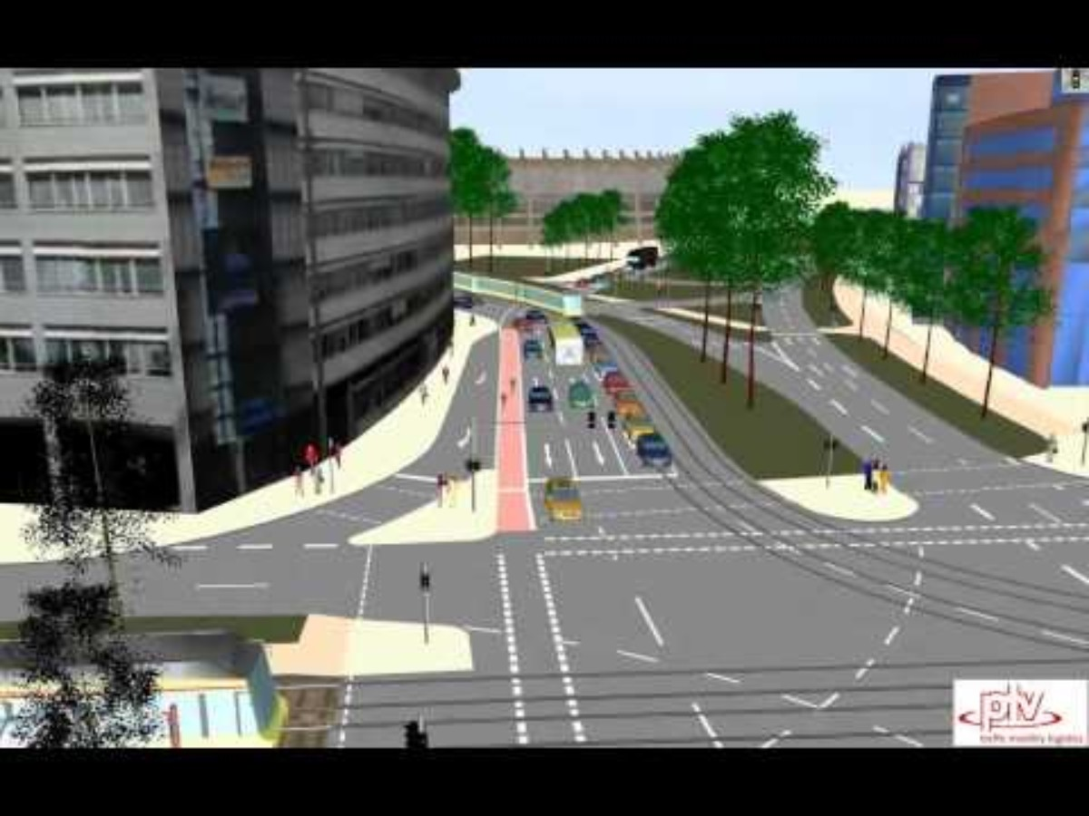
Traffic Flow Simulation - Video
Complex Intersection Simulation Using VISSIM:
This VISSIM simulation models a complex signalized intersection in Karlsruhe, Germany, showing cars, buses, trams, trucks, pedestrians, and cyclists using advanced 3D visualization.
Video Credits: PTV Group
Video link:
https://youtu.be/OtYby7QnyAE
Notes:
# English
Here’s a detailed simulation of a complex intersection in Karlsruhe, Germany, built using PTV VISSIM. This intersection includes cars, buses, trucks, trams, pedestrians, and cyclists, all moving together in a busy urban setting. The video shows how VISSIM’s 3D visualization helps traffic engineers design safer and more efficient signal timings. It’s a great example of how simulation tools can solve real-world traffic problems and help communicate ideas to both technical and non-technical audiences.
# French

Slide 10
Section 02:
Introduction and Install VISSIM

Slide 11
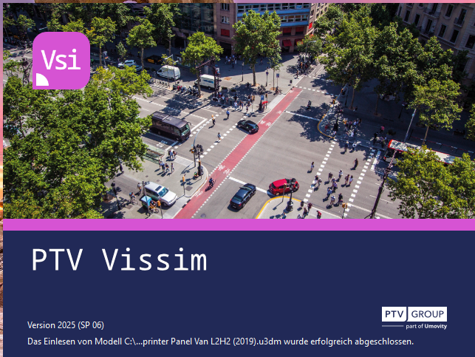
2. Introduction and Install VISSIM
2.1.1 Introduction
VISSIM is a microscopic traffic simulation software developed by PTV Group. It is widely used by transportation engineers and researchers to model and analyze traffic flow, optimize intersections, and evaluate signal timing strategies.
Application Areas:
✅ Urban intersections
✅ Highway corridors
✅ Public transport analysis
✅ Pedestrian crossings
✅ Intelligent Transportation Systems (ITS)
      Follow the Lab 1 for learn more about VISSIM.
Notes:
VISSIM is a microscopic traffic simulation software developed by PTV Group. It’s used by engineers and planners to model real-world traffic conditions. What makes VISSIM special is its ability to simulate the behavior of individual vehicles—like how they accelerate, change lanes, or respond to traffic signals.
So, why should we use VISSIM? It’s great for testing different road layouts, signal timings, or traffic policies—without having to build anything in the real world. It helps us make smarter planning decisions, reduce congestion, and improve safety.

Slide 12
2. Introduction and Install VISSIM
2.1.2 System Requirements
To run VISSIM efficiently, ensure your system meets the following requirements:
Minimum Requirements:
      ✅ OS: Windows 10 (64-bit)
      ✅ Processor: Intel Core i5 or equivalent
      ✅ RAM: 8 GB
      ✅ Graphics: DirectX 11 compatible GPU
      ✅ Storage: 5 GB free disk space
2.2 Download VISSIM Student Version and Install
      Follow the Lab 1 for install VISSIM student version.
✅ Get the student version here:
https://your.visum.ptvgroup.com/vision-traffic-suite-students-en
Notes:
To get started, install the VISSIM student version from the link in your guide. Once installed, open the program and create a new project. You’ll use the map background to locate a real intersection in Klagenfurt—ideally near the university—and then draw road segments called ‘links’.

Slide 13
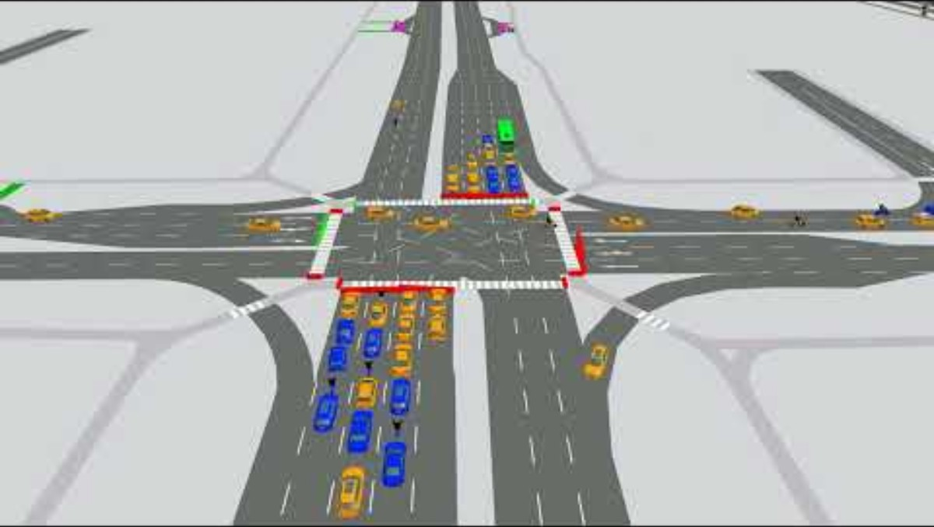
Traffic Flow Simulation - Video
Real World Traffic flow simulation in Singapore:
This video shows a VISSIM simulation of a proposed traffic solution for the East Coast Extension in Singapore, focusing on restricted turn lanes to improve traffic flow.
Video Credits: PTV Group
Video link:
https://youtu.be/K0Ejf0xQ_LU
Notes:
# English
Here’s an interesting simulation video created as part of a master's project in Singapore. The team used PTV VISSIM to model traffic in the East Coast Extension area. This project explores how restricted turn lanes can improve traffic movement in a busy corridor. You can see how they tested future mobility scenarios and used VISSIM to support urban traffic planning.
# French

Slide 14
Section 03:
Create and Run VISSIM Simulation

Slide 15
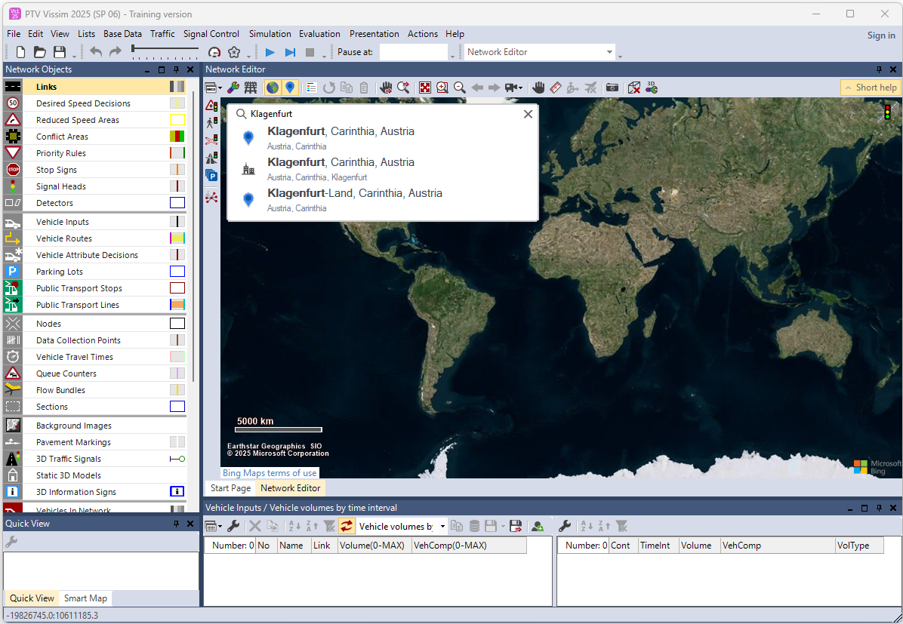
3. Create and Run VISSIM Simulation
3.1 Setting Up a Basic Intersection for Simulation
Step 1: Launch VISSIM and create a new project
  Open PTV VISSIM.
  Click on File > New to create a new simulation
  project.
  Save the file with a name like:
  VISSIM_Lab7_Klagenfurt_Intersection.inpx
Step 2: Locate the area using background map
  Use the “Find Location” icon in the search bar to find an intersection in Klagenfurt.
  Keyword: Klagenfurt, Austria

Slide 16
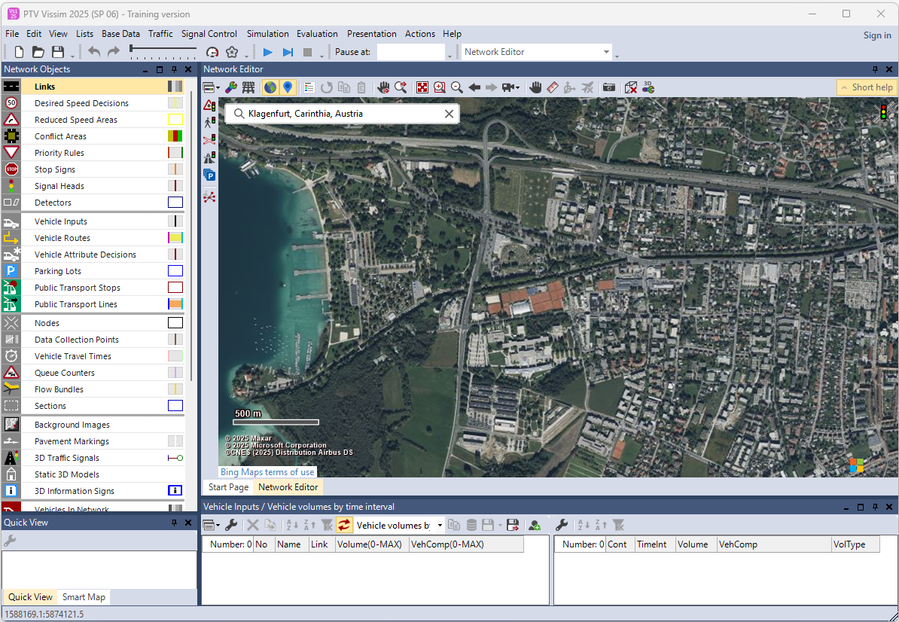
3. Create and Run VISSIM Simulation
  Zoom in to find an intersection near Alpen-Adria-Universität Klagenfurt.
  Example: https://maps.app.goo.gl/UYrqEas8xDv3HAz57

Slide 17
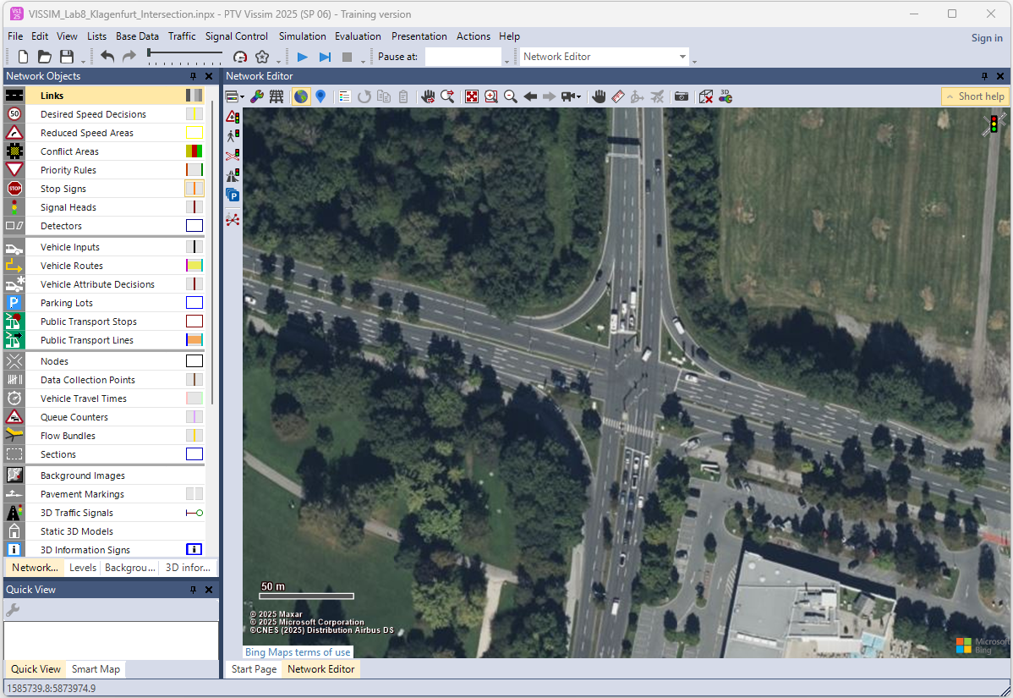
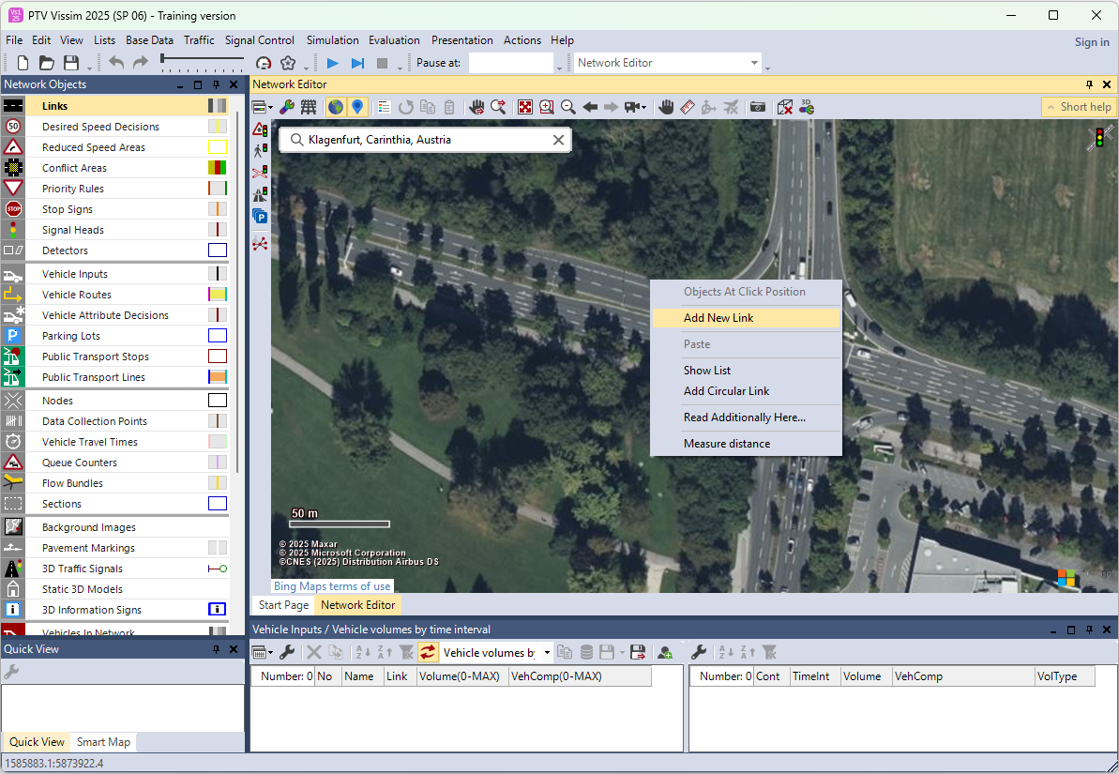
3. Create and Run VISSIM Simulation
Step 3: Draw Links (Road/Lane Segments)
  On the left toolbar,
  click Network Objects > Links.
  Right-click on the road and click one end of a road to start drawing. Follow the real-world geometry on the satellite image.

Slide 18
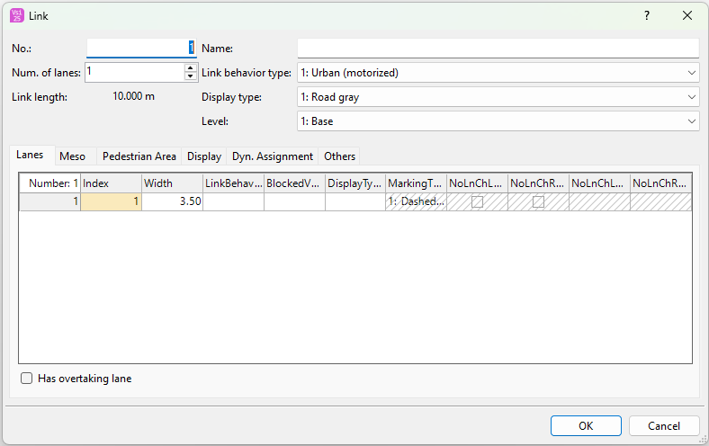
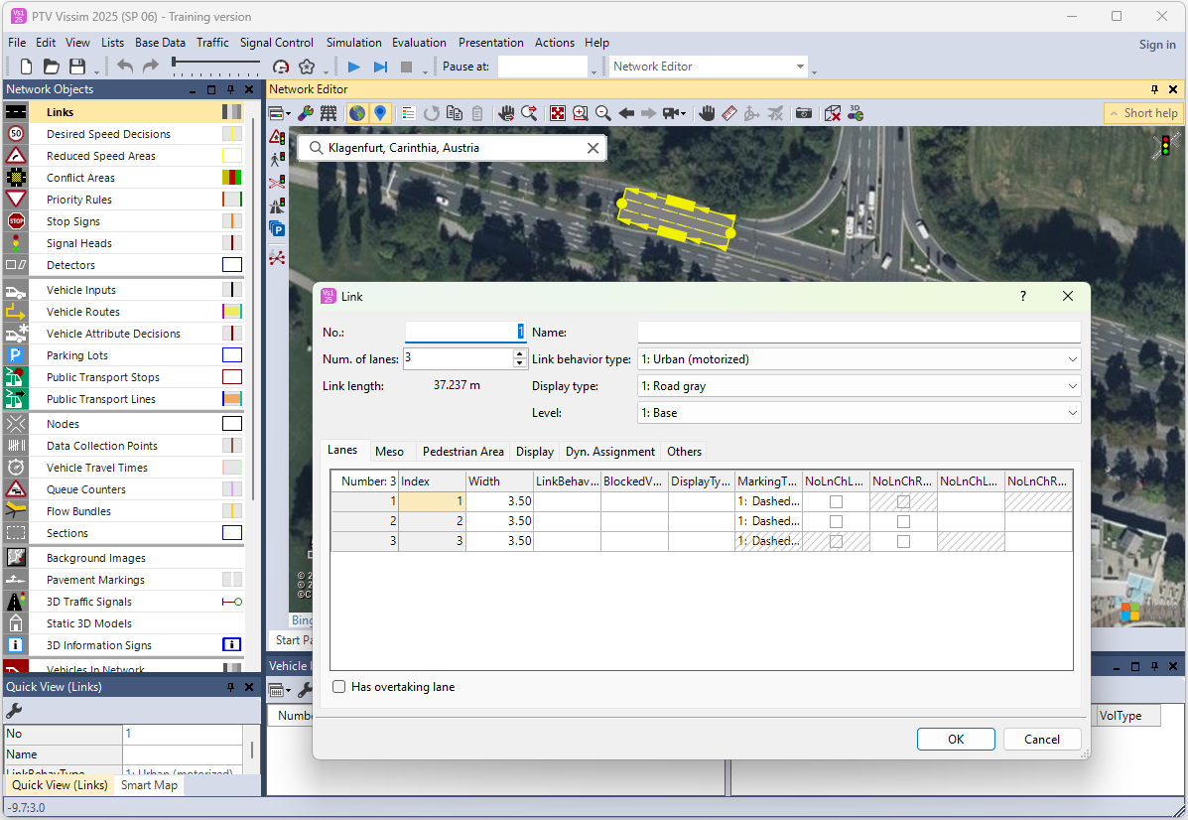
3. Create and Run VISSIM Simulation
  Define the number of lanes in the link attributes
  (ex: 2 lanes for main roads, 1 for side roads)
  You can edit the link by double clicking on the link or right clicking on the link and select “Edit”
  According to the road, you can change the attributes on the links;
  ✅ Link Number, Number of lanes, Name, Link behavior type, Display type, Level, Lane width, etc.

Slide 19
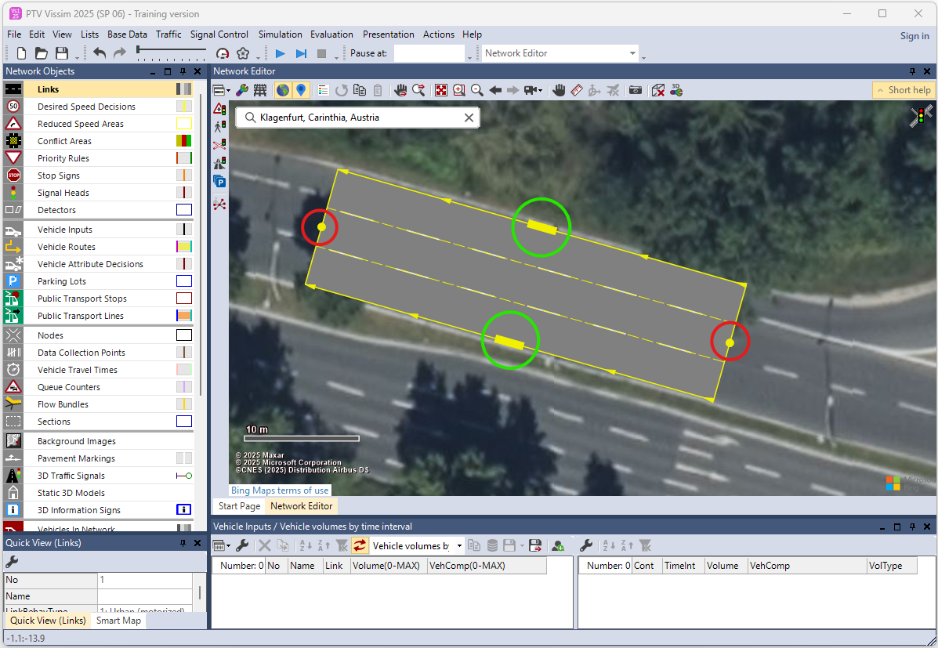
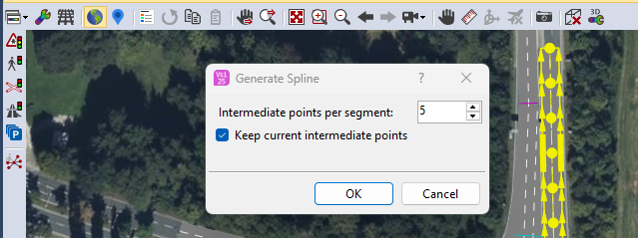
3. Create and Run VISSIM Simulation
  You can increase and decrease lane count by dragging edges and can change the lane length and end position by clicking two yellow dots. And vehicle roadway (vehicle travelling way) indicates by the arrows, you can change the way by dragging two dots.
  Add Points for Curve Lanes (optional but recommended), after drawing a link, right-click on it & click on add points to smoothen curves, especially useful for slightly bended lanes. Either adding points you can “Generate Spline” for curve the links, you can decide the count of points per segment.

Slide 20
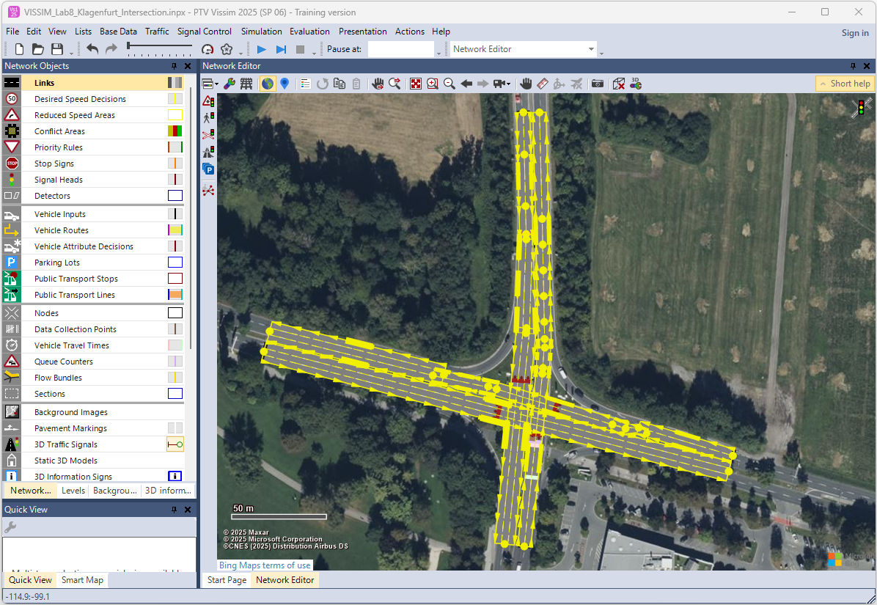
3. Create and Run VISSIM Simulation
  Repeat for all incoming and outgoing roads forming the intersection.

Slide 21
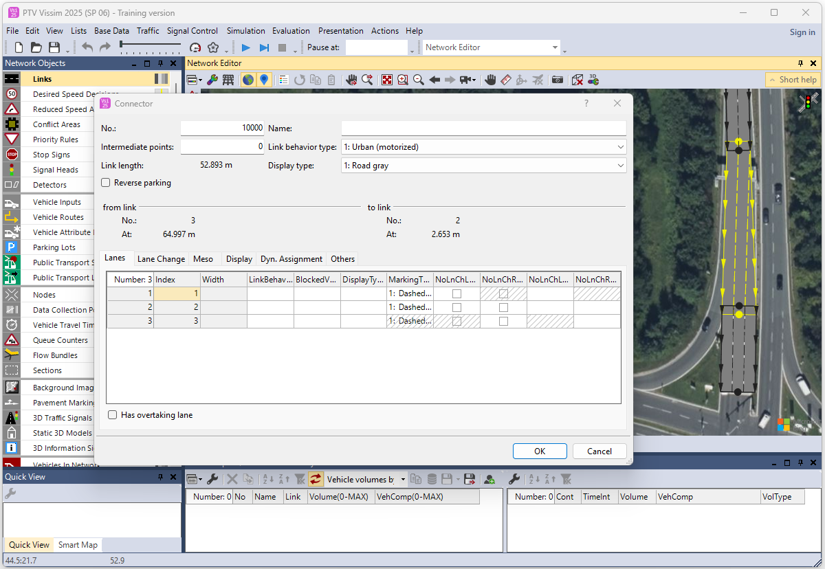
3. Create and Run VISSIM Simulation
Step 4: Add Connectors
✅ Turns, Dividers, Expanders, Connectors and Cross-Movements
  Press CTRL + RMB (right mouse button) on the end of the first link and drag & drop to the second link to draw connectors.

Slide 22
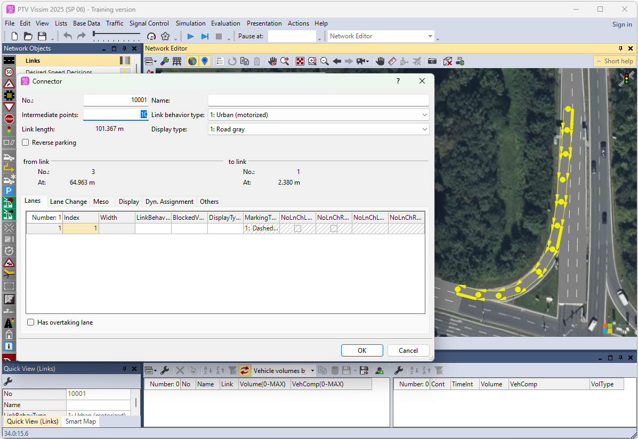
3. Create and Run VISSIM Simulation
  Do the same process for all turning possibilities:
  ✅ Left turn
  ✅ Right turn
  ✅ Straight ahead (for each direction)
  If necessary, add curves to connectors just like
  links or you can use “Generate Spline”
  for curve the links.

Slide 23
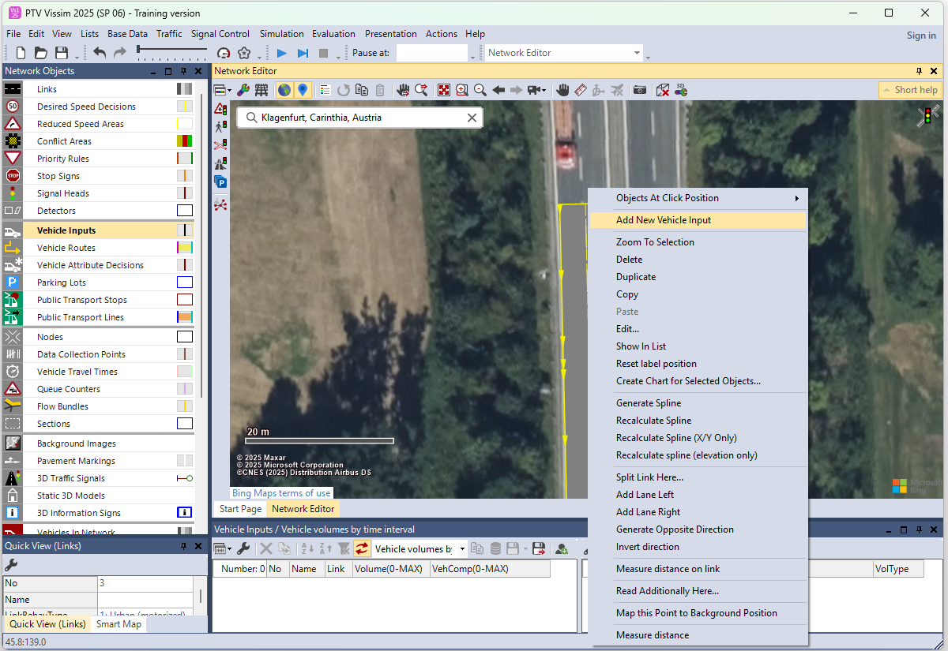
3. Create and Run VISSIM Simulation
Step 5: Define Vehicle Inputs
  Go to Network Objects > Vehicle Inputs.

Slide 24
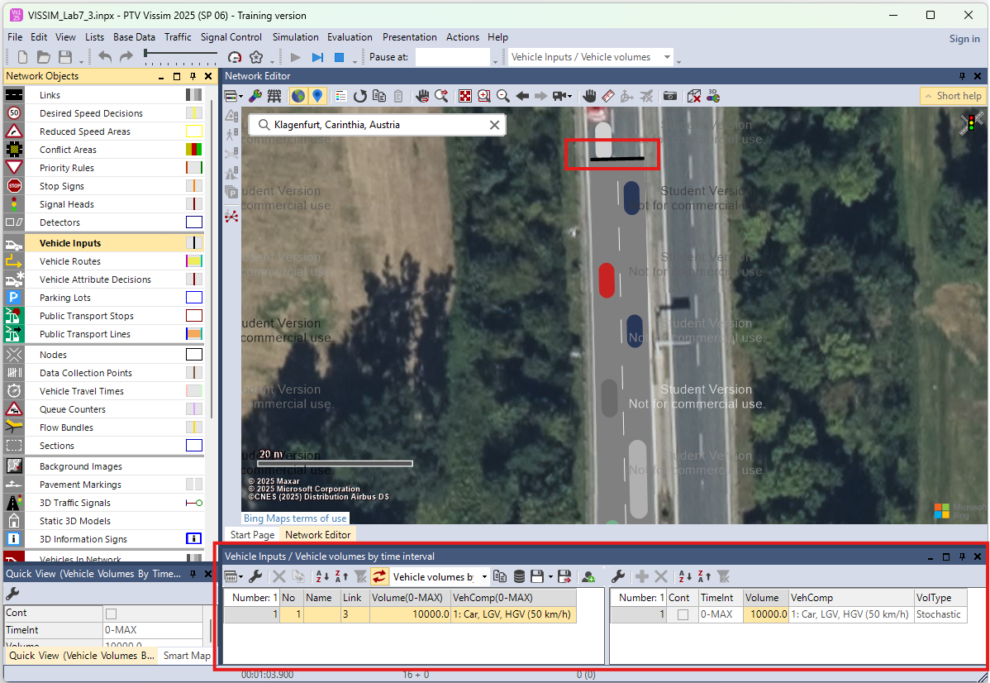
3. Create and Run VISSIM Simulation
  Click on the inbound link and you set parameters like:
✅ Volume (vehicles/hour)
(ex: 10,000)
✅ Vehicle composition
(ex: 90% cars, 10% buses)
✅ Desired speed distribution

Slide 25
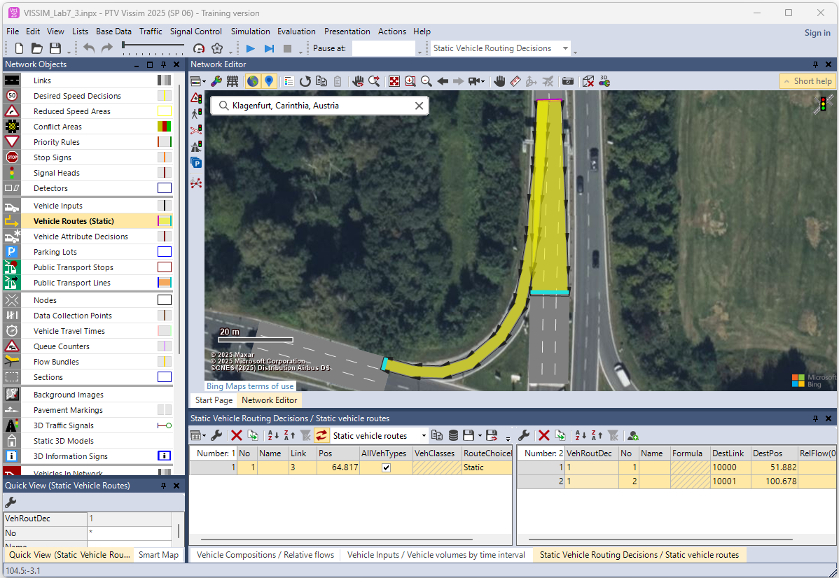
3. Create and Run VISSIM Simulation
Step 6: Add Vehicle Routes (Routing Decisions)
  Go to Network Objects > Routing Decisions (if available).
  Assign routing percentages at intersections for each incoming/outgoing streams.
      Example:
      ✅ 60% go straight
      ✅ 25% turn left
      ✅ 15% turn right
Step 7: Save Your Project
  Click File > Save and ensure your .inpx file is up to date.
  Right click and select “Add new static vehicle routing decision”, drag and drop for each incoming/outgoing streams.

Slide 26
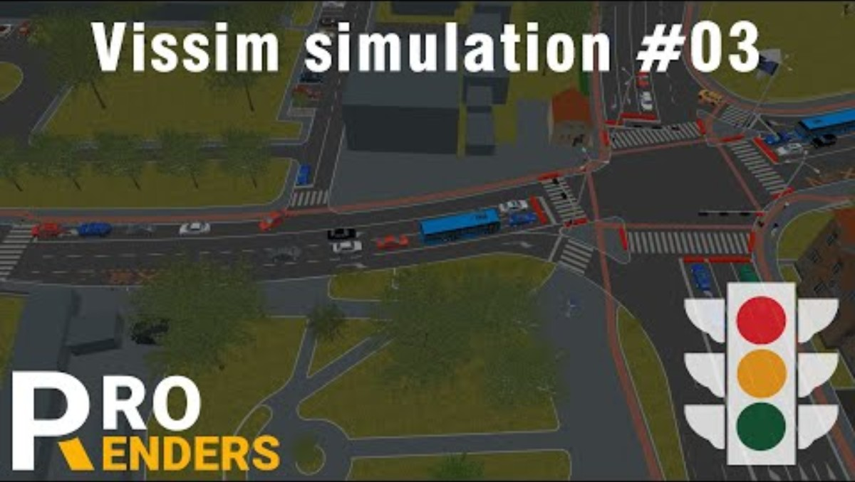
Traffic Flow Simulation - Video
School Area Intersection Simulation (example simulation video)
This PTV Vissim simulation showcases the Ilica-Vrapcanska intersection in a school area in Zagreb. It was created for the NPSCP Project to visually present traffic patterns and flows.
Video Credits: ProRenders
Video link:
https://youtu.be/eygkfJsoqk0
Notes:
# English
Here’s an interesting PTV Vissim simulation showing the Ilica-Vrapcanska intersection near a school in Zagreb. This video was part of the NPSCP Project and is used to visually present how traffic moves in school zones. It helps us understand traffic flow and safety around sensitive areas like schools.
# French

Slide 27
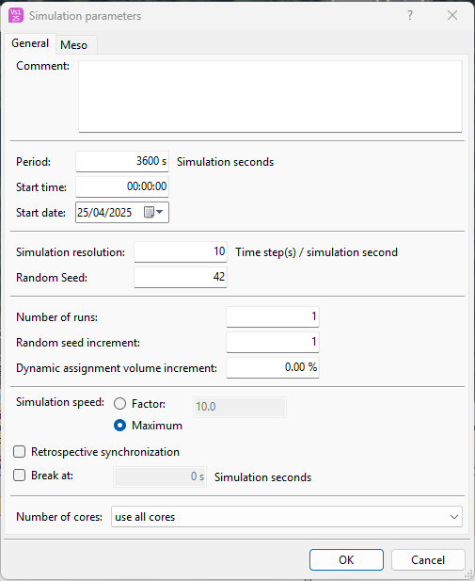
3. Create and Run VISSIM Simulation
3.2 Run Simulations
  After setting up your basic intersection (links, connectors, inputs, and routing), this part helps students simulate the scenario, observe how traffic behaves, and identify any congestion or inefficiencies.
Step 1: Open the Simulation Panel
  Go to the Simulation menu at the top.
  Click Simulation Parameters and set:
  ✅ Simulation Resolution: 10s
  ✅ Simulation Duration: ex: 3600 seconds (1 hour)
  ✅ Random Seed: Any value (ex: 42)
  useful for repeating simulations
  ✅ Number of runs: 1
  ✅ Simulation speed:
  Use Factor for low speed – Factor 10%

Slide 28
3. Create and Run VISSIM Simulation
Step 2: Display Vehicle Animation
  On the toolbar, click the "Play" icon (▶️) or go to Simulation > Start.
  VISSIM will begin simulating traffic movement in real time.
  Watch the:
  ✅ Vehicle arrivals
  ✅ Turning movements
  ✅ Queues at connectors
  ✅ Signal reactions (if signal control is applied)
  Tip: Use the “Step” (⏭️) button to go frame-by-frame and analyze critical areas.
Step 3: Adjust Simulation Speed
  Use the simulation speed slider (bottom of screen).
  ✅ Slide right for faster animation (ex: to skip long idle time)
  ✅ Slide left to slow down and observe close vehicle interactions

Slide 29
3. Create and Run VISSIM Simulation
3.3 Observe Traffic Flow Patterns
  During the simulation, take note of:
# | Feature | What to Watch
1 | Vehicle Flow | Smooth movement vs. stop-and-go patterns
2 | Turns at Connectors | Correct turning movements? Lane discipline?
3 | Queue Lengths | Do vehicles back up into intersections?
4 | Conflict Areas | Any close calls or overlaps at crossings?
5 | Underused Lanes | Are some lanes empty while others are jammed?

Slide 30
Section 04:
Analyzing and Improving Traffic Flow

Slide 31
4. Analyzing and Improving Traffic Flow
4.1 What is a Bottleneck?
  A bottleneck occurs when traffic demand exceeds capacity at a specific point in the network, causing congestion, vehicle delay, and queue spillback.
  This section helps students understand how to use VISSIM’s real-time visual output to spot traffic problems such as bottlenecks, long queues, and underused lanes during simulation.
1. Run the Simulation
  ✅ Click ▶️ Simulation > Start or use the toolbar play button.
  ✅ Make sure the simulation speed is appropriate to observe real-time movement: Use the speed slider
  to slow it down if needed.
2. Watch the Visual Display Closely
  Focus on:
  ✅ Lane usage – Are all lanes utilized equally?
  ✅ Turning movements – Do vehicles turn correctly or get blocked?
  ✅ Vehicle behavior at signals – Are queues forming before red lights?

Slide 32
4. Identify Bottlenecks and Queue Lengths
4.2 Identify Bottlenecks and Queues Visually
  Signs of trouble include:
# | Indicator | What It Means
1 | Long queue spilling backward | Signal cycle is too short or too much demand
2 | Vehicles stuck in intersection | Poor signal coordination or insufficient space
3 | One lane heavily loaded, others free | Unbalanced demand or incorrect routing
4 | Frequent stopping/starting | Congestion and unstable flow conditions
1. Add Queue Counters (Optional for Accuracy)
  If available:
  ✅ Go to Network Objects > Queue Counter
  ✅ Place just before signals or stop lines
  ✅ Used later to export actual queue length values

Slide 33
4. Identify Bottlenecks and Queue Lengths
2. Take Screenshots or Notes
      ✅ Take screenshots of areas with high congestion
      ✅ Write a few observations (ex: “North approach queue exceeded 10 cars during peak”)
  These observations will support analysis and comparison in later steps.

Slide 34
Section 05:
Adjust Signal Timings

Slide 35
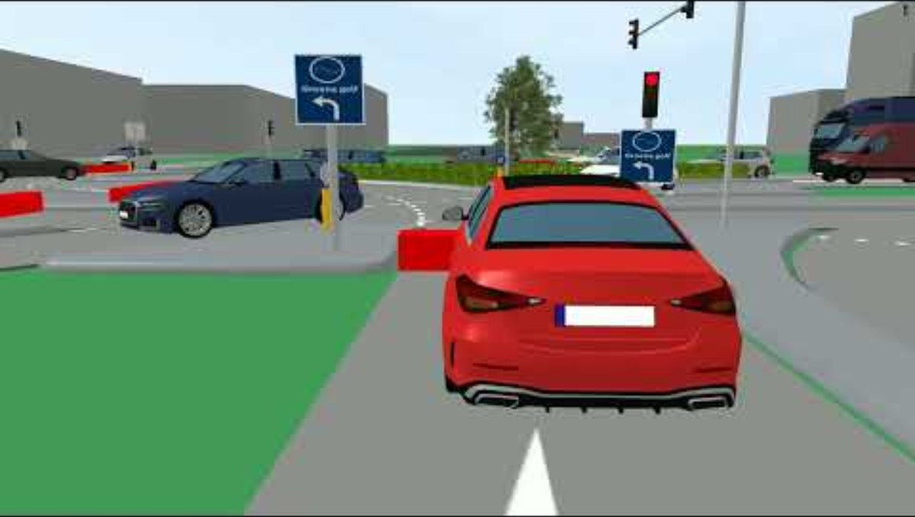
Traffic Flow Simulation - Video
Signal-Controlled Turbo Intersection Simulation:
This PTV Vissim simulation shows a three-phase signal-controlled turbo intersection in Breda during peak hour traffic, with a 30% intensity increase and a maximum cycle time of 75 seconds.
Video Credits: Maarten Vrolijk
Video link:
https://youtu.be/lZ_ZAVC1fVo
Notes:
# English
Here’s a quick look at a signal-controlled turbo intersection simulation from Breda. This model shows peak hour traffic with an added 30% intensity to test the intersection’s performance. The signal cycles every 75 seconds, and the video is played at double speed to clearly show the traffic flow and signal coordination in a busy urban setting.
# French

Slide 36
5. Adjust Signal Timings
5.1 Why Signal Timing Matters?
  Signal timing is a critical factor in traffic management because it directly affects:
  ✅ Vehicle Delays: Poor timing increases waiting times at signals.
  ✅ Queue Lengths: Inefficient timing can cause long lines of vehicles, leading to congestion.
  ✅ Intersection Throughput: Well-timed signals allow more vehicles to pass through smoothly.
  When traffic signals are not properly synchronized, intersections can quickly become bottlenecks. Long red lights, short green times, or inconsistent phasing can waste valuable road capacity and frustrate drivers.
  On the other hand, good signal timing can optimize traffic flow, reduce vehicle stops, improve safety, and minimize travel delays.

Slide 37
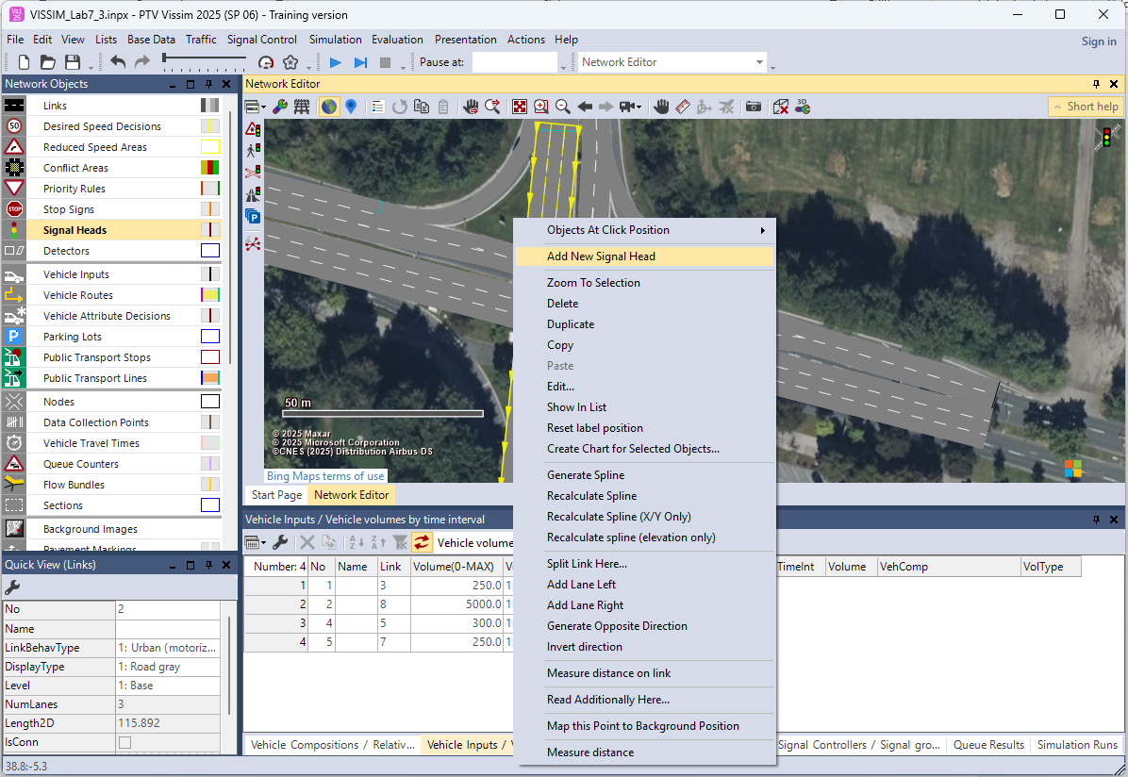
5. Adjust Signal Timings
5.2 Add Signal Heads to the Intersection
  Signal heads are required to control traffic with visual signals (red/yellow/green).
  Go to Network Objects > Signal Heads
  Right click on the lane near the stop
  line where vehicles stop and select
  Add New Signal Heads.

Slide 38
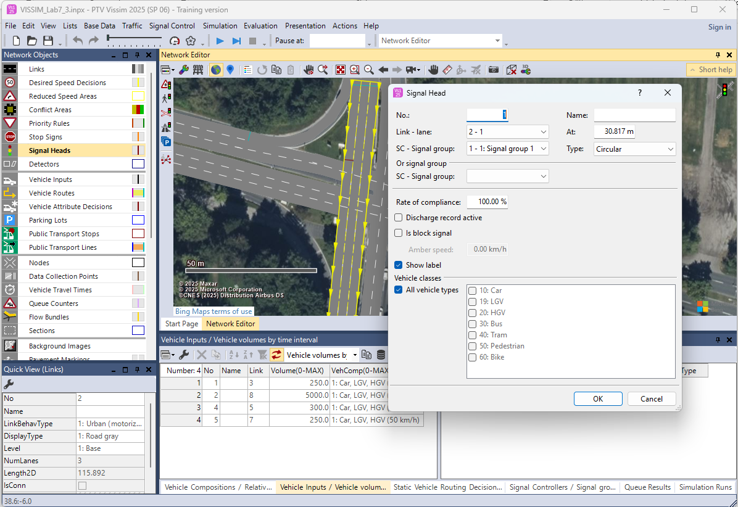
5. Adjust Signal Timings
  Place one signal head per lane (ex: straight, left, right).
  Make sure the arrow on the signal head points in the direction of movement.
  Right-click the signal head and choose Edit Signal Head: Set Signal Group Number
  (ex: 1, 2, 3...) this links the head to a controller
  phase.

Slide 39
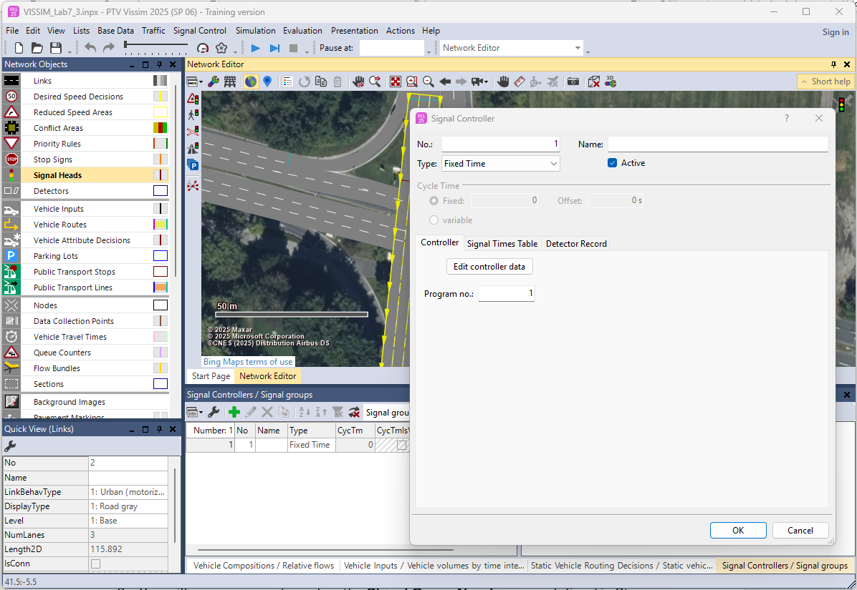
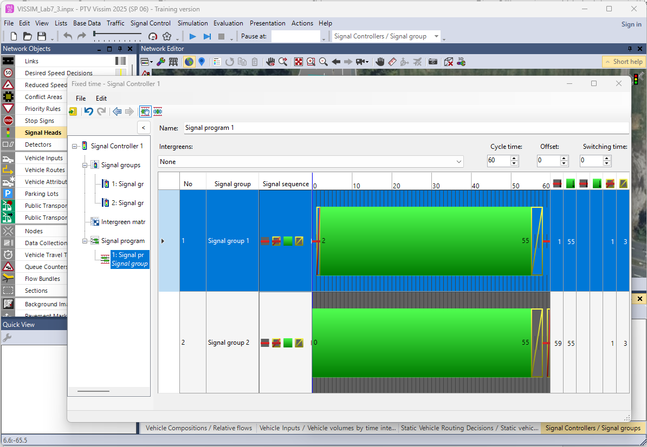
5. Adjust Signal Timings
5.3 Create and Assign a Signal Controller
  Go to Signal Control > Signal Controllers
  Add a new controller (if not already there).
  Assign this controller to the entire intersection or relevant approaches.
  Click on Edit controller data.
  Click on Signal Groups and add 2 new group.
  Click on Signal Program and add a new signal program.

Slide 40
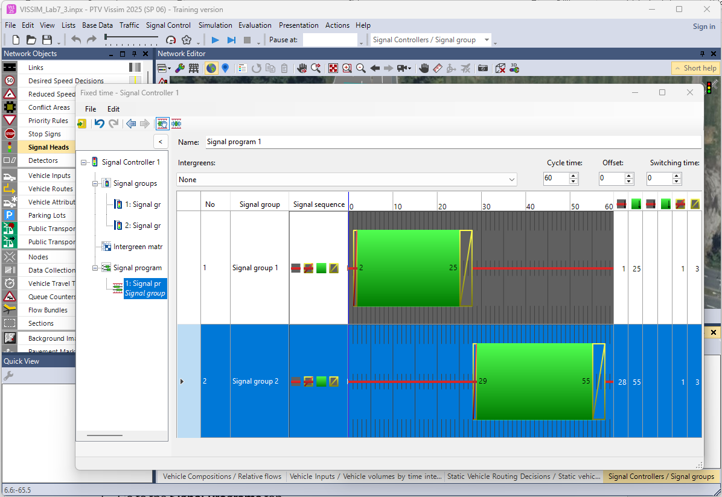
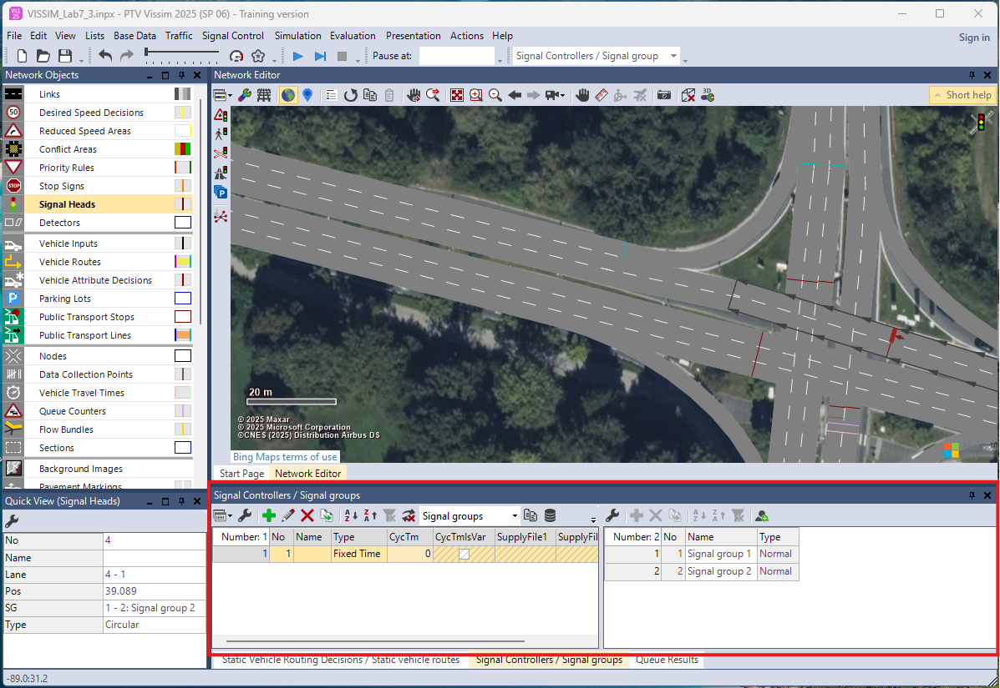
5. Adjust Signal Timings
  Adjust 2 signal groups as bellow for the selected simple junction.
  Click on “Save data and go back to VISSIM icon”.
  You can see the Signal Controllers below.

Slide 41
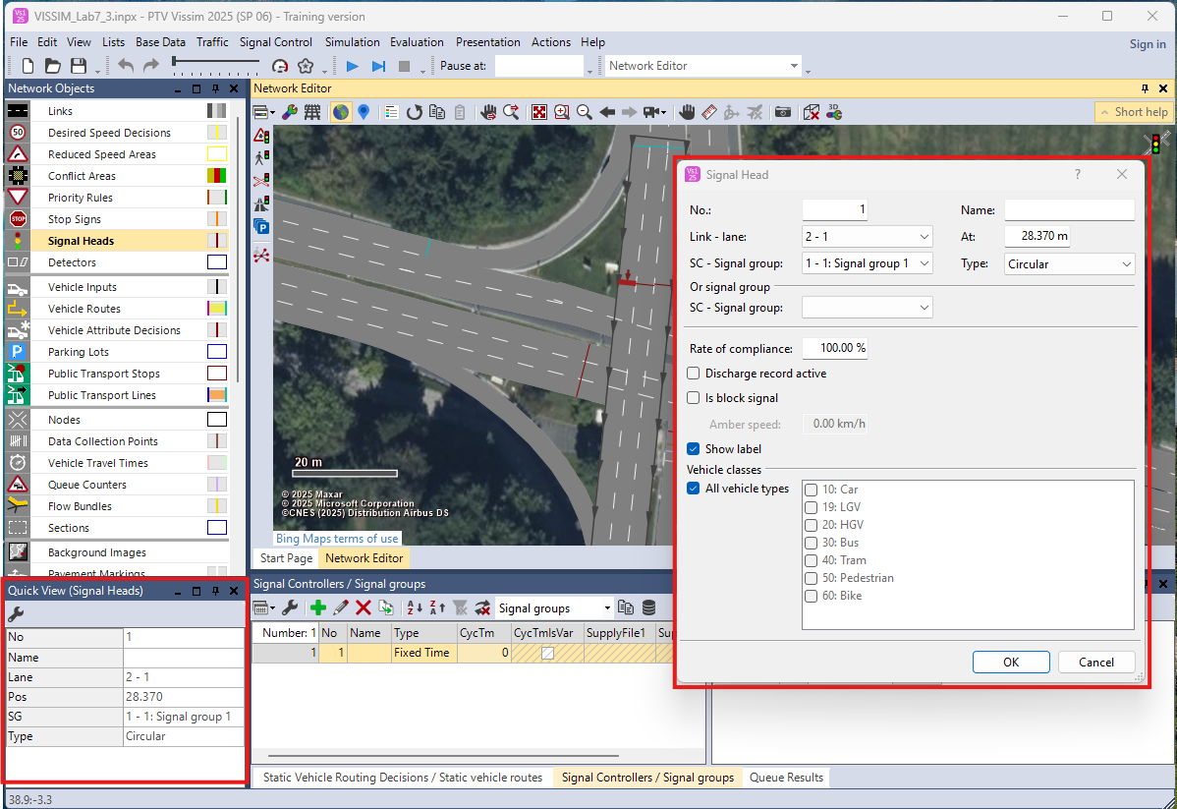
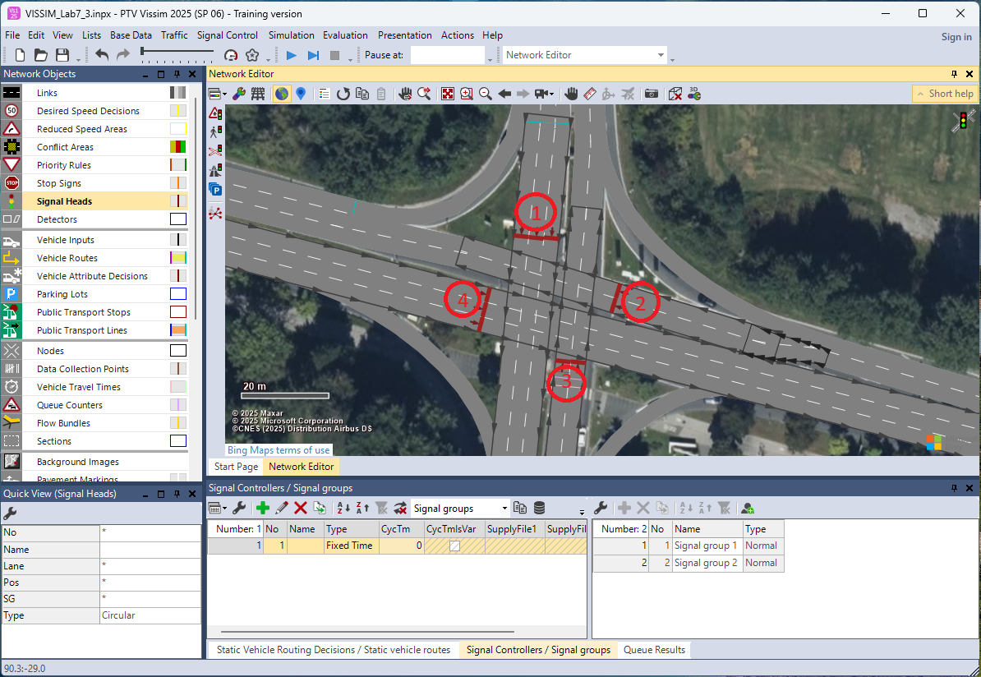
5. Adjust Signal Timings
  Double click on the Signal Heads to assign Signal Controllers. (Or you can select the Signal Heads and can change the group on Quick View in left menu bar).
  Ex: To the simplified junction assign opposite signal to same group.
  ✅ Signal Head 1: Signal Group 1
  ✅ Signal Head 2: Signal Group 2
  ✅ Signal Head 3: Signal Group 1
  ✅ Signal Head 4: Signal Group 2

Slide 42
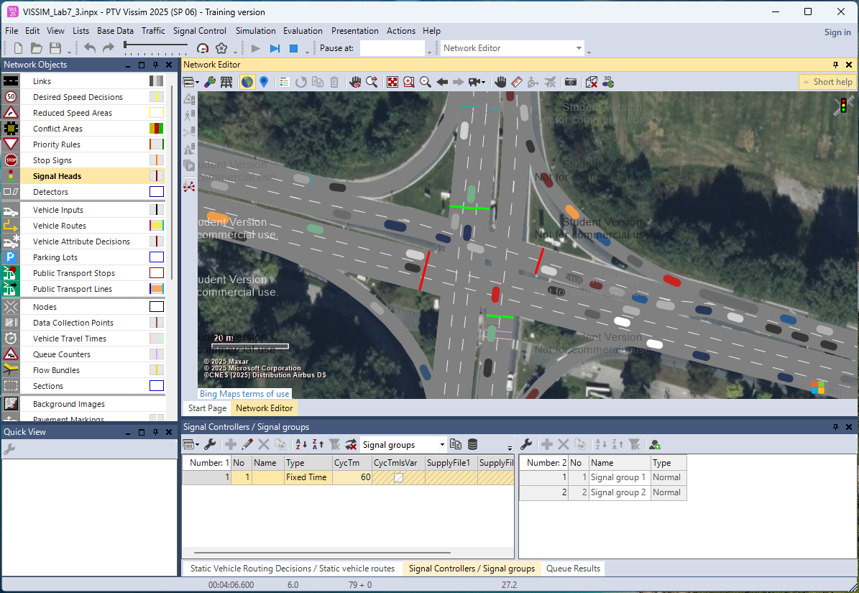
5. Adjust Signal Timings
5.4 Save and Re-Run the Simulation
  Click OK or Apply to save your signal timing edits.
  Go to the main simulation window and Start the simulation.
  Observe how the adjusted signal timing affects:
  ✅ Queue lengths
  ✅ Stop-and-go behavior
  ✅ Vehicle delays at the approach lanes
Optional: Adjust Cycle Time or Offset
  Cycle Time: Total length of one full signal sequence (ex: 90s)
  Offset: Timing difference between signals (used in coordination)
  These can also be edited in the signal controller interface for more advanced tuning.

Slide 43
5. Adjust Signal Timings
5.5 Observe the Changes in Traffic Flow After Signal Adjustments
  After modifying signal timings and assigning signal heads, students will run simulations again to analyze the impact of the new settings on traffic flow, queue lengths, and congestion.
  Learn how signal timing adjustments influence:
  ✅ Vehicle delays
  ✅ Queue formations
  ✅ Throughput (vehicles processed)
  ✅ Overall intersection efficiency
Step 1: Run the Updated Simulation
  Click Simulation > Start or the ▶️ Play button.
  Set an appropriate simulation duration (ex: 3600 seconds for 1 hour).
  Watch vehicle behavior at the intersection after the signal timing changes.

Slide 44
5. Adjust Signal Timings
5.6 Compare Traffic Flow Visually
  During the simulation, observe carefully:
# | Before Signal Adjustment | After Signal Adjustment
1 | Long queues forming before signals | Shorter queues or smoother flow
2 | Frequent stop-and-go movements | Reduced stops and more continuous flow
3 | Delay at certain approaches | Improved green time allocation
4 | Vehicles spilling into adjacent links | Reduced queue spillbacks
Optional: Adjust Cycle Time or Offset
Step 1: Watch Specific Indicators and Focus on Below Factors
  Queue Length Reduction: Are queues now shorter? Are some lanes fully cleared within the green phase?
  Delay Time Reduction: Do vehicles wait less at red lights?
  Balanced Lane Usage: Are vehicles using all available lanes better than before?
  Throughput Improvement: Is the number of vehicles passing through the intersection per cycle higher?

Slide 45
5. Adjust Signal Timings
Step 2: Take Notes / Screenshots
  Suggest to do:
  Capture before and after screenshots of congested points.
  Note any unexpected results (ex: a minor movement now causing delay).
  Record observations for later discussion.

Slide 46
Section 06:
Traffic Performance Metrics Analysis and Data Export

Slide 47
6. Traffic Performance Metrics Analysis and Data Export
6.1 Add and Enable Evaluation Objects to Your Network
  Before running simulation and enabling evaluation:
  Add Queue Counters
  ✅ Go to Network Objects > Queue Counter.
  ✅ Place a queue counter just before signalized intersections or stop lines where queues
  may form.
  ✅ It measures queue length and queue time at that point.
  Add Travel Time Measurements
  ✅ Go to Network Objects > Travel Time Measurement.
  ✅ Place a start point and end point to define the section where you want to measure
  vehicle travel times.
  Add Data Collection Points
  ✅ Go to Network Objects > Data Collection Point.
  ✅ Place points at major entry or exit locations.
  ✅ It measures vehicle throughput (number of vehicles passing a point).

Slide 48
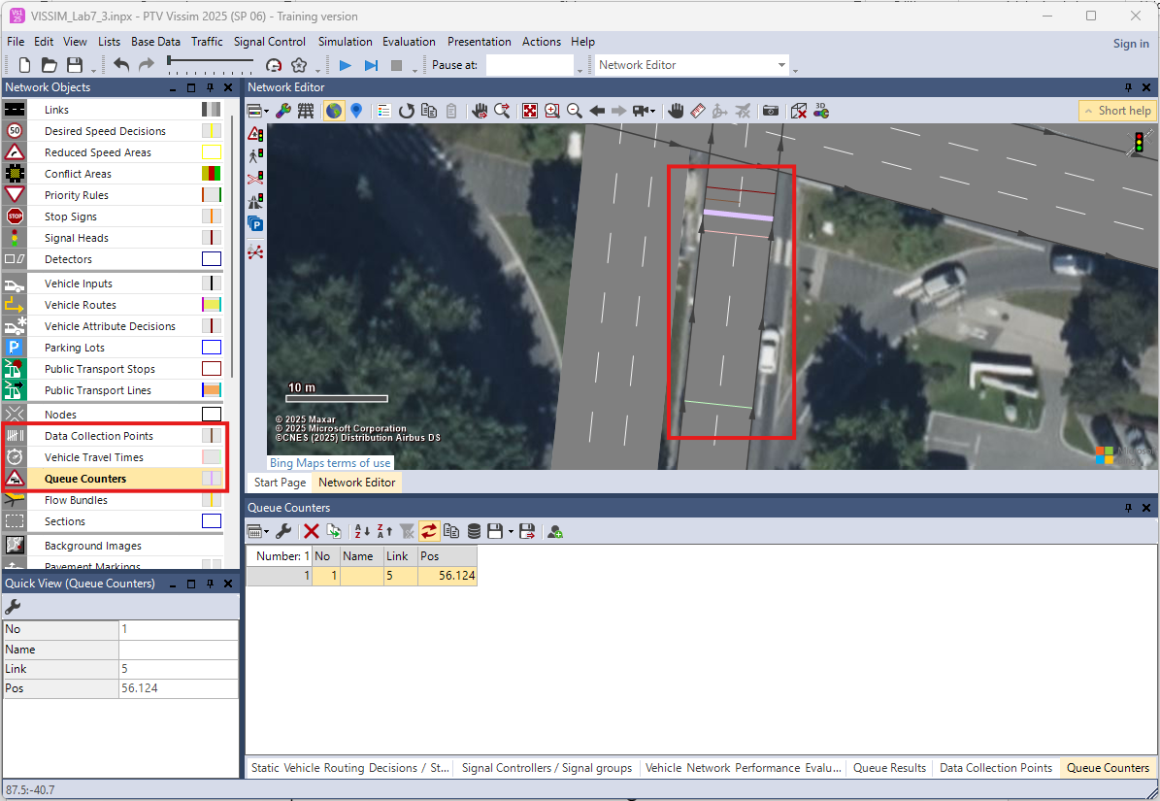
6. Traffic Performance Metrics Analysis and Data Export

Slide 49
6. Traffic Performance Metrics Analysis and Data Export
Enable Evaluation in VISSIM:
  Go to the top menu Evaluation > Evaluation Configuration
  Enable:
  ✅ Queue Counter (for queue lengths)
  ✅ Travel Time Measurement (for travel times)
  ✅ Delay Time (for waiting times)
  ✅ Data Collection Point (for flow/throughput)
Place Evaluation Objects (If Not Already Done):
  Go to Network Objects > Queue Counter and place them before intersections where queues are likely.
  Go to Network Objects > Travel Time Measurement and place start and end points across important routes.
  Go to Network Objects > Data Collection Point and place at strategic points to measure flow rates.

Slide 50
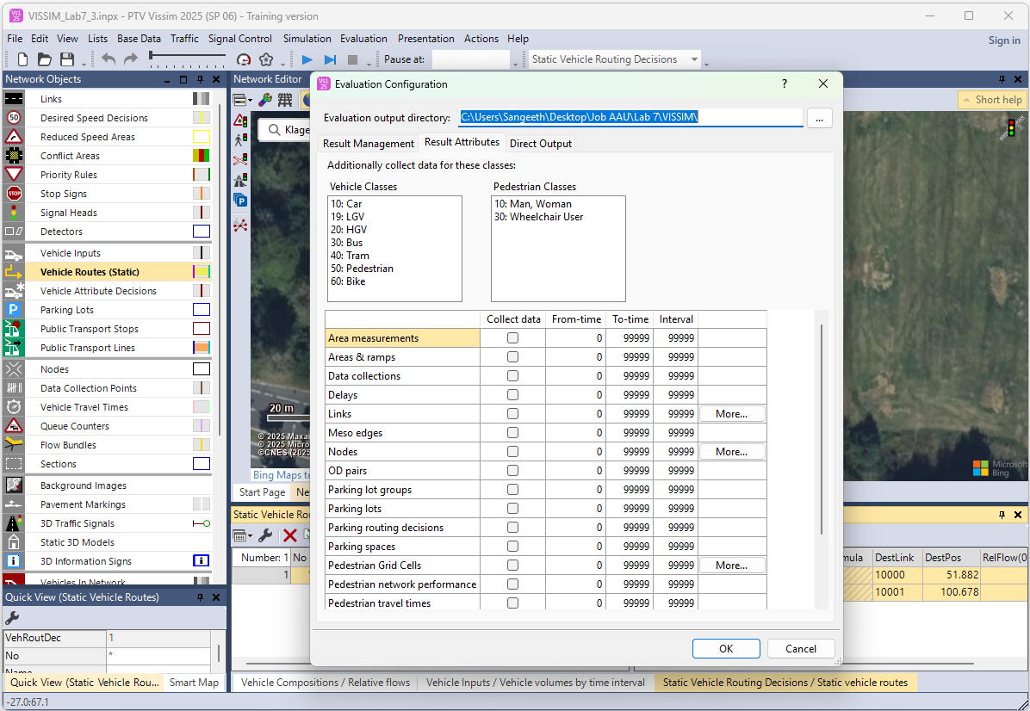
6. Traffic Performance Metrics Analysis and Data Export

Slide 51
6. Traffic Performance Metrics Analysis and Data Export
Run the Simulation Again:
  Save your setup.
  Run a full simulation (ex: 3600 seconds or longer).
  VISSIM will automatically record data based on your active evaluation configuration.
Data Analyse in VISSIM (Using Built-In Charts):
  Open the Evaluation Results Panel
  Go to the Evaluation menu.
  Click Results or Show Results (depending on your VISSIM version).
  A results window will appear showing different categories:
    ✅ Queue Results
    ✅ Travel Time Results
    ✅ Delay Results
    ✅ Data Collection Results, etc.

Slide 52
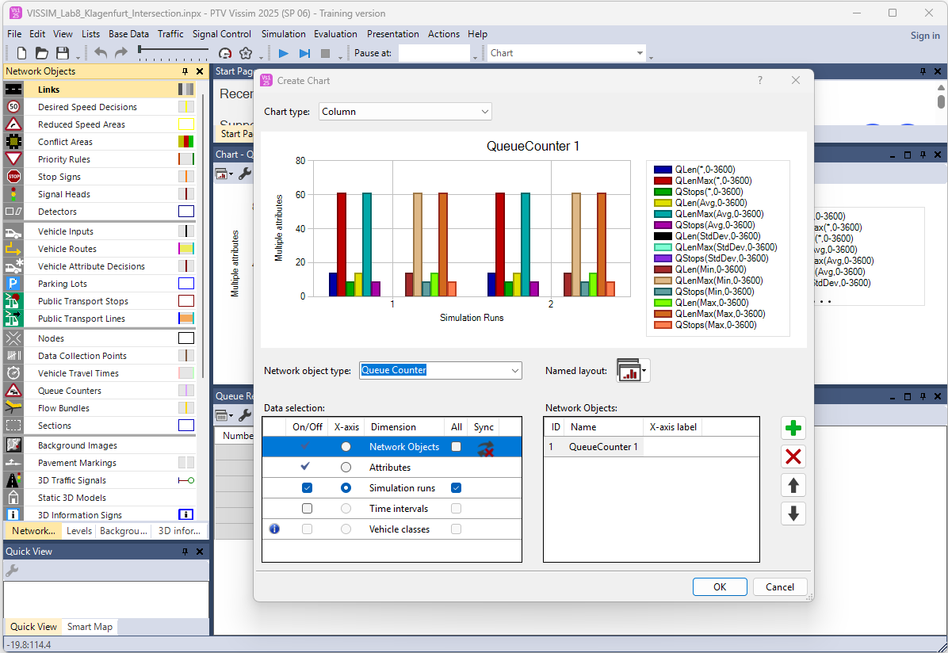
6. Traffic Performance Metrics Analysis and Data Export
6.3 Create & Analyze Charts - Directly from VISSIM
  Select all cells and Right-click on the selected data table.
  Choose Add Chart or Create Chart. A chart dialog will pop up.
Customize the Chart:
  In the chart settings window:
  Choose the x-axis and y-axis:
  ✅ X-axis: Scenario, movement, or time step
  ✅ Y-axis: Average queue length, average
  delay, travel time, etc.
  Choose chart type:
  ✅ Line Chart (for travel time trends)
  ✅ Bar Chart (for queue length, delay
  comparison)
  You can customize:
  ✅ Colors, Axis labels, Titles, Legend display

Slide 53
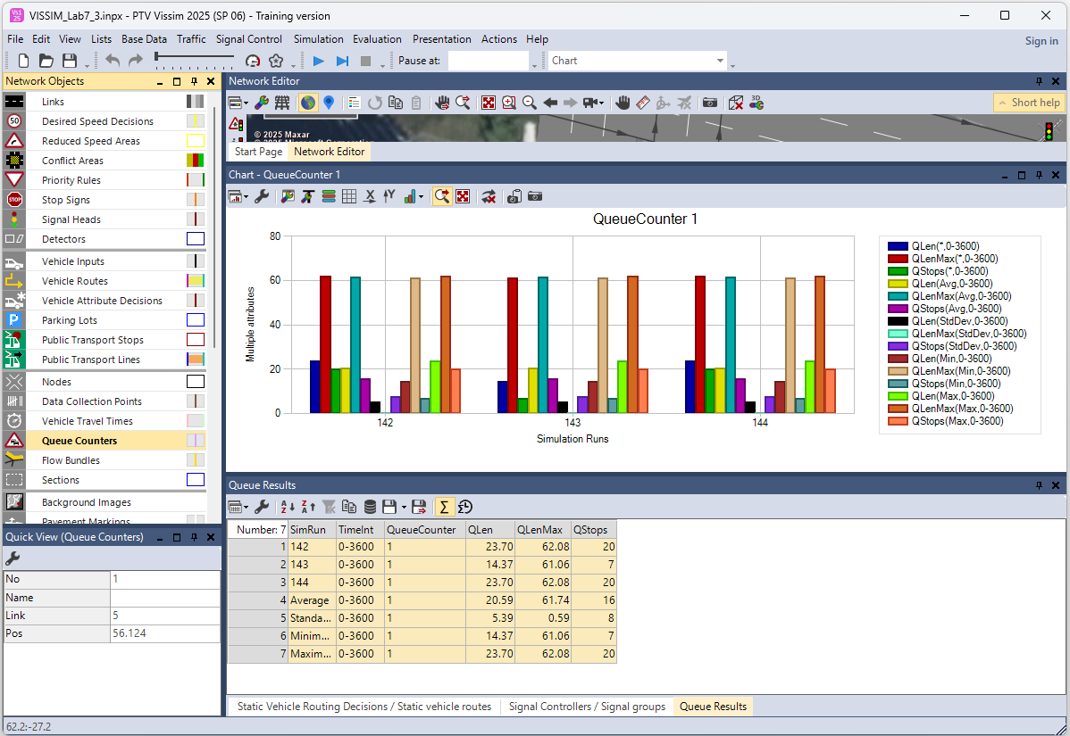
6. Traffic Performance Metrics Analysis and Data Export
Analyze Charts:
  Visually check if the new signal timing:
  ✅ Reduced average queue lengths
  ✅ Reduced travel times
  ✅ Improved throughput
Save Charts:
  You can save the charts:
  ✅ Click on the chart save button
  → Save as image (.png, .jpg)

Slide 54
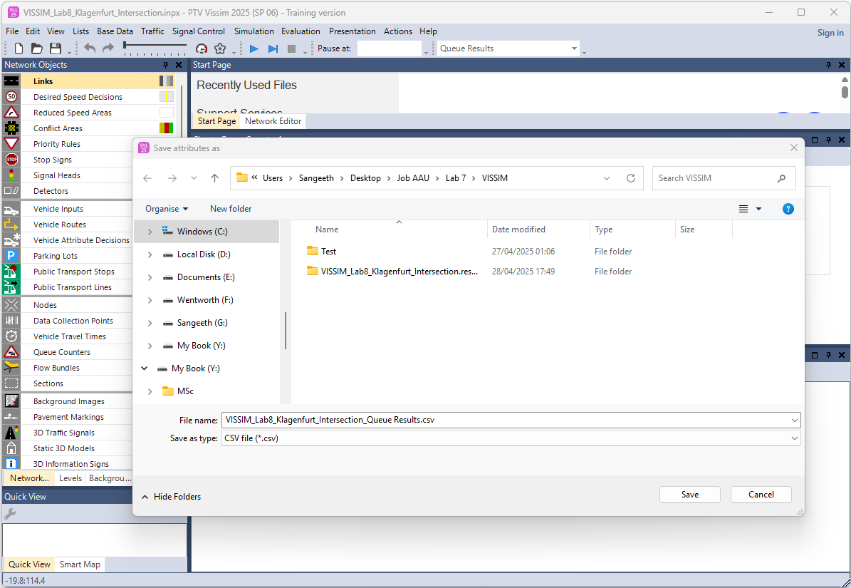
6. Traffic Performance Metrics Analysis and Data Export
6.4 Export Data to CSV
  Click on the Save button and choose Save CSV file.
  Save the files with clear names:
  ex: VISSIM_Lab7_Klagenfurt_Intersection_Queue_Results.csv

Slide 55
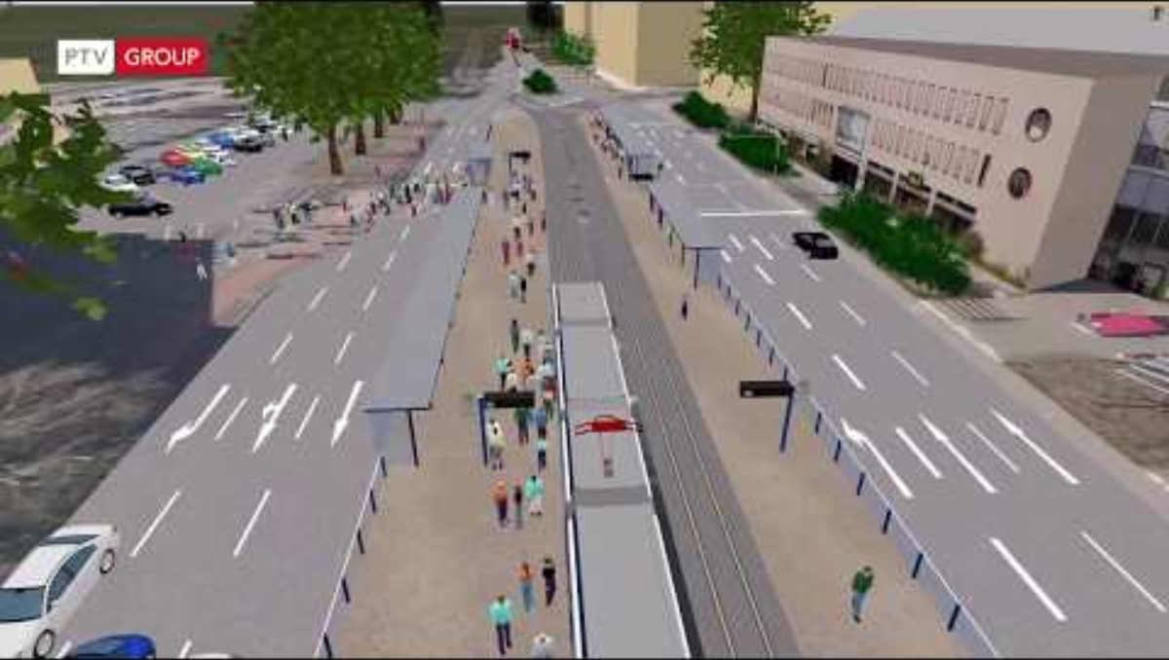
Traffic Flow Simulation - Video
Multimodal Capacity Study – Heidelberg Intersection, Germany:
This PTV Vissim simulation shows a multimodal capacity study of the central junction near Heidelberg main station in Germany, analyzing the interaction of cars, buses, trams, bicycles, and pedestrians to support traffic optimization.
Video Credits: PTV Group
Video link:
https://youtu.be/18q4is-xyI8
Notes:
# English
Here’s an interesting simulation showing a multimodal capacity study at a busy junction near Heidelberg’s main station in Germany. The model includes cars, buses, trams, bicycles, and pedestrians all moving through the intersection. This simulation helps analyze travel times, vehicle counts, delays, and queues, which can then be used to test and recommend traffic improvements for smoother flow.
# French

Slide 56
Section 07:
Homework: Assignment 1
Notes:
# English
Next, let’s take a look at your homework assignment for Lab 4.
# French
Ensuite, examinons vos devoirs pour le laboratoire 4.

Slide 57
7. Homework: Assignment 1 – Lab 7
7.1.1 Assignment 1 - Traffic Flow Simulation using VISSIM
This assignment is part of Lab 7: Traffic Flow Simulation in the Transport Research and Analysis course. You will apply the concepts practiced in class to build and simulate a signalized intersection using PTV VISSIM, then submit your work in a structured report.
Objective of the assignment:
The goal is to create a simple microscopic simulation model of a real-world intersection, modify signal timing, and evaluate traffic performance using VISSIM's analysis tools.
Notes:
# English
# French

Slide 58
7. Homework: Task Instructions
7.1.3 Assignment 1 - Task Instructions
Follow these steps using PTV VISSIM:
Create a new network and draw the intersection based on the class activity.
Add vehicle inputs, routes, and traffic volumes.
Insert signal heads and define the signal timing plan.
Run the simulation for a selected period (ex: 10–20 minutes).
Modify the signal timing (ex: green/red phase) and observe traffic flow changes.
Use evaluation tools to collect key metrics like queue length, travel time, and delays.
Capture screenshots of the simulation and performance charts.
Prepare a short report summarizing your observations and improvements.
Notes:
# English
# French

Slide 59
7. Homework: Submission Guidelines
7.1.4 Assignment 1 - Submission Guidelines
Follow these steps using Python (preferably in Google Colab):
Simulation File (.inpx format)
PDF Report with observations and screenshots
Screenshots/Charts from the evaluation results
Notes:
# English
# French

Slide 60
7. Homework: Report Structure
7.1.5 Assignment 1 - Report Structure
Your report should include:
Title Page with your name, course, and date
Model Description and layout details
Signal Timing Modification Summary
Screenshots of Simulation & Outputs
Evaluation Results & Analysis
Conclusion: What did you learn, and how did signal changes impact traffic?
Notes:
# English
# French

Slide 61
7. Homework: Deadline & Notes
7.1.6 Assignment 1 - Deadline & Notes
Deadline: Submit all required files before … / … / … (1 week after the Lab 4)
Note: Grading will consider model accuracy, logic of signal timing, use of evaluation tools, and clarity of the report.
Notes:
# English
# French

Slide 62
Section 08:
References

Slide 63
8. References
Reference Textbooks
  “Transportation Engineering and Planning” by C.S. Papacostas and P.D. Prevedouros (Covers basics of transport systems, data, planning, and policy)
  “Introduction to Transportation Systems” by Joseph Sussman
  “Data Science for Transport: A Self-Study Guide with Computer Exercises” by Charles Fox
  “Modeling Transport” by Juan de Dios Ortúzar and Luis G. Willumsen
  (Travel demand modeling)
  “Transportation Systems Planning: Methods and Applications” by Konstadinos G. Goulias
Reference Video Resources
  A to Z video tutorials for VISSIM from PTV Group:
  https://us-resources.ptvgroup.com/en-us/ptv-academy/getting-to-know-ptv-vissim

Slide 64
Thank you for your attention!

