Slide 1
Transport Research and Analysis
Module 4: Sustainable Transport and Policy Analysis
Lab 9: Introduction to Environmental Impact Assessment

Slide 3
Table of Contents
Lab 9: Introduction to Environmental Impact Assessment
0. Objective | 1
0.1 Learning Objectives | 2
1. Goals and Relevance of Environmental Impact Assessment (EIA) | 3
1.1 Definition and Purpose of EIA | 4
1.2 Importance of EIA in Infrastructure and Transport Projects | 5
1.3 Regulatory Frameworks and International Standards | 6
1.4 Role of EIA in Sustainable Development | 7
2. Key Environmental Indicators in Transport Projects | 8
2.1 Overview of Environmental Indicators | 9
2.2 Emissions (CO₂, NOₓ, PM2.5, etc.) | 10
2.3 Noise Pollution and Vibrations | 11
2.4 Land Use and Biodiversity Impacts | 12
2.5 Water and Soil Quality | 13
2.6 Visual and Community Impact Assessment | 14
3. Case Studies and Real-World Examples | 15
3.1 Metro Line Expansion in Urban Area – EIA Highlights | 16
3.2 Highway Construction in Protected Areas – Challenges and Outcomes | 18
3.3 Airport Development – Stakeholder Conflict and Resolution in EIAs | 20
3.4 Creating Scatter Plots in Excel | 21
4. Challenges in Conducting EIAs for Transport Projects | 22
4.1 Data Collection and Quality Issues | 23
4.2 Forecasting Future Impacts Accurately | 24
4.3 Balancing Economic and Environmental Objectives | 25
4.4 Stakeholder Engagement and Public Consultation | 26
i
Importance of Data Visualization in Transport Research

Slide 4
Table of Contents
Lab 9: Introduction to Environmental Impact Assessment
5. Practical Component – Excel for Emissions | 27
5.1 Introduction to Emission Factor Calculations | 28
5.2 Excel Formula Walkthrough | 29
5.3 Sample Dataset Activity | 30
5.4 Interpretation of Results in the Context of Transport EIAs | 31
5.5 Home Assignment | 32
6. References | 33
6.1 Reference Textbooks & Tutorials | 34
ii
Importance of Data Visualization in Transport Research

Slide 5
Section 0:
Objective
Sustainable Transport and Policy Analysis
1

Slide 6
0.1 Learning Objectives
Section No | Activity | Activity Type | Tools | Activity Done by | Allocated Time (min)
1 | Understand the purpose of Environmental Impact Assessment (EIA) and its role in sustainable transport planning. | Presentation | Slides | Teacher | 20
1 | Identify and evaluate key environmental indicators such as emissions, noise, and land use. | Presentation | Slides | Teacher | 20
2 | Familiarize with major EIA frameworks, laws, and international standards. | Presentation | Slides | Teacher | 15
2 | Analyze real-world case studies to explore EIA challenges and mitigation strategies. | Presentation | Slides | Teacher | 30
2 | Apply Excel tools for emission calculations and derive policy-relevant insights. | Presentation | Excel | Teacher | 45
5 | Home Assignment | Homework | Excel | Students | 120
 | TOTAL |  |  |  | 265
Sustainable Transport and Policy Analysis
2

Slide 7
Section 01:
Goals and Relevance of Environmental Impact Assessment (EIA)
Sustainable Transport and Policy Analysis
3

Slide 8
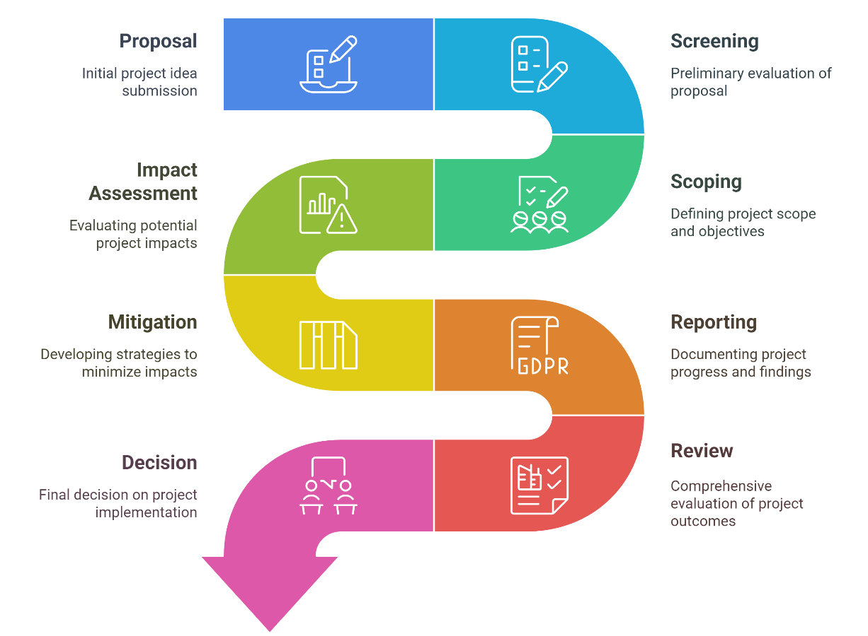
1. Goals and Relevance of Environmental Impact Assessment (EIA
1.1 Definition and Purpose of EIA
EIA is a structured process to identify, predict, and evaluate the environmental effects of proposed projects before decisions are made.
It helps decision-makers understand potential environmental consequences and integrate mitigation strategies.
Focuses on:
i. Preventing environmental harm
ii. Improving project design
iii. Involving stakeholders early
Sustainable Transport and Policy Analysis
4

Slide 9
1. Goals and Relevance of Environmental Impact Assessment (EIA
1.2 Importance of EIA in Infrastructure and Transport Projects
      Transport projects often affect air quality, land use, water resources, and human settlements.
      EIAs help:
      i. Identify direct, indirect, cumulative impacts
      ii. Avoid costly design errors through early analysis
      iii. Secure legal and community approvals
      Promotes efficient use of resources and minimizes delays due to environmental non-compliance.
      Real-World Examples:
      i. EIA prevented a highway from being built through a protected forest in Sri Lanka.
      ii. Metro system in India adjusted tunneling methods due to groundwater impact identified in the EIA.
Sustainable Transport and Policy Analysis
5

Slide 10
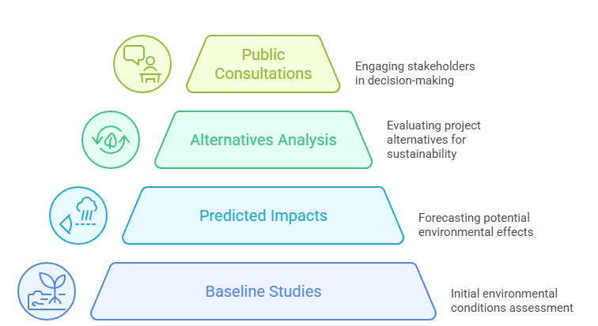
1. Goals and Relevance of Environmental Impact Assessment (EIA
1.3 Regulatory Frameworks and International Standards
      EIAs are mandatory for large projects under many national laws and international agreements.
      Key frameworks:
      i. EU EIA Directive (Directive 2014/52/EU)
      ii. US NEPA (National Environmental Policy Act)
      iii. World Bank & ADB Environmental Safeguards
      EIAs must include:
      i. Baseline studies
      ii. Predicted impacts
      iii. Alternatives analysis
      iv .Public consultations
Transport Research and Analysis
6

Slide 11
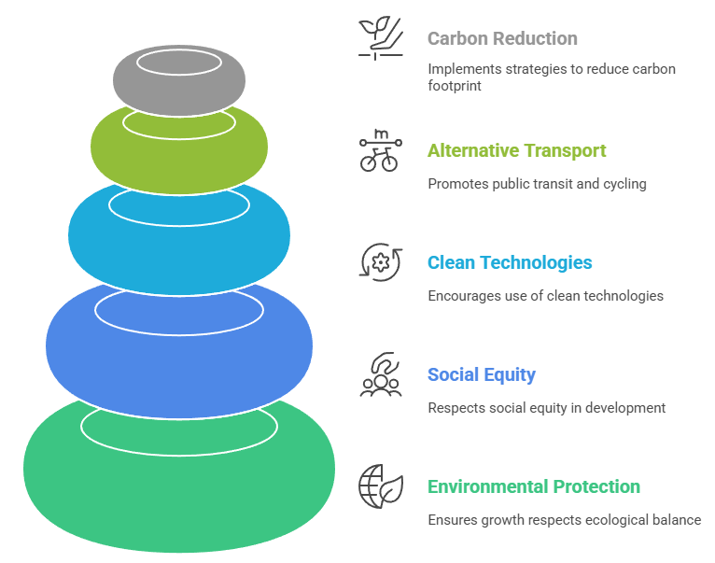
1. Goals and Relevance of Environmental Impact Assessment (EIA
1.4 Role of EIA in Sustainable Development
      EIA aligns with the UN Sustainable Development Goals (SDGs):
      i. SDG 11 (Sustainable Cities)
      ii. SDG 13 (Climate Action)
      iii. SDG 15 (Life on Land)
      Ensures that growth:
      i. Does not come at the cost of the environment
      ii. Respects social equity and long-term ecological balance
      Encourages use of:
      i. Clean technologies
      ii. Alternative transport modes (public transit, cycling)
      iii. Carbon footprint reduction strategies
Transport Research and Analysis
7

Slide 12
Section 02:
Key Environmental Indicators in Transport Projects
Transport Research and Analysis
8

Slide 13
2. Key Environmental Indicators in Transport Projects
2.1 Overview of Environmental Indicators
      Environmental indicators are measurable variables used to assess the impact of a transport project.
Indicator Type | Example | Measurement Tool
Air Quality | CO₂, NOₓ | Emission models (e.g., COPERT)
Noise | dB Levels | Sound meters, monitoring stations
Biodiversity | Habitat disruption | GIS & ecological surveys
Transport Research and Analysis
9

Slide 14
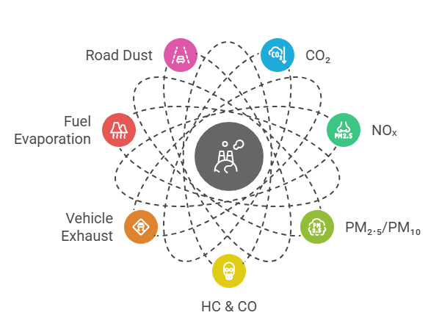
2. Key Environmental Indicators in Transport Projects
2.2 Emissions
Key Emissions:
i. CO₂ – Climate change (global warming)
ii. NOₓ – Respiratory health, smog formation
iii. PM₂.₅/PM₁₀ – Penetrate lungs, cardiovascular issues
iv. HC & CO – Toxic gases from incomplete combustion
Sources:
i. Vehicle exhaust
ii. Fuel evaporation
iii. Road dust
Transport Research and Analysis
10

Slide 15
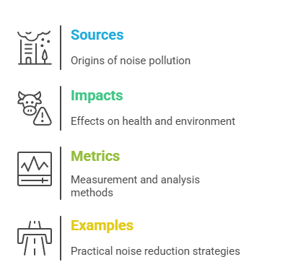
2. Key Environmental Indicators in Transport Projects
2.3 Noise Pollution and Vibrations
Sources:
i. Engine noise, tire-road interaction, horns, railway tracks
Impacts:
i. Stress, sleep disturbance, hearing loss
ii. Disturbance to wildlife
Metrics:
i. Measured in decibels (dB(A))
ii. Time-weighted averages (e.g., Ldn, Leq)
Examples:
i. Noise barriers in highways
ii. Speed limits to reduce engine noise
Transport Research and Analysis
11

Slide 16
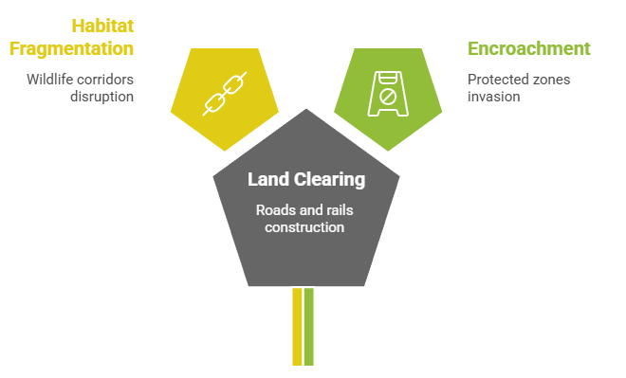
2. Key Environmental Indicators in Transport Projects
2.4 Land Use and Biodiversity Impacts
Impacts:
i. Land clearing for roads/rails
ii. Fragmentation of habitats and wildlife corridors
iii. Encroachment on protected zones
Indicators:
i. Hectares of forest removed
ii. Number of affected species (IUCN Red List)
Transport Research and Analysis
12

Slide 17
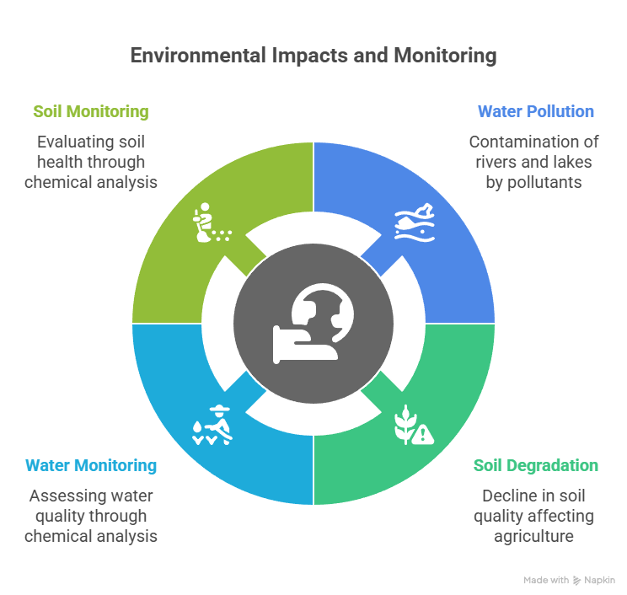
2. Key Environmental Indicators in Transport Projects
2.5 Water and Soil Quality
Sources:
i. Oil, fuel spills, heavy metals from tires and brakes
ii. Construction sediment
Impacts:
i. Water pollution in rivers/lakes
ii. Soil degradation affecting agriculture
Monitoring
i. Water: BOD, COD, heavy metal concentrations
ii. Soil: pH, lead content, organic matter
Transport Research and Analysis
13

Slide 18
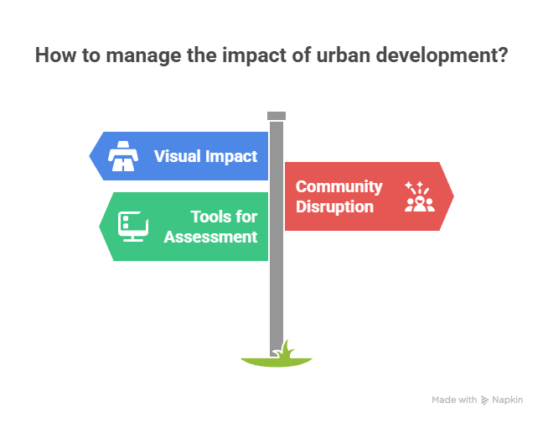
2. Key Environmental Indicators in Transport Projects
2.6 Visual and Community Impact Assessment
Visual Impact:
i. Change in scenic quality (e.g., flyovers in historic cities)
Community Disruption:
i. Relocation, traffic congestion, cultural site disturbance
Tools:
i. Visual simulations
ii. Social surveys
Transport Research and Analysis
14

Slide 19
Section 03:
Case Studies and Real-World Examples
Transport Research and Analysis
15

Slide 20
3. Case Studies and Real-World Examples
3.1 Metro Line Expansion in Urban Area – EIA Highlights
Urban Metro Line Expansion - Delhi Metro, India (also applicable: Vienna U-Bahn or London Crossrail)
Project Description:
i. Multi-phase underground/overground metro system in a dense urban environment
Key Concerns:
i. Noise and vibration during tunneling
ii. Displacement of informal settlements
iii. Groundwater level disruptions
Mitigation Measures:
i. Vibration-dampening tunnel boring machines
ii. Rehabilitation for displaced communities
iii. Rainwater harvesting and aquifer recharge
Transport Research and Analysis
16

Slide 21
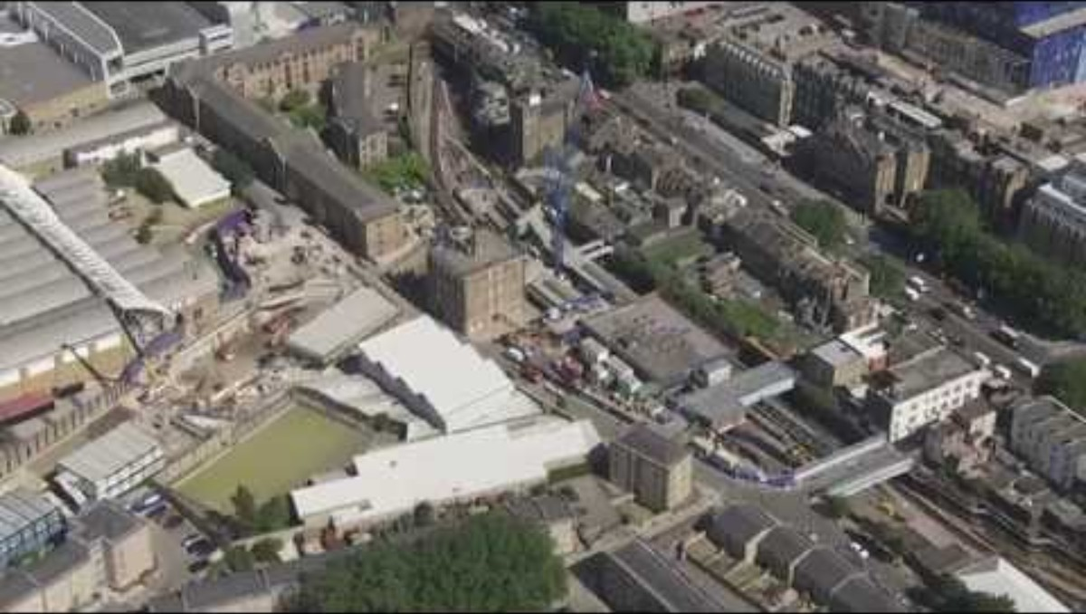
3. Case Studies and Real-World Examples
3.1 Metro Line Expansion in Urban Area – EIA Highlights
London Crossrail Project
Focus: Sustainability strategy, reuse of excavated material, emissions reduction and long-term environmental benefits
https://youtu.be/OBfTvWTzl68
Transport Research and Analysis
17

Slide 22
3. Case Studies and Real-World Examples
3.2 Highway Construction in Protected Areas – Challenges and Outcomes
Highway Through Ecologically Sensitive Area (Example: Southern Expressway, Sri Lanka or A303 Tunnel near Stonehenge, UK)
Project Description:
i. Highway project designed to improve regional connectivity but cuts through wetlands/forests
EIA Challenges:
i. Deforestation and wildlife corridor interruption and Wetland degradation
ii. Opposition from environmental groups
Outcomes:
i. Changes in Alignment to minimize impact
ii. Wildlife crossings (overpasses and underpasses)
iii. Ongoing environmental monitoring post-construction
Transport Research and Analysis
18

Slide 23

3. Case Studies and Real-World Examples
3.2 Highway Construction in Protected Areas – Challenges and Outcomes
A303 Tunnel near Stonehenge, UK
Focus: Shows how traffic would be diverted underground, reducing intrusion into the heritage landscape. Perfect for highlighting visual and ecological mitigation.
https://youtu.be/Vexogpfnm9Q
Transport Research and Analysis
19

Slide 24
3. Case Studies and Real-World Examples
3.3 Airport Development – Stakeholder Conflict and Resolution in EIAs
Airport Megaproject and Stakeholder Engagement (Example: Istanbul Airport, Turkey or Heathrow Third Runway, UK)
Project Description:
i. Major international airport project to boost tourism and logistics
Conflict Points:
i. Large-scale deforestation (Istanbul: 6600 hectares), Bird migration path disruption
ii. Community displacement and land acquisition disputes
EIA Process:
i. Multiple revisions due to strong public opposition
ii. Legal action from environmental NGOs
iii. Additional studies and public hearings mandated
Transport Research and Analysis
20

Slide 25

3. Case Studies and Real-World Examples
3.3 Airport Development – Stakeholder Conflict and Resolution in EIAs
Heathrow Third Runway, UK
Focus: Animated visuals of proposed infrastructure paired with public and political dispute coverage, especially regarding environmental implications and community concerns around wildlife, noise, and emissions
https://youtu.be/BPrJxRcMJ9A
Transport Research and Analysis
21

Slide 26
Section 04:
Challenges in Conducting EIAs for Transport Projects
Transport Research and Analysis
22

Slide 27
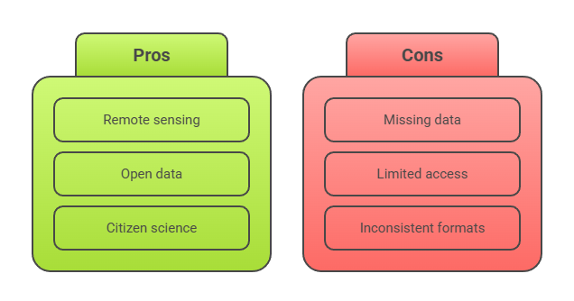
4. Challenges in Conducting EIAs for Transport Projects
4.1 Data Collection and Quality Issues
Problems:
i. Missing or outdated baseline data (air, biodiversity, etc.)
ii. Limited access to accurate traffic/environmental data
iii. Inconsistent formats across sources
Solutions:
i. Use remote sensing, open data, citizen science
ii. Standardize data collection and formats
Transport Research and Analysis
23

Slide 28
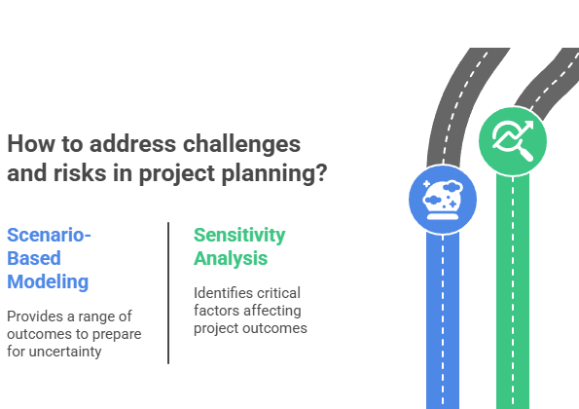
4. Challenges in Conducting EIAs for Transport Projects
4.2 Forecasting Future Impacts Accurately
Challenges:
i. Long project timelines increase uncertainty
ii. Changing fuel types, regulations, traffic patterns
Risks:
i. Inaccurate predictions → weak mitigation
Solutions:
i. Scenario-based modeling (best/worst case)
ii. Sensitivity analysis in emissions and land-use models
Transport Research and Analysis
24

Slide 29
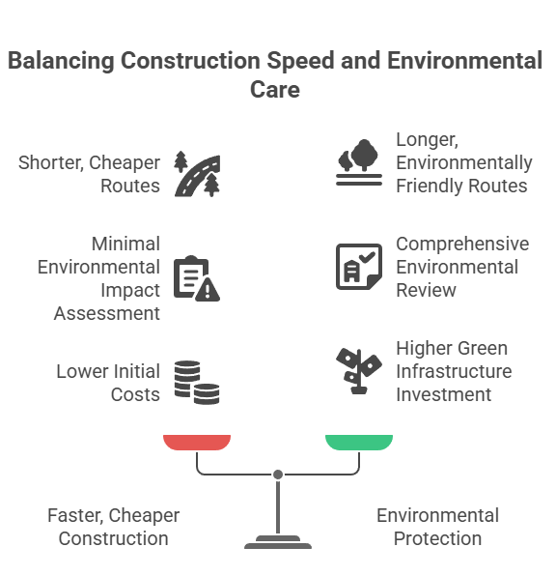
4. Challenges in Conducting EIAs for Transport Projects
4.3 Balancing Economic and Environmental Objectives
Conflict:
i. Faster, cheaper construction vs. environmental protection
Examples:
i. Route through forests vs. longer detour
ii. Minimal EIA vs. comprehensive review
Approach:
i. Include environmental costs in cost-benefit analysis
ii. Invest in green infrastructure (e.g., EV support, sound barriers with vegetation)
Transport Research and Analysis
25

Slide 30
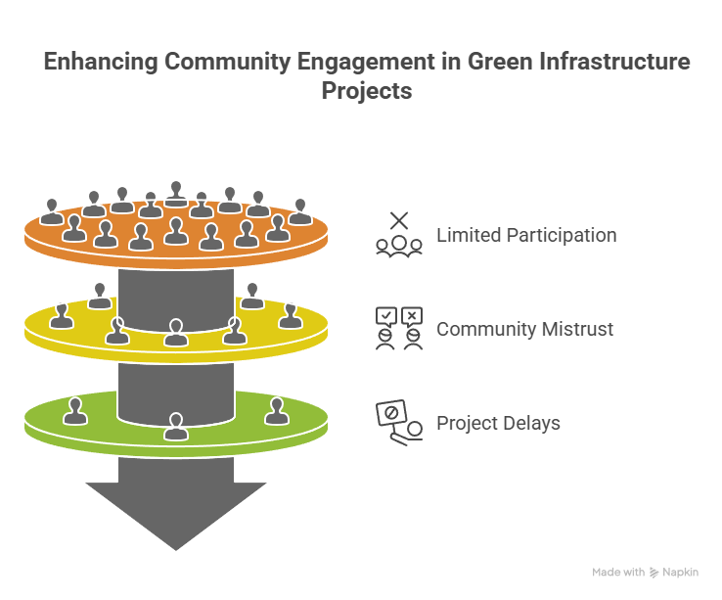
4. Challenges in Conducting EIAs for Transport Projects
4.4 Stakeholder Engagement and Public Consultation
Issues:
i. Limited participation
ii. Community mistrust
iii. Project delays due to legal or public opposition
Solutions:
i. Engage early with affected groups
ii. Use maps/simulations to explain impacts
iii. Communicate in local languages, accessible formats
Transport Research and Analysis
26

Slide 31
Section 05:
Practical Component – Excel for Emissions
Transport Research and Analysis
27

Slide 32
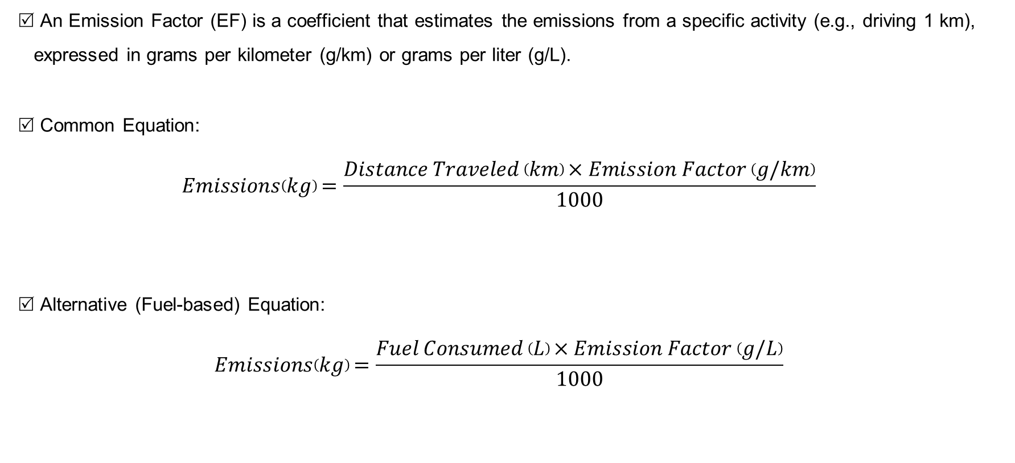
5. Practical Component – Excel for Emissions
5.1 Introduction to Emission Factor Calculations
An Emission Factor (EF) is a coefficient that estimates the emissions from a specific activity (e.g., driving 1 km), expressed in grams per kilometer (g/km) or grams per liter (g/L).
Common Equation:
$$Emissions\left(kg\right)=\frac{Distance Traveled \left(km\right)×Emission Factor \left(g/km\right)}{1000}$$
Alternative (Fuel-based) Equation:
$$Emissions\left(kg\right)=\frac{Fuel Consumed \left(L\right)×Emission Factor \left(g/L\right)}{1000}$$
Transport Research and Analysis
28

Slide 33
5. Practical Component – Excel for Emissions
5.2 Excel Formula Walkthrough
Vehicle ID | Fuel Consumed (L) | EF (g/L) | Emissions (kg)
F001 | 30 | 2392 | =B2*C2/1000
F002 | 85 | 2640 | =B3*C3/1000
Extra Excel Tips
  i. Use SUM() to find total emissions
ii. Use AVERAGE() to analyze efficiency across vehicle types
iii. Add conditional formatting to highlight high emitters
Transport Research and Analysis
29

Slide 34
5. Practical Component – Excel for Emissions
5.3 Sample Dataset Activity
Use the provided dataset (emissions_dataset.csv) to calculate CO₂ emissions from different vehicles based on fuel consumption and emission factors.
Calculate emissions for each vehicle:
  Formula → =D2*E2/1000
Visualize total emissions per vehicle type:
Insert → Pivot Table
Rows: Vehicle Type
Values: Sum of Emissions (kg)
Insert → Pie or Bar Chart
Compare diesel vs petrol emissions using filters or: =SUMIF(C:C, "Diesel", F:F)
Transport Research and Analysis
30

Slide 35
5. Practical Component – Excel for Emissions
5.4 Interpretation of Results in the Context of Transport EIAs
Discussion Questions
i. Which vehicle types contribute the highest CO₂ emissions?
ii. Do diesel engines emit significantly more than petrol?
iii. How much impact do buses or trucks have relative to smaller vehicles?
iv. What happens if these are replaced with electric or hybrid options?
Policy Implications
i. Identify priority areas for emission reduction (e.g., switch bus fleets to electric)
ii. Results can feed into EIA reports to recommend mitigation measures
iii. Supports cost-benefit decisions for adopting cleaner technologies
Extended Activity Ideas
i. Modify the dataset to simulate switching all diesel vehicles to electric
ii. Measure percentage change in total emissions
iii. Prepare a short policy memo or visual dashboard in Excel
Transport Research and Analysis
31

Slide 36
5. Practical Component – Excel for Emissions
5.5 Home Assignment
Define a realistic transport infrastructure scenario
Map five key environmental indicators (e.g., CO₂, noise, biodiversity)
Perform Excel-based emissions analysis with visualizations (transport_emissions_dataset.csv)
Write a professional policy memo with actionable recommendations
Reflect on practical EIA challenges and stakeholder dynamics
Deliverables:
        i. Structured PDF report
        ii. Annotated Excel workbook
        iii. Clear formatting and evidence of critical thinking
Transport Research and Analysis
32

Slide 37
Section 06:
References
Transport Research and Analysis
33

Slide 38
6. References
6.1 Reference Textbooks & Tutorials
European Union. (2014). Directive 2014/52/EU on the assessment of the effects of certain public and private projects on the environment. Official Journal of the European Union.
https://youtu.be/OBfTvWTzl68
https://youtu.be/Vexogpfnm9Q
https://youtu.be/Vexogpfnm9Q
Transport Research and Analysis
34

Slide 39
Thank You for Your Attention

