Slide 1
Transport Research and Analysis
Module 4: Sustainable Transport and Policy Analysis
Lecture 16: Environmental Impact of Transport

Slide 3
Table of Contents
Lecture 16: Environmental Impact of Transport
1. Introduction and Motivation | 1
1.1 Background on transport and environment | 2
1.2 Importance of addressing emissions | 3
1.3 Global and local implications | 4
2. Transport Emissions and Pollution | 5
2.1 Major pollutants | 6
2.2 Importance of Sustainable Transport | 7
2.3 Effects on health, air quality, and climate | 8
4. Dimensions of Sustainable Transport | 14
4.1 Units and indicators | 15
4.2 Temporal and spatial data collection | 16
4.3 Regulatory standards and compliance | 17
4.4 Case examples of measurement programs | 18
5. Mitigation Strategies | 19
5.1 Vehicle technology | 20
5.2 Cleaner fuels and fuel efficiency | 21
5.3 Urban transport policies (LEZs, congestion pricing) | 22
5.4 Modal shift and demand management | 23
6. Environmental Impact Assessment | 24
6.1 Purpose and process of EIA | 25
3. Detection and Monitoring Technologies | 9
3.1 On-board emission sensors | 10
3.2 Roadside and remote sensing systems | 11
3.3 Satellite and drone-based monitoring | 12
3.4 Role of IoT and smart city integration | 13
i
Environmental Impact of Transport

Slide 4
Table of Contents
Lecture 16: Environmental Impact of Transport
6.2 Assessment tools and indicators | 26
6.3 EIA in transport project planning | 27
6.4 Case study examples | 28
7. Quiz / Interactive Session | 29
7.1 Short MCQs or True/False questions | 30
7.2 Discussion of answers | 32
8. Conclusion and Key Takeaways | 33
8.1 Summary of key points | 34
8.2 Open challenges and innovations | 35
8.3 Direction for further study | 36
ii
Environmental Impact of Transport

Slide 5
Section 01:
Introduction and Motivation
Environmental Impact of Transport

Slide 6
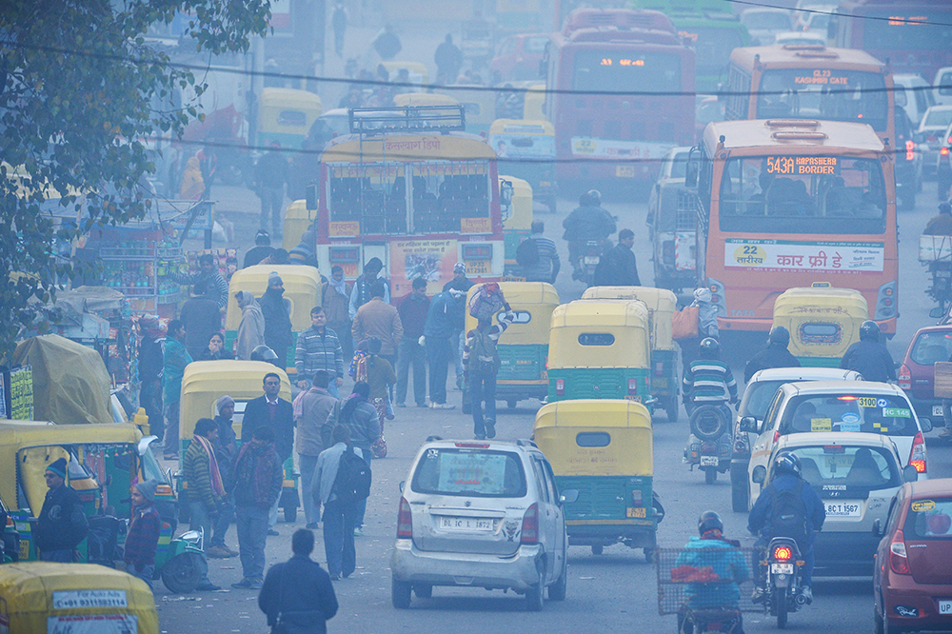
1. Introduction and Motivation
1.1 Background on Transport and Environment
Transport sector: major contributor to greenhouse gas emissions (GHG)
Includes road, rail, air, and maritime transport
Emissions include:
i. Carbon dioxide (CO₂)
ii. Nitrogen oxides (NOₓ)
iii. Particulate matter (PM)
iv. Volatile organic compounds (VOCs)
Environmental effects:
i. Air and water pollution
ii. Noise pollution
iii. Urban heat island effect
Clogged New Delhi streets during rush hour commuting in December 2015.
2
Environmental Impact of Transport

Slide 7
1. Introduction and Motivation
1.2 Importance of addressing emissions
      Transport contributes ~24% of direct CO₂ emissions from fuel combustion (IEA, 2021)
      Impacts:
        i. Public health risks (e.g., respiratory diseases)
        ii. Climate change acceleration
        iii. Biodiversity loss and habitat degradation
      Regulatory push:
      i. Paris Agreement
      ii. EU Green Deal, Clean Air Acts, etc.
      Need for multidisciplinary action – engineering, policy, behavior
3
Environmental Impact of Transport

Slide 8
1. Introduction and Motivation
1.3 Global and Local Implications
      Global:
      i. Melting glaciers, extreme weather, global sea-level rise
      ii. International shipping and aviation as transboundary pollutants
      Local:
      i. Urban smog and poor AQI (Air Quality Index)
      ii. Disproportionate effects on vulnerable communities
      iii. Congestion and noise near transport corridors
      iv. Localized monitoring and customized mitigation strategies essential
4
Environmental Impact of Transport

Slide 9
Section 02:
Transport Emissions and Pollution
Environmental Impact of Transport

Slide 10
2. Transport Emissions and Pollution
2.1 Major pollutants
Pollutant | Source | Impact
CO₂ | Fuel combustion (all modes) | Climate change (greenhouse gas)
NOₓ | Diesel engines, aviation | Respiratory issues, ozone formation
PM (PM₂.₅/PM₁₀) | Brake/tire wear, diesel exhaust | Lung disease, cardiovascular problems
VOCs | Unburned fuel vapors | Smog formation, carcinogenic effects
SO₂ | Marine fuels | Acid rain, respiratory harm
CO | Incomplete combustion | Reduces oxygen delivery in humans
Reference: M. de (2019), IEA reports
6
Environmental Impact of Transport

Slide 11
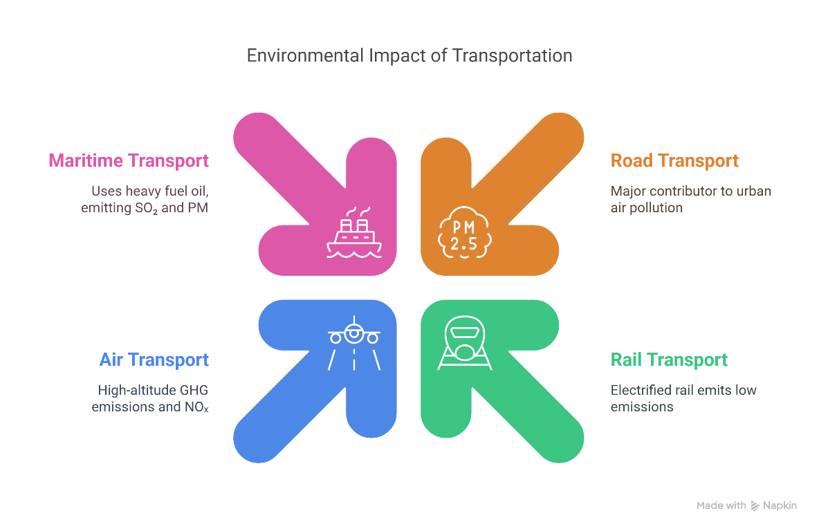
2. Transport Emissions and Pollution
2.2 Sources by transport mode
Road Transport:
i. Major contributor to urban air pollution
ii. Private cars, trucks, and buses (high diesel use)
Rail Transport:
i. Electrified: low emissions
ii. Diesel-powered: emits NOₓ and PM
Air Transport:
i. High-altitude GHG emissions, NOₓ
ii. Limited mitigation options currently
Maritime (Sea):
i. Uses heavy fuel oil → high SO₂ and PM
ii. Large global share in freight-related emissions
7
Environmental Impact of Transport

Slide 12
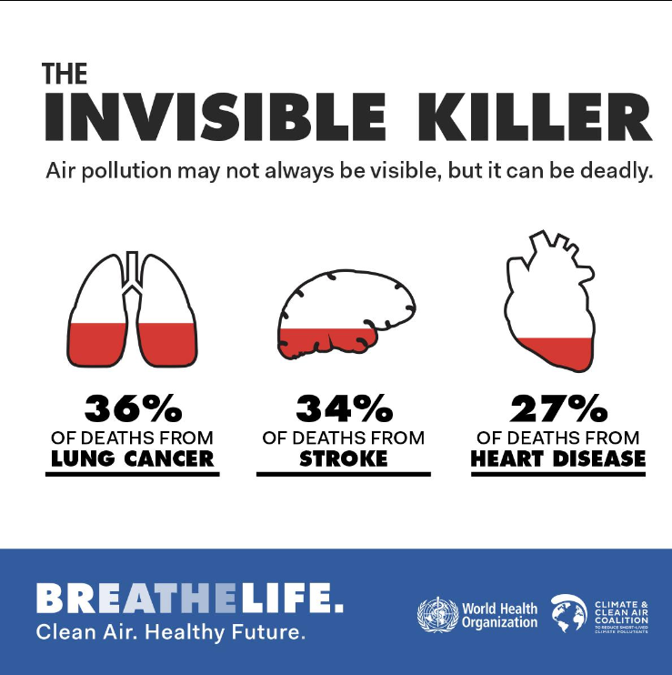
2. Transport Emissions and Pollution
2.3 Effects on health, air quality, and climate
Human Health
  i. WHO: 4.2 million deaths/year due to air pollution
ii. Urban transport: key source of exposure
Air Quality
i. Transport emissions increase AQI to hazardous levels
ii. Urban hotspots: highways, bus stops, airports
Climate Impact
i. CO₂ and methane → long-term global warming
ii. Black carbon from diesel engines absorbs heat
Ecosystems
i. Acidification from SO₂/NOₓ → forest and water damage
ii. Pollutants affect flora, fauna, and food chains
8
Environmental Impact of Transport

Slide 13
Section 03:
Detection and Monitoring Technologies
Environmental Impact of Transport

Slide 14
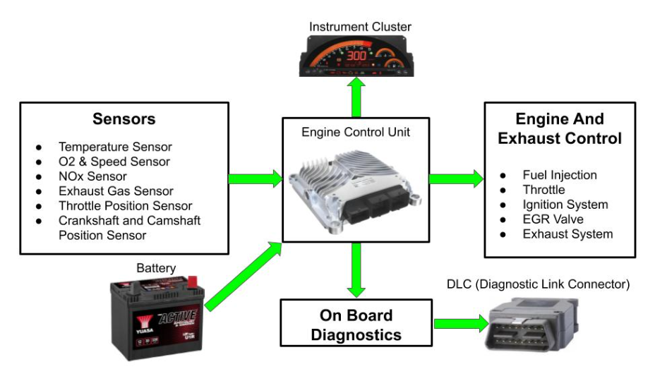
3. Detection and Monitoring Technologies
3.1 On-board emission sensors
Installed in vehicles to monitor real-time emissions
Common sensors:
i. OBD-II (On-Board Diagnostics): monitors engine and emission components
ii. NOₓ and O₂ sensors, Particulate Matter (PM) filters
Applications:
i. Fleet management
ii. Emission reduction audits
Advantages:
i. Accurate vehicle-specific data
ii. Enables preventive maintenance
Challenges:
i. Cost and compatibility with older vehicles
ii. Data ownership and privacy concerns
10
Environmental Impact of Transport

Slide 15

3. Detection and Monitoring Technologies
3.2 Roadside and remote sensing systems
Fixed infrastructure monitors emissions without vehicle contact
Technologies:
i. Infrared and UV spectroscopy
ii. Laser-induced fluorescence
iii. Passive diffusion tubes for NO₂/VOCs
Use cases:
i. Detection of high emitters
ii. Monitoring urban pollution hotspots
Examples:
i. London's Roadside Emissions Monitoring Network
Pros:
i. Continuous, automated data
Cons:
i. Stationary; requires multiple units for citywide coverage
An Advanced Multi-Lane VIDAR Speed Detection Camera
11
Environmental Impact of Transport

Slide 16
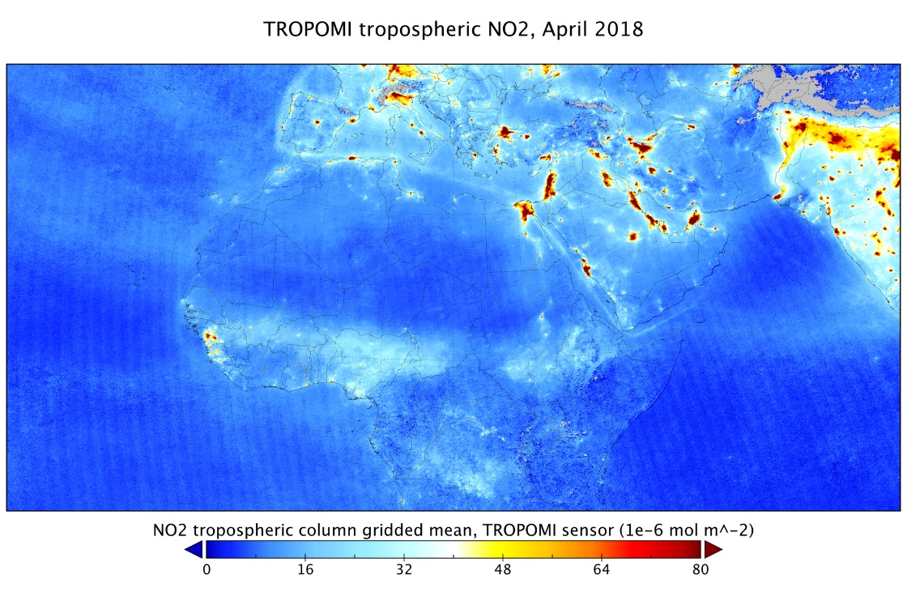
3. Detection and Monitoring Technologies
3.3 Satellite and drone-based monitoring
Satellites (e.g., Sentinel-5P, GOSAT):
i. Measure tropospheric gases (CO₂, NO₂, CH₄)
Enable regional/global pollution mapping
Drones (UAVs):
i. Collect localized, high-resolution data
ii. Equipped with gas sensors and thermal imaging
Applications:
i. Monitoring industrial corridors, highways, ports
Pros:
i. Large-scale (satellites) and flexible (drones)
Cons:
i. Limited resolution (satellites), legal/battery limits (drones)
Nitrogen dioxide from Sentinel-5P
12
Environmental Impact of Transport

Slide 17
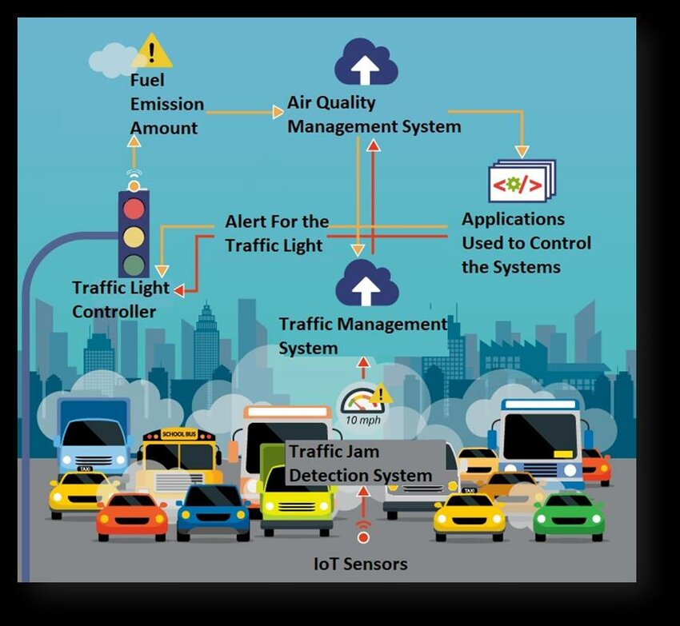
3. Detection and Monitoring Technologies
3.4 Role of IoT and smart city integration
IoT-based air quality monitoring:
i. Network of low-cost, cloud-connected sensors (e.g., AirVisual, Airly)
Features:
i. Live AQI dashboards, alert systems, predictive analytics
Integration with:
i. Traffic systems, weather stations, public health databases
Smart city use cases:
i. Dynamic speed limits and congestion pricing
ii. Pollution-based route planning
Benefits:
i. Scalability, transparency, citizen engagement
Applications of IoT in the Traffic system
13
Environmental Impact of Transport

Slide 18
Section 04:
Measurement of Pollution Levels
Environmental Impact of Transport

Slide 19
4. Measurement of Pollution Levels
4.1 Units and indicators
Pollutant | Common Units | Indicator Type
CO₂ (Carbon Dioxide) | grams per kilometer (g/km) | Vehicle emissions
NOₓ, SO₂, CO | parts per million (ppm) / billion (ppb) | Air concentration
PM₂.₅, PM₁₀ | micrograms per cubic meter (µg/m³) | Ambient air quality
O₃ (Ozone) | µg/m³ or ppm | Tropospheric pollution
Composite index: Air Quality Index (AQI) – simplifies multiple pollutants into a single scale
15
Environmental Impact of Transport

Slide 20
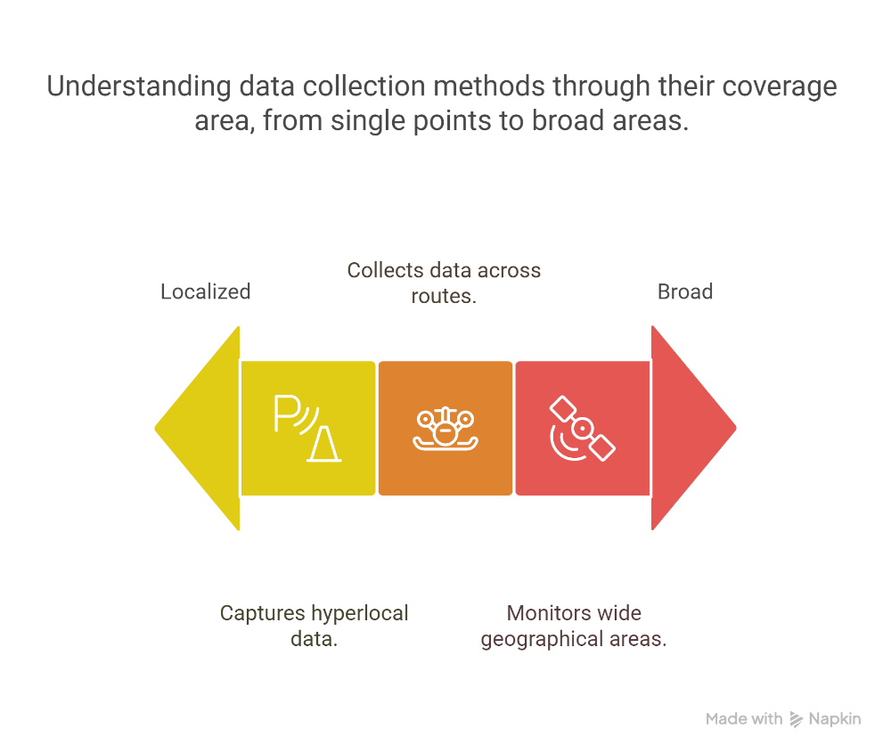
4. Measurement of Pollution Levels
4.2 Temporal and spatial data collection
Temporal resolution
i. Real-time: seconds/minutes (e.g., IoT sensors, traffic-based monitoring)
ii. Periodic: hourly, daily averages (e.g., government stations)
Spatial resolution
i. Fixed: roadside stations
ii. Mobile: vehicles/drones
iii. Remote: satellite imagery
Data is analyzed for:
i. Daily trends
ii. Seasonal patterns
iii. Peak pollution hours (e.g., rush hours)
16
Environmental Impact of Transport

Slide 21
4. Measurement of Pollution Levels
4.3 Regulatory standards and compliance
International benchmarks:
i. WHO Air Quality Guidelines
ii. EU Directive 2008/50/EC
iii. US EPA NAAQS (National Ambient Air Quality Standards)
Vehicle emission standards:
i. Euro 6 (EU)
ii. Tier 3 (USA)
iii. BS-VI (India)
Compliance tools:
i. On-road inspections
ii. Emission certificates
iii. Remote emission sensing
17
Environmental Impact of Transport

Slide 22
4. Measurement of Pollution Levels
4.4 Case examples of measurement programs
London (UK):
i. Automatic Urban and Rural Network (AURN)
ii. Monitors PM, NO₂, O₃, CO across the city
Netherlands:
i. RIVM Air Quality Monitoring Network
ii. Integrates data from over 50 stations and mobile labs
Beijing:
i. Combines satellite, ground, and roadside sensors
ii. Supports enforcement of emission quotas and bans
Copernicus Atmosphere Monitoring Service (CAMS):
i. EU program offering open-access satellite-based pollution maps
18
Environmental Impact of Transport

Slide 23
Section 05:
Mitigation Strategies
Environmental Impact of Transport

Slide 24
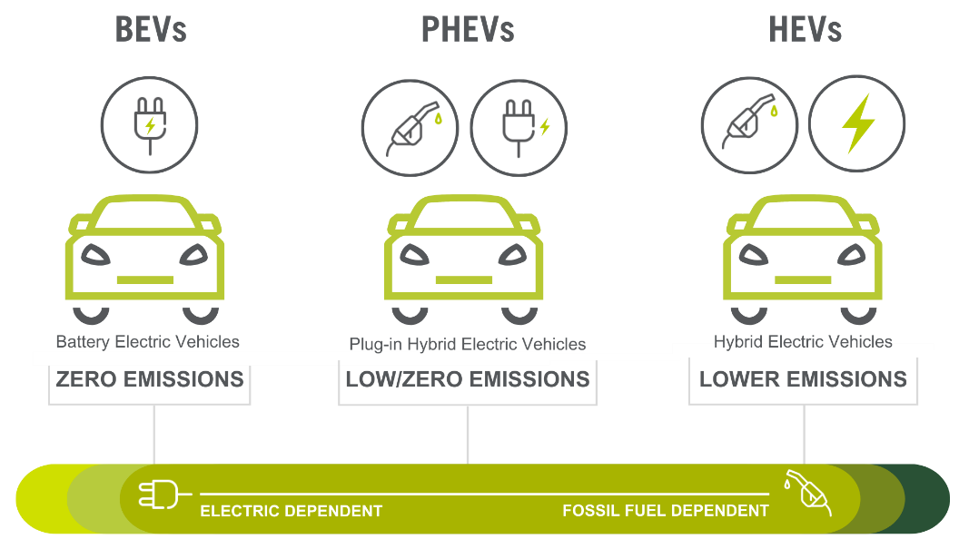
5. Mitigation Strategies
5.1 Vehicle Technology
Electric Vehicles (EVs):
i. Zero tailpipe emissions
ii. Lower lifecycle emissions (if powered by renewables)
iii. Challenges: battery sourcing, charging infrastructure
Hybrids (HEVs, PHEVs):
i. Combine internal combustion engines with electric motors
ii. Improved fuel economy, reduced emissions
Hydrogen Fuel Cell Vehicles (FCEVs):
i. Emit only water vapor
ii. Suitable for heavy-duty transport
iii. Hurdles: hydrogen production, refueling stations
20
Environmental Impact of Transport

Slide 25
5. Mitigation Strategies
Cleaner fuels:
i. Biofuels (ethanol, biodiesel)
ii. Natural gas (CNG, LNG)
iii. Synthetic e-fuels (in development)
Fuel efficiency improvements:
i. Engine optimization
ii. Aerodynamic design
iii. Lightweight materials (e.g., aluminum, composites)
Policy examples:
i. Corporate Average Fuel Economy (CAFE) standards (USA)
ii. EU CO₂ performance standards for cars and vans
5.2 Cleaner fuels and fuel efficiency
21
Environmental Impact of Transport

Slide 26
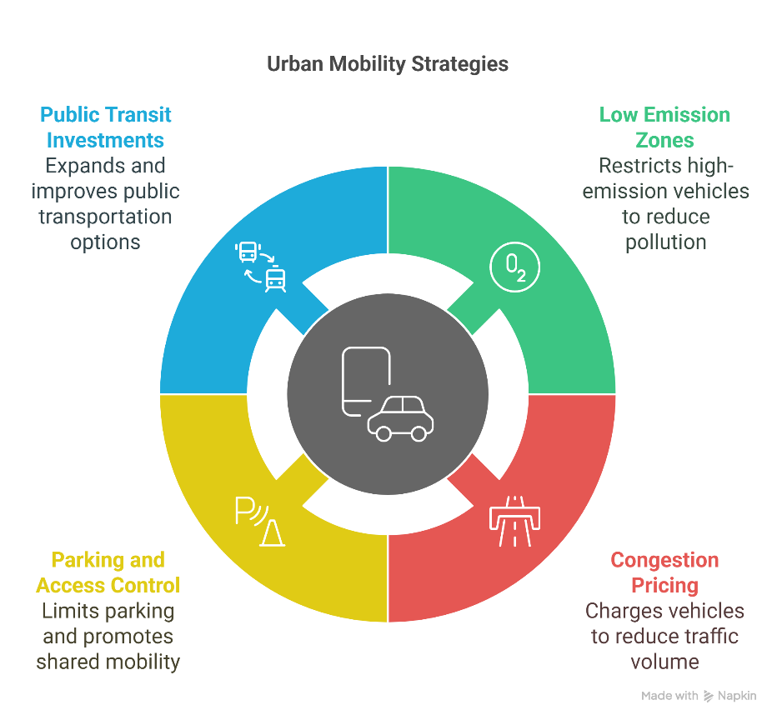
5. Mitigation Strategies
5.3 Urban Transport Policies
Low Emission Zones (LEZs):
i. Restrict access for high-emission vehicles (e.g., London, Milan)
Congestion Pricing:
i. Charges vehicles entering congested urban areas (e.g., Singapore, Stockholm)
ii. Reduces traffic volume and emissions
Parking and access control:
i. Limited on-street parking, higher parking fees
ii. Promotion of shared mobility (carpooling, ride-sharing)
Public transit investments:
i. Bus rapid transit (BRT), metro expansions, green buses
22
Environmental Impact of Transport

Slide 27
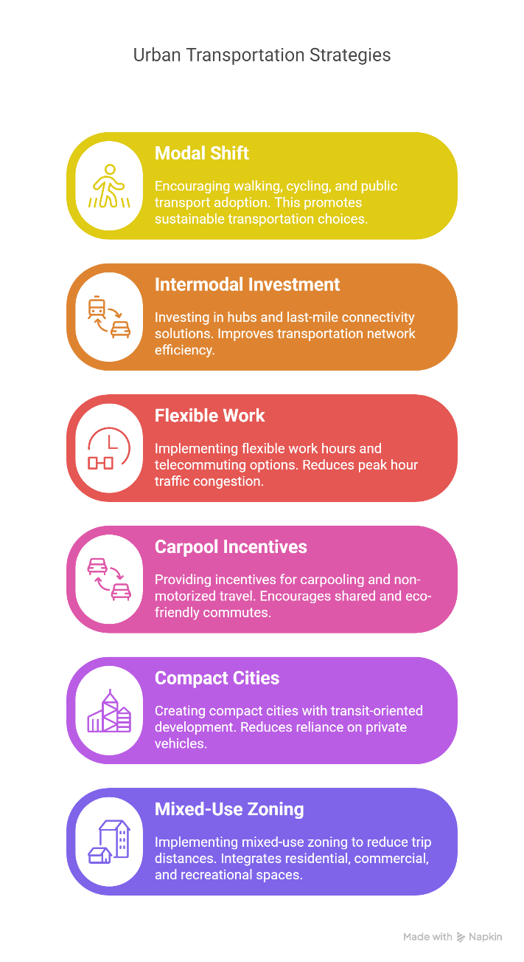
5. Mitigation Strategies
5.4 Modal shift and demand management
Modal shift strategies:
i. Promote walking, cycling, and public transport
ii. Invest in intermodal hubs and last-mile connectivity
Transport demand management (TDM):
i. Flexible work hours and telecommuting
ii. Incentives for carpooling and non-motorized travel
Land use planning:
i. Compact cities, transit-oriented development (TOD)
ii. Mixed-use zoning to reduce trip distances
23
Environmental Impact of Transport

Slide 28
Section 06:
Environmental Impact Assessment (EIA)
Environmental Impact of Transport

Slide 29
6. Environmental Impact Assessment (EIA)
6.1 Purpose and process of EIA
Purpose:
i. Predict environmental impacts of transport projects before execution
ii. Propose mitigation to reduce adverse effects
iii. Inform decision-makers, stakeholders, and the public
General EIA Process:
1. Screening – Is an EIA required?
2. Scoping – Identify key issues and impacts
3. Impact Assessment – Quantify and qualify impacts
4. Mitigation – Propose actions to minimize impacts
5. Reporting – Prepare the Environmental Impact Statement (EIS)
6. Review and Decision – Authority evaluates the EIS
7. Monitoring – Follow-up during and after implementation
25
Environmental Impact of Transport

Slide 30
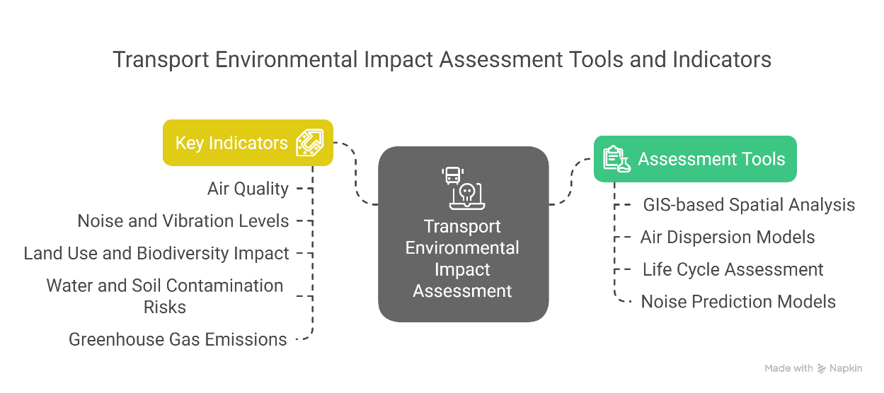
6. Environmental Impact Assessment (EIA)
6.2 Assessment tools and indicators
Assessment tools:
i. GIS-based spatial analysis
ii. Air dispersion models (e.g., AERMOD)
iii. Life Cycle Assessment (LCA)
iv. Noise prediction models (e.g., CNOSSOS-EU)
Key indicators in transport EIAs:
i. Air quality (PM, NOₓ, CO₂ levels)
ii. Noise and vibration levels
iii. Land use and biodiversity impact
iv. Water and soil contamination risks
v. Greenhouse gas (GHG) emissions
Quantitative and qualitative approaches are used together for holistic analysis
26
Environmental Impact of Transport

Slide 31
6. Environmental Impact Assessment (EIA)
6.3 EIA in transport project planning
Applied in projects like:
i. Highway construction
ii. Railway expansion
iii. Airport development
iv. Urban transit corridors
Integration into early project stages improves:
i. Public acceptance
ii. Risk mitigation
iii. Regulatory approval success
Challenges:
i. Balancing development with environmental protection
ii. Data limitations in developing regions
iii. Coordinating across multiple stakeholders
27
Environmental Impact of Transport

Slide 32
6. Environmental Impact Assessment (EIA)
6.4 Case study examples
🚗 HS2 High-Speed Rail (UK):
i. Comprehensive EIA with focus on biodiversity, noise, and heritage
ii. Mitigation included green bridges, noise barriers, and tree planting
✈️ New Istanbul Airport (Turkey):
i. Large-scale EIA for wetland impact, air quality, and bird migration
ii. Resulted in relocation of affected communities and ecological offsets
🛣️ Delhi-Mumbai Expressway (India):
i. Integrated wildlife crossings, solar-powered facilities, and rainwater harvesting as part of EIA-based mitigation
28
Environmental Impact of Transport

Slide 33
Section 07:
Quiz / Interactive Session
Environmental Impact of Transport

Slide 34
7. Quiz / Interactive Session
7.1 Short MCQs or True/False questions
Q1 (MCQ):
Which pollutant is primarily responsible for global warming from transport activities?
A) NOₓ
B) PM₂.₅
C) CO₂
D) SO₂
Q2 (True/False):
Electric vehicles (EVs) have zero greenhouse gas emissions throughout their entire life cycle.
30
Environmental Impact of Transport
Notes:
Q1: C) CO₂
Q2: False (Depends on energy source and manufacturing emissions)

Slide 35
7. Quiz / Interactive Session
7.1 Short MCQs or True/False questions
Q3 (MCQ):
Which of the following is a roadside method for emission monitoring?
A) Drone-based sensing
B) OBD-II sensors
C) Passive diffusion tubes
D) Satellite remote sensing
Q4 (True/False):
The Air Quality Index (AQI) is a composite indicator based on the concentration of multiple pollutants.
31
Environmental Impact of Transport
Notes:
Q3: C) Passive diffusion tubes
Q4: True

Slide 36
7. Quiz / Interactive Session
7.2 Discussion of answers
Clarify any misunderstandings
Expand briefly on the real-world importance of each answer:
i. Why CO₂ is the main GHG
ii. Why EVs’ sustainability depends on electricity source
iii. How AQI supports public health decisions
Practical examples of congestion pricing (e.g., Singapore, London)
32
Environmental Impact of Transport

Slide 37
Section 08:
Conclusion and Key Takeaways
Environmental Impact of Transport

Slide 38
8. Conclusion and Key Takeaways
8.1 Summary of key points
Transport emissions include CO₂, NOₓ, PM, and VOCs — impacting climate, health, and ecosystems
Detection technologies range from on-board sensors to satellite systems
Measurement uses standardized units (g/km, µg/m³, ppm) and must consider temporal and spatial variations
Mitigation strategies involve:
i. Advanced vehicle technologies (EVs, hydrogen)
ii. Cleaner fuels and improved efficiency
iii. Urban policies like LEZs and congestion pricing
iv. Promoting modal shifts and smarter urban design
Environmental Impact Assessments (EIA) are crucial tools for evaluating and mitigating project risks
34
Environmental Impact of Transport

Slide 39
8. Conclusion and Key Takeaways
8.2 Open challenges and innovations
Challenges:
i. Electrification of heavy-duty and aviation sectors
ii. Charging and hydrogen infrastructure gaps
iii. Global disparities in technology adoption
iv. Data gaps in emissions monitoring
Innovations:
i. AI and Big Data in real-time transport emissions modelling
ii. Development of zero-carbon fuels (e-fuels, green hydrogen)
iii. Smart cities integrating dynamic pollution management
iv. Autonomous and connected vehicles reducing urban congestion
35
Environmental Impact of Transport

Slide 40
8. Conclusion and Key Takeaways
8.3 Direction for further study
Research Areas:
i. Life Cycle Assessment (LCA) of emerging transport technologies
ii. Comparative studies of urban emission mitigation strategies
iii. Role of behavioral economics in influencing transport choices
iv. Integration of transport planning with broader sustainability goals (SDGs)
Recommended Reading:
i. M. de, Transportation, Energy Use and Environmental Impacts (2019)
ii. Reports by IEA, IPCC, and WHO on transport and environment
36
Environmental Impact of Transport

