Slide 1
Transport Research and Analysis
Module 4: Sustainable Transport and Policy Analysis
Lecture 15: Sustainable Transport Concepts

Slide 3
Table of Contents
Lecture 15: Sustainable Transport Concepts
1. Introduction to Sustainable Transport | 1
1.1 Overview of the Session | 2
1.2 Learning Objectives | 3
1.3 Relevance to Engineering and Society | 4
2. Definition and Importance of Sustainable Transport | 5
2.1 Definitions from Key Sources | 6
2.2 Importance of Sustainable Transport | 7
2.3 Challenges of Current Transport Systems | 8
4. Dimensions of Sustainable Transport | 13
4.1 Environmental Sustainability | 14
4.2 Economic Sustainability | 15
4.3 Social Sustainability | 16
4.4 Interactions Among the Three Dimensions | 17
5. Key Indicators of Sustainable Transport | 18
5.1 Environmental Indicators | 19
5.2 Economic Indicators | 20
5.3 Social Indicators | 21
6. Strategies for Achieving Sustainable Transport | 22
6.1 Mobility Management and Travel Planning | 23
6.2 Policy and Regulatory Measures | 24
3. Examples of Sustainable Transport Modes | 9
3.1 Public Transport | 10
3.2 Non-Motorized Transport | 11
3.3 Shared and Low-Emission Mobility | 12
i
Sustainable Transport Concepts

Slide 4
Table of Contents
Lecture 15: Sustainable Transport Concepts
6.3 Land Use and Urban Design Integration | 25
6.4 Technological and Behavioral Innovations | 26
7. Case Studies / Real-World Examples | 27
7.1 European Sustainable Urban Mobility Plans (SUMPs) | 28
7.2 Curitiba, Brazil – Bus Rapid Transit | 29
7.2 Curitiba, Brazil – Bus Rapid Transit.3 Amsterdam – Cycling Infrastructure | 30
9. Discussion and Reflections | 34
9.1 Group Reflection: What Makes Transport Sustainable? | 35
9.2 Role of Engineers in Driving Change | 36
9.3 Regional Perspectives: Challenges in Our Context | 37
8. Quiz | 31
8.1 Multiple Choice Questions | 32
8.2 True/False Questions | 33
ii
Sustainable Transport Concepts

Slide 5
Section 01:
Introduction to Sustainable Transport
Sustainable Transport Concepts

Slide 6
1. Introduction to Sustainable Transport
1.1 Overview of the Session
Understanding the core idea of sustainable transport
Exploring its significance in modern urban planning
Identifying key dimensions and strategies
Reviewing real-world applications and case studies
Engaging in discussion and quiz to reinforce learning
2
Sustainable Transport Concepts

Slide 7
1. Introduction to Sustainable Transport
1.2 Learning Objectives
Define sustainable transport and explain its importance
Identify key dimensions and indicators of sustainability in transport
Describe various sustainable transport modes
Evaluate strategies used to promote sustainable mobility
Reflect on the role of engineers in designing sustainable systems
3
Sustainable Transport Concepts

Slide 8
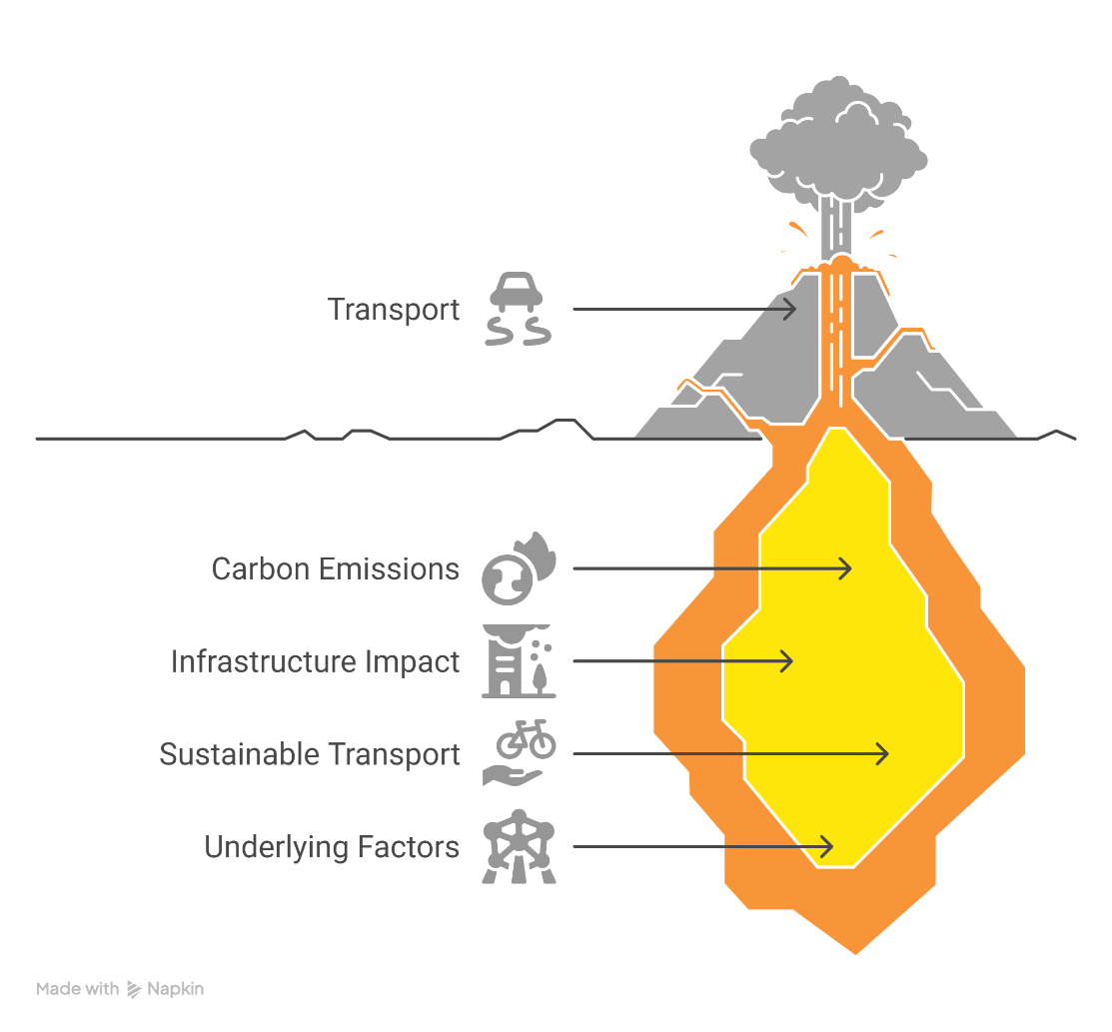
1. Introduction to Sustainable Transport
1.3 Relevance to Engineering and Society
      Transport is a major contributor to carbon emissions (≈24% globally)
      Engineers shape infrastructure that impacts emissions, equity, and quality of life
      Sustainable transport improves health, reduces congestion, and enhances mobility
      Aligns with SDGs (e.g., SDG 11 – Sustainable Cities & Communities)
4
Sustainable Transport Concepts

Slide 9
Section 02:
Definition and Importance of Sustainable Transport
Sustainable Transport Concepts

Slide 10
2. Definition and Importance of Sustainable Transport
2.1 Definitions from Key Sources
European Commission: “Transport that meets society's current mobility needs without compromising the ability of future generations to meet theirs.”
M. Enoch (2016): Emphasizes integration of environmental, economic, and social goals.
UN Habitat: Focuses on accessibility, safety, affordability, and environmental friendliness.
Sustainable Transport and Policy Analysis
6
Sustainable Transport Concepts

Slide 11
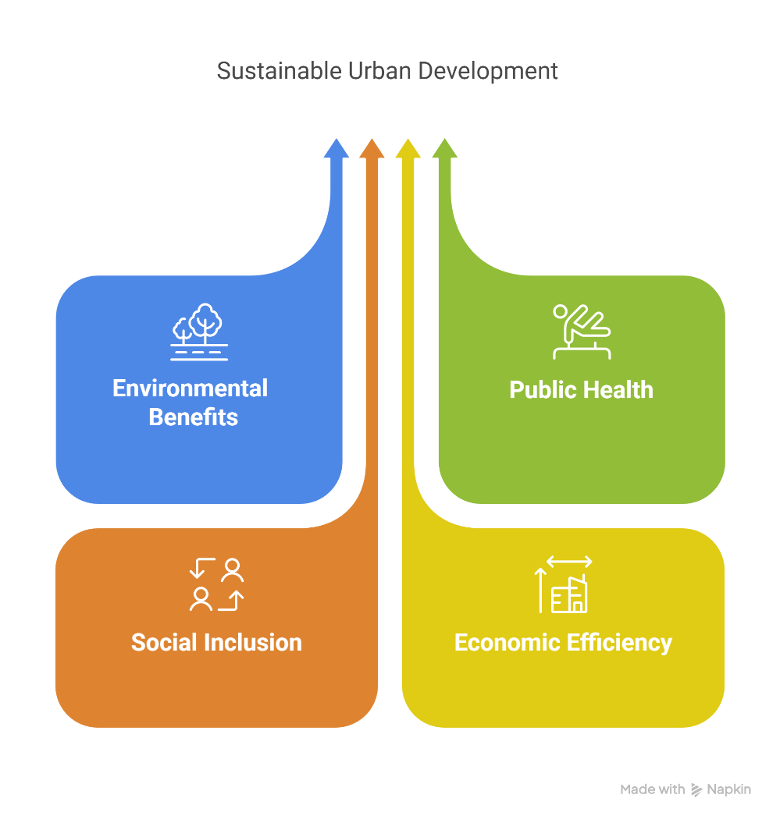
2. Definition and Importance of Sustainable Transport
2.2 Supporting Decision-Making in Transport Planning
Reduces greenhouse gas emissions and combats climate change
Promotes public health through reduced air pollution and active mobility
Enhances social inclusion by improving access to jobs, education, and healthcare
Supports economic efficiency by reducing congestion and fuel dependency
Sustainable Transport and Policy Analysis
7
Sustainable Transport Concepts

Slide 12
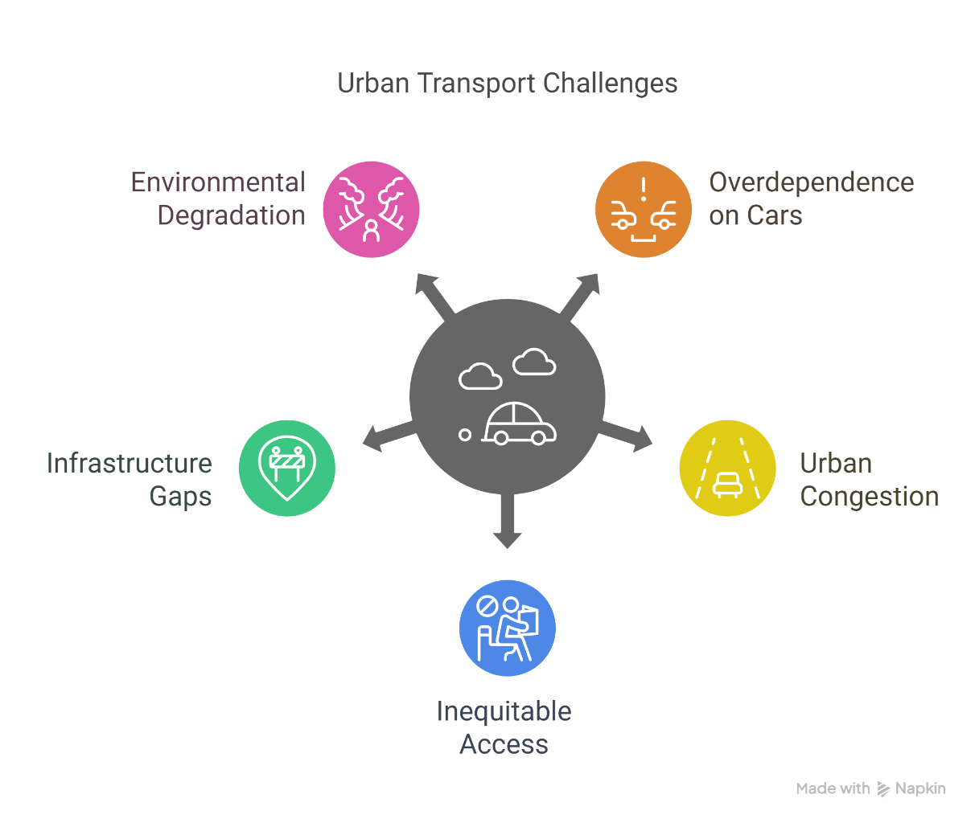
2. Definition and Importance of Sustainable Transport
2.3 Challenges of Current Transport Systems
Overdependence on private cars and fossil fuels
Urban congestion and long commute times
Inequitable access to reliable transport
Infrastructure gaps in developing regions
Rising emissions and environmental degradation
Sustainable Transport and Policy Analysis
8
Sustainable Transport Concepts

Slide 13
Section 03:
Examples of Sustainable Transport Modes
Sustainable Transport and Policy Analysis
Sustainable Transport Concepts

Slide 14
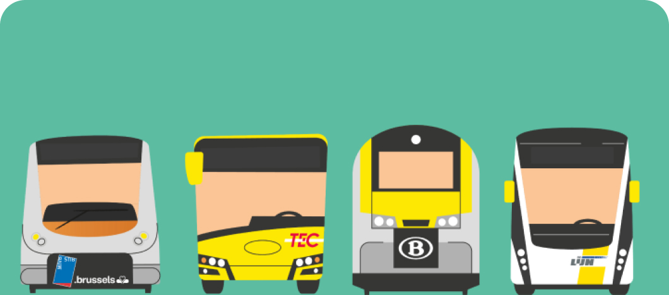
3. Examples of Sustainable Transport Modes
3.1 Public Transport
High-capacity and energy-efficient
Reduces number of vehicles on the road
Examples: Bus Rapid Transit (BRT), Metro/Subway, Light Rail Transit (LRT)
Supports equitable access to mobility
Mass Mobility with Less Impact
Sustainable Transport and Policy Analysis
10
Sustainable Transport Concepts

Slide 15
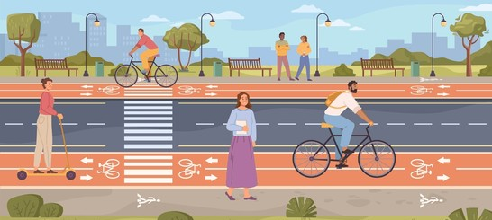
3. Examples of Sustainable Transport Modes
3.2 Non-Motorized Transport
Zero emissions, low-cost, and health-promoting
Ideal for short-distance travel in urban areas
Requires dedicated infrastructure (bike lanes, pedestrian zones)
Examples: Copenhagen’s cycling culture, pedestrianized city centers in Europe
Sustainable Transport and Policy Analysis
11
Sustainable Transport Concepts

Slide 16
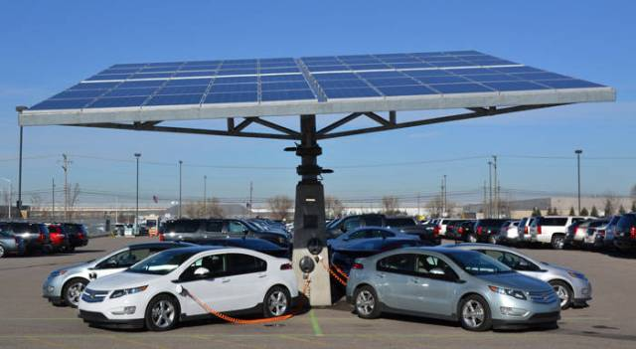
3. Examples of Sustainable Transport Modes
3.3 Shared and Low-Emission Mobility
Shared Mobility: Carpooling, bike/scooter sharing, ride-hailing (e.g., Uber Pool)
Low-Emission Vehicles: Electric Vehicles (EVs), Hydrogen Fuel Cell Vehicles
Reduces carbon footprint and congestion
Requires supporting infrastructure (charging stations, smart apps)
Sustainable Transport and Policy Analysis
12
Sustainable Transport Concepts

Slide 17
Section 04:
Dimensions of Sustainable Transport
Sustainable Transport and Policy Analysis
Sustainable Transport Concepts

Slide 18
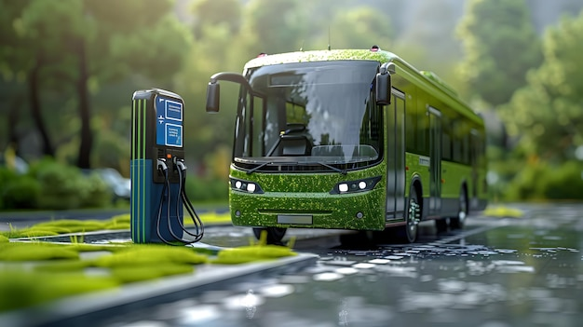
4. Dimensions of Sustainable Transport
4.1 Environmental Sustainability
Reduces greenhouse gas emissions and air pollutants
Minimizes land use, habitat fragmentation, and noise pollution
Promotes use of renewable energy and clean vehicle technologies
Supports compact urban development to limit travel distances
Sustainable Transport and Policy Analysis
14
Sustainable Transport Concepts

Slide 19
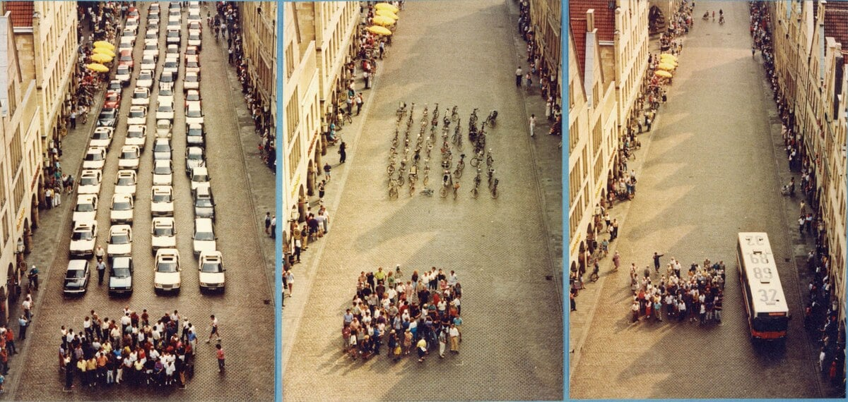
4. Dimensions of Sustainable Transport
4.2 Economic Sustainability
Enhances productivity through reduced congestion
Lowers fuel costs and infrastructure maintenance in the long run
Supports local economic development via better accessibility
Encourages cost-effective investments like public and active transport
Sustainable Transport and Policy Analysis
15
Sustainable Transport Concepts

Slide 20
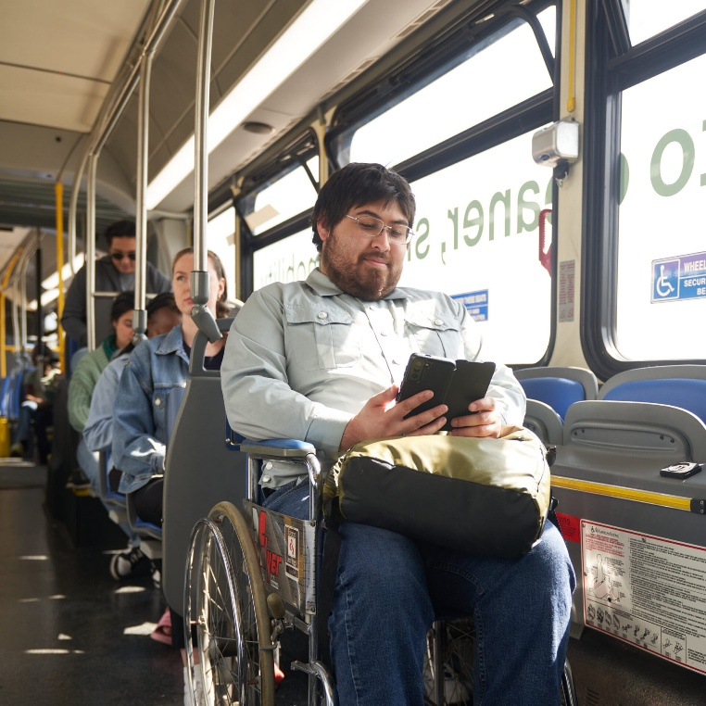
4. Dimensions of Sustainable Transport
4.3 Social Sustainability
Ensures equitable access for all (women, elderly, disabled, low-income groups)
Improves safety and health through reduced accidents and active travel
Strengthens social interaction and community cohesion
Reduces transport-related stress and isolation
Sustainable Transport and Policy Analysis
16
Sustainable Transport Concepts

Slide 21
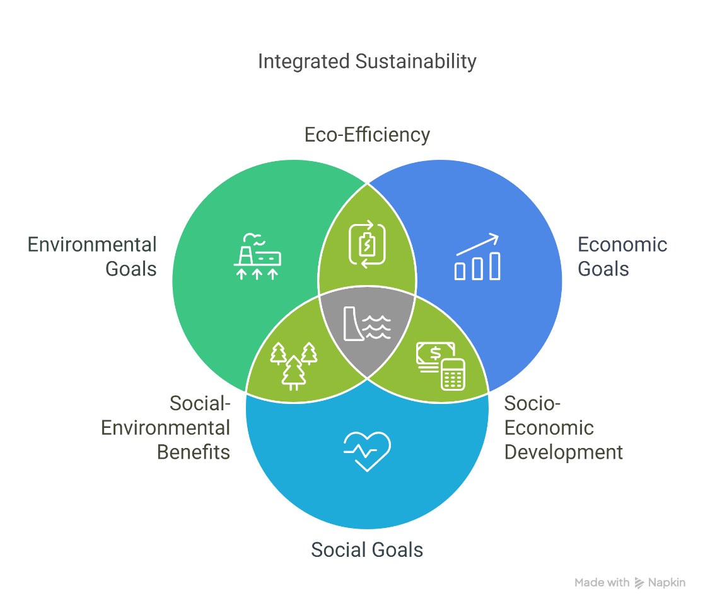
4. Dimensions of Sustainable Transport
4.4 Interactions Among the Three Dimensions
Environmental, economic, and social goals are mutually reinforcing
Policies must balance trade-offs (e.g., cost vs. equity)
Success depends on integrated planning and cross-sector collaboration
Example: A well-planned bike-sharing program improves health, saves costs, and lowers emissions
Sustainable Transport and Policy Analysis
17
Sustainable Transport Concepts

Slide 22
Section 05:
Key Indicators of Sustainable Transport
Sustainable Transport and Policy Analysis
Sustainable Transport Concepts

Slide 23
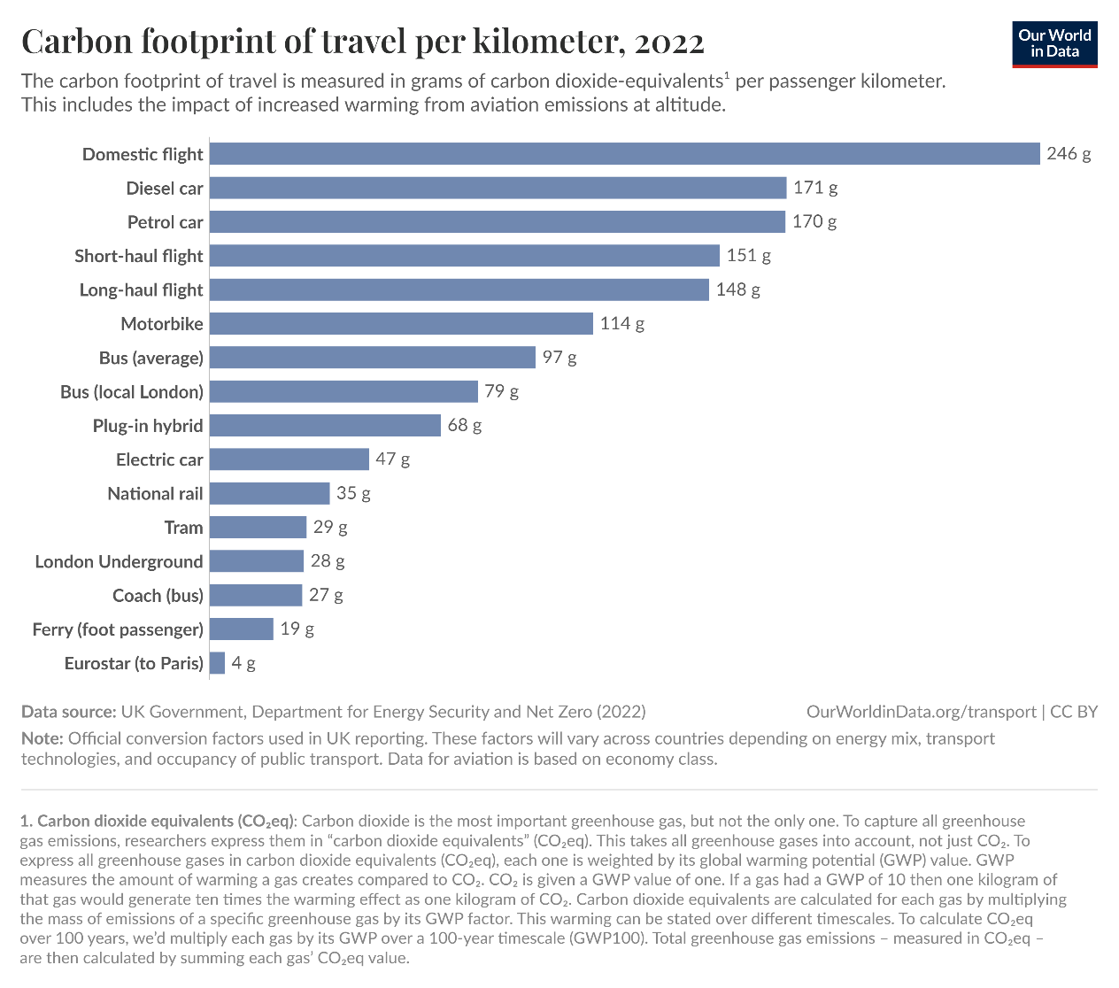
5. Key Indicators of Sustainable Transport
5.1 Environmental Indicators
Greenhouse Gas (GHG) Emissions per capita or per km traveled
Air pollutant levels (NOx, PM2.5, CO2) in urban areas
Modal share of low-emission or non-motorized modes
Fuel consumption per vehicle or per passenger-km
Adoption rate of electric and hybrid vehicles
Sustainable Transport and Policy Analysis
19
Sustainable Transport Concepts

Slide 24
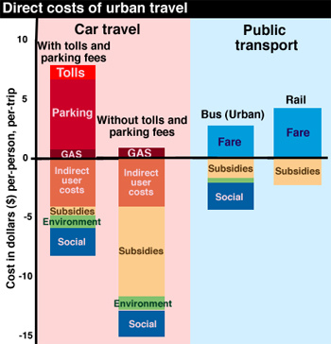
5. Key Indicators of Sustainable Transport
5.2 Economic Indicators
Affordability of transport for low-income populations
Cost-efficiency of different modes (operating cost per passenger-km)
Time efficiency: average travel time, delays, and congestion
Economic productivity supported by improved connectivity
Investment in transport infrastructure vs. return on investment (ROI)
Cost of Transit - Derived from (1999) Transportation for Livable Cities By Vukan R. Vuchic in the US
Sustainable Transport and Policy Analysis
20
Sustainable Transport Concepts

Slide 25
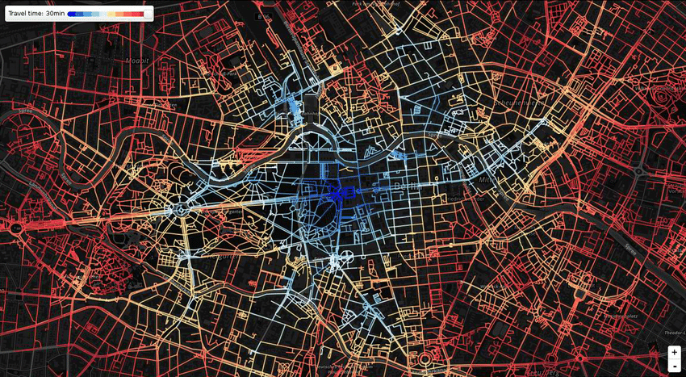
5. Key Indicators of Sustainable Transport
5.3 Social Indicators
Accessibility: % of population within walking distance of public transport
Transport equity: availability across gender, age, income, and ability groups
Transport-related injury and fatality rates
Public satisfaction and perceived safety
Inclusion of community feedback in transport planning
A detailed web-based map showcasing travel times across an urban area, using color gradients to represent accessibility levels.
Sustainable Transport and Policy Analysis
21
Sustainable Transport Concepts

Slide 26
Section 06:
Strategies for Achieving Sustainable Transport
Sustainable Transport and Policy Analysis
Sustainable Transport Concepts

Slide 27
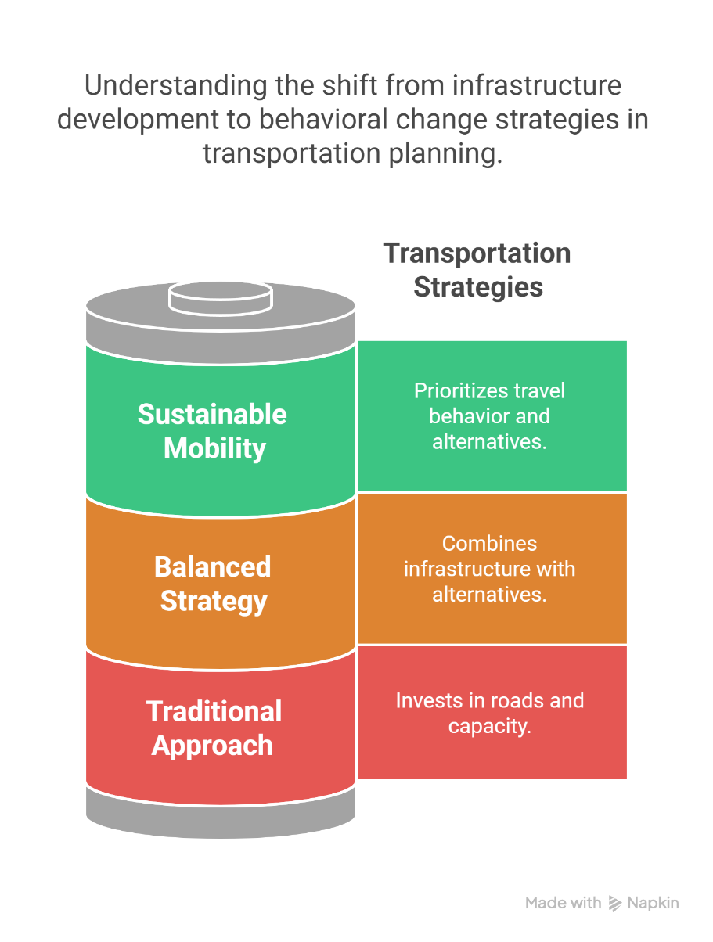
6. Strategies for Achieving Sustainable Transport
6.1 Mobility Management and Travel Planning
Focuses on influencing travel behavior rather than expanding infrastructure
Promotes alternatives: public transport, cycling, walking, carpooling
Examples: Workplace Travel Plans, University Mobility Programs
Encourages trip reduction and off-peak travel
Sustainable Transport and Policy Analysis
23
Sustainable Transport Concepts

Slide 28
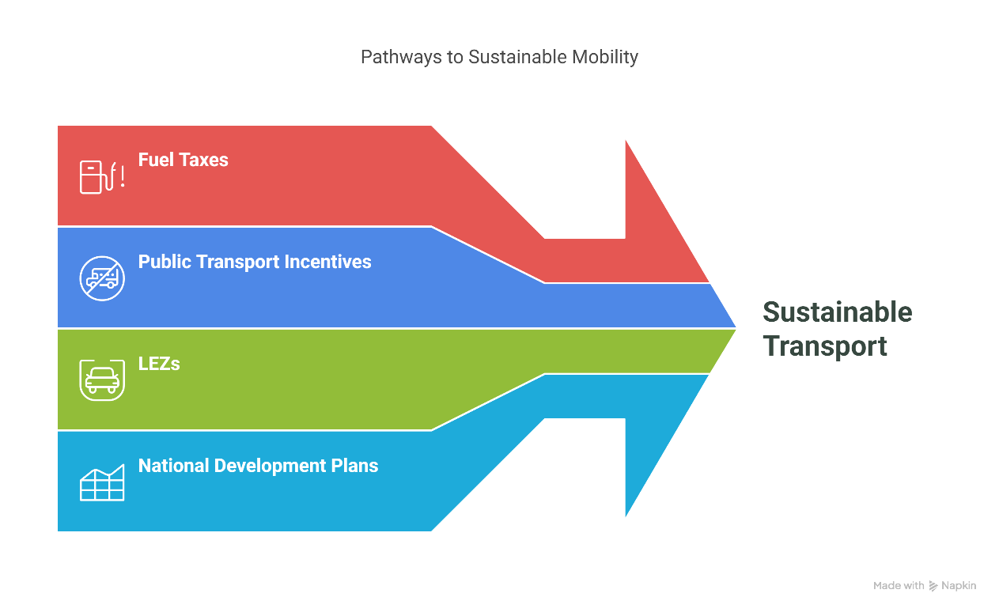
6. Strategies for Achieving Sustainable Transport
6.2 Policy and Regulatory Measures
Fuel taxes and congestion pricing to discourage car use
Subsidies and incentives for public and non-motorized transport
Low Emission Zones (LEZs) and vehicle restrictions
Integration of sustainable transport in national development plans
Sustainable Transport and Policy Analysis
24
Sustainable Transport Concepts

Slide 29
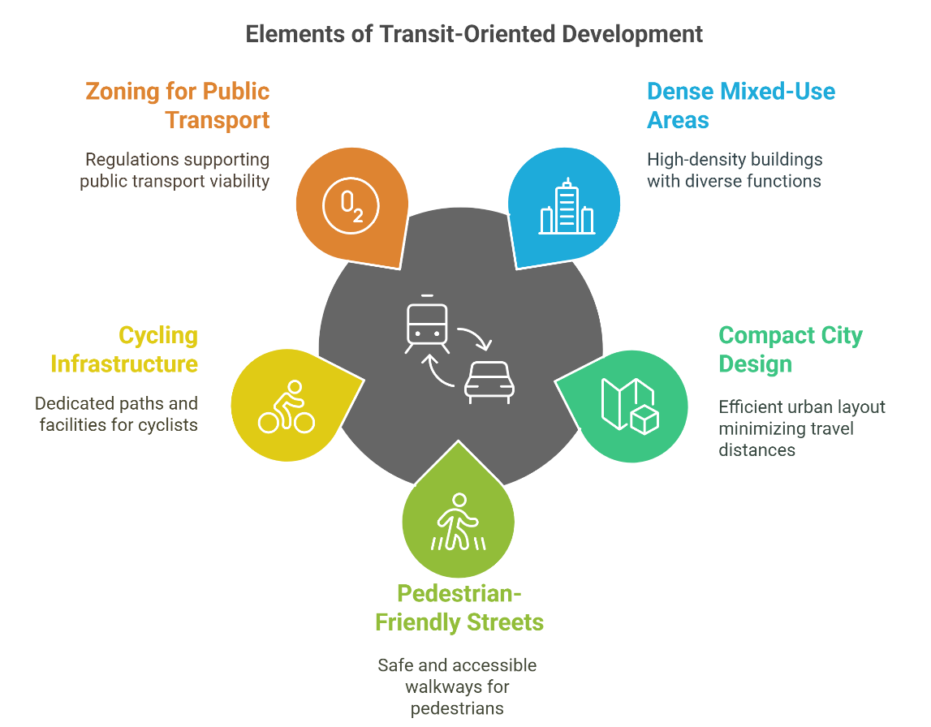
6. Strategies for Achieving Sustainable Transport
6.3 Land Use and Urban Design Integration
Transit-Oriented Development (TOD): dense, mixed-use areas near transit hubs
Compact city design reduces need for long commutes
Pedestrian-friendly streets and integrated cycling infrastructure
Zoning that supports public transport viability
Sustainable Transport and Policy Analysis
25
Sustainable Transport Concepts

Slide 30
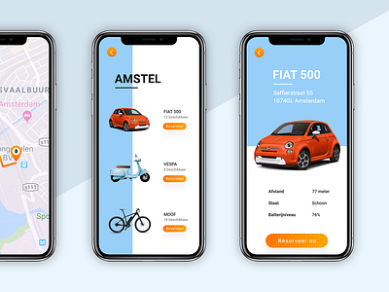
6. Strategies for Achieving Sustainable Transport
6.4 Technological and Behavioral Innovations
Electric and autonomous vehicles for cleaner, efficient mobility
Smart mobility apps (MaaS – Mobility as a Service)
Data-driven planning using real-time transport data
Behavior change campaigns and gamification of sustainable travel
UI design of a MaaS application, integrating various transport modes like car-sharing, biking, and public transit into a single platform.
Sustainable Transport and Policy Analysis
26
Sustainable Transport Concepts

Slide 31
Section 07:
Case Studies / Real-World Examples
Sustainable Transport and Policy Analysis
Sustainable Transport Concepts

Slide 32
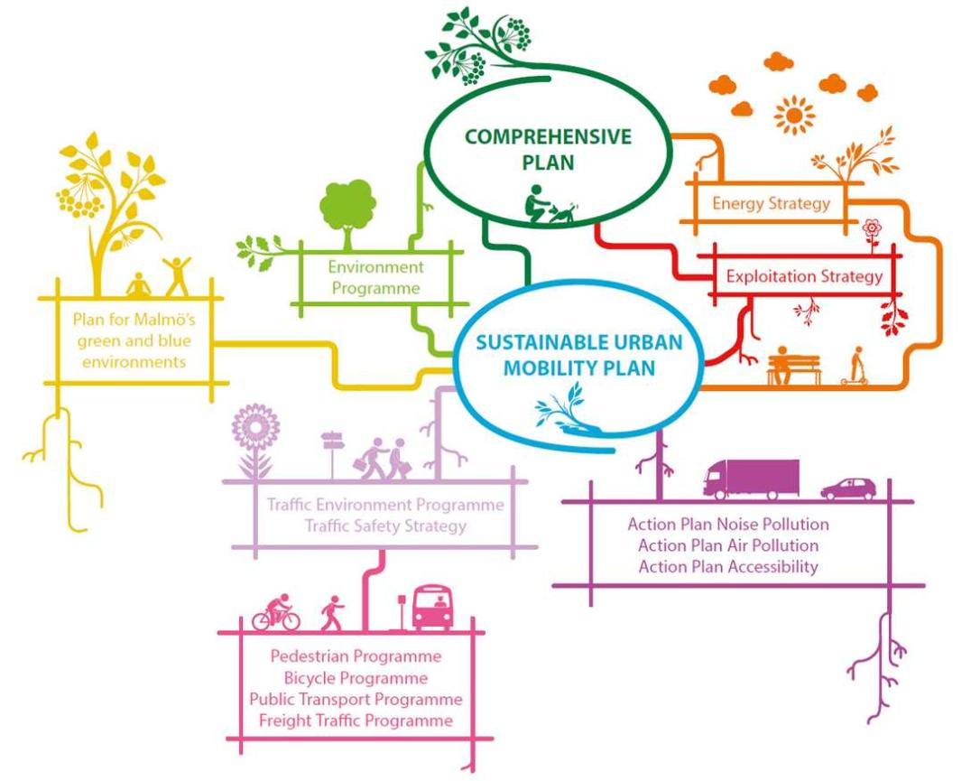
7. Case Studies / Real-World Examples
7.1 European Sustainable Urban Mobility Plans (SUMPs)
SUMPs = strategic plans designed to satisfy mobility needs sustainably
Adopted widely in EU cities (e.g., Barcelona, Vienna, Ghent)
Core principles: integration, participation, evaluation
Focus on multimodal transport, emissions reduction, and active travel
Emphasis on continuous monitoring and stakeholder involvement
Diagram depicting Malmö's comprehensive approach to sustainable urban mobility, integrating various programs and strategies under its SUMP.
Sustainable Transport and Policy Analysis
28
Sustainable Transport Concepts

Slide 33
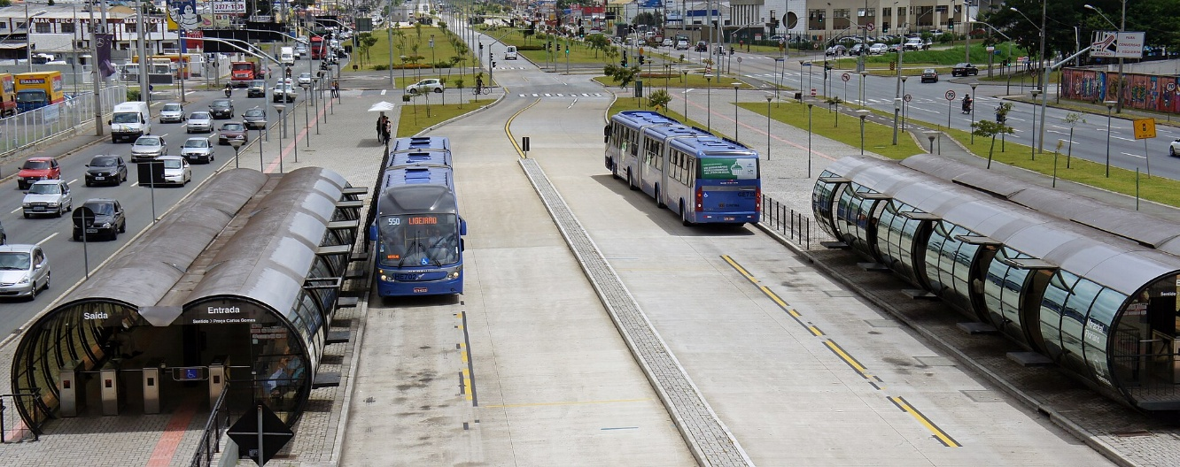
7. Case Studies / Real-World Examples
7.2 Curitiba, Brazil – Bus Rapid Transit
Launched the world’s first Bus Rapid Transit (BRT) system in the 1970s
Integrated land use and transport planning
Dedicated bus lanes, pre-paid boarding, high-frequency service
Reduced car use and increased public transport modal share
Model replicated in cities worldwide (e.g., Bogotá, Guangzhou)
A bi-articulated BRT bus at Marechal Floriano Station, part of Curitiba's Integrated Transportation Network, facilitating high-capacity transit along dedicated corridors.
Sustainable Transport and Policy Analysis
29
Sustainable Transport Concepts

Slide 34
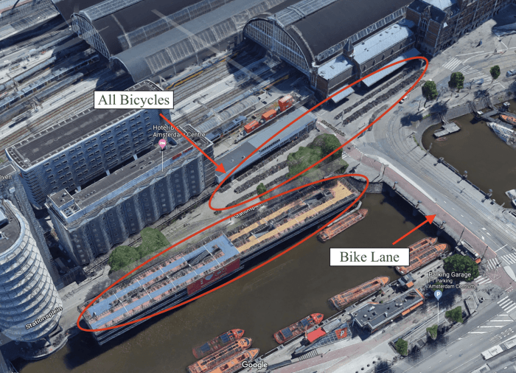
7. Case Studies / Real-World Examples
7.3 Amsterdam – Cycling Infrastructure
Over 60% of trips in the city center are made by bike
Investment in separated bike lanes, parking, and priority at intersections
Cycling culture supported by education and safety policies
Environmental benefits: reduced emissions, improved public health
Inspired other cities to adopt cycling-centric urban design
A multi-tiered bicycle parking facility near Amsterdam Central Station, accommodating thousands of bikes and reflecting the city's commitment to cycling infrastructure.
Sustainable Transport and Policy Analysis
30
Sustainable Transport Concepts

Slide 35
Section 08:
Quiz
Sustainable Transport and Policy Analysis
Sustainable Transport Concepts

Slide 36
8. Quiz
8.1 Multiple Choice Questions
Quick Quiz – Multiple Choice
Q1. Which of the following is NOT a dimension of sustainable transport?
a) Environmental
b) Economic
c) Political
d) Social
Q2. What is an example of Mobility Management?
a) Building new highways
b) Promoting carpooling and flexible work hours
c) Increasing fuel taxes
d) Launching electric vehicle subsidies
Q3. Curitiba, Brazil is famous for pioneering which transport system?
a) Metro system
b) Bus Rapid Transit (BRT)
c) Light Rail Transit (LRT)
d) High-Speed Rail
Sustainable Transport and Policy Analysis
32
Sustainable Transport Concepts
Notes:
Q1. (Answer: c)
Q2. (Answer: b)
Q3. (Answer: b)

Slide 37
8. Quiz
8.2 True/False Questions
True/False Questions
Q1. Sustainable transport focuses only on reducing emissions.
Q2. Cycling is considered a sustainable mode of transport.
Q3. Land use planning has no relation to sustainable transport.
Q4. SUMPs stand for Sustainable Urban Mobility Plans.
Sustainable Transport and Policy Analysis
33
Sustainable Transport Concepts
Notes:
Q1. False (It also considers social and economic sustainability.)
Q2. True
Q3. False (It plays a critical role.)
Q4. True

Slide 38
Section 09:
Discussion and Reflections
Sustainable Transport and Policy Analysis
Sustainable Transport Concepts

Slide 39
9. Discussion and Reflections
9.1 Group Reflection: What Makes Transport Sustainable?
What are the key elements that define sustainable transport?
Which modes or systems do you think are most sustainable and why?
Can sustainability vary depending on city size, geography, or culture?
Sustainable Transport and Policy Analysis
35
Sustainable Transport Concepts

Slide 40
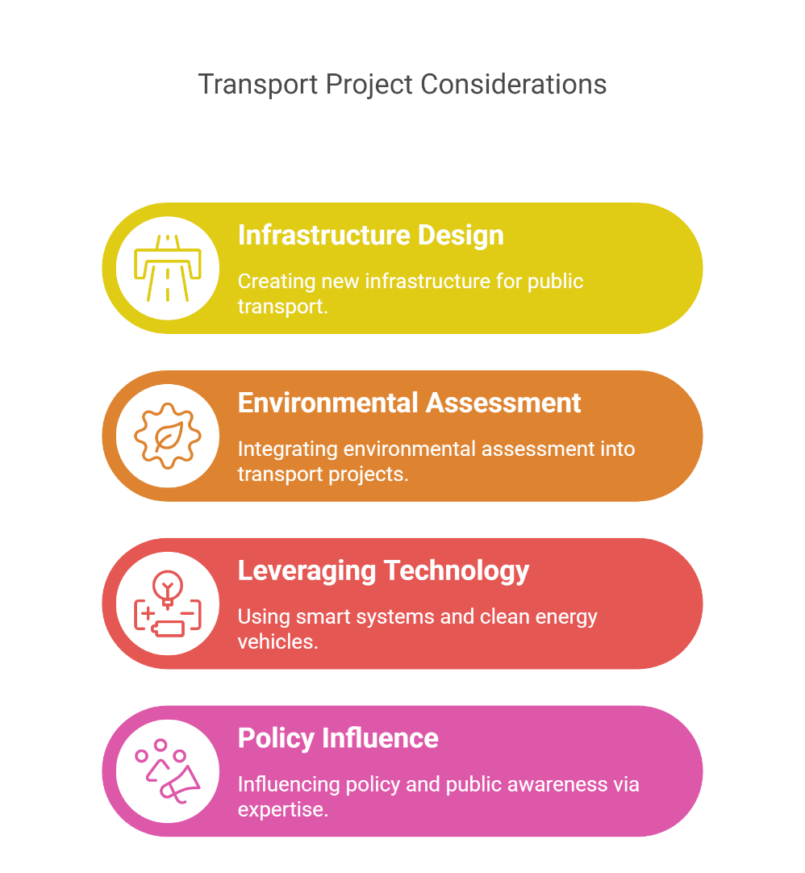
9. Discussion and Reflections
9.2 Role of Engineers in Driving Change
Designing innovative infrastructure for active and public transport
Integrating environmental assessment into transport projects
Leveraging technology: smart systems, clean energy vehicles
Influencing policy and public awareness through technical expertise
Sustainable Transport and Policy Analysis
36
Sustainable Transport Concepts

Slide 41
9. Discussion and Reflections
9.3 Regional Perspectives: Challenges in Our Context
What specific transport challenges exist in our region/country?
How feasible are cycling, public transport, or shared mobility here?
What cultural, economic, or political factors influence sustainable transport adoption?
How can local innovations address global sustainability goals?
Sustainable Transport and Policy Analysis
37
Sustainable Transport Concepts

