Slide 1
Transport Research and Analysis
Module 4: Sustainable Transport and Policy Analysis
Lecture 18: Sustainable Transport and Policy Analysis

Slide 3
Table of contents
Section 1 Economic Analysis of Transport Projects ……............... 4
What Is Economic Analysis in Transport Projects? .................... 5
The Role of Economic Analysis in Appraising Transport Projects .................................................................................................. 6
Key Economic Indicators .......................................................... 7
Market Prices vs. Shadow Prices ............................................. 8
Valuing Non-Market Impacts .................................................... 9
Time Value of Money & Discounting ........................................ 10
Examples of Economic Impacts in Transportation .................... 11
Section 2 Cost-Benefit Analysis (CBA) – Concepts & Steps .......... 12
Introduction to Cost-Benefit Analysis (CBA) ......................... 13
Steps to apply CBA …..................................................... 14
Step 1 – Define the Project and Alternatives ................. 15
Step 2 – Identify Costs and Benefits ............................ 16
Step 3 – Quantify Costs and Benefits ........................... 17
Step 4 – Discounting Future Cash Flows ...................... 18
Step 5 – Calculate NPV, IRR, and BCR ........................ 19
Step 6 – Sensitivity and Risk Analysis .......................... 20
Case Snapshot – Economic Appraisal of a Transport Project .................................................................................. 21
Treatment of Externalities in CBA ............................... 23
Environmental and Equity Considerations in Transport Project Appraisal ........................................................................ 24
Limitations and Common Pitfalls ...................................... 26
Summary & Best Practices for CBA .................................. 27
Section 3 Financial Analysis of Transport Projects ….............................. 28
Introduction to Financial Analysis ..................................... 29
Revenue, Costs, and Cash Flow Projections ..................... 30
Key Financial Metrics ...................................................... 32
Comparing Economic and Financial Analyses ................... 33
Applications of Financial Analysis..................................... 34
Section 4 Financing Transport Projects ..................................................... 35
Traditional Public Financing Methods ............................... 36
Alternative Financing Models ........................................... 37
Policy Implications & Future Trends ................................. 38
Section 5 Quiz & Group Discussion ............................................................. 39
Quiz ............................................................................... 40
Group Discussion ............................................................ 41
Sustainable Transport and Policy Analysis

Slide 4
0. Objectives of the Lecture
0.1. Learning Objectives
Understand Economic Analysis: Define economic analysis in the context of transport projects, focusing on social welfare, opportunity costs, and the valuation of non-market impacts (like time savings and environmental changes).
Master Cost-Benefit Analysis (CBA): Learn the comprehensive CBA framework, including the step-by-step process of identifying costs/benefits, discounting future cash flows, and calculating key indicators like Net Present Value (NPV) and Benefit-Cost Ratio (BCR).
Analyze Financial Viability: Assess projects from a financial perspective by examining revenue streams, operating costs, and profitability metrics such as the Internal Rate of Return (IRR) and Payback Period.
Distinguish Perspectives: Clearly differentiate between Economic Analysis (focused on societal benefits and shadow pricing) and Financial Analysis (focused on investor returns and market prices).
Explore Financing Mechanisms: Evaluate various funding strategies for transport infrastructure, ranging from traditional public financing to Public-Private Partnerships (PPPs) and innovative models like green bonds.
Sustainable Transport and Policy Analysis

Slide 5
Section 01:
Economic Analysis of Transport Projects
Sustainable Transport and Policy Analysis

Slide 6
1. Economic Analysis of Transport Projects
1.1. What Is Economic Analysis in Transport Projects?
Definition & Purpose
Explains how transport investments generate benefits for society—not just profits but improvements in social welfare.
Emphasizes efficiency, opportunity cost, and the allocation of scarce resources.
Key Principles
Time Value of Money: Future benefits and costs must be adjusted to today’s value.
Externality Recognition: Captures benefits (e.g., reduced congestion) and costs (e.g., environmental impacts) not reflected in market prices.
Opportunity Cost & Shadow Pricing:
– Account for the benefits forgone by choosing one option over another.
– Adjust market prices using shadow prices when market failures are present.
Sustainable Transport and Policy Analysis

Slide 7
1. Economic Analysis of Transport Projects
1.2. The Role of Economic Analysis in Appraising Transport Projects
Social vs. Financial Perspectives
Economic Analysis: Focuses on societal benefits such as health, productivity, and environmental quality.
Counts all resource flows, including externalities
Uses shadow prices (especially for non-market items)
Financial Analysis: Concentrates on cash flow, investor returns, and market viability.
Focuses on direct revenues, expenditures, and returns
Ignores or undervalues certain externalities unless monetized
Application in Decision-Making
Provides a framework to justify public investments by comparing comprehensive costs and benefits.
Supports policy decisions and prioritization among competing projects.
Impact Areas
Accessibility improvements, reduced travel time, and increased safety.
Sustainable Transport and Policy Analysis

Slide 8
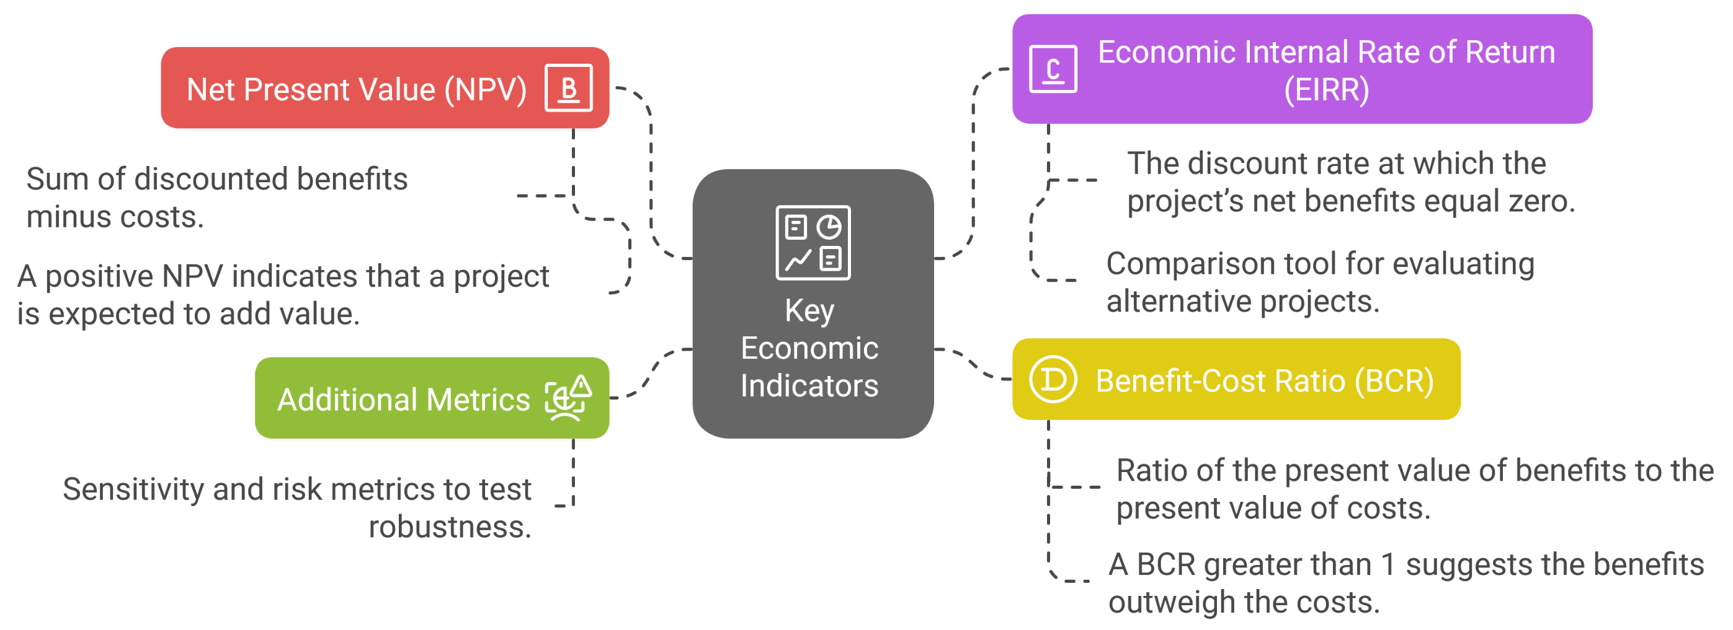
1. Economic Analysis of Transport Projects
1.3. Key Economic Indicators
Sustainable Transport and Policy Analysis
Notes:
More details will be discussed in the future lectures

Slide 9
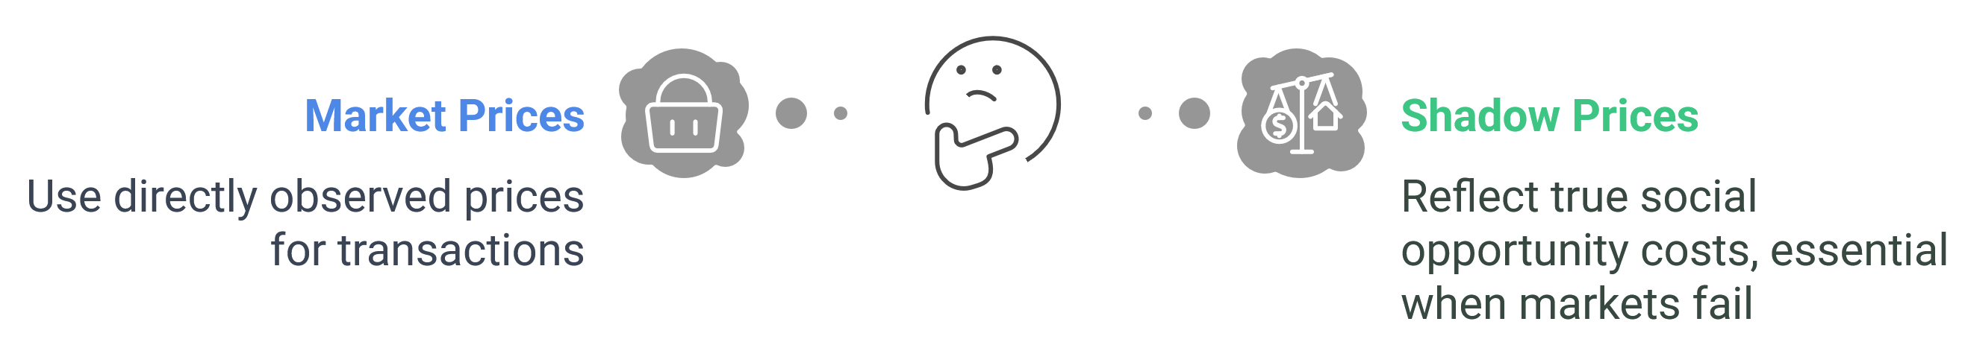
1. Economic Analysis of Transport Projects
1.4. Market Prices vs. Shadow Prices
Understanding the Difference
Market Prices: Directly observed prices that guide transactions.
Shadow Prices: Adjusted values that reflect true social opportunity costs.
Why Shadow Pricing?
Essential when markets fail or externalities are present (e.g., environmental impacts, travel time).
Methods for Determination
Use of estimation techniques such as surveys and expert analysis.
Sustainable Transport and Policy Analysis

Slide 10
1. Economic Analysis of Transport Projects
1.5. Valuing Non-Market Impacts
Identifying Intangibles
Non-market benefits such as reduced travel time, improved air quality, enhanced public health, and lower accident rates.
Monetization Techniques
Contingent Valuation (willingness to pay surveys)
Hedonic Pricing (value inferred from related market goods, like housing prices)
Travel Cost Method (value based on cost incurred to access a site or service)
Why It Matters
Captures externalities and social benefits not reflected in direct market prices, ensuring more comprehensive project evaluation.
Practical Example
Example: Estimating the value of a 10-minute daily travel time saving over a year:
(Time saved × value of time × number of days)
Sustainable Transport and Policy Analysis

Slide 11
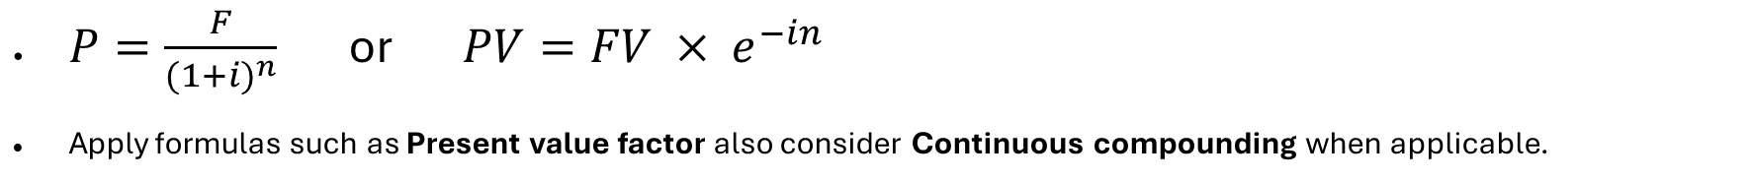
1. Economic Analysis of Transport Projects
1.6. Time Value of Money & Discounting
Concept Overview:
A dollar today is worth more than a dollar in the future due to its earning potential.
Transport projects typically span multiple decades, with costs and benefits occurring at different times.
TVM ensures all future cash flows are brought to a common reference point (usually present) for proper comparison and decision-making.
Discounting Methods:
$P=\frac{F}{{(1+i)}^{n}}$ or $PV=FV × e^{−in}$
Apply formulas such as Present value factor also consider Continuous compounding when applicable.
Selecting the Discount Rate:
Reflects risk, inflation, and opportunity cost in public projects.
Application:
Compare costs and benefits occurring at different times on the same “present value” basis.
Sustainable Transport and Policy Analysis

Slide 12
1. Economic Analysis of Transport Projects
1.7. Examples of Economic Impacts in Transportation
Case Points
Highway upgrade reduces:
Travel time by 25%
Accident rates by 40%
Emissions via smoother traffic flows
Quantitative estimates: savings in time, reduction in vehicle operating costs, improvement in air quality.
Broader Impact
Increased labor market accessibility
Higher economic productivity
Enhanced quality of life for residents and commuters
Sustainable Transport and Policy Analysis

Slide 13
Section 02:
Cost-Benefit Analysis (CBA) – Concepts & Steps
Sustainable Transport and Policy Analysis

Slide 14
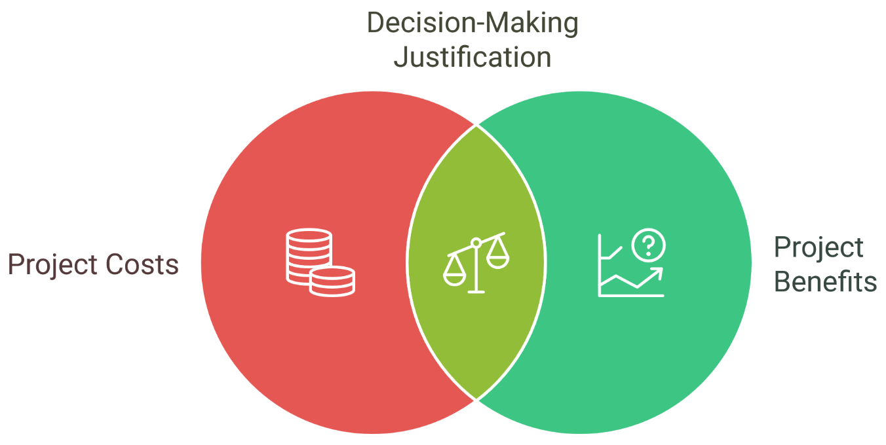
2. Cost-Benefit Analysis (CBA) – Concepts & Steps
2.1. Introduction to Cost-Benefit Analysis (CBA)
What Is CBA?
CBA aggregates all project costs and benefits into monetary terms.
Establishes a framework for comparing alternative investments.
Importance
Helps decision-makers justify or reject projects based on a systematic comparison.
Scope
Direct impacts (e.g., capital cost, time savings)
Indirect impacts (e.g., land use changes)
Intangible/external impacts (e.g., pollution, noise)
Sustainable Transport and Policy Analysis

Slide 15
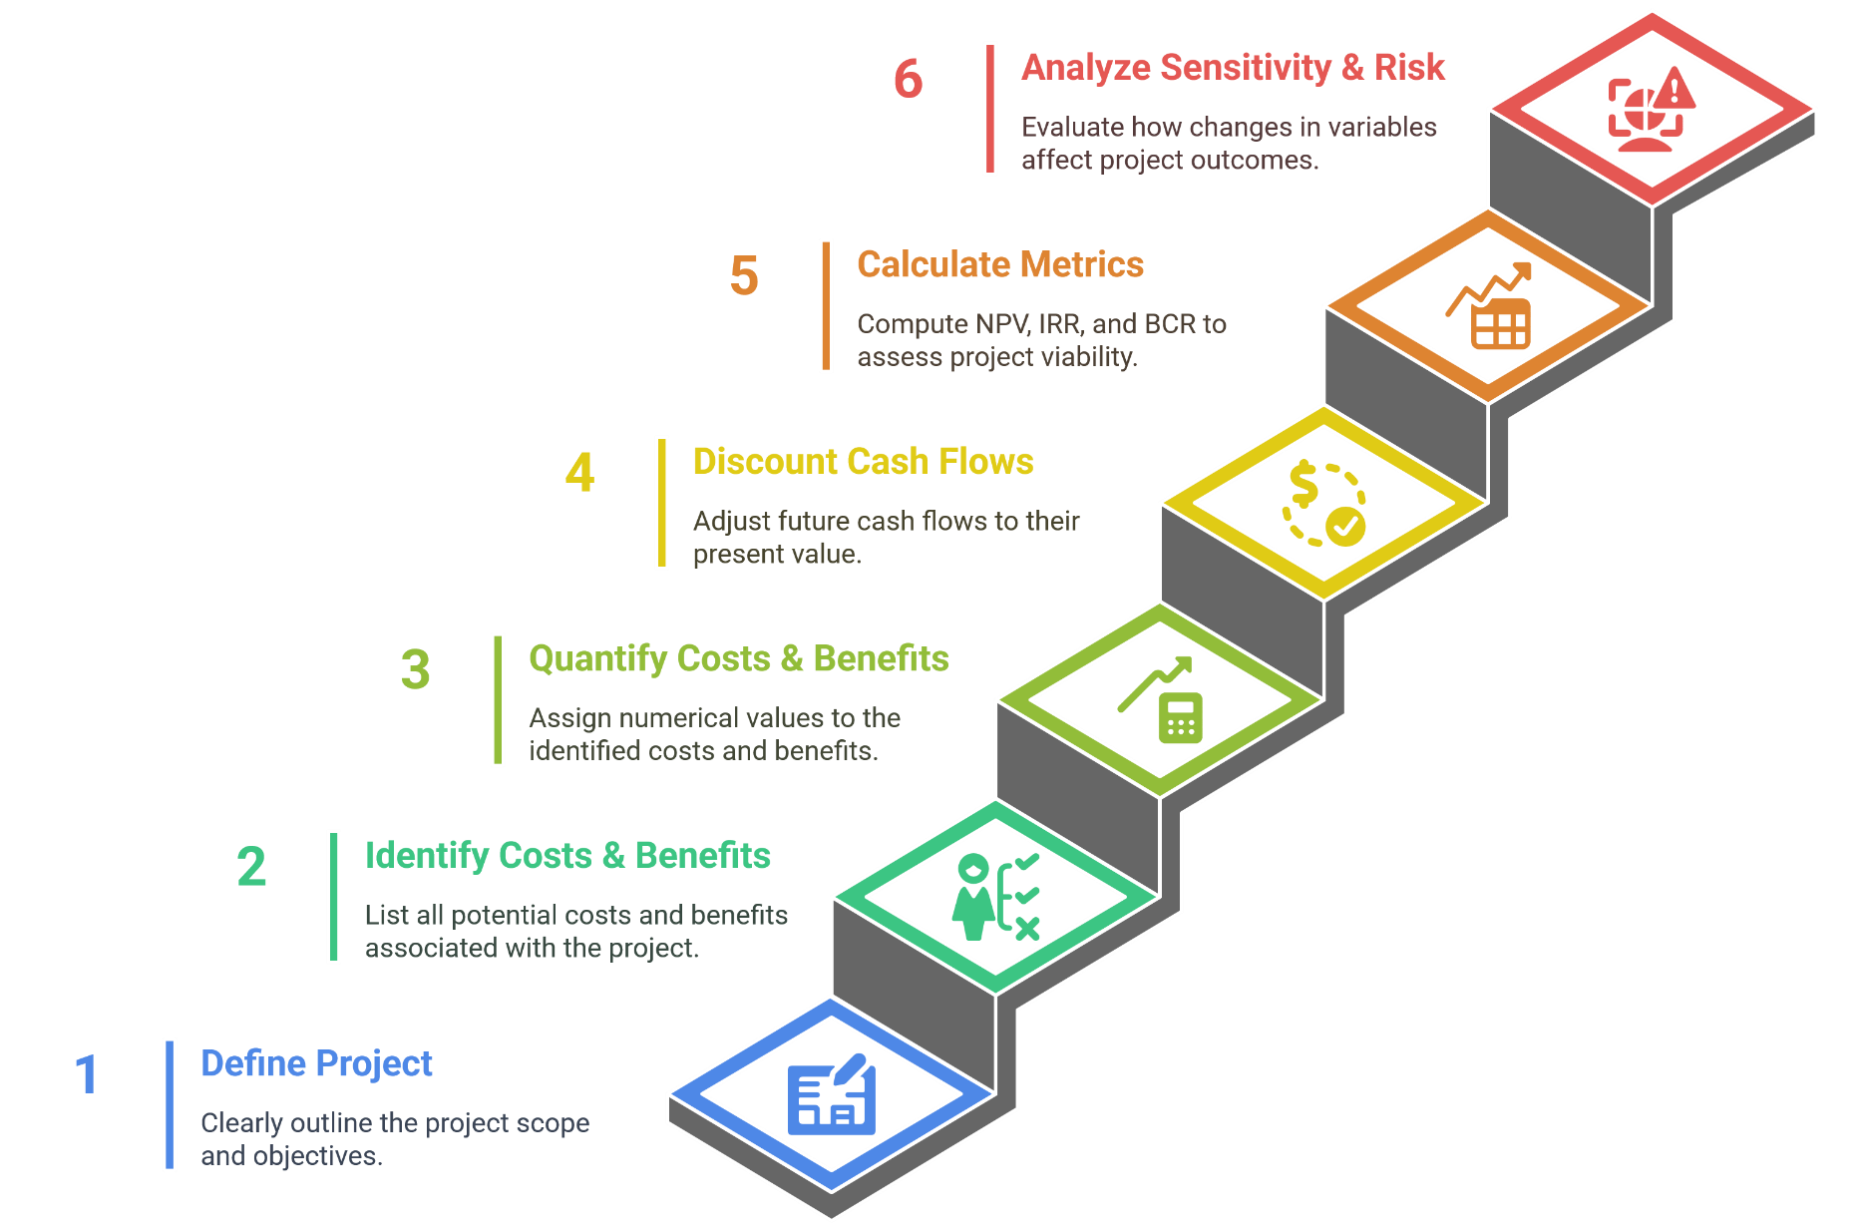
2. Cost-Benefit Analysis (CBA) – Concepts & Steps
2.2. Steps to apply CBA
Sustainable Transport and Policy Analysis

Slide 16
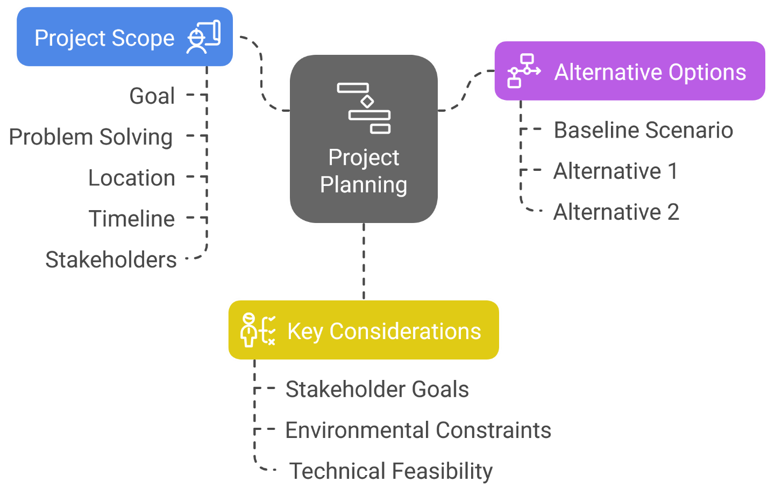
2. Cost-Benefit Analysis (CBA) – Concepts & Steps
2.3. Step 1 – Define the Project and Alternatives
Project Scope
What is the goal? What problem does the project solve?
Define location, timeline, stakeholders.
Alternative Options
Establish a baseline scenario (null alternative) and one or more alternatives.
Key Considerations
Stakeholder goals, environmental constraints, and technical feasibility.
Sustainable Transport and Policy Analysis

Slide 17
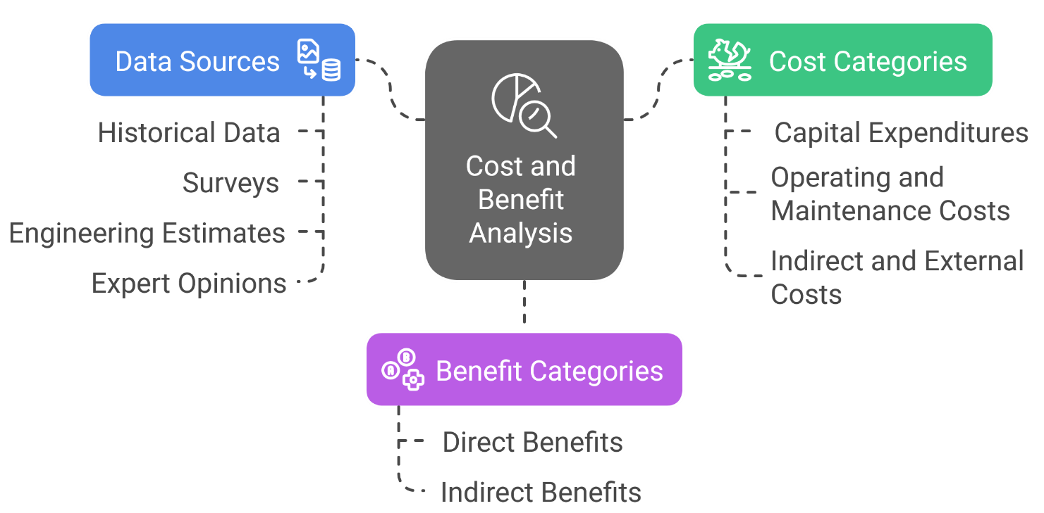
2. Cost-Benefit Analysis (CBA) – Concepts & Steps
2.4. Step 2 – Identify Costs and Benefits
Cost Categories
Capital expenditures: design, construction, and procurement.
Operating and maintenance costs. - Labor, utilities, repairs.
Indirect and external costs (e.g., noise, air quality impacts).
Benefit Categories
Direct benefits: travel time savings, reduced vehicle operating costs.
Indirect benefits: improved safety, environmental gains, economic development.
Data Sources
Historical data, surveys, engineering estimates, and expert opinions.
Sustainable Transport and Policy Analysis

Slide 18
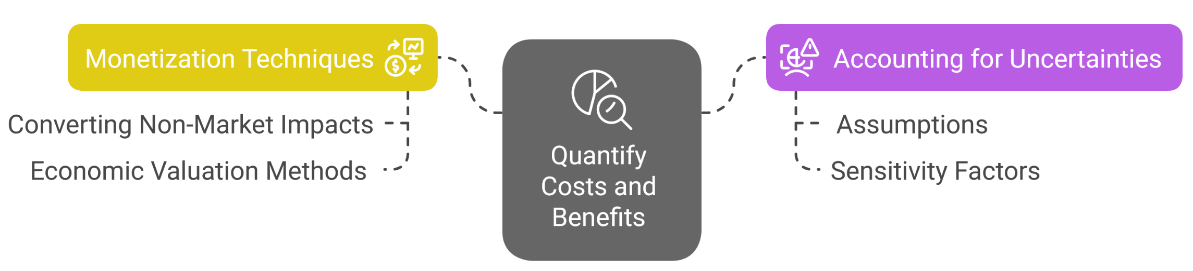
2. Cost-Benefit Analysis (CBA) – Concepts & Steps
2.5. Step 3 – Quantify Costs and Benefits
Monetization Techniques
Converting non-market impacts to monetary values.
Use of economic valuation methods (e.g., cost of illness, contingent valuation).
Accounting for Uncertainties
Incorporate assumptions and sensitivity factors. (e.g., expected vs. high/low cost scenarios).
Example Calculation
Value of 10-minute daily savings × commuters × wage rate × working days.
Sustainable Transport and Policy Analysis

Slide 19
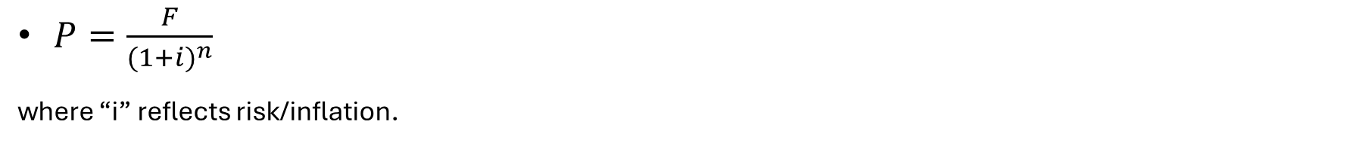
2. Cost-Benefit Analysis (CBA) – Concepts & Steps
2.6. Step 4 – Discounting Future Cash Flows
Need for Discounting
Future costs and benefits must be expressed in today’s terms.
Key Formula (Present Value Factor)
$P=\frac{F}{{(1+i)}^{n}}$
    where “i” reflects risk/inflation.
Selecting the Discount Rate
Factors include risk, inflation, and opportunity cost.
Sustainable Transport and Policy Analysis

Slide 20
2. Cost-Benefit Analysis (CBA) – Concepts & Steps
2.7. Step 5 – Calculate NPV, IRR, and BCR
Net Present Value (NPV)
Sum of discounted benefits minus costs; a positive NPV indicates economic viability.
NPV=∑(PV of Benefits−PV of Costs)
Internal Rate of Return (IRR)
    The discount rate at which NPV becomes zero.
    The rate at which NPV = 0
Benefit-Cost Ratio (BCR)
Ratio of total discounted benefits to total discounted costs.
BCR=PV of Benefits/PV of Costs
Interpreting the Results
NPV > 0, IRR > discount rate, BCR > 1 = Economically viable.
Sustainable Transport and Policy Analysis

Slide 21
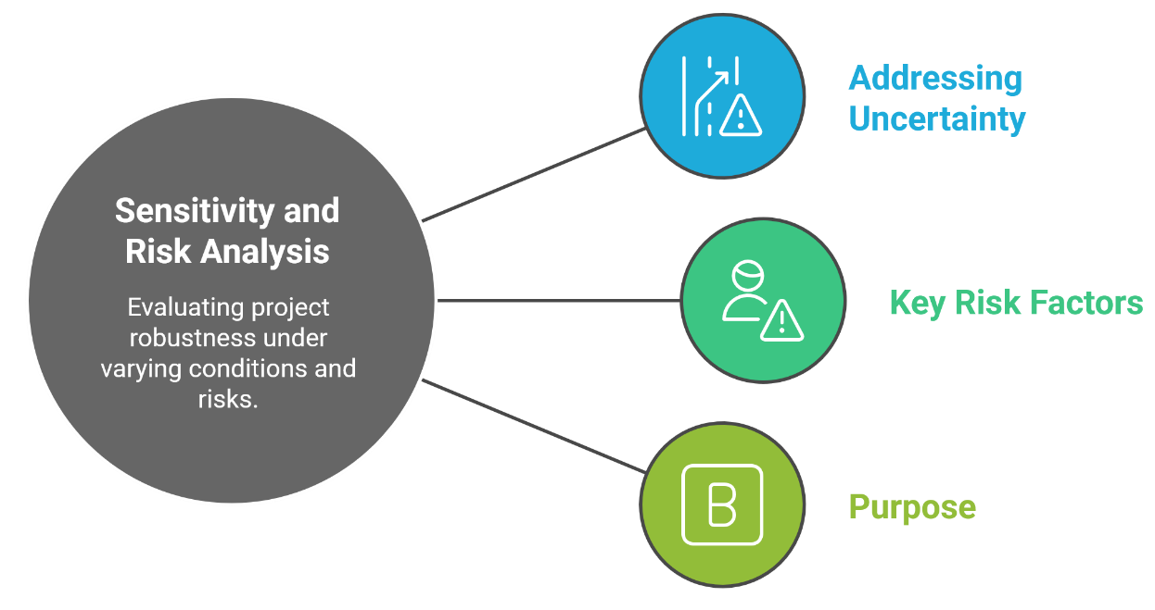
2. Cost-Benefit Analysis (CBA) – Concepts & Steps
2.8. Step 6 – Sensitivity and Risk Analysis
Addressing Uncertainty
Discussion of various sensitivity analysis techniques (scenario analysis, Monte Carlo simulations).
Key Risk Factors
    Variability in traffic forecasts, construction cost uncertainties, changes in policy.
Purpose
To test the robustness of the CBA outcomes under different assumptions.
Sustainable Transport and Policy Analysis

Slide 22
2. Cost-Benefit Analysis (CBA) – Concepts & Steps
2.9. Case Snapshot – Economic Appraisal of a Transport Project
Illustrative Example: Urban Rail Expansion
Project Description:
Build a new 15 km urban light rail line.
Capital Cost: $500 million (initial investment)
Annual Benefits:
Time savings: $35 million/year
Reduced vehicle operating costs: $5 million/year
Emissions reduction benefits: $3 million/year
Project life: 30 years
Discount rate: 6%
Sustainable Transport and Policy Analysis

Slide 23
2. Cost-Benefit Analysis (CBA) – Concepts & Steps
2.9. Case Snapshot – Economic Appraisal of a Transport Project
Illustrative Example: Urban Rail Expansion
Key Evaluation Metrics:
Net Present Value (NPV):
NPV ≈ $220 million
Economic Internal Rate of Return (EIRR):
EIRR ≈ 9.5%
Benefit-Cost Ratio (BCR):
BCR ≈ 1.45
Critical Insight:
Sensitivity Analysis:
If capital costs increase by 20% (to $600 million), NPV drops to about $120 million and BCR falls to ~1.2, but the project remains economically viable.
Sustainable Transport and Policy Analysis

Slide 24
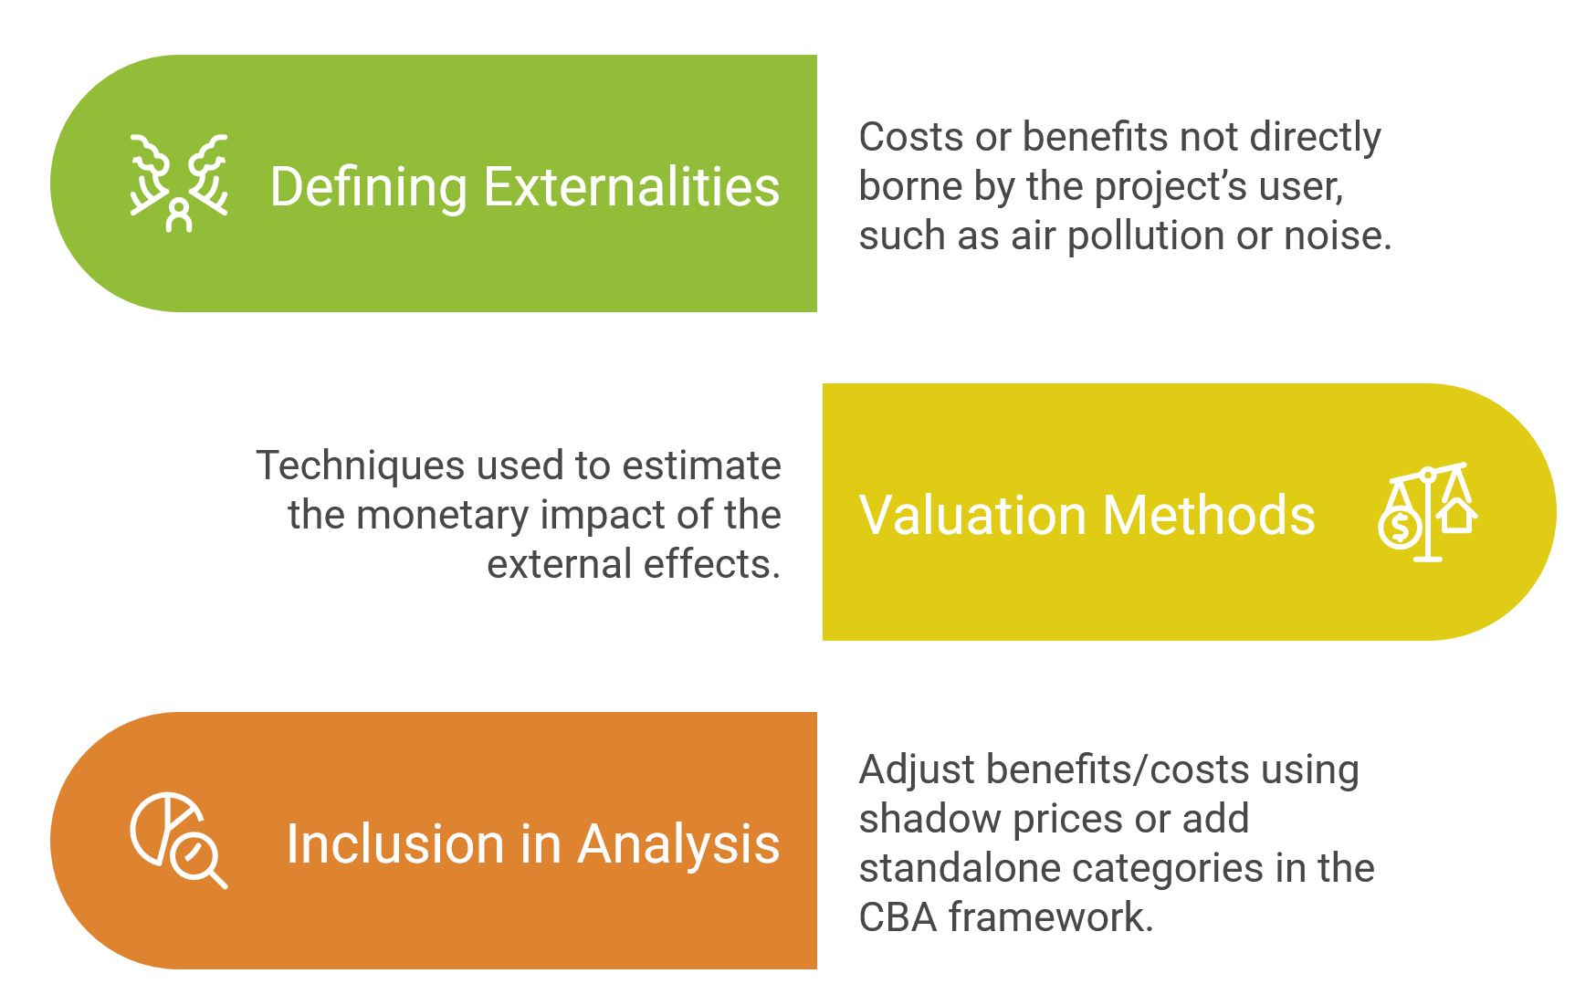
2. Cost-Benefit Analysis (CBA) – Concepts & Steps
2.10. Treatment of Externalities in CBA
Sustainable Transport and Policy Analysis

Slide 25
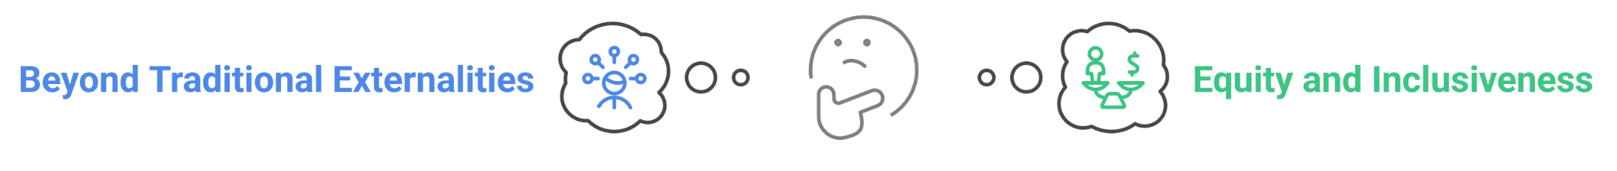
2. Cost-Benefit Analysis (CBA) – Concepts & Steps
2.11. Environmental and Equity Considerations in Transport Project Appraisal
Why These Matter
Beyond Traditional Externalities
Climate change impacts (GHG emissions, long-term sustainability)
Ecosystem disruption and land use changes
Local air quality and health consequences
Equity and Inclusiveness
Accessibility for marginalized groups (low-income, elderly, disabled)
Distribution of benefits and burdens (e.g., does the project gentrify or displace communities?)
Fairness in funding and user fees
Sustainable Transport and Policy Analysis

Slide 26
2. Cost-Benefit Analysis (CBA) – Concepts & Steps
2.11. Environmental and Equity Considerations in Transport Project Appraisal
Approaches for Valuation and Inclusion
Monetizing environmental impacts (e.g., Social Cost of Carbon, air pollution costs)
Qualitative assessments and stakeholder engagement for social impacts
Distributional analysis to ensure fair allocation of benefits across society
Integration in CBA and Decision-Making
Integration in CBA and Decision-MakinUse shadow prices and explicit scenarios to capture full environmental and social costs/benefits
Complement monetary analysis with qualitative and equity assessments.
Align project outcomes with sustainability and social inclusion policies.
Sustainable Transport and Policy Analysis

Slide 27
2. Cost-Benefit Analysis (CBA) – Concepts & Steps
2.12. Limitations and Common Pitfalls
Key Limitations
Challenges in accurately monetizing non-market benefits (e.g., air quality, safety improvements).
High uncertainty in long-term forecasts and assumptions (e.g., demand growth, technology changes).
Common Pitfalls
Oversimplifying complex societal impacts (e.g., equity issues, displacement effects).
Bias in selecting, estimating, or valuing benefits and costs.
Recommendations
Ensure full transparency in methods and assumptions.
Document all sources of data and justify key parameters.
Use sensitivity analysis to test robustness of conclusions.
Sustainable Transport and Policy Analysis

Slide 28
2. Cost-Benefit Analysis (CBA) – Concepts & Steps
2.13. Summary & Best Practices for CBA
CBA Workflow Recap
Define project → Identify/Quantify costs & benefits → Discounting → Calculate indicators → Sensitivity testing.
Best Practices
Engage stakeholders early.
Use realistic and up-to-date data.
Validate key assumptions.
Include externalities to capture full societal impact.
Sustainable Transport and Policy Analysis

Slide 29
Section 03:
Financial Analysis of Transport Projects
Sustainable Transport and Policy Analysis

Slide 30
3. Financial Analysis of Transport Projects
3.1 Introduction to Financial Analysis
Definition & Scope
Assesses the project’s financial viability based on cash inflows/outflows, revenues, costs, and profitability indicators.
Analytical Perspective
Investor-oriented: focuses on return on investment (ROI), payback period, and financial sustainability.
Why It Matters
Essential for attracting private investment and structuring funding mechanisms.
Widely used in Public-Private Partnerships (PPPs) and commercial viability assessments.
Sustainable Transport and Policy Analysis

Slide 31
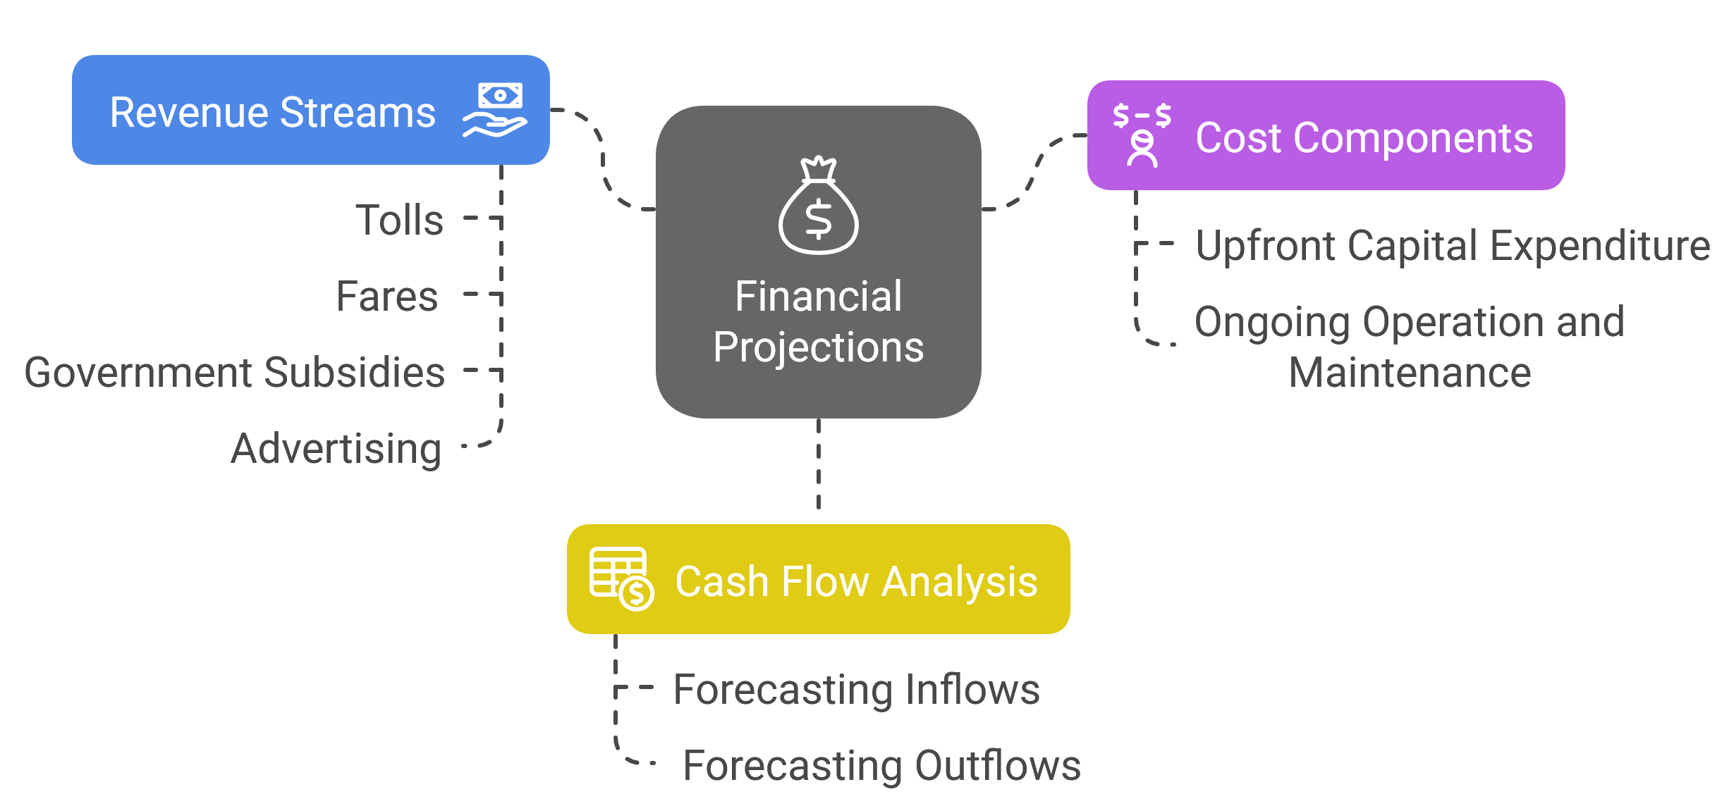
3. Financial Analysis of Transport Projects
3.2. Revenue, Costs, and Cash Flow Projections
Sustainable Transport and Policy Analysis

Slide 32
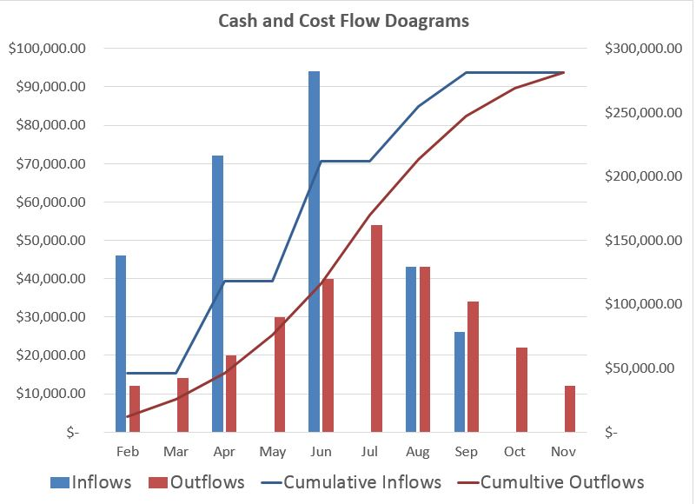
3. Financial Analysis of Transport Projects
3.2. Revenue, Costs, and Cash Flow Projections
Sustainable Transport and Policy Analysis

Slide 33
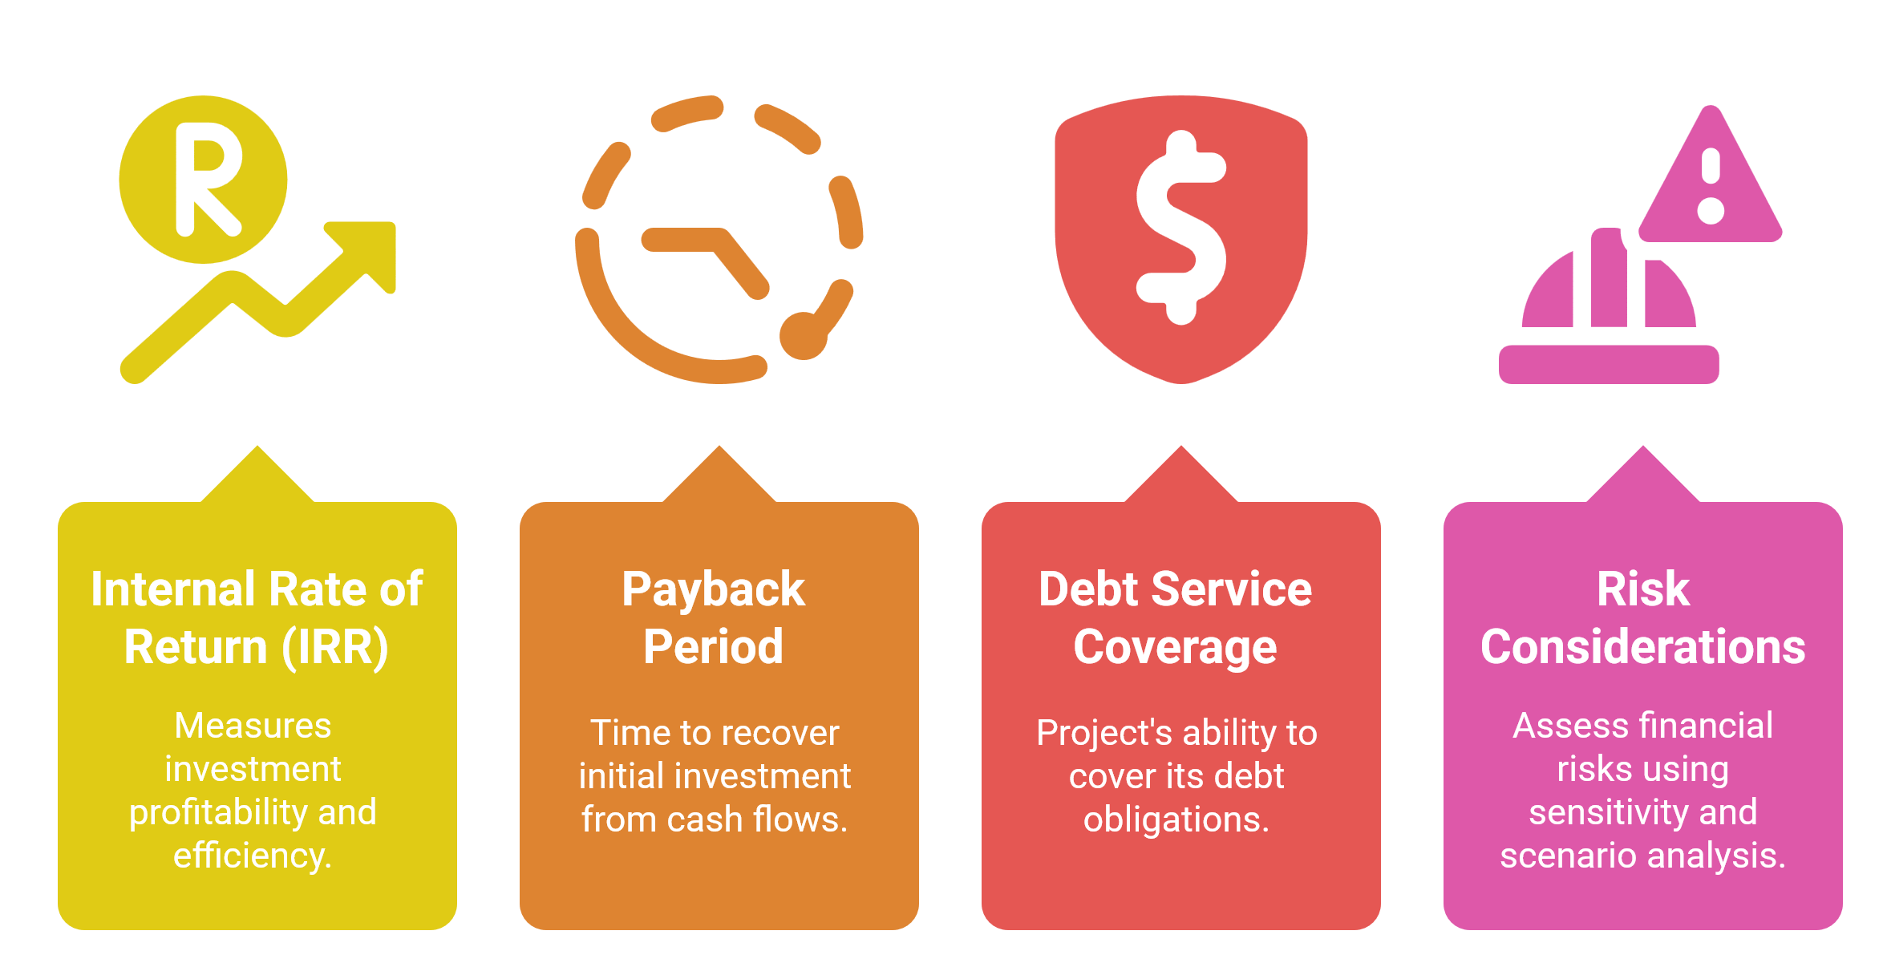
3. Financial Analysis of Transport Projects
3.3. Key Financial Metrics
Sustainable Transport and Policy Analysis

Slide 34
3. Financial Analysis of Transport Projects
3.4. Comparing Economic and Financial Analyses
Side by Side Comparison
Economic Analysis: Broader societal benefits; uses shadow prices.
Financial Analysis: Focused on market returns and liquidity.
Differences in Objectives
Economic evaluations stress public welfare
Financial evaluations stress investor returns.
Integration
Both analyses are used complementarily to support well rounded decision making.
Sustainable Transport and Policy Analysis

Slide 35
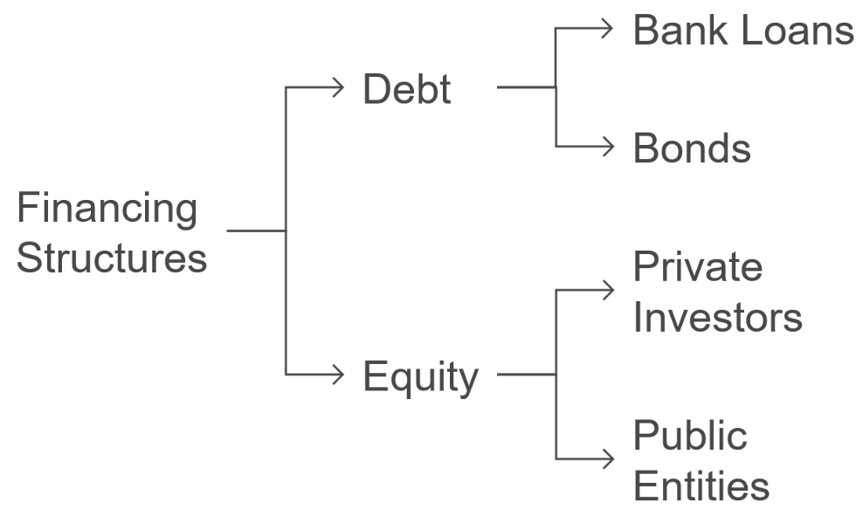
3. Financial Analysis of Transport Projects
3.5. Applications of Financial Analysis
Practical Examples
Projects such as toll road developments, PPP initiatives, and transit concessions.
Financing Structures
Debt: bank loans, bonds.
Equity: private investors, public entities.
Critical Outcomes
How financial analysis informs risk management, pricing strategies, and refinancing strategies.
Industry Relevance
PPP metro line: $800M financed via 60% debt, 40% equity with farebox recovery ratio of 75%.
Sustainable Transport and Policy Analysis

Slide 36
Section 04:
Financing Transport Projects
Sustainable Transport and Policy Analysis

Slide 37
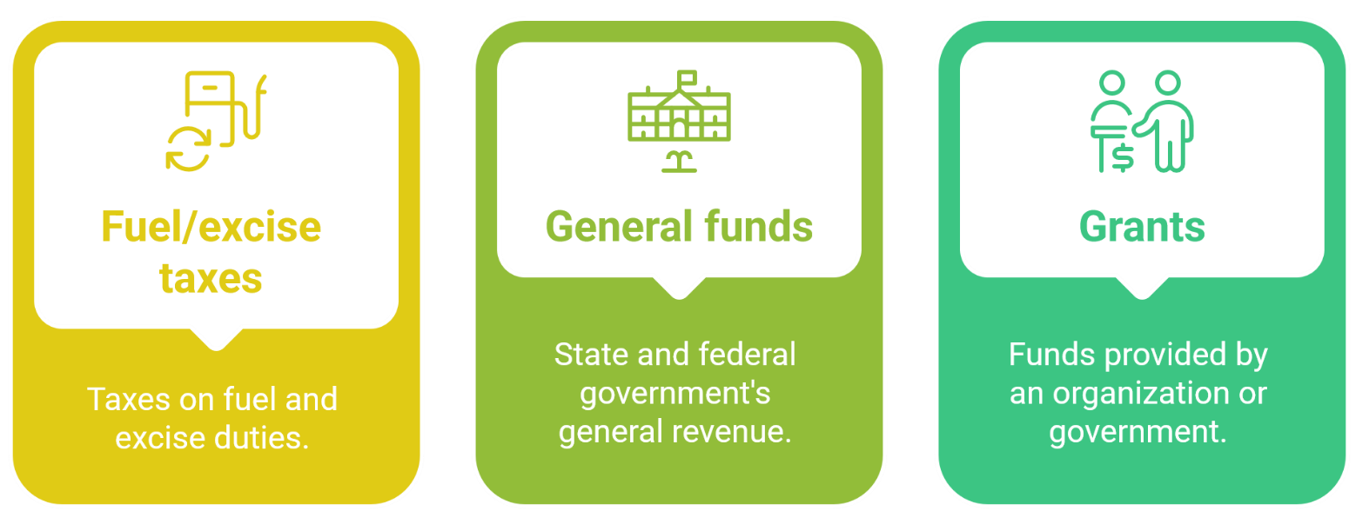
4. Financing Transport Projects
4.1. Traditional Public Financing Methods
Primary Sources of Funding
Historical Context
Evolution of programs (e.g., Federal-Aid Highway Program) and their challenges.
Limitations
Shrinking revenues from fuel tax due to EV adoption and fuel efficiency.
Budget constraints and competing demands.
Sustainable Transport and Policy Analysis

Slide 38
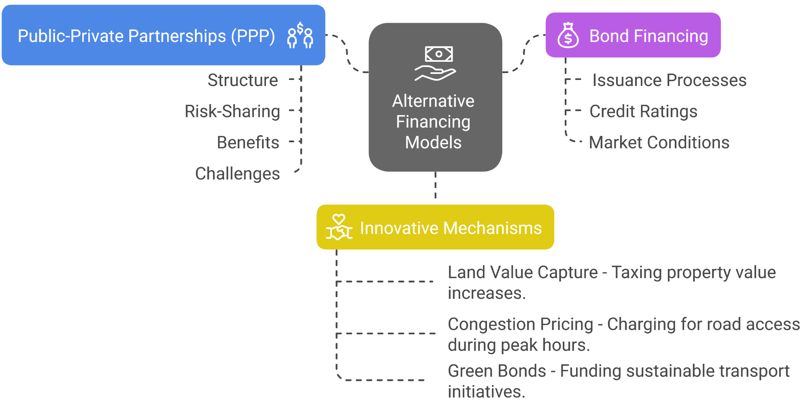
4. Financing Transport Projects
4.2. Alternative Financing Models
Benefits
Diversification of funding sources and improved capital efficiency.
Sustainable Transport and Policy Analysis

Slide 39
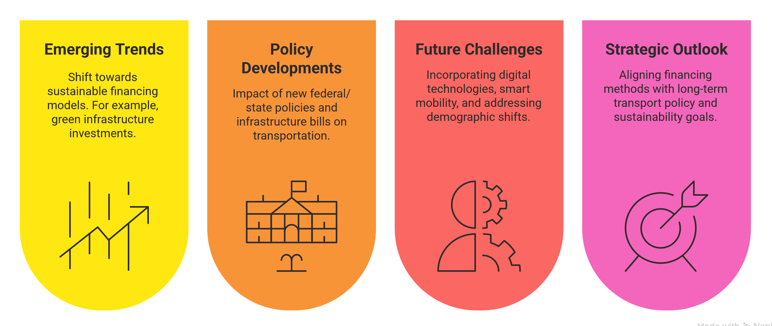
4. Financing Transport Projects
4.3. Policy Implications & Future Trends
Sustainable Transport and Policy Analysis

Slide 40
Section 05:
Quiz & Group Discussion
Sustainable Transport and Policy Analysis

Slide 41
5. Quiz & Group Discussion
5.1. Quiz
How would you explain the difference between transport policy and transport planning to someone unfamiliar with the field?
Why is stakeholder engagement so important in transport planning, and which stakeholder group do you think is the hardest to satisfy?
What do you think is the biggest barrier to aligning transport policy and planning successfully? Political change? Funding? Coordination?
Among the planning principles discussed (e.g., sustainability, equity, flexibility), which one do you believe is the most difficult to achieve in practice? Why?
If you were a transport planner in a growing city facing major traffic congestion, which case study model (London, Bogotá, Netherlands, Singapore) would you be most inspired to follow? Why?
In your opinion, should governments prioritize reducing private car usage or improving public transport options? Can they really do both effectively at the same time?
Sustainable Transport and Policy Analysis

Slide 42
5. Quiz & Group Discussion
5.2. Group Discussion
Scenario Presentation
For example, a proposed urban light rail project with high upfront capital costs but significant long-term societal benefits.
Discussion Prompts
What are the key economic benefits (e.g., reduced congestion, lower pollution)?
What financial challenges (e.g., revenue uncertainty, loan repayments) must be addressed?
How would you integrate both analyses to guide decision-making?
Activity Format
Small group discussion followed by a quick report-back.
Sustainable Transport and Policy Analysis

Slide 43
Thank you for your attention!

