Slide 1
Transport Research and Analysis
Module 4: Sustainable Transport and Policy Analysis
Lecture 17: Transport Policy and Planning

Slide 3
Table of contents
Section 1 Overview of Transport Policy ……...................................... 4
What is Transport Policy? ............................................................ 5
Purpose of Transport Policy ......................................................... 6
Goals and Objectives of Transport Policy .................................... 7
Types of Transport Policy ............................................................ 8
Stakeholders in Transport Policy ................................................. 9
Section 2 Overview of Transport Planning ......................................... 10
What is Transport Planning? .............................................. 11
Objectives of Transport Planning …..................................... 12
The Transport Planning Process …................................. 13
Strategic vs Tactical vs Operational Planning ................. 14
Tools and Techniques in Transport Planning ................... 15
Section 3 Policy vs Planning ............................................................... 16
Comparing Policy and Planning ..................................... 17
How Policy and Planning Interact .................................. 18
Practical Example ......................................................... 19
Challenges in Aligning Policy and Planning .................... 20
Section 4 Principles of Transport Planning …............................................. 21
Principle 1 – Sustainability ................................................... 22
Principle 2 – Integration ....................................................... 23
Principle 3 – Efficiency and Effectiveness ............................. 24
Principle 4 – Equity and Accessibility .................................... 25
Principle 5 – Public Participation .......................................... 26
Principle 6 – Flexibility and Adaptability ................................ 27
Section 5 Policy Development Process ........................................................ 28
Steps in Transport Policy Development ................................ 29
Actors in Policy Development .............................................. 30
Influences on Policy Choices............................................... 31
Section 6 Case Studies of Successful Policies ........................................... 32
London Congestion Charge (UK) .......................................... 33
TransMilenio Bus Rapid Transit (Bogotá) .............................. 34
Netherlands Cycling Infrastructure Policy .............................. 35
Singapore’s Integrated Transport Policy ................................ 36
Section 7 Quiz & Group Discussion ............................................................. 37
Quiz .................................................................................... 38
Group Discussion ................................................................. 39
Transport Policy and Planning

Slide 4
0. Objectives of the Lecture
0.1. Objectives
Key Objectives:
Understand key concepts and definitions in transport policy and planning.
Differentiate between policy (the strategic vision) and planning (the technical implementation).
Learn the core principles guiding transport planning.
Examine the policy development process from issue identification to implementation and evaluation.
Analyze real-world case studies illustrating successful policy and planning integration.
Transport Policy and Planning

Slide 5
Section 01:
Overview of Transport Policy
Transport Policy and Planning

Slide 6
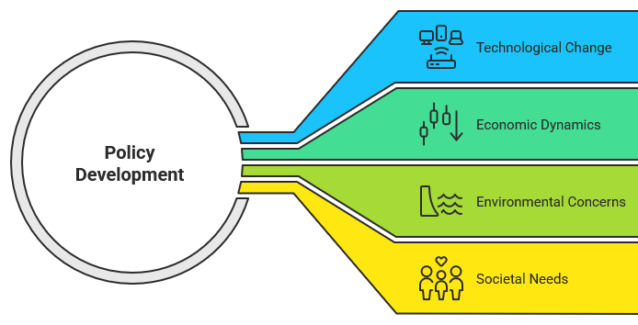
1. Overview of Transport Policy
1.1. What is Transport Policy?
Definition & Scope:
A set of strategic guidelines, laws, and decisions that govern the development, management, and regulation of transportation systems.
Includes infrastructure investment frameworks, regulatory standards, fiscal measures, and behavioral incentives.
Context:
Informed by technological change, economic dynamics, environmental concerns, and societal needs.
Example: Setting emission standards or developing congestion pricing as part of a broader sustainability goal.
Transport Policy and Planning

Slide 7
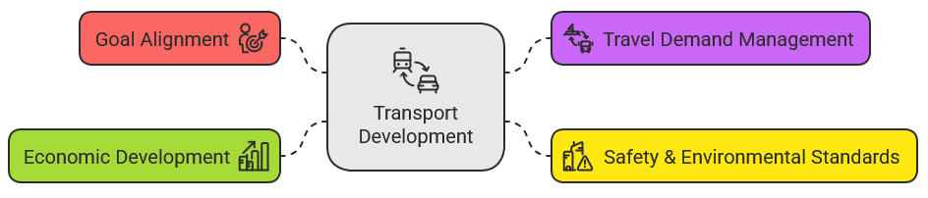
1. Overview of Transport Policy
1.2. Purpose of Transport Policy
Key Purposes:
Goal Alignment: Ensure transport development supports broader societal objectives (e.g., economic growth, social equity).
Travel Demand Management: Influence modal choices through incentives and regulations (e.g., encouraging public transport use).
Safety & Environmental Standards: Establish measures that reduce accident risks and environmental degradation.
Economic Development: Enhance connectivity and support regional growth.
Transport Policy and Planning

Slide 8
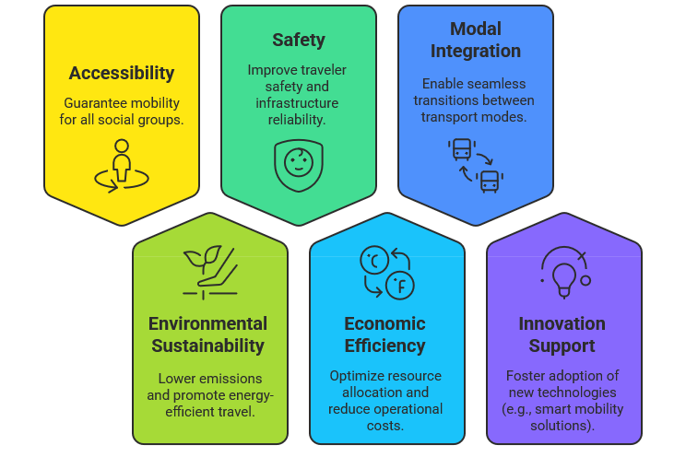
1. Overview of Transport Policy
1.3. Goals and Objectives of Transport Policy
Main Goals:
Transport Policy and Planning
Notes:
More details will be discussed in the future lectures

Slide 9
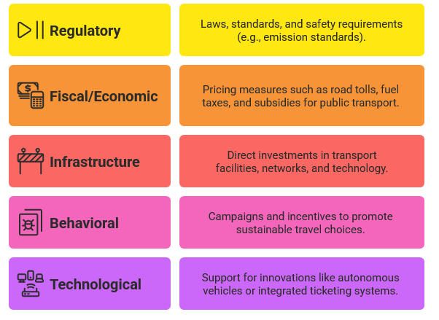
1. Overview of Transport Policy
1.4. Types of Transport Policy
Policy Categories:
Transport Policy and Planning

Slide 10
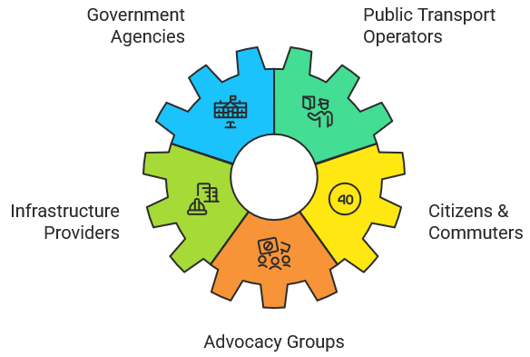
1. Overview of Transport Policy
1.5. Stakeholders in Transport Policy
Key Stakeholders:
Government Agencies: National, regional, and local authorities responsible for setting policies.
Public Transport Operators: Agencies managing transit services.
Infrastructure Providers: Construction and maintenance firms, private investors.
Citizens & Commuters: The end users whose needs drive policy formulation.
Advocacy Groups: NGOs and community organizations advocating for environmental and social issues.
Transport Policy and Planning

Slide 11
Section 02:
Overview of Transport Planning
Transport Policy and Planning

Slide 12
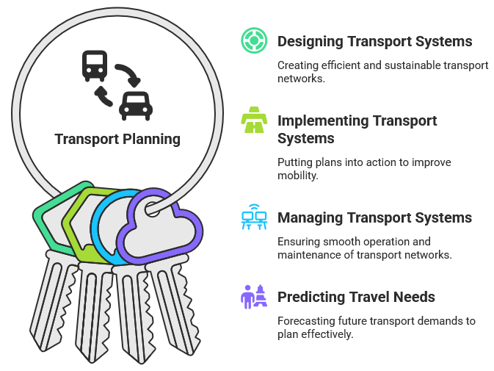
2. Overview of Transport Planning
2.1. What is Transport Planning?
Definition:
The systematic process of designing, implementing, and managing transport systems based on current and predicted travel needs.
Scope:
Encompasses forecasting, spatial and network analysis, and the development of operational projects.
Balances short-, medium-, and long-term considerations to meet dynamic mobility demands.
Transport Policy and Planning

Slide 13
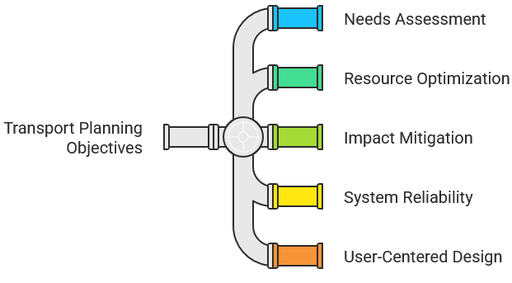
2. Overview of Transport Planning
2.2. Objectives of Transport Planning
Primary Objectives:
Needs Assessment: Evaluate current and future travel patterns using data and modeling.
Resource Optimization: Ensure effective allocation of funds, personnel, and infrastructure.
Impact Mitigation: Reduce negative social, environmental, and economic effects.
System Reliability: Enhance safety, efficiency, and user satisfaction.
User-Centered Design: Focus on accessibility and convenience for a diverse user base.
Transport Policy and Planning

Slide 14
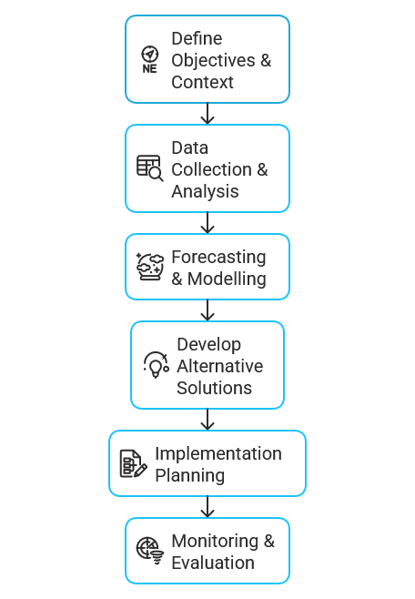
2. Overview of Transport Planning
2.3. The Transport Planning Process
Step-by-Step Process:
Define Objectives & Context: Align with policy goals and understand local conditions.
Data Collection & Analysis: Utilize surveys, travel diaries, and spatial analysis.
Forecasting & Modelling: Apply quantitative models (e.g., four-step models) to predict future demand.
Develop Alternative Solutions: Evaluate different modes, routes, and service designs.
Implementation Planning: Detail project timelines, budgets, and operational strategies.
Monitoring & Evaluation: Establish KPIs and continuously adapt based on performance data.
Transport Policy and Planning

Slide 15
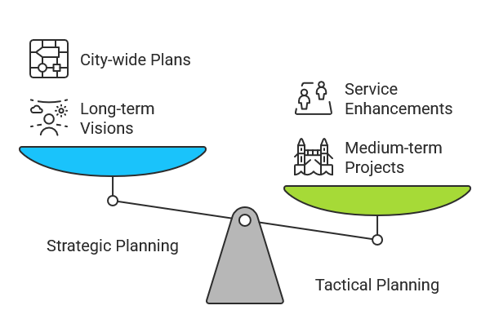
2. Overview of Transport Planning
2.4. Strategic vs Tactical vs Operational Planning
Differentiation:
Strategic Planning: Long-term visions and master planning (e.g., city-wide mobility plans).
Tactical Planning: Medium-term projects and service enhancements (e.g., introducing a new bus route).
Operational Planning: Day-to-day management and adjustments (e.g., traffic signal optimization).
Transport Policy and Planning

Slide 16
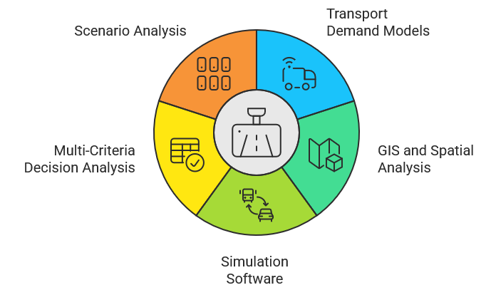
2. Overview of Transport Planning
2.5. Tools and Techniques in Transport Planning
Key Tools:
Transport Demand Models: Four-step models, gravity models, etc., for predicting traffic flows.
GIS and Spatial Analysis: Mapping tools for visualizing accessibility and network performance.
Simulation Software: Platforms like VISSIM or AIMSUN for simulating traffic and transit operations.
Multi-Criteria Decision Analysis (MCDA): For evaluating multiple project outcomes.
Scenario Analysis: Testing different future conditions and policy impacts.
Transport Policy and Planning

Slide 17
Section 03:
Policy vs Planning
Transport Policy and Planning

Slide 18
3. Policy vs Planning
3.1. Comparing Policy and Planning
Comparison Table:
Aspect | Policy | Planning
Nature | Strategic, visionary | Technical, operational
Timeframe | Long-term goals | Short- to medium-term actions
Decision-making | Political/legislative | Evidence-based, analytical
Focus | Broad societal objectives | Detailed project design
Transport Policy and Planning

Slide 19
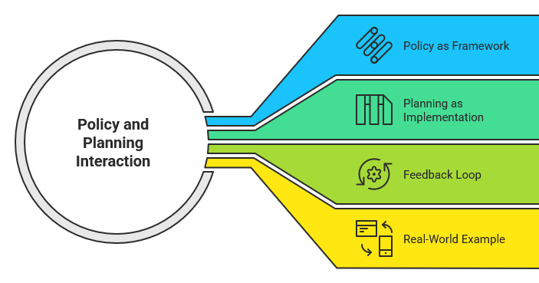
3. Policy vs Planning
3.2. How Policy and Planning Interact
Key Points:
Policy as Framework: Provides the vision, legal mandate, and priorities.
Planning as Implementation: Designs detailed projects that put the policy into practice.
Feedback Loop: Outcomes of implemented plans inform future policy refinements.
Real-World Example: Non-motorized transport policy leads to the development of cycling lanes and pedestrian zones.
Transport Policy and Planning

Slide 20
3. Policy vs Planning
3.2. Practical Example
Example Details:
Policy Directive:
Promote non-motorized transport to improve urban air quality and reduce congestion.
Planning Response:
Design safe and dedicated cycling paths and improved pedestrian infrastructure.
Integrate these facilities with existing public transit networks.
Integration Outcome:
Monitor usage data; refine routes and safety measures based on feedback.
Transport Policy and Planning

Slide 21
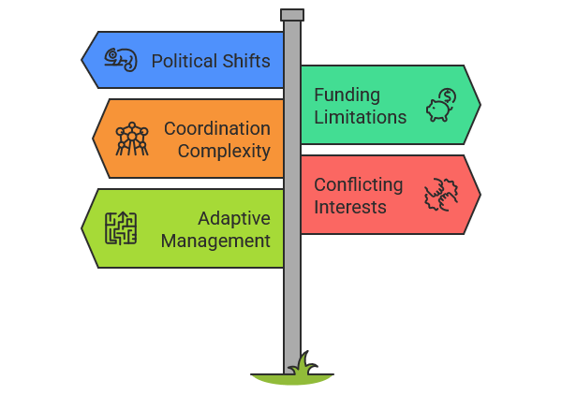
3. Policy vs Planning
3.3. Challenges in Aligning Policy and Planning
Challenges:
Political Shifts: Changing administrations can lead to priority changes.
Funding Limitations: Budget constraints may force compromises.
Coordination Complexity: Multiple agencies, overlapping jurisdictions, and diverse stakeholders.
Conflicting Interests: Balancing economic objectives with environmental and social equity goals.
Need for Adaptive Management: Continuous monitoring and flexibility are crucial.
Transport Policy and Planning

Slide 22
Section 04:
Principles of Transport Planning
Transport Policy and Planning

Slide 23
4. Principles of Transport Planning
4.1. Principle 1 – Sustainability
Environmental Focus:
Transport planning must prioritize minimizing resource consumption, including energy, land, and water use. A major objective is reducing greenhouse gas emissions and air pollutants that harm both health and ecosystems.
Modal Shift:
Strategies should encourage shifts from private car use to more sustainable modes like walking, cycling, and public transportation. Infrastructure investments should make these modes safer, more attractive, and more convenient.
Resilience:
New transport infrastructure must be designed to withstand the impacts of climate change—such as extreme weather events—and support long-term environmental stability.
Transport Policy and Planning

Slide 24
4. Principles of Transport Planning
4.2. Principle 2 – Integration
Land Use Coordination:
Transport networks should be planned alongside housing, commercial, and industrial developments. Good integration can shorten travel distances, encourage public transport use, and foster vibrant, connected communities.
Multi-modal Connectivity:
Seamless transitions between buses, trains, bicycles, and pedestrian pathways enhance user experience and efficiency. For example, well-designed transport hubs facilitate easy transfers without long waits or confusing navigation.
Institutional Collaboration:
Successful integration requires cooperation between different government departments, private sector actors, and civil society. Aligning objectives across sectors helps create a unified, efficient system.
Transport Policy and Planning

Slide 25
4. Principles of Transport Planning
4.3. Principle 3 – Efficiency and Effectiveness
Resource Optimization:
Transport systems should deliver the greatest mobility benefit with the least use of materials, energy, and financial resources. This includes planning smart routes, optimizing vehicle capacities, and minimizing wasted infrastructure.
Timeliness:
Delivering projects on schedule saves costs and maintains public trust. Good project management, risk assessments, and proactive mitigation strategies are critical for keeping transport initiatives on track.
Congestion Management:
Modern transport planning must use data-driven tools like intelligent transport systems (ITS) to monitor traffic flow, adjust signals dynamically, and provide real-time information to users, keeping cities moving efficiently.
Transport Policy and Planning

Slide 26
4. Principles of Transport Planning
4.4. Principle 4 – Equity and Accessibility
Inclusiveness:
Transport planning must accommodate people of all ages, incomes, and abilities, including the elderly, people with disabilities, and low-income communities. Mobility should not be a privilege for a few but a right for all.
Rural vs. Urban Balance:
While cities often receive more investment, rural and remote areas require tailored solutions to prevent isolation. Equity means recognizing the different mobility challenges across geographic contexts.
Policy Measures:
Practical steps like offering subsidized fares, conducting regular accessibility audits, and adopting universal design principles ensure that all users can benefit from transport systems.
Transport Policy and Planning

Slide 27
4. Principles of Transport Planning
4.4. Principle 5 – Public Participation
Engagement:
Engaging the public from the early stages helps planners understand community needs and priorities. It leads to solutions that better reflect real-world use patterns and concerns.
Transparency:
Open communication about decision-making processes, project goals, and potential impacts builds trust and reduces opposition or misunderstandings.
Feedback Loops:
Mechanisms like surveys, public forums, and digital feedback platforms allow planners to adjust projects based on input, improving both the process and outcomes.
Transport Policy and Planning

Slide 28
4. Principles of Transport Planning
4.4. Principle 6 – Flexibility and Adaptability
Planning for Uncertainty:
Scenario planning helps prepare for different futures—whether technological innovations, demographic shifts, or unforeseen disruptions like pandemics or extreme weather events.
Incremental Implementation:
Instead of rigid, all-at-once development, phased projects allow transport systems to adapt as new information emerges, ensuring continued relevance.
Resilient Design:
Infrastructure must be designed to adjust and scale based on changing needs. This includes expandable metro systems, flexible bus routes, and multimodal corridors.
Transport Policy and Planning

Slide 29
Section 05:
Policy Development Process
Transport Policy and Planning

Slide 30
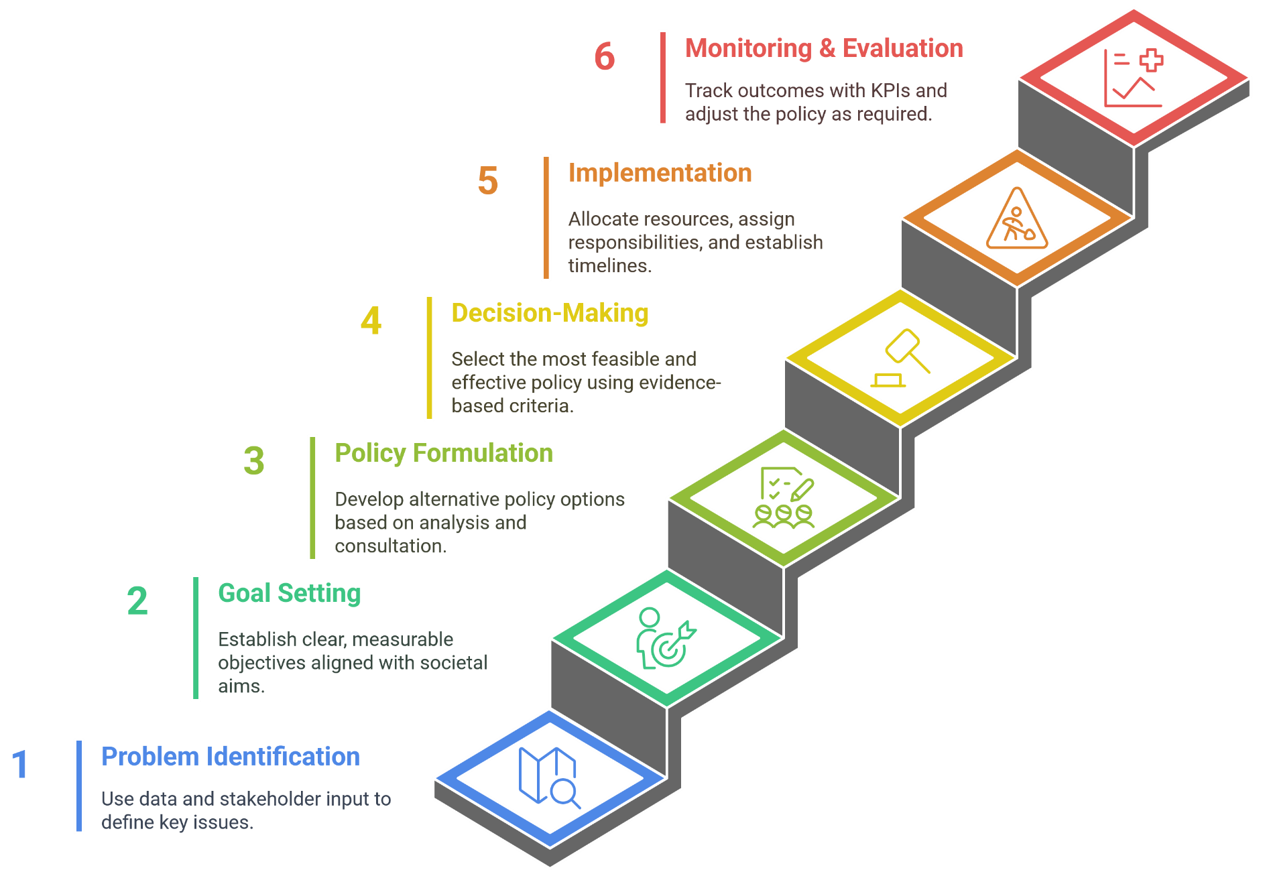
5. Policy Development Process
5.1. Steps in Transport Policy Development
Transport Policy and Planning

Slide 31
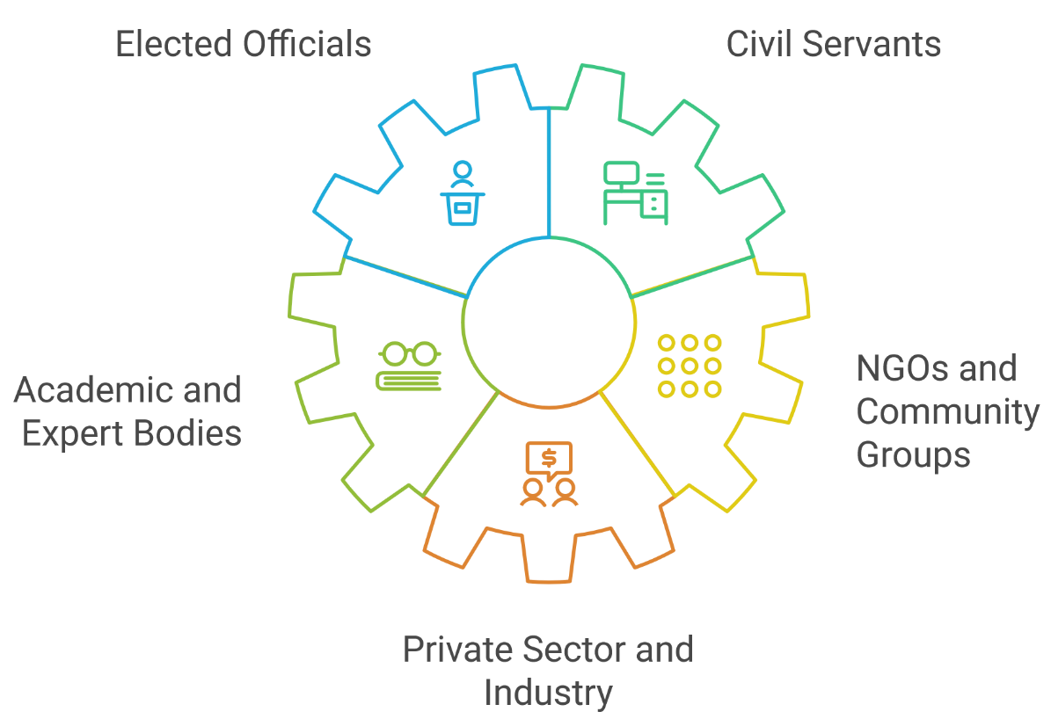
5. Policy Development Process
5.2. Actors in Policy Development
Key Actors:
Elected Officials: Set the policy agenda and provide political support.
Civil Servants: Develop and manage technical aspects of the policy.
Academic and Expert Bodies: Offer research-based insights and forecasts.
NGOs and Community Groups: Represent societal interests and provide ground-level feedback.
Private Sector and Industry: Collaborate on implementation and share expertise.
Transport Policy and Planning

Slide 32
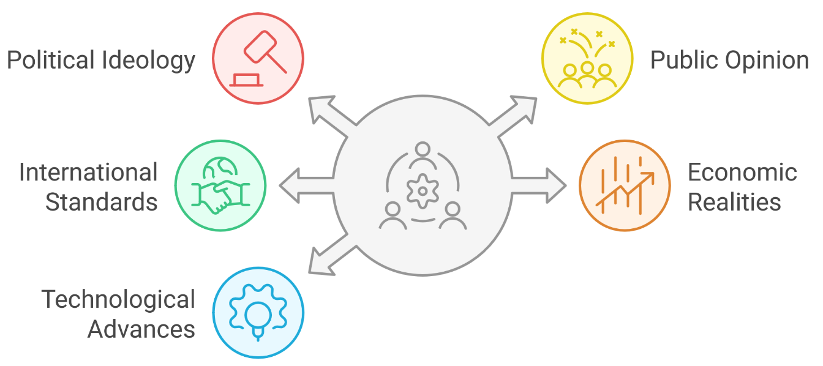
5. Policy Development Process
5.3. Influences on Policy Choices
Influential Factors:
Political Ideology & Leadership: Shape overall priorities and policy directions.
Public Opinion & Media: Drive responsiveness through pressure and advocacy.
International Standards & Agreements: Encourage conformity to global best practices (e.g., sustainable development goals).
Economic Realities: Budget constraints and market conditions influence policy feasibility.
Technological Advances & Research Data: Provide the basis for innovative and effective policy options.
Transport Policy and Planning

Slide 33
Section 06:
Case Studies of Successful Policies
Transport Policy and Planning

Slide 34
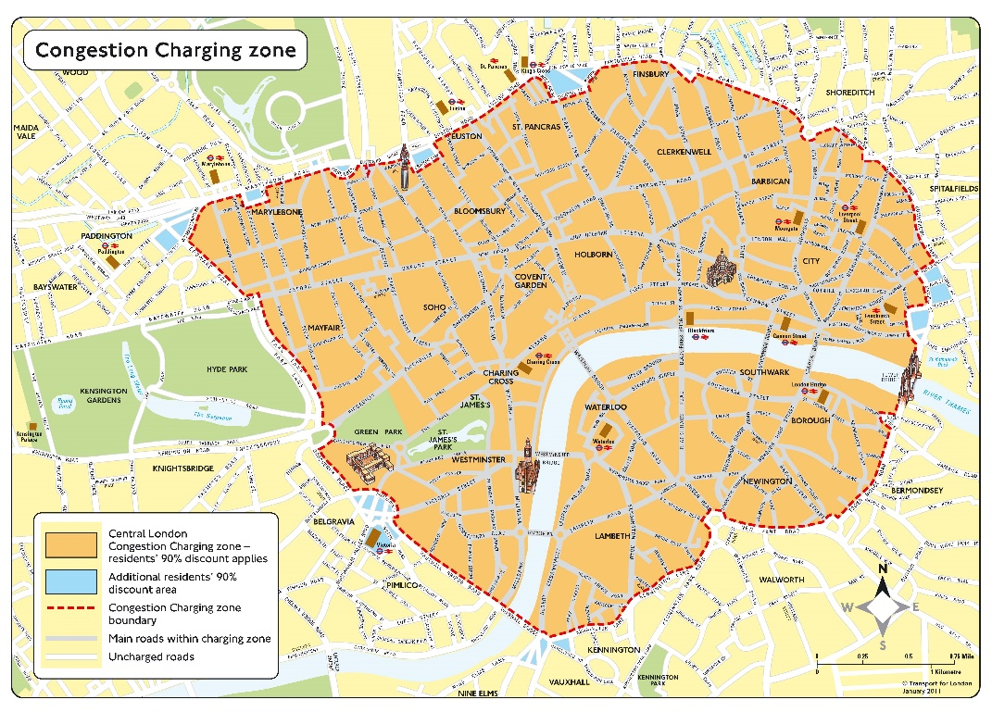
6. Case Studies of Successful Policies
6.1. London Congestion Charge (UK)
Case Study Overview:
Background: Introduced in 2003 to address central London congestion.
Policy Objectives: Reduce traffic volumes, improve air quality, and generate revenue for transit improvements.
Implementation:
Zone-based electronic charging with automated enforcement.
Incremental roll-out and public information campaigns.
Outcomes & Impact:
Approximately 30% reduction in traffic congestion.
Increased public transport usage and quality improvements funded by revenue.
Challenges:
Political resistance and initial compliance issues.
Transport Policy and Planning

Slide 35
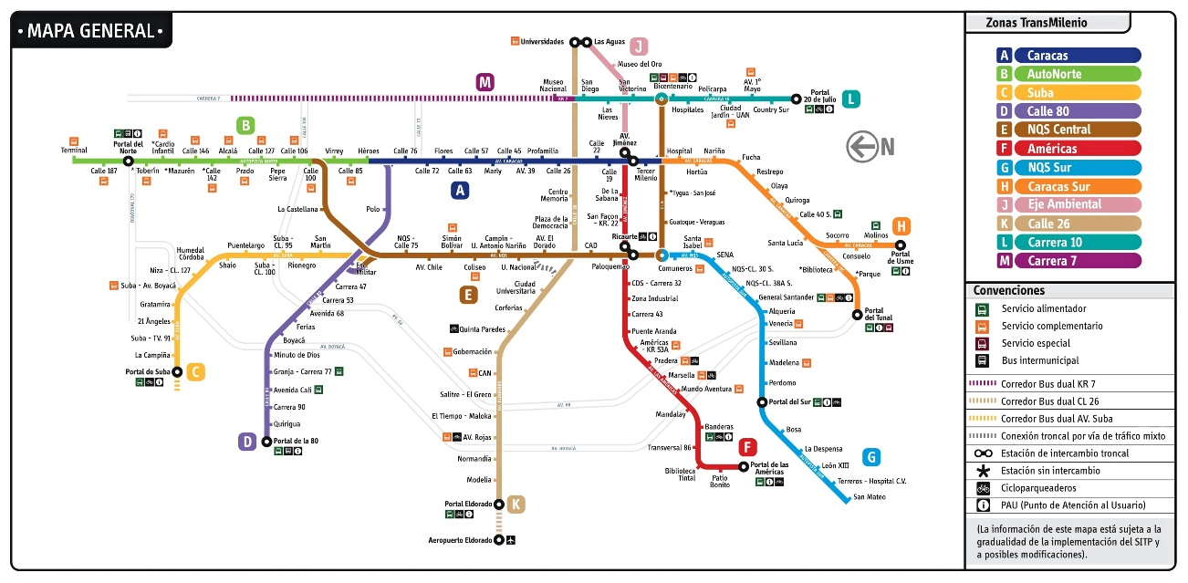
6. Case Studies of Successful Policies
6.2. TransMilenio Bus Rapid Transit (Bogotá)
Case Study Overview:
Background: Launched in the early 2000s in response to severe urban mobility challenges in Bogotá.
Policy and Planning Vision:
Provide high-frequency, efficient, and affordable public transport.
Dedicated bus lanes and integrated station facilities.
Key Outcomes:
Significant reductions in travel time and air pollution.
Improved accessibility for low-income populations.
Implementation Challenges:
Managing peak-period demand and continuously upgrading service quality.
Transport Policy and Planning

Slide 36
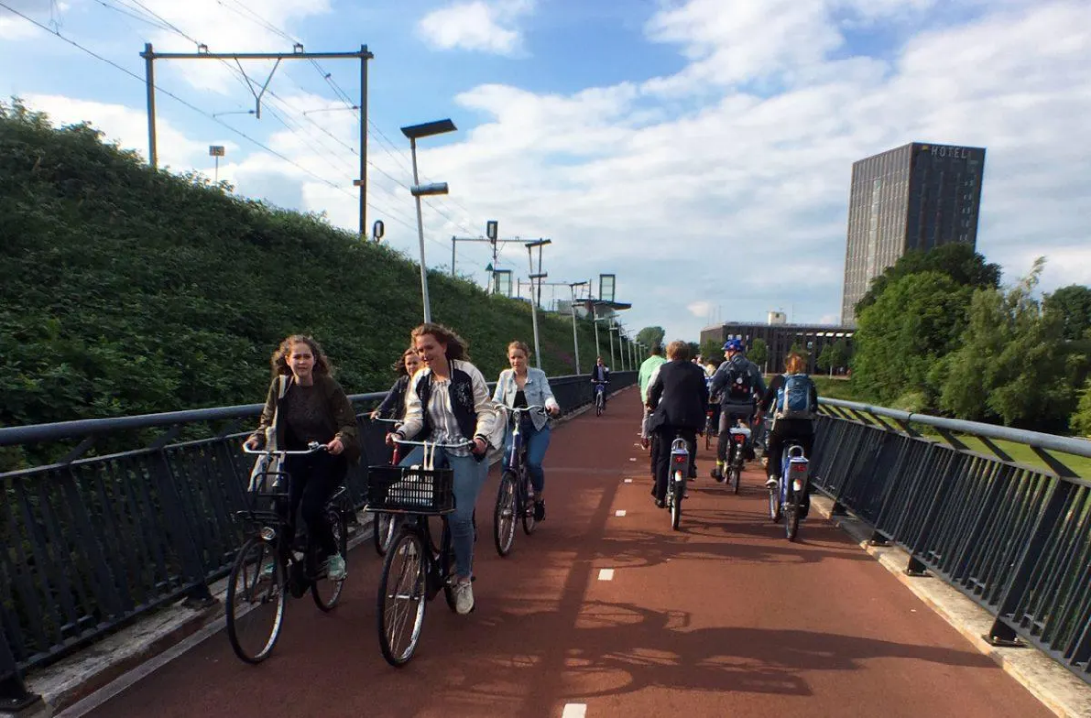
6. Case Studies of Successful Policies
6.3. Netherlands Cycling Infrastructure Policy
Case Study Overview:
Policy Vision: Promote cycling as a key sustainable mobility mode.
Key Initiatives:
Invest in a nationwide network of dedicated, safe cycling lanes and supporting infrastructure.
Integrate cycling with public transport hubs and urban planning.
Support public awareness and education campaigns.
Outcomes:
Approximately 27% of trips in the Netherlands are by bicycle.
Reduced congestion and lower environmental impacts.
Lessons Learned:
Long-term political commitment and cultural shifts are essential.
Transport Policy and Planning

Slide 37
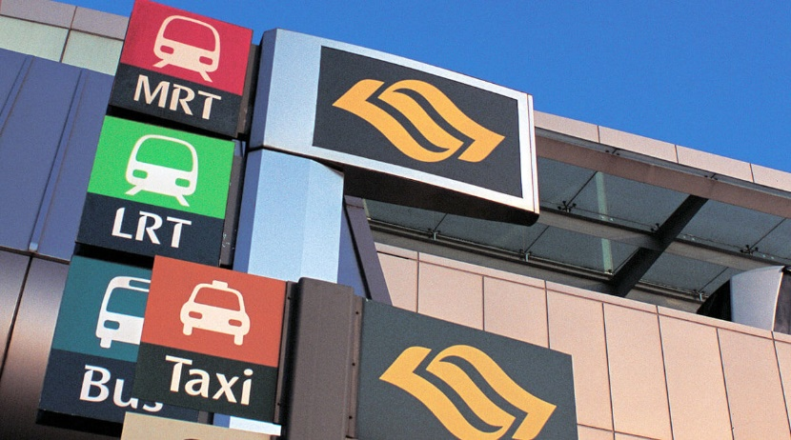
6. Case Studies of Successful Policies
6.4. Singapore’s Integrated Transport Policy
Case Study Overview:
Policy Vision: Create a seamless, integrated, and efficient urban transport system that is both sustainable and responsive to rapid growth.
Key Components:
Electronic Road Pricing (ERP): Dynamic congestion management.
Vehicle Quota System: Control private car ownership to mitigate overuse.
Integrated Land-Use Planning: Coordinate transport investments with urban development.
Robust Public Transit Network: High-quality bus and rail services that work in tandem.
Outcomes:
High public transit usage and effective traffic management.
Consistent improvements in mobility and environmental performance.
Challenges:
Ongoing management of rapid urban growth and technological updates.
Transport Policy and Planning

Slide 38
Section 07:
Quiz & Group Discussion
Transport Policy and Planning

Slide 39
7. Quiz & Group Discussion
7.1. Quiz
How would you explain the difference between transport policy and transport planning to someone unfamiliar with the field?
Why is stakeholder engagement so important in transport planning, and which stakeholder group do you think is the hardest to satisfy?
What do you think is the biggest barrier to aligning transport policy and planning successfully? Political change? Funding? Coordination?
Among the planning principles discussed (e.g., sustainability, equity, flexibility), which one do you believe is the most difficult to achieve in practice? Why?
If you were a transport planner in a growing city facing major traffic congestion, which case study model (London, Bogotá, Netherlands, Singapore) would you be most inspired to follow? Why?
In your opinion, should governments prioritize reducing private car usage or improving public transport options? Can they really do both effectively at the same time?
Transport Policy and Planning

Slide 40
7. Quiz & Group Discussion
7.2. Group Discussion
Instructions:
Form small groups (3–5 people).
Choose a specific urban mobility challenge (e.g., congestion, pollution, lack of public transit, rural access).
Design a basic Policy + Planning outline:
2 Policy Measures
2 Planning Actions
Prepare a 2-minute group presentation.
Guiding Questions:
What problem are you solving?
How do your policy and planning steps interact?
What stakeholders would be involved?
How would you measure success?
Transport Policy and Planning

Slide 41
Thank you for your attention!

