Slide 1
Transport Research and Analysis
Module 4: Sustainable Transport and Policy Analysis
Lecture 19: Social Equity and Transport
Notes:
"Good morning, everyone. Welcome to Lecture 19. Today, we address a topic that is not just a subfield of transportation, but is increasingly seen as the very foundation of sustainable and just transport planning: Social Equity. For a long time, our field was primarily concerned with efficiency—moving as many vehicles as possible, as quickly as possible. But today, we understand that transportation is not an end in itself; it is a means to an end. It is the critical link to opportunity—to jobs, to education, to healthcare, to social connection. And if that link is broken for certain segments of society, then the system has failed. Over the next 90 minutes, we will explore the meaning of transport equity, diagnose the causes and consequences of inequity, and examine the policy tools we have to build a fairer, more just transportation future."

Slide 3
Table of contents
Lecture 19: Social Equity and Transport
00: Introduction & Objectives……...................................4
0.0. Lecture Overview......................................................5
0.1. Linking to Traffic Flow Fundamentals........................6
0.2. Learning Objectives…………………………………....7
01 Foundations of Transport Equity………………..........8
1.0. Defining Social Equity in Transport...........................9
1.1. Two Lenses of Equity: Horizontal vs. Vertical…......10
1.2. Key Concepts: Mobility vs. Accessibility……...........11
1.3. The Central Importance of Accessibility……...........12
1.4. The Rationale for Equitable Transport..……...........13
1.5. The "15-Minute City": A Vision for Accessibility.......14
02 Identifying Transport Inequity………………….........15
2.0. The Historical Roots of Inequity…………………......16
2.1. Consequences for Marginalized Communities….....17
2.2. The Spatial Mismatch Hypothesis…………………..18
2.3. Barriers for Disabled Users……………………….....19
2.4. Gender Equity in Transport……………….………….20
2.5. Affordability in Transit………………...……..………21
03 Frameworks for Equity Analysis............................22
3.0. Ethical Theories as Policy Lenses.…….................23
3.1. The Debate…………………………..……………….24
3.2. Rawlsianism: Prioritizing the Least Advantaged.…25
3.4. The Capability Approach……….............................27
04 Policy & Practice: Building Equitable Systems....29
4.0. Translating Theory into Actionable Dimensions....30
4.1. The Policy Cycle…………………………................31
4.2. Policy Tool: Distributional Impact Assessments….32
4.4. Policy Tool: Inclusive & Participatory Planning......34
4.6. From Theory to Practice…………….……………....36
4.7. Case Study 2: The NYC 14th Street Busway.........37
4.8. A Holistic Approach…….……………………..….….38
4.9. Video Discussion: What is Mobility Justice?......….39

Slide 4
Table of contents
Lecture 19: Social Equity and Transport
05: Measurement, Synthesis & Conclusion…...............................40
5.0. Measuring What Matters……………………………………….....41
5.1. Monitoring, Metrics, and Accountability…………......................43
5.2. Final Class Activity…………………………................................44
5.3. Recapitulation of Core Concepts……………............................45
5.4. Concluding Reflections & Future Directions…..........................46
5.4. References & Further Reading.................................................47

Slide 5
Section 00:
Introduction and Objectives
Notes:
"Good morning, everyone. Welcome to Lecture 19. Today, we address a topic that is not just a subfield of transportation, but is increasingly seen as the very foundation of sustainable and just transport planning: Social Equity. For a long time, our field was primarily concerned with efficiency—moving as many vehicles as possible, as quickly as possible. But today, we understand that transportation is not an end in itself; it is a means to an end. It is the critical link to opportunity—to jobs, to education, to healthcare, to social connection. And if that link is broken for certain segments of society, then the system has failed. Over the next 90 minutes, we will explore the meaning of transport equity, diagnose the causes and consequences of inequity, and examine the policy tools we have to build a fairer, more just transportation future."

Slide 6

00. Introduction & Objectives
0.0. Lecture Overview.
Lecture Roadmap
Foundations of Transport Equity: Defining our core concepts.
Identifying Inequity: Diagnosing the problems and their historical roots.
Frameworks for Analysis: Introducing the ethical "lenses" for evaluating equity.
Policy & Practice: Exploring the solutions, from planning processes to case studies.
Measurement & Conclusion: How we track progress and summarize our findings.
Notes:
"To guide our discussion, we will follow a clear, five-part narrative. We'll begin with the Foundations, establishing a shared vocabulary for core concepts like equity, mobility, and accessibility.
Next, we will move into Identifying Inequity, where we will diagnose the real-world problems, examining both the historical causes and contemporary manifestations of transport disparities.
In Section Three, we will introduce key Frameworks for Analysis, looking at the ethical theories that help us understand and argue for different policy approaches.
From there, we will pivot to solutions in our section on Policy and Practice, exploring the specific tools and interventions that planners use to build more equitable systems.
Finally, we will conclude by discussing Measurement and Synthesis, looking at how we track our progress toward equity goals and summarizing the lecture's key lessons. This 'Problem-Framework-Solution' structure will provide a comprehensive overview of the topic."

Slide 7
00. Introduction & Objectives
0.1. Linking to Previous Lectures
Recap: From Systems to People
  In previous lectures, we modeled transport systems, focusing on efficiency, capacity, and flow (System-Focused).
  We analyzed policies for sustainability, focusing on environmental and economic outcomes.
Today's Focus: Adding the "Third E" - Equity
  We now integrate the crucial 'Social' dimension, shifting our focus from moving vehicles to serving people.
  This lecture asks: Who benefits from our transport systems, and who is left behind?
Notes:
"Before we dive in, let's explicitly connect today's topic to our previous discussions. So far in this module, we have often looked at transportation through a system-focused lens. We've talked about modeling traffic flow, optimizing network efficiency, and the environmental and economic pillars of sustainability.
Today, we add the third, critical pillar: Equity. We are making a deliberate shift in perspective. We are moving our focus from the efficiency of moving vehicles to the effectiveness of serving people.
The core questions of this lecture are therefore fundamentally different. We are no longer just asking 'How can we make the system faster?' or 'How can we reduce emissions?' We are asking the much more profound questions: 'Who benefits from these improvements?' and 'Who bears the burdens?' and 'Who is being left behind?' This focus on the social and human dimension is the cornerstone of modern, sustainable transport planning."

Slide 8

00. Introduction & Objectives
0.2. Learning Objectives.
By the end of this lesson, you should be able to:
Define social equity in transport and distinguish it from equality.
Explain the difference between mobility and accessibility, and why accessibility is a better measure of equity.
Identify the historical causes and current examples of transport inequity.
Compare the key ethical frameworks used to analyze transport equity.
Describe the main policy tools and interventions used to create a more equitable transport system.
Notes:
"To set a clear target for our session, here are the key skills you will have by the end of this lecture.
You will be able to define social equity in a transport context and, crucially, distinguish it from the simpler concept of equality.
You will be able to explain the vital difference between mobility and accessibility and argue why accessibility is the more meaningful metric.
You will be able to identify both the historical roots of transport inequity and the specific ways it manifests in our communities today.
You will be able to compare the main philosophical frameworks that planners use to analyze equity, giving you a more sophisticated lens for evaluation.
And finally, you will be able to describe the practical, real-world policy tools that are used to fix these problems and build fairer systems. These five objectives form a comprehensive introduction to the field."

Slide 9
Section 01:
Foundations of Transport Equity
Notes:
"Let's begin. Our first section is dedicated to laying the foundations. Before we can diagnose problems or propose solutions, we must establish a clear and shared understanding of the core principles and terminology that underpin the entire field of transport equity. This section will provide that essential vocabulary."

Slide 10

01. Foundations of Transport Equity
1.0. Defining Social Equity in Transport.
What is Social Equity in Transport?
  Social equity means that the benefits (like access to jobs) and costs (like air pollution or displacement) of mobility systems are distributed fairly across all segments of society.
Core Principle:
  Every individual deserves equitable access to affordable, reliable, and safe transportation, regardless of their income, gender, race, ability, or geographic location.
Notes:
"So, what do we actually mean when we say 'social equity in transport'? Let's establish a clear, working definition. At its heart, social equity means that the benefits and the costs of our transportation systems are distributed fairly. It's a two-sided coin. The benefits are things like access to opportunities. The costs are things like exposure to air pollution from a highway, or the risk of being displaced from your home to build a new rail line. Equity demands that we consider both sides of this ledger and who is affected.
This leads to our core principle: that access to mobility is a fundamental right. Every person, regardless of who they are, where they live, or how much money they have, deserves a fair chance to access the transportation they need to participate fully in society. As you can see, this is a deeply normative, values-driven starting point for transport planning."

Slide 11
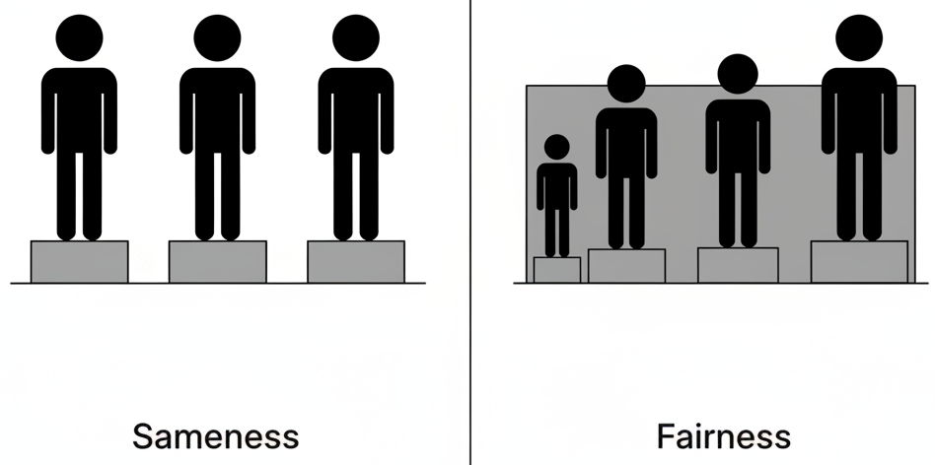
01. Foundations of Transport Equity
1.1. Two Lenses of Equity: Horizontal vs. Vertical
To apply the principle of fairness, we use two key lenses:
Horizontal Equity (Equal Treatment):
  Principle: Treating individuals in similar situations in the same way.
  Example: Ensuring all neighborhoods with a similar population density have a bus stop within a reasonable walking distance (e.g., 400 meters).
Vertical Equity (Fair Treatment):
  Principle: Treating individuals in different situations differently to address disadvantages and create fairer outcomes.
  Example: Providing subsidized or free transit fares for low-income riders to ensure the service is affordable for them.
Notes:
"Now, the word 'fairly' in our definition is doing a lot of work. To make it more concrete, planners think about fairness through two lenses: horizontal and vertical equity.
Horizontal Equity is the principle of treating equals equally. It means that people in comparable situations should receive a comparable level of service. For example, it would be a violation of horizontal equity if two neighborhoods with the same population and density had wildly different levels of bus service.
However, sometimes treating everyone the same can actually lead to an unfair outcome. This is where Vertical Equity comes in. This is the principle of treating people differently in order to achieve a fairer result. It acknowledges that some groups start with significant disadvantages and may require targeted support to have the same opportunities as everyone else. The classic example in transportation is a subsidized fare program for low-income individuals. We are treating them differently based on their income, but we are doing it to achieve the equitable outcome of ensuring that everyone can afford to use the transit system. A truly equitable transport plan requires a sophisticated balance of both."

Slide 12
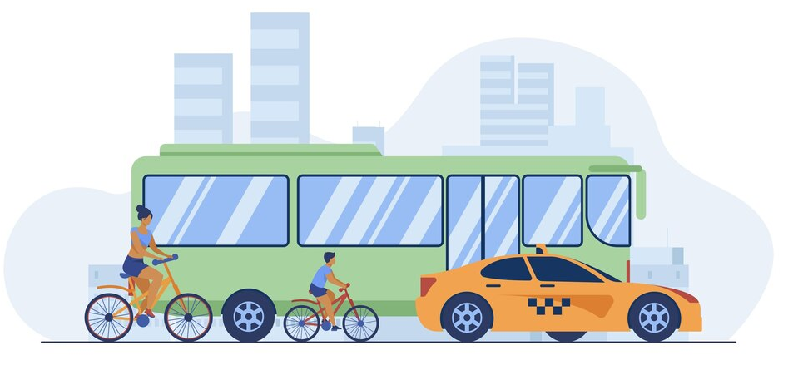
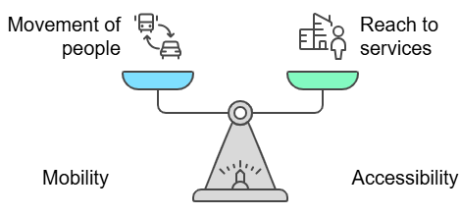
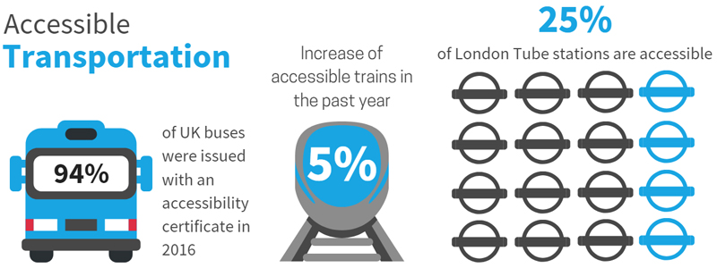
01. Foundations of Transport Equity
1.2. Key Concepts: Mobility vs. Accessibility
Mobility is about movement. Accessibility is about opportunity.
Mobility:
  Refers to the movement of people or vehicles.
  Metric: Speed, travel time, vehicle throughput.
Mobility
Accessibility:
  Focuses on the ability of individuals to reach essential services and destinations (jobs, schools, healthcare).
  Metric: Number of jobs reachable within a 30-minute transit ride.
Accessibility
While both are important, accessibility is a more meaningful measure of social equity.
Notes:
"The next critical distinction we need to make is between mobility and accessibility. For decades, transport planning was obsessed with mobility. Our primary goal was to increase the speed and ease of movement, often for cars. We measured success with metrics like average traffic speed or vehicle throughput.
However, a major shift in modern planning has been to focus instead on accessibility. Accessibility is not about movement for its own sake; it's about what that movement allows you to reach. It's a measure of opportunity. The key question of accessibility is not 'How fast can you go?' but 'Where can you go?' How many jobs, schools, hospitals, or grocery stores can a person reach within a reasonable amount of time and for a reasonable cost?
As the scale in this diagram illustrates, we are now trying to balance our focus. And as we'll see, focusing on accessibility—on connecting people to opportunities—is a much more direct and meaningful way to measure and achieve social equity."

Slide 13
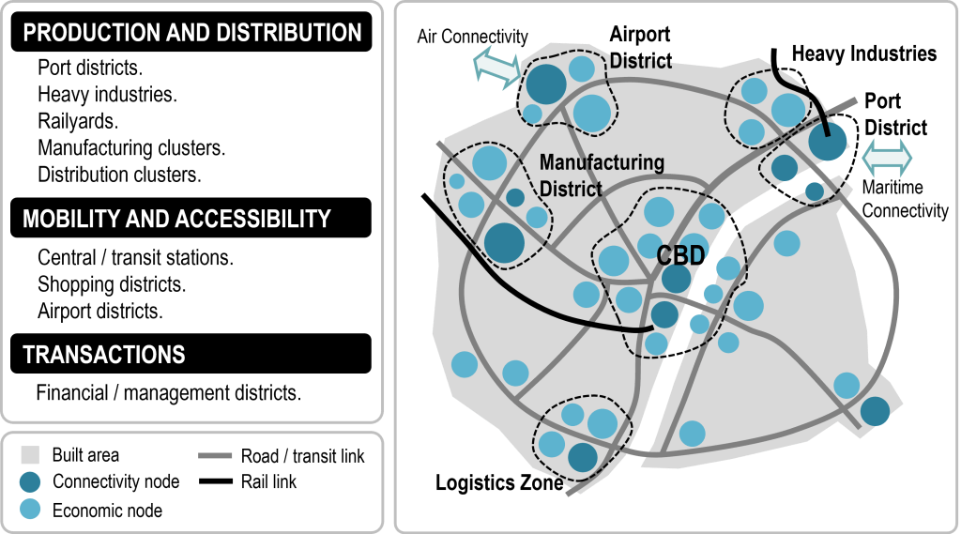
01. Foundations of Transport Equity
1.3. The Central Importance of Accessibility.
Why focus on accessibility?
It Measures Opportunity, Not Just Movement: Traditional metrics like traffic flow don't tell us if people can reach key destinations.
It's Outcome-Oriented: It links transport improvements directly to tangible benefits for people, like employment opportunities and healthcare access.
It Guides Policy: Accessibility metrics help planners identify underserved areas and guide targeted investments to address disparities.
Notes:
"So why has this shift from mobility to accessibility become so central to modern, equitable planning? There are three key reasons.
First, accessibility measures what actually matters to people: opportunity. A new highway might improve mobility by increasing average car speeds, but if it bypasses the low-income neighborhood that needs jobs, it has failed to improve their accessibility. Accessibility metrics give us a much clearer picture of the actual opportunities available to a community.
Second, it is outcome-oriented. It forces us to think beyond the transport project itself and focus on the tangible benefits it provides. The goal is not to build a new bus line; the goal is to connect people to jobs, and the bus line is simply the means to that end.
Finally, and most practically, accessibility metrics are essential for guiding policy. By creating 'accessibility maps'—which we'll see later—planners can visually identify which communities are well-served and which are cut off from opportunity. This allows for data-driven, targeted interventions to address the most significant gaps and reduce disparities in access."

Slide 14
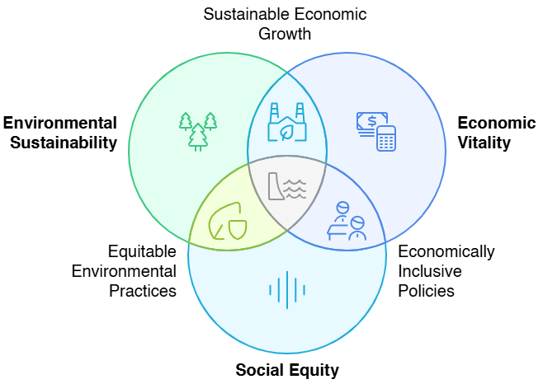
01. Foundations of Transport Equity
1.4. The Rationale for Equitable Transport.
Why does equity matter in transport planning?
  It's a Gateway to Opportunity: Transportation is not about moving vehicles; it is a means to access jobs, education, healthcare, and social connections.
  It's a Pillar of Sustainability: Modern planning must balance the "three E's": Environment, Economy, and Equity.
  It's a Moral & Practical Imperative: Pursuing equity is both a moral obligation to create a just society and a practical necessity for building strong, vibrant, and inclusive communities.
Notes:
"To conclude our foundational section, let's synthesize the core rationale for why equity is no longer a niche topic, but a central pillar of good transport planning.
First, we must recognize that transportation is a gateway to opportunity. An affordable and reliable bus route isn't just a bus route; for someone without a car, it's a lifeline to a better job, a better school for their children, or essential medical care.
Second, equity is now understood as an essential pillar of sustainability. For decades, planning focused on the environment and the economy. As this Venn diagram illustrates, we now understand that a truly sustainable system must also be equitable. A green, economically vibrant city that only works for the wealthy is not a success.
Finally, pursuing equity is both a moral and a practical imperative. It is a moral obligation because access to opportunity is a fundamental human right. And it is a practical necessity because inequitable systems lead to social exclusion, concentrated poverty, and ultimately, weaker and less resilient communities. A city that works for everyone is stronger than a city that only works for some.
With this 'why' firmly established, we will now turn our attention to diagnosing the 'what'—the real-world problems of inequity in our transport systems."

Slide 15
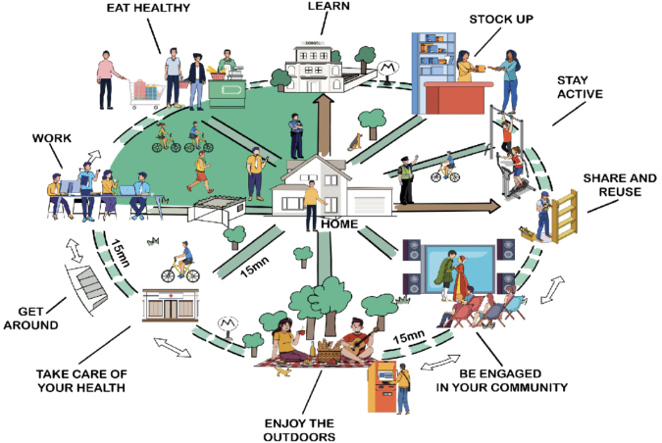
01. Foundations of Transport Equity
1.5. The "15-Minute City": A Vision for Accessibility.
A popular and influential planning concept that operationalizes accessibility.
Definition:
The "15-minute city" is a vision for urban living where residents can access most of their daily needs (work, housing, food, health, education, culture) within a 15-minute walk or bike ride.
Connection to Equity:
It prioritizes people over cars, promoting localism and reducing forced auto-dependency.
It is an inherently equitable model that aims to provide a high quality of life and access to opportunity for all residents, regardless of whether they own a car.
Transit Columbus Glossary, 2023​
Sheller, M. (2018). Mobility Justice: The Politics of Movement in an Age of Extremes. Verso.​
Image: Buro Happold
Notes:
"To conclude our foundational section, let's synthesize the core rationale for why equity is no longer a niche topic, but a central pillar of good transport planning.
First, we must recognize that transportation is a gateway to opportunity. An affordable and reliable bus route isn't just a bus route; for someone without a car, it's a lifeline to a better job, a better school for their children, or essential medical care.
Second, equity is now understood as an essential pillar of sustainability. For decades, planning focused on the environment and the economy. As this Venn diagram illustrates, we now understand that a truly sustainable system must also be equitable. A green, economically vibrant city that only works for the wealthy is not a success.
Finally, pursuing equity is both a moral and a practical imperative. It is a moral obligation because access to opportunity is a fundamental human right. And it is a practical necessity because inequitable systems lead to social exclusion, concentrated poverty, and ultimately, weaker and less resilient communities. A city that works for everyone is stronger than a city that only works for some.
With this 'why' firmly established, we will now turn our attention to diagnosing the 'what'—the real-world problems of inequity in our transport systems."

Slide 16
Section 02:
Identifying Transport Inequity: Problems & Causes
Notes:
"That concludes our section on the foundational concepts. We have defined what we mean by equity and accessibility. Now, we must turn our attention to the much more difficult reality. In this second section, we will diagnose the problem of inequity as it exists in the real world. We will explore its historical roots, its contemporary manifestations, and its profound impact on the lives of marginalized communities. We are moving from the 'ideal' to the 'real'."

Slide 17
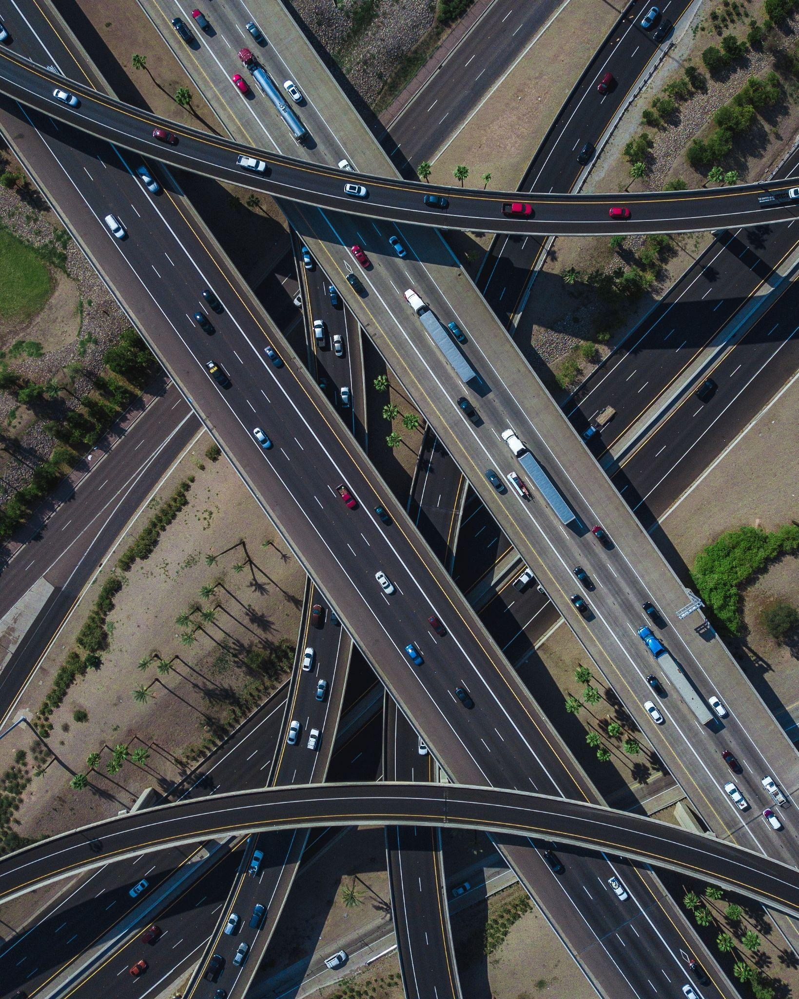
02. Identifying Transport Inequity: Problems & Causes
2.0. The Historical Roots of Inequity
Today's inequities are not accidental; they are often the result of past policy decisions.
The Legacy of Car-Oriented Infrastructure:
  Historical decisions in the mid-20th century heavily favored highway construction over public transit.
  Many of these massive infrastructure projects were routed directly through low-income and minority communities.
  This led to the physical destruction of neighborhoods, displacement of residents, and diminished local accessibility, creating long-lasting inequities that persist today.
Notes:
"To understand the problems of today, we must first look to the past. The transport inequities we see in our cities are rarely accidental; they are often the direct, predictable result of policy choices made decades ago.
The most significant of these was the decision, particularly in the post-war era, to prioritize the private automobile and the construction of massive urban highway systems. This was done at the expense of investment in public transit.
Critically, the routing of these highways was often a political choice. Time and again, these projects were built directly through the heart of the most politically powerless communities—typically low-income neighborhoods and communities of color. The consequences were devastating. Homes and businesses were demolished, communities were severed by impenetrable concrete barriers, and local accessibility was destroyed. This created deep, physical scars on our cities and generated patterns of inequity and segregation that we are still grappling with today. It is impossible to understand modern transport inequity without first acknowledging this history."

Slide 18
02. Identifying Transport Inequity: Problems & Causes
2.1. The Consequences for Marginalized Communities
The legacy of inequitable planning results in quantifiable disparities today.
Category | Impact | Data Example
Longer Commutes | Marginalized groups face 2–3x longer travel times vs. affluent residents | "Low-income Houston residents spend 45% more time commuting than high-income peers"
Job Access | Limited transit routes to major employment hubs | "60% of Detroit’s jobs are unreachable by transit within 90 minutes for low-wage workers"
Environmental Harm | Elevated exposure to air pollution and noise. | "Black communities face 1.5x higher PM2.5 levels than white communities in Los Angeles"
Transit Quality | Service disparities in underserved areas | "Southside Chicago bus routes see 30% fewer vehicles/hour than Northside routes"
Notes:
"That historical legacy, combined with ongoing underinvestment, creates very real and measurable consequences for marginalized communities today. This is not just a matter of feeling; it is a matter of data.
We see it in commute times. Studies consistently show that low-income individuals and people of color face significantly longer and more burdensome commutes than their wealthier, often white, counterparts.
We see it in access to jobs. As this staggering statistic from Detroit shows, the majority of jobs can be physically unreachable for someone who relies on public transport, creating a major barrier to economic mobility. We call this 'transport poverty.'
We see it in environmental harm. Neighborhoods located next to highways or with poor transit service often suffer from disproportionately high levels of air and noise pollution, leading to negative health outcomes. This is a core issue of environmental justice.
And we see it in the very quality of the transit service itself, with documented disparities in service frequency, vehicle quality, and shelter provision between different parts of the same city. These are the concrete problems that equity-focused planning seeks to solve."

Slide 19
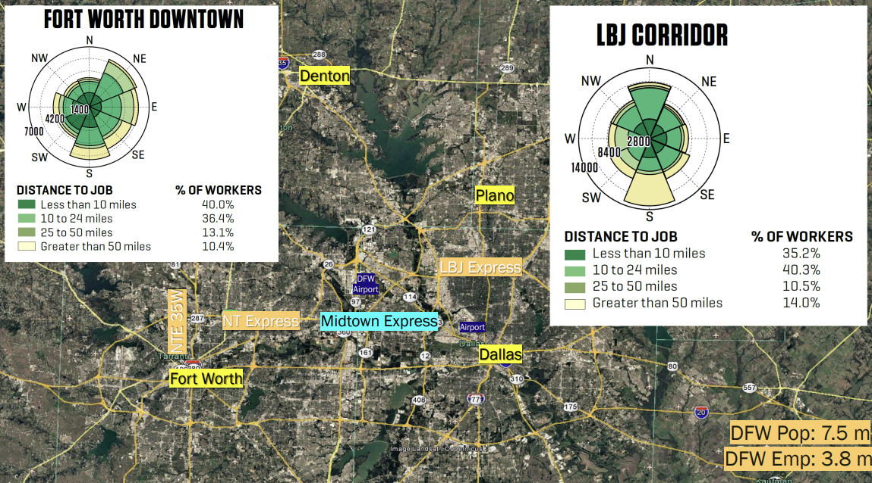
02. Identifying Transport Inequity: Problems & Causes
2.2. The Spatial Mismatch Hypothesis
A key theory for explaining the link between geography and economic inequality.
The Hypothesis:
  The "spatial mismatch" is the disconnect between where low-income and minority populations are often forced to live (due to housing segregation and affordability issues) and where new job opportunities are being created (often in car-dependent suburbs).
The Result:
  This lack of effective transit connections between people and jobs creates a major barrier to employment, contributing to economic isolation and social exclusion.
More Info:https://lehd.ces.census.gov/doc/workshop/2019/sardari.pdf?utm_source=chatgpt.com
Notes:
"There is a formal academic theory that helps explain the 'Job Access' problem we just saw. It's called the Spatial Mismatch Hypothesis, first introduced by John Kain in the 1960s.
The hypothesis is simple but powerful. It observes that, due to factors like housing segregation and a lack of affordable housing, low-income populations are often concentrated in inner-city neighborhoods. At the same time, many new jobs are being created in sprawling, car-dependent suburbs.
The 'mismatch' is the lack of effective public transportation connecting the people who need jobs to the places where those jobs are. This geographic disconnect creates a massive barrier to employment. As this map of the Dallas-Fort Worth area illustrates, the major job centers are often located far from the residential areas where a large percentage of the population lives, and the transit options are insufficient to bridge that gap. This is a fundamental, structural cause of transport-related economic inequality."

Slide 20
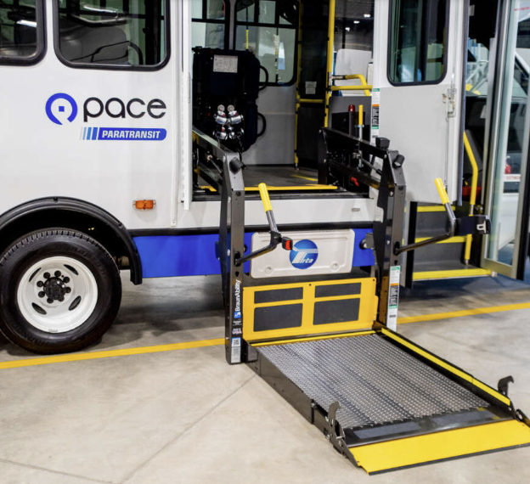
02. Identifying Transport Inequity: Problems & Causes
2.3. Barriers for Disabled Users
Many transport systems are designed for an "average" user, failing to accommodate people with physical or cognitive disabilities.
Common Barriers:
Infrastructure Challenges: Lack of ramps, non-operational elevators in stations, inaccessible sidewalks, and poorly designed bus stops.
Vehicle Design: Lack of space for wheelchairs, inadequate audio/visual announcements for passengers with sensory impairments.
Insufficient Service: A lack of reliable and convenient paratransit services for those who cannot use fixed-route transit.
https://www.rtachicago.org/riders/accessible-transit?utm_source=chatgpt.com
https://www.mta.info/elevator-escalator-status?utm_source=chatgpt.com
The Goal: Universal Design - designing environments to be usable by all people, to the greatest extent possible, without the need for adaptation.
Notes:
"Beyond economic and racial dimensions, a critical aspect of transport equity is disability. Far too often, our transport systems are designed with a hypothetical 'average' user in mind, which creates significant barriers for the millions of people with physical or cognitive disabilities.
These barriers are everywhere. They are in the infrastructure: stations with broken elevators, bus stops without accessible curb ramps, or sidewalks that are impossible to navigate in a wheelchair. They are in the vehicles themselves: buses without enough space for mobility devices, or trains that lack the clear audio and visual announcements needed by people with vision or hearing impairments. And they are in the service design, with paratransit services that are often unreliable or require users to book trips far in advance.
The guiding principle to address this is Universal Design. This is the philosophy that we should design our systems from the outset to be usable by everyone, rather than trying to add on special accommodations as an afterthought. An elevator that is essential for a wheelchair user is also a benefit to a parent with a stroller or a traveler with heavy luggage. This is a cornerstone of inclusive planning."

Slide 21
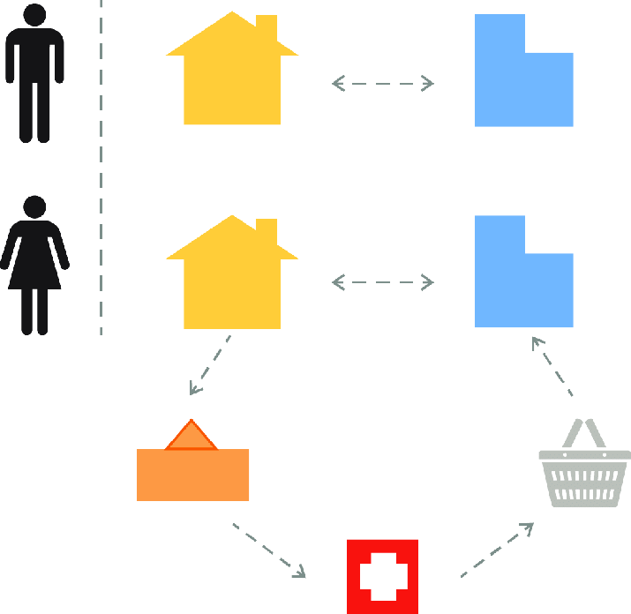
02. Identifying Transport Inequity: Problems & Causes
2.4. Gender Equity in Transport
Traditional planning has often been "gender-blind," ignoring the different travel patterns and safety needs of women.
Key Differences in Travel:
  Trip Chaining: Women, who still perform a disproportionate share of caregiving duties, often make more complex, multi-stop trips (e.g., home -> daycare -> work -> grocery -> home).
  Off-Peak Travel: Women are more likely to travel outside of traditional peak commute hours.
The Critical Issue: Safety & Security:
  Safety concerns, particularly after dark, heavily influence women's travel choices. Up to 50% of female transit users report feeling unsafe at stations or stops.
Trip Chaining as a Gendered Mode of Travel
https://www.researchgate.net/figure/Trip-Chaining-as-a-Gendered-Mode-of-Travel_fig2_322330719
Notes:
"Another crucial dimension of equity is gender. For a long time, transport planning was implicitly designed by men, for men, focusing almost exclusively on the simple, twice-a-day commute from a suburban home to a downtown office. This 'gender-blind' approach has failed to serve the distinct travel needs of women.
Data consistently shows key differences. One is 'trip chaining.' Because women still handle a disproportionate share of household and caregiving responsibilities, their travel patterns are often more complex than a simple A-to-B commute. A typical trip might involve chaining together multiple stops, as this diagram illustrates. A transit system designed only for simple commutes can make these essential trips very difficult.
Women are also more likely to travel during off-peak hours, when service is often less frequent and stations are more deserted. This connects to the most critical issue: safety and security. Surveys reveal that a staggering number of women feel unsafe on public transport, especially after dark. This fear is a massive barrier to mobility. Gender-sensitive planning, therefore, must consider things like better lighting at stations, increased staff presence, and on-demand services for late-night travel."

Slide 22

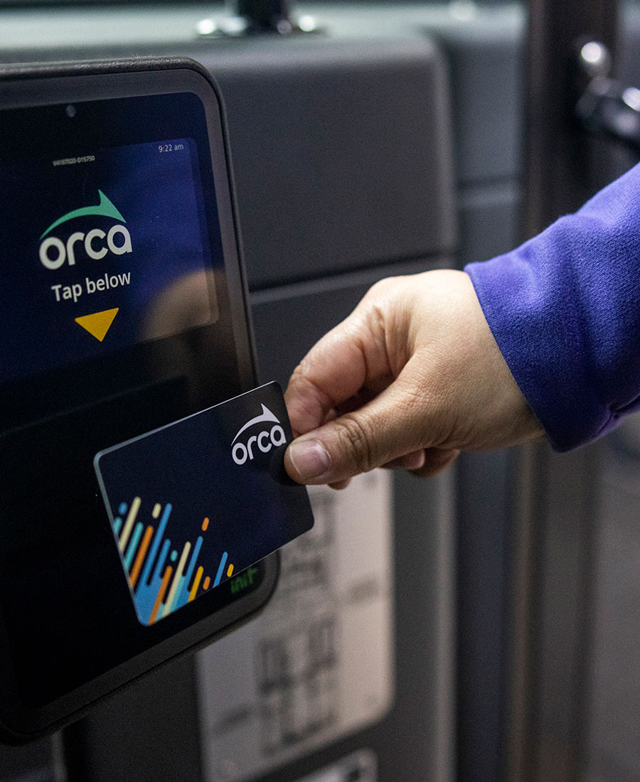
02. Identifying Transport Inequity: Problems & Causes
2.5. Affordability in Transit
High transport costs are a major burden for low-income households, consuming a large share of their income.
Policy Solutions to Improve Affordability:
  Subsidized Fare Programs: Offering reduced or free fares for specific groups (e.g., seniors, students, low-income individuals).
  Fare Capping: A system where users automatically stop paying for rides after they have spent a certain amount in a day or a week, effectively giving them a weekly or monthly pass without the upfront cost.
Case Study: Seattle's ORCA LIFT Program
  Caps fares at $1.00 per ride for qualifying low-income riders.
  Studies show it saves riders up to $900 annually and doubles their transit use.
Notes:
"Finally, let's address the fundamental issue of affordability. For many low-income households, the cost of transportation can be a crushing burden, consuming a significant portion of their monthly budget and forcing them to make difficult choices between getting to work and buying groceries. Making transit affordable is therefore a foundational element of equity.
There are two main policy approaches to achieve this. The most traditional is subsidized fare programs, where specific groups, like seniors or low-income residents who apply for a program, are eligible for reduced fares.
A more modern and often more equitable approach is fare capping. This is a system where a rider using a smart card, like the ORCA card in Seattle, automatically stops paying once they've hit the equivalent price of a daily or weekly pass. This provides the benefit of a pass without requiring the user to have a large amount of cash upfront at the beginning of the month.
The ORCA LIFT program in Seattle is a perfect case study. It combines these ideas, offering income-qualified riders a fare of just one dollar. The results are clear: it provides significant financial relief and makes it possible for people to travel more frequently to access the opportunities they need. This is a prime example of vertical equity in action."

Slide 23
Section 03:
Frameworks for Equity Analysis
Notes:
"That concludes our diagnosis of the many facets of transport inequity. We have seen the historical roots and the contemporary impacts on a wide range of communities.
We now pivot to Section 3. In this section, we will briefly step back from the specific problems and introduce some of the key ethical and philosophical frameworks that planners and academics use to analyze these issues. These theories provide us with structured 'lenses' to evaluate what 'fair' means in different contexts and to build a principled argument for the policy solutions we will discuss later. This is the theoretical foundation for our practice."

Slide 24
03. Frameworks for Equity Analysis
3.0. Ethical Theories as Policy Lenses
Different ethical theories provide different "lenses" for what constitutes a fair transport policy.
Ethical Theory | Core Principle | Transport Policy Implication
Utilitarianism | Maximize overall societal benefits and efficiency. | Prioritizes projects with the greatest total benefit (e.g., total time saved), even if benefits are unevenly distributed.
Rawlsian Egalitarianism | Ensure fairness by improving conditions for the least advantaged. | Supports policies that prioritize access for disadvantaged groups (e.g., subsidized fares, service in low-income areas).
Capability Approach | Focus on individuals' actual opportunities and ability to achieve. | Encourages policies that enhance people's real access to essential services (jobs, healthcare, education).
Libertarianism | Emphasize individual freedoms and market-driven solutions. | Advocates for minimal government intervention, favoring private-sector or user-funded services.
Notes:
"When we say a policy should be 'fair' or 'equitable,' what is the philosophical basis for that claim? Different ethical theories give us different ways to answer that question, and they have profoundly different implications for transport policy.
A Utilitarian approach, for example, is focused on maximizing the overall good. It would support the project that produces the greatest total benefit for the whole city, often measured in things like total travel time saved.
A Rawlsian approach, based on the philosopher John Rawls, argues that a just policy is one that most benefits the least well-off in society. This lens would prioritize projects that serve disadvantaged communities, even if the 'total' city-wide benefit is smaller.
The Capability Approach, developed by Amartya Sen, shifts the focus from resources to real opportunities. It asks: does a new transport service actually enable people to get a better job or access healthcare? It's a very outcome-oriented framework.
Finally, a Libertarian perspective would emphasize individual freedom and minimal government interference, advocating for market-based solutions where users pay for the services they consume.
As you can see, there is no single, universally agreed-upon definition of 'fair.' These theories provide the lenses through which planners and politicians debate and justify their choices."

Slide 25
03. Frameworks for Equity Analysis
3.1. The Debate: Overall Benefit vs. Individual Needs
The central debate in transport equity often pits a Utilitarian focus on aggregate benefits against an equity-focused concern for specific needs.
The Utilitarian Approach:
  Advocates for projects that produce the greatest overall benefits for the city (e.g., reducing total travel time).
  The Risk: This approach can overlook the needs of minority or disadvantaged groups and can even cause them harm.
Illustrative Example:
  A new highway project might reduce total travel times across a city (a large aggregate benefit), but achieve this by bypassing, displacing, or increasing pollution in a low-income neighborhood that needs better service, not another highway.
Notes:
"Let's make this theoretical debate more concrete by focusing on the most common conflict in transport planning: the tension between a Utilitarian goal of maximizing overall efficiency and an equity-focused goal of serving specific needs.
The Utilitarian perspective, which has historically dominated transport planning, argues that we should choose the projects that deliver the biggest 'bang for the buck' for the city as a whole. This is often calculated using a cost-benefit analysis that adds up all the travel time saved for all users.
The major risk of this approach is that it can be blind to how those benefits and costs are distributed. A project can have a hugely positive net benefit for the city, while still making life significantly worse for a small, vulnerable community.
The example of a new highway is classic. It might save thousands of commuters a few minutes each, adding up to a massive 'total time saved.' However, if that highway is built through a low-income community, displacing residents and increasing local air pollution, an equity lens would argue that the project is unjust, regardless of its aggregate benefits. This fundamental conflict is at the heart of many of the most contentious debates in transportation planning."

Slide 26
03. Frameworks for Equity Analysis
3.2. Rawlsianism: Prioritizing the Least Advantaged
This theory, based on philosopher John Rawls, provides a powerful framework for prioritizing fairness.
The "Difference Principle":
  Inequalities are only justified if they provide the greatest possible benefit to the least advantaged members of society.
Application in Transport:
  This theory supports policies that explicitly prioritize the needs of vulnerable groups.
  It argues for both Horizontal Equity (equal treatment) and Vertical Equity (additional support for those in need).
  Example: Subsidized transit fares for low-income riders are a perfect example of the "difference principle" in action, as they improve access and opportunity for the worst-off.
Notes:
"As an alternative to pure utilitarianism, the philosophy of John Rawls has become extremely influential in modern equity planning. He provides a powerful framework for explicitly prioritizing fairness.
The core of his argument is the 'Difference Principle.' Rawls argues that a society can have inequalities, but they are only morally justified if those inequalities are structured in a way that provides the greatest possible benefit to the people who are the most disadvantaged.
When we apply this to transportation, the implication is clear: we should judge our transport policies and investments based on their impact on the most vulnerable members of our community. This framework gives us a strong ethical justification for policies of both horizontal and vertical equity—providing a good baseline of service for everyone, but offering additional, targeted support for those who need it most. A subsidized fare program is a perfect example. It is an unequal policy—some people pay less than others—but it is justified under the difference principle because it channels benefits directly to the least advantaged, improving their access to opportunity."

Slide 27
03. Frameworks for Equity Analysis
3.3. Rawlsianism: Prioritizing the Least Advantaged
Identify least advantaged groups
Apply Difference Principle
Design targeted interventions
Engage communities & conduct impact assessments
Iterate and refine policies
Validate improvements for least advantaged
Monitor accessibility & ridership metrics
Notes:
"As an alternative to pure utilitarianism, the philosophy of John Rawls has become extremely influential in modern equity planning. He provides a powerful framework for explicitly prioritizing fairness.
The core of his argument is the 'Difference Principle.' Rawls argues that a society can have inequalities, but they are only morally justified if those inequalities are structured in a way that provides the greatest possible benefit to the people who are the most disadvantaged.
When we apply this to transportation, the implication is clear: we should judge our transport policies and investments based on their impact on the most vulnerable members of our community. This framework gives us a strong ethical justification for policies of both horizontal and vertical equity—providing a good baseline of service for everyone, but offering additional, targeted support for those who need it most. A subsidized fare program is a perfect example. It is an unequal policy—some people pay less than others—but it is justified under the difference principle because it channels benefits directly to the least advantaged, improving their access to opportunity."

Slide 28
03. Frameworks for Equity Analysis
3.4. The Capability Approach: Focusing on True Opportunity
This approach, championed by Amartya Sen, shifts the focus from resources to real-world outcomes.
The Core Idea:
  What matters is not just providing a transport service (a resource), but whether individuals can use that service to achieve what they value (a capability).
Application in Transport:
  This means focusing on and measuring accessibility.
  It provides a practical framework for evaluating projects by asking: Does this project enhance people's ability to reach jobs, healthcare, and education within a reasonable time?
Notes:
"A final key theory that is very influential today is the Capability Approach, most famously associated with the economist and philosopher Amartya Sen. This approach provides a subtle but incredibly important shift in focus.
The core idea is that we shouldn't just focus on the resources we provide, but on what people can actually do or be with those resources. In transport terms, the goal is not simply to provide a bus service. The goal is to provide a bus service that someone can actually use to get a good job. The bus is the means; the access to the job is the 'capability' or the true opportunity.
When we apply this to transport, it leads us directly back to our concept of accessibility. The Capability Approach gives us a powerful philosophical grounding for why we should focus on measuring accessibility. It provides a practical framework for evaluating projects. We don't just ask, 'Did we build the rail line?' We ask, 'Did the rail line actually improve the ability of residents in this neighborhood to access education and healthcare?' It forces us to be relentlessly focused on real-world outcomes for people."

Slide 29
03. Frameworks for Equity Analysis
3.5. The Capability Approach: Focusing on True Opportunity
YES
End: Enhanced Quality of Life
Evaluate Improvements in Capabilities
Start: Assess Transport Accessibility
Implement Interventions and Monitor Outcomes
Is Accessibility Adequate?
NO
Identify Gaps in Access to Essential Services
Design Targeted Interventions
Notes:
"A final key theory that is very influential today is the Capability Approach, most famously associated with the economist and philosopher Amartya Sen. This approach provides a subtle but incredibly important shift in focus.
The core idea is that we shouldn't just focus on the resources we provide, but on what people can actually do or be with those resources. In transport terms, the goal is not simply to provide a bus service. The goal is to provide a bus service that someone can actually use to get a good job. The bus is the means; the access to the job is the 'capability' or the true opportunity.
When we apply this to transport, it leads us directly back to our concept of accessibility. The Capability Approach gives us a powerful philosophical grounding for why we should focus on measuring accessibility. It provides a practical framework for evaluating projects. We don't just ask, 'Did we build the rail line?' We ask, 'Did the rail line actually improve the ability of residents in this neighborhood to access education and healthcare?' It forces us to be relentlessly focused on real-world outcomes for people."

Slide 30
Section 04:
Policy & Practice: Building Equitable Systems
Notes:
"That concludes our brief but important tour of the theoretical frameworks that underpin transport equity. These theories provide us with the 'why' and the 'how' to think about the problem.
We now pivot, in Section 4, to the crucial topic of Policy and Practice. How do we translate these abstract ideas into concrete actions? This section will focus on the real-world tools, planning processes, and specific interventions that are used to build more equitable transportation systems. We are now moving from theory to action."

Slide 31
04. Policy & Practice: Building Equitable Systems
4.0. Translating Theory into Actionable Dimensions
To apply these theories, planners evaluate equity across four key dimensions:
  Distributional Equity:
    Question: How are the benefits (e.g., access) and burdens (e.g., pollution) of the transport system distributed among different groups?
  Procedural Equity:
    Question: How inclusive and fair is the planning and decision-making process itself? Are all community voices heard?
  Recognitional Equity:
    Question: Are the unique needs and historical disadvantages of different groups (e.g., women, disabled users) acknowledged in the planning process?
  Evaluative Equity:
    Question: How do we measure and track our progress toward equity goals over time?
Notes:
"So how do we bridge the gap between a grand theory like Rawlsianism and a practical decision about a bus route? We do it by translating those theories into a set of actionable dimensions of equity that we can actually analyze. We can think of these as the four key questions we must ask of any new project or policy.
First, Distributional Equity: Who wins and who loses? This is where we analyze how the benefits and burdens are spread across different income groups, racial groups, and geographic areas.
Second, Procedural Equity: Who gets a say in the decision? This focuses on the fairness of the planning process itself. Did we genuinely engage with the communities that will be affected, or did we just hold a token public meeting?
Third, Recognitional Equity: Do we acknowledge the different needs of different people? This is where we address the specific challenges faced by, for example, women, the elderly, or people with disabilities, ensuring our plans are sensitive to their unique contexts.
And finally, Evaluative Equity: How do we keep score? This asks what metrics we are using to measure our success and how we will hold ourselves accountable for our equity goals.
The policy tools we are about to discuss are all designed to answer one or more of these critical questions."

Slide 32
04. Policy & Practice: Building Equitable Systems
4.1. The Policy Cycle: Embedding Equity from the Start
To be effective, equity must be a core objective during all phases of policy development, not an afterthought.
An Integrated Equity Policy Cycle:
  Key Idea: Equity checks, and community engagement must be embedded at every single step.
Feedback loop
End: Enhanced Quality of Life
Monitor & Evaluate
Equity Check: Audit outcomes
Example: NYC MTA dashboard
Problem Identification
Equity Check: Engage marginalized communities
Example: Portland's community-led transit surveys
Implementation
Equity Check: Targeted allocation
Example: LA Metro subsidies
Embed equity at every phase → prevent retroactive fixes
Research & Data
Equity Check: Use equity indicators
Example: Boston's journey-based analysis
Impact Assessment
Equity Check: Distributional analysis
Example: Minneapolis Framework
Policy Design
Equity Check: Apply Difference Principle
Example: Chicago's SAMS
Key Equity Tools:
→ Distributional analysis
→ Equity impact assessments
→ Participatory budgeting
Notes:
"This diagram illustrates a crucial concept for modern public administration: to be effective, equity must be woven into the entire policy-making process, from the very beginning. It cannot be something you just check for at the end.
This is an example of an Integrated Equity Policy Cycle. As you can see, it starts with Problem Identification, where we might use community surveys to understand the needs of marginalized groups. It moves through Research and Data, where we use equity indicators to guide our analysis. During Policy Design, we might apply a Rawlsian principle to develop targeted solutions. At the Impact Assessment stage, we conduct a distributional analysis to see who benefits and who is burdened. We then move to Implementation and, finally, to Monitoring and Evaluation, where we use public dashboards to track our outcomes.
The key takeaway from this visual is the continuous feedback loop. At every single stage, we are checking for equity impacts and engaging with the community. This holistic approach is far more effective than simply hoping an efficiency-focused project will also turn out to be equitable."

Slide 33
04. Policy & Practice: Building Equitable Systems
4.2. Policy Tool: Distributional Impact Assessments
A core method for evaluating Distributional Equity.
The Core Question: Who gains and who loses from a proposed transport project or policy?
The Process:
  Rigorous assessments evaluate the impacts of projects across different social groups (defined by income, race, age, disability status, etc.).
  Data-driven methods like GIS mapping of service access, travel time analysis, and community impact studies are used.
  Helps ensure that investments are fair and effective, and do not unintentionally harm vulnerable communities.
Notes:
"Let's now zoom in on some of the key tools that planners use within that policy cycle, starting with one of the most important: Distributional Impact Assessments. This is the primary tool we use to answer that first question of 'Who gains and who loses?'
The process involves a rigorous, data-driven analysis of how the positive and negative impacts of a proposed project are distributed across different segments of the population. For example, before building a new light rail line, the agency would conduct an assessment to analyze who would benefit from improved access to jobs, and who might be negatively impacted by construction noise or potential displacement.
These are not back-of-the-envelope calculations. They involve sophisticated methods, like GIS mapping, to see which communities gain the most access, and formal community impact studies, which are often required by law for major projects. The ultimate goal of these assessments is to make the consequences of our decisions transparent and to provide the information needed to ensure that investments are both fair and effective."

Slide 34
04. Policy & Practice: Building Equitable Systems
4.3. Policy Tool: Distributional Impact Assessments
4. Map Impacts
GIS analysis of service gaps/displacement risks
Example: Atlanta's transit desert mapping
5. Community Feedback
Surveys, town halls, focus groups
Example: Detroit's community benefits agreements
6. Model Outcomes
Predict accessibility gains/losses by group
Example: Chicago's SAMS equity analysis
2. Collect Demographic Data
Race, income, age, disability status
Example: Seattle's Equity Scorecard
3. Title VI Evaluation
Check for racial/ethnic discrimination
Example: USDOT compliance review
7. Adjust Policy
Redirect investments to prioritize equity
Example: NYC IBX low-income priority zones
Outcome: Transparent process to ensure
investments reduce, not worsen,
inequities
1. Define Scope
Identify project, stakeholders, and equity goals
Example: LA Metro's fare equity study
Key Tools:
→ Equity impact assessments
→ Distributional analysis
→ GIS mapping
→ Participatory budgeting
8. Monitor & Report
Track metrics via equity dashboard
Example: SFMTA's public dashboard
Feedback loop
Notes:
"Let's now zoom in on some of the key tools that planners use within that policy cycle, starting with one of the most important: Distributional Impact Assessments. This is the primary tool we use to answer that first question of 'Who gains and who loses?'
The process involves a rigorous, data-driven analysis of how the positive and negative impacts of a proposed project are distributed across different segments of the population. For example, before building a new light rail line, the agency would conduct an assessment to analyze who would benefit from improved access to jobs, and who might be negatively impacted by construction noise or potential displacement.
These are not back-of-the-envelope calculations. They involve sophisticated methods, like GIS mapping, to see which communities gain the most access, and formal community impact studies, which are often required by law for major projects. The ultimate goal of these assessments is to make the consequences of our decisions transparent and to provide the information needed to ensure that investments are both fair and effective."

Slide 35
04. Policy & Practice: Building Equitable Systems
4.4. Policy Tool: Inclusive & Participatory Planning
A core method for achieving Procedural Equity.
The Core Principle: The people who are most affected by planning decisions should have a genuine opportunity to influence those decisions.
The Process:
  Goes beyond traditional public meetings.
  Involves proactive community outreach, hosting workshops, conducting surveys, and using multilingual communication to engage traditionally underserved groups.
The Outcome:
  Early and continuous engagement ensures that the voices of all community members are heard, leading to more sustainable, acceptable, and truly equitable transit solutions.
Notes:
"The next critical tool addresses procedural equity: Inclusive and Participatory Planning. The core principle here is simple but radical: the community members who will be most impacted by a transportation project are experts in their own lives and should be treated as genuine partners in the planning process.
This goes far beyond the legal minimum of hosting a single public meeting. True participatory planning involves a proactive and sustained effort to engage the community, especially those who have been historically left out of the conversation. This means hosting workshops in the affected neighborhoods, at times that working people can attend. It means conducting multilingual outreach and providing accessible materials. It means going to where the people are, rather than expecting them to come to you.
The outcome of this deep engagement is not just a plan that has 'public buy-in.' It is a fundamentally better plan. By incorporating the lived experience of the community, we can design solutions that are more effective, more sustainable, and truly responsive to the needs of the people they are meant to serve."

Slide 36
04. Policy & Practice: Building Equitable Systems
4.5. Policy Tool: Inclusive & Participatory Planning
Analyze Feedback
Unsupported markdown:
list
Integrate Input
Unsupported markdown:
list
Community Meetings
Unsupported markdown:
list
Outreach Campaign
Unsupported markdown:
list
Surveys & Feedback
Unsupported markdown:
list
Monitor & Report
Unsupported markdown:
list
Key Tools:
→ Multilingual surveys
→ Digital platforms (e.g., MetroQuest)
→ Equity-focused focus groups
Plan Engagement
Unsupported markdown:
list
Feedback loop
Outcome: Sustainable solutions + community trust
Notes:
"The next critical tool addresses procedural equity: Inclusive and Participatory Planning. The core principle here is simple but radical: the community members who will be most impacted by a transportation project are experts in their own lives and should be treated as genuine partners in the planning process.
This goes far beyond the legal minimum of hosting a single public meeting. True participatory planning involves a proactive and sustained effort to engage the community, especially those who have been historically left out of the conversation. This means hosting workshops in the affected neighborhoods, at times that working people can attend. It means conducting multilingual outreach and providing accessible materials. It means going to where the people are, rather than expecting them to come to you.
The outcome of this deep engagement is not just a plan that has 'public buy-in.' It is a fundamentally better plan. By incorporating the lived experience of the community, we can design solutions that are more effective, more sustainable, and truly responsive to the needs of the people they are meant to serve."

Slide 37
04. Policy & Practice: Building Equitable Systems
4.6. From Theory to Practice: Designing Interventions
Different ethical theories provide different "lenses" for what constitutes a fair transport policy.
Policy Type | Target Group | Example | Intended Impact
Increase Service Frequency | Low-income workers, hourly employees | Los Angeles Metro's Equity Focus Communities | 30% reduction in wait times
Subsidized Last-Mile Services | Rural/suburban residents, seniors | Denver RTD's 'Access-a-Ride' microtransit | 45% increase in transit connectivity
Free/Reduced Fare Programs | Students, low-income families | Portland's YouthPass (free transit for students) | 58% ridership increase among beneficiaries
Accessibility Upgrades | Disabled riders, elderly | NYC MTA's elevator initiative | 80% improved station accessibility by 2030
Notes:
"So, how does this all come together in practice? Equitable planning is about using the theoretical frameworks we've discussed to design targeted interventions that address the specific, recognized needs of different groups. This table provides a few powerful, real-world examples.
To address the needs of low-income, hourly workers who cannot afford to waste time waiting, a city like Los Angeles might increase bus frequency specifically in its designated Equity Focus Communities, directly impacting wait times.
To address the needs of seniors or residents in lower-density areas, an agency like Denver's might provide subsidized 'last-mile' services, like a microtransit shuttle, to connect them to the main transit network.
To address affordability for young people, a city like Portland can offer free transit passes for all students, which has been shown to dramatically increase their ridership and access to opportunities.
And to address the needs of disabled riders, an agency like New York's MTA can launch a major capital program to install more elevators, with the clear, measurable goal of making the majority of its stations accessible.
Each of these is a concrete example of moving from the abstract theory of equity to a targeted, measurable, and impactful policy intervention."

Slide 38
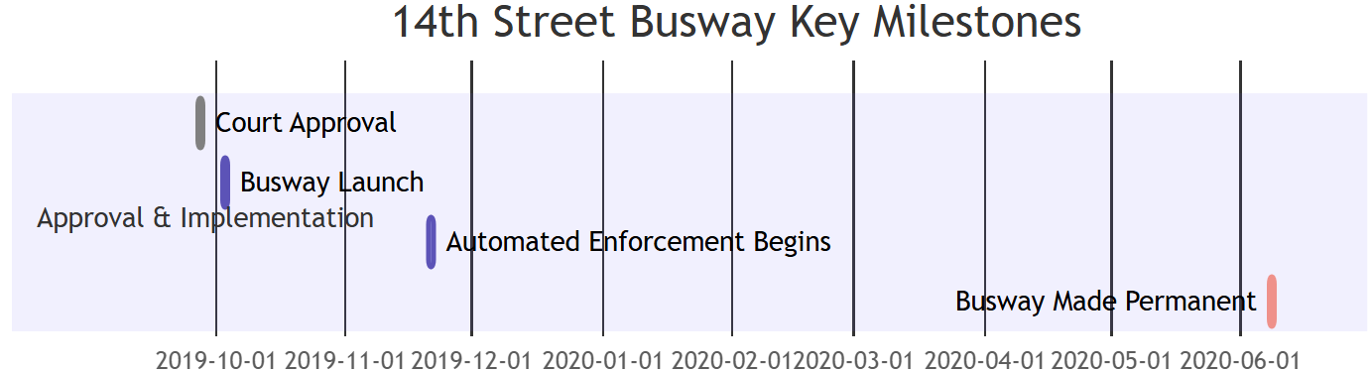
04. Policy & Practice: Building Equitable Systems
4.7. Case Study: The NYC 14th Street Busway
An example of a targeted policy delivering measurable equity improvements.
The Project:
  New York City reallocated road space from cars on the heavily congested 14th Street, creating a bus-only transitway.
The Impact:
  Reduced Travel Times: Bus travel times on the corridor decreased by 15-25%.
  Higher Ridership: The improved speed and reliability attracted more passengers.
  Equitable Benefits: This initiative primarily benefited the diverse, lower-and-middle-income communities who were the majority users of the bus route, saving them valuable time.
Notes:
"Let's look at one more powerful case study of a specific policy intervention: the 14th Street Busway in New York City.
For years, the bus on this corridor was one of the slowest in the entire city, bogged down in traffic. The project was simple but bold: the city banned most private car traffic from the street, effectively turning it into a transit-and-delivery-only corridor.
The impacts were immediate and dramatic. With cars out of the way, bus travel times fell by up to 25%. This improved reliability led to an increase in ridership.
Most importantly, from an equity perspective, the benefits of this project flowed directly to the people who needed them most. The ridership of this bus route is predominantly made up of lower-to-middle-income residents. For them, a time saving of 10 minutes each way is not a minor convenience; it's a significant improvement in their quality of life. This is a perfect example of how a targeted infrastructure project, focused on prioritizing transit, can deliver clear and measurable equity benefits."

Slide 39
04. Policy & Practice: Building Equitable Systems
4.8. A Holistic Approach: The "15-Minute Neighborhood"
The most effective solutions integrate transport planning with land use planning.
A Holistic Planning Approach:
  Integrate transit networks with safe, continuous infrastructure for walking and cycling.
  Coordinate transport planning with land use policy to create dense, mixed-use, and connected communities.
The Goal: The "15-Minute Neighborhood"
  By ensuring daily needs are within a short distance, this approach reduces forced car dependency and creates a more accessible and equitable urban form.
Notes:
"While targeted interventions are crucial, the most profound and lasting solutions are holistic. This means breaking down the silos between transport planning and land use planning.
A truly equitable system is not just about running more buses; it's about building a city where people don't have to travel long distances for their basic needs in the first place. This requires an integrated approach. It means building complete, multimodal networks where bus routes connect seamlessly with safe sidewalks and protected bike lanes.
And it means coordinating this transport planning with land use policy to encourage the development of denser, mixed-use communities where homes, jobs, shops, and schools are located close together.
This brings us back to the concept we introduced at the beginning: the 15-Minute Neighborhood. This is the ultimate goal of a holistic, equity-focused approach. By co-locating daily needs and connecting them with high-quality active and public transportation, we can create a more accessible urban form for everyone and reduce the forced reliance on private cars that is a primary driver of inequity."

Slide 40
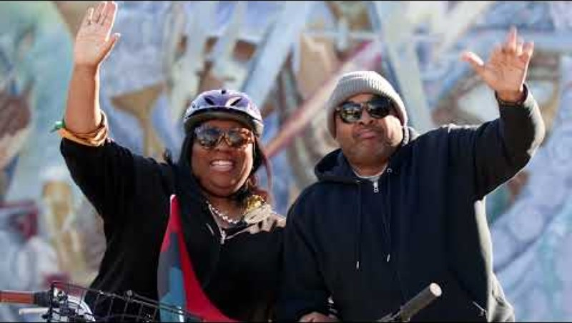
04. Core Application: Network & Service Optimization
4.9 Video Discussion: What is Mobility Justice?
Notes:
"To begin to synthesize the many ideas we've covered today, we're going to watch one final short video that introduces a very important and contemporary term: Mobility Justice.
This concept, which has been championed by community advocates and scholars, provides a powerful framework that ties together many of our themes. As you watch, I want you to listen for how the speakers in the video connect their definition of mobility justice to the concepts we've discussed today—to accessibility, to the historical legacy of infrastructure decisions, and to the importance of community participation. This will help us transition to our final summary and conclusion."

Slide 41
Section 05:
Measurement, Synthesis & Conclusion
Notes:
To conclude the lecture, we will briefly discuss how we can measure our progress toward a more equitable system. We will then have a final activity to recap our core concepts and end with some concluding reflections."

Slide 42
05. Measurement, Synthesis & Conclusion
5.0. Measuring What Matters: Mobility vs. Accessibility Metrics
If we want to achieve equity, we must measure what matters.
Traditional Mobility Metrics (Limited View):
  Examples: Vehicle throughput, congestion delay, average traffic speed.
  Focus: The movement of vehicles.
Modern Accessibility Metrics (Holistic View):
  Examples: Opportunity Reach (number of jobs/services reachable in 30 mins), Equity-Income Access Gaps.
  Focus: The ability of people to reach opportunities.
A focus on accessibility metrics is essential for centering equity in transport planning.
Notes:
"There is a common saying in policy: 'What gets measured, gets managed.' If we want to manage our transportation system for equity, we must stop relying solely on outdated, car-oriented metrics.
For decades, the primary way we measured the success of our transport system was through Mobility Metrics. We looked at things like vehicle throughput and traffic speed. These metrics tell us a lot about the efficiency of moving cars, but they tell us almost nothing about whether people can actually get to where they need to go.
That's why modern, equity-focused planning has shifted to using Accessibility Metrics. These metrics are fundamentally different. They don't measure movement; they measure opportunity. A classic accessibility metric is 'Opportunity Reach'—the number of jobs, schools, or hospitals a person can get to from their home within a 30-minute transit ride. By using these kinds of metrics, we can start to see the city from the perspective of a resident, not just from the perspective of a car. This shift in measurement is absolutely fundamental to achieving a more equitable system."

Slide 43
05. Measurement, Synthesis & Conclusion
5.1. Measuring What Matters: Mobility vs. Accessibility Metrics
Accessibility Metrics
Opportunity Reach: Jobs in 30 mins
Essential Services: Clinics, schools
Equity: Low-income access gaps
Strength: Measures outcomes, not just movement
Accessibility Focus
Mobility Metrics
Throughput: Vehicles per hour
Congestion: Delay hours
Speed: Avg. traffic mph
Limitation: Measures movement, not access
Mobility Focus
Sources: World Bank Accessibility Indicators, Brookings Institution, Litman (2023)
Notes:
"There is a common saying in policy: 'What gets measured, gets managed.' If we want to manage our transportation system for equity, we must stop relying solely on outdated, car-oriented metrics.
For decades, the primary way we measured the success of our transport system was through Mobility Metrics. We looked at things like vehicle throughput and traffic speed. These metrics tell us a lot about the efficiency of moving cars, but they tell us almost nothing about whether people can actually get to where they need to go.
That's why modern, equity-focused planning has shifted to using Accessibility Metrics. These metrics are fundamentally different. They don't measure movement; they measure opportunity. A classic accessibility metric is 'Opportunity Reach'—the number of jobs, schools, or hospitals a person can get to from their home within a 30-minute transit ride. By using these kinds of metrics, we can start to see the city from the perspective of a resident, not just from the perspective of a car. This shift in measurement is absolutely fundamental to achieving a more equitable system."

Slide 44
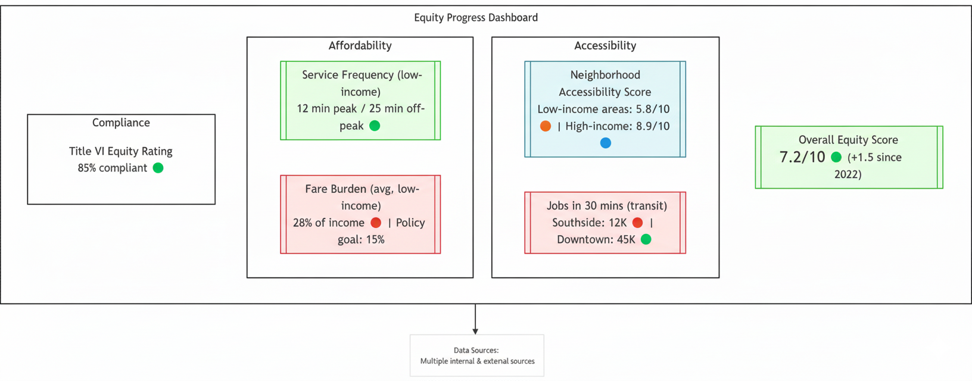
05. Measurement, Synthesis & Conclusion
5.2. Monitoring, Metrics, and Accountability
Data Sources:
Multiple internal and external sources
Notes:
"Measuring accessibility is the first step. The next step is to use those measurements to create accountability. If an agency says that equity is a priority, it must be able to prove it with data.
This is done by establishing clear Equity Performance Metrics. Instead of only measuring on-time performance, an agency might also measure the average wait time in low-income neighborhoods versus high-income neighborhoods, with a clear goal to reduce that gap over time.
The key to making this work is transparency. Many agencies are now creating public-facing equity dashboards, like the example shown here. This allows researchers, advocates, and the public to see exactly how the agency is performing on key equity dimensions like affordability and accessibility. This kind of data-driven transparency is a powerful tool for holding our public institutions accountable and ensuring that they are making continuous progress toward a more equitable system."

Slide 45
05. Measurement, Synthesis & Conclusion
5.3. Final Class Activity
Let's Synthesize Our Core Concepts (In Groups):
  Define social equity in transport. Distinguish between horizontal and vertical equity.
  Explain Rawls's "difference principle" and how it could justify a policy like subsidized transit fares.
  Contrast mobility and accessibility in transport planning. Why is the distinction important for equity?
Notes:
"Alright, for our final activity, I want you to form small groups. This will be a quick, five-minute discussion to help you synthesize the core concepts of the entire lecture.
There are three prompts here. First, I want you to work together to come up with a clear definition of social equity and explain the difference between the horizontal and vertical lenses.
Second, I want you to recall our discussion of philosophy and explain how Rawls's 'difference principle' provides an ethical justification for a policy like subsidized fares.
And third, I want you to contrast mobility and accessibility and explain why that distinction is so fundamental to this entire topic.
Take about five minutes to discuss these in your groups, and be prepared to link your answers back to the frameworks we've covered today."
(Facilitate the activity, allowing groups to discuss and then calling on a few to share their answers. This serves as a powerful, student-led review of the lecture's main pillars.)

Slide 46

05. Measurement, Synthesis & Conclusion
5.4. Recapitulation of Core Concepts
Key Takeaways:
  Social equity in transport is critical not just for fairness, but for overall community well-being, economic opportunity, and social inclusion.
  Focusing on accessibility (connecting people to opportunities) rather than just mobility is essential for achieving equitable outcomes.
  The integration of ethical theory and data-driven practice leads to sustainable and just transport solutions.
Equitable Transit Delivers Tangible Benefits:
  Health & Safety: Reduces traffic fatalities and encourages active travel.
  Economic Opportunity: Connects residents to jobs and lowers household transport costs.
  Environmental Justice: Reduces emissions and pollutant exposure in vulnerable neighborhoods.
Notes:
"Excellent. That discussion shows a strong grasp of the material. Let me now formally summarize the key takeaways from our lecture.
First, we have established that social equity is not a 'nice-to-have' or a secondary goal; it is a critical component of a healthy, functioning community. Equitable transit is a powerful tool for promoting economic opportunity and social inclusion.
Second, we've learned that to achieve this, we must shift our focus from mobility to accessibility. The goal is not to move cars faster; it is to connect people to the opportunities they need to thrive.
And third, we've seen that the most effective solutions come from the integration of theory and practice—using our ethical frameworks to guide a data-driven, community-engaged planning process.
When we do this successfully, the benefits are immense and tangible. We see improvements in public health and safety. We see real economic opportunity unlocked for low-income households. And we see progress on environmental justice, creating a healthier environment for all. This is the promise of equitable transportation."

Slide 47

05. Measurement, Synthesis & Conclusion
5.5. Concluding Reflections & Future Directions
Looking Forward:
  Emerging data analytics and community engagement methods will drive future improvements.
  Innovations in technology and planning are still needed to overcome persistent disparities.
  Future research must focus on refining metrics to better measure real-life outcomes.
Final Thoughts & Open Questions:
  A socially equitable transport system benefits every segment of society.
  How can policy makers better integrate technology with community engagement?
  What additional data and metrics are needed to measure true accessibility improvements?
Notes:
"To conclude, let's look to the future. The work of transport equity is far from finished. The way forward will be driven by emerging data analytics, which will allow us to understand disparities with even greater precision. But this must be paired with even deeper and more authentic community engagement.
We still need significant innovation to overcome the persistent challenges we've discussed. And a major focus of future research will be on refining our metrics, moving beyond simple indicators to truly capture the real-life outcomes and quality of life improvements that our projects deliver.
I will leave you with a few final thoughts and open questions. We have made the case that an equitable system benefits everyone. But the key challenges remain: How can we best use technology not just for efficiency, but to genuinely empower communities? And what are the next-generation data sources and metrics that will allow us to truly understand if we are making progress? These are the questions that your generation of planners and researchers will be tasked with answering. Thank you."

Slide 48
05. Measurement, Synthesis & Conclusion
5.6. References & Further Reading
For further exploration of these topics, please consult the following resources:
Foundational Texts:
  Sheller, M. (2018). Mobility Justice: The Politics of Movement in an Age of Extremes. Verso.
  Martens, K. (2016). Transport Justice: Designing Fair Transportation Systems. Routledge.
Key Concepts & Research:
  Kain, J. F. (1968). Housing Segregation, Negro Employment, and Metropolitan Decentralization. The Quarterly Journal of Economics, 82(2), 175-197. (On the Spatial Mismatch Hypothesis).
  Sen, A. (1999). Development as Freedom. Oxford University Press. (On the Capability Approach).
Policy & Practice:
  Karner, A., et al. (2020). From Transportation Equity to Transportation Justice: A Call to End the Status Quo. Journal of the American Planning Association, 86(3), 320-333.
Notes:
"Finally, for those of you who wish to go deeper into the rich academic literature on this topic, these texts are excellent starting points. Mimi Sheller's book on Mobility Justice is a modern classic. Karel Martens' Transport Justice provides a rigorous framework for designing fair systems. The original paper by John Kain is essential reading on the Spatial Mismatch Hypothesis. Amartya Sen's work provides the foundation for the Capability Approach. And the paper by Karner and his colleagues is a powerful call to action for the planning profession. Thank you again for your time and engagement. I am now happy to take any questions."

Slide 49
Thank you for your attention!
Notes:
Thank You

