Slide 1
Transport Research and Analysis
Module 5: Advanced Topics and Case Studies
Lab 14: Urban Mobility and Smart Cities

Slide 3
Table of contents
Lab 14: Cost-Benefit Analysis
Section 0: Objectives & Learning Outcomes | 3
0.1. Objectives | 4
0.2. Learning Outcomes | 5
Section 1: Recap: Urban Smart Mobility (Lecture 22) | 7
1.1. Recap – What is Smart Mobility? | 8
Section 2: Conceptual foundation | 10
2.1. Urban mobility challenges | 11
2.2. Smart solutions in public transit | 12
 | 13
Section 3: Simulation Design and Setup (Practical) | 14
3.1. Tools, File & Scenario | 15
3.2. Activity 1: Static Baseline
3.3. Activity 2: Smart Headway Policy
Section 4: Challenges & Opportunities | 16
4.1. Implementation Challenges | 18
4.2. Opportunities in Smart mobility | 19
Section 4: Homework Assignment | 20
4.1. Assignment Tasks | 21
4.2. Report Structure and Submission | 25
Urban Mobility and Smart Cities

Slide 4
Section 00:
Objectives and Learning Outcomes
Urban Mobility and Smart Cities

Slide 5
0. Objectives and Learning Outcomes
0.1. Objectives
Section No | Activity | Tool(s) | Activity Type | Activity done by | Duration
0 | Objectives, scope of lab | Slides | Presentation | Teacher | 10mins
1 | Recap: what is “Smart Mobility” and why it matters | Slides | Presentation | Teacher | 10mins
2 | Notebook tour & setup: parameters, how to run, where outputs/plots are saved | Colab (Python) | Demonstration | Teacher + Student | 10mins
2 | Teacher-guided experiment: run Static vs Smart schedules; record KPIs; discuss quick takeaways | Colab (Python) | Demonstration | Teacher + Student | 25mins
2 | Student Activity A: controlled parameter sweep (e.g., headway, capacity, peak window) with KPI table + 1 plot | Colab (Python) | Demonstration+ Practical | Student | 25mins
2 | Student Activity B: stress test/equity check (demand shock or uneven stops); compare worst-stop wait | Colab (Python) | Demonstration+ Presentation | Student | 25mins
3 | Rapid share-outs & synthesis against challenges/opportunities | Slides | Presentation | Teacher | 15min
4 | Wrap-up & homework instructions | Slides | Presentation | Teacher | 10min
Urban Mobility and Smart Cities

Slide 6
0. Objectives and Learning Outcomes
0.2. Learning Outcome
By the end of this lab session, students will be able to:
  Describe how smart scheduling addresses urban mobility challenges and define the KPIs we use (avg/max & 95th-percentile wait, occupancy, passengers served, worst-stop metrics).
  Run & reproduce the provided Python/Colab simulator (baseline vs. smart schedules) with fixed seeds and logged parameters.
  Compute & visualize KPIs and interpret plots/tables for route- and stop-level performance.
  Design & execute controlled experiments (parameter sweeps) and stress tests (demand shocks/uneven stops) while keeping methods reproducible.
  Analyze trade-offs between efficiency and equity; identify when “smart” improves tails vs. just the average.
  Evaluate alternative configurations and justify recommendations (when to prefer static vs. smart headways).
  Communicate findings via a concise mini-presentation and a short, reproducible report (methods, results, discussion, limitations).
  Reflect on ethics & accessibility: privacy risks in real-time systems, transparent assumptions, and clear/accessible figures.
Urban Mobility and Smart Cities

Slide 7
Section 01:
Recap: Urban Smart Mobility (Lecture 22)
Urban Mobility and Smart Cities

Slide 8
1. Recap: Urban Smart Mobility (Lecture 22)
1.1. Recap – What is Smart Mobility?
Smart mobility refers to the use of modern digital and communication technologies to create more efficient, integrated, and sustainable urban transportation systems. It combines data-driven decision-making, automation, and connectivity to respond dynamically to the needs of commuters and the city environment.
Digital Integration: Combines various transport modes (buses, metros, bikes, taxis) into a single, seamless user experience.
Real-Time Information: Uses sensors, GPS, and mobile apps to provide live updates on bus arrivals, congestion levels, and optimal routes.
User-Centric Systems: Empowers passengers with choices (e.g., multimodal journey planning, payment options) and adapts to demand patterns.
Automation & AI: Incorporates machine learning and AI to optimize scheduling, predict demand, and manage fleets.
Sustainability Focus: Aims to reduce emissions, energy use, and road congestion through smart planning and efficient operations.
Urban Mobility and Smart Cities

Slide 9
Section 02:
Conceptual Foundation
Urban Mobility and Smart Cities

Slide 10
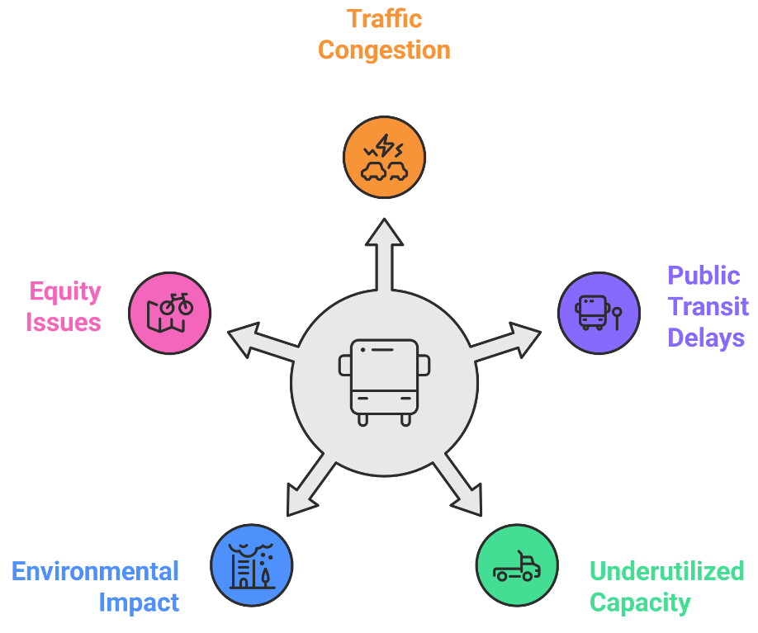
2. Conceptual Foundation
2.1. Urban Mobility Challenges
Urban transport systems in modern cities face growing complexity and strain due to multiple interconnected challenges:
Traffic Congestion: Rapid urbanization and rising private vehicle ownership cause chronic traffic delays, increasing travel time and reducing productivity.
Public Transit Delays: Fixed-time bus schedules are not responsive to sudden surges in demand, especially during rush hours, leading to overcrowding and long passenger wait times.
Underutilized Capacity: During off-peak hours, many buses run under-capacity, wasting fuel and operational resources.
Environmental Impact: High dependency on cars and inefficient bus operations contribute to significant greenhouse gas emissions and urban air pollution.
Equity Issues: Fixed schedules and routes may not serve all communities equally, leaving suburban and low-income areas underserved.
Urban Mobility and Smart Cities

Slide 11
2. Conceptual Foundation
2.2. Smart Solutions in Public Transit
To address the complex challenges of urban mobility, smart transit systems apply a range of digital innovations:
Dynamic Scheduling: Uses real-time demand data to adjust bus frequency, increasing fleet deployment during peak hours and scaling back during off-peak periods. This reduces passenger wait times and optimizes energy use.
Passenger Forecasting: Leveraging historical and sensor data, AI models predict passenger volume trends by stop, time, and day. This informs preemptive scheduling and capacity planning.
Optimized Routing Algorithms: GPS and traffic monitoring tools help reroute buses in real-time based on current congestion levels, road closures, or disruptions, ensuring minimal delays.
Smart Infrastructure Deployment: Advanced infrastructure such as real-time passenger information displays, contactless ticketing, and automated vehicle location (AVL) systems enhances the passenger experience and operational visibility.
Integration with Multimodal Platforms: Seamless links with bike-share, metro, and ride-hailing services promote first-mile/last-mile connectivity.
Data-Driven Operations: Transport authorities can monitor performance, adjust services, and conduct scenario analysis using data dashboards.
Urban Mobility and Smart Cities

Slide 12
Section 03:
Simulation Design and Setup
Urban Mobility and Smart Cities

Slide 13
3. Simulation Design and Setup
3.1. Tools, File & Scenario
Platform: Google Colab (preferred) or local Jupyter (Python 3.10+).
Filename: Urban_Mobilities_and_Smart_Cities_Lab_Session.ipynb.
Libs: numpy, pandas, matplotlib (preinstalled on Colab).
What’s inside: parameter cells (headways, peak window, capacity), run cell, plotting/export cells.
Outputs: tables + plots of avg/max wait, passengers served, hourly trends, stop-level heatmap.
Scenario:
Context: Single bus line serving 20 stops across CBD (Central Business District) ↔ suburbs. Morning/evening peaks; midday.
Question: Should we switch from Static to Smart headways to handle peaks without over-serving off-peak?
Run 1 (Baseline): Static 20-min headway all day → record KPIs.
Run 2 (Policy): Smart: 10-min in peaks, 20-min off-peak → record KPIs.
Compare: hourly wait curves, occupancy balance, worst-stop wait (equity).
Urban Mobility and Smart Cities

Slide 14
3. Simulation Design and Setup
3.2. Activity 1 — Static Baseline
Objective: Establish a reproducible baseline to compare against the smart policy.
Parameters to set (in the Parameters cell):
  simulation_time = 1440 (keep as is)
  initial_bus_interval = 20 (Static headway; baseline)
  bus_capacity = 80 (keep as is for baseline)
  stop_positions = np.arange(0, 20, 1) (keep as is)
  passenger_arrival_rate = 5 (keep as is)
  np.random.seed(42) (already set; do not change)
Student tasks (step-by-step):
  Restart & Run All to ensure a clean state.
  Set initial_bus_interval = 20 (leave all other defaults).
  Run the notebook; it will output:
    combined_df with both modes labeled in column type = "Static" or "Smart".
    summary_df with average/max wait and passengers served for both modes.
    Boxplot, hourly line plot, and several Smart-only visuals.
Urban Mobility and Smart Cities

Slide 15
3. Simulation Design and Setup
3.2. Activity 1 — Static Baseline
What to plot / interpret (using built-ins):
  Boxplot “Wait Time Comparison: Static vs Smart” → read the Static distribution.
  Hourly average wait line chart (it overlays both; read the Static curve).
  (Optional) Produce a Static-only line by re-plotting static_df if you want a clean baseline figure.
Deliverables (Baseline):
  One KPI row labeled Static (from summary_df).
  One figure referencing the Static baseline (either the overlay plot or a Static-only plot you generate).
  A 1–2 sentence baseline insight (e.g., “Static yields avg wait X, max Y; peak hours show the largest spikes.”)
Important note about this notebook:
  It automatically simulates both modes for whatever parameters you set:
    Static buses: bus_times_static = np.arange(0, simulation_time, initial_bus_interval)
    Smart buses: bus_times_smart with half interval during peak: interval = initial_bus_interval/2 if 480 <= t <= 1080 else initial_bus_interval (i.e., 08:00–18:00).
  So for Activity 1, you’ll run once and read the Static results from the combined outputs.
Urban Mobility and Smart Cities

Slide 16
3. Simulation Design and Setup
3.3. Activity 2 — Smart Headway Policy
Objective: Test a simple smart policy (denser service in peak, relaxed off-peak) against the static baseline.
Parameters to set (in the same Parameters cell):
  Do not change initial_bus_interval (keep it at 20 so Smart peak becomes 10 automatically).
  Keep bus_capacity, passenger_arrival_rate, and the seed unchanged for a fair A/B.
What the notebook does for Smart:
  Creates bus_times_smart where 08:00–18:00 (480–1080 minutes) uses initial_bus_interval / 2.
  Runs simulate(bus_times_smart, "Smart") and merges with Static into combined_df.
Student tasks (step-by-step):
  With the same parameters as Activity 1, Run All (or just the simulation and plotting cells).
  Use the built-in outputs to compare Smart vs Static:
    summary_df for Avg/Max Wait and Passengers Served by mode.
    The hourly average wait overlay (both modes).
    The boxplot overlay (both modes).
    Smart-only visuals (hourly avg wait, passenger load per bus, per-stop volumes, Smart wait-time heatmap).
  Equity check: Identify worst-performing stops under Smart (from the Smart heatmap), and compare qualitatively to Static.
Urban Mobility and Smart Cities

Slide 17
3. Simulation Design and Setup
3.3. Activity 2 — Smart Headway Policy
What to plot / interpret:
  Hourly average wait (overlay): Smart vs Static on the same axes (already produced).
  Boxplot overlay: distributional comparison.
  Delta heatmap or table (optional code above): where Smart improved/worsened by stop.
  Quote KPIs from summary_df for both modes and compute/mention the deltas.
Deliverables (Policy):
  Overlay figure(s) (hourly average wait and/or boxplot).
  A brief equity note (e.g., “worst 10% stops improved by …; a few low-demand stops see neutral/slightly worse waits”).
  A three-bullet takeaway:
    What changed (quantify KPI deltas).
    Why it changed (link to halved peak headway).
    Who benefited/was harmed (stops/time windows).
Compare results across:
  Wait time distribution
  Passenger load per bus
  Stop-wise boarding and delays
  Which scheduling type performs better under peak loads?
  Is the smart system always superior?
Urban Mobility and Smart Cities

Slide 18
Section 04:
Challenges & Opportunities
Urban Mobility and Smart Cities

Slide 19
4. Challenges & Opportunities
4.1. Implementation Challenges
Implementing smart mobility systems in public transport comes with several real-world hurdles:
Cost & Investment: Upfront cost for deploying IoT devices (e.g., GPS, sensors), communication infrastructure, and control centers is high. Public agencies may lack capital or face procurement delays.
Data Privacy: Collecting location data and travel behavior raises concerns about user privacy. Strong policies and anonymization mechanisms are needed to build public trust.
System Integration: Legacy transit systems may not be compatible with modern APIs or cloud systems, requiring costly upgrades or middleware development.
Human & Institutional Resistance: Operators and staff may resist automation and data-centric decision-making. Institutional silos (e.g., transport authority vs IT department) can slow progress.
Urban Mobility and Smart Cities

Slide 20
4. Challenges & Opportunities
4.2. Opportunities in Smart Mobility
While challenges exist, smart mobility opens numerous opportunities for innovation and equity:
Operational Optimization: Better scheduling, route planning, and fleet management reduce fuel costs and labor inefficiencies.
Equity & Accessibility: Real-time updates, accessible routing, and on-demand services help marginalized and low-mobility users.
Environmental Benefits: Optimized operations and reduced congestion contribute to emission reductions and urban sustainability goals.
Data-Driven Planning: Rich travel data enables long-term urban and transport planning, demand forecasting, and resilience modeling.
Successful Examples:
Helsinki's Whim app: Combines taxis, buses, bikes, and car rentals in a single platform.
Singapore's Smart Bus System: Uses real-time data to manage headways and optimize fleet usage.
Urban Mobility and Smart Cities

Slide 21
Section 05:
Homework Assignment
Urban Mobility and Smart Cities

Slide 22
4. Homework Assignment
4.1. Homework: “Tune & Test Route R12” (Individual or Pairs)
Goal (what you’ll learn)
  Show you can (i) run the simulator reproducibly, (ii) make one simple, justified change to operations, and (iii) compare outcomes to the in-class Static vs Smart baseline using clear KPIs and plots.
What to do:
  Track A — Headway Tuning
    Keep the Smart logic but change the baseline headway:
    In the Config/Parameters cell, edit only:
    initial_bus_interval = 18 (so Smart peak becomes 9 minutes automatically)
    Do not change seed, capacity, or peak window.
  Track B — Capacity Sensitivity
    Keep schedules identical to class; change vehicle capacity:
    Edit only:
      bus_capacity = 60 (or 100 if you prefer an “oversupply” check)
Urban Mobility and Smart Cities

Slide 23
4. Homework Assignment
4.1. Homework: “Tune & Test Route R12” (Individual or Pairs)
What to do:
  Track C — Peak Window Shift
    Keep intervals identical; adjust peak times to reflect a later city peak:
    In the Smart construction loop, change the condition from
    480 <= t <= 1080 (08:00–18:00) to 540 <= t <= 1110 (09:00–18:30)
    Everything else stays the same.
Execution steps (identical for all tracks)
  Restart & Run All Tracks separately.
  Apply your one parameter change.
  Run the notebook to produce both Static and Smart results (the notebook already does this).
  Export results (if cells are present):
  r12_results.csv and r12_summary.csv
  Save overlay figure(s) with clear names (e.g., overlay_hourly_wait.png, boxplot_static_smart.png).
  (Optional) Run the small delta cell if present to summarize stop-level improvements/worsening.
What to Submit:
  Report
  Notebook
Urban Mobility and Smart Cities

Slide 24
4. Homework Assignment
4.2. Lab Report Structure
Section | Title | Description
1 | Title Page | Lab title, course, student name, ID, date
2 | Objectives | 3–5 goals for the homework: reproduce Static vs Smart, apply one controlled change, quantify KPIs, assess equity, and make an operational recommendation.
3 | Introduction | Brief description of Route R12 (24h, 20 stops, peaks), baseline Static policy, Smart policy (half headway in peak), and why the chosen track matters operationally.
4 | Methodology | Notebook name, environment (Colab/local), fixed seed, parameters kept constant, the single parameter changed (what & value), and where it was edited.
5 | Experiment Design | A/B structure (Static vs Smart under identical conditions), any additional variant if explored (logged separately), data captured (combined results + summary).
6 | Results (Base vs Redesign) | Table with rows Static and Smart: Avg Wait, 95th/Max Wait (if available), Passengers Served, Avg Occupancy. Include overlay hourly-wait plot, boxplot, and (optional) stop-level delta/heatmap.
7 | Analysis & Interpretation | Quantify deltas (how much changed and when), causal explanation tied to the single parameter, equity note (worst stops / 95th percentile), and operational trade-offs.
8 | Conclusion | Summary of findings, reflection on redesign process, and key
9 | References | List of any cited sources: datasets used, official values for economic impacts, tutorials, etc.
10 | Appendices | Optional: screenshots of code, outputs, tables, additional charts or sensitivity results
Urban Mobility and Smart Cities

Slide 25
Thank you for your attention!

