Slide 1
Transport Research and Analysis
Module 5: Advanced Topics and Case Studies
Lecture 23: Freight Transport and Logistics

Slide 3
Table of Contents
Lecture 23: Freight Transport and Logistics
1. Introduction | 1
1.1 Scope and Key Definitions | 2
1.2 Intermodal Transport – Definition & Evolution | 3
1.3 Significance and Trends in Freight Transport | 5
2. Principles of Freight Transport | 6
2.1 Freight Transport Modes & Characteristics | 7
2.2 Modal Choice and Cost Trade-offs | 10
2.3 Effects on health, air quality, and climate | 12
3. Logistics & Supply Chain Management | 15
3.1 Logistics vs. Supply Chain – Integration and Value | 16
3.2 Logistics Trade-offs and Distribution Strategies | 17
3.3 Integration and Collaboration in Supply Chains | 18
3.4 Recent Developments in Freight & Logistics (2017–2025) | 19
4. Case Studies | 20
4.1 Case Study 1 – UK Grocery Retailers Adopting Intermodal Logistics | 21
4.2 Case Study 2 – Shipper-Forwarder Collaboration: Jula and DB Schenker (Sweden | 22
4.3 Case Study 3 – China–Europe Railway Express (“Belt and Road” Rail Corridor) | 23
5. Discussion | 24
5.1 Discussion & Critical Thinking | 25
i
Freight Transport and Logistics

Slide 4
Section 01:
Introduction
Freight Transport and Logistics

Slide 5
1. Introduction
1.1 Scope and Key Definitions
Freight Transport: The movement of goods (raw materials, parts, finished products) using transport modes (road, rail, sea, air, etc.) across supply chains. Emphasizes tonnage and distance, typically measured in tonne-kilometers (ton-km).
Logistics: The process of planning, implementing, and controlling procedures for the efficient and effective transportation and storage of goods (and related information) from origin to destination, ensuring customer requirements are met. It includes transportation, warehousing, inventory management, packaging, and information flow.
Supply Chain Management (SCM): Broader coordination across multiple firms in a supply chain – integrating key business processes from end suppliers to end customers. SCM involves collaboration among suppliers, manufacturers, distributors, retailers, and logistics providers to optimize the endto-end flow of products, information, and finances. Logistics is a subset of SCM focused on moving and storing goods.
2
Freight Transport and Logistics

Slide 6
1. Introduction
1.2 Intermodal Transport – Definition & Evolution
      Unimodal, Multimodal, Intermodal: Multimodal transport means using more than one mode in a transport chain (e.g., truck + ship) to move goods. Intermodal transport is a specialized case of multimodal where goods stay in the same loading unit (e.g., a shipping container or trailer) for the entire journey across modes. This avoids direct handling of the cargo itself during mode transfers, improving efficiency.
      Containerization Revolution: The rise of the standard ISO shipping container (pioneered by Malcom McLean in 1956) enabled true intermodal transport. Containers drastically cut handling time and cost: in the pre-container era, ships spent weeks in port being manually unloaded; now, cranes can transfer thousands of containers in hours. This innovation slashed port turnaround times and reduced cargo damage, yielding major cost reductions by keeping goods in one unit through the journey.
3
Freight Transport and Logistics

Slide 7
1. Introduction
1.2 Intermodal Transport – Definition & Evolution
      Globalization & Scale: Containerization and intermodal systems fueled global trade expansion. Ocean shipping companies consolidated into large global carriers, and major ports grew into high-capacity container hubs. Many ports relocated or expanded to deep-water locations (e.g., Rotterdam’s Maasvlakte 2) to accommodate larger ships, often severing their traditional city-center links. Vertical integration increased (e.g., shipping lines owning port terminals), creating seamless sea-port networks. With ports and ocean transport highly efficient, the inland transport leg became the “new battleground” for optimization – competition now centers on moving goods from ports to inland markets efficiently via rail, barge, or truck.
4
Freight Transport and Logistics

Slide 8
1. Introduction
1.3 Significance and Trends in Freight Transport
      Economic Importance:
      i. Freight transport supports global trade: 80% by volume, ~70% by value carried by
      ships → maritime = backbone of globalization.
      ii. Road freight dominates short-haul/domestic: e.g., ~1.7 trillion ton-km in EU-28 (2012).
      iii. Rail freight ideal for long distances & bulk goods: In the U.S., rail ton-km even exceed road freight.
      iv. Air freight <1% of tonnage but high trade value: Used for urgent, high-value, or time-sensitive goods.
      Contemporary Trends:
      i. E-commerce boom: Increases demand for fast, last-mile delivery.
      ii. Digitalization: Real-time tracking, AI route optimization, digital freight platforms.
      iii. Sustainability push: Modal shift, greener fuels, emissions reduction.
      iv. Resilience focus: COVID-19 & geopolitics exposed fragility → drive toward near-shoring, supplier diversification, and safety stock strategies.
5
Freight Transport and Logistics

Slide 9
Section 02:
Principles of Freight Transport
Freight Transport and Logistics

Slide 10
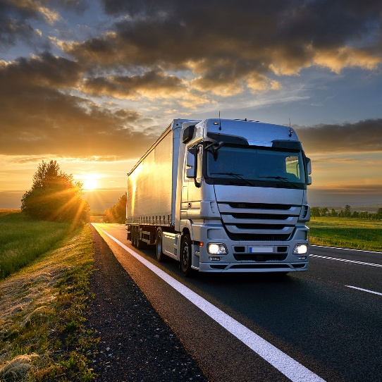
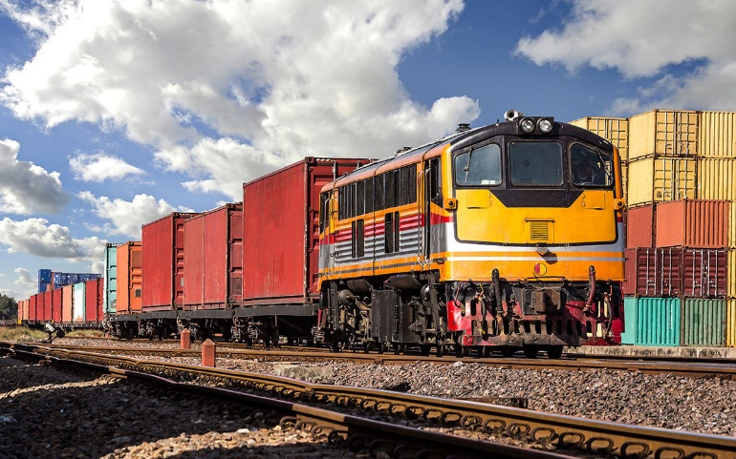
2. Principles of Freight Transport
2.1 Freight Transport Modes & Characteristics
      Road (Trucking):
      i. High flexibility and accessibility (door-to-door, fast scheduling).
      ii. Ideal for short to medium distances, especially last-mile.
      iii. Higher cost and emissions per ton-km vs rail/maritime.
      iv. Often used for first/last leg in intermodal chains.
      Rail:
      i. Best for long distances and high-volume transport.
      ii. Lower cost per ton-km (at scale), especially for bulk and containers.
      iii. Needs fixed infrastructure and transfer terminals.
      iv. Less flexible but more energy-efficient; needs volume + distance to be cost-effective.
7
Freight Transport and Logistics

Slide 11
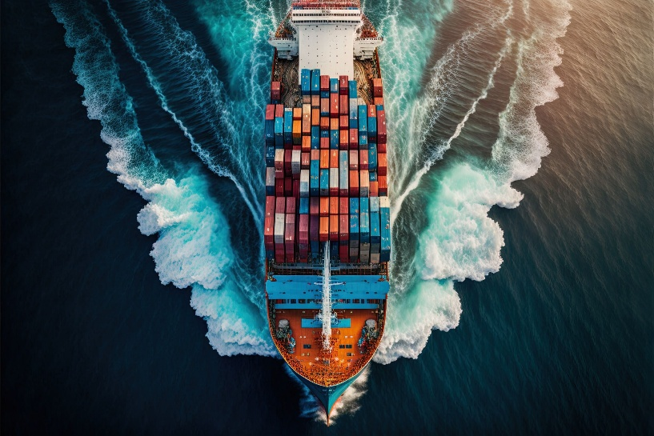
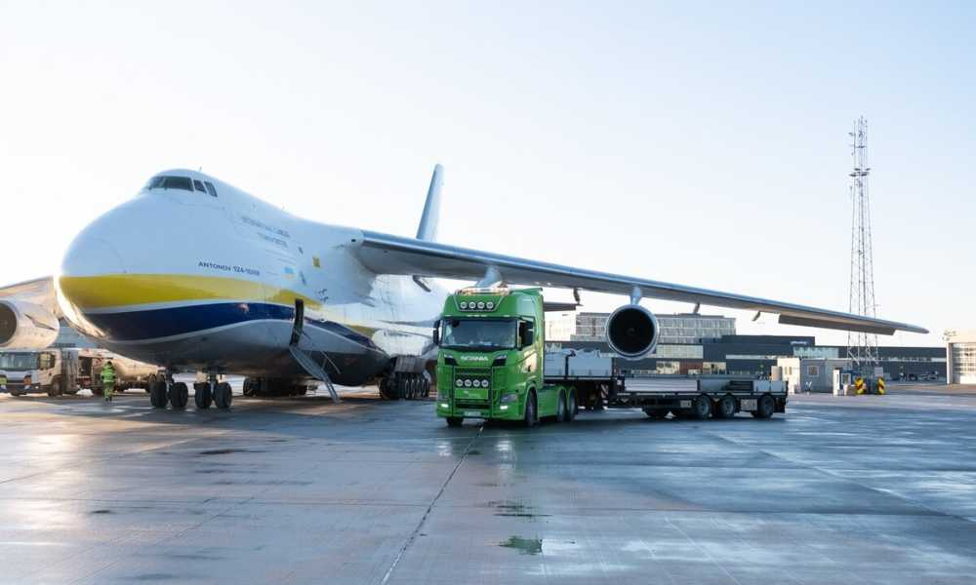
2. Principles of Freight Transport
2.1 Freight Transport Modes & Characteristics
      Maritime:
      i. Dominates global trade (lowest cost per ton-km).
      ii. Handles massive volumes using large ships (20,000+ TEUs).
      iii. Slow transit but highly cost-efficient.
      iv. Needs ports and hinterland connections for land access.
      v. Crucial for international freight (by tonnage).
      Air Freight:
      i. Fastest mode for urgent, high-value, or perishable goods.
      ii. Very high cost per kg and high fuel use → small in volume, large in trade value.
      iii. Integrated with express networks (often in passenger flights).
      iv. Key for just-in-time delivery and global e-commerce.
8
Freight Transport and Logistics

Slide 12
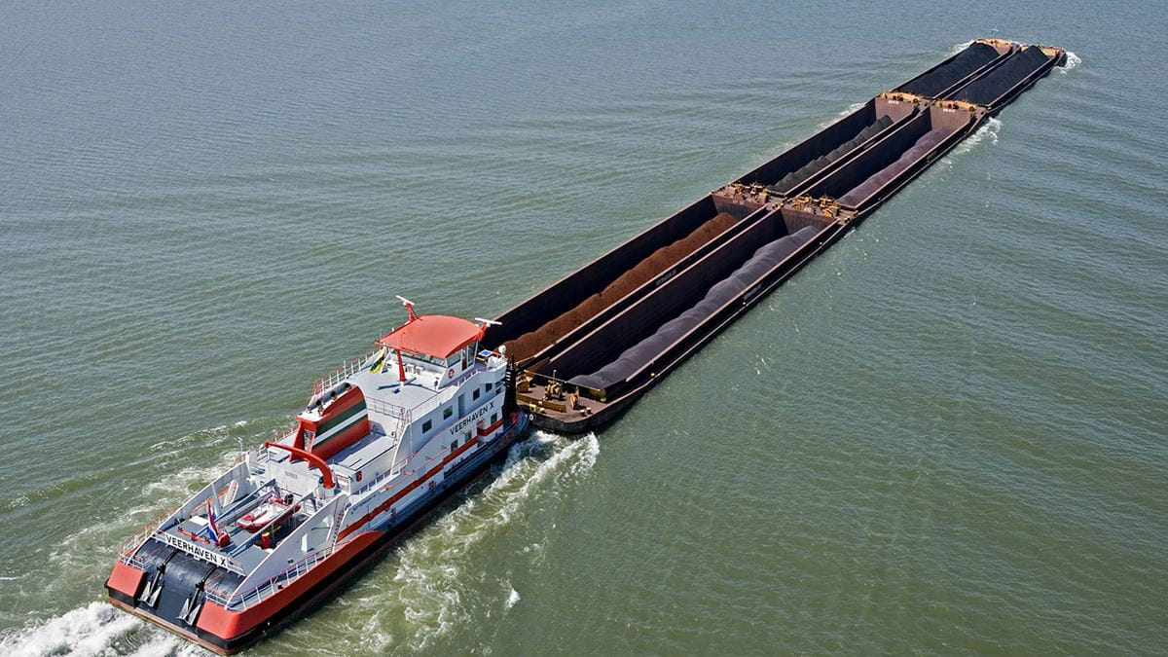
2. Principles of Freight Transport
2.1 Freight Transport Modes & Characteristics
      Inland Waterways & Pipelines:
      i. Inland Waterways: Low-cost option for bulk (e.g. grain, coal, iron) via rivers/canals.
      ii. Slow and dependent on geography and conditions.
      iii. Pipelines: Specialized for fluids and slurry solids (e.g. oil, gas).
      iv. High fixed costs but efficient, continuous flow in commodity supply chains.
9
Freight Transport and Logistics

Slide 13
2. Principles of Freight Transport
2.2 Modal Choice and Cost Trade-offs
      Cost Structures:
      i. Trucking: High variable costs per km (fuel, labor), low fixed costs.
      ii. Rail/Water: Lower per-km cost, but high fixed costs (infrastructure, terminals).
      iii. Creates a distance-based break-even: Intermodal becomes cheaper beyond ~300–500 km (Europe avg).
      iv. Needs ports and hinterland connections for land access.
      v. Viable even for shorter distances if origin/destination is at a port/terminal.
      Intermodal Cost Curve:
      i. Each mode transfer adds cost/time → causes a step increase at transfer points.
      ii. Road: Linear high-cost curve; Intermodal: Upfront costs, flatter long-haul cost curve.
      iii. At scale/distance, intermodal is cheaper overall.
      iv. Scale economies: Large volume lowers per-unit cost; full capacity usage is key.
10
Freight Transport and Logistics

Slide 14
2. Principles of Freight Transport
2.2 Modal Choice and Cost Trade-offs
      Speed vs. Service Trade-off:
      i. Trucking = faster, flexible; rail/water = slower but cheaper.
      ii. Inventory impact: Slower modes increase stock in transit; faster modes reduce stock but cost more. iii. Classic transport vs. inventory cost trade-off:
      → e.g., ship by sea (save cost, stock buffer) vs. air (cut time, pay premium).
11
Freight Transport and Logistics

Slide 15
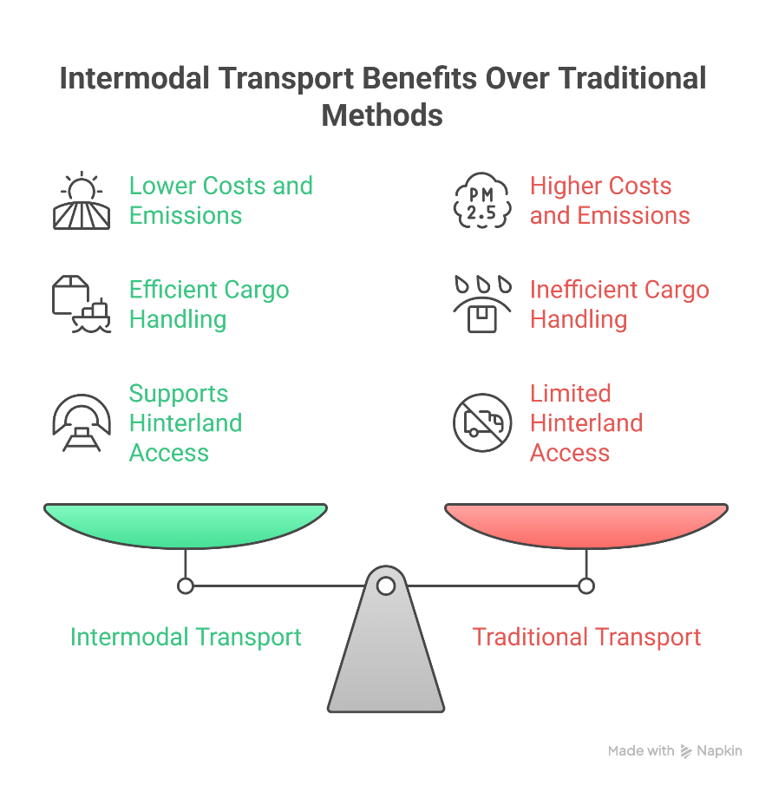
2. Principles of Freight Transport
2.3 Intermodal Transport – Benefits & Challenges
Benefits of Intermodal:
i. Combines modal strengths: Use rail/ship for long haul → lower costs, emissions.
ii. Reduces congestion and energy use.
iii. Efficient cargo handling: Goods remain in the same container → less damage, fewer delays.
iv. Supports hinterland access from ports and economies of scale.
Distance & Volume Conditions effective when:
i. Long enough distance to offset transfer costs.
ii. Sufficient volume to regularly fill trains/barges.
iii. Dense networks of origins/destinations (supports scale).
12
Freight Transport and Logistics

Slide 16
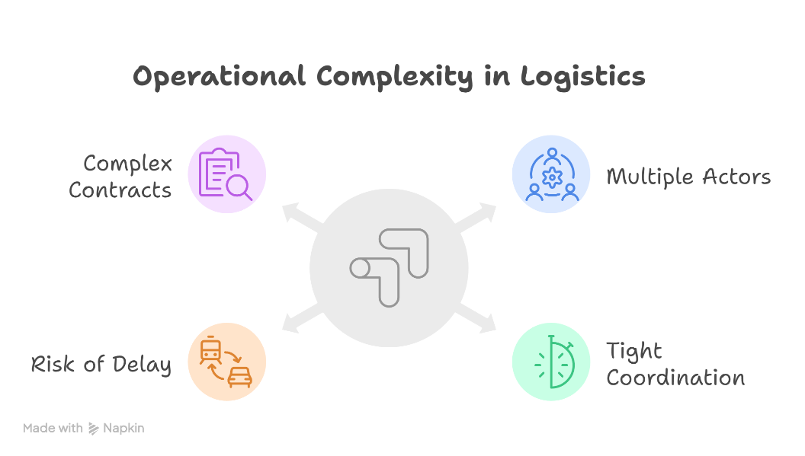
2. Principles of Freight Transport
2.3 Intermodal Transport – Benefits & Challenges
Asset Utilization:
i. Utilization must be high to stay cost-effective.
ii. Issues like night-only train runs → wasted daytime capacity.
iii. Solutions: dynamic scheduling, short daytime trips.
Operational Complexity
i. Multiple actors involved (truckers, rail/barge ops, terminals, forwarders).
ii. Needs tight coordination (scheduling, fast handoffs, info sharing).
iii. Risk of delay at transfer nodes (missed trains, system cascade).
iv. Contracts and liability become complex across modes.
13
Freight Transport and Logistics

Slide 17
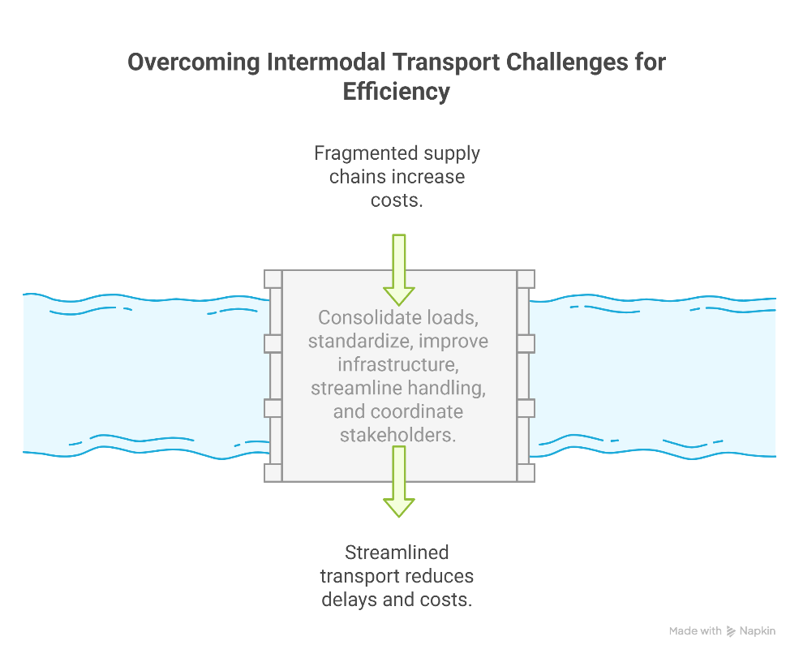
2. Principles of Freight Transport
2.3 Intermodal Transport – Benefits & Challenges
Key Challenges:
i. Load consolidation is hard with fragmented supply/demand.
ii. Compatibility issues (e.g. container size, rail gauge).
iii. Infrastructure gaps: terminal space, track access, regulation.
iv. Multi-handling inefficiencies: delay, damage risk, extra cost.
v. Intermodal still struggles to compete with road freight over shorter distances.
vi. Success depends on a clear business model and strong stakeholder coordination.
14
Freight Transport and Logistics

Slide 18
Section 03:
Logistics & Supply Chain Management
Freight Transport and Logistics

Slide 19
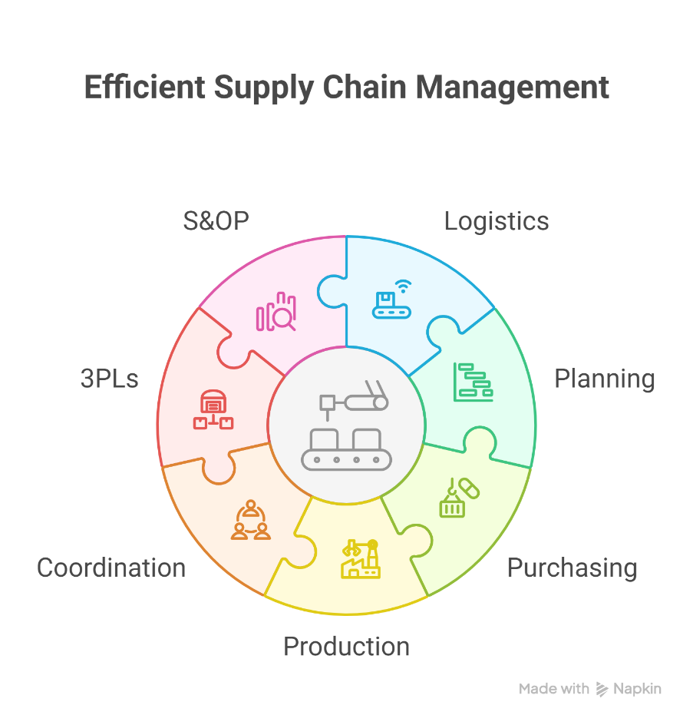
3. Logistics & Supply Chain Management
3.1 Logistics vs. Supply Chain – Integration and Value
Logistics handles transport, storage, and delivery of goods efficiently.
It includes tasks like shipping, warehousing, inventory, and packaging.
Supply Chain Management (SCM) connects all steps from raw materials to customer.
SCM includes planning, purchasing, production, and logistics.
Good coordination across teams (like logistics and production) is essential.
Companies often work with 3PLs and use tools like S&OP to stay efficient and responsive.
16
Freight Transport and Logistics

Slide 20
3. Logistics & Supply Chain Management
3.2 Logistics Trade-offs and Distribution Strategies
Transport vs. Inventory Cost: Cheaper shipping needs more inventory; faster shipping costs more but lowers stock levels. Companies must balance both.
Centralized Distribution: Fewer, larger warehouses save on storage and inventory but increase delivery distances and time.
Decentralized Distribution: More local warehouses offer faster delivery but raise warehousing and inventory costs.
Choice Depends On: Product type, customer location, service goals, and transport costs.
Just-in-Time (JIT): Keeps inventory low by delivering only when needed – efficient but risky if delays happen.
Hybrid Strategy: Many firms now mix JIT with safety stock or multiple transport options to stay resilient.
17
Freight Transport and Logistics

Slide 21
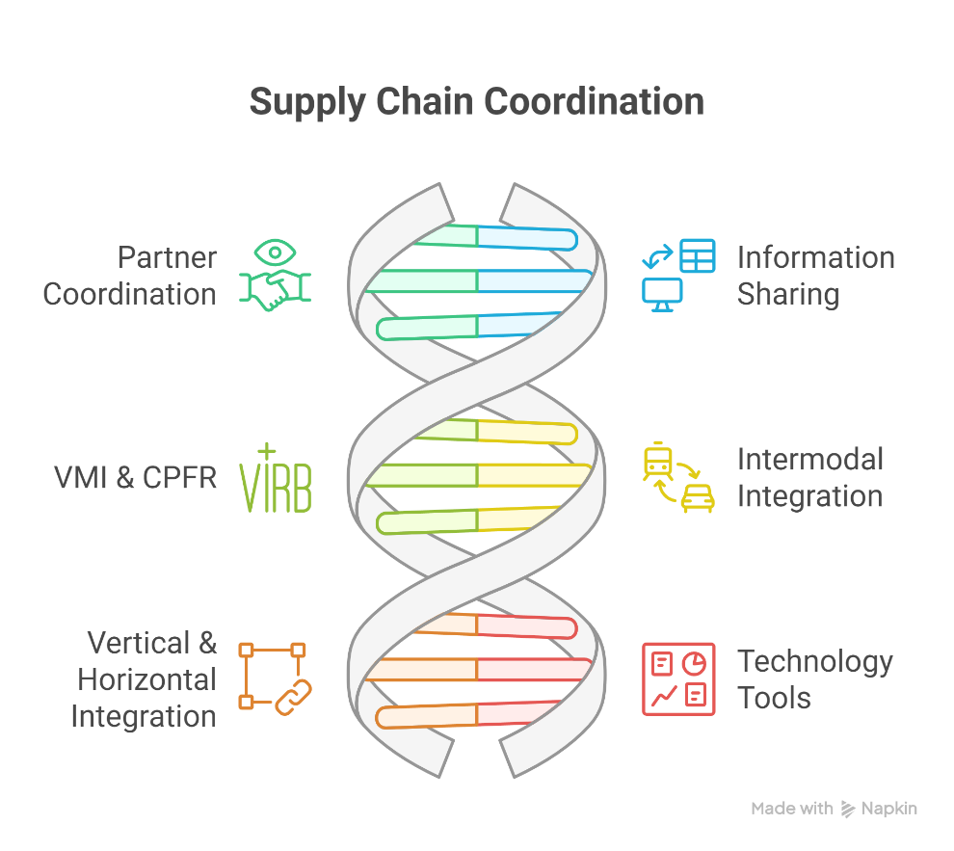
3. Logistics & Supply Chain Management
3.3 Integration and Collaboration in Supply Chains
Partner Coordination is key: suppliers, carriers, and distributors must work closely together.
Use information sharing (e.g., forecasts, inventory levels) to reduce uncertainty and improve decisions.
Practices like VMI and CPFR help align supply chain activities and build trust.
Intermodal Integration needs collaboration across modes (e.g., rail + truck) and often involves 4PLs.
Vertical & horizontal integration improves efficiency across the chain (e.g., shipper + carrier partnerships).
Technology tools like ERP, TMS, tracking, blockchain, and warehouse automation support real-time visibility and smarter decisions.)
18
Freight Transport and Logistics

Slide 22
3. Logistics & Supply Chain Management
3.4 Recent Developments in Freight & Logistics (2017–2025)
Digital tools (e.g., real-time GPS, AI, and digital freight platforms) improve routing, asset use, and pricing transparency.
E-commerce growth drives faster delivery with new models: urban hubs, parcel lockers, delivery bots, and route optimization.
Sustainability push: IMO rules, net-zero targets, and adoption of electric trucks and green fuels (LNG, hydrogen, biofuels).
Reverse logistics is rising with more returns from online shopping.
Resilience focus post-COVID: firms are near-shoring, using multiple suppliers, and keeping safety stock.
Agility matters: supply chains must adapt fast using tech + flexible sourcing when disruptions occur.
19
Freight Transport and Logistics

Slide 23
Section 04:
Case Studies
Freight Transport and Logistics

Slide 24
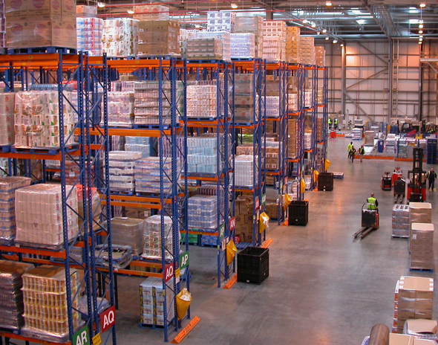
4. Case Studies
4.1 Case Study 1 – UK Grocery Retailers Adopting Intermodal Logistics
Large UK grocery chains dominate the market and operate big centralized distribution networks.
In the 2000s, they shifted to fewer, larger DCs in the Midlands to cut warehousing and transport costs.
This increased travel distances, but also enabled intermodal transport (e.g., rail to Scotland).
High-volume routes allowed cost-effective rail freight (e.g., Midlands to Scotland corridor).
Retailers used ICT systems to forecast demand and shifted to pull-based inventory (real-time sales).
Factory Gate Pricing (FGP) and backhauling improved truck usage, enabling fuller loads and better scheduling.
Large DCs in the Midlands helped UK retailers cut costs and centralize logistics.
21
Freight Transport and Logistics

Slide 25
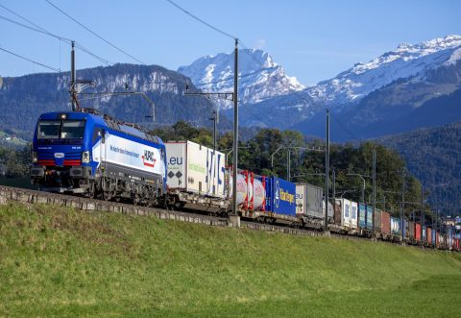
4. Case Studies
4.2 Case Study 2 – Shipper-Forwarder Collaboration: Jula and DB Schenker (Sweden)
Jula, a Swedish retailer, had a large central warehouse and imported goods via Gothenburg Port.
Port congestion and storage costs led to interest in a rail shuttle to inland Falköping terminal.
Volume (~10,000 TEU/year) made the rail service viable; DB Schenker managed operations.
The service started in 2013 and grew from half train to full train, now running 5x/week.
Collaboration and open-book contracts between Jula, Schenker, rail operator, and terminal were key.
The case shows how shared vision and long-term agreements made <150 km intermodal route cost-effective.
DB Schenker manages the rail shuttle operations, transporting containers from the Port of Gothenburg to Falköping.
22
Freight Transport and Logistics

Slide 26
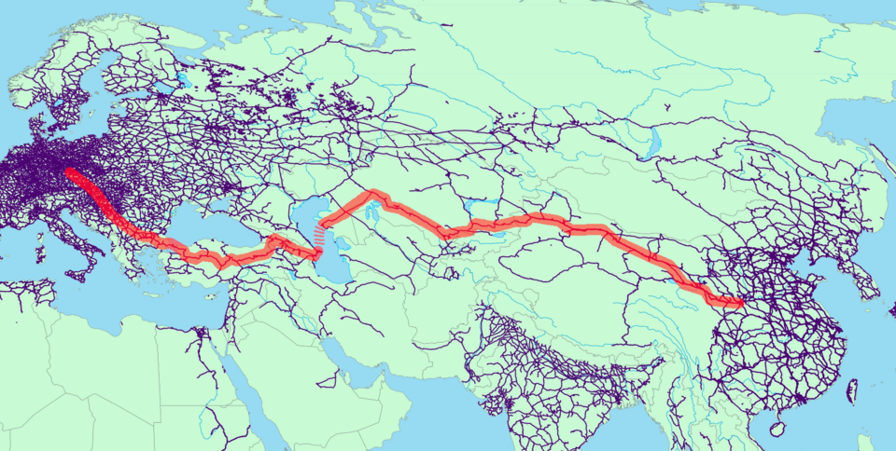
4. Case Studies
4.3 Case Study 3 – China–Europe Railway Express (“Belt and Road” Rail Corridor)
Major growth since 2011: over 90,000 train trips by 2024; connects 50+ Chinese cities to Europe.
Faster than sea (~15–20 days) and cheaper than air; ideal for mid-priority goods (e.g. electronics, clothing).
Uses standard containers, runs in both directions, and avoids port congestion delays.
Example: A firm in Xi’an built a factory near the rail hub to cut lead times to Europe.
Became a strategic option during COVID disruptions and global shipping delays.
Shows how intercontinental intermodal solutions are reshaping global logistics.
A map illustrating the various routes of the China–Europe Railway Express, connecting multiple cities across China and Europe.
23
Freight Transport and Logistics

Slide 27
Section 05:
Discussion & Critical Thinking
Freight Transport and Logistics

Slide 28
5. Discussion & Critical Thinking
5.1 Vehicle Technology
Q1: Modal Shift – What are the main barriers preventing more freight from shifting off roads to intermodal (rail, waterways)? Consider factors like cost, flexibility, infrastructure, and how technology or policy might help overcome these barriers.
Q2: Case Insights – From the case studies (retail distribution, Jula-Schenker, China-Europe rail), what key factors enabled those intermodal solutions to succeed? Are those factors generalizable to other regions or industries, or were they context-specific?
Q3: Technology Impacts – How might emerging technologies (e.g. autonomous trucks, digital platforms, AI-driven supply chain visibility) disrupt or enhance freight transport and logistics in the next decade? Which parts of the logistics chain are most likely to be transformed, and what efficiencies or new challenges could result?
25
Freight Transport and Logistics
Notes:
Q1: Modal Shift – What are the main barriers and possible solutions?
Barriers include cost, flexibility, and lack of infrastructure.
Road transport is more flexible and direct than intermodal options like rail or barge.
Intermodal requires terminals, scheduling, and extra handling.
Digital systems between modes are often poorly integrated.
Solutions:
Invest in rail and waterway infrastructure.
Offer government incentives (tax breaks, subsidies).
Improve digital coordination platforms.
Use policy tools like emissions caps or road tolls.
Q2: Case Insights – What made the intermodal cases successful?
Key success factors: high freight volumes and stakeholder cooperation.
UK retailers used centralized DCs for rail-friendly volumes.
Jula and DB Schenker shared risks and planned long-term.
China-Europe Rail was backed by policy and inland hub development.
Generalizable if:
Stakeholders align long-term.
There’s supporting infrastructure.
Public-private coordination is strong.
Q3: Technology Impacts – How will technology affect logistics?
Emerging technologies:
Autonomous trucks reduce driver reliance.
AI improves routing and forecasting.
Blockchain adds security and trust.
Digital freight platforms optimize matching.
Impacted areas: last-mile delivery, visibility, and multimodal routing.
Risks: job loss, cybersecurity, and high costs of implementation.

Slide 29
5. Discussion & Critical Thinking
5.1 Vehicle Technology
Q4: Balancing Act – In designing a logistics network, how should companies balance cost, speed, and sustainability? For example, when might it make sense to choose a slower, greener transport option over a faster, more expensive one? How do corporate sustainability goals and external regulations influence such decisions?
Q5: Resilience vs Efficiency – After recent global supply chain disruptions, there is a tension between building resilience and maintaining efficiency. What strategies would you recommend to a logistics manager to improve resilience without excessively driving up costs (e.g. inventory buffers, dual sourcing, flexible transport modes)? How can data and predictive analytics play a role in this balance?
26
Freight Transport and Logistics
Notes:
Q4: Balancing Act – Cost, speed, or sustainability?
Must balance based on product type and customer need.
Use cheaper, slower modes for non-urgent goods.
Use faster modes for just-in-time or premium items.
Decision influenced by sustainability targets and regulations.
Tools: total cost modeling, scenario planning, ESG reporting.
Q5: Resilience vs Efficiency – How to manage both?
Build resilience without losing efficiency:
Keep safety stock for critical items only.
Use multiple suppliers (dual/multi-sourcing).
Have backup transport options ready.
Use predictive analytics to spot risks early.
Focus on agility: the ability to adapt quickly without high extra cost.

