Slide 1
Transport Research and Analysis
Module 5: Advanced Topics and Case Studies
Lecture 24: Case Studies in Transport Research

Slide 3
Table of Contents
Lecture 24: Case Studies in Transport Research
1. Introduction | 1
1.1 Importance of Transport Research | 2
1.2 Objectives of This Lecture | 3
1.3 Relevance to Engineering Practice | 4
2. Detailed Analysis of Successful Projects | 5
2.1 Case Study: Revenue Protection Reforms | 6
2.2 Case Study: Rail Transit Disruption Management | 7
2.3 Case Study: Swedish Bus Ridership Growth | 8
2.4 Case Study: Incorporating Mobility-as-a-Service (MaaS) | 9
2.5 Case Study: On-Road Public Transport Priority | 10
2.6 Insights from ACES (Autonomous, Connected, Electric, Shared) Integration | 11
3. Lessons Learned | 12
3.1 Interdisciplinary Integration for Complex Problems | 13
3.2 Role of Policy and Governance in Transport Projects | 14
3.3 Technological Enablement and User-Centric Design | 15
3.4 Failures and Fixes: Managing Disruption and Service Reliability | 16
3.5 Key Takeaways from International Experience | 17
4. Best Practices in Transport Research & Implementation | 18
4.1 Design Thinking and Co-Creation with Users | 19
4.2 Data-Driven Decision Making | 20
4.3 Planning for Resilience and Flexibility | 21
4.4 Integrated Approaches to Governance and Funding | 22
i
Case Studies in Transport Research

Slide 4
Table of Contents
Lecture 24: Case Studies in Transport Research
4.5 Measuring Total Social Cost (TSC) and Long-Term Impact | 23
5. Discussion and Final Remarks | 24
5.1 Open Discussion with Students | 25
5.2 Final Thoughts and Reflections | 26
5.3 Recommendations for Future Research/Practice | 27
i
Case Studies in Transport Research

Slide 5
Section 01:
Introduction
Case Studies in Transport Research

Slide 6
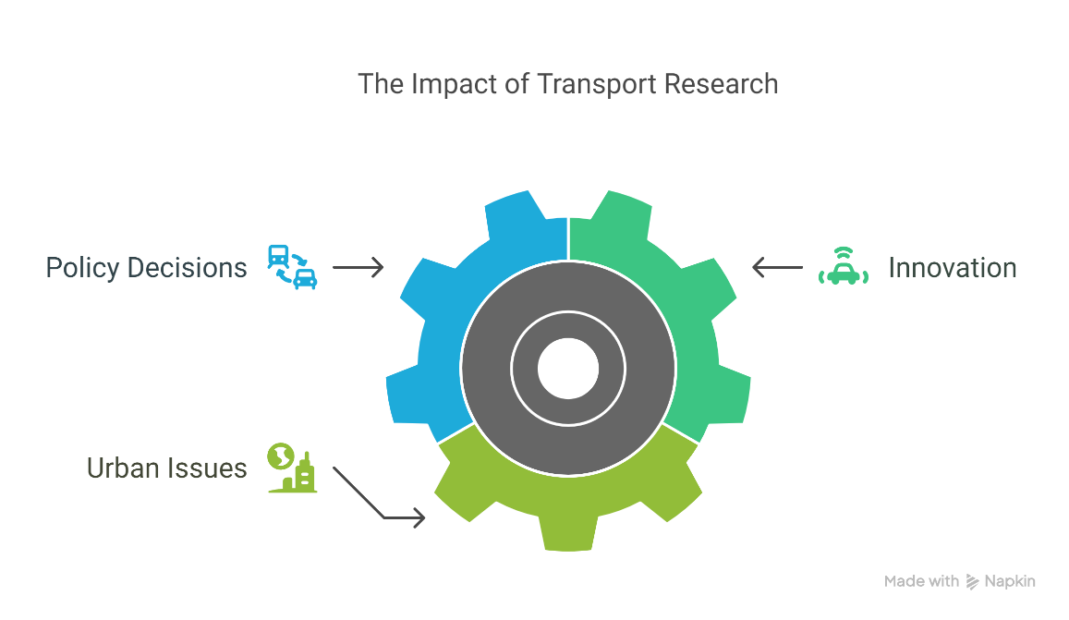
1. Introduction
1.1 Importance of Transport Research
Transport research plays a pivotal role in shaping sustainable, inclusive, and efficient mobility systems. It informs policy decisions, supports innovation, and addresses pressing urban issues like congestion, pollution, and social inequity.
As cities grow and mobility needs evolve, transport research helps bridge the gap between theory and practice through evidence-based solutions.
2
Case Studies in Transport Research

Slide 7
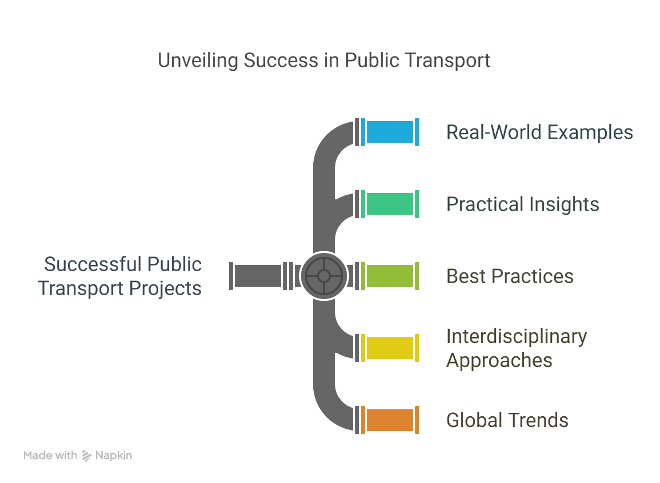
1. Introduction
1.2 Objectives of This Lecture
      Explore real-world examples of successful public transport projects.
      Extract practical insights and lessons learned from each case.
      Highlight best practices that engineers and planners can apply.
      Encourage a critical understanding of interdisciplinary approaches and global trends in public transport.
3
Case Studies in Transport Research

Slide 8
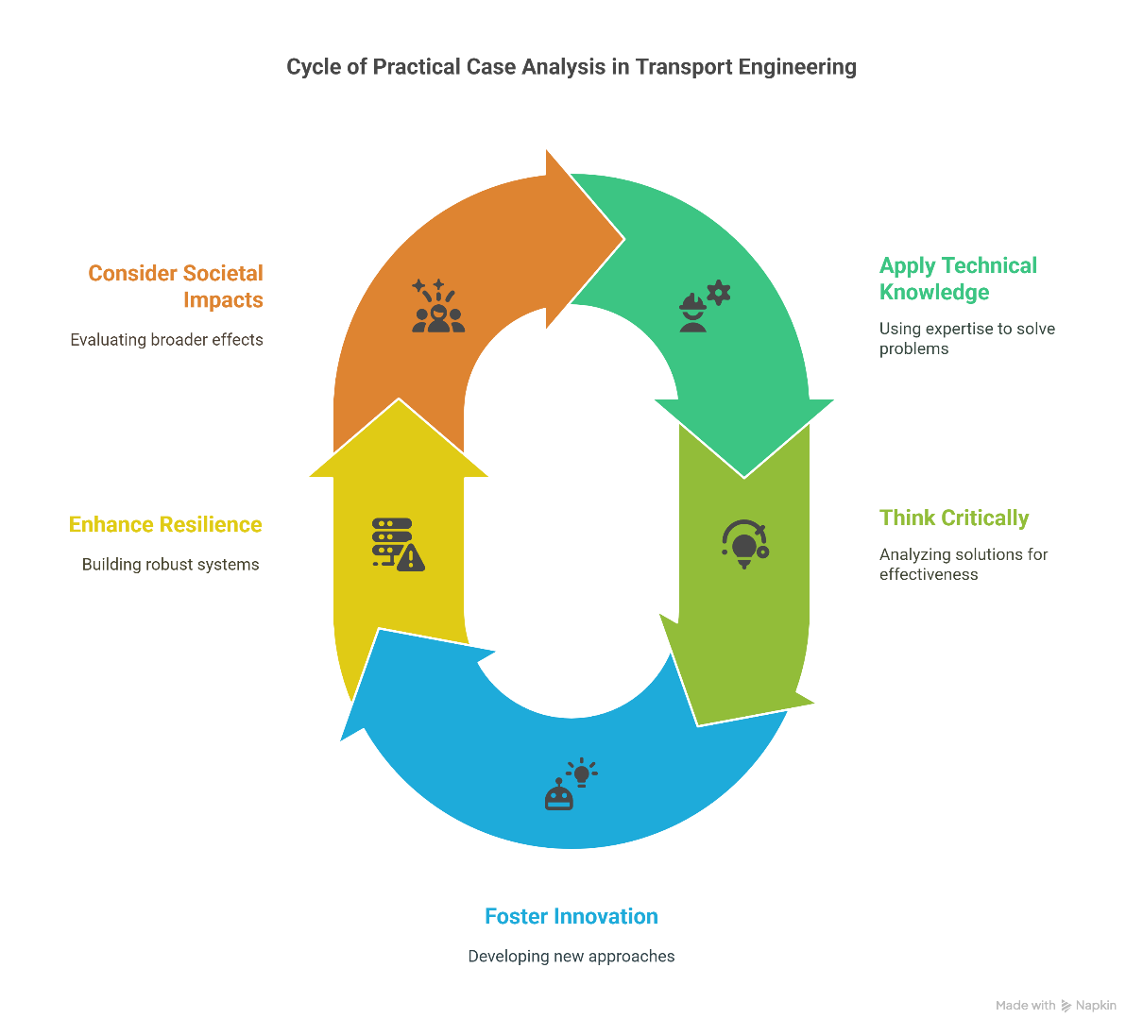
1. Introduction
1.3 Relevance to Engineering Practice
      For transport engineers, practical case analysis enhances understanding of systemic design, operational challenges, and user-centered planning.
      It provides a platform to apply technical knowledge in the real world and to think critically about innovation, resilience, and societal impacts.
4
Case Studies in Transport Research

Slide 9
Section 02:
Detailed Analysis of Successful Projects
Case Studies in Transport Research

Slide 10
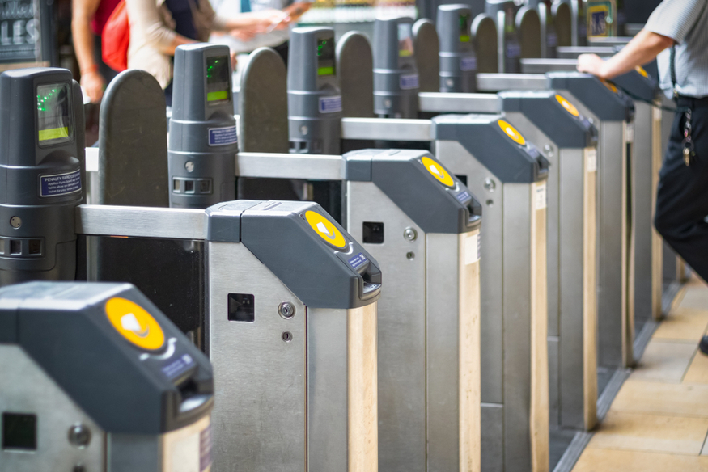
2. Detailed Analysis of Successful Projects
2.1 Case Study: Revenue Protection Reforms
      Fare evasion leads to significant revenue loss and undermines fairness in public systems.
      London’s reforms included enforcement consolidation, CCTV analytics, and targeting habitual offenders.
      The use of smart ticketing and mobile teams helped reduce evasion rates and build public trust in the system.
Contactless Ticket Barrier in London Underground
6
Case Studies in Transport Research

Slide 11
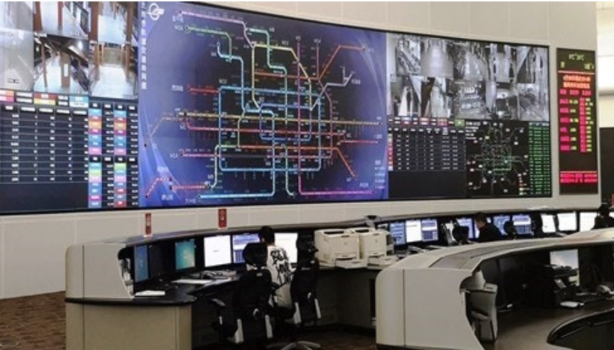
2. Detailed Analysis of Successful Projects
2.2 Case Study: Rail Transit Disruption Management
      Disruptions in rail transit due to technical faults or external events can cripple cities.
      Singapore’s integrated command centers coordinate alternative services, while staff are trained for rapid decision-making. Effective communication strategies, such as real-time mobile alerts, also ensure passenger confidence.
AGIL Integrated Transport Operations Centre
7

Slide 12
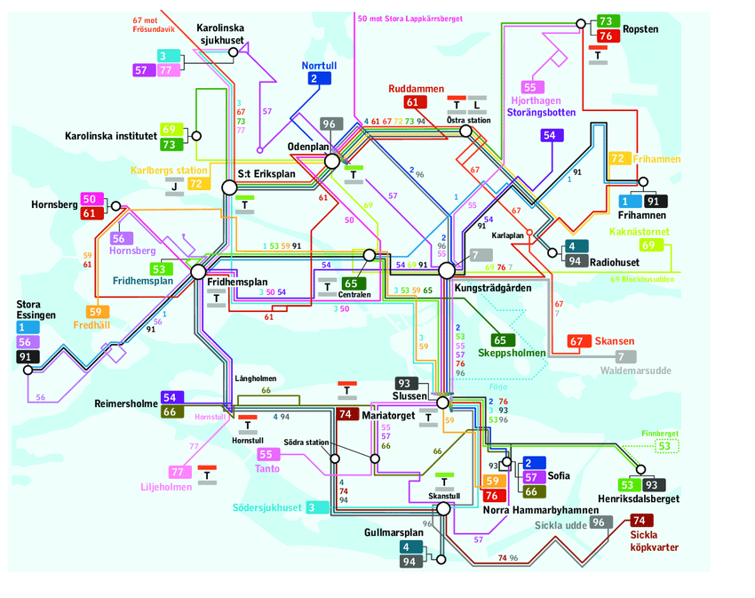
2. Detailed Analysis of Successful Projects
2.3 Case Study: Swedish Bus Ridership Growth
      Sweden’s bus network improvements in regions like Skåne and Västra Götaland resulted from long-term planning, frequency boosts, and dedicated corridors.
      Operator incentive contracts and public-private collaboration further accelerated ridership gains. Local engagement ensured changes met community needs.
Central Bus Lines in Stockholm
8
Case Studies in Transport Research

Slide 13
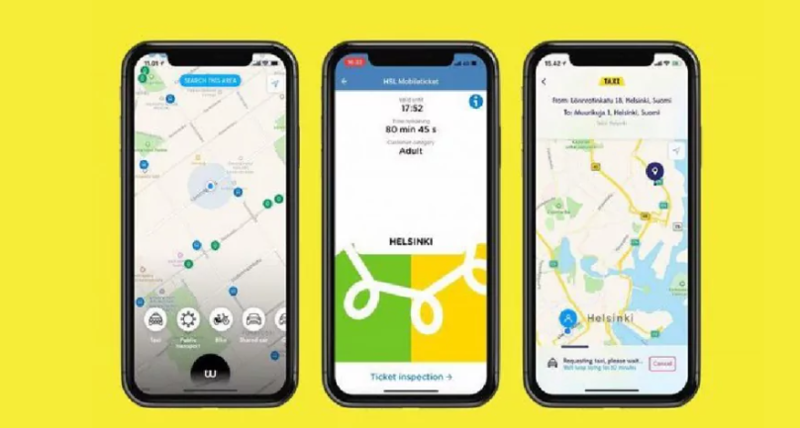
2. Detailed Analysis of Successful Projects
2.4 Case Study: Incorporating Mobility-as-a-Service (MaaS)
      MaaS integrates multiple travel modes into one seamless digital platform. Helsinki’s Whim app bundles metro, bus, bike, taxi, and rental services.
      The system aims to replace car ownership by offering convenient, flexible travel solutions.
      Barriers include interoperability of fare systems, data sharing, and commercial viability.
A screenshot of the Whim app's home screen, showcasing various transportation options integrated into a single platform from Helsinki
9
Case Studies in Transport Research

Slide 14
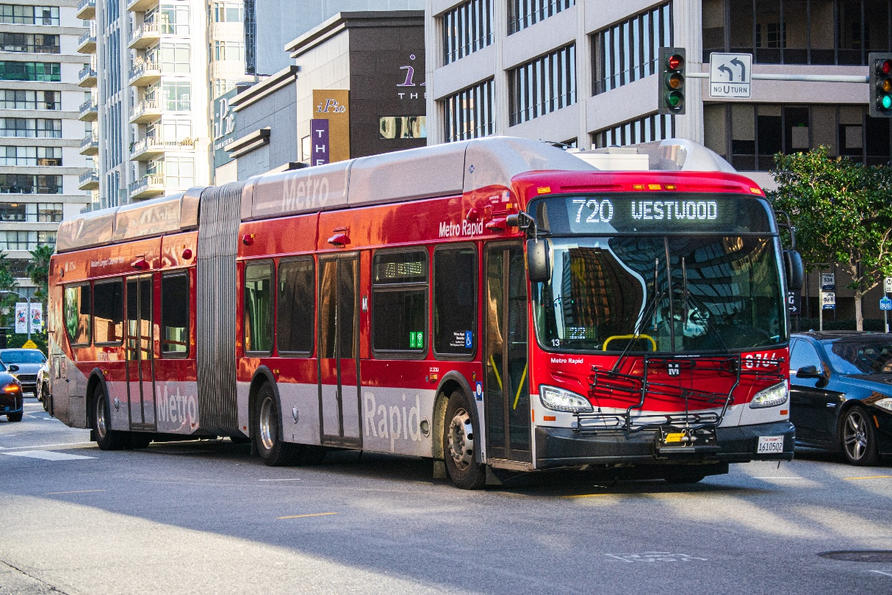
2. Detailed Analysis of Successful Projects
2.5 On-Road Public Transport Priority
      Bus Rapid Transit systems with dedicated lanes, traffic signal priority, and all-door boarding have reduced travel time significantly.
      London, Bogotá, and Los Angeles have implemented these measures to improve service punctuality and attract new riders.
Los Angeles Metro Rapid Bus on Wilshire Boulevard
10
Case Studies in Transport Research

Slide 15
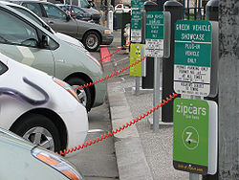
2. Detailed Analysis of Successful Projects
2.6 Insights from ACES Integration
ACES technologies (Autonomous, Connected, Electric, Shared) reshape how cities design and operate transport systems.
Autonomous shuttles support first/last mile solutions, electric buses reduce emissions, and shared mobility fills transit gaps.
Success requires clear regulatory frameworks, stakeholder collaboration, and inclusive design.
Zipcar Charging Station in San Francisco, California
11
Case Studies in Transport Research

Slide 16
Section 03:
Lessons Learned
Case Studies in Transport Research

Slide 17
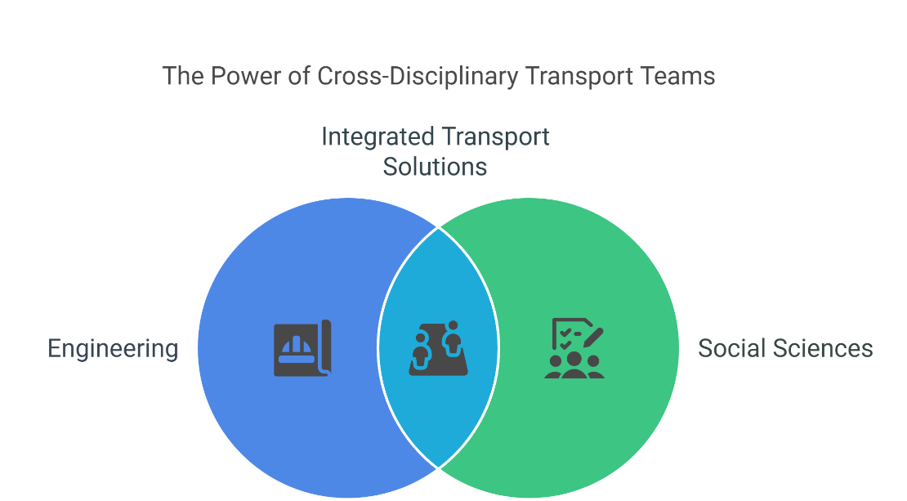
3. Lessons Learned
3.1 Interdisciplinary Integration for Complex Problems
Effective transport research and implementation increasingly rely on a blend of disciplines. Engineering provides the backbone infrastructure, but successful systems are those shaped by contributions from urban planning, data analytics, behavioral science, economics, and governance. Cross-disciplinary teams are better at:
    Understanding socio-economic impacts of transport decisions
    Designing for equity and inclusiveness
    Modeling real-world behavior and system interactions
For example, congestion pricing in Stockholm succeeded due to economic modeling, traffic simulation, and public communication strategies led by a diverse team.
13
Case Studies in Transport Research

Slide 18
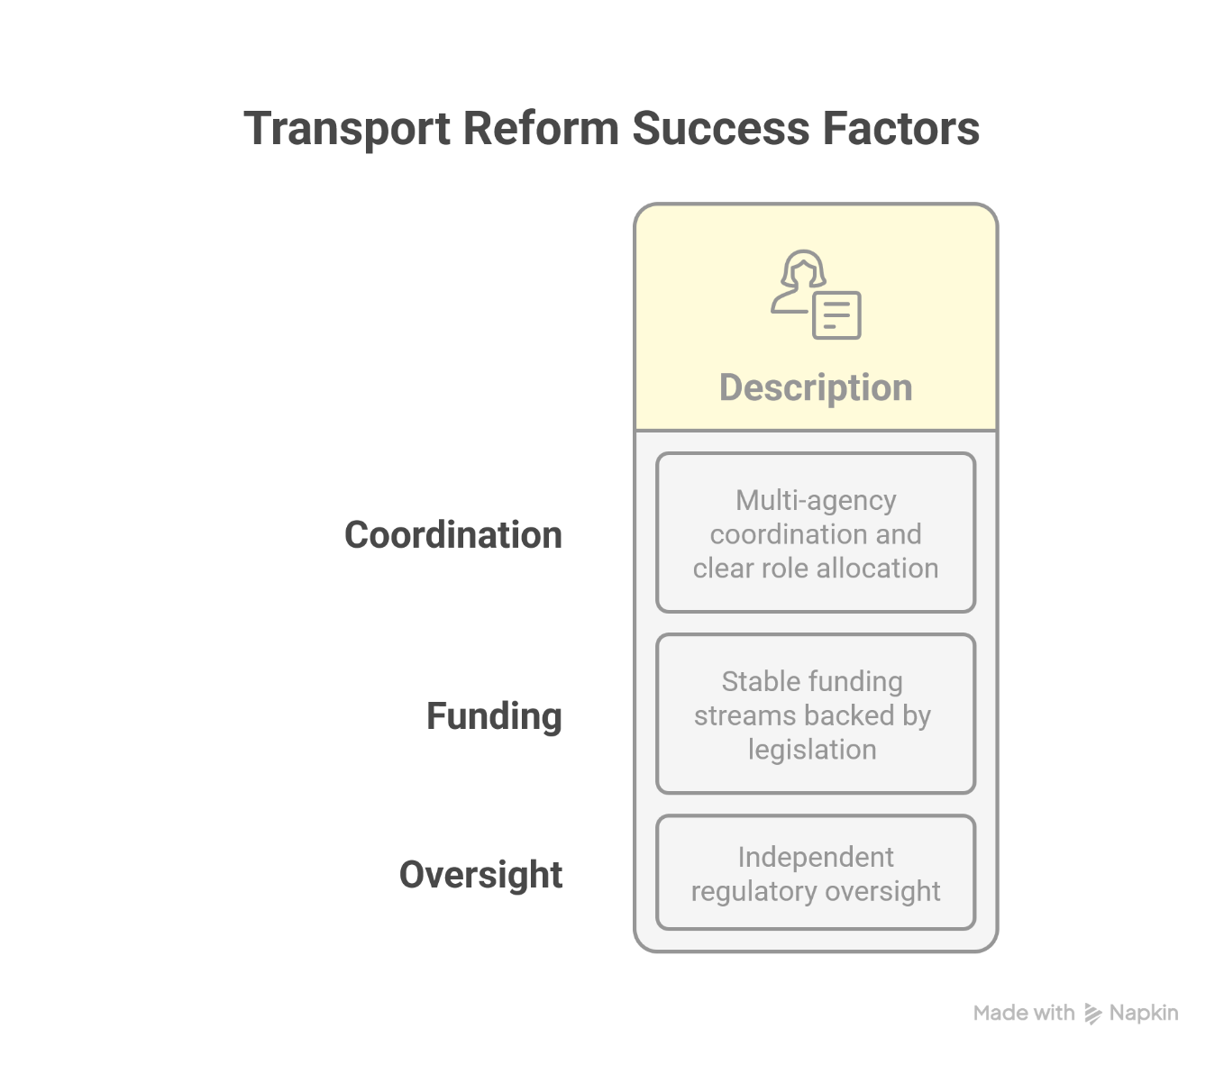
3. Lessons Learned
3.2 Role of Policy and Governance in Transport Projects
Policy and governance shape the scope, speed, and sustainability of transport reforms. Projects with strong political support and clear governance structures show higher success rates. Key success factors include:
Multi-agency coordination and clear role allocation
Stable funding streams backed by legislation
Independent regulatory oversight
For instance, London's establishment of Transport for London (TfL) as a unified body allowed for integrated planning, fare setting, and modal coordination. In contrast, fragmented governance often leads to duplicated efforts and underutilized resources.
14
Case Studies in Transport Research

Slide 19
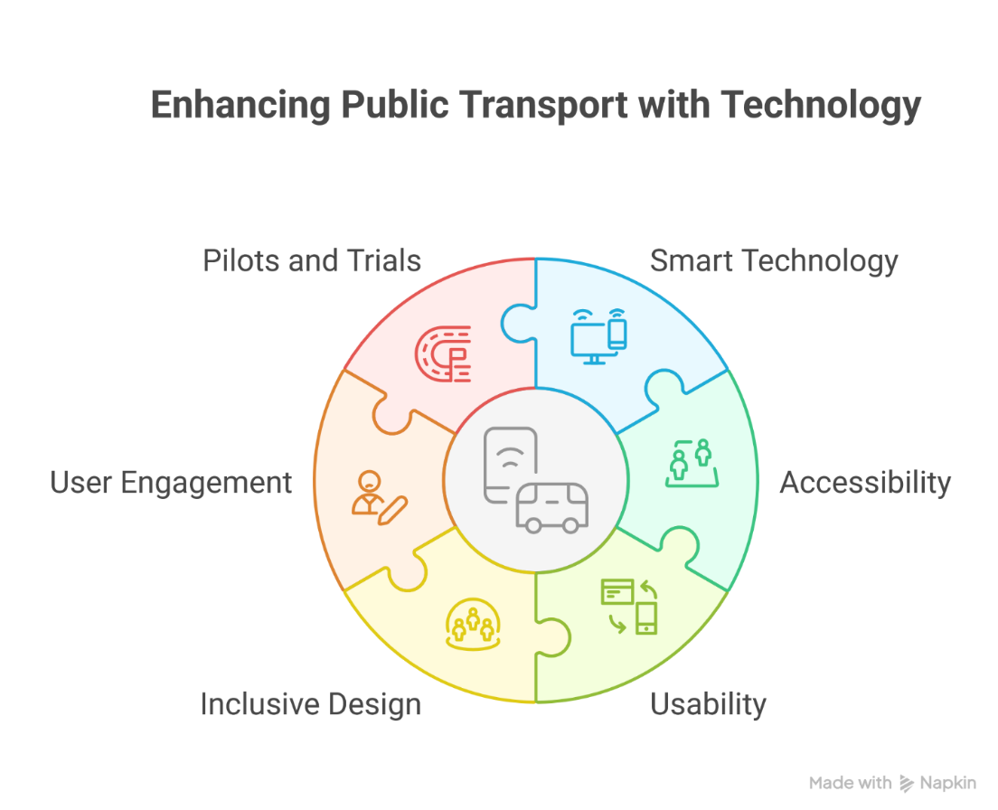
3. Lessons Learned
3.3 Technological Enablement and User-Centric Design
Technology can transform public transport, but only when aligned with user needs. Successful systems incorporate smart tech like real-time tracking, contactless payments, and predictive analytics but always prioritize accessibility and usability.
Best practices include:
Inclusive design principles for apps, stations, and signage
Continuous feedback loops through user engagement
Pilots and trials before full-scale deployment
For example, Seoul’s metro integrates multilingual interfaces, color-coded maps, and mobile alerts to cater to tourists and locals alike.
15
Case Studies in Transport Research

Slide 20
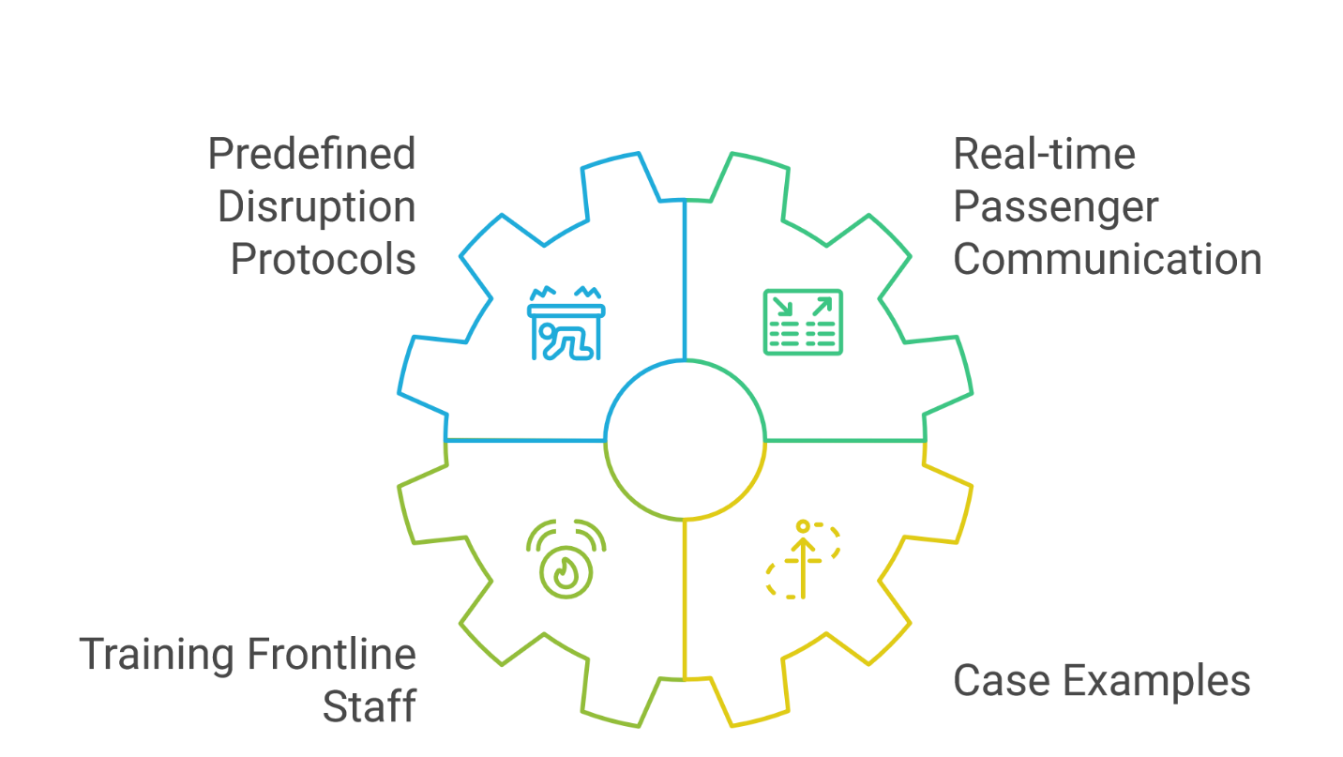
3. Lessons Learned
3.4 Failures and Fixes: Managing Disruption and Service Reliability
No transport system is immune to disruptions—technical faults, strikes, accidents, or natural disasters. Learning from past failures allows systems to embed resilience and recover quickly. Successful strategies include:
Predefined disruption protocols and backup plans
Real-time passenger communication (alerts, apps, station displays)
Training frontline staff in emergency scenarios
Case examples:
New York’s MTA uses real-time social media alerts and alternative routing via apps.
Hong Kong MTR prioritizes post-disruption transparency and public engagement.
16
Case Studies in Transport Research

Slide 21
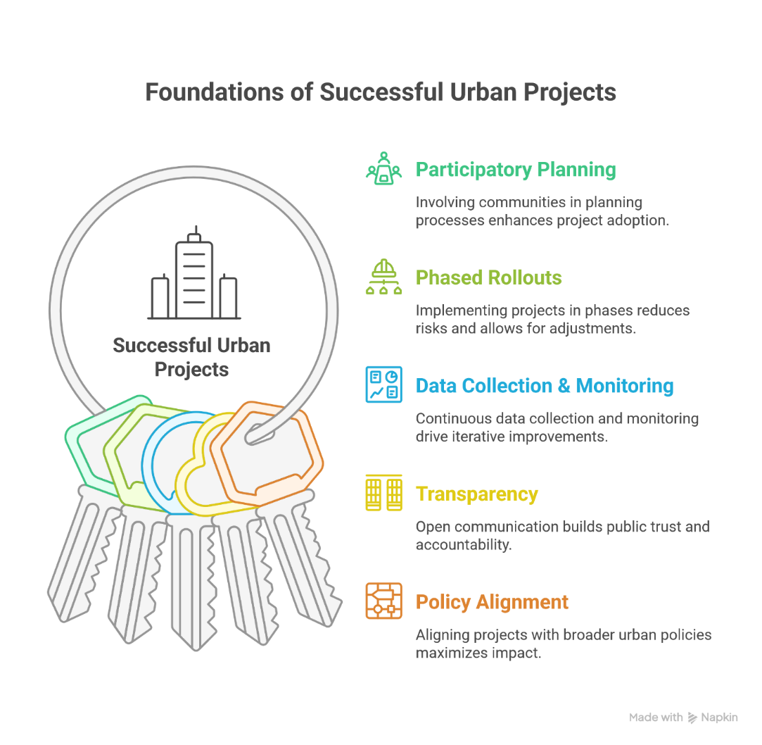
3. Lessons Learned
3.5 Key Takeaways from International Experience
Cross-national comparison highlights that context matters, but successful projects share common foundations:
Participatory planning with communities leads to higher adoption
Phased rollouts and pilots reduce implementation risks
Data collection and monitoring help iterate and improve
Transparency fosters public trust
Alignment with broader urban policies (housing, climate, economy) increases systemic impact
For example, Vienna's integrated land-use and transit planning model has been adopted globally due to its long-term, citizen-oriented framework.
17
Case Studies in Transport Research

Slide 22
Section 04:
Best Practices in Transport Research & Implementation
Case Studies in Transport Research

Slide 23
4. Best Practices in Transport Research & Implementation
4.1 Design Thinking and Co-Creation with Users
Design thinking emphasizes empathy, ideation, prototyping, and testing with the end user in mind. In transport, co-creation involves stakeholders—commuters, operators, people with disabilities, local businesses—in the design process.
Best practices include:
Conducting workshops and focus groups during early planning phases
Rapid prototyping of station layouts and interfaces for user testing
Including feedback loops post-deployment
Examples:
London's Underground redesigns signage through public trials.
Vienna uses participatory budgeting to allocate funds to community-prioritized transit improvements.
19
Case Studies in Transport Research

Slide 24
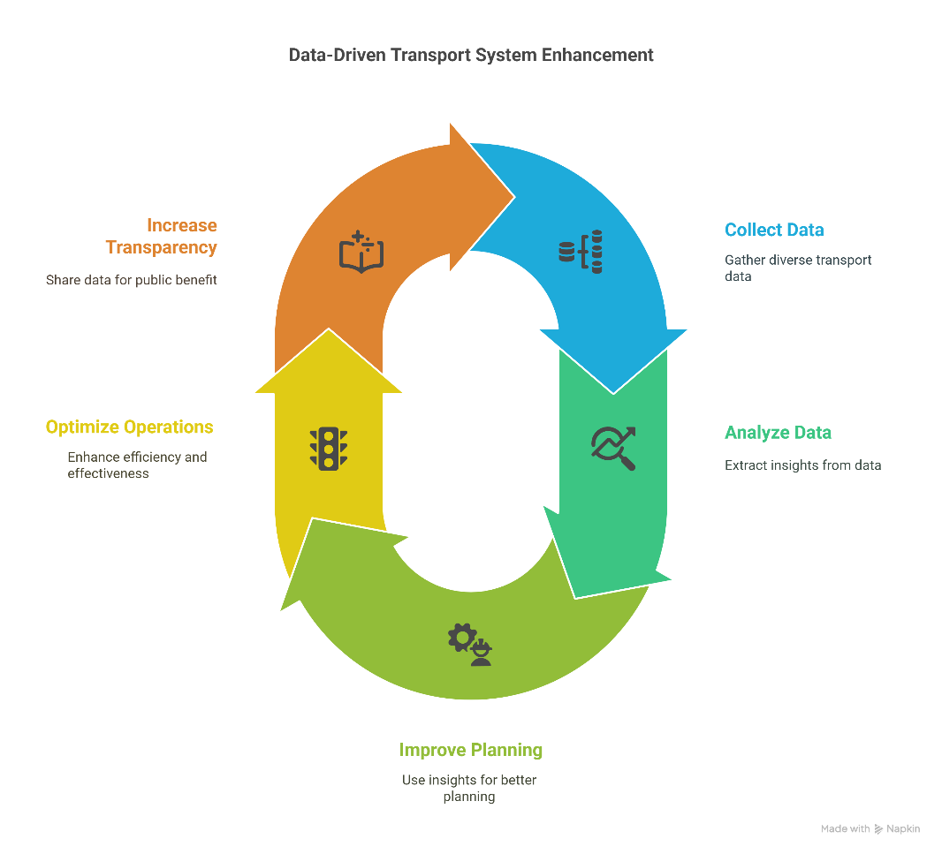
4. Best Practices in Transport Research & Implementation
4.2 Data-Driven Decision Making
Transport systems generate vast amounts of data—ridership, traffic flows, vehicle health. When analyzed correctly, this data improves planning, operations, and transparency.
Applications include:
Predictive maintenance for buses and trains
Dynamic route optimization and traffic signal control
Monitoring fare evasion or underutilized routes
Case Studies:
Amsterdam’s smart mobility dashboards optimize tram frequency.
Seoul uses mobile ticketing and GPS data for real-time bus scheduling.
20
Case Studies in Transport Research

Slide 25
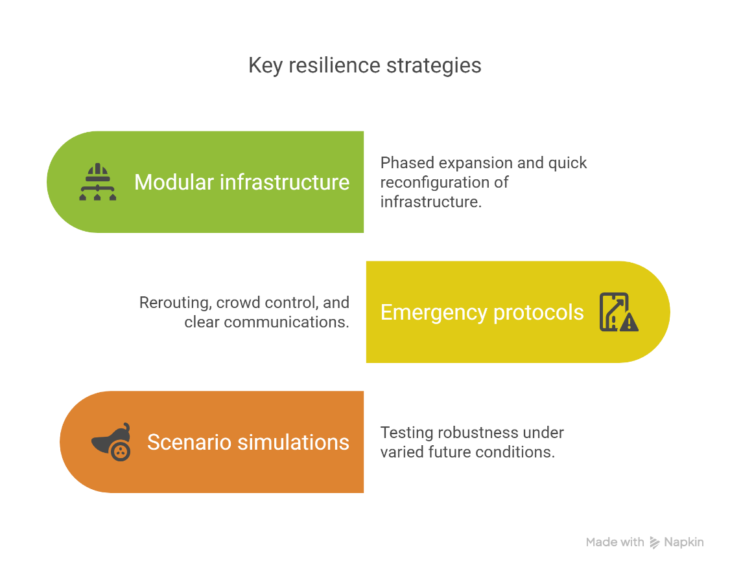
4. Best Practices in Transport Research & Implementation
4.3 Planning for Resilience and Flexibility
Transport systems must adapt to climate change, pandemics, and unexpected shocks. Embedding resilience in project design ensures service continuity under stress.
Key strategies:
Modular infrastructure allowing phased expansion or quick reconfiguration
Emergency protocols for rerouting, crowd control, and communications
Scenario-based simulations to test robustness under varied futures
Example:
Tokyo’s rail network uses real-time earthquake sensors to halt operations safely and resume quickly.
21
Case Studies in Transport Research

Slide 26
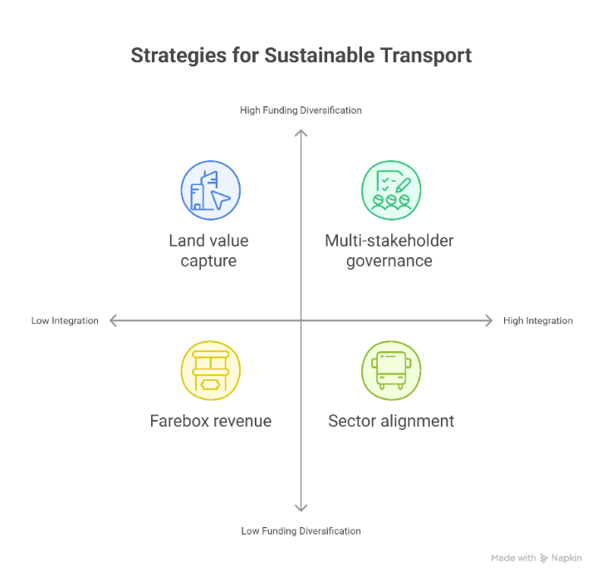
4. Best Practices in Transport Research & Implementation
4.4 Integrated Approaches to Governance and Funding
Long-term transport sustainability depends on integrated planning and diversified funding models.
Approaches include:
Combining farebox revenue with land value capture (e.g., taxes on real estate benefiting from improved transit)
Aligning urban transport with housing, environment, and health sectors
Multi-stakeholder governance bodies coordinating investment and priorities
Example:
Hong Kong’s MTR Corporation funds metro expansion through real estate development at station sites.
22
Case Studies in Transport Research

Slide 27
4. Best Practices in Transport Research & Implementation
4.5 Measuring Total Social Cost (TSC) and Long-Term Impact
Transport projects are traditionally evaluated on capital cost and ridership. However, measuring Total Social Cost (TSC) includes a broader range of indicators:
Emissions and environmental impact
Social equity and accessibility
Land use efficiency
Health and well-being benefits
Tools like Multi-Criteria Analysis (MCA) and cost-benefit frameworks can better capture these elements. This leads to more equitable and sustainable investment decisions.
Example:
Copenhagen evaluates cycling infrastructure based on health savings, travel time, and reduced emissions—not just bike counts.
23
Case Studies in Transport Research

Slide 28
Section 05:
Discussion and Final Remarks
Case Studies in Transport Research

Slide 29
5. Discussion and Final Remarks
5.1 Vehicle Technology
Q1: Which of these case studies could be implemented in your local context?
Q2: What barriers technical or political would you anticipate?
Q3: Can technology alone solve mobility challenges?
25
Case Studies in Transport Research
Notes:
Q1:
The Mobility-as-a-Service (MaaS) model (e.g., Helsinki’s Whim app) could be adapted to urban centers in our region, particularly where multiple transport modes exist (e.g., buses, taxis, trains, and ride-hailing).
Additionally, On-Road Public Transport Priority measures, such as bus-only lanes and traffic signal prioritization, could be implemented to address peak-hour congestion.
Q2:
Technical Barriers:
Fragmented data systems across transport operators.
Lack of real-time GPS or fare integration infrastructure.
Low digital literacy in certain population segments.
Political Barriers:
Resistance from private operators or unions fearing loss of control or income.
Funding constraints and competing priorities (e.g., road development over public transport).
Institutional fragmentation—multiple authorities managing different aspects of mobility.
Q3:
No, technology is an enabler—not a silver bullet.
While smart cards, real-time apps, and AI optimization can enhance efficiency and user experience, true solutions require:
Institutional reforms (e.g., integrated planning authorities).
Community engagement and inclusive design.
Policies promoting sustainability and equity.
Long-term funding and governance stability.

Slide 30
5. Discussion and Final Remarks
5.2 Final Thoughts and Reflections
Successful transport projects are rarely about infrastructure alone they depend on people, policy, process, and purpose. Engineers must think systemically and act collaboratively.
26
Case Studies in Transport Research

Slide 31
5. Discussion and Final Remarks
5.3 Recommendations for Future Research/Practice
Research MaaS adoption in low-income communities.
Explore ethical and operational challenges of autonomous public transport.
Develop metrics for transport equity and well-being.
27
Case Studies in Transport Research

