Slide 1
Industrial Energy Use, Efficiency, and Savings:
Methods for Quantitative Analysis
Professor Anna Volkova, PhD
Tallinn University of Technology

Slide 2

The measurement trap in manufacturing EE
Aggregation can hide order-of-magnitude differences in manufacturing.
Today: methods landscape → evolution → quality risks → methods→ practical checklist
Heterogeneity
EE ≠ EI
Method - context fit

Slide 3
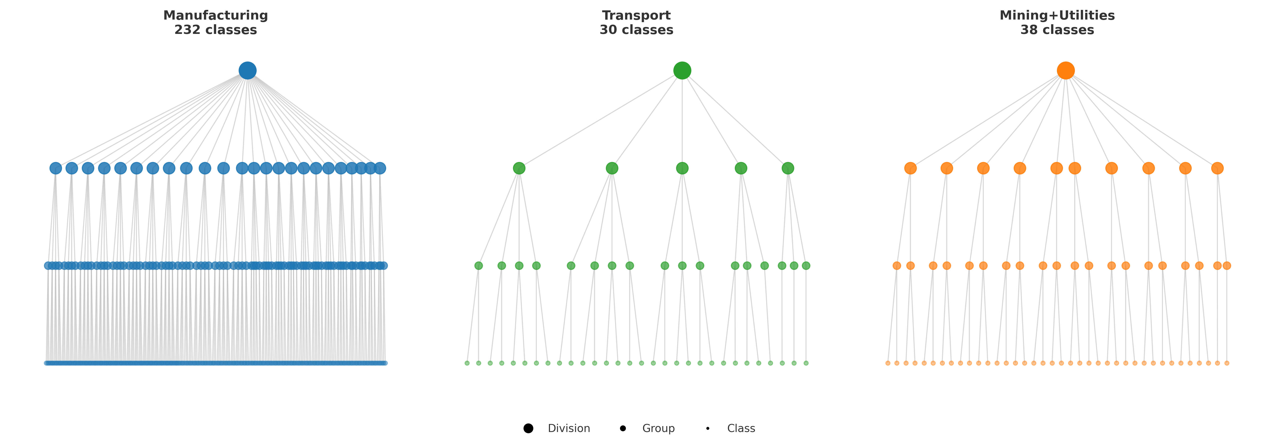
NACE sectoral complexity

Slide 4
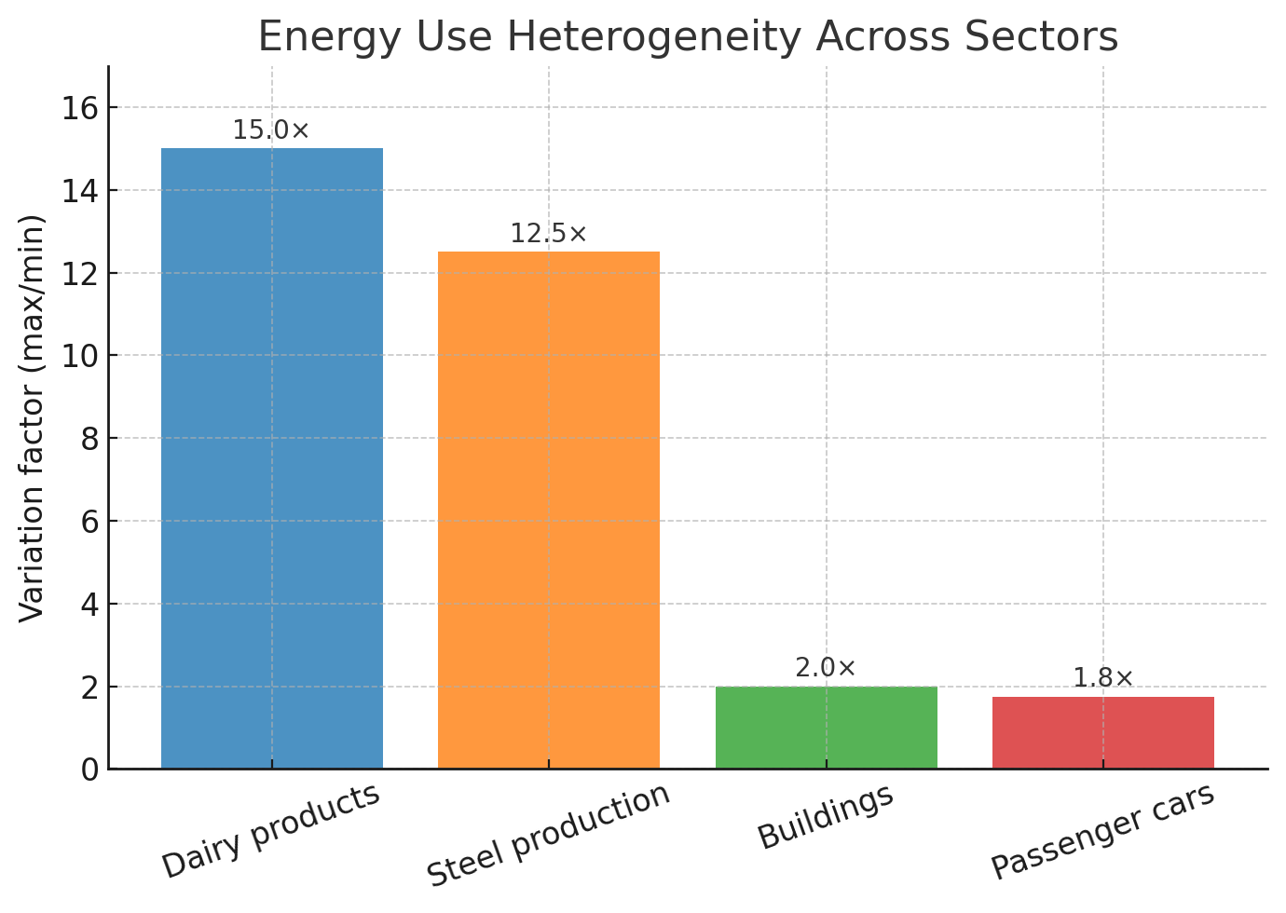
Why manufacturing is a different beast
WITHIN-CLASS VARIATION

Slide 5


Research questions
Methods for country-level EE in
manufacturing: evolution
How data & method choice
affect reliability of EE assessments
Contribution:
first cross-method comparative review for manufacturing EE

Slide 6
Systematic review design
Scopus (query in annex) → 7,229 records →
title/abstract + full-text screening → 110 included (2005–2024).
Search & screening:
Assessment criteria:
  definition consistency,
  data granularity,
  method-context alignment.

Slide 7
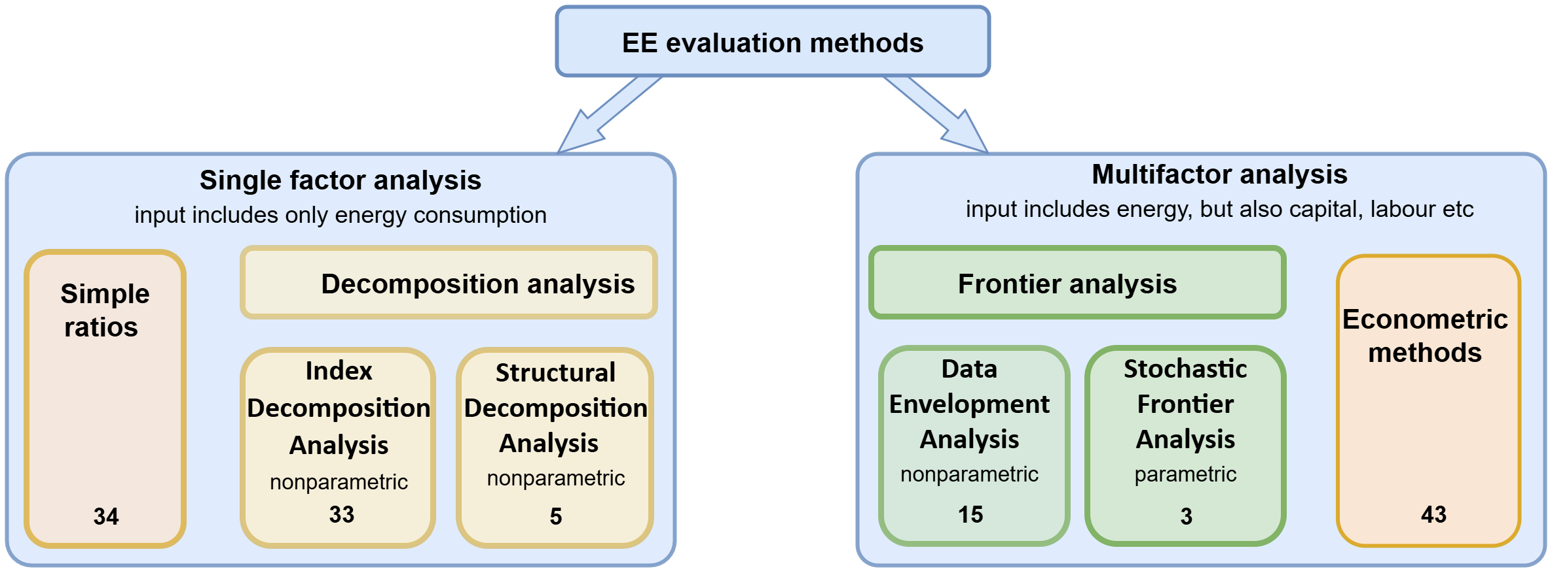
Methods landscape

Slide 8
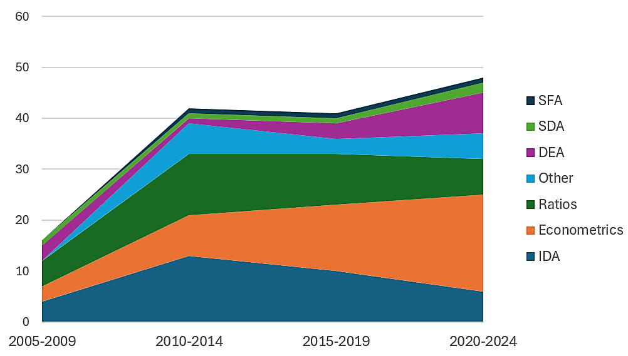
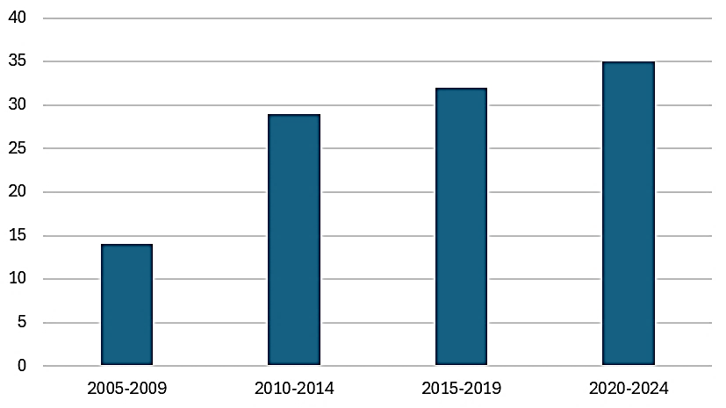
Trends over time

Slide 9
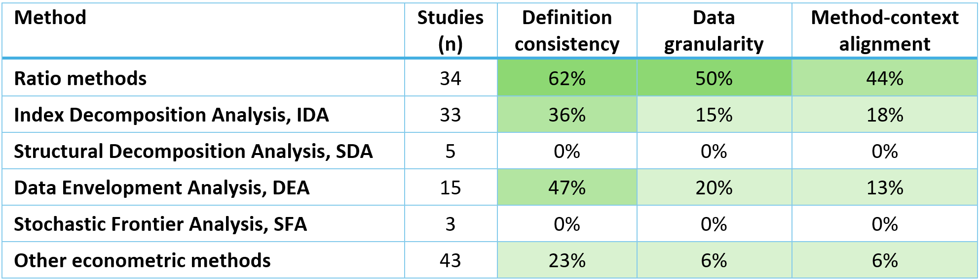
Quality at GLANCE

Slide 11

1. Ratio-Based METHOD
Approaches
Energy Intensity (EI): energy per € output (often used as proxy for EE).
Energy Productivity (EP):inverse of EI
Specific Energy Consumption (SEC): energy per physical unit (e.g., GJ/t steel).
Energy Efficiency Index (EEI): actual energy vs reference/best practice (=100 baseline).
How used in studies
Pros
Transparent, easy to communicate & benchmark;
Works well when physical output is available
Watch-outs
EE ≠ EI: economic denominators embed prices/structure/cycles.
Can’t by themselves separate technical efficiency from product mix or external factors.
62%
50%
44%

Slide 12
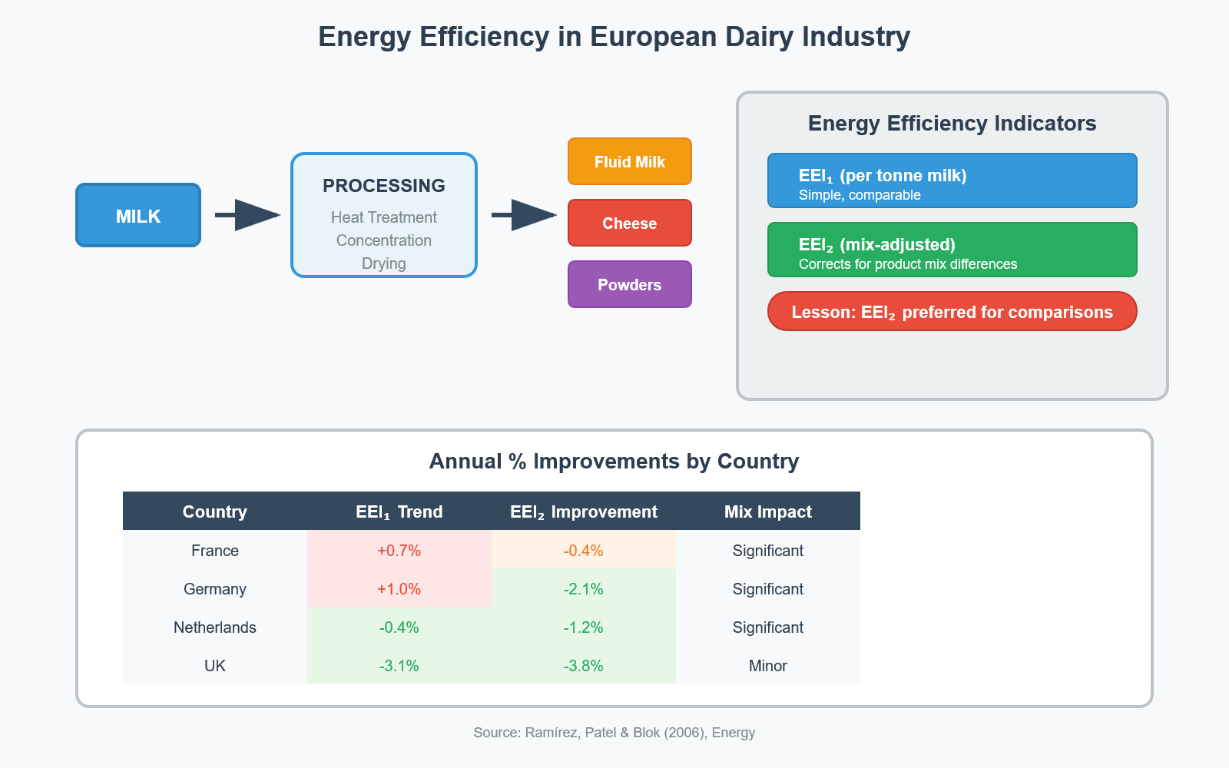
1. RatioS - Case: Dairy in 4 EU countries —
why product mix matters
Ramírez, Patel & Blok (2006), Energy
Data & setting
Sector: Dairy (NACE 155); Countries/years: FR, DE, NL, UK (late-80s/90s).
Energy: by carrier (electricity, fossil/steam), corrected to primary (×2.5 for electricity); NCV/GCV and climate corrections applied.
Outputs: raw milk delivered + product volumes by branch (fluid milk, cheese, powders, etc.).
Method & what’s special
Two ratio indicators:
Indicator 1 = energy per tonne of raw milk (SEC); simple, communicable.
Indicator 2 = mix-corrected SEC (energy use/output) using product-specific reference SECs (counterfactual). Preferred for cross-country/over-time comparison.
Findings
After mix-correction, annual improvements:
FR −0.4%, DE −2.1%, NL −1.2%, UK −3.8%; DE/NL/UK converge, FR lags.
Policy frame: FR could save ~30% if converging to DE/UK efficiency levels

Slide 14
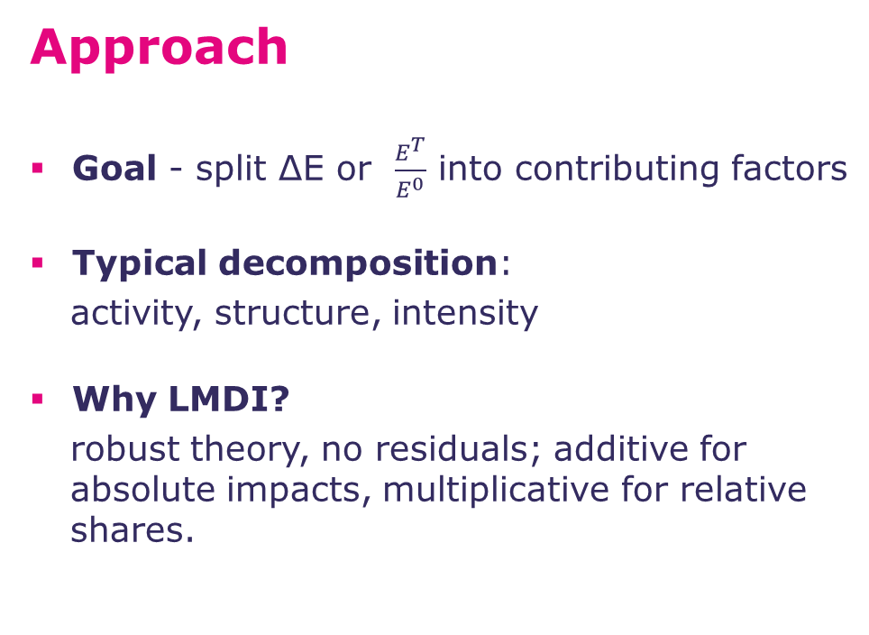
2. Decomposition (IDA/LMDI):
separating drivers of energy change
Approach
Goal - split ΔE or $\frac{E^{T}}{E^{0}}$ into contributing factors
Typical decomposition:
activity, structure, intensity
Why LMDI?
robust theory, no residuals; additive for absolute impacts, multiplicative for relative shares.
How used in studies
Pros
Clear attribution of what drove change (activity vs structure vs intensity).
Works well with official statistics/time series; easy to align with policy narratives.
Watch-outs
Intensity effect ≠ pure technical EE
Coarse (1–2 digit) aggregation hides tech routes; factor independence.
12%
15%
18%

Slide 15
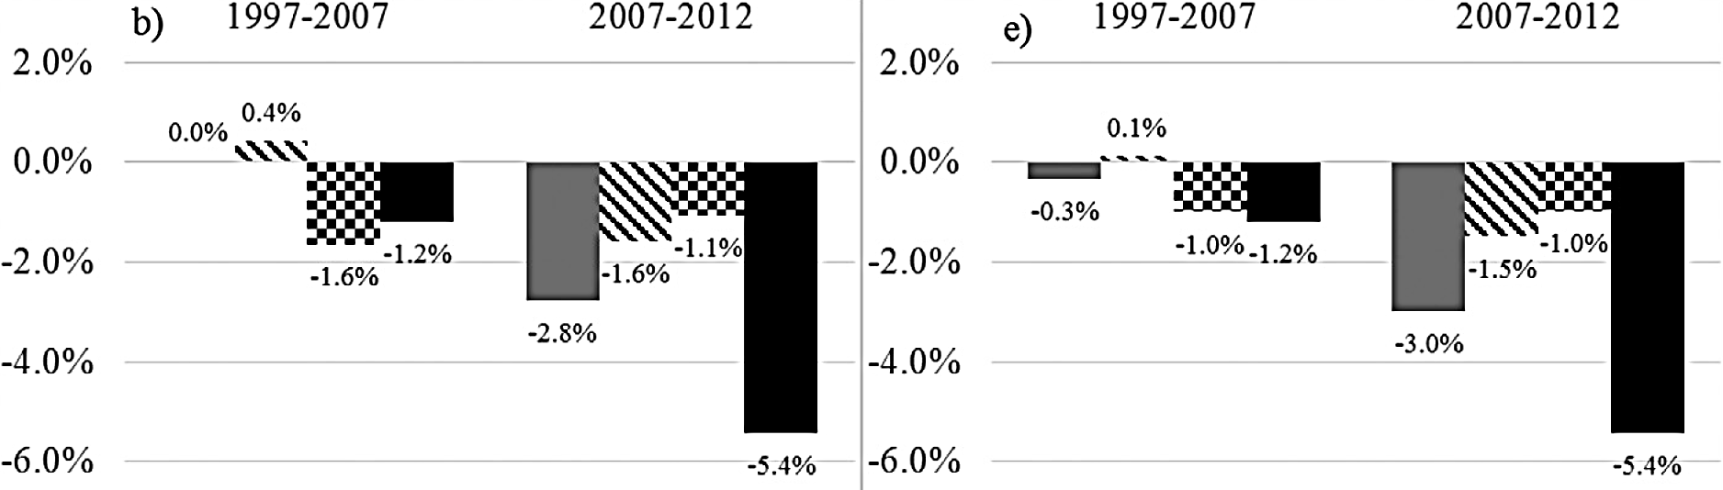
IDA - Case: UK manufacturing (1997–2012), AR-LMDI
Norman (2017), Energy
Data & setting
Sector: Whole UK manufacturing,
43 subsectors, EI vs NEI split.
Data: CCA scheme (energy, physical output), ONS Environmental Accounts, ABS (costs, number of enterprises),
physical output for steel & cement injected via AR.
Method & what’s special
LMDI (additive, chained): ΔE = Activity + Structure + Intensity.
Activity-Refactorisation (AR): blends monetary + physical outputs → reduces bias when monetary output alone misstates physical change. Overcomes overestimation of “efficiency.”
Findings
AR matters: using only monetary output overestimates efficiency gains; adding physical output shrinks the intensity contribution, esp. in EI (steel/cement).
Policy ask: publish physical outputs with national energy accounts to track true EE.
Standard LMDI
monetary input
AR Method
physical input partly
Energy intensive sector, 1997-2007

Slide 17
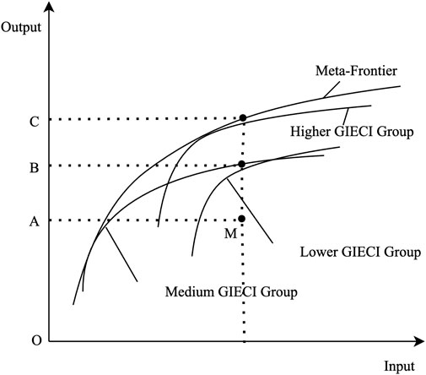
3. Frontier analysis (DEA)
Approach
Goal - benchmark DMUs against a best-practice frontier → “technical EE” gap. Minimize energy for given outputs.
Extensions
Malmquist (time), metafrontier, TFEE
How used in studies
Pros
Multi-input/multi-output; no functional-form assumptions.
Benchmarks DMUs vs best practice; identifies peers & targets.
Watch-outs
Most studies rely on 2-digit data (and assume homogeneity)
Treats noise as inefficiency; sensitive to outliers & small samples
Frontier work is credible at macro-scale only if product mix/physical structure are embedded.
47%
20%
13%
Source: Han, Qu, Han 2023

Slide 18
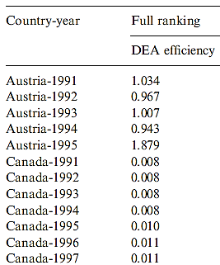
DEA Case - Petroleum Refining
(OECD + IRAN, 1991-1995)
Azadeh et al. (2007), Energy Policy
Data & setting
DMUs: country-years (IRAN + OECD)
Inputs: Electricity (MWh), Fossil fuels (toe)
Outputs: inverse AWBP = structure (light/heavy product mix).
TWP (throughput weighted by best-practice SECs) = activity at best practice;
Method & what’s special
DEA, input-oriented, CRS & VRS; super-efficiency for sensitivity.
Physical/structural outputs encode heterogeneity.
PCA, NT used to validate DEA rankings.
Findings
Efficient peers: e.g., Austria in multiple years;
many units are scale-inefficient (CRS≪VRS).
For inefficient DMUs, electricity is typically the
limiting input; potential savings larger in fossil
fuels overall.

Slide 20
4. Econometrics – case: Plastics (Italy, 2019 audits)
Approaches
Panel regression
Censored / discrete choice (Tobit / Logit)
Dynamic panels (GMM)
VAR / VECM / cointegration
Convergence (β / σ)
How used in studies
Pros
Determinants, dynamics.
Best practice: audit/physical data, clear EE definitions, and models aligned to sector/process diversity (e.g., cement, plastics).
Watch-outs
Intensity misused as EE, low physical data
Coarse 1–2 digit data
Models not tailored to industrial diversity
62%
50%
44%
23%
6%
6%

Slide 21
Econometrics – case: Plastics (Italy, 2019 audits)
what drives energy-saving performance?
Costantini et al. (2024), Energies
Data & setting
Microdata: ENEA energy audits (2019) for plastics (4-digit) + AIDA firm accounts; ~1.3k EEMs, 453 companies.
Outcome: energy-saving performance (EEM savings / site total)
Covariates: investment, payback, incentives (White Certificates), monitoring/ISO 50001, region, firm finance.
Method & what’s special
Measuring energy saving performance with EEM
Logit (drivers) for above-mean performance
OLS (with/without firm FE)
Diagnostics
Findings
Capex and quick paybacks drive energy saving performance
Regional and incentive contexts significant in some specs.
Lesson: audit microdata + firm controls produce actionable levers (capex, PBP, incentives).
21

Slide 22
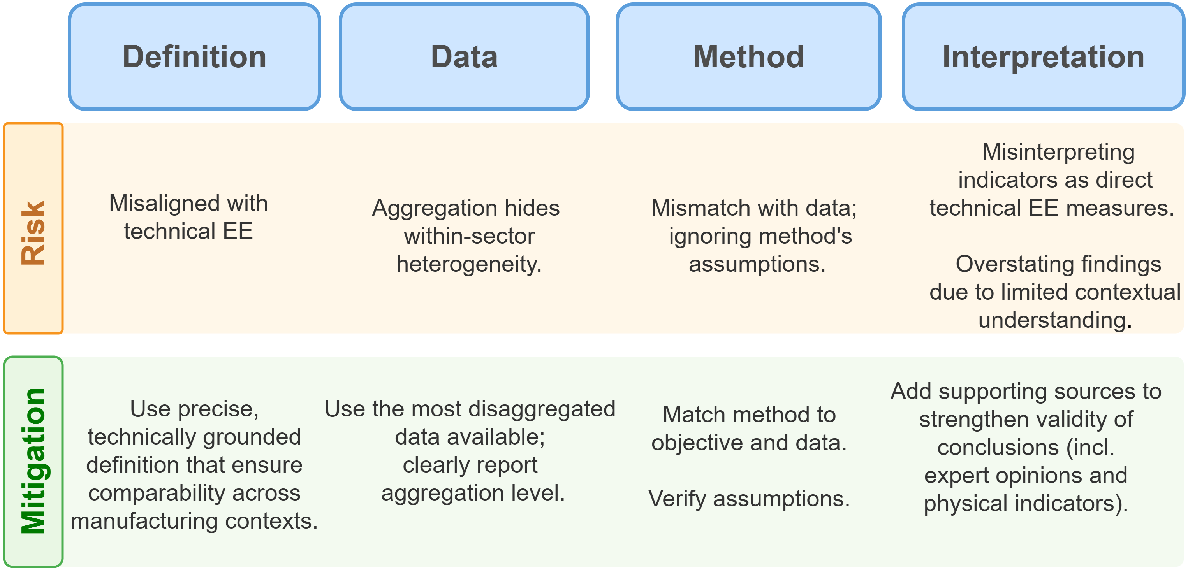
A 4-level risk → mitigation map

Slide 23
Practical checklist for evaluators
State EE definition (EE vs EI);
Prefer physical indicators;
Fully grasp the heterogeneity of the manufacturing sector;
Disaggregate (≥3-digit; ≥4-digit for e.g. Food & Bev);
if IDA then show sensitivity to aggregation, consider injecting physical output;
if DEA then ensure DMU homogeneity; choose input-orientation; use VRS; group by technology or use metafrontier;
Pair top-down with expert/process evidence.

Slide 24
Summary/takeaways
Manufacturing ≠ buildings/transport:
heterogeneity makes method–context fit decisive
In 110 studies, context alignment is weakest;
data granularity is the other major gap
Ratios can be most credible when physical & mix-corrected
Priority: physical-output series with national energy accounts

