Slide 1
Introduction to Renewable Energy Systems

Slide 2
Content
World primary energy consumption
Generation and total emissions
Where energy is used most and how to reduce energy use and emissions and waste
What are the projections for future energy use?
What technologies are planned to be used for this purpose?
What are green energy technologies at all? What are their opportunities and problems? What have been the technological developments in these different productions? How much have capacities and efficiency increased?
Have prices changed and how?
What limits the uptake of green technologies?

Slide 3
Primary Energy
Energy chain
Consumption
Production
CO₂ emissions

Slide 4
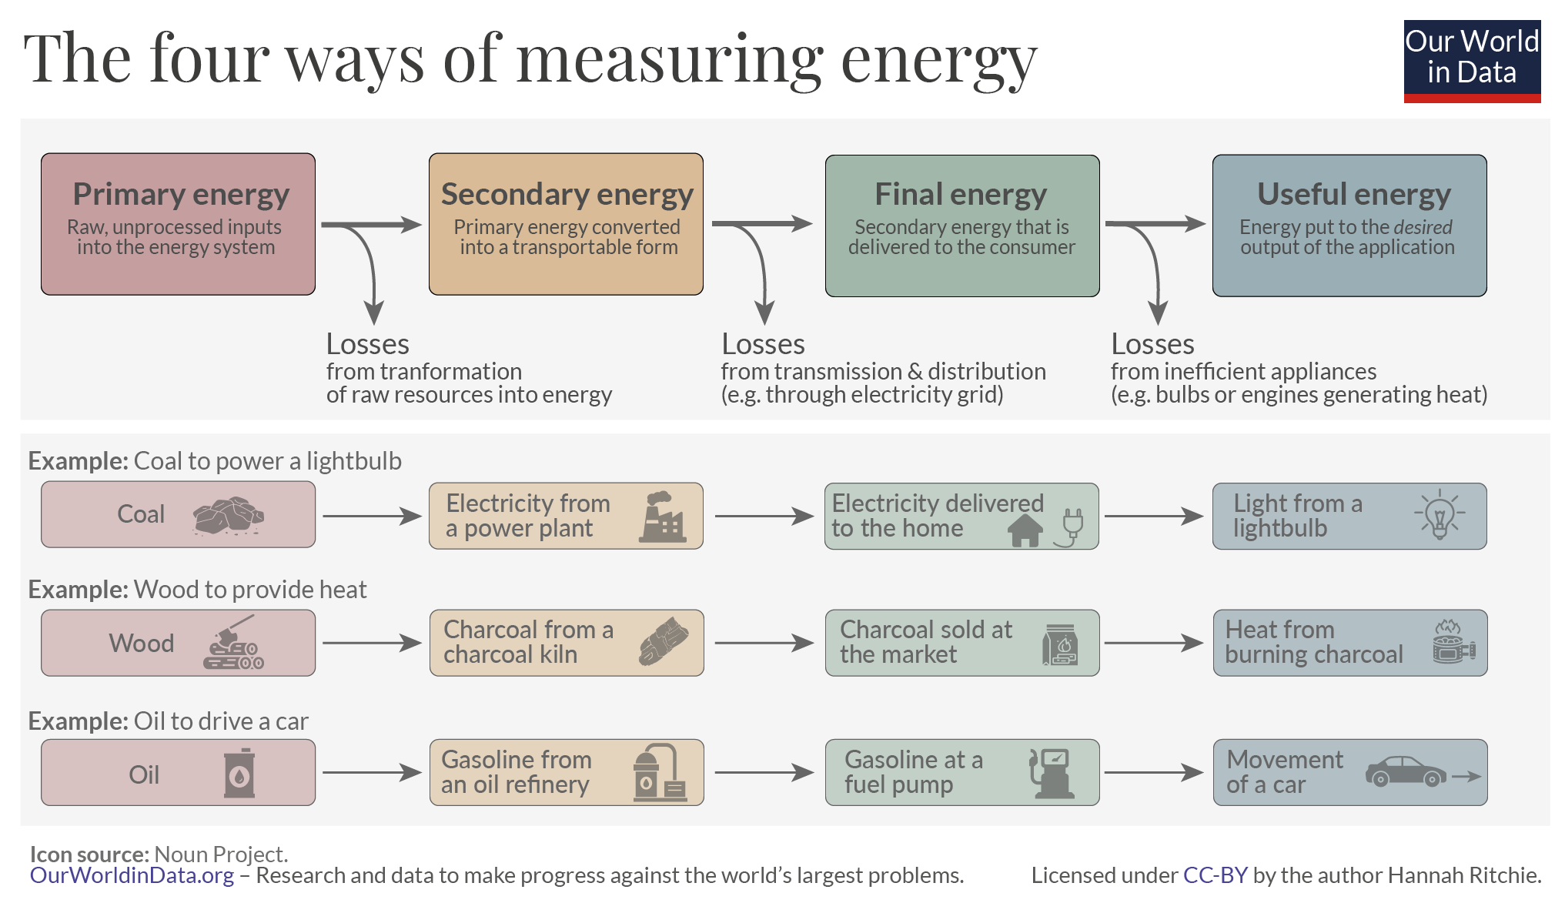
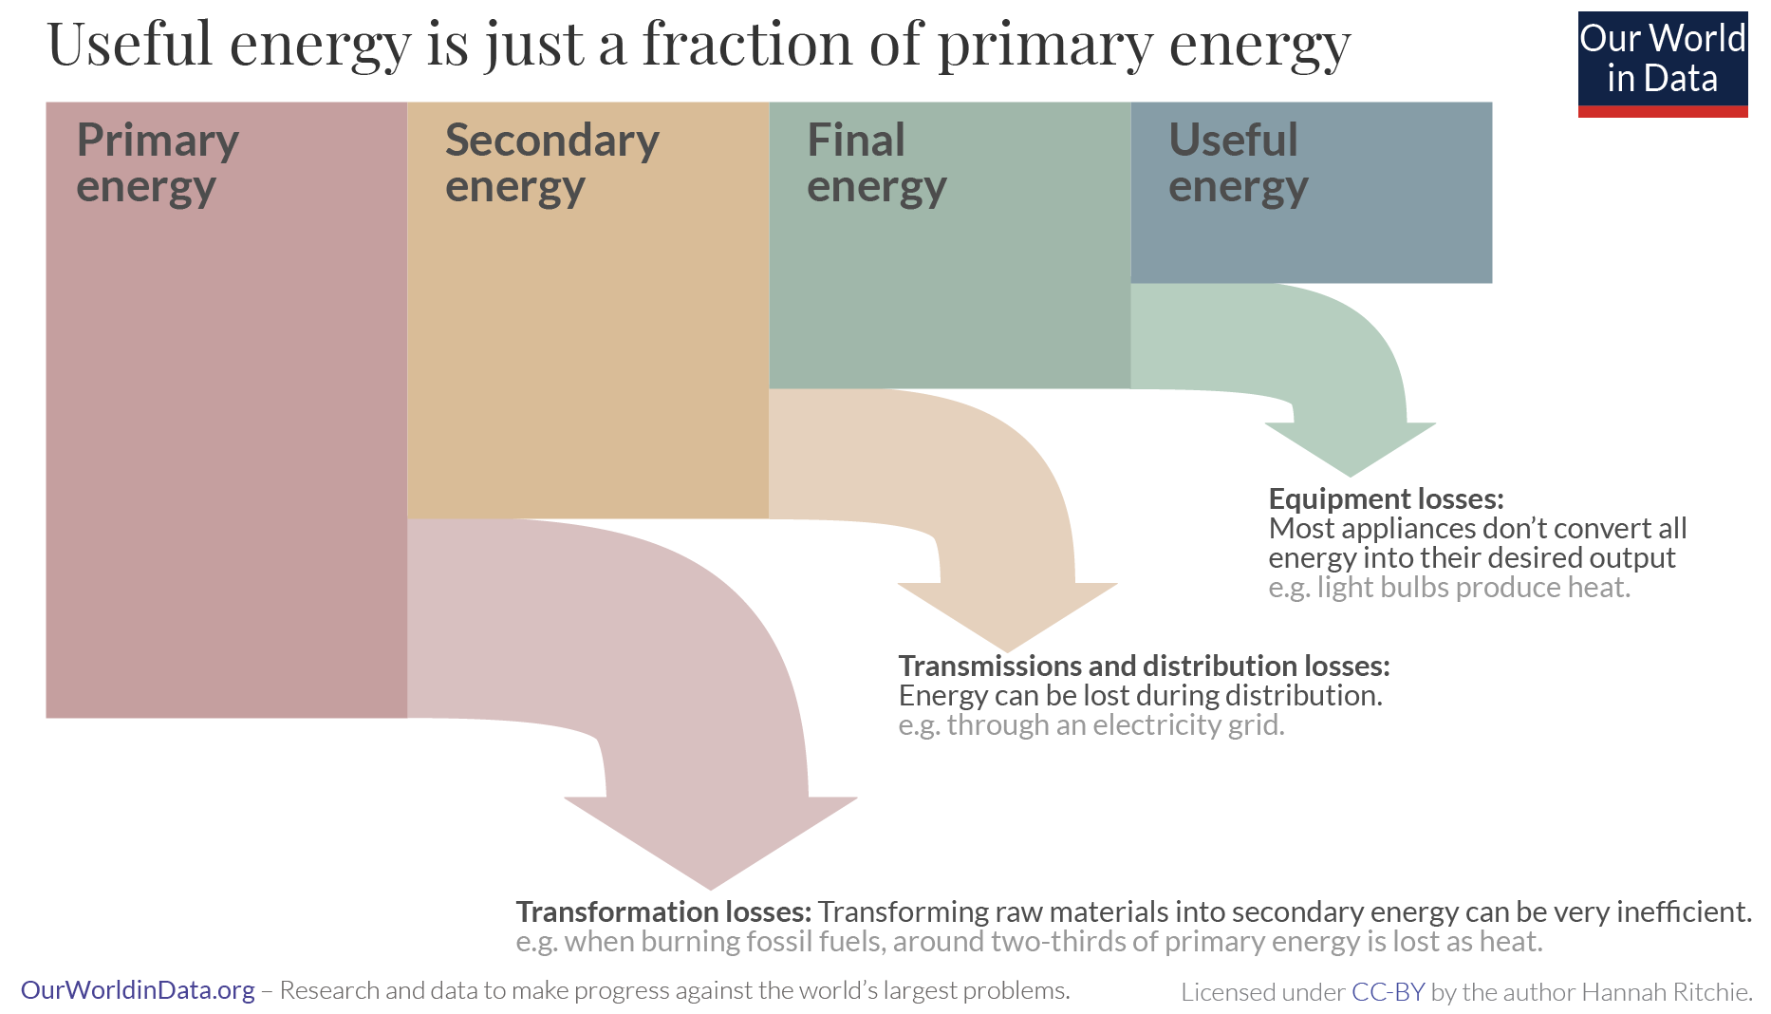
energy chains
Primary energy is the energy as it is available as resources, which is the most widely available statistic and very commonly used.
Each stage of the energy chain results in losses

Slide 5
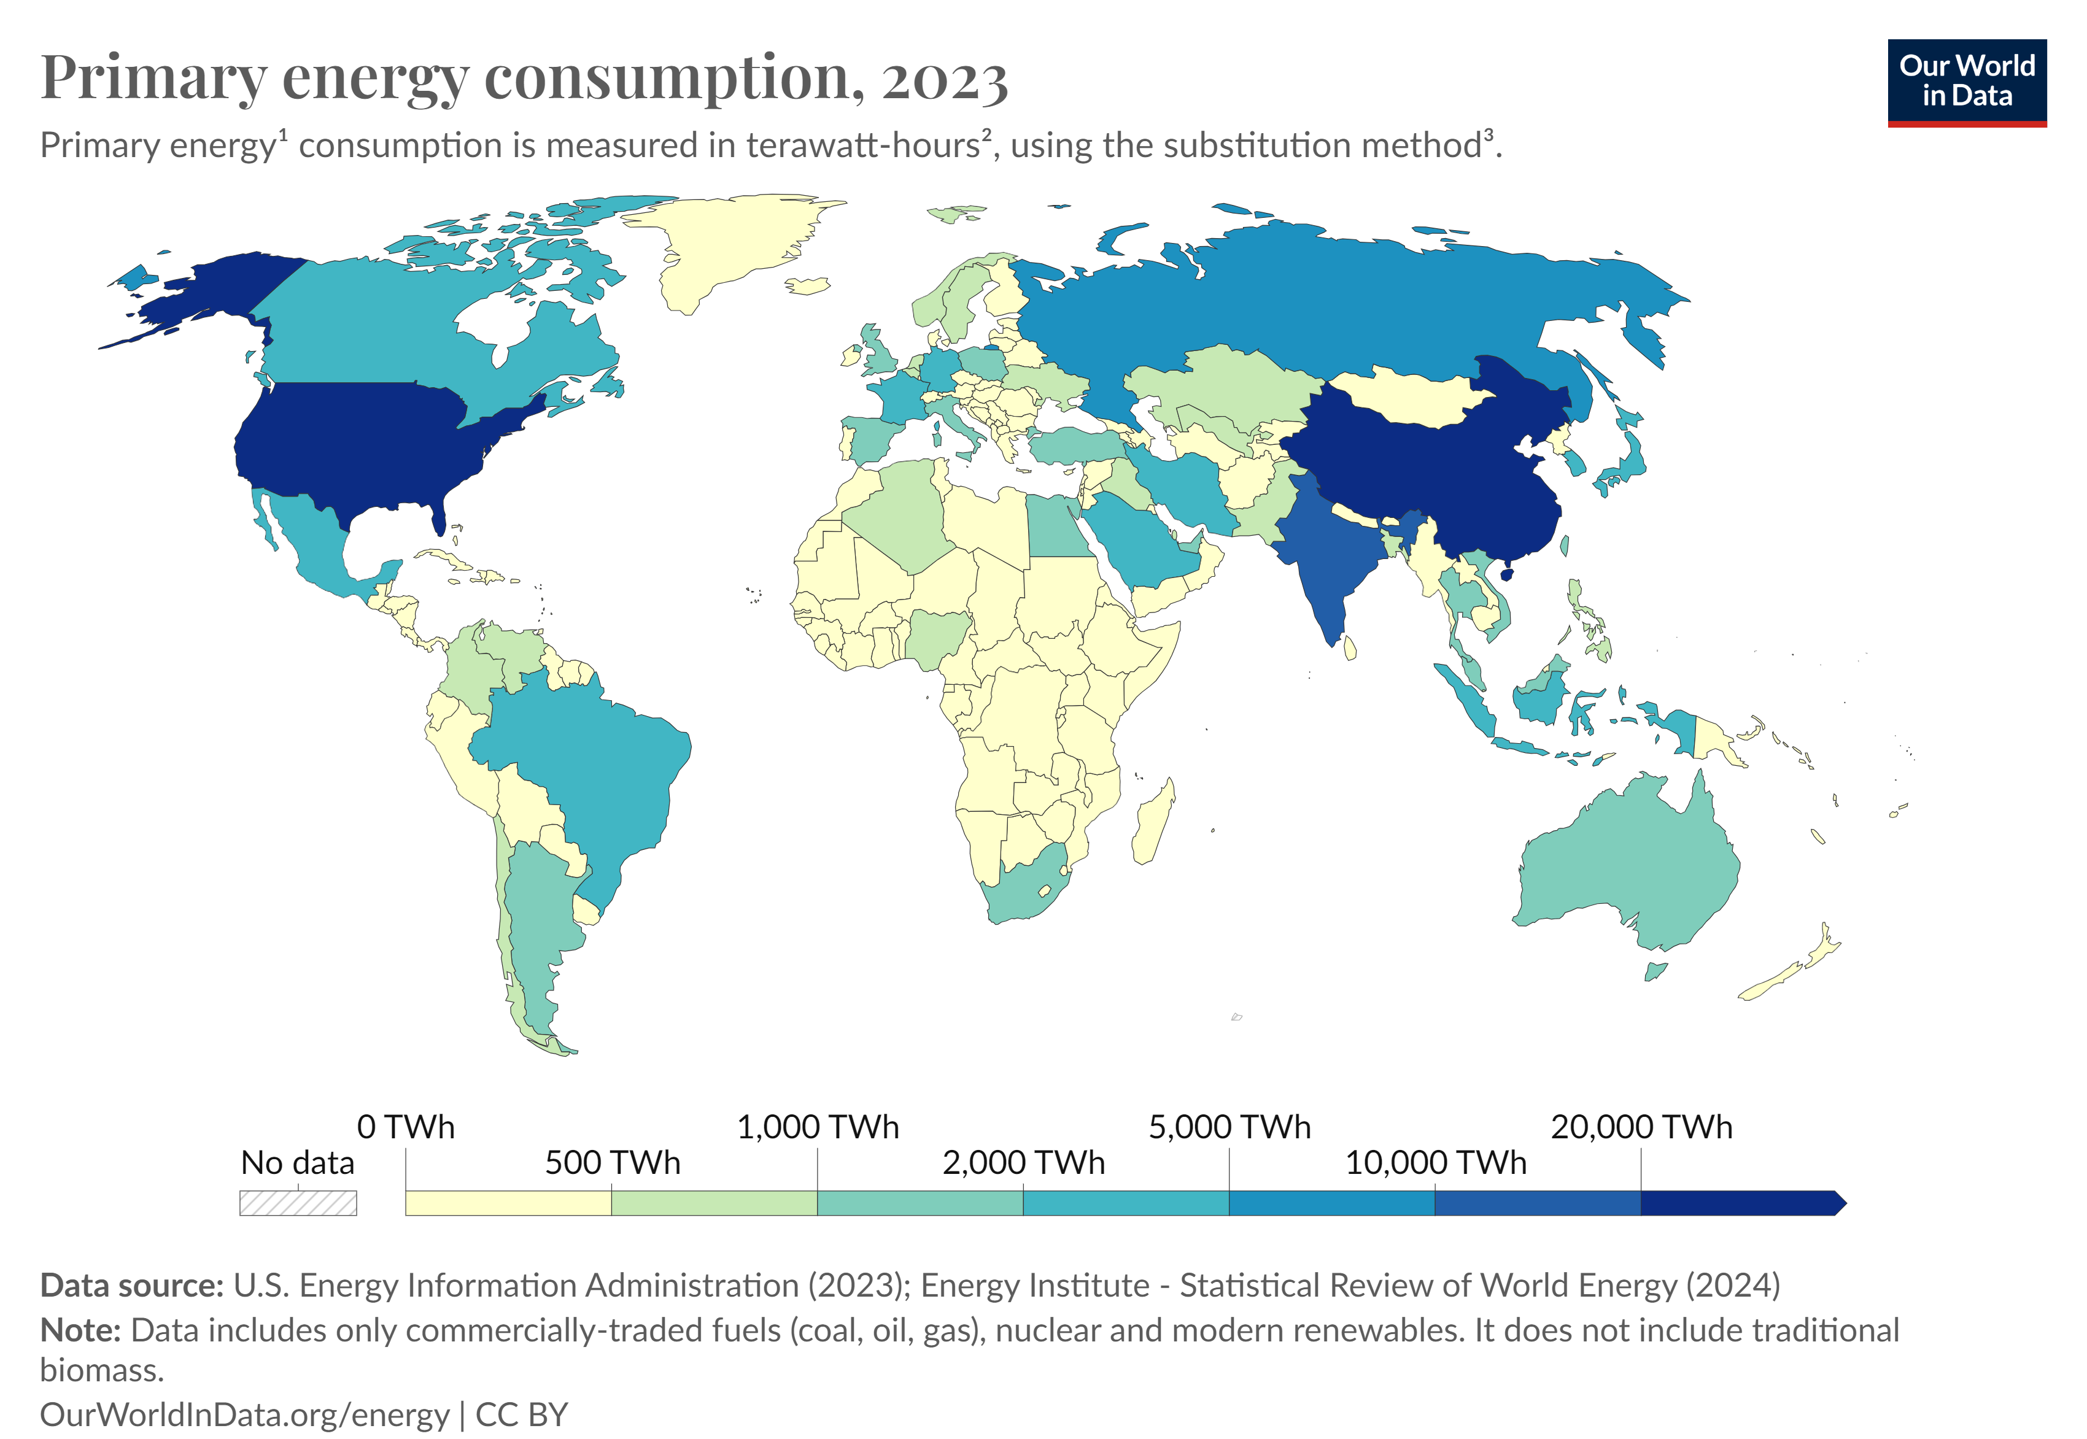
primary energy consumption
world
Global energy consumption growth accelerated in 2023 (+2.2%), much faster than its average 2010-2019 growth rate (+1.5%/year).
The total primary energy consumption, in 2023 across the world, is leading by China (47,428 TWh), the United States (26,189 TWh), and India (10,838 TWh).
The consumption for Estonia is 56 TWh.

Slide 6
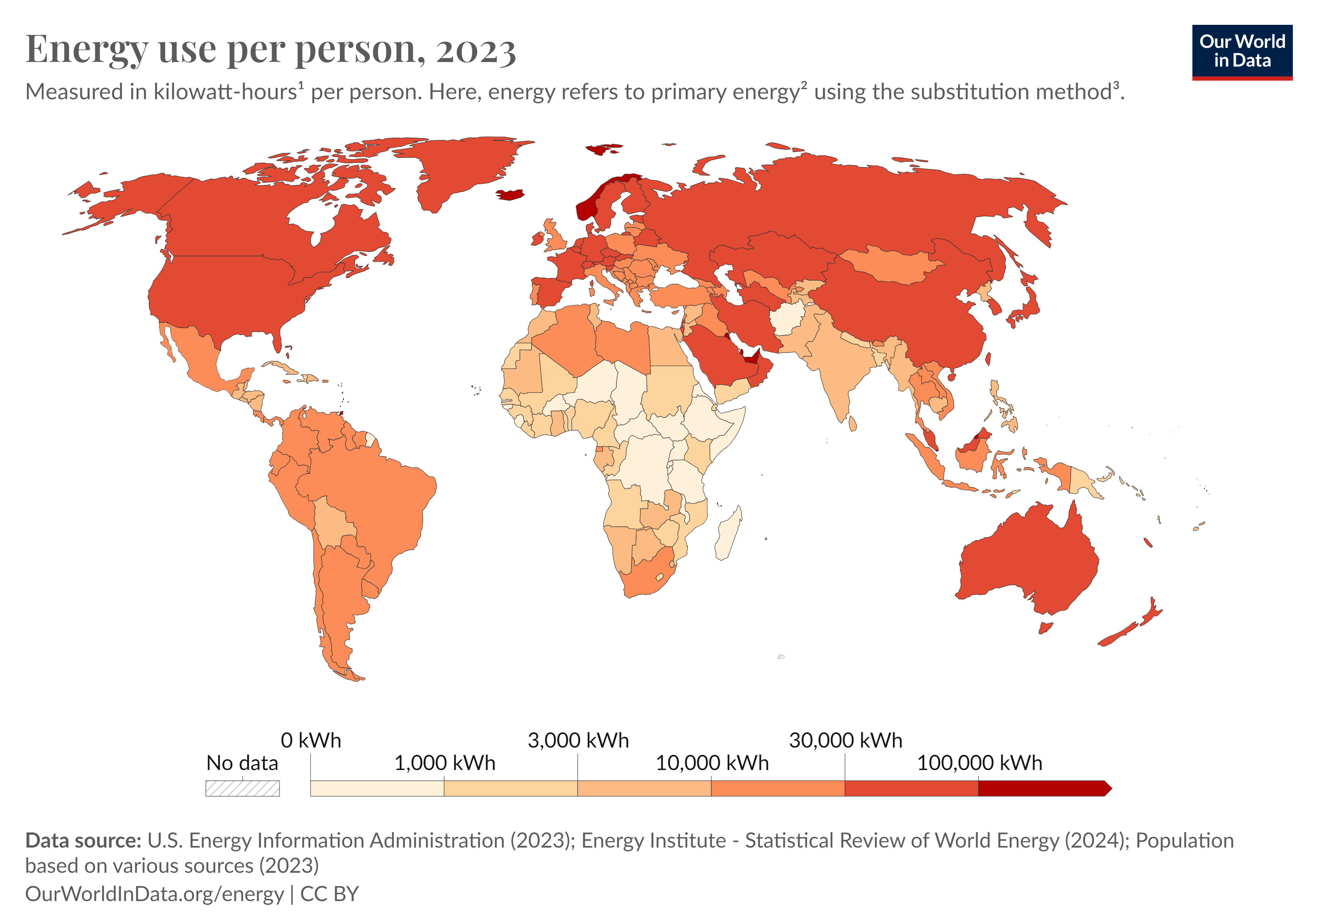
primary energy consumption
world
In fact, the primary energy use per person has significant differences to total consumption across countries.
The largest energy consumers include Iceland, Norway, Canada, the United States, and wealthy nations in the Middle East such as Oman, Saudi Arabia, and Qatar.

Slide 7
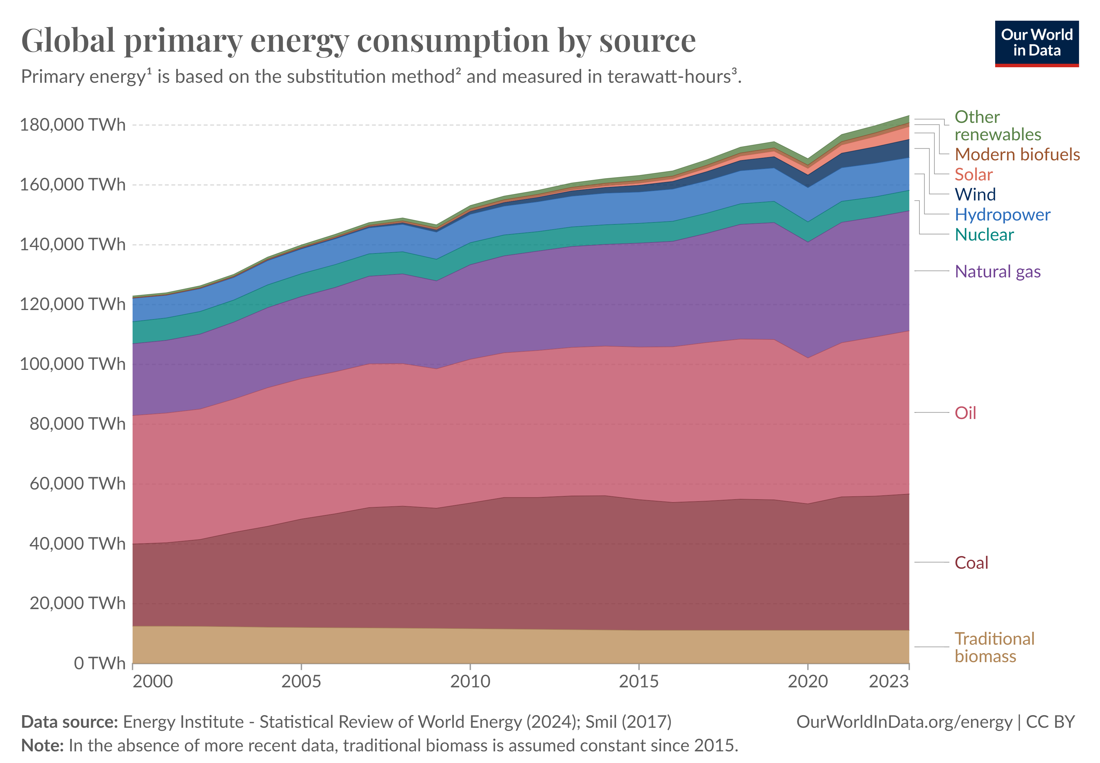
primary energy consumption
world

Slide 8
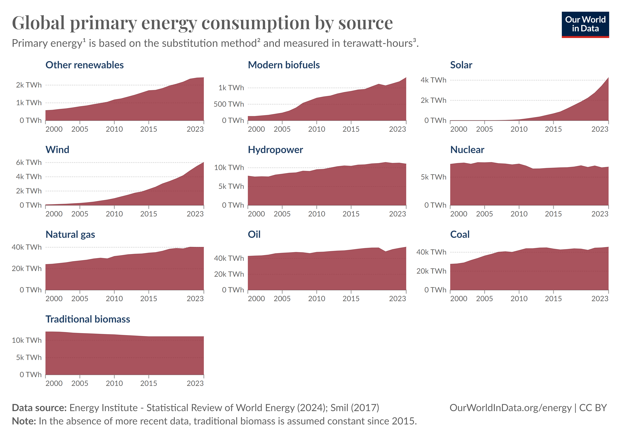
primary energy consumption
world

Slide 9
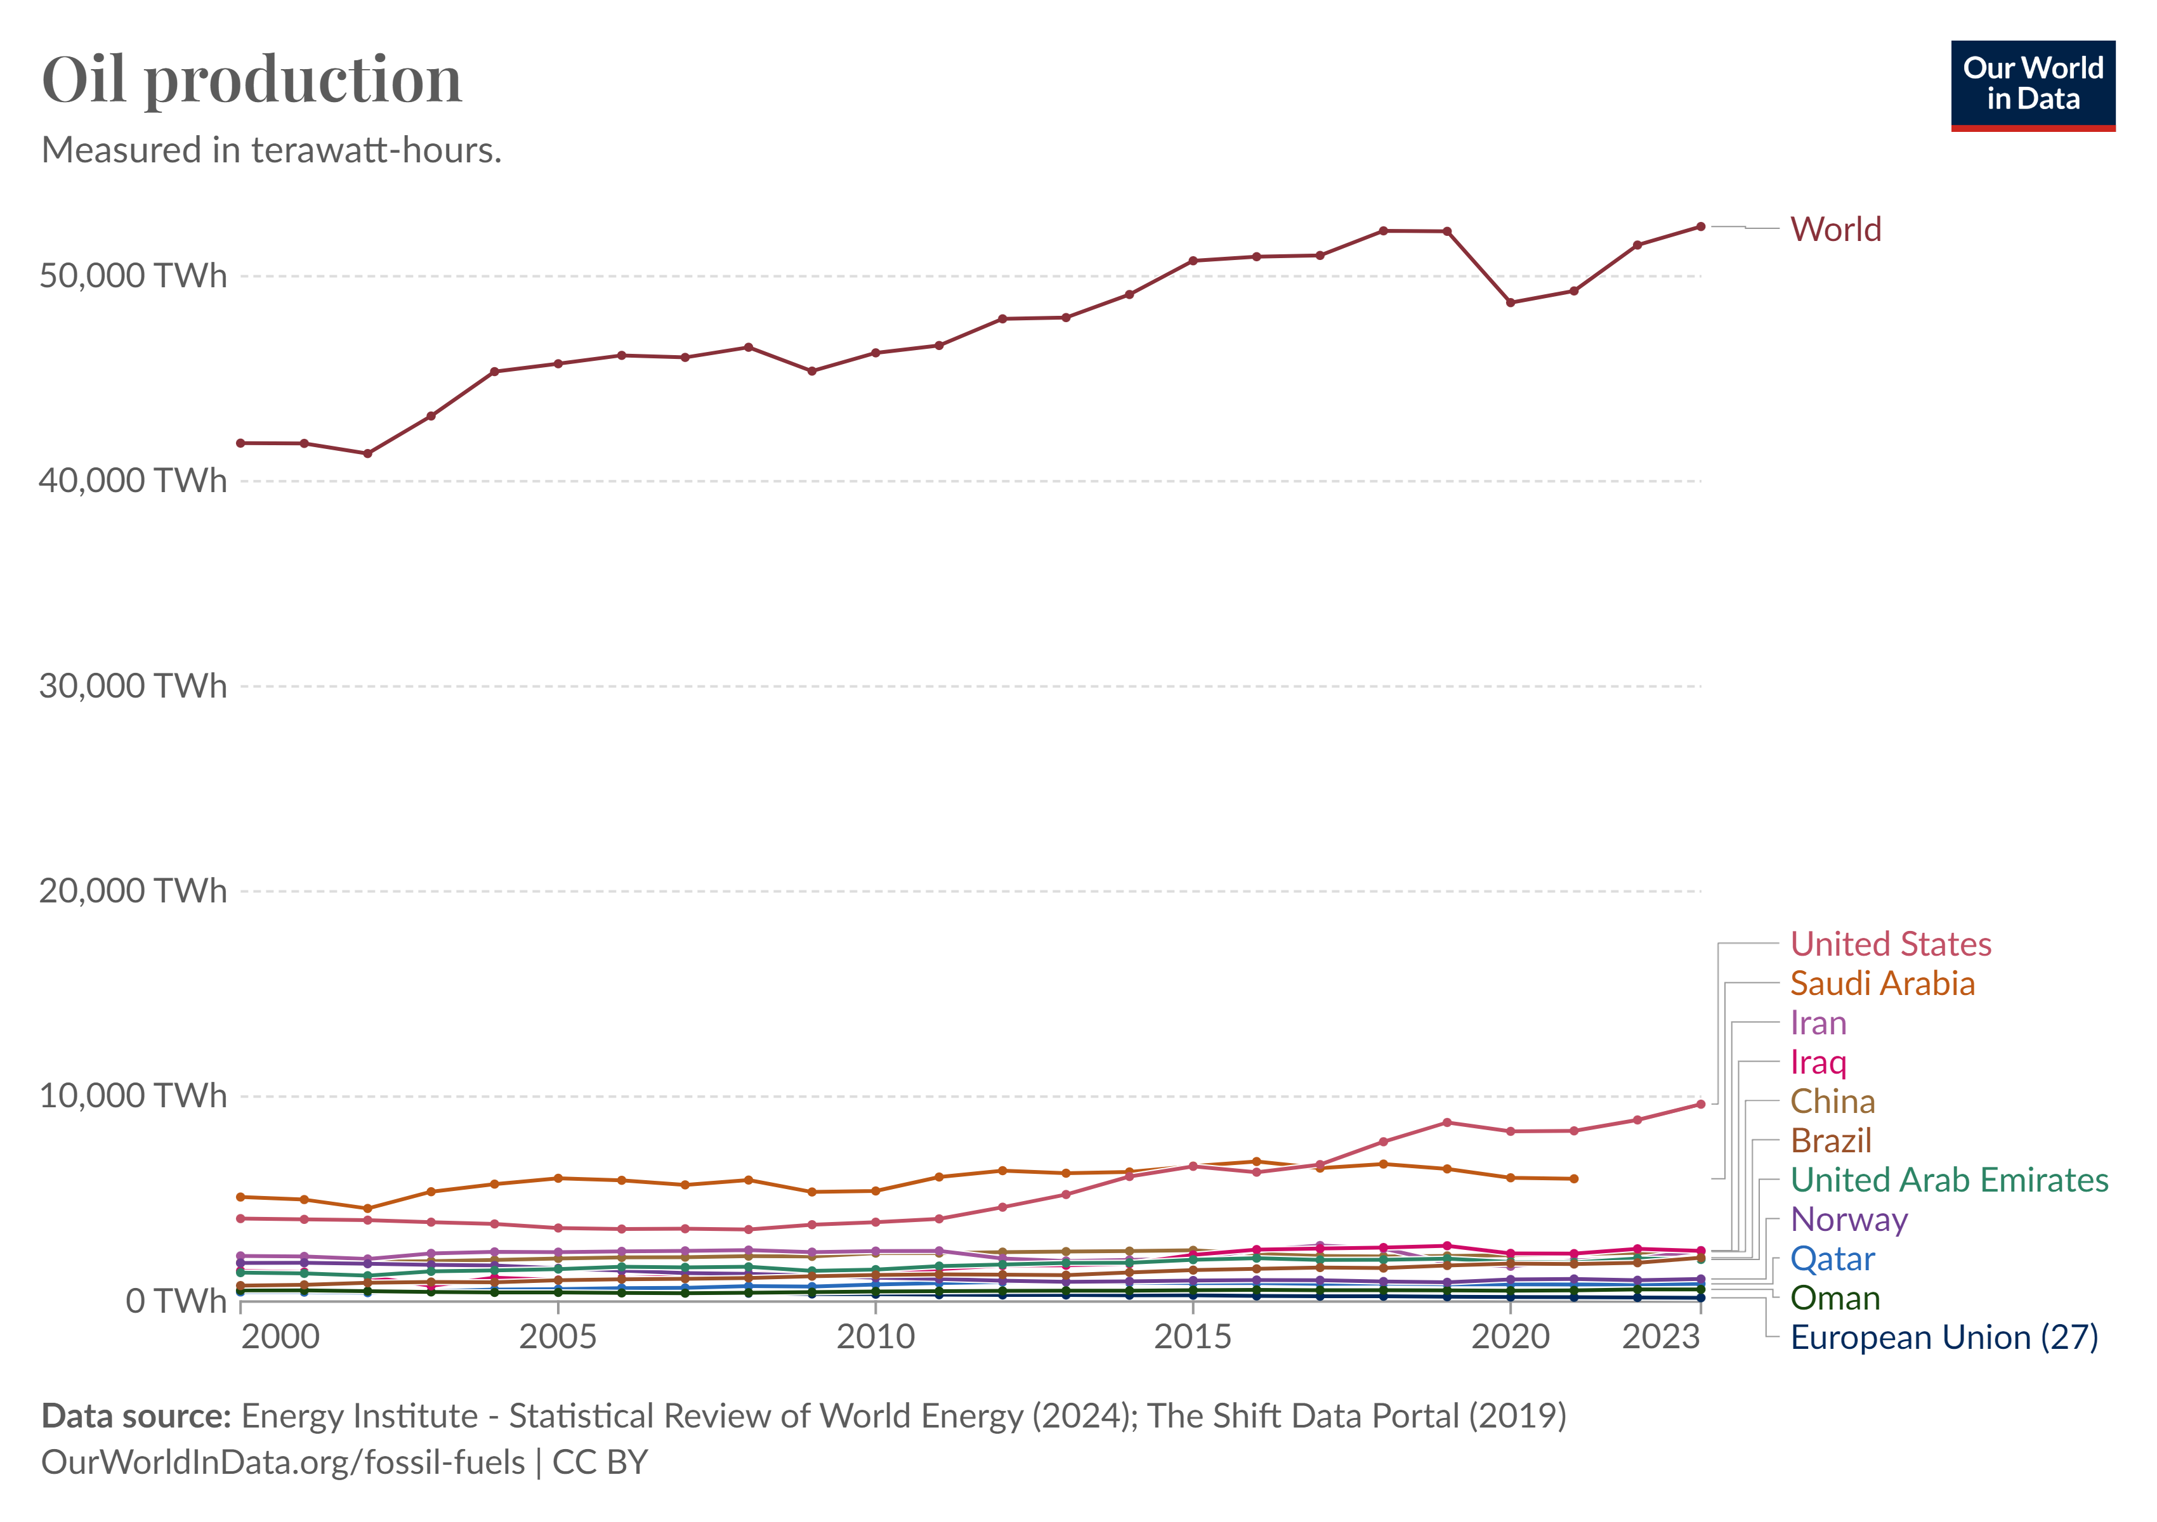
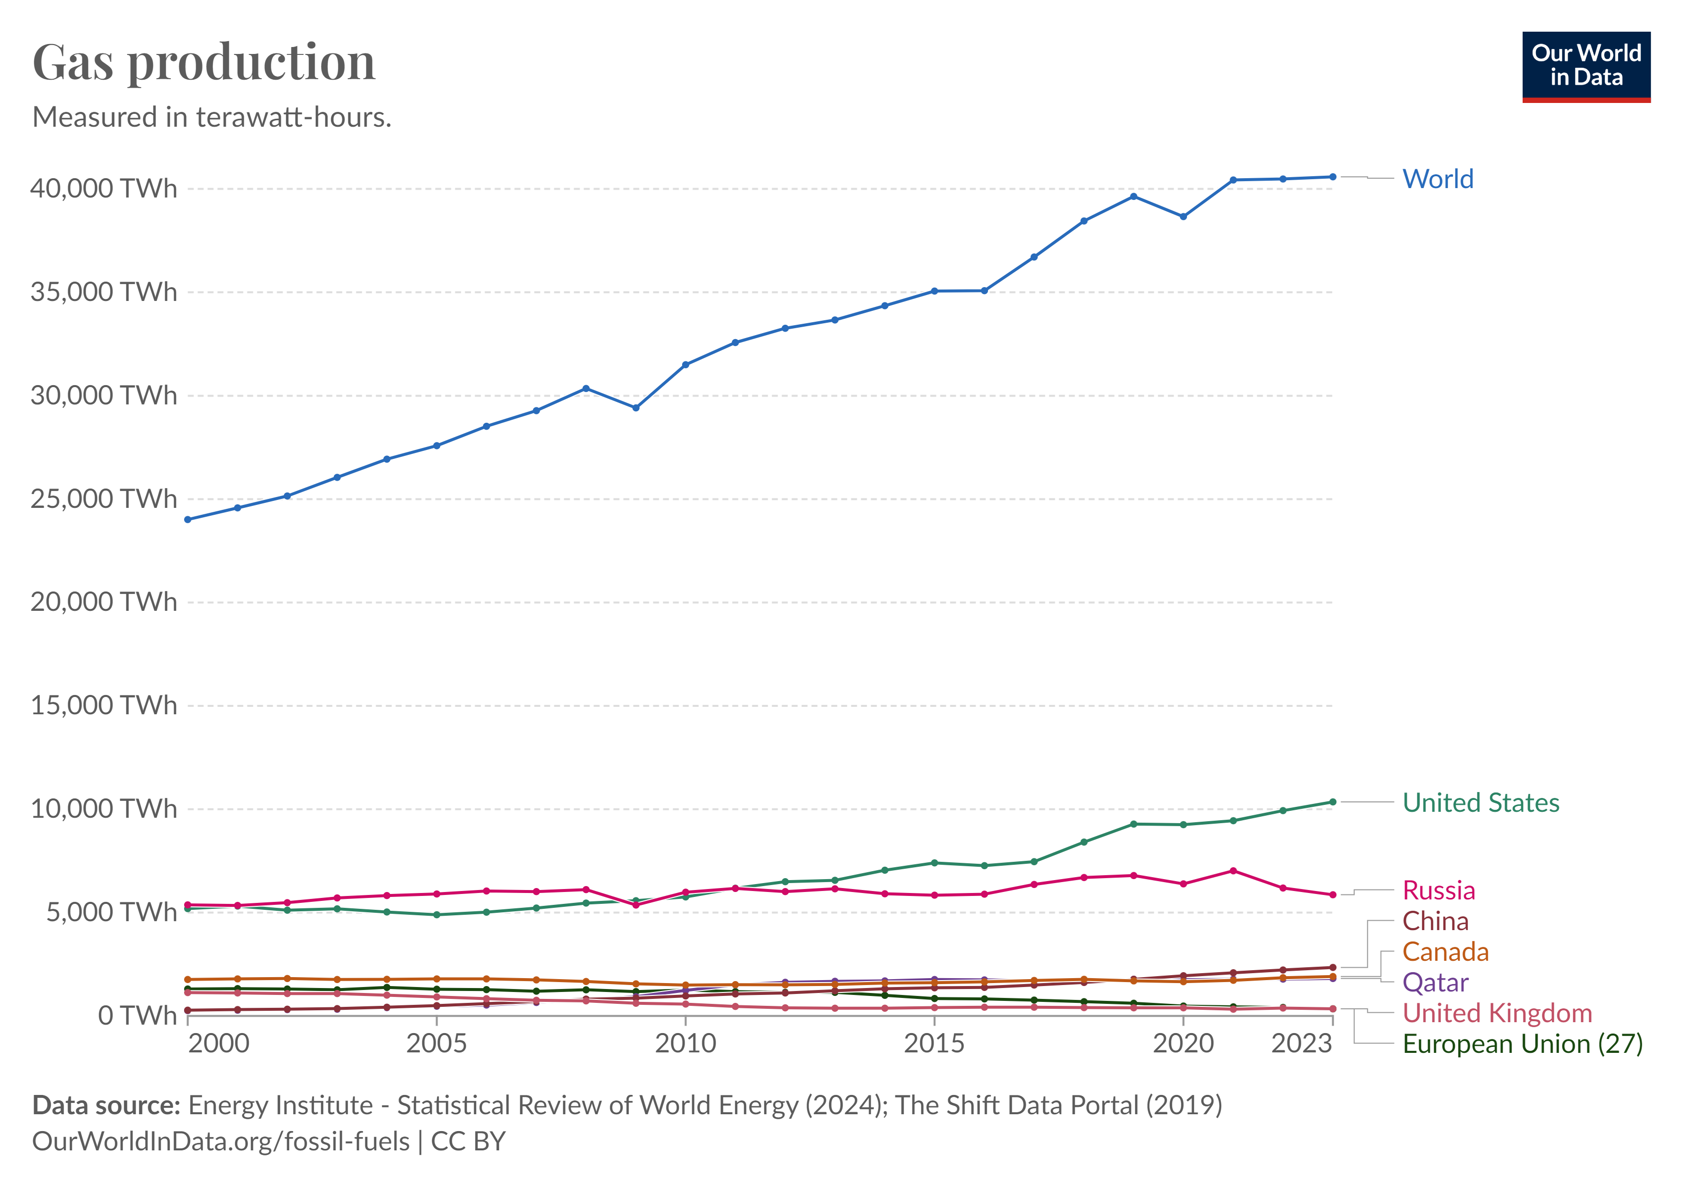
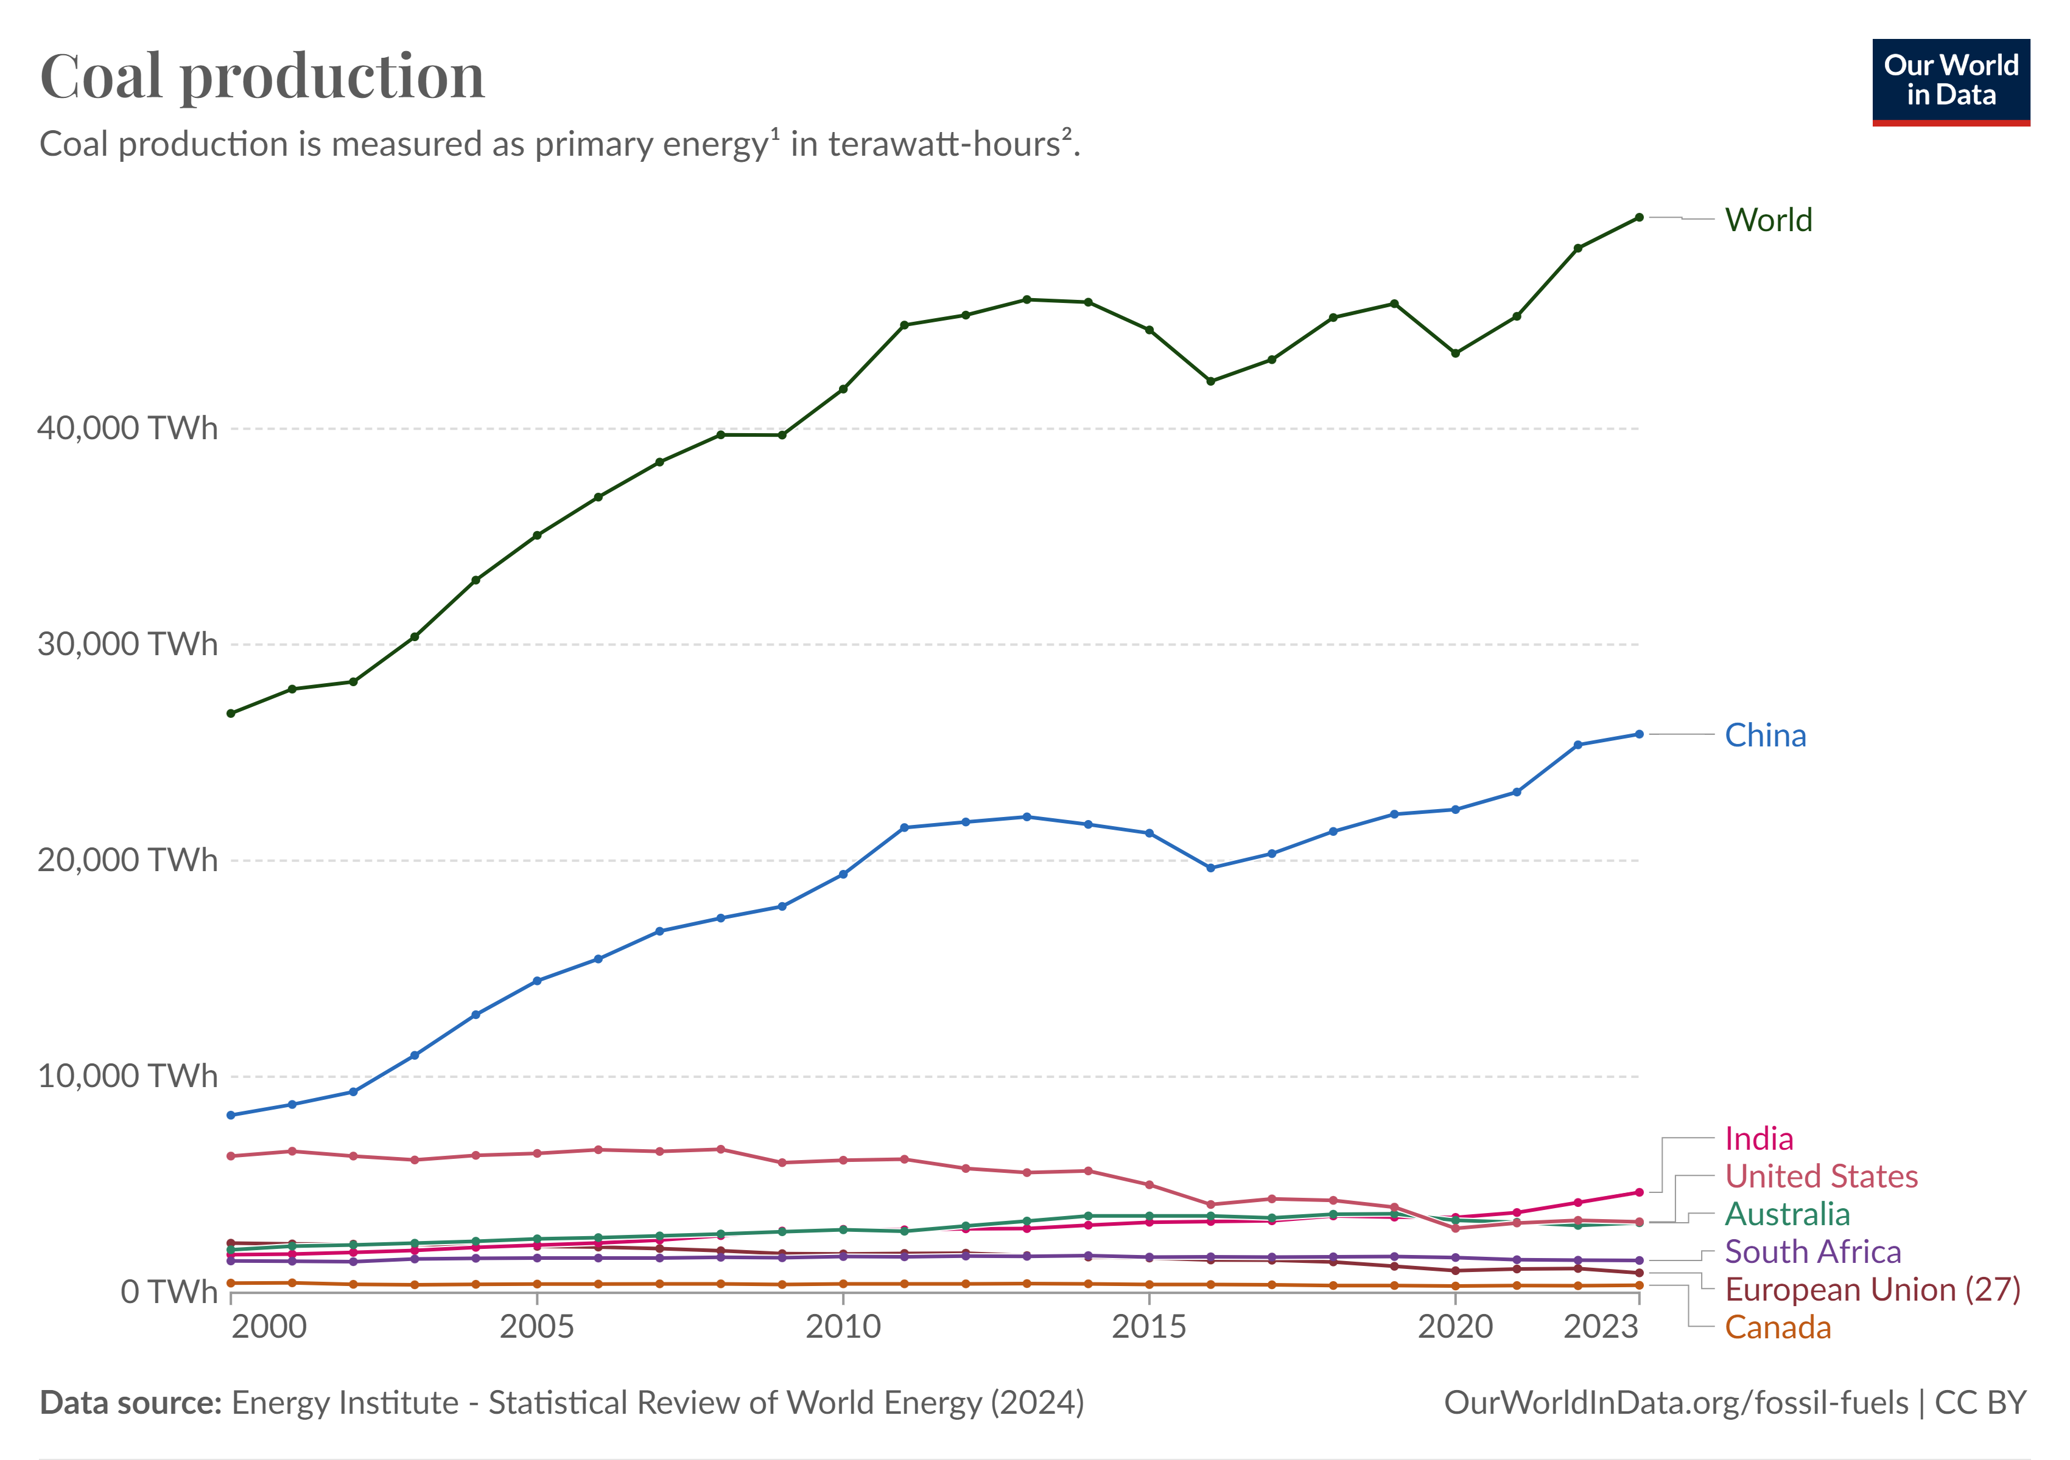
primary energy Production
world
Global energy production is slowing down, rising by 1.4% in 2023 (below its 2010-2019 average growth of 1.7%/year), despite higher production in the US, China and India.

Slide 10
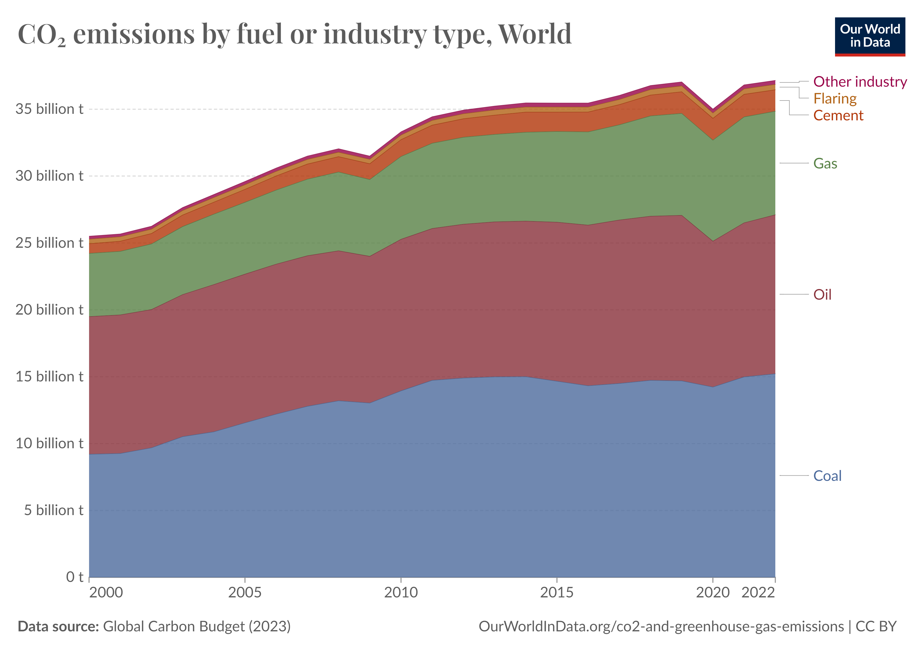
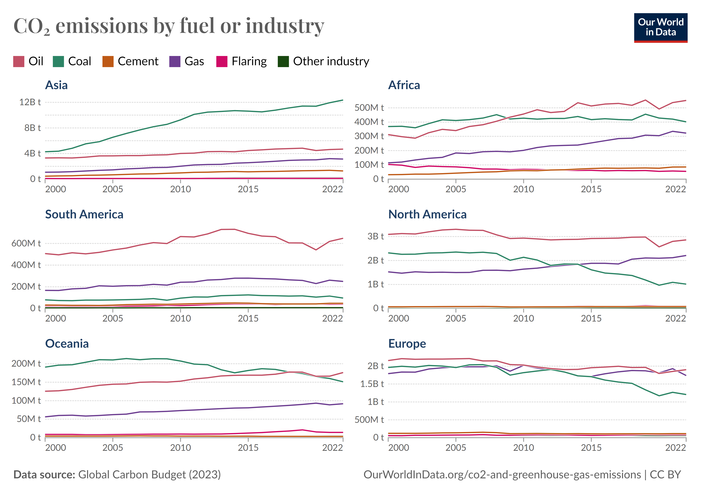
primary energy Production
Co2 emissions
Carbon dioxide emissions associated with energy and industrial production can come from a range of fuel types.

Slide 11
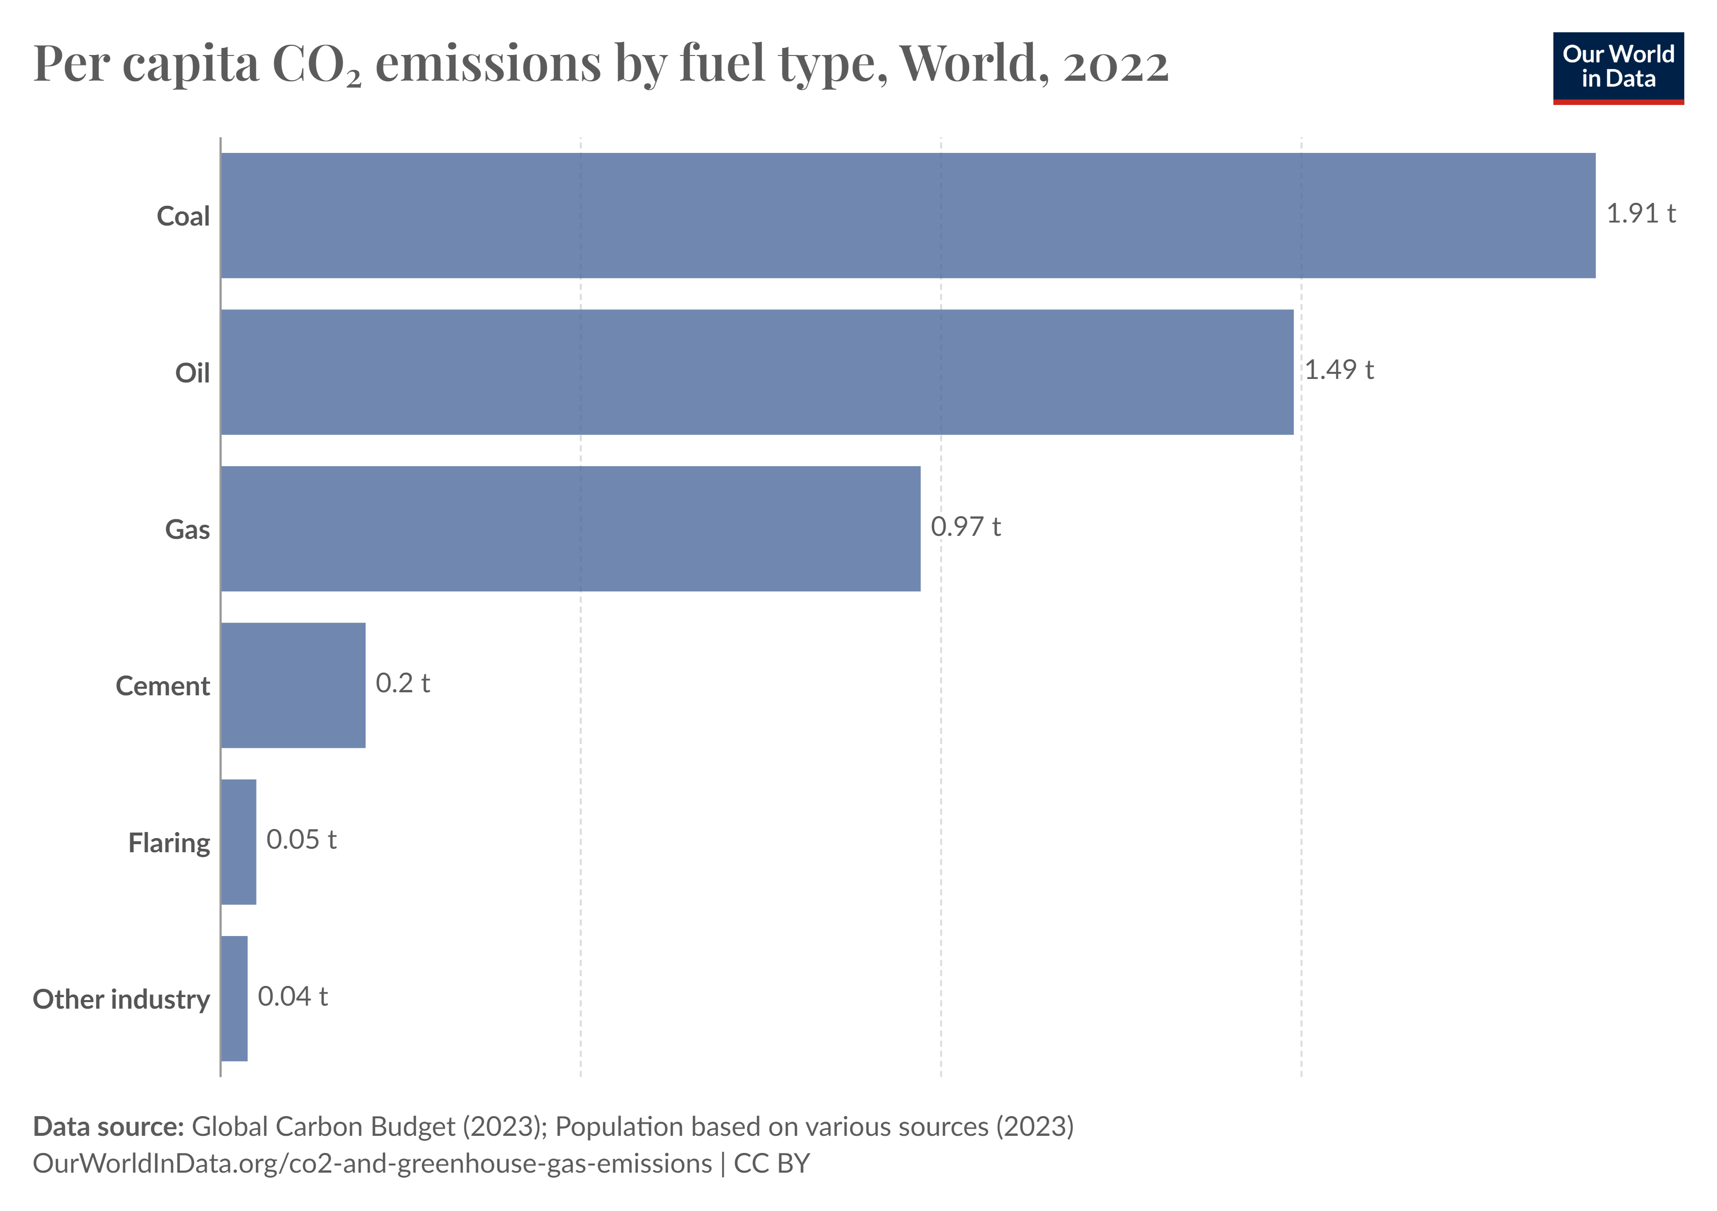
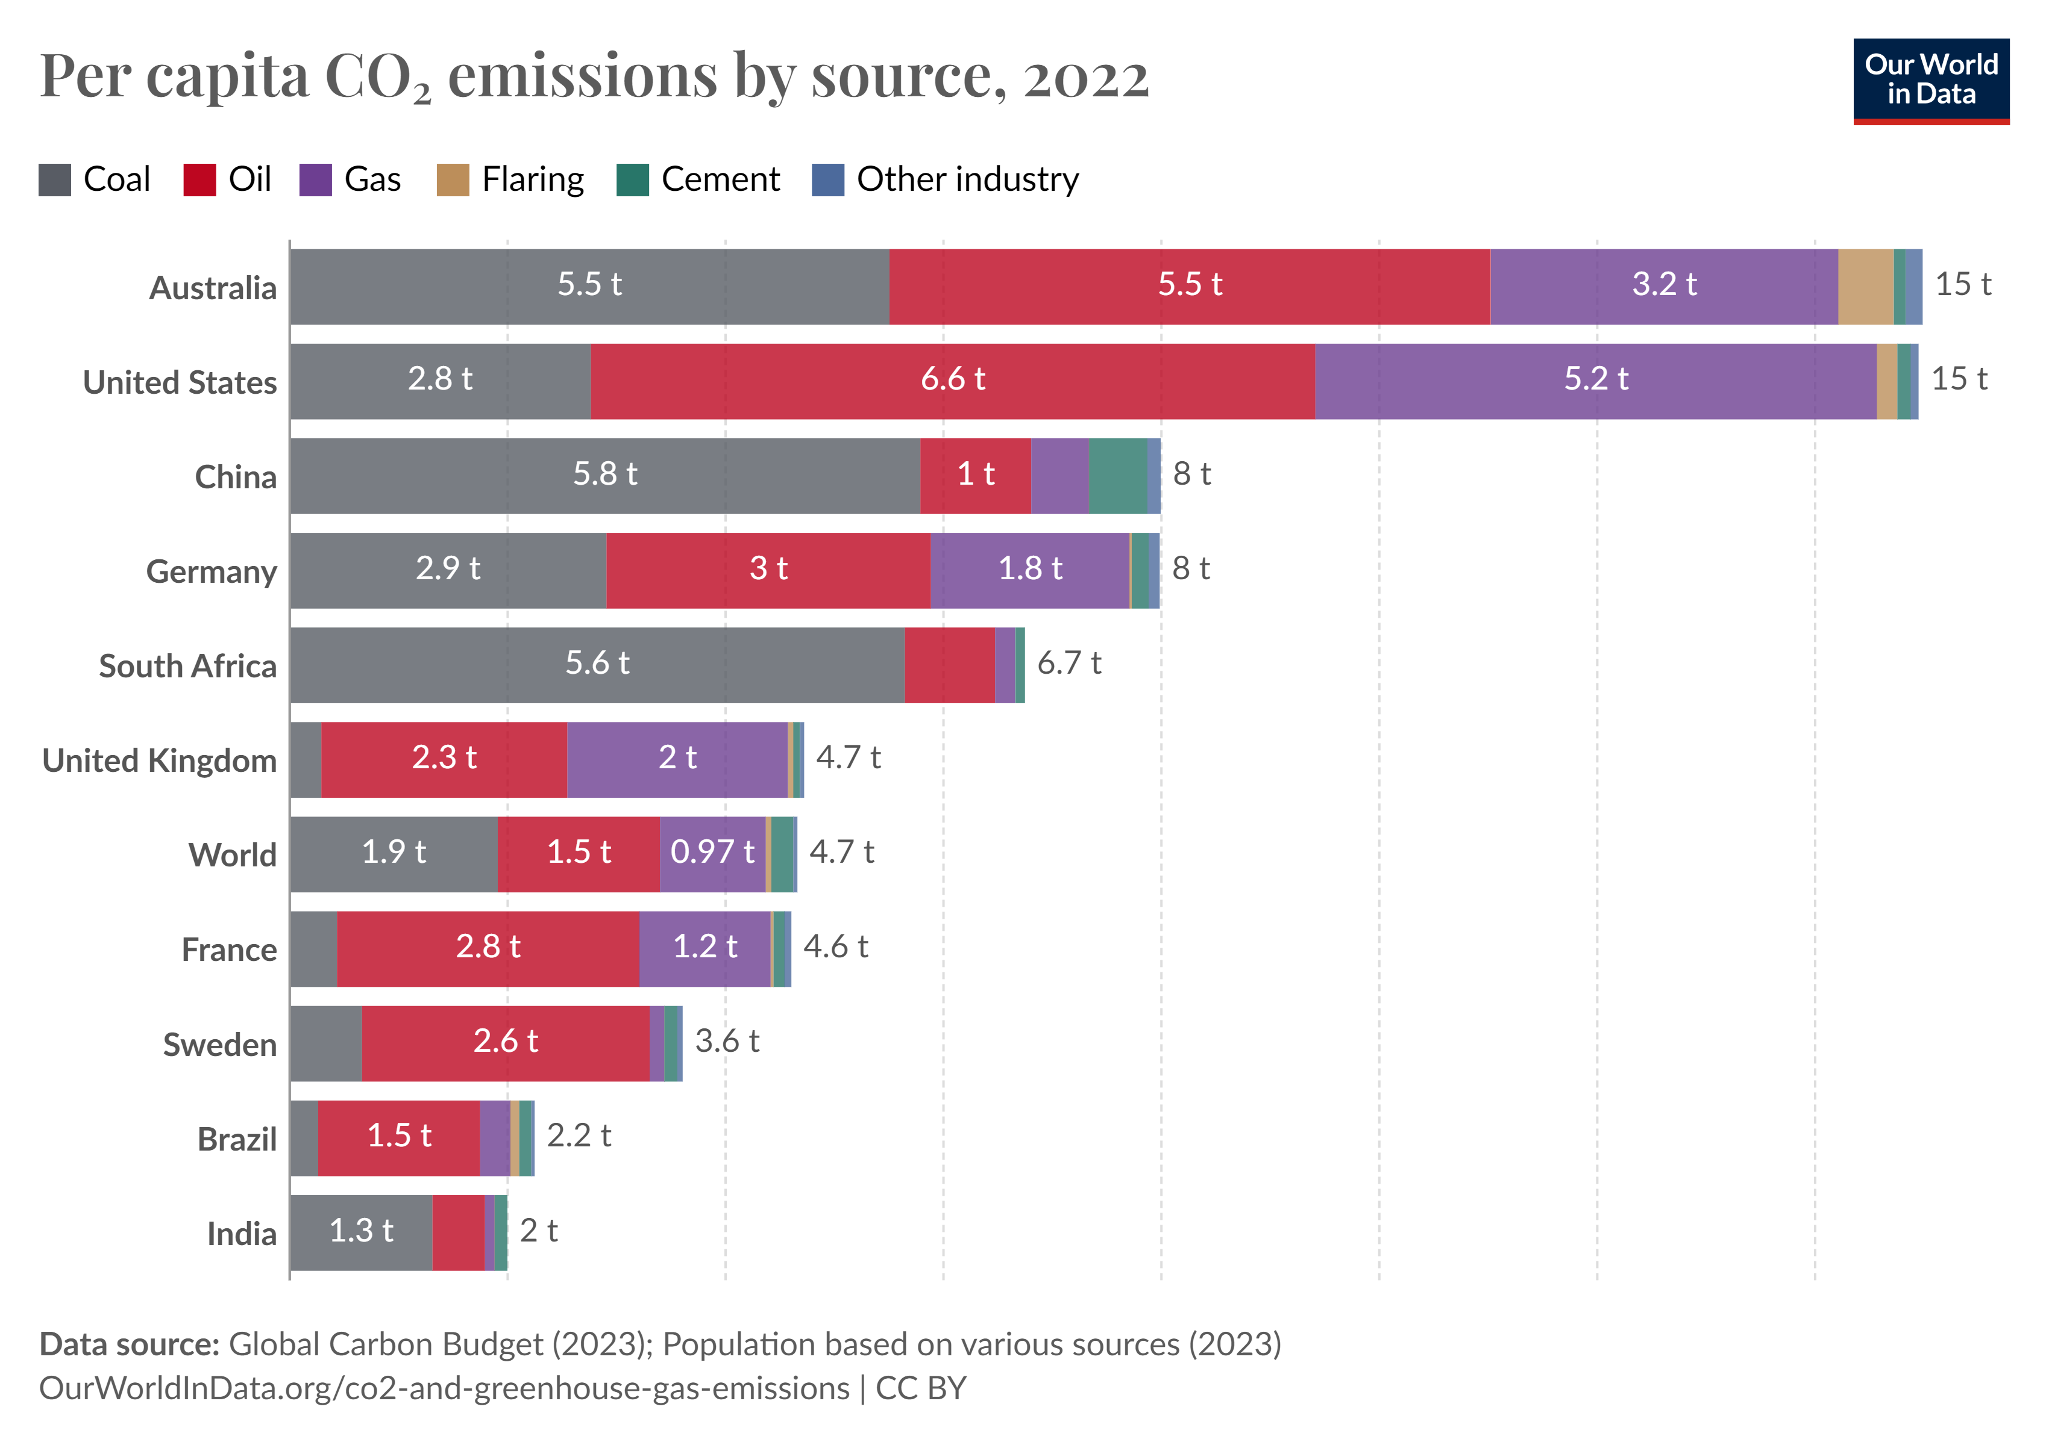
primary energy Production
Co2 emissions
Carbon dioxide emissions associated with energy and industrial production can come from a range of fuel types.
The distribution of CO2 emissions across different fuel sources is very dependent on energy production and mix in a given country. In the US or the UK, for example, oil followed by gas are the largest contributors. In China and India, coal is much more dominant. In Russia, it's gas.

Slide 12
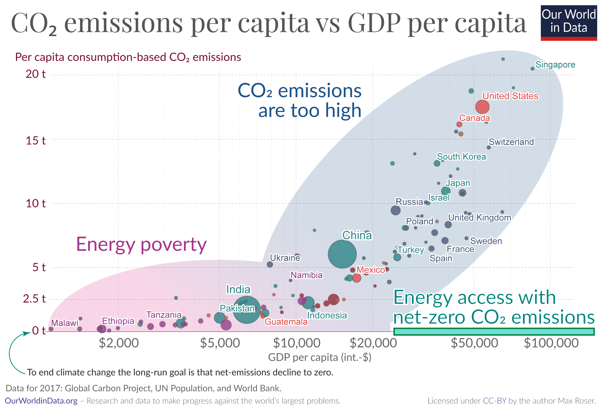
primary energy Production
Co2 emissions – The problems
The production of energy is responsible for 87% of global greenhouse gas emissions.
The first energy problem: those that have low carbon emissions lack access to energy.
The second energy problem: those that have access to energy produce greenhouse gas emissions that are too high

Slide 13
Electricity Generation
From fossil fuels
From renewables

Slide 14
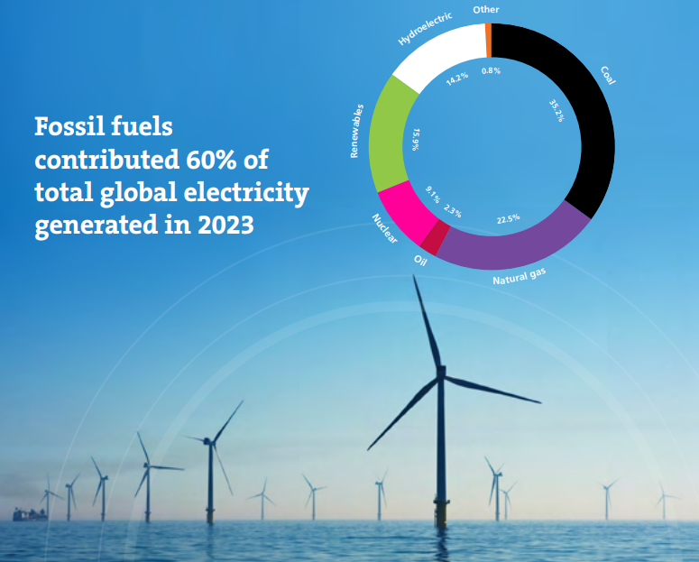
electricity generation
Overall
Global electricity generation increased by 2.5% in 2023 to reach a record level of 29,925 TWh.
Coal retained its position as the dominant fuel for power generation with fossil fuels overall forming 60% of global electricity generation.
Renewables share of total power generation rose from 29% to 30%.

Slide 15
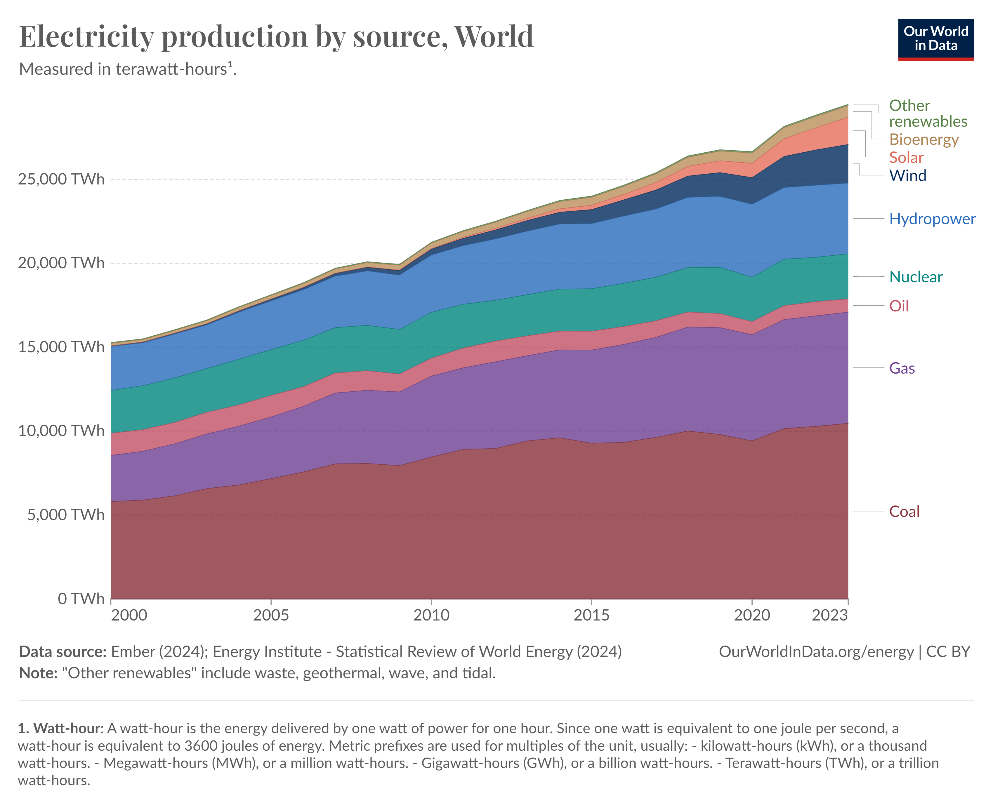
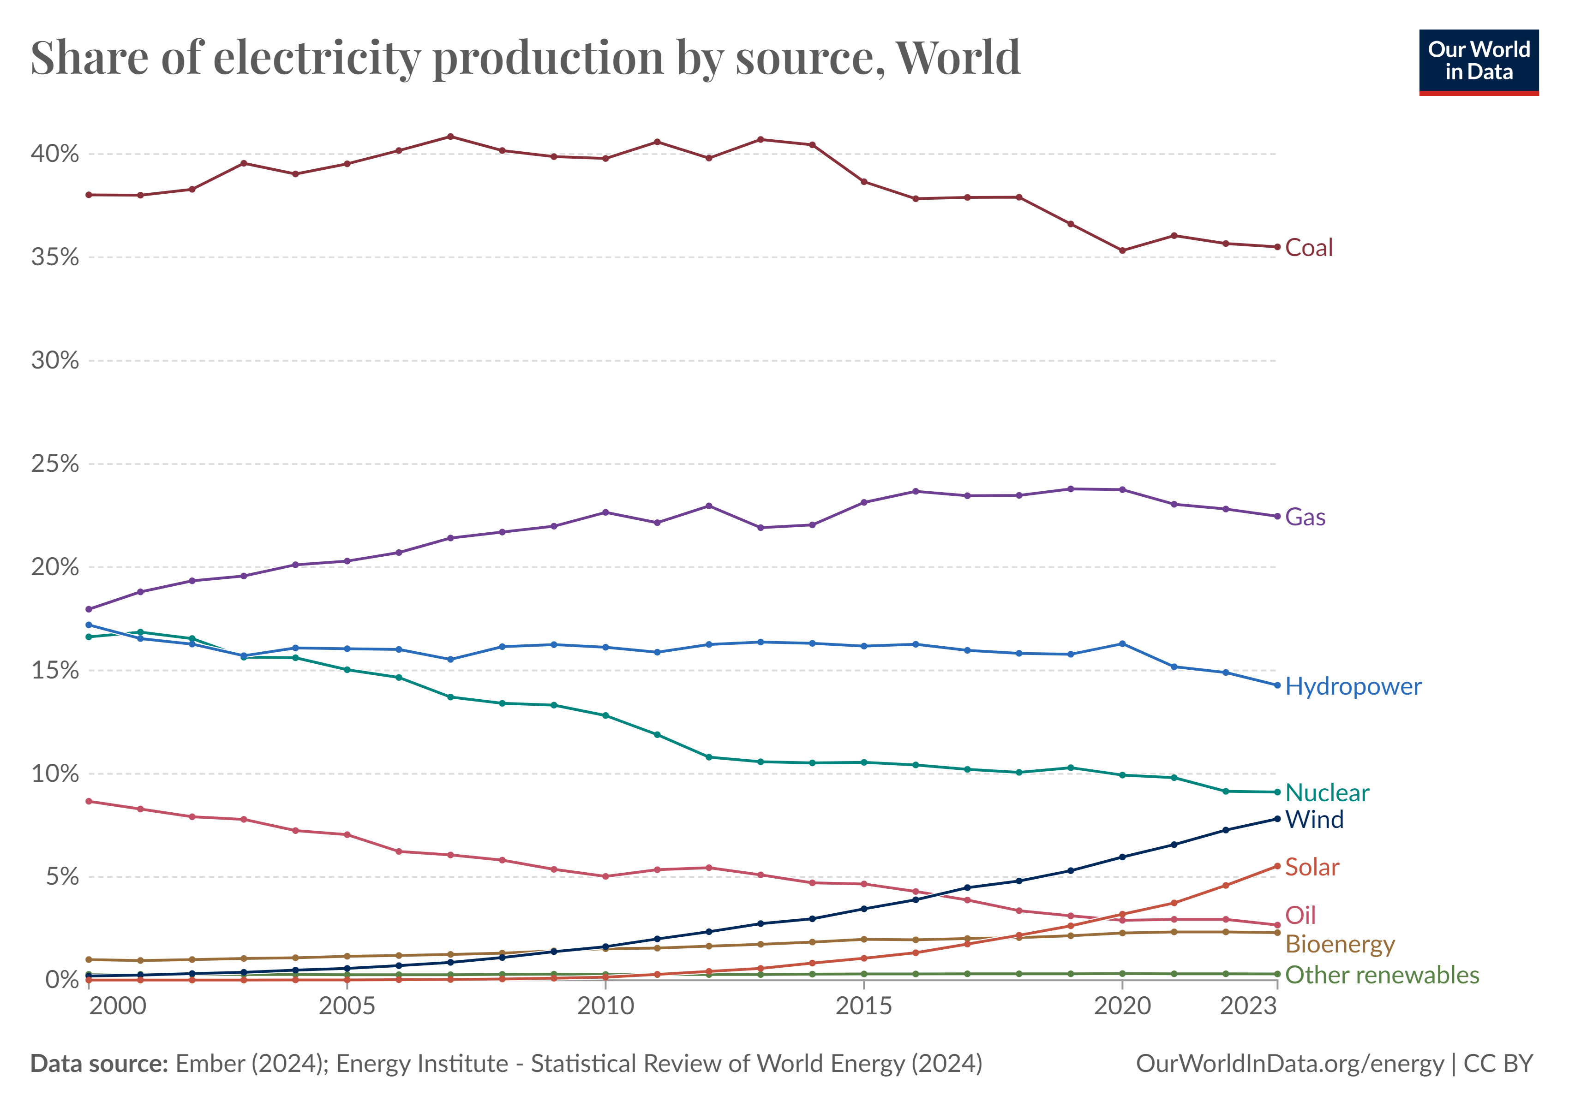
electricity generation
Overall
Globally, coal, followed by gas, is the largest source of electricity production.
Hydropower and nuclear make the largest contribution of renewables.

Slide 16
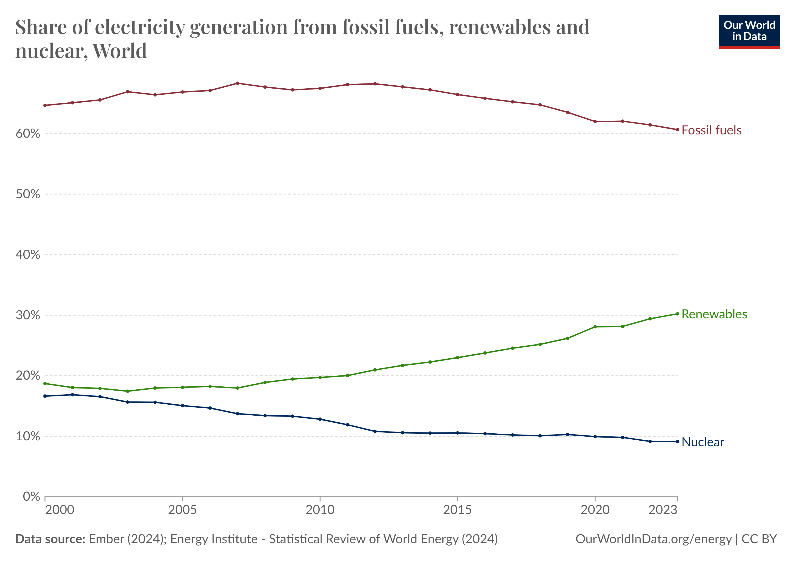
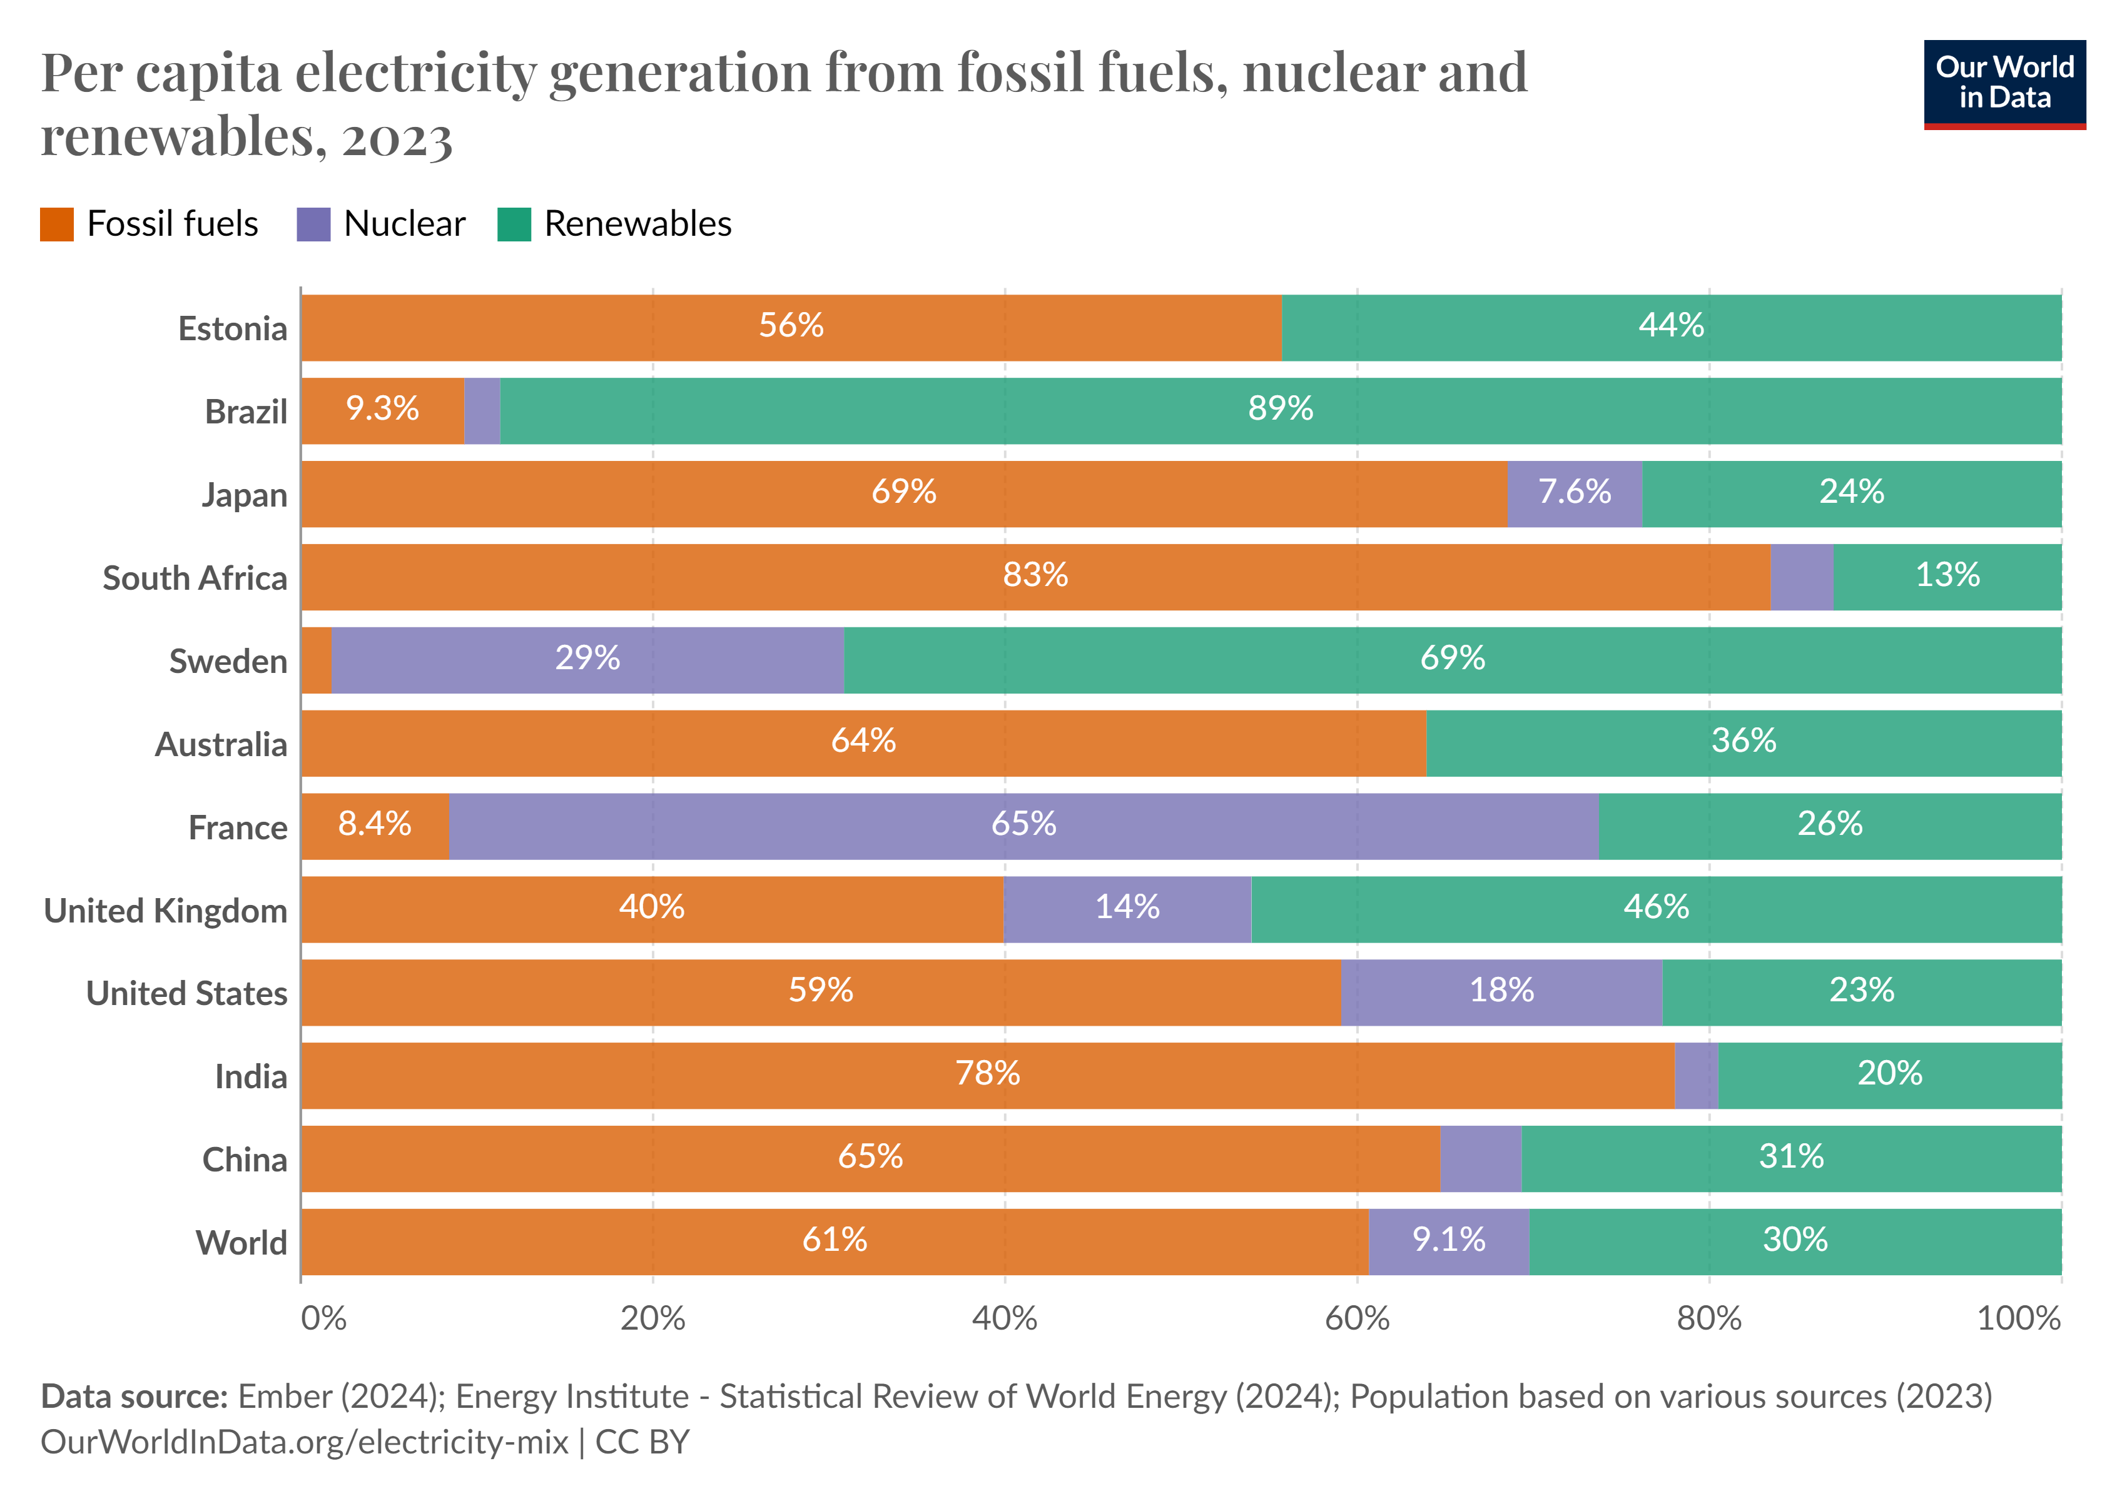
electricity generation
Overall
Share of renewables in electricity generation 10 percentage globally since 2000.
Most countries rely on fossil fuels for electricity generation, especially India.
Brazil has highest share of renewables, and France has highest share of nuclear.

Slide 17
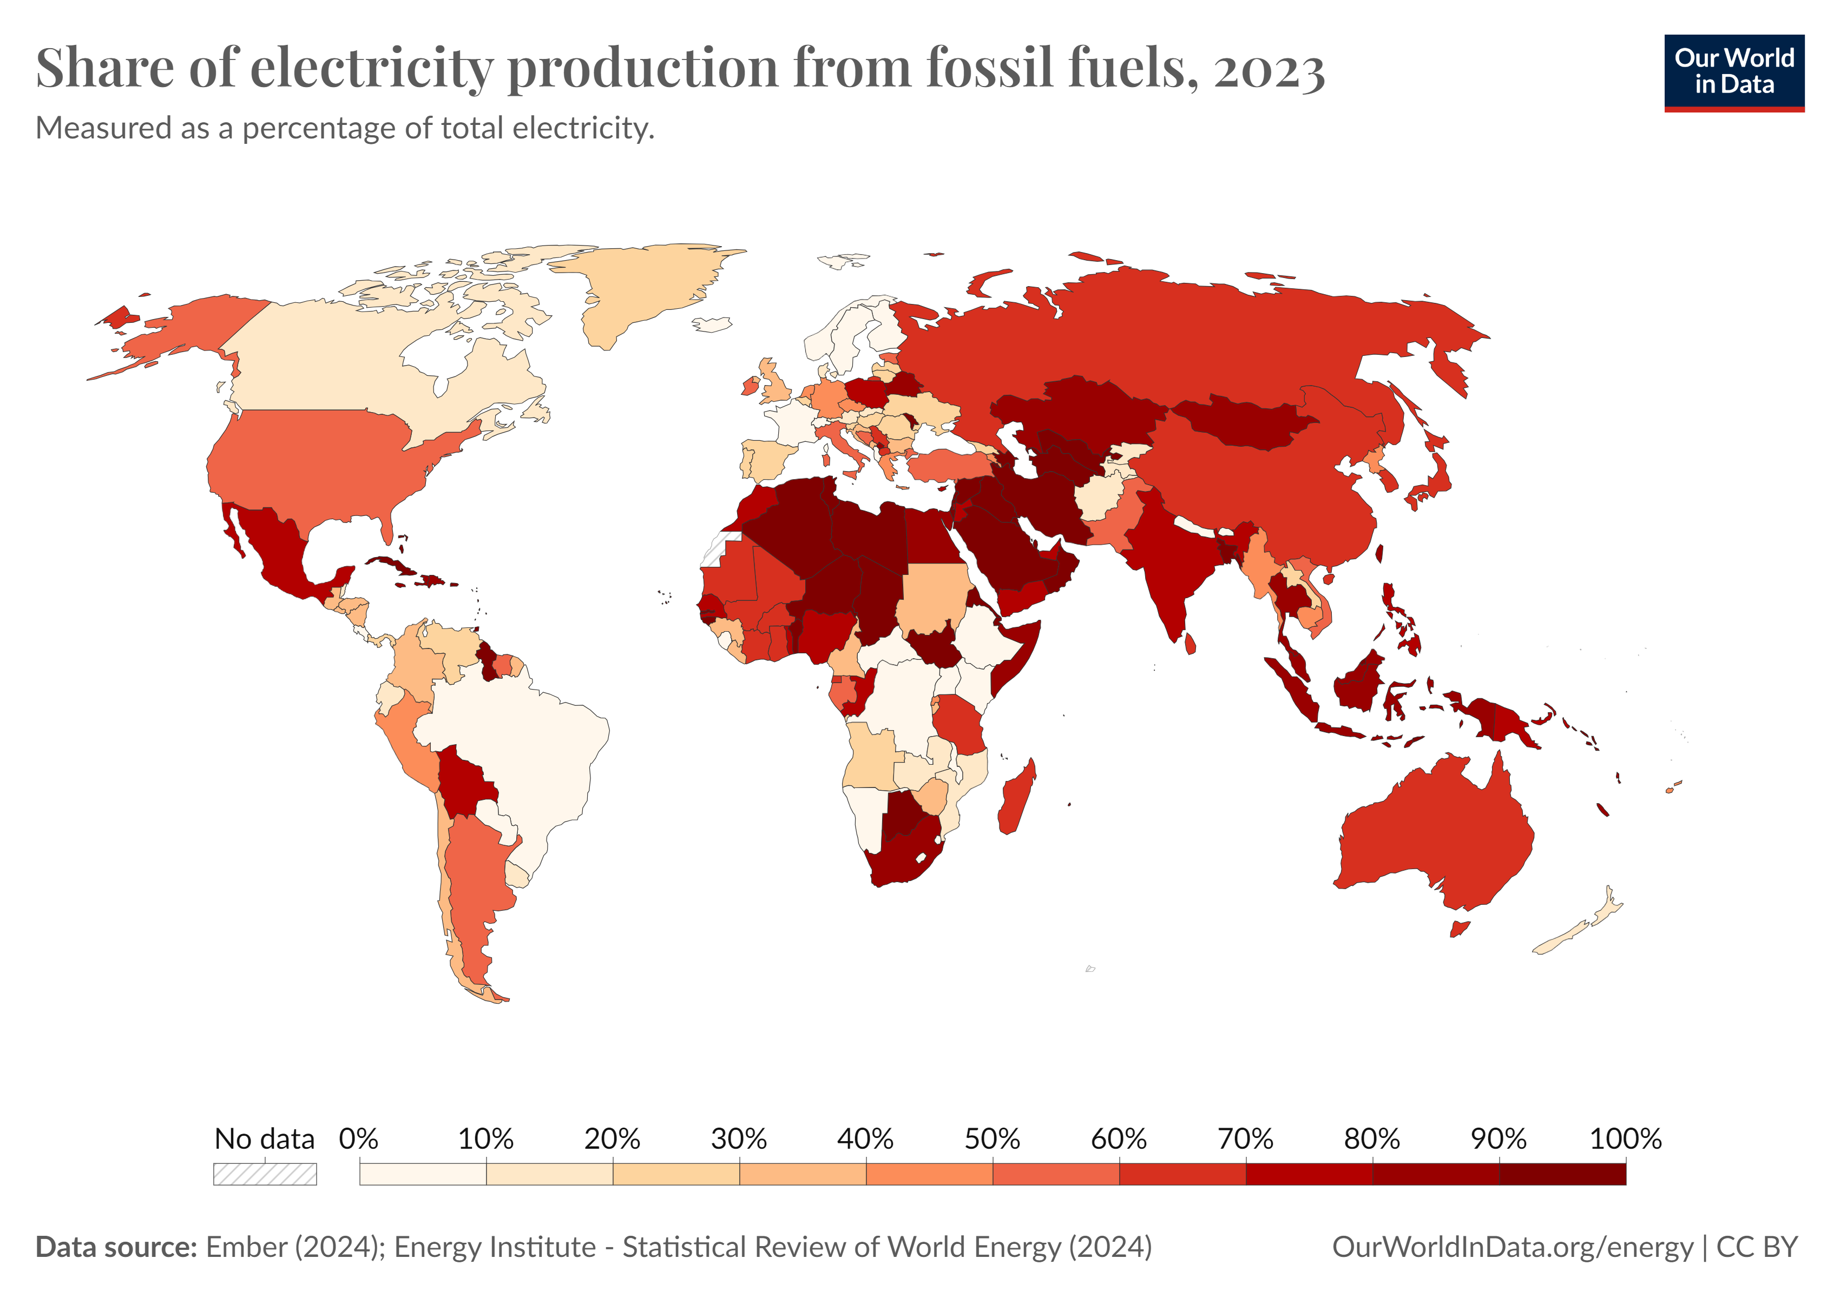
electricity generation
From CONVENTIONAL FUELS
In 2023, fossil fuels still supplied most of the world’s electricity.
Global average share: ~60% from coal, gas, and oil.
Some countries rely on fossil fuels for over 90% of electricity.
Only a few countries generate the majority of power from renewables or nuclear.

Slide 18
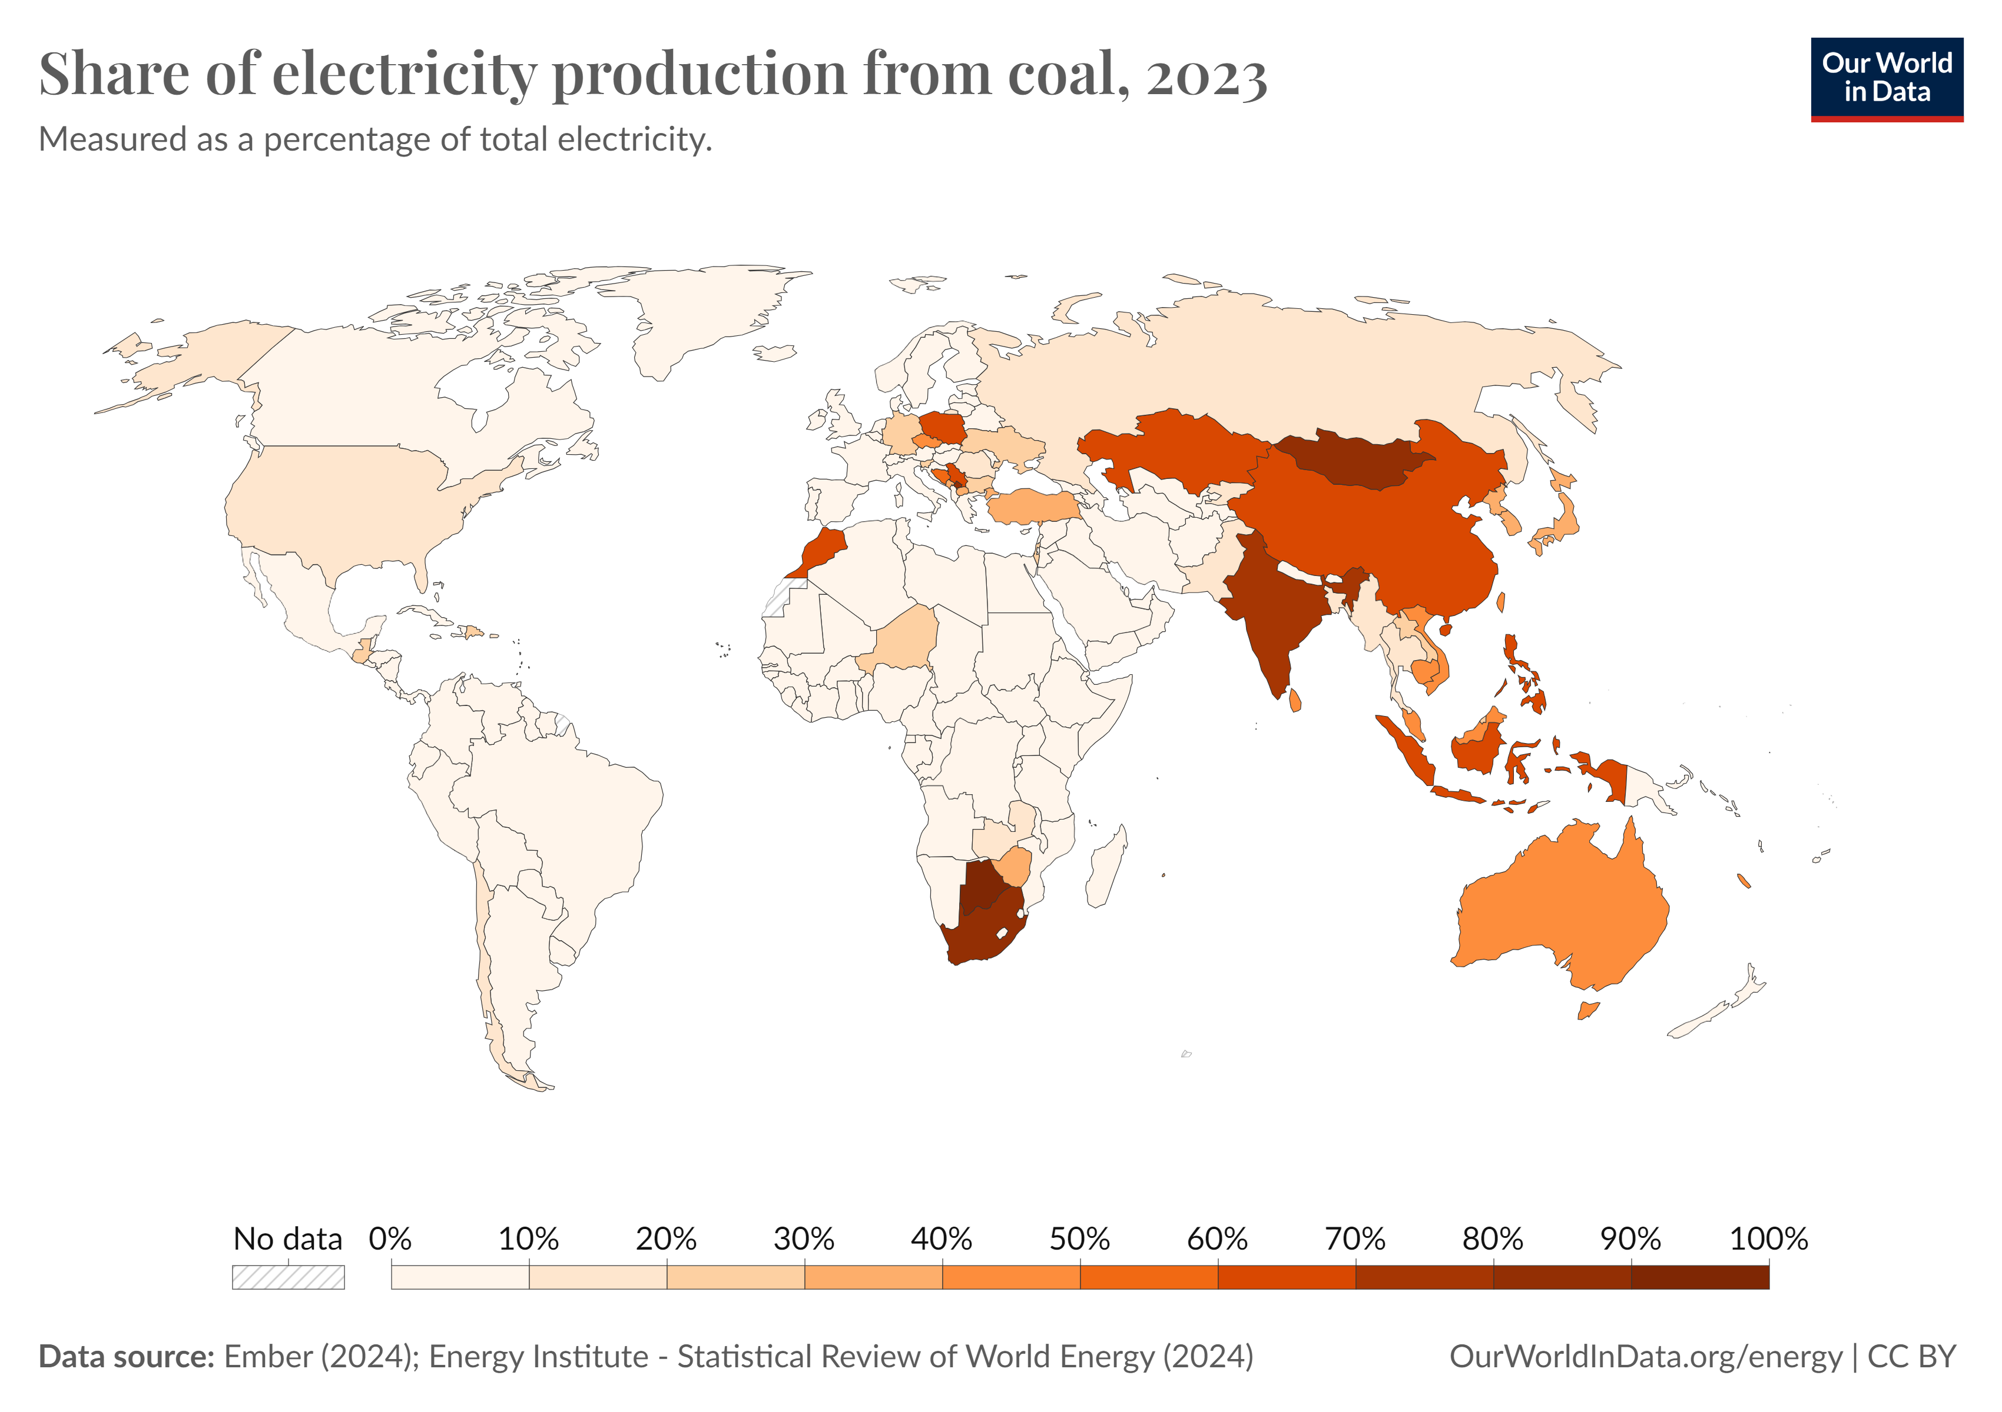
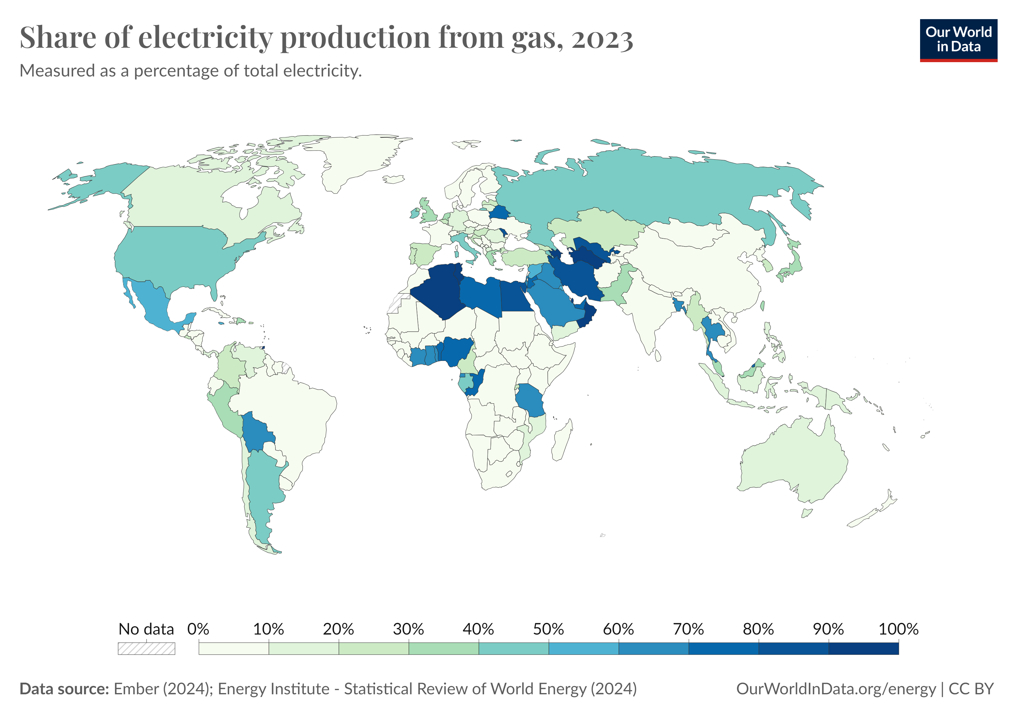
electricity generation
From CONVENTIONAL FUELS
India, South Africa, Mongolia, Indonesia, Botswana, Philippines have more than 60% electricity from coal.
The electricity generated from most Middle East countries is over 70 % from gas.

Slide 19
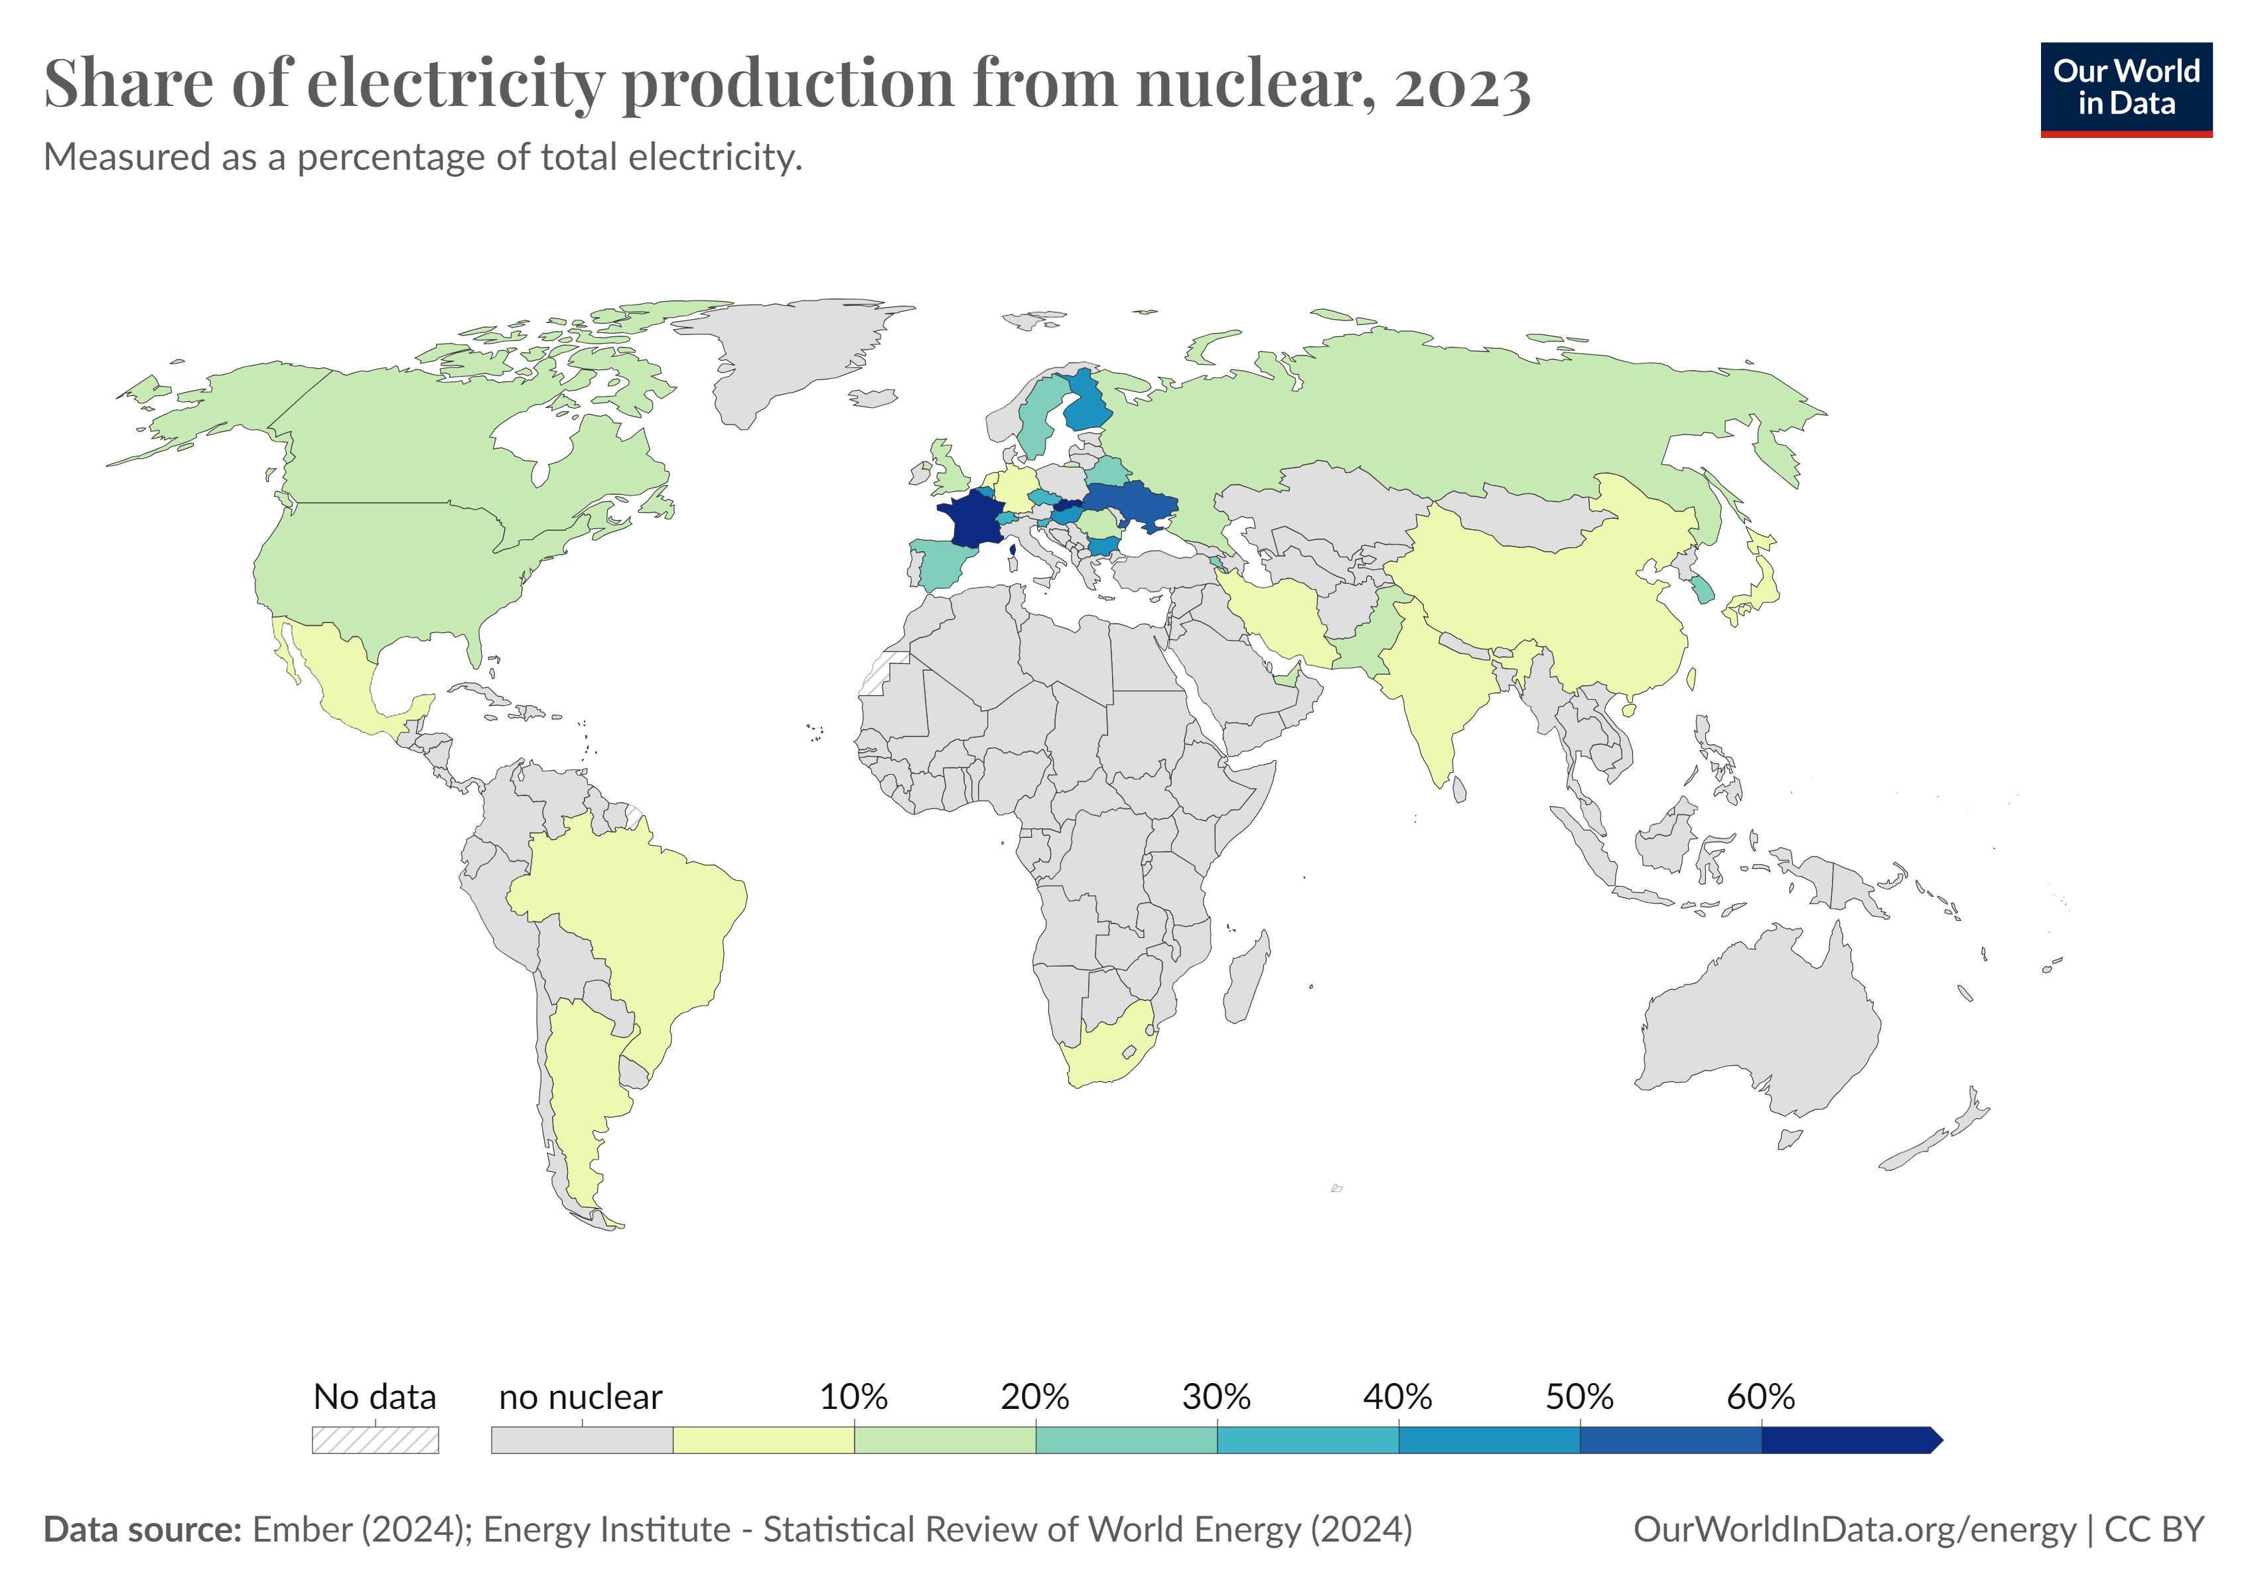
electricity generation
From Nuclear
Nuclear power provided about 9% of global electricity.
France is the largest nuclear-dependent country, with over 60% of its power from nuclear.
Several European countries rely on nuclear for 20–40% of generation (e.g., Sweden, Finland, Hungary).
Large economies like the US and China use nuclear, but at a lower share of their mix (≈15–20%).

Slide 20
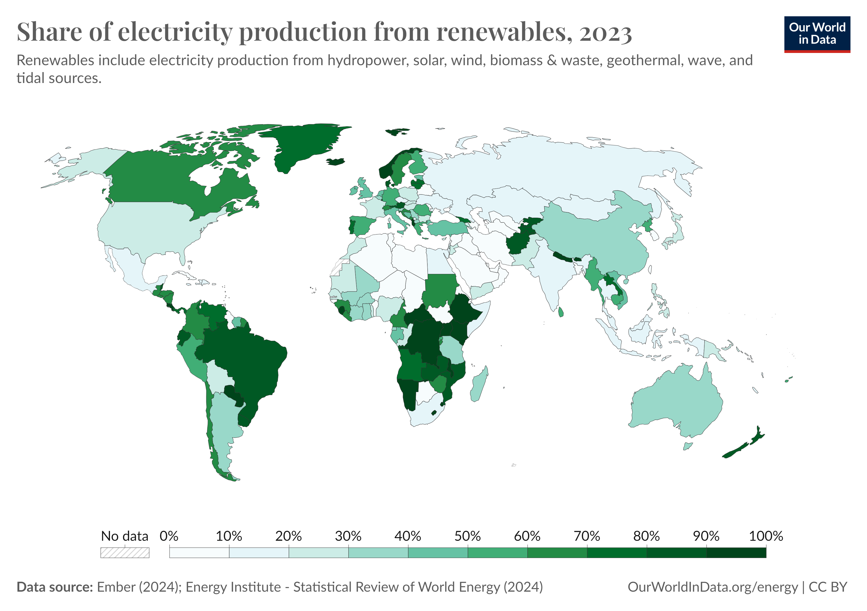
electricity generation
From renewables
Renewables provided about one-third of global electricity.
Some regions get over 50 % of their electricity from renewables, Nordic, South American, Africa, etc.
Hydropower remains the largest renewable source, followed by wind and solar.
Renewable shares vary widely, from under 10% in some regions to nearly 100% in others (e.g., Norway, Paraguay).

Slide 21
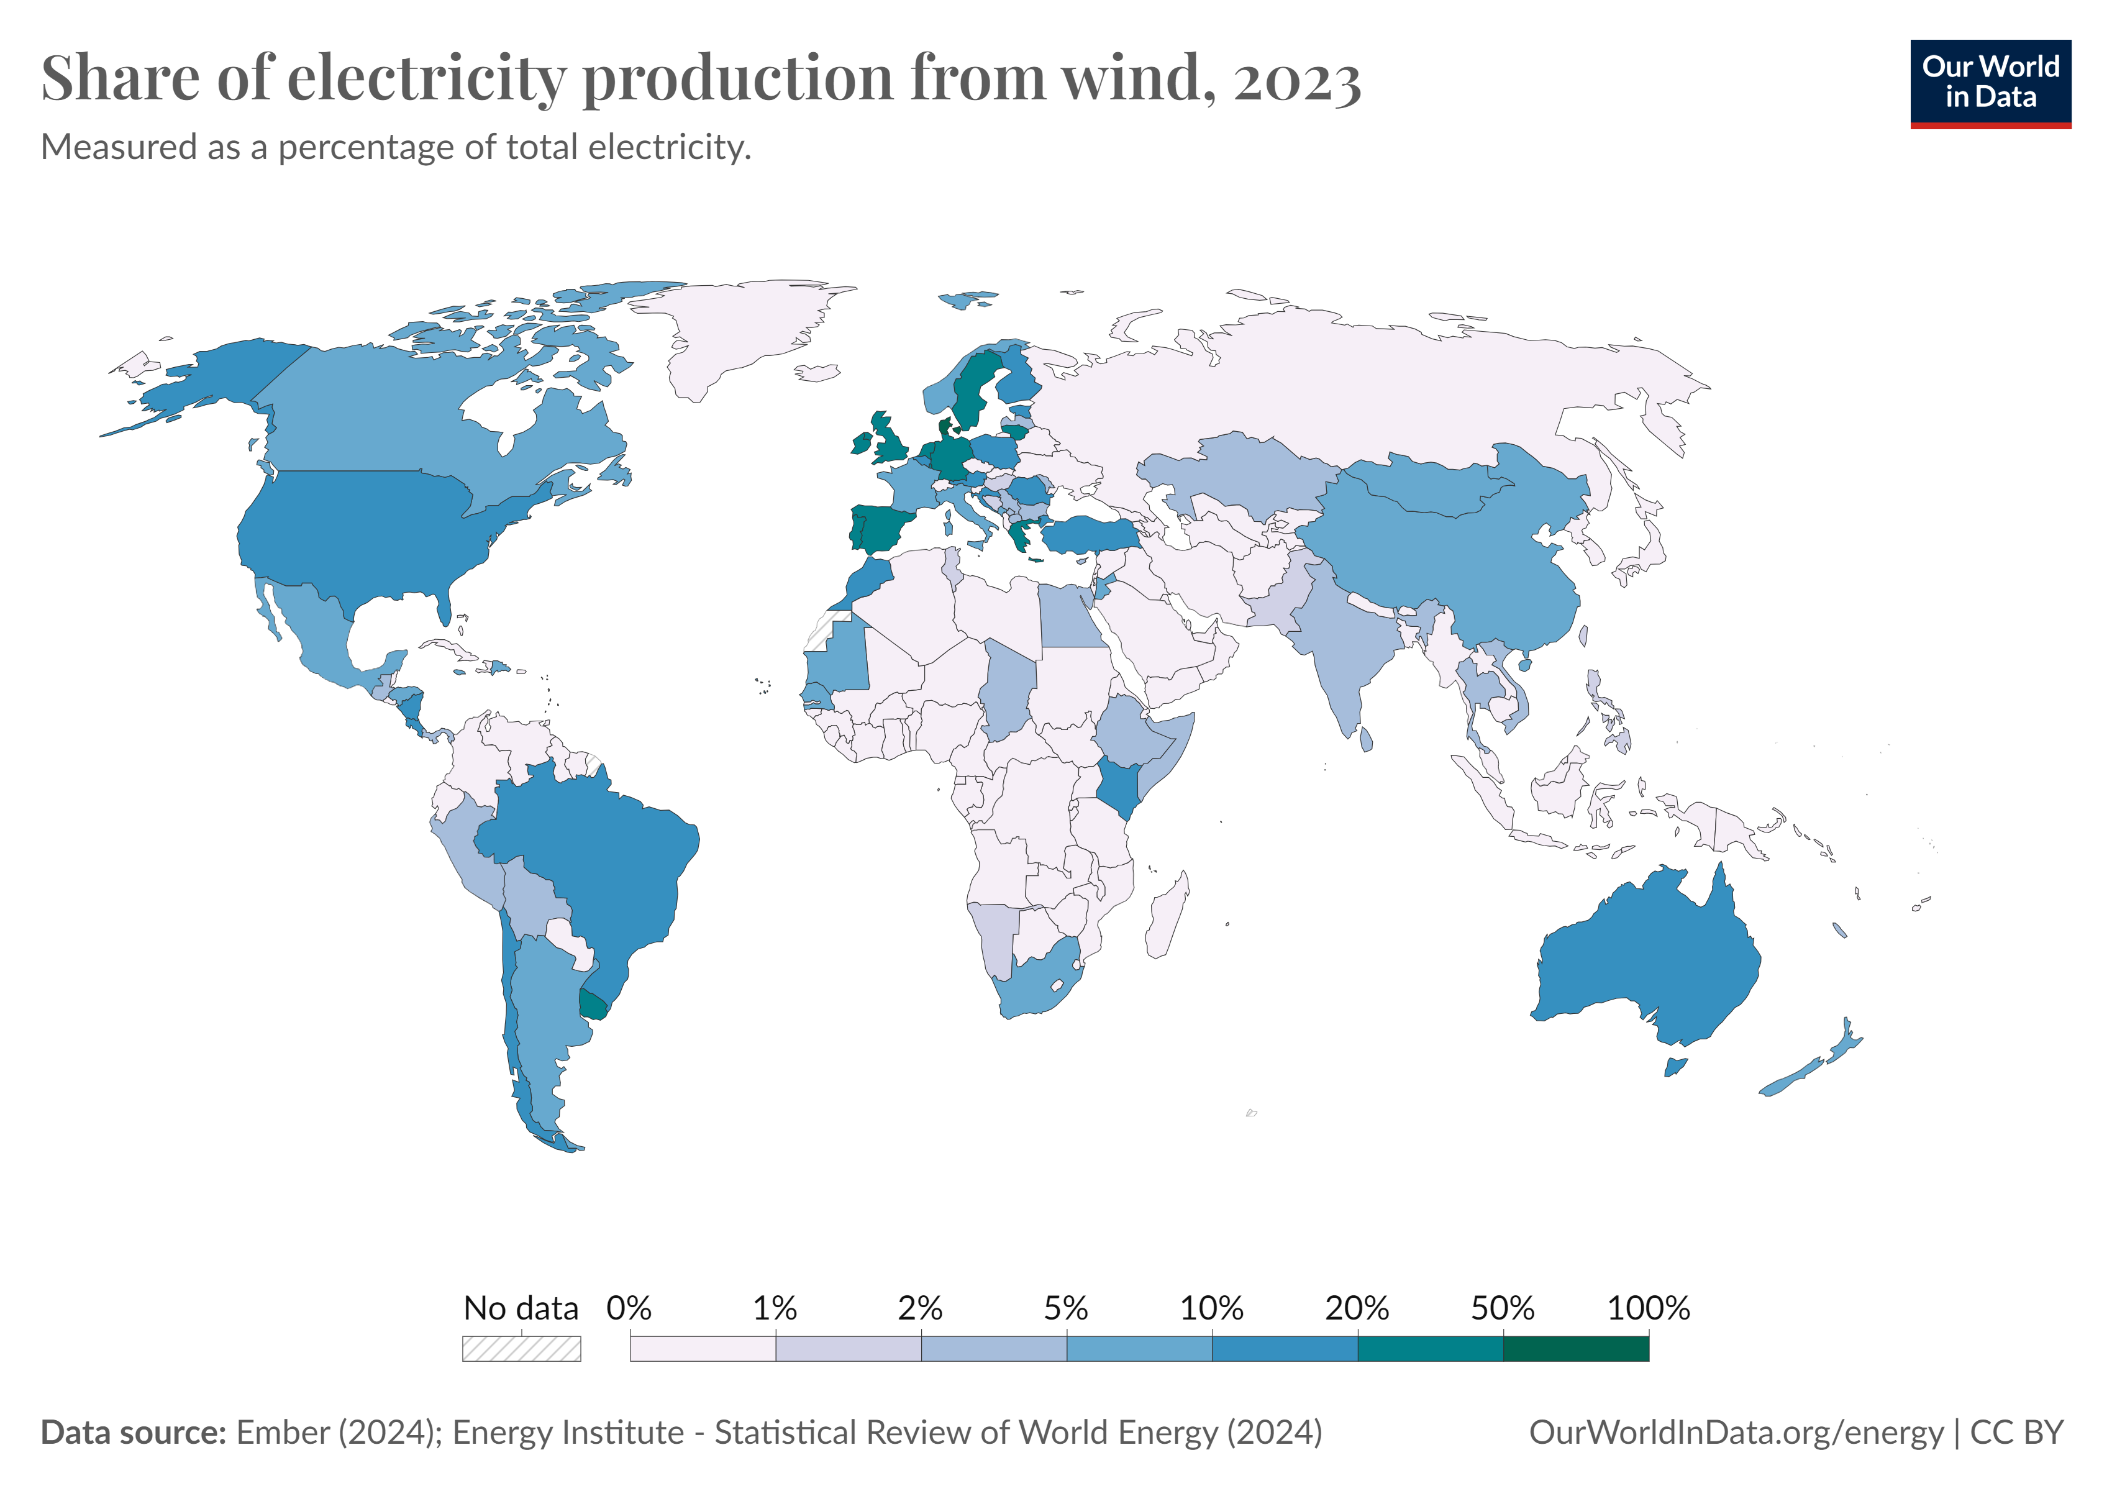
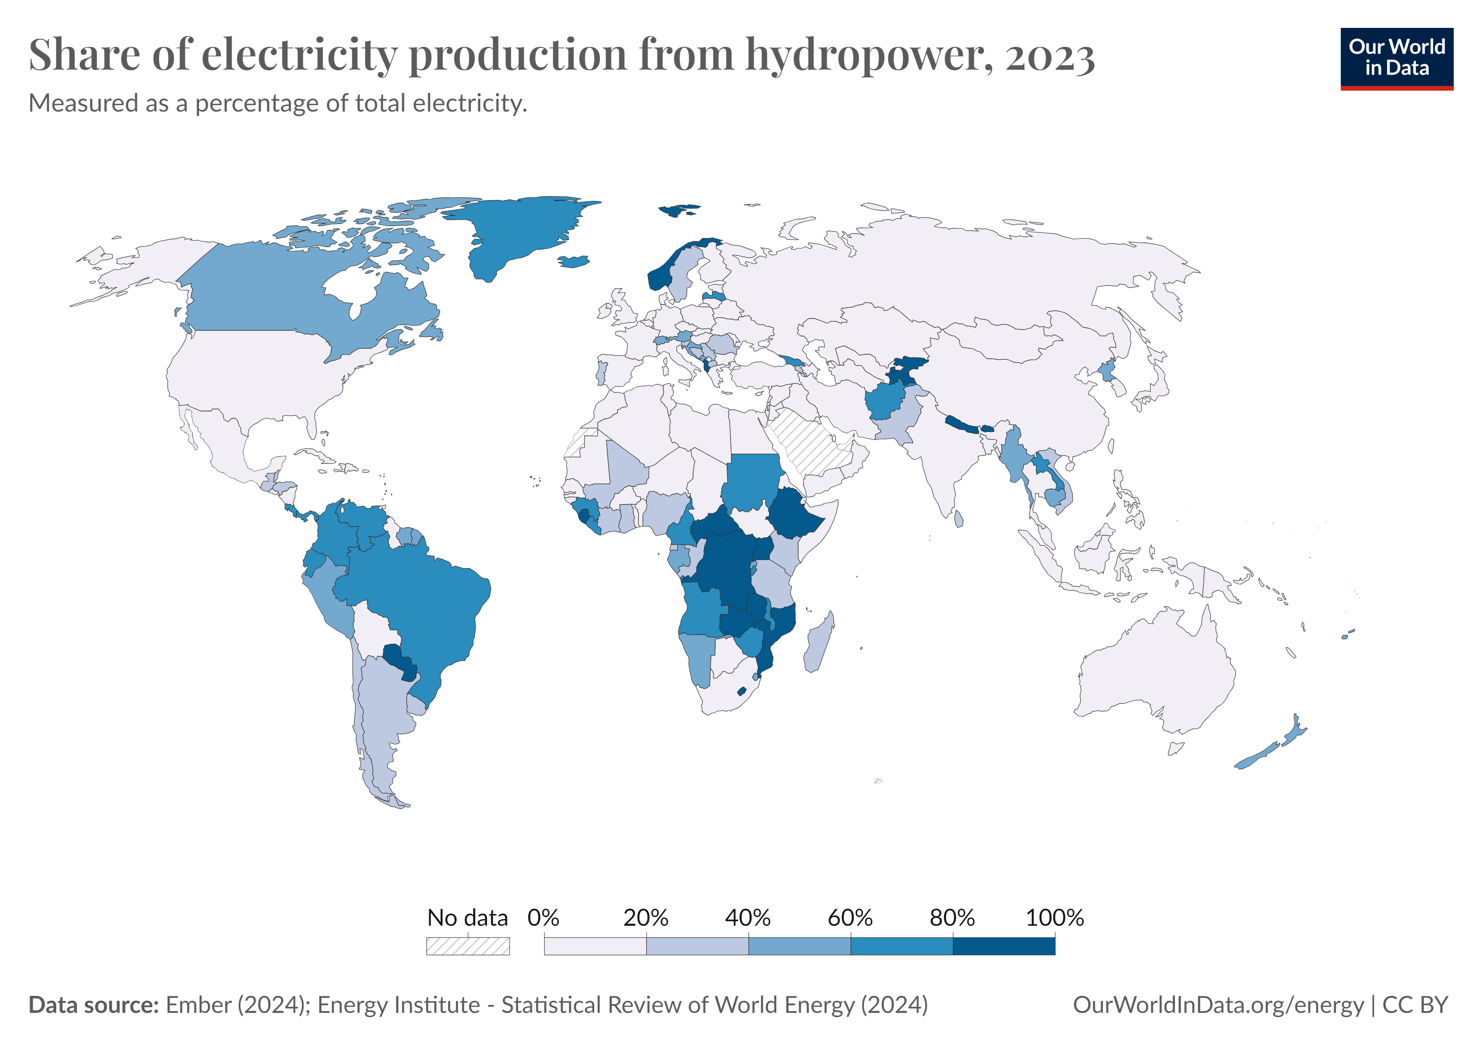
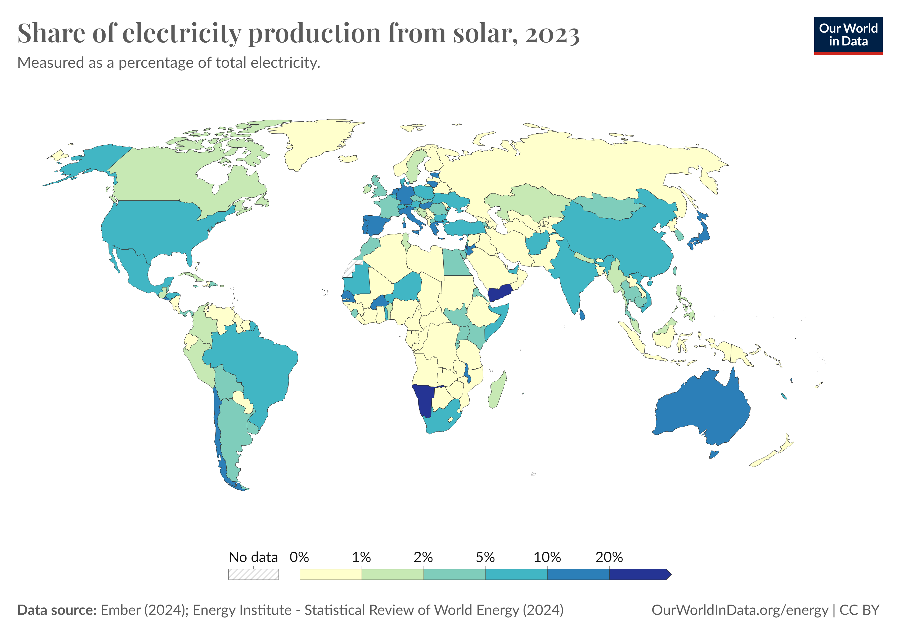
electricity generation
From renewables
Hydropower is still the dominant renewable source in many regions, especially South America, Africa, and parts of Asia.
Wind power has become significant in Europe, the US, and China, exceeding 20% in several countries.
Solar power is expanding rapidly, with high shares in countries such as Spain, Italy, Chile, and Australia.
Together, hydropower, wind, and solar are reshaping the global electricity mix and driving renewable growth.

Slide 22
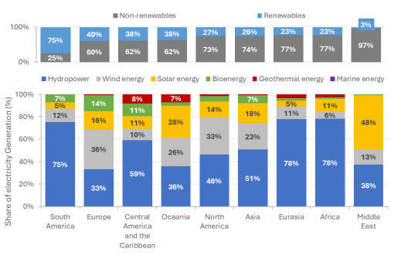
electricity generation
Summary by regions
Renewable shares vary widely by region.
South America and Africa rely heavily on hydropower (≈75–78%).
Europe has a more balanced mix, with wind (36%), solar (16%), and bioenergy (14%) significant.
The Middle East shows the lowest renewable share, dominated by solar (48%) but with overall low contribution to total generation.
Eurasia and North America combine hydropower with wind and solar, while Central America uses both hydro and geothermal.
Summary of fossil fuels and renewables in electricity generation by regions
IRENA (2024), Renewable energy statistics 2024, International Renewable Energy Agency, Abu Dhabi.

Slide 23
Future Energy Projections
Comparison
Transformative changes
Demand prediction

Slide 24
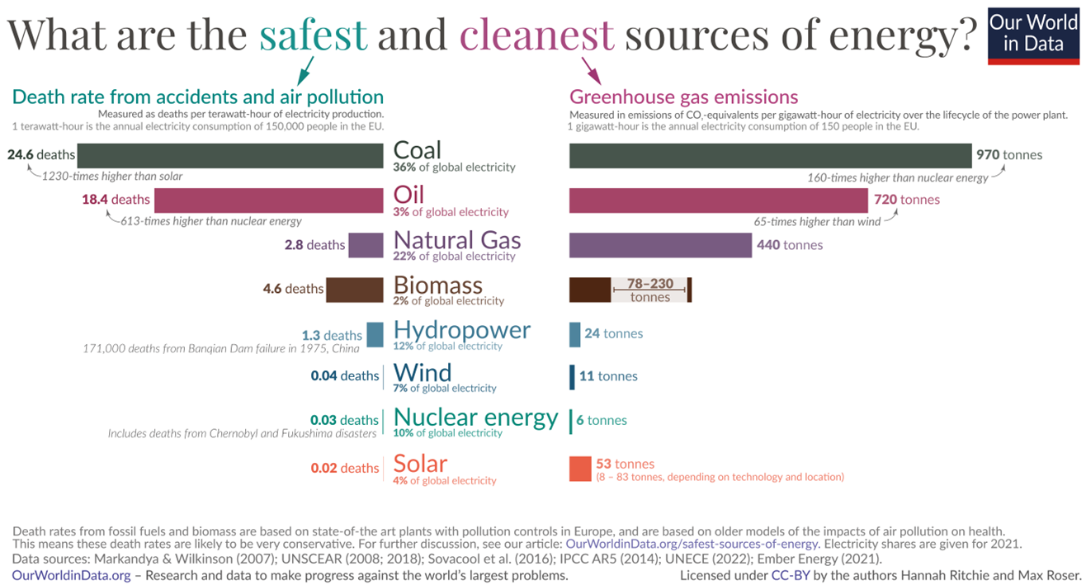
projections for future energy use
Comparison between different energy sources
Coal, oil, and natural gas are the most dangerous and polluting energy sources, with the highest death rates and greenhouse gas emissions.
Renewables and nuclear are far safer and cleaner, with very low deaths per TWh and low lifecycle CO₂ emissions.
Solar, wind, and nuclear stand out as both safe (near zero deaths per TWh) and clean (under 60 tonnes CO₂/TWh).
Hydropower is generally safe and low-carbon, though large dam failures remain rare but catastrophic risks.
Nuclear and renewables are far, far safer than fossil fuels.
The safest energy sources are also the cleanest, for example, nuclear energy and renewables.

Slide 25
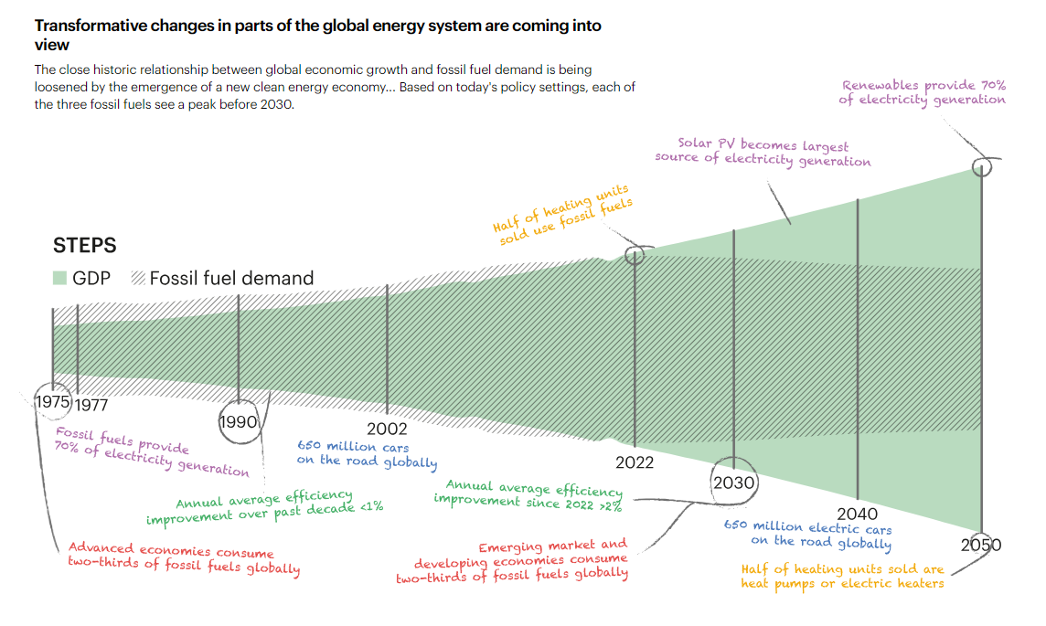
projections for future energy use
Transformative changes
Based on today's policy settings, each of the three fossil fuels see a peak before 2030.
The share of fossil fuels in primary energy demand will continue decline.
Since the 1970s, fossil fuels have provided most of global electricity, but their share is shrinking as renewables grow.
Efficiency improvements have accelerated since 2022, helping reduce fossil fuel demand even as GDP rises.
By 2030, over 650 million electric cars are expected on the road, and heat pumps will replace half of heating units sold.
By 2050, renewables are projected to provide about 70% of global electricity, with solar PV becoming the single largest source.
IEA (2023), World Energy Outlook 2023, IEA, Paris https://www.iea.org/reports/world-energy-outlook-2023, License: CC BY 4.0 (report); CC BY NC SA 4.0 (Annex A)

Slide 26
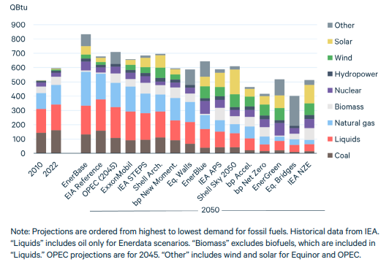
projections for future energy use
Demand prediction
World Primary Energy Demand
Energy outlooks to 2050 vary, but all show major growth in renewables (solar, wind, hydro, biomass).
Coal and oil use decline sharply in most scenarios, while natural gas remains more resilient but still falls in net-zero pathways.
Solar and wind emerge as the largest growth areas, surpassing fossil fuels in low-carbon scenarios.
The scale of change depends on policy ambition: in net-zero cases, fossil fuels drop below one-third of total energy by 2050.
D. Raimi, Y. Zhu, R.C. Newell, B.C. Prest (2024), Global Energy Outlook 2024: Peaks or Plateaus? Resources for the Future (RFF) Washington, DC. https://media.rff.org/documents/Report_24-06.pdf, License: CC BY-NC-ND 4.0

Slide 27
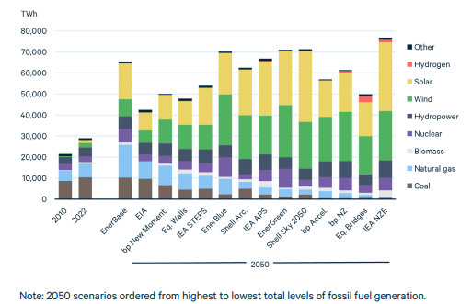
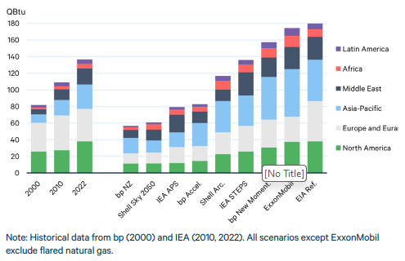
D. Raimi, Y. Zhu, R.C. Newell, B.C. Prest (2024), Global Energy Outlook 2024: Peaks or Plateaus? Resources for the Future (RFF) Washington, DC. https://media.rff.org/documents/Report_24-06.pdf, License: CC BY-NC-ND 4.0
projections for future energy use
Demand prediction
World Electricity Demand
World Natural Gas Demand
By 2050, all scenarios show strong growth in renewables, especially solar and wind.
Coal nearly disappears in net-zero pathways, while gas and nuclear vary by scenario.
Hydrogen starts to appear but remains small compared to solar and wind.
Overall electricity generation increases, but the mix depends on climate ambition.
Natural gas demand still grows strongly, led by North America, Europe, and Asia-Pacific.
Future scenarios diverge: net-zero pathways show steep declines, while reference cases project continued growth.
Middle East and Asia-Pacific remain the main growth regions in high-demand cases.
Latin America and Africa stay minor contributors across all scenarios.

Slide 28
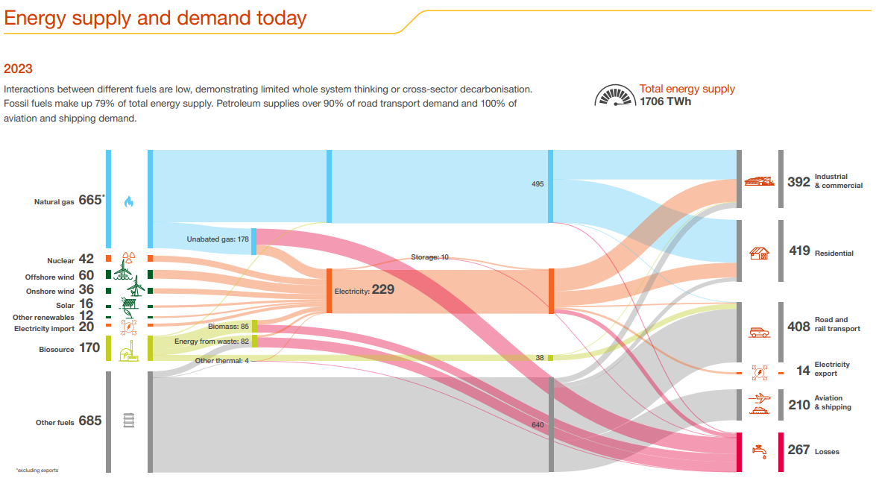
projections for future energy use
Demand prediction
Fossil fuels dominate the system, making up 79% of total supply (1706 TWh).
Natural gas and oil account for the largest shares, with petroleum supplying over 90% of road transport and 100% of aviation and shipping demand.
Electricity generation (229 TWh) comes from a mix of gas, nuclear, wind, solar, biomass, and imports.
Demand sectors: residential (419 TWh), industrial & commercial (392 TWh), transport (408 TWh), and aviation & shipping (210 TWh).
Losses remain high at 267 TWh, showing efficiency challenges.
Overall, interactions between fuels are limited, showing the need for cross-sector decarbonisation.
D. Raimi, Y. Zhu, R.C. Newell, B.C. Prest (2024), Global Energy Outlook 2024: Peaks or Plateaus? Resources for the Future (RFF) Washington, DC. https://media.rff.org/documents/Report_24-06.pdf, License: CC BY-NC-ND 4.0

Slide 29
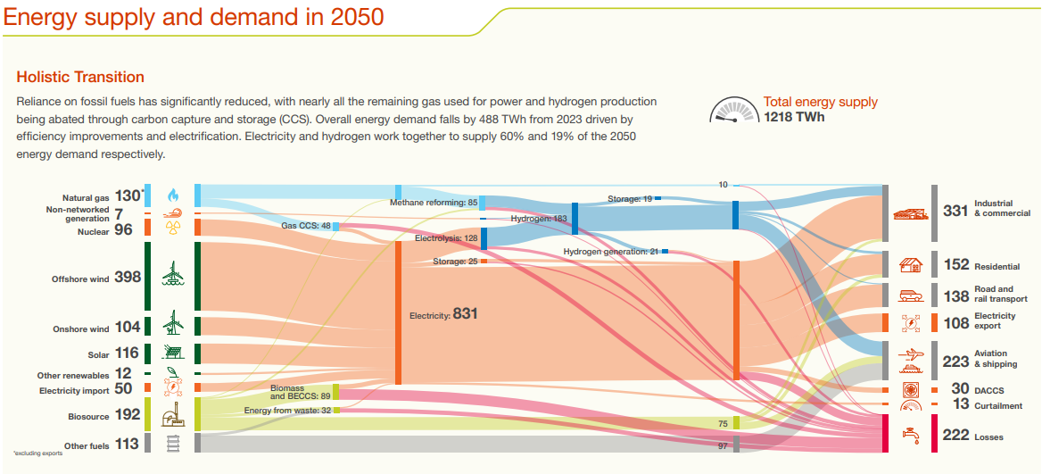
projections for future energy use
Demand prediction
Fossil fuels are greatly reduced, with remaining natural gas mainly used for power and hydrogen production, combined with CCS.
Total energy supply drops to 1218 TWh, almost 500 TWh lower than in 2023, due to efficiency and electrification.
Electricity dominates, providing 60% of final energy (831 TWh).
Hydrogen emerges as a major energy carrier, supplying 19% of demand (183 TWh).
Wind and solar expand massively (over 600 TWh combined), supported by nuclear, biomass, and imports.
Demand sectors: industrial (331 TWh), aviation & shipping (223 TWh), residential (152 TWh), transport (138 TWh).
Losses shrink slightly, but remain significant (222 TWh).
Future Energy Scenarios: ESO Pathways to Net Zero. https://www.nationalgrideso.com/document/322321/download, License: CC BY-NC-ND 4.0

Slide 30
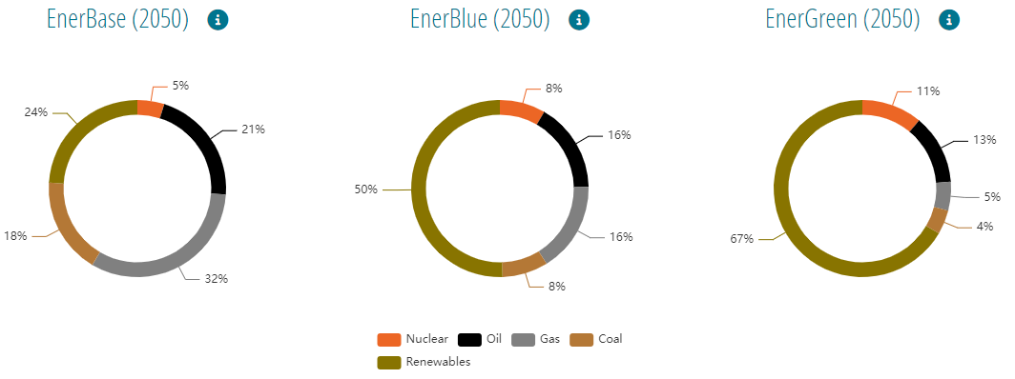
projections for future energy use
Total energy prediction
Total primary energy consumption
By 2050, renewable energy sources will account for half of primary energy consumption. Fossil fuel demand, and especially coal consumption, are expected to drop substantially.
The scenarios diverge: EnerBase still relies heavily on fossil fuels (only 24% renewables), EnerBlue reaches a balanced 50% renewables, while EnerGreen is strongly decarbonised with 67% renewables and minimal coal and gas.
Energy and emissions projections 2050 - EnerOutlook. https://eneroutlook.enerdata.net/forecast-world-energy-primary-consumption.html

Slide 31
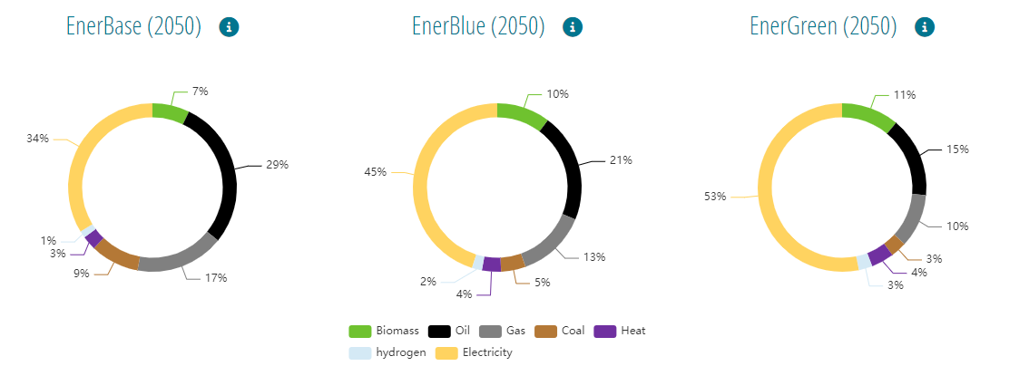
projections for future energy use
Total energy prediction
Total final energy consumption
In terms of final energy mix, end-uses will tend to become electrified, especially in scenarios with high climate ambition, enabling the share of fossil fuels in final consumption to quickly reduce.
Electricity dominates in all scenarios: 34% in EnerBase, 45% in EnerBlue, and 53% in EnerGreen. Fossil fuels decline sharply, with oil and gas falling from nearly half in EnerBase to just a quarter in EnerGreen, while biomass, hydrogen, and heat remain smaller but steady contributors.
Energy and emissions projections 2050 - EnerOutlook. https://eneroutlook.enerdata.net/forecast-world-energy-primary-consumption.html

Slide 32
Green Energy Technologies
Overview
Developments
Opportunities
Challenges
Status

Slide 33
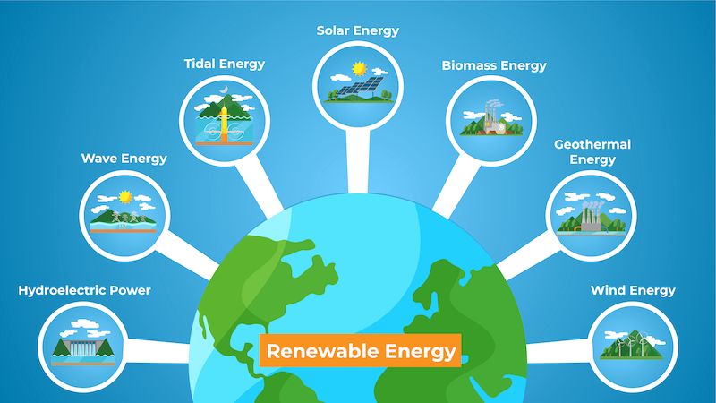
Green energy technologies
Overview
Solar photovoltaic (PV) panels convert sunlight into electricity
Tidal energy from the rise and fall of sea levels via tidal stream generators and tidal barrages
Bioenergy is converting biomass into biogas, bio-oil, biochar via thermochemical or biochemical process.
Wave energy devices capture the energy from surface waves created by wind blowing over the ocean.
Geothermal plants use heat from the Earth’s interior to generate electricity or provide direct heating
Hydropower plants convert the energy of flowing water into electricity
Wind turbines convert kinetic energy from the wind into electricity
Green Energy

Slide 34
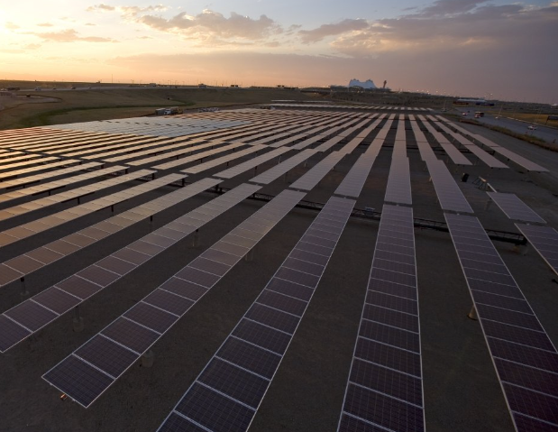
Green energy technologies
Solar energy
Solar technologies convert sunlight into electrical energy either through photovoltaic (PV) panels or through mirrors that concentrate solar radiation.
At the moment, solar PV alone accounts for three-quarters of renewable capacity additions worldwide.
Solar PV and wind additions are forecast to more than double by 2028 compared with 2022, continuously breaking records over the forecast period to reach almost 710 GW.

Slide 35
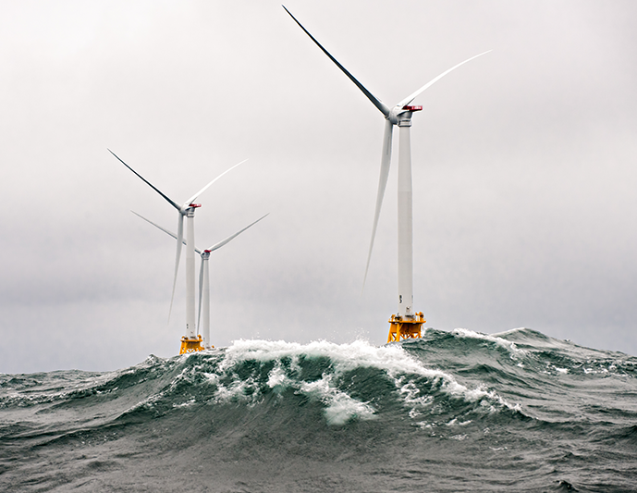
Green energy technologies
Wind energy
Wind energy harnesses the power of the wind to generate electricity. It involves using wind turbines to convert the turning motion of blades, pushed by moving air (kinetic energy) into electrical energy (electricity).
Wind has one of the greatest potentials to increase the renewable capacity growth.
In 2026, wind is expected to surpass nuclear electricity generation.

Slide 36

Green energy technologies
Hydroelectric power
Hydroelectric power is a renewable source of energy that generates power by using a dam or diversion structure to alter the natural flow of a river or other body of water.
Hydropower currently generates more electricity than all other renewable technologies combined and is expected to remain the world’s largest source of renewable electricity generation into the 2030s.
Hydroelectricity generation increased by almost 70 TWh (up close to 2%) in 2022, reaching 4 300 TWh. In 2028, hydropower will remain the largest renewable electricity source.

Slide 37

Green energy technologies
Geothermal energy
Geothermal energy is energy available as heat contained in or discharged from the earth’s crust that can be used for generating electricity and providing direct heat for numerous applications.
Geothermal energy is clean, reliable, huge potential energy source.
Meeting about 0.3% (0.13 EJ) of global heat demand, direct geothermal, although on the rise, is currently the smallest renewable heat source.

Slide 38

Green energy technologies
Bioenergy
Bioenergy is a source of energy from the organic material that makes up plants, known as biomass. Biomass contains carbon absorbed by plants through photosynthesis.
Modern bioenergy is the largest source of renewable energy globally today, accounting for 55% of renewable energy and over 6% of global energy supply.
Bioenergy is an important pillar of decarbonization in the energy transition as a near zero-emission fuel.

Slide 39
Green energy technologies
opportunities
Policies
CO2 emissions
New policies introduced in 2022 in the biggest global economies are expected to boost renewable energy use.
In May 2022, the European Commission proposed to increase the European Union’s renewable energy target for 2030 to 45% as part of the REPowerEU Plan.
In August 2022, the federal government of the United States introduced the IRA, which significantly expands support for renewable energy in the next ten years through tax credits and other measures.
China published its 14th Five-Year Plan for Renewable Energy in June 2022, which includes an ambitious target of 33% of electricity generation to come from renewables by 2025.
Renewables, in particular wind and solar energy, are responsible for one of the largest shares of global CO2 emission reductions between now and 2030 in the NZE Scenario.
Technology deployment
Accelerating wind and solar PV capacity additions are driving the growth in renewable energy supply.
In the case of wind, hydropower and bioenergy, more efforts are needed to get on track

Slide 40
Green energy technologies
Challenges
Intermittency and Reliability
Infrastructure Investment
Many green energy sources (solar and wind) are intermittent, requiring improved energy storage solutions or backup from traditional power plants.
Expanding renewable energy capacity requires significant infrastructure investments in generation, transmission, and storage.
Regulatory and Social Issues
Large-scale renewable projects can face opposition due to land use, environmental concerns, and social impacts, particularly with hydropower and biomass.

Slide 41
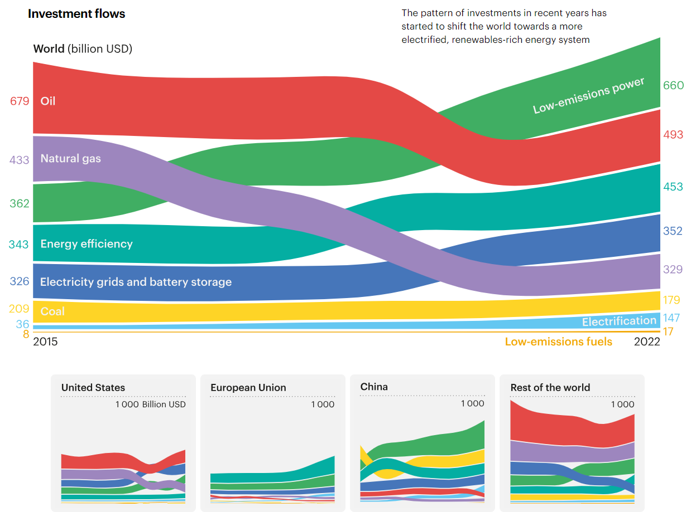
Green energy technologies
Developments - Investment
The pattern of investments in recent years has started to shift the world towards a more electrified, renewables-rich energy system.
Global energy investment in 2025 is projected at USD 3.3 trillion.
Clean energy leads, attracting about USD 2.2 trillion, more than double fossil fuels at USD 1.1 trillion.
Solar PV dominates, with around USD 450 billion in investment, alongside rapid growth in battery storage.
Efficiency and electrification investments, including EVs and building retrofits, approach USD 800 billion.
Fossil fuel investment remains sizeable at ~USD 570 billion, though declining, with oil falling slightly and gas/LNG still expanding.
Compared with 2015, the balance has flipped: clean energy now attracts twice the capital of fossil fuels.
IEA (2023), World Energy Outlook 2023, IEA, Paris https://www.iea.org/reports/world-energy-outlook-2023, License: CC BY 4.0 (report); CC BY NC SA 4.0 (Annex A)

Slide 42
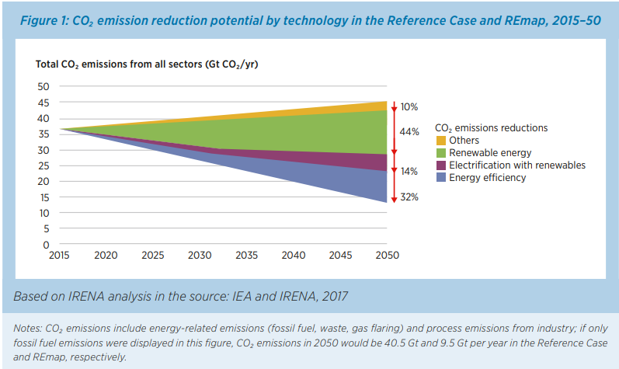
Green energy technologies
CO2 emissions
Globally, 36 gigatonnes (Gt) of energy-related CO₂ were emitted in 2015.
Emissions will need to fall continuously to between 9.5 Gt and 12 Gt by 2050 to limit warming to a maximum of 2°C above pre-industrial levels, in line with the Paris Agreement Goals.
IRENA and C2E2 (2015), Synergies between renewable energy and energy efficiency, Working paper, IRENA, Abu Dhabi and C2E2, Copenhagen.

Slide 43
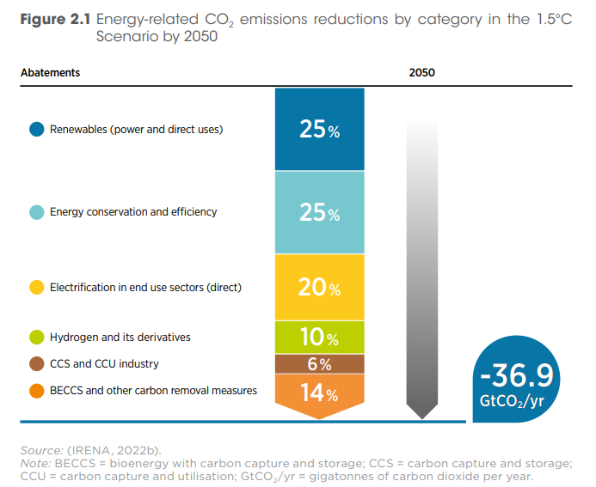
Green energy technologies
CO2 emission reduction
Renewables and energy efficiency each contribute the largest share (25% each).
Electrification of end-use sectors provides another 20%.
Hydrogen accounts for 10%, while CCS/CCU adds 6%.
BECCS and other removals cover the remaining 14%.Altogether, these measures achieve about −36.9 GtCO₂/year of avoided emissions.
IRENA (2023), Low-cost finance for the energy transition, International Renewable Energy Agency, Abu Dhabi.

Slide 44
Energy Costs
Primary Energy price
Investment
Comparison

Slide 45
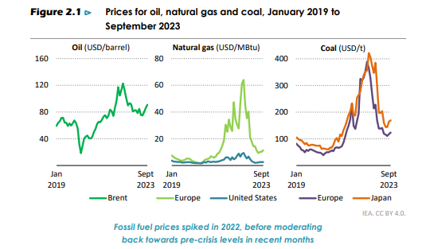
energy Costs
Fossil fuel price
Oil (Brent crude)
Peaked above $120/barrel in 2022, then moderated to about $70–90/barrel by late 2023.
Forecasted to average $73/bbl in 2025, dropping to around $72 in 2026.
Natural Gas
Europe had a dramatic spike to nearly $60/MBtu in 2022
U.S. prices rose much less.U.S. gas is expected to stay cheaper than coal, averaging $2.15/MBtu in 2024.
Prices are projected to rise toward $4/MBtu by 2026.
Coal
(Europe & Asia)Prices surged above $400/ton in 2022, then fell below $200/ton by 2023.
Demand stayed high into 2024, particularly in Asia.
IEA (2023), World Energy Outlook 2023, IEA, Paris https://www.iea.org/reports/world-energy-outlook-2023, License: CC BY 4.0 (report); CC BY NC SA 4.0 (Annex A)

Slide 46
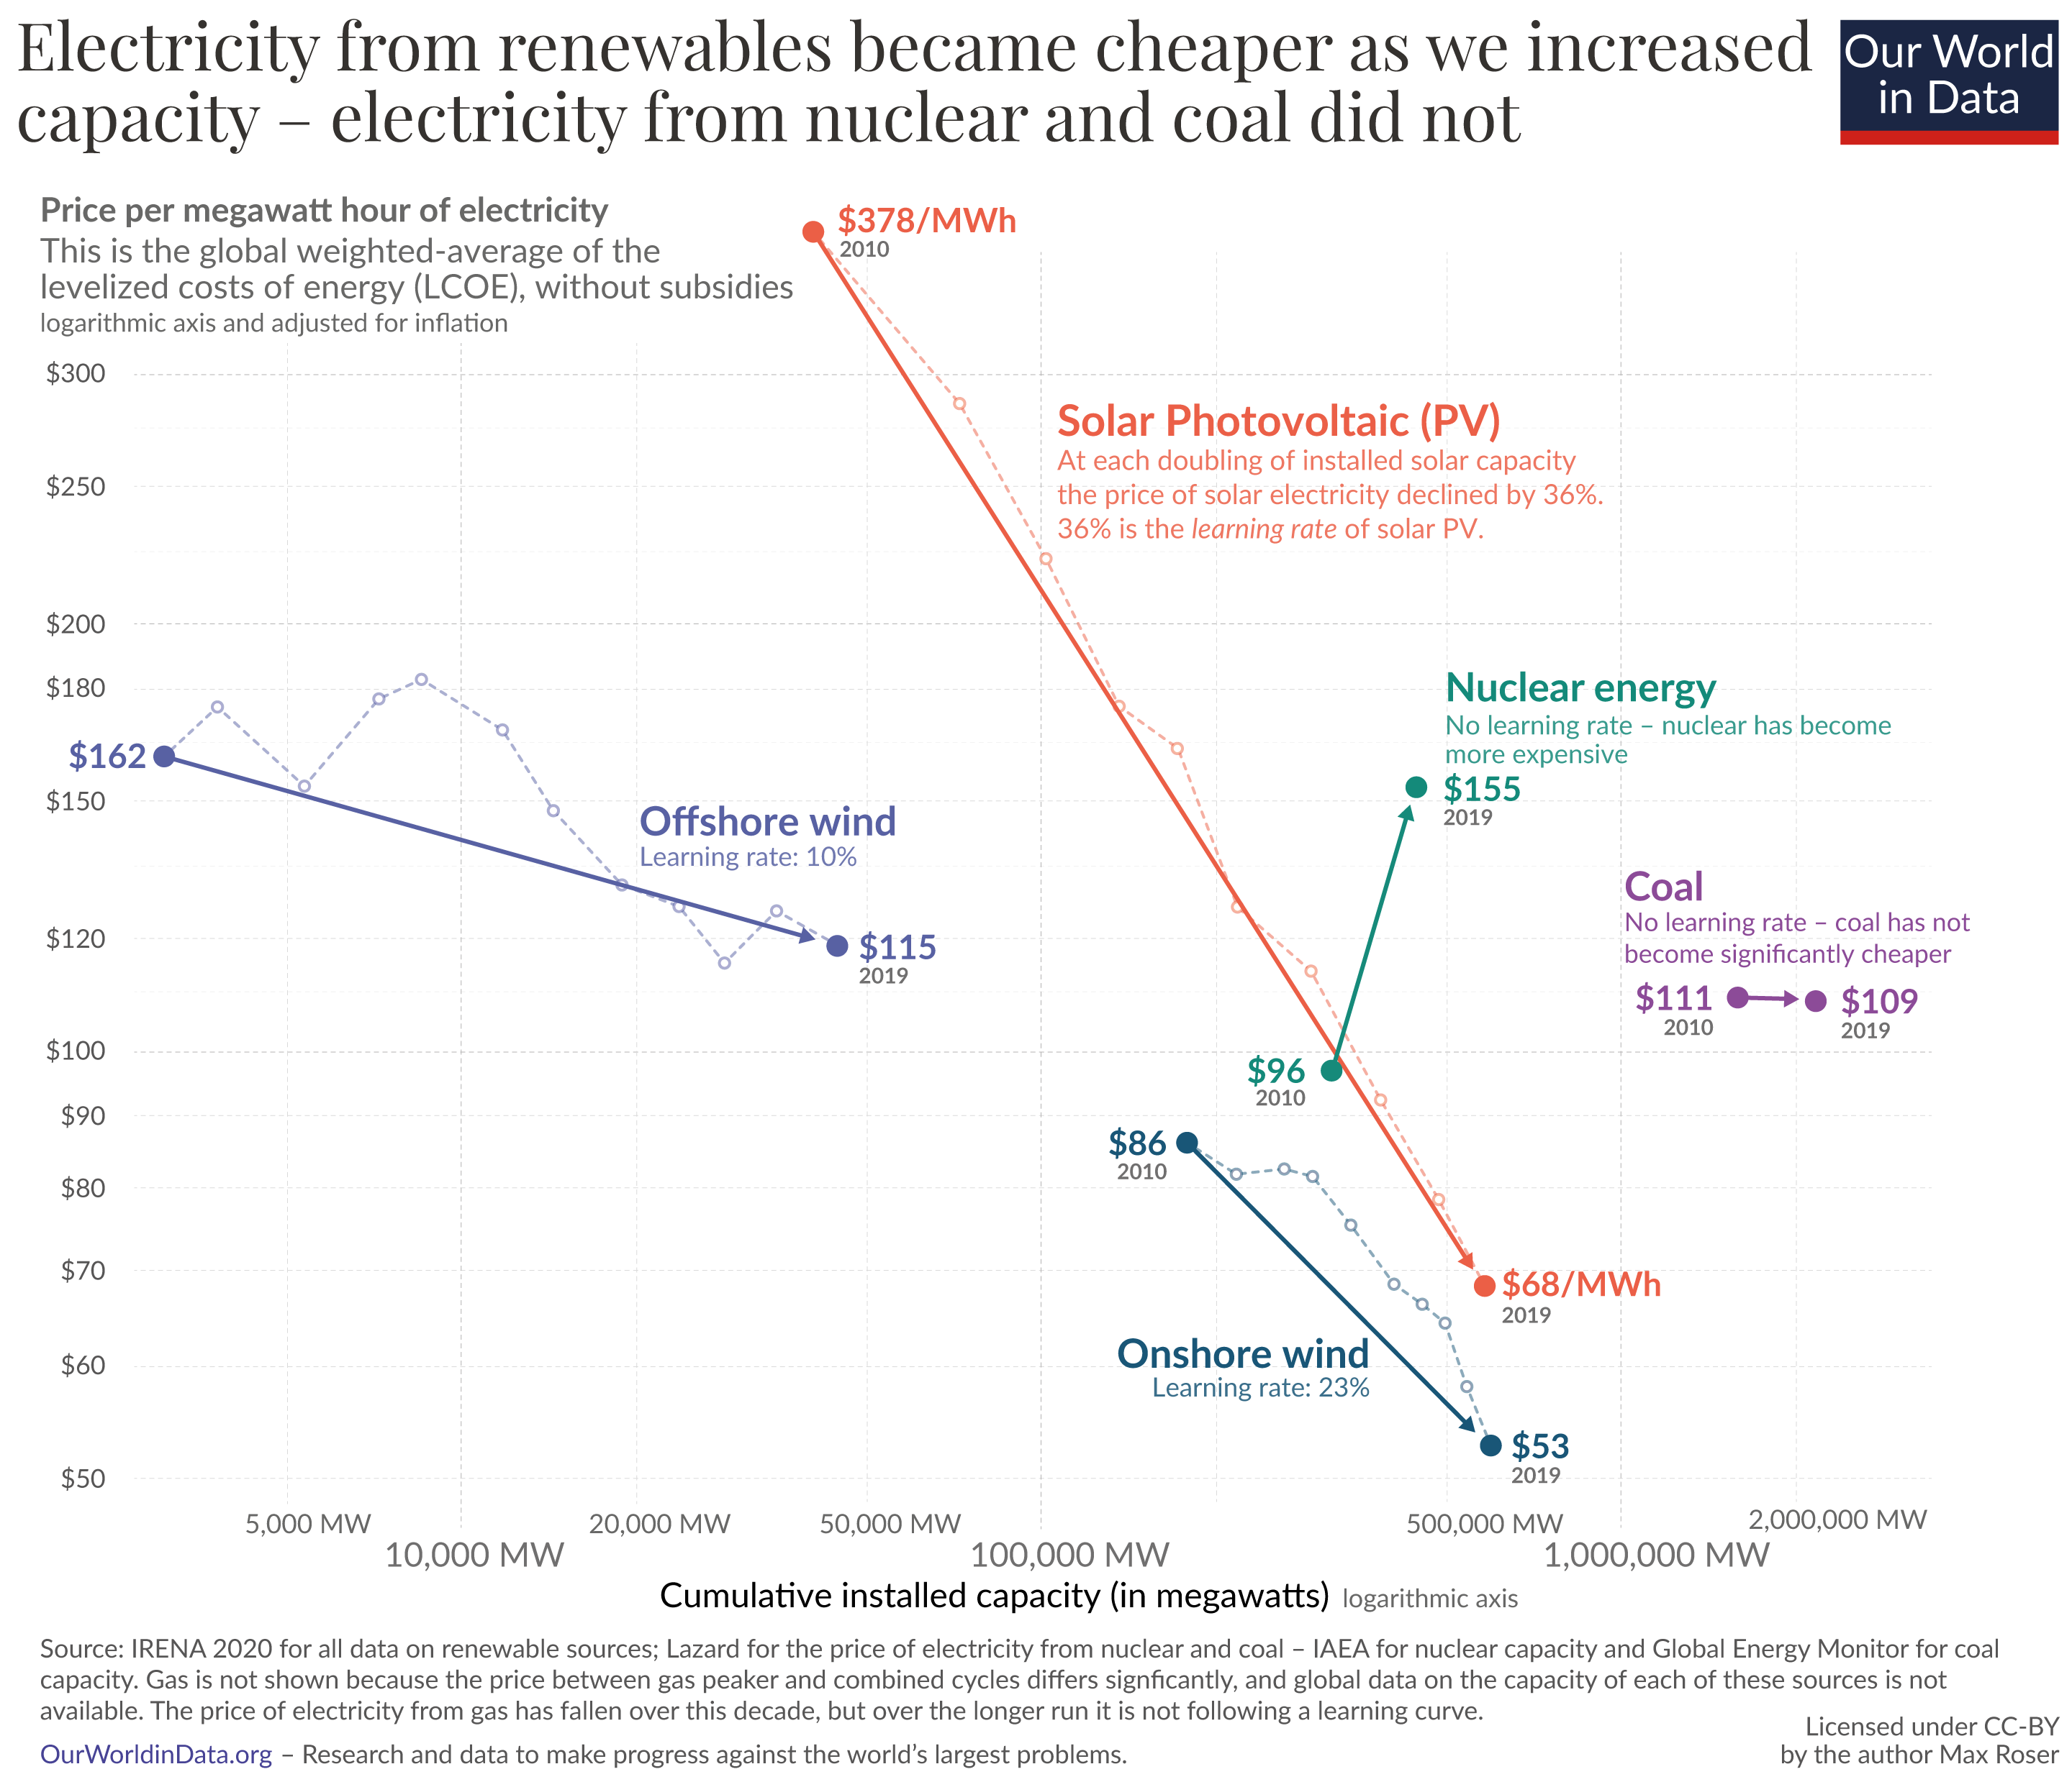
energy Prices
Price comparison
Electricity generation from renewables is getting rapidly cheaper, as the development of technologies.
Efficiency and fuel price limit the price of electricity from fossil fuels, e.g., coal.
Installation and regulation for nuclear power increase the price.

Slide 47
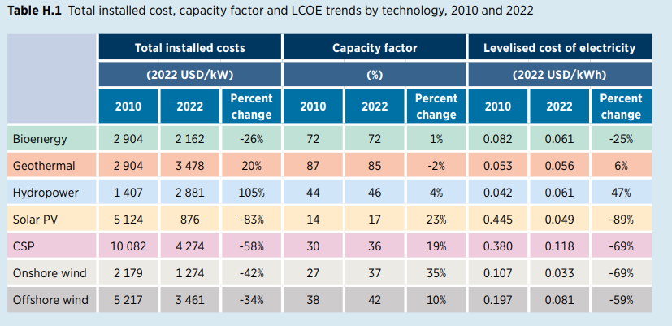
energy Prices
Total installation cost for renewables
Renewable power deployed globally since 2000 saved an estimated USD 521 billion in fuel costs in the electricity sector.
The economic benefits of solar and wind technologies, in addition to their environmental benefiits, are now compelling.
The Levelised Cost of Electricity (LCOE) is the average cost per unit of electricity generated over a plant’s lifetime, covering all investment, operation, and fuel expenses.
IRENA (2023), Renewable power generation costs in 2022, International Renewable Energy Agency, Abu Dhabi.

Slide 48
Barriers
Current Barriers
Virtuous Cycle

Slide 49
Barriers of Green energy technologies
Barriers
Implementation Costs
Lack of Centralized Information
High investment costs result in higher implementation costs, making clean energy technology adoption expensive.
More centralized information is needed to analyze and aggregate data, understand the current state of emissions, and make plans and projections for a clean future.
Lagging Systems and Infrastructure
Decentralized clean energy systems require additional siting and transmission efforts, such as permitting, powerlines, and updated infrastructure, making implementation difficult.

Slide 50
References
Our World in Data, https://ourworldindata.org/
The International Renewable Energy Agency (IRENA), https://www.irena.org/
The International Energy Agency (IEA), https://www.iea.org/
U.S. Department of Energy (DOE), https://www.energy.gov/
National Grid ESO, https://www.nationalgrideso.com/
The Energy Institute (EI), https://www.energyinst.org/
Statistic Estonia, https://www.stat.ee/en
Enerdata, https://www.enerdata.net/

