Slide 1



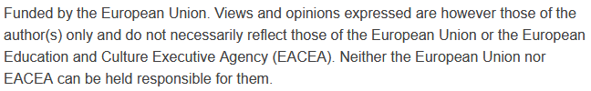
Introduction to Smart Cities
& Urban Mobility Challenges
Sustainability and Quality Assurance for Academic Governance and Redesign Engineering Studies
MODULE 1
Justyna Staszak-Winkler

Slide 2
The concept of a Smart City
Smart City is a modern concept of urban development that involves the use of advanced information and communication technologies (ICT) to improve the quality of life of residents, increase the efficiency of urban services, and ensure sustainable resource management.
At the heart of the smart city idea is the human being – their needs, safety, comfort, and access to services.

Slide 3
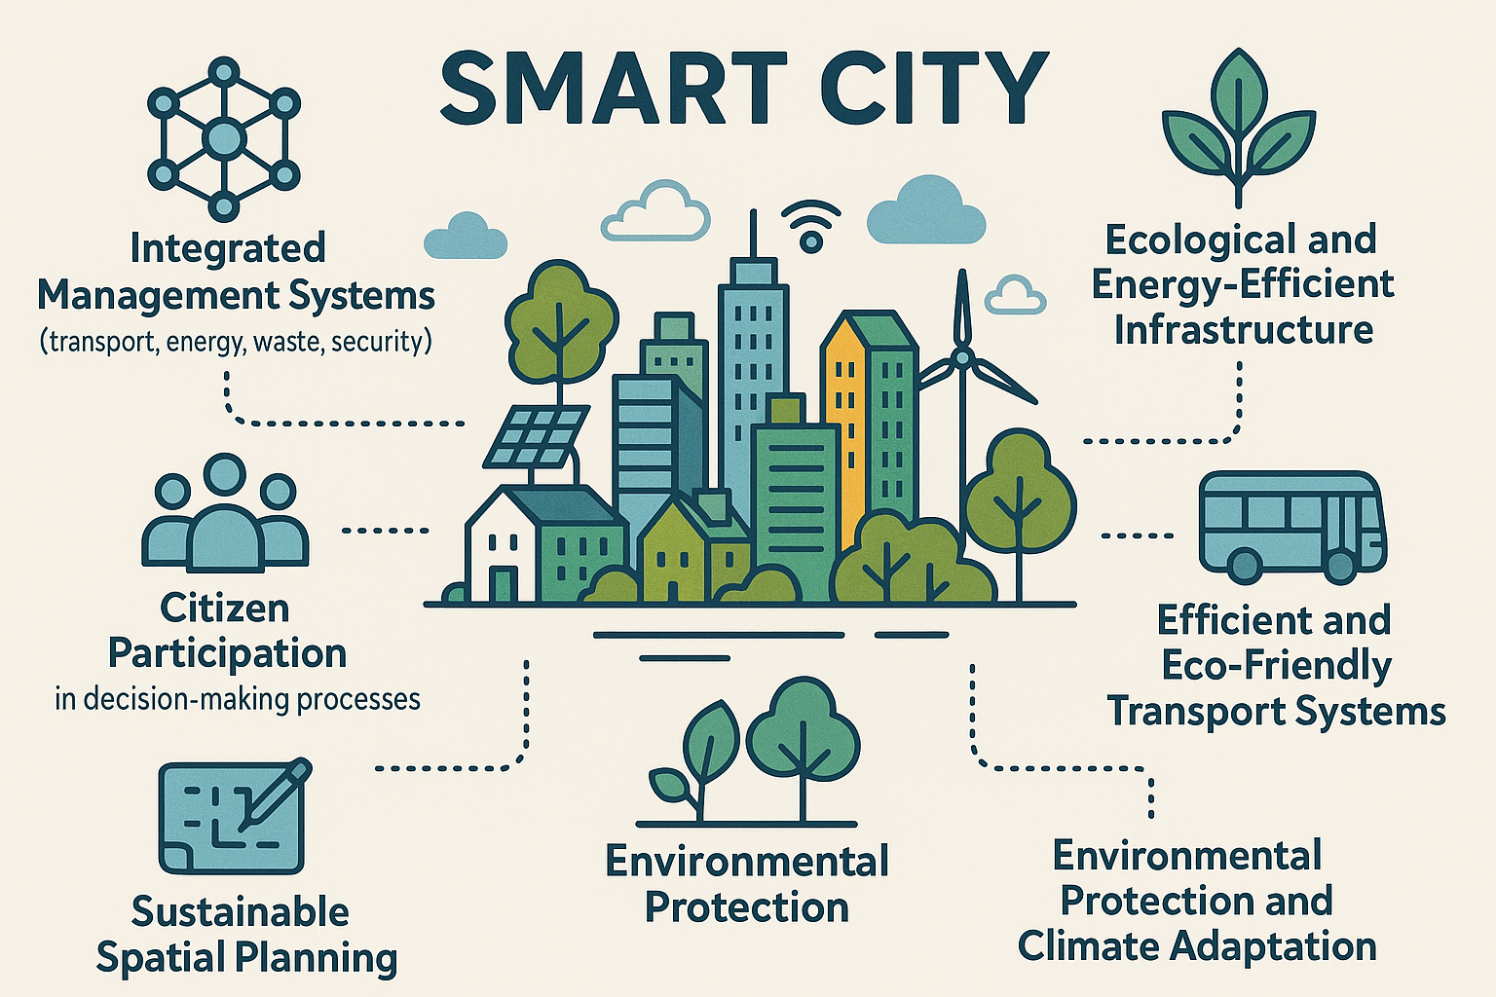
Key features of a Smart City

Slide 4
Why are data crucial for a smart city?
Integrated Urban Data Management Systems
A smart city is a city that "knows what is happening within it."
City management is based on:
collecting real-time data (from sensors, urban systems),
analyzing this data,
making informed decisions based on it.

Slide 5
Key Components of Integrated Urban Data Management Systems
Urban Data Platforms
– collect data from various sources (transport, energy, environment, security)
– provide data access for officials, companies, and residents
City Management Dashboards
– real-time data visualization tools
– display, for example, pollution levels, traffic flow, energy consumption
IT Systems Interoperability
– integration of different systems and databases
– facilitates institutional cooperation and faster response
Integrated Urban Data Management Systems

Slide 6
Smart govermance
Citizen Participacion in decision - making processes
It is intelligent city management based on:
transparency of decisions,
collaboration between the administration and residents,
open access to information,
the use of digital technologies for communication and decision-making.

Slide 7
E-participation (digital participation)
Citizen Participacion in decision - making processes
It is the active participation of residents in city life through digital tools, such as:
mobile applications,
online consultation platforms,
electronic voting (e-voting),
problem maps (e.g., “fix it!”),
systems for submitting local ideas/projects.

Slide 8
Seeds of smart solutions
– local innovations that can evolve towards full smart city systems
In Kathmandu, initiatives involving residents were conducted in the process of hazard mapping (e.g., earthquakes, floods, narrow streets, lack of infrastructure).
Technology:
Open-source tools such as OpenStreetMap and mobile applications for field data collection were used.
Goal:
To improve spatial planning and crisis response by incorporating local knowledge.
Result:
Up-to-date maps of needs and risks were created to support decision-making by city authorities and non-governmental organizations.
Participatory Mapping in Kathmandu (Nepal)

Slide 9
Eco-friendly and energy-efficient infrastructure in a smart city
Ecological and Energy-efficient infrastructure
Green Infrastructure
A system of natural and semi-natural elements in the city that:
cools urban space (e.g., green roofs, green walls, pocket parks),
supports water retention (e.g., rain gardens, permeable surfaces),
improves air quality and biodiversity (e.g., urban forests, street greenery).

Slide 10
Eco-friendly and energy-efficient infrastructure in a smart city
Ecological and Energy-efficient infrastructure
Smart Energy Systems
A smart city develops infrastructure that supports energy efficiency and the use of renewable energy sources (RES):
smart grids: enable monitoring and automatic adjustment of energy consumption,
distributed energy production systems (e.g., building-mounted solar panels, local microgrids),
real-time energy management (Energy Management Systems – EMS).

Slide 11
Eco-friendly and energy-efficient infrastructure in a smart city
Ecological and Energy-efficient infrastructure
Smart Street Lighting
LED lamps with motion sensors that automatically adjust light intensity,
can be integrated with other services: air quality sensors, security cameras, Wi-Fi hotspots,
significant energy savings and improved safety.

Slide 12
Eco-friendly and energy-efficient infrastructure in a smart city
Ecological and Energy-efficient infrastructure
E-mobility and Charging Infrastructure
Local charging stations for electric vehicles equipped with smart systems for managing grid load.
Use of renewable energy sources and optimization of consumption based on peak hours.

Slide 13
Why is eco-friendly and energy-efficient infrastructure so important?
Ecological and Energy-efficient infrastructure
Reduction of CO₂ emissions and energy consumption
Adapting cities to the impacts of climate change
Better quality of life for residents (less noise, cleaner air, more people-friendly spaces)
Support for local energy sources and innovative solutions

Slide 14
Seeds of smart solutions
– local innovations that can evolve towards full smart city systems
Technology: Air quality monitoring systems and smart municipal waste management using sensors and mobile applications.
Goal: Collect real-time environmental data to enable more effective planning of green spaces and improve waste management.
Effect: Better pollution control, more efficient waste management, and a foundation for developing an intelligent, eco-friendly urban system.
Air quality monitoring systems and smart municipal waste management
Kathmandu (Nepal)

Slide 15
Seeds of smart solutions
– local innovations that can evolve towards full smart city systems
Technology: Energy-efficient LED public lighting and small-scale solar installations on public buildings and schools.
Goal: Reduce electricity consumption and CO₂ emissions by using renewable energy sources and modern lighting technologies.
Effect: Lower energy costs, reduced carbon footprint, and increased awareness and readiness for broader implementation of smart city systems.
Energy-efficient LED public lighting and small-scale solar installations
Dhaka (Bangladesh)

Slide 16
Environmental Protection and Climate Adaptation in Smart Cities
Environmental Protection and Climate Adaptation
Environmental protection and climate adaptation in smart cities involve integrated actions aimed at reducing the negative impact of urbanization on the environment and preparing the city for the effects of climate change.

Slide 17
Key Goals of Environmental Protection and Climate Adaptation in Smart Cities
Environmental Protection and Climate Adaptation
Reducing greenhouse gas emissions and pollution.
Protecting natural resources (water, air, soil).
Minimizing risks and impacts of extreme weather events (floods, droughts, heatwaves).
Enhancing the resilience of urban infrastructure.

Slide 18
Technologies and Solutions
Environmental Protection and Climate Adaptation
Intelligent air and water quality monitoring systems.
Energy management using renewable sources (solar panels, wind turbines).
Green infrastructure: parks, green roofs, living walls, natural water retention systems.
Early warning and crisis management systems.
Smart transport systems reducing emissions.

Slide 19
Benefits for the City
Environmental Protection and Climate Adaptation
Improved quality of life for residents.
Increased energy efficiency and cost savings.
Reduced impacts of climate change.
Enhanced attractiveness of the city as a place to live and invest.

Slide 20
Sustainable spatial planning for a smart city
It is the process of shaping urban space in a way that balances social, economic, and environmental needs — for both present and future generations.
Sustainable spatial planning

Slide 21
The importance of sustainable spatial planning for a smart city
Sustainable spatial planning
It creates a foundation for implementing modern technologies in a responsible manner.
It supports the integration of city functions (housing, transport, services, recreation).
It reduces the carbon footprint through compact development and limiting urban sprawl.
It facilitates access to green spaces, public transport, cycling, and pedestrian infrastructure.
It strengthens social participation in planning processes.

Slide 22
Main areas of action
Sustainable spatial planning
Reduction of CO₂ and other pollutant emissions:
Implementation of renewable energy sources (solar, wind energy)
Promotion of low-emission transport (electromobility, public transport)
Intelligent energy and infrastructure management (smart grids)
Efficient resource management:
Saving water and energy
Recycling and waste management

Slide 23
Main areas of action
Sustainable spatial planning
Climate adaptation:
Infrastructure resilient to extreme weather events (floods, droughts, heatwaves)
Monitoring and early warning systems
Spatial planning that takes climate risks into account

Slide 24
Key features of efficient and eco-friendly transport systems
Sustainable public transport
Development of shared mobility
Electromobility
Intelligent traffic management
Active transport (walking and cycling)
Mobility as a Service (MaaS)

Slide 25
Seeds of smart solutions
– local innovations that can evolve towards full smart mobility systems
The electric bus is part of the project - Promoting Green Electric Mobility for Urban Transport in Bhutan and wider Hindu Kush Himalaya—implemented through a partnership between United Nations Industrial Development Organisation, the Prime Minister’s Office, the Thimphu City Council and CBS.
Bhutan tries electric bus as focus shifts to eco-friendly transport

Slide 26
Seeds of smart solutions
– local innovations that can evolve towards full smart mobility systems
Main goals of the project:
Facilitating residents of Thimphu in accessing economic opportunities and services through the development of sustainable urban transport options.
Providing reliable, safe, and environmentally friendly urban mobility choices.
Improving infrastructure for public transport and pedestrians.
Bhutan tries electric bus as focus shifts to eco-friendly transport

Slide 27
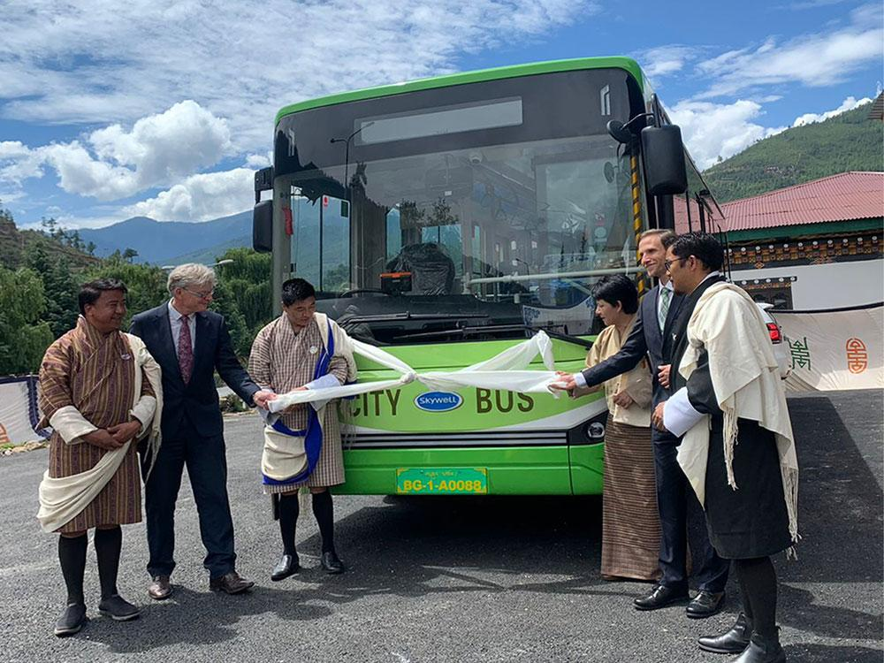
Seeds of smart solutions
– local innovations that can evolve towards full smart mobility systems
Bhutan tries electric bus as focus shifts to eco-friendly transport
https://en.sicomedia.com/2023/0720/24300.shtml

Slide 28
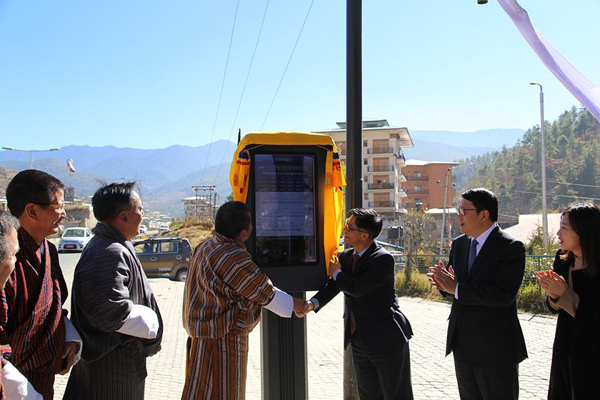
Seeds of smart solutions
– local innovations that can evolve towards full smart mobility systems
Bhutan tries electric bus as focus shifts to eco-friendly transport
https://nigt.re.kr/eng/newsImg.do?mode=view&articleNo=2160&title=%5BBhutan%5D+Thimphu+City+Green+Transport+Bus+Information+System+Exemplary+Project+Completion

Slide 29
Key components of the project
Priority bus transport infrastructure | Improvement of pedestrian infrastructure | Integration with the “Bhutan Transport 2040” vision
Development of a 16-kilometer priority bus corridor along the north-south axis of Thimphu (from Babesa to Dechencholing), including features such as dedicated lanes, intersection priority, and modern traffic management systems. | Construction of safe and accessible pedestrian routes in the city center and along main transport corridors | The project aligns with the country’s long-term transport strategy, which focuses on creating “green” cities by promoting public transport and walking as the dominant modes of movement in urban areas.

Slide 30
Seeds of smart solutions
– local innovations that can evolve towards full smart mobility systems
BGTP (Bhutan Green Transport Project) represents Bhutan’s approach to sustainable development, combining the modernization of transport infrastructure with environmental protection and improving residents’ quality of life. This project can serve as a model for other developing countries striving to implement smart urban mobility solutions.
Bhutan tries electric bus as focus shifts to eco-friendly transport

Slide 31
The concept of Smart Mobility
Smart mobility is an approach to planning and organizing urban transport using modern technologies, aimed at providing an efficient, sustainable, and accessible transportation system.

Slide 32
Key benefits of Smart Mobility
Economic
Environmental
Social

Slide 33
Economic Benefits
Reduction of transport costs
Smart mobility solutions like shared vehicles, ride-pooling, and optimized routing reduce the need for private car ownership and lower fuel consumption. This translates into savings on vehicle purchase, maintenance, fuel, and parking fees for individuals and businesses.
Better accessibility to workplaces and services
Integrated mobility systems and first/last mile solutions improve access to jobs, healthcare, education, and retail, especially for residents in suburban or underserved areas. This connectivity boosts workforce participation and economic inclusion.

Slide 34
Economic Benefits
Increased efficiency of goods and people flows
Smart logistics, real-time traffic management, and multimodal transport reduce congestion and delays, speeding up deliveries and commutes. This efficiency lowers operational costs for businesses and enhances overall urban productivity.

Slide 35
Environmental Benefits
Reduction of CO₂ emissions and air pollution:
By promoting electric vehicles, shared mobility, and public transport use, smart mobility decreases reliance on fossil fuels, cutting greenhouse gas emissions and harmful air pollutants that affect public health.
Limitation of noise pollution:
Quieter electric vehicles and better traffic flow management reduce urban noise levels, improving comfort and reducing stress for city residents.

Slide 36
Environmental Benefits
Reduced space consumption
Shared mobility and improved public transport reduce the number of private cars on roads, freeing up space currently used for parking lots and wide streets. This reclaimed space can be transformed into green areas, pedestrian zones, or bike lanes.

Slide 37
Social Benefits
Increased accessibility of transport for all social groups
Smart mobility fosters inclusive transport options tailored for people with disabilities, elderly citizens, and low-income groups. Affordable, on-demand services and user-friendly apps make mobility more equitable.
Improvement of safety and quality of life in the city
Smart traffic control systems reduce accidents and optimize traffic flow, while fewer cars and more active transport options contribute to healthier, safer urban environments.

Slide 38
Social Benefits
Promotion of active mobility (walking, cycling)
Smart city planning and mobility apps encourage walking and cycling by improving infrastructure (bike lanes, pedestrian paths) and providing real-time information, thus enhancing public health and reducing emissions.

Slide 39
Key components of Smart Mobility
Shared Mobility (carsharing, bikesharing, ridesharing)
Electromobility (electric vehicles and charging infrastructure)
Public Transport Enhanced by Technology
Mobility-as-a-Service (MaaS)
Smart Traffic and Infrastructure Management
Notes:
infografika

Slide 40
Shared Mobility (carsharing, bikesharing, ridesharing)
Carsharing: short-term rental of cars through apps, often charged by the hour or kilometer, reducing the need to own a private vehicle.
Bikesharing and scootersharing: shared fleets of bicycles and e-scooters available for one-way trips, helping cover short urban distances.
Ridesharing and ride-hailing: platforms that connect passengers with drivers or help people share rides going in the same direction to reduce traffic and costs.
Shared mobility means offering flexible, on-demand access to different vehicles and rides, rather than private ownership.

Slide 41
Shared Mobility (carsharing, bikesharing, ridesharing)
Efficient use of resources: By sharing vehicles instead of owning them, fewer cars and bikes are needed overall, reducing production, maintenance, and parking demands.
Flexibility and convenience: Users can choose the most suitable transport mode depending on their needs—cars for longer trips, bikes or scooters for short distances, and ridesharing for commuting.

Slide 42
Shared Mobility (carsharing, bikesharing, ridesharing)
Cost savings: Shared mobility lowers individual transport costs by spreading them across many users, making mobility more affordable, especially for people who only need occasional access to a vehicle.
Reduced congestion: Fewer privately owned vehicles on the road help decrease traffic congestion, shorten travel times, and reduce the environmental footprint.

Slide 43
Electromobility (electric vehicles and charging infrastructure)
Electric vehicles (EVs): cars, buses, vans, trucks, and even bikes and scooters powered by batteries instead of internal combustion engines.
Charging infrastructure: a network of public and private charging stations—fast chargers, ultra-fast chargers, and standard chargers—to keep EVs running reliably.
This focuses on transitioning urban and regional transport systems toward low-emission electric power.

Slide 44
Electromobility (electric vehicles and charging infrastructure)
Lower emissions: Electric vehicles (EVs) produce zero tailpipe emissions, helping cities combat air pollution and reduce CO₂ emissions.
Quiet operation: EVs are quieter than traditional vehicles, contributing to reduced noise pollution in urban areas.

Slide 45
Electromobility (electric vehicles and charging infrastructure)
Modern charging infrastructure: Expansion of fast and smart charging stations supports wider EV adoption and integration with renewable energy sources.
Cost efficiency over time: Though purchase costs can be higher, EVs typically have lower running and maintenance costs, benefiting both private users and companies operating vehicle fleets.

Slide 46
Public Transport (data-driven and digital technologies)
Real-time passenger information systems that show live arrival times, delays, and service updates on apps, screens, or websites.
Contactless and mobile ticketing that speeds up boarding and makes payment more convenient.
Smart card systems and apps that integrate with other mobility services for seamless travel.
Data analytics to monitor ridership patterns, optimize routes, and adjust schedules to better match demand.
Digital tools for service planning that help cities design more efficient and sustainable transit networks.
This focuses on using digital tools and real-time data to make public transport smarter, more reliable, and more user-friendly.

Slide 47
Public Transport (data-driven and digital technologies)
Real-time information: Digital tools like mobile apps and online platforms provide passengers with up-to-date data on schedules, delays, and crowd levels, making travel more predictable and convenient.
Optimized services: Data analytics help transport authorities adjust routes, schedules, and vehicle deployment based on actual demand, improving efficiency and reducing operating costs.

Slide 48
Public Transport (data-driven and digital technologies)
Integration with other modes: Public transport becomes part of a seamless multimodal system (e.g., combined with bike-sharing or car-sharing), supporting first and last mile connections.
Sustainability: Modern electric and hybrid buses, along with better route planning, reduce the environmental impact of urban transport systems.

Slide 49
Integration of Transport Modes (MaaS)
MaaS apps that help users plan door-to-door journeys using multiple transport modes.
Unified ticketing and payment so travelers don’t need to use separate apps or tickets for each mode.
Real-time data integration to suggest the fastest, cheapest, or most sustainable travel options.
Access to schedules, availability, and pricing in one place for convenience and flexibility.
Digital platforms for planning, booking and paying for transport. This concept aims to seamlessly combine different modes of transport—such as public transit, bikesharing, carsharing, trains, and ride-hailing—into a single, user-friendly service.

Slide 50
Smart Traffic and Infrastructure Management
Smart traffic lights that adjust signal timings in real time based on current traffic conditions.
Intelligent parking systems that guide drivers to available spaces via apps or dynamic signage.
Traffic monitoring and congestion prediction using data from sensors, cameras, and GPS devices.
Dynamic lane management and speed limits that change according to traffic demand or incidents.
The goal is to reduce congestion, lower emissions, and improve the overall travel experience.
This refers to a set of advanced technologies and systems designed to optimize traffic flow and manage parking resources in urban areas.

Slide 51
Smart mobility as a tool for economic growth and improvement of quality of life
Mobility and economic development:
Modern transport supports the development of the local labor market, services, and tourism.
Innovative mobility solutions stimulate investment and create new jobs in the ICT, energy, and industrial sectors.
Improving transport efficiency reduces costs for businesses.

Slide 52
Smart mobility as a tool for economic growth and improvement of quality of life
Cost reduction and productivity growth:
Intelligent traffic management systems reduce time lost in traffic jams.
Better organization of public transport improves punctuality and service reliability.
Integration of transport modes makes trip planning and logistics easier.

Slide 53
Smart mobility as a tool for economic growth and improvement of quality of life
Smart mobility as a tool for social inclusion:
Providing access to transport for people with disabilities, seniors, and residents of peripheral areas.
Reducing economic barriers (more affordable and shared means of transport).
Promoting equal access to urban services (education, healthcare, culture).

Slide 54
The role of smart mobility in reducing transportation costs and increasing economic productivity
Smart mobility not only reduces direct transport costs through efficiency and technology but also strengthens economic competitiveness by saving time, improving accessibility, and enabling new digital business models.

Slide 55
The role of smart mobility in reducing transportation costs
Efficient use of resources: Shared mobility (e.g., carsharing, bikesharing) reduces the need for individual vehicle ownership and maintenance.
Intelligent Transport Systems (ITS): Smart traffic management lowers congestion, saving time and fuel.
Mobility as a Service (MaaS): Integrating different transport modes into one app helps users choose the most cost-effective options.
E-mobility: Lower long-term operational costs compared to traditional combustion vehicles.

Slide 56
The role of smart mobility in increasing economic productivity
Time savings: Faster, smoother trips mean more time for work and leisure, boosting employee productivity.
Improved market access: Better mobility supports trade, services, and connections between businesses and customers.
Data-driven development: Smart mobility generates valuable data for planning and creating innovative digital services.
Reduced external costs: Lower pollution and traffic decrease public spending on healthcare and infrastructure.

Slide 57
Smart mobility as a tool for promoting inclusivity and social equity in urban environments
Smart mobility can reduce social and economic inequalities by making urban transport more accessible, flexible, and responsive to diverse needs. When designed thoughtfully, it helps build more inclusive, equitable cities where everyone can participate fully in urban life.

Slide 58
Smart mobility as a tool for promoting inclusivity and social equity in urban environments
Reducing barriers to mobility:
Accessible shared services: Shared bikes, scooters, and carsharing can be more affordable than private cars, helping low-income residents access transportation.
First and last mile solutions: Smart mobility connects underserved neighborhoods to main transit lines, reducing isolation.
Universal design: Apps and vehicles designed with features for people with disabilities, seniors, and other vulnerable groups improve accessibility for all.

Slide 59
Smart mobility as a tool for promoting inclusivity and social equity in urban environments
Enhancing equal access to opportunities:
Better access to jobs, education, and healthcare: Efficient and affordable transport helps residents participate fully in urban life.
Flexible and on-demand services: Smart shuttles and demand-responsive transport adapt to individual needs and areas with lower demand, which are often neglected by traditional transit.
Multilingual and inclusive apps: Digital tools can be designed to accommodate different languages and literacy levels.

Slide 60
Smart mobility as a tool for promoting inclusivity and social equity in urban environments
Empowering communities through technology:
Data-driven planning: Cities can identify mobility gaps and direct resources where they’re needed most, supporting equity-focused investments.
Community engagement: Smart mobility projects often involve local input, giving marginalized groups a voice in designing solutions.
Digital inclusion: Providing access to digital tools and platforms reduces the digital divide and helps more people benefit from smart mobility.

Slide 61
Student assignment: Mapping Urban Mobility Challenges
Choose a city (it can be your own city or an example city from a developing country).
Identify the main urban mobility challenges, e.g., traffic congestion, pollution, lack of public transport, poor integration of transport modes, pedestrian safety, etc.
Create a problem map – a visual representation showing the locations and types of challenges (you can use Google Maps, simple diagrams, or paper maps)
Highlight priority areas for intervention – what should be addressed first and why.
Prepare a short presentation summarizing your findings and suggested solutions.

