Slide 1



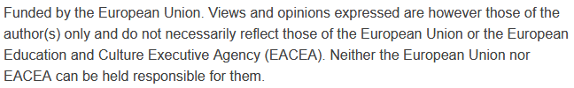
Smart Mobility Technologies
& Low-Cost Digital Innovations
Sustainability and Quality Assurance for Academic Governance and Redesign Engineering Studies
MODULE 3
Justyna Staszak-Winkler

Slide 2
Introduction to Mobile Technology in Smart Mobility
Mobile technology plays a transformative role in modern urban transportation systems by enhancing how people access, use, and interact with various mobility services. The widespread adoption of smartphones and mobile internet has enabled seamless integration of transport modes and services into daily life, making travel more convenient, efficient, and sustainable.

Slide 3
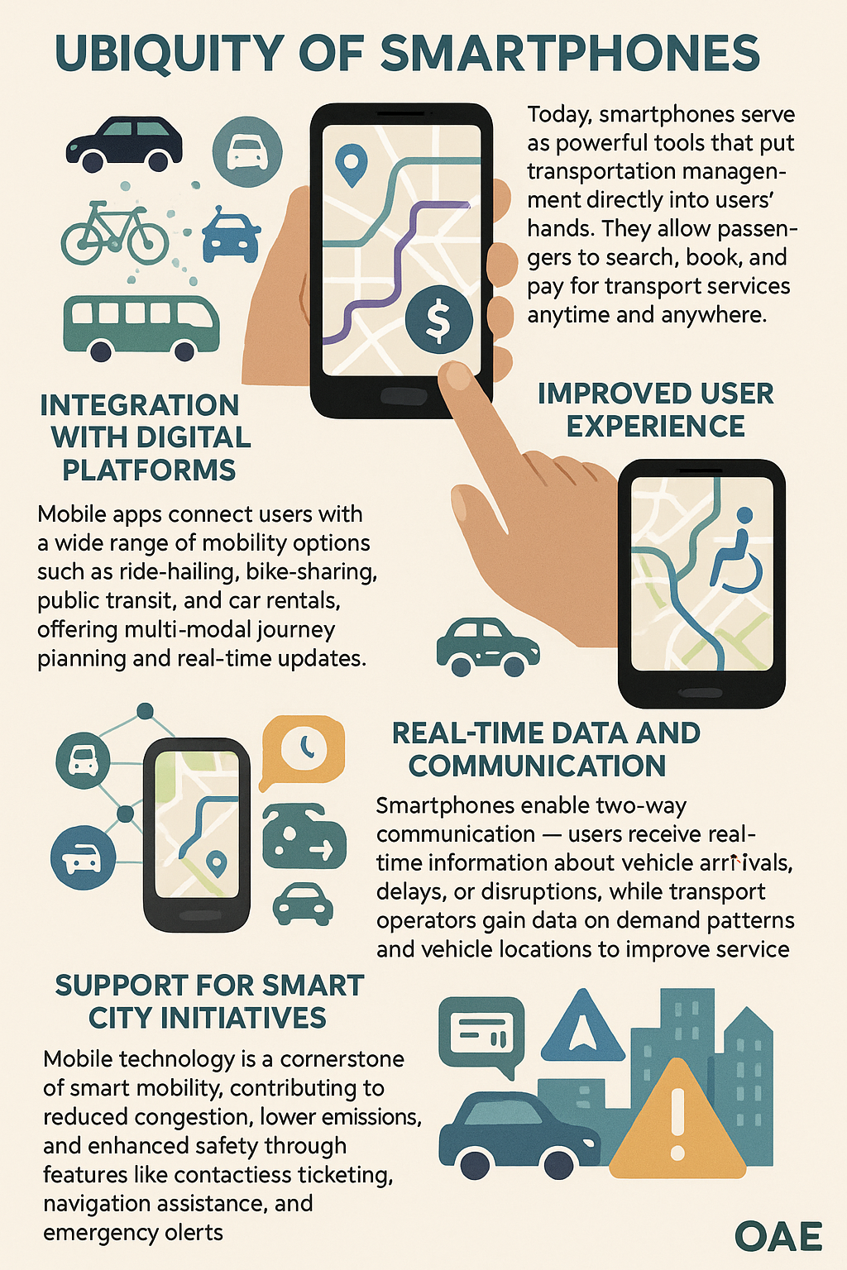
Introduction to Mobile Technology in Smart Mobility

Slide 4
Role of Mobile Apps and Digital Platforms
Access to transport services: Easy booking and payment for taxis, buses, bike-sharing, car-sharing.
Enhanced efficiency: Optimized routes, demand prediction, and fleet management.
Real-time information: Traffic updates, vehicle arrival times, delays notifications.
User feedback: Ratings and reviews improve service quality.

Slide 5
Smart Parking Solutions Enabled by IoT and Mobile Technology
IoT sensors detect available parking spaces in real time.
Sensors embedded in parking spots or entry points that detect whether a space is occupied or vacant.
Camera systems with license plate recognition (ANPR) to monitor entry/exit times and facilitate payment.
Mobile apps or digital signboards to inform drivers about available spaces nearby, reducing time spent searching for parking.
Integration with digital payment platforms, allowing for contactless and automatic fee collection.

Slide 6
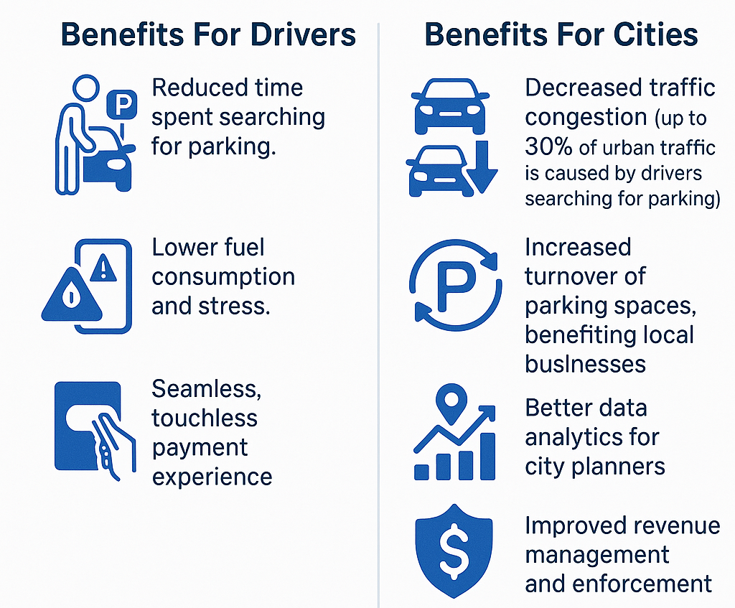
Benefits of a Smart Parking Solutions for Cities and Drivers

Slide 7
Smart parking in Pakistan refers to mobile apps or digital platforms that help drivers locate available parking spaces, reserve them online, and make payments through their smartphones.
Pakistan’s major cities like Karachi, Lahore, and Islamabad are gradually adopting smart urban solutions. Smart parking apps are emerging but still at an early stage of adoption.
Pakistani government and city authorities are exploring integration of parking systems with smart traffic management platforms, which would enable more holistic mobility management and congestion reduction.
Apps like “Smartparking” (or similar platforms) typically allow users to book and pay for parking in designated zones or private parking lots.
Seeds of smart solutions
– local innovations that can evolve towards smart parking solutions
Smart parking apps (Pakistan)

Slide 8
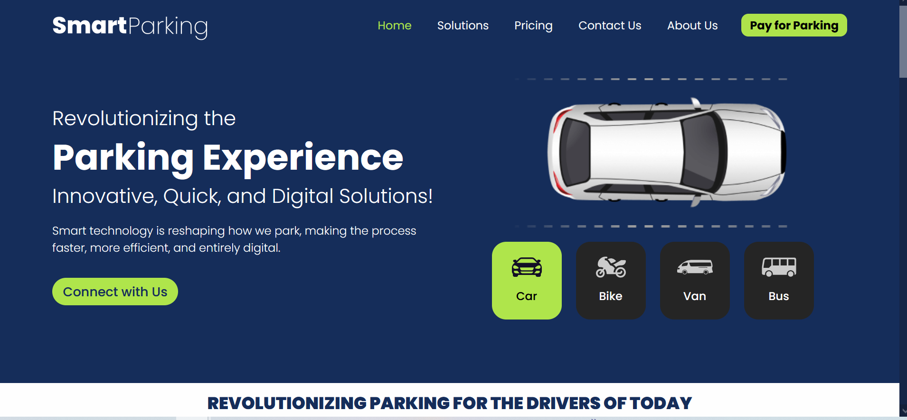
Seeds of smart solutions
– local innovations that can evolve towards smart parking solutions
https://smartparkings.com.pk/
Smart parking apps (Pakistan)

Slide 9
Launched: June 16, by Kathmandu Metropolitan City & Wheels Truly Yours Pvt. Ltd.
Location: 5 parking sites in New Road (e.g., Dharmapath, Pako, RB Complex)
Type: Public-Private Partnership (PPP) - Kathmandu Metropolitan City, in partnership with the private company Wheels Truly Yours, introduced a smart parking system.
Revenue split: 80% to private company, 20% to city authority
Seeds of smart solutions
– local innovations that can evolve towards smart parking solutions
Smart parking (Nepal -Kathmandu)

Slide 10
Parking reservation via Park KTM mobile app
Users select vehicle type (car or motorbike)
App provides a phone number - user must call and share license plate number
On-site staff issue paper tokens
Payment: cash only
Real-time availability shown on LED displays
Seeds of smart solutions
– local innovations that can evolve towards smart parking solutions
Smart parking (Nepal -Kathmandu)

Slide 11
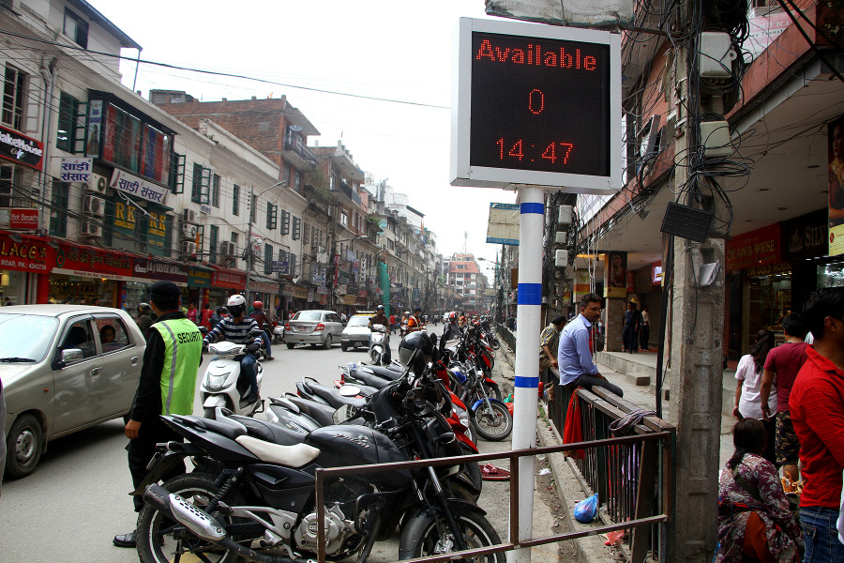
Seeds of smart solutions
– local innovations that can evolve towards smart parking solutions
“I appreciate the initiative, but the cost we are paying is too high,” said Thapa, who paid Rs 25 for parking his motorbike for three minutes. “I have to come here five times a day. How can I afford to pay the same amount every time?”
Smart parking (Nepal -Kathmandu)
https://kathmandupost.com/valley/2019/06/30/kathmandu-residents-appreciate-the-smart-parking-on-new-road-but-complain-of-higher-costs

Slide 12
Issues Identified
High cost: Rs 25 (2-wheelers), Rs 80 (4-wheelers) – minimum 1 hour, even for short stays - Although it has offered some relief for drivers, concerns have been raised regarding its pricing.
Manual processes despite being labeled “smart”
Cash-only system
Limited automation - only digital aspect is slot availability display
Seeds of smart solutions
– local innovations that can evolve towards smart parking solutions
Smart parking (Nepal -Kathmandu)

Slide 13
Seeds of smart solutions
– local innovations that can evolve towards smart parking solutions
Planned Improvements
Time-based pricing under consideration
Free parking for:
  Disabled-friendly three-wheelers
  Discounts for EVs
Reserved spots for shop owners
Commitment to expand and revise based on public feedback
Smart parking (Nepal -Kathmandu)

Slide 14
Understanding the Internet of Things (IoT) in Transportation
The Internet of Things (IoT) refers to the network of interconnected physical devices embedded with sensors, software, and other technologies that enable them to collect and exchange data over the internet. In the context of transportation, IoT is revolutionizing the way people and goods move by enabling smarter, more efficient, and safer transport systems.

Slide 15
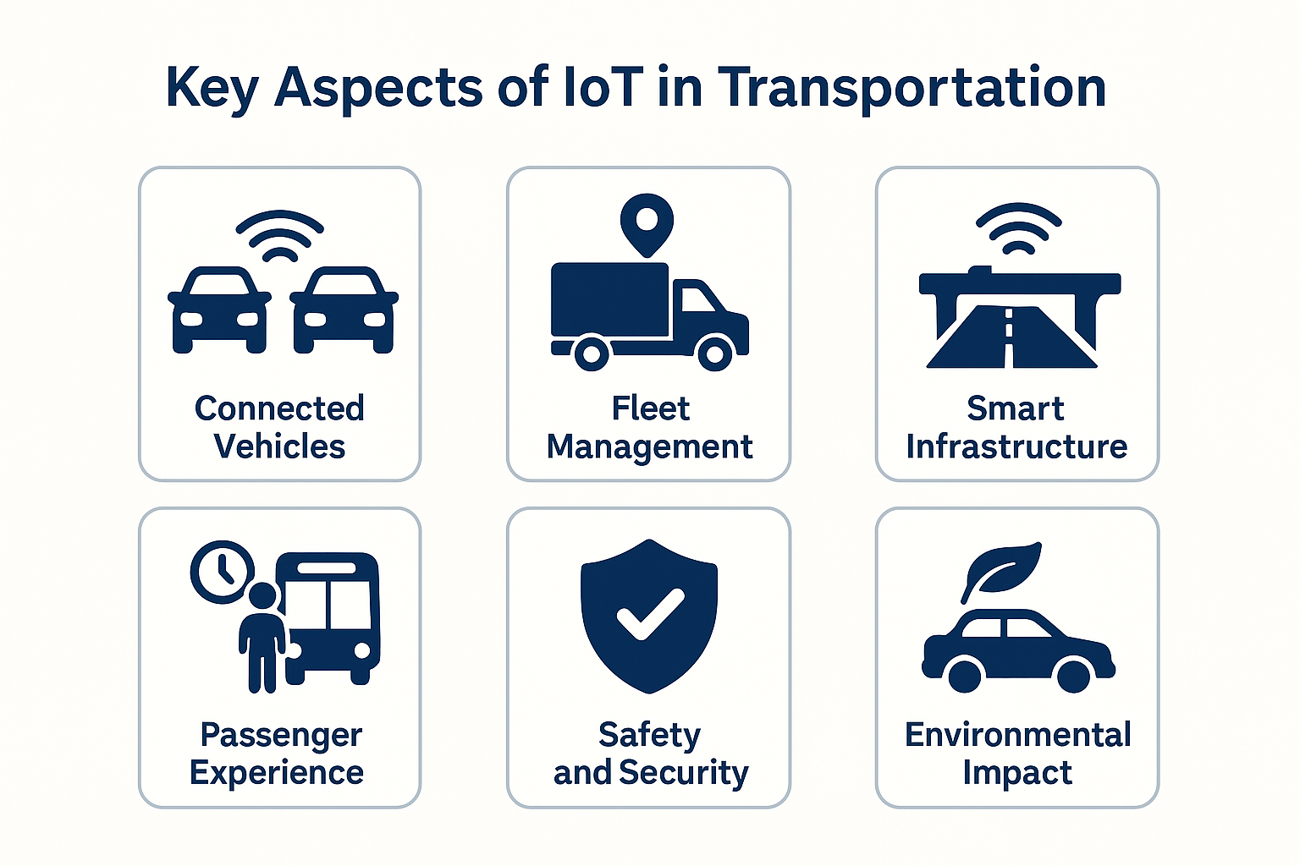

Slide 16
Key Aspects of IoT in Transportation – Connected Vehicles
Vehicle-to-Vehicle (V2V) means that cars “talk” directly to each other — exchanging information such as current speed, position on the road, or sudden braking. Thanks to this, they can, for example, warn other vehicles about dangers like an accident or slippery road conditions before the driver sees it with their own eyes. This helps to avoid collisions.
Vehicle-to-Infrastructure (V2I) means communication between the vehicle and elements of urban infrastructure, such as traffic lights, signs, sensors, or traffic management systems. Thanks to this, the car can receive information, for example, about when the traffic light will turn green or about traffic jams on the road, and adjust its speed or route accordingly.
IoT enables vehicles to communicate with each other (Vehicle-to-Vehicle, V2V) and with infrastructure (Vehicle-to-Infrastructure, V2I). This connectivity supports real-time traffic management, collision avoidance, and improved navigation by sharing data on speed, location, and road conditions.

Slide 17
Key Aspects of IoT in Transportation – Connected Vehicles
Collision warning systems and automatic emergency braking: Many modern cars, especially premium brands (e.g., Audi, BMW, Mercedes), already have safety support functions based on V2V communication or radar and camera sensors.
Tests and pilots of intelligent traffic lights (V2I): the car receives information about when the light will turn green, allowing it to adjust speed and pass through the intersection smoothly without stopping.

Slide 18
Key Aspects of IoT in Transportation – Fleet Management
Vehicle location tracking: Using GPS and IoT sensors, companies can track their trucks and vans in real time. This enables better route planning, monitoring delivery progress, and reacting quickly to unexpected events such as traffic jams or detours.
Fuel consumption monitoring: Sensors record fuel usage data, allowing companies to identify inefficient driving or excessive fuel consumption. This helps implement cost-saving measures such as driver training or route optimization.
Fleet Management refers to systems and solutions that use Internet of Things (IoT) devices to monitor and manage a fleet of vehicles used in logistics and freight transport.

Slide 19
Key Aspects of IoT in Transportation – Fleet Management
Maintenance and condition monitoring: IoT systems can alert managers to required inspections, part replacements, or emerging faults before major breakdowns occur. This reduces costly downtime and enhances safety.
Driver behavior analysis: Monitoring sudden braking, acceleration, speed, and driving hours helps improve driving style, reduce accident risk, and lower operating costs.

Slide 20
Key Aspects of IoT in Transportation – Smart Infrastructure
Sensors embedded in roads and Bridges: These sensors monitor various parameters such as traffic volume, vehicle speed, weight loads, vibrations, and structural integrity. For example, strain gauges or accelerometers in bridges can detect stress or damage early on.
Traffic signal sensors: Cameras, inductive loops, or radar sensors embedded near traffic lights collect data about vehicle queues, pedestrian movements, and traffic density.
Environmental sensors: Additional sensors monitor weather conditions like temperature, humidity, rain, fog, or ice formation on road surfaces.
Smart Infrastructure refers to the integration of sensors and digital technologies into physical infrastructure elements like roads, bridges, and traffic signals to collect and transmit data in real time.

Slide 21
Key Aspects of IoT in Transportation – Passenger Experience
User-friendly mobile apps: Allow passengers to search for connections, purchase tickets, and track vehicles in real time. Passengers know exactly when a bus, tram, or train will arrive, which reduces uncertainty and stress.
Real-time information: IoT devices and smart sensors provide updates on delays, detours, schedule changes, or weather-related disruptions. This helps passengers make informed decisions and adjust their plans accordingly.
Personalized notifications: Systems can send alerts based on a user’s location and preferences (e.g., “Your usual bus is delayed by 5 minutes”). People with disabilities can receive updates about elevators, accessible vehicles, or platform changes.
Passenger Experience refers to the overall perception and satisfaction of a passenger throughout their journey — from planning and booking, to waiting, traveling, and reaching their destination. Thanks to technologies like the Internet of Things (IoT), mobile apps, and smart transport systems, this experience is becoming more personalized, convenient, efficient, and stress-free.

Slide 22
Key Aspects of IoT in Transportation – Passenger Experience
Onboard digital amenities: Wi-Fi, USB charging ports, and digital entertainment improve comfort during travel, especially on long or intercity journeys. Passengers can work, study, or relax while on the move.
Seamless transfers and integrated ticketing: A single ticket or app can cover multiple modes of transport (e.g., bus + metro + bike-share). Integration saves time and simplifies the travel experience — no need to buy separate tickets or plan each segment manually.
Increased safety and confidence: Onboard surveillance, safety alerts, and SOS features in apps contribute to a greater sense of security, especially during off-peak hours or in unfamiliar areas.

Slide 23
Key Aspects of IoT in Transportation – Safety - Preventing Accidents and Enhancing Road Safety
Safety –Collision avoidance systems (V2V): Vehicles equipped with sensors and Vehicle-to-Vehicle (V2V) communication can detect sudden braking, dangerous proximity, or lane departure — warning drivers or even initiating automatic braking.
Infrastructure monitoring: Bridges, roads, and tunnels with embedded sensors provide early warnings of structural damage, which allows for preventive maintenance and avoids potential collapses or hazards.
Traffic light optimization: Intelligent traffic signals reduce risky situations like red-light running or intersection congestion by adapting in real time to traffic flow.
Real-time hazard alerts: Connected vehicles and mobile apps can notify drivers about accidents, road closures, fog, black ice, or heavy rain ahead — improving reaction time and route planning.
Modern transportation systems are increasingly leveraging digital technologies, especially IoT (Internet of Things), to improve both safety (preventing accidents and physical harm) and security (protection against crime and threats).

Slide 24
Key Aspects of IoT in Transportation – Security – Protecting Passengers and Infrastructure
Surveillance and smart cameras: Public transport vehicles and stations are increasingly equipped with CCTV and AI-powered cameras to monitor suspicious activity and ensure passenger safety.
Emergency communication systems: Many apps and transit systems include SOS buttons, panic alerts, or emergency call features, especially useful in low-traffic or night-time conditions.
Cybersecurity of connected systems: As vehicles and infrastructure become more connected, protection against cyberattacks (e.g., on autonomous vehicles, smart traffic control, or ticketing systems) becomes crucial. Secure data transmission and system encryption are key elements.
Passenger tracking in emergencies: In cases like natural disasters, terrorism, or large-scale accidents, connected systems can help locate and evacuate passengers more efficiently.

Slide 25
Key Aspects of IoT in Transportation – Environmental impact - Reduced Air Pollution
Optimized traffic flow: Smart traffic lights and real-time navigation reduce idling and stop-and-go traffic, which leads to lower fuel consumption and fewer exhaust emissions.
Eco-driving support: Fleet management systems monitor driver behavior and promote smoother acceleration and braking, which improves fuel efficiency and reduces CO₂ output.
Integration with low-emission zones (LEZs): Connected systems can help enforce LEZs by detecting high-emission vehicles and guiding them away from restricted areas, promoting cleaner air in city centers.
Smart and connected transportation systems — powered by IoT, data analytics, and automation — can significantly reduce the negative environmental effects of mobility. These technologies help cities and operators use resources more efficiently, cut emissions, and promote greener travel behaviors.

Slide 26
Key Aspects of IoT in Transportation – Environmental impact -Promotion of Electric and Shared Mobility
Support for electric vehicles (EVs): IoT systems help monitor EV battery status, optimize charging, and locate the nearest available stations — making EV use more practical and widespread.
Shared mobility platforms: Bike-sharing, scooter-sharing, and ride-pooling apps reduce the number of private vehicles on the road, contributing to less traffic and fewer emissions.

Slide 27
Key Aspects of IoT in Transportation – Environmental impact -Data-Driven Environmental Policies
Air quality monitoring: Real-time data from roadside sensors allows cities to track pollution levels and adjust policies accordingly — like reducing speed limits or promoting public transport on smoggy days.
Sustainable transport planning: Authorities can use IoT-collected data to design greener urban mobility systems, like prioritizing pedestrian zones, expanding bike lanes, or optimizing public transport routes.

Slide 28
IoT Applications in Smart Mobility
Vehicle tracking and fleet management: Monitor location, condition, and optimize routes.
Predictive maintenance: IoT sensors detect issues before breakdowns.
Traffic management: Adaptive traffic signals based on real-time data.
Public transport: Real-time tracking and passenger information systems.

Slide 29
Seeds of smart solutions
– local innovations that can evolve towards smart public transport
Operator: Sajha Yatayat – the largest public bus operator in Kathmandu Valley.
Technology: GPS devices installed on selected buses; real-time tracking available through a mobile app (pilot phase).
Features:
Real-time bus location on map,
Estimated arrival time at bus stops,
Future plan: integration with digital ticketing and push notifications.
Challenges: Limited bus fleet, low system coverage, lack of integration with other operators.
Public Transport: Real-Time Tracking & Passenger Information Systems – Kathmandu (Nepal)

Slide 30
Seeds of smart solutions
– local innovations that can evolve towards smart public transport
Operator: Bhutan Construction and Transport Authority (BCTA)
Status: Implementation began in 2022 under a modernization project supported by the Asian Development Bank (ADB).
Features:
GPS tracking of city buses,
LED arrival time displays at selected bus stops,
Pilot mobile application with route and location information.
Goal: Encourage public transport use and reduce urban congestion in Thimphu.
Public Transport: Real-Time Tracking & Passenger Information Systems – Bhutan – Thimphu City Bus Smart Transport System

Slide 31
What is Mobile Ticketing?
Mobile ticketing refers to the use of smartphones and other mobile devices to purchase, store, and validate tickets for public transportation. Instead of using paper tickets or smartcards, passengers use apps, QR codes, NFC (Near Field Communication), or SMS-based systems to travel.

Slide 32
How Mobile Fare Collection Works?
Passengers download a mobile app provided by the transport operator or city authority.
They purchase tickets or passes using mobile wallets, debit/credit cards, or third-party platforms.
At the time of boarding, passengers validate their ticket by scanning a QR code, tapping their phone (NFC), or showing the digital ticket to an inspector.

Slide 33
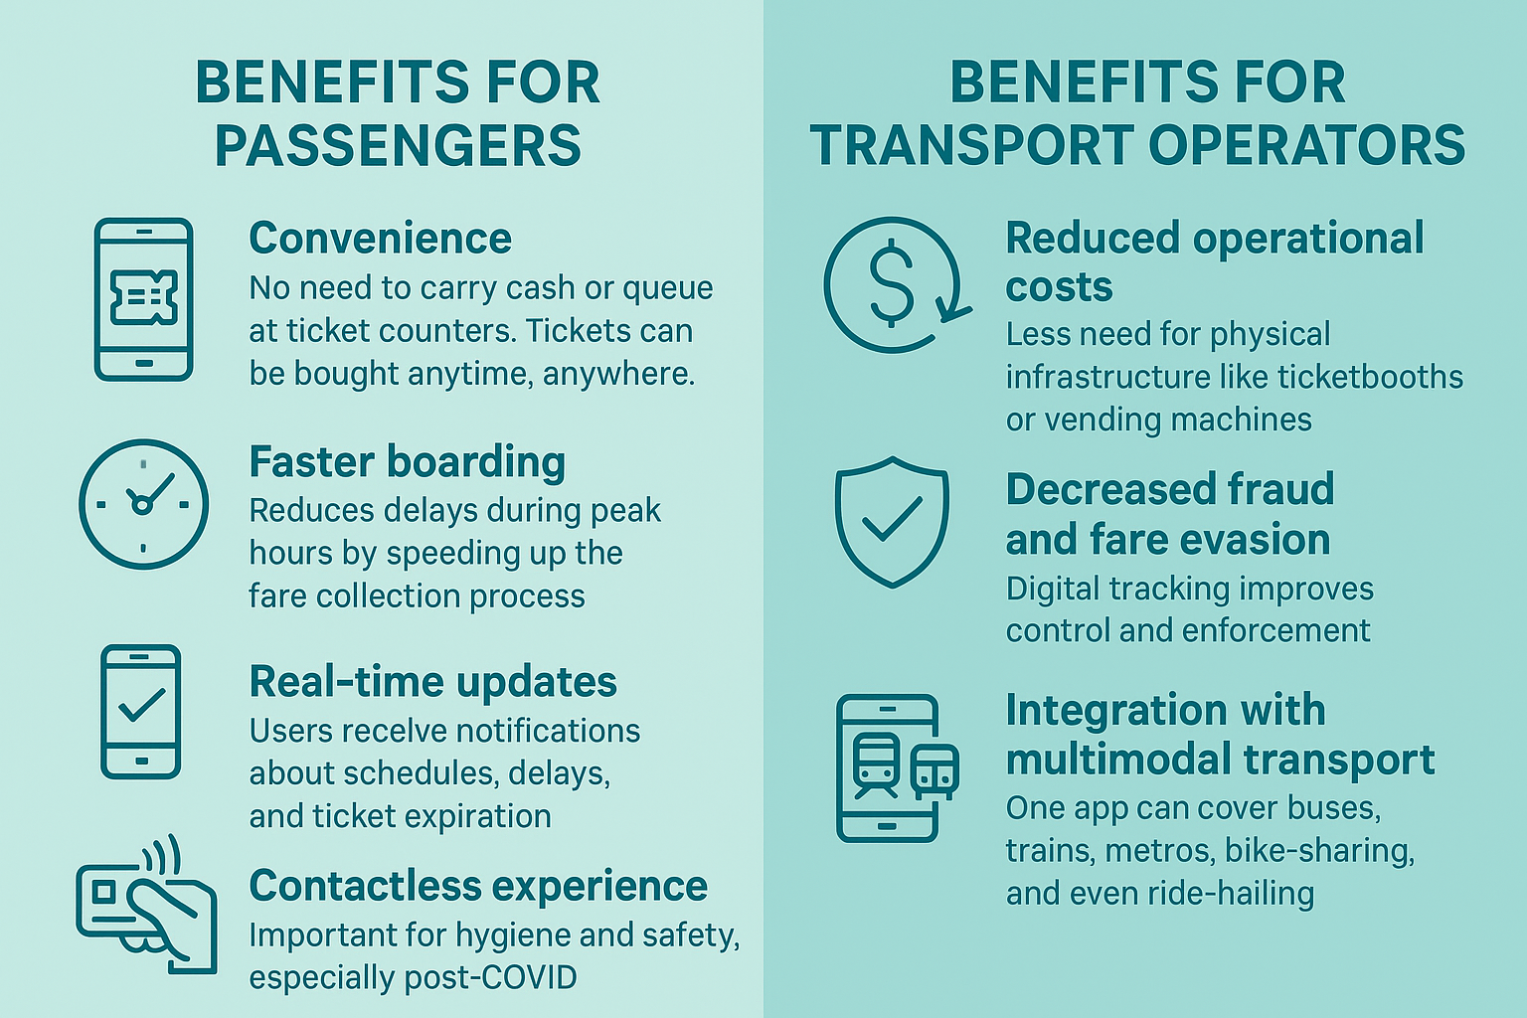
Benefits for Passengers and Transport Operators

Slide 34
Challenges
Digital divide: Not all users have access to smartphones or mobile internet.
System compatibility: Integration with existing infrastructure can be costly.
Cybersecurity: Requires robust protection against data breaches and payment fraud.

Slide 35
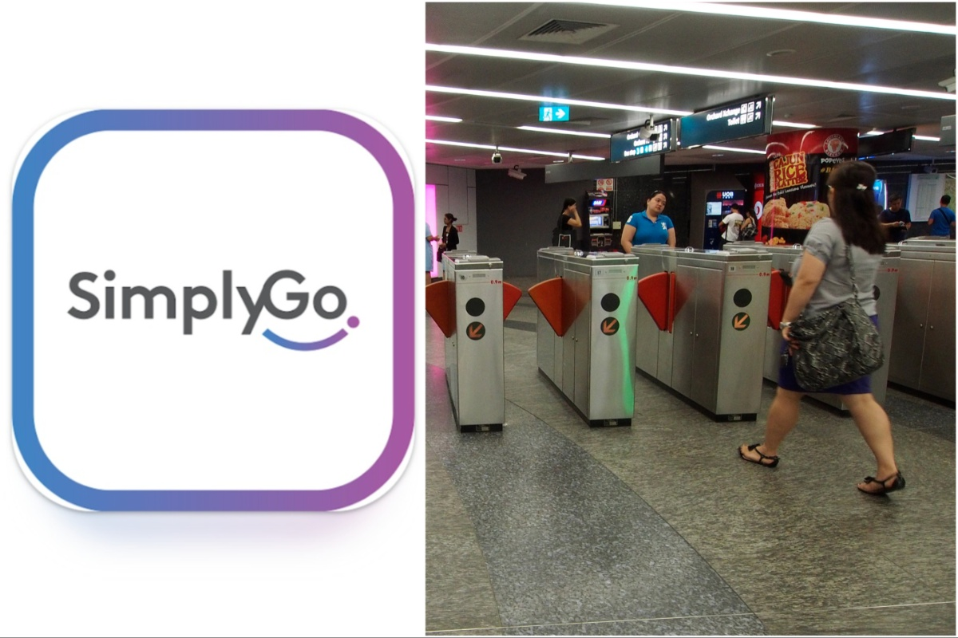
Global Examples of Successful Implementation - Singapore – SimplyGo (TransitLink)
SimplyGo is a contactless fare payment system operated by TransitLink and the Land Transport Authority (LTA) of Singapore.
It enables commuters to use their bank cards or mobile devices to pay for public transport fares without the need for a stored-value card like EZ-Link or NETS FlashPay.
https://sg.news.yahoo.com

Slide 36
Global Examples of Successful Implementation - Singapore – SimplyGo (TransitLink)
Tap-and-go convenience:
Commuters can tap contactless bank cards (e.g., Visa or Mastercard) or smartphones/smartwatches with Apple Pay, Google Pay, or Samsung Pay directly at MRT fare gates or bus readers.
No need for top-ups:
Fares are automatically deducted from the commuter’s linked debit/credit card account. There's no need to manually reload or monitor a transport card balance.
Real-time transaction tracking:
Users can view trip history and fare deductions in real-time via the SimplyGo app or TransitLink website.

Slide 37
Global Examples of Successful Implementation - Singapore – SimplyGo (TransitLink)
Integration across transport modes:
The system works seamlessly on MRT trains, LRT, and public buses, allowing multimodal travel on a single card or device.
Tourist-friendly:
Visitors to Singapore can use their foreign-issued contactless cards if compatible, without needing to buy a local transport card.

Slide 38
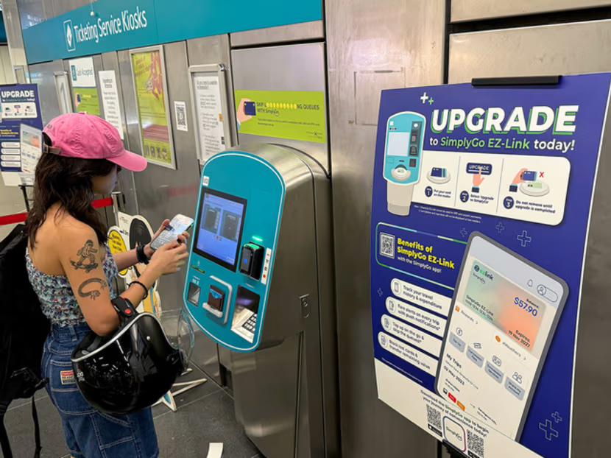
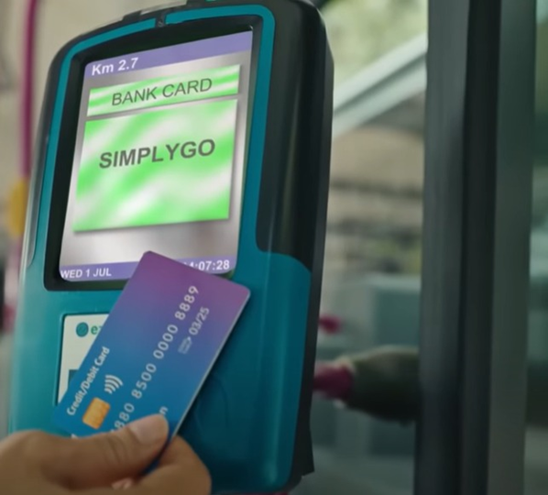
Global Examples of Successful Implementation - Singapore – SimplyGo (TransitLink)
https://www.todayonline.com/singapore/analysis-simplygo-lta-missteps-what-went-wrong-needs-be-done-2347861
https://www.connectedtoindia.com/singapore-students-will-be-able-to-convert-their-school-smart-cards-to-simplygo-from-september-7/#google_vignette

Slide 39
Global Examples of Successful Implementation - Singapore – SimplyGo (TransitLink)
Benefits for Commuters:
Simplified experience – no need to manage a separate transport card.
Reduced queues at ticket machines and top-up stations.
Easy to keep track of expenses via app or e-statements.
Contactless, hygienic solution – especially relevant post-COVID.

Slide 40
Regional Context of South Asia
High population density in cities and rapid urbanization.
Limited transport infrastructure and large informal transport sector.
Limited capital available for large-scale infrastructure investments.
High share of pedestrians, bicycles, rickshaws, and motorcycles.
Challenges with air pollution and traffic congestion.

Slide 41
Key statistics on high population density and rapid urbanization in Bangladesh, Nepal, Pakistan, Bhutan
Country | Urban Population (%) | Urban Population Density (people/km²) | Annual Urban Growth Rate (%) | Example of Major City Population (millions) | Notes
Bangladesh | ~39% | ~44,500 (Dhaka metro area) | ~3.3% | Dhaka: ~21.0 | Dhaka is one of the most densely populated cities worldwide
Nepal | ~21% | ~20,000 (Kathmandu valley) | ~4.5% | Kathmandu: ~2.9 | Rapid urban growth mainly in Kathmandu valley and Pokhara
Pakistan | ~38% | ~15,000 (Karachi metro area) | ~2.4% | Karachi: ~17.5 | Karachi is Pakistan’s largest and fastest-growing city
Bhutan | ~39% | ~5,000 (Thimphu city area) | ~5.1% | Thimphu: ~0.13 | Bhutan’s urbanization rate is rising, but urban areas remain small

Slide 42
Region-Specific Challenges
Lack of formal regulations and oversight of microtransit (many microbuses and tempos operate without clear permits, making coordination and safety enforcement difficult).
Limited road infrastructure, especially in mountainous (hilly terrain means many rural areas rely on narrow, unpaved roads where only small vehicles or motorcycles can pass)
Low safety awareness and absence of quality standards (overcrowded minibuses often operate with no seatbelts, poor ventilation, and minimal safety checks).

Slide 43
Region-Specific Challenges
Difficulties integrating low-cost transport with formal urban systems (informal minibuses in often compete with planned BRT systems instead of connecting with them, leading to inefficiencies)
Poor maintenance and unreliable service in low-income areas (electric tempos sometimes stop operating due to lack of spare parts and charging infrastructure)
Need for digital literacy and smartphone access for tech-based tools (ride-hailing apps are growing in big cities, but many low-income groups still lack smartphones or internet access.
Ensuring gender equity and safety in shared modes (women face harassment in overcrowded minibuses, which discourages them from using public or shared transport)

Slide 44
Low-Cost Urban Mobility Solutions for Developing Regions - Opportunities for Enhancing Public Transportation
In many developing regions, limited infrastructure, financial constraints, and rapid urbanization create challenges in providing accessible and efficient urban transport. However, low-cost mobility solutions offer scalable and adaptable alternatives to expensive rail systems or metro networks.
Low-cost urban mobility solutions represent a practical and inclusive path toward better transport in developing regions. When combined with digital technologies and community-based planning, they can dramatically improve mobility, economic opportunity, and quality of life in emerging cities — at a fraction of the cost of large infrastructure projects.

Slide 45
Low-Cost Urban Mobility Solutions for Developing Regions - Opportunities for Enhancing Public Transportation
Moreover, better integration of public transport with low-cost urban mobility solutions ensures a more coherent, efficient, and sustainable system. This approach allows last-mile connectivity, reduces dependence on private vehicles, and helps create a seamless mobility experience for users.

Slide 46
Low-Cost Mobility Solutions
Rickshaws and Electric Rickshaws (E-rickshaws)
On-Demand Minibuses and Microbuses (Informal Minibus Services) - flexible routes, often without fixed schedules.
Mobile Payment Systems and Transport Apps
Shared Mobility Solutions
Promoting Non-Motorized Transport (build safe pedestrian walkways and cycling infrastructure to encourage walking and biking as primary, low-emission modes of transport).

Slide 47
How trends enable new mobility solutions - Urbanization and Population Growth
Trend: Rapid expansion of cities (Dhaka, Karachi, Kathmandu) with rising demand for transport.
Enabler: High demand for affordable and flexible mobility options (most urban residents belong to low- and middle-income groups, transport solutions must balance low fares, high capacity, and accessibility)

Slide 48
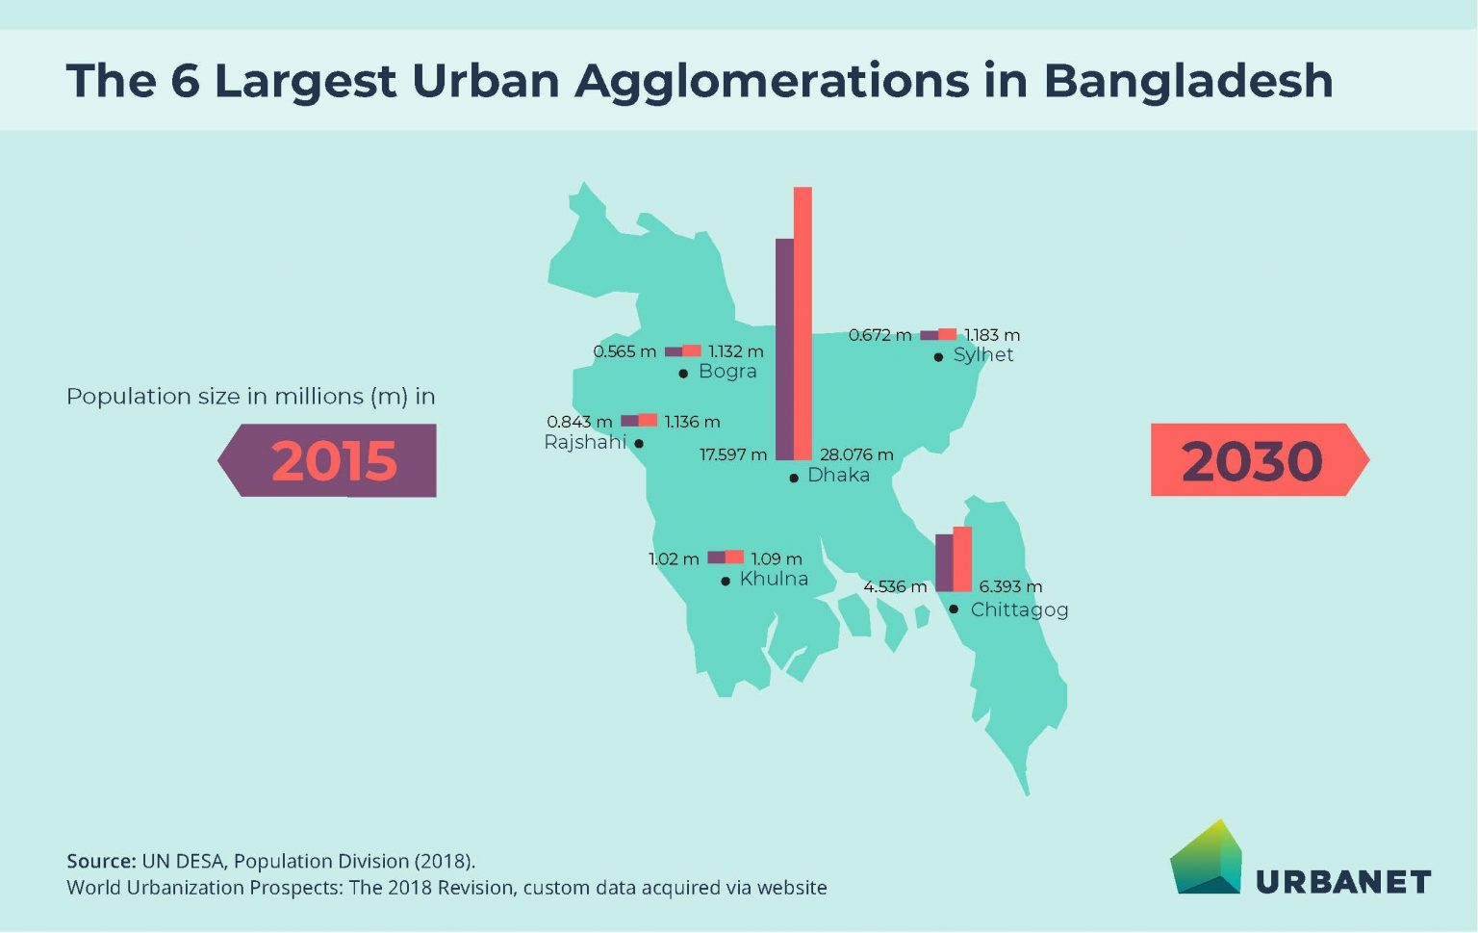
Rapid urbanization
https://www.urbanet.info/infographics-urbanisation-urban-development-bangladesh/

Slide 49
Bike-sharing and e-bike rental systems
In many South Asian cities (e.g., Dhaka in Bangladesh), congestion, pollution, and overcrowded public transport make first- and last-mile connectivity a critical challenge. Traditional bike-sharing models often fail in such contexts due to poor maintenance, theft, and lack of integration with digital platforms.

Slide 50
Bike-sharing and e-bike rental systems
Jobike is Bangladesh’s first bike-sharing service (launched in 2018, mainly in university campuses and Dhaka city).
With IoT- enabled smart locks and mobile app integration, users can: find nearby bikes in real time, unlock and pay using their phone, use the service affordably for short-distance commutes.
This directly addresses affordability, accessibility, and sustainability for urban residents.
Dhaka (Bangladesh)

Slide 51
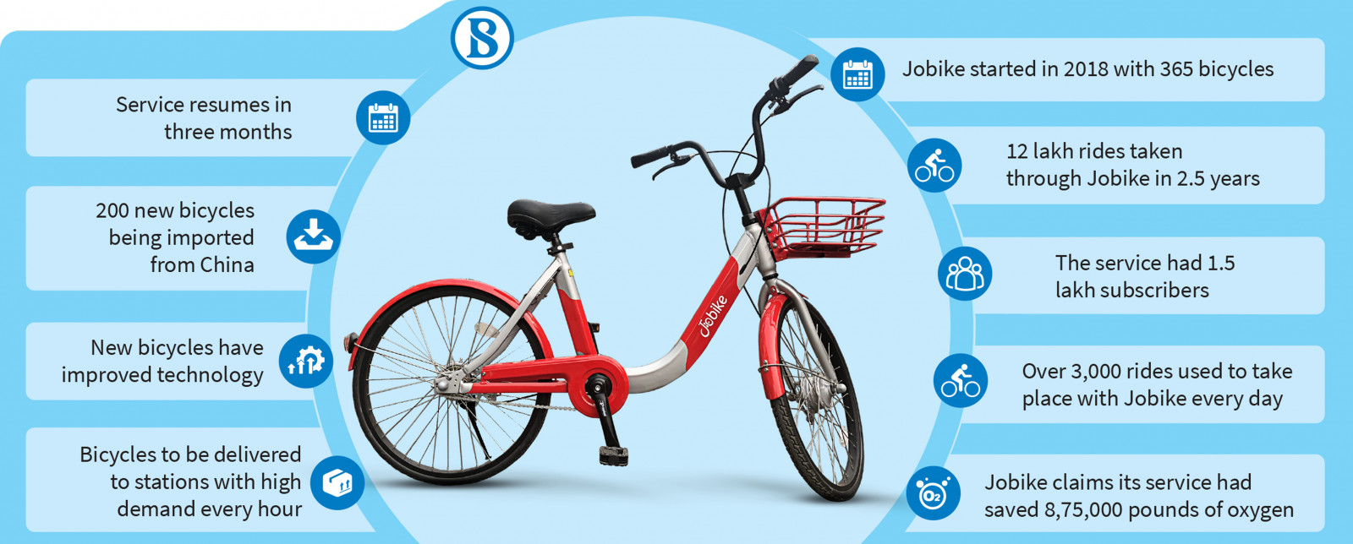
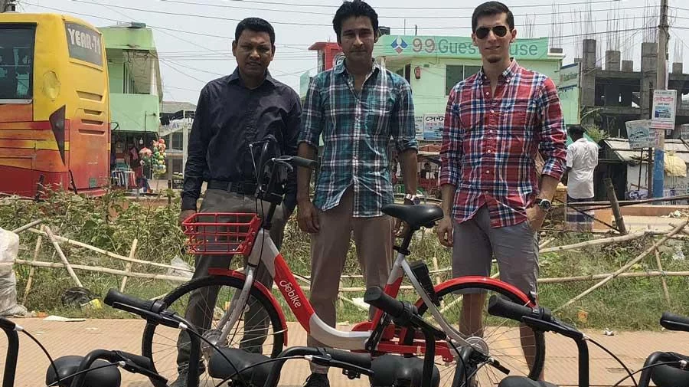
Bike-sharing and e-bike rental systems
https://www.tbsnews.net/economy/bicycle-rental-service-jobike-plans-stronger-comeback-3-months-670458
Dhaka (Bangladesh)
https://www.dhakatribune.com/feature/tech/148366/first-bicycle-sharing-app-launched

Slide 52
Bike-sharing and e-bike rental systems
Cobira is a Danish IoT connectivity provider that supports smart mobility operators. Their IoT technology allows real-time GPS tracking, smart locks, usage data monitoring, and remote diagnostics of bikes.
This enables operators to manage fleets more efficiently, ensure bikes are available where needed, and reduce misuse/theft.
Cobira provides the IoT backbone, while Jobike builds the mobility service around it. Together, they create a sustainable, scalable, and user-friendly bike-sharing ecosystem tailored to the realities of South Asian cities.
Dhaka (Bangladesh)

Slide 53
Paratransit Integration into formal networks
Integration helps increase efficiency, reduce costs, and improve accessibility, rather than attempting to eliminate this sector.
It involves:
registering vehicles, drivers, and operators, granting licenses, and introducing safety and environmental standards (e.g., shifting to CNG or electric tuk-tuks).
fare and ticketing integration – for example, allowing the use of a single city card or app to pay for both buses and rickshaws.
route and schedule coordination – incorporating paratransit into the overall network so it provides first- and last-mile connections (e.g., linking to BRT or major bus stations).
digital platforms – mobile apps (e.g., Uber, Pathao in Bangladesh, inDrive in Pakistan) that integrate rickshaws, and motorcycles within ride-hailing services.

Slide 54
Paratransit Integration into formal networks
In Dhaka, informal minibuses and auto-rickshaws already serve millions daily. Through digital platforms and policy support, these can be transformed into a semi-formalized, demand-responsive service that complements BRT corridors.
Research at the University of Leeds (2013) explored integrating rickshaws as feeder services for the BRT system in Dhaka. The study showed that rickshaws could effectively serve as first- and last-mile connections if proper infrastructure (boarding/alighting areas within 200 m of BRT stations), queue management, and fare coordination involving all stakeholders—including rickshaw drivers—are implemented.
Dhaka (Bangladesh)

Slide 55
How trends enable new mobility solutions –
Climate Change & Energy Transition
Trend: Pollution, rising fuel prices, and climate commitments push for cleaner transport.
Enabler: Shift toward low-emission and affordable energy solutions.

Slide 57
Battery Swapping Stations
In developing cities (e.g., Dhaka, Kathmandu), small electric mobility vehicles are increasingly being introduced: e-rickshaws, e-bikes, e-scooters, and small electric minibuses.
The problem is battery charging – drivers often do not have the time or space for long charging periods, and not everyone has access to private chargers.
Instead of waiting for their battery to charge, drivers can exchange a depleted battery for a fully charged one in just a few minutes (2–5 minutes).
These swapping stations function like “mini fuel stations” for electric vehicles.

Slide 58
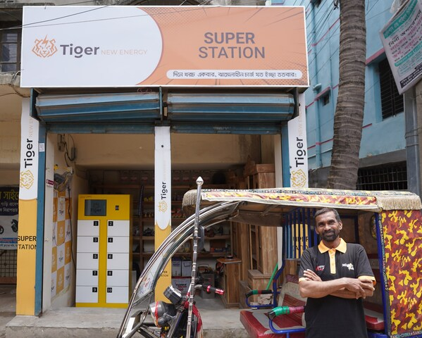
Battery Swapping Stations
„An innovative battery swapping station by Tiger New Energy, empowering rickshaw drivers with affordable and efficient green energy solutions in Bangladesh”
https://www.digitimes.com/biz/news.asp?feed=6713
"Our mission is clear: to make clean mobility accessible to all in emerging markets," said Nicole Mao, co-founder and CEO of Tiger New Energy. "This funding validates our technology and business model and strengthens our commitment to reducing carbon footprints, fostering sustainable development, and enhancing the livelihoods of local communities."
Dhaka (Bangladesh)

Slide 59
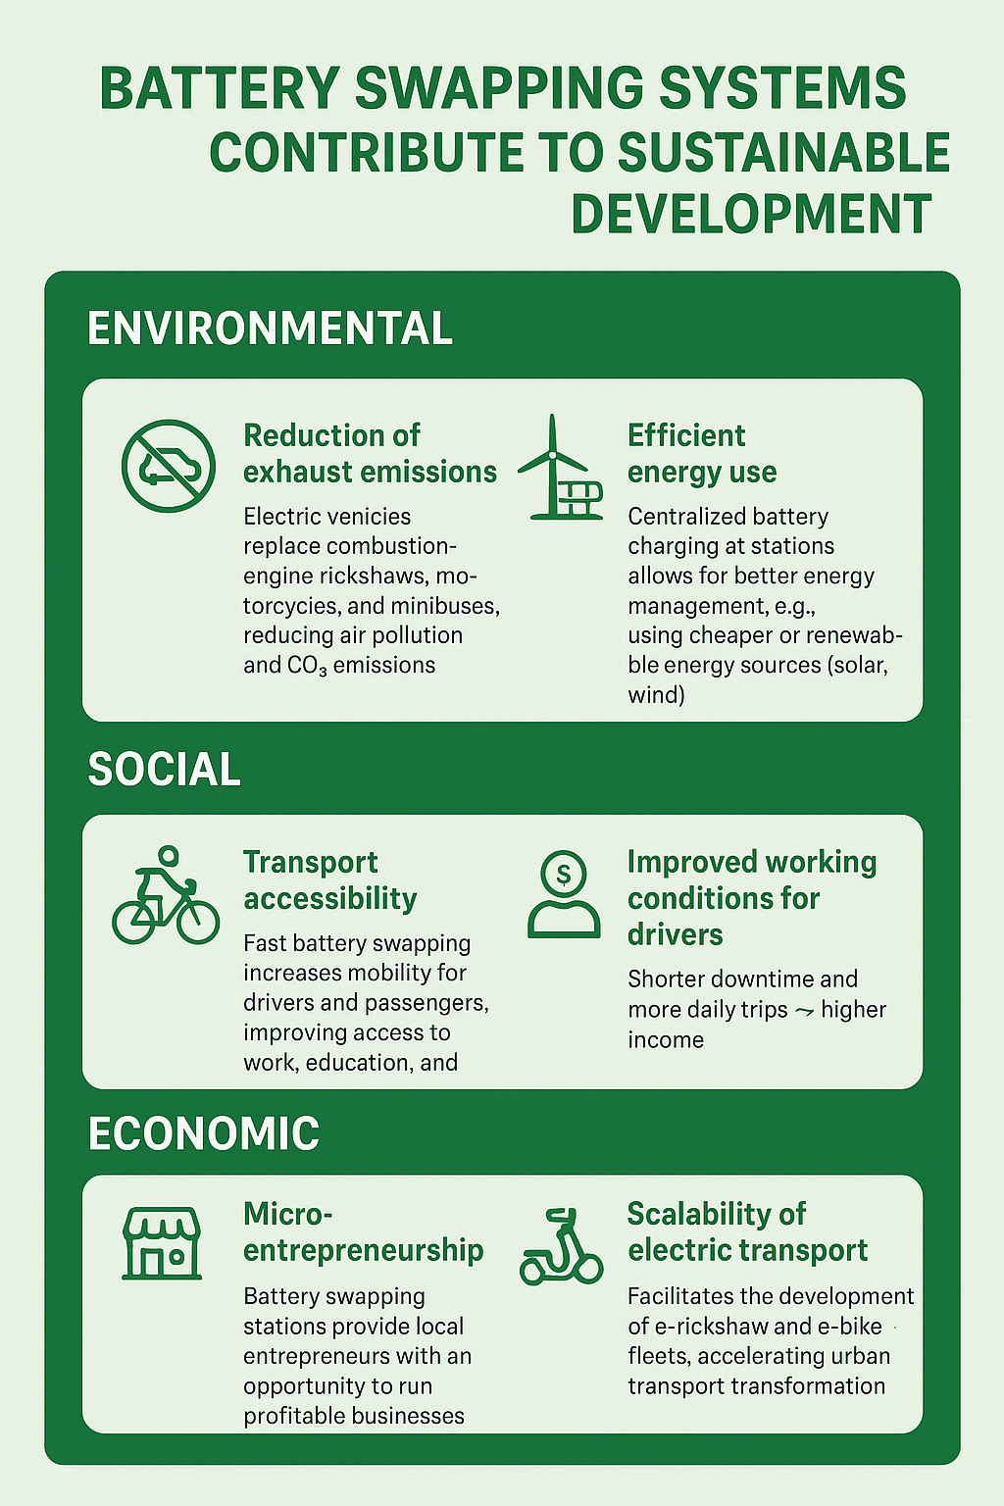
Battery Swapping System

Slide 60
How trends enable new mobility solutions –
Economic Pressures & Affordability
Trend: Low income levels + high costs of car ownership.
Enabler: Demand for cheap, accessible mobility.
Solutions:
Micro-mobility (bicycles, e-bikes, scooters for last-mile).
Subscription models (daily/weekly ride passes instead of vehicle ownership).
Community-based transport cooperatives (villages pooling resources for shared vans).
Notes:
Economic Pressures & Affordability

