Slide 1



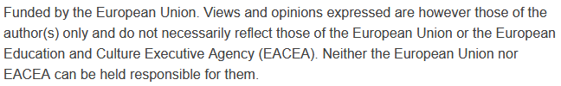
Policy, Governance for Smart Mobility
Sustainability and Quality Assurance for Academic Governance and Redesign Engineering Studies
MODULE 4
Justyna Staszak-Winkler

Slide 2
What is Smart Mobility Governance?
The set of policies, regulations, and decision-making processes that guide the development and management of smart mobility solutions.
Ensures that technology-driven transport systems are safe, inclusive, efficient, and sustainable.
Smart mobility governance links technology, policy, and people. It transforms transport from being only about infrastructure to being about efficient, data-driven, and human-centered mobility systems.
Smart mobility requires not only good policies, but also effective governance models.

Slide 3
Why Governance Matters?
Aligns transport innovations with broader urban, social, and environmental goals.
Provides a framework for balancing the needs of governments, private operators, and citizens.
Helps cities manage rapid urbanization, congestion, and climate challenges.

Slide 4
Governance Models
Centralization vs. Decentralization
Centralized model: strong role of national government in setting policies, funding, and regulations.
Decentralized model: local governments and cities have more autonomy in mobility decisions.
Balance often depends on political structure and institutional capacity.

Slide 5
Governance Models
Multi-level Governance
Cooperation between national, regional, and local authorities.
Ensures consistency of national goals with local needs.
Example: national EV policy supported by local incentives for charging infrastructure.

Slide 6
Governance Models
Public-Private Partnerships (PPPs)
Collaboration between governments and private companies to deliver smart mobility solutions.
PPPs can provide financing, innovation, and efficiency.
Examples: shared mobility platforms, smart ticketing systems, urban logistics hubs.

Slide 7
Governance Models – Comparison
Model | Key Features | Advantages | Challenges
Centralized | National government sets strategy, funding, regulations | Clear direction, national consistency, large-scale impact | Limited local flexibility, risk of bureaucracy
Decentralized | Local/city authorities have autonomy over mobility policies | Tailored solutions to local needs, faster implementation | Risk of fragmentation, unequal resources across cities
Multi-level Governance | Cooperation between national, regional, and local levels | Balance between national goals and local priorities | Requires strong coordination and communication
Public-Private Partnership (PPP) | Joint projects between government and private sector to deliver smart mobility | Access to funding, innovation, efficiency | Risk of profit-driven solutions, need for transparency

Slide 8
Financing and Business Models
Smart mobility is not only about technology and governance, but also about how projects are financed and sustained.
Financing and business models are not only about raising money but also about shaping behavior and steering cities toward sustainable mobility goals

Slide 9
Financing and Business Models - Sources of Financing
Public funding – national budgets, municipal funds, international grants (e.g., World Bank, Asian Development Bank).
Public-Private Partnerships (PPPs) – joint investment in infrastructure and services.
Impact investing & green finance – private capital directed at projects with social and environmental benefits.

Slide 10
Financing and business models - Subsidies and Incentives
Governments also use subsidies and incentives to accelerate adoption. For example, many countries offer direct subsidies for the purchase of electric vehicles or for building charging stations and micro-mobility. Tax incentives, reduced import duties for clean transport technologies, and innovation grants are also common tools to support clean mobility.

Slide 11
Role of Tariffs, Taxes, and Road Pricing
Fare policies to ensure affordability and sustainability of public transport.
Congestion charges and road pricing to reduce traffic in urban areas.
Fuel taxes and carbon pricing to encourage low-emission mobility.

Slide 12
Subsidies and Incentives
Direct subsidies for electric vehicles, charging infrastructure, and micro-mobility
Tax incentives and reduced import duties for clean transport technologies.
Support for innovation and start-ups in mobility services.

Slide 13
Traditional Approach to Transport Policy
Focused on road infrastructure and investments in private vehicles.
Dominated by large projects: highways, bridges, parking areas.
Low accessibility for people without private vehicles.
Little attention to environmental issues and long-term sustainability.

Slide 14
Policy Shift: The New Role of Transport Policy
New policy objectives:
Reduce congestion and air pollution.
Promote public and shared transport.
Integrate different transport systems (formal and informal).
Improve access for vulnerable groups (e.g., women, elderly, low-income).
Encourage digitalization: data use, mobile apps, smart traffic systems.
As urban populations grow and climate issues become more serious, transport policy is evolving.

Slide 15
Smart Mobility Policy Context – Expanded Overview
No formal smart mobility policy, but increasing importance of local solutions
Nepal does not yet have a nationwide strategy or policy dedicated to smart mobility. However, at the local and municipal level—especially in the Kathmandu Valley—we observe the development of tools and services that align with the idea of smart mobility. These examples show that bottom-up initiatives and digital innovations can support modern forms of transport, even in countries with limited infrastructure.
Nepal

Slide 16
Further development requires:
support from local authorities and the central government (subsidies, training, e-mobility development strategy),
investments in infrastructure (charging stations, digitalization of public services),
creation of public-private partnerships (e.g., with app operators and electric vehicle manufacturers).
Smart Mobility Policy Context – Expanded Overview
Nepal

Slide 17
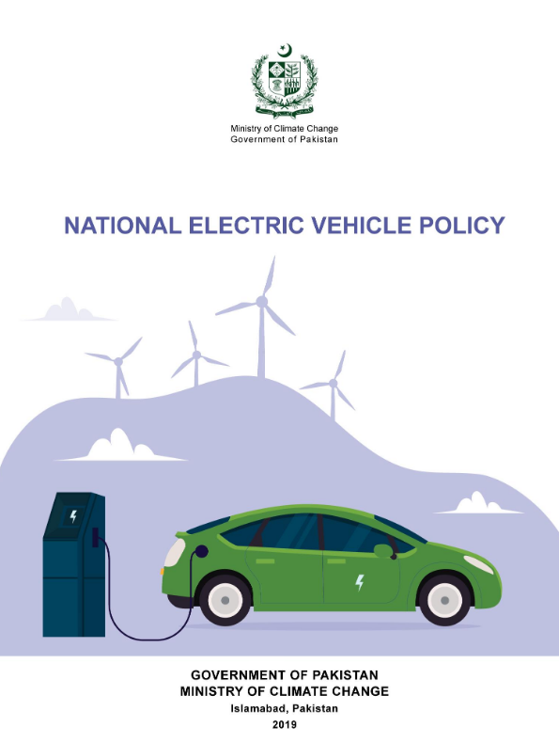
Pakistan's Electric Vehicle (EV) policy, formally known as the National Electric Vehicle Policy (NEVP) 2020-2025, was approved in November 2019.
The policy aims to promote the adoption of electric vehicles in Pakistan, with the goal of converting 30% of all vehicles to electric by 2030. The policy includes incentives for both manufacturers and consumers, as well as measures to develop the necessary charging infrastructure
Smart Mobility Policy Context – Expanded Overview
Pakistan: EV Policy 2020 – support for electric vehicles
https://mocc.gov.pk/SiteImage/Policy/EV%20Policy%20Final.pdf

Slide 18
Smart Mobility Policy Context – Expanded Overview
Key Features of the Policy:
Promote the use of electric vehicles (EVs), especially two-wheelers (motorcycles, scooters) and three-wheelers (rickshaws), which form a significant part of urban transport.
Encourage production, import, and use of EVs through:
  Tax exemptions and reduced duties on electric vehicles.
  Preferential conditions for investors and manufacturers.
  Creating legal frameworks to support charging infrastructure development.
Pakistan: EV Policy 2020 – support for electric vehicles

Slide 19
Smart Mobility Policy Context – Expanded Overview
Bangladesh does not yet have a comprehensive national smart mobility policy, developments in the capital city, Dhaka, indicate growing attention to sustainable and intelligent transport solutions in urban planning.
The Dhaka Urban Transport Network Development Plan includes components that promote sustainable mobility, such as the improvement of public transport networks, integration of different transport modes, and support for environmentally friendly mobility options.
Bangladesh: Dhaka Urban Transport Network Development Plan

Slide 20
Smart Mobility Policy Context – Expanded Overview
Main Components of Dhaka Urban Transport Network Development Plan:
Mass Rapid Transit (MRT) and Bus Rapid Transit (BRT):
  Expansion of metro and BRT lines to form the backbone of public transport.
  Seamless interchanges between MRT, BRT, and local buses.
Transport Integration:
  Unified ticketing and fare systems across different modes.
  Strategic location of terminals and transfer points for efficiency.
Bangladesh: Dhaka Urban Transport Network Development Plan

Slide 21
Smart Mobility Policy Context – Expanded Overview
Infrastructure Development:
  Road improvements, intelligent traffic signal systems, and pedestrian-friendly infrastructure.
  Investment in smart technologies to support traffic monitoring and public transport information systems.
Sustainable and Smart Mobility Focus:
  Encouraging the use of non-motorized transport (NMT) such as cycling and walking.
  Support for low-emission vehicles and future-ready mobility policies.
Bangladesh: Dhaka Urban Transport Network Development Plan

Slide 22
Smart Mobility Policy Context – Expanded Overview
Institutional and Policy Reforms:
Strengthening coordination among various agencies involved in transport planning and operation.
Capacity building and public awareness campaigns for sustainable transport behavior.
Bangladesh: Dhaka Urban Transport Network Development Plan

Slide 23
Smart Mobility Policy Context – Expanded Overview
While not labeled explicitly as a smart mobility policy, the UTNDP lays important groundwork by:
  Promoting digital tools for transport planning.
  Encouraging modal integration and user-centered transport services.
  Enabling a shift from private car usage to shared and sustainable modes.
  The plan represents a key step in transitioning Dhaka towards a smarter, greener, and more efficient urban mobility system.
Bangladesh: Dhaka Urban Transport Network Development Plan

Slide 24
Student Assignment: Smart Mobility Policy Analysis
Select a city (real or hypothetical) and briefly describe its urban transport system. Identify existing or proposed transport policies that aim to support smart mobility, sustainable transport, or innovative solutions.
Analyze the role of key stakeholders, such as local authorities, public-private partnerships, and data management systems, in policy development and implementation.
Evaluate transparency, accountability, and collaboration in the policy-making process.
Propose policy recommendations to improve urban transport, considering sustainability, innovation, and citizen engagement.
Deliverable: A short report or presentation summarizing your analysis, evaluation, and recommendations.

