Slide 1
Course C.03.06.01
Asphalt mixture – Placing operations
Marek Pszczola
(presentation was prepared on the basis of lectures prof. S. Romanoschi, USA)

Slide 2
Road Transportation Systems Engineering Development in the Sub-Saharan Africa – Modern EU Master Programme & Capacity Building

Slide 4
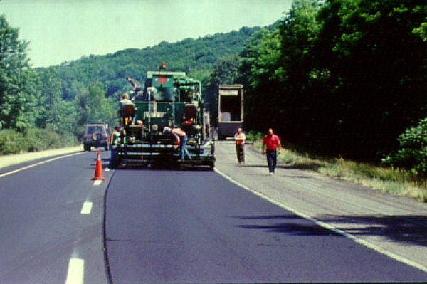

Slide 5
Topics
Surface Preparation
HMA Delivery
Paving Equipment
Paving Procedures
Mix and Mat Inspection
Constructing Joints

Slide 6
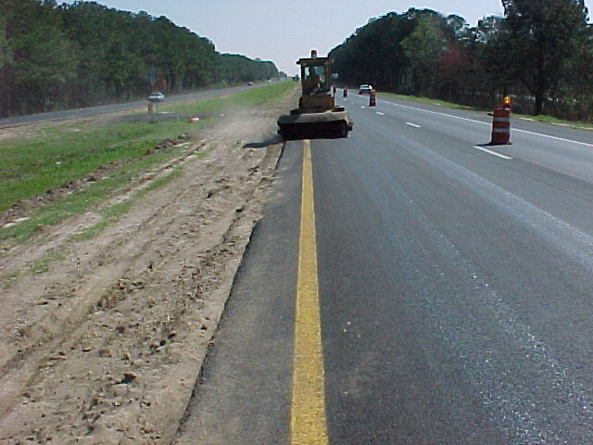
Sweeping Existing Pavements

Slide 7
Tack coats promote bonding between layers
Should be uniform
Should not be excessive

Slide 8
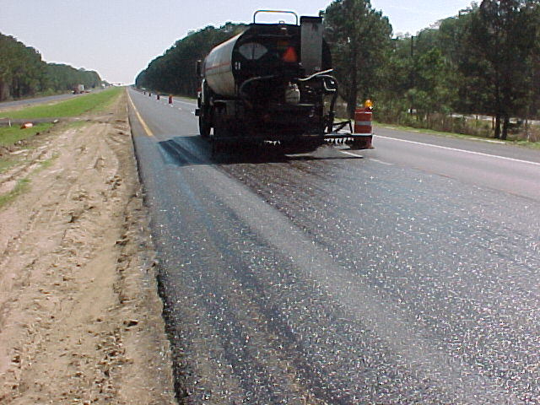
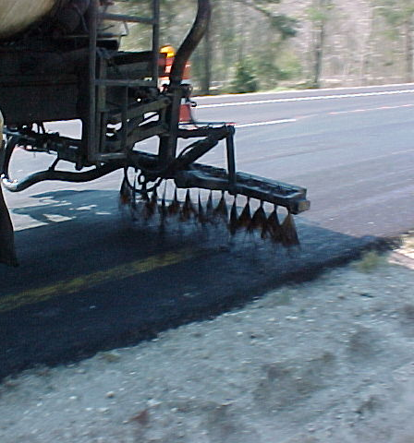

Slide 9


Slide 10
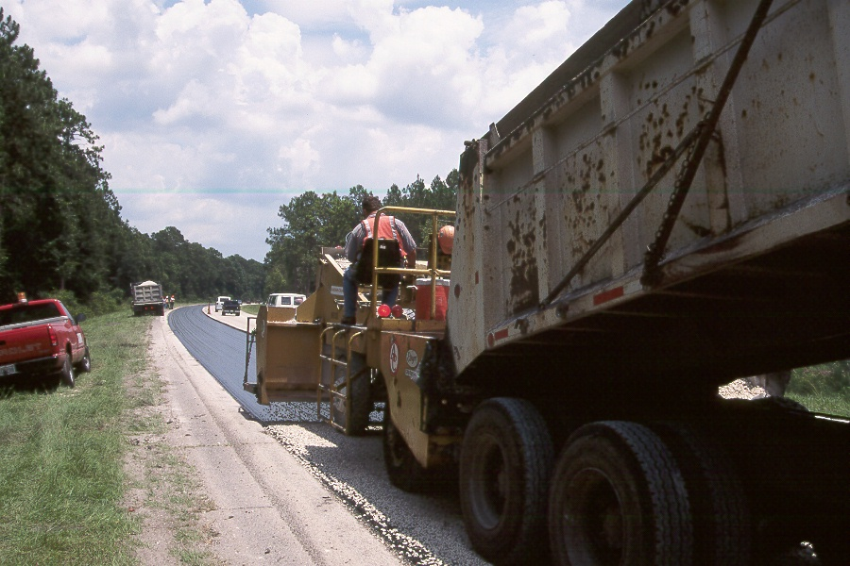

Slide 11
HMA
Delivery

Slide 12
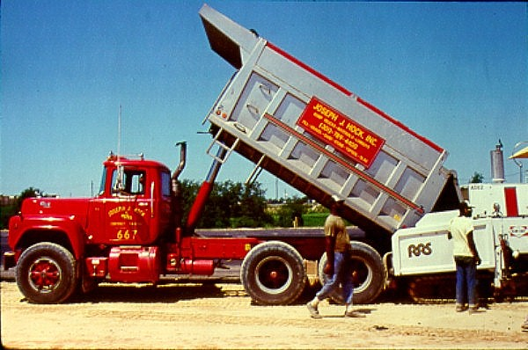

Slide 13
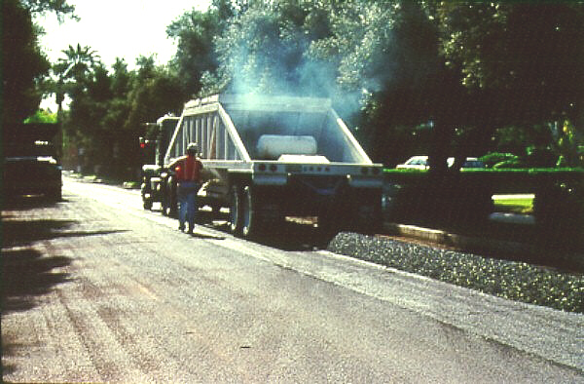

Slide 14


Slide 15
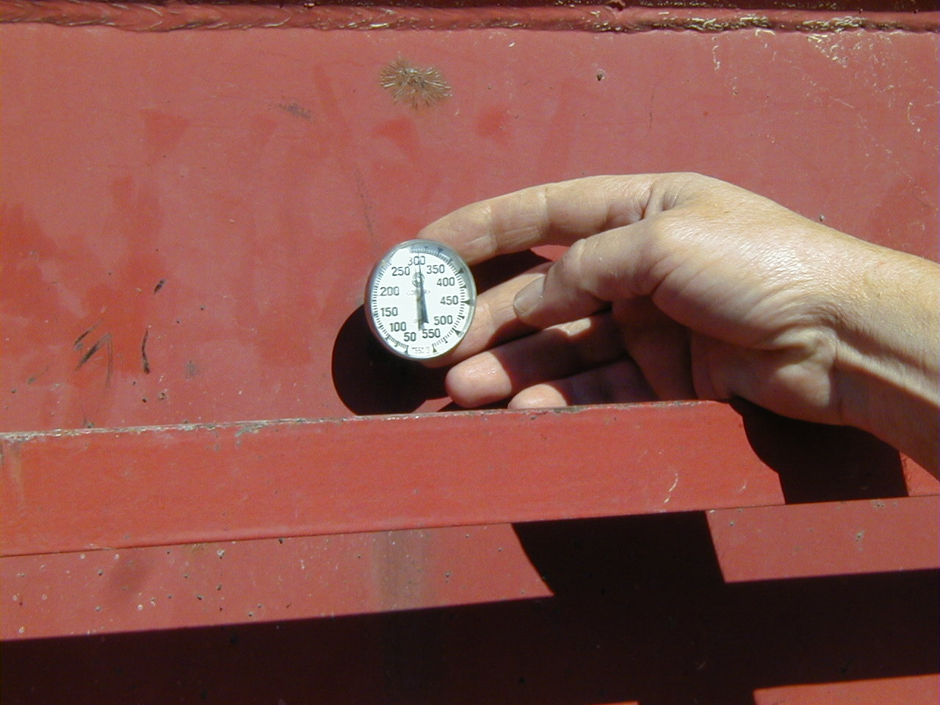
Checking Temperatures

Slide 16
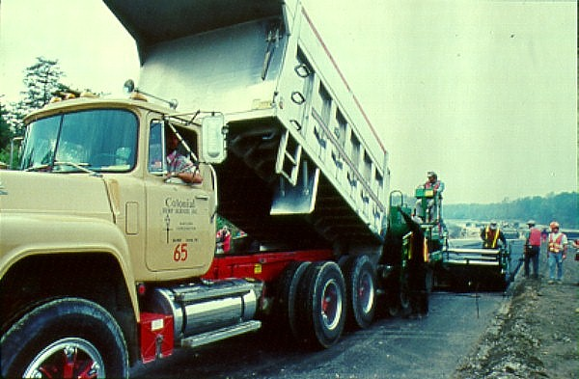

Slide 17
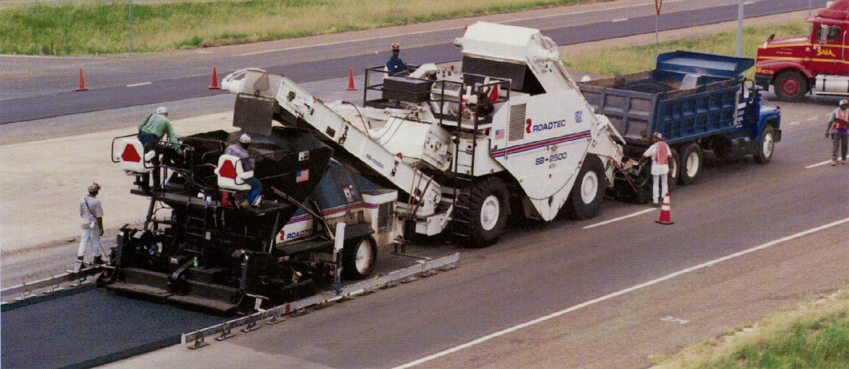

Slide 18
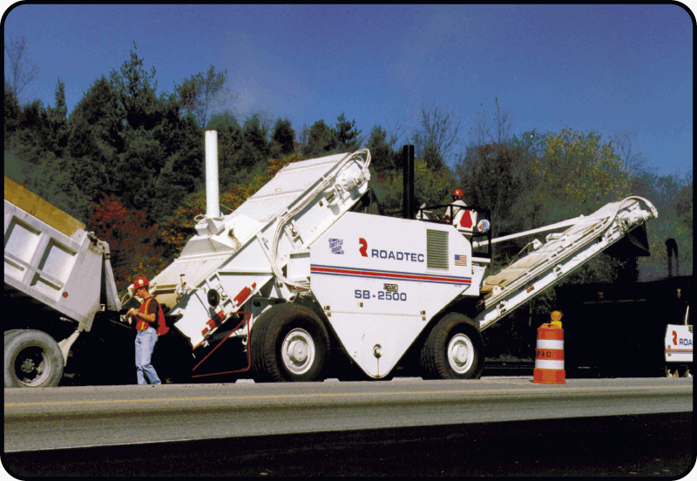

Slide 19
Paving Equipment and
Paving Procedures

Slide 20
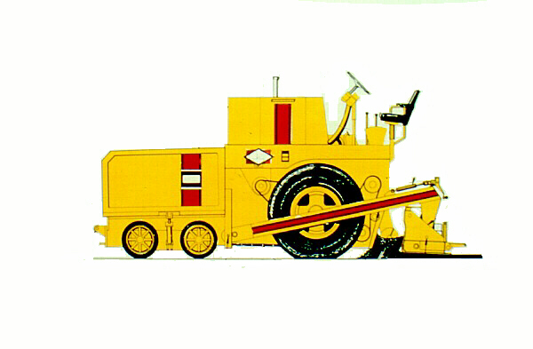
Tractor
Hopper
Depth Crank
Screed
Push Rollers
Tow Point
Conveyors
Augers
Side Arm

Slide 21
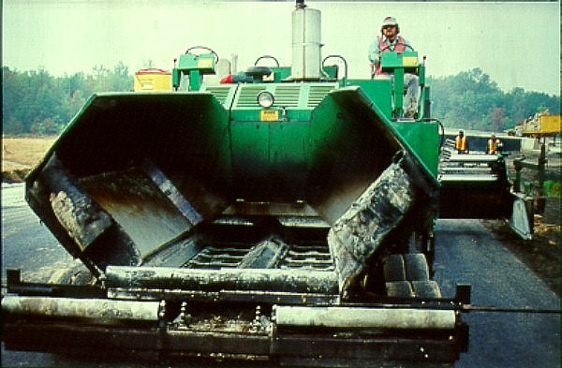

Slide 22
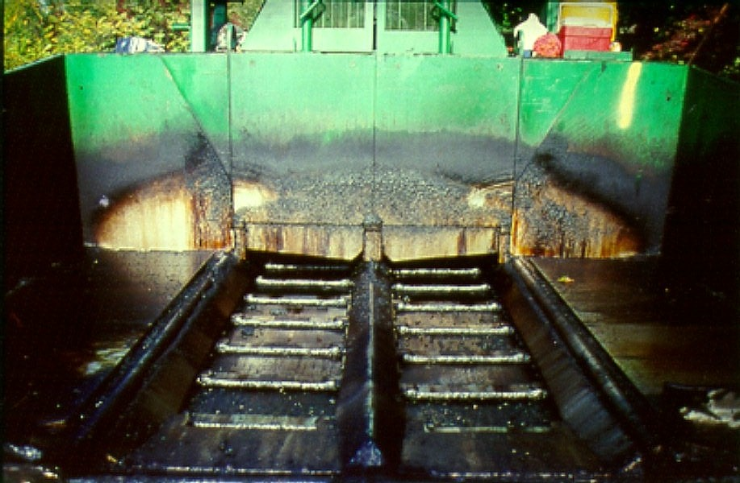

Slide 23
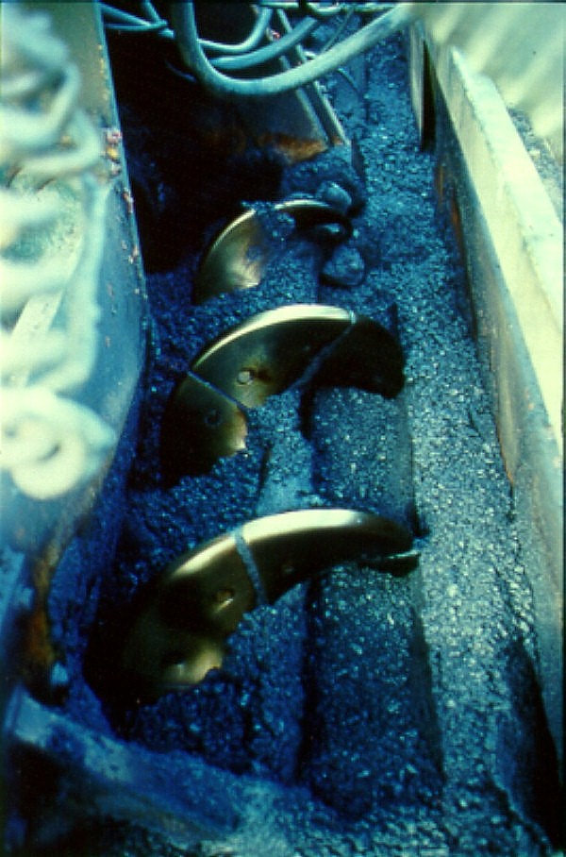

Slide 24
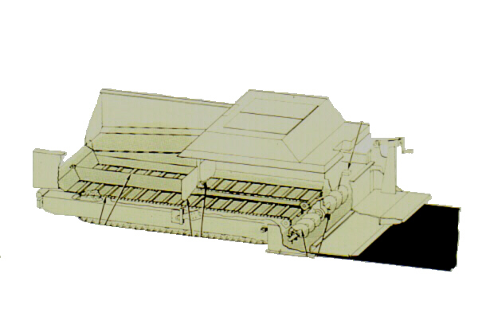
Material Flow
Hopper Wings
Proportional
Feed Control
Slat Conveyors
Hopper Gates
Augers
Screed Plate

Slide 25
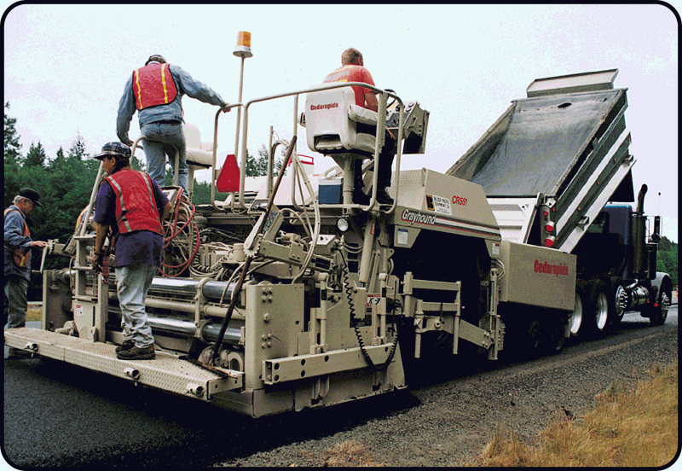

Slide 26
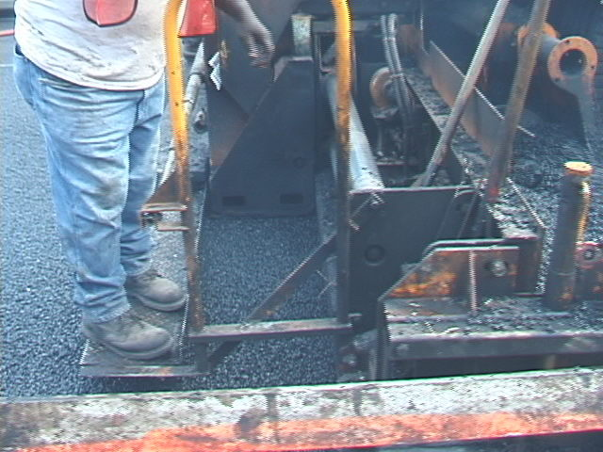
1 foot rigid extension

Slide 27
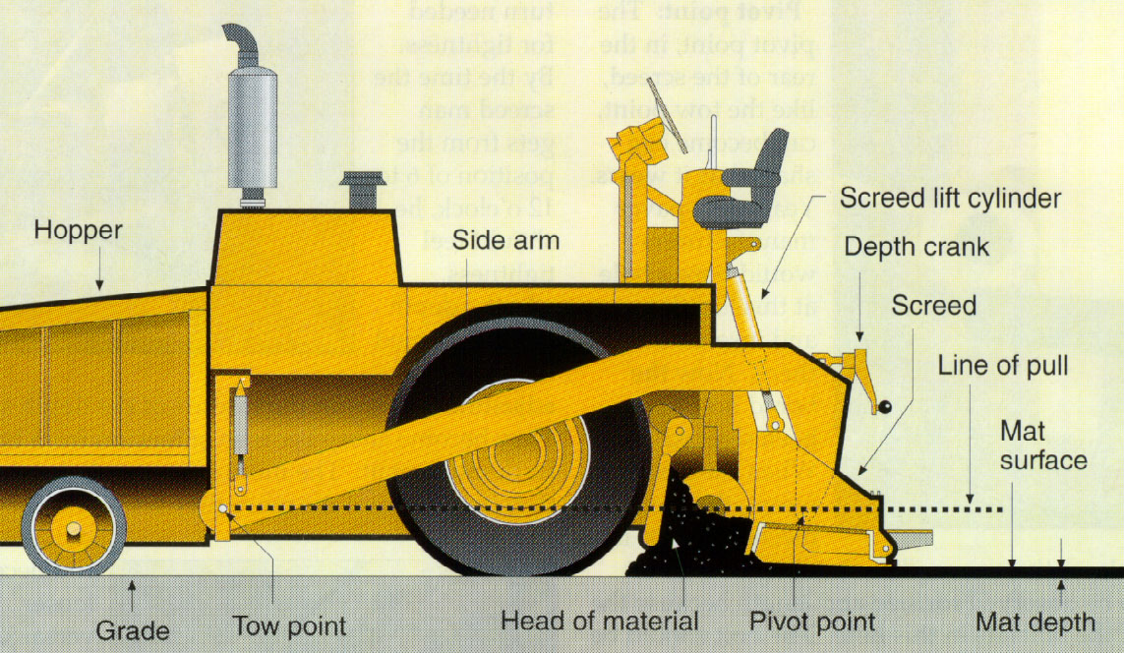

Slide 28
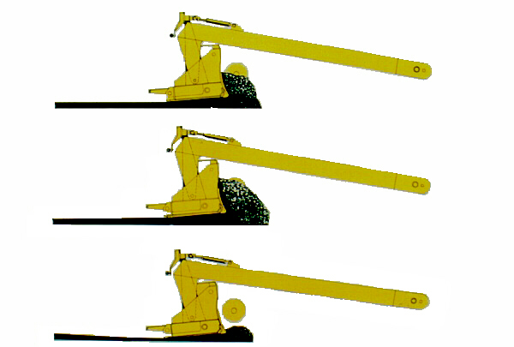
Correct Depth of
Mat Maintained
Constant Head of Material Volume
Screed Rises Due to
Excess Material Forced
Under Nose of Screed
Head of Material Volume Too High
Screed Settles Due to
Inadequate Supporting
Material
Head of Material Volume Too Low

Slide 29
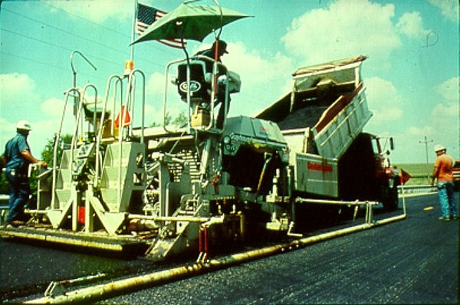

Slide 30
Balancing Production
HMA
Facility
Paving
Trucking
Compaction

Slide 31
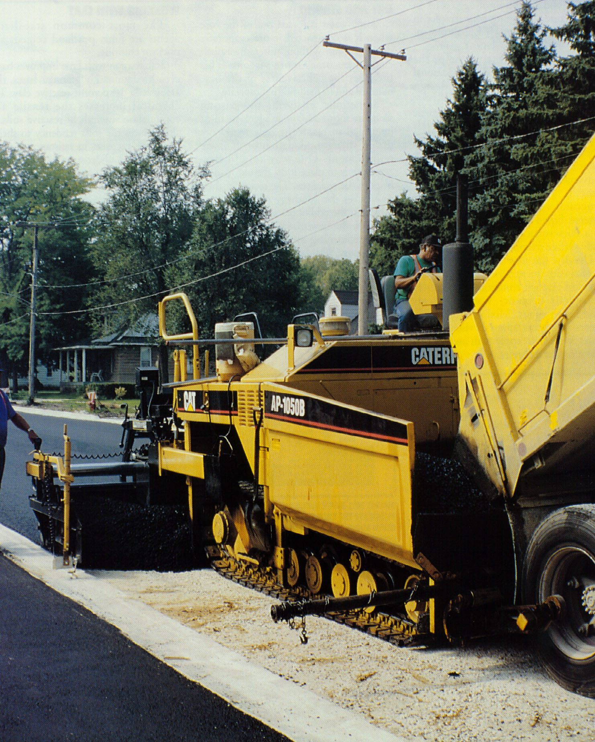

Slide 32
Mix Deficiency Indications
Blue Smoke
Stiffness
Slumping
Bleeding
Lean, dull look
Steam
Segregation
Contamination

Slide 33
Placing Procedures
Inspection Items
Uniformity
Temperature
Appearance
Geometrics

Slide 34

Checking the Temperature

Slide 35
Surface Appearance
Texture Deficiencies
- Tearing & scuffing
- Cracking
- Irregularities
Smoothness Deficiencies
- Dips
- Ripples
- Indentations
Notes:
Hence, there is a need for a mechanical test which can tell us whether the designed mix is resistant to rutting. It should be able to proof test the mixes and tell us whether a mix satisfies a definite criteria and passes or fails the torture test. This test should be a laboratory test method so that it can be used on designed mixes, and it should be a simple test method so that it can be used routinely by the folks who actually build our pavements.

Slide 36
Pavement Geometrics
Thickness
Grade
Alignment
Crown
Notes:
Hence, there is a need for a mechanical test which can tell us whether the designed mix is resistant to rutting. It should be able to proof test the mixes and tell us whether a mix satisfies a definite criteria and passes or fails the torture test. This test should be a laboratory test method so that it can be used on designed mixes, and it should be a simple test method so that it can be used routinely by the folks who actually build our pavements.

Slide 37
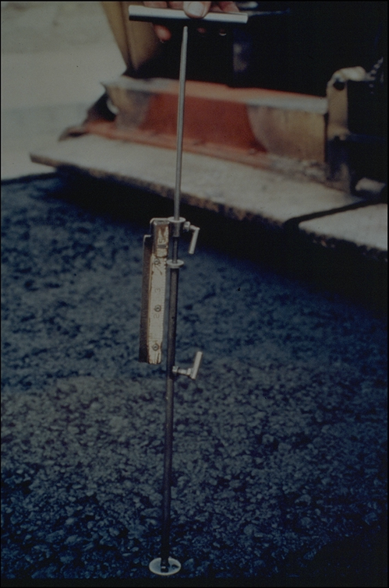

Slide 38
Constructing
Joints

Slide 39
Types of Joints
Transverse
Longitudinal

Slide 40


Slide 41
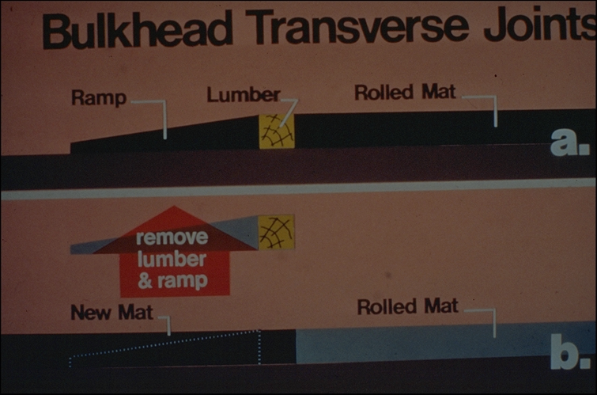

Slide 42
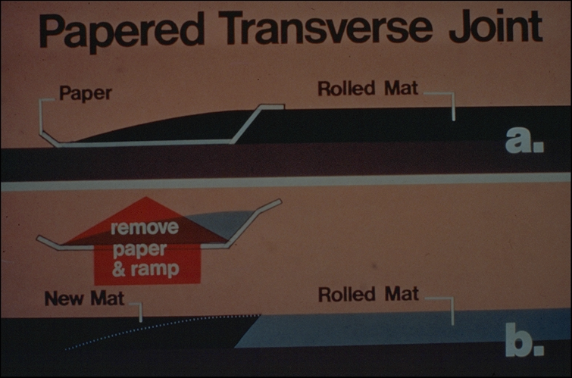

Slide 43
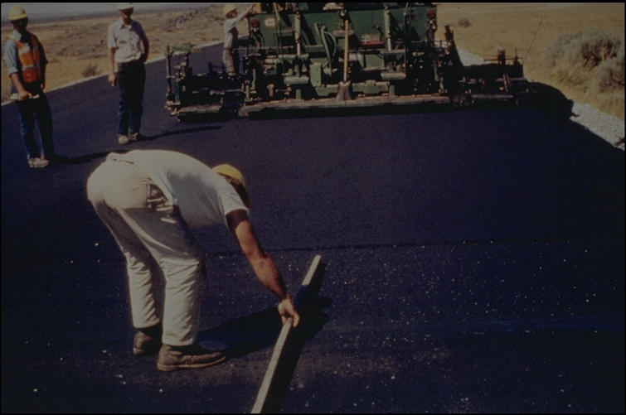

Slide 44
Longitudinal Joints
Cold Joints

Slide 45
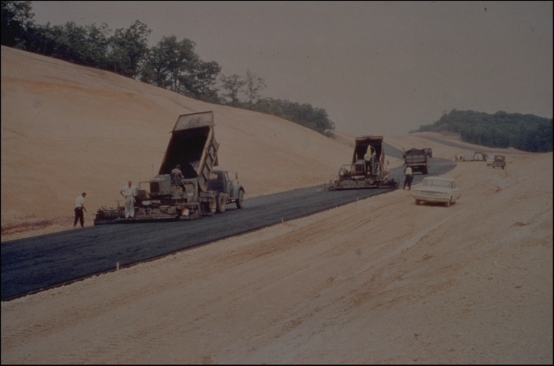

Slide 46


Slide 47


Slide 48


1 to 1-1/2 inches (25-40 mm)
Typical Overlap on Longitudinal Joints
Thickness of Rolldown
Uncompacted Mat
Compacted Mat

Slide 49
Mix “Bumped Back” to Joint
Uncompacted Mat
Compacted Mat

Slide 50


Slide 51
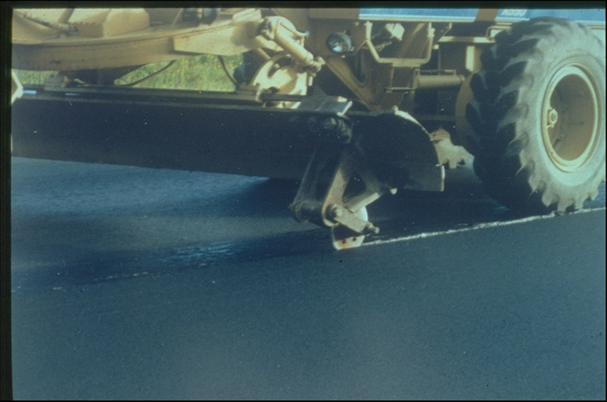

Slide 52
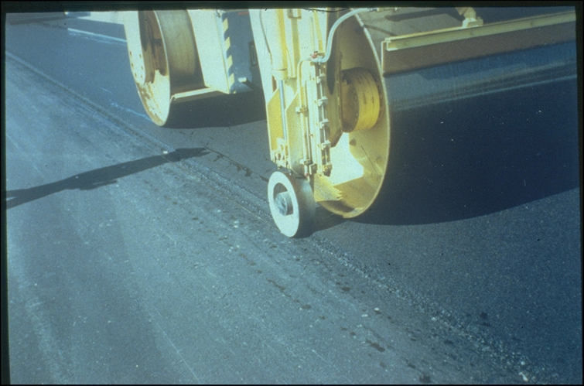

Slide 53
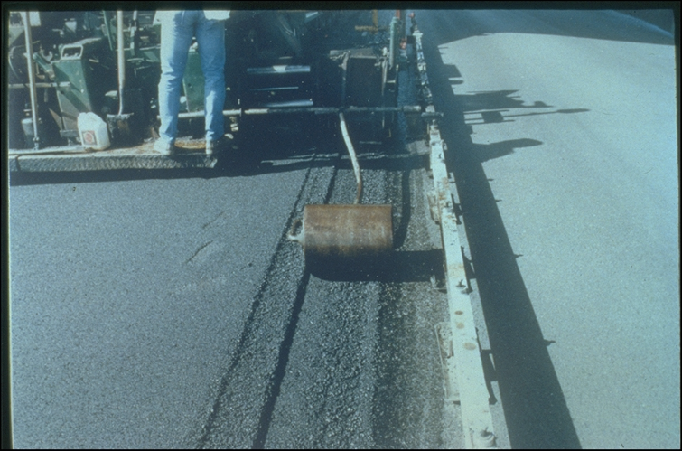

Slide 54
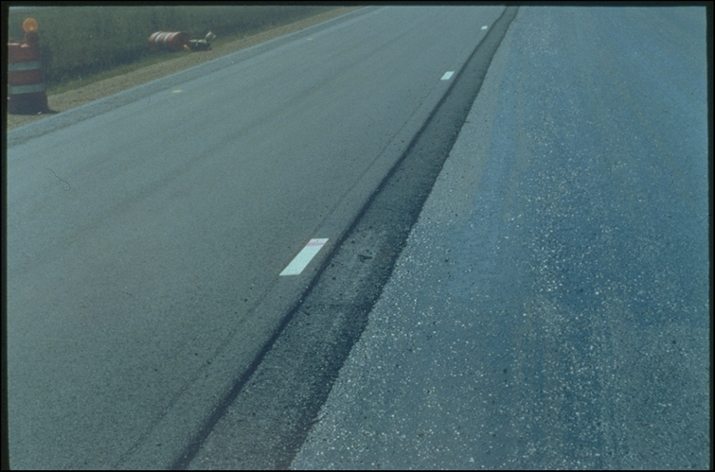

Slide 55
