Slide 1
Course C.03.06.01
Asphalt mixture – history of design
Marek Pszczola
(presentation was prepared on the basis of lectures prof. S. Romanoschi, USA)

Slide 2
Road Transportation Systems Engineering Development in the Sub-Saharan Africa – Modern EU Master Programme & Capacity Building

Slide 4
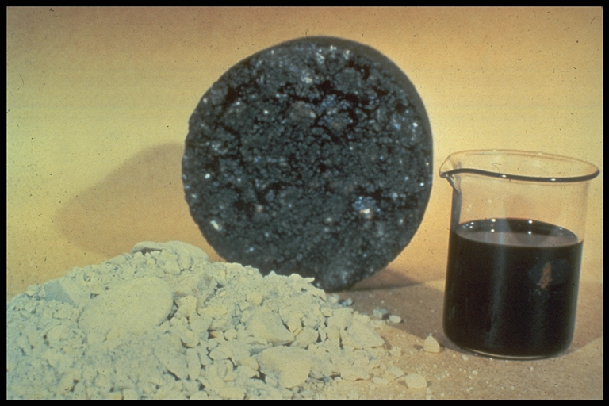
Asphalt mixture

Slide 5
The Pat Test
Used for sheet asphalt from about 1900 to early 1920s
Pat samples of sheet asphalt made with different binder contents
Pressed against a brown manila paper:
- Heavy stain - too much binder
- Light stain - too little binder
- Medium stain - optimum binder

Slide 6
Bitulithic Pavement
Warren Brothers obtained patent around 1900
Large stone 19mm to 75 mm
Good for steel-rimmed wheels or solid-tired trucks in 1900s
Notes:
Hence, there is a need for a mechanical test which can tell us whether the designed mix is resistant to rutting. It should be able to proof test the mixes and tell us whether a mix satisfies a definite criteria and passes or fails the torture test. This test should be a laboratory test method so that it can be used on designed mixes, and it should be a simple test method so that it can be used routinely by the folks who actually build our pavements.

Slide 7
Bitulithic Pavement
Mixes with 12 mm top size used to avoid patent infringements
Performance satisfactory due to advent of pneumatic tire
Suitable for mechanized paving
Notes:
Hence, there is a need for a mechanical test which can tell us whether the designed mix is resistant to rutting. It should be able to proof test the mixes and tell us whether a mix satisfies a definite criteria and passes or fails the torture test. This test should be a laboratory test method so that it can be used on designed mixes, and it should be a simple test method so that it can be used routinely by the folks who actually build our pavements.

Slide 8
Hubbard-Field Method
Developed in 1920s to determine optimum AC of sheet asphalt surface and sand asphalt bases
Specimen 2 inches diameter by 1 inch high forced through a 1.75 inch diameter orifice
Maximum load reported as stability
Notes:
Hence, there is a need for a mechanical test which can tell us whether the designed mix is resistant to rutting. It should be able to proof test the mixes and tell us whether a mix satisfies a definite criteria and passes or fails the torture test. This test should be a laboratory test method so that it can be used on designed mixes, and it should be a simple test method so that it can be used routinely by the folks who actually build our pavements.

Slide 9
Hubbard-Field Method (Cont.)
First attempt to quantify stability at different binder contents
Modified in 1950s to test 6 inch HMA specimens containing coarse aggregates
Notes:
Hence, there is a need for a mechanical test which can tell us whether the designed mix is resistant to rutting. It should be able to proof test the mixes and tell us whether a mix satisfies a definite criteria and passes or fails the torture test. This test should be a laboratory test method so that it can be used on designed mixes, and it should be a simple test method so that it can be used routinely by the folks who actually build our pavements.

Slide 10


Slide 11
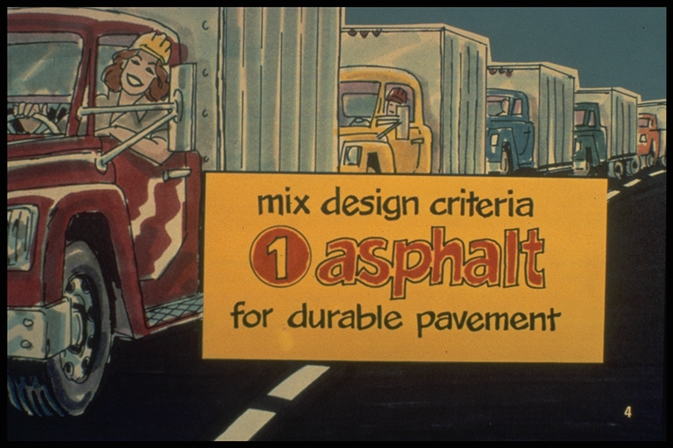

Slide 12
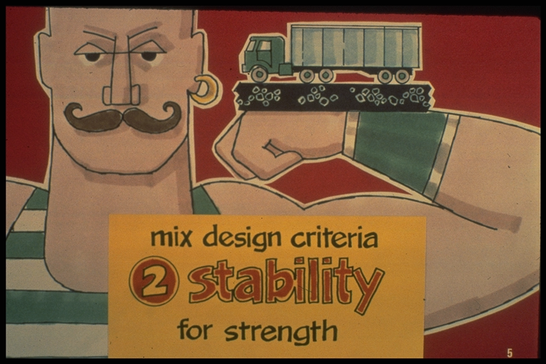

Slide 13
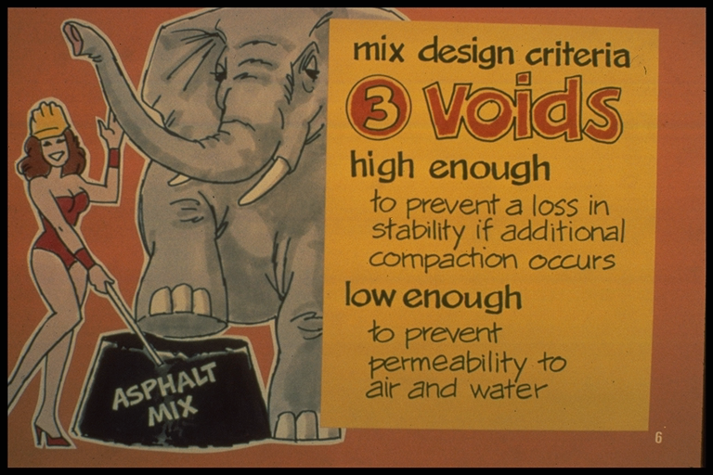

Slide 14


Slide 15
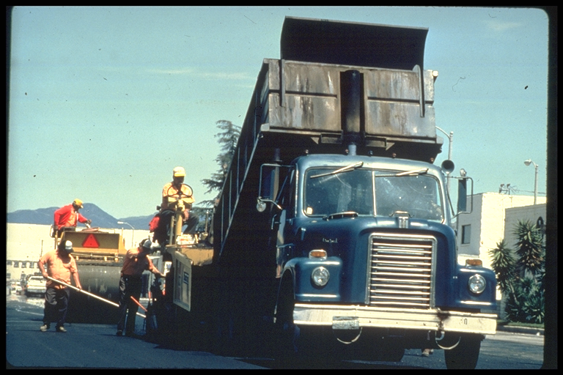

Slide 16
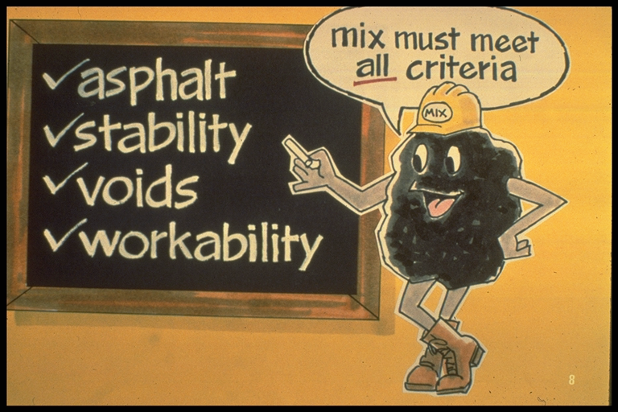

Slide 17
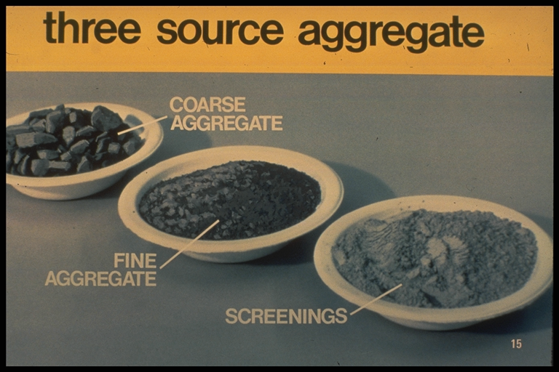

Slide 18
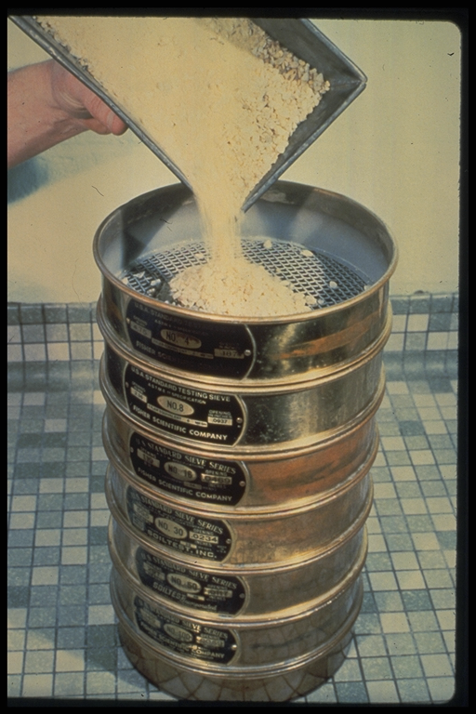

Slide 19
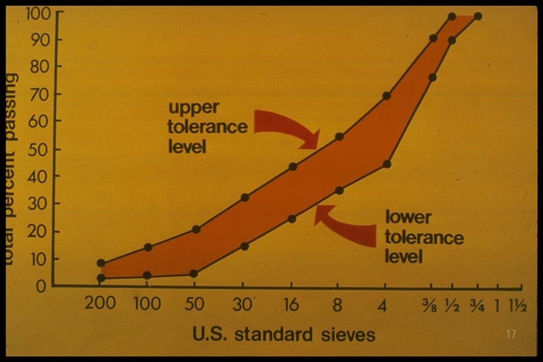

Slide 20
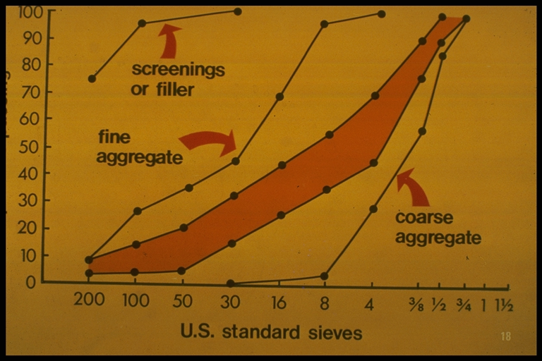

Slide 21
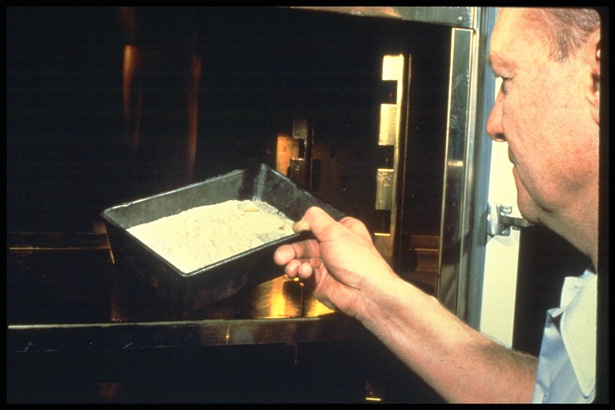

Slide 22
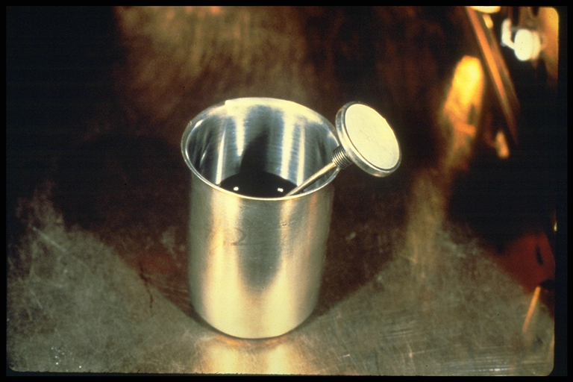

Slide 23
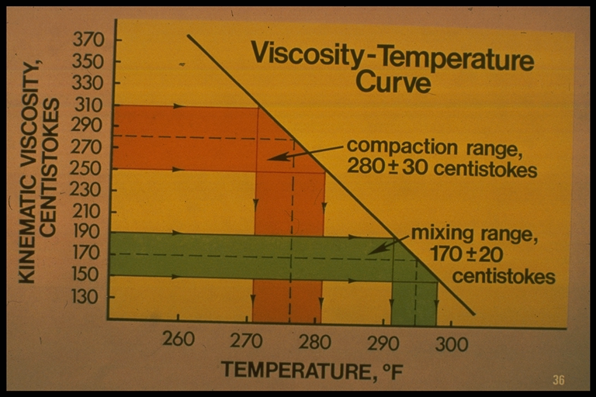

Slide 24
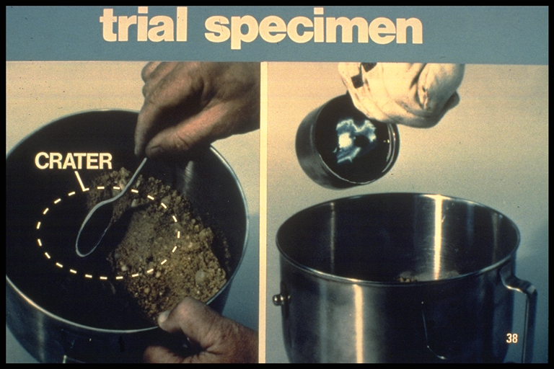

Slide 25
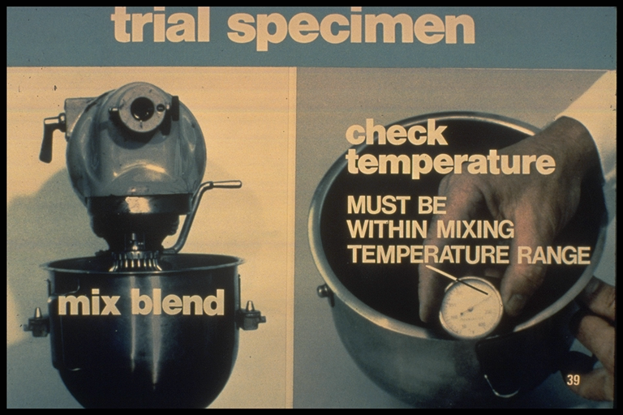

Slide 26
Hot Mix Asphalt Concrete (HMA)
Mix Designs
Objective:
  Develop an economical blend of aggregates and asphalt that meet design requirements
Historical mix design methods
  Marshall
  Hveem
New
  Superpave gyratory
Notes:
The objective of HMA mix design is to develop an economical blend of aggregates and asphalt. In the developing of this blend the designer needs to consider both the first cost and the life cycle cost of the project. Considering only the first cost may result in a higher life cycle cost.
Historically asphalt mix design has been accomplished using either the Marshall or the Hveem design method. The most common method was the Marshall. It had been used in about 75% of the DOTs throughout the US and by the FAA for the design of airfields. In 1995 the Superpave mix design procedure was introduced into use. It builds on the knowledge from Marshall and Hveem procedures. The primary differences between the three procedures is the machine used to compact the specimens and strength tests used to evaluate the mixes. The current plan is to implement the Superpave procedures throughout the US for the design and quality control of HMA highway projects early in the next century. It appears that the Marshall method will continue to be used for airfield design for many years and that the Hveem procedure will continue to be used in California.

Slide 27
Requirements in Common
Sufficient asphalt to ensure a durable pavement
Sufficient stability under traffic loads
Sufficient air voids
  Upper limit to prevent excessive environmental damage
  Lower limit to allow room for initial densification due to traffic
Sufficient workability
Notes:
No matter which design procedure is going to be used the HMA mixture that is placed on the roadway must meet certain requirements.
The mix must have sufficient asphalt to ensure a durable, compacted pavement by thoroughly coating, bonding and waterproofing the aggregate.
Enough stability to satisfy the demands of traffic without displacement or distortion (rutting).
Sufficient voids to allow a slight amount of added compaction under traffic loading without bleeding and loss of stability. However, the volume of voids should be low enough to keep out harmful air and moisture. To accomplish this the mixes are usually designed by 4% VTM in the lab and compacted to less than 7% VTM in the field.
Enough workability to permit placement and proper compaction without segregation.

Slide 28
Marshall Mix Design Method
Developed by Bruce Marshall of Mississippi Highway Department (1939)
Corps of Engineers conducted study in 1943
Notes:
Hence, there is a need for a mechanical test which can tell us whether the designed mix is resistant to rutting. It should be able to proof test the mixes and tell us whether a mix satisfies a definite criteria and passes or fails the torture test. This test should be a laboratory test method so that it can be used on designed mixes, and it should be a simple test method so that it can be used routinely by the folks who actually build our pavements.

Slide 29
Need for a portable apparatus to design and control HMA for airfield pavements
Laboratory compactive effort developed to simulate field density
Basis for selecting optimum binder content
Notes:
Hence, there is a need for a mechanical test which can tell us whether the designed mix is resistant to rutting. It should be able to proof test the mixes and tell us whether a mix satisfies a definite criteria and passes or fails the torture test. This test should be a laboratory test method so that it can be used on designed mixes, and it should be a simple test method so that it can be used routinely by the folks who actually build our pavements.

Slide 30
MARSHALL MIX DESIGN
Density & Voids Analysis
Stability & Flow Test

Slide 31

Marshall Mix Design
Developed by Bruce Marshall for the Mississippi Highway Department in the late 30’s
WES began to study it in 1943 for WWII
  Evaluated compaction effort
    No. of blows, foot design, etc.
    Decided on 10 lb.. Hammer, 50 blows/side
    4% voids after traffic
Initial criteria were established and upgraded for increased tire pressures and loads
Notes:
Point out that the criteria has been modified since initial development; but, the basic process is the same as it was when it was initially developed.

Slide 32
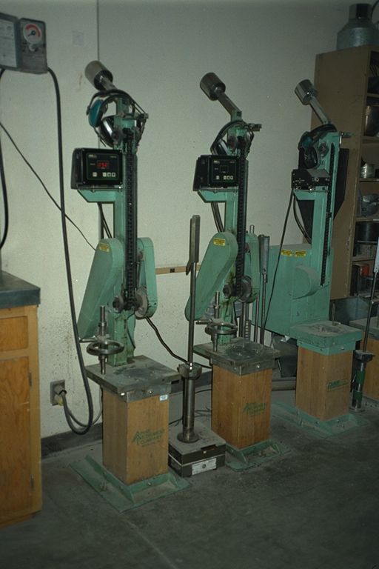
Automatic Marshall Hammer
Notes:
This picture is of automatic hammers. There are also hand held hammers. The key is that the base for the mold has to be solid.

Slide 33
Marshall Mix Design
Select and test aggregate
Select and test asphalt cement
  Establish mixing and compaction temperatures
Develop trial blends
  Heat and mix asphalt cement and aggregates
  Compact specimen (100 mm diameter)
Notes:
This slide outlines the major steps in the development of a Marshall mix design.

Slide 35
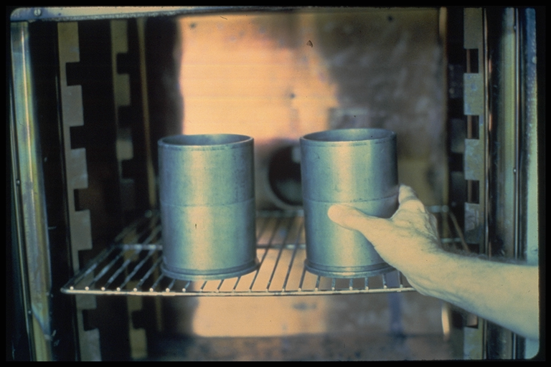

Slide 36
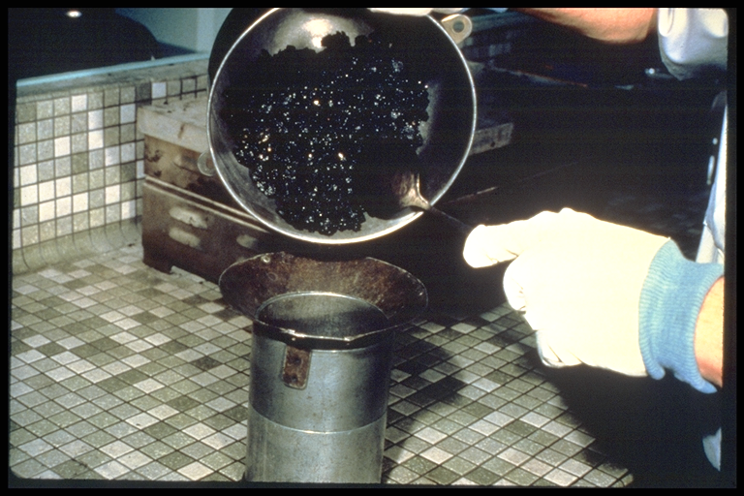

Slide 37
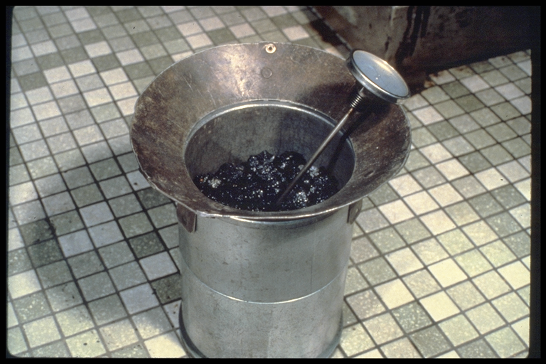

Slide 38
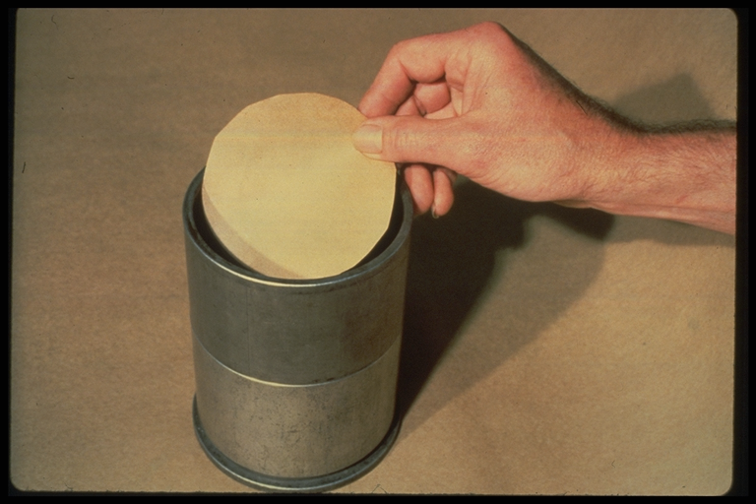

Slide 39
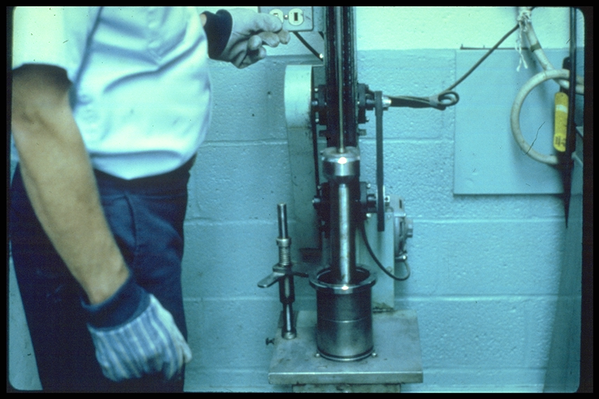

Slide 40
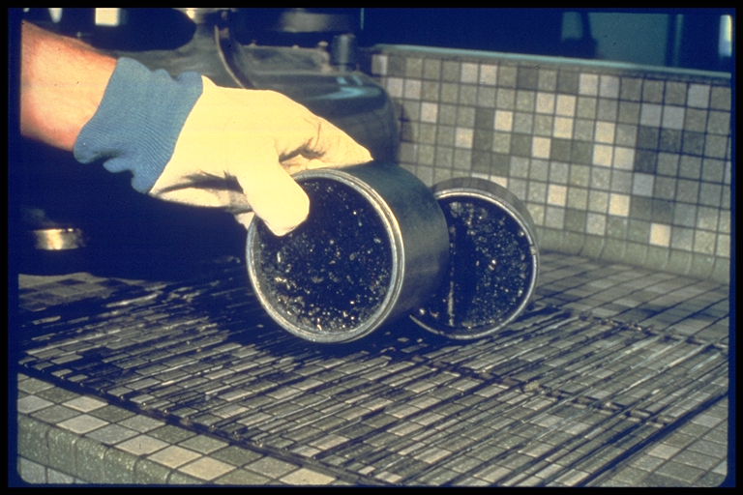

Slide 41
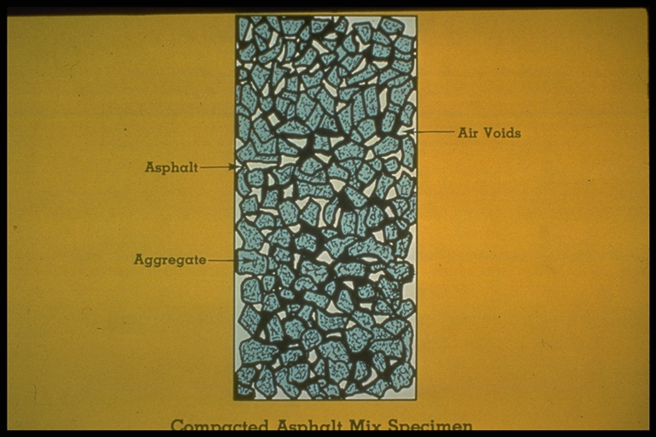

Slide 42
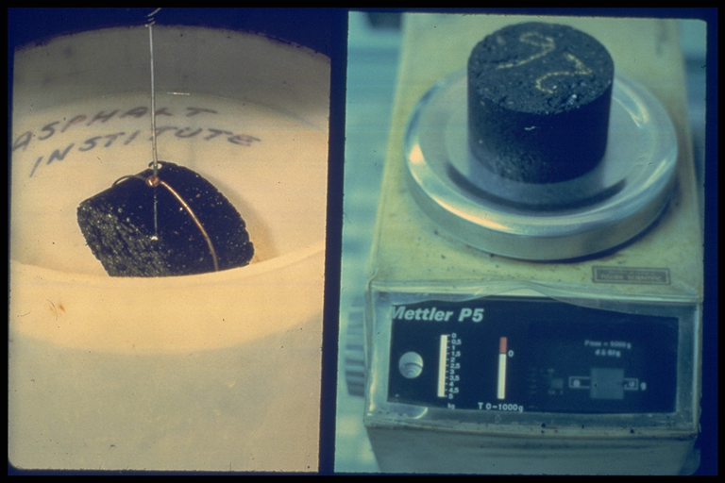

Slide 43
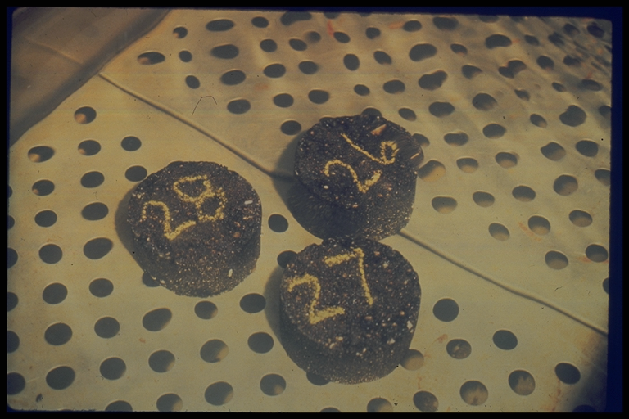

Slide 44
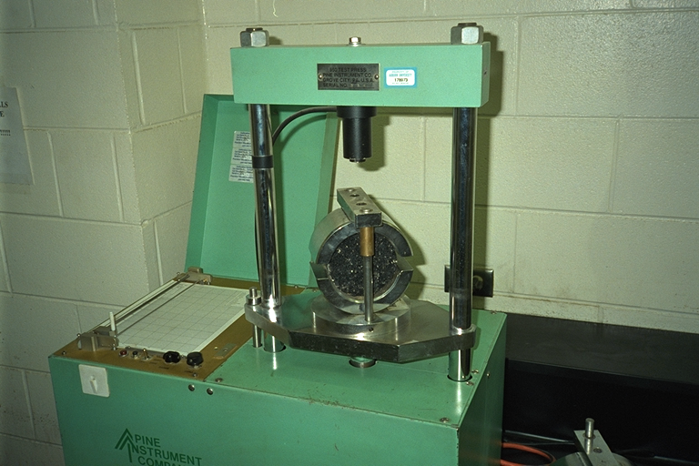
Marshall Stability and Flow
Notes:
This is a Rainhart stability device. It uses a chart recorder to document the load and the flow (deformation of the specimen).

Slide 45
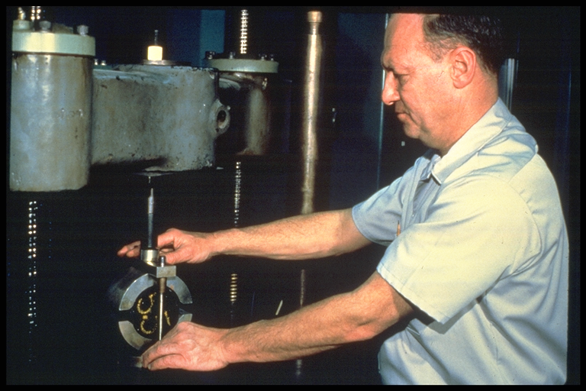

Slide 46
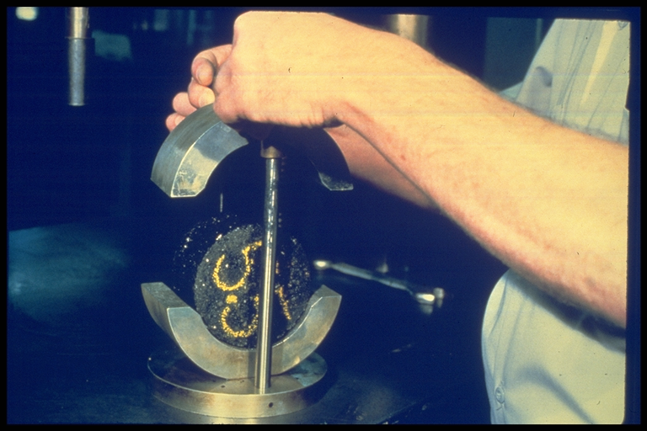

Slide 47
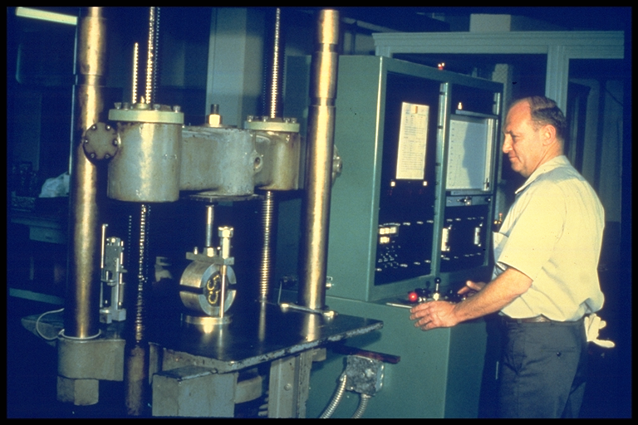

Slide 48
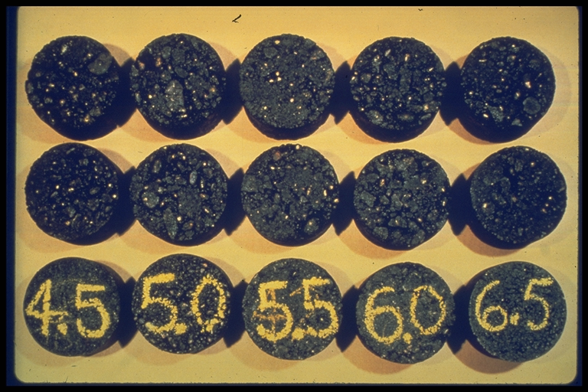

Slide 49
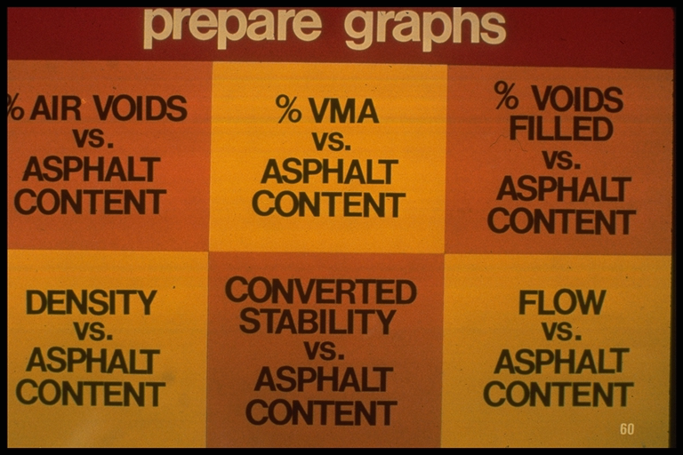

Slide 50
Mixing/Compaction Temps
Viscosity, Pa s
10
5
1
.5
.3
Compaction Range
.2
Mixing Range
.1
100
110
120
130
140
150
160
170
180
190
200
Temperature, C
Notes:
To establish mixing and compaction temperatures it is necessary to develop a temperature viscosity chart. This can be done by determining the viscosity at two different temperatures - generally 135 C and 165 C. These two viscosities are then plotted on the graph above and a straight line is drawn between the two points.
The desired viscosity range for mixing is between 0.15 and 0.19 Pa-s and 0.25 and 0.31 Pa-s for compaction. Appropriate mixing and compaction temperatures are selected as the temperature where these viscosity requirements are met. This information can be obtained from the suppliers. In many DOTs this information is developed during the mix design process.
If using modified binders - it is recommended that you should contact the supplier to determine the mixing and compaction temperatures.

Slide 51
Marshall Design Criteria
Light Traffic Medium Traffic Heavy Traffic
ESAL < 10⁴ 10 ⁴ < ESAL< 10 ESAL > 10⁶
Compaction 35 50 75
Stability N (lb.) 3336 (750) 5338 (1200) 8006 (1800)
Flow, 0.25 mm (0.1 in) 8 to 18 8 to 16 8 to 14
Air Voids, % 3 to 5 3 to 5 3 to 5
Voids in Mineral Agg.
(VMA) Varies with aggregate size
Notes:
The criteria on this slide is that recommended by The Asphalt Institute. Most DOTs have their own requirements and they may vary some from that noted here.

Slide 52
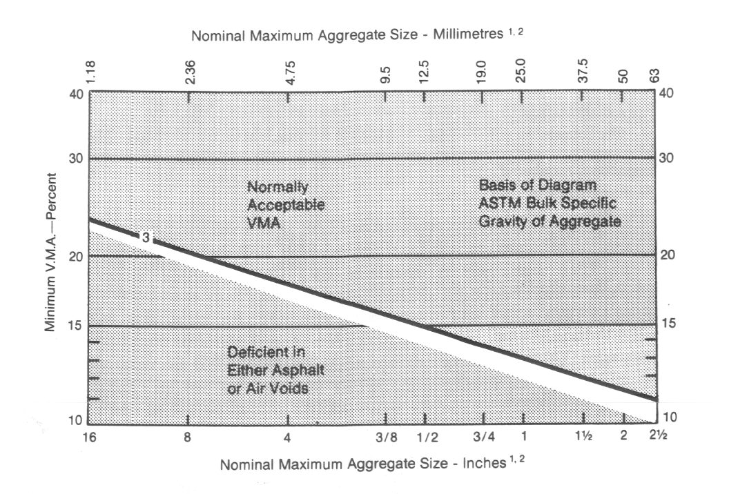
Minimum VMA Requirements
Notes:
As the aggregate size increases the VMA requirement will drop.

Slide 53
Marshall Mix Design Tests
Heights
  Used to correct stability measurements
Bulk specific gravity of compacted sample
Maximum specific gravity of loose mix
Stability and flow
  60ºC water bath (30 to 40 minutes)
  50 mm/min loading rate
  Max. load = uncorrected stability
  Corresponding vertical deformation = flow
Notes:
This slide shows the mixture tests required to complete a Marshall mix design.
In the stability calculations there is an assumption that the height is 2 1/2 inches. If the height is different there is a correction procedure for the Marshall Stability that must be followed.
The bulk specific gravity along with the maximum specific gravity is used in the volumetric calculations.
The Marshall procedure calls for a strength test - the Marshall stability and flow test.

Slide 54
Marshall Design Use of Data
Asphalt Institute Procedure
Air Voids, %
Stability
Unit Wt.
4%
Asphalt Content, %
Asphalt Content, %
Asphalt Content, %
Target optimum asphalt content = average
Notes:
There are a number of plots used to analyze Marshall data:
Air voids vs asphalt content: goes down as AC content increases
Stability vs asphalt content: goes up to a peak and then drops off
Unit Wt vs asphalt content: This is similar to a moisture density relationship for soils. The unit wt increases until the asphalt cement acts like an extender rather than a lubricant.

Slide 55
Marshall Design Use of Data
Asphalt Institute Procedure
Flow
VMA, %
Upper limit
OK
OK
Minimum
Lower Limit
Asphalt Content, %
Asphalt Content, %
Use target optimum asphalt content to check if these criteria are met
Notes:
The other two curves are:
Flow versus ac content: This will initially drop and then increase.
VMA versus ac content: This will initially drop and then rise. It is desirable to design mixes on the down side of this curve. They are easier to control.

Slide 56
Marshall Design Use of Data
NAPA Procedure
Air Voids, %
4%
Asphalt Content, %
Target optimum asphalt content =
the asphalt content at 4% air voids
Notes:
The design asphalt content is defined as the asphalt content that will produce 4% air voids.

Slide 57
Marshall Design Use of Data
NAPA Procedure
Stability
OK
Asphalt Content, %
The target stability is checked
Notes:
After the design asphalt content is picked, the other properties are checked.

Slide 58
Marshall Design Use of Data
NAPA Procedure
Flow
VMA, %
Upper limit
OK
OK
Minimum
Lower Limit
Asphalt Content, %
Asphalt Content, %
Use target optimum asphalt content to check if these criteria are met

Slide 59
Marshall Design Method
Advantages
  Attention on voids, strength, durability
  Inexpensive equipment
  Easy to use in process control/acceptance
Disadvantages
  Impact method of compaction
  Does not consider shear strength
  Load perpendicular to compaction axis
Notes:
One of the strengths of the Marshall method is its attention to density/voids analysis. This ensures that the important volumetric properties of the mix are at their optimum levels to achieve a durable HMA pavement. Another advantage is that it required equipment that was relatively inexpensive and very portable. This lead to its use for quality control operations. Unfortunately the impact method of compaction does not simulate densification that occurs under traffic in a real pavement. The strength parameter does not adequately measure the shear strength of the HMA.

Slide 60
Hveem mix design

Slide 61
Hveem Mix Design Method
Francis Hveem developed for California DOT in mid 1920’s
Limited use
  Primarily in West coast states
Addresses similar design considerations as Marshall
Considers asphalt absorption by aggregate
Notes:
As a resident engineer in California Francis Hveem began to work with “oil mixes” in the late 1920s. Hveem noticed in his work that there was a relationship between the gradation of the aggregate and the amount of oil needed to develop a consistent mix. He found a way of determining the surface area of the gradations and using that with a “kerosene equivalent test” to determine absorption of the asphalt he developed a design procedure. But, he noticed that the procedure did not insure rutting resistance. He decided that another test was needed to evaluate the ability of the mix to resist shear forces applied by wheel loads. This led to the development of the Hveem stabilometer.
The system has been used primarily in the Western states and is still used in California.

Slide 62
Hveem Mix Design Method
Selection and testing of aggregates
Selection and testing of binders
Centrifuge kerosene equivalent (CKE)
  Surface capacity of aggregate
  Estimate optimum asphalt content
Notes:
A thorough evaluation of the aggregates and binders is conducted. The procedure calls for determining an approximate asphalt content by the Centrifuge Kerosene Equivalent test and then subjecting specimens at that asphalt content, and a higher and lower asphalt contents to a stability test.

Slide 63
Hveem Mix Design Method
Use kneading compactor to prepare specimens
Determine stability with Hveem stabilometer
  Evaluates horizontal deformation under axial load
  Specimen loaded along axis of compaction
Visual observation, volumetrics, and stability used to select optimum asphalt content
Notes:
Samples are made using the California Kneading Compactor. The stability is then determined using the Hveem stabilometer.

Slide 64
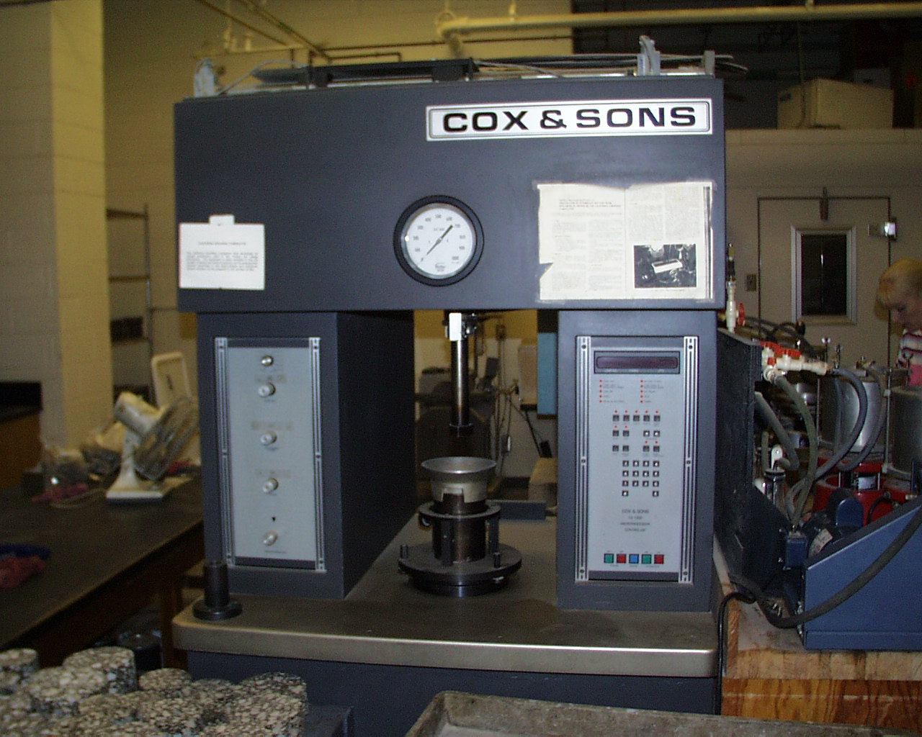
Hveem Kneading Compactor

Slide 65
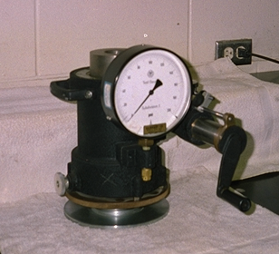
Hveem Stabilometer
Notes:
The procedure for the Hveem Stabilometer test is:
Heat the specimens to 60 C.
A test load is applied to the specimen at the rate of 1.3 mm per minute and gauge readings are made at 2.22, 4.45 increments up to 26.7 kN.
Turn the displacement pump handle clockwise rapidly until the pressure is 690 kPa. Read the Ames dial and record in 0.25 mm units.
The Stabilometer value is determined from that data.

Slide 66
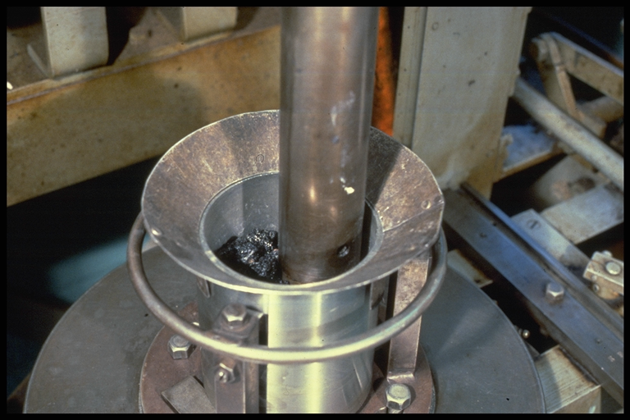

Slide 67
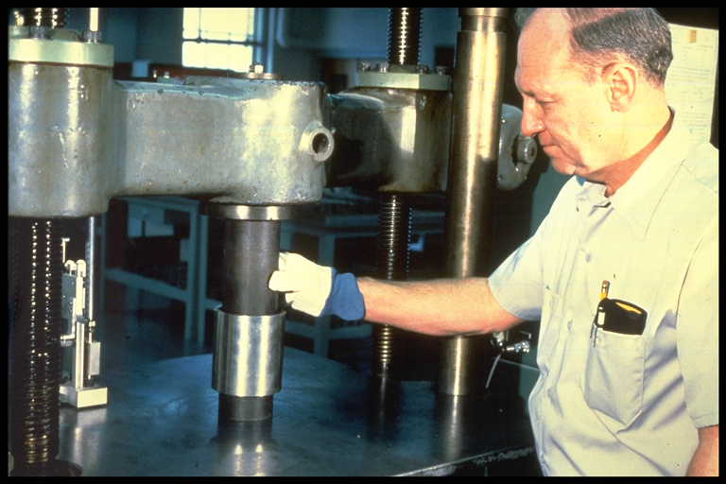

Slide 68
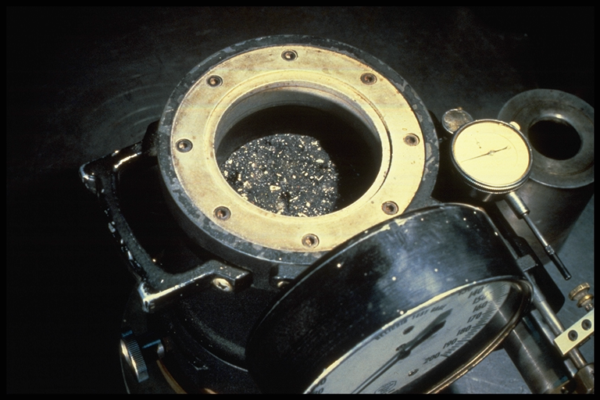

Slide 69
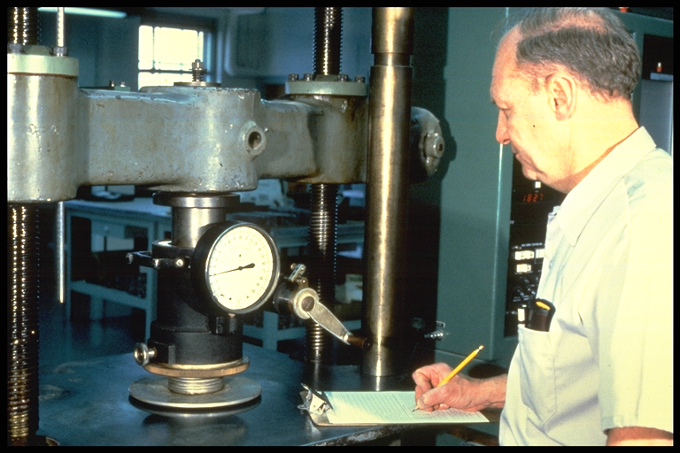

Slide 70
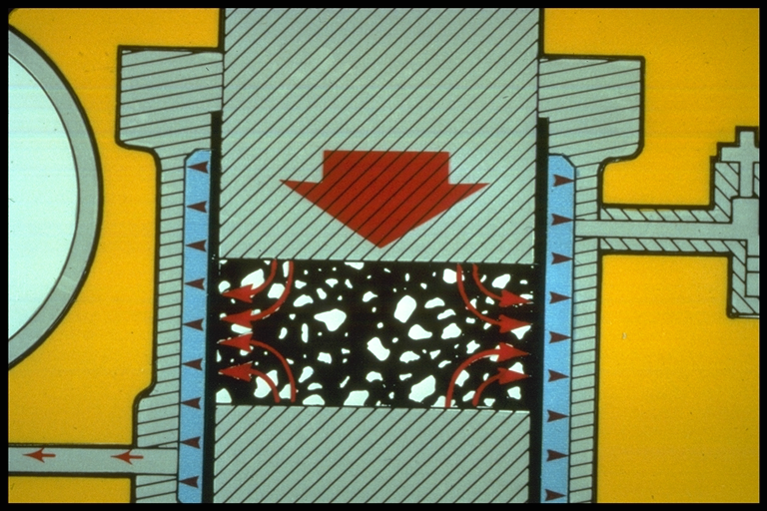

Slide 71
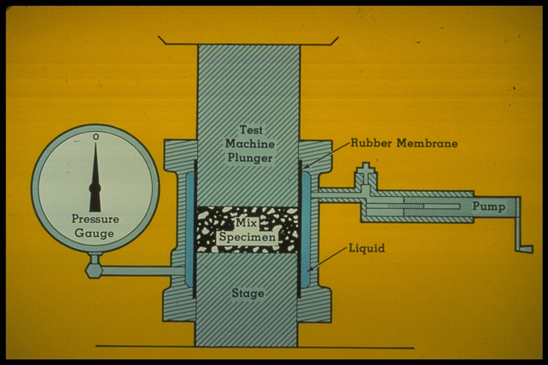

Slide 72
Hveem Mix Design Method
Stability
Air Voids, %
Minimum
Asphalt Content, %
Asphalt Content, %
VMA
Minimum
Asphalt Content, %
Heavy traffic = 37 stability min.
Medium = 35 min.
Light = 30 min.
Notes:
As the asphalt content increases the Hveem Stability decreases, the air voids decrease and the VMA decreases to a point and then increases. As the traffic level increases the stability requirement increases.

Slide 73
Hveem Mix Design Method
Step 4
Max. AC with 4% Voids
Step 3
Min. Stability
Step 2
Flushing
Step 1
Design Series
Notes:
The following steps are followed in determining the design asphalt content:
Step 1 - Record the four asphalt contents used for preparing the mix specimens. Record them in order of increasing amount from left to right.
Step 2 - Select from Step 1 the three highest asphalt contents that do not exhibit moderate or heavy flushing and record them in step 2.
Step 3 - Select from Step 2 the two specimens that provide the specified minimum stability and enter them in step 3.
Step 4 - Select from Step 3 the highest asphalt content that provides at least 4% air voids.

Slide 74
Hveem Mix Design
Advantages
  Attention to voids, strength, durability
  Kneading compaction similar to field
  Strength parameter direct indication of internal friction component of shear strength
Disadvantages
  Equipment expensive and not easily portable
  Not wide range in stability measurements
Notes:
The Hveem method has two real advantages. First, the kneading compactor of laboratory compaction is thought by most engineers to simulate the densification characteristics of HMA in the field. Second the Hveem stability is a direct measurement of the internal friction component of shear strength. It measures the ability of a test specimen to resist lateral displacement from application of a vertical load.
The disadvantage of the Hveem procedure is that the testing equipment is that the equipment is expensive - particularly the kneading compactor and stabiliometer. There is not a wide range in the stability results.

Slide 75
Hveem Mix Design
1984 Survey - 75% states used Marshall, 25% states used Hveem
Both Marshall and Hveem methods are empirical
No longer adequate for increased traffic loadings
Rational mix design method needed based on engineering principles

Slide 76
Superpave Mix Design Method
Result of strategic highway research program (SHRP)
5-year, $50 million research completed in 1992
Volumetric mix design using a gyratory compactor
Implementation by 2000 by most states
Notes:
Hence, there is a need for a mechanical test which can tell us whether the designed mix is resistant to rutting. It should be able to proof test the mixes and tell us whether a mix satisfies a definite criteria and passes or fails the torture test. This test should be a laboratory test method so that it can be used on designed mixes, and it should be a simple test method so that it can be used routinely by the folks who actually build our pavements.

