Slide 1
Course C.03.06.02
Distresses of pavements
Marek Pszczola
(presentation was prepared on the basis of lectures prof. S. Romanoschi, USA)

Slide 2
Road Transportation Systems Engineering Development in the Sub-Saharan Africa – Modern EU Master Programme & Capacity Building

Slide 4
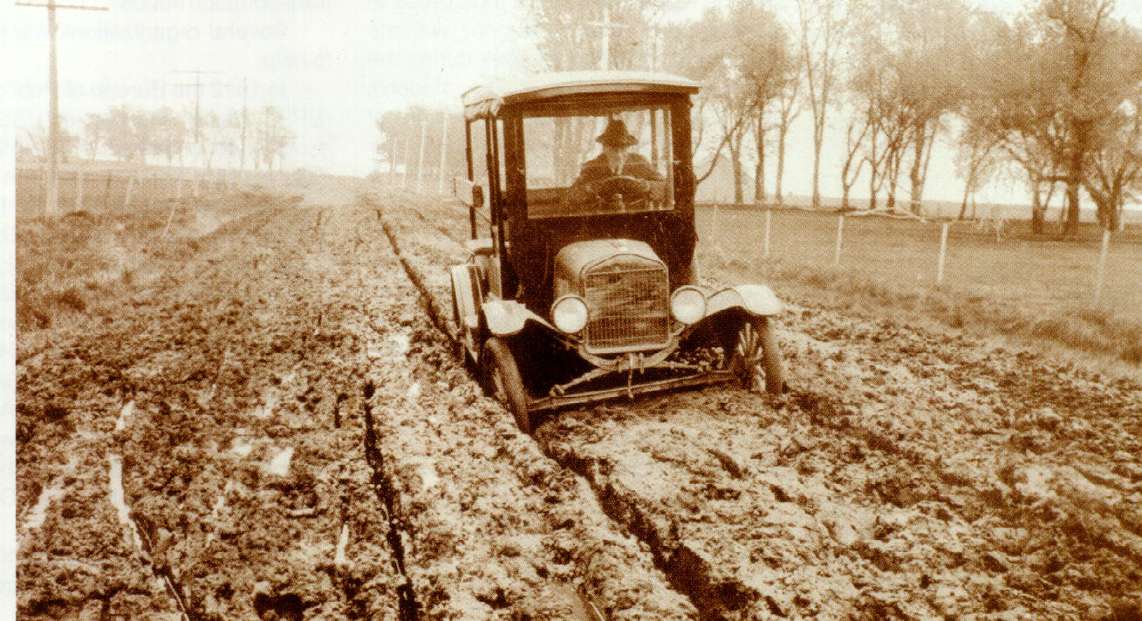

Slide 5
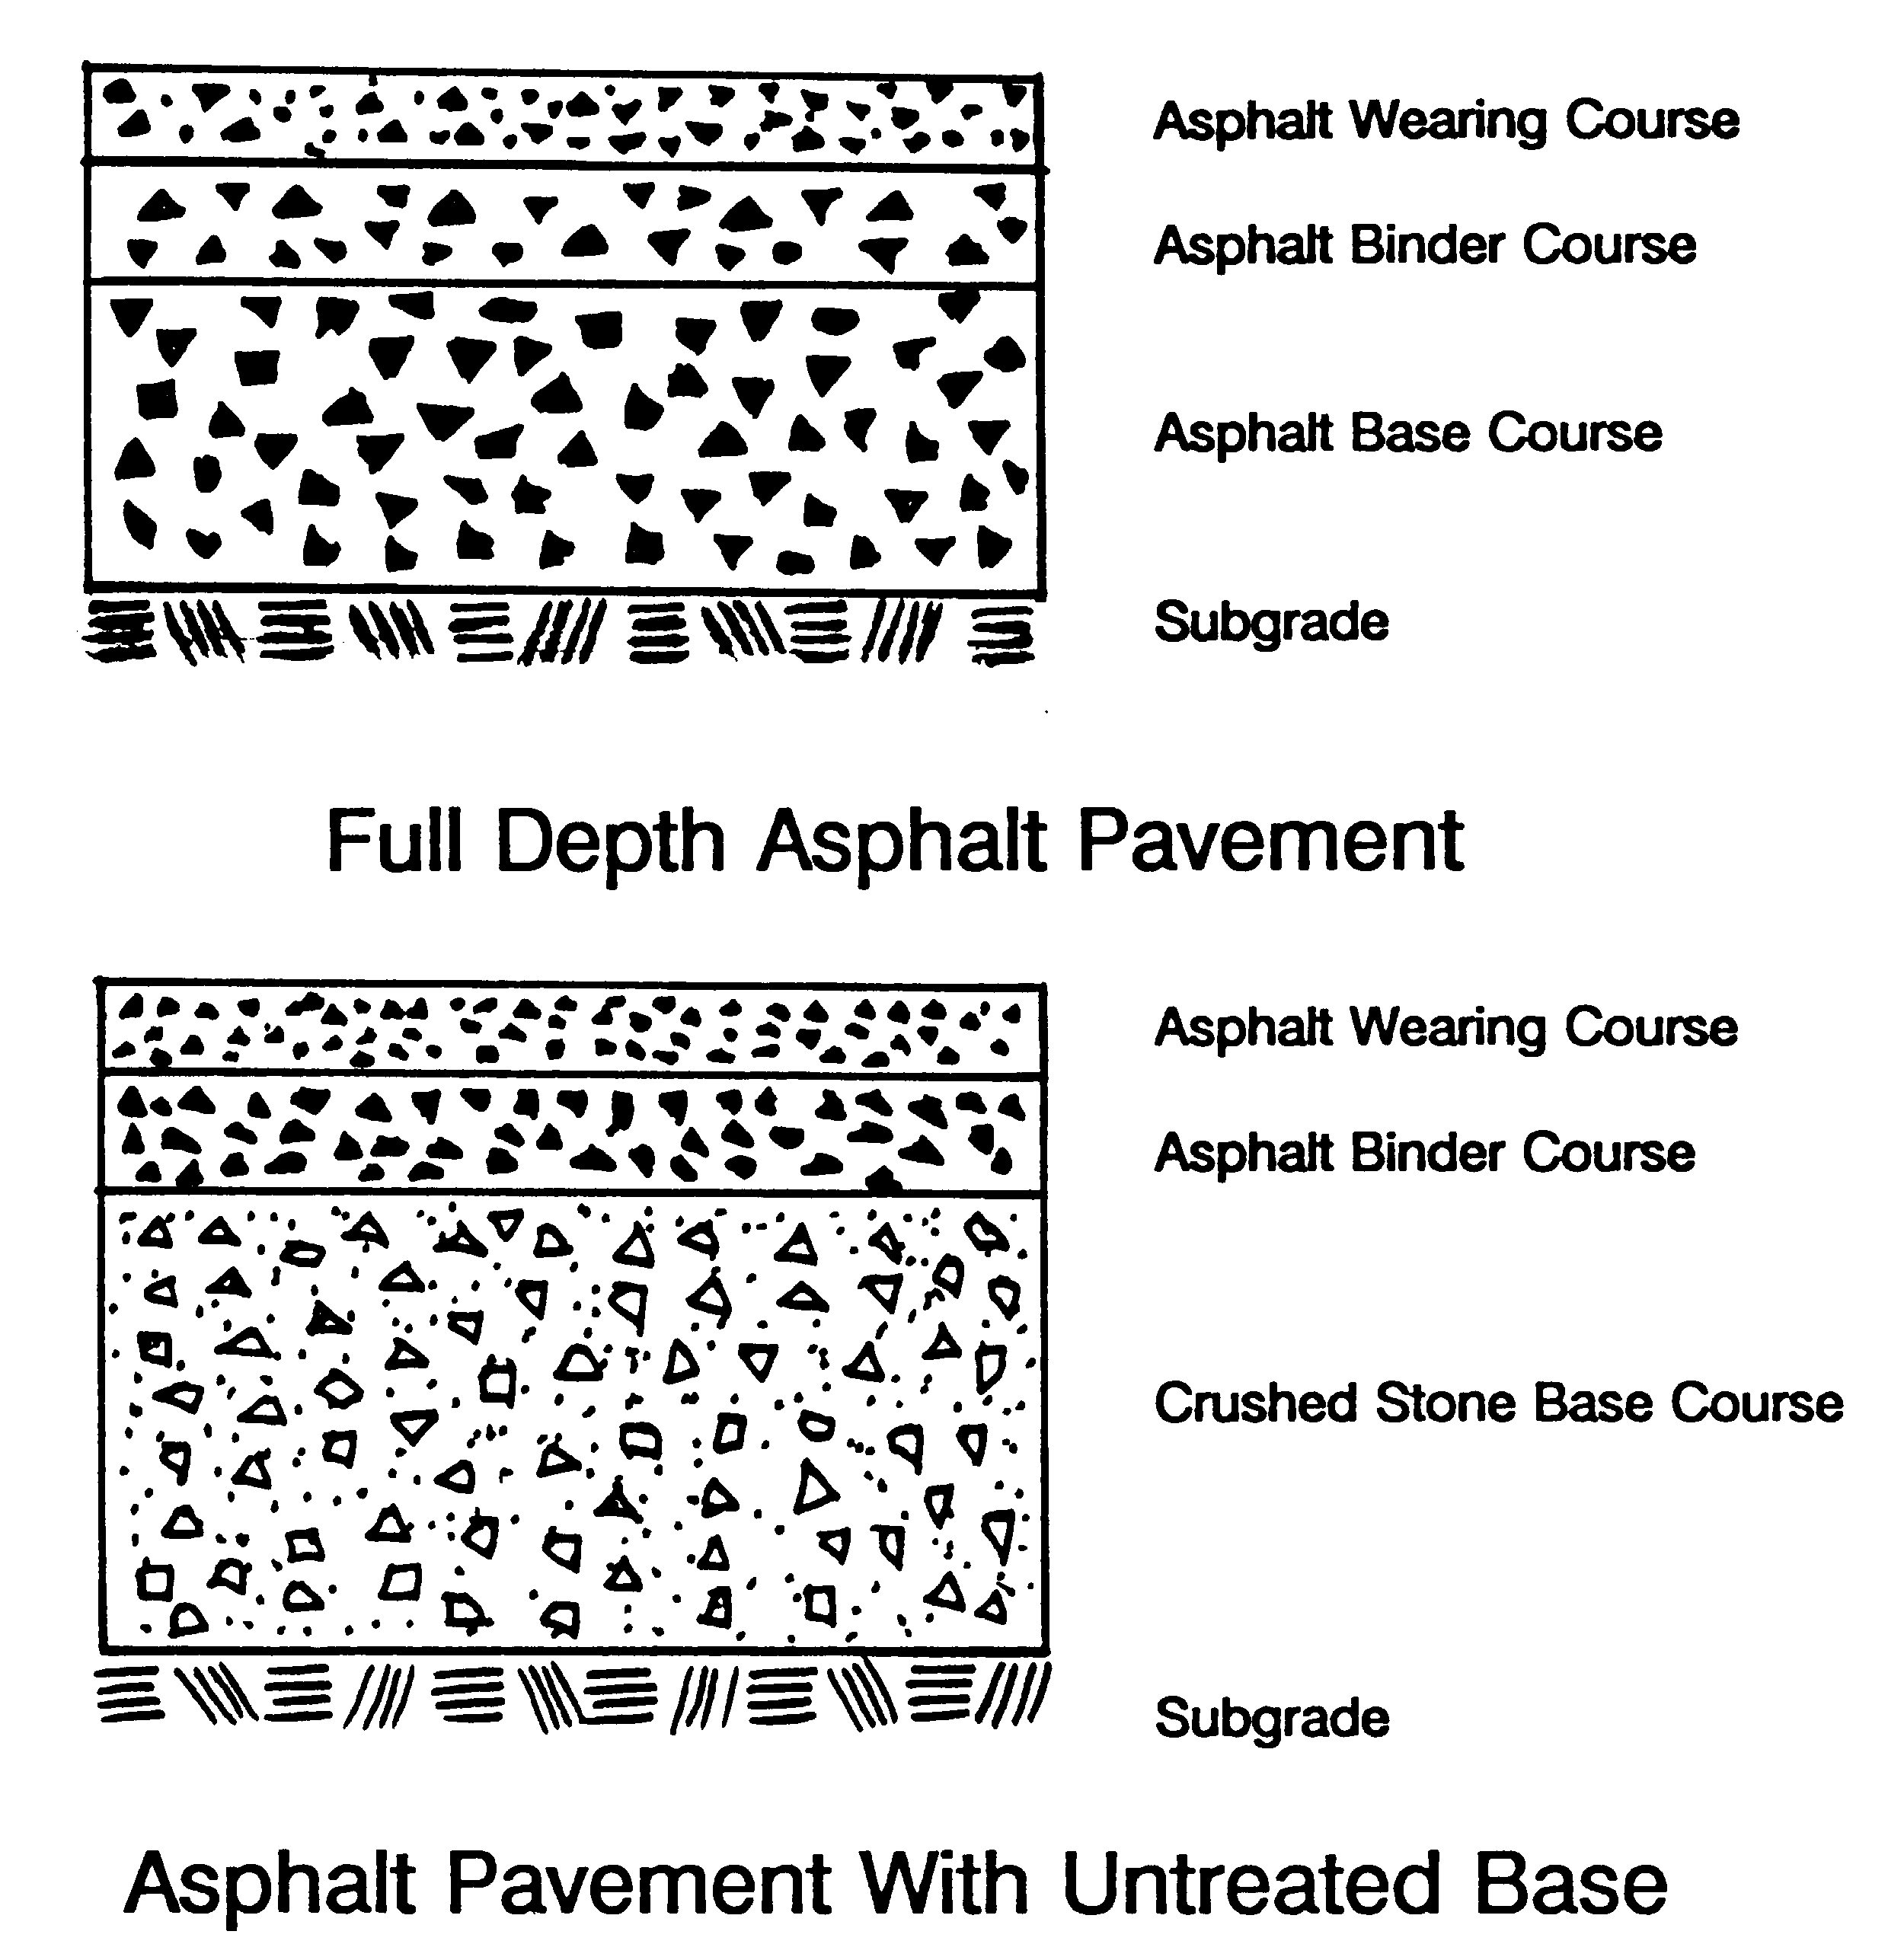

Slide 6
Basic Requirements for Flexible Pavements
Drainage, drainage, drainage
Sufficient thickness and internal strength to carry expected traffic loads
Adequately dense to prevent penetration of moisture from underneath, sides, and surface
Top surface which is smooth; waterproof; skid resistant; resistant to wear, distortion, and deterioration by weather and deicing chemicals

Slide 7
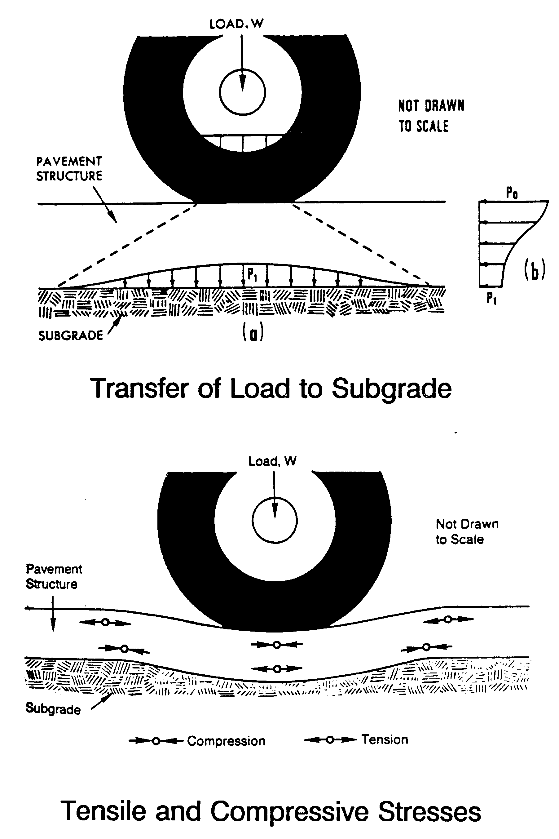

Slide 8
Typical Distresses in Asphalt Pavements
Distress Manifestation
Cracking
load associated (fatigue)
non-load associated
reflection
Spalling
Permanent Deformation
densification
creep (rutting/shoving/ corrugations)
swelling/frost
Slippage
Distress Mode
Fracture
Distortion

Slide 9
Typical Distresses in Asphalt Pavements (Cont.)
Distress Manifestation
Stripping
Raveling
Scaling
Potholes
Reduced skid resistance
Riding quality-roughness
Distress Mode
Disintegration
Other

Slide 10
Cracking of Asphalt Pavements: Causes

Slide 11
Load Associated (Fatigue) Cracking
Also called alligator or map cracking
Loads too heavy for the pavement structure
Too many repetitions of load
Inadequate support (pavement layers/subgrade)
Poor drainage
Very stiff binder in surface course
Occurs in wheel path, potholes develop in advanced stage

Slide 12
Non-Load Associated (Thermal) Cracking
Transverse cracks occur at regular intervals
Asphalt too stiff at low service temperatures
Rapid chilling of the road surface
Highly temperature susceptible asphalt
Subgrade type (more on sandy)
Age of the pavement

Slide 13
Longitudinal Cracking
Occurs parallel to the center line of roadway
Center Line Joint
Joint between adjacent lanes
Density gradient across the joint
Low density - low tensile strength
Edge Cracking
Lack of lateral (shoulder) support
Settlement of widened pavement
Poor drainage (ditches)

Slide 14
Block Cracking
Both transverse and longitudinal cracking
Most often on low volume roads/parking lots
Thixotropic hardening (structuring) of asphalt binder

Slide 15
Reflection Cracking
Discontinuities in the underlying layers propagate through the HMA surface due to movement of cracks
Discontinuities
Cracks or joints in underlying PCC pavement
Cracks in soil-cement base course
All types of cracks in the existing HMA pavement
Causes
Thermal (movement of joints/cracks)
Load

Slide 16
Slippage Cracking
Associated with slippage mechanism
Poor bond between the surface and underlying layer
Too much or too little tack coat
Steep grades/intersections
Acceleration/braking exert surface traction forces
U-shaped

Slide 17
Rutting
Corrugations
Lack of adequate subgrade support
Unstable HMA course(s)
  Poor mix design
  Rounded aggregate
  Excessive binder
Stripping
  Lack of bond between HMA courses
  Unstable surface course mix
  Braking and accelerating action near intersections

Slide 18
Stripping
Breaking of adhesive bond between the aggregate surface and asphalt binder usually in presence of moisture
Inadequate pavement drainage system
Mixes with excessive air voids (poor compaction), and low asphalt content
Incompatible aggregate surface and asphalt binder, asphalt binder displaced by water
Excessive pore pressure induced by traffic
Spontaneous emulsification of binder by water

Slide 19
Raveling
Progressive disintegration of HMA surface as a result of dislodgment of aggregate particles in the mix
Lack of sufficient cohesion due to low in-place density
Lack of fines in the matrix, especially in coarse, segregated areas
Aging of asphalt binder

Slide 20
Skid Resistance
Friction between the tire and road surface. Quantified by Friction Number (FN). Critical when surface is wet.
Causes for Low FNs
Flushing/bleeding of HMA surface
Inadequate microtexture
- aggregate prone to polishing
Inadequate macrotexture
- no drainage channels
- causes hydroplaning
- important at high speeds

Slide 21
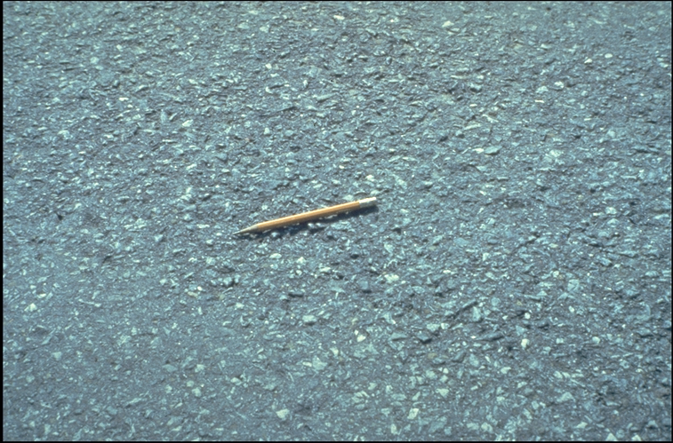

Slide 22
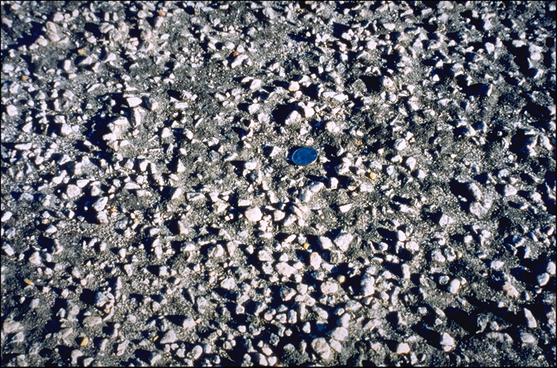

Slide 23
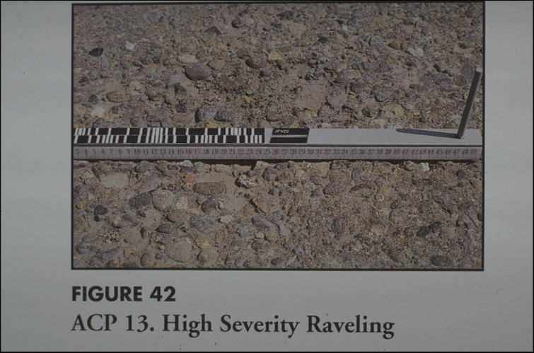

Slide 24
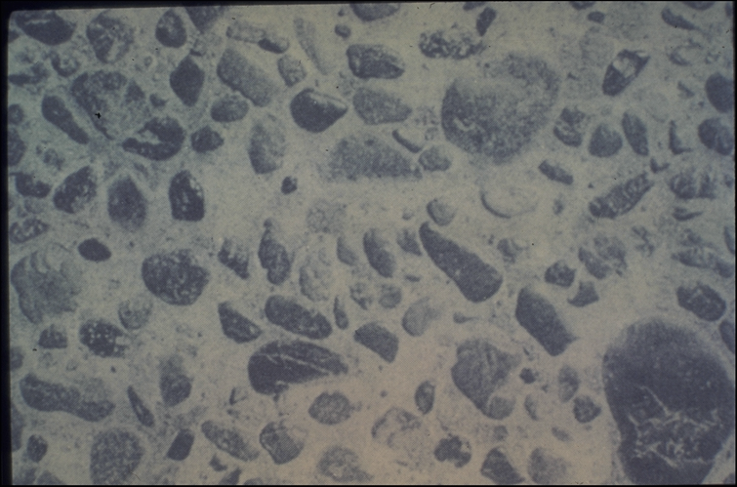

Slide 25
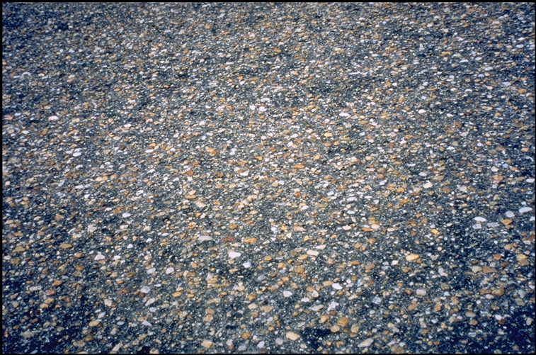

Slide 26
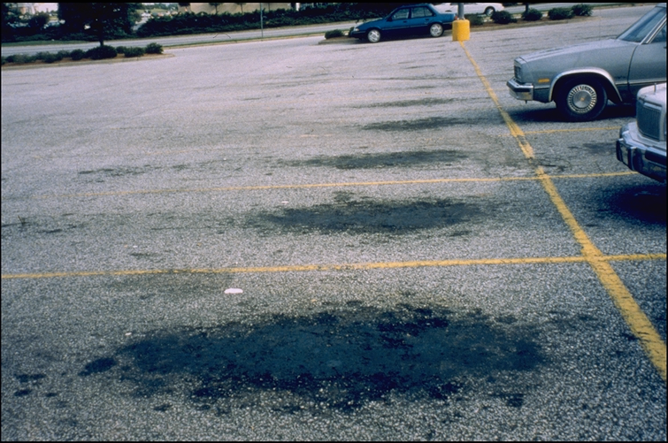

Slide 27
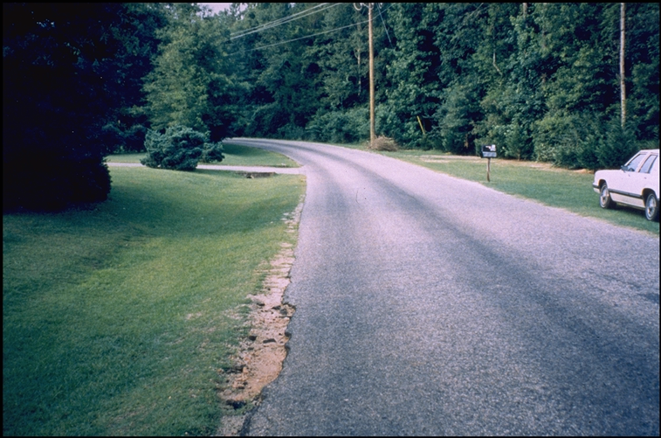

Slide 28
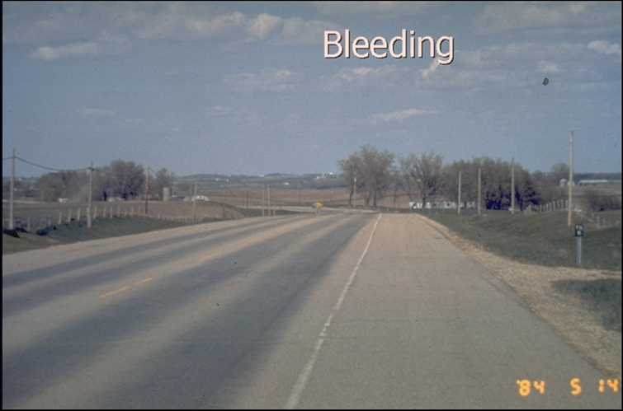

Slide 29
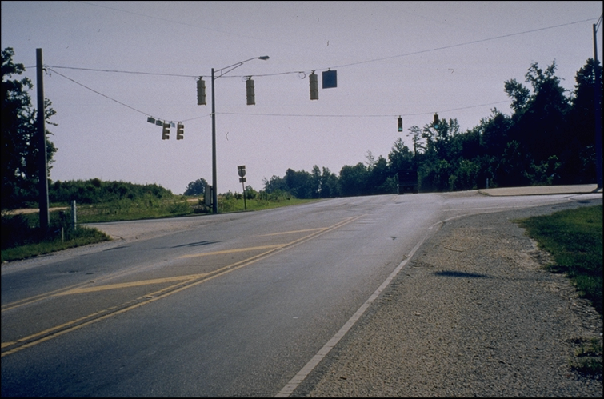

Slide 30
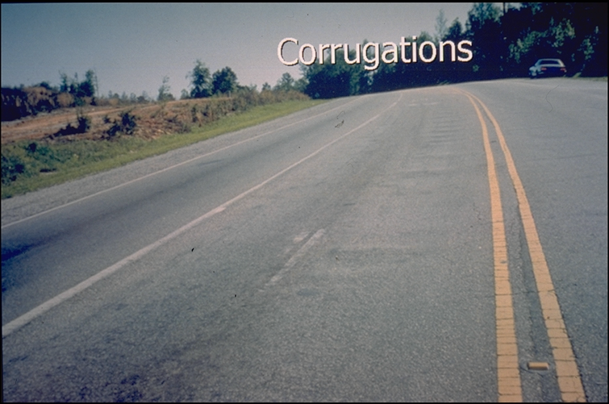

Slide 31
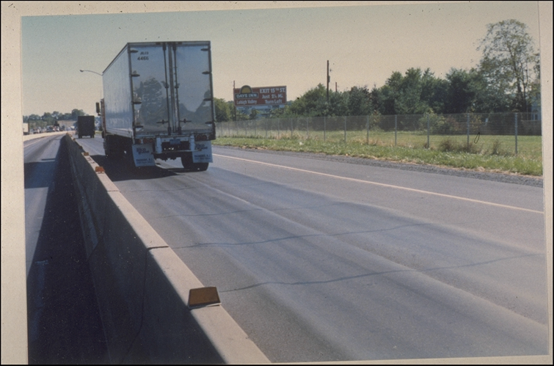

Slide 32
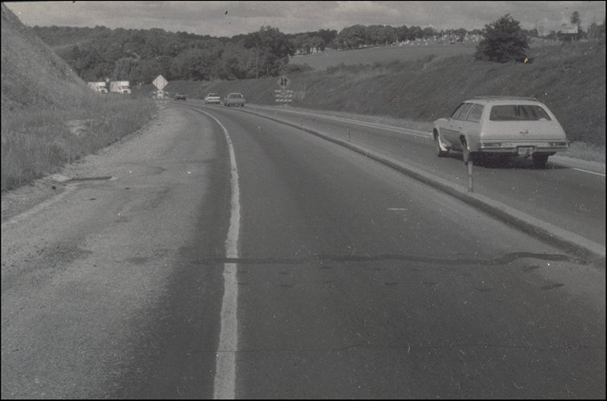

Slide 33
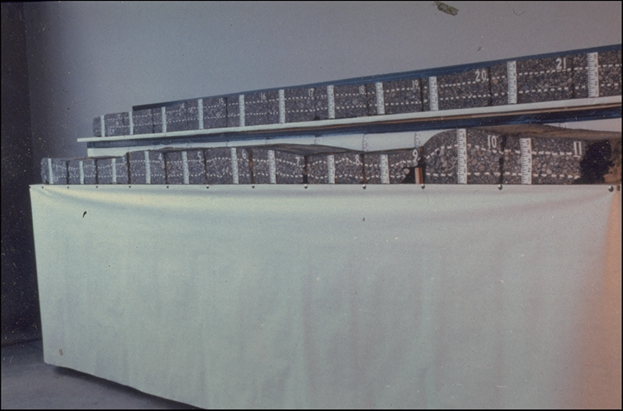

Slide 34
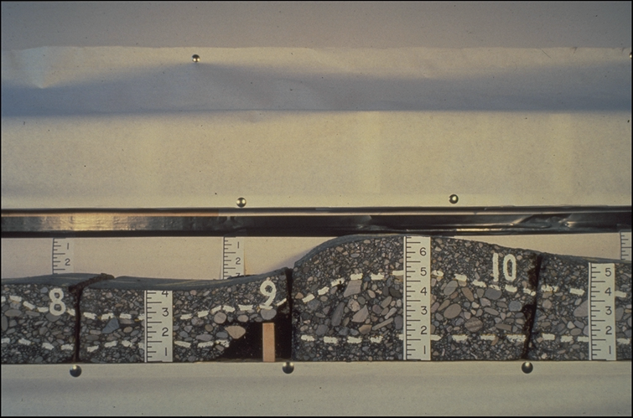

Slide 35
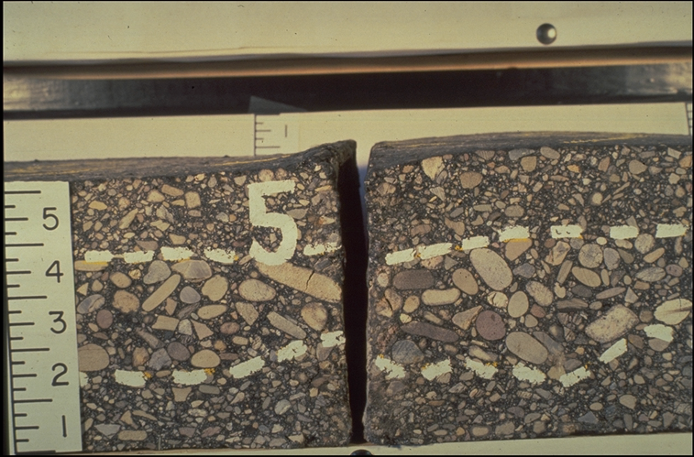

Slide 36
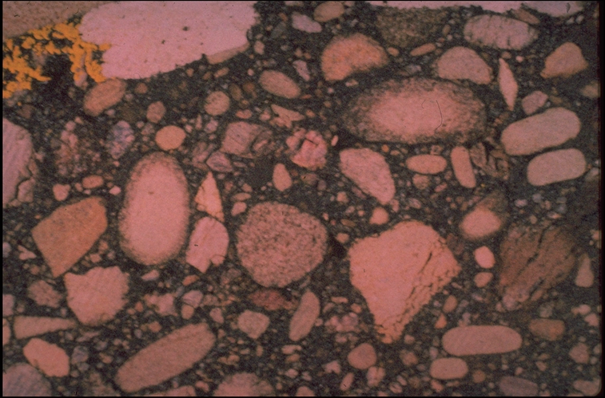

Slide 37
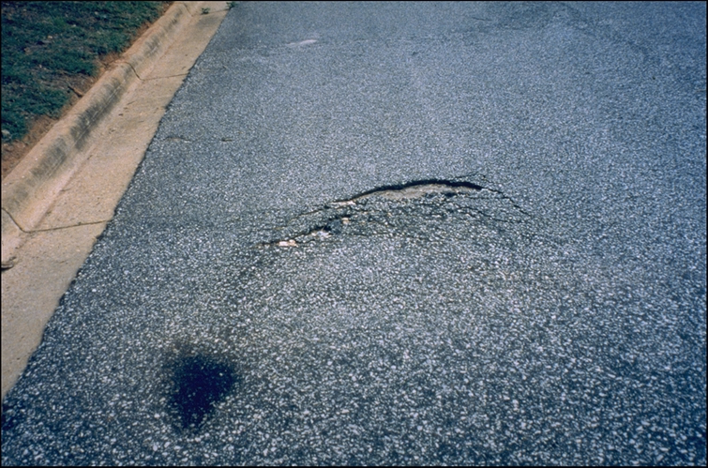

Slide 38
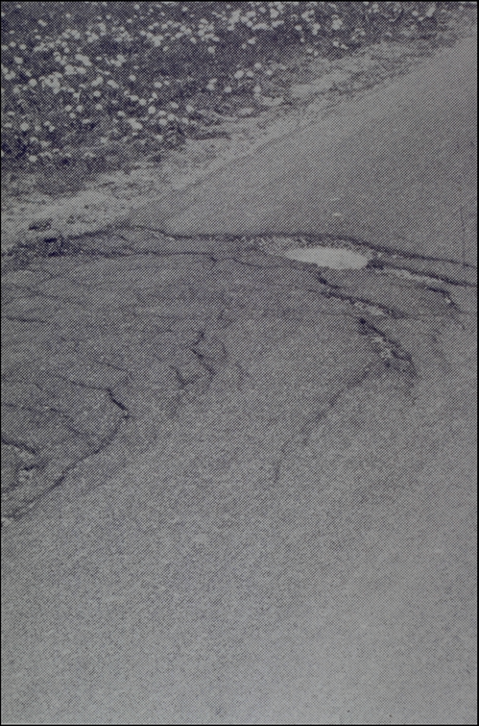

Slide 39
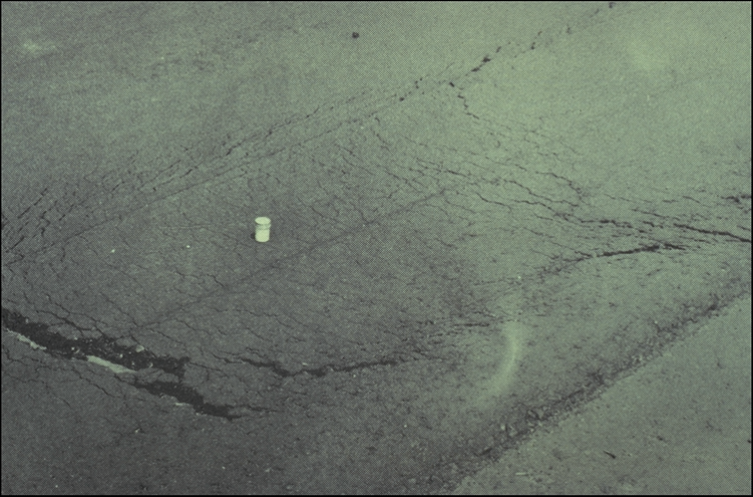

Slide 40
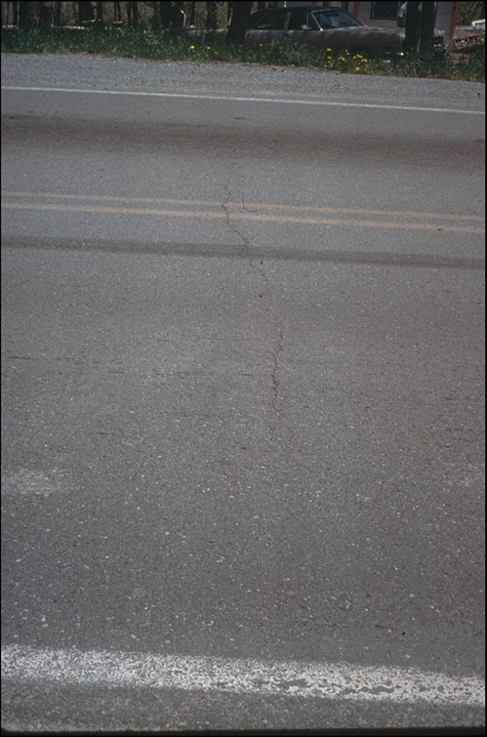

Slide 42
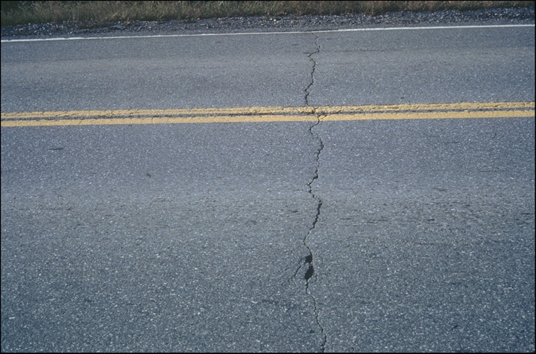

Slide 44
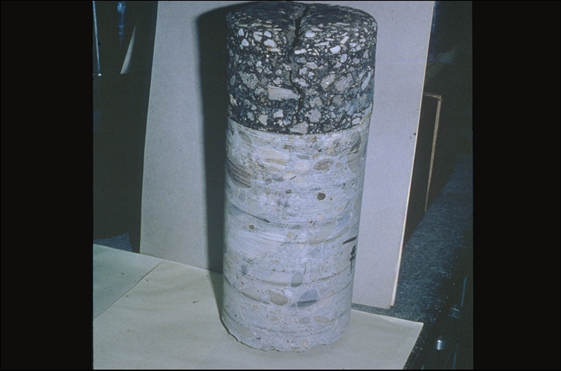

Slide 45
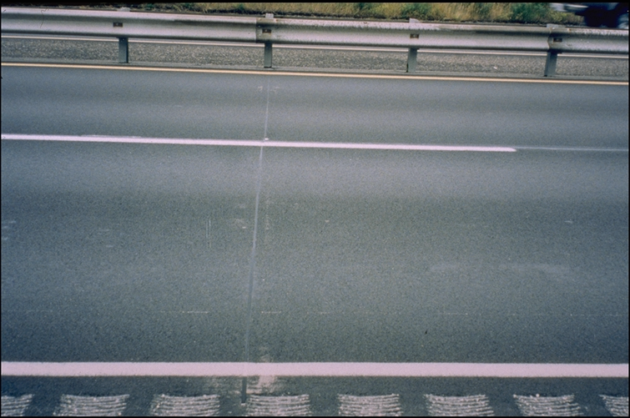

Slide 46
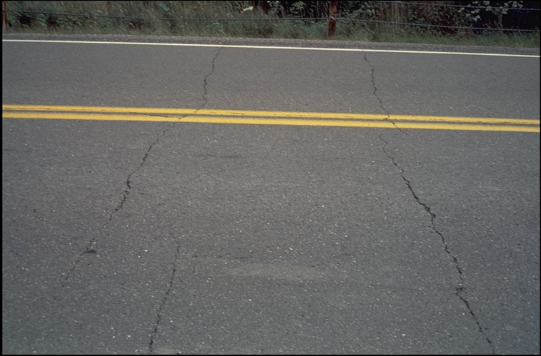

Slide 47
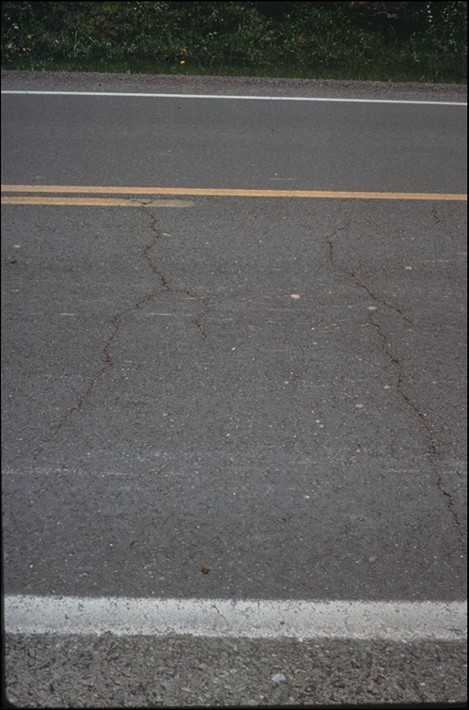

Slide 48
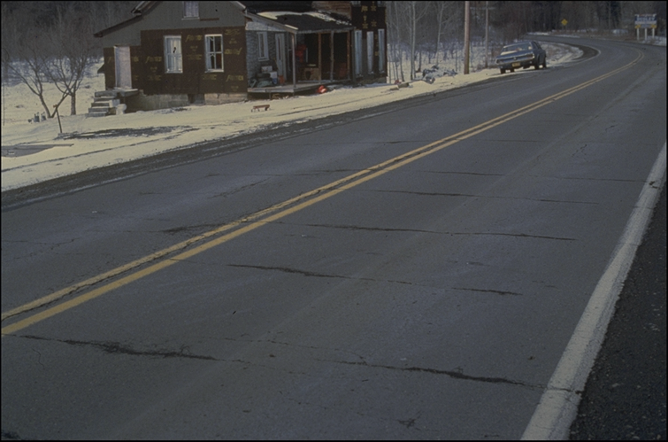

Slide 49
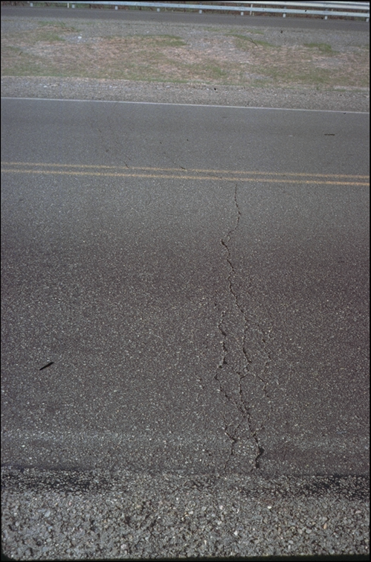

Slide 50
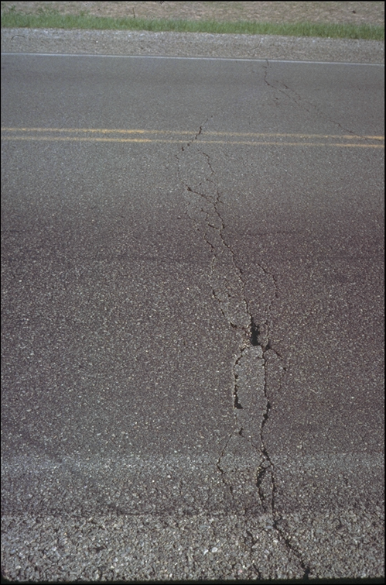

Slide 51
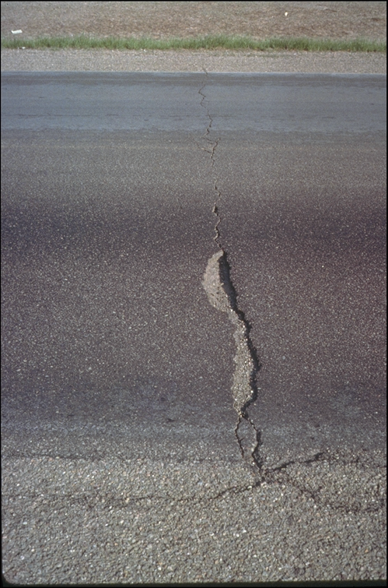

Slide 52
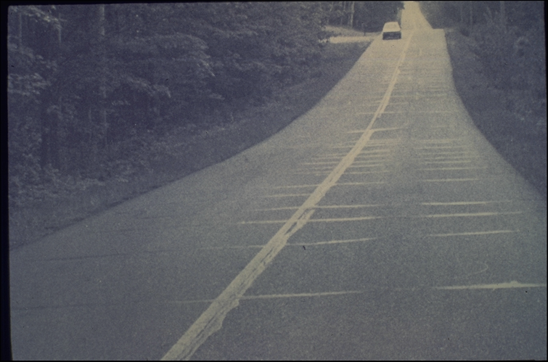

Slide 53
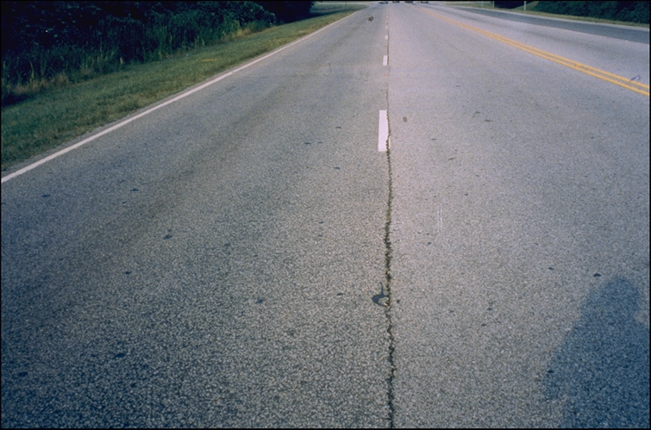

Slide 54
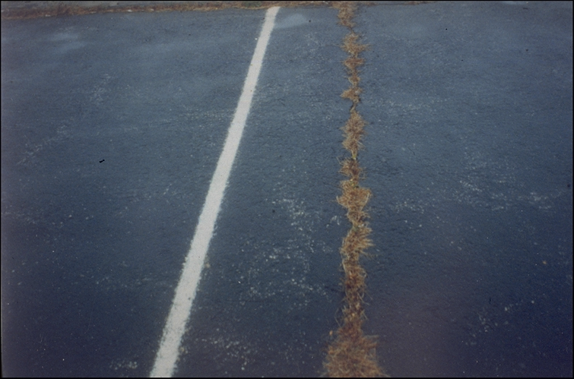

Slide 55
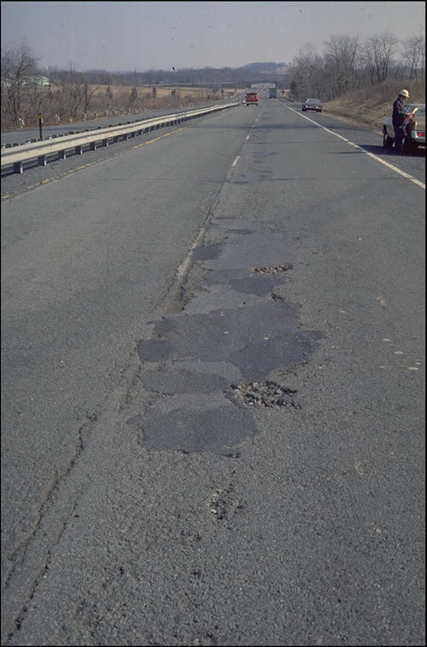

Slide 56
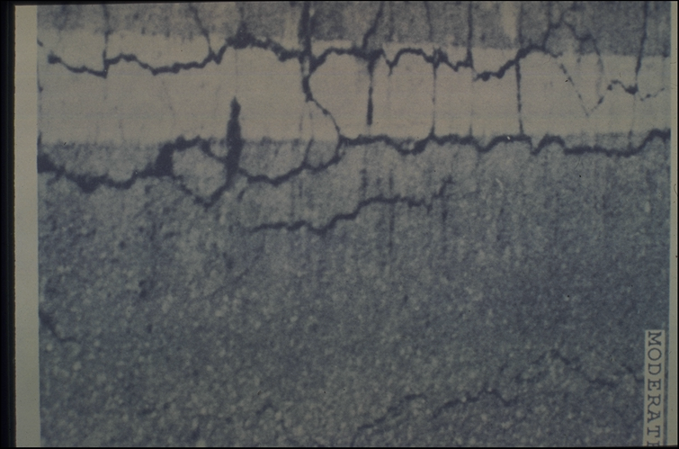

Slide 57
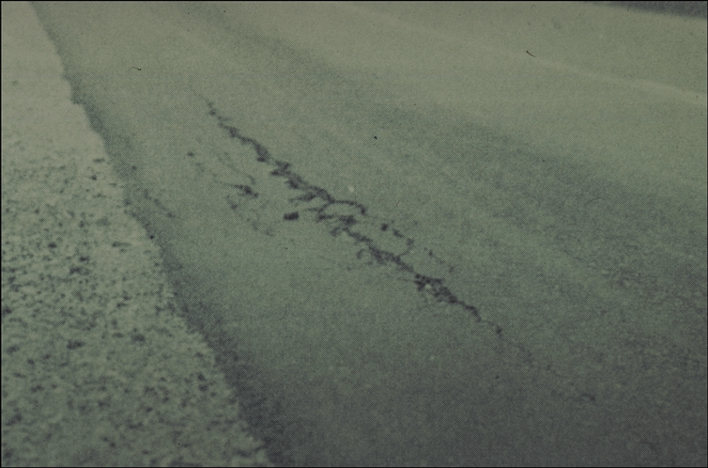

Slide 58
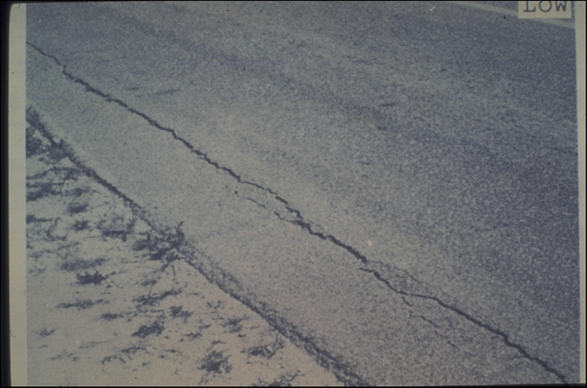

Slide 59
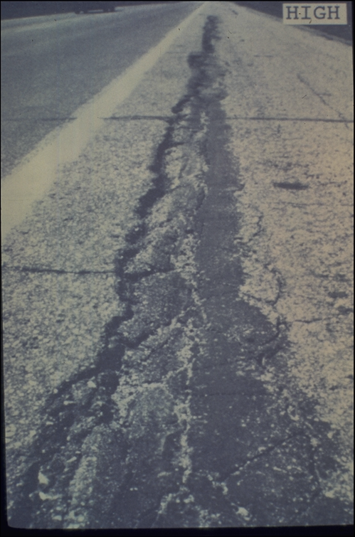

Slide 60
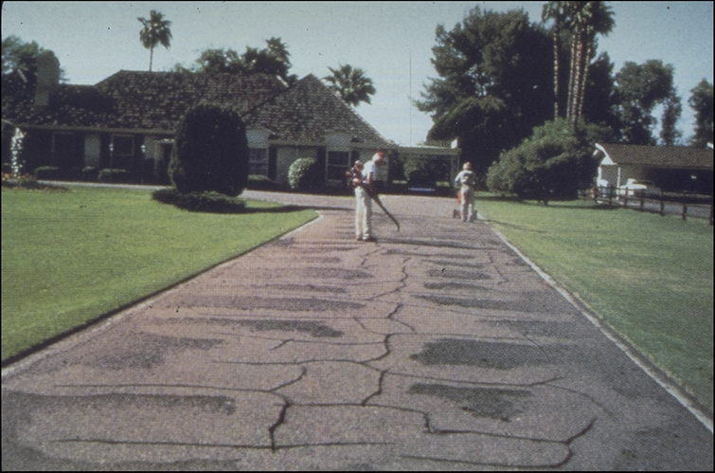

Slide 61
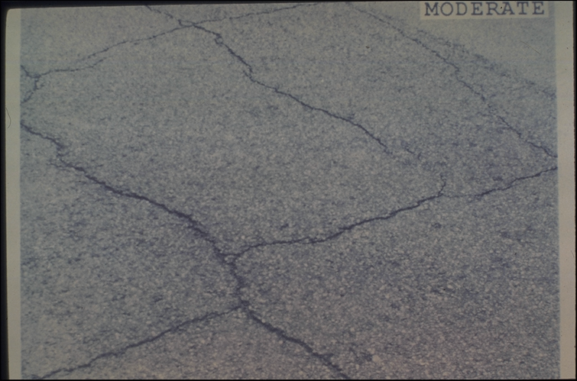

Slide 62
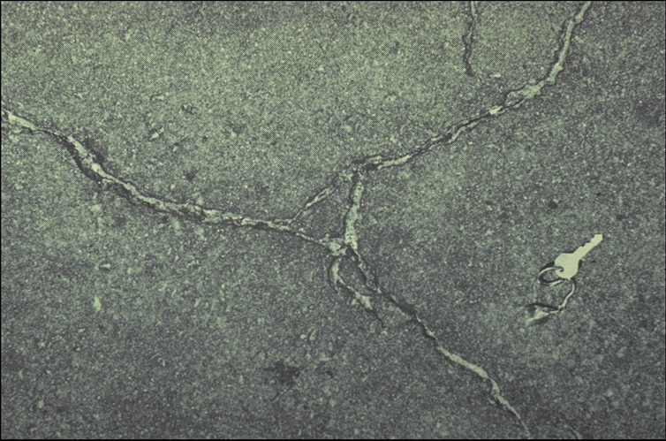

Slide 63
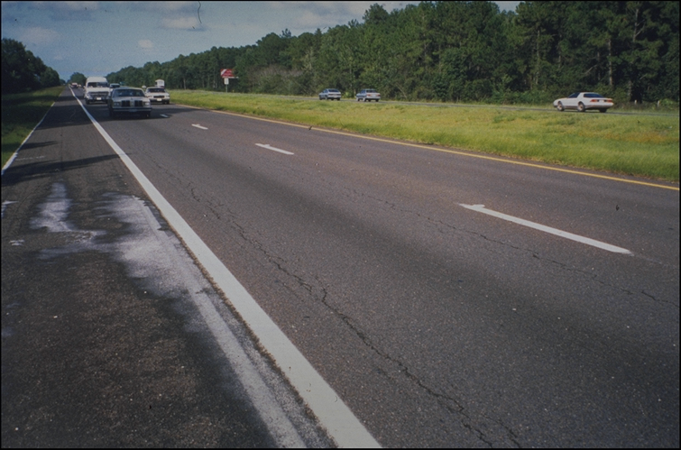

Slide 64
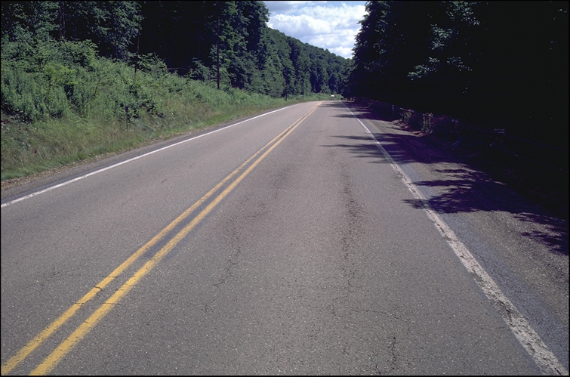

Slide 65
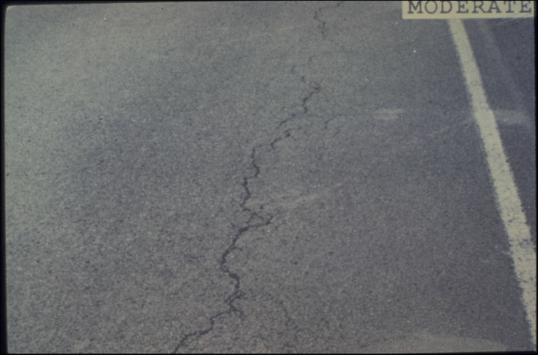

Slide 66
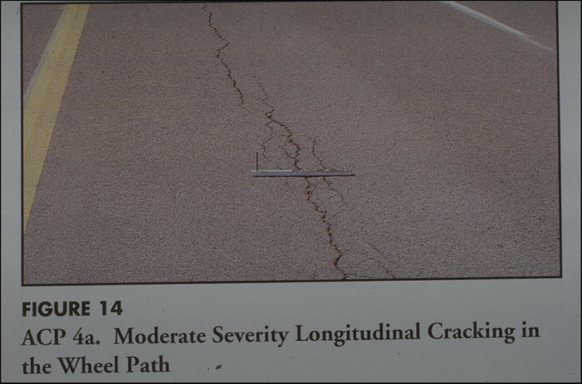

Slide 67
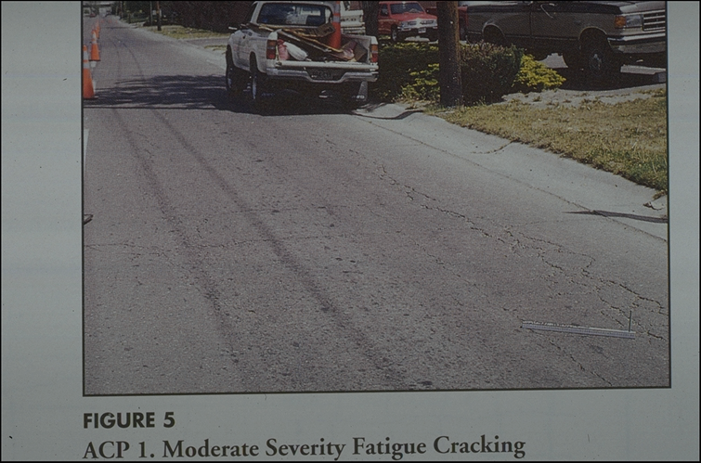

Slide 68
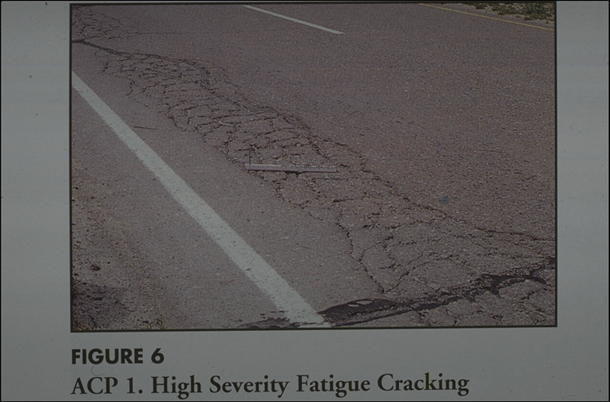

Slide 69
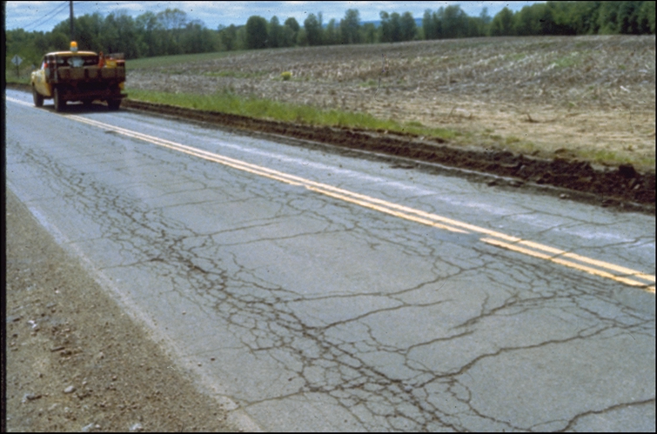

Slide 70


Slide 71


Slide 72


Slide 73


Slide 74


Slide 75


