Slide 1
Sustainability and Ethical Supply Chains
Daniel Kaszubowski

Slide 2
Road Transportation Systems Engineering Development in the Sub-Saharan Africa – Modern EU Master Programme & Capacity Building

Slide 4
Learning Objectives
Define sustainable supply chain and understand the triple bottom line concept
Calculate and reduce carbon footprint and understand green logistics
Apply circular economy principles to reduce waste and increase reuse/recycling
Implement social responsibility practices in supply chains
Apply ethical sourcing and fair trade principles in procurement
Manage conflict minerals (especially relevant to Congo) and ensure responsible sourcing

Slide 5
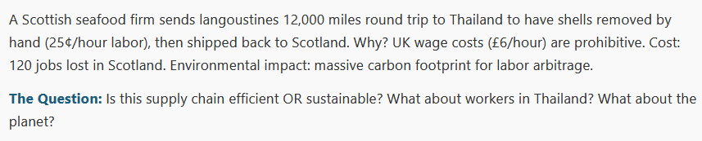
Focus: The Hidden Cost of Global Supply Chains

Slide 6
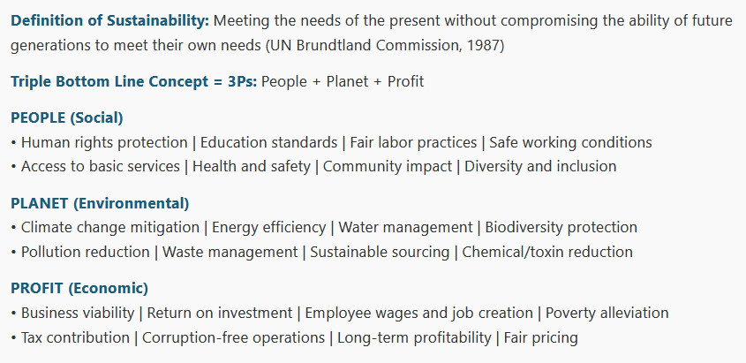
1. Sustainable Supply Chain – The Triple Bottom Line

Slide 7
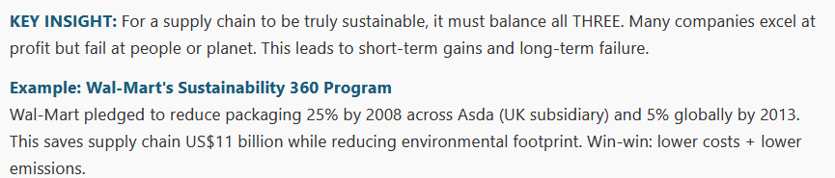
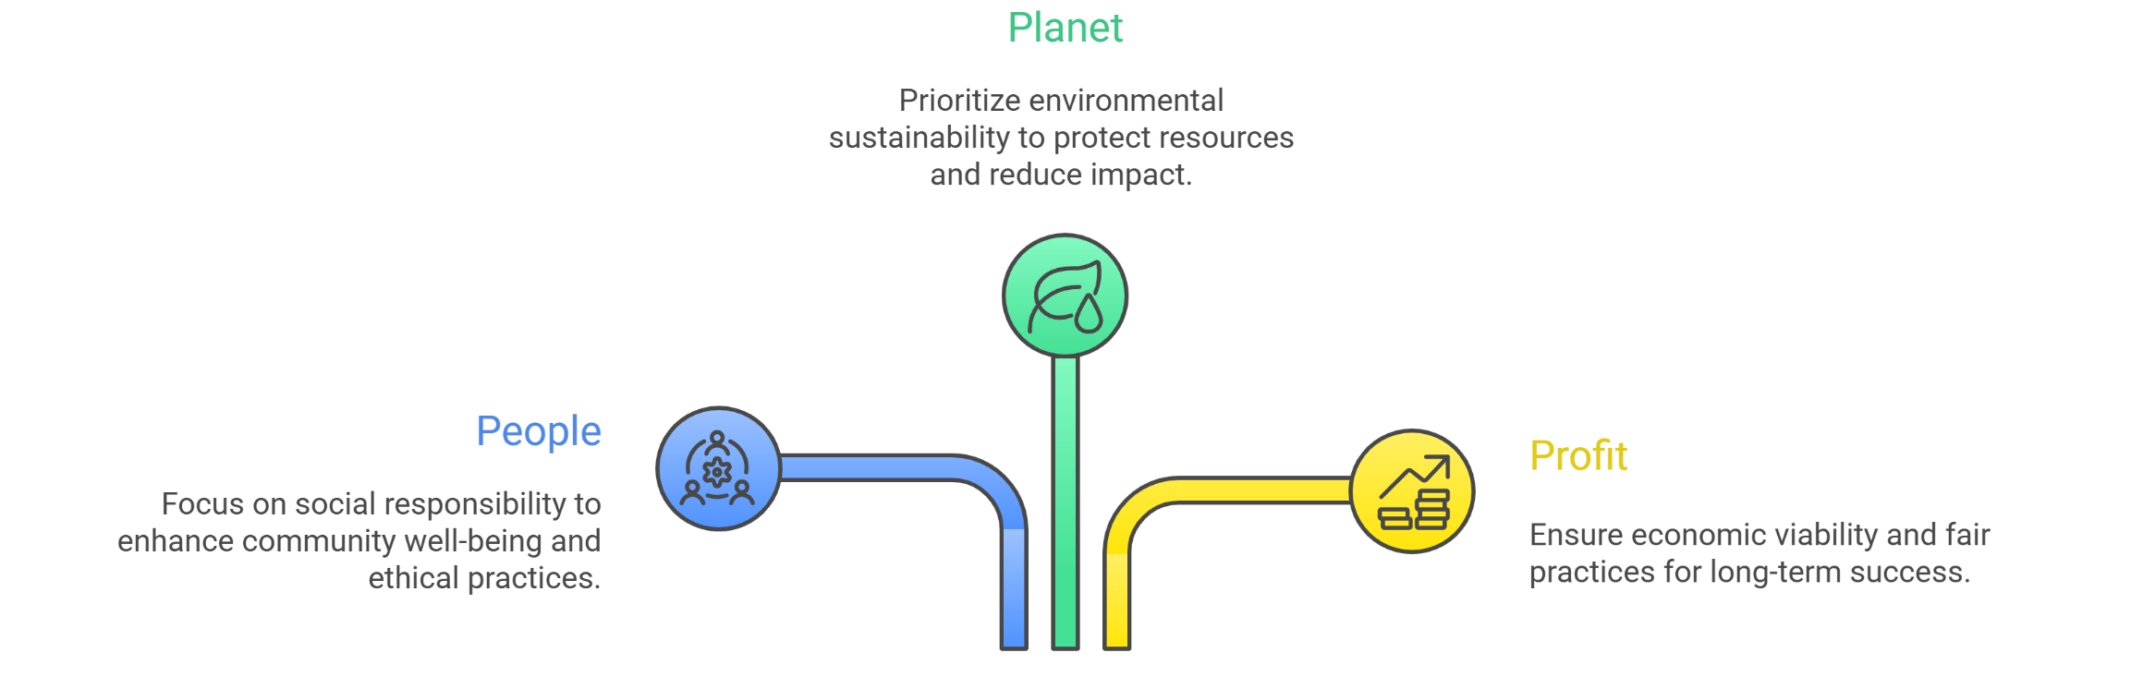
1. Sustainable Supply Chain – The Triple Bottom Line

Slide 8
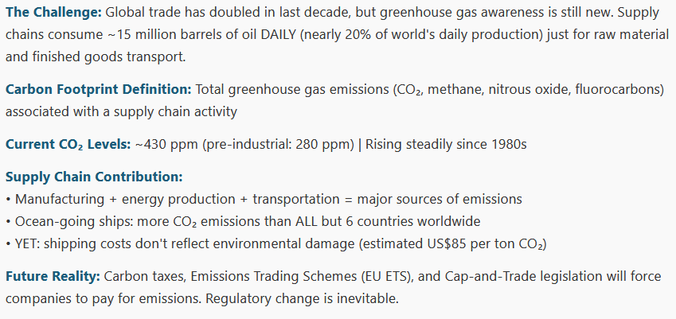
2. Environmental Considerations – Greenhouse Gases and Carbon Footprint

Slide 9
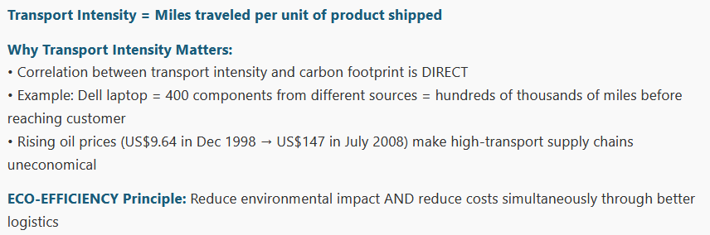
3. Reducing Transport Intensity and Green Logistics

Slide 10
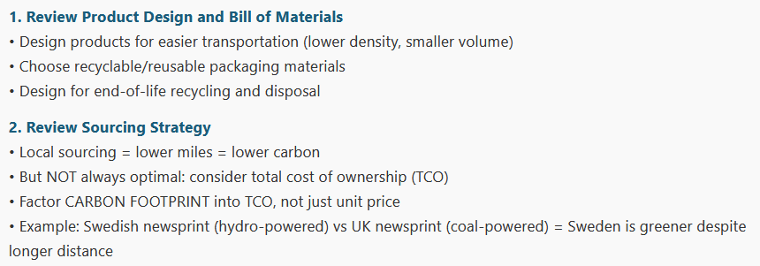
Practical Steps to Reduce Transport Intensity

Slide 11
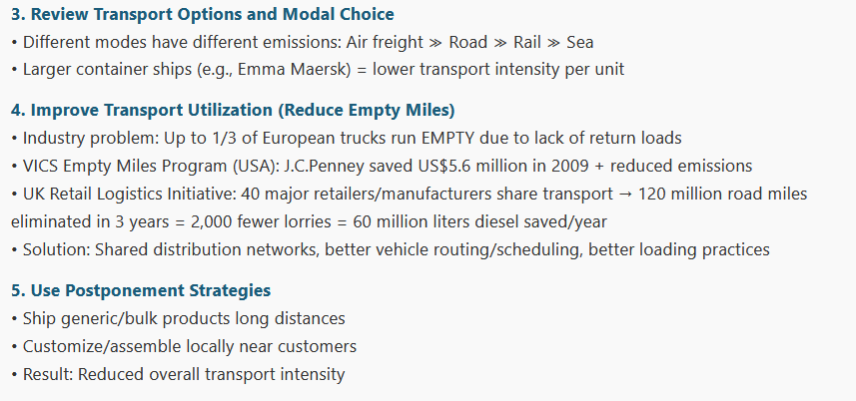
Practical Steps to Reduce Transport Intensity

Slide 12
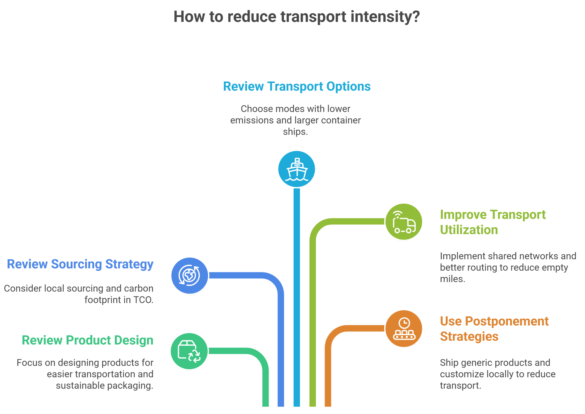

Slide 13
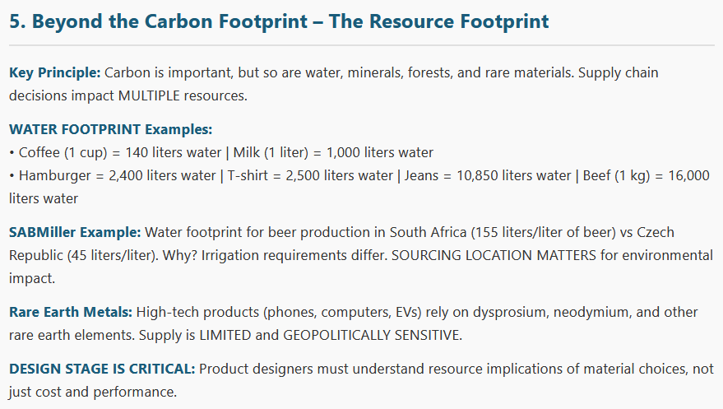
4. Beyond the Carbon Footprint – The Resource Footprint

Slide 14
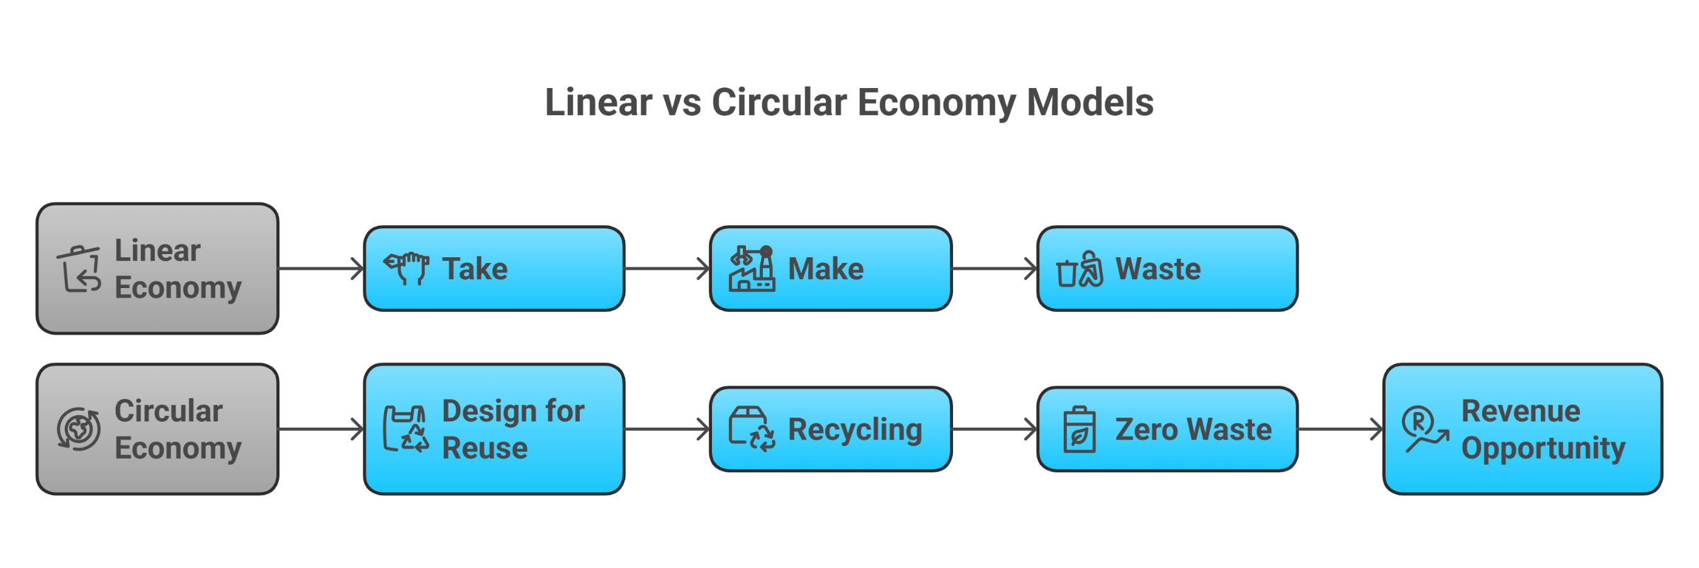
5. Circular Economy and the 3Rs – Reduce, Reuse, Recycle

Slide 15
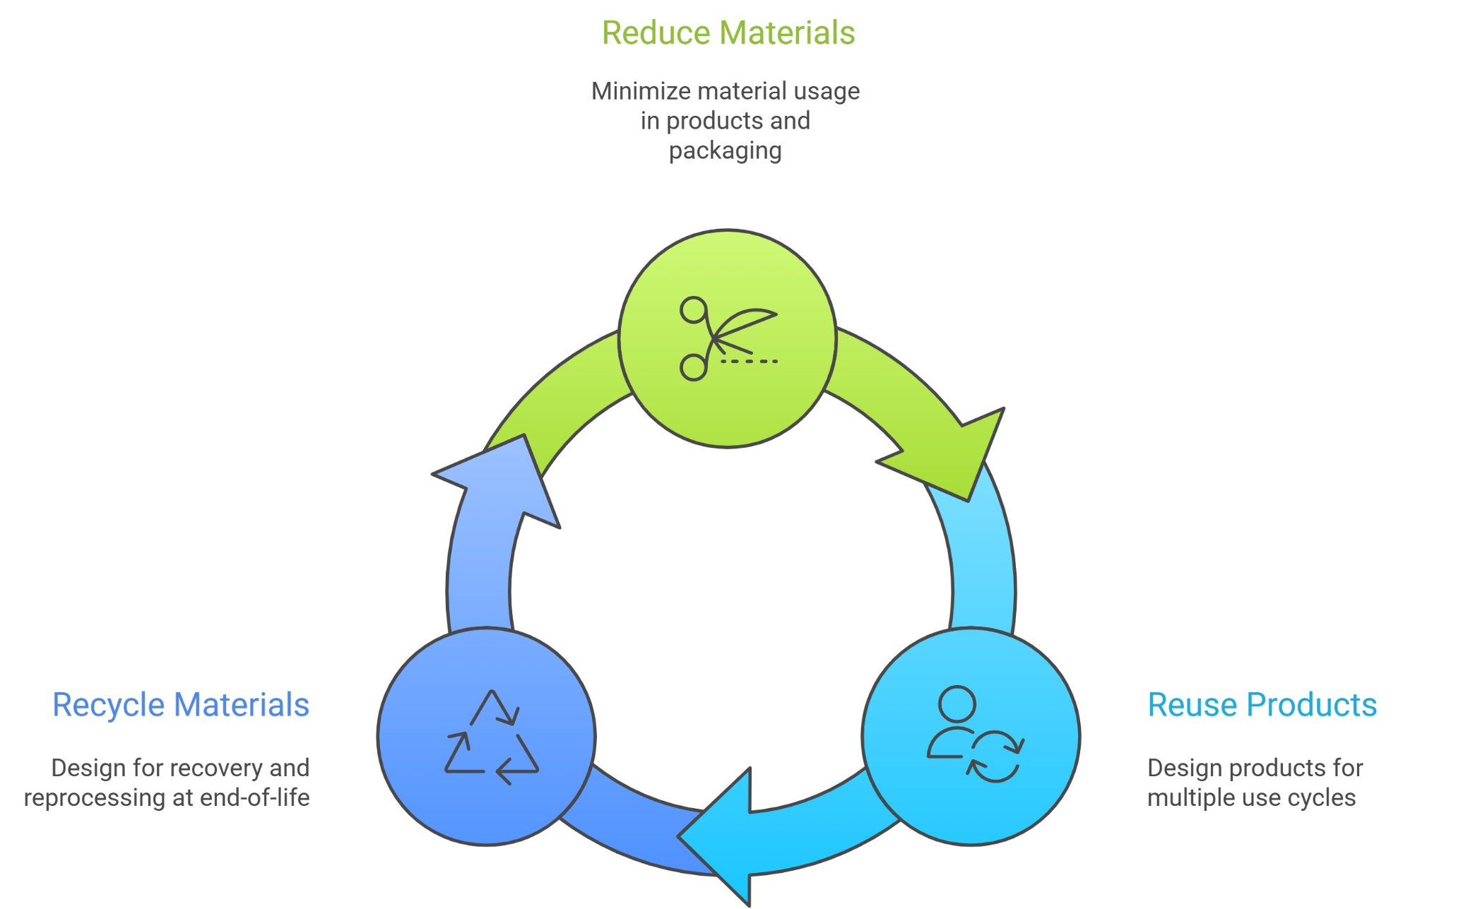
The 3Rs Framework

Slide 16
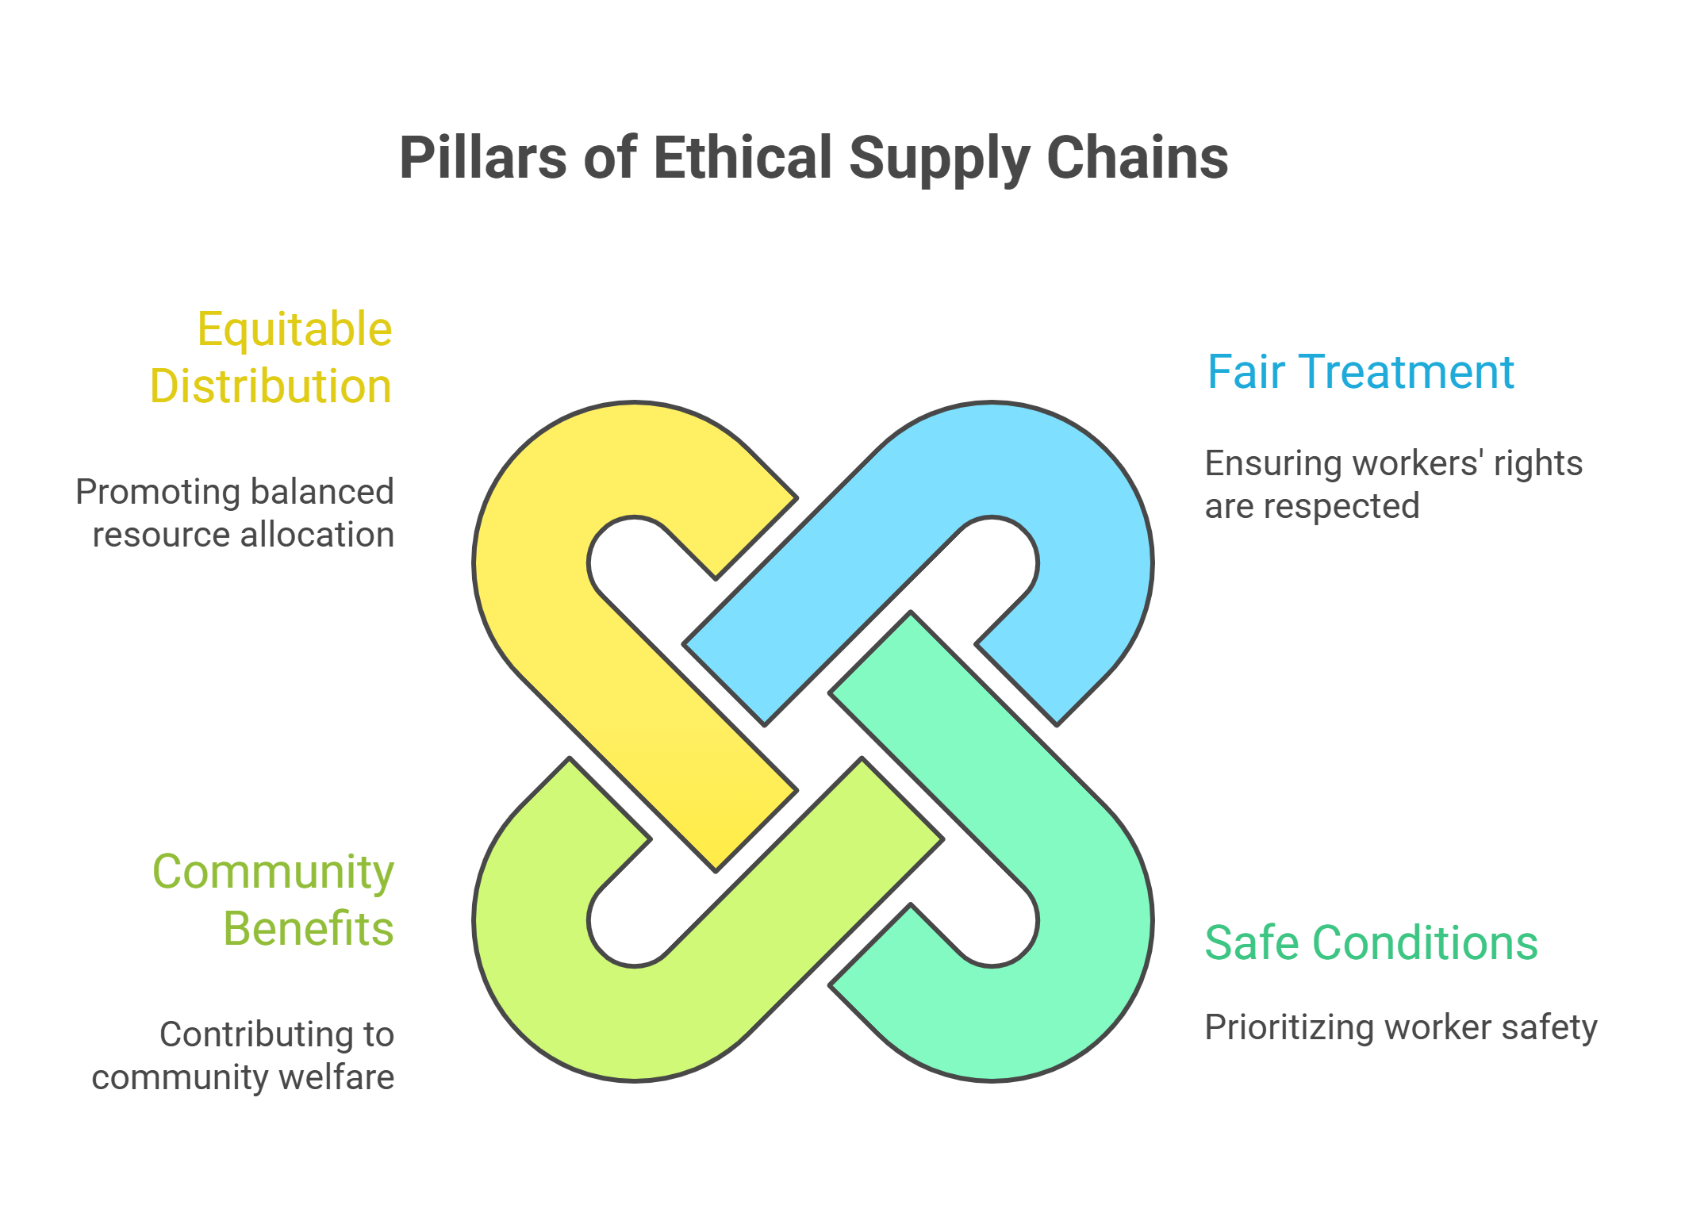
6. Social Responsibility in Supply Chains

Slide 17
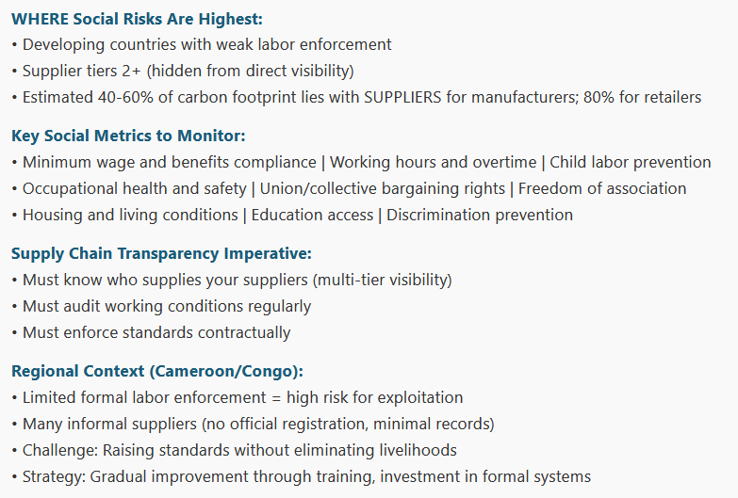
6. Social Responsibility in Supply Chains

Slide 18
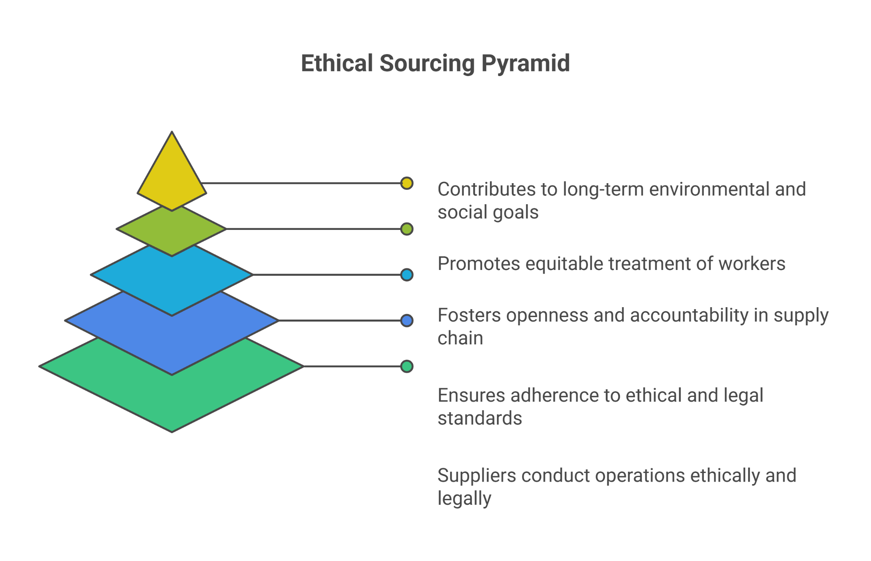
7. Ethical Sourcing and Responsible Procurement

Slide 19
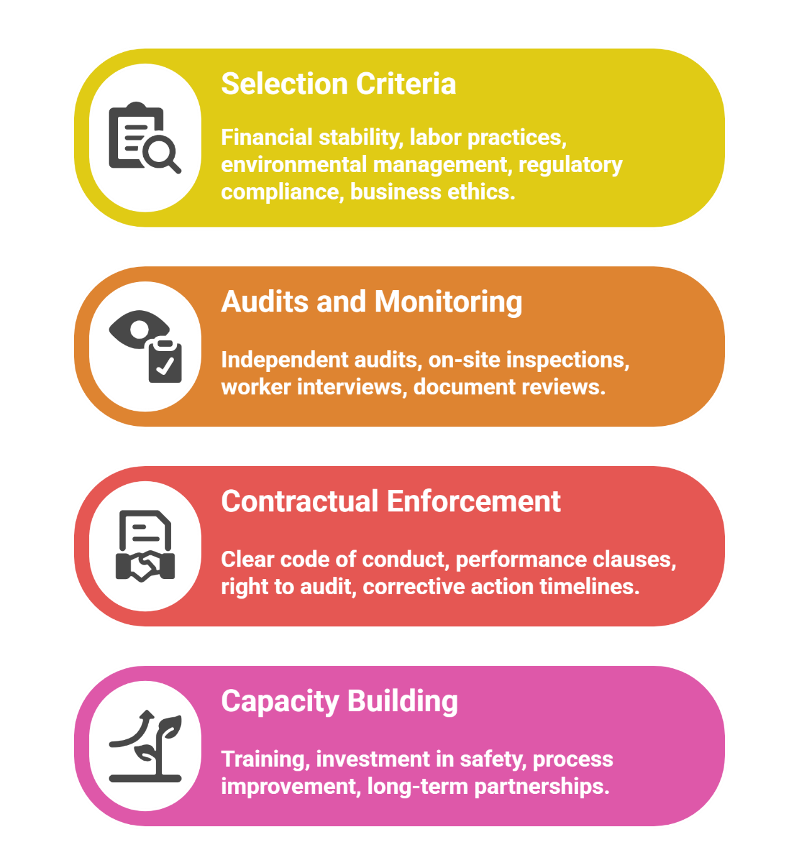
Ethical Sourcing Framework

Slide 20
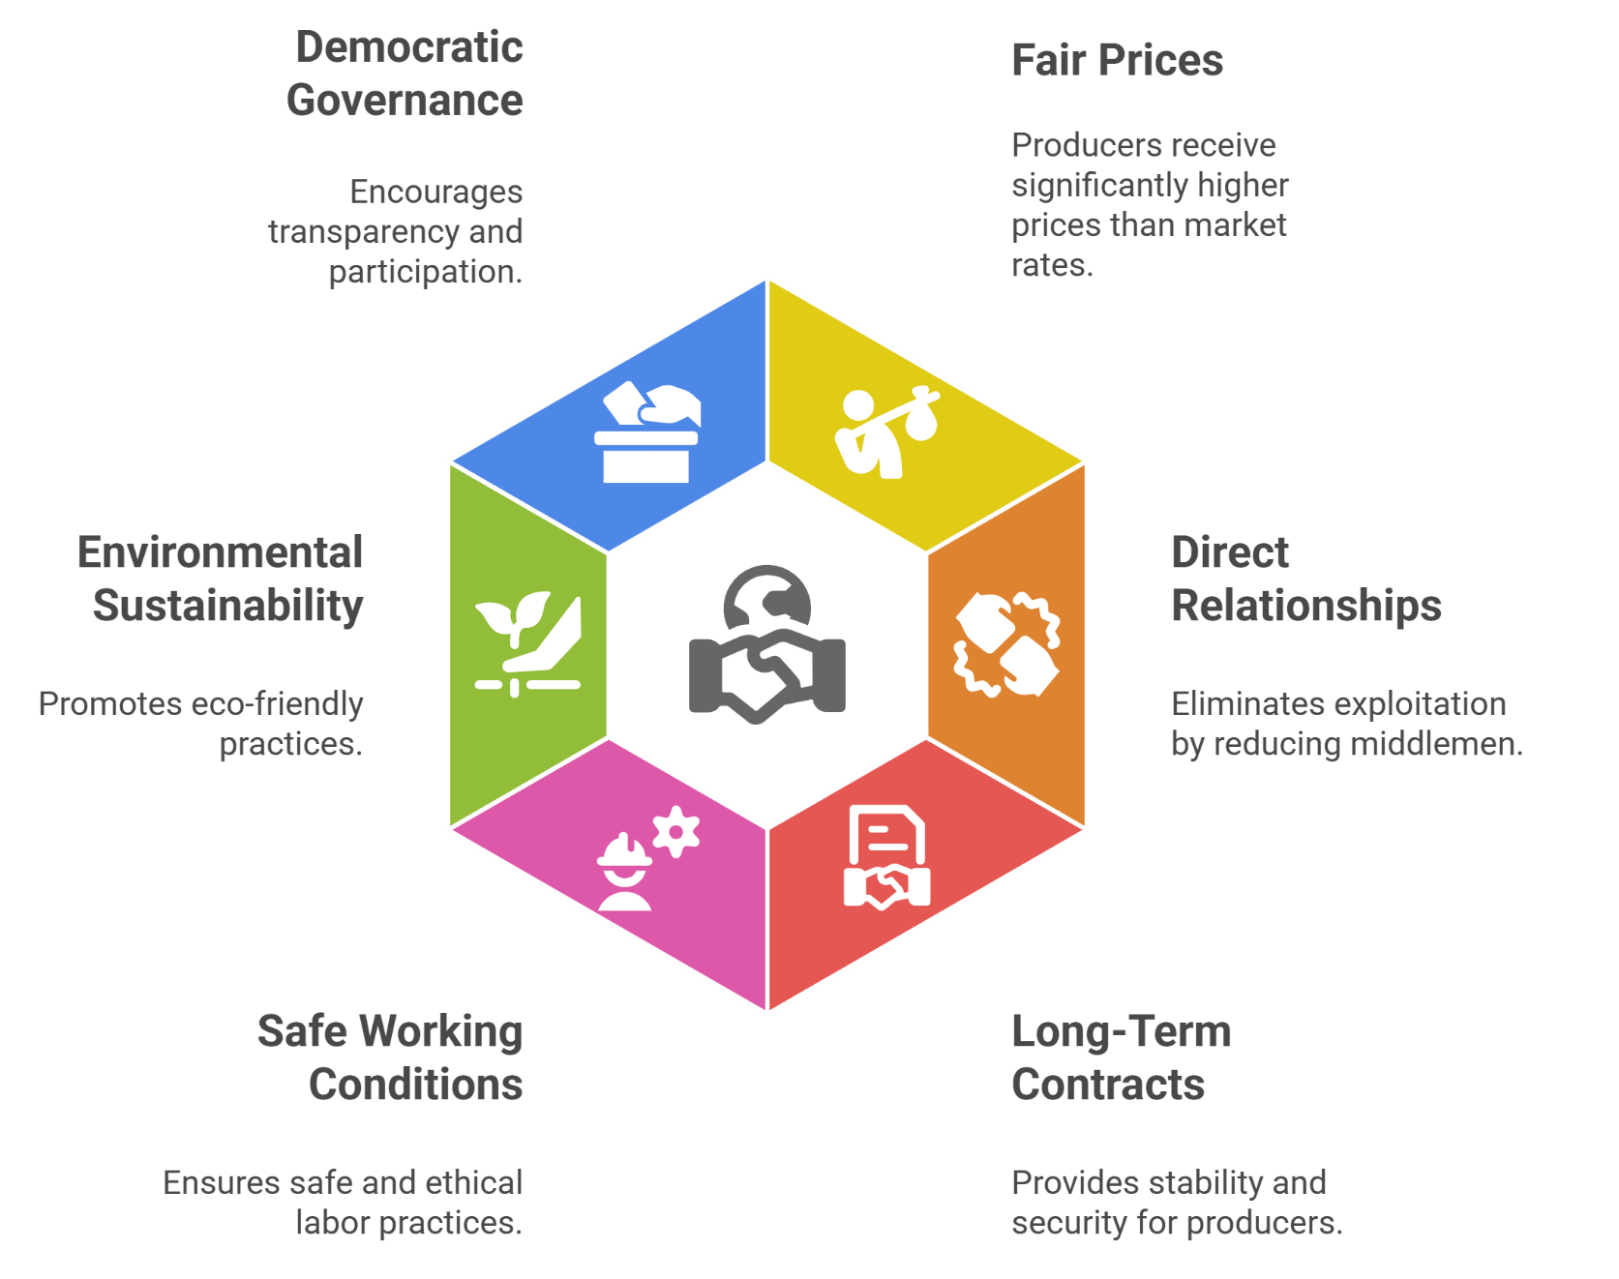
8. Fair Trade Principles

Slide 21
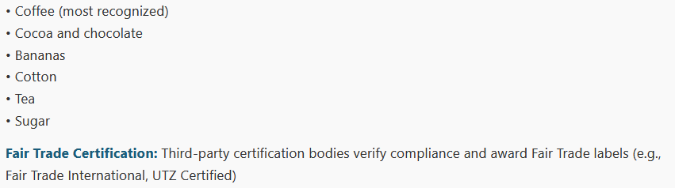
Industries Where Fair Trade is Strong

Slide 22
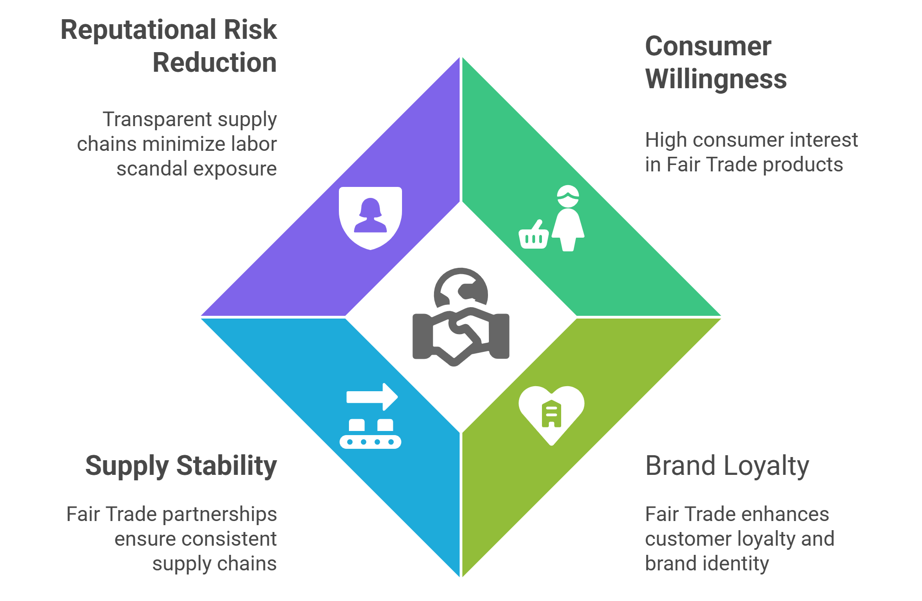
Business Case for Fair Trade

Slide 23
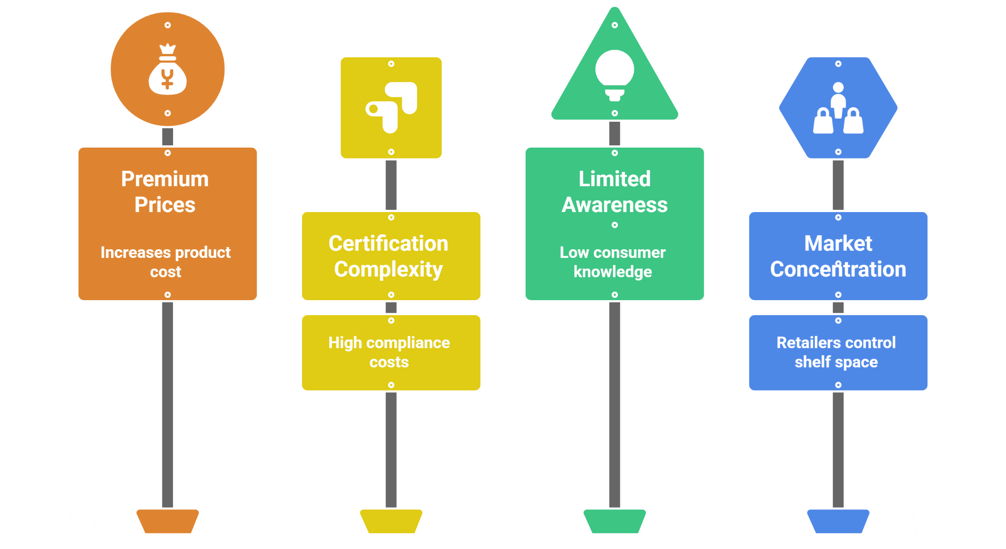
Challenges in Implementing
Fair Trade

Slide 24
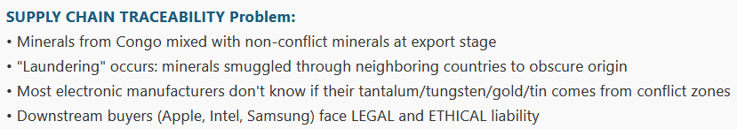
9. Conflict Minerals and Responsible Sourcing

Slide 25
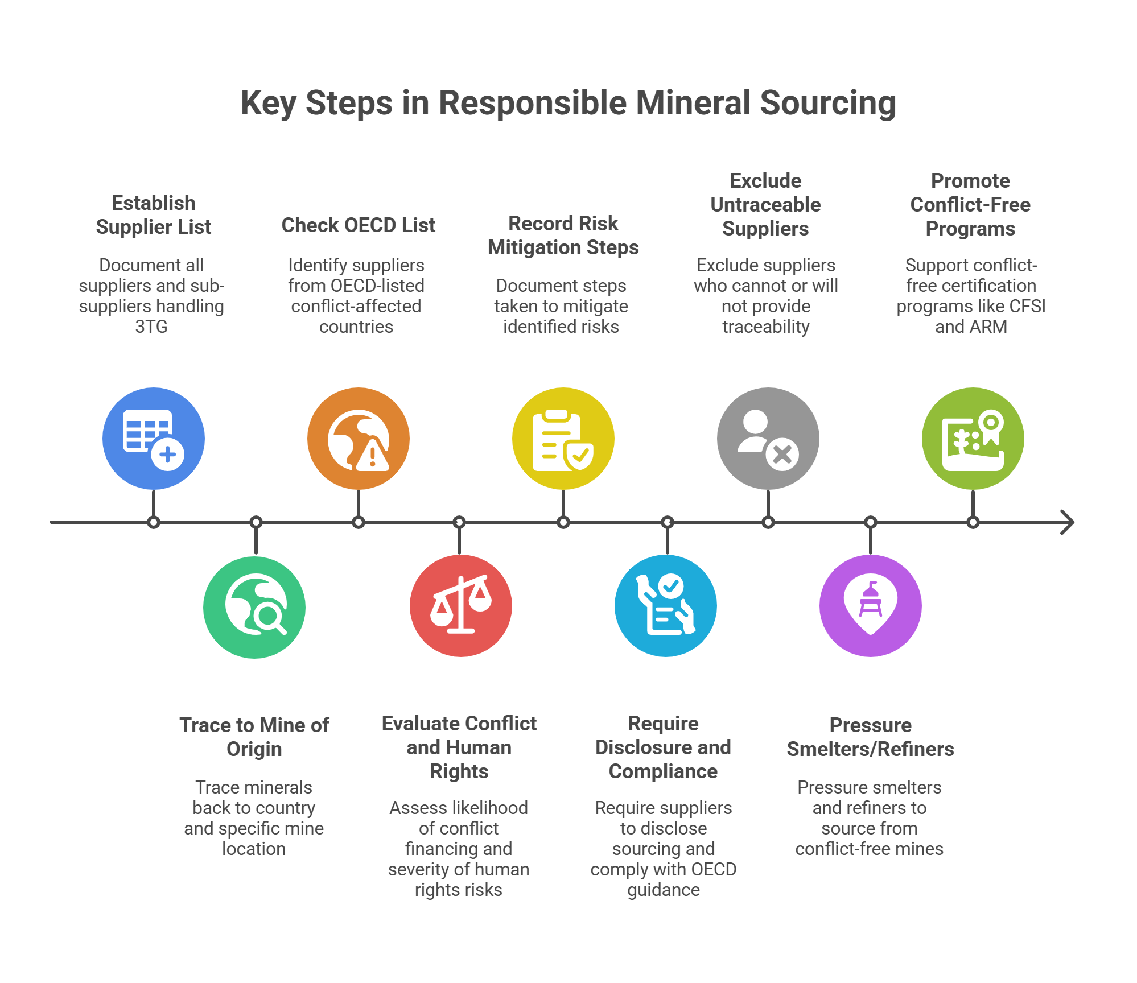

Slide 26
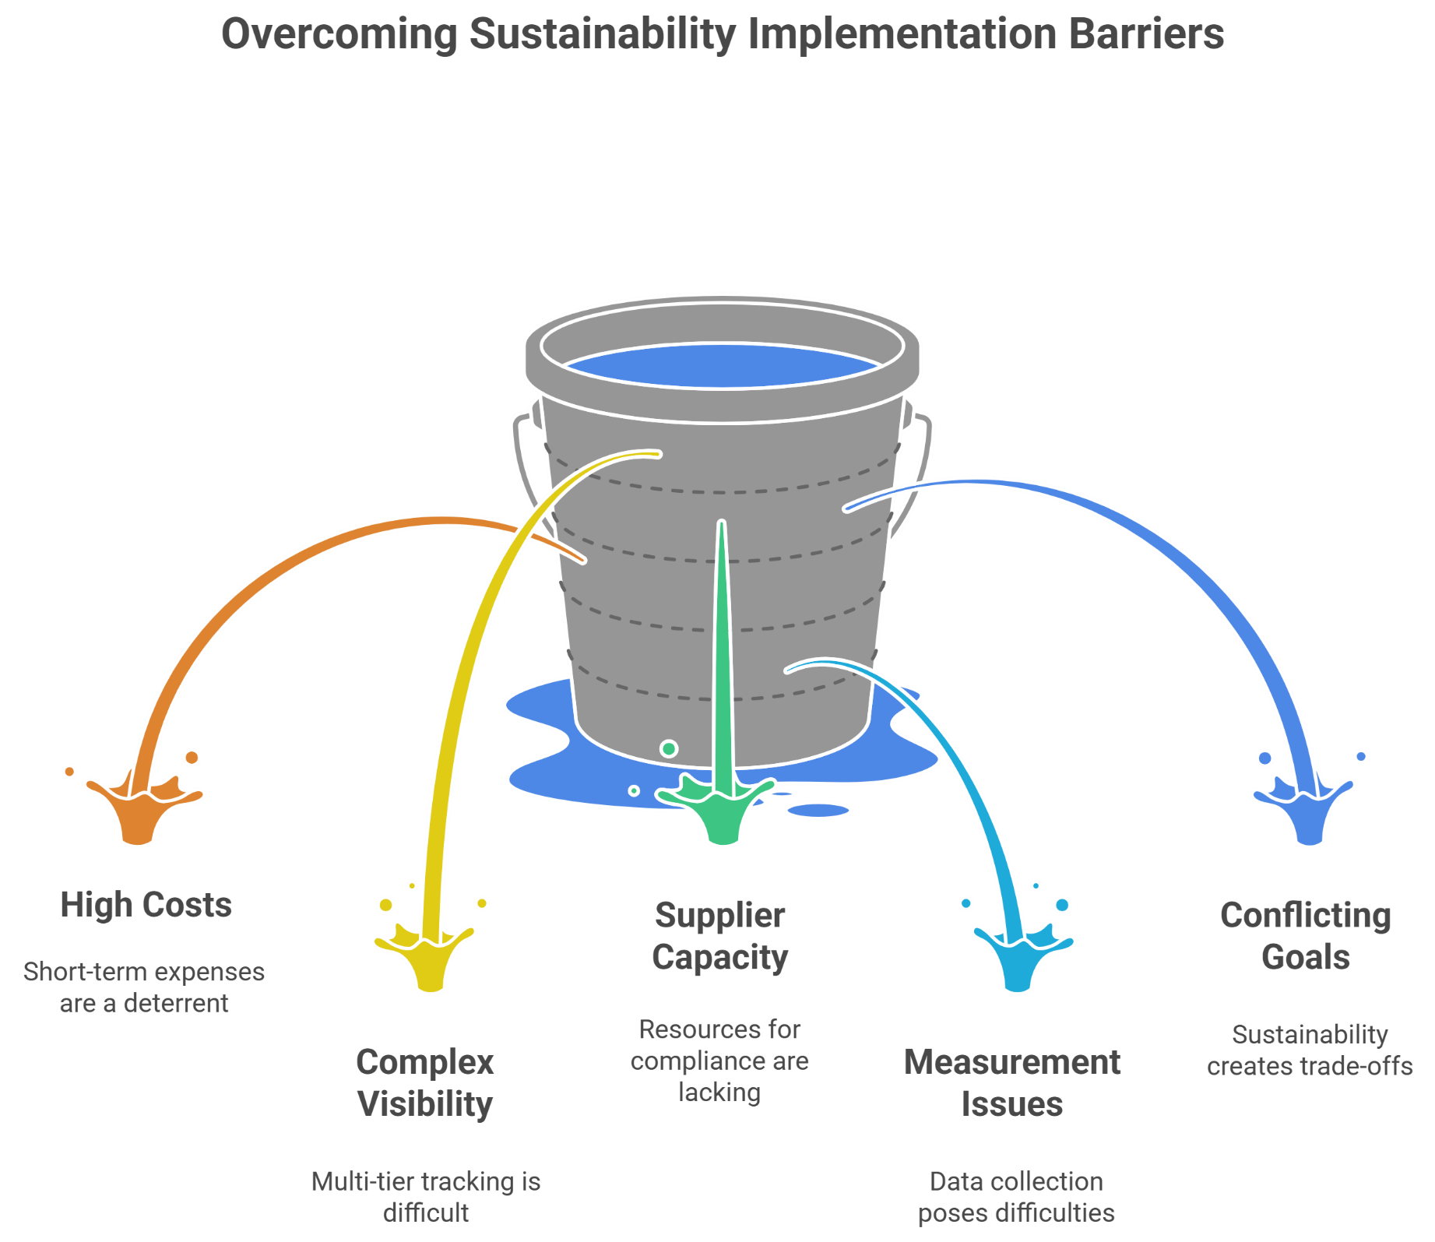
10. Implementation Strategy – Moving to Sustainable Supply Chains

Slide 27
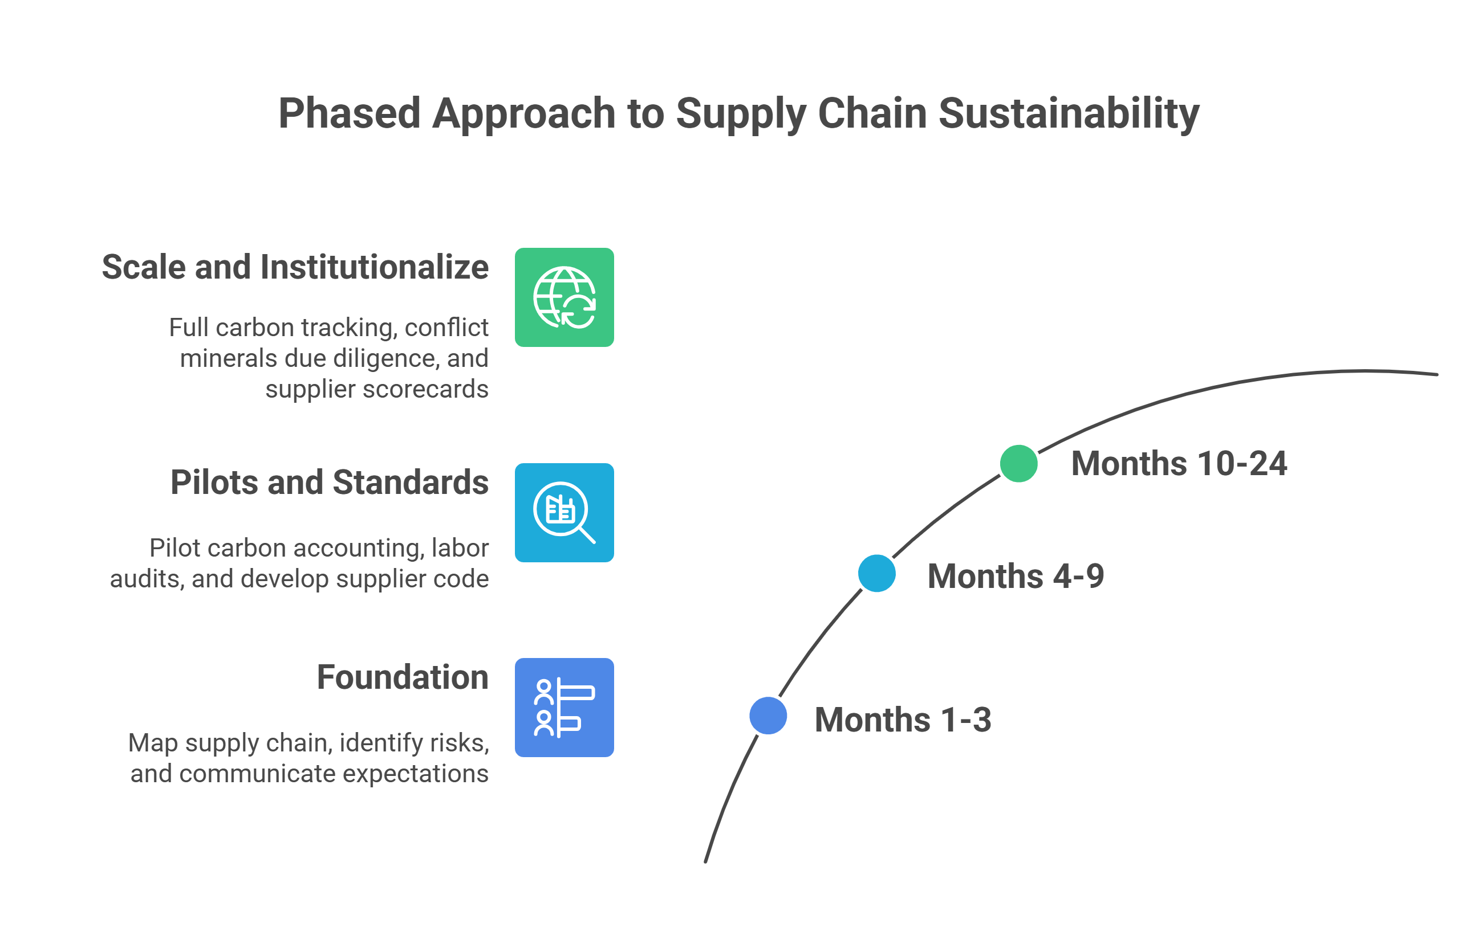

Slide 28
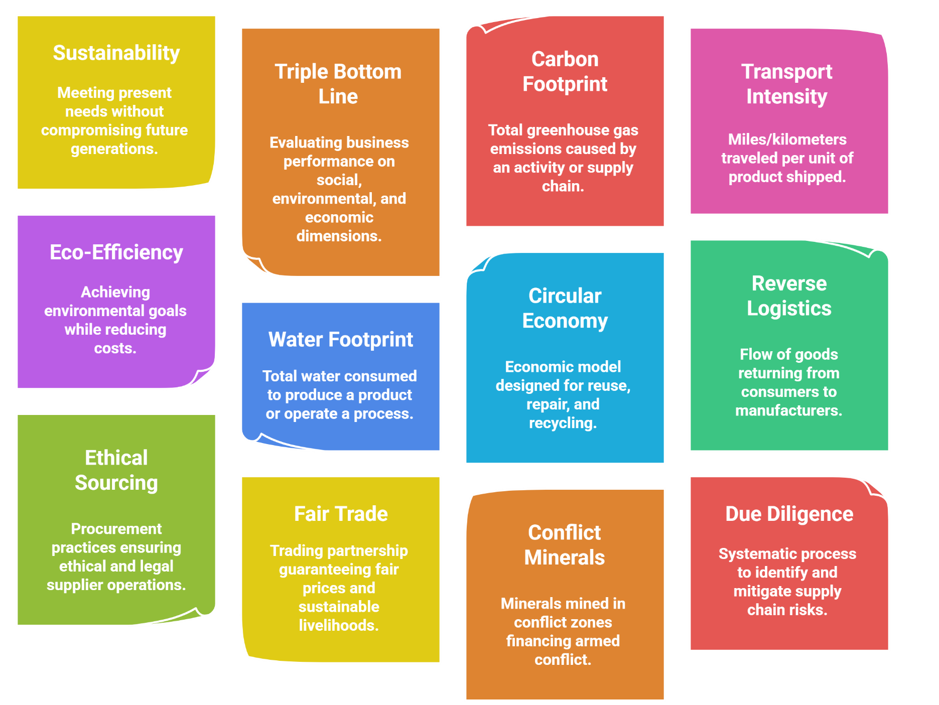
Key Definitions (Reference Sheet)

