Slide 1
Future Logistics in Africa
Daniel Kaszubowski

Slide 2
Road Transportation Systems Engineering Development in the Sub-Saharan Africa – Modern EU Master Programme & Capacity Building

Slide 4
Learning Objectives
Understand digital transformation reshaping African logistics
Apply mobile technology and digital tools to supply chain operations
Evaluate emerging technologies: RFID, IoT, blockchain, AI, big data
Recognize the role of information systems in modern supply chains
Identify skills and competencies needed for future logistics careers
Explore AfCFTA regional integration opportunities and implications
Understand local-for-local manufacturing and resilient supply chains
Navigate challenges and capitalize on opportunities in African logistics

Slide 5
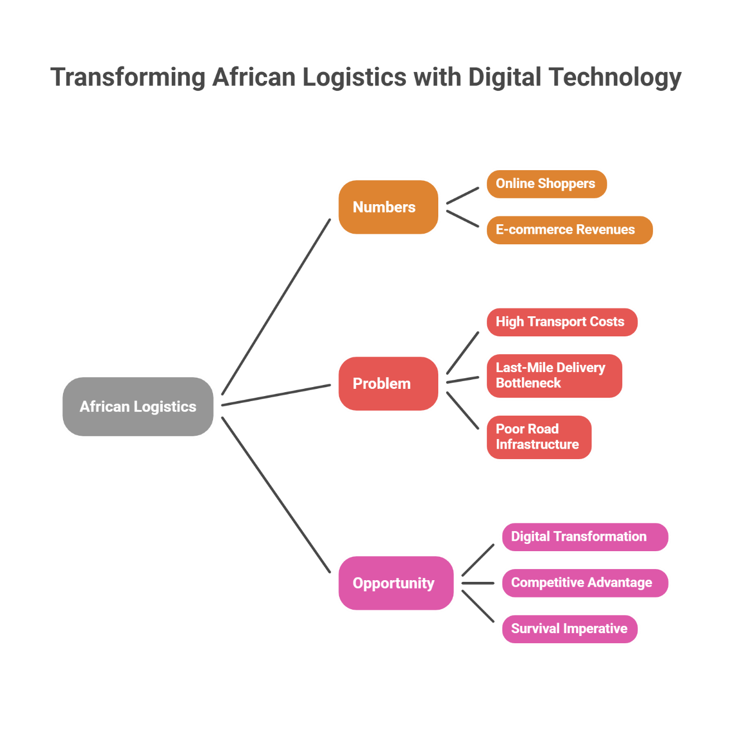
Focus: Africa's E-Commerce Explosion and the Logistics Challenge

Slide 6
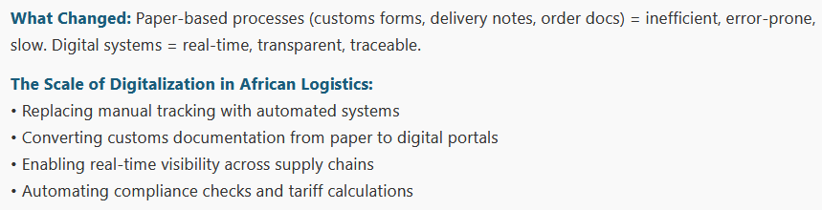
1. Digital Transformation – The Shift from Paper to Digital

Slide 7
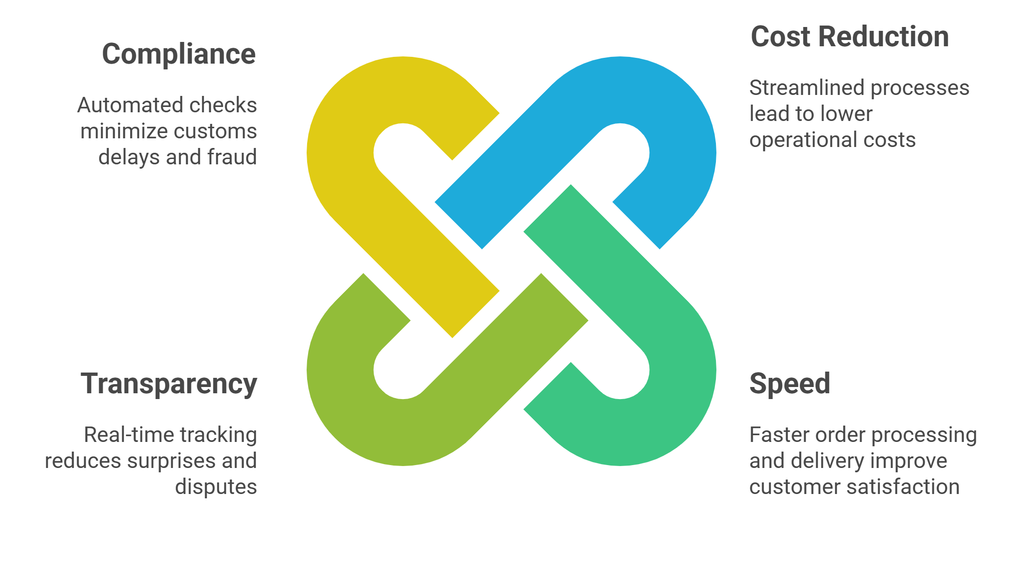
The Benefits of Digital Logistics

Slide 8
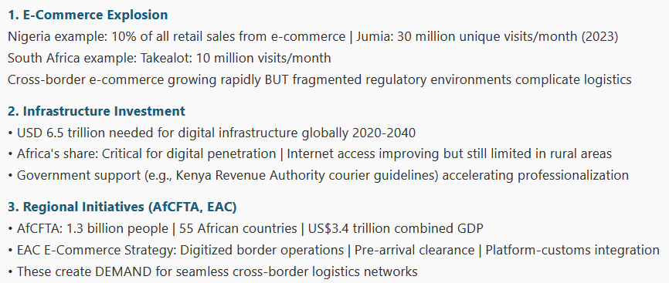
Key Drivers of Digital Transformation in Africa

Slide 9
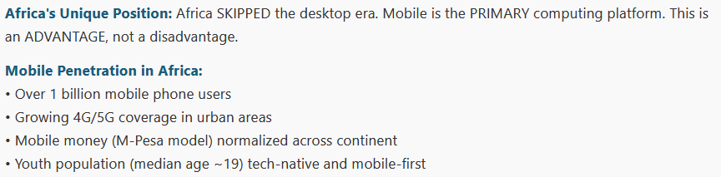
2. Mobile Technology – The Leapfrog Advantage

Slide 10
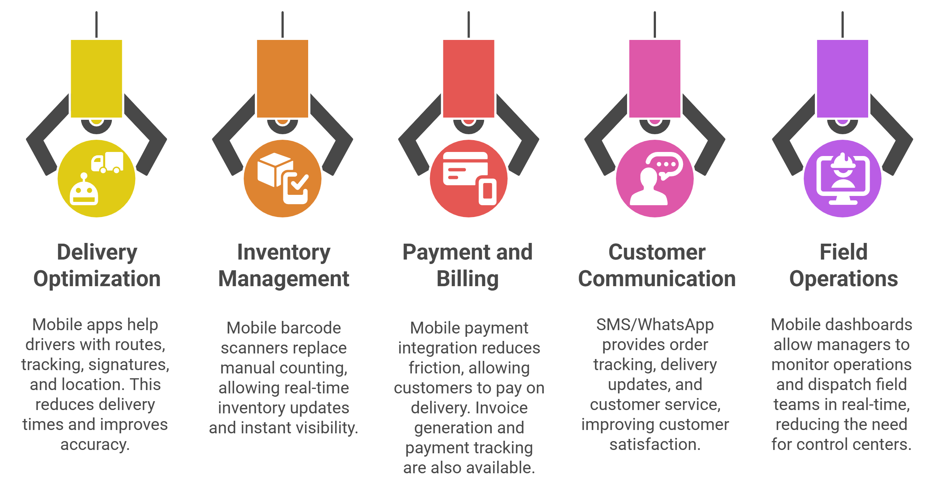
Mobile Applications in Logistics

Slide 11
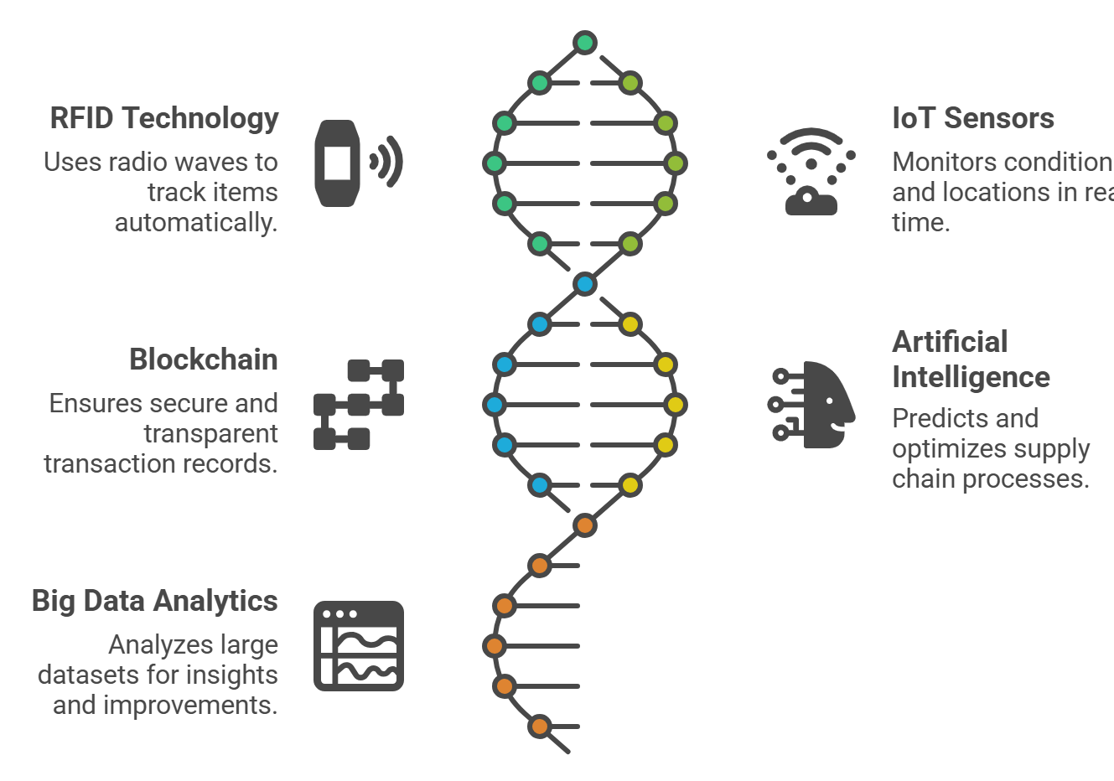
3. Technology Trends – RFID, IoT, Blockchain, AI, Big Data

Slide 12
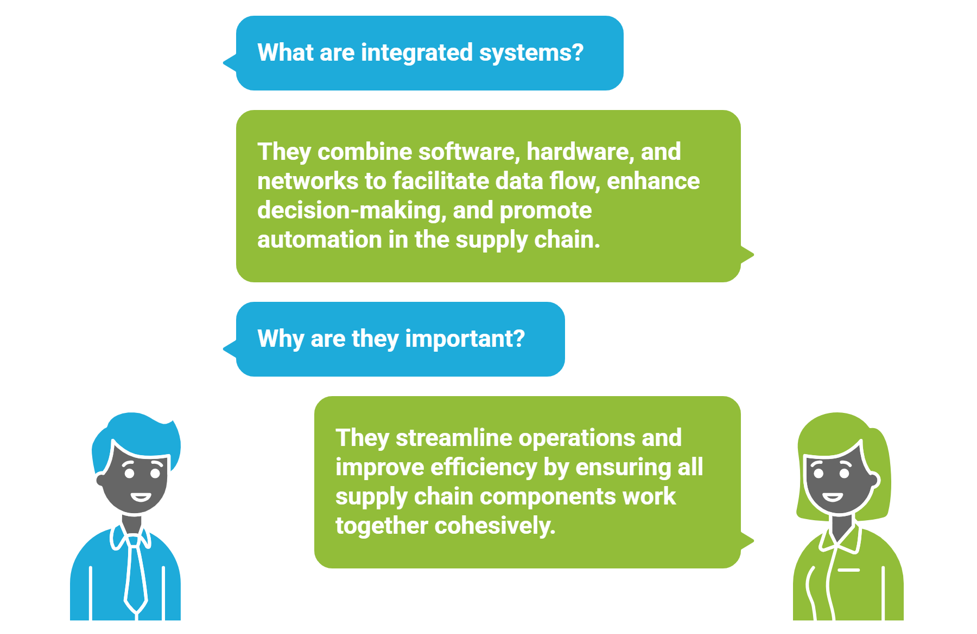
4. Role of Information Systems (IS) – The Nervous System of Logistics

Slide 13
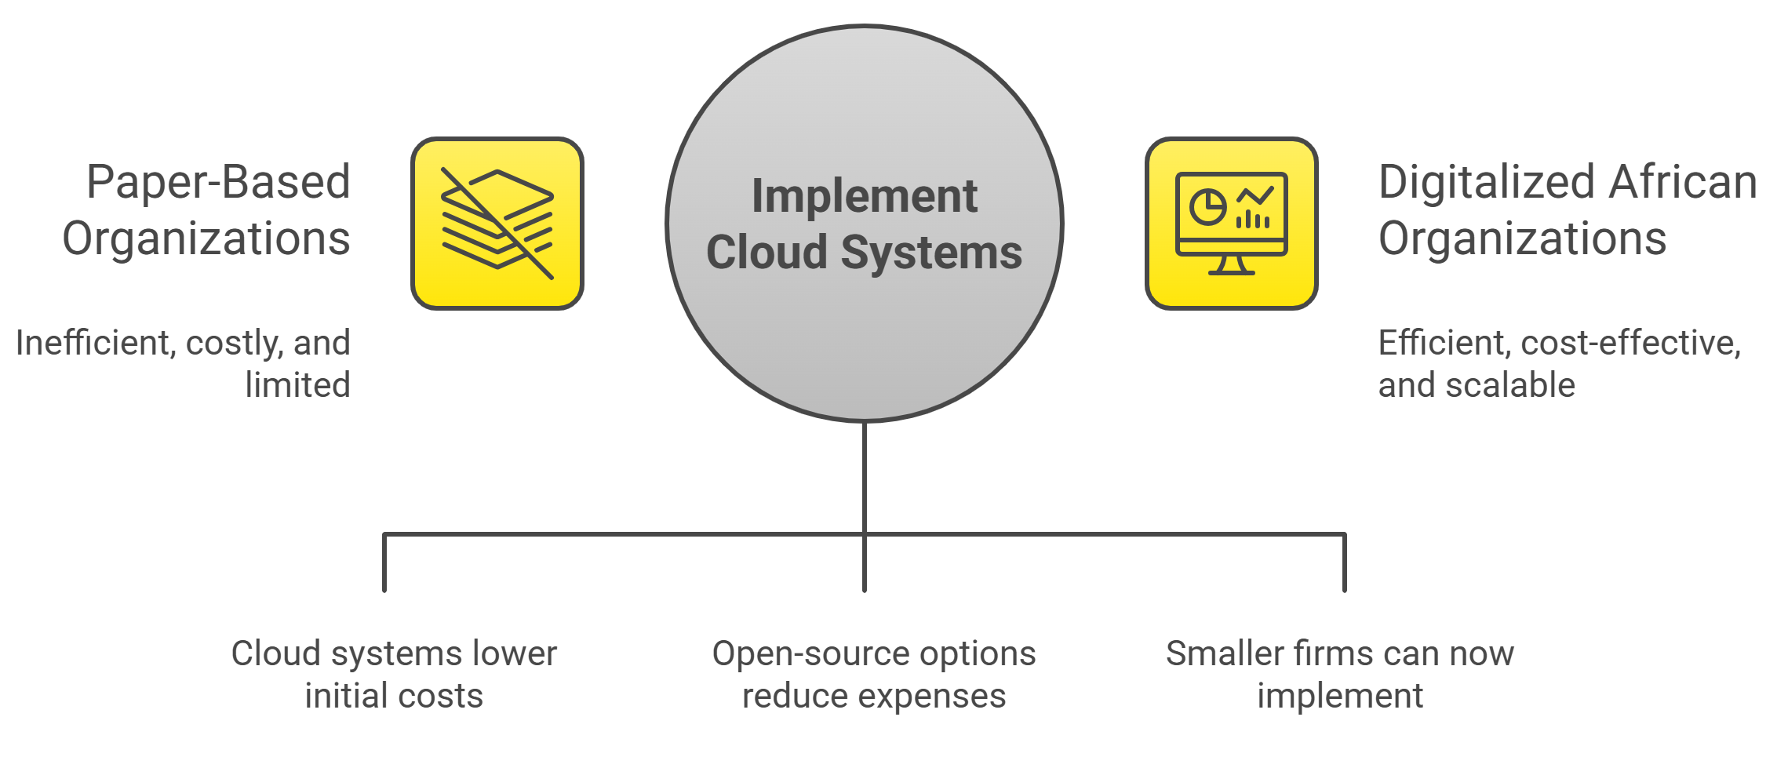
Why Information Systems Matter in Africa

Slide 14
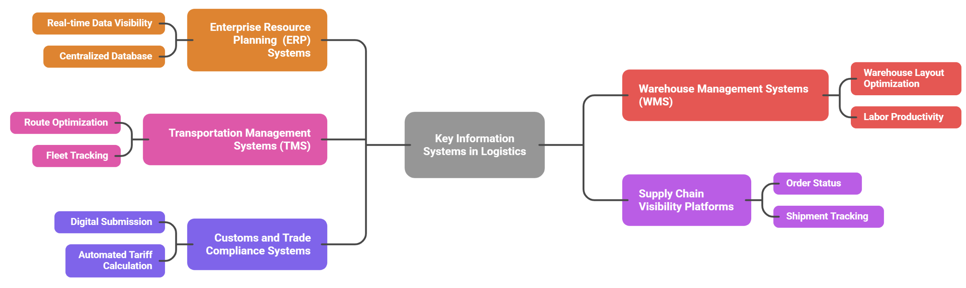
Key IS Components

Slide 15
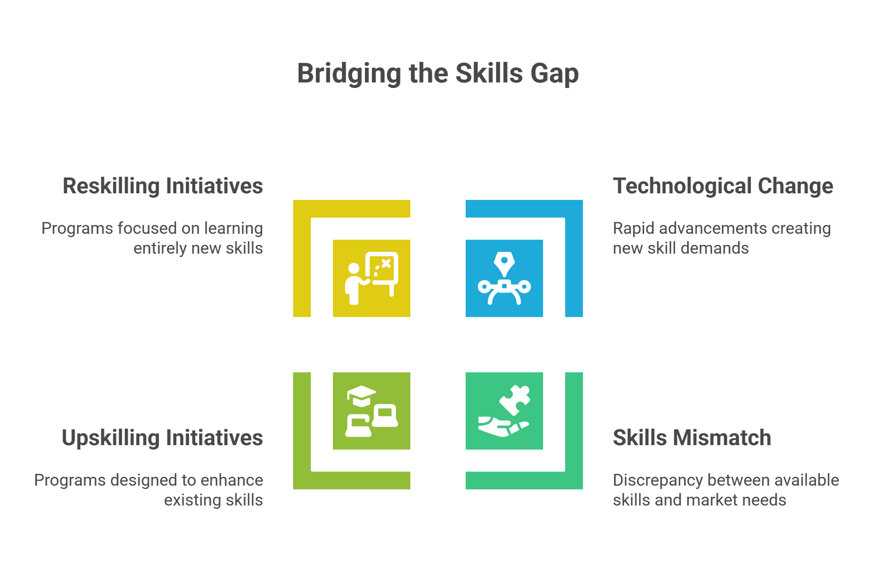
5. Skills and Competency Development – Building Africa's Logistics Workforce

Slide 16
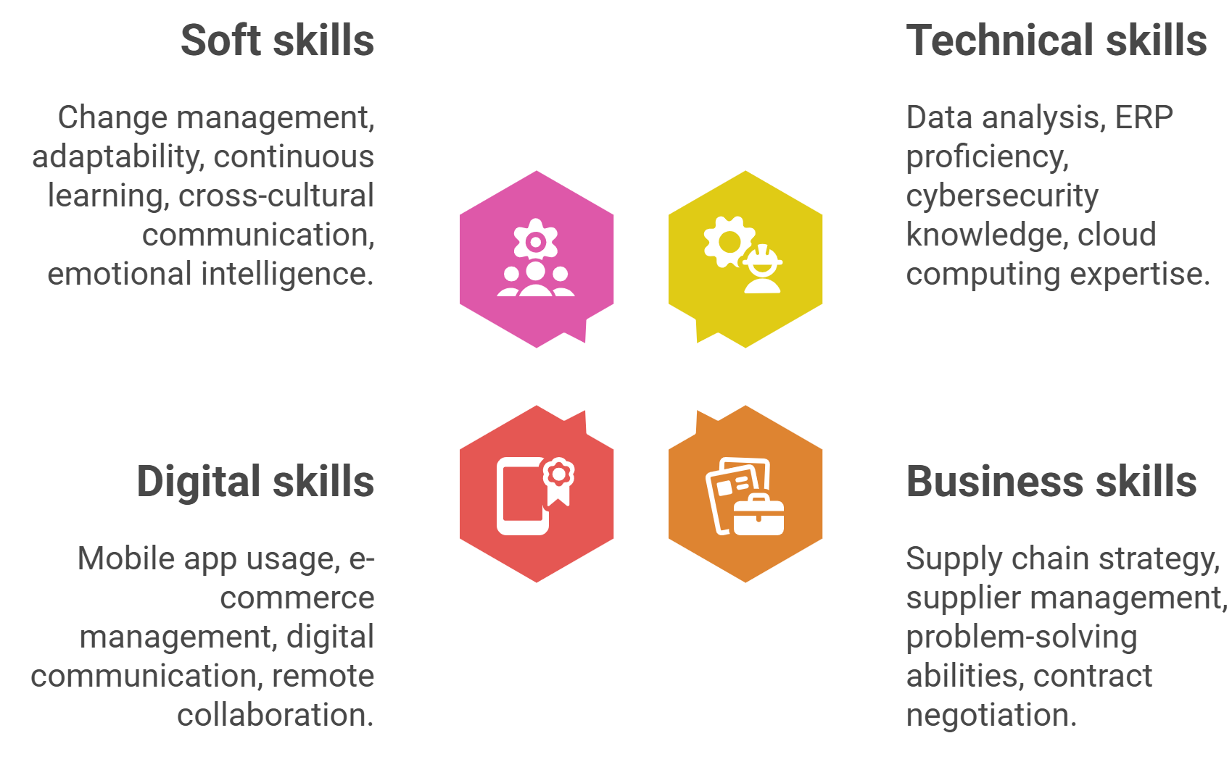
21st Century Logistics Skills Required

Slide 17
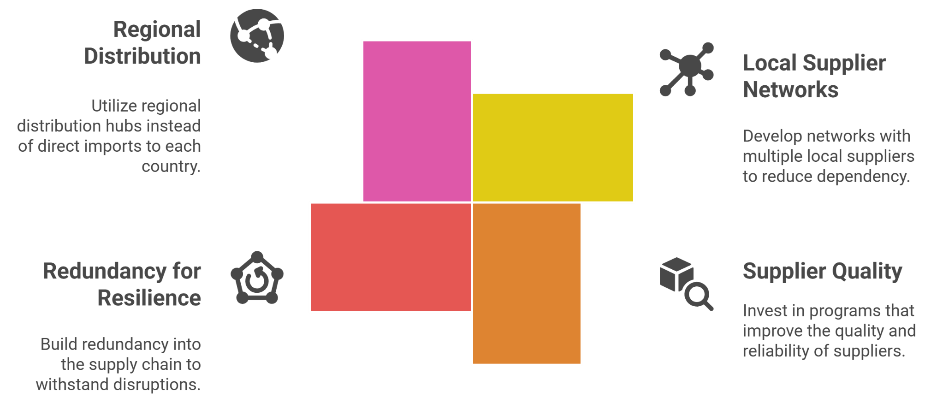
6. Local-for-Local Manufacturing and Resilience

Slide 18
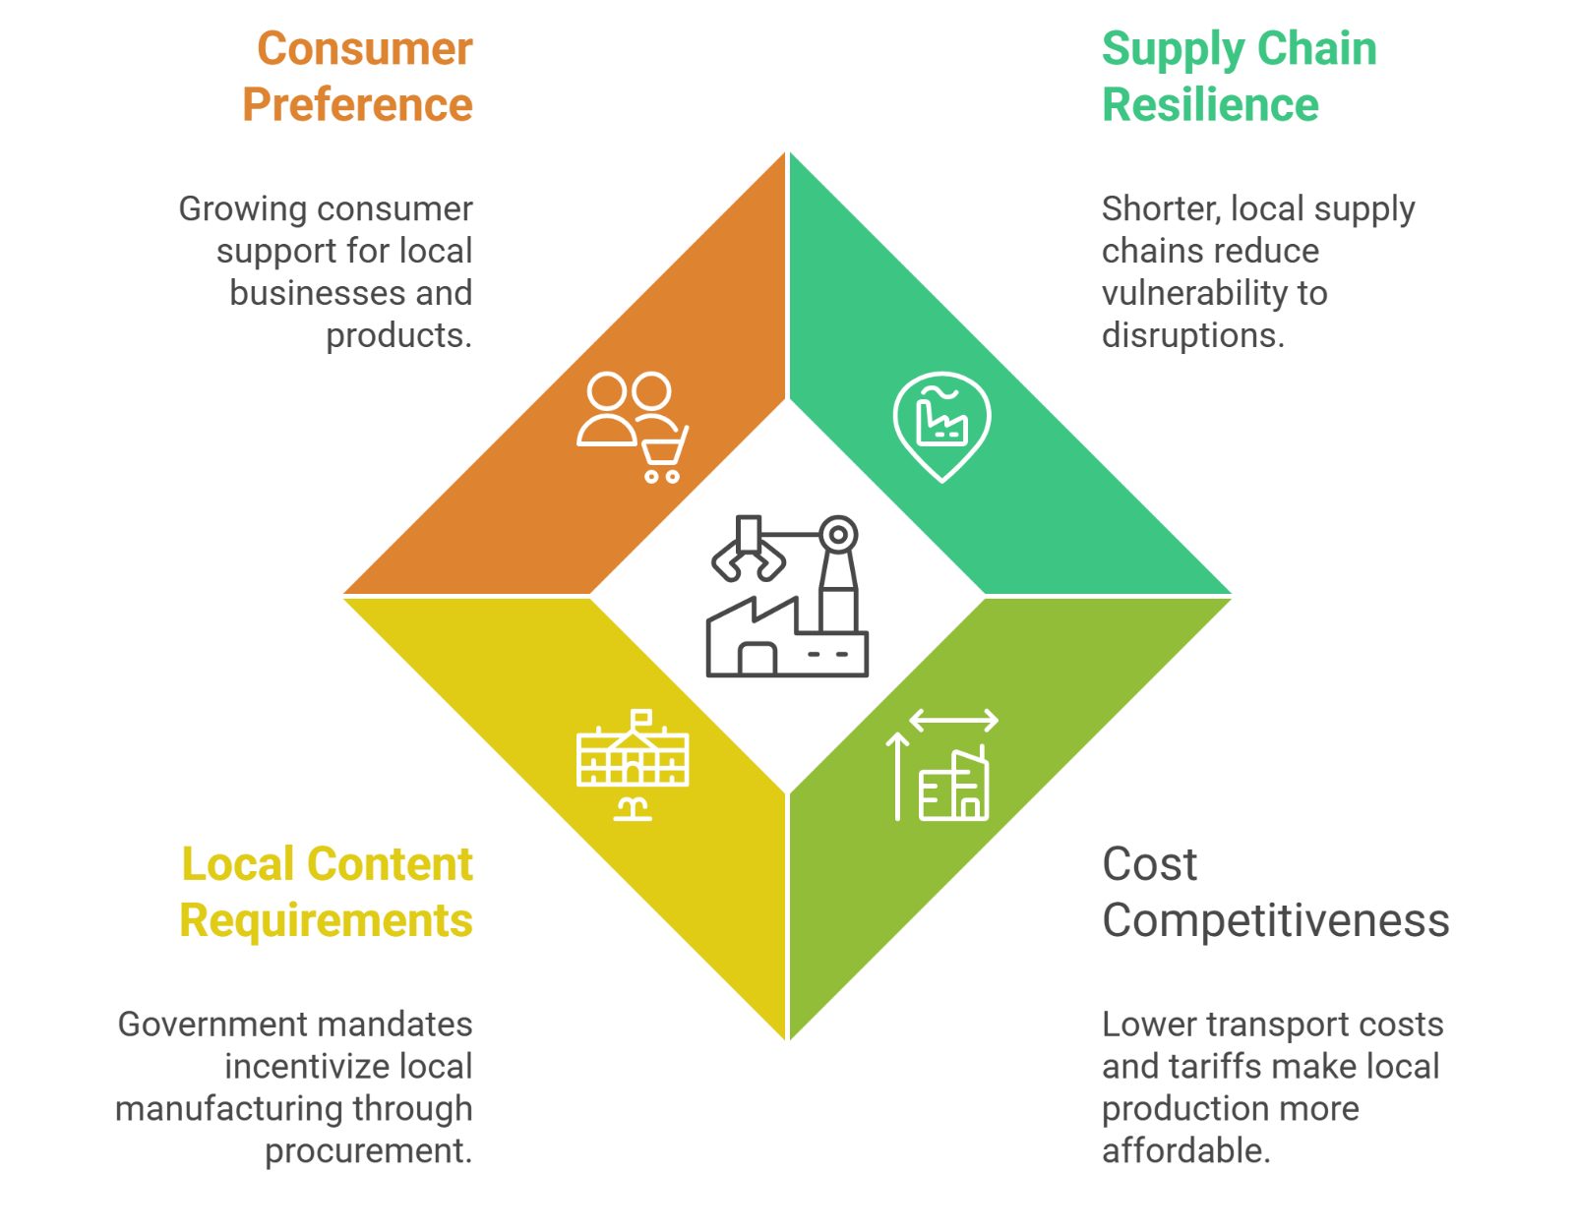
Local-for-Local Manufacturing Drivers

Slide 19
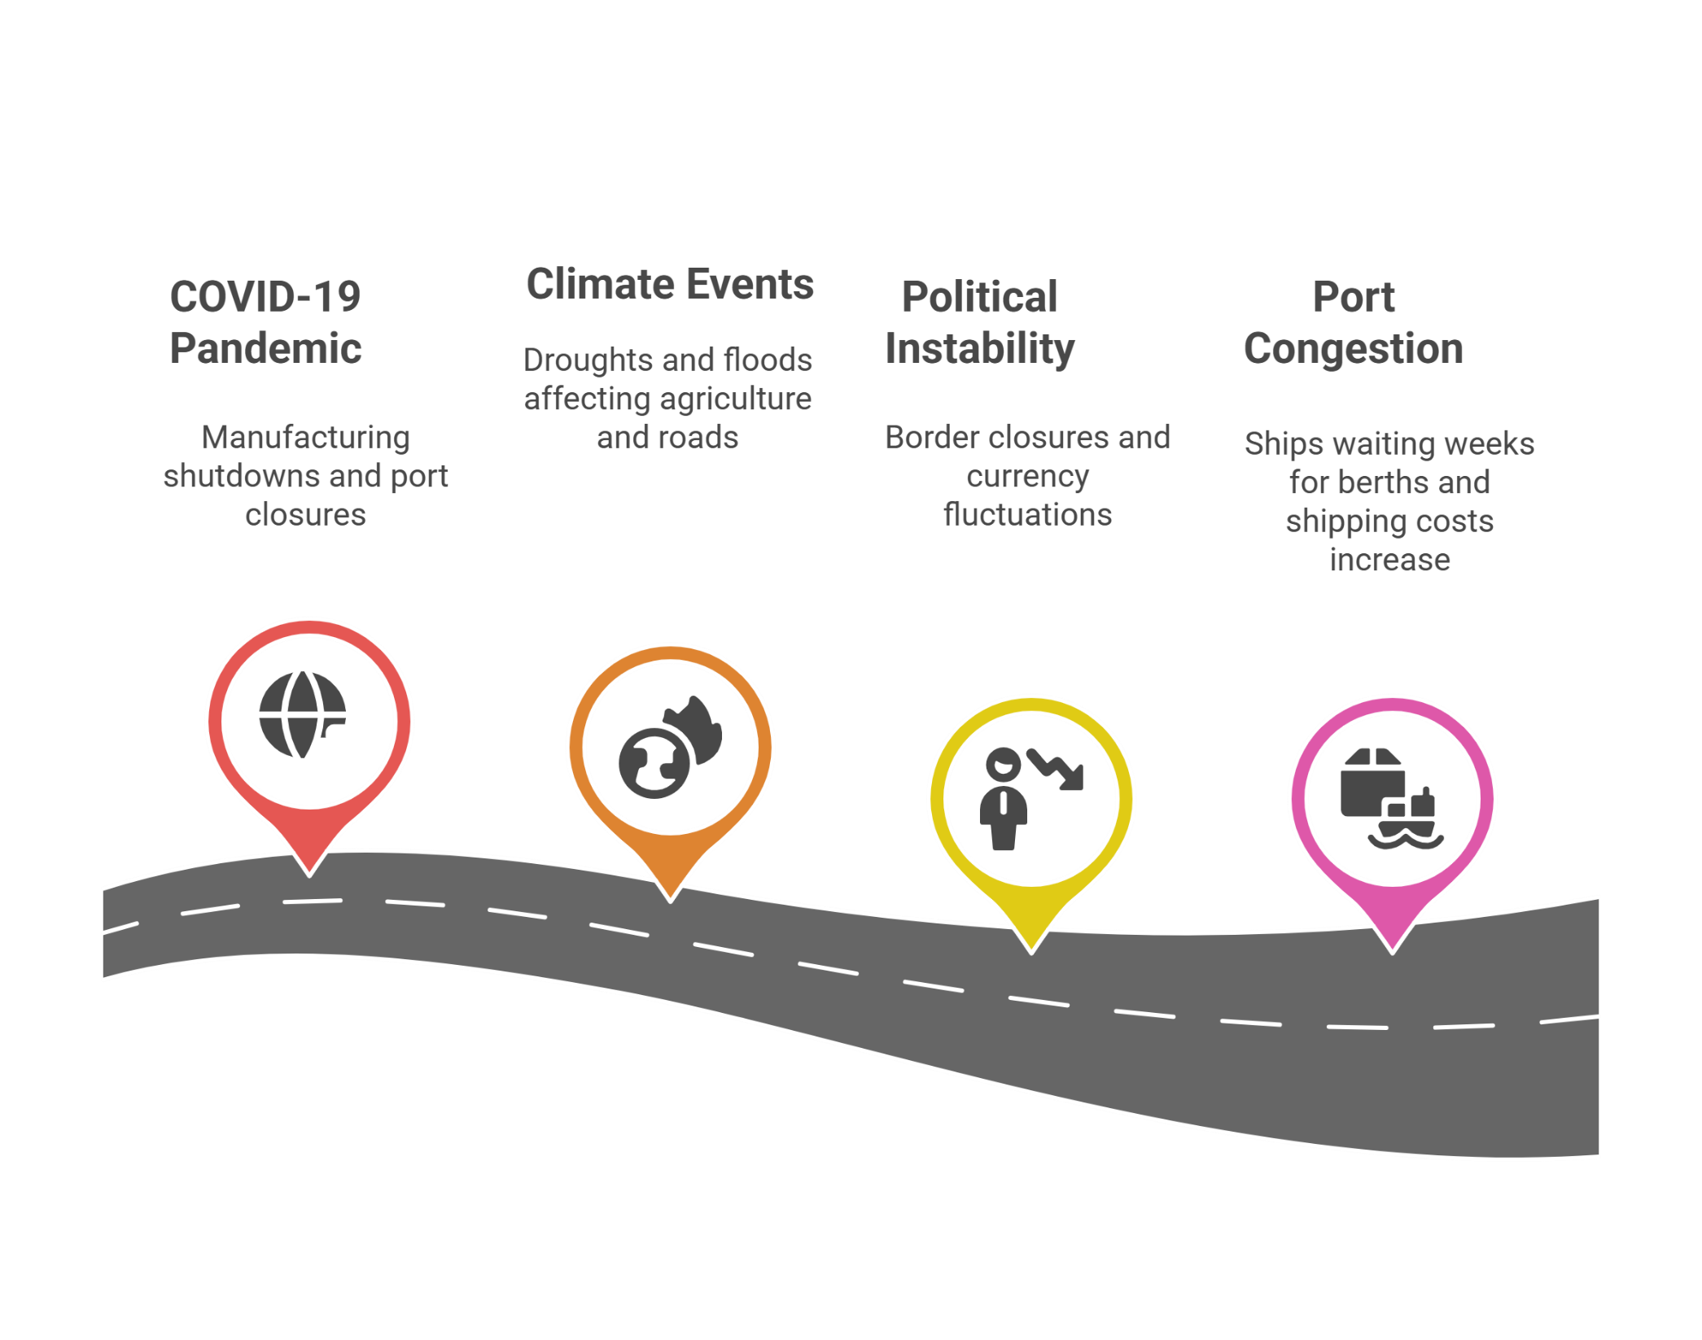
8. Building Resilient Supply Chains – Lessons from Disruption

Slide 20
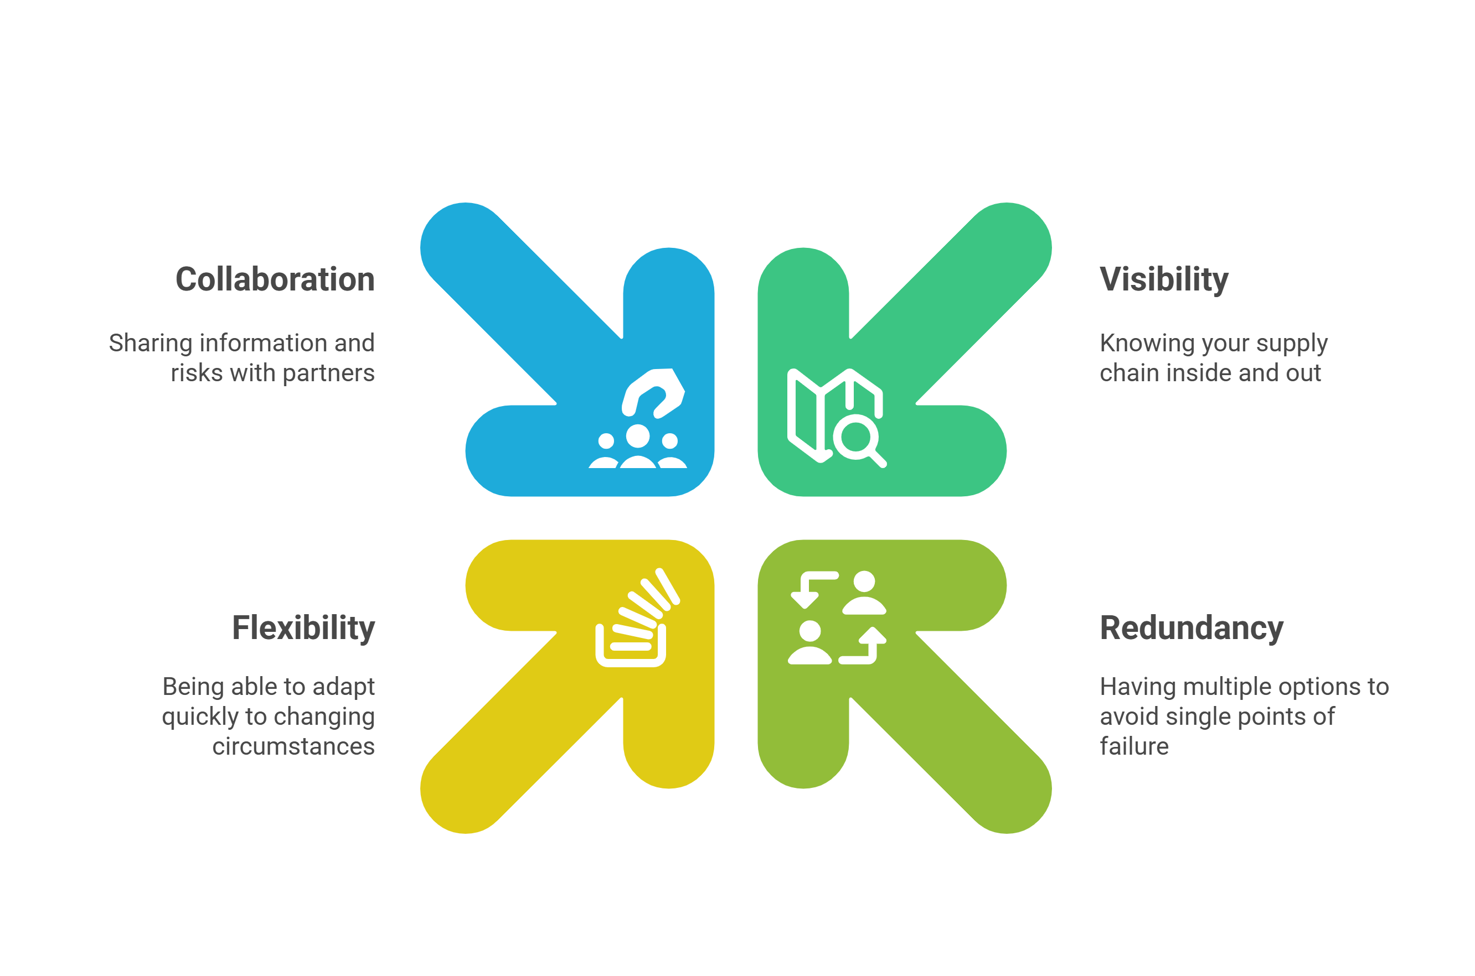
Resilience Framework (4 Pillars)

Slide 21
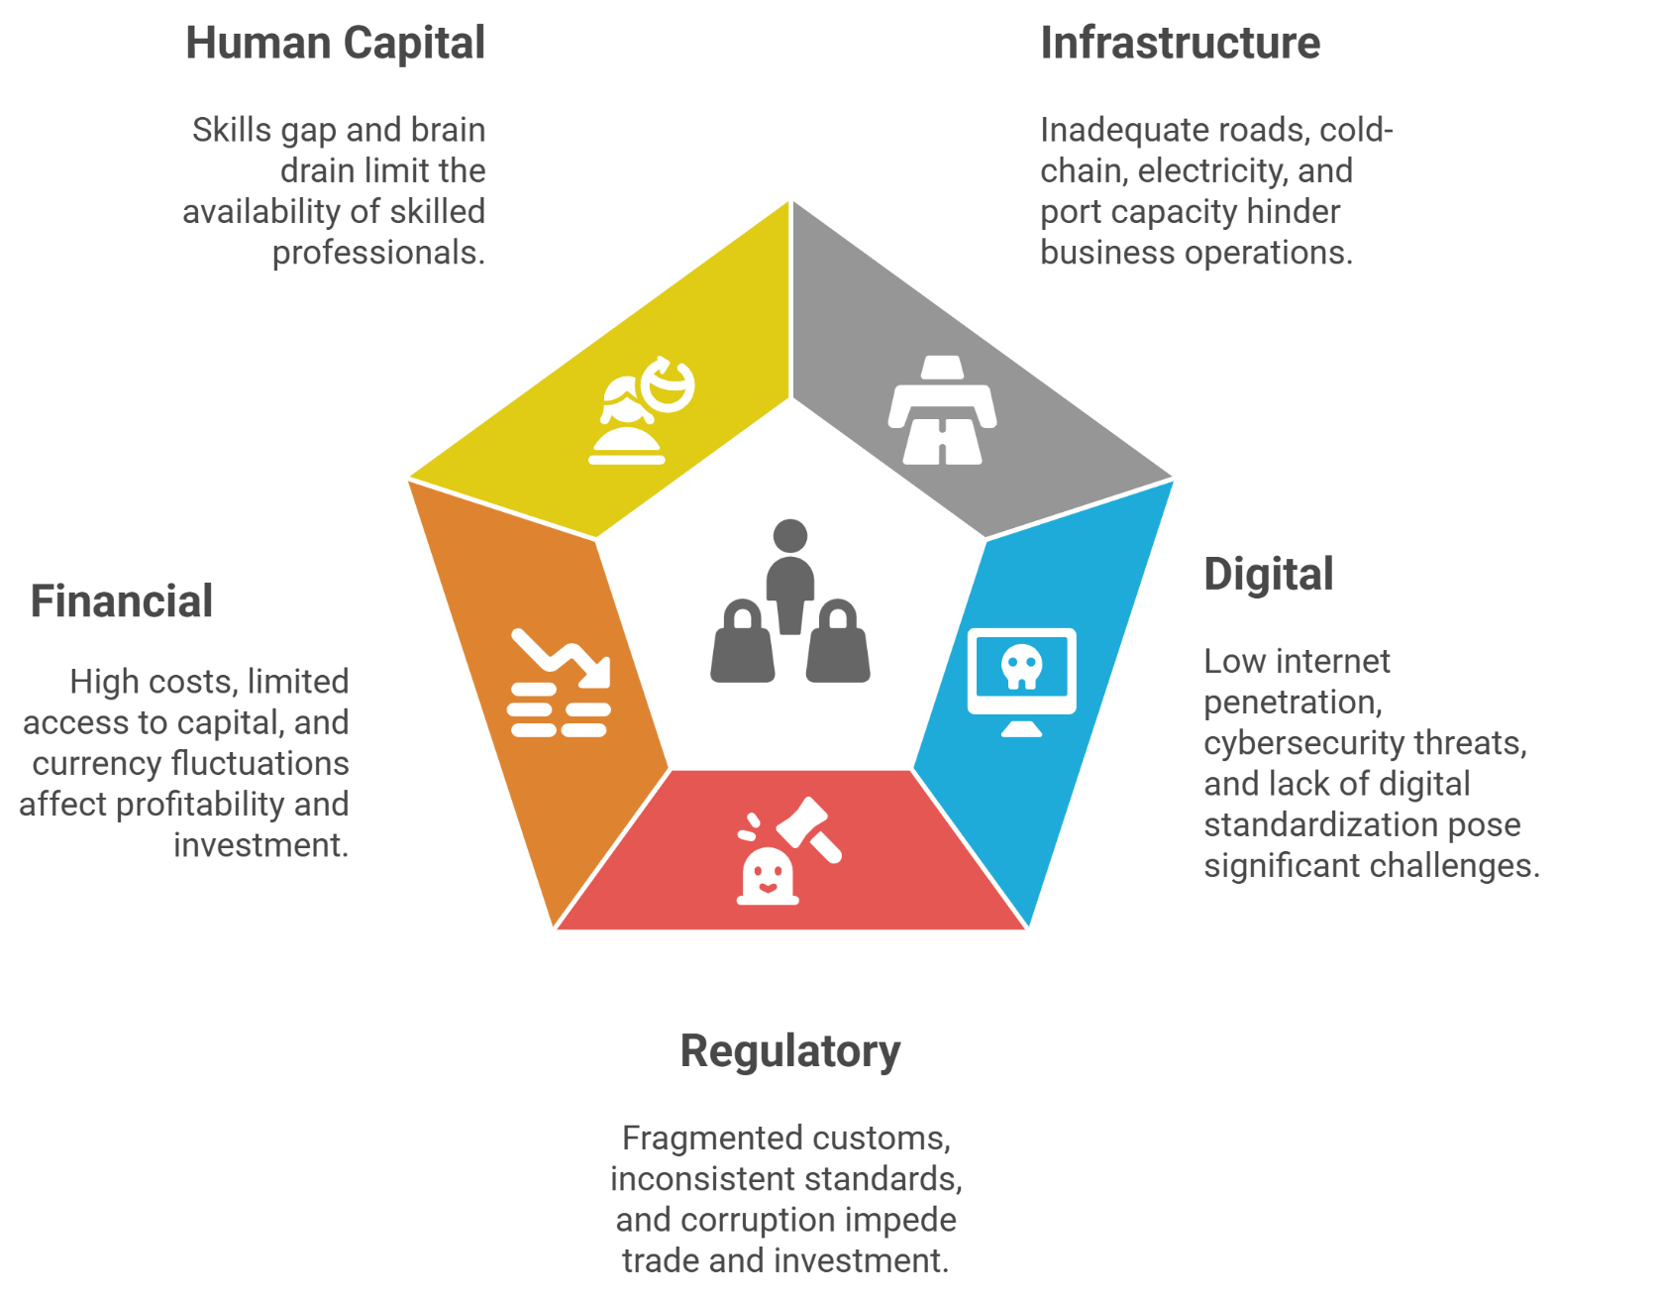
8. Challenges Ahead – Realistic Obstacles

Slide 22
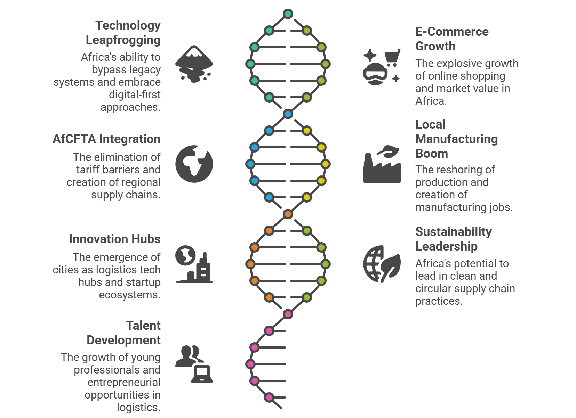
9. Opportunities Ahead – Catalysts for Growth

Slide 23
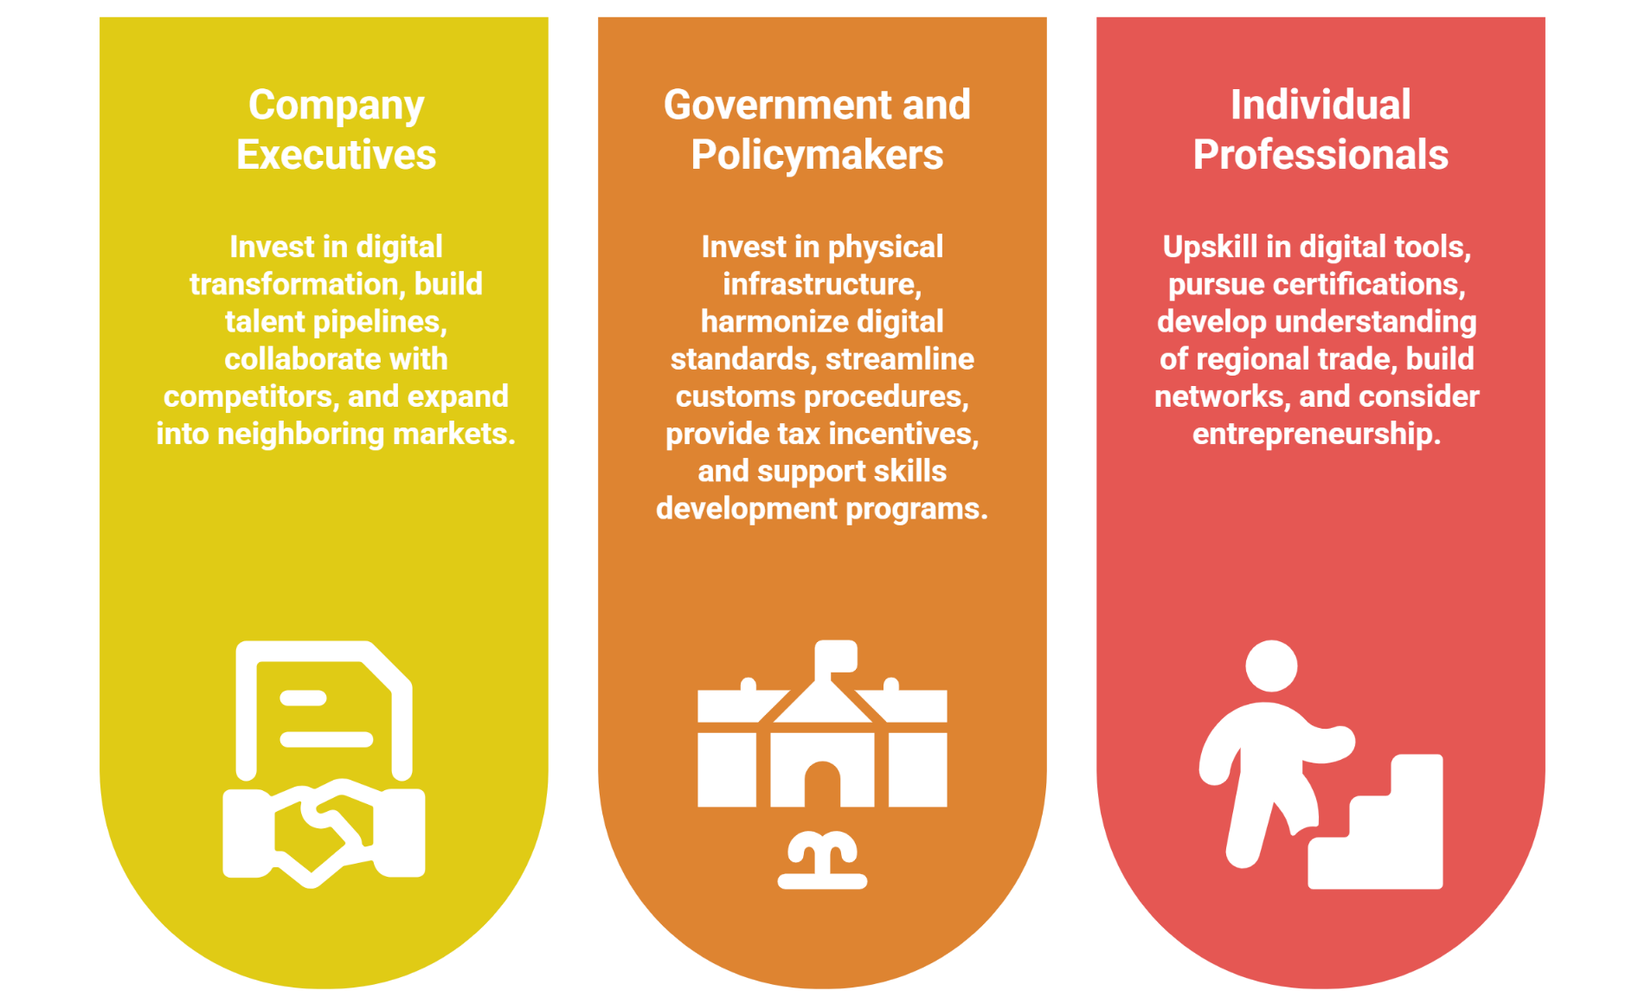
10. Strategic Priorities for African Logistics Leaders

Slide 24
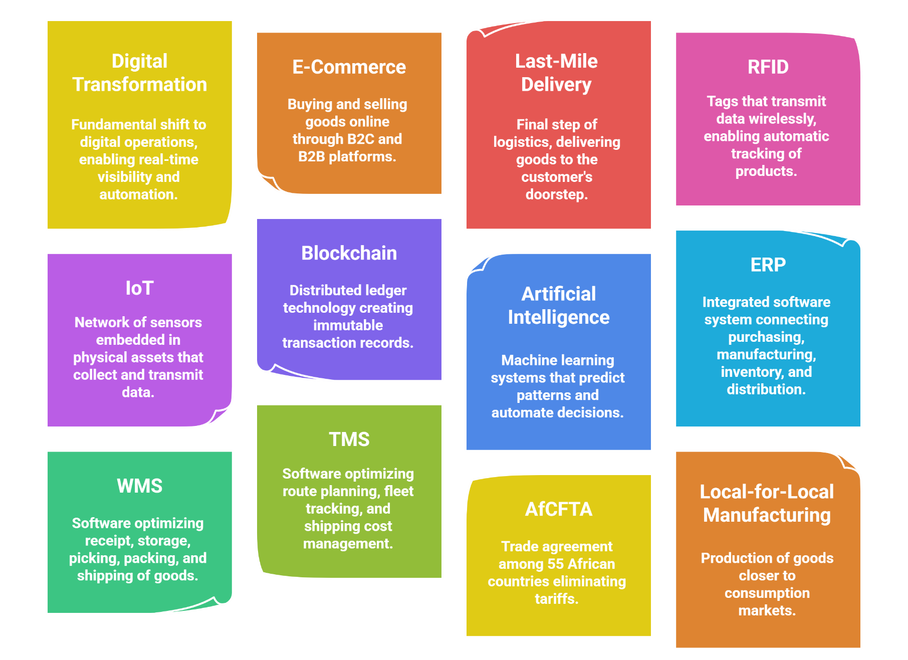
Key Definitions (Reference Sheet)

