Slide 1
Work Package 3: Theoretical and practical teaching materials development to transport in Cameroon and the Democratic Republic of Congo
Daniel Kaszubowski, Wojciech Kustra, Justyna Staszak-Winkler

Slide 2
Road Transportation Systems Engineering Development in the Sub-Saharan Africa – Modern EU Master Programme & Capacity Building

Slide 4

Downloading the installation file
Go to the website:
  https://www.flexsim.com/academia/
Go to the Student tab

Slide 5
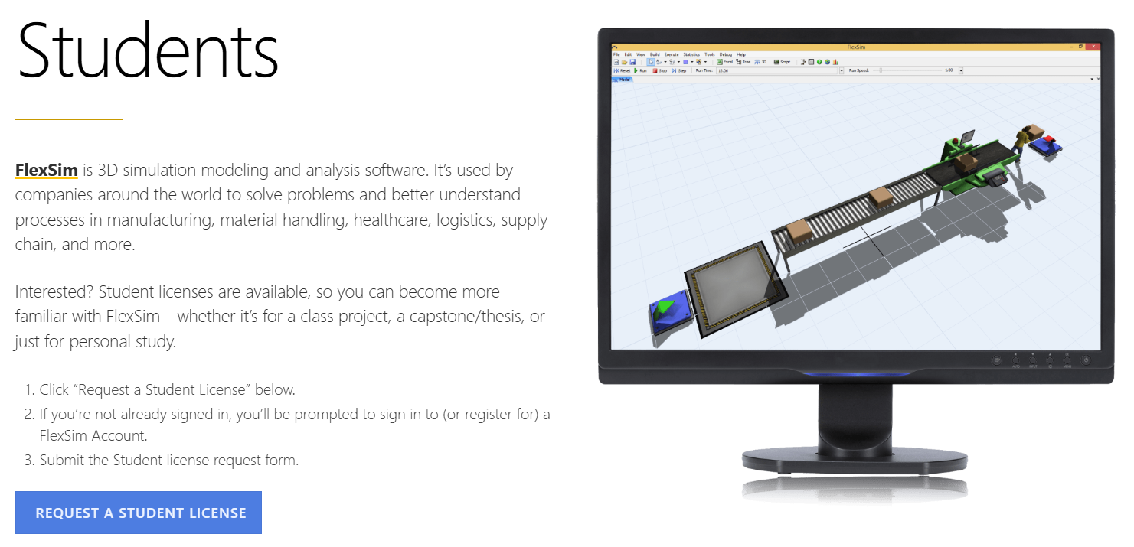
Student license

Slide 6
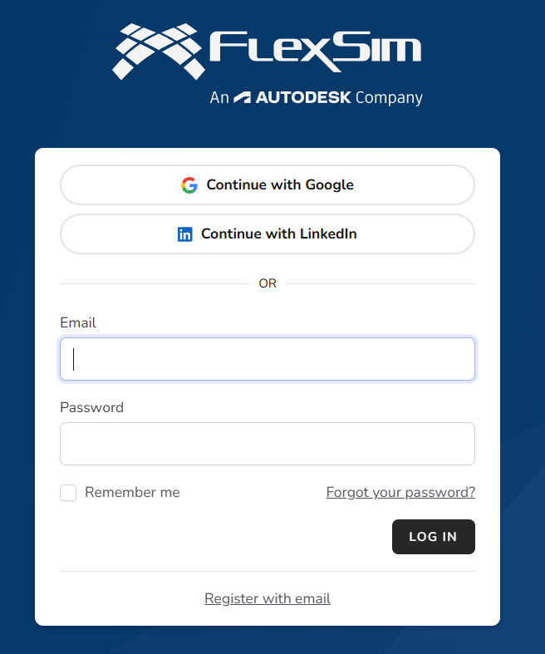
Register for the website

Slide 7
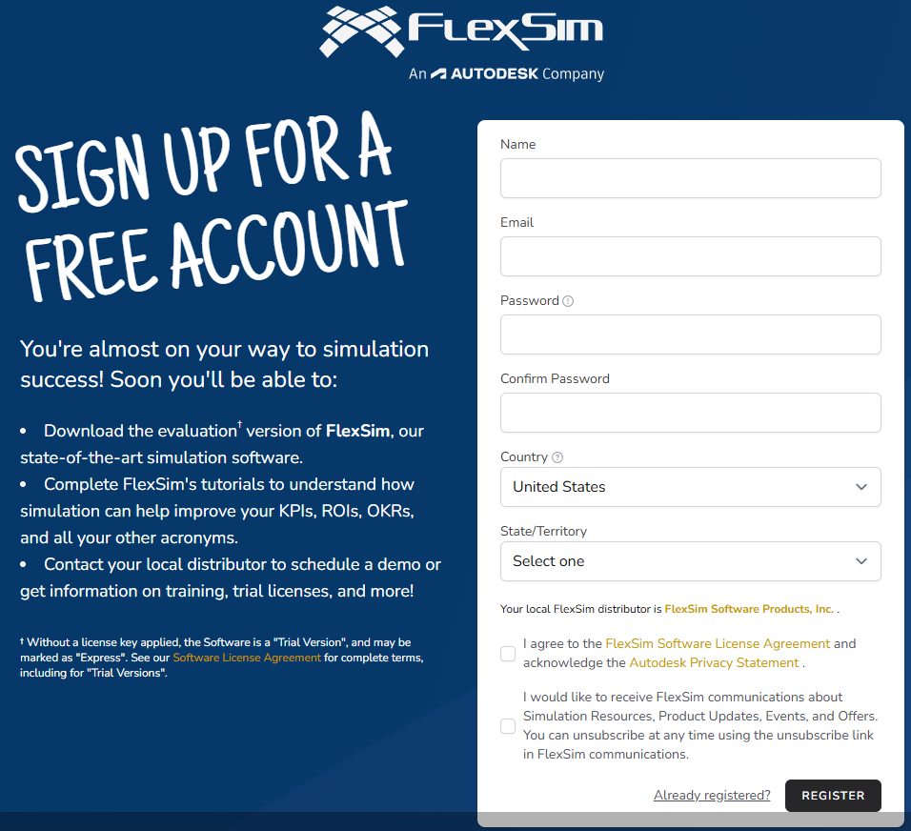
Register for the website - fill in your details

Slide 8
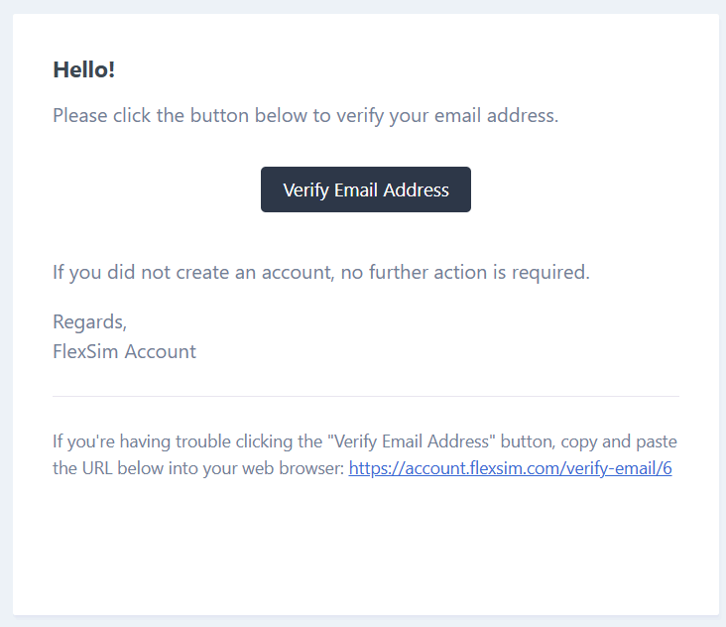
Confirm email

Slide 9
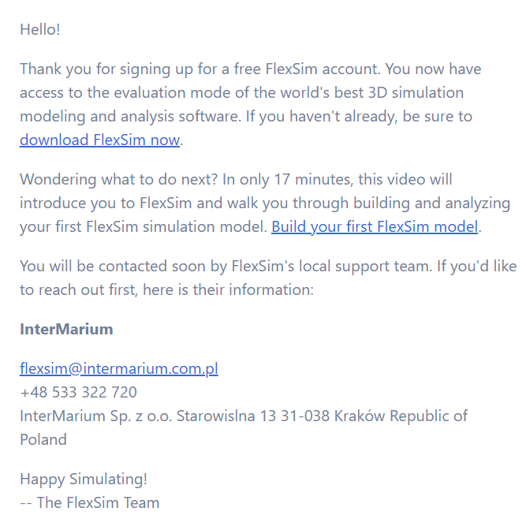
You have an account! Download and install the software.

