Slide 1
African Logistics and Supply Chain Case Studies
Justyna Staszak-Winkler
Daniel Kaszubowski

Slide 2
Road Transportation Systems Engineering Development in the Sub-Saharan Africa – Modern EU Master Programme & Capacity Building

Slide 4
Designing Resilient Transportation Networks in Sub-Saharan Africa: From Infrastructure Bottlenecks to Smart Logistics under AfCFTA
MODULE 1

Slide 5
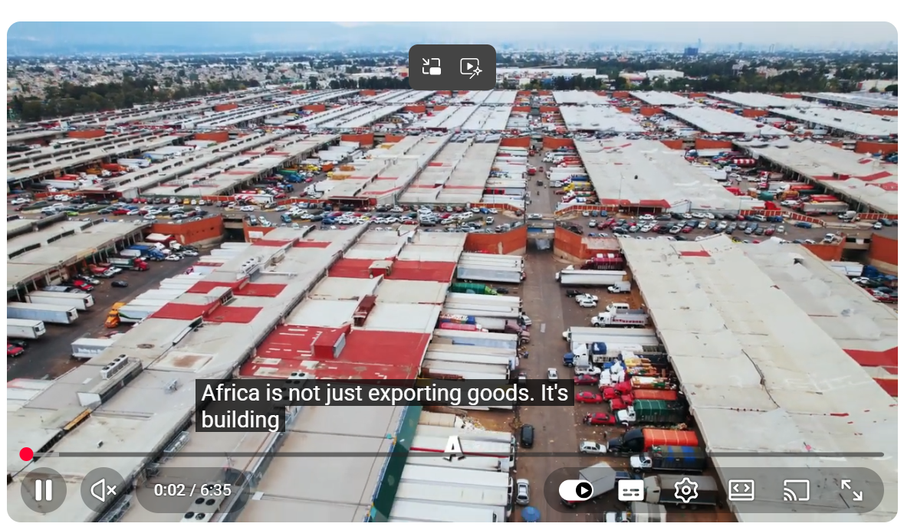
Designing Resilient Transportation Networks in Sub-Saharan Africa: From Infrastructure Bottlenecks to Smart Logistics under AfCFTA
https://www.youtube.com/watch?app=desktop&v=vRXVQIYDh1A&t=199s

Slide 6
Summary of the Film
The video explores the transformation of African supply chains from raw material exporters into a sophisticated "trade engine." A central transportation problem highlighted is the inefficiency and delays caused by poor infrastructure, port congestion (e.g., in Tanzania), and complex regulatory hurdles that act as "obstacle courses." Key concepts include building network resilience, the impact of the African Continental Free Trade Area (AfCFTA), and the integration of the Artificial Intelligence of Things (AIoT) for smart logistics.
Case studies mentioned include Nigeria’s agricultural exports, Kenya’s Standard Gauge Railway, and Rwanda’s e-logistics platforms. The main conclusion is that Africa must transition from being a "price taker" to a "price maker" by adding value through local processing and leveraging technology to ensure visibility and speed. This shift is largely driven by a new generation of African youth and tech entrepreneurs.

Slide 7
Learning Outcomes
Upon completion of this task, the student:
analyzes the impact of road and port infrastructure on the overall efficiency of regional supply chains.
evaluates the suitability of AIoT and smart tracking technologies within the context of constrained or fragmented transportation networks.
identifies specific regulatory and physical barriers to cross-border trade in the Sub-Saharan region.
proposes realistic management solutions to improve cargo flow, aligning with AfCFTA objectives.

Slide 8
Instructions for Students
Based on the video and your engineering knowledge, complete the following:
Identify the primary transportation problem described in the material that you believe has the most critical impact on trade in your specific region.
Describe the technical and administrative causes and the economic consequences of this problem, using examples from the film (e.g., port delays or the "labyrinth" of cross-border trade).
Relate this problem to local conditions in the DR Congo, Cameroon, or another Sub-Saharan country. Do the barriers mentioned (infrastructure, regulations) manifest locally in the same way?
Propose three realistic corrective or developmental actions that combine physical infrastructure improvements with digital "smart logistics" innovations.

Slide 9
Supporting Questions
Why is the transport of agricultural products, such as ginger in Nigeria, often inefficient despite the country being a top global producer?
How can technology partnerships (like the one between MTN and Powerfleet) reduce uncertainty in road transport operations?
What are the limitations of implementing real-time tracking systems in areas with poor or inconsistent telecommunications coverage?
How can major rail projects (like Kenya’s Standard Gauge Railway) alleviate road congestion, and what are the challenges of intermodal integration?

Slide 10
Supporting Questions
What role does the AfCFTA play in harmonizing customs procedures, and how does this simplify the work of a transport systems engineer?
What specific data would you need to gather to assess the "resilience" of a transport corridor in your home country?
What role should local technical universities and logistics startups play in "reclaiming the network"?

Slide 11
Expected Results
Students are required to prepare:
a report (3–5 pages) or a presentation (5–7 slides),
3–5 practical recommendations aimed at improving the functioning of transport and logistics systems in the analyzed Sub-Saharan African region.
The recommendations may concern, among others:
modernization of road, port, or railway infrastructure,
improvement of cross-border transport operations and customs procedures,
implementation of smart logistics technologies (e.g., AIoT, GPS, cargo tracking systems),
enhancement of intermodal transport integration,
development of logistics centers and distribution hubs,
improvement of cargo flow visibility and monitoring systems,
reduction of transport delays and logistics costs,
increasing the resilience of supply chains,
development of local technical competencies and cooperation between universities and the logistics sector.

Slide 12
Evaluation Criteria
Criterion | Description | Excellent Performance | Poor Performance | Points
Understanding of the Material | Accurate identification of key concepts such as AfCFTA, AIoT, resilience, and logistics integration. | Correctly identifies and explains all major themes and relationships. | Misinterprets or omits core concepts. | 20
Quality of Problem Analysis | Ability to connect infrastructure limitations with supply chain and distribution consequences. | Demonstrates analytical insights. | Provides only superficial or descriptive observations. | 20
Local Context Application | Use of relevant examples from the DRC, Cameroon, or the student’s home country. | Precisely identifies local logistics corridors, transport barriers, or regional realities. | No meaningful regional reference or contextualization. | 20
Quality of Recommendations | Realism, feasibility, and innovation of proposed logistics improvements. | Proposes balanced and realistic technological and infrastructure solutions. | Recommendations are unrealistic or impossible to implement. | 20
Structure & Critical Thinking | Clarity, professionalism, and critical reflection on the source material. | Well-structured analysis with critical evaluation of optimistic/promotional narratives. | Disorganized structure and lack of critical reflection. | 20
 |  | TOTAL |  | 100

Slide 13
Short Description for Students
Task: Analyzing Transport Network Resilience in Africa under AfCFTA
Watch the video "Africa’s Supply Chain Network System" and prepare a 3–5 page report and a short presentation. Your task is to identify the transport barriers (infrastructure, regulations) discussed and relate them to the specific realities of the DR Congo or Cameroon. You must propose three realistic solutions—such as AIoT implementation or transport corridor modernization—to help transition African supply chains from "price takers" to "price makers." This task is designed to develop your critical analysis and system design skills in infrastructure-constrained environments. Deadline: [Insert Date]

