Slide 1
Introduction to Distribution
Part 1
Justyna Staszak-Winkler
Distribution and material movement

Slide 2
Road Transportation Systems Engineering Development in the Sub-Saharan Africa – Modern EU Master Programme & Capacity Building

Slide 4
Introduction to Distribution
MODULE 1
Part 1
Justyna Staszak-Winkler
Distribution and material movement

Slide 5
MODULE 1 - Objectives
to understand the essence of distribution
to identify different types of distribution channels
to be able to evaluate the effectiveness of a distribution channels
Distribution and material movement

Slide 6

Distribution and its role in the supply chains

Slide 7
What is distribution?
Perspective | Explanation
Functional (activity-based) perspective | Distribution is a set of activities and decisions related to offering a product (or products) in a place and at a time that correspond to customer needs.
Supply chain management perspective | Distribution is a component of the supply chain, defined as the cooperation between different functional areas of companies — extractive, manufacturing, commercial, and service — and their customers, between whom flows of products, information, and financial resources occur.
Position in the logistics chain | Distribution is an intermediary link between production and consumption, whose role is to bridge the gaps separating these two spheres.
Distribution and material movement

Slide 8
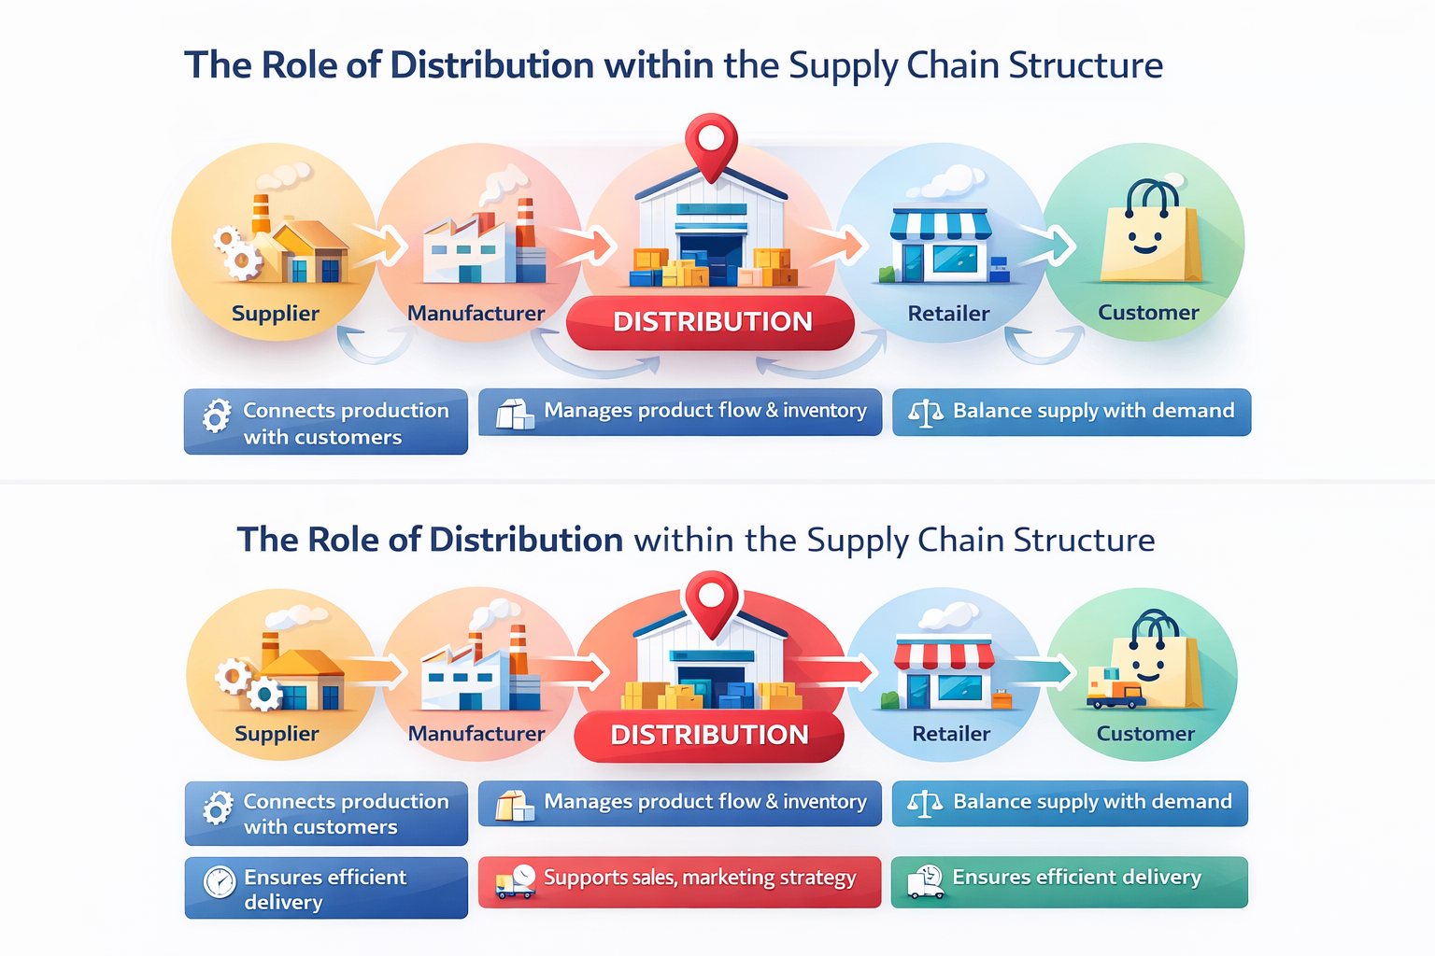
Distribution and material movement

Slide 9
The role of distribution within the supply chain structure
Ensures product availability across different markets.
Balances inventory between different supply chain nodes.
Reduces delays and bottlenecks in product delivery.
Supports reliable and predictable customer service.
Distribution and material movement

Slide 10
Essence of distribution
Distribution refers to all activities involved in moving products from the producer to the final customer.
It ensures product availability in the right place, at the right time, in the right quantity, and at an acceptable cost.
It connects production with market demand and enables value creation for customers.
Distribution and material movement

Slide 11
Decision-making problems within distribution
Choice of the method of selling, which essentially refers to determining the types of distribution channels in a transactional sense.
Choice of the method of moving products from the place of production to the place of destination, referred to as physical distribution.
Distribution and material movement

Slide 12
Decision-making problems within distribution –
Choice of the method of selling
This decision concerns how the company intends to reach its customers from a transactional perspective. It involves selecting the appropriate distribution channels and deciding:
whether the sales process will be direct or indirect,
which intermediaries (if any) will participate in the exchange,
how responsibilities for pricing, promotion, customer service, and risk will be divided among channel members,
how relationships with intermediaries will be managed (short-term transactions vs. long-term partnerships).
The aim is to design a channel structure that ensures accessibility of the product while optimizing profitability, control, and market coverage.
Distribution and material movement

Slide 13
Decision-making problems within distribution –
Choice of the method of moving products from the place of production to the place of destination
This area focuses on the logistical flow of goods from production sites to final destinations. It includes decisions related to:
transportation modes and routes,
location and number of warehouses and distribution centers,
inventory levels and order fulfillment systems,
packaging, handling, and storage,
coordination of deliveries (e.g., just-in-time vs. stock-based systems),
cost control and service level optimization.
The objective is to deliver products at the right time, in the right quantity, to the right place, while minimizing costs and maintaining service quality.
Distribution and material movement

Slide 14
Distribution as a part of logistics and marketing
Aspect | Distribution in logistics | Distribution in marketing
Main focus | Physical flow of goods and operational efficiency | Customer access, value delivery, and market reach
Key activities | Warehousing, transportation, order picking, inventory control, handling | Channel selection, retailer relationships, market coverage, placement decisions
Primary objective | Deliver products on time, in the right quantity and condition, at the lowest possible cost | Ensure products are available where and when customers want them
Decision criteria | Costs, capacity, lead time, reliability, process optimization | Customer preferences, market strategy, brand positioning
Role in the company | Supports operations and supply chain performance | Supports sales, marketing strategy, and revenue growth
Performance indicators | Delivery time, logistics cost, stock levels, service reliability | Sales volume, customer satisfaction, channel effectiveness
Distribution and material movement

Slide 15
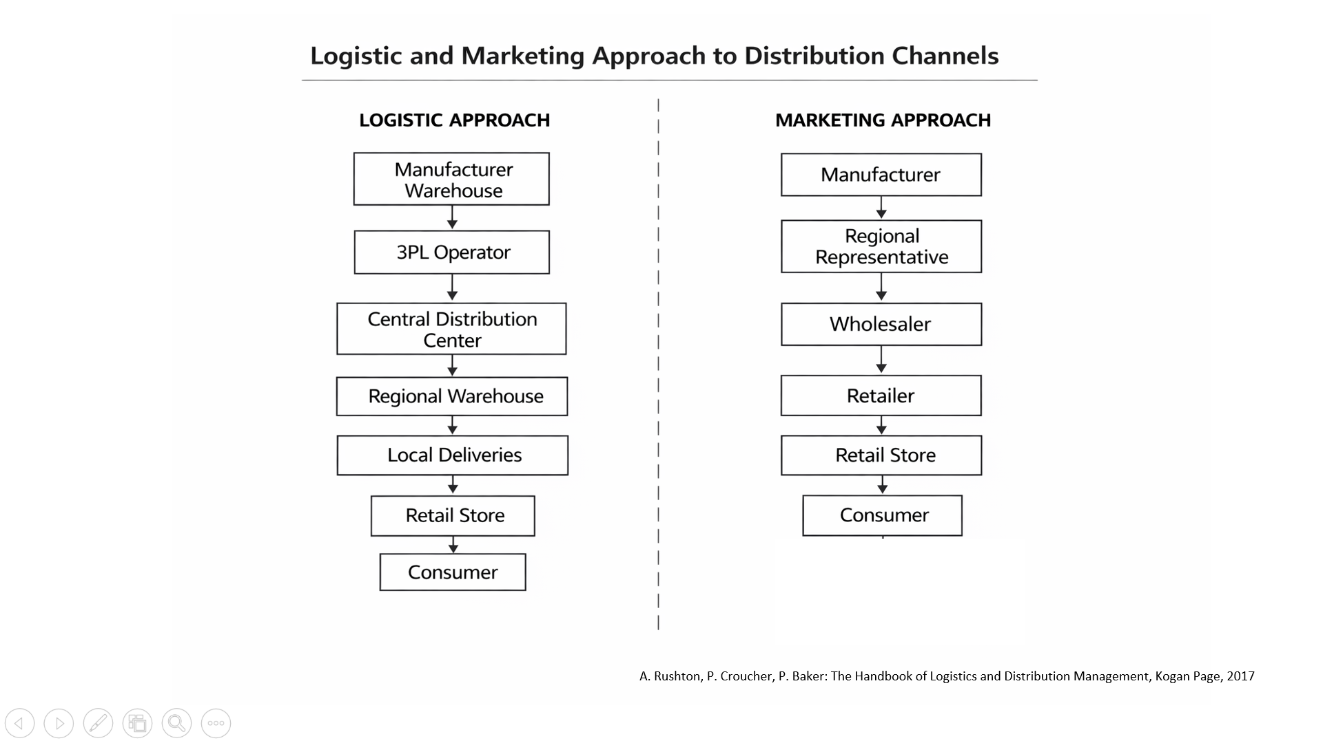
Distribution and material movement

Slide 16
How logistics and marketing meet in distribution ?
Logistics focuses on efficiency and cost, while marketing focuses on customer value and accessibility.
Effective distribution integrates both perspectives to deliver:
  shorter delivery times,
  lower costs,
  better product availability,
  higher customer satisfaction.
Distribution and material movement

