Slide 1

Material flow management
Part 2
Justyna Staszak-Winkler

Slide 2
Road Transportation Systems Engineering Development in the Sub-Saharan Africa – Modern EU Master Programme & Capacity Building

Slide 4
Material flow management
MODULE 2
Part 2
Justyna Staszak-Winkler

Slide 5

Planning and control of material flows

Slide 6
Planning and control of material flows
Planning and control of material flows focus on ensuring the smooth, efficient, and coordinated movement of materials across the supply chain while minimizing costs, waste, and risks.

Slide 7
Just-in-Time (JIT)
Just-in-Time is a material flow concept aimed at delivering materials exactly when they are needed, in the required quantity, and without excessive inventory.
Key characteristics of JIT:
Minimal inventory levels
Frequent and small deliveries
Close cooperation with suppliers
High reliability of transport and production schedules

Slide 8
Just-in-Time (JIT)
Benefits:
Reduced inventory holding costs
Lower risk of obsolescence and damage
Improved responsiveness to demand changes
Limitations (especially relevant in developing regions):
High sensitivity to disruptions
Dependence on infrastructure quality and supplier reliability
Teaching note (Africa context):
In African supply chains, full JIT is often difficult due to infrastructure constraints, but partial JIT solutions (e.g. scheduled deliveries, local sourcing) are increasingly applied in manufacturing and FMCG sectors.

Slide 9
Lean Logistics
Lean logistics focuses on the elimination of waste (non-value-adding activities) in material flows.
Main types of waste in material flows:
Excess inventory
Unnecessary transport
Waiting time
Overprocessing
Errors and rework

Slide 10
Lean Logistics
Lean logistics principles include:
Flow orientation instead of batch processing
Simplification of material handling
Standardization of logistics processes
Continuous improvement (Kaizen)
Key message:
Lean logistics improves material flow efficiency while supporting cost reduction and sustainability

Slide 11
MRP Principles
Material Requirements Planning (MRP)
MRP is a planning system used to determine:
what materials are needed,
in what quantities,
and when they should be available.

Slide 12
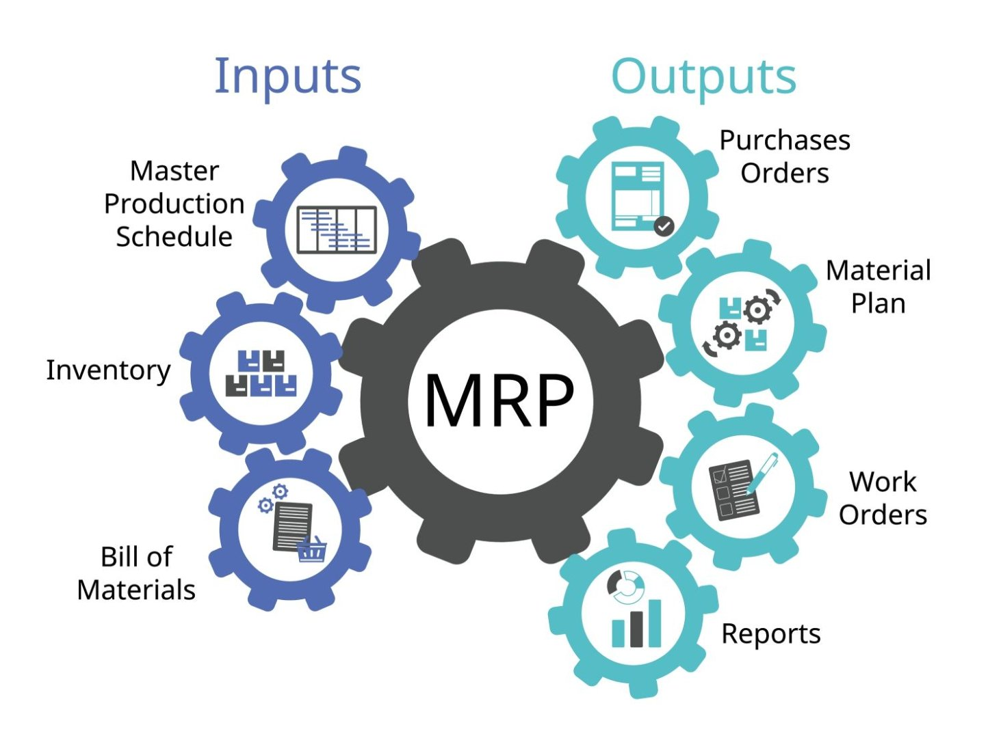
MRP Principles
https://aresth.co.th/en/information/what-is-mrp

Slide 13
MRP Principles
MRP inputs:
Master production schedule
Bill of materials
Inventory records
MRP outputs:
Purchase orders
Production orders
Delivery schedules
Role in material flow control:
MRP ensures that materials arrive in line with production needs, preventing shortages and excess stock.

Slide 14
MRP Inputs - Master Production Schedule (MPS)
The Master Production Schedule specifies what products are to be produced, in what quantities, and at what times.
It translates customer demand and sales forecasts into a detailed production plan for finished goods.
The MPS defines delivery dates, production priorities, and time horizons, and serves as the main driver for all material planning activities.

Slide 15
MRP Inputs
- Bill of Materials (BOM)
The Bill of Materials is a structured list of all components, parts, subassemblies, and raw materials required to manufacture a finished product.
It shows the product structure, including the quantity of each item needed and the relationship between parent items and their components.
The BOM allows the MRP system to explode demand from finished products down to individual materials and parts.

Slide 16
MRP Inputs - Inventory Records (Inventory Status File)
Inventory records contain accurate, up-to-date information about the status of all items in stock.
They include data on:
On-hand inventory
Scheduled receipts (open purchase or production orders)
Lead times
Safety stock levels
Lot sizes and reorder rules
These records ensure that the MRP system can calculate net material requirements and avoid shortages or excess inventory.

Slide 17
MRP Outputs - Purchase Orders
Purchase orders are formal requests sent to suppliers for raw materials, components, or services.
They specify:
Item descriptions and quantities
Required delivery dates
Prices and terms of delivery
They ensure that materials are available on time to meet the production schedule.

Slide 18
MRP Outputs - Production Orders (Manufacturing Orders / Work Orders)
Production orders authorize the manufacturing of specific quantities of items within the company.
They define:
What is to be produced
Where and when production should take place
The sequence of operations and required resources
These orders coordinate activities on the shop floor and ensure timely completion of semi-finished and finished products.

Slide 19
MRP Outputs - Delivery Schedules
Delivery schedules specify when and how finished products or materials should be delivered to customers, warehouses, or internal departments.
They help align production, transportation, and distribution activities, ensuring on-time delivery and efficient logistics planning.

Slide 20
Distribution Requirements Planning (DRP)
DRP extends MRP principles to the distribution side of the supply chain.
DRP focuses on:
inventory levels in distribution centers,
replenishment planning,
coordination between warehouses and retail outlets.

Slide 21
Distribution Requirements Planning (DRP)
Benefits of DRP:
Improved product availability
Reduced distribution inventory
Better coordination between production and distribution
In African contexts, DRP is especially useful for managing long-distance distribution networks and supplying urban markets from centralized warehouses.

Slide 22
Monitoring and Regulating Inventory Levels and Stock Movements
Effective material flow management requires continuous monitoring and control of inventory and stock movements.
Key monitoring tools and techniques:
Inventory turnover ratio
Safety stock calculation
ABC analysis
Reorder point systems

Slide 23
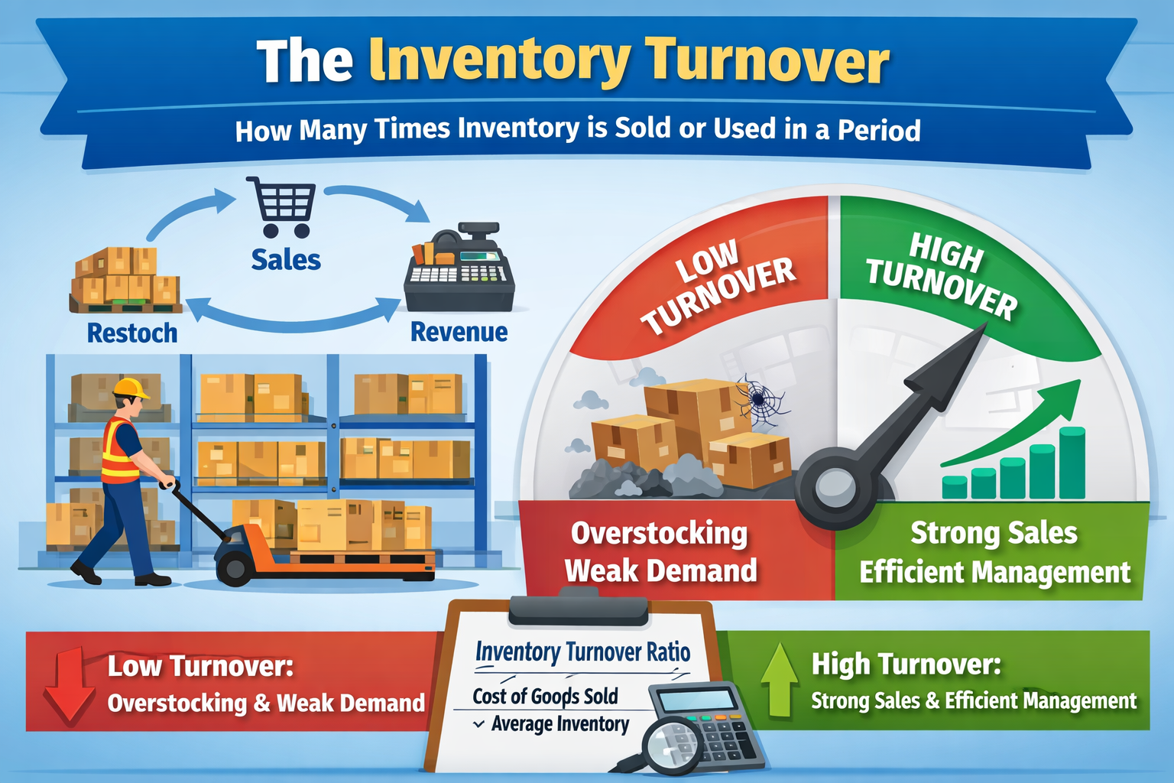
Inventory Turnover Ratio

Slide 24
Inventory Turnover Ratio
The inventory turnover ratio measures how many times inventory is sold or used during a specific period.
It indicates how efficiently a company manages its stock.
A high turnover suggests strong sales and efficient inventory management, while a low turnover may indicate overstocking or weak demand.

Slide 25
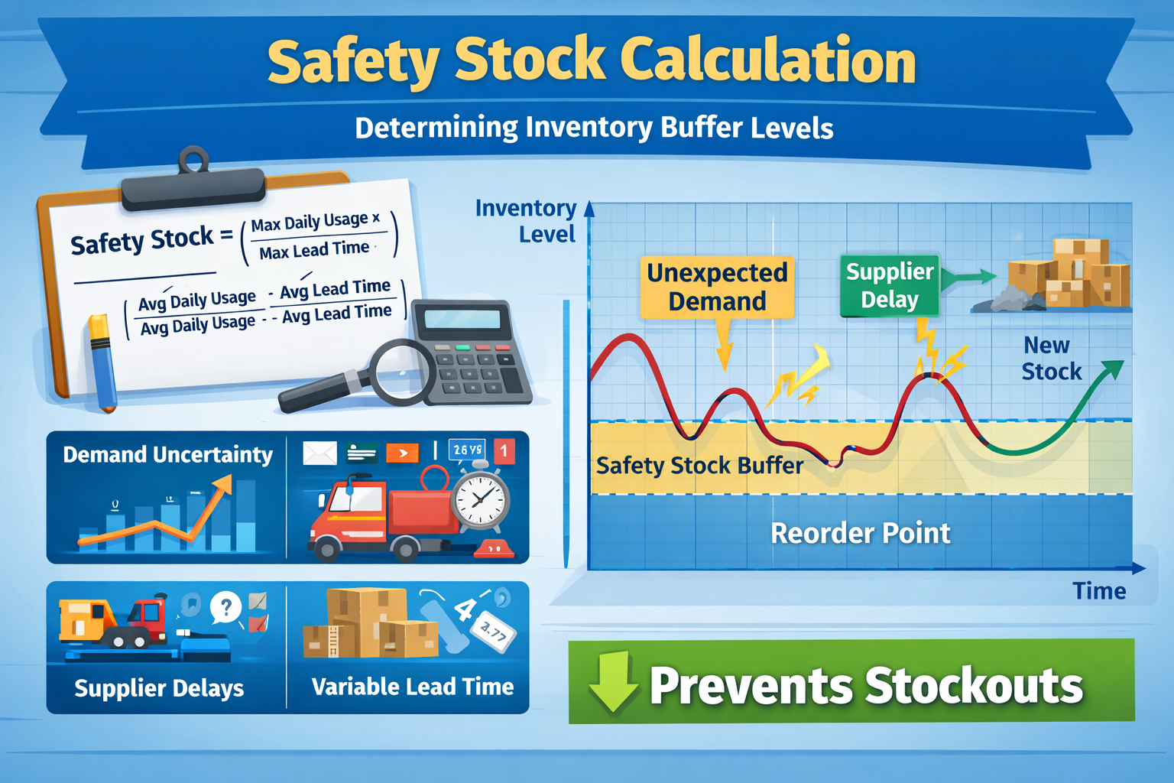
Safety Stock Calculation

Slide 26
Safety Stock Calculation
Safety stock calculation determines the extra quantity of inventory held to protect against uncertainty in demand and supply.
It helps prevent stockouts caused by unexpected increases in demand, supplier delays, or lead time variability.
Proper safety stock levels balance service quality and inventory holding costs.

Slide 27
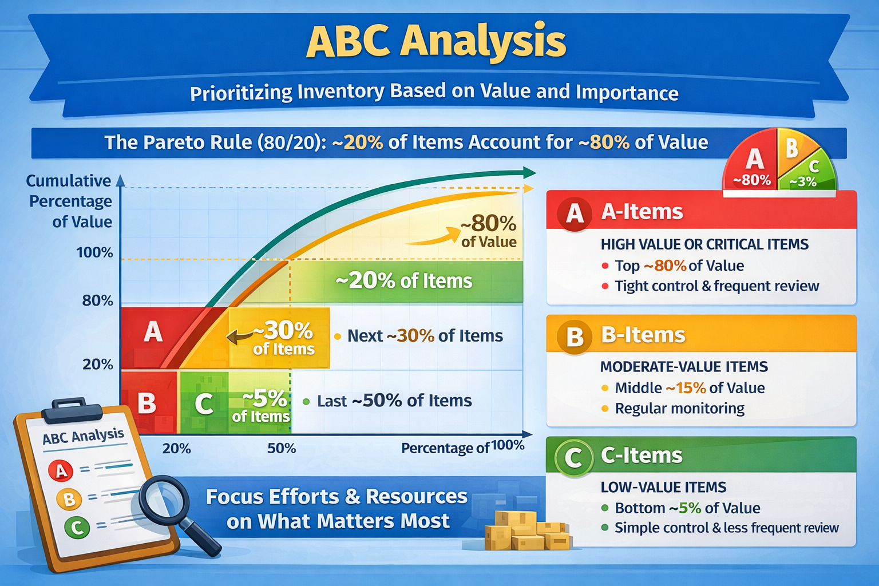
ABC Analysis

Slide 28
ABC Analysis
ABC analysis is an inventory classification method based on the Pareto principle (80/20 rule). Items are divided into three groups according to their value and importance:
  A-items: High-value items, typically around 20% of the inventory, accounting for about 70–80% of total value.
  B-items: Medium-value items, about 30% of inventory, contributing 15–25% of total value.
  C-items: Low-value items, around 50% of inventory, representing only 5–10% of total value.
This method helps companies focus control and resources on the most important items, optimizing inventory management and reducing costs.

Slide 29
Reorder point systems
Reorder point systems define the inventory level at which a new order should be placed.
The reorder point is typically based on expected demand during lead time plus safety stock.
These systems help ensure continuous availability of products while minimizing excess inventory.

Slide 30
Monitoring and Regulating Inventory Levels and Stock Movements
Technological support:
ERP systems
Warehouse Management Systems (WMS)
Barcode and RFID technologies
Objectives of inventory control:
Avoid stockouts
Prevent overstocking
Ensure accurate stock records
Improve material traceability
In many African supply chains, improving inventory visibility is one of the fastest ways to enhance material flow efficiency.

Slide 31
ERP systems
ERP systems provide technical support for:
Inventory Monitoring
  Real-time tracking of stock levels across multiple warehouses or locations.
  Automatic updates when items are received, shipped, or transferred.
  Alerts for low stock, overstock, or expiration of perishable items.
Stock Movements and Logistics
  Recording inbound and outbound transactions (purchases, sales, transfers).
  Tracking goods in transit or reserved for orders.
  Integration with barcoding, RFID, or IoT sensors for precise tracking.
An ERP (Enterprise Resource Planning) system is a software platform that integrates key business processes across an organization. In the context of inventory management and stock control, ERP systems play a crucial role in monitoring, regulating, and optimizing inventory levels and movements.

Slide 32
ERP systems
Inventory Optimization
  Forecasting demand using historical data and predictive analytics.
  Recommending reorder points and quantities to avoid shortages or excess stock.
  Supporting just-in-time (JIT) and lean inventory strategies.
Technical Support Features
  Automated reporting and dashboards for inventory KPIs (turnover, holding costs, stock aging).
  Integration with purchasing, production, and sales modules to ensure seamless flow of goods.
  Alerts and notifications for discrepancies or anomalies in stock movements.

Slide 33
ERP systems
Benefits
Improved accuracy: reduces human errors in stock management.
Efficiency: streamlines warehouse operations and stock replenishment.
Cost reduction: minimizes excess inventory and storage costs.
Transparency: provides a clear view of inventory across the supply chain.
Decision support: technical insights help managers make data-driven decisions.

Slide 34
Examples of ERP Support in Inventory Management
SAP Inventory Management: Real-time visibility of stock, automated reorder suggestions.
Oracle NetSuite: Tracks inventory across multiple locations, integrates with demand planning.
Odoo ERP: Supports barcode scanning, real-time stock updates, and alerts for stock shortages.

Slide 35
Challenges and Optimization of Material Flows
Main challenges in material flow management:
Poor transport infrastructure
Long lead times
Unreliable suppliers
Demand uncertainty
Limited access to advanced IT systems

Slide 36
Challenges and Optimization of Material Flows
Optimization strategies:
Consolidation of shipments
Use of regional logistics hubs
Multimodal transport solutions
Supplier diversification
Digitalization of logistics processes
Sustainability considerations:
Reduction of empty runs
Energy-efficient transport modes
Support for circular material flows
Optimizing material flows requires balancing efficiency, resilience, and sustainability, especially in emerging and developing economies.

Slide 37

Planning and Control of Material Flows in Africa
FMCG Supply Chain in East Africa (Kenya)
A regional FMCG company produces and distributes:
food products,
beverages,
basic household goods
to:
wholesalers,
informal retailers (kiosks),
supermarkets in Nairobi and surrounding urban areas.
The supply chain includes:
local suppliers,
one central production plant,
regional warehouses,
last-mile distributors.

Slide 38
Just-in-Time (JIT) and Lean Logistics in Practice
Application
Raw materials are delivered in scheduled time windows rather than stored in large quantities.
Frequent, smaller deliveries are used for high-demand products.
Lean principles are applied in warehouses:
  simplified picking routes,
  standardized packaging units,
  reduced handling steps.
Results
Lower inventory holding costs
Reduced spoilage of perishable goods
Faster response to demand fluctuations
FMCG Supply Chain in East Africa (Kenya)
In African FMCG supply chains, hybrid JIT models are used — combining JIT principles with safety buffers due to infrastructure risks.

Slide 39
MRP and DRP Principles in the Case
MRP – Production Planning
Sales forecasts from urban markets generate production plans.
MRP calculates:
  material quantities,
  delivery timing,
  procurement needs.
Local suppliers are preferred to reduce lead times.
DRP – Distribution Planning
DRP plans replenishment of regional warehouses based on:
  historical sales,
  seasonal demand,
  promotion periods.
Distribution schedules are aligned with transport availability.
FMCG Supply Chain in East Africa (Kenya)
MRP and DRP help synchronize production capacity with geographically dispersed demand, a common challenge in African markets.

Slide 40
Monitoring and Regulating Inventory Levels
Inventory Control Tools Used
ABC analysis:
  A-items: fast-moving essentials (daily monitoring),
  B-items: regular consumer goods,
  C-items: low-demand products.
Reorder point systems based on average demand and lead time.
Mobile-based inventory reporting from warehouses and distributors.
Benefits
Reduced stockouts in urban retail outlets
Improved inventory visibility
Better coordination between warehouse and transport operations
FMCG Supply Chain in East Africa (Kenya)
Simple digital tools (mobile apps, SMS-based reporting) significantly improve material flow control in resource-constrained environments.

Slide 41
Challenges and Optimization of Material Flows
Key Challenges
Traffic congestion in urban areas
Poor road conditions in peri-urban zones
Demand volatility linked to income levels and seasonality
Limited cold-chain infrastructure
Optimization Measures
Use of regional micro-hubs closer to consumption areas
Transport route optimization and delivery time windows
Inventory buffering for critical products
Collaboration with local transport operators
Sustainability Aspect
Consolidated deliveries reduce fuel consumption
Lower waste due to improved demand matching
FMCG Supply Chain in East Africa (Kenya)
Optimization in African supply chains focuses on resilience and flexibility, not only cost minimization.

Slide 42
Case Study – Key Learning Outcomes
Planning and control are essential for reliable material flows
JIT and Lean must be adapted to local conditions
MRP and DRP improve coordination across the supply chain
Inventory monitoring enhances service level and reduces waste
Optimization balances efficiency, risk, and sustainability
FMCG Supply Chain in East Africa (Kenya)

