Slide 1

Distribution Logistics
Part 3
Justyna Staszak-Winkler

Slide 2
Road Transportation Systems Engineering Development in the Sub-Saharan Africa – Modern EU Master Programme & Capacity Building

Slide 4
Distribution logistics
MODULE 4
Part 3
Justyna Staszak-Winkler

Slide 5

Last-mile delivery and challenges in urban distribution

Slide 6
Last-Mile Delivery and Challenges in Urban Distribution
Last-mile delivery refers to the final stage of the delivery process, from a distribution hub or warehouse to the customer’s doorstep.
It is critical for customer satisfaction, as speed, reliability, and cost directly impact the perception of service quality.
In urban areas, last-mile delivery faces specific challenges, including traffic congestion, narrow streets, limited parking, and environmental concerns.

Slide 7
Main Challenges in Urban Last-Mile Delivery
Traffic congestion: Delays caused by peak-hour traffic and urban density.
High delivery costs: Last-mile accounts for up to 50% of total logistics costs.
Limited parking and access restrictions: Difficulty in unloading in crowded city areas.
Environmental impact: High CO₂ emissions from delivery vehicles.
Customer expectations: Increasing demand for fast or same-day delivery.

Slide 8
Role of Local Consolidation Centers and Microhubs
Local Consolidation Centers (LCCs)
Facilities where goods from multiple suppliers are consolidated before being delivered to the urban area.
Benefits:
  Reduces the number of trips into the city center.
  Optimizes delivery routes and vehicle capacity.
  Can help reduce traffic congestion and emissions.

Slide 9
Role of Local Consolidation Centers and Microhubs
Microhubs
Small urban warehouses or storage points located close to the final delivery area.
Benefits:
  Enable faster and more frequent deliveries.
  Support the use of eco-friendly vehicles such as cargo bikes or electric vans.
  Can serve as pickup points for customers, reducing failed delivery attempts.

Slide 10
Role of Local Consolidation Centers and Microhubs
Combined Benefits
LCCs handle bulk consolidation outside the city, microhubs manage last-mile deliveries efficiently.
Together, they reduce costs, delivery times, and environmental footprint.

Slide 11
Sustainable Last-Mile Delivery Solutions
Green Vehicles
Electric vans, cargo bikes, and e-trikes reduce CO₂ emissions.
Route Optimization
Using technology to plan efficient delivery routes, minimizing distance and time.
Shared Deliveries
Collaborating with other logistics providers to consolidate deliveries in the same area

Slide 12
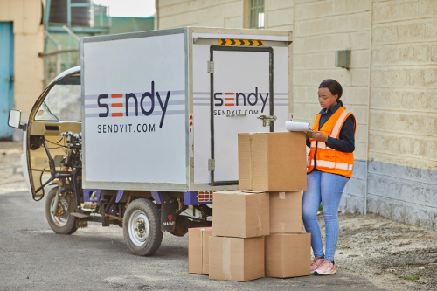
Kenyan logistics firm Sendy deploying e‑cargo vehicles
https://www.dabafinance.com/en/news/kenyan-logistics-firm-sendy-enters-into-administration
Sendy, a Kenyan logistics company, has introduced electric three‑wheeler vehicles and electric bikes for last‑mile deliveries in partnership with ARC Ride. These e‑cargo vehicles (similar to electric tuk‑tuks) help reduce carbon emissions and delivery costs while improving environmental sustainability in urban delivery operations.

Slide 13
Why is this important for Africa?
Electric two‑ and three‑wheelers are often cheaper to operate and maintain than fuel‑powered vehicles, especially where fuel costs are high.
They are highly maneuverable in traffic and on narrow urban roads, common in many African cities.
Cargo e‑bikes and electric vans produce zero tailpipe emissions, which helps cut pollution and supports sustainability goals.

Slide 14
Sustainable Last-Mile Delivery Solutions
Parcel Lockers and Pickup Points
Customers collect their packages at secure lockers or local shops, reducing failed delivery attempts and vehicle trips.
Time Slot Delivery
Scheduling deliveries in specific time windows to smooth demand peaks and reduce congestion.

Slide 15
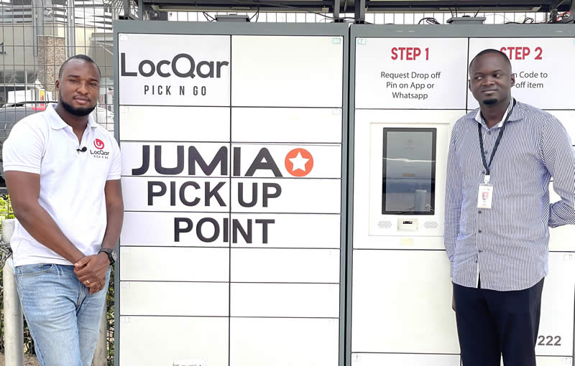
Jumia – e‑commerce with local hubs and pick‑up points
https://group.jumia.com/news/jumia-ghana-brings-deliveries-closer-to-consumers-by-partnering-with-locqar

Slide 16
Jumia – e‑commerce with local hubs and pick‑up points
Jumia, one of the largest e‑commerce platforms in Africa, uses local warehouses, dispatch/collection stations, and logistics partners to manage last-mile delivery in multiple countries. The company implements:
  micro pick‑up points closer to customers,
  partner drop‑off/pick‑up points in local shops,
  which increases delivery accessibility and shortens delivery distances.

Slide 17
Why is this important for Africa?
Road and addressing infrastructure is often insufficient (lack of formal addresses, poor roads), which makes traditional “door-to-door” deliveries difficult.
Solutions based on local pick‑up points and apps have helped make last-mile logistics more reliable, efficient, and accessible even for customers in less privileged areas.

