Slide 1
Transport Planning II
Fundamentals of Transport - Lecture 19

Slide 2
Road Transportation Systems Engineering Development in the Sub-Saharan Africa – Modern EU Master Programme & Capacity Building

Slide 4
Learning Objectives
Students can:
identify the key actors in transport planning
explain the role of public participation and stakeholder involvement
understand political and institutional framework conditions
distinguish different planning levels (local, regional, national)
analyse practical examples of transport governance and decision-making

Slide 5
Contents
Introduction
Actors in Transport Planning
Public Participation & Involvement
Political Framework Conditions
Levels of Transport Planning
Practical Examples
Emerging Trends in Governance

Slide 6
Introduction: Why Governance Matters in Transport Planning
Transport Planning is a Multi-Actor Process
Transport systems affect many groups simultaneously
Decisions involve:
  technical aspects
  political priorities
  financial constraints
  public interests
-> Transport planning is not only engineering: it is also governance and negotiation

Slide 7
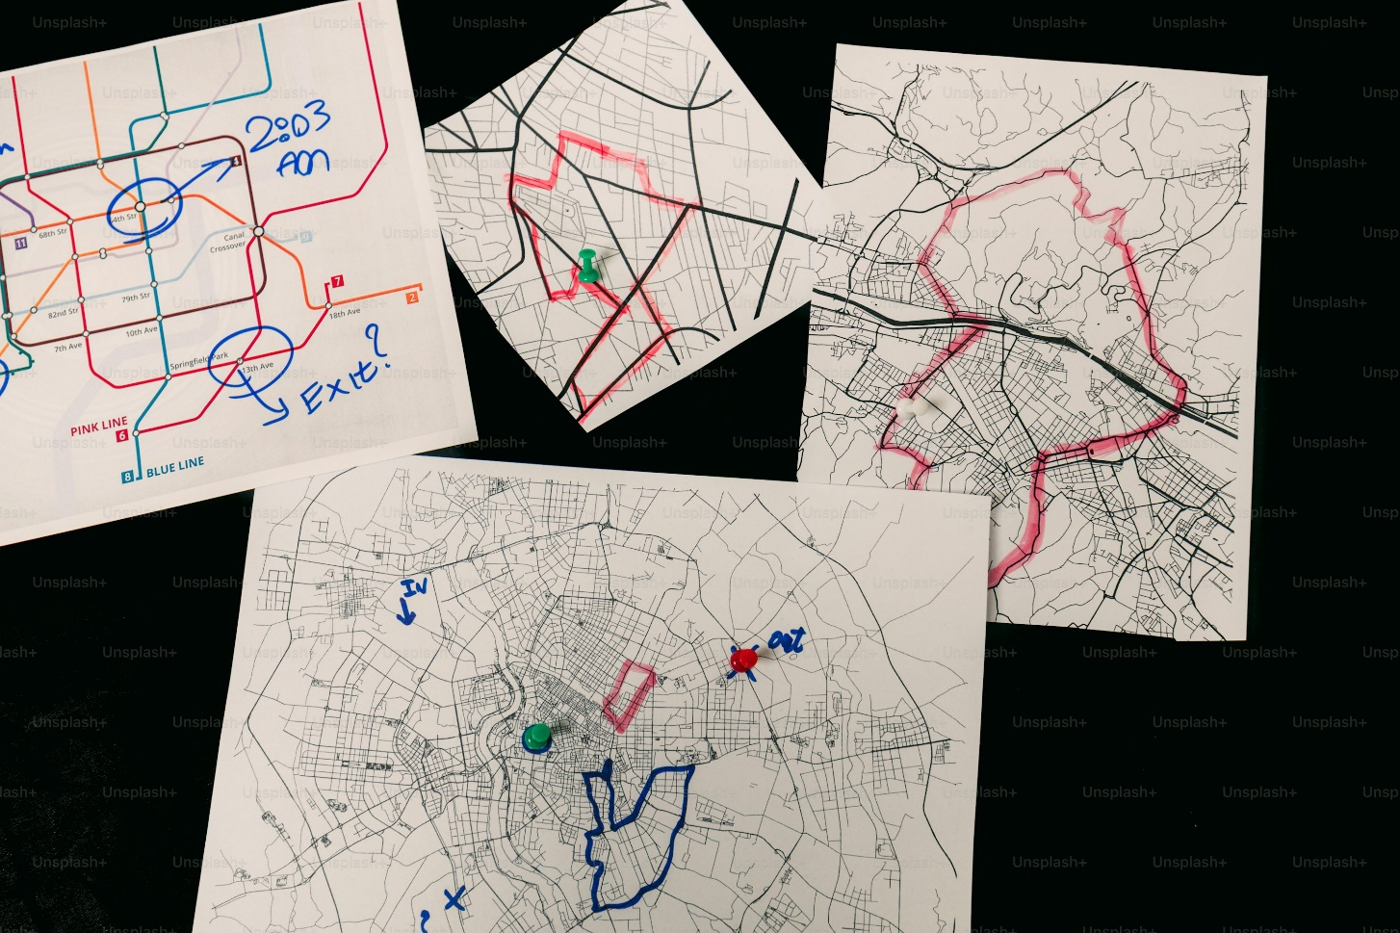
Key Questions in Transport Governance
Who makes transport decisions?
Who finances infrastructure?
Who benefits from planning measures?
How are conflicts resolved?
Fig. 1: Unsplash

Slide 8
Contents
Introduction
Actors in Transport Planning
Public Participation & Involvement
Political Framework Conditions
Levels of Transport Planning
Practical Examples
Emerging Trends in Governance

Slide 9
Main Actor Groups in Transport Planning
Transport planning involves:
governments and public authorities
transport operators
private companies
civil society and communities
NGOs and advocacy groups
international organisations

Slide 10
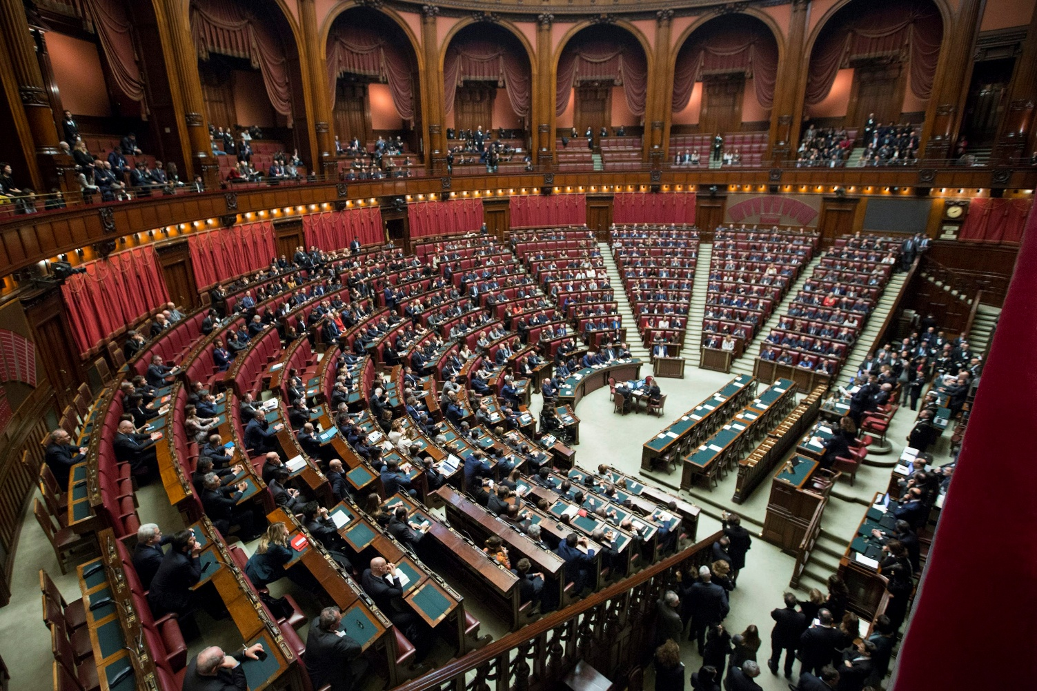
Governments and public authorities
Responsibilities
  infrastructure planning
  regulation
  funding
  policy development
Examples
  ministries of transport
  municipalities
  regional planning agencies
Fig. 2: Unsplash

Slide 11
Transport Operators & Private Companies
public transport companies
railway and airport operators
logistics companies
infrastructure contractors
-> Public and private actors often cooperate in transport systems

Slide 12

Civil Society & NGOs
Examples:
cycling advocacy groups
environmental organisations
neighbourhood associations
Role:
represent public interests
influence political decisions
participate in planning processes
Fig. 3: Unsplash

Slide 13

International Organisations
Key actors:
World Bank
OECD
International Transport Forum
UN-Habitat
Roles:
funding
policy guidance
research and standards
Fig. 4: Unsplash

Slide 14
Contents
Introduction
Actors in Transport Planning
Public Participation & Involvement
Political Framework Conditions
Levels of Transport Planning
Practical Examples
Emerging Trends in Governance

Slide 15
Why Public Participation Matters
transport projects directly affect communities
improves legitimacy and acceptance
helps identify local needs and problems
-> Modern transport planning increasingly emphasises participatory approaches

Slide 16

Forms of Participation
public hearings
workshops and forums
surveys
online participation platforms
stakeholder consultations
Fig. 5: Unsplash

Slide 17
Benefits of Participation
better local knowledge
increased transparency
conflict reduction
stronger democratic legitimacy

Slide 18
Challenges of Participation
conflicting stakeholder interests
unequal representation
time-consuming processes
balancing expert knowledge and public opinion

Slide 19
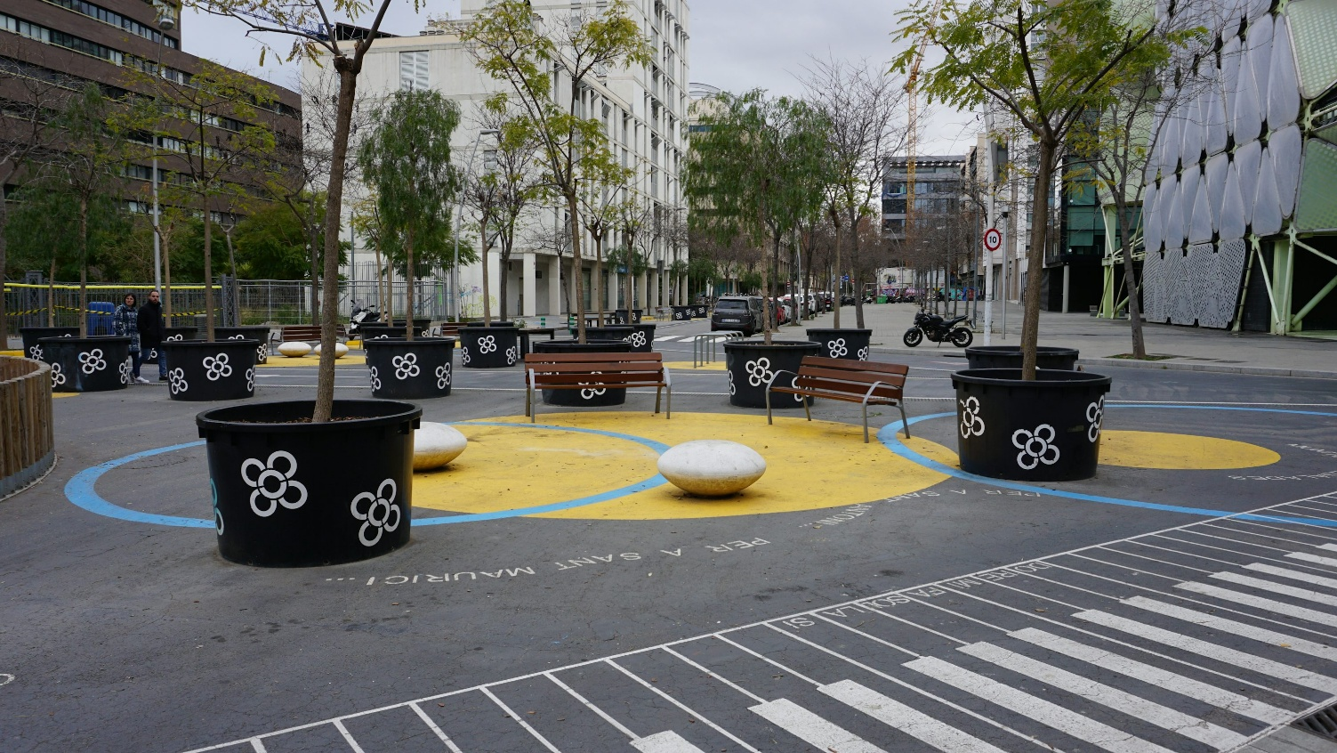
Participatory Planning Example
Example: Cycling Infrastructure Projects
Public participation often includes:
  community workshops
  citizen feedback on street design
  temporary pilot projects (“tactical urbanism”)
Fig. 6: Unsplash

Slide 20
Contents
Introduction
Actors in Transport Planning
Public Participation & Involvement
Political Framework Conditions
Levels of Transport Planning
Practical Examples
Emerging Trends in Governance

Slide 21
Role of Politics in Transport Planning
Transport planning depends on:
political priorities
funding availability
legal frameworks
institutional responsibilities

Slide 22
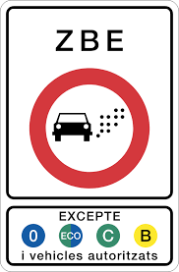
Policy Objectives
Common political goals:
economic growth
congestion reduction
climate protection
social equity
regional development
Fig. 7: Palma Parking

Slide 23
Legal Frameworks
Transport planning is shaped by:
national laws
environmental regulations
urban planning regulations
international agreements

Slide 24
Funding & Investment Decisions
Infrastructure projects require:
public funding
long-term investment planning
prioritisation of projects
-> Political decisions strongly influence which projects are implemented

Slide 25
Contents
Introduction
Actors in Transport Planning
Public Participation & Involvement
Political Framework Conditions
Levels of Transport Planning
Practical Examples
Emerging Trends in Governance

Slide 26
Levels of Transport Planning: Local Level
Focus
  urban mobility
  public transport services
  cycling and pedestrian infrastructure
  parking management
Actors:
  municipalities
  local transport authorities

Slide 27
Levels of Transport Planning: Regional Level
Focus
  regional rail systems
  commuter transport
  coordination between municipalities
  regional economic development

Slide 28
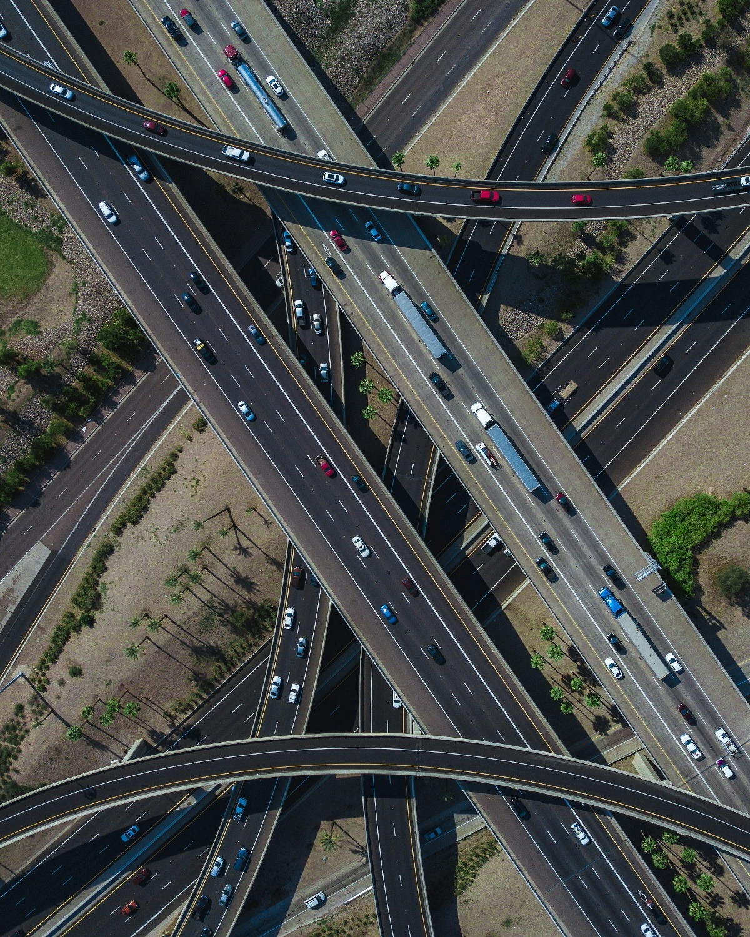
Levels of Transport Planning: National Level
Focus
  national infrastructure networks
  highways and rail corridors
  aviation and ports
  transport legislation
Actors:
  ministries of transport
  national governments
Fig. 8: Unsplash

Slide 29
Levels of Transport Planning: International Level
Focus
  cross-border infrastructure
  climate policy
  aviation and maritime regulation
Examples:
  EU transport policy
  international aviation agreements

Slide 30
Contents
Introduction
Actors in Transport Planning
Public Participation & Involvement
Political Framework Conditions
Levels of Transport Planning
Practical Examples
Emerging Trends in Governance

Slide 31
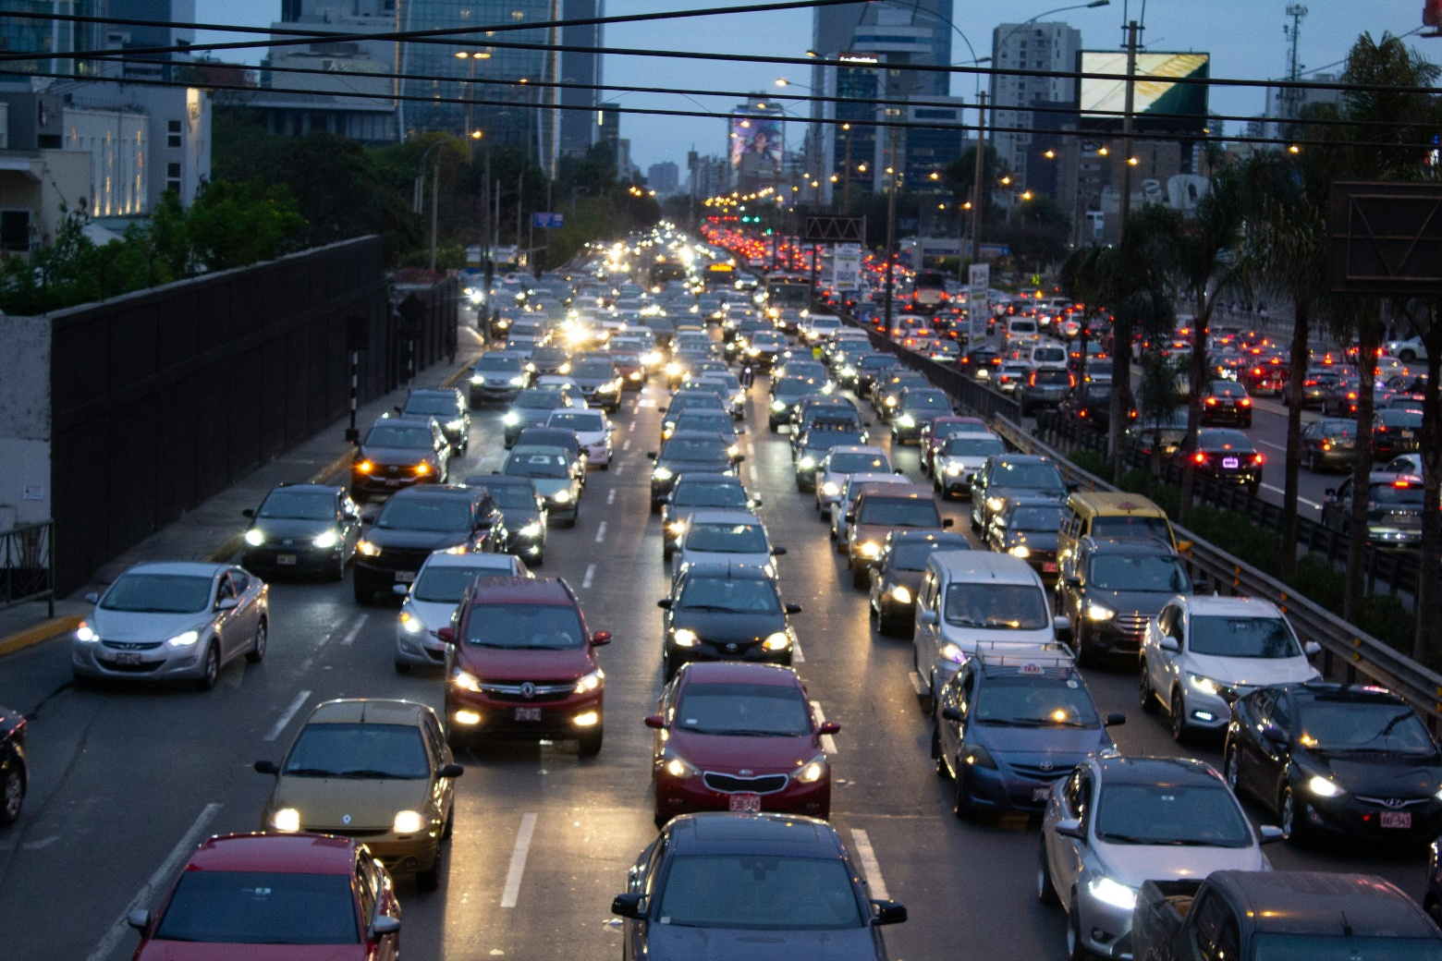
Example 1: Congestion Charging in London
Actors involved:
  city government
  transport authority
  businesses
  citizens
Goals:
  reduce congestion
  improve air quality
  strengthen public transport
Fig. 9: Unsplash

Slide 32
Example 2: High-Speed Rail Development in Europe & China
Requires coordination between:
national governments
infrastructure operators
regional authorities
financing institutions

Slide 33
Public Participation in Urban Street Redesign
Examples:
  pedestrianisation projects
  cycling infrastructure expansion
  temporary street closures
-> Demonstrates interaction between politics, planning and citizens

Slide 34
Contents
Introduction
Actors in Transport Planning
Public Participation & Involvement
Political Framework Conditions
Levels of Transport Planning
Practical Examples
Emerging Trends in Governance

Slide 35
Current Trends
integrated governance approaches
smart city concepts
digital participation tools
climate-oriented planning
increasing stakeholder complexity

Slide 36
Key Takeaways
Transport planning involves many actors and interests
Public participation is increasingly important
Political and legal frameworks shape planning outcomes
Different planning levels have different responsibilities
Successful transport planning requires coordination and cooperation

Slide 37
Thank you for your attention!

Slide 38
Sources - Pictures
Fig. 1: https://unsplash.com/photos/four-hand-drawn-maps-with-pins-UeLrgJBMwn4
Fig. 2: https://unsplash.com/photos/birds-eye-view-of-sitting-on-bench-while-discussion-wqLGlhjr6Og
Fig. 3: https://unsplash.com/photos/text-P2XVxYTGfLM
Fig. 4: https://unsplash.com/photos/the-united-nations-emblem-is-on-display-in-front-of-a-window-WVXJSJmA0Zc
Fig. 5: https://unsplash.com/photos/photo-of-bulb-artwork-82TpEld0_e4
Fig. 6: https://unsplash.com/photos/a-group-of-benches-sitting-in-the-middle-of-a-park-Uv_n1i1E5I0
Fig. 7: https://palmaparking.info/en/artikel/umweltzone-in-palma
Fig. 8: https://unsplash.com/photos/high-angle-photo-of-road-with-vehicles-NSuufgf-BME
Fig. 9: https://unsplash.com/photos/a-busy-city-street-filled-with-lots-of-traffic-SuKAltSwdxs

Slide 39
Sources – Literature (Further Reading)
European Commission n.y.: Mobility and Transport. https://transport.ec.europa.eu/index_en (10.05.26).
International Transport Forum 2026: https://www.itf-oecd.org/ (10.05.26).
OECD n.y.: Transport. https://www.oecd.org/en/topics/transport.html (10.05.26).
World Bank n.y.: Transport. https://www.worldbank.org/ext/en/topic/transport (10.05.26).

