Slide 1
Transport Policy
Fundamentals of Transport

Slide 2
Road Transportation Systems Engineering Development in the Sub-Saharan Africa – Modern EU Master Programme & Capacity Building

Slide 4
Learning Objectives
Students can:
analyse how transport is represented in different media
understand how media influences transport perception and behaviour
identify narratives and stereotypes related to transport modes
critically evaluate transport communication and public discourse
reflect on the relationship between media, mobility and society

Slide 5
Contents
Introduction: Why Media Matters in Transport
Representation of Different Transport Modes
Media Framing of Transport Issues
Transport Experiences in Film, TV & Culture
Transport Communication & Public Opinion
Media, Equity & Accessibility
Reflection & Discussion

Slide 6
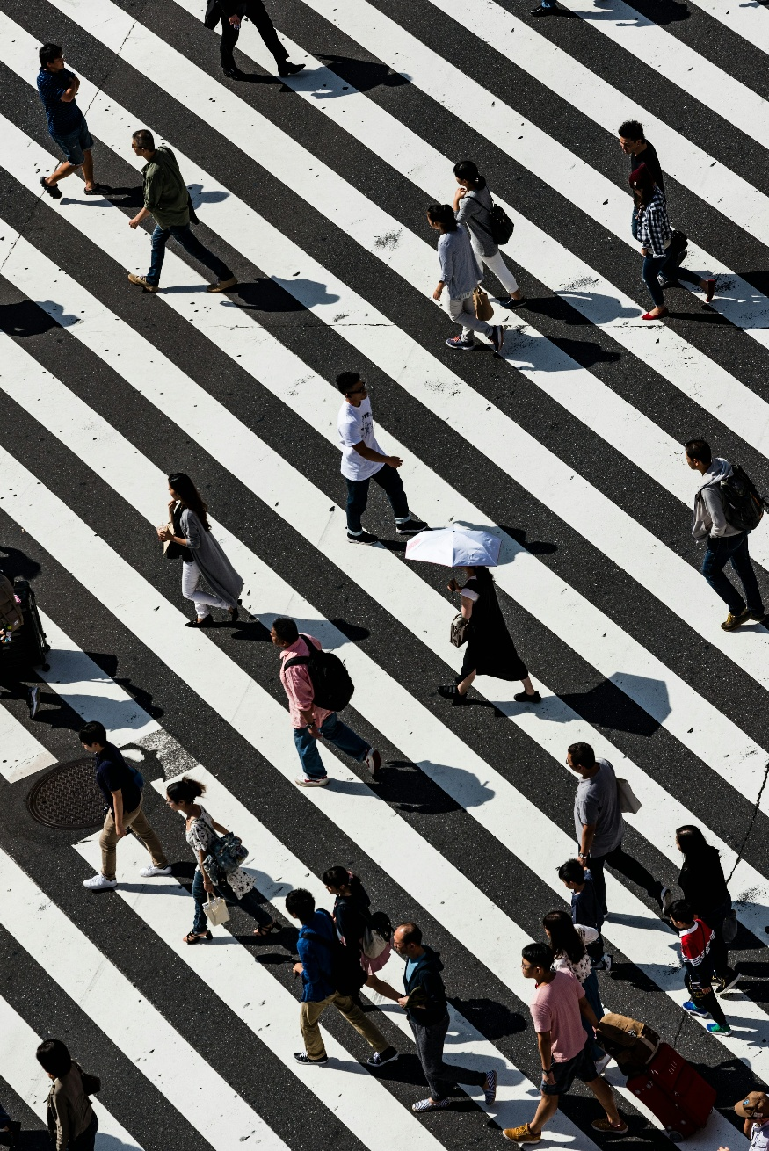
Transport is More Than Infrastructure
Transport is also:
experience
identity
emotion
social interaction
-> Media shapes how people perceive mobility
Fig. 1: Unsplash

Slide 7
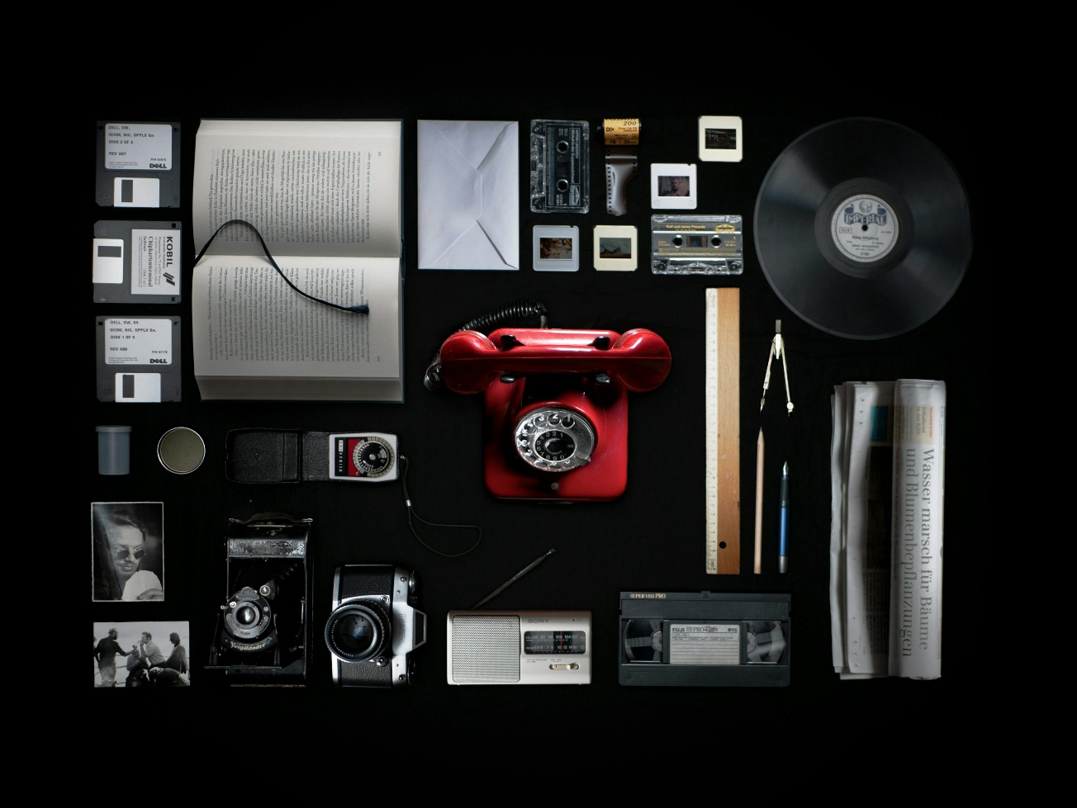
What Do We Mean by “Media”?
Examples:
news media
social media
films and TV
advertisements
video games
documentaries
online mobility platforms
Fig. 2: Unsplash

Slide 8
Media Influences Mobility Behaviour
Media affects:
perceptions of safety
attractiveness of transport modes
travel choices
political acceptance of transport policies

Slide 9
Contents
Introduction: Why Media Matters in Transport
Representation of Different Transport Modes
Media Framing of Transport Issues
Transport Experiences in Film, TV & Culture
Transport Communication & Public Opinion
Media, Equity & Accessibility
Reflection & Discussion

Slide 10
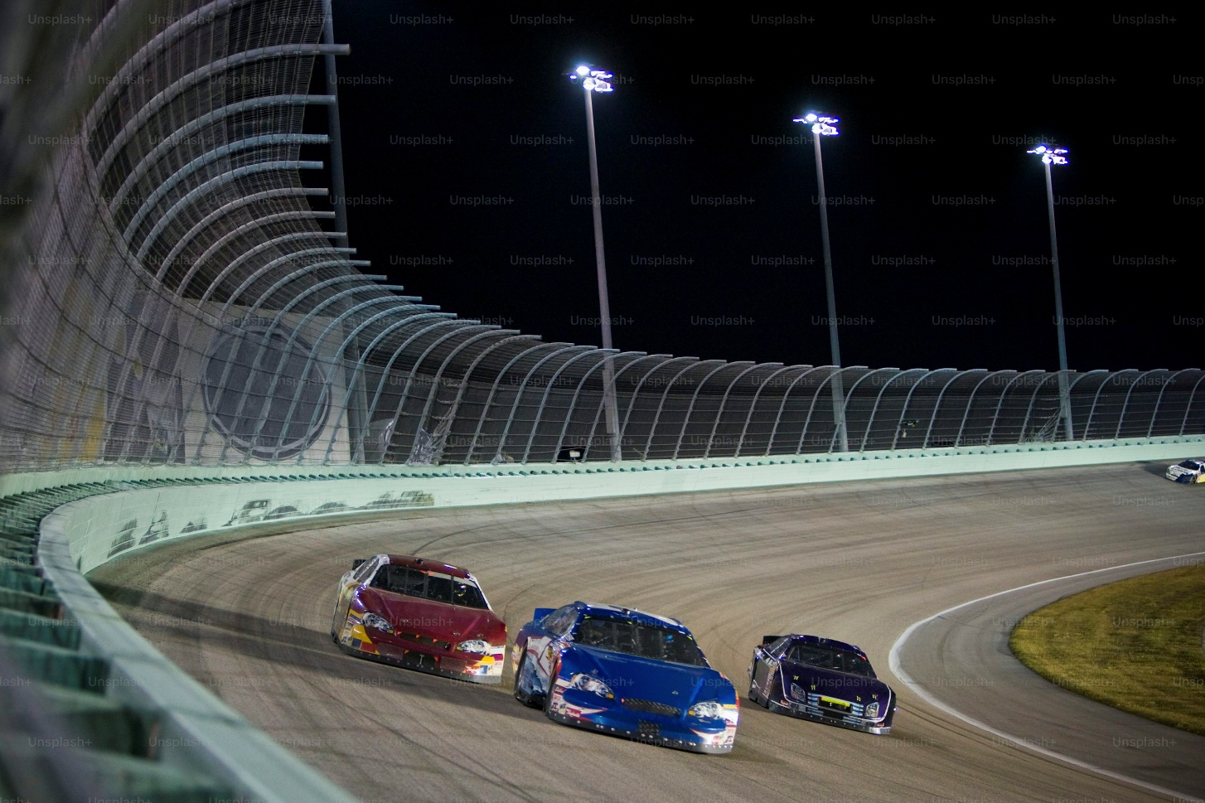
Cars in the Media
Common representations:
  freedom
  independence
  status and identity
  speed and power
Examples:
  car advertisements
  action movies
  motorsport media
-> Cars are often emotionally framed
Fig. 3: Unsplash

Slide 11
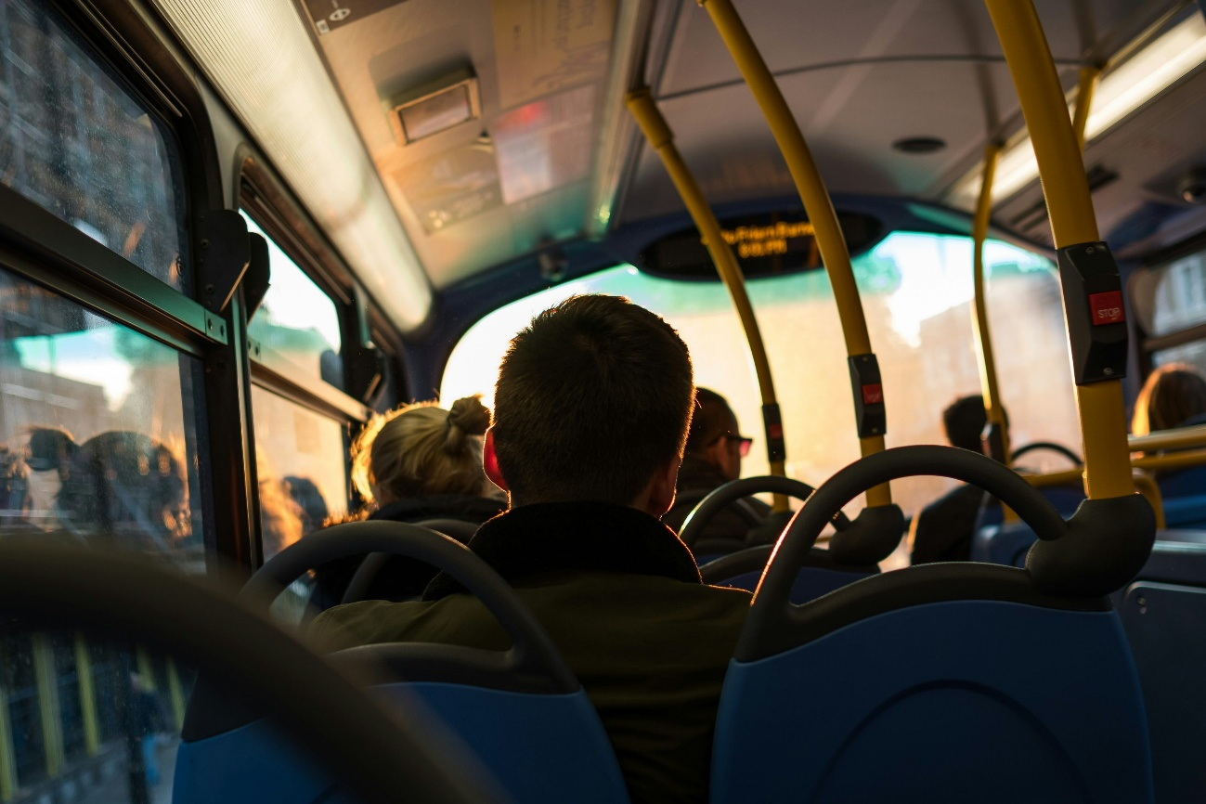
Public Transport in the Media
Representations vary:
efficient and sustainable
crowded and stressful
modern urban lifestyle
social inclusivity
Fig. 4: Unsplash

Slide 12
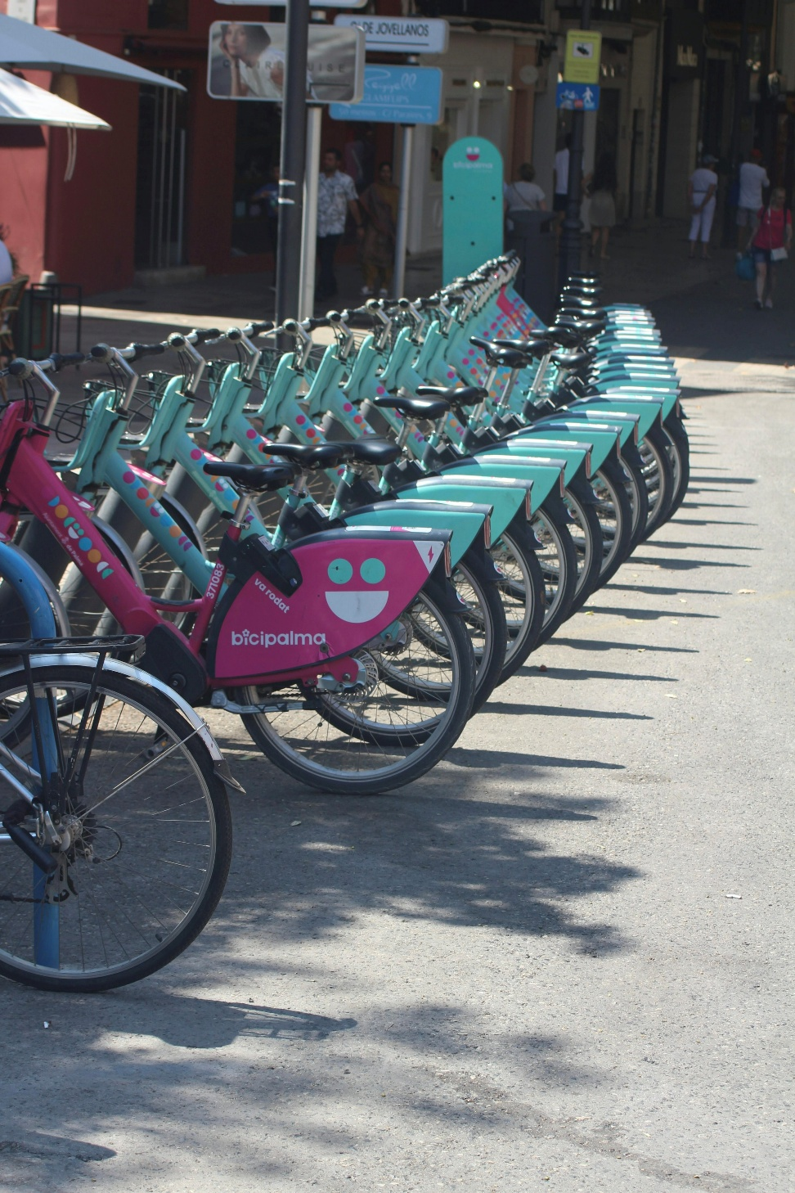
Cycling & Walking in the Media
Cycling often portrayed as:
  healthy
  sustainable
  urban and modern
Walking often associated with:
  livability
  public space quality
  human-scale cities
Fig. 5: Unsplash

Slide 13
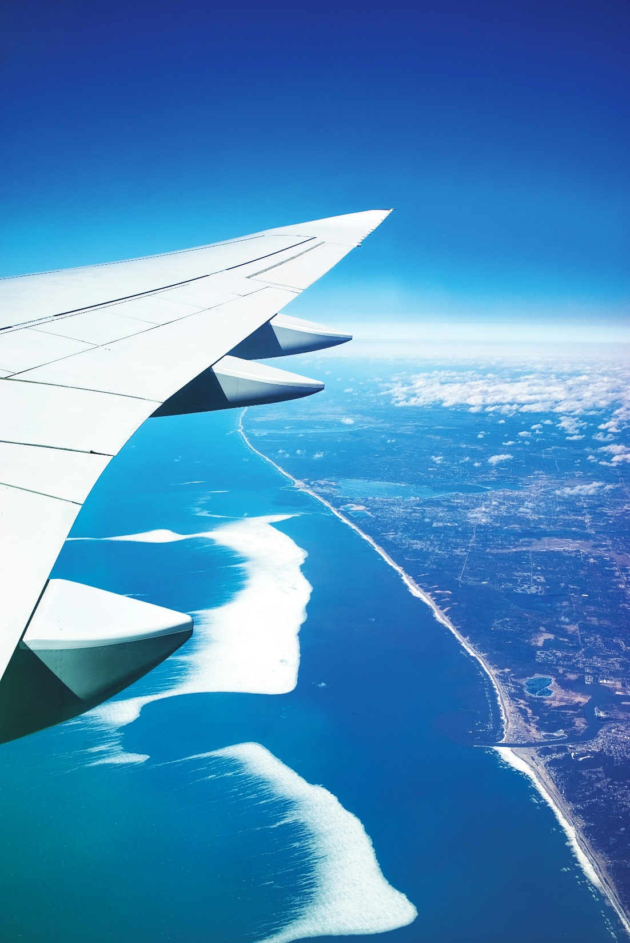
Air Travel in the Media
Often associated with:
  globalization
  luxury and tourism
  freedom of movement
But increasingly also:
  climate criticism
  “flight shame” debates
Fig. 6: Unsplash

Slide 14
Contents
Introduction: Why Media Matters in Transport
Representation of Different Transport Modes
Media Framing of Transport Issues
Transport Experiences in Film, TV & Culture
Transport Communication & Public Opinion
Media, Equity & Accessibility
Reflection & Discussion

Slide 15
What is Media Framing?
Media framing = how media selects and presents information
Example:
  traffic congestion framed as:
  infrastructure problem
  behavioural problem
  policy failure

Slide 16
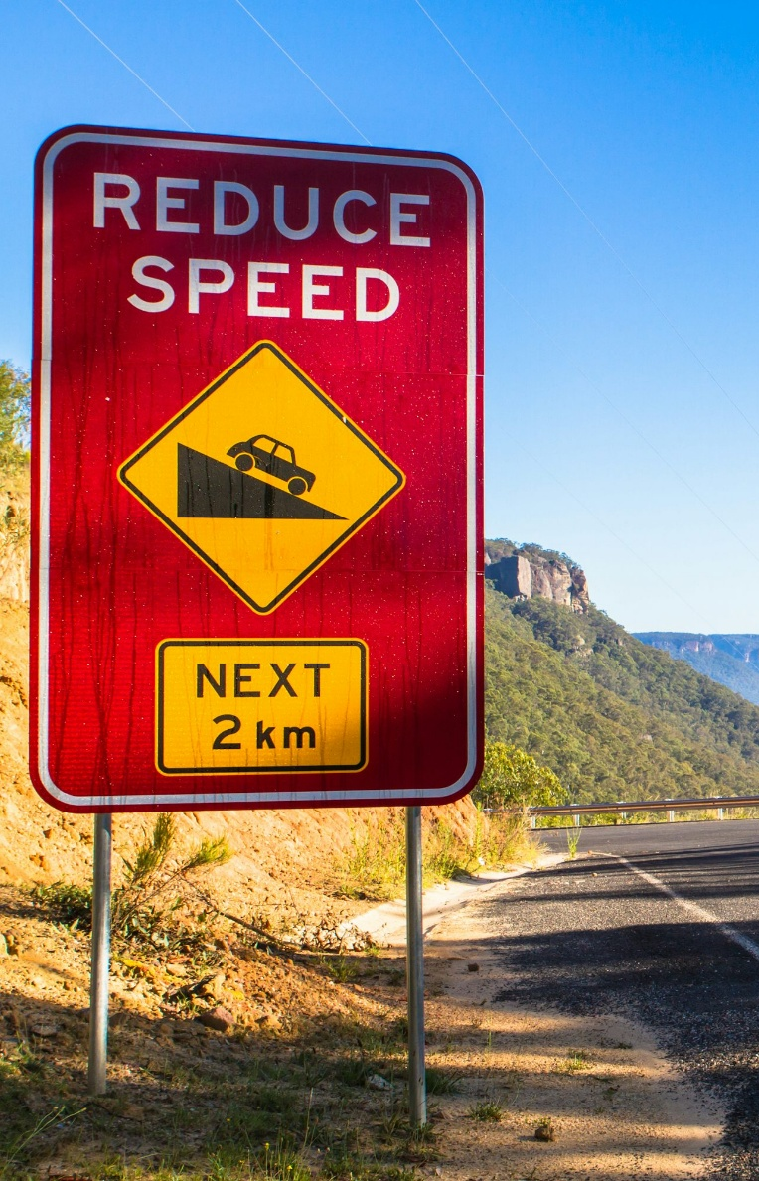
Framing of Road Safety
Different narratives:
“accidents happen”
“unsafe infrastructure”
“dangerous drivers”
“vulnerable road users”
-> Language influences responsibility perception
Fig. 7: Unsplash

Slide 17
Climate & Transport Narratives
Media debates include:
electric vehicles
public transport expansion
aviation emissions
sustainable mobility transitions

Slide 18
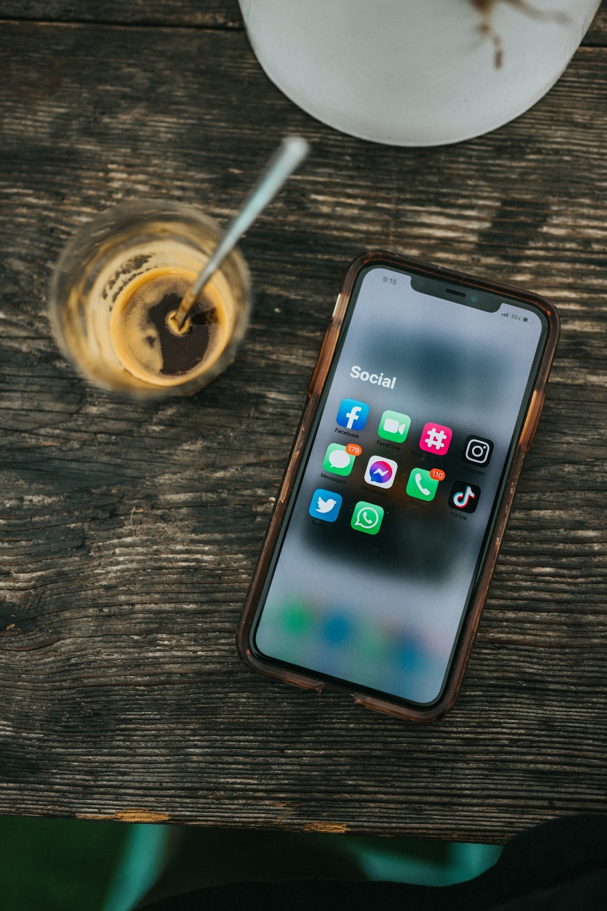
Social Media & Mobility
Social Media influence:
  travel trends
  tourism destinations
  cycling culture
  public opinion on mobility projects
Examples:
  travel vloggers
  viral videos of travel destinations
  call to action for petitions
  ...
Fig. 8: Unsplash

Slide 19
Contents
Introduction: Why Media Matters in Transport
Representation of Different Transport Modes
Media Framing of Transport Issues
Transport Experiences in Film, TV & Culture
Transport Communication & Public Opinion
Media, Equity & Accessibility
Reflection & Discussion

Slide 20
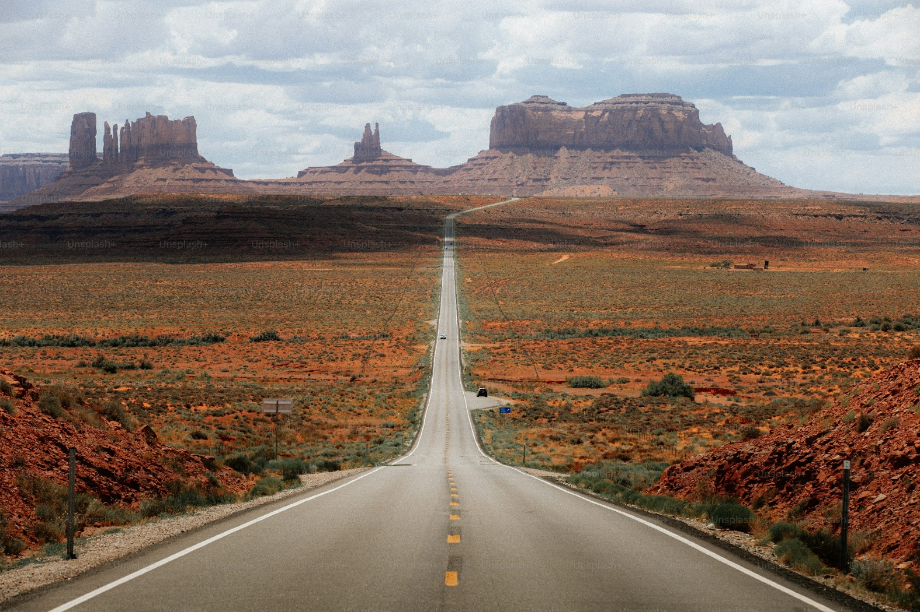
Transport in Movies
Transport often symbolizes:
  freedom
  transition
  escape
  modernity
Examples:
  road movies
  train journeys
  airport scenes
Fig. 9: Unsplash

Slide 21
Cities & Mobility in Popular Culture
Examples:
subway systems as symbols of big cities
cycling cities as “livable” and modern
traffic congestion as symbol of urban stress

Slide 22
Video Games & Virtual Mobility
Examples:
driving simulators
city-building games
transport management games
-> Media can simulate transport systems and experiences

Slide 23
Contents
Introduction: Why Media Matters in Transport
Representation of Different Transport Modes
Media Framing of Transport Issues
Transport Experiences in Film, TV & Culture
Transport Communication & Public Opinion
Media, Equity & Accessibility
Reflection & Discussion

Slide 24

Communication in Transport Policy
Governments use media for:
  safety campaigns
  public transport marketing
  sustainability communication
Examples:
  anti-drunk-driving campaigns
  cycling promotion campaigns
Fig. 10: Travis Air Force Base

Slide 25
Public Acceptance of Transport Policies
Media strongly affects acceptance of:
congestion charging
low-emission zones
road pricing
pedestrianisation projects
-> Communication can determine policy success

Slide 26
Transport & Misinformation
Challenges:
simplified narratives
politicization of mobility
emotional debates on transport projects
ideology driven misinformation

Slide 27
Contents
Introduction: Why Media Matters in Transport
Representation of Different Transport Modes
Media Framing of Transport Issues
Transport Experiences in Film, TV & Culture
Transport Communication & Public Opinion
Media, Equity & Accessibility
Reflection & Discussion

Slide 28
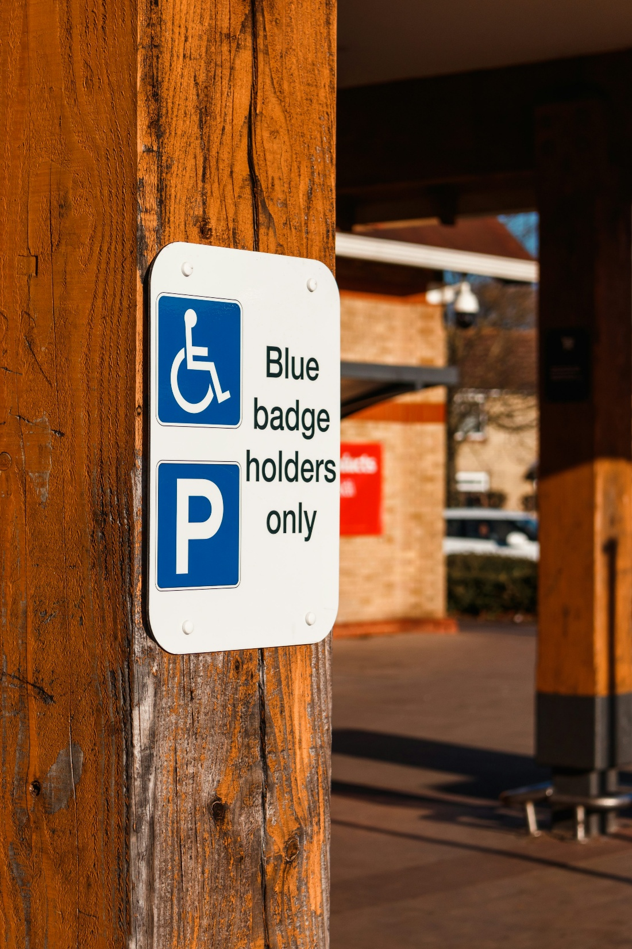
Representation of Different User Groups
Media often underrepresents:
disabled users
elderly people
low-income transport users
Fig. 11: Unsplash

Slide 29
Inclusive Mobility Narratives
Modern communication increasingly focuses on:
accessibility
gender-sensitive mobility
sustainable urban mobility

Slide 30
Contents
Introduction: Why Media Matters in Transport
Representation of Different Transport Modes
Media Framing of Transport Issues
Transport Experiences in Film, TV & Culture
Transport Communication & Public Opinion
Media, Equity & Accessibility
Reflection & Discussion

Slide 31
Discussion Questions
Which transport mode is portrayed most positively in media?
How does media influence mobility behaviour?
Should media actively promote sustainable transport?
Are transport debates emotional or evidence-based?

Slide 32
Key Takeaways
Media strongly shapes transport perception and behaviour
Transport experiences are emotional and cultural, not only technical
Different transport modes are framed differently in public discourse
Communication influences transport policy acceptance
Critical media analysis is important for modern transport planning

Slide 33
Thank you for your attention!

Slide 34
Sources - Pictures
Fig. 1: https://unsplash.com/photos/peoples-walking-on-pedestrian-lane-X53e51WfjlE (10.05.26).
Fig. 2: https://unsplash.com/photos/red-rotary-phone-wallpaper-oC66vXsqnc8 (10.05.26).
Fig. 3: https://unsplash.com/photos/three-cars-racing-on-a-track-at-night-FB9VEA40cus (10.05.26).
Fig. 4: https://unsplash.com/photos/photo-of-man-sitting-inside-bus-CrwmXVbxxZs (10.05.26).
Fig. 5: https://unsplash.com/photos/a-row-of-bicycles-parked-next-to-each-other-vWfswDzjcX8 (10.05.26).
Fig. 6: https://unsplash.com/photos/aerial-photo-of-airplane-wings-during-daytime-C9dhUVP-o6w (10.05.26).
Fig. 7: https://unsplash.com/photos/reduce-speed-road-signage-during-daytime-xFkO2AAKc3A (10.05.26).
Fig. 8: https://unsplash.com/photos/white-samsung-android-smartphone-on-brown-wooden-table-kLmt1mpGJVg
Fig. 9: https://unsplash.com/photos/a-long-road-in-the-middle-of-a-desert-j4grJ2kW5IU
Fig. 10: https://www.travis.af.mil/News/Article/1224688/team-travis-engages-in-anti-dui-campaign/
Fig. 11: https://unsplash.com/photos/a-blue-and-white-sign-that-says-blue-badge-holders-only-6TwJRjhGd70

Slide 35
Sources – Literature (Further Reading)
European Commission n.y.: Mobility and Transport. https://transport.ec.europa.eu/index_en (10.05.26).
European Environment Agency 2026: Transport and Mobility. https://www.eea.europa.eu/en/topics/in-depth/transport-and-mobility (10.05.26).
Global Designing Cities Initiative n.y.: Change Streets, change the world. https://globaldesigningcities.org/ (10.05.26).
International Association of Public Transport n.y.: https://www.uitp.org/ (10.05.26).
International Transport Forum 2026: https://www.itf-oecd.org/ (10.05.26).
OECD n.y.: Transport. https://www.oecd.org/en/topics/transport.html (10.05.26).
UN Habitat n.y.: Mobility and Transport. https://unhabitat.org/topic/mobility-and-transport (10.05.26).
United Nations n.y.: Sustainable Development. https://sdgs.un.org/goals (10.05.26).
World Bank n.y.: Transport. https://www.worldbank.org/ext/en/topic/transport (10.05.26).

