Slide 1
Fundamentals of Transportation
Fundamentals of Traffic Safety

Slide 3
Learning objectives
Define traffic safety and explain why it matters
Understand global and LMIC road safety trends
Identify major risk factors influencing crashes and severity
Explain the Safe System approach and its core principles
Describe Road Infrastructure Safety Management (RISM) tools
Apply engineering thinking to reduce crash risk and severity

Slide 4
Lecture outline
Road Traffic Safety
Key Factors Influencing Safety
Haddon Matrix (Traffic Safety Framework)
Global Road Safety Burden
Safe System Approach
Road Infrastructure Safety Management (RISM)

Slide 5
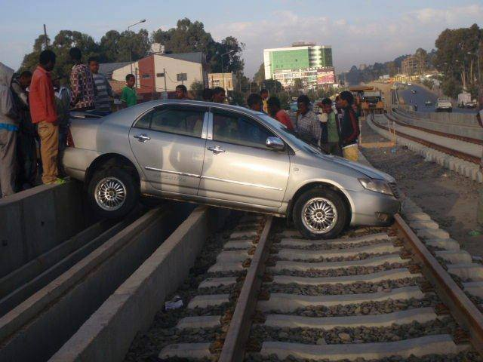
What is Road Traffic Safety?
How do you define it?

Slide 6
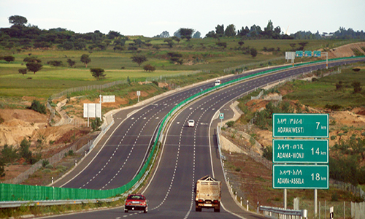
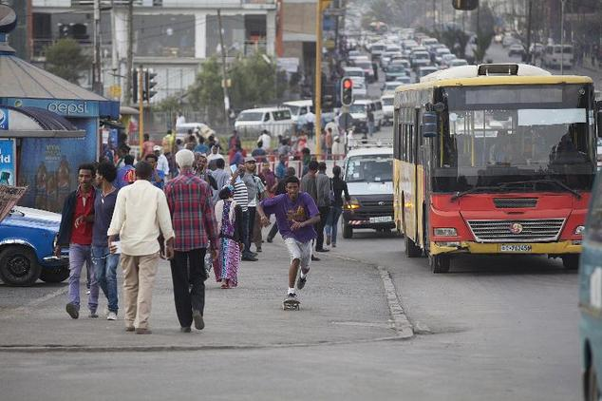
Road Traffic Safety
Definition
How do you feel if you are driving over these roads?
Do you have the same feeling?
What is the difference?

Slide 7
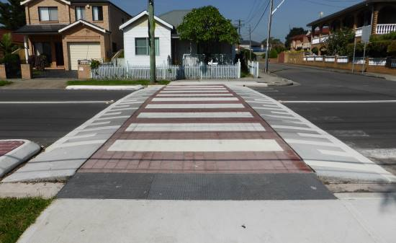
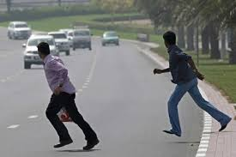
Road Traffic Safety
Definition
How do you feel if you are crossing over these roads?

Slide 8
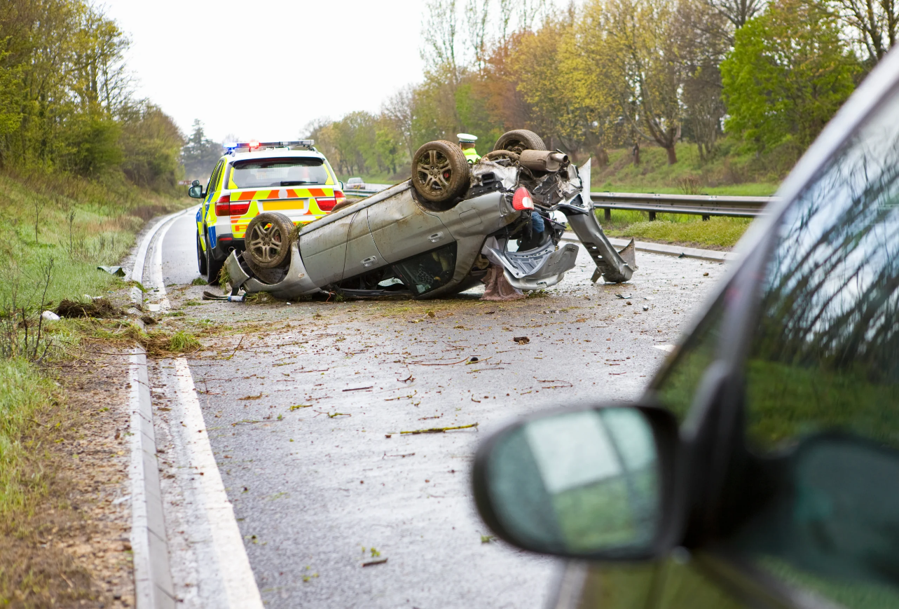
Road Traffic Safety
Definition
Road Safety:
  is both a subjective perception of road users for an entity (an intersection, road section, or network) and
  an objective measure expressed in terms of the number of accidents (crashes) or crash consequences, by kind and severity.

Slide 9
Road Traffic Safety
Definition-Key terms
Crash (preferred) Vs Accident:
  Usually used interchangeably
  However, “Accident” can imply inevitability, but “Crash” emphasizes that the events have a cause and can be prevented.
Crash Vs Collision:
  Crash: road incident involving vehicles/road users resulting in damage, injury, or death
  Collision: physical impact between two objects (vehicle-vehicle, vehicle-pedestrian, vehicle-object)

Slide 10
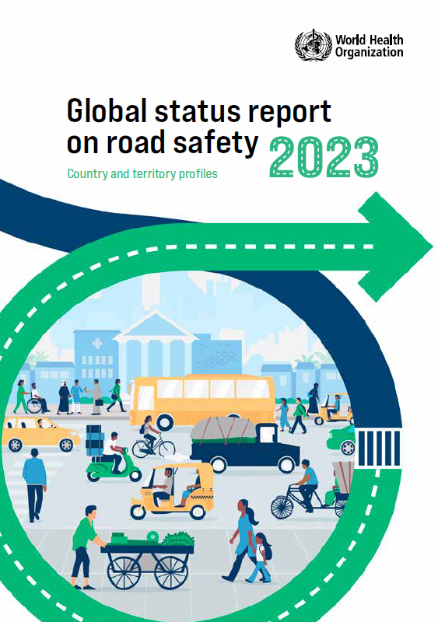
Road Traffic Safety
Why Traffic Safety Matters?
  Road traffic injuries are the leading causes of death and disabilities worldwide.
  Deaths and serious injuries are not random: patterns repeat by road type, speed, and user mix
  They create long-term economic and social burdens
  Safety is a key requirement for sustainable mobility and development

Slide 11
Road Traffic Safety
A Transport System Problem
Road users
Road and environment
Vehicle
Crashes result from interactions between road users, vehicles, roads, and the environment
Road safety depends on:
  Human behavior
  Road design & maintenance
  Vehicle condition & safety features
  Traffic management & enforcement
Desired output
Mobility
Undesired outputs
Other consequences of transport
Road traffic crashes
Work
School
Human factors
Vehicle factors
Leisure
Shopping
Road and environmental factors
Others

Slide 12
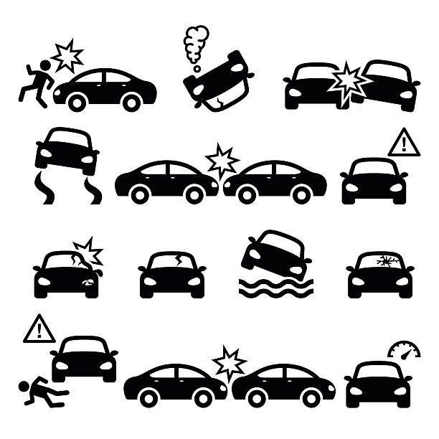
Types of Road Traffic Crashes
Rear-end crashes
Head-on crashes
Side-impact (T-bone) crashes
Run-off-road crashes
Pedestrian and cyclist crashes
Motorcycle crashes
Single-vehicle crashes

Slide 13
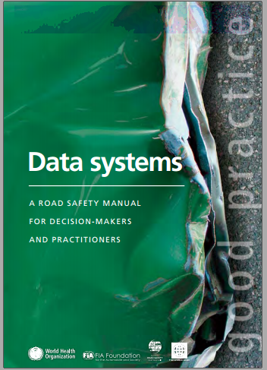
Crash Severity Levels
The most common crash severity levels are
      Property Damage Only (PDO)
      Slight injury Crashes
      Serious injury rashes
      Fatal injury

Slide 14
Crash Severity Levels
Injury Accident/Crash: is a road traffic accident in which at least one individual is killed or injured as a result of the road traffic accident.
Fatal Accident/Crash: is a road traffic accident in which one or more individuals are killed immediately or die within 30 days of the occurrence and as a result of the road traffic accident. Proven suicides are excluded.
A serious Injury is an injury in which a victim sustains severe cuts, bleeding, breaks, and other damages that require him to receive medical treatment as an Inpatient in a hospital for at least 24 hours or need specialist attention.
A Slight injury is one in which the victim sustains only small cuts, scratches, and other small damages that may be treated as an outpatient without requiring admission to a hospital or treated in a hospital for less than 24 hours.

Slide 15
Key Factors Influencing Safety
Exposure factors:
  Traffic volume
  Vehicle-kilometers traveled (VKT)
  Population mobility
Risk factors:
  Speeding
  Alcohol/drugs
  Distraction
  Unsafe overtaking
Severity factors:
  Impact speed
  Roadside objects
  Lack of protective equipment

Slide 16
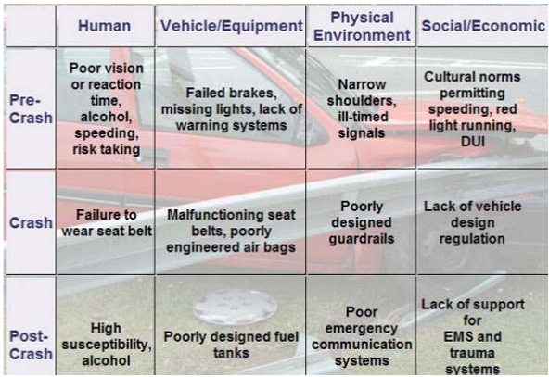
Haddon Matrix (Traffic Safety Framework)
https://safetrec.berkeley.edu/sites/default/files/haddon-matrix-safetrec.pdf

Slide 17

Human Factors in Road Safety
  Speed choice and risk-taking
  Fatigue and sleepiness
  Alcohol and drug impairment
  Distraction (mobile phone use)
  Poor perception and decision-making
  Non-compliance with rules

Slide 18
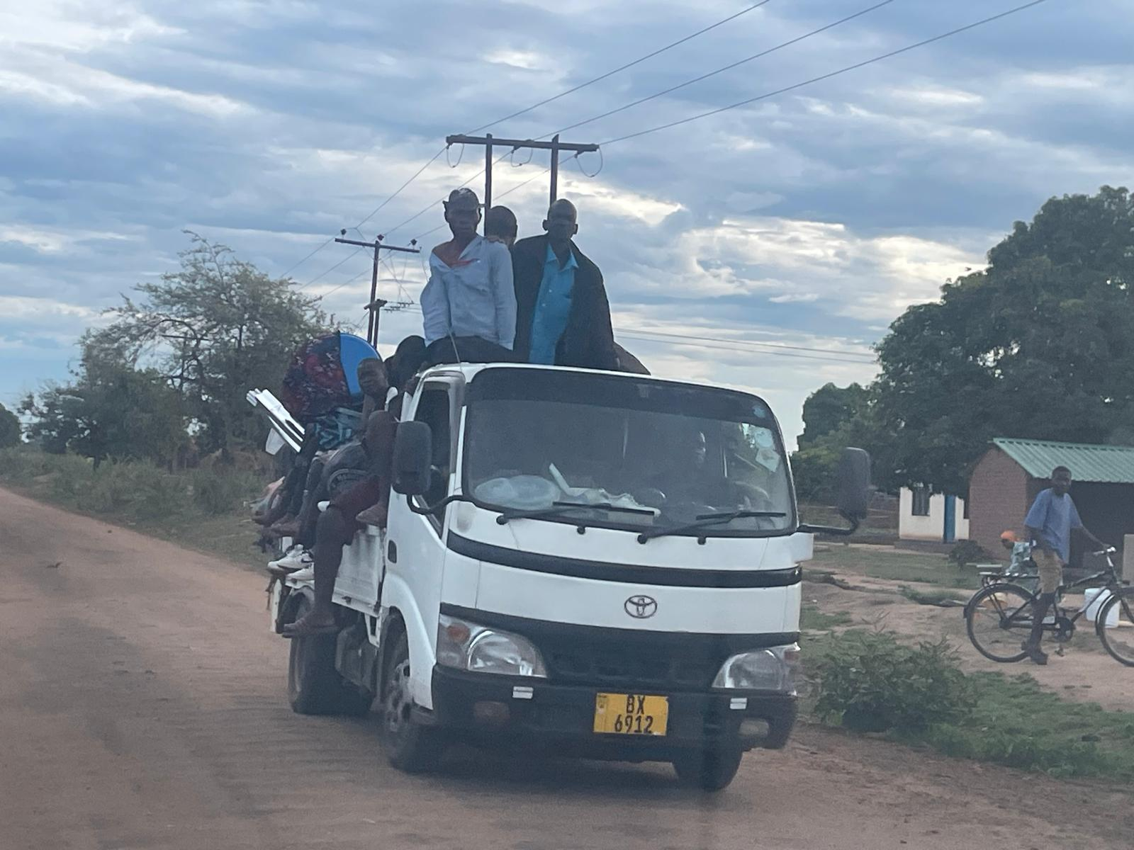
Vehicle Factors in Road Safety
  Braking system condition
  Tire condition
  Lighting and visibility
  Vehicle stability and crashworthiness
  Safety technologies (ABS, ESC, airbags)
  Overloading and poor maintenance

Slide 19
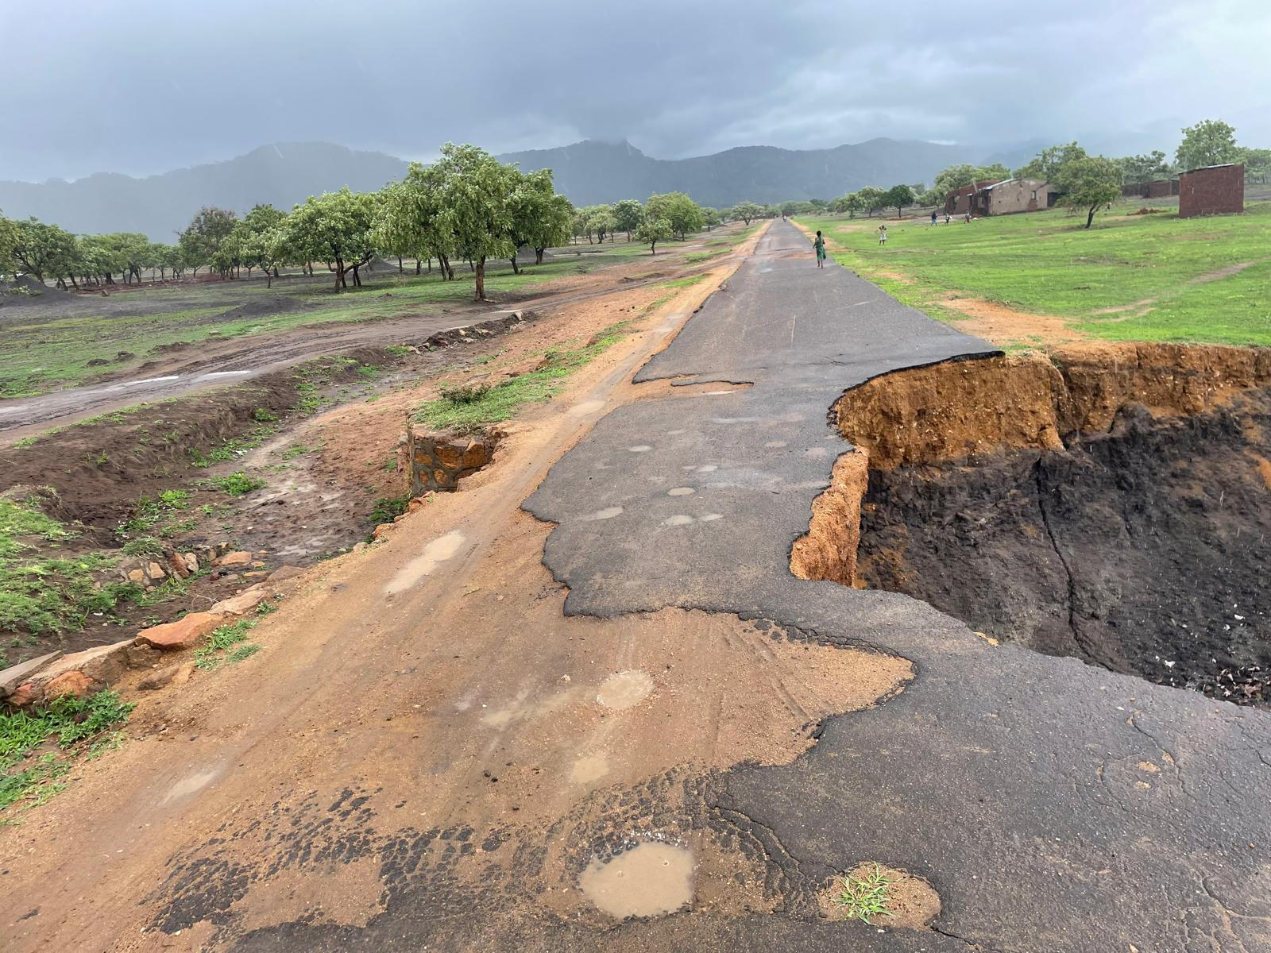
Road and Environmental Factors
  Poor road geometry (sharp curves, narrow lanes)
  Inadequate signing and marking
  Lack of pedestrian crossings and sidewalks
  Unsafe intersections and access points
  Poor lighting and visibility
  Weather conditions (rain, fog)

Slide 20
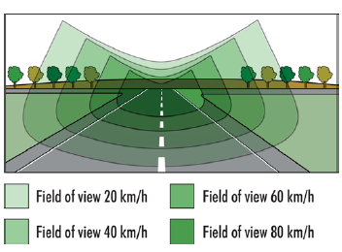
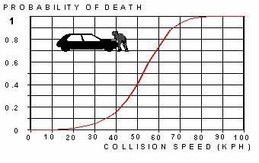
Role of Speed in crash severity
Higher speed decreases the field of vision
Higher speed increases crash likelihood (less reaction time)
Higher speed increases crash severity or risk of fatality (energy increases with speed squared)
Speed management is one of the most effective safety strategies

Slide 21
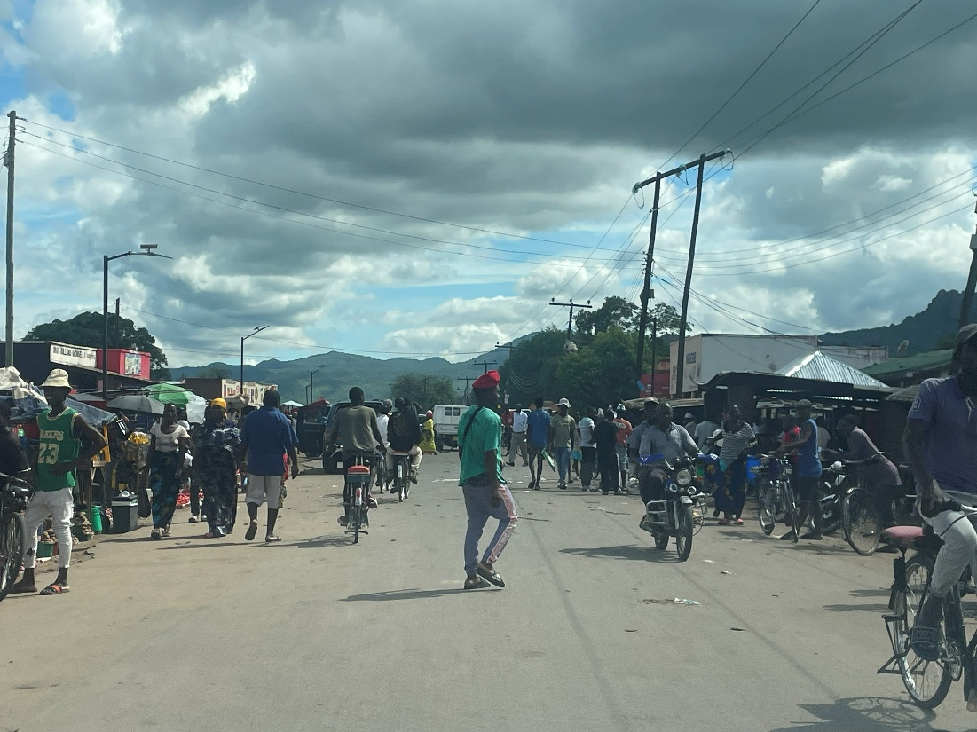
Vulnerable Road Users (VRUs)
Vulnerable road users include:
  Pedestrians
  Cyclists
  Motorcyclists
  Children and elderly people
  People with disabilities
Higher exposure to impact and lower physical protection
Often share space with high-speed motor vehicles
VRUs are overrepresented in LMIC crash fatalities

Slide 22
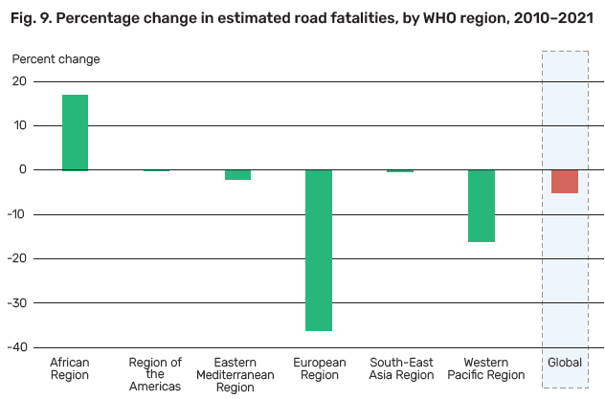
Global Road Safety Burden
About 1.19 million deaths and 50+ million injuries annually (WHO)
Over 90% of road deaths occur in low- and middle-income countries (LMICs)
LMICs have fewer vehicles but much higher fatality rates
High-income countries have reduced deaths through safe design, enforcement, and vehicle standards
Source: Global Status report on road safety, WHO 2023

Slide 23
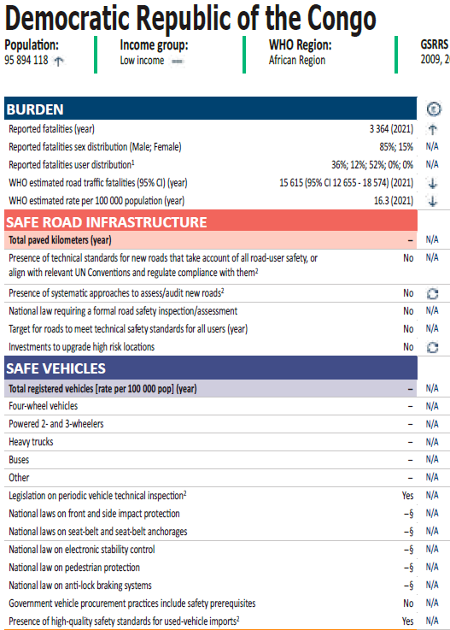
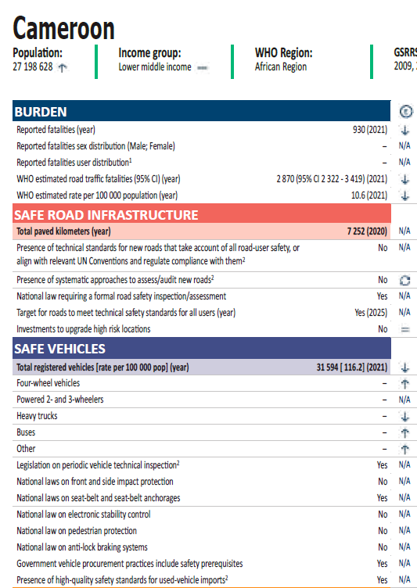
Global Road Safety Burden
Source: Global Status report on road safety, WHO 2023

Slide 24
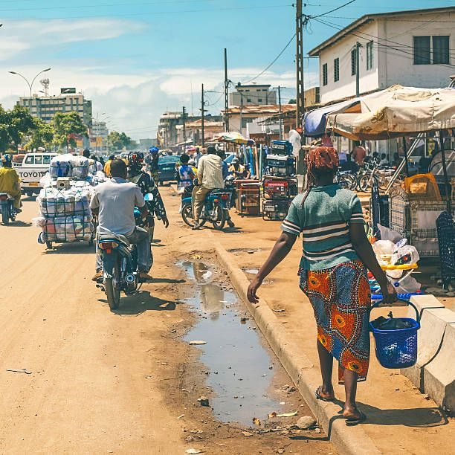
Road Safety Situation in LMICs
  Rapid urbanization and motorization
  Mixed traffic with weak separation (cars, buses, motorcycles, pedestrians)
  Inadequate enforcement capacity
  Poor road infrastructure and maintenance
  Unsafe public transport operations

Slide 25
Economic Cost of Road Crashes
  Road crashes cost countries approximately 3–5% of GDP
  Costs include medical care, productivity loss, property damage, and insurance
  Road safety improvement is a high-return investment

Slide 26
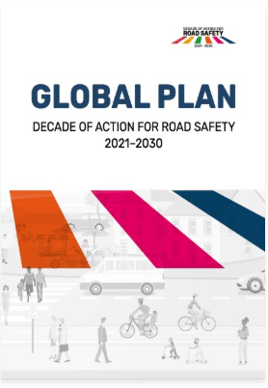
Global Targets and Commitments
UN Decade of Action for Road Safety
Sustainable Development Goals (SDG 3.6 and SDG 11.2)
Vision Zero strategies adopted by many countries
Focus on reducing fatalities and serious injuries

Slide 27
Safe System Approach
A road safety approach that ensures no one is killed or seriously injured
System is designed around human limitations and vulnerability
Responsibility is shared among designers, operators, policy makers, and road users

Slide 28
Safe System Approach
Core Principles
People make mistakes
Human tolerance is limited
Responsibility is shared (not only the driver)
Redundancy and resilience
Proactive prevention is essential
Design the system so errors do not cause death or serious injury
Biomechanics sets limits for speeds, forces, and conflict types
System designers and users both contribute, but designers must accept errors
If one layer fails (e.g. speeding), other layers still protect (e.g., separation, forgiving roads)
Use data, near misses, and audits to prevent crashes before they happen

Slide 29
Safe System Pillars
Safe Road Users
Safe Vehicles
Safe Roads and Roadsides
Safe Speeds
Post-crash Response

Slide 30
Safe Speeds
Safe System Pillars
Speed limits must reflect crash risk and road user vulnerability
Typical Safe System guidance:
  30 km/h where pedestrians mix with traffic
  50 km/h on urban arterial roads
  80 km/h on undivided rural roads
  100–120 km/h on controlled-access highways

Slide 31
Safe Roads and Roadsides
Safe System Pillars
Roads should be forgiving and self-explaining
Provide separation between traffic streams
Protect against run-off-road crashes using clear zones and barriers
Provide safe pedestrian crossings and sidewalks
Improve intersection design (roundabouts, channelization)

Slide 32
Safe Vehicles
Safe System Pillars
Crashworthiness and occupant protection
Vehicle stability and braking performance
Safety technologies (ABS, ESC, airbags)
Pedestrian-friendly vehicle design
Regular inspection and maintenance systems

Slide 33
Safe Road Users
Safe System Pillars
Driver licensing and training systems
Enforcement against speeding and impaired driving
Seat belt and helmet compliance
Reducing distraction (phone use)
Road safety education integrated with enforcement and design

Slide 34
Post-Crash Response
Safe System Pillars
Fast detection and reporting of crashes
Emergency medical response (ambulance, trauma care)
Rescue accessibility and equipment
Coordination between police, ambulance, and hospitals
Post-crash care reduces fatality risk significantly

Slide 35
Road Infrastructure Safety Management (RISM)
  A systematic process to ensure roads are planned, designed, built, operated, and maintained safely
  Focuses on preventing crashes and reducing crash severity through engineering measures
  Uses both proactive and reactive safety tools
  Many crashes occur due to infrastructure-related risk factors. For example:
      Sharp curves without warning, Poor sight distance, Missing sidewalks, Unsafe intersections, Roadside hazards, Poor lighting

Slide 36
Road Infrastructure Safety Management (RISM) Tolls
  Road Safety Impact Assessment (RSIA)
  Road Safety Audit (RSA)
  Road Safety Inspection (RSI)
  Network safety ranking
  Black spot identification and treatment
  Speed management engineering (traffic calming)

Slide 37
Road Safety Impact Assessment (RSIA)
Performed at the planning stage for new roads or major upgrades
Evaluates safety impacts of different alignment and design alternatives
Ensures safety is integrated early before construction begins

Slide 38

Road Safety Audit (RSA)
Independent, systematic examination of a road project to identify safety problems
Applied at stages:
  Feasibility
  Preliminary design
  Detailed design
  Construction
  Pre-opening
RSA is proactive and cost-effective

Slide 39
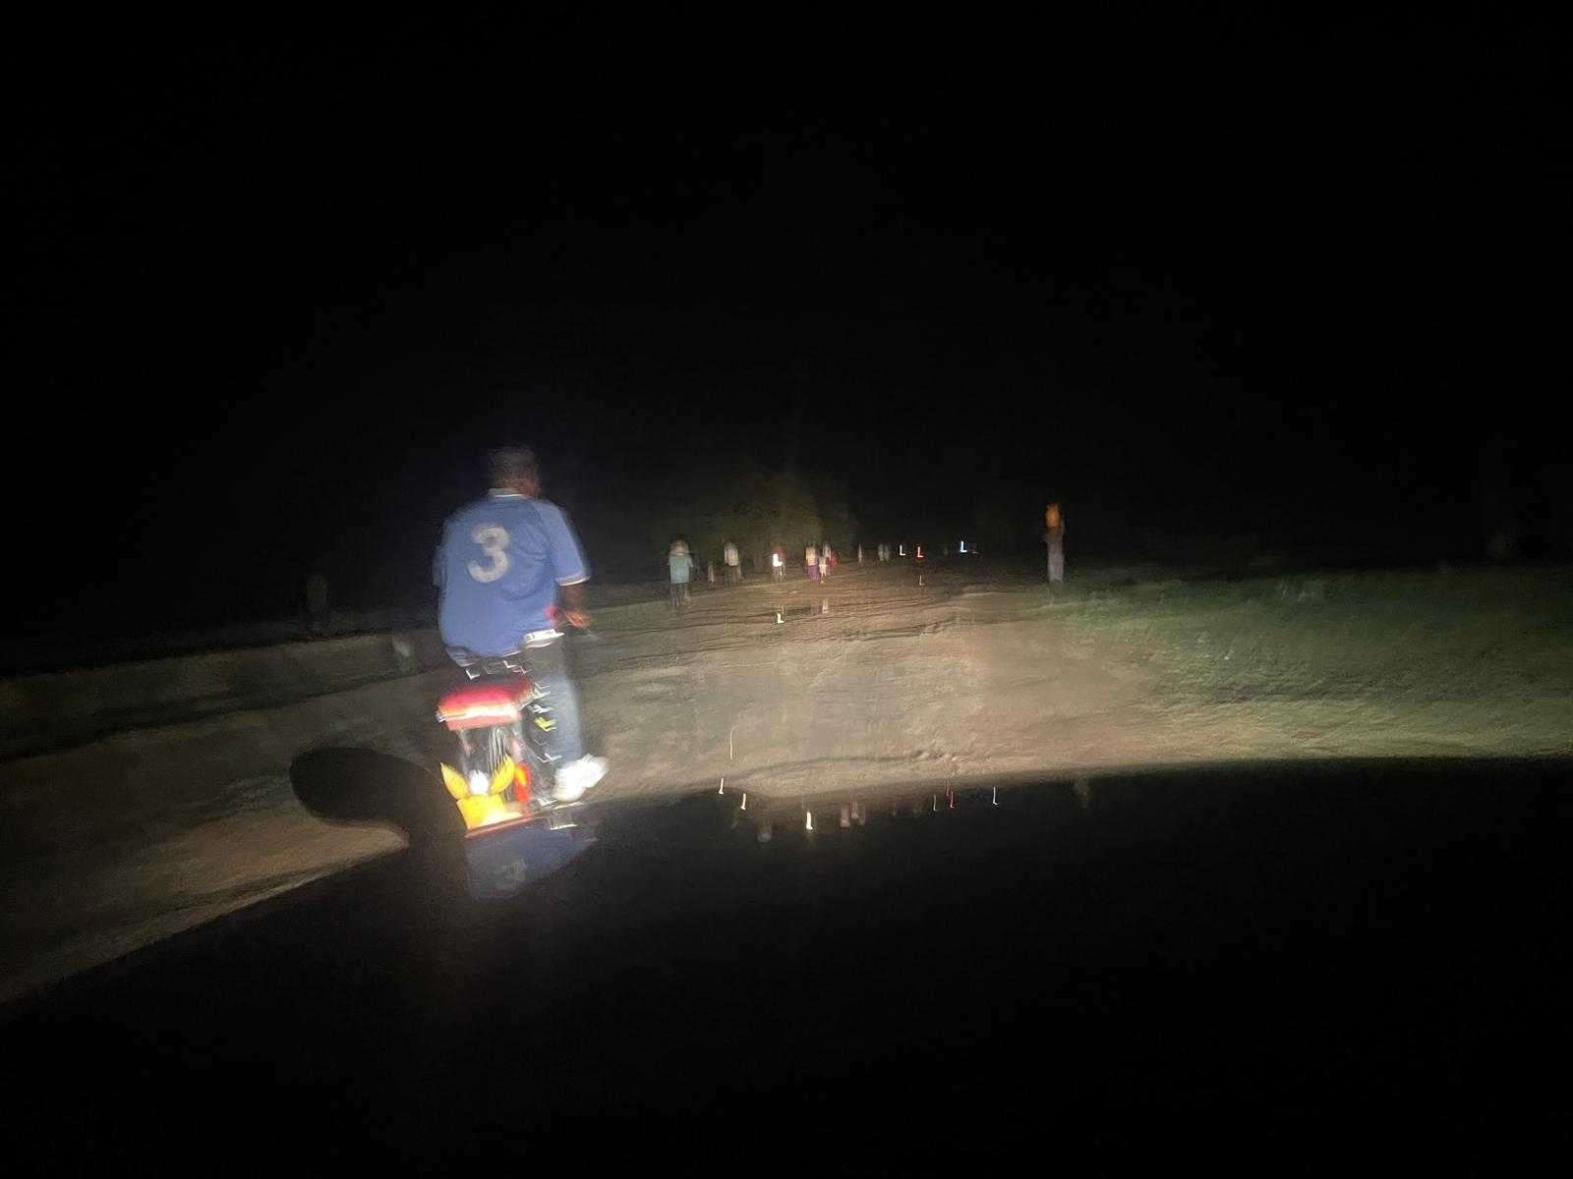
Road Safety Inspection (RSI)
Systematic inspection of existing roads to detect hazardous conditions
Focus areas:
  Pavement condition
  Signage/markings
  Visibility
  Roadside hazards
  Pedestrian safety
  Drainage
  Lighting

Slide 40
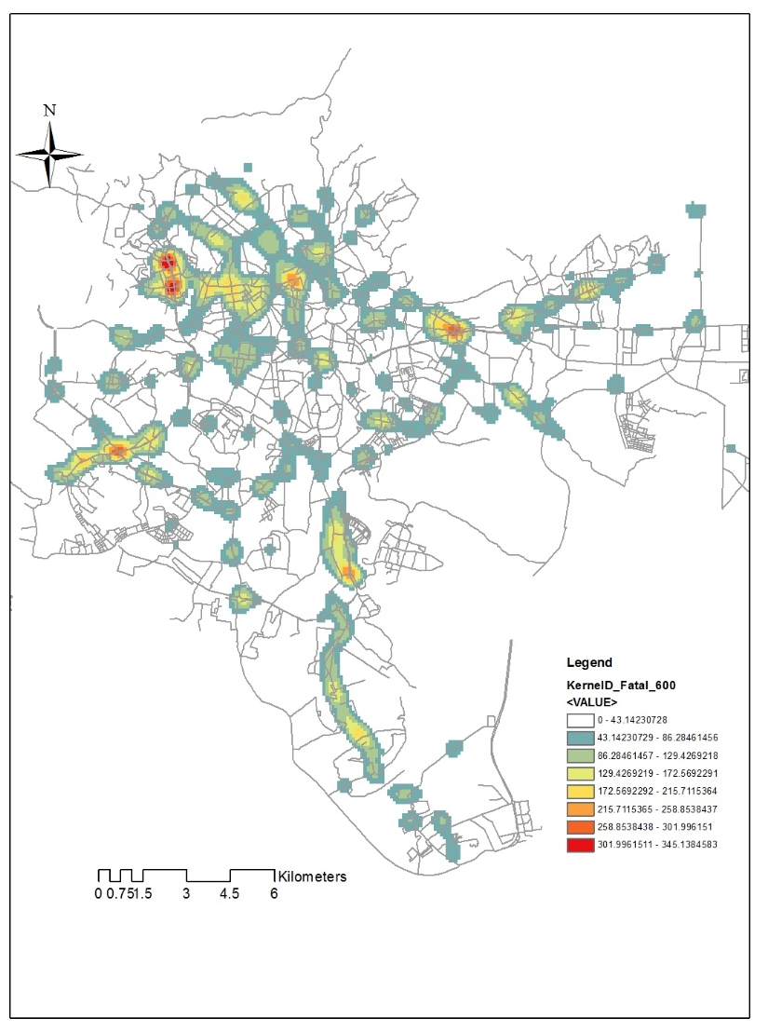
Black Spot Analysis (High-Risk Locations)
A black spot is a location with unusually high crash frequency or severity
Process:
  Identify using crash data
  Diagnose causes
  Select countermeasures
  Implement improvements
  Evaluate effectiveness (before and after study)

Slide 41
Common Engineering Countermeasures:
    Speed calming (humps, raised crossings)
    Roundabouts and protected intersections
    Median barriers and pedestrian refuges
    Roadside clear zones and guardrails
    Improved signage, markings, and lighting
    Dedicated lanes for buses, bicycles, and motorcycles

Slide 42
Discussion Question?
Crash and crash severity classification usually vary across countries. Review existing literature on crash severity classifications and definitions, and compare the approaches used in different countries.
How are crash injury severities defined in your country? How do traffic police distinguish between minor and serious injuries? Visit the traffic police office and discuss their procedures.
How do these differences in severity classification affect the quality and reliability of traffic crash data?
Many countries adopted the UN Global Decade of Action plan. Which road safety strategy is adopted in your country? How is the implementation?

Slide 43
Reading materials
https://www.sciencedirect.com/science/article/pii/S235214651630309X
https://www.itf-oecd.org/sites/default/files/docs/15irtadsafetymanagement.pdf#page=13.40
https://www.who.int/teams/social-determinants-of-health/safety-and-mobility/global-status-report-on-road-safety-2023
https://www.who.int/teams/social-determinants-of-health/safety-and-mobility/decade-of-action-for-road-safety-2021-2030

