Slide 1
Transport Planning III
Fundamentals of Transport

Slide 2
Road Transportation Systems Engineering Development in the Sub-Saharan Africa – Modern EU Master Programme & Capacity Building

Slide 4
Learning Objectives
Students can:
explain the purpose and functions of transport network planning
understand principles of Integrated Network Design (IND)
distinguish different transport network structures
analyse network organisation for public transport, cycling and walking
evaluate transport networks using quality criteria

Slide 5
Contents
Introduction to Transport Network Planning
Functions & Purposes of Network Planning
Integrated Network Design (IND)
Structures of Integrated Network Design
Principles in Network Design
Transport Networks: Functional Organization
Quality Criteria for Network Design
Current Trends & Future Challenges

Slide 6
What is Transport Network Planning?
Transport network planning = design and organisation of transport connections within a region or city
Focuses on:
  connectivity
  accessibility
  efficiency
  integration of transport modes
-> Goal: create functional and coordinated mobility systems

Slide 7
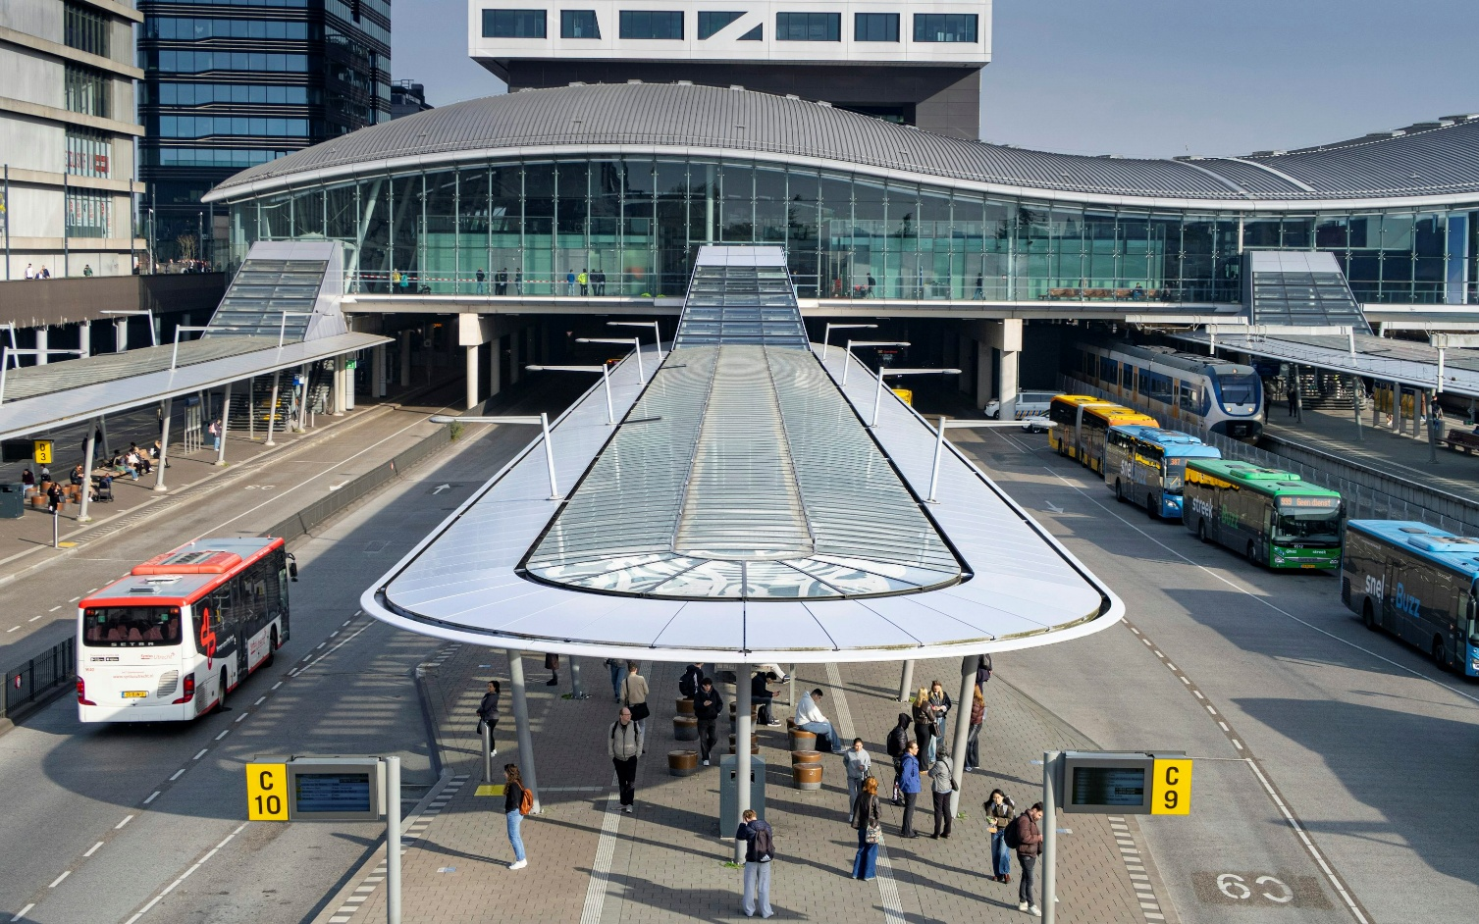
Why Transport Networks Matter
Transport networks determine:
travel possibilities
accessibility to jobs and services
economic development
urban structure and land use
Fig. 1: Unsplash

Slide 8
Contents
Introduction to Transport Network Planning
Functions & Purposes of Network Planning
Integrated Network Design (IND)
Structures of Integrated Network Design
Principles in Network Design
Transport Networks: Functional Organization
Quality Criteria for Network Design
Current Trends & Future Challenges

Slide 9
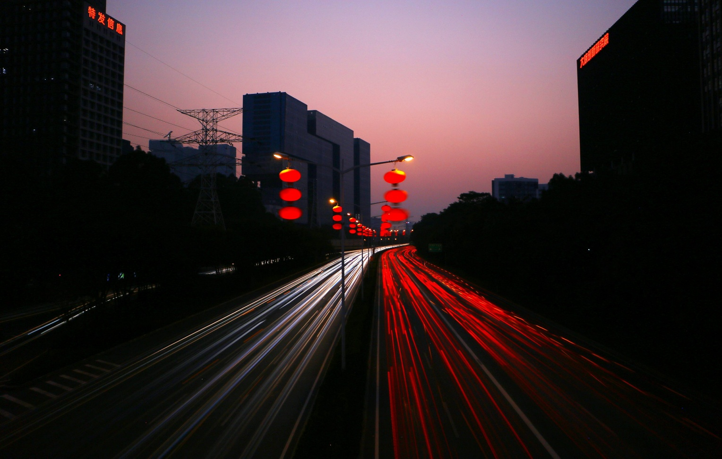
Main Functions of Transport Networks
connect origins and destinations
distribute traffic flows
ensure accessibility
support economic and social interaction
Fig. 2: Unsplash

Slide 10
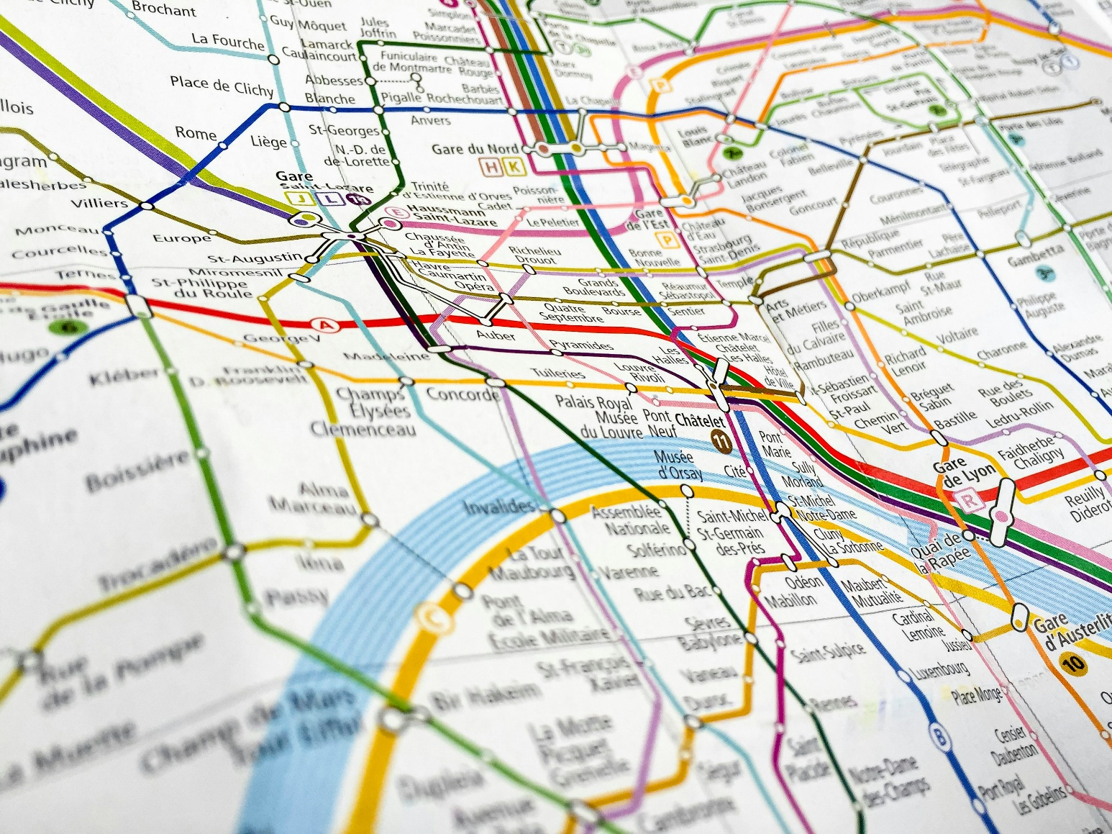
Purposes of Network Planning
Operational Goals:
  efficient movement
  capacity optimisation
  travel time reduction
Strategic Goals:
  sustainability
  safety
  multimodal integration
  equitable access
Fig. 3: Unsplash

Slide 11
Network Planning and Urban Development
transport networks shape settlement patterns
strong interaction between:
  land use
  transport demand
  infrastructure provision

Slide 12
Contents
Introduction to Transport Network Planning
Functions & Purposes of Network Planning
Integrated Network Design (IND)
Structures of Integrated Network Design
Principles in Network Design
Transport Networks: Functional Organization
Quality Criteria for Network Design
Current Trends & Future Challenges

Slide 13
What is Integrated Network Design (IND)?
coordinated planning of multiple transport modes
considers:
  public transport
  cycling
  walking
  motorized traffic
aims for seamless mobility systems
-> Integration instead of isolated planning

Slide 14
Guidelines for Integrated Network Design
Key Principles:
multimodal connectivity
hierarchy of networks
accessibility for all users
sustainable mobility orientation
safety and user comfort

Slide 15
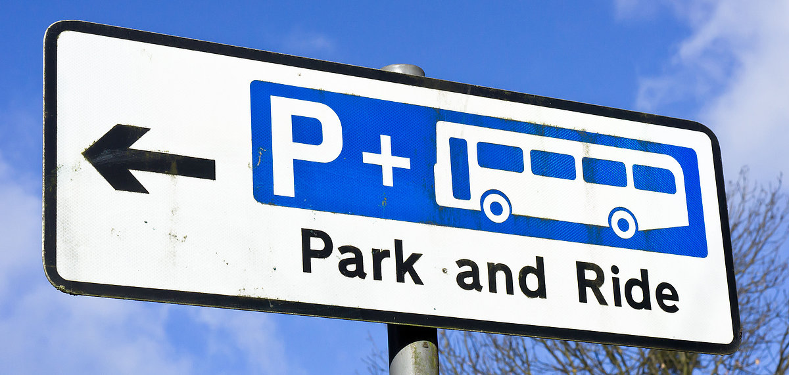
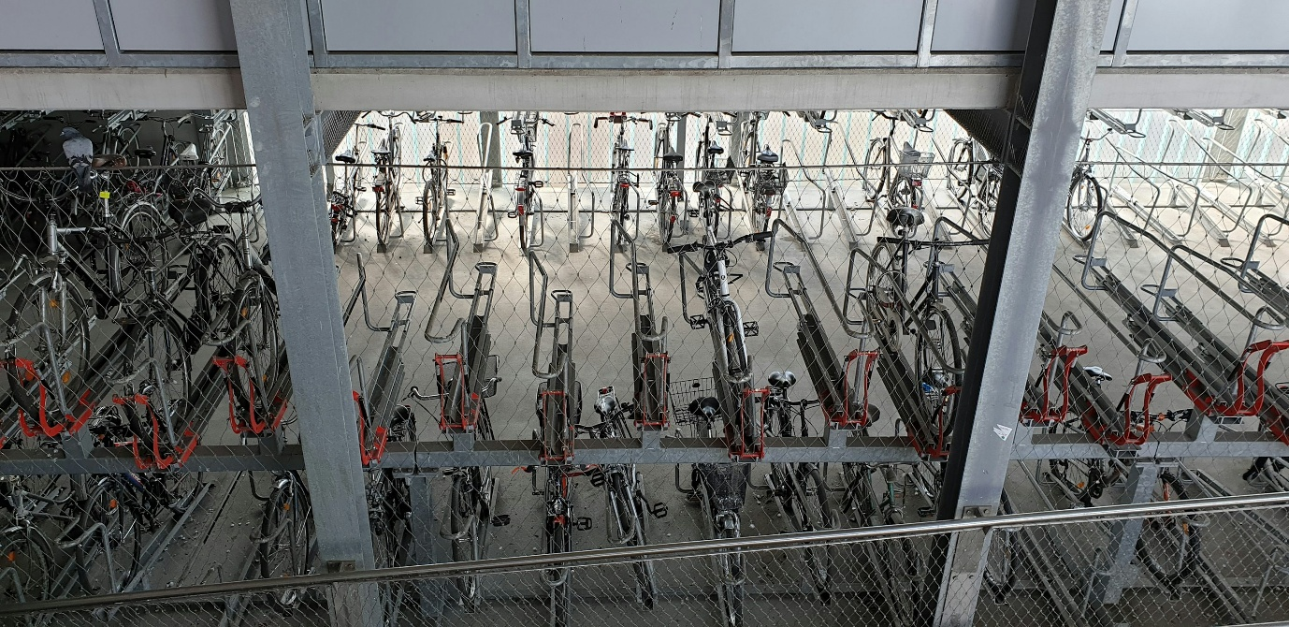
Integration Between Modes
Examples:
bike parking at rail stations
pedestrian access to bus stops
park-and-ride systems
integrated ticketing systems
Fig. 4: VRM
Fig. 5: Unsplash

Slide 16
Classification in the Planning Process
Network planning can be:
strategic (long-term structure)
tactical (service/network optimisation)
operational (daily management)

Slide 17
Contents
Introduction to Transport Network Planning
Functions & Purposes of Network Planning
Integrated Network Design (IND)
Structures of Integrated Network Design
Principles in Network Design
Transport Networks: Functional Organization
Quality Criteria for Network Design
Current Trends & Future Challenges

Slide 18
Common Network Structures
Grid Network:
many direct connections
high flexibility
common in dense urban areas
Radial Network:
routes connect suburbs to city centre
common in monocentric cities
Ring & Radial Structure:
radial lines + orbital connections
reduces pressure on city centres
Hierarchical Networks:
Different functional levels:
  primary corridors
  secondary routes
  local access roads/paths
-> Different functions require different network standards

Slide 19
Contents
Introduction to Transport Network Planning
Functions & Purposes of Network Planning
Integrated Network Design (IND)
Structures of Integrated Network Design
Principles in Network Design
Transport Networks: Functional Organization
Quality Criteria for Network Design
Current Trends & Future Challenges

Slide 20
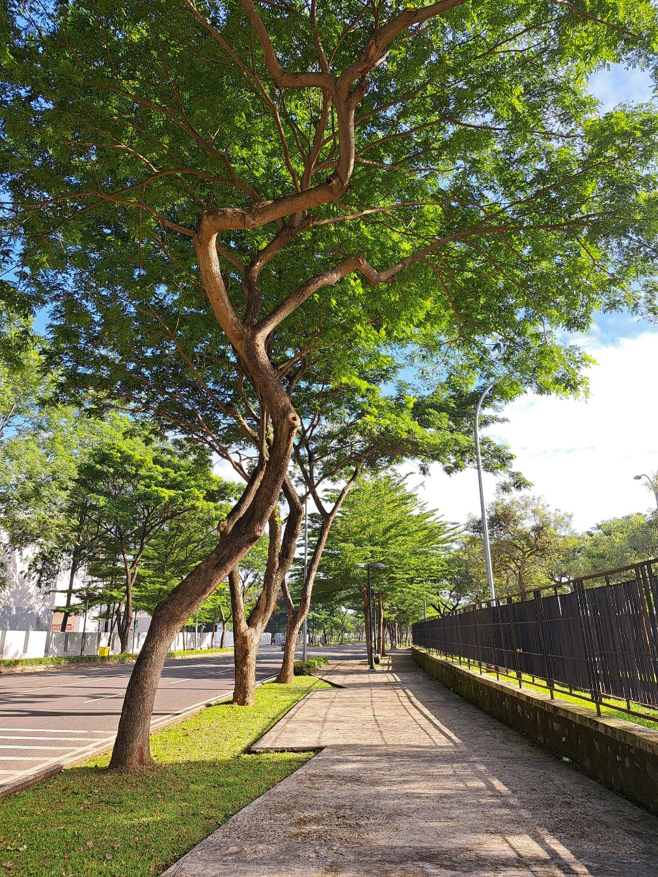
Principles in Network Design:
Connectivity
users should easily reach destinations
minimisation of detours and barriers
Fig. 6: Unsplash

Slide 21
Principles in Network Design:
Directness & Efficiency
short and logical routes
reduced transfer times
efficient traffic distribution

Slide 22
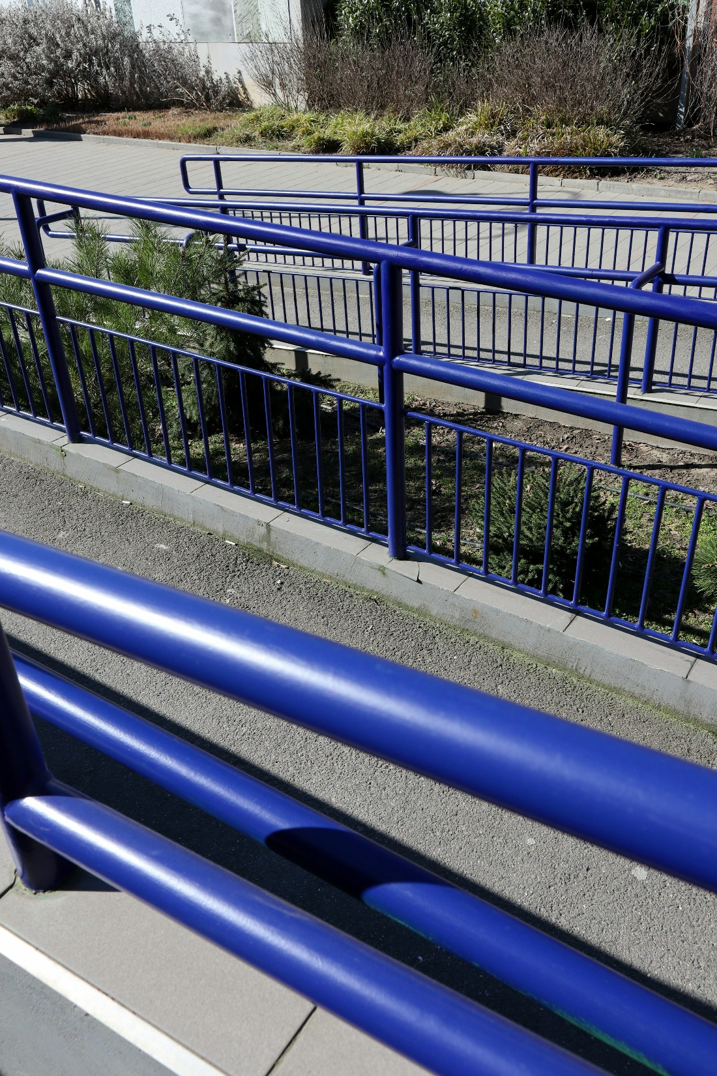
Principles in Network Design:
Accessibility
universal access for different user groups
barrier-free infrastructure
spatial coverage
Fig. 7: Unsplash

Slide 23
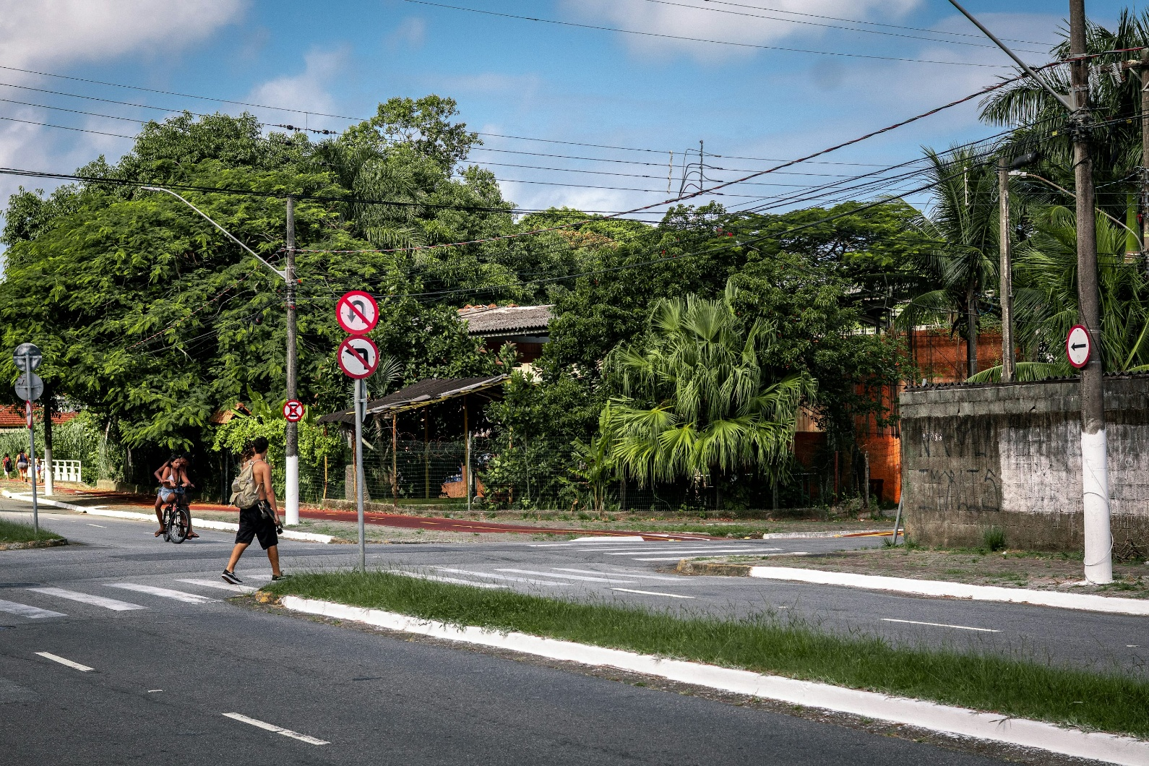
Principles in Network Design:
Safety
safe intersections
separation of transport modes where necessary
traffic calming measures
Fig. 8: Unsplash

Slide 24
Principles in Network Design:
Resilience & Flexibility
networks should handle disruptions
alternative routes increase robustness

Slide 25
Contents
Introduction to Transport Network Planning
Functions & Purposes of Network Planning
Integrated Network Design (IND)
Structures of Integrated Network Design
Principles in Network Design
Transport Networks: Functional Organization
Quality Criteria for Network Design
Current Trends & Future Challenges

Slide 26
Functional Hierarchy of Networks
Different network levels serve different purposes:
long-distance movement
regional distribution
local access

Slide 27
Public Transport Network Design
Goals:
  high accessibility
  efficient transfers
  reliable operation
Typical structures:
  radial systems
  trunk-and-feeder systems
  grid systems

Slide 28
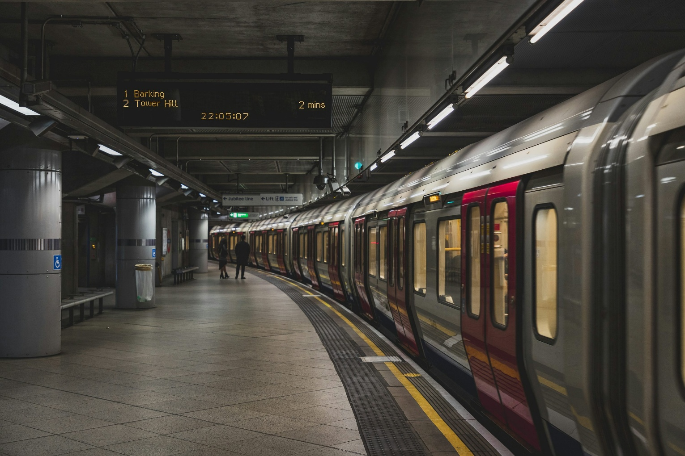
Public Transport Integration
multimodal hubs
coordinated timetables
integrated ticketing systems
Fig. 9: Unsplash

Slide 29
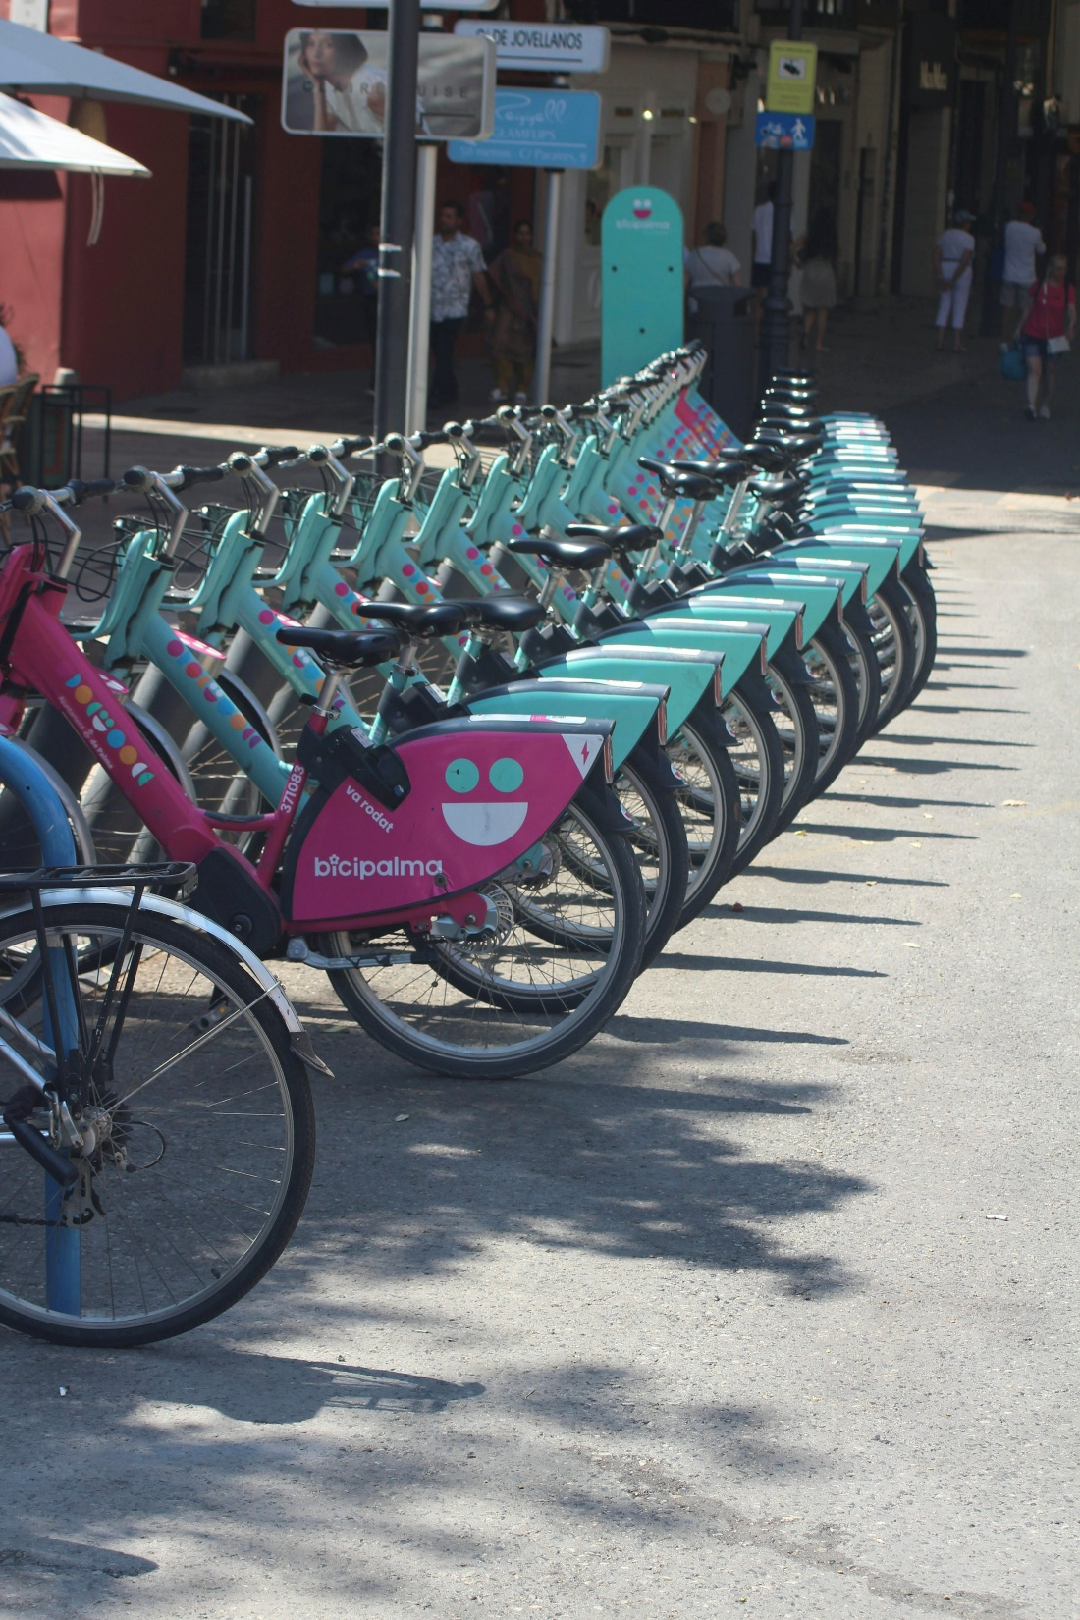
Cycling Network Design
Key requirements:
safety
continuity
direct routes
separation from heavy traffic
Fig. 10: Unsplash

Slide 30
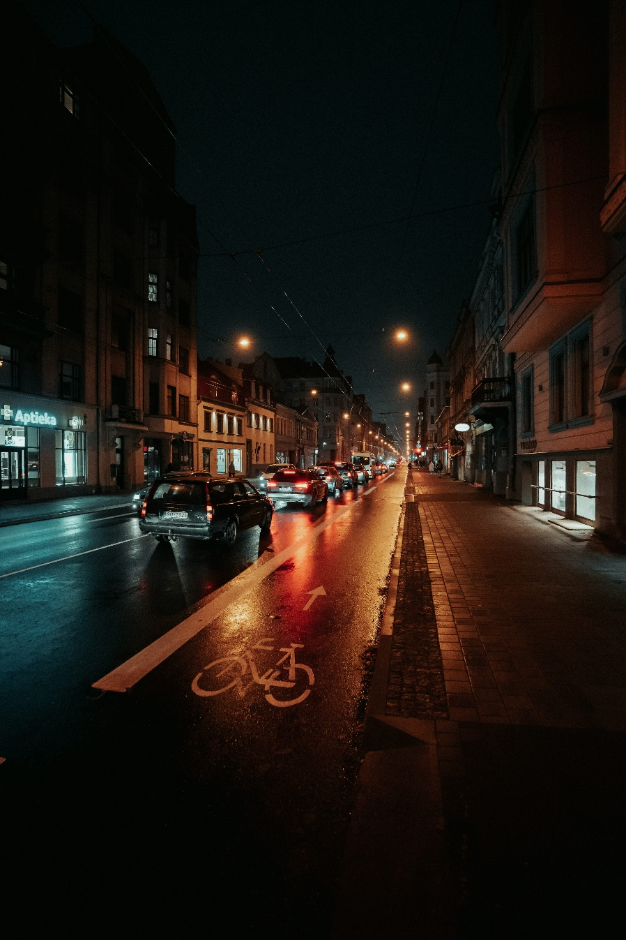
Cycling Infrastructure Elements
bike lanes
protected cycle tracks
bicycle parking
bike-sharing integration
Fig. 11: Unsplash

Slide 31
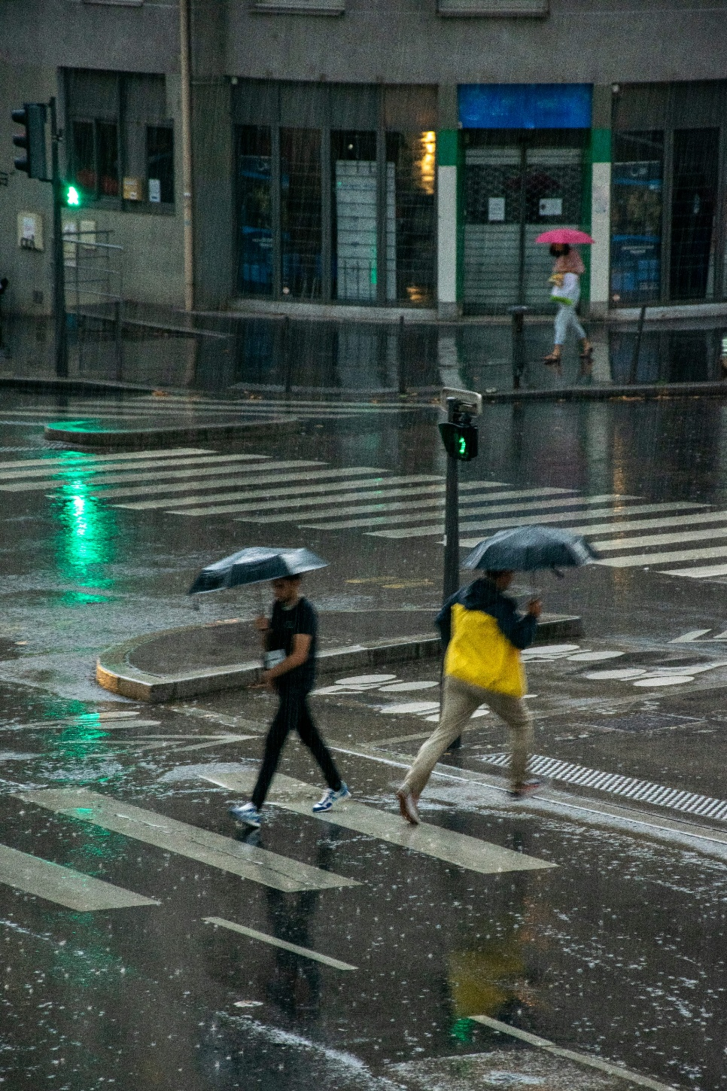
Pedestrian Network Design
Key requirements:
short walking distances
safe crossings
attractive public spaces
accessibility for all users
Fig. 12: Unsplash

Slide 32
Walkability
Indicators:
sidewalk quality
connectivity
crossing density
urban design quality

Slide 33
Contents
Introduction to Transport Network Planning
Functions & Purposes of Network Planning
Integrated Network Design (IND)
Structures of Integrated Network Design
Principles in Network Design
Transport Networks: Functional Organization
Quality Criteria for Network Design
Current Trends & Future Challenges

Slide 34
Operational Criteria
travel time
network capacity
reliability
connectivity

Slide 35
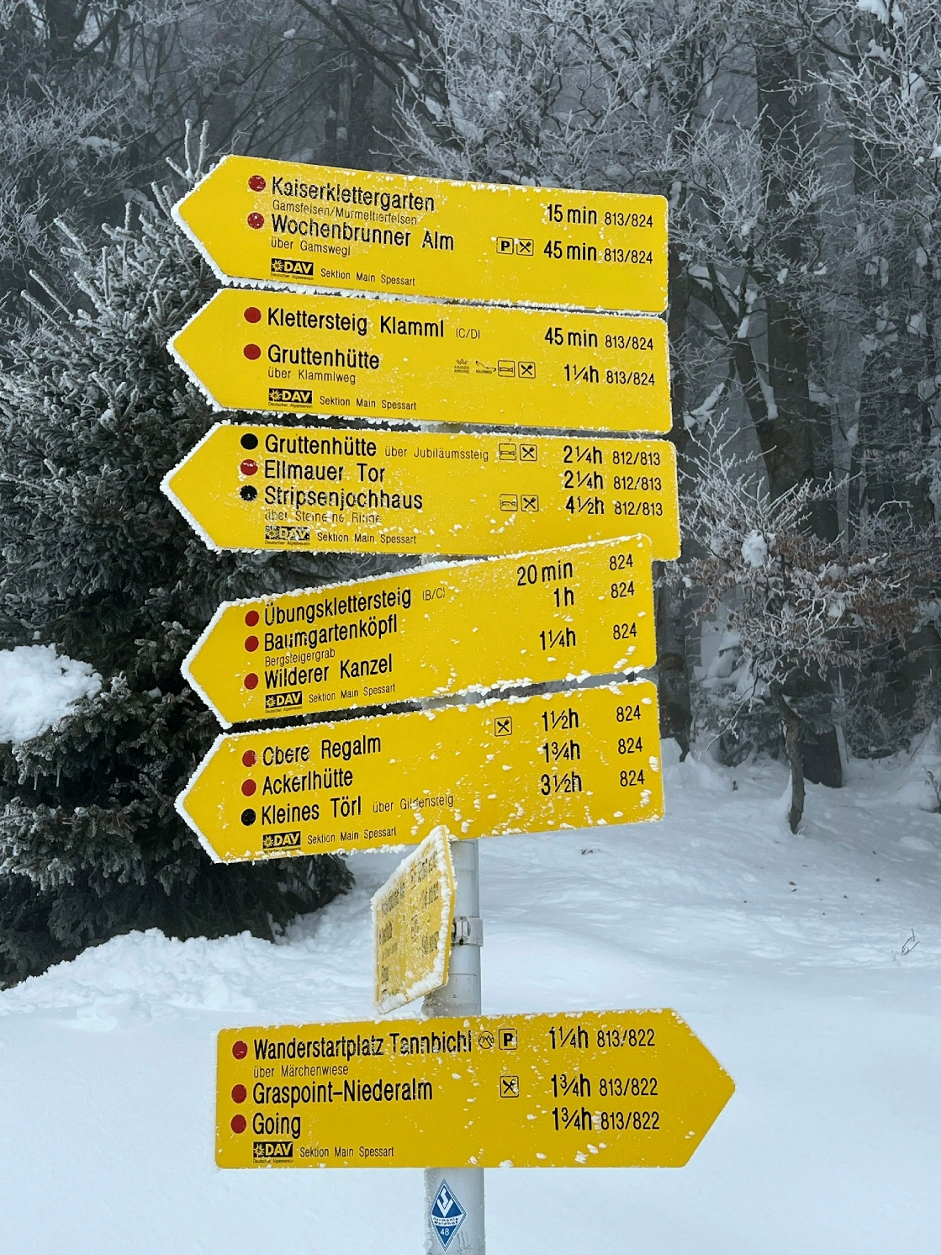
User-Oriented Criteria
comfort
safety perception
accessibility
ease of orientation
Fig. 13: Unsplash

Slide 36
Sustainability Criteria
environmental impact
land consumption
energy efficiency
support for active mobility

Slide 37
Evaluation of Networks
Methods include:
accessibility analysis
GIS-based modelling
transport simulation
user surveys

Slide 38
Contents
Introduction to Transport Network Planning
Functions & Purposes of Network Planning
Integrated Network Design (IND)
Structures of Integrated Network Design
Principles in Network Design
Transport Networks: Functional Organization
Quality Criteria for Network Design
Current Trends

Slide 39
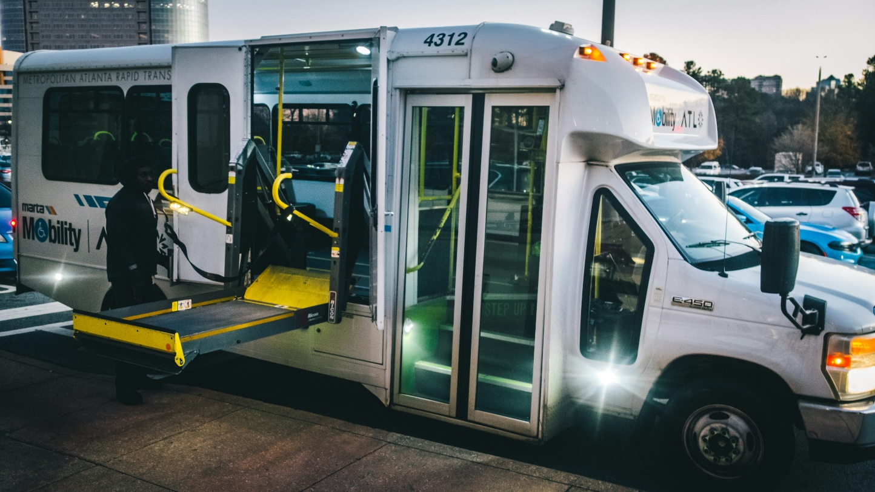
Emerging Trends
smart mobility networks
Mobility-as-a-Service (MaaS)
climate-resilient infrastructure
increasing multimodal integration
increasing accessibility
Fig. 14: Unsplash

Slide 40
Key takeaways
Transport network planning organises mobility systems spatially and functionally
Integrated Network Design connects different transport modes
Network quality depends on accessibility, safety and connectivity
Public transport, cycling and pedestrian networks require different design principles
Modern planning emphasises multimodal and sustainable systems

Slide 41
Thank you for your attention!

Slide 42
Sources - Pictures
Fig. 1: https://unsplash.com/photos/modern-bus-station-with-multiple-buses-and-people-waiting-AK0RFK5Ymx4
Fig. 2: https://unsplash.com/photos/timelapes-photography-of-car-lights-on-road-during-night-time-Yc9QXbAsGtA
Fig. 3: https://unsplash.com/photos/a-close-up-of-a-map-of-a-city-4kzTcN8CJtQ
Fig. 4: https://www.vrminfo.de/fahrplan/uebersichtsplaene/park-ride/
Fig. 5: https://unsplash.com/photos/a-bunch-of-bikes-that-are-in-a-building-K56-Vu8voFo
Fig. 6: https://unsplash.com/photos/a-sidewalk-with-trees-on-the-side-lhW857KjPQc
Fig. 7: https://unsplash.com/photos/blue-metal-railing-next-to-a-paved-walkway-d5sHs5EXPiA
Fig. 8: https://unsplash.com/photos/man-crosses-street-with-lush-trees-in-background-ga1r0SYCoTg
Fig. 9: https://unsplash.com/photos/person-near-train-qZ6if8WXl7E
Fig. 10: https://unsplash.com/photos/a-row-of-bicycles-parked-next-to-each-other-vWfswDzjcX8
Fig. 11: https://unsplash.com/photos/cars-parked-on-side-of-the-road-during-night-time-p0AtyWl6Sf4
Fig. 12: https://unsplash.com/photos/people-walking-in-the-rain-with-umbrellas-gxED67vV16M
Fig. 13: https://unsplash.com/photos/a-yellow-sign-sitting-on-the-side-of-a-snow-covered-road-1EaMUOW6JYc
Fig. 14: https://unsplash.com/photos/a-city-bus-with-its-doors-open-and-a-ramp-attached-to-it-DywNI8MTfEo

Slide 43
Sources – Literature (Further Reading)
European Commission n.y.: Mobility and Transport. https://transport.ec.europa.eu/index_en (10.05.26).
Global Designing Cities Initiative n.y.: Change Streets, change the world. https://globaldesigningcities.org/ (10.05.26).
International Association of Public Transport n.y.: https://www.uitp.org/ (10.05.26).
International Transport Forum 2026: https://www.itf-oecd.org/ (10.05.26).
OECD n.y.: Transport. https://www.oecd.org/en/topics/transport.html (10.05.26).
World Bank n.y.: Transport. https://www.worldbank.org/ext/en/topic/transport (10.05.26).

