Slide 1
Non-motorized private transport: Pedestrians
Fundamentals of Transport

Slide 2
Road Transportation Systems Engineering Development in the Sub-Saharan Africa – Modern EU Master Programme & Capacity Building

Slide 4
Overview
Basics: Non-motorized Private Transport
Pedestrian Traffic: Development and Challenges
Traffic Safety for Pedestrians
Promotion of Pedestrian Traffic

Slide 5
Overview
Basics: Non-motorized Private Transport
Pedestrian Traffic: Development and Challenges
Traffic Safety for Pedestrians
Promotion of Pedestrian Traffic

Slide 6

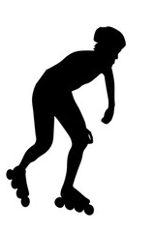
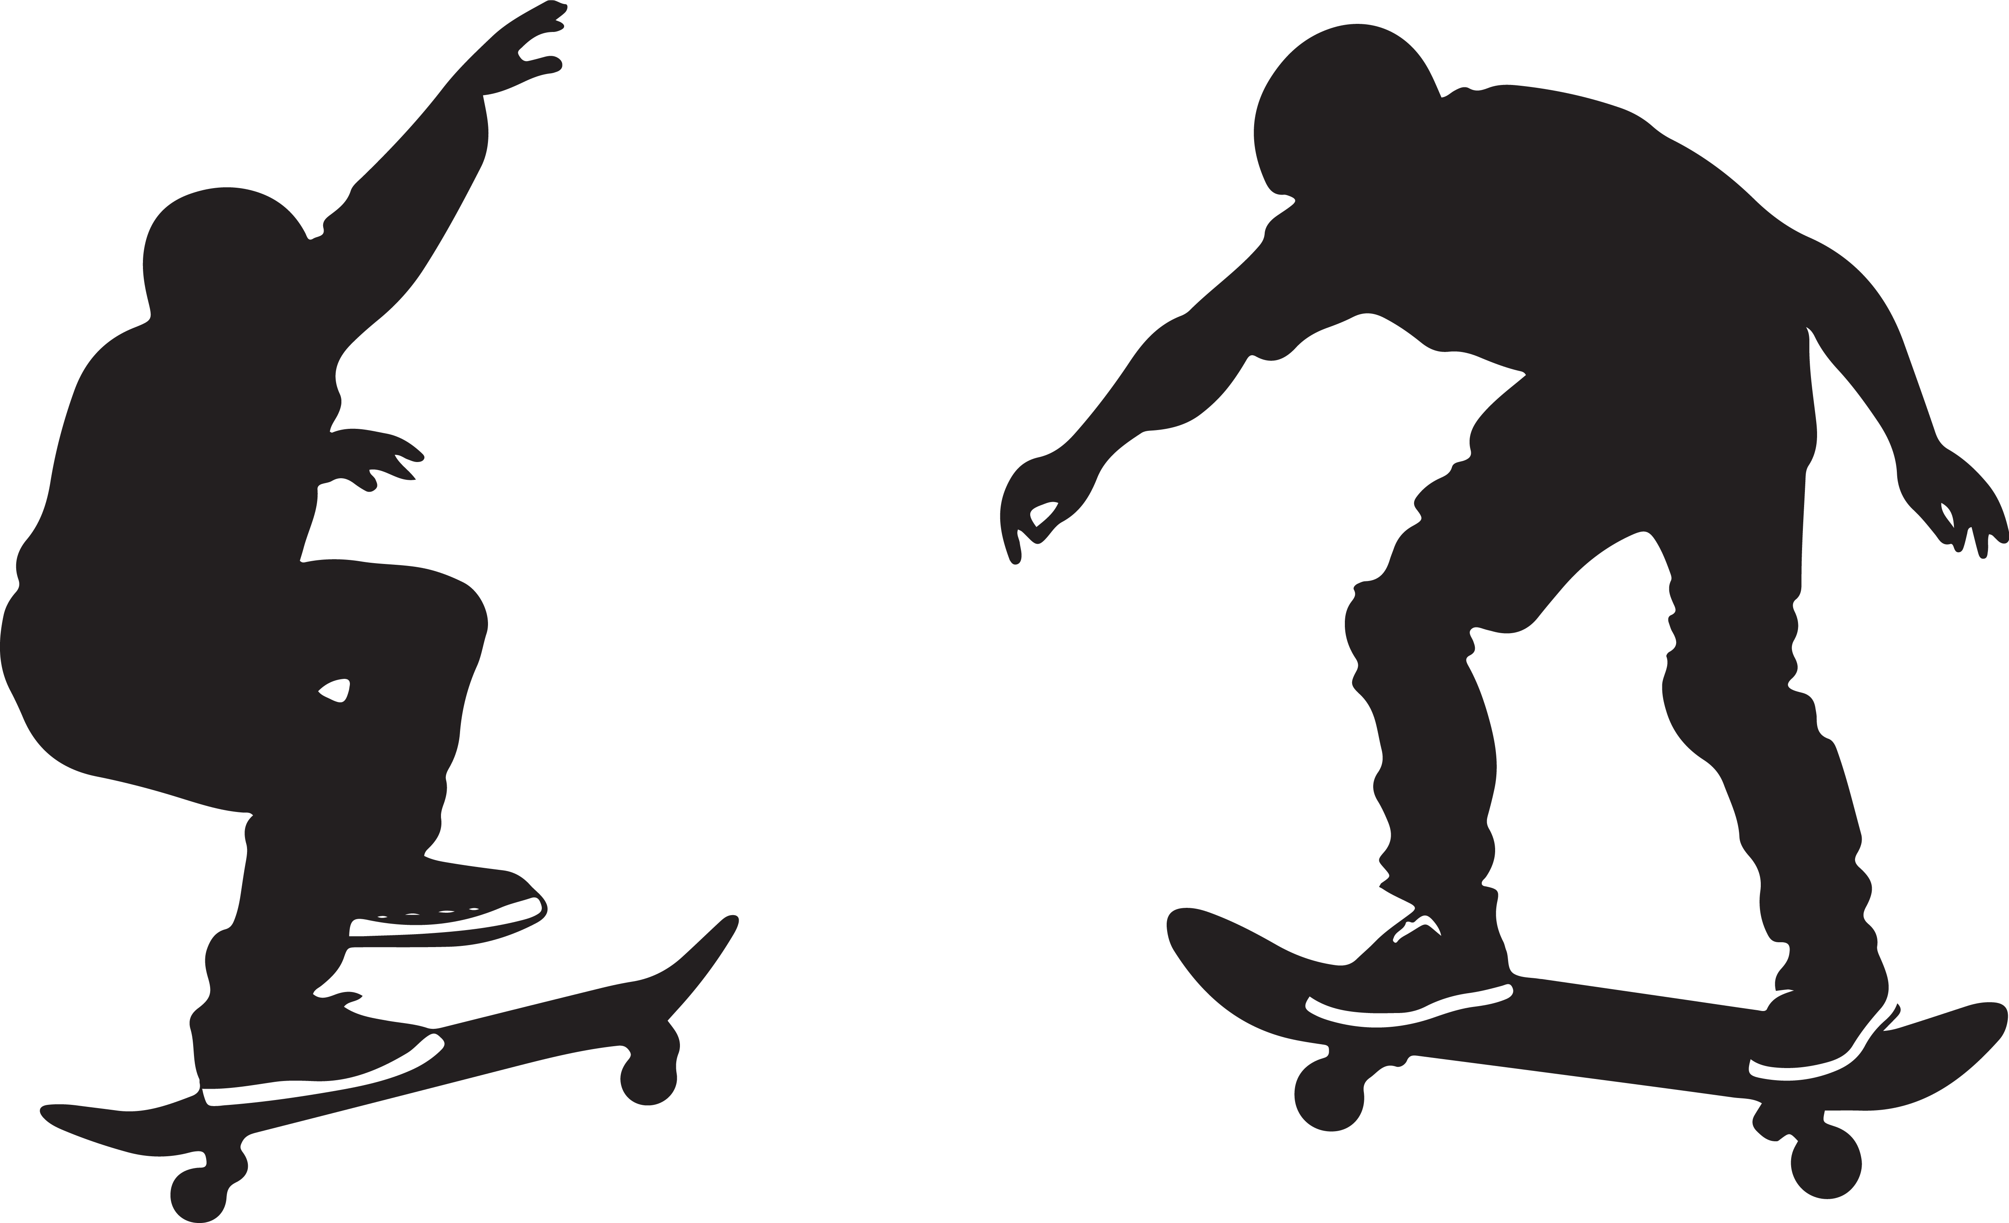
Definition, what count as Pedastrian

Slide 7
Basics:
The Environmental Compound
The Environmental Compound as a cooperation of environmentally friendly means of transportation:
  walking, also using mobility aids like wheelchairs
  cycling
  (local) public transport
  car sharing
  special forms: skateboards, segways, hoverboards,...

Slide 8
Basics:
Mobility Transition
towards sustainable transport
is based on two collumns
  behavioural transition
  - „avoid and relocate“
  - reduction of motorized transport; e.g. through increased attractiveness of pedestrian traffic, public transport and cycling,
technological transition
improvement of technologies, replacement of fossil fuels
- reduction of emissions while driving

Slide 9
Basics:
Foot Traffic as a mode of transport
On average, 20-30% of all trips worldwide are walked
The regional variation is high, in regions such as North America, the share of walking and cycling in the modal split is only around 3.5%, while it is about 43-46% in Western and Eastern Africa
Walking is also usually part of trips using public transport, 91% walk to/from public transit stops in European cities

Slide 10
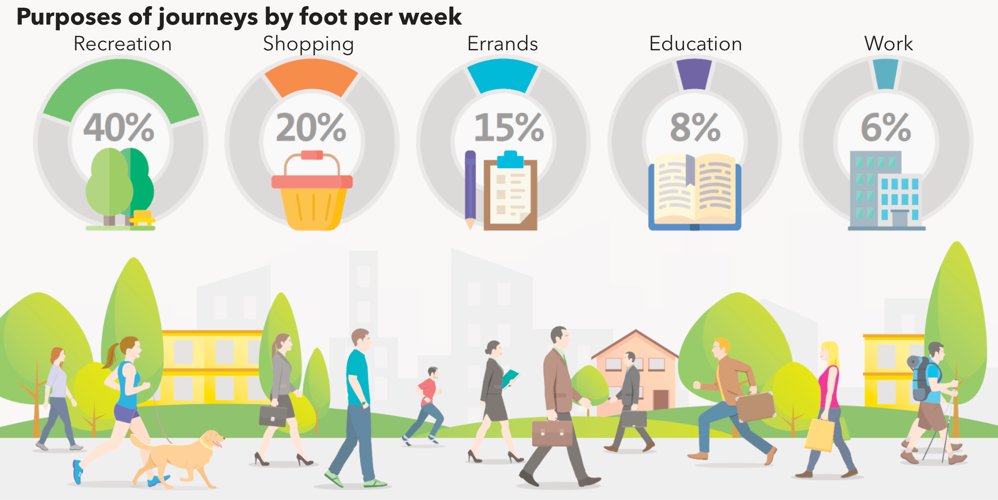
Basics:
Purposes of journeys by foot
German data, but internationally quite similar distribution
MiD 2017

Slide 11
Overview
Basics: Non-motorized Private Transport
Pedestrian Traffic: Development and Challenges
Traffic Safety for Pedestrians
Promotion of Pedestrian Traffic

Slide 12
Development of Foot Traffic
Walking has not disappeared with motorization, it persists strongly for short distances, and as an integral part of multimodal travel
There is growing formal recognition that walking must be supported through strategic planning, not only infrastructure
Walking does not evolve uniformely, it increases where urban form and policies support it and can stagnate or decline where motorization dominates

Slide 13
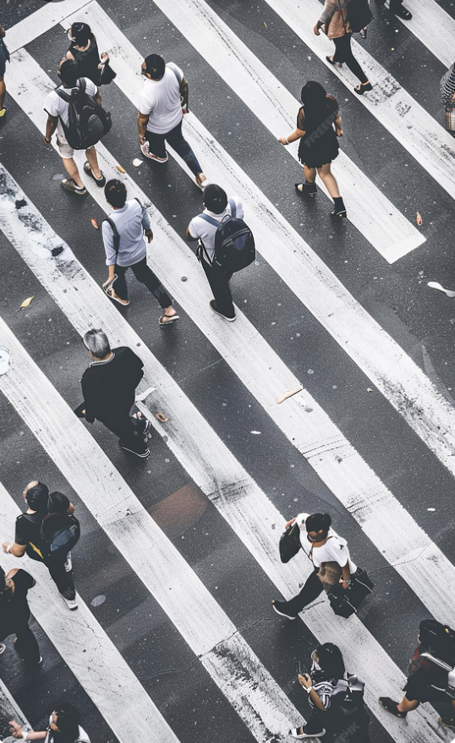
Foot Traffic: Advantages
high degree of accessibility
individual accessibility
cost-effective
health-promoting
no emissions: the most environmentally friendly mode of transportation
Freepik

Slide 14
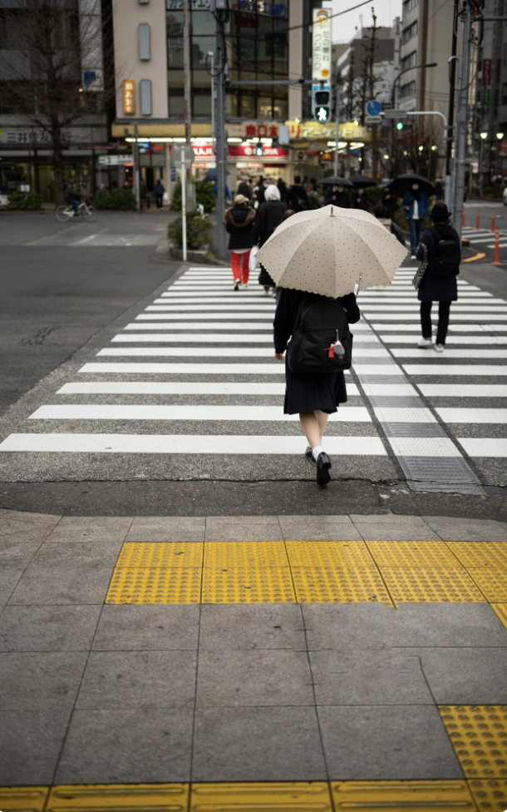
Foot Traffic: Challenges
Weather dependency
Detour sensitivity
High vulnerability
  Air- & noise pollution
  Risk of accidents at gaps in the footpath network
Vehicle-oriented urban-/traffic planning: Pressured by space requirements of other uses
➡️ Consequence: Decreasing attractiveness of pedestrian traffic
Freepik

Slide 15
Overview
Basics: Non-motorized Private Transport
Pedestrian Traffic: Development and Challenges
Traffic Safety for Pedestrians
Promotion of Pedestrian Traffic

Slide 16
Fatalities in Foot Traffic
Nearly a quarter of all road crash deaths are pedestrians worldwide
  in the WHO African Region, this rate is the highest at 40%
The number of pedestrian victims is rising at nearly twice the rate of all other road crash fatalities
Per kilometre travelled, pedestrians face a nine times higher risk of death than car occupants
Each year, around 270.000-310.000 pedestrians are killed on roads worldwide
A larger proportion of fatalities happen in the dark, in urban areas and to males

Slide 17
Accident Contribution of Pedestrians
The proportion of accidents in which pedestrians are at fault varies greatly depending on the region, context and even study
Especially in pedestrian friendly zones, drivers are predominantly at fault
Crashes often occur when
  Pedestrians cross outside crosswalks
  Drivers fail to yield or misjudge gaps
  Vehicles turn without noticing pedestrians
Poor infrastructure, fast traffic, and low visibility increase crash risk and affect responsibility assignment

Slide 18
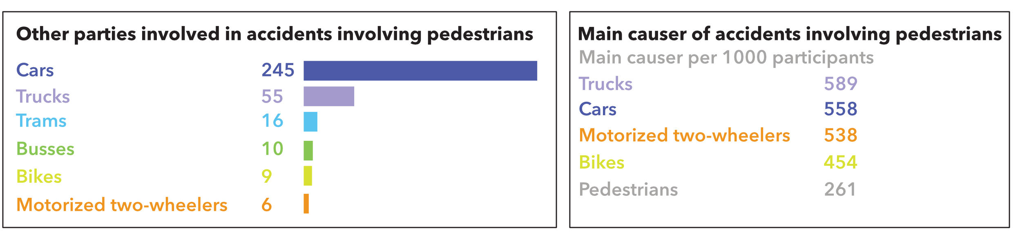
Accident Contribution of Pedestrians – German Data (DVR 2020)
Most pedestrians die after accidents with cars
Pedestrians cause the accidents in which they are involved significantly less often than other road users

Slide 19
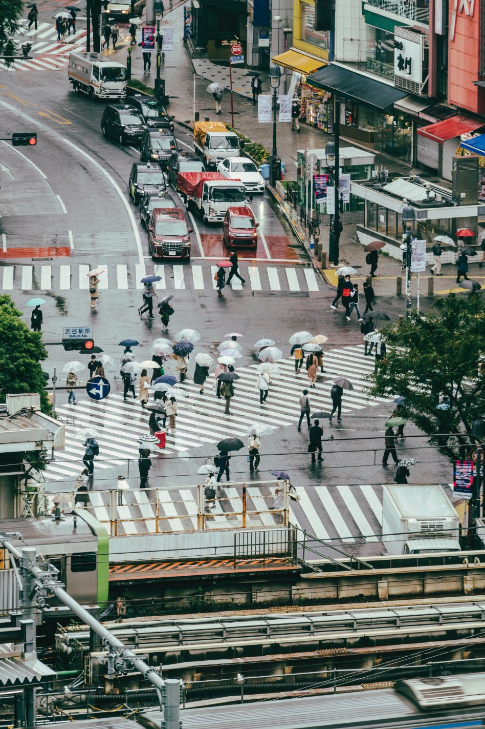
Pedestrian Safety: Road Safety
Road safety deficits result primarily from excessive speeds of other road users
  speed reducing measures for motor vehicle traffic, especially in places with high pedestrian traffic volumes and at accident hotspots
  general speed reducing
Other safety deficits: Intersections
  safe crossing aids: traffic signals, crosswalks, spatial sparation from other traffic by underpasses or overpasses
Freepik

Slide 20
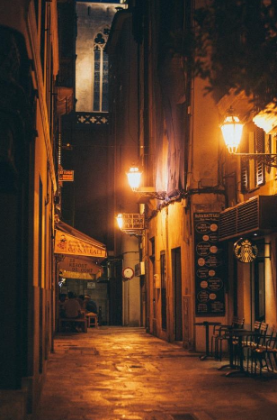
Pedestrian Safety: Social Safety
Pedestrian traffic facilities should be a fear-free experience for everyone
Increasing social safety:
  presence of other people
  lighting
  good visibility: no restriction of movement options and lines of sight
https://unsplash.com/

Slide 21
Overview
Basics: Non-motorized Private Transport
Pedestrian Traffic: Development and Challenges
Traffic Safety for Pedestrians
Promotion of Pedestrian Traffic

Slide 22
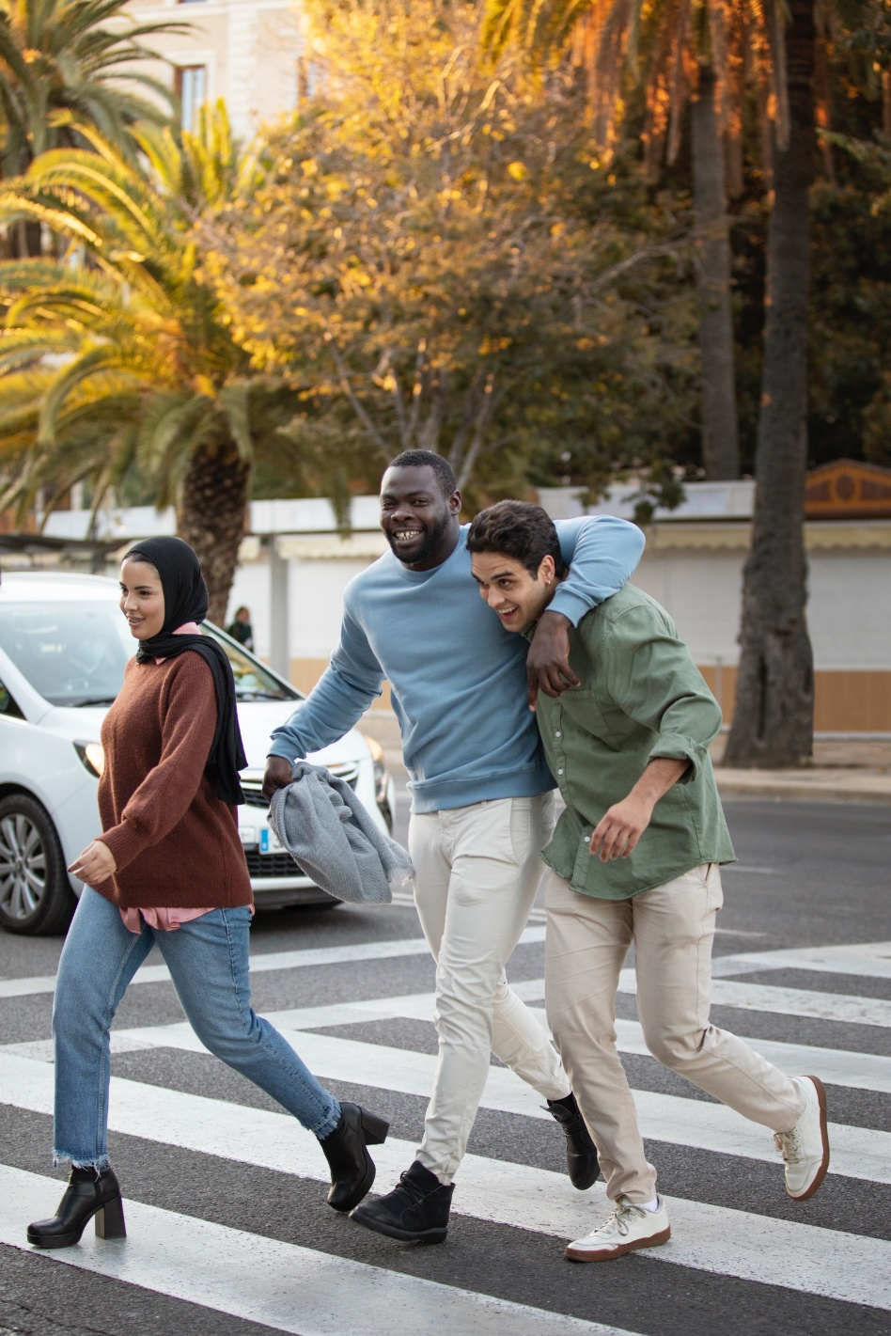
Promotion of foot traffic
– Why it matters
Strengthening the Environmental Compound
Accessibility for everyone, enables participation in society
The only free of charge mode of transport
Health benefits
Freepik

Slide 23
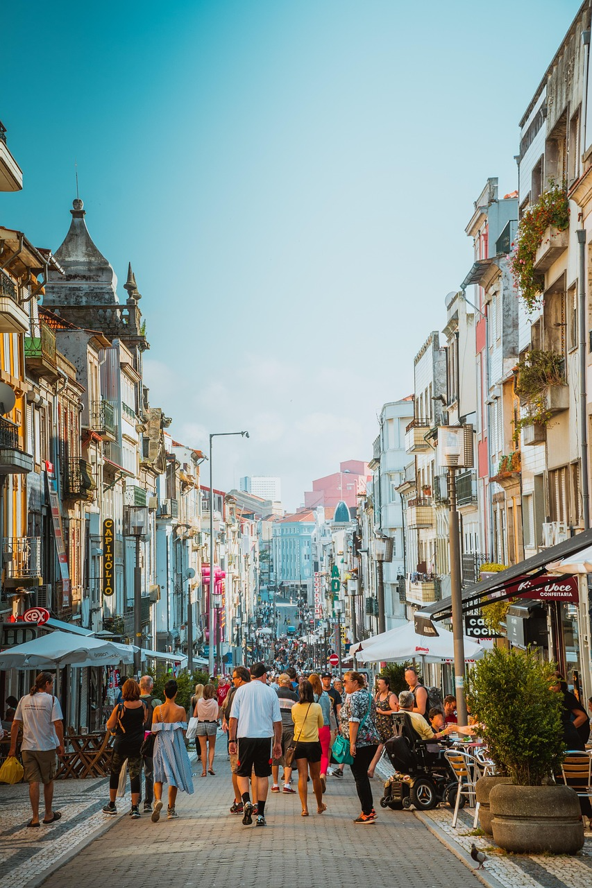
Promotion of foot traffic
– How to achieve it
Revitalization of public spaces
Short distances to places of public interest
Diverse structures and suggestions at eye level
Inviting places to stay
Reduction of noise and air pollutants
Safety
Pixabay

Slide 24
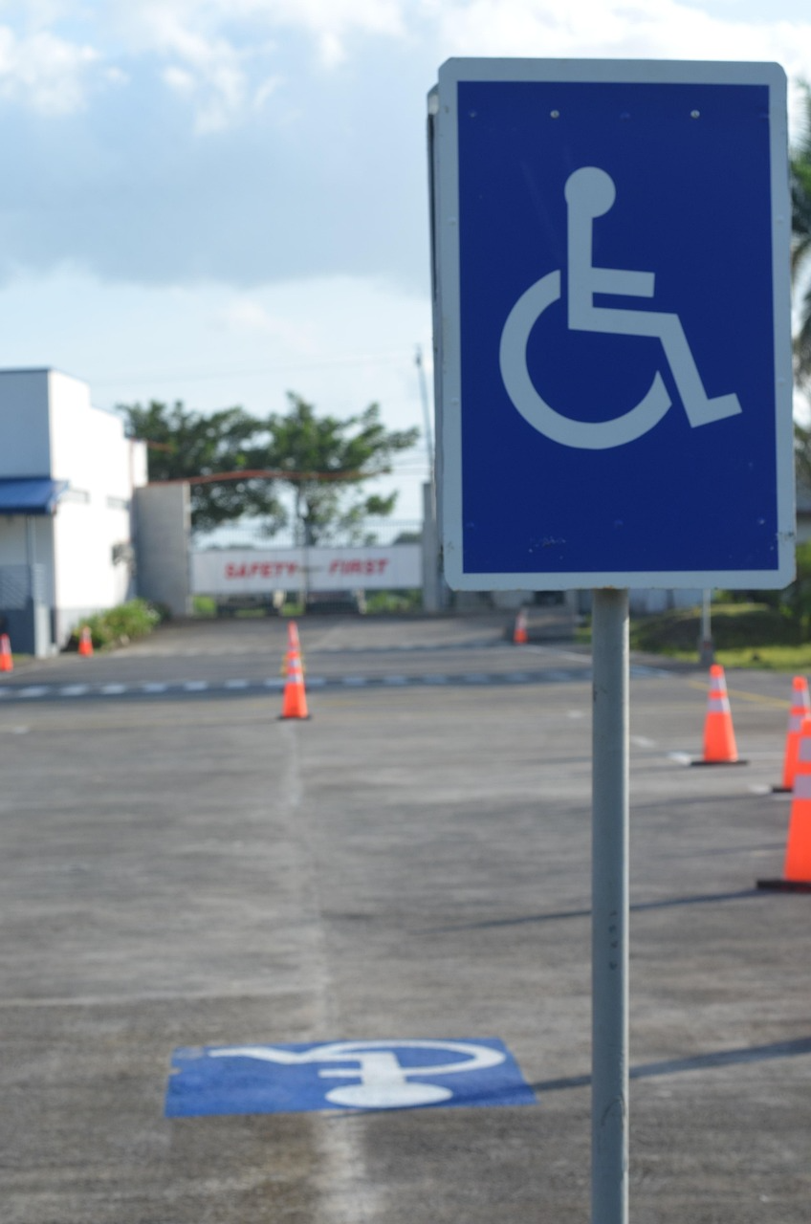
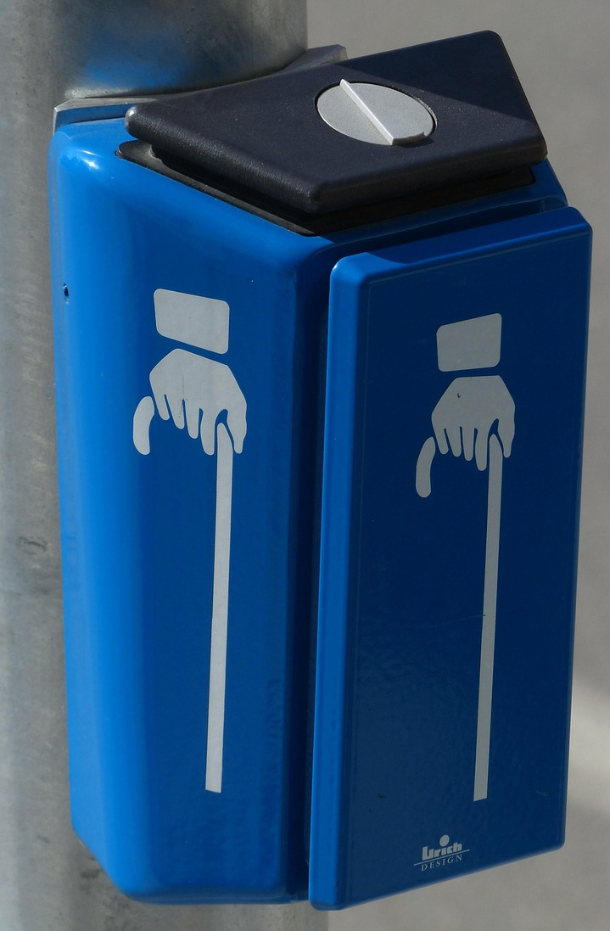
Accessibility
An accessible environment is essential for:
  people with limited mobility who are dependent on a wheelchair, rollator, walking stick, etc.; also relevant for people with baby buggies
  people with limited eyesight who are dependent on a white cane, acoustic signals or a guide dog
  people with limited hearing who are dependent on a quick assessment of their environment and possible dangers without acoustic signals
Pixabay

Slide 25
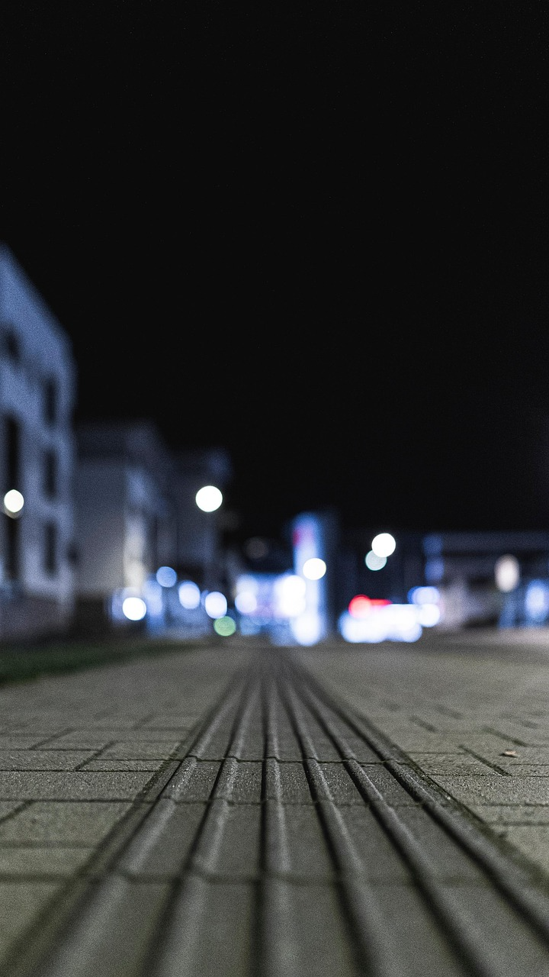
Accessibility: What‘s barrier-free design for pedestrians?
Adequate dimensioning of pedestrian traffic facilities
Sidewalk areas must be barrier-free, tactile and visually demarcated from the street
The lowest possible transverse gradient (max. 2.5%) and the lowest possible longitudinal gradient (max. 3%)
Avoiding height differences, if not possible: installation of ramps and elevators
Making traffic areas comprehensible for visually impaired people through guidance systems
Pixabay

Slide 26
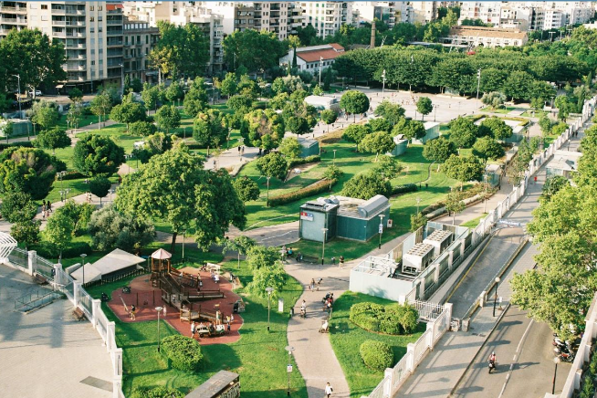
Good Practice: 15-minute-cities – The Concept
Urban planning concept: most daily needs (work, shopping, healthcare, education, leisure) should be reachable within a 15-minute walk, bike ride, or public transport trip from home
A lifestyle model promoting proximity, mixed land use, and human-scale urban living
Unsplash

Slide 27
Good Practice: 15-minute-cities – Why?
Reduces car dependency and associated carbon emissions and air pollution
Active travel (walking/biking) improves physical and mental health and reduces lifestyle-related diseases
Supports social interaction, vibrant neighborhoods and local community identity
More foot traffic boosts local businesses and neighborhood economies
Less traffic and more green/public space makes cities safer, quieter, healthier and more liveable
Stronger sense of place and belonging through accessible local amenities

Slide 28
Good Practice: 15-minute-cities - Examples
Paris, France: Integrated the concept into city planning; expanded pedestrian areas and bike lanes; local services accessible within short distances
Copenhagen, Denmark: Mixed-use neighborhoods with pedestrian zones, bike infrastructure and sustainable districts like Nordhavn
Other cities worldwide: Programs or adaptations underway in Barcelona, Milan, Bogotá, Vienna, Shanghai, Vancouver and beyond

Slide 29
Thank you for your attention!

Slide 30
Sources - Graphics
https://www.mobilitaet-in-deutschland.de/archive/pdf/MiD2017_Ergebnisbericht.pdf
https://de.freepik.com/fotos-premium/menschen-die-die-strasse-ueberqueren-eine-geschaeftige-stadt_213665826.htm#fromView=search&page=1&position=22&uuid=9bdedc7d-5ac0-4550-b7d6-2689f24cb2fa&query=pedestrians
https://de.freepik.com/fotos-kostenlos/stadtlandschaft-von-tokio-mit-fussgaengeruebergang_24490014.htm#fromView=search&page=1&position=0&uuid=9bdedc7d-5ac0-4550-b7d6-2689f24cb2fa&query=pedestrians
https://de.freepik.com/fotos-kostenlos/ansicht-der-belebten-strasse-mit-leuten-und-karte_11168298.htm#fromView=search&page=1&position=27&uuid=ff7a1adc-9595-46bb-acb1-6d1fe29b5f4f&query=intersection+pedestrians
https://pixabay.com/de/photos/ampeldr%c3%bccker-signal-anforderungsger%c3%a4t-1053727/
https://pixabay.com/de/photos/rollstuhlsymbol-stra%c3%9fenschild-stra%c3%9fe-6874070/
https://pixabay.com/de/photos/b%c3%bcrgersteig-stra%c3%9fe-barrierefreiheit-5748852/
https://de.freepik.com/fotos-kostenlos/voller-schuss-glueckliche-menschen-die-zusammen-gehen_23179514.htm#fromView=search&page=1&position=29&uuid=29ee22e6-556b-4e1d-bd34-715469535a6d&query=foot+traffic
https://pixabay.com/de/photos/stadt-einkaufsstra%c3%9fe-einkaufszentrum-3577655/

Slide 31
Sources - Literature
DVR 2020: Jahresbericht. https://www.dvr.de/fileadmin/downloads/Jahresbericht/DVR-Jahresbericht-2020.pdf (03.02.26).
MiD 2017: Ergebnisbericht. https://www.mobilitaet-in-deutschland.de/archive/pdf/MiD2017_Ergebnisbericht.pdf (03.02.26).
NHTSA 2021: Traffic Safety Facts. https://crashstats.nhtsa.dot.gov/Api/Public/ViewPublication/813458.pdf (03.02.26).
Transport Lexicon n.y.: Copenhagen‘s 15-minute-city. https://www.transport-lexicon.com/cms/lexicon/lexikon-c/copenhagen-s-15-minute-city.html (03.02.26).
WHO 2023: New WHO Manual aims to strengthen pedestrian safety. https://www.who.int/news/item/03-05-2023-new-who-manual-aims-to-strengthen-pedestrian-safety? (03.02.26).

