Slide 1
Media, modes & means of transport
Fundamentals of Transport

Slide 2
Road Transportation Systems Engineering Development in the Sub-Saharan Africa – Modern EU Master Programme & Capacity Building

Slide 4
Learning Objectives
Students can:
distinguish means, modes and media of transport
explain the elements of a transportation system
differentiate passenger vs freight transport
analyse why transport is essential for economies and societies
evaluate advantages and limitations of major transport media

Slide 5
Transport as a Foundation of Society
Transportation...
enables access to jobs, education, healthcare
supports trade and economic development
connects regions and markets, links regional and global production processes
shapes urban structure and land use
makes recreational activities accessible
is its own economic sector with various sub-sectors (production, services,...)
-> No modern economy without transport systems

Slide 6
Transport Demand Drivers
population distribution
economic activity
spatial separation of activities
globalisation of production and trade
Transport is derived demand (people usually don’t travel for its own sake)

Slide 7
MEANS VS. MODES VS. MEDIA OF TRANSPORT
- CORE CONCEPT

Slide 8
Elements of the transportation system
Transport infrastructure
"comprises the fixed components of a transportation system, primarily the transport routes and stations" (Kummer 2010: 38)
Transport routes
"include [...] the routes and technical facilities that are prerequisites carrying out transportation on the routes" (Kummer 2010: 39)
Use the transportation media land, water and air
Transportation media
"The transportation media of land, water and air are framework conditions determined by nature that significantly influence the characteristics of a transportation system" (Kummer 2010: 39)

Slide 9
Means of Transport (Vehicle Level)
Definition: Physical vehicle used for movement
Examples:
  car, bus, train, bicycle
  ship, airplane, truck
„Micro-level perspective“

Slide 10
Mode of Transport (Operational Category)
Definition: Category of transport defined by technology and infrastructure.
Examples:
  road transport
  rail transport
  air transport
  water transport
  non-motorized transport
„System level classification“

Slide 11
Media of Transport
(Infrastructure Environment)
Definition: Physical medium enabling movement.
Examples:
  roads
  rail tracks
  waterways
  airspace
  pedestrian infrastructure
„Environment where movement occurs.“

Slide 12
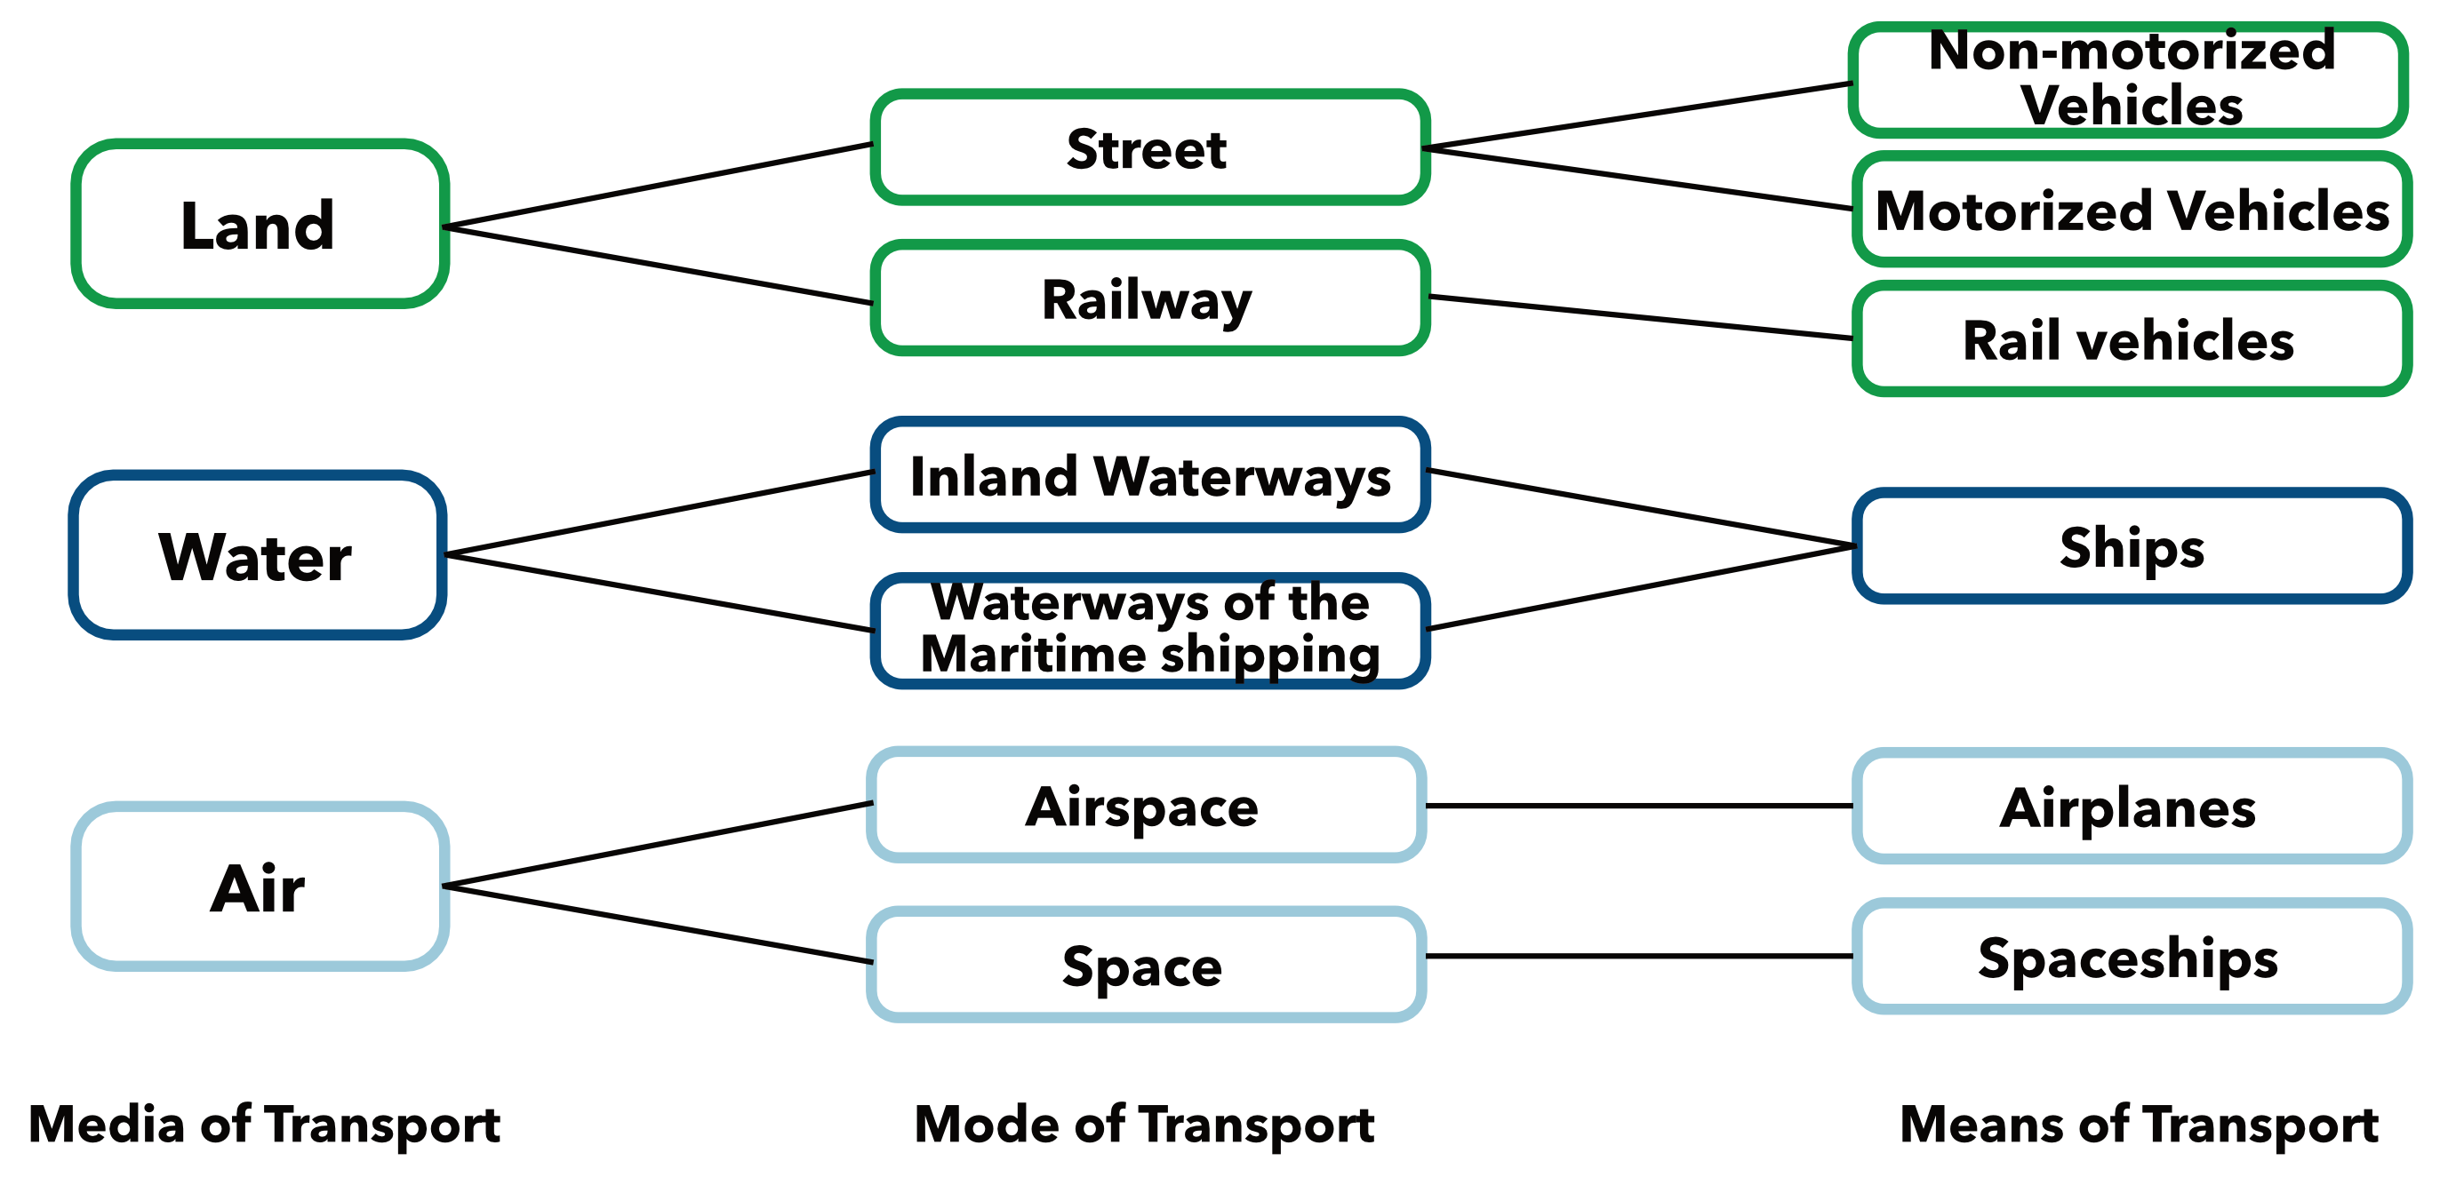
Relationship between those three

Slide 13
ELEMENTS
OF A TRANSPORTATION SYSTEM

Slide 14
Core System Components
A transportation system consists of:
Infrastructure
Vehicles
Users
Operations & control
Institutions & regulation
Energy supply
Transport = socio-technical system

Slide 15
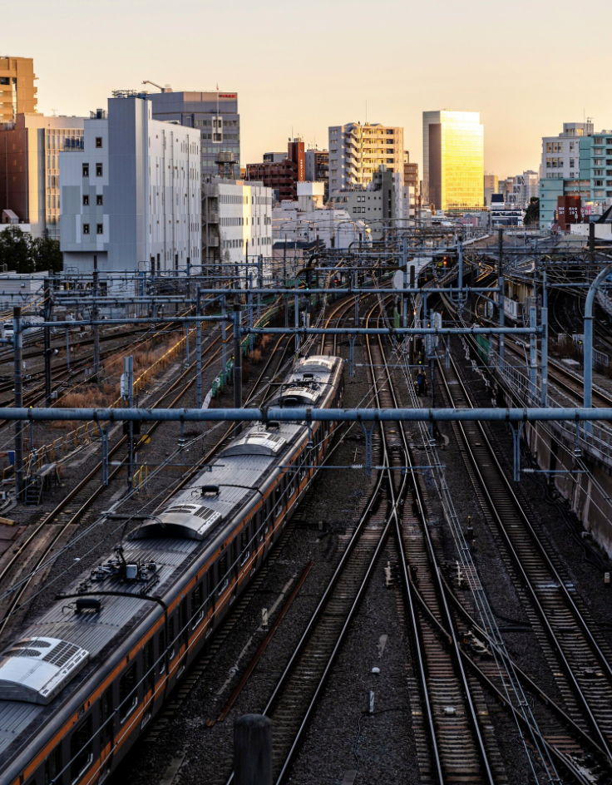
Infrastructure
Networks (roads, railways, ports, airports, cycling paths,...)
Terminals & stations
Maintenance systems
Freepik

Slide 16
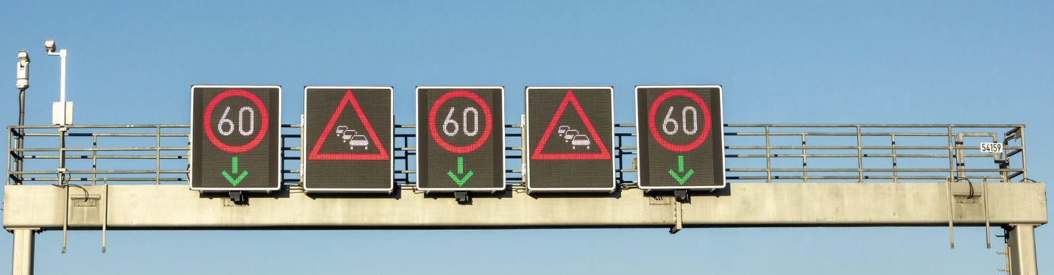
Operations & Management
Scheduling
Traffic control
Pricing
Information systems
Freepik

Slide 17
Institutions & Governance
Planning authorities
Operators
Regulatory framework
Funding structures

Slide 18
PASSENGER
VS.
FREIGHT
TRANSPORT

Slide 19
Passenger vs. Freight Transport
Differentiation and characteristics with regard to the transported goods

Slide 20
Passenger Transport
Transportation of people by private or public transport
Traffic volume: Number of passengers transported Passengers in passenger transport [per time unit]
Traffic performance: the traffic volume extended by the distance traveled (Unit: passenger kilometers [Pkm])

Slide 21
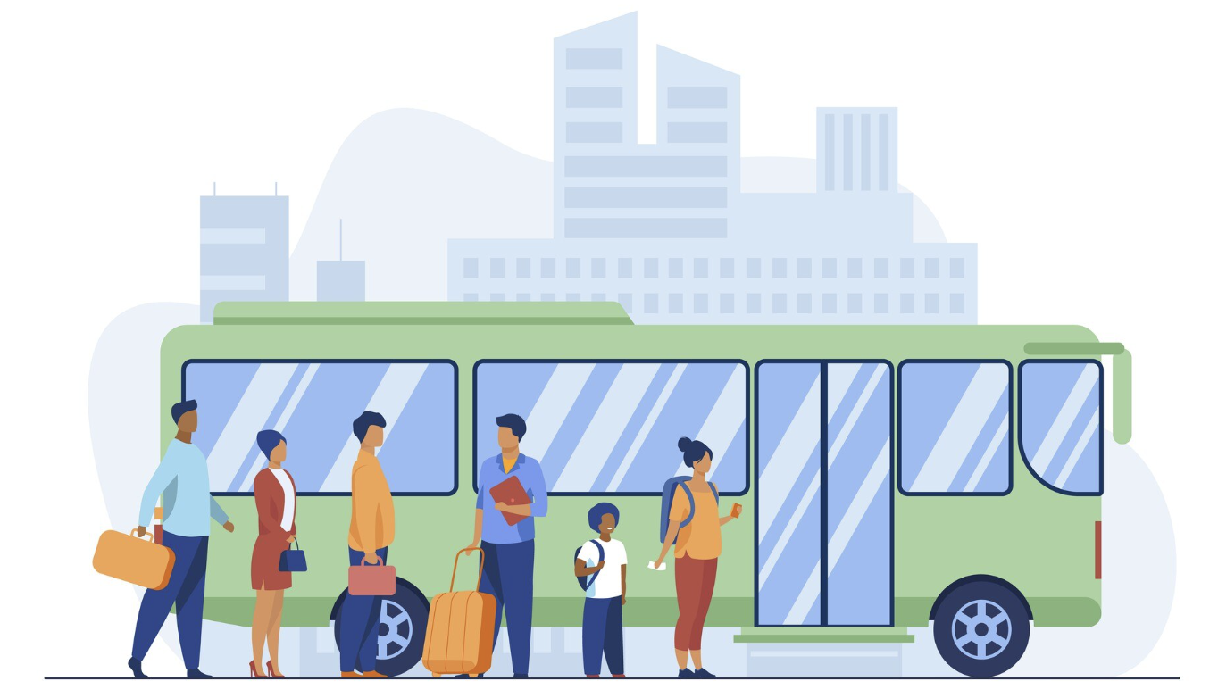
Passenger Transport
Key characteristics:
  Time sensitivity
  Comfort requirements
  Safety perception
  Daily regularity
  Accessibility requirements
Freepik

Slide 22
Freight Transport
Transportation of goods
Traffic volume: Quantity of transported tons in freight transport [per time unit]
Traffic performance: the traffic volume extended by the distance traveled (Unit: tonne-kilometer [tkm])

Slide 23
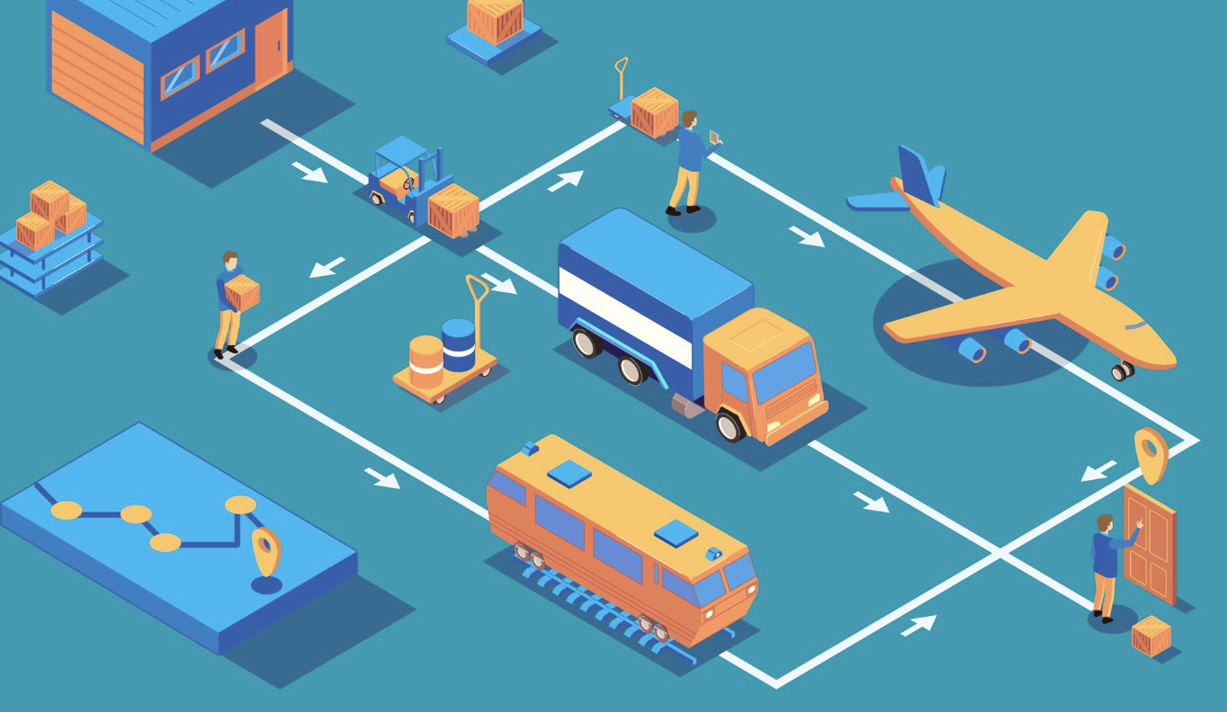
Freight Transport
Key characteristics:
  Cost efficiency
  Reliability of delivery
  Logistics integration
  Load optimisation
Freepik

Slide 24
Structural Differences
Aspect | Passenger | Freight
Decision maker | individual | company
Key priority | time & comfort | cost & reliability
Demand pattern | regular trips | supply chain driven
System integration | urban mobility | global logistics
Same infrastructure — completely different requirements

Slide 25
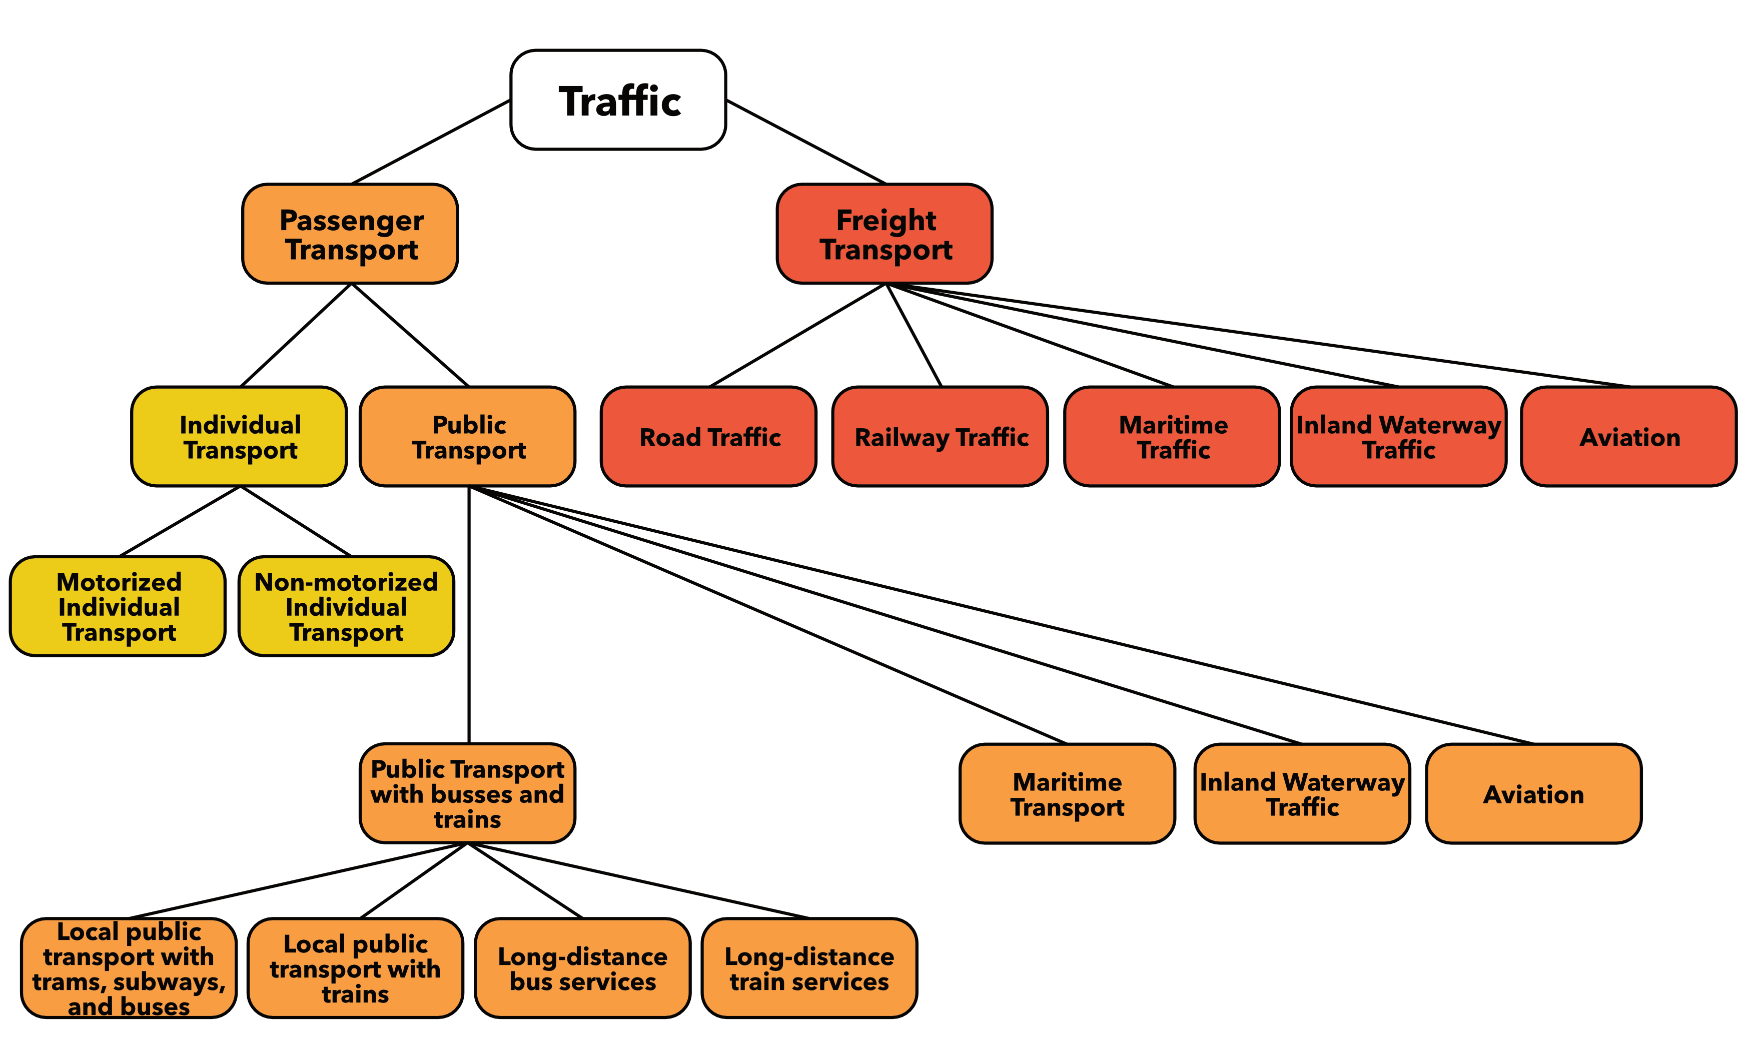

Slide 26
STRENGTHS & LIMITATIONS
OF
MAJOR TRANSPORT MEDIA

Slide 27
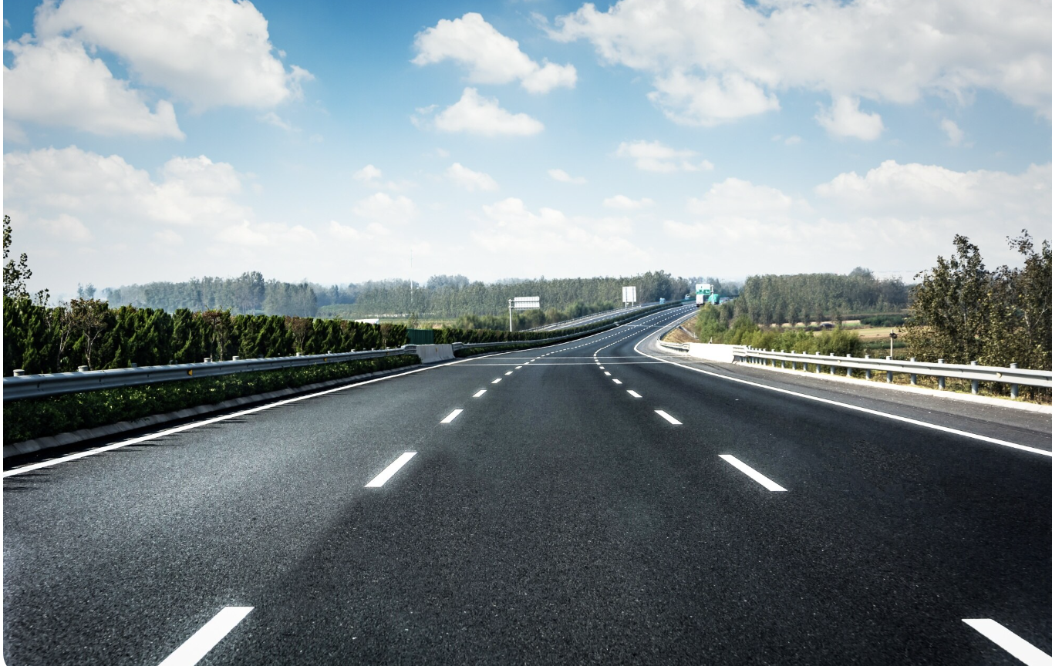
Road as Transport Medium
Advantages:
High flexibility
Dense network coverage
Door-to-door capability
Limitations:
Congestion
Safety risks
Environmental impact
Freepik

Slide 28
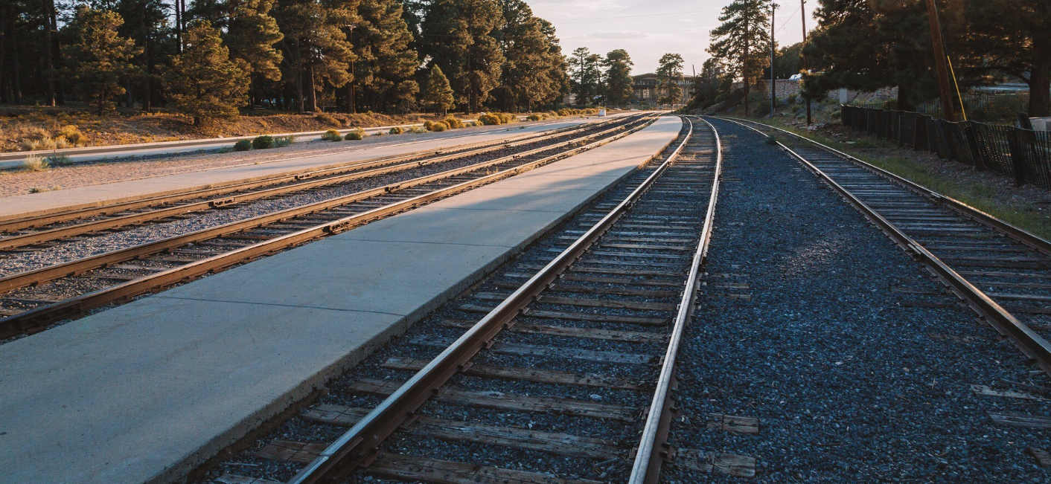
Rail as Transport Medium
Advantages:
High capacity
Energy efficiency
Safety
Limitations:
High infrastructure cost
Low flexibility
Fixed routes
Freepik

Slide 29
Water & Air Transport
Water:
Very cost efficient for bulk goods
Slow but high capacity
Air:
Very fast
High cost
Energy intensive
-> Medium determines system performance.

Slide 30
SYSTEM
THINKING PERSPECTIVE

Slide 31
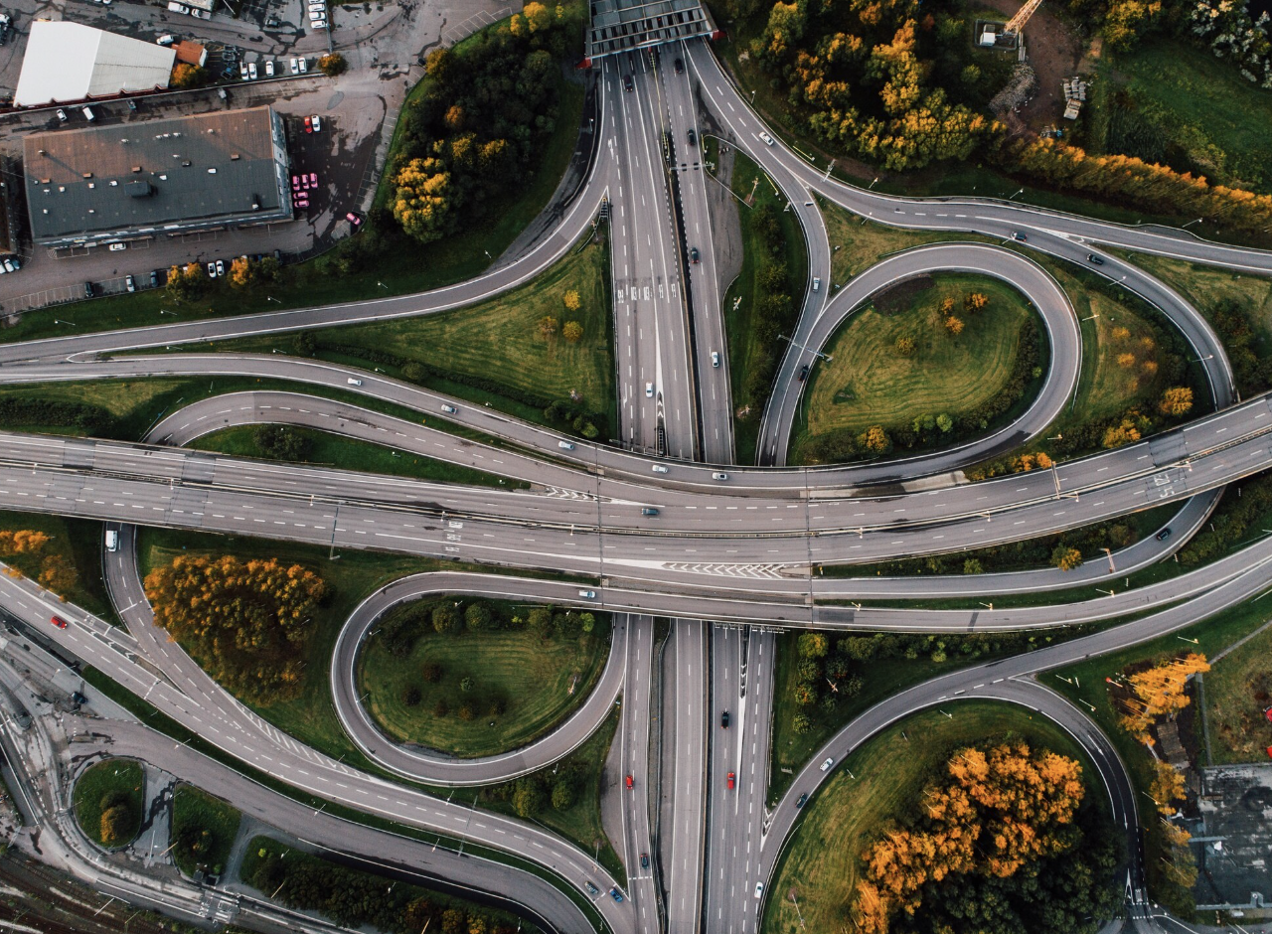
Interdependence of System Elements
Changes in:
infrastructure
vehicles
demand
→ affect entire system performance.
Freepik

Slide 32
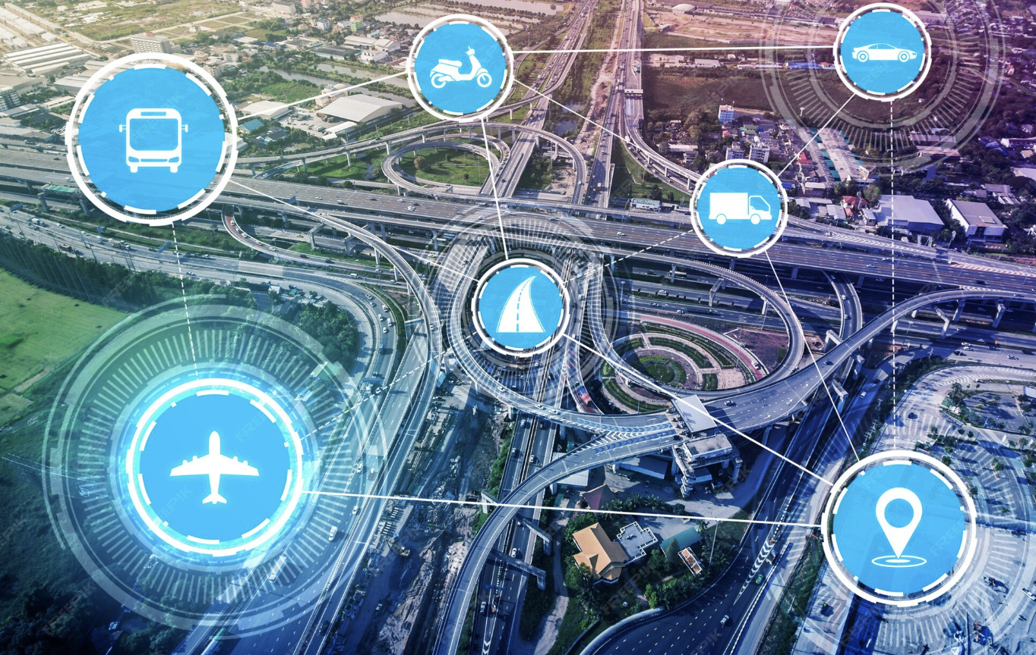
Multimodal Transport Systems
Combination of modes within one trip
Requires coordination
Increasing importance in sustainable transport planning
Freepik

Slide 33
Key Takeaways
Transport systems consist of interacting components
Means, modes and media represent different levels of analysis
Passenger and freight transport have different system requirements
Infrastructure media shape transport performance
Transport is essential for economic and social functioning

Slide 34
Thank you for your attention!

Slide 35
Sources: Graphics
https://www.freepik.com/free-photo/urban-landscape-japan-train_12977385.htm#fromView=search&page=1&position=6&uuid=d7c74a58-bb3c-4574-ab2e-21ac58a88fb1&query=traffic+infrastructure+road+and+railway
https://www.freepik.com/free-photo/smart-boards-warn-about-traffic-jams-dynamic-road-control_422700291.htm#fromView=search&page=1&position=3&uuid=0e4b0f7e-496c-4f3c-8bc0-ca4710b1d799&query=traffic+control
https://www.freepik.com/free-vector/passengers-waiting-bus-city-queue-town-road-flat-vector-illustration-public-transport-urban-lifestyle_10173277.htm#fromView=search&page=1&position=1&uuid=f5b6aa14-a29d-453b-9a3d-c64390cfdc8b&query=passenger+transport
https://www.freepik.com/free-vector/isometric-logistics-horizontal-composition-flowchart-with-view-human-characters-various-vehicles-connected-with-arrows-vector-illustration_7201712.htm#fromView=search&page=1&position=17&uuid=d390296a-2f4b-4d8b-95ba-379629c36461&query=multimodal+transport+system
https://www.freepik.com/free-photo/road-forest_1242615.htm#fromView=search&page=1&position=17&uuid=2d733864-144e-4da4-981e-8d3d14852d79&query=road
https://www.freepik.com/free-photo/view-grand-canyon-railway-station-cloudy-day_17649379.htm#fromView=search&page=1&position=1&uuid=b81221ae-1d8a-43bd-b5e9-e1f84870188f&query=railway
https://www.freepik.com/free-photo/aerial-shot-twisted-roads-surrounded-by-parks-middle-city_11697935.htm#fromView=search&page=1&position=5&uuid=e4bd5798-08e9-417c-b592-1699aee74d31&query=traffic+infrastructure
https://www.freepik.com/premium-photo/smart-transport-technology-concept-future-car-traffic-road_16600921.htm#fromView=search&page=1&position=7&uuid=d390296a-2f4b-4d8b-95ba-379629c36461&query=multimodal+transport+system

