Slide 1
Fondements du transport
Cours : Transport et environnement

Slide 3
Objectifs d’apprentissage
Comprendre basic définitions and paramètres related to transport et environnement
Examiner trafic émissions, immission, air qualité, and climat impacts
Analyser politique cadres including the European Green Deal and modal shift
Identifier mitigation strategies and suivi indicateurs for transport émissions

Slide 4
Plan du cours
Clé définitions et paramètres
Trafic et environnement : émissions, air qualité, GHGs
Politique cadres : EU Green Deal, modal shift, e-mobility
Régional focus : Africa — DRC et Cameroon cas études
Méthodes, indicateurs, and recommandations

Slide 5
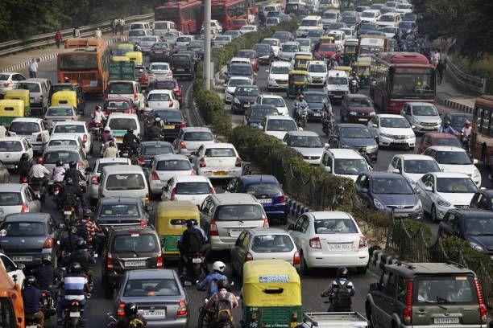
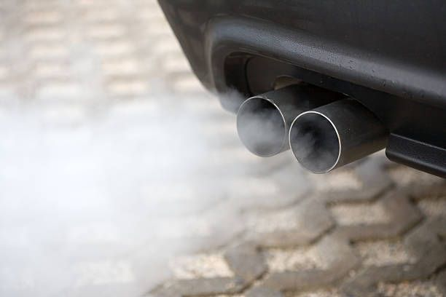
Trafic et environnement :
Émission
  any release of polluants or énergie from a source into the environnement
According to the Federal Immission Contrôle Act of Germany (BImSchG) : "the air pollution, bruit, vibrations, light, heat, radiation and similar phenomena emanating from an installation" [§3, Art. 3].
      Measured at the point of release (tailpipe, chimney, carburant evaporation).
      Typically quantified as mass per unit temps or mass per kilometer, e.g., g/km, g/s, tons/année
      Used for inventory, modeling, and regulation of polluting sources.

Slide 6
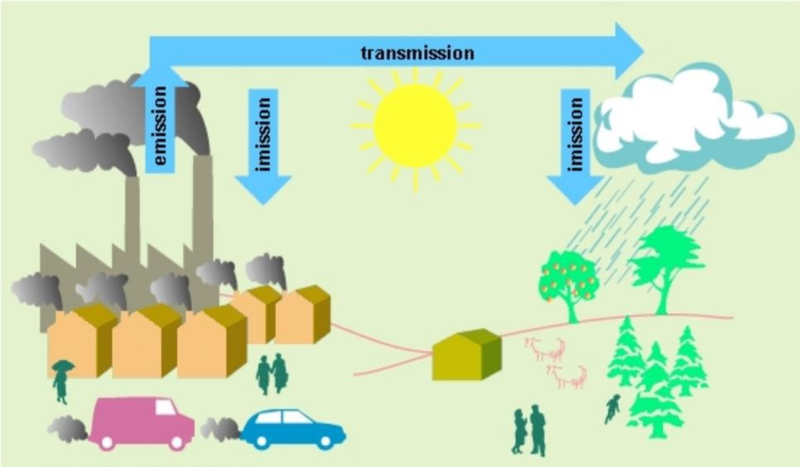
Trafic et environnement :
Immission
  refers to the concentration of émissions on the environnement où personnes, ecosystems, or materials are exposed.
  According to BImSchG : "air pollution, bruit, vibrations, light, heat, radiation and similar phenomena affecting humans, animals and plants, the soil, eau, the atmosphere and cultural and other material assets" [§3, Art. 2].
      Represent ambient air pollution after émissions disperse, react, or accumulate.
      Measured at receptor points—où humans or ecosystems experience the pollution.
      Expressed as concentration : e.g., µg/m³, ppm
Image source : Federal Office for the Environnement, Forests and Landscape 1996

Slide 7
Trafic et environnement :
Gaz à effet de serre et polluants atmosphériques
Gaz à effet de serre
Gaz that affect the climat : Retain heat radiation from the earth's surface back into espace and thus contribute to the effet de serre effect
Of natural or anthropogenic origin
These include for exemple carbon dioxide (CO2), methane (CH4) and nitrous oxide (N2O)
Polluants atmosphériques
"any substance present in the air that has a harmful effect on human santé". santé or the environnement as whole" (39th BImSchV)
Changes in the natural composition of the air
These include nitrogen oxides (N₂O), particulate matter, ozone and carbon monoxide (CO)
Transport emits both effet de serre gaz and air polluants

Slide 8
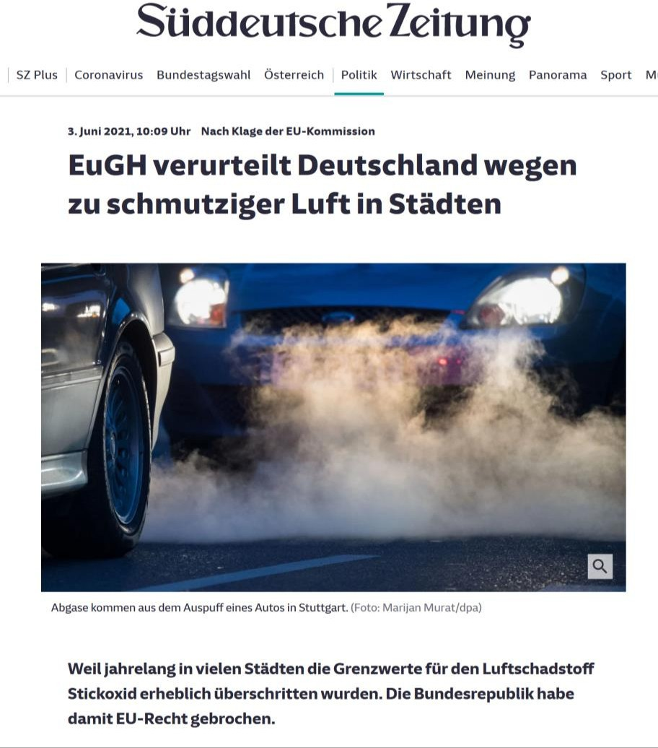
Trafic et environnement :
Qualité de l’air
Qualité de l’air in villes is a mondial problem
' Polluants atmosphériques are identified as highly hazardous to santé
The principal causes of santé problems are particulate matter and nitrogen oxides
(Legally binding) limit values are often exceeded
' This is also the cas in many villes in Germany
The right to clean air is enforceable
' Conviction of the Federal Republic of Germany by the ECJ for exceeding the limit values for nitrogen oxide too frequently

Slide 9
Trafic et environnement :
Qualité de l’air : base juridique
Juridique cadre
EC Air Qualité Cadre Directive and daughter directives
EC Environnemental Bruit Directive
Federal Immission Contrôle Act and Ordinance (BImSchG, BImSchV)
Objective
Compliance with immission limites (municipal obligation)
Reduction of effet de serre gas émissions
Realization
Développement and implementation of effective action plans
Increased use of trafic gestion to reduce traffic-related émissions
Integrative view of trafic and environnemental gestion

Slide 10
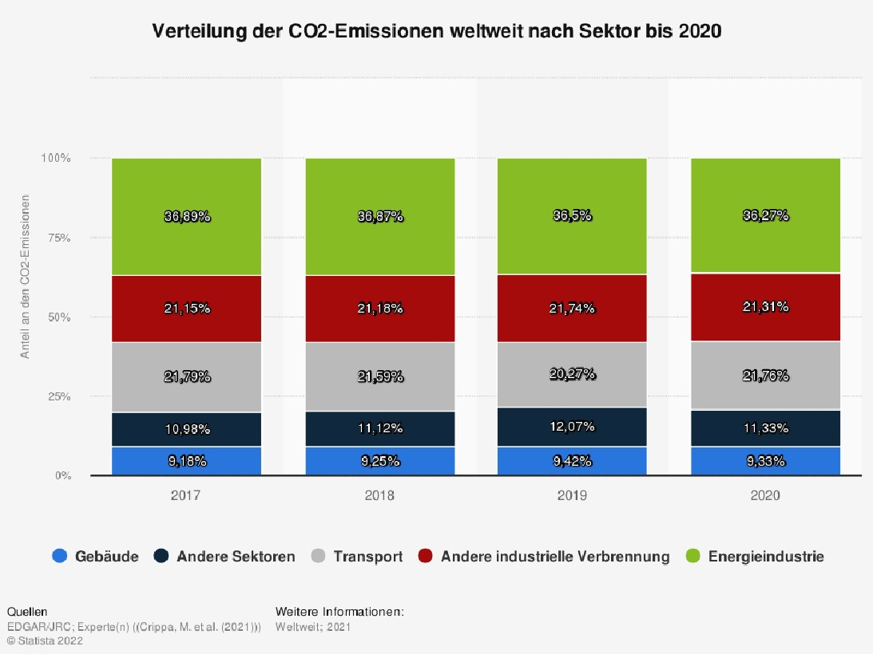
Trafic et environnement :
Indicateurs de qualité de l’air
Describe polluants in the air that affect human santé and local air qualité.
typically measured as ambient concentrations (µg/m³ or ppm) at ground niveau.
    PM₂.₅ (Fine Particulate Matter ≤ 2.5 µm) : Tiny inhalable particles from combustion (véhicules, industry, biomass).
PM₁₀ (Coarse Particulate Matter ≤ 10 µm) :Larger particles from route dust, construction, brake/tire wear.
NOₓ (Nitrogen Oxides : NO + NO₂) : Produced by high-temperature combustion in véhicule engines. Strong roadside pollutant, especially in congested urbain corridors.
    SO₂ (Sulfur Dioxide), CO (Carbon Monoxide), O₃ (Ground-Level Ozone), and Black Carbon (BC)

Slide 11
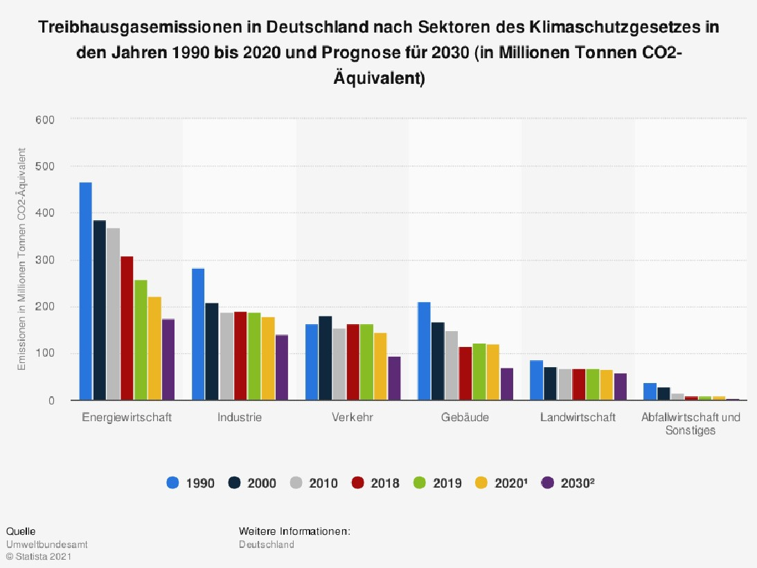
Trafic et environnement :
Impact climatique des émissions de gaz à effet de serre
measure long-lived effet de serre gaz that drive mondial climat change..
CO₂ (Carbon Dioxide) : Primary effet de serre gas from fossil carburant combustion (véhicules, industry) with long atmospheric lifetime (hundreds of years).
CH₄ (Methane) : Strong short-lived effet de serre gas (lifetime ~12 years). It has about 28 temps the warming effect of CO₂ over 100 years.
N₂O (Nitrous Oxide) : Very potent, long-lived effet de serre gas (lifetime ~120 years). Emitted from agriculture and some véhicule catalytic converters. It has ~273 temps the warming effect of CO₂ over 100 years.
CO₂-eq (GWP100) : “Carbon dioxide equivalent,” calculated using Mondial Warming Potential over 100 years (GWP100). It converts different GHGs into a common metric.

Slide 12

Trafic et environnement
Cadre politique : le Pacte vert pour l’Europe
Objectif : Durable transformation of the EU-wide economy
By 2030 : Reduction of net effet de serre gas émissions by at least 55% compared to 1990
By 2050 : Reduction of net effet de serre gas émissions to zéro
Mobilization of at least one trillion euros to implement the agreement

Slide 13
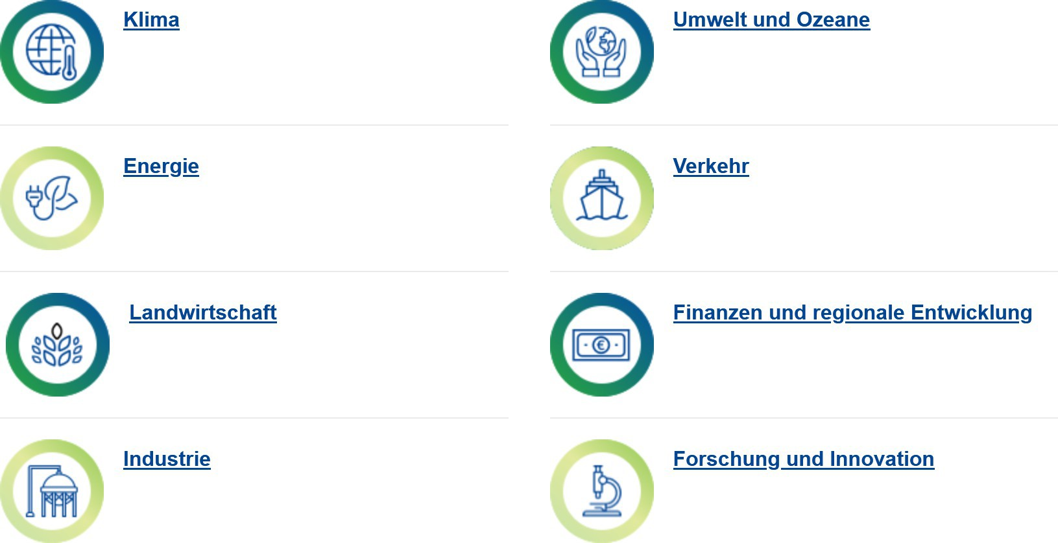
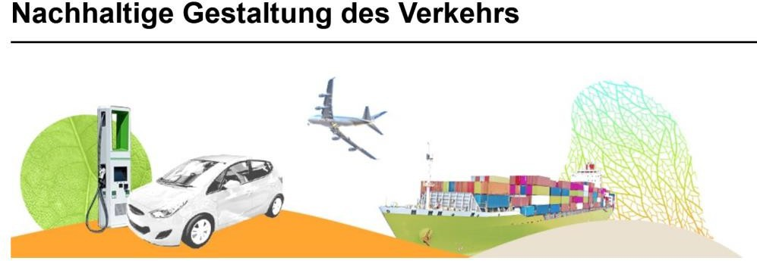
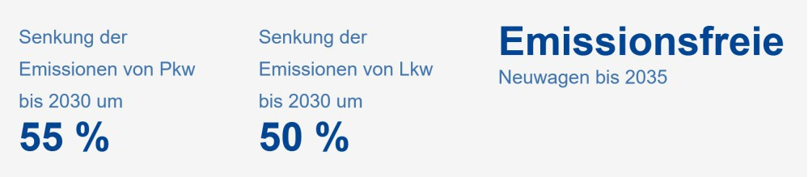
Trafic et environnement
Cadre politique : le Pacte vert pour l’Europe
Fields of action :
+ from 2026 : Route transport part of the émissions trading système

Slide 14
Trafic et environnement
Cadre politique : le Pacte vert pour l’Europe
Cadre politique : loi fédérale sur la protection du climat (KSG)
The amended Climat Protection Act 2021 stipulates a reduction in émissions in the transport secteur by by 48% in 2030 compared to 1990.
The German government's Climat Action Program 2030 structures the mesures to achieve this objectif in six fields of action :
Voyageurs transport : strengthening the environnemental réseau
Fret transport : shifting transportation to rail and inland voies navigables
Alternative carburants : biofuels and e-fuels in air, navire and heavy marchandises transport
Voyageurs voitures : increasing the proportion of électrique voitures
Commercial véhicules : Camions with climate-friendly drives
Digital networking : e.g. linking different modes of transport via digital mobilité platforms

Slide 15
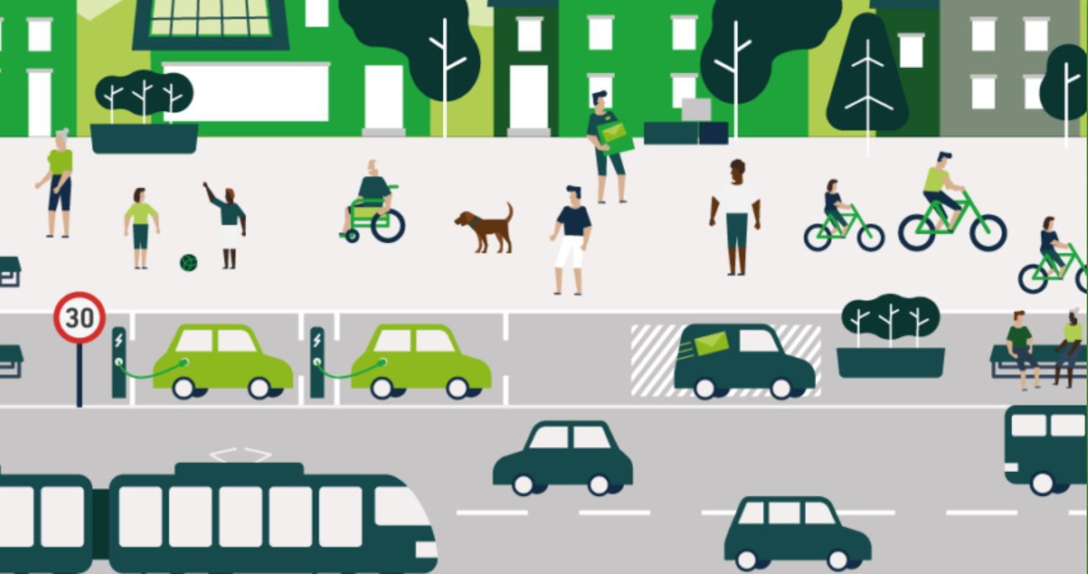
Trafic et environnement
Transition des transports / du trafic
Transition du trafic
= the processus towards a durable transport système
All trois aspects of sustainability must be taken into account :
Ecological sustainability
Social sustainability
Économique sustainability

Slide 16

Trafic et environnement
Transition des transports / du trafic
Trafic turnaround
Based on two pillars :
Transition de la mobilité
+
Transition des motorisations
🡪 Avoiding et relocating trafic
🡪 Amélioration of Drive technologies
Reduction of MIV
Expansion of public transport
Promotion of vélo and marche
Replacing fossil carburants with alternative, climate-neutral carburants, Drive types
Reduction of émissions during
of the driving operation
Own representation ; see Agora Verkehrswende and VCD 2021

