Slide 1
Fondements du transport
Cours : Transport et environnement -Voies vers la neutralité climatique

Slide 3
Objectifs d’apprentissage
Comprendre basic définitions and paramètres related to transport et environnement
Examiner trafic émissions, immission, air qualité, and climat impacts
Analyser politique cadres including the European Green Deal and modal shift
Identifier mitigation strategies and suivi indicateurs for transport émissions

Slide 4
Plan du cours
Clé définitions et paramètres
Trafic et environnement : émissions, air qualité, GHGs
Politique cadres : EU Green Deal, modal shift, e-mobility
Régional focus : Africa — DRC et Cameroon cas études
Méthodes, indicateurs, and recommandations

Slide 5

Trafic et environnement
Cadre politique : le Pacte vert pour l’Europe
Objectif : Durable transformation of the EU-wide economy
By 2030 : Reduction of net effet de serre gas émissions by at least 55% compared to 1990
By 2050 : Reduction of net effet de serre gas émissions to zéro
Mobilization of at least one trillion euros to implement the agreement

Slide 6
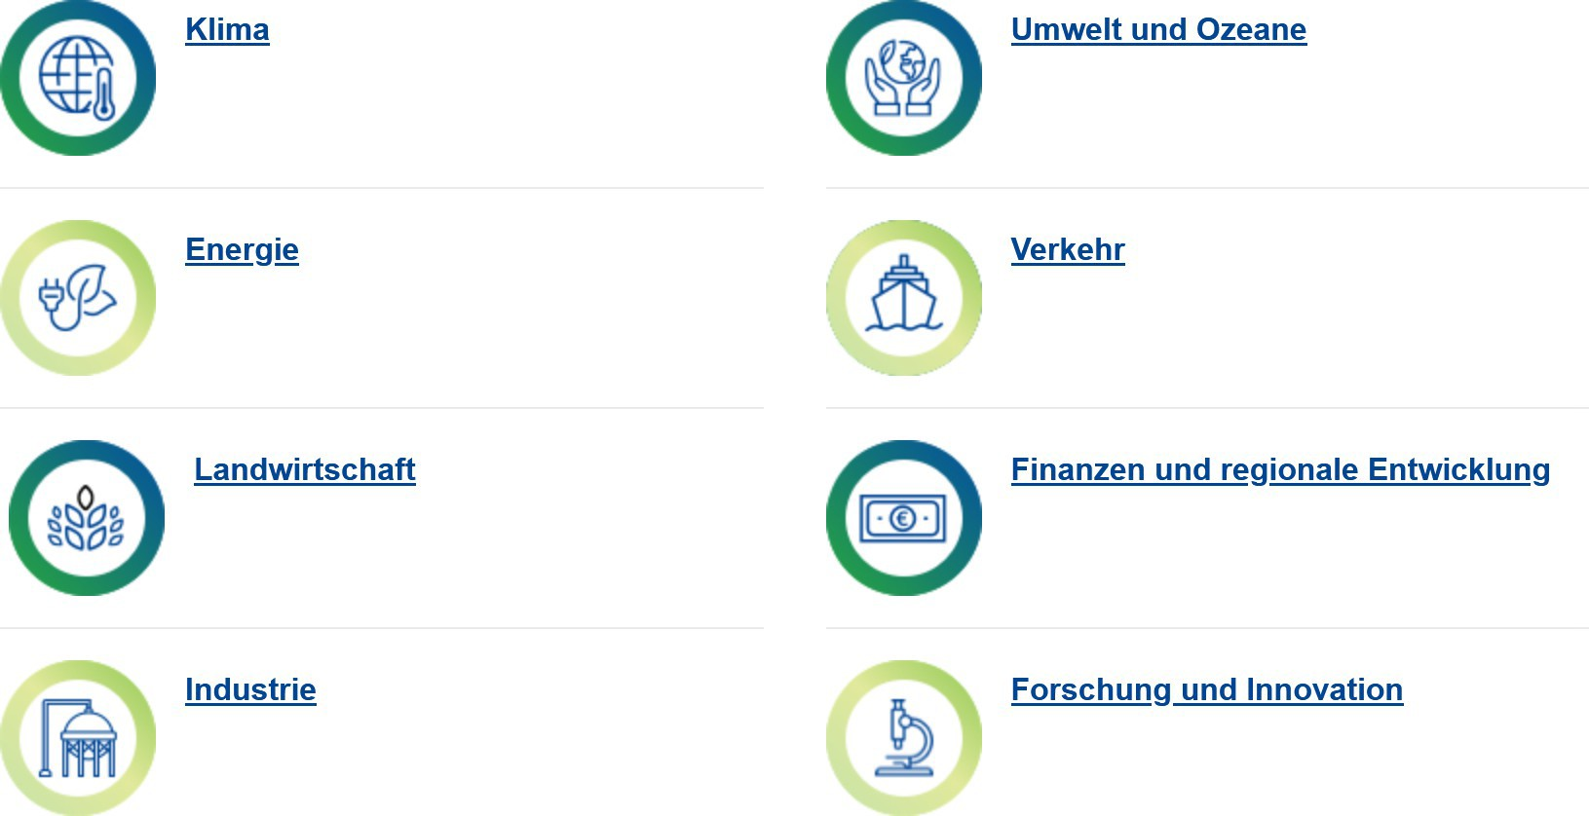
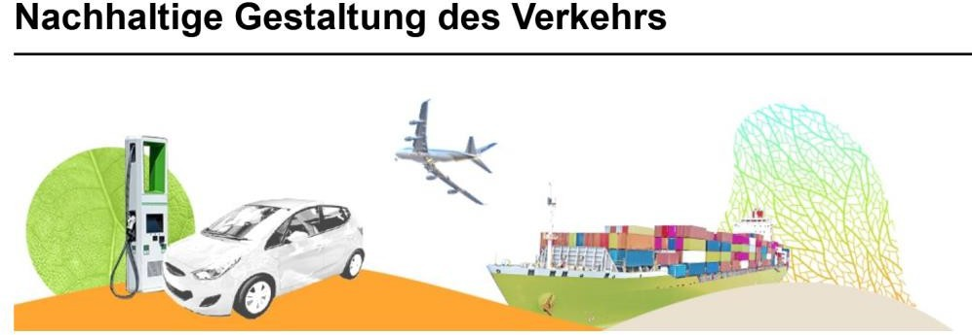
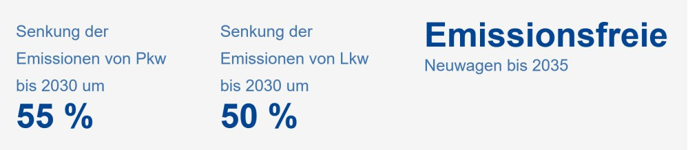
Trafic et environnement
Cadre politique : le Pacte vert pour l’Europe
Fields of action :
+ from 2026 : Route transport part of the émissions trading système

Slide 7
Trafic et environnement
Cadre politique : le Pacte vert pour l’Europe
Cadre politique : loi fédérale sur la protection du climat (KSG)
The amended Climat Protection Act 2021 stipulates a reduction in émissions in the transport secteur by by 48% in 2030 compared to 1990.
The German government's Climat Action Program 2030 structures the mesures to achieve this objectif in six fields of action :
Voyageurs transport : strengthening the environnemental réseau
Fret transport : shifting transportation to rail and inland voies navigables
Alternative carburants : biofuels and e-fuels in air, navire and heavy marchandises transport
Voyageurs voitures : increasing the proportion of électrique voitures
Commercial véhicules : Camions with climate-friendly drives
Digital networking : e.g. linking different modes of transport via digital mobilité platforms

Slide 8

Trafic et environnement
Transition des transports / du trafic
Transition du trafic
= the processus towards a durable transport système
All trois aspects of sustainability must be taken into account :
Ecological sustainability
Social sustainability
Économique sustainability

Slide 9

Trafic et environnement
Transition des transports / du trafic
Trafic turnaround
Based on two pillars :
Transition de la mobilité
+
Transition des motorisations
🡪 Avoiding et relocating trafic
🡪 Amélioration of Drive technologies
Reduction of MIV
Expansion of public transport
Promotion of vélo and marche
Replacing fossil carburants with alternative, climate-neutral carburants, Drive types
Reduction of émissions during
of the driving operation
Own representation ; see Agora Verkehrswende and VCD 2021

Slide 10
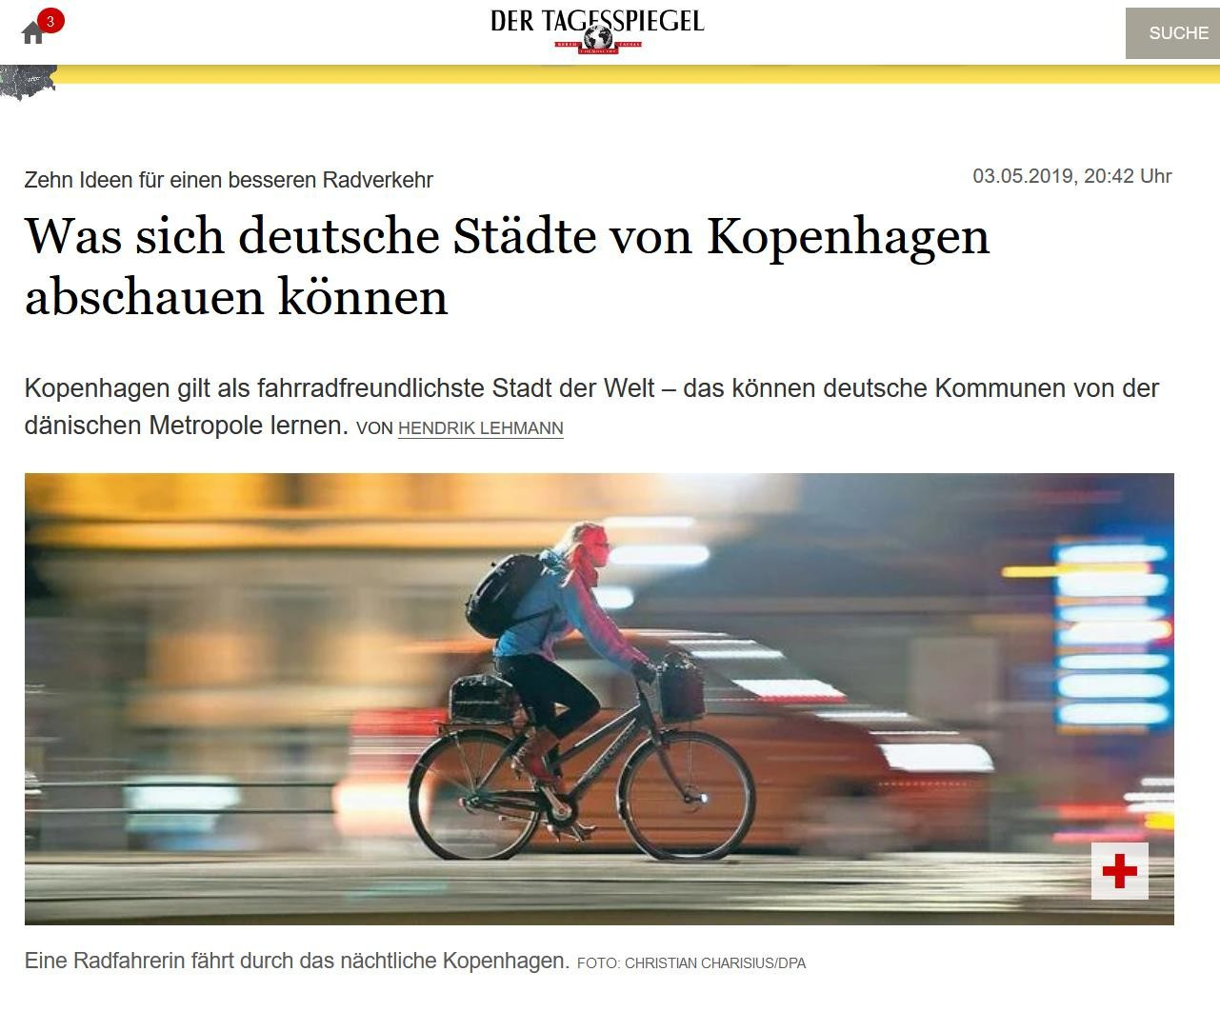
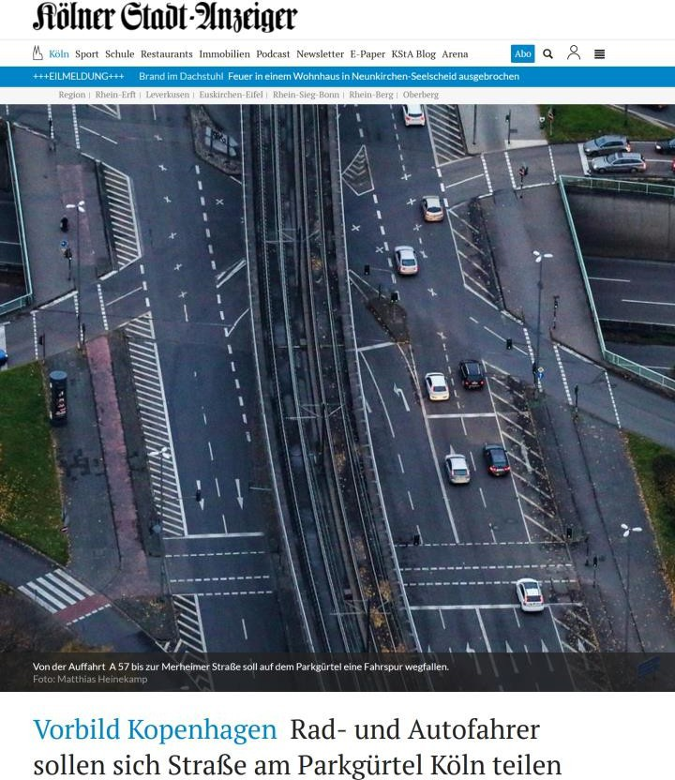
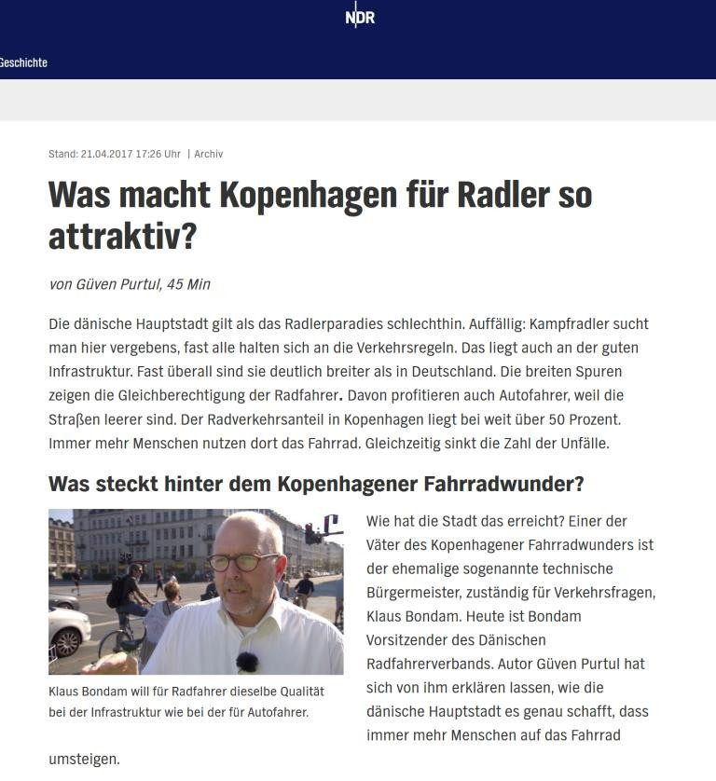
Copenhague comme exemple de bonne pratiqueAll eyes on vélo in Copenhagen...

Slide 11
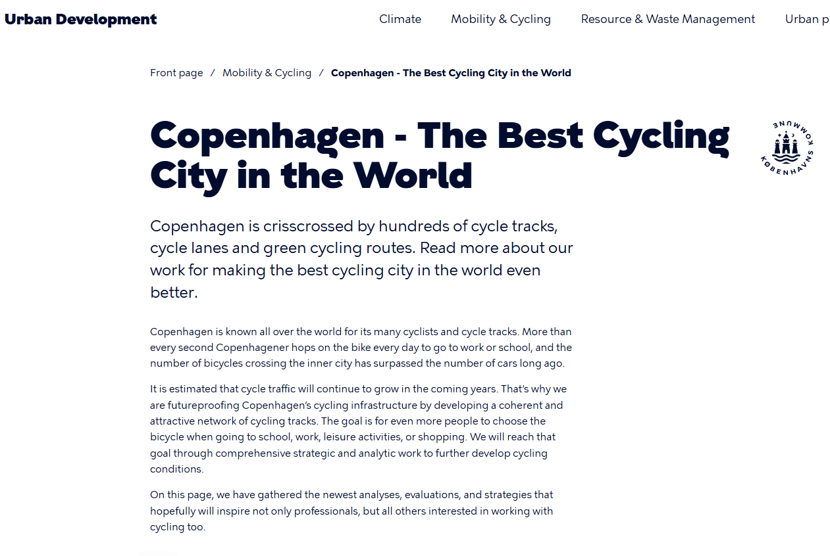
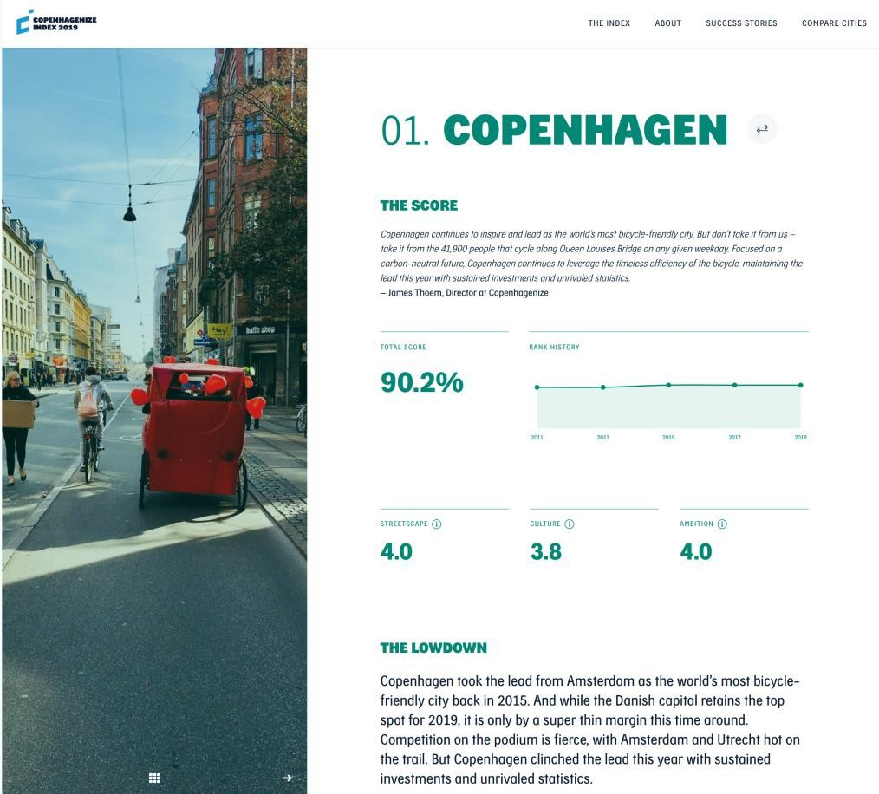
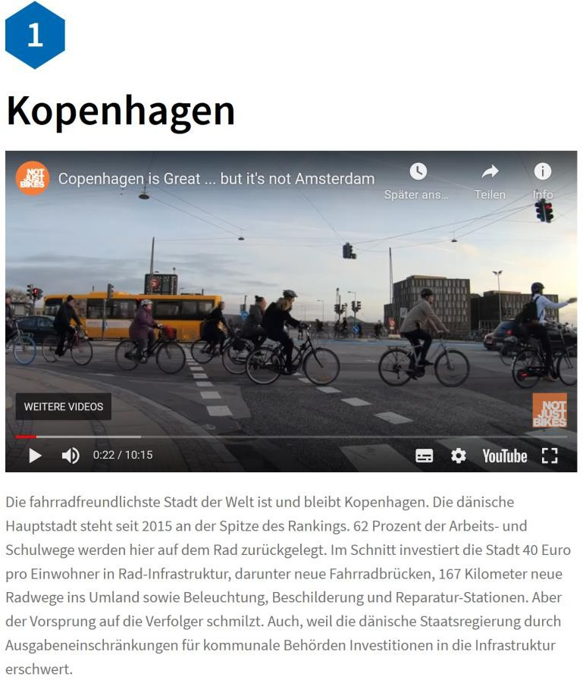
Copenhague comme exemple de bonne pratiquethe "most bicycle-friendly ville in the world" !

Slide 12
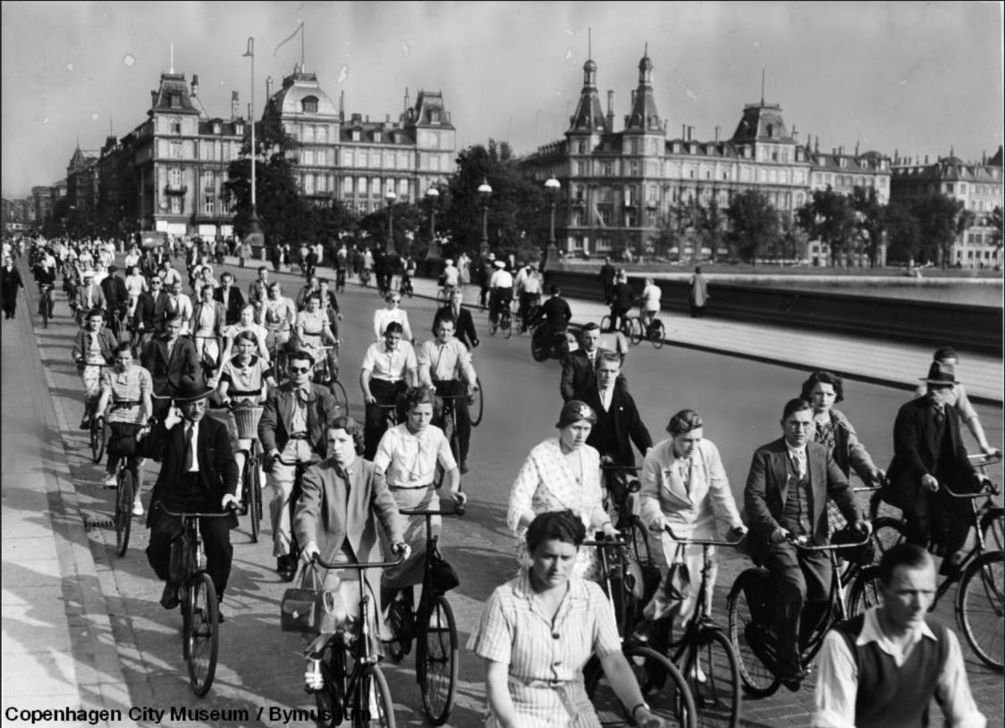
Copenhague comme exemple de bonne pratique
Historique développement of urbain transportation
Beginning to the middle of the 20th century :
Développement into a vélo ville
1949 : Former peak of vélo trafic
The beginning of the 1950s also saw the start of the "voiture decades."
Dismantling vélo infrastructure to make room for creating voiture trafic
1972 Removal of the streetcar réseau and replacement of streetcars by bus
Increase in motorisé trafic and a rapide decline in the number of cyclistes
November 25, 1973 : first car-free Sunday in Copenhagen
Quoi had happened ?
Image source : https ://www.flickr.com/photos/16nine/4161151526/

Slide 13
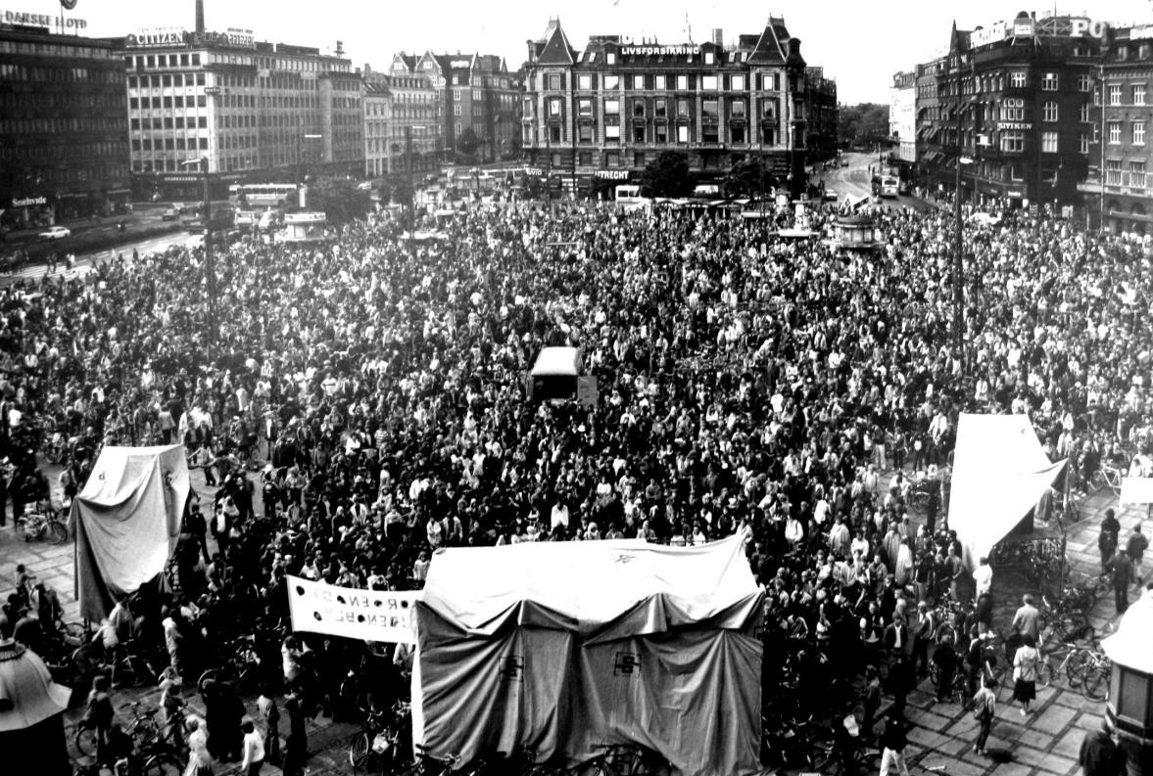
Copenhague comme exemple de bonne pratiquethe "most bicycle-friendly ville in the world" !
Historique développement of urbain transportation
The oil crisis at the beginning of the 1970s hit Denmark hard
Lack of funds led to the halt of many planned majeur route construction projects
Rapide increase in gasoline prices
Voiture and bus journeys are no longer affordable for many
Further increase in vélo trafic
But : The new infrastructure as a security risque
All-time high of fatal vélo accidents
Demands from the public for more sécurité for cyclistes and the reconstruction of vélo infrastructure
Colville-Andersen 2020 : 76ff. ; Vélo Embassy of Denmark

Slide 14
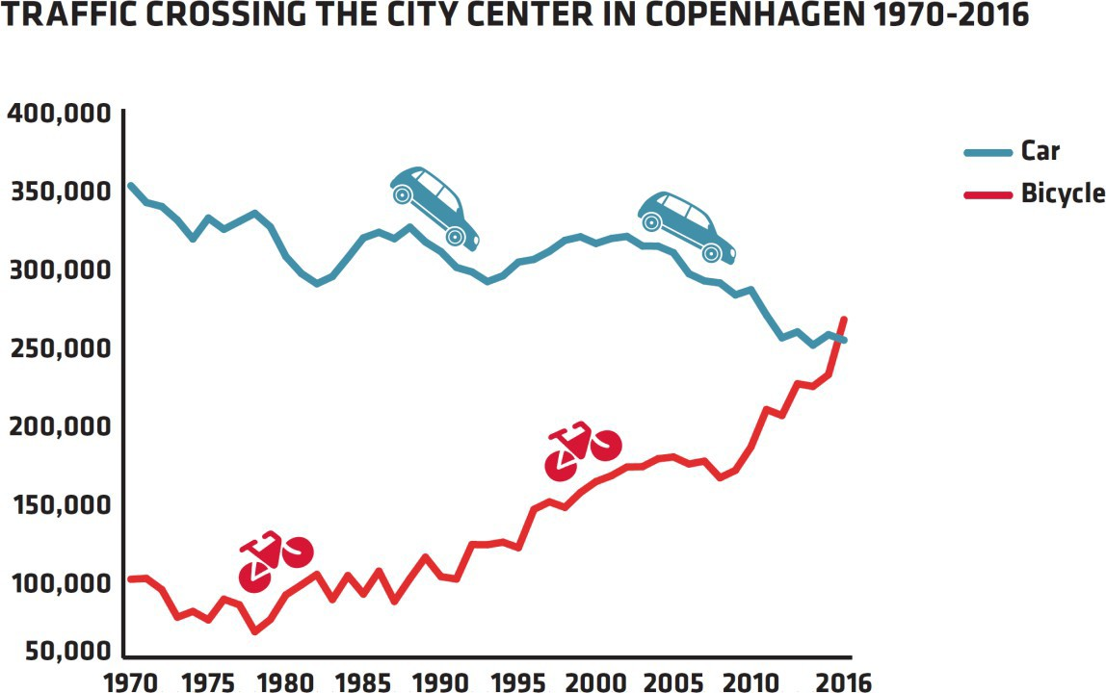
Copenhague comme exemple de bonne pratiquethe "most bicycle-friendly ville in the world" !
Historique développement of urbain transportation
Beginning of the 80s : Slow start of the Reconstruction of vélo infrastructure
...
...
...
2016 : The number of cyclistes in Copenhagen exceeds the number of voitures for the first temps since 1970.
Quoi has happened in the meantime ?
Colville-Andersen 2020 : 76ff. ; Vélo Embassy of Denmark

Slide 15
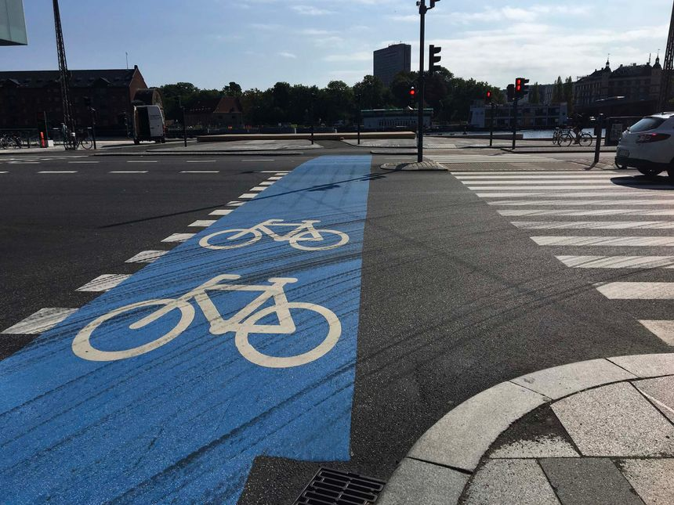
Copenhague comme exemple de bonne pratiqueSustainable mobilité in today's Copenhagen
"In a durable ville, it should be easy for everyone to get around using the greenest possible forms of transport :
marche, vélo, and public transport."
- K benhavens Kommune (o.d.)

Slide 16
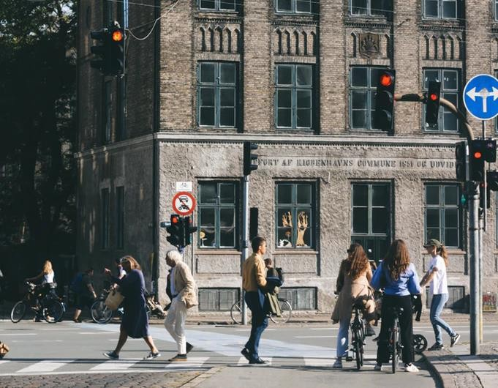
Copenhague comme exemple de bonne pratiqueSustainable mobilité in today's Copenhagen
Objectif
75% of all journeys in Copenhagen should be made on foot, by vélo or by public transport
a maximum of 25% of all trips should be made by voiture
Image source : unsplash.com, 2021

Slide 17
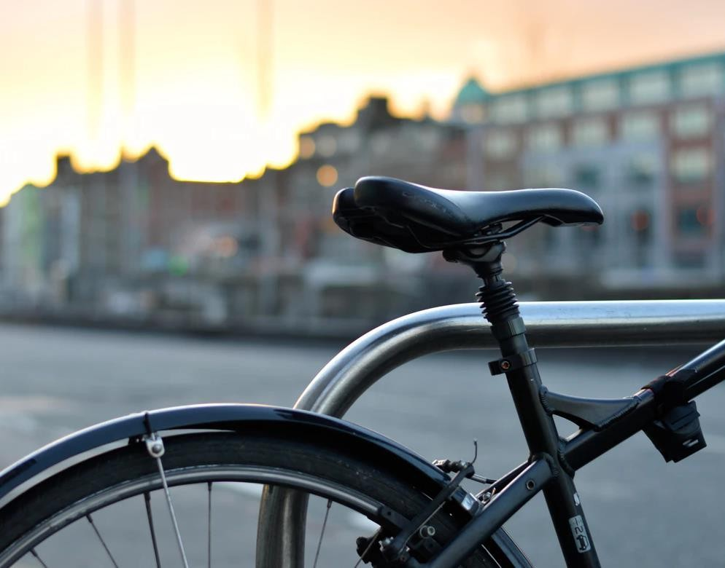
Copenhague comme exemple de bonne pratiqueSustainable mobilité in today's Copenhagen
Mesures
Optimization of transport infrastructures
Extension of the métro by a Ville Ring line
Coordination of public transportation (bus, train, métro) to make it easier to combine them
Provision of ville bikes, vélo stationnement spaces at train gares, and the option of taking your bike with you on the métro, train, and bus
Amélioration of trafic flow through targeted Trafic gestion :
Définition of service targets : Comment quickly should cyclistes, piétons, bus, and voitures reach their destination ?
Définition of preferential rights
Image source : unsplash.com, 2021

Slide 18
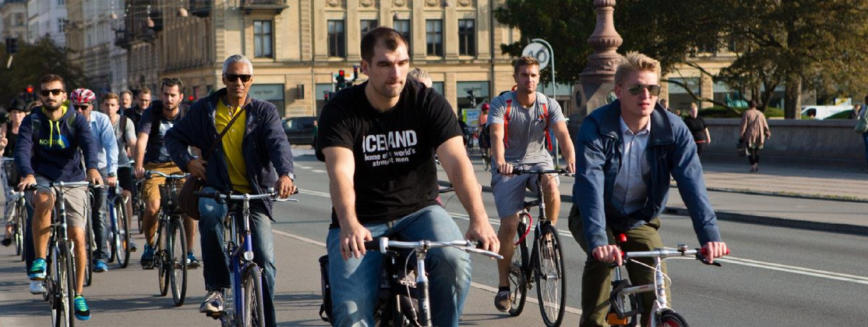
Copenhague comme exemple de bonne pratiqueThe vélo ville….
Image source : Ville of Copenhagen 2017
https://www.youtube.com/watch?v=u6Fsu3EXk4M

Slide 19
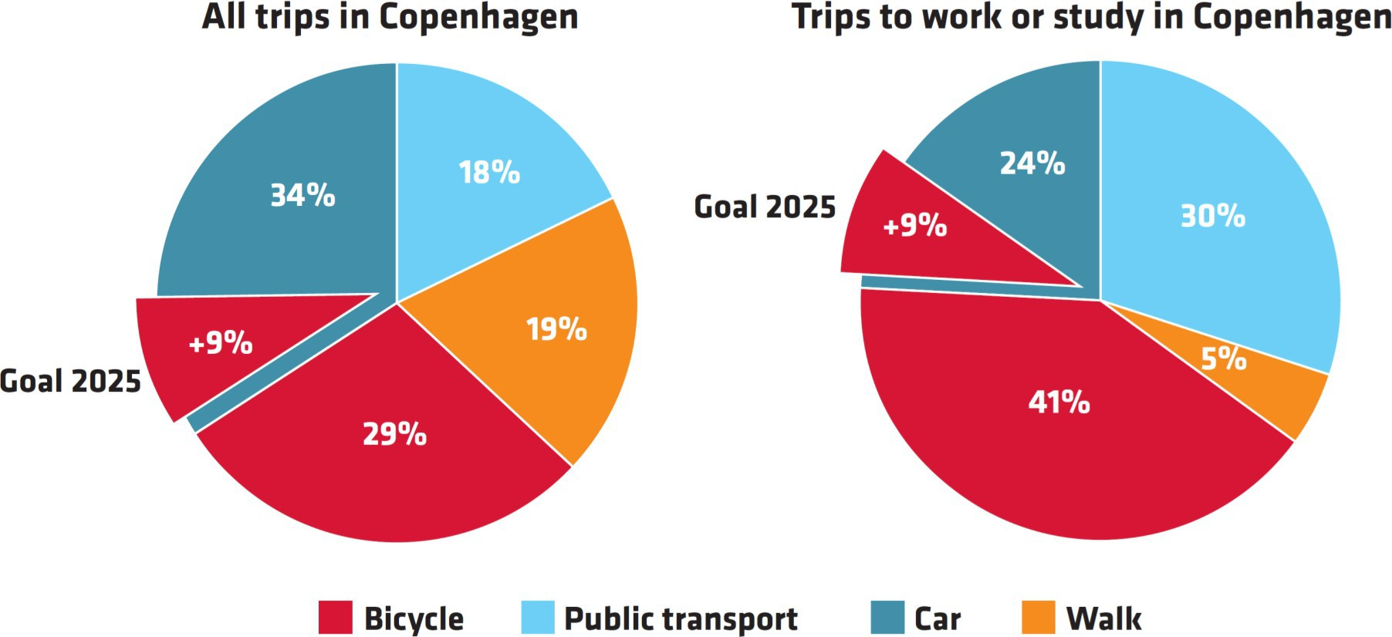
Copenhague comme exemple de bonne pratiqueThe vélo ville : modal répartition….
https://international.kk.dk/sites/international.kk.dk/files/velo-city_handout.pdf/

Slide 20
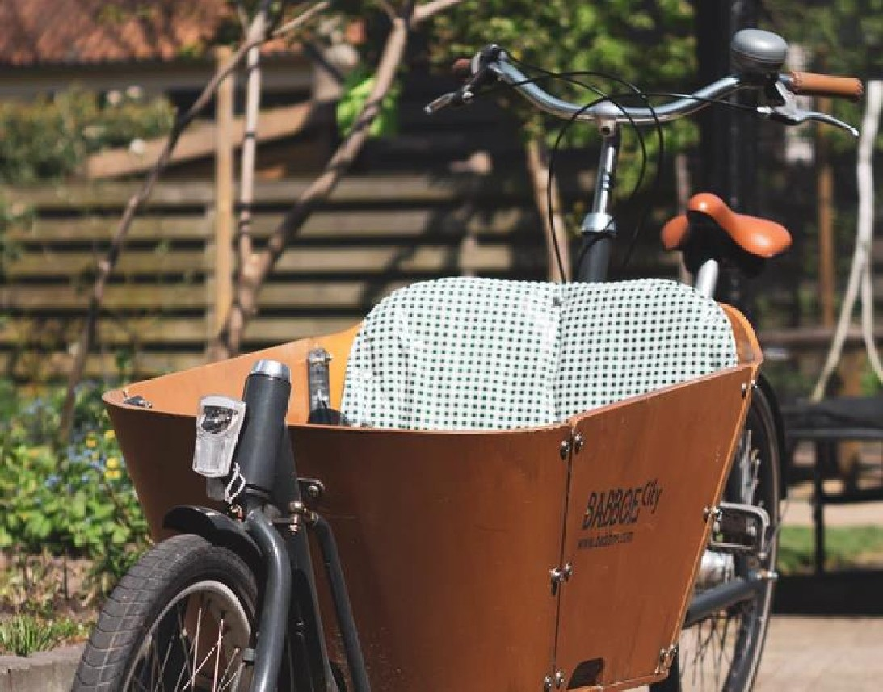
Copenhague comme exemple de bonne pratiqueThe vélo ville : cargo bike instead of a voiture…
25% of all families in Copenhagen with 2 enfants have a cargo bike. In 30% of households that own a cargo bike, it replaces a voiture.
Ville of Copenhagen

Slide 21
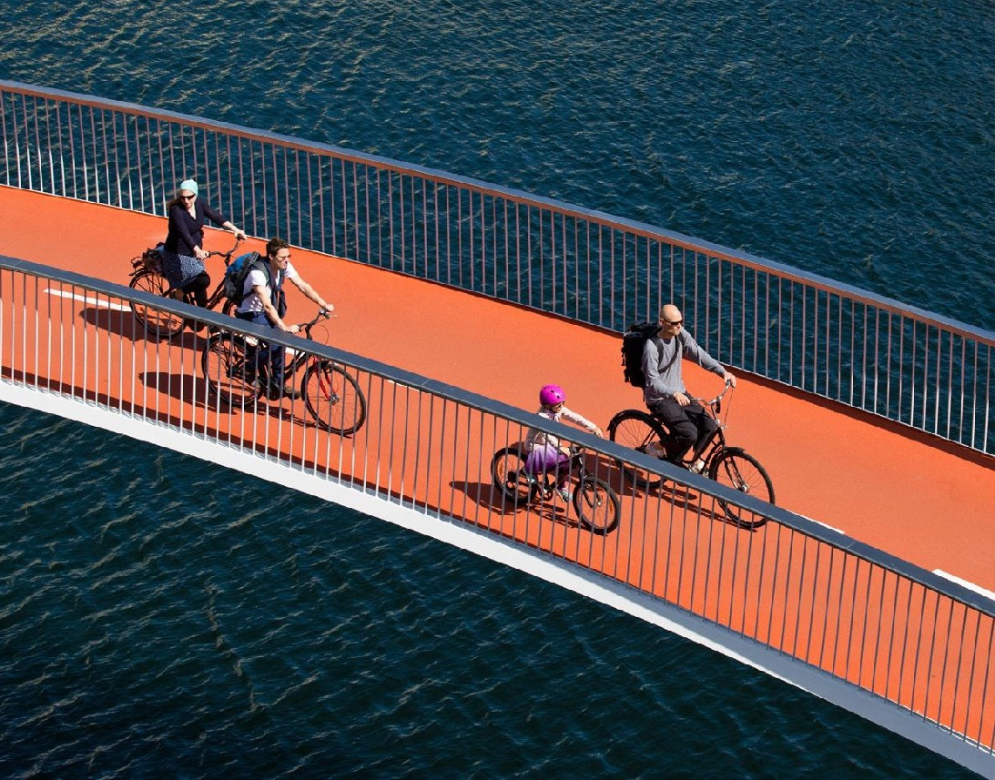
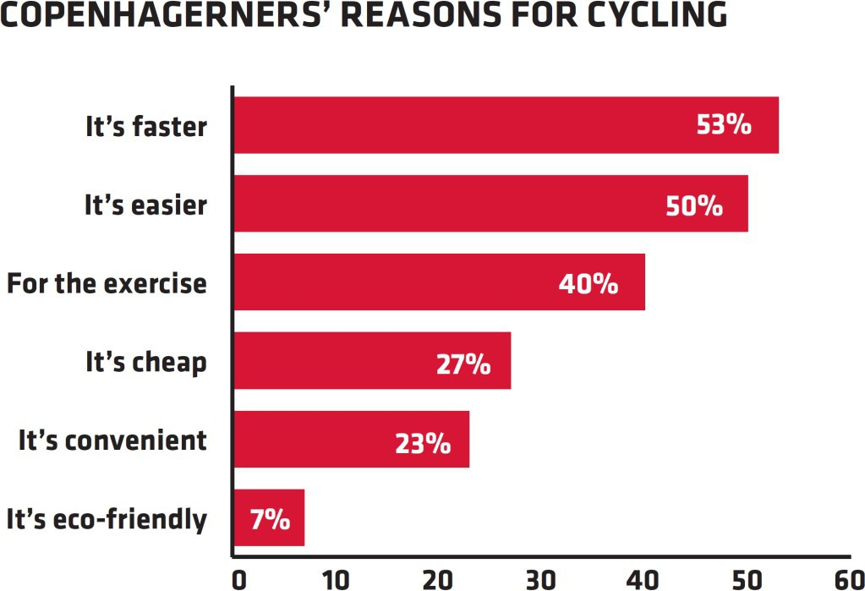
Copenhague comme exemple de bonne pratiqueThe vélo ville : reasons for vélo …
https://international.kk.dk/sites/international.kk.dk/files/velo-city_handout.pdf/

Slide 22
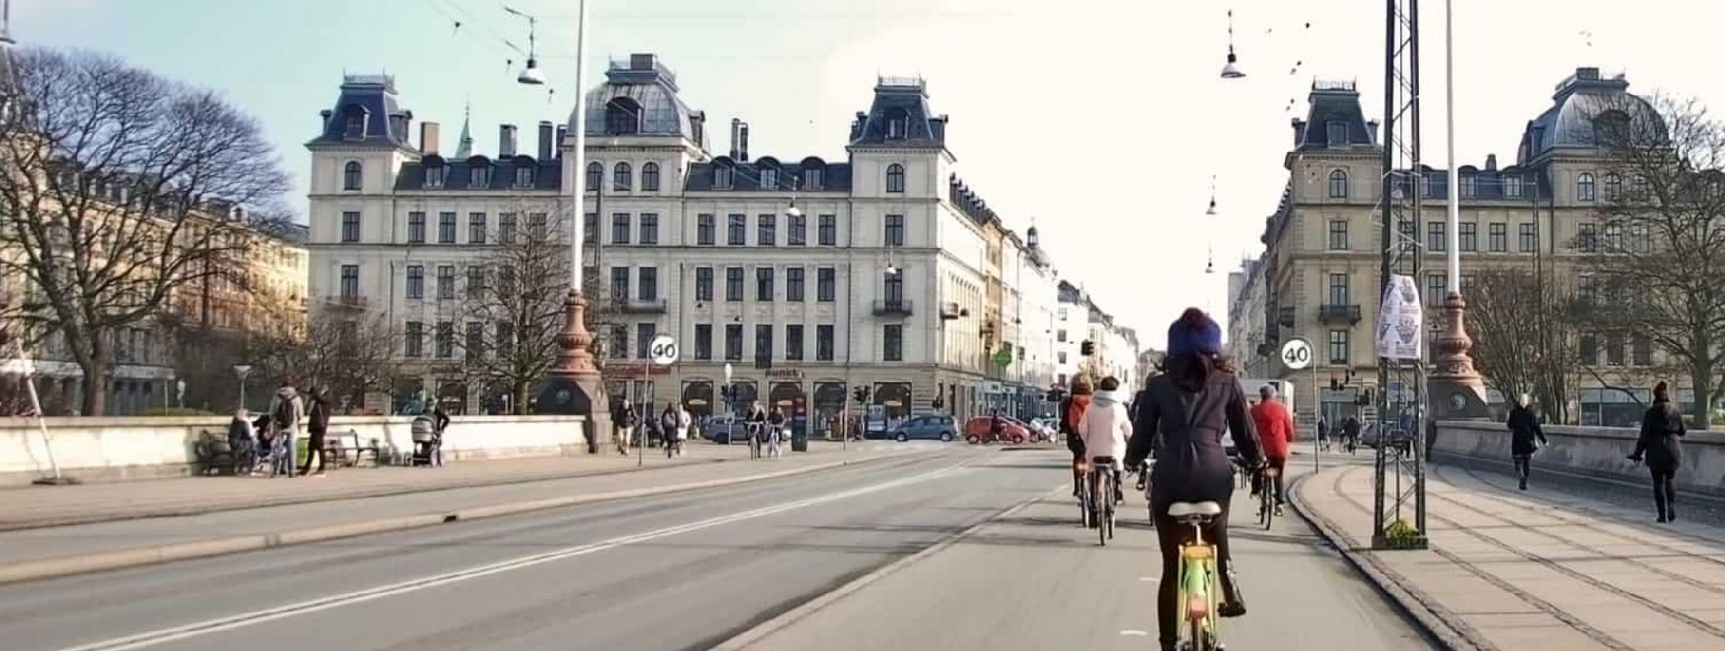
Copenhague comme exemple de bonne pratiqueThe route to becoming a vélo ville…
https://www.donkey.bike/5-reasons-why-youll-want-to-experience-copenhagen-on-a-bike/
https://www.youtube.com/watch?v=LuNPKqJtlQ4

Slide 23
Copenhague comme exemple de bonne pratiqueThe route to becoming a vélo ville : learning from mistakes
In the course of the 1980s and 1990s, the processus of expanding vélo infrastructure was gradually paced :
Initially, cycle pistes were created in quiet side streets - away from the busy principal routes
However, the new itinéraires were hardly accepted by cyclistes : most of them stuck to their direct itinéraires along the principal routes
Lesson : Cycle pistes should not be detours !
Change of strategy : Rerouting the cycle itinéraires to the principal trafic itinéraires in the ville center
Vélo is an everyday form of mobilité that allows you to get from A to B quickly
With the expansion of the cycle réseau, the proportion of cyclistes also increased

Slide 24
Copenhague comme exemple de bonne pratiqueThe route to becoming a vélo ville : learning from mistakes
Copenhagen has been collecting specific data on vélo since the early 1990s :
Trafic data : 20 sensors under the asphalt collect trafic data in Copenhagen, which is supplemented by régulier trafic counts at around 200 locations
Mobilité data : The so-called Vélo Account is collected in Copenhagen every two years
Focus : Cyclists' perception and comportement
Sample : around 1000 Copenhagen citizens
Evaluation of the Ville of Copenhagen's work towards becoming a bicycle-friendly ville
The resulting data sets are an important tool for urbain planners
Evaluation of mesures already taken
Identifier où (further) mesures are necessary

Slide 25
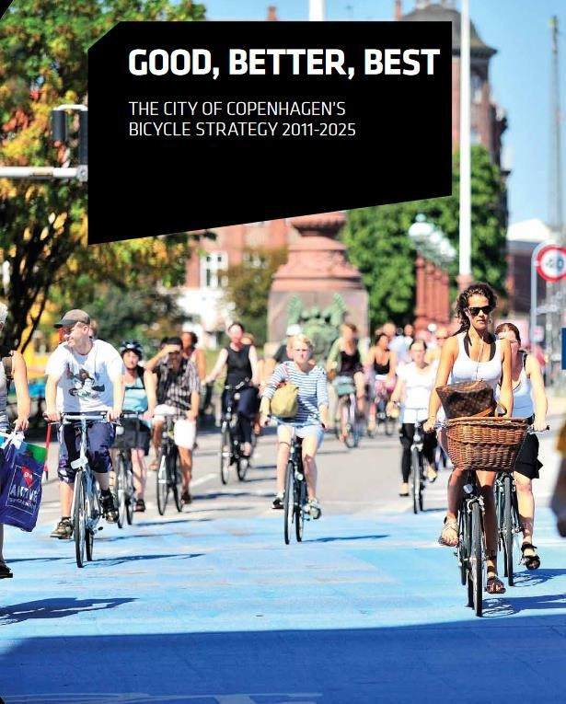
Copenhague comme exemple de bonne pratiqueThe route to becoming a vélo ville : political cadre conditions
2001 : Cycle Politique 2002-2012
Publication of the first Copenhagen’s vélo strategy
' "The cycle politique objectifs are to increase the proportion of the workforce qui cycle to work, to improve sécurité and a sense of security quand vélo, and to increase traveling vitesse and vélo confort. The objectifs are to be met within 11 years" (Ville of Copenhagen 2001 : 5)
Since the early 2000s : Various action plans and programs
Cycle route priority program 2006-2016 et from 2017
Action plan for sûr vélo 2007-2012
' ...
2011 : Good, Better, Best 2011-2025 → Current vélo strategy

Slide 26
Copenhague comme exemple de bonne pratiqueThe route to becoming a vélo ville : "Good, Better, Best" - objectifs by 2025
Increase the proportion of navetteurs qui cycle to work or training to 50 %
Increase the number of cycle pistes in the Copenhagen PLUS réseau (green itinéraires, fast cycle pistes, and the most frequently used cycle itinéraires) by 80%.
Reduce the average déplacement temps of cyclistes by 15%
Increase the number of cyclistes qui feel sûr in trafic to 90%
Reduce the number of seriously injured cyclistes by 70%
Increase the proportion of cyclistes qui think cycle pistes are well-maintained to 80%
Increase in the proportion of citizens qui believe that the vélo culture has a positive impact on the atmosphere of the ville, to 80%.
Increase citizen satisfaction with vélo stationnement to 70%

Slide 27
Copenhague comme exemple de bonne pratiqueThe "Copenhagen strategy."
Convenience
Vitesse et sécurité
Communication et participation

Slide 28
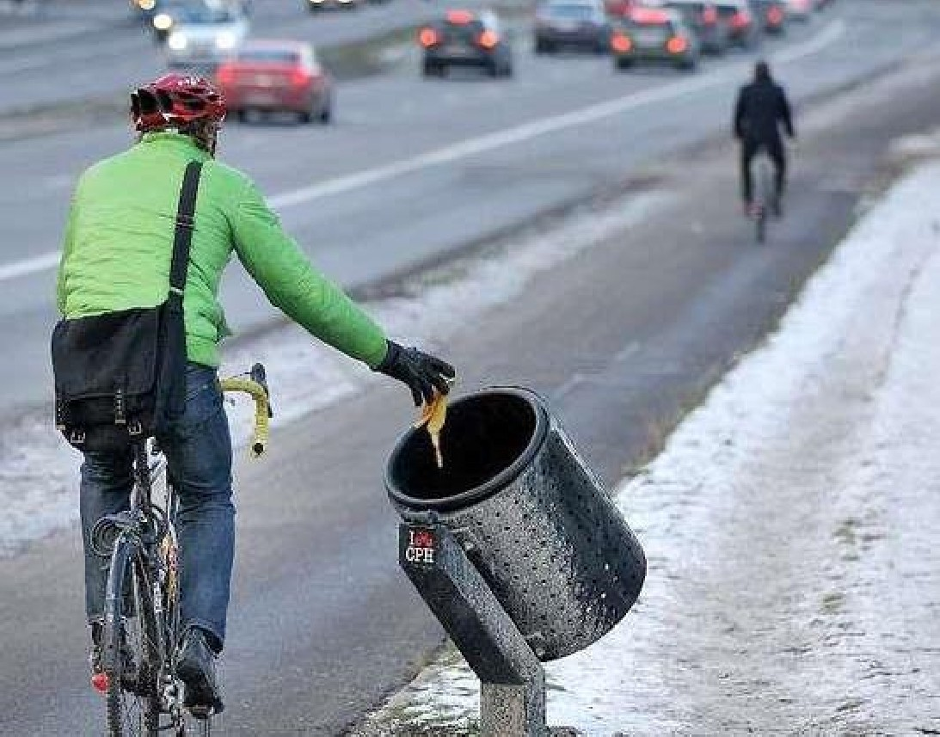
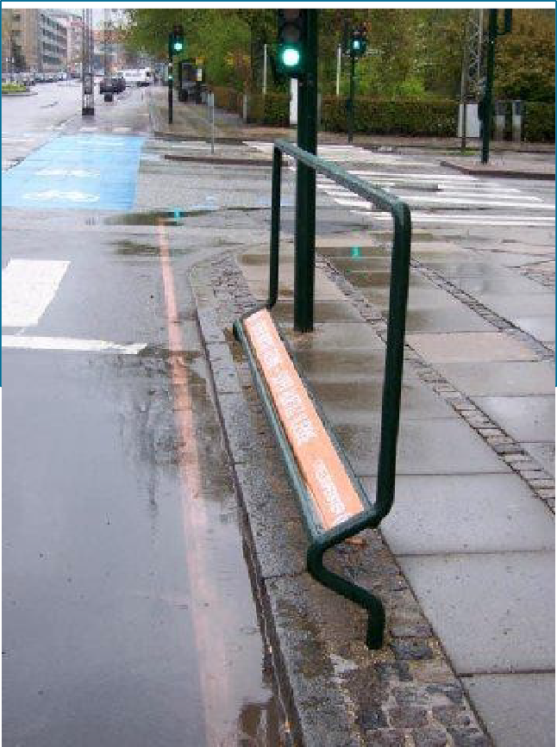
Copenhague comme exemple de bonne pratiqueThe "Copenhagen strategy : Convenience
Garbage can tilted in the direction of déplacement
footrest and grab handle

Slide 29
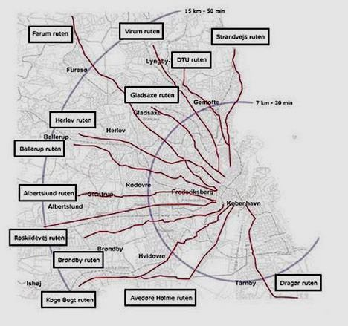
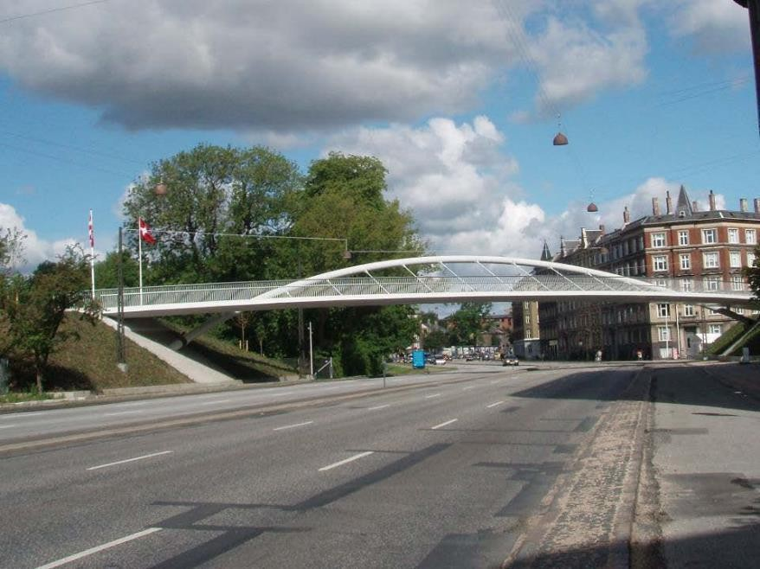
Copenhague comme exemple de bonne pratiqueThe "Copenhagen strategy : Vitesse et sécurité
Vélo bridge as part of a Cycle Superhighway : avoiding Crossing situations with other route usagers
Cycle Superhighways : from the periphery to the center

Slide 30
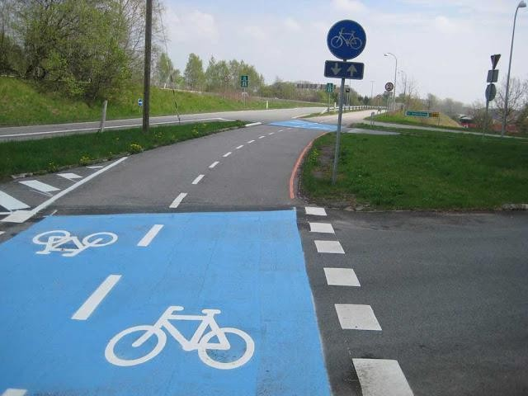
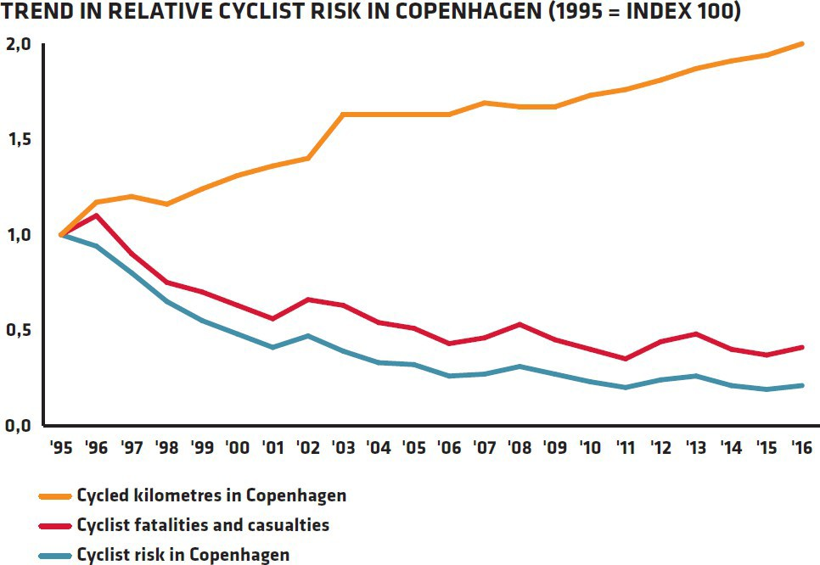
Copenhague comme exemple de bonne pratiqueThe "Copenhagen strategy : Vitesse et sécurité
Vélo route
https://international.kk.dk/sites/international.kk.dk/files/velo-city_handout.pdf/

Slide 31

Copenhague comme exemple de bonne pratiqueThe "Copenhagen strategy : Vitesse et sécurité
Communication et participation : I bike in Copenhagen
In 2008, the ville of Copenhagen launched the "I bike Copenhagen" as a bridge between the ville administration and citizens
Summary of all activités for vélo under the I Bike CPH brand
The initiative includes :
Social forum for Copenhagen cyclistes on the Internet
Objectif : Renforcer communication and cooperation between cyclistes to avoid conflicts in everyday trafic
Public relations
Objectif : Promoting acceptance and motivation for vélo
e.g., increased cooperation with the press, promotional activités, participation in campagnes, etc.
Opening events for new itinéraires, bridges, etc.

Slide 32
References
Ville of Copenhagen. 2001 Cycle Politique 2002-2012. URL : http ://www.hembrow.eu/vélo/413_cykelpolitik_uk.pdf Ville of Copenhagen. 2011 Good, Better, Best.
Ville of Copenhagen, The Technical and Environnemental Administration (ed.), (n.d.). Copenhagen Ville of Cyclistes. Facts and figures 2017.
Colville-Andersen, Mikael. 2020. Copenhagenize : The ultimate piste to urbain vélo culture. Röthenbach an der Pegnitz : Thiemo Graf Verlag.
Vélo Embassy of Denmark. Danish vélo history. URL : https ://cyclingsolutions.info/embassy/danish-cycling-history/ Vélo portal. Vélo Account Copenhagen. URL : https ://nationaler-radverkehrsplan.de/en/projetcs/bicycle-account-copenhagen Vélo portal. I bike CPH. URL : https ://www.nationaler-radverkehrsplan.de/en/projects/i-bike-cph
Knie, A., Zehl, F., Schelewsky, M. 2021. Mobilité Report 05, results from observations via representative survey and supplementary Mobilité tracking until the end of July, edition 16.08.2021, Bonn, Berlin, with financement from the BMBF.
Kobenhavens Kommune (undated). Mobilité et Vélo. URL : https ://urbandevelopmentcph.kk.dk/node/3 (12.10.2021).

