Slide 1
Cours : Fondements du transport
Cours : Introduction aux systèmes de transport
Prof.Dr.-Ing. Claude Takenga

Slide 3
Module Structure
Principes fondamentaux des systèmes et processus de transport
  C3.01.1 Principes fondamentaux du transport (3 ECTS credits – 45H)
    3 crédits ECTS – 45 h
    Éducation Niveau - Master
    Année of Study – 2
    Semestre - 3
  C3.01.2 Trafic engineering
    3 ECTS credits – 45H
    Éducation Niveau - Master
    Année of Study – 2
    Semestre - 1

Slide 4
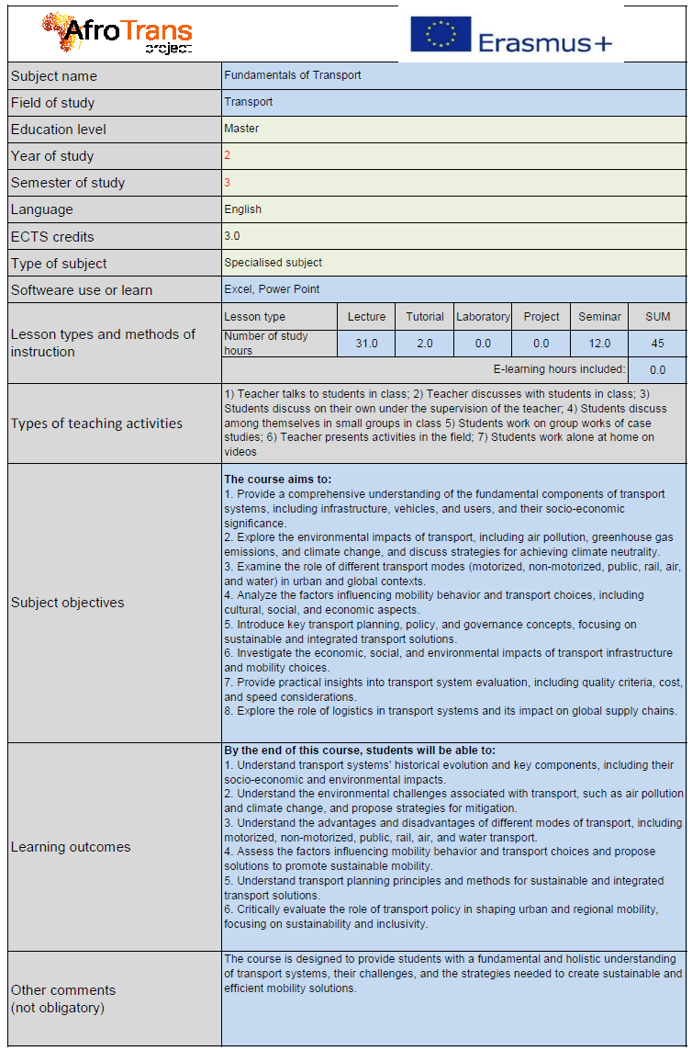
Cours : C3.01.1 Fundamentals of transport
    Cours 1 – Introduction aux systèmes de transport
    Cours 2 – Transport et environnement I
    Cours 3 – Transport et environnement II : Voies vers la neutralité climatique
    Séminaire - Présentation d’études de cas
    Cours 5 – Comportements de mobilité
    Cours 6 – Milieux de transport and Moyens de transport
    Cours 7 – Transport Systèmes Evaluation
    Cours 8 – Transport motorisé
    Cours 9 – Non motorisé Transport : Piétons
    Cours 10 – Non motorisé Transport : Cyclistes
    Cours 11 – Transport public
    Sortie pédagogique - Visite d’opérateurs de transport public
    Séminaire - Presentation on Sortie pédagogique
    Cours 14 – Railway Transport
    Cours 15 – Air Transport
    Cours 16 – Eau Transport
    Cours 17 – Logistique
    Cours 18 – Transport Planification I
    Cours 19 – Transport Planification II
    Cours 20 – Transport Planification III : Réseau Planification
    Séminaire - Présentation d’études de cas
    Cours 22 – Trafic Sécurité
    Cours 23 – Transport Politique
    Cours 24 – Transport in the Milieux
    Travaux dirigés - Synthèse du cours

Slide 5
Introduction aux systèmes de transportCours 1 - Plan :
Aperçu des systèmes de transport
Évolution historique
Composants : infrastructure, véhicules, usagers
Importance socio-économique
Études de cas : rôle dans l’urbanisation et la mondialisation

Slide 6
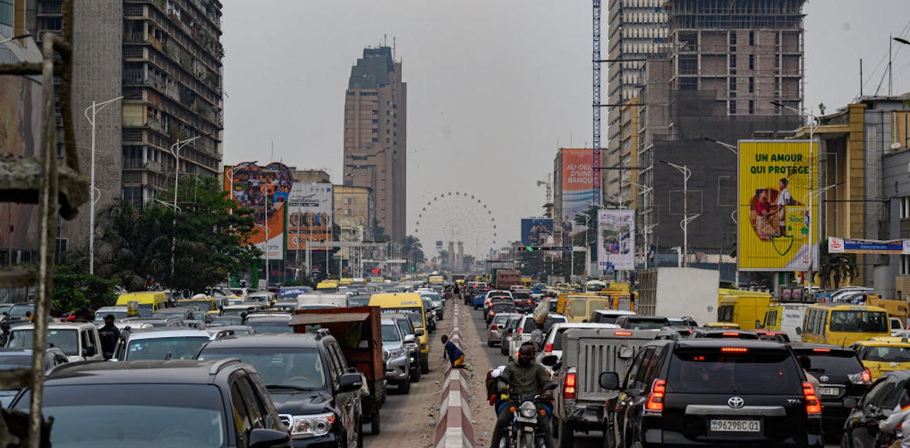
Aperçu des systèmes de transport
Qu’est-ce qu’un système de transport ?
  Un système de transport est l’ensemble de :
    Infrastructure
    Véhicules
    Usagers
    Politiques et institutions
  qui fonctionnent ensemble pour déplacer efficacement les personnes et les marchandises.
Kinshasa-DR.Congo
Notes:
A transport system is not just roads or buses. It’s the entire network of infrastructure, the vehicles that use it, the people involved, and the rules and institutions that govern mobility.
In Africa (DR Congo and Cameroon), these four elements often operate under constraints like limited funding, rapid urbanization, and strong informal transport presence

Slide 7
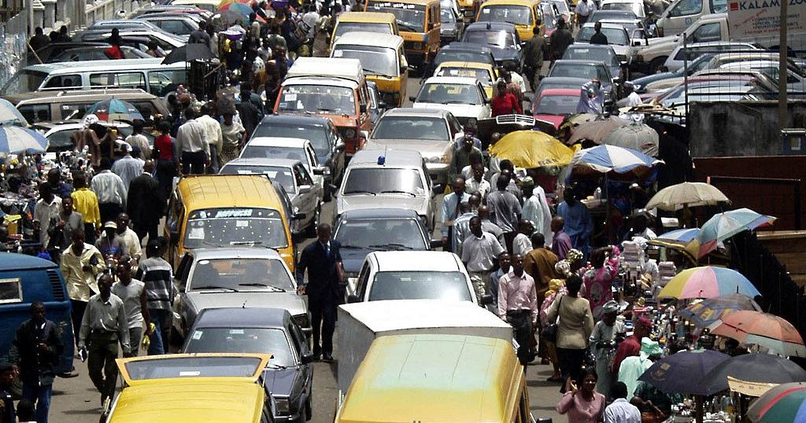
Aperçu des systèmes de transport
Pourquoi les systèmes de transport sont-ils importants ?
  Le transport permet :
    Mobilité et accès
    Croissance économique
    Connectivité sociale
    Accès à la santé et à l’éducation
    Commerce et intégration régionale
Douala-Cameroon
Notes:
Transport systems affect every part of society. In rural DRC, poor roads can mean hours to reach a hospital. In Cameroon, transport corridors like Douala–Yaoundé support national and regional trade. When transport improves, opportunities expand

Slide 8
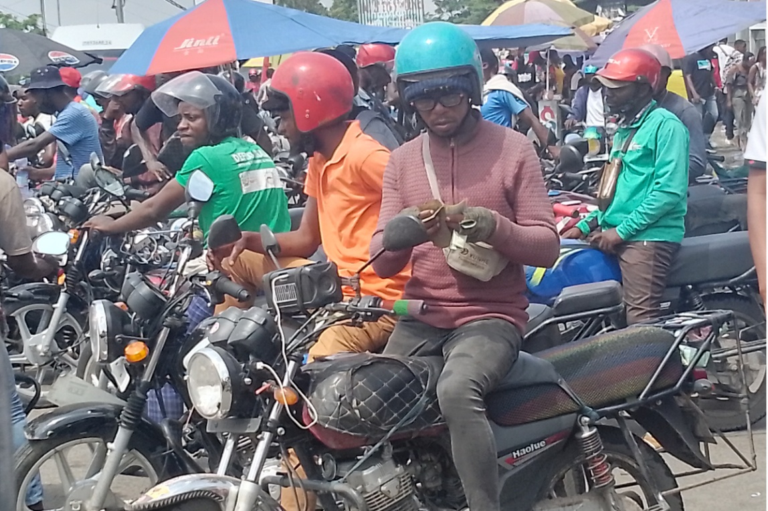
Aperçu des systèmes de transport
Réalité du transport urbain africain
  Caractéristiques typiques :
  Villes à croissance rapide
  Systèmes formels et informels mixtes
  Offre limitée de transport public
  Congestion et longs temps de trajet
  Lacunes en matière d’infrastructures
Kinshasa DR-Congo
Notes:
Cities like Kinshasa, Douala, Yaoundé, and Lubumbashi are expanding very fast. Formal transport cannot keep up with demand, so informal options like motorcycle taxis and minibuses dominate. This creates mobility, but also issues of safety, pollution, and unpredictability

Slide 9
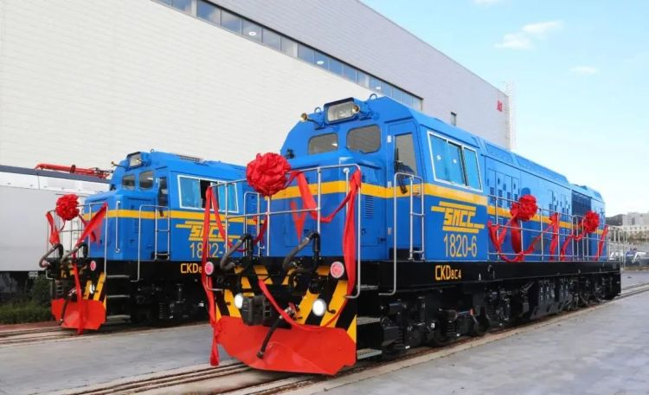
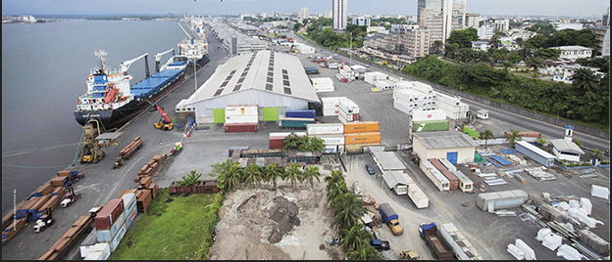
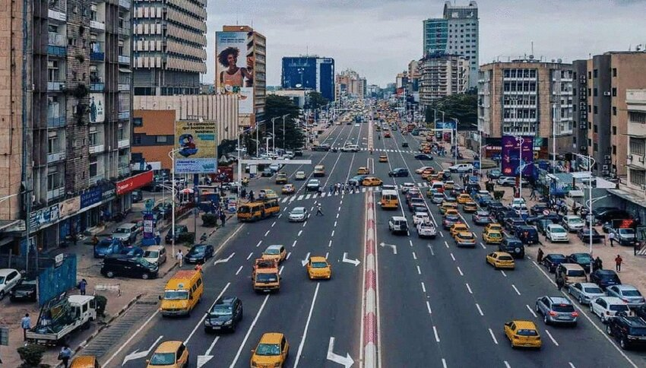
Aperçu des systèmes de transport
Infrastructure de transport
  Principaux types :
  Itinéraires et autoroutes
  Chemins de ferAéroports
  Ports et voies navigables
  Terminaux et gares
Kinshasa DR-Congo
Douala Port
Kinshasa DR-Congo
Notes:
Transport infrastructure varies greatly across Africa. DR Congo has the Congo River as a major transport artery, while Cameroon has the crucial port of Douala. However, paved road networks remain limited, especially in rural regions, causing isolation and high transport costs.

Slide 10
Aperçu des systèmes de transport
Véhicules dans le système
  Catégories courantes de véhicules :
  Véhicules privés
  Véhicules de transport public
  Modes non motorisés
  Véhicules de fret
  Bateaux et aéronefs
Notes:
Most vehicles in Central Africa are second-hand imports. Public transport often consists of taxis, minibuses, and motorcycle taxis like ‘benskins’ in Cameroon. On rivers, barges and wooden boats play a crucial role, especially in DR Congo. These vehicles form the backbone of everyday mobility

Slide 11
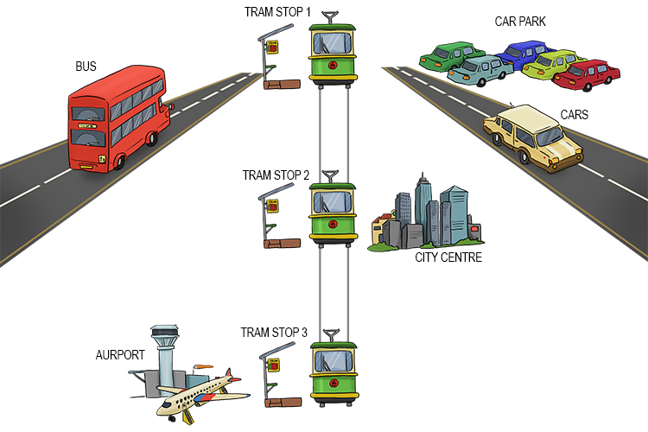

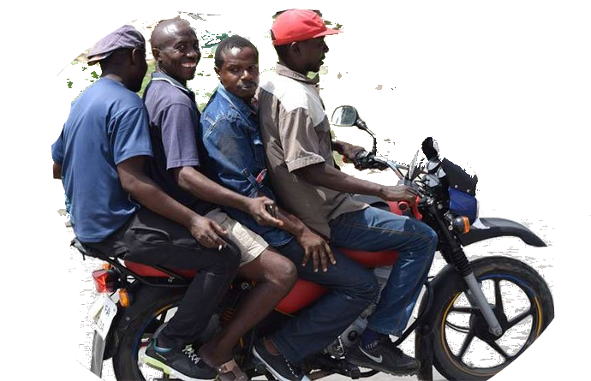

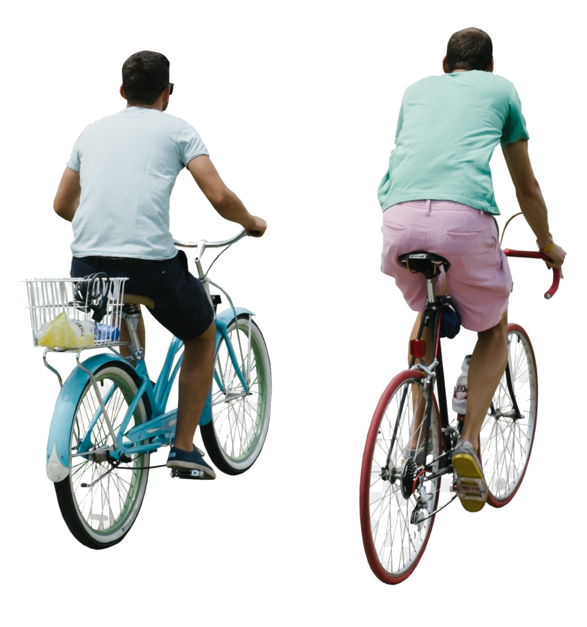


Aperçu des systèmes de transport
Usagers du système de transport
  Les usagers comprennent :
  Navetteurs
  Étudiants
  Opérateurs de fretConducteurs informels
  Piétons et cyclistes
  Groupes vulnérables
Notes:
Understanding the users is essential. Many African cities have a very high share of walking due to economic constraints. Students in Kinshasa or Yaoundé may rely on minibuses or motorbikes. Women, children, and people with disabilities face barriers due to poor infrastructure and unsafe conditions

Slide 12
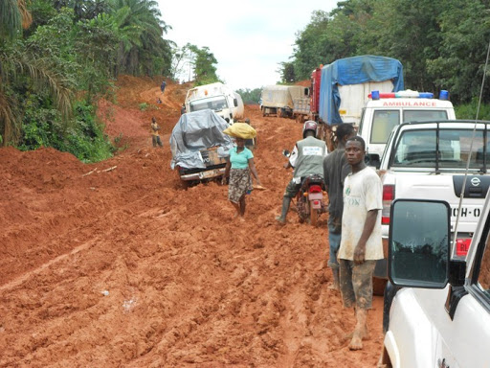
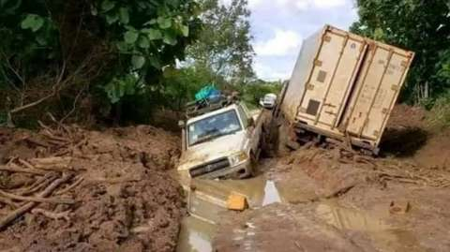
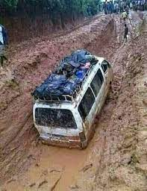
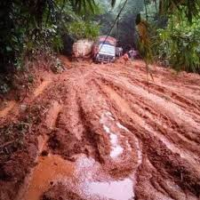
Aperçu des systèmes de transport
Fonctionnement des systèmes de transport
  Un système fonctionnel requiert :
    Connectivité
    Accessibilité
    Fiabilité
    Sécurité
    Accessibilité financière
Notes:
A transport system is only effective when it connects people to opportunities—reliably and safely. If buses are inconsistent, or roads are in bad shape, people suffer long delays and high costs. This is a major challenge in DR Congo and Cameroon, where infrastructure maintenance is often limited

Slide 13
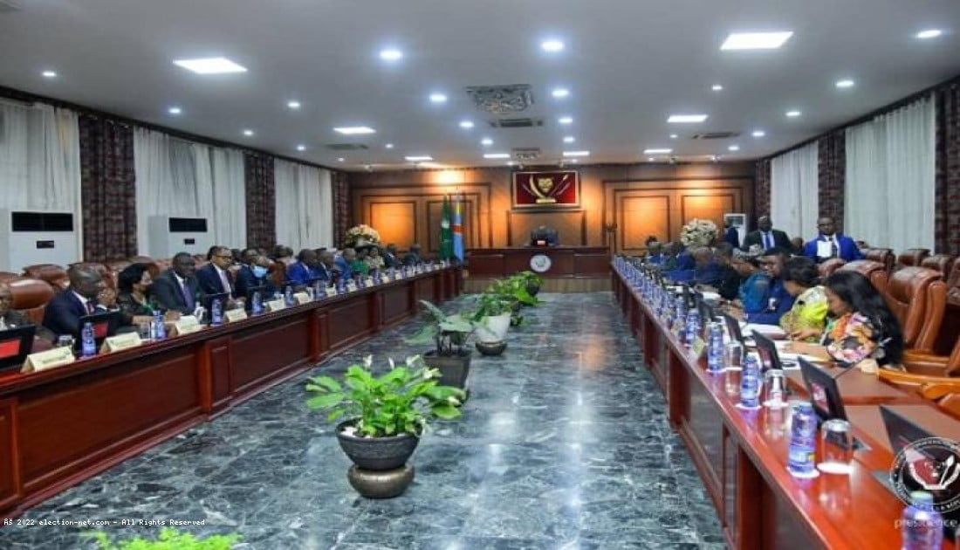
Aperçu des systèmes de transport
Acteurs et institutions du transport
    Acteurs clés :
    Ministères gouvernementaux
    Autorités localesOpérateurs privés
    Bailleurs et partenaires ONG
    Acteurs du secteur informel
DRC Ministères Meeting
Exemples of institutions for DRC :
Exemples of institutions for Cameroon :
Ministry of Infrastructure (MITP)
Office des Itinéraires (OR)
Office des Voiries et Drainage (OVD)
Office des Voies de Développement Agricole (OVDA)
Ministry of Transport et Communications
SCTP (ex-ONATRA)
Société Nationale des Chemins de Fer du Congo (SNCC)
Régie des Voies Aériennes (RVA)
Autorité de l’Aviation Civile (AAC)
Commission Nationale de Prévention Routière (CNPR)
FONER – Fonds National d'Entretien Routier
Ministry of Public Works (MINTP)
Ministry of Transport (MINT)
Ministry of Housing and Urbain Développement (MINHDU)
Ministry of Public Security (Délégation Générale à la Sûreté Nationale)
Route Fund of Cameroon (Fonds Routier)
CAMRAIL (Cameroon Chemins de fer)
Port Authority of Douala (PAD)
National Civil Aviation Authority (CCAA)
Cameroon Aéroports Company (ADC – Aéroports du Cameroun)
SOCATUR / Urbain Transport Companies
Councils et Urbain Communities
Notes:
In many African countries, transport governance is shared across several institutions. However, informal operators play a major role, often filling gaps left by formal systems. Collaboration between government and informal sectors is essential to improve safety, service quality, and regulation

Slide 14
Aperçu des systèmes de transport
Acteurs et institutions du transport (DRC)
Ministry of Infrastructure and Public Works (Ministère des Infrastructures et Travaux Publics – MITP)
  Plans, builds, and oversees national transport infrastructure and majeur public works.
Office des Itinéraires (OR)
  Maintains and rehabilitates national and régional interurban route réseaux.
Office des Voiries et Drainage (OVD)
  Constructs and maintains urbain routes and drainage systèmes in majeur villes.
Office des Voies de Développement Agricole (OVDA)
  Builds and maintains rural feeder routes to relier villages and agricultural zones to markets.
Ministry of Transport and Communications (Ministère des Transports, Voies de Communication et Désenclavement)
  Regulates transport modes, mobilité services, and national transport politique.
Office National des Transports (ONATRA) (now Société Commerciale des Transports et Ports – SCTP)
  Manages ports, river transport, and western railway exploitation.
Société Nationale des Chemins de Fer du Congo (SNCC)
  Operates and maintains central and southern railway réseaux for fret and voyageurs.
Régie des Voies Aériennes (RVA)
  Manages aéroports and air navigation services nationwide
Autorité de l’Aviation Civile (AAC)
  Regulates civil aviation sécurité, certification, and compliance.
Commission Nationale de Prévention Routière (CNPR)
  Promotes route sécurité through driver éducation, sensibilisation campagnes, and accident prevention initiatives.
FONER – Fonds National d'Entretien Routier
  Finances the maintenance of national and local routes using carburant taxes and road-user charges.
Notes:
In many African countries, transport governance is shared across several institutions. However, informal operators play a major role, often filling gaps left by formal systems. Collaboration between government and informal sectors is essential to improve safety, service quality, and regulation

Slide 15
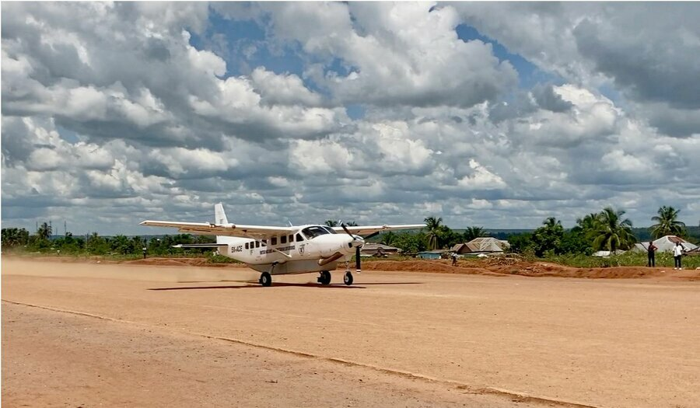
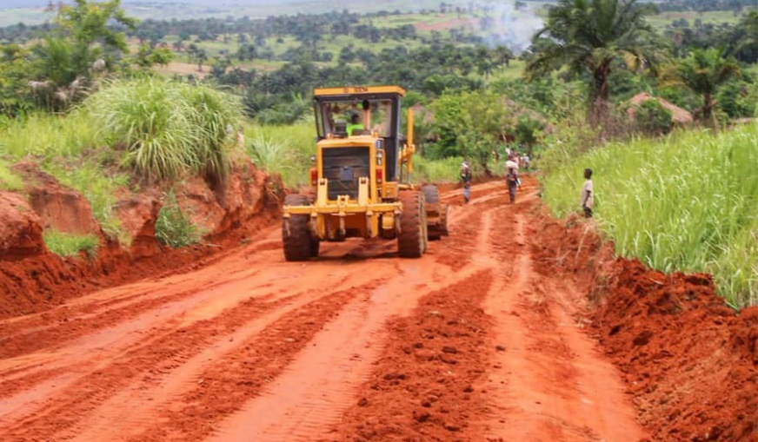
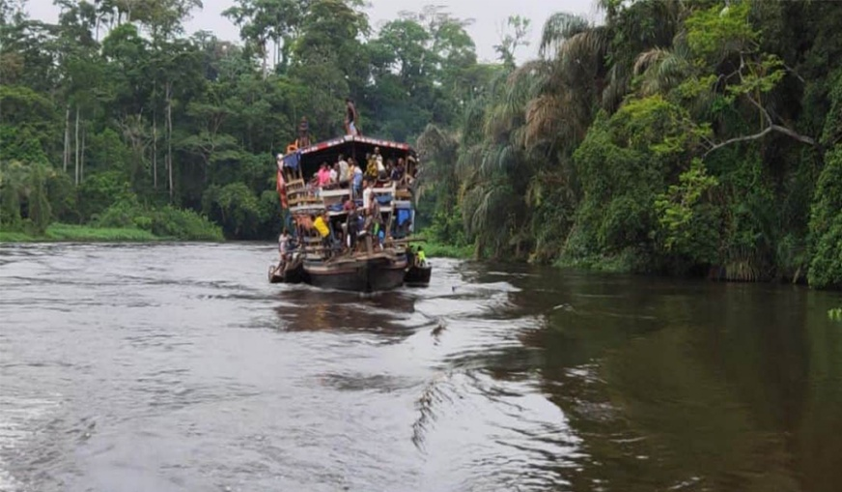
Aperçu des systèmes de transport
Défis des systèmes de transport africains
    Principaux défis :
      Mauvais état des itinéraires
      Transport public insuffisant
      Taux élevés d’accidents
      Financement et maintenance limités
      Croissance démographique rapide
DRC- OVDA
Notes:
In DR Congo, many regions become inaccessible during rainy seasons. In Cameroon, congestion in Douala and Yaoundé significantly impacts daily life. Accidents involving motorbike taxis are common. Funding constraints make it difficult to expand and maintain infrastructure.

Slide 16
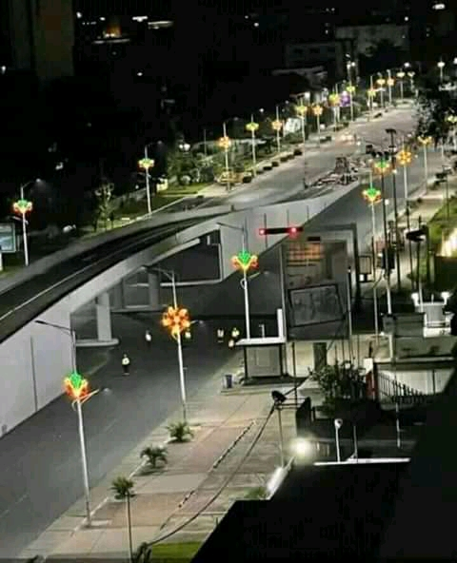
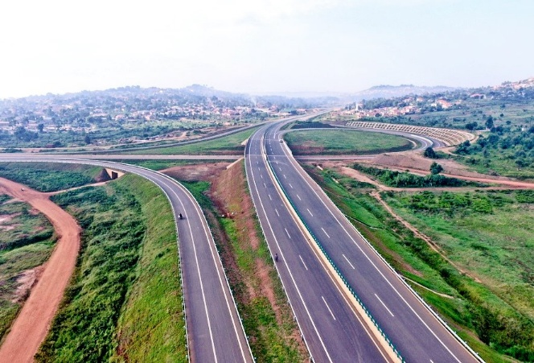
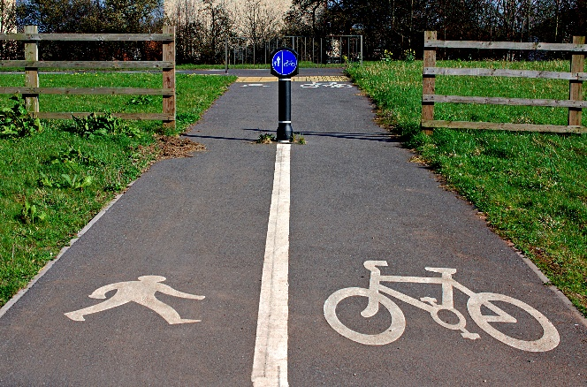
Aperçu des systèmes de transport
Possibilités d’amélioration
    Améliorations possibles :
      Améliorations possibles :
      Développer les systèmes de transport public
      Intégrer le transport informel
      Améliorer la maintenance des infrastructures
      Promouvoir la marche et le vélo
      Renforcer les capacités institutionnelles
DRC-Saut de Mouton
Uganda-Entebbe Expressway
marche et vélo
Notes:
While challenges exist, there are significant opportunities. Cities like Kigali and Addis Ababa show that African urban transport can evolve with proper planning. For DR Congo and Cameroon, strengthening institutions, upgrading roads, and formalizing informal transport can dramatically improve mobility and quality of life.

Slide 17
Introduction aux systèmes de transportPlan :
Aperçu des systèmes de transport
Évolution historique
Composants : infrastructure, véhicules, usagers
Importance socio-économique
Études de cas : rôle dans l’urbanisation et la mondialisation

Slide 18
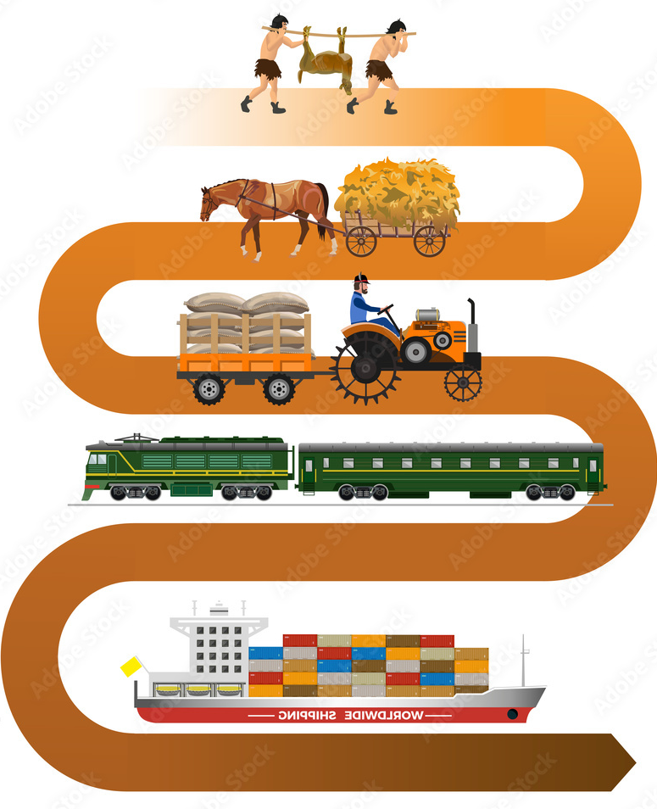
Évolution historique du transport
Ère préindustrielle
La mobilité ancienne reposait sur :
        Marche et transport animal
        Charrettes simples et pirogues
        Itinéraires commerciales fluviales
        Itinéraires de migration humaine
Africa (context) :Use of rivers :
        Nile, Niger, Congo
        Footpaths linking villages et kingdoms
        Camel caravans across the Sahara
Notes:
Early transport systems were shaped by geography and human needs. Globally, people relied on animals, walking, and simple watercraft. In Africa, rivers like the Congo and Nile were vital natural highways. Footpaths connected villages and kingdoms, and caravans moved salt, gold, and goods across the Sahara long before European contact. This era shows how transport evolved from basic human mobility to more organized systems

Slide 19
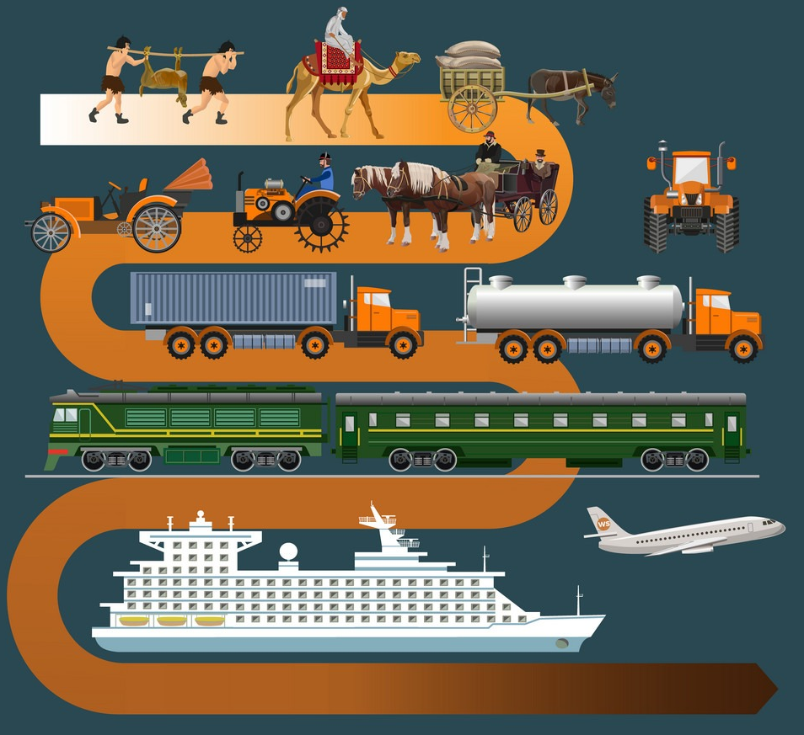
Évolution historique du transport
Révolution industrielle : naissance du transport moderne
Clé developments (18th–19th century) :
        Steam engines
        Chemins de fer développer globally
        Mass shipping et steamships
        Early urbain transit (tramways, bus)
Africa (context) :
        Colonial chemins de fer for resource extraction
        Formation of majeur ports (e.g., Douala, Matadi)
Notes:
The Industrial Revolution transformed transport worldwide. Steam engines enabled trains and ships to move goods and people faster than ever. Cities began introducing tram systems and organized buses. In Africa, this period marked the construction of colonial railways—such as the Matadi–Kinshasa line in DR Congo and the Douala–Ngaoundéré line in Cameroon. These infrastructures were built mainly for extraction, not for local mobility, but they still laid the foundation for modern transport networks.

Slide 20
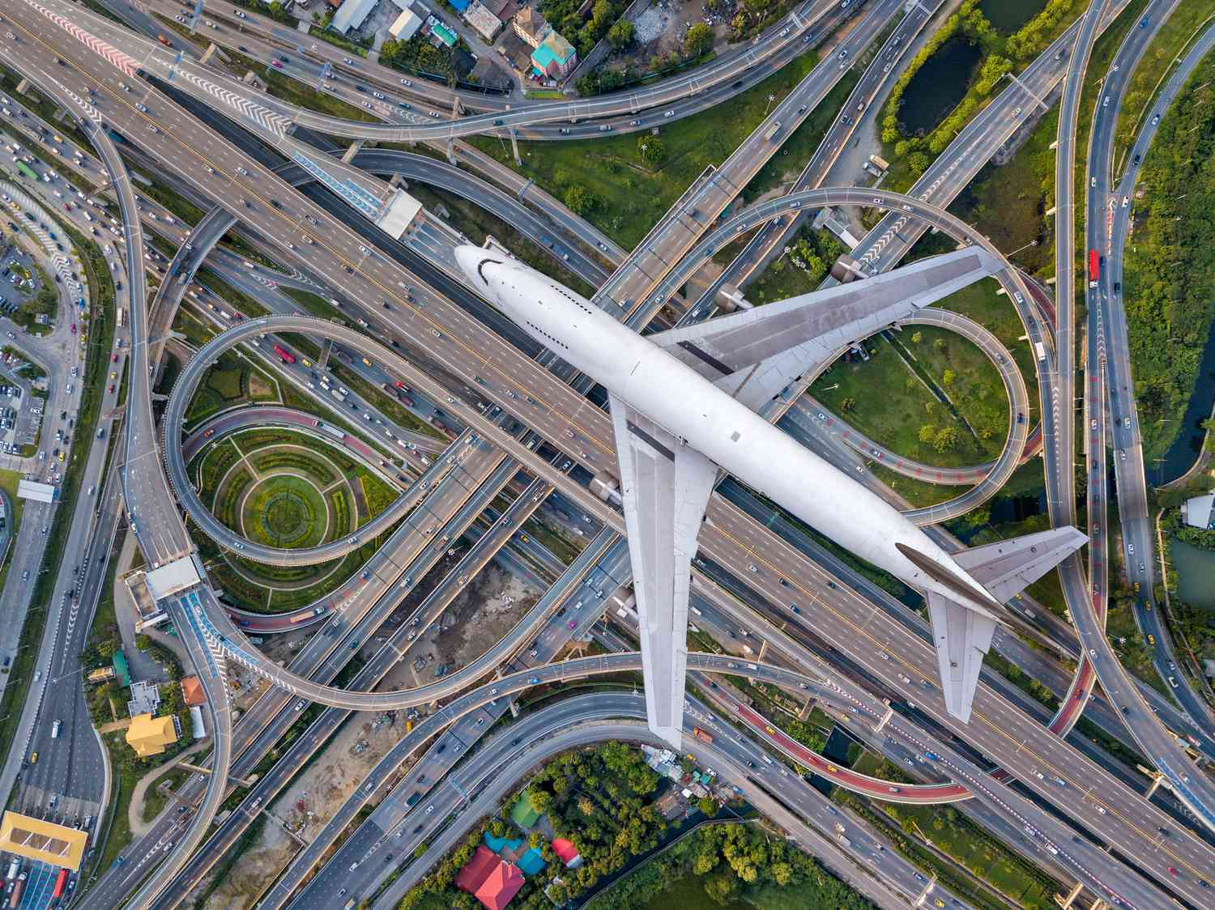
Évolution historique du transport
XXe siècle : motorisation et expansion mondiale
Mondial trends :
        Mass production of voitures
        Expansion of autoroutes et air déplacement
        Urbanisation changes mobilité patterns
        Logistique et offre chains emerge
Africa (context) :
        Croissance of route réseaux after independence
        Increase in imported véhicules
        Rise of informel transport systèmes
Notes:
The 20th century brought motorization. Cars became widely available and roads expanded. Air transport connected continents, and global supply chains emerged. In Africa, newly independent nations invested in roads to connect regions. However, limited resources slowed expansion, and imported second-hand vehicles became the norm. Informal transport—minibuses, taxis, motorcycles—rose to meet the mobility needs of fast-growing urban populations

Slide 21
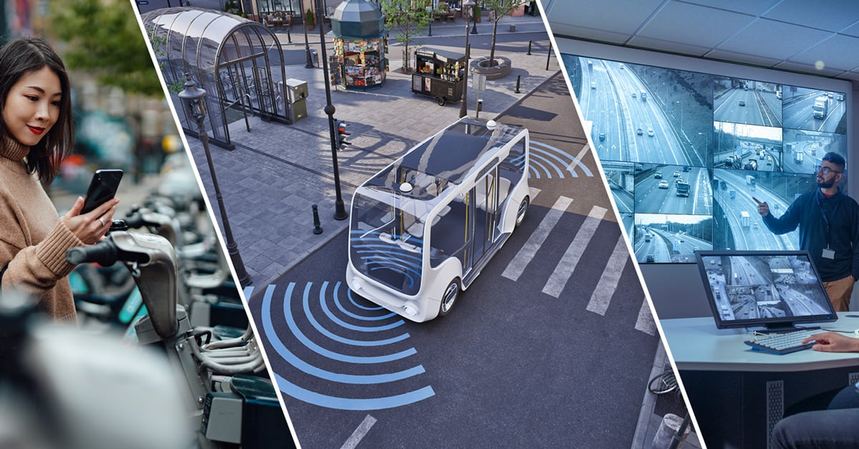
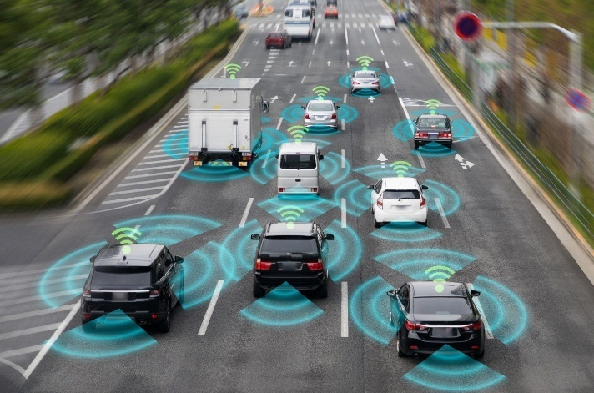
Évolution historique du transport
Fin du XXe et début du XXIe siècle : mondialisation et mobilité numérique
Worldwide developments :
        Aéroports become mondial hubs
        Container shipping revolution
        Digital technologies in mobilité
        Emergence of ride-hailing platforms
Africa (context) :
        Croissance of régional corridors (e.g., Central African corridor)
        Container ports : Douala, Matadi
        Early adoption of mobile-based transport apps
        Gradual expansion of modern bus et BRT attempts
Notes:
Transport became global and digital. Container shipping reduced costs, airports connected markets, and digital tools improved logistics. Platforms like Uber changed mobility in many cities. In Africa, regional corridors link landlocked countries to ports like Douala or Matadi. Mobile technology is widespread, so transport apps are emerging even in cities with limited formal systems. Some countries are testing BRT or structured bus systems, though progress varies

Slide 22
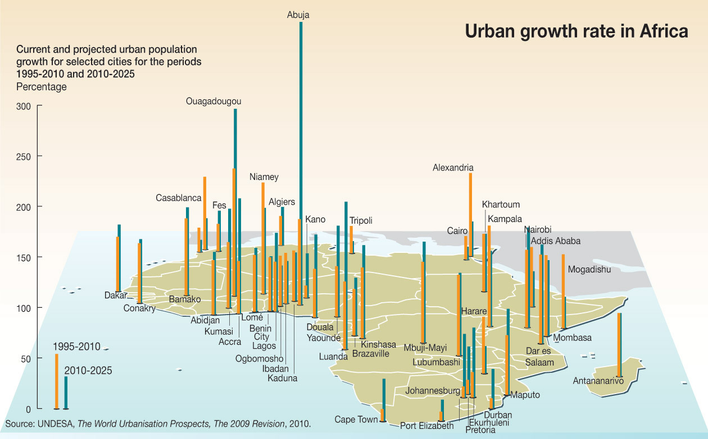
Évolution historique du transport
Transition du transport africain : aujourd’hui et demain
Current African trends :
        Rapide urbain population croissance
        Expanding but strained route réseaux
        Renewed interest in rail revival
        Need for durable mobilité
        Modernization of ports et aéroports
        International investments in infrastructure
Exemples :
        Kinshasa–Brazzaville bridge project (planned)
        Nairobi SGR et hints of similar ambitions in Central Africa
        Douala port modernization
Notes:
Today Africa is experiencing a transport transition. Cities like Kinshasa, Douala, and Yaoundé grow at unprecedented rates, placing huge pressure on road networks. There is renewed interest in modern rail systems and large investments in ports and airports. Sustainability is becoming more important due to congestion, pollution, and climate change. The future depends on strong planning, resilient infrastructure, and integration between formal and informal transport systems.

Slide 23
Introduction aux systèmes de transportPlan :
Aperçu des systèmes de transport
Évolution historique
Composants : infrastructure, véhicules, usagers
Importance socio-économique
Études de cas : rôle dans l’urbanisation et la mondialisation

Slide 24
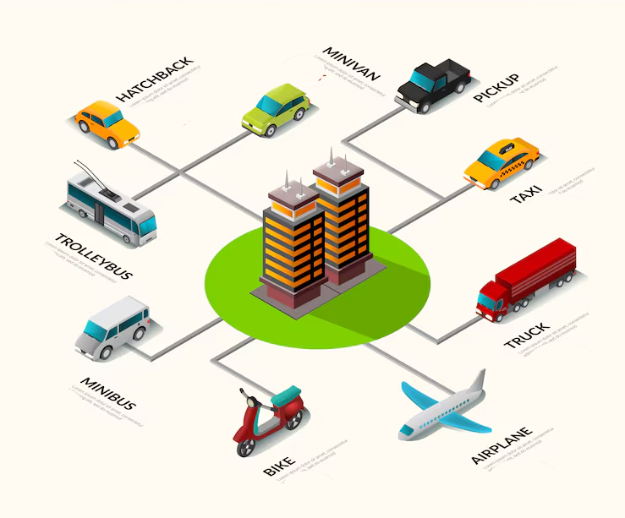
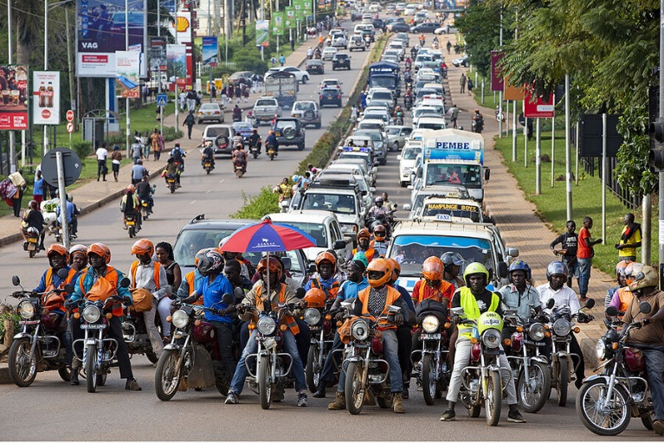
Composants : infrastructure, véhicules, usagers
Transport Système Composants : The Big Picture
A complete transport système includes :
          Infrastructure
          Véhicules
          Usagers
          Supporting institutions et politiques
        These composants work together to ensure mobilité.
Uganda-Kampala
Notes:
Transport is a system made of interacting parts. Infrastructure provides the physical backbone, vehicles move people and goods, and users shape demand and behavior. In Africa, especially in DR Congo and Cameroon, these components often grow at different speeds—for example, vehicle numbers increase faster than infrastructure development, creating congestion and safety issues.

Slide 25
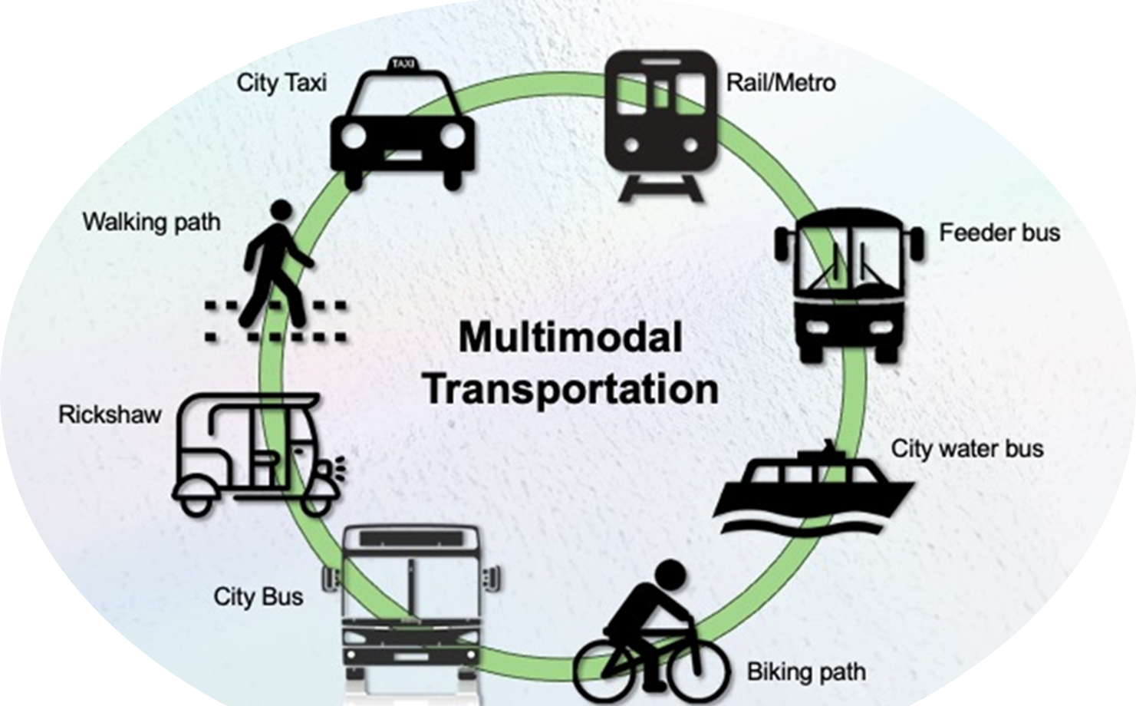
Composants : infrastructure, véhicules, usagers
Infrastructure : The Foundation of Mobilité
Types of transport infrastructure :
          Routes et Autoroutes
          Chemins de fer
          Ports et Voies navigables
          Aéroports
          Terminaux et Gares
        Mondial Context :
          High-density, well-maintained réseaux
          Integrated multimodal systemsRoads et Autoroutes
        African Context :
          Uneven route distribution
          Limité rail coverage
          Clé ports serving landlocked régions
          Reliance on rivers for transport (e.g., Congo River)
Notes:
Infrastructure determines how easily people and goods can move. Globally, countries like Japan or Germany have integrated systems with reliable roads, rail, and metros. In Africa, infrastructure varies: Cameroon’s Douala port is a regional gateway, while DR Congo relies heavily on waterways due to limited road networks. Poor road conditions in rural areas delay transport and increase costs.

Slide 26
Composants : infrastructure, véhicules, usagers
Véhicules : Tools for Movement
  Categories of véhicules :
    Véhicules privés
    Véhicules de transport public (bus, minibuses)
    Véhicules de fret
    Modes non motorisés (vélos, carts)
    Eau and air transport véhicules
  Mondial Trends :
    Electrification (EVs)
    High-capacity bus et trains
    Modern logistique fleets
  African Trends :
    Imported second-hand véhicules
    Dominance of minibuses et motocyclette taxis
    River boats essentiel in régions like DR Congo
    Limité but growing air déplacement
Notes:
Vehicles reflect economic realities. While high-income countries move toward electric mobility and high-speed trains, many African countries depend on older imported vehicles. In Cameroon, ‘benskins’ (motorbike taxis) are everywhere due to their affordability and maneuverability. In DR Congo, river barges are crucial for moving goods between cities

Slide 27
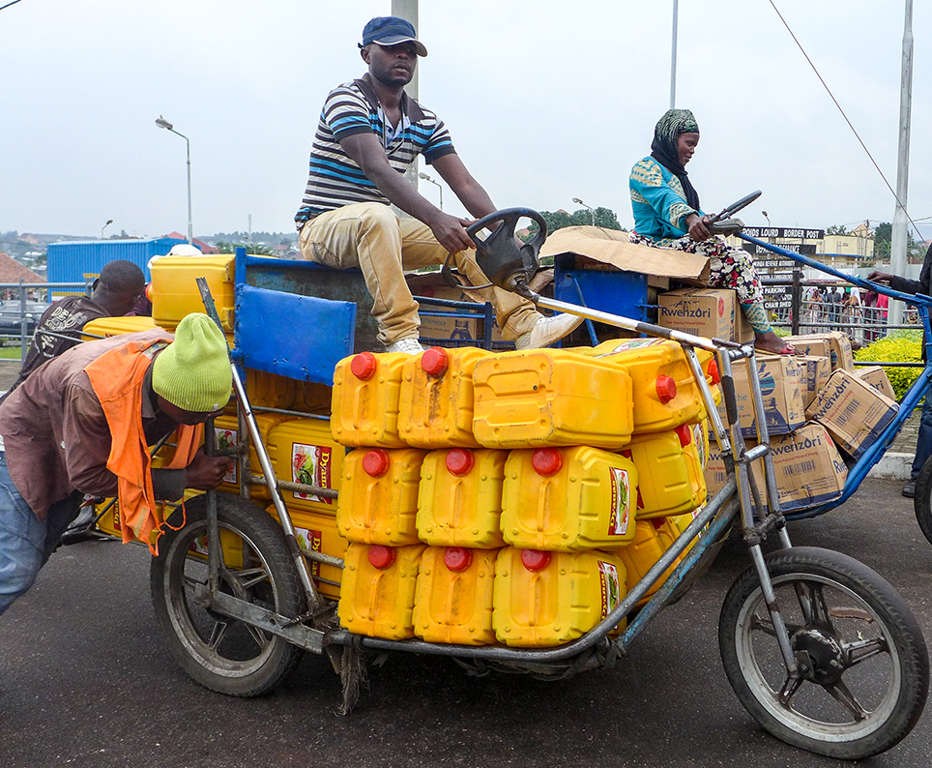
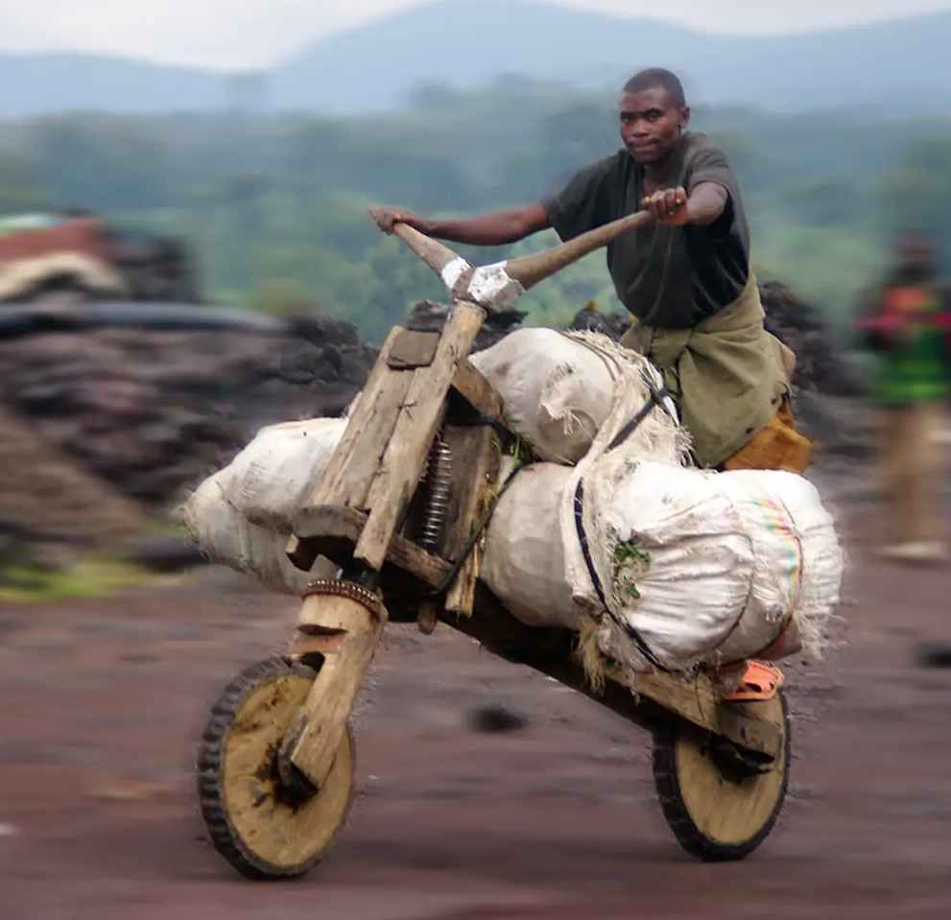
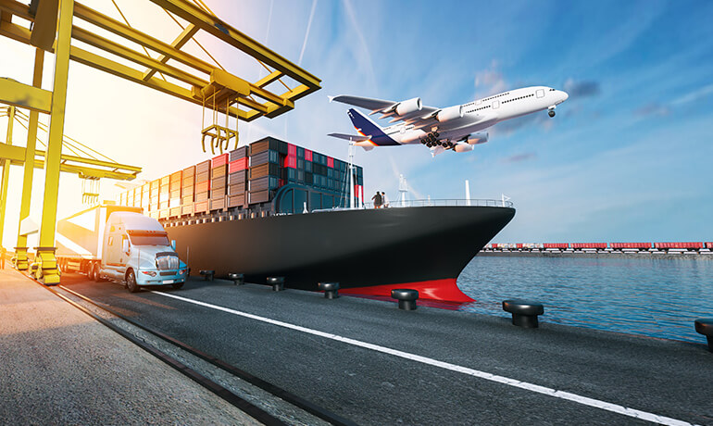
Composants : infrastructure, véhicules, usagers
Usagers : Qui Uses the Transport Système ?
  Types of usagers :
    Navetteurs
    Étudiants
    Opérateurs de fret
    Informel transport opérateurs
    Piétons et cyclistes
    Groupes vulnérables (femmes, personnes âgées,
    handicapées)
  Mondial Context :
    High reliance on structured public transport systèmes
    Strong piéton and vélo infrastructure
  African Context :
    Very high share of marche trips
    Heavy use of informel transport
    Sécurité issues for vulnerable groupes
Notes:
Understanding users is essential for designing effective systems. In many African cities, walking accounts for 40–70% of daily trips. Students rely heavily on minibuses and motorcycles. Vulnerable users face challenges because sidewalks are limited or poorly maintained. Transport planning must consider all users—not just motorists.

Slide 28
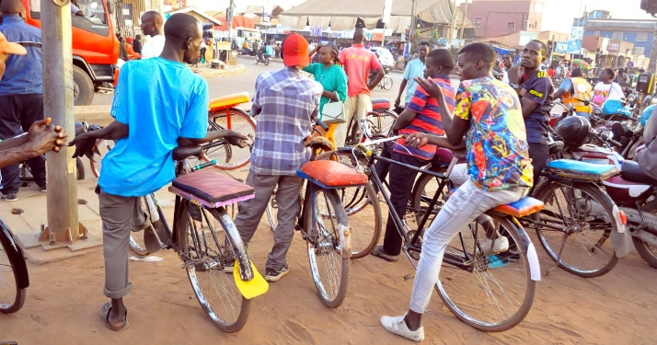
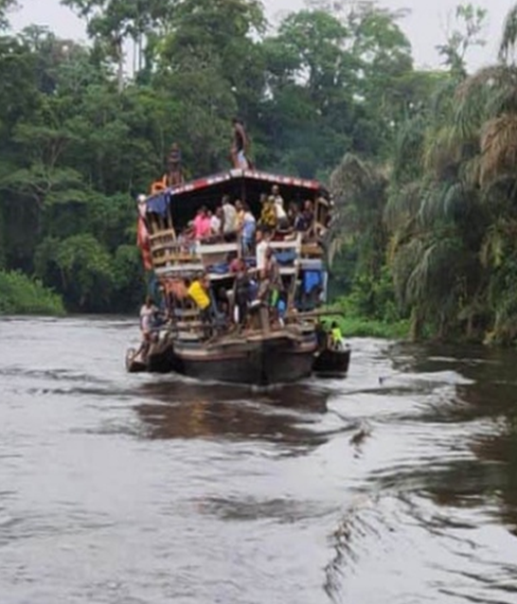
Composants : infrastructure, véhicules, usagers
Comment Infrastructure, Véhicules, and Usagers Interact
  The interaction determines système performance :
    Infrastructure façonne véhicule flow
    Véhicules generate demande for infrastructure
    Usagers influence déplacement patterns
    Politiques mediate the relationships
  Exemples (Africa) :
    Congestion in Douala due to high véhicule volume + limité route expansion
    River transport in DR Congo shaped by usager needs et infrastructure gaps
    Motorbike taxis fill public transport shortages
Notes:
The components don’t exist separately—they interact constantly. In Cameroon, rapid growth of vehicles in Douala has outpaced road capacity, causing chronic congestion. In DR Congo, lack of roads pushes users toward river transport. Informal transport grows organically when formal systems are weak. Understanding these interactions helps policymakers design solutions.

Slide 29
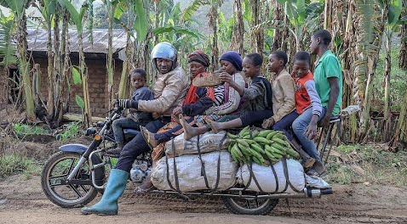
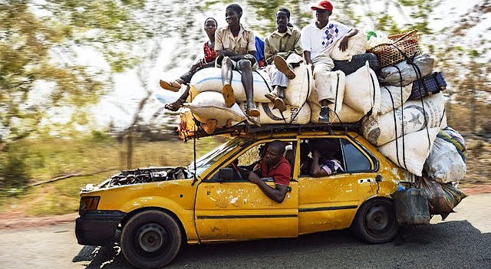
Composants : infrastructure, véhicules, usagers
Défis et Opportunités in African Transport Composants
  Défis :
    Mauvais état des itinéraires
    Transport public insuffisant
    Old véhicule fleets
    Sécurité issues
    Limité transport planification capacité
  Opportunités :
    Modernizing ports et aéroports
    Upgrading public transport systèmes
    Integrating informel modes
    Expanding vélo et piéton facilities
    Investing in durable mobilité
Notes:
Despite challenges, there are major opportunities for growth. Investments in Douala port modernization or planned rail improvements in DR Congo show progress. Formalizing and supporting informal transport could improve safety and efficiency. African cities can also leapfrog to new technologies, such as digital ticketing or transport apps, just as they did with mobile payments like M-Pesa

Slide 30
Introduction aux systèmes de transportPlan :
Aperçu des systèmes de transport
Évolution historique
Composants : infrastructure, véhicules, usagers
Importance socio-économique
Études de cas : rôle dans l’urbanisation et la mondialisation

Slide 31
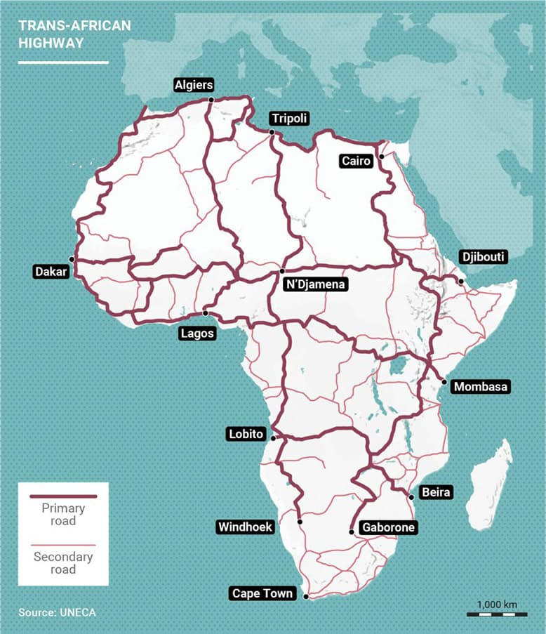
Importance socio-économique du transport
Transport as a Driver of Économique Croissance
  Transport contributes to :
    National productivity
    Commerce et market accès
    Industrial développement
    Job creation
    Lower coût of marchandises
  African Context :
    Clé corridors soutenir régional commerce
    Transport coûts remain high
    Lacunes en matière d’infrastructures limit croissance
Trans-African Highway : Nine New Autoroutes Under Construction
Notes:
Transport is essential for economic growth. Efficient systems reduce travel time, lower costs, and allow industries to reach markets. In Cameroon, the Douala–Bangui and Douala–Ndjamena corridors are lifelines for Central African trade. In DR Congo, transport costs are among the highest in Africa due to limited road networks. Improving transport directly boosts national and regional economies.
The Trans-African Highway (TAH) is one of Africa’s most ambitious continental infrastructure projects — a network of nine major highways designed to connect the entire continent from north to south and east to west.

Slide 32
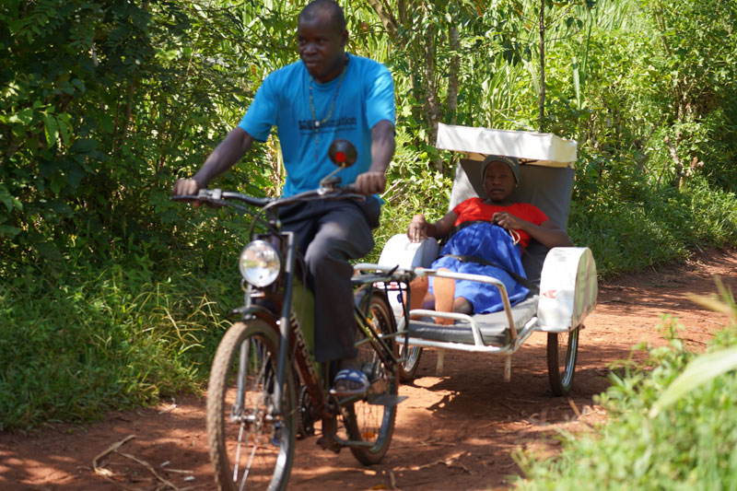
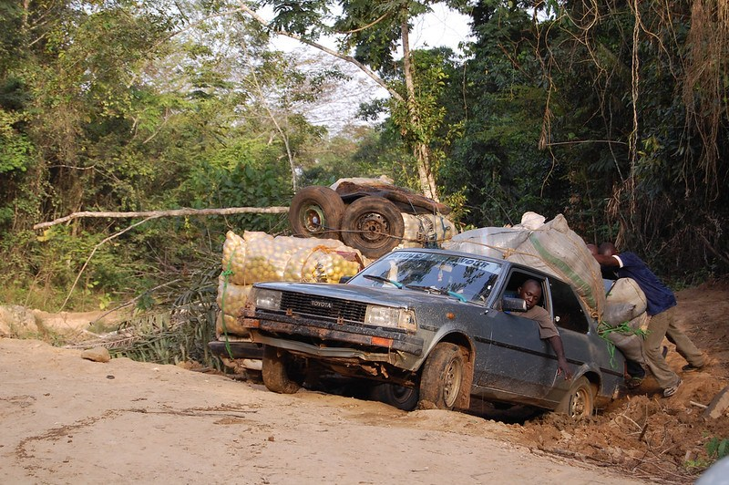
Importance socio-économique du transport
Transport and Social Développement
  Transport improves accès to :
    Éducation
    Soins de santé
    Employment
    Social services
    Opportunités for femmes et youth
  African Context :
    Rural populations often isolated
    Poor route accès = reduced school attendance
    Urbain congestion affects daily life
Notes:
Transport is not just about moving goods—it transforms lives. In many Congolese provinces, reaching a hospital may require hours on unpaved roads. In Cameroonian cities like Yaoundé, students and workers lose valuable time in traffic. Better transport reduces social inequalities by connecting people to opportunities

Slide 33
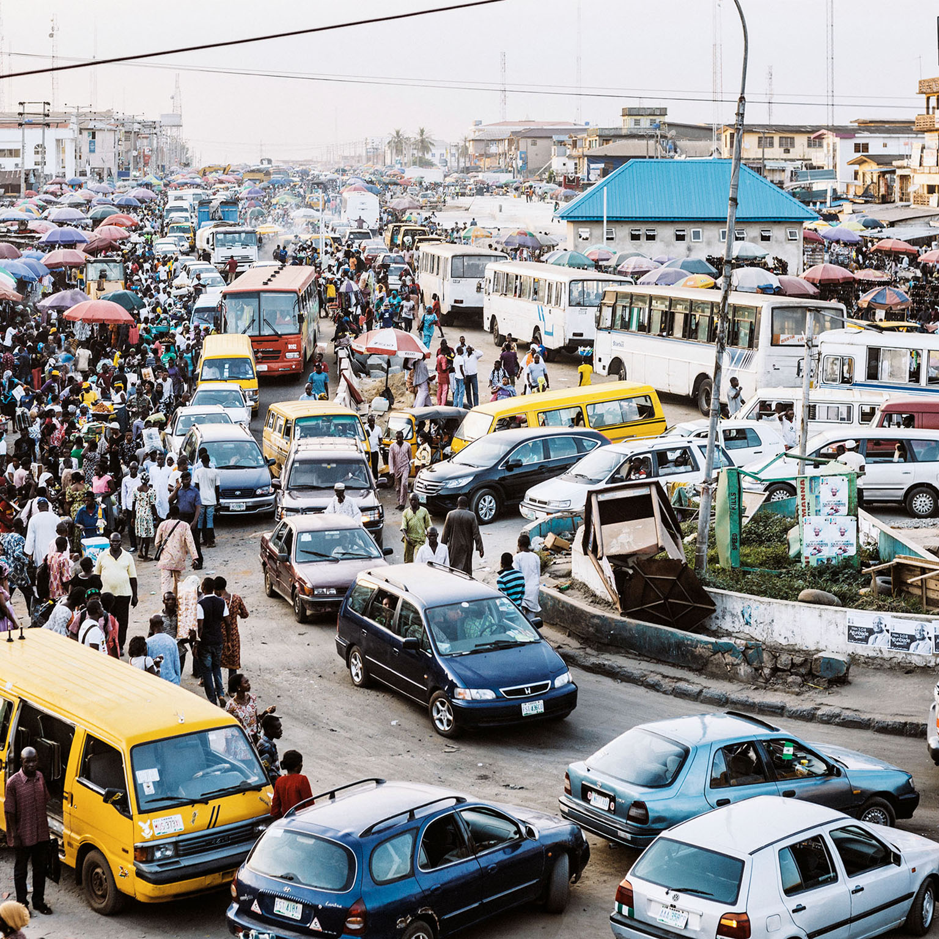
Importance socio-économique du transport
Transport and Urbanisation
  Transport influences :
    Ville croissance et land use
    Housing location choices
    Économique zones et job centers
    Qualité of urbain life
  African Context :
    Rapide urbain expansion
    Reliance on informel transport
    Lack of integrated planification
    Congestion et pollution increasing
Notes:
As African cities grow, transport shapes their structure. In Kinshasa, informal settlements expand far from the city center, creating long commutes. In Douala, lack of coordinated planning results in congestion hotspots. Transport systems must evolve to support sustainable, inclusive urbanization

Slide 34
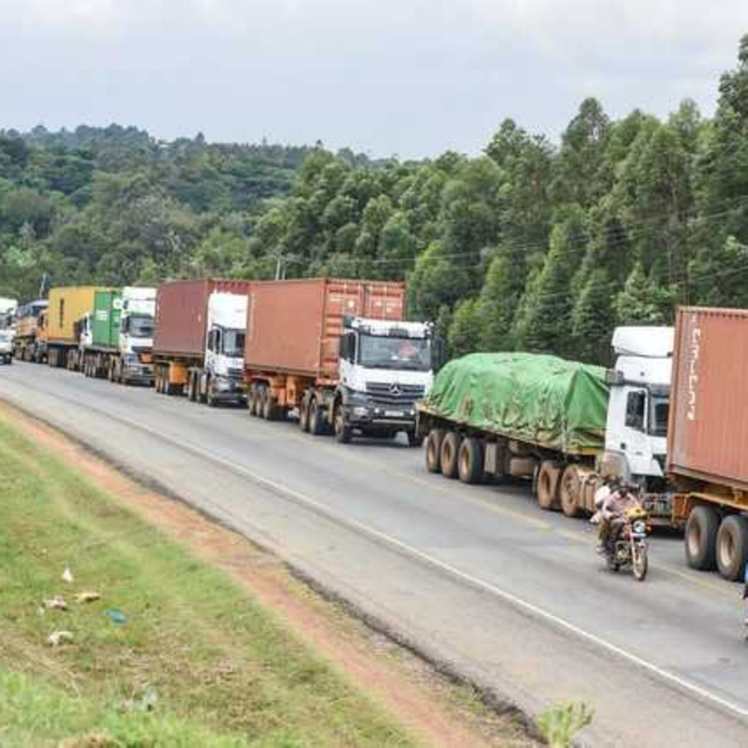
Importance socio-économique du transport
Transport and Régional/Mondial Intégration
  Le transport permet :
    Export et import flows
    Régional cooperation
    Participation in mondial markets
    Cross-border mobilité
  African Context :
    Ports like Douala relier Central Africa globally
    Congo River relie remote régions
    Poor connectivity limites commerce potential
    Investments from mondial partners (EU, China, AfDB)
Notes:
Modern transport systems link countries to global markets. Cameroon’s port of Douala is the main access point for Chad and the Central African Republic. DR Congo’s river system allows movement across vast distances where roads are absent. However, weak connectivity limits competitiveness. Regional integration efforts—such as corridors and cross-border infrastructure—are critical for Africa’s economic future.

Slide 35
Introduction aux systèmes de transportPlan :
Aperçu des systèmes de transport
Évolution historique
Composants : infrastructure, véhicules, usagers
Importance socio-économique
Études de cas : rôle dans l’urbanisation et la mondialisation

Slide 36
Études de cas – rôle du transport dans l’urbanisation et la mondialisation
Transport as an Engine of Urbain Croissance
  Transport façonne urbanisation by :
    Attracting personnes to villes
    Enabling économique clusters
    Expanding residential areas
    Linking suburbs to ville centers
  Cas Study Focus :
    DR Congo
    Cameroon
Kinshasa Boulevard du 30 Juin
Notes:
Transport drives how cities grow. When transport links improve, people move closer to opportunities, and businesses cluster around accessible areas. DRC and Cameroon will be used for examples of case studies.

Slide 37
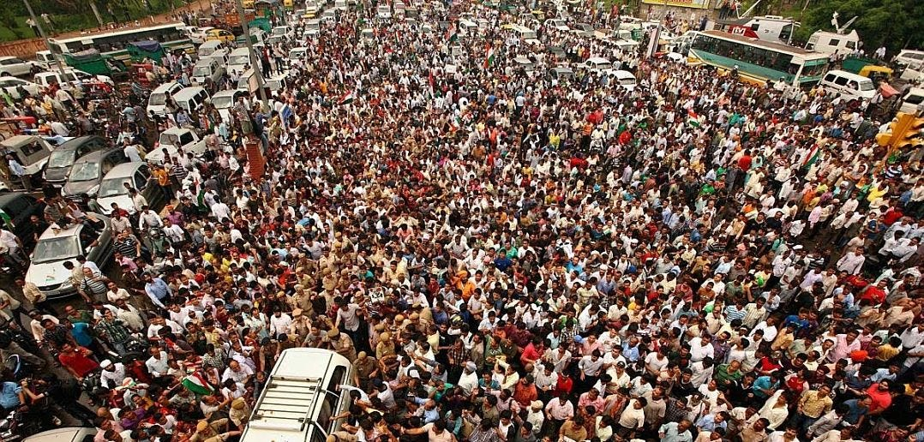
Études de cas – rôle du transport dans l’urbanisation et la mondialisation
Kinshasa : Transport Défis in a Megacity
  Kinshasa (17+ million personnes) :
    Dependence on informel transport (bus, taxis, motorbikes)
    Congestion et longs temps de trajet
    Limité route density
    Rapide suburban expansion
  Urbanisation Effect :
    Transport gaps push housing further outward
Uganda-Kampala
Notes:
Kinshasa is one of Africa’s largest cities, yet it lacks a mass transit system. People rely heavily on informal modes—‘ketch’, taxi-buses, motorcycles. Congestion is severe, and travel from suburbs can take hours. Transport shortages are both a cause and consequence of uncontrolled urban growth

Slide 38
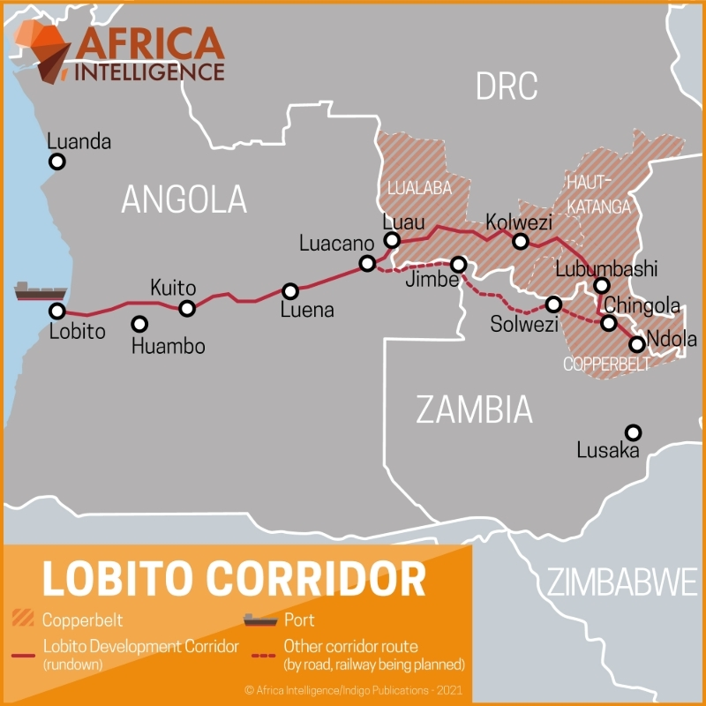
Études de cas – rôle du transport dans l’urbanisation et la mondialisation
Cas Study : Lobito Corridor (DRC–Angola)
  Lobito Corridor (Benguela Railway + Lobito Port) :
    New Atlantic gateway for DRC’s Copperbelt
    Faster export route for copper et cobalt
    Modernized railway reduces transport temps et coût
    Boosts competitiveness in mondial EV battery markets
    Promotes urbain et économique croissance along Kolwezi–Dilolo–Luau–Lobito axis
  Socio-Economic Impact :
    Stimulates mining towns in southern DRC
    Expands logistique hubs in Angola and DRC
    Attracts large foreign investment (EU, US, AfDB).
Notes:
The Lobito Corridor is currently one of Africa’s most strategic transport developments. By connecting Kolwezi and the DRC Copperbelt directly to the Atlantic, it dramatically reduces export time for cobalt and copper—resources essential for the global electric vehicle and battery industry. This project enhances the DRC’s position in global supply chains and stimulates new urban growth along the route, especially in Kolwezi and Dilolo. It also reduces dependence on longer routes through South Africa or Tanzania.

Slide 39
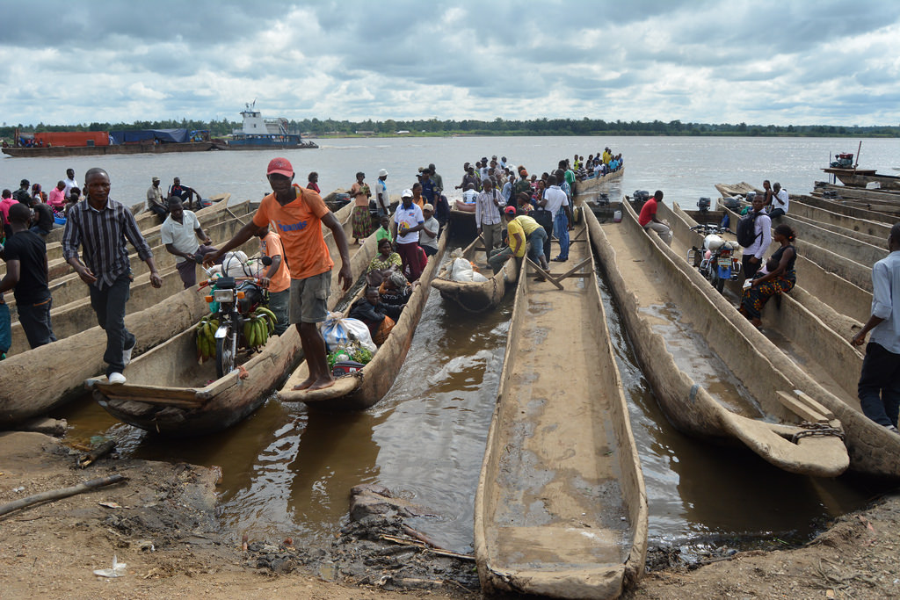
Études de cas – rôle du transport dans l’urbanisation et la mondialisation
Cas Study : Congo River Transport Système (DRC)
  Congo River Système :
    4,700+ km navigable voies navigables
    Majeur transport artery linking remote provinces
    Clé nodes : Kisangani, Mbandaka, Kinshasa, Boma
    Soutient commerce, food offre, migration et urbain markets
  Urbanisation Role :
    Villes develop along river ports
    Eau transport compensates for weak route réseaux
Notes:
The Congo River is one of Africa’s most important transport systems. It connects several provinces that are otherwise inaccessible by road. River boats transport food, construction materials, fuel, and people between cities like Kisangani, Mbandaka, and Kinshasa. This supports the growth of river cities and helps stabilize food supply. River transport is vital because many DRC provinces remain isolated during rainy seasons due to poor road conditions.

Slide 40
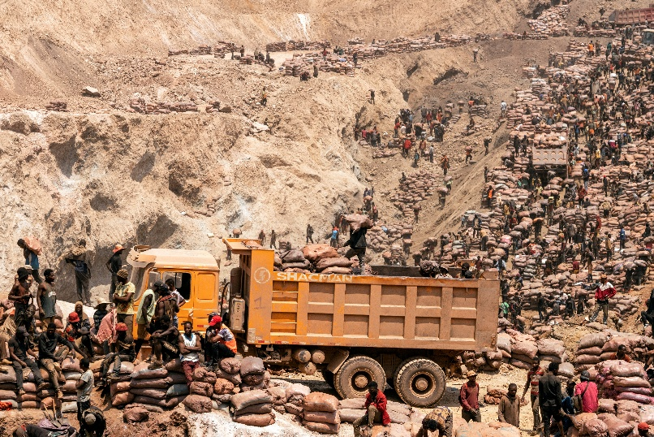
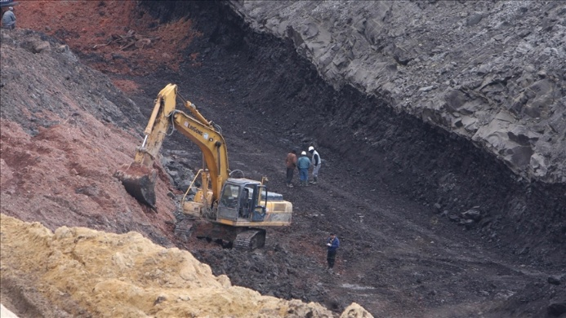
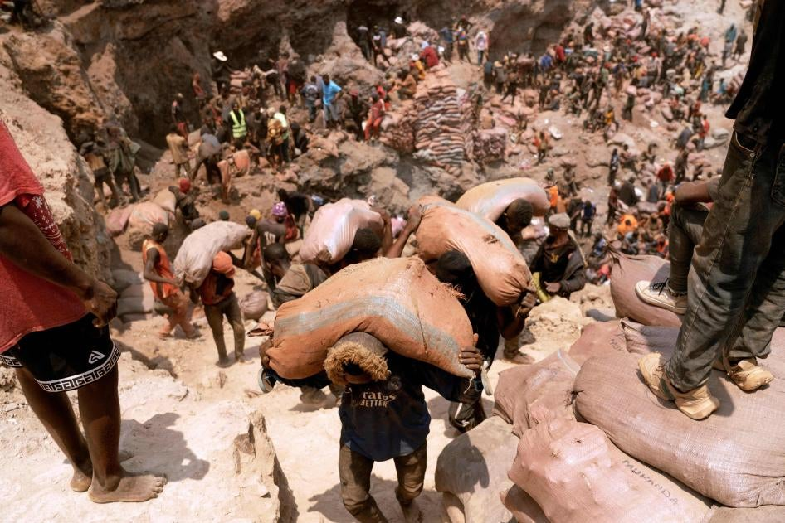
Études de cas – rôle du transport dans l’urbanisation et la mondialisation
Cas Study : Mining Corridors et Border Commerce (DRC – East et South)
  Clé Corridors :
    Kasumbalesa (DRC–Zambia) : Copper et cobalt exports
    Goma–Gisenyi (DRC–Rwanda) : Cross-border markets
    Bukavu–Cyangugu corridor : Agriculture et commerce
    Uvira–Bujumbura (DRC–Burundi) : Lake Tanganyika shipping
  Urbanisation Impact :
    Border villes grow around transport et commerce
    Logistique and transport services développer
    Mining trafic drives économique activity
Notes:
In eastern and southern DRC, transport corridors shape entire economies. Kasumbalesa is one of Africa’s busiest mining border crossings, generating significant revenue and attracting thousands of workers. Cities like Goma and Bukavu grow due to intense cross-border trade with Rwanda and Burundi. Transport here acts as a catalyst for commerce, urban employment, and regional integration.

Slide 41
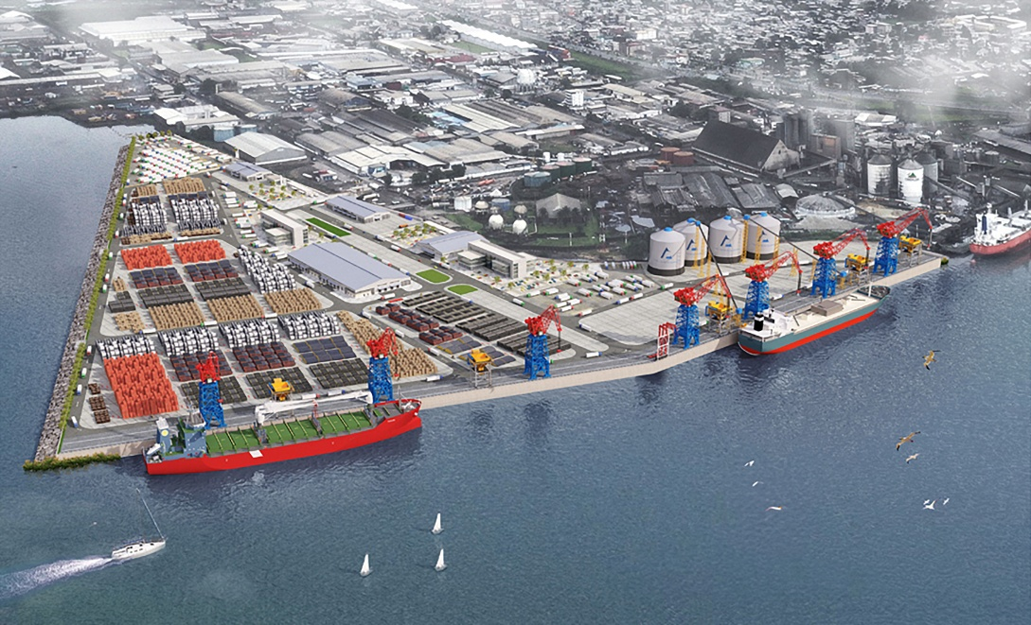
Études de cas – rôle du transport dans l’urbanisation et la mondialisation
Cas Study : Douala Port et Central African Commerce (Cameroon)
  Douala Port :
    Principal gateway for Central Africa (Chad, VOITURE, Congo-Brazzaville)
    Handles the majority of Cameroon's imports/exports
    Clé corridors : Douala–Bafoussam–Ngaoundéré ; Douala–Yaoundé
    Logistique and transport industries cluster around the port
  Mondialisation Impact :
    Integrates Cameroon into international shipping
    Soutient landlocked économies
    Drives rapide urbain expansion in Douala
Notes:
Douala Port is the economic heart of Cameroon and a vital link for Central Africa. It handles cargo not only for Cameroon but also for Chad and the Central African Republic. This international role shapes city growth, attracts industries, and stimulates urban migration. The heavy movement of trucks and goods along the Douala–Ngaoundéré corridor demonstrates how transport infrastructure drives regional development and globalization.

Slide 42

Études de cas – rôle du transport dans l’urbanisation et la mondialisation
Cas Study : Northern Transport Corridor et Agricultural Commerce (Cameroon)
  Northern Corridor :
    Garoua–Ngaoundéré–Maroua axis
    Soutient agricultural commerce (cotton, livestock, cereals)
    Links to Chad and Nigeria
    Relies on routes, rail (Camrail), and informel transport réseaux
  Urbanisation Impact :
    Market towns grow along the corridor
    Transport drives rural–urbain connectivity
    Soutient régional food offre chains
Notes:
In northern Cameroon, transport corridors play a crucial role in agricultural trade. The Garoua–Ngaoundéré–Maroua axis supports cotton, livestock, and cereal markets, connecting farmers to national and international buyers. Urban centers such as Maroua and Garoua depend on these routes for economic activity and mobility. These corridors also strengthen links with Chad and Nigeria, making the region more integrated and resilient.

Slide 43
Conclusion
Quoi We Learned in This Chapter
  Throughout this course, we developed a solid understanding of :
    The composants of transport systèmes : infrastructure, véhicules, usagers
    The socio-economic role of transport in développement
    The environnemental impacts : air pollution, GHG émissions, climat change
    The diversity of transport modes and their urbain et mondial roles
    Mobilité comportement and the cultural/social facteurs that shape déplacement choices
Notes:
In this chapter, we examined how transport systems function and why they matter. We explored infrastructure, vehicles, and users—not as isolated elements but as interconnected components that influence economic growth and quality of life. We also discussed environmental challenges, from local air pollution to global climate impacts, and considered the transition toward greener, climate-neutral mobility. Finally, we looked at different transport modes and how people choose between them based on cultural, economic, and social realities, particularly in African contexts

Slide 44
Conclusion
We also built skills to :
  Moving Forward : Planification, Evaluation et Mondial Intégration :
    Comprendre transport planification, politique et gouvernance
    Évaluer transport systèmes (qualité, coût, vitesse, accessibilité)
    Analyser économique, social et environnemental impacts of mobilité
    Recognize the importance of logistique in mondial offre chains
    Soutenir durable, integrated transport solutions for the future
    Clé Message :Transport systèmes shape développement — and your expertise can shape transport systèmes.
Notes:
As we conclude, remember that transport is much more than movement—it shapes economies, cities, social inclusion, and environmental futures. You learned how planning and policy guide decisions, how to evaluate systems using real criteria, and how logistics connect Africa to global supply chains. Whether in the DRC, Cameroon, or anywhere in the world, you now have the tools to understand and contribute to sustainable, inclusive, and efficient transport systems. The next step is using this knowledge to create real solutions in your communities

