Slide 1
Traffic Engineering
Exercise 4.1: Traffic Control Devices: Signs, Signals, and Road Markings

Slide 2
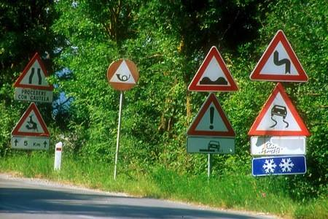
Exercise
Carefully observe the image on the left. Describe what you see and identify any problems related to traffic signs. Explain why these issues are problematic and propose a practical solution to improve the situation.
Make a site visit to major roads in your city and identify locations where road markings are improperly marked or missing. Examine the existing traffic signs and document your observations with photographs. Evaluate the identified problems and discuss appropriate solutions and improvements.

Slide 3
Exercise
Does your country have an official traffic signs and road markings manual? If yes, describe its main features and objectives. Compare it with at least one international standard, highlighting similarities, differences, and areas of alignment or deviation.
If your country does not have a dedicated traffic signs manual, identify the standard currently used by road authorities for road signage. Select one regional or international standard (e.g., Germany’s road traffic regulations, the MUTCD of the United States, or UK standards) and compare it with at least one other country’s system in terms of design, color coding, symbols, and application.

Slide 4
Reference
https://mutcd.fhwa.dot.gov/kno_11th_Edition.htm
https://www.gov.uk/government/publications/traffic-signs-manual

