Slide 1
Traffic Engineering
Lecture 3.3: Speed, travel time, and delay studies

Slide 2
Learning objectives
Understand traffic volume concepts
Differentiate volume, demand, and capacity
Explain temporal traffic variation patterns
Apply concepts to intersection and network studies

Slide 3
Lecture outline
Fundamental Concepts
Spot Speed Studies
Travel Time Studies
Methods of Travel Time Studies
Basic reference:
Roger P. Roess; Elena S. Prassas; William R. McShane, Traffic Engineering, 5th edition, Pearson, 2019

Slide 4
Fundamental Concepts
Speed, Travel Time, and Delay
  are primary performance indicators for traffic facilities.
  Reflect the motorist's experience of how long it takes to travel between two points.
  Speed and travel time are inversely related; however, they are measured under different conditions.
  Speed at a point (free-flow) and travel time over a distance (congested)

Slide 5
Fundamental Concepts
  Delay is the portion of travel time beyond free-flow conditions.
  Delay represents the time lost while traveling due to various impediments.
  At signalized and STOP-controlled intersections, it includes
    Stopped-time delay,
    Approach delay,
    Time-in-queue delay,
    Control delay.

Slide 6
Spot Speed Studies
Measure vehicle speeds at a point or a short segment
Measured under free flow conditions (below 750-1000 veh/h/ln for freeways or 500 veh/h/ln for other facilities)
Resulted in a speed distribution plot and key parameters
    Average or time mean speed:
    Standard deviation
    85th percentile speed
    Median speed

Slide 7
Spot Speed Studies
Application of spot speed data,
Determine existing traffic operation and evaluation of traffic control device
Evaluate new or existing speed limit practice
Determine appropriate speed limits (85th percentile speed is commonly used)
Establish speed trends and policies
Traffic signal timing design
Investigation of high-accident location

Slide 8
Spot Speed Studies
Location for spot speed studies
    Mid-block of urban or rural highway sections
    Location with unique traffic conditions
    Locations with specific traffic engineering problems
Should be conducted during off-peak hours and free-flow conditions.
Minimum duration of 1 hour and sample size of 30 vehicles.

Slide 9
Method of Spot Speed Studies
The most common spot speed data collection methods are:
Stopwatch Method
Radar Gun Method
Pneumatic Road Tube Method

Slide 10
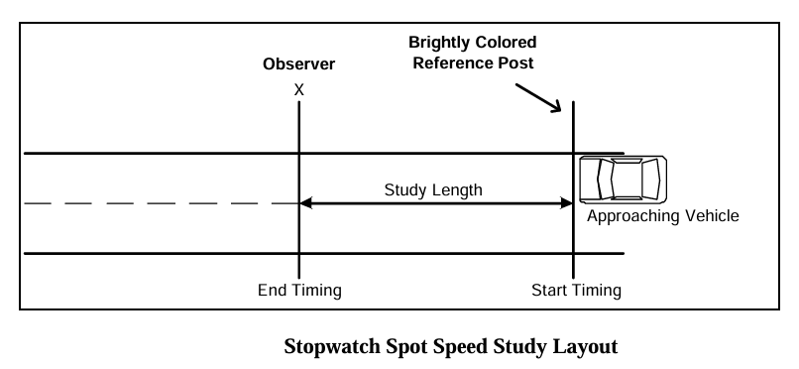
Stopwatch spot speed study
Stopwatch study includes the following steps:
  Decide appropriate study length (road segment)
  Select a proper location and layout
  Record observations of speed
  Calculate vehicle speed
  Generate a frequency distribution table and speed percentiles

Slide 11
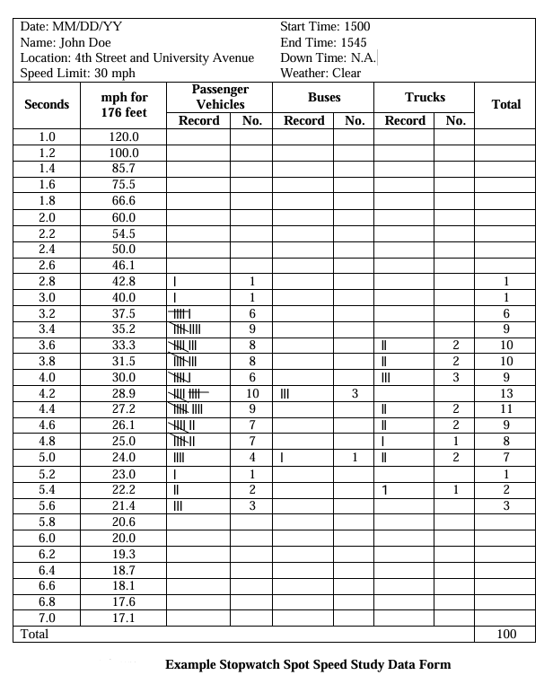
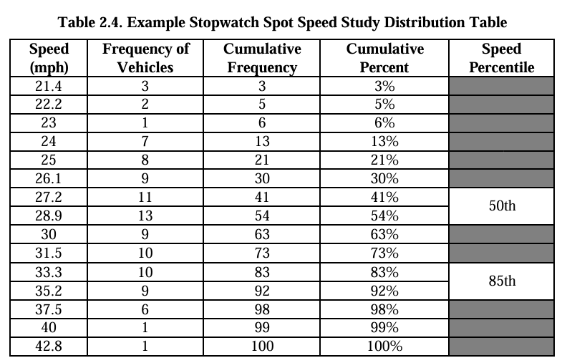
Source: Reference-1

Slide 12
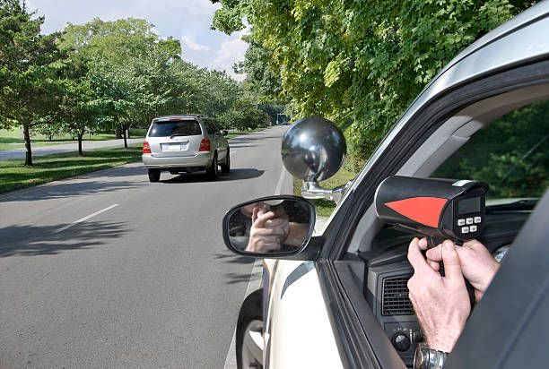
Radar Gun Method
Commonly used device for direct measurement of speed
Instantaneous: Provides real-time speed data immediately.
Portable: Handheld units are easy to transport and set up quickly.
However, the result could be biased due to target misidentification, drivers being aware, and the angle of measurement.

Slide 13
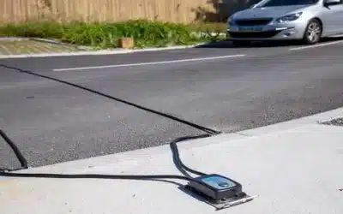
Pneumatic Road Tube Method
The pneumatic road tube method is normally used for longer data collection time periods,
Can also determine vehicle classification (cars vs. trucks) based on axle spacing

Slide 14
Travel Time Studies
Measure the time required to traverse a from one point to another on a given route
  Include moving and stopped time
Helps to identify congestion locations
  Evaluate the level of service
  Compare alternative routes

Slide 15
Applications of Travel Time Studies
Determination of route efficiency
Identification of traffic bottlenecks and high delay
Assessment of before-and-after traffic improvement
Congestion indexing
Economic evaluation of facilities
Compare alternative routes
Input for traffic assignment model

Slide 16
Methods of Travel time Studies
Floating Car Technique:
  A test car is driven by an observer along the test section,
  The driver of the test vehicle attempts to pass as many vehicles as those that pass his test vehicle,
  Travel time, stops, and delays are recorded during the trip, and the process is repeated.
  Simple, low-cost, and commonly used for urban corridor studies

Slide 17
Example
A traffic engineer wants to estimate the average travel time, speed, and delay on a 6.0 km urban corridor during the peak hour using the floating car technique. A test vehicle is driven so that it floats with the traffic stream. Five runs are conducted, and the total travel time and stopped delay for each run are recorded as shown below:
Determine the average travel time for the corridor.
Calculate the average stopped delay.
Calculate average moving time.
Find the average travel speed of traffic on the corridor.
Compute the average running speed (excluding stopped delay).
Run | Total travel time (min) | Stopped delay (min)
1 | 14.2 | 3.1
2 | 15.0 | 3.6
3 | 13.6 | 2.7
4 | 16.4 | 4.5
5 | 14.8 | 3.3

Slide 18
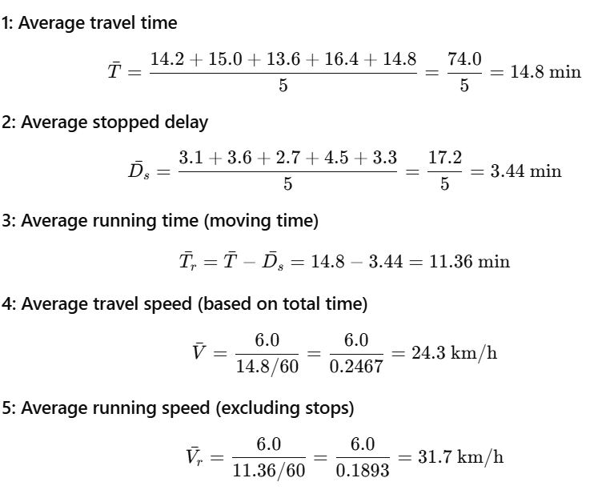

Slide 19
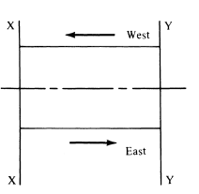
Methods of Travel time Studies
Average-Speed Technique
    involves driving the test car along the test section at the average speed of the traffic stream.
Moving-Vehicle Technique
    The observer makes a round trip on a test section
License-Plate Observations
    requires that observers be positioned at the beginning and end of the test section.
    Each observer records the last three or four digits of the license plate
ITS Advanced Technologies

Slide 20
Reference
https://popcenter.asu.edu/sites/g/files/litvpz3631/files/learning/speeding/SpotSpeed.pdf

