Slide 1
Traffic Engineering
Lecture 3.4: Origin-Destination Surveys and Travel Pattern Analysis

Slide 2
Learning objectives
Understand the concept of Origin–Destination surveys
Identify different O–D data collection methods
Explain how travel patterns are analyzed using O–D data
Recognize applications of O–D surveys

Slide 3
Lecture outline
Introduction
Origin–Destination Survey
Types of Origin–Destination Surveys
O–D Matrices
Travel Pattern Analysis

Slide 4

Introduction
Travel demand arises from the need to move between locations
Understanding where trips start and end is fundamental to transportation planning
Origin–Destination surveys provide this essential information

Slide 5

Introduction
The "Why": It answers four critical questions:
  Where do trips begin and end?
  What mode of transport is used?
  What is the purpose of the trip (Work, School, Leisure)?
  At what time do these movements occur?

Slide 6
Origin–Destination Survey
Key Terminology
    Trip origins (starting points)
    Trip destinations (ending points)
    Traffic Analysis Zones (TAZs): Geographic areas used to divide the study region into manageable units for data aggregation.
    Trip Generation: The total number of trips originating from or destined for a TAZ.

Slide 7
Origin–Destination Survey
Purpose of O–D Surveys
Basis for transportation planning and modeling
Helps understand travel demand and movement patterns
Supports the design of road networks, public transport, and traffic management schemes

Slide 8
Origin–Destination Survey
Applications of O–D Surveys
Traffic forecasting and demand modeling
Road and transit network planning
Traffic impact assessment
Parking and terminal planning

Slide 9
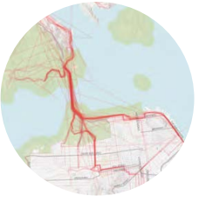
Origin–Destination Survey
Data Collected in O–D Surveys
Trip origin and destination
Trip purpose (work, education, shopping, etc.)
Mode of travel
Time of travel
Trip length and frequency
Additional socio-economic data

Slide 10
Types of Origin–Destination Surveys
Household O–D surveys
Roadside O–D surveys
License plate surveys
GPS- and mobile-based O–D surveys

Slide 11
Types of Origin–Destination Surveys
Household O–D Surveys
Conducted through interviews or questionnaires
Provide detailed socio-economic and trip information
Suitable for long-term planning studies

Slide 12
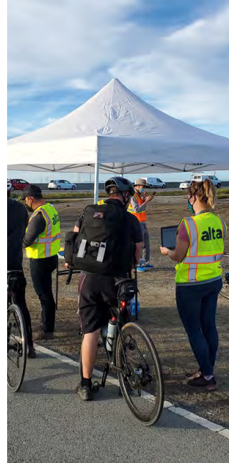
Types of Origin–Destination Surveys
Roadside O–D Surveys
The oldest OD study method requires little or no technology,
Drivers are stopped briefly and interviewed
Pros: High response rates, Data is available immediately,
Cons: cause disruption to traffic, safety hazards, and more staff and labor cost
Source: Reference-1

Slide 13
Types of Origin–Destination Surveys
License Plate Matching Surveys
License plates recorded at multiple locations or Automatic license plate recognition (ALPR) can be used
roadways need to be equipped with a vehicle sensor, camera, and image processor
Pros: Can have high detection rates, provides travel time information, and no manual labor or disruption to traffic
Cons: Costly, and privacy concerns

Slide 14
Types of Origin–Destination Surveys
GPS- and mobile-based O–D surveys
Captured when connected mobile devices transmit location data to third-party providers.
Location and speed data is transmitted in real-time,
providing accurate travel time information
Pros: No hardware or manual labor, no disruption of traffic,
Cons: privacy concerns

Slide 15
Types of Origin–Destination Surveys
Emerging/Modern O–D Data Collection Methods
GPS-equipped vehicles
Mobile phone location data
Smart card and ticketing data
Connected and probe vehicles
Advantages of Modern O–D Methods
Large data coverage
Real-time or near real-time information
Reduced need for manual surveys

Slide 16
O–D Matrices
Tabular representation of trips between zones
Rows represent origins, columns represent destinations
Each cell in the matrix indicates the volume of trips from one zone to another
Fundamental input for
  Trip distribution analysis
  Traffic assignment models
  Public transport planning
  Congestion and network performance evaluation

Slide 17
Traffic Analysis Zone in O–D Analysis
Study area divided into traffic analysis zones (TAZs)
Zones should be homogeneous in land use and travel characteristics
Each zone represents a trip origin and/or destination in travel demand models.
TAZs are the basic units used to collect, aggregate, and analyze Origin–Destination (O–D) data.
Smaller TAZs in dense urban areas
Larger TAZs in suburban or rural areas

Slide 18
Challenges in O–D Data Analysis
Data accuracy and completeness
Expansion of sample data to the population level
Integration of multiple data sources

Slide 19
Limitations of O–D Surveys
High cost and time requirements
Problem is proper Sampling
Response bias
Privacy and data protection concerns

Slide 20
Travel Pattern Analysis
Examines how, when, and why people travel
Focuses on:
    Trip purpose
    Mode choice
    Temporal distribution
    Spatial distribution

Slide 21
Travel Pattern Analysis
Trip Purpose Analysis
Work trips:
    Daily commuting trips between home and workplace,
    Major contributor to peak-hour traffic demand
Education trips:
    Trips made to schools, colleges, and universities
    Often concentrated in morning and afternoon peak periods

Slide 22
Travel Pattern Analysis
Trip Purpose Analysis
Shopping and social trips:
    Trips for commercial activities, leisure, and personal visits
    More flexible in time and spread throughout the day
Freight and service trips:
    Trips related to goods delivery, logistics, and service vehicles
    Important for economic activity and affects roadway capacity due to heavy vehicles

Slide 23
Travel Pattern Analysis
Mode Choice
Private vehicles: Includes cars and motorcycles
      Preferred for flexibility, privacy, and direct travel, but contributes to congestion
Public transport: Includes buses, trains, and metro systems
      Efficient for moving large numbers of people, especially in urban areas
Walking and cycling:
      Common for short-distance trips
      Environmentally friendly and supports sustainable mobility
Modal selection Influencing factors include cost (fuel, fare, parking fees), time (travel time, waiting time, and delay), comfort and accessibility

Slide 24
Travel Pattern Analysis
Share of transport modes in traffic volume, Germany

Slide 25
Reference
https://www.smatstraffic.com/blog/5-origin-destination-study-methods
https://mtc.ca.gov/planning/transportation/regional-transportation-studies/origin-destination-study

