Slide 1
Traffic Engineering
Lecture 5.2: Capacity and Level of Service (LOS) Analysis -1

Slide 2
Learning objectives
At the end of this lecture, students should be able to:
Define uninterrupted flow facilities and describe their characteristics
Explain the concept of highway capacity and factors affecting it
Define Level of Service (LOS) and interpret LOS grades A–F
Identify the measures of effectiveness (MOEs) for different facilities
Discuss the limitations of LOS as a performance indicator

Slide 3
Lecture outline
Introduction
LOS Determination Process
Step 1 – Base Conditions
Step 2 – Determining Free-Flow Speed (FFS)
Step 3 – Determining Analysis Flow Rate
Step 4 – Service Measure(s) and LOS
Basic reference:
Roger P. Roess; Elena S. Prassas; William R. McShane, Traffic Engineering, 5th edition, Pearson, 2019 (Chapter 13, pp 275-284)

Slide 4
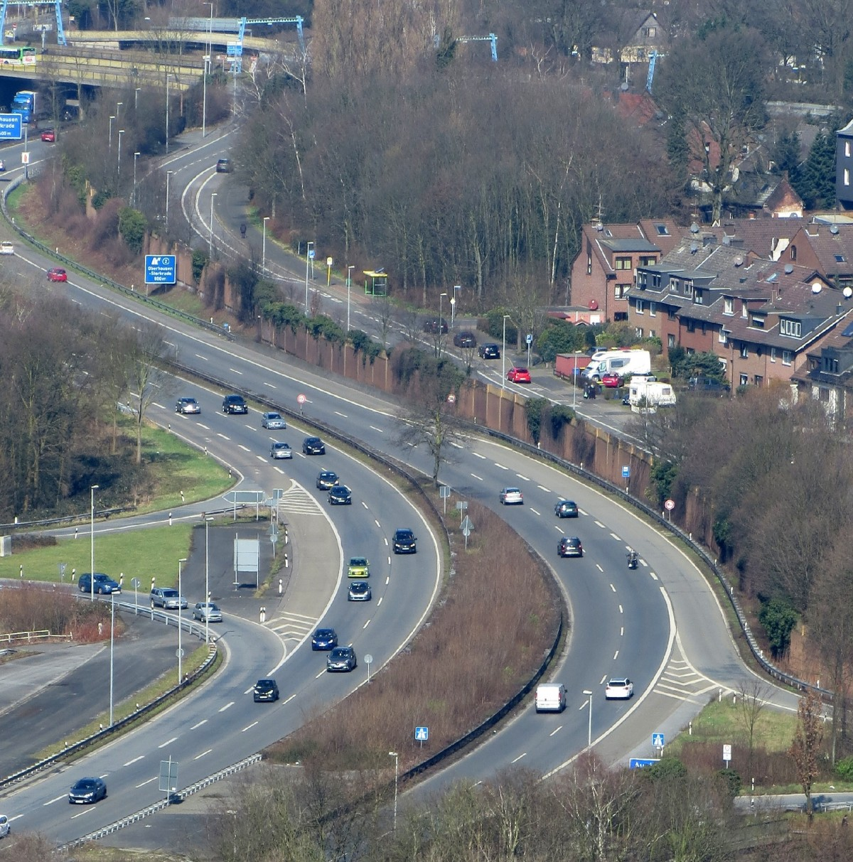
Introduction
Level of Service (LOS) analysis is used to describe the operating quality of a roadway facility.
For uninterrupted-flow facilities such as freeways and multilane highways, LOS is mainly determined based on:
    Speed
    Flow rate
    Density
    Volume-to-capacity ratio
The LOS determination follows a systematic step-by-step process.

Slide 5

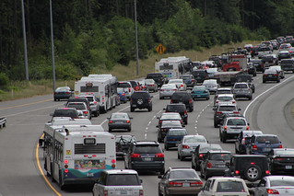

Introduction
How can we systematically determine the LOS of the following traffic?
Figure -1
Figure -2
Figure -3

Slide 6
LOS Determination Process
The basic LOS determination procedure for uninterrupted flow facilities includes:
    Specify base roadway conditions and capacity
    Determine free-flow speed (FFS)
    Determine Analysis Flow Rate
    Compute service measure(s) and determine LOS

Slide 7
LOS Determination Process
Step 1 – Base Conditions
Base roadway conditions include geometric characteristics such as:
    Lane width
    Lateral clearance
    Shoulder width
    Access frequency
    Terrain conditions (level/rolling/mountainous)
  These factors strongly influence operating speed and capacity.

Slide 8
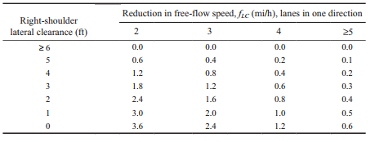
LOS Determination Process
Step 1 – Base Conditions
Source: Principles of Highway Engineering and Traffic Analysis, 5th Edition, (PP 185)

Slide 9
LOS Determination Process
Step 1 – Base Conditions
Traffic Stream Factors in Base Conditions assumes
    Passenger cars only
    No heavy vehicles (trucks, buses, RVs)
    The driver population is mostly familiar with the roadway
    When real traffic differs, adjustment factors must be applied.

Slide 10
LOS Determination Process
Step 1 – Base Conditions
The roadway segment has maximum capacity only when:
    Roadway conditions meet base standards
    Traffic stream conditions meet base standards
    Increasing conditions beyond base values does not increase capacity.
    Restrictive conditions below base values reduce capacity.
    Example: lane width above 12 ft does not increase capacity, but lane width below 12 ft reduces capacity.

Slide 11
LOS Determination Process
Step 1 – Base Conditions
Example: Base Conditions for Freeway Segments include
    12-ft lanes
    6-ft right shoulder lateral clearance
    2-ft median clearance
    Passenger cars only
    More than 5 lanes per direction (urban case)
    2-mile or greater interchange spacing
    Level terrain (≤2% grades)
    Familiar driver population

Slide 12
LOS Determination Process
Step 2 – Determining Free-Flow Speed (FFS)
Free-flow speed (FFS) is defined as the mean speed of traffic as density approaches zero.
FFS depends on:
    Roadway geometry
    Access points
    Driving environment complexity
    Speed limit and driver behavior

Slide 13
LOS Determination Process
Step 2 – Determining Free-Flow Speed (FFS)
Two methods to determine FFS
  Direct field measurement (preferred)
  Estimation method
    Start with base free-flow speed (BFFS)
    Apply adjustment factors for roadway characteristics
  BFFS represents the free-flow speed under ideal conditions.

Slide 14
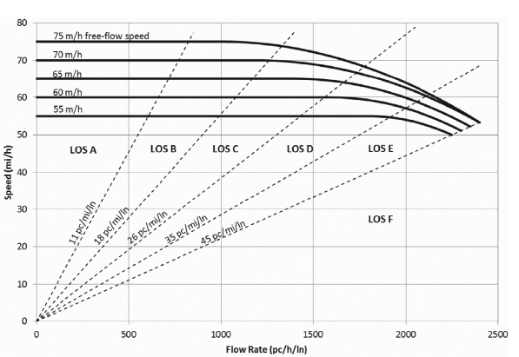
LOS Determination Process
Step 2 – Determining Free-Flow Speed (FFS)
  BFFS represents the free-flow speed under ideal conditions.
Source: Principles of Highway Engineering and Traffic Analysis, 5th Edition, (PP 182)

Slide 15

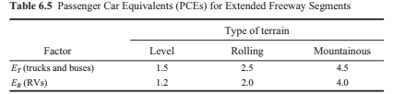
LOS Determination Process
Step 2 – Determining Free-Flow Speed (FFS)
Source: Principles of Highway Engineering and Traffic Analysis, 5th Edition, (PP 184, 187)

Slide 16
LOS Determination Process
Step 3 – Determining Analysis Flow Rate
The highest volume in a 24-hour period should be adjusted for
  The temporal variation of traffic demand within the analysis hour,
  The impacts due to heavy vehicles and
  Characteristics of the driving population
  Therefore, we convert V into a passenger car flow rate

Slide 17
LOS Determination Process
Step 4 – Service Measure(s) and LOS
After determining:
    Free-flow speed (FFS)
    Analysis flow rate (vp)
Compute the service measure (MOE), such as:
    Density (freeways)
    Speed
    v/c ratio
  Then determine LOS using LOS criteria tables or graphs.

Slide 18
Additional references
Transportation Research Board (TRB). Highway Capacity Manual, Washington, DC: The National Academies Press, 2010.
https://www.youtube.com/watch?v=V3bEdLs_8pE&t=385s
https://www.sciencedirect.com/science/article/pii/S2352146516305324

