Slide 1
Traffic Engineering
Lecture 4.1: Traffic Control Devices: Signs, Signals, and Road Markings

Slide 2
Learning objectives
Understand traffic control devices
Explain types and functions
Apply to traffic safety and operations

Slide 3
Lecture outline
Importance of Traffic Control Devices
Classification of Traffic Control Devices
Road Marking
Traffic Signs
Traffic Signal
Basic reference:
Roger P. Roess; Elena S. Prassas; William R. McShane, Traffic Engineering, 5th edition, Pearson, 2019
https://mutcd.fhwa.dot.gov/

Slide 4
Introduction
Traffic control devices are used to regulate, warn, and guide road users.
help ensure safe, efficient, and orderly flow of traffic
Proper use of these devices:
    reduces conflicts,
    minimizes crashes, and
    improves overall traffic operations.

Slide 5
Importance of Traffic Control Devices
Traffic control devices play a vital role in:
Providing clear and consistent information to road users
Improving road safety for drivers, pedestrians, and cyclists
Reducing confusion and conflicts at intersections and along roadways
Supporting efficient traffic flow and enforcement of traffic laws

Slide 6
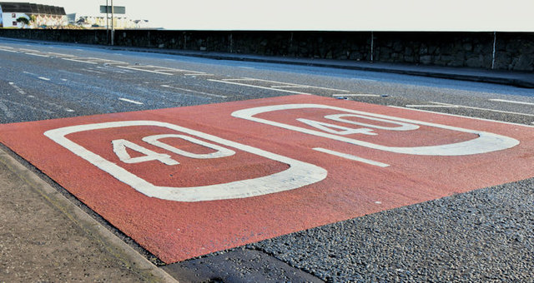
Classification of Traffic Control Devices
Traffic control devices are generally classified into three main categories:
Road markings
Traffic signs
Traffic signals
Each category serves a distinct but complementary function.

Slide 7
Road Marking
Functions of Road Markings
Guide vehicles along proper paths
Control lane usage and turning movements
Warn drivers of hazards and restrictions

Slide 8
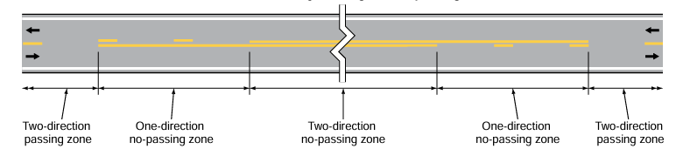
Road Markings
Types of Road Markings
Longitudinal markings: Center lines, lane lines, and edge lines
Transverse markings: Stop lines, yield lines, and crosswalks
Object and hazard markings: Highlight fixed objects and obstructions
Source: MUTCD, 11th Edition

Slide 9
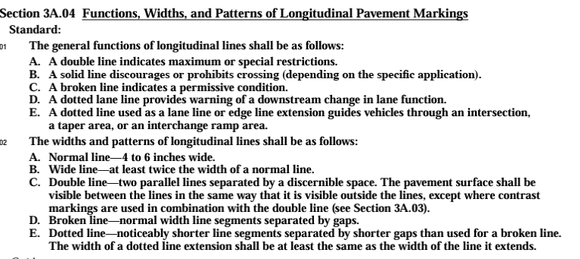
Road Markings
As per the MUTCD manual

Slide 10
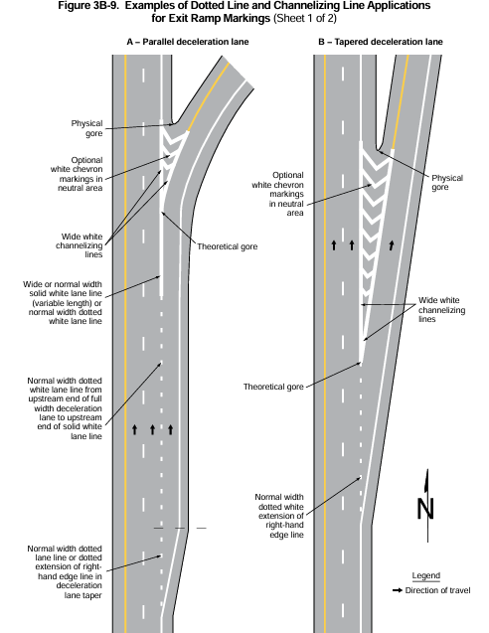
Road Markings -Example
Source: MUTCD, 11th Edition

Slide 11
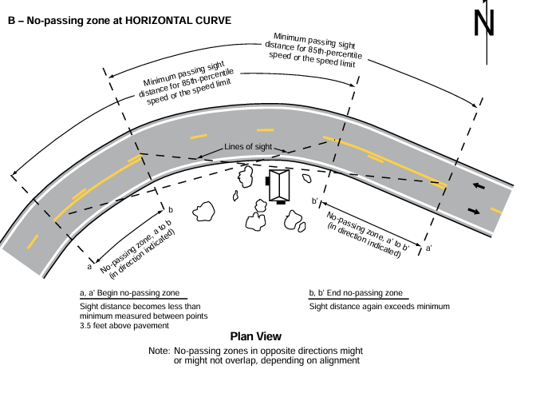
Road Markings -Example
Source: MUTCD, 11th Edition

Slide 12
Traffic Signs
Devices installed beside or above roads
Convey information using symbols, words, or both
inform road users of rules, potential hazards, and directions.
Functions of Traffic Signs
Regulate traffic movements (Regulatory signs)
Warn road users of hazards or changes in road conditions (Warning signs)
Guide drivers to destinations and services (Guide signs)

Slide 13
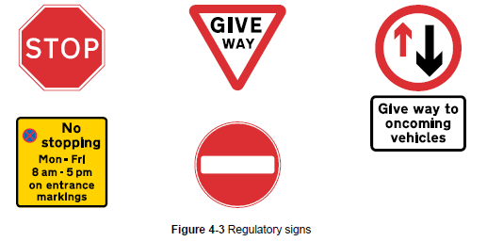
Traffic Signs
Regulatory Signs:
include all signs that give notice of requirements, prohibitions, or restrictions.
Mandatory compliance
Examples of Regulatory Signs
    Stop
    Yield
    Speed limit
Source: Traffic Sign Manual, UK

Slide 14
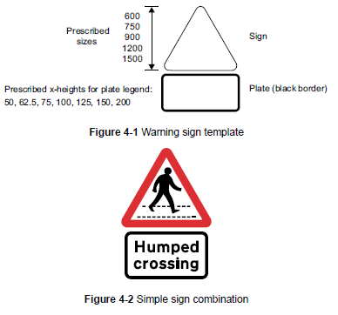
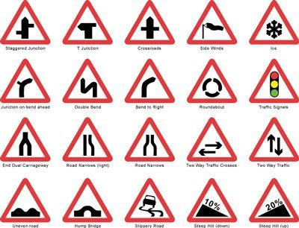
Traffic Signs
Warning Signs
Signs give warning of a hazard ahead
Alert road users and encourage caution
Generally triangular in shape, and with the exception of the Give Way warning sign
The size related to the design speed of the road
Source: Traffic Sign Manual, UK

Slide 15
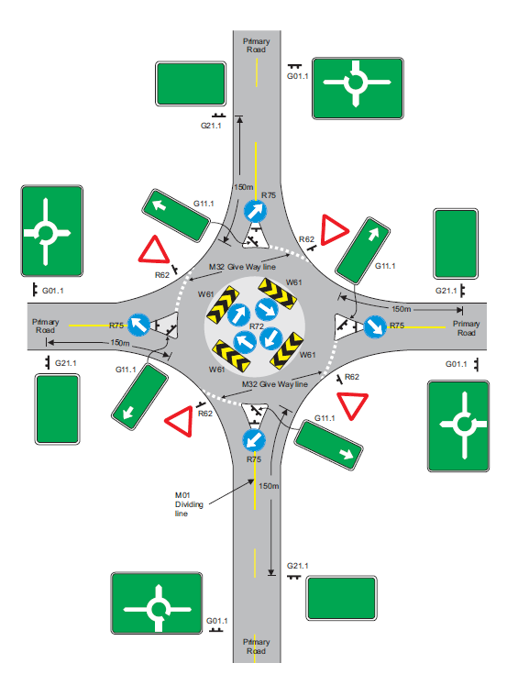
Traffic Signs
Guide Signs
Give road users information about a route or places and facilities of particular value or interest
Most guide signs are rectangular, including advance direction signs (ADS)
Source: Traffic Sign Manual, UNRA, Uganda

Slide 16
Traffic Signal
Are electrically operated devices used mainly at intersections,
Assign right-of-way among conflicting traffic movements.
Purpose of Traffic Signals:
    Reduce conflicts between traffic streams
    Improve intersection efficiency
    Enhance safety for vehicles and pedestrians

Slide 17
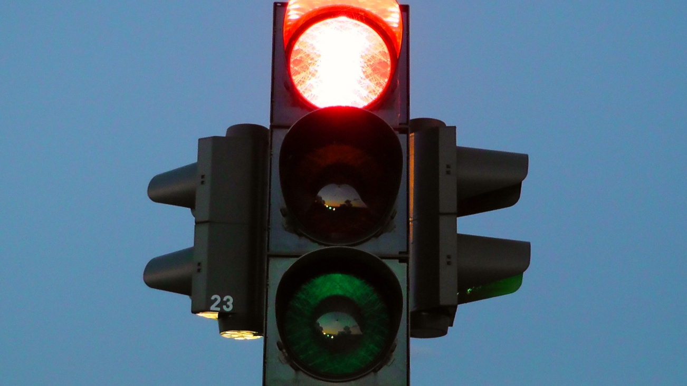
Traffic Signal
Signal Phases:
Green: go
Yellow: prepare to stop
Red: stop
Types of Traffic Signals
    Fixed-time signals: Operate on preset time cycles
    Vehicle-actuated signals: Adjust timings based on traffic demand

Slide 18
Traffic Signal
Signal Timing Concepts
Cycle length
  Total time required to complete one full sequence of signal phases
  Includes all green, yellow, and red intervals
Green split
  Portion of the cycle length allocated to a specific traffic movement
  Determines how long a movement receives a green signal
Offset
  Time difference between the start of green signals at successive intersections
  Used to coordinate signals and improve traffic progression along corridors

Slide 19
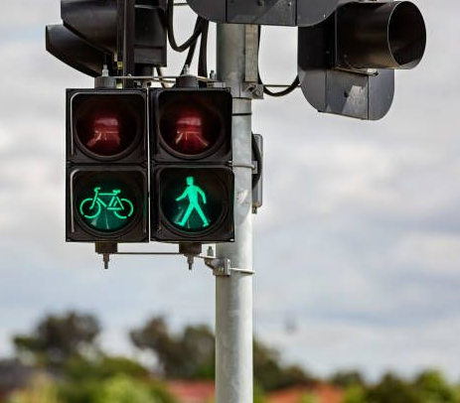
Traffic Signal
Pedestrian and Special Signals
Pedestrian crossing signals: Help separate pedestrian and vehicle movements, reducing conflicts
Flashing signals: Warn or control traffic under special conditions
Railroad crossing signals: Warn of approaching trains at rail–road crossings

Slide 20
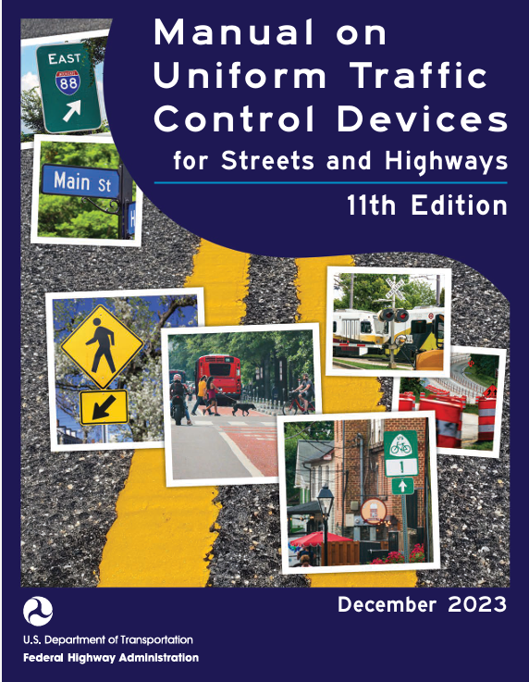
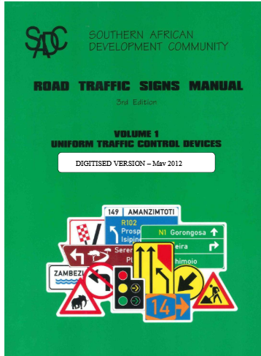
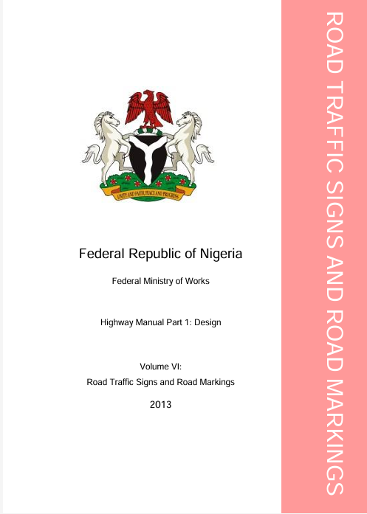
Standards and Manuals
Uniformity in traffic control devices is essential so that road users can quickly recognize and understand their meaning,
National and international standards ensure consistency in shape, color, size, and placement.
Many countries have their own traffic signs and traffic control devices manuals

Slide 21
Reference
https://mutcd.fhwa.dot.gov/kno_11th_Edition.htm
https://www.gov.uk/government/publications/traffic-signs-manual
https://www.youtube.com/watch?v=Qn753J46dMk

