Slide 1
Traffic Engineering
Lecture 5.4: Capacity and Level of Service (LOS) Analysis –3

Slide 2
Learning objectives
At the end of this lecture, students should be able to:
Identify freeway and multilane highway facility types
Compute LOS using density criteria
Estimate free-flow speed (FFS) for freeway and multilane segments
Adjust flow rates using PHF and heavy vehicle factors
Conduct capacity and LOS analysis using HCM methodology

Slide 3
Lecture outline
Uninterrupted flow facilities
Freeways
Multilane Highways
Base Speed–Flow Curves
LOS Criteria
Service flow rates and capacity
Determining Free-Flow Speed
Basic reference:
Roger P. Roess; Elena S. Prassas; William R. McShane, Traffic Engineering, 5th edition, Pearson, 2019 (Chapter 13, pp 275-284)

Slide 4
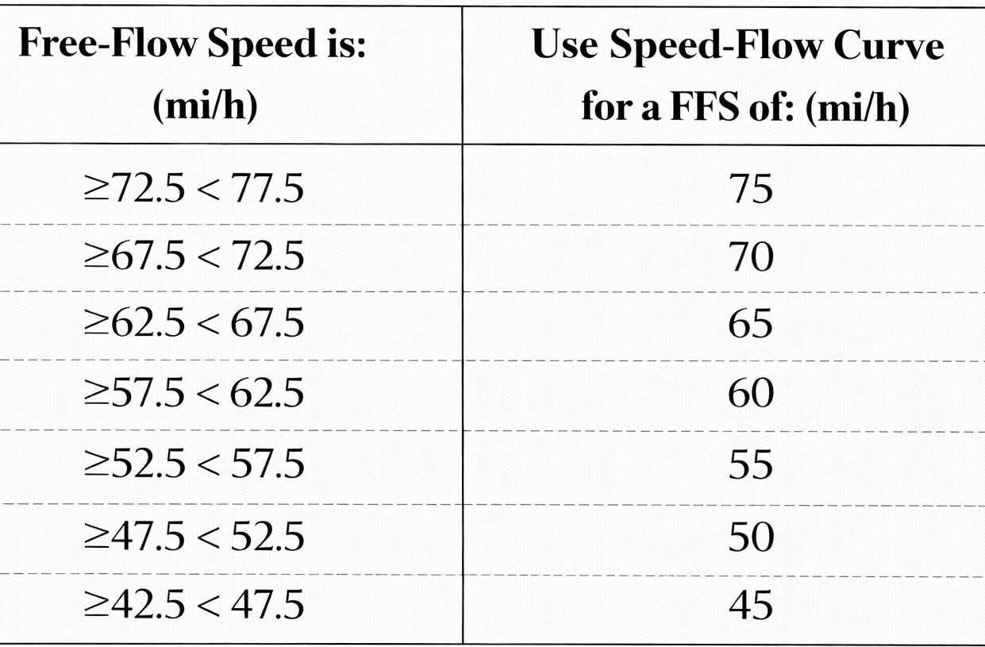
Determining Free-Flow Speed
Choosing the Correct FFS Curve
Do not interpolate curves.
Use the nearest curve as shown in the table.
  Example: In the previous examples, the free-flow speeds were estimated as 63.8 mi/h for the freeways (example 1) and 43.6 mi/h for the multilane highway (example 2). Determine the correct FFS curves.
  For free-flow speed 63.8 mi/h => FFS curve is 65 mi/h
  For free-flow speed 43.6 mi/h => FFS curve is 45 mi/h

Slide 5
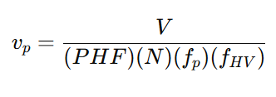
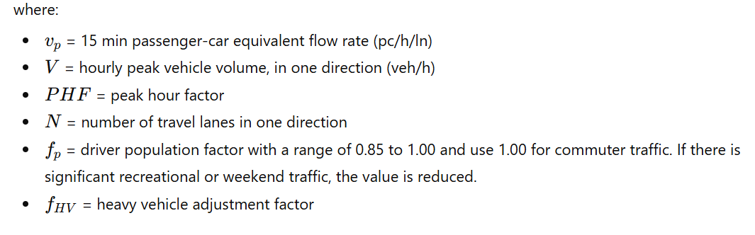
Calculate Analysis Flow Rate
This step includes the following tasks
  Adjust for PHF
  Adjust for vehicle mix
  Adjust for driver population

Slide 6
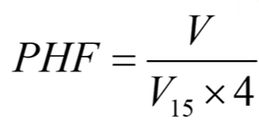
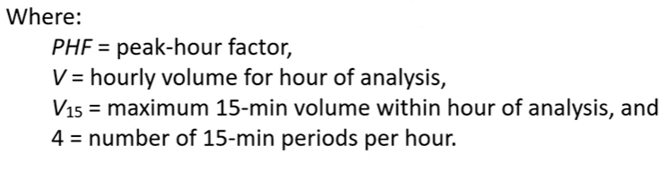

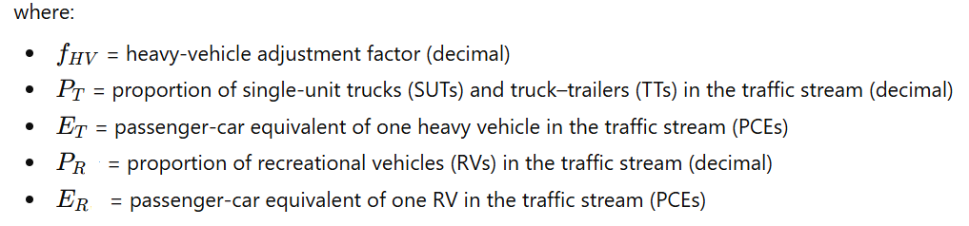
Calculate Analysis Flow Rate
Peak Hour Factor (PHF)
Heavy vehicle adjustment factor (f_{HV}):

Slide 7
Calculate Analysis Flow Rate
Passenger Car Equivalency (PCE) factor
    Two vehicle classes
      Trucks and Buses (T)
      Recreational vehicles (RVs)
    Passenger equivalence values
      1 Trucks = 2.5 passenger car
      1 RV = 2.0 passenger car
    However, for different terrains, the PCE values will be
      Level terrain: ET = 1.5, ER = 1.2
      Rolling terrain: ET = 2.5, ER = 2.0
      Mountainous terrain: ET = 4.5, ER = 4.0
    Detailed values of PCE are also available for different grades

Slide 8
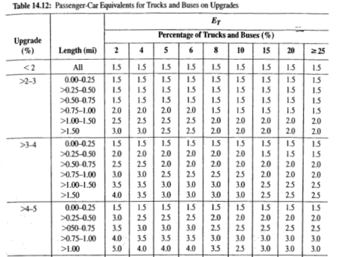
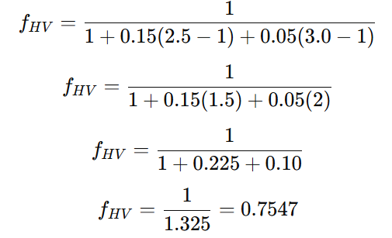
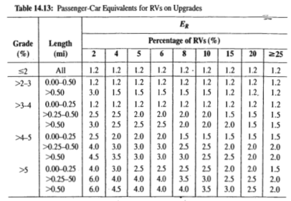
Example-3
Consider the following situation: A volume of 2,500 veh/h traverses a section of freeway and contains 15% trucks and 5% RVs. The section in question is a 5% upgrade, 0.75 miles long. What is the equivalent volume in passenger-car equivalents?
Solution:
first determine E_{T} =2.5 and E_{R} = 3.0 from the tables for 5% grade and a 0.75-mile length
The heavy-vehicle adjustment factor is computed as:

Slide 9

Example-3
Solution:
Hence, the passenger-car equivalent volume is estimated as:
Alternative Method (Direct Application of PCEs)
    The solution can also be found by applying passenger-car equivalents directly:
    Truck PCE: 2500 X 0.15 X2.5 = 938
    RVs PCE : 2500 X 0.05 X 3.0 = 375
    Passenger cars: 2500 X 0.80 X 1.0 = 2000
    Hence, Total PCE = 2000+ 375+ 938= 3,313

Slide 10
Calculate Analysis Flow Rate
Driver Population Factor (f_{p})
    The value for f_{p} ranges from 1.0 to 0.85.
    Consider 1.0 for commuter traffic (i.e., familiar road users)
    Unless there is sufficient evidence available, a value of 1.0 is generally used.
    Where future situations are analyzed, and recreational users dominate, a value of 0.85 is suggested.

Slide 11
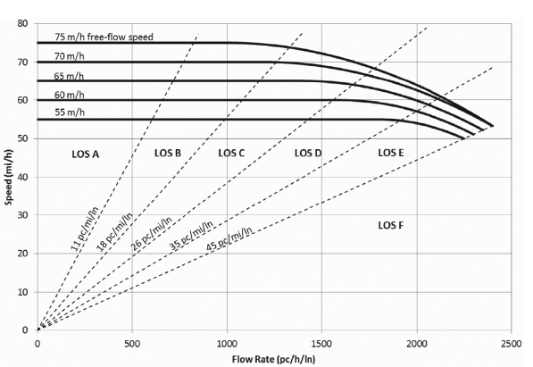
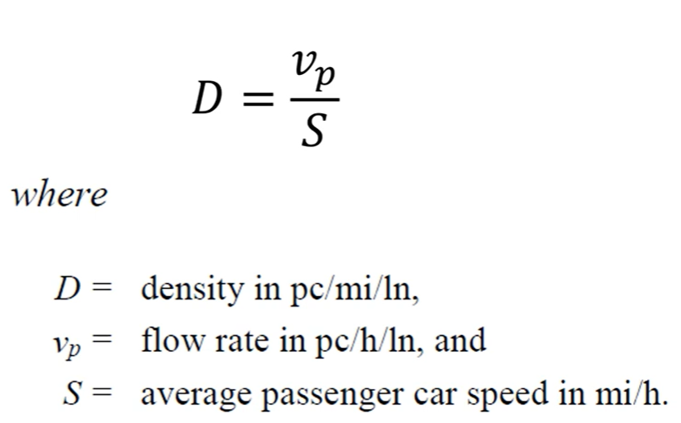
Calculate Density and LOS
Density

Slide 12
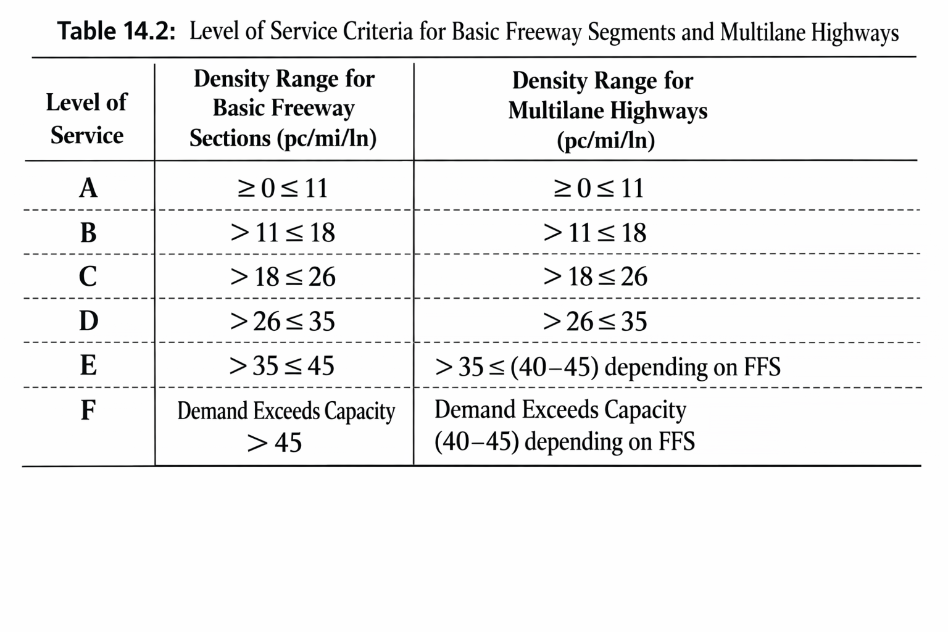
Calculate Density and LOS
LOS

Slide 13
Example-4
A six-lane urban freeway (three lanes in each direction) is on rolling terrain with 11-ft lanes, with obstructions 2 ft from the right edge of the traveled pavement, and 9 ramps within 3 miles upstream and 3 miles downstream of the midpoint of the analysis segment. The traffic stream consists primarily of commuters. A directional weekday peak-hour volume of 2300 veh/h is observed, with 700 vehicles arriving in the most congested 15-minute period. If the traffic stream has 15% large trucks and buses and no recreational vehicles, determine the level of service (LOS).

Slide 14
Example-4
Given:
    Lane width = 11 ft
    Right-shoulder lateral clearance=2 ft
    Heavy vehicle percentage = 15%
    No. of ramps within 3-mi upstream and downstream =9
    Terrain type = rolling
    Driver population = frequent commuters or familiar users

Slide 15





Example-4
Solution:
Step 1 — Estimate free-flow speed (FFS)
    For freeway FFS model:
      = 1.9 mi/h ( Lane adjustment for 11-ft)
      = 1.6 mi/h ( Adjustment for Lateral clearance of 2-ft)
      Compute total ramp density (TRD)
          There are 9 ramps within a total length of 3+3=6 miles.
          Hence,
    Accordingly, the appropriate FFS curve is the 65 mi/h curve

Slide 16




Example-4
Solution:
Step 2 — Determine the flow rate ( )
  Compute Peak Hour Factor (PHF)
  Heavy-vehicle adjustment factor ( )
  use equation

Slide 17


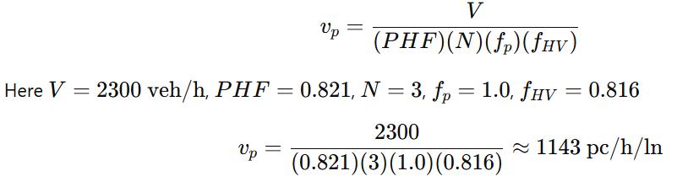
Example-4
Solution:
Step 2 — Determine the flow rate ( )
  Heavy-vehicle adjustment factor ( )
      However, P_{T}= 0.15, P_{RV} = 0
      For rolling terrain basic freeway segment, E_{T} = 2.5
      Hence,
    Driver population factor for commuters:
  Therefore, Passenger-car equivalent flow rate per lane will be:

Slide 18


Example-4
Solution:
Step 3 — Determine the Density and LOS
    For a basic freeway segment, LOS is determined primarily by density:
    At this moderate flow, the average speed is close to the free-flow speed; use S=65 mi/h
    Since D=17.6, the facility operates at: LOS =B
    Level of Service (LOS) = B (stable flow with slight restrictions; speeds near free-flow and moderate density).

Slide 19
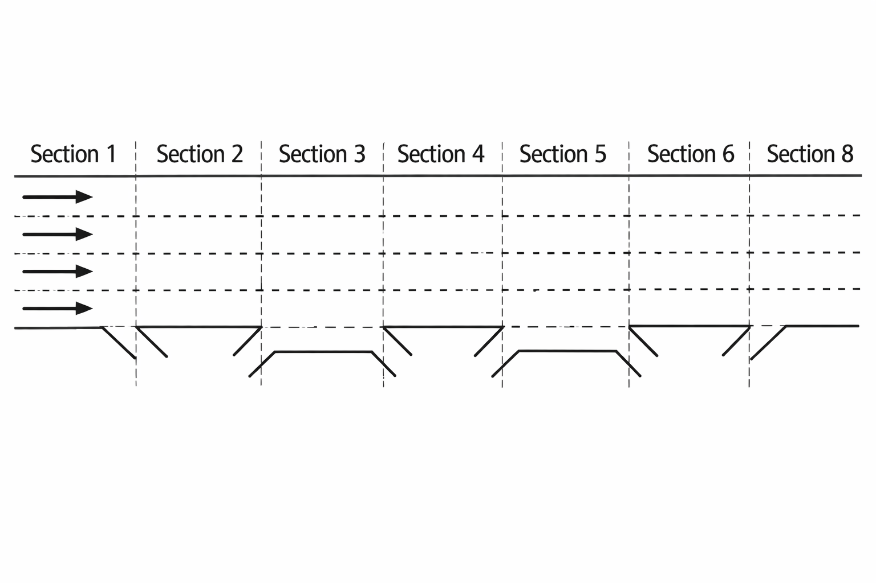
Exercise
Example:
Define the following freeway sections as basic, off-ramp (diverging), on-ramp (merging), or weaving.

Slide 20
Additional references
Transportation Research Board (TRB). Highway Capacity Manual, Washington, DC: The National Academies Press, 2010.
https://www.youtube.com/watch?v=V3bEdLs_8pE&t=385s
https://www.sciencedirect.com/science/article/pii/S2352146516305324

