Slide 1
Traffic Engineering
Lecture 5.4: Capacity and Level of Service (LOS) Analysis –3 Two-Lane Highway

Slide 2
Learning objectives
At the end of this lecture, students should be able to:
Estimate the demand volume for a two-lane highway
Field-adjust the measured free-flow speed for a two-lane highway
Estimate the free-flow speed of a two-lane highway
Calculate the average travel speed, percent time spent following, and percent free-flow speed
Determine the LOS for two-lane highways

Slide 3
Lecture outline
Introduction
Passing Sight Distance (PSD)
Capacity -Two-Lane Highway
Measures of Effectiveness (MOEs)
LOS Criteria
Free-Flow Speed Determination
Basic reference:
Roger P. Roess; Elena S. Prassas; William R. McShane, Traffic Engineering, 5th edition, Pearson, 2019 (Chapter 20, pp 461-484)

Slide 4

Introduction
Two-lane highways
form a major portion of rural road networks
Have one lane per direction
Usually undivided
Passing occurs using the opposing lane
Operations in one direction affect the other direction

Slide 5
Introduction
Unlike multilane highways, two-lane highways
Vehicles must overtake using the opposing lane
Passing depends on sight distance and opposing traffic
Platoons form easily
Congestion occurs at relatively low volumes
This makes the analysis unique compared to freeways or multilane highways.

Slide 6

Introduction
Two-lane highways serve:
Intercity mobility corridors
Rural collectors
Agricultural and resource routes
Remote access roads
Demand can range from very low (<100 veh/day) to heavy commuter volumes.
Free flow speed generally ranges from 45-65 mi/hr

Slide 7
Introduction
HCM defines three facility classes:
Class I: High-speed expectation, mobility routes
  Major intercity highways, commuter routes
Class II: Lower speed expectation, scenic/access routes
  Scenic roads, rugged terrain roads
Class III: Developed areas (main street), low speed, restricted passing
  Small towns, developed rural communities
These affect LOS criteria.

Slide 8

Passing Sight Distance (PSD):
Importance of Passing:
Passing is critical because:
  Slow vehicles create platoons
  Passing improves travel speed and reduces delay
  Limited passing increases driver frustration
  Unsafe passing increases crash risk
Passing sight distance is the minimum distance needed to safely:

Slide 9
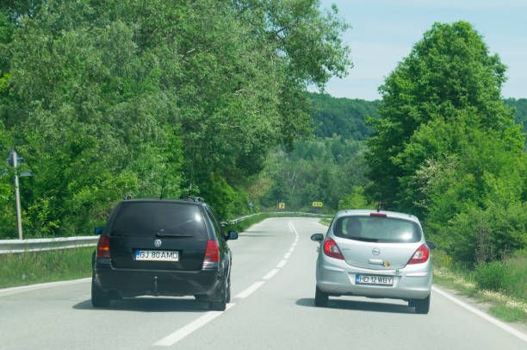
Passing Sight Distance (PSD):
Passing sight distance is the minimum distance needed to safely:
    Start passing
    Complete passing
    Return to the lane before the conflict
Where PSD is insufficient:
    Pavement markings and signs prohibit passing
    Percentage of roadway marked as no-passing significantly affects LOS
    Higher no-passing zones → higher platooning and lower speeds

Slide 10
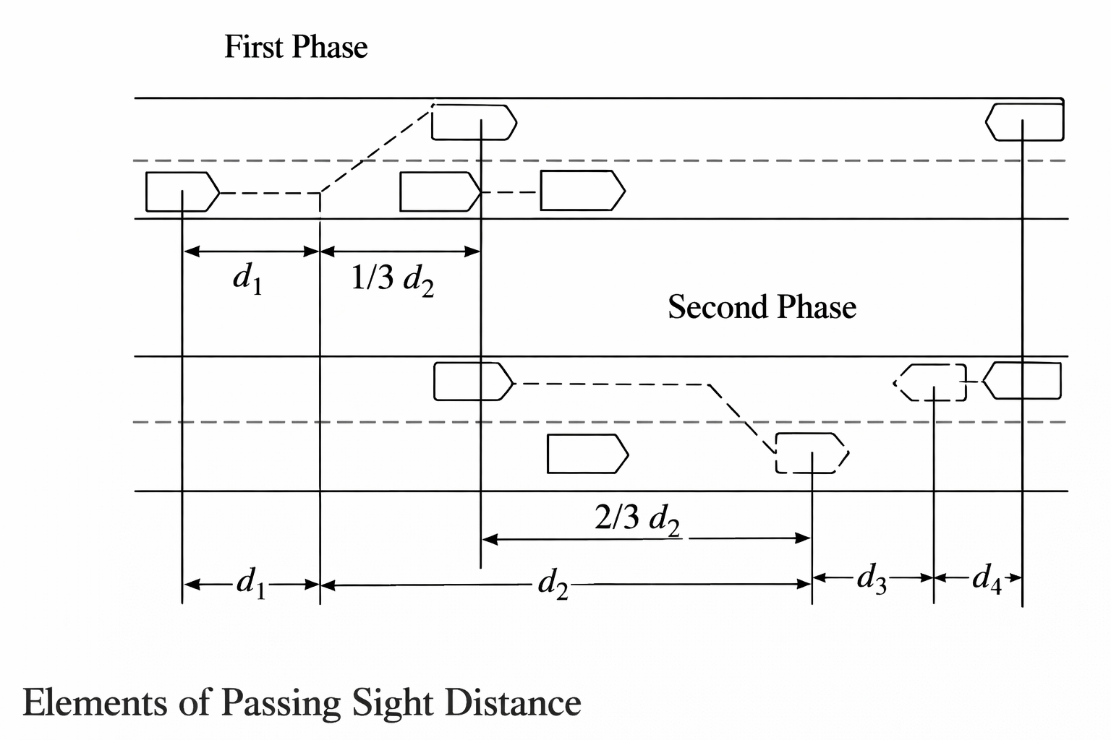

Passing Sight Distance (PSD):
PSD consists of four distances:
    d1​: perception and acceleration before lane encroachment
    d2​: distance while passing a vehicle in the opposing lane
    d3​: clearance distance between vehicles at the end
    d4​: opposing vehicle distance traveled during passing

Slide 11
Capacity Analysis-Two-Lane Highway
Capacity is the maximum sustainable flow rate that can be served under prevailing conditions.
For two-lane highways, capacity is defined as two-way capacity, but analysis is usually done per direction.
As per HCM base capacity values:
    Capacity in both directions 3,200 pc/h
    Capacity in one direction 1,700 pc/h

Slide 12
Capacity -Two-Lane Highway
Base conditions include:
    12-ft lanes
    6-ft shoulders
    Level terrain
    No heavy vehicles or passenger cars only
    100% passing allowed
    50/50 directional split
    No traffic interruptions
Under these conditions, both direction capacity = 3200 pc/h.

Slide 13
LOS Concept- Two-Lane Highway
LOS describes the quality of operation from the user’s perspective:
    Speed
    passing freedom
    Comfort
    delay due to platoons
LOS is measured using specific performance indicators.

Slide 14

Measures of Effectiveness (MOEs)
HCM uses three main Measures of Effectiveness (MOEs) for two-lane highways:
    Average Travel Speed (ATS)
    Percent Time Spent Following (PTSF)
    Percent Free-Flow Speed (PFFS)
Different highway classes use different MOEs.

Slide 15
Measures of Effectiveness (MOEs)
Average Travel Speed (ATS)
    Is the average speed of all vehicles traveling in the segment
    Length of the analysis segment divided by the average travel time of all vehicles traversing the segment during the analysis period.
    Measured over analysis time (often peak 15-min period)
    Space-mean speed!
    Lower ATS indicates poor performance.

Slide 16
Measures of Effectiveness (MOEs)
Percent Time Spent Following (PTSF)
PTSF measures platooning:
    Average Percentage of time drivers are trapped behind slower vehicles
    Unable to pass due to geometry or opposing traffic
    Often approximated using headways ≤ 3 seconds.
    Higher PTSF means worse service.

Slide 17
Measures of Effectiveness (MOEs)
Percent Free-Flow Speed (PFFS)
    PFFS = (ATS / FFS) × 100%
    This is used mainly for Class III highways, where speed limits are already low.

Slide 18
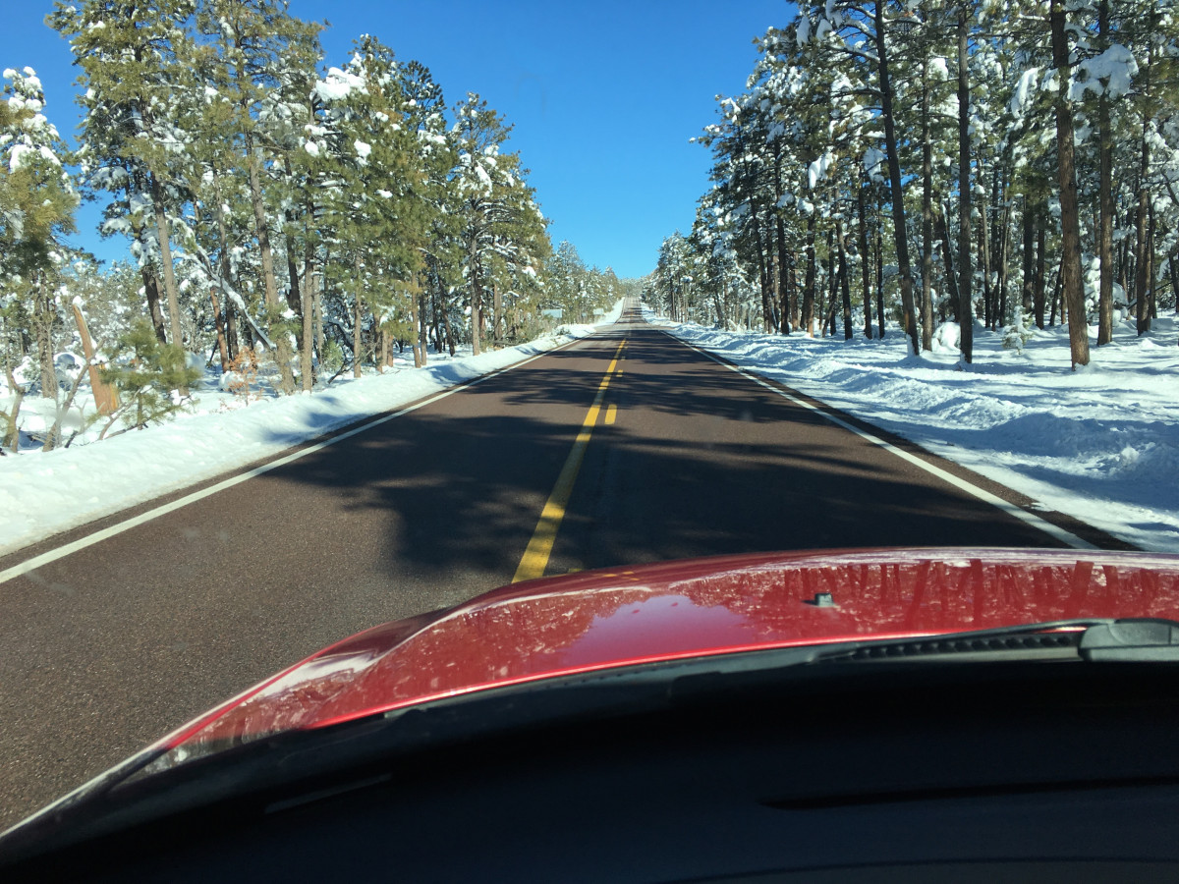
LOS Criteria
LOS thresholds vary by class.
    Class I
          Based on ATS and PTSF (worst governs)
    Class II
          Based only on PTSF
    Class III
          Based on PFFS

Slide 19
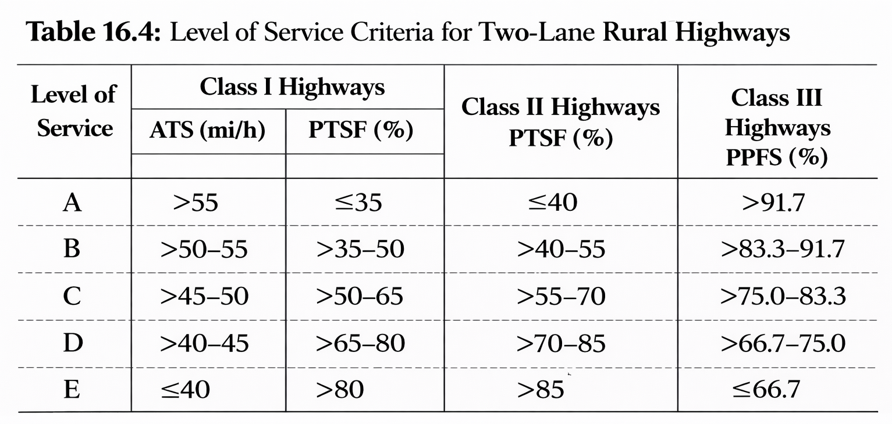
LOS Criteria

Slide 20
Free-Flow Speed Determination
For 2-lane highways, FFS is equal to the mean speed of passenger cars operating in flow rates up to 200 pc/h (both directions)
FFS is essential because it is the baseline for:
    Estimating ATS
    Computing PFFS
    understanding speed reduction due to roadway conditions
FFS can be measured or estimated.

Slide 21
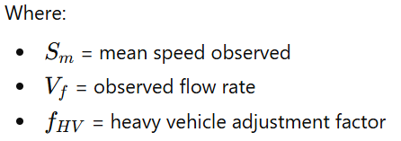

Free-Flow Speed Determination
Field Measurement of FFS
To measure FFS in the field:
    Use ≥100 vehicle observations
    Total two-way flow ≤200 pc/h
    Observe only the direction under study
    Systematic sampling allowed (e.g., every 10th vehicle)
If total flow >200 pc/h:

Slide 22

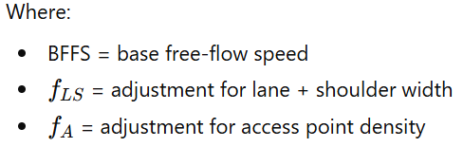
Free-Flow Speed Determination
Estimating FFS (When Field Data is Not Available)
FFS can be estimated by:

Slide 23
Free-Flow Speed Determination
Base Free-Flow Speed (BFFS)
BFFS depends on class:
    Class I: typically 55–65 mi/h
    Class II: 45–50 mi/h
    Class III: 40–50 mi/h
BFFS can be approximated from design speed or posted speed + 5 to 7 mi/h.

Slide 24
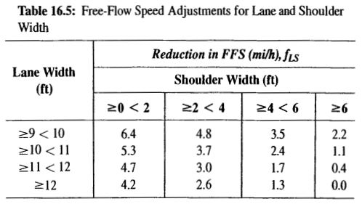

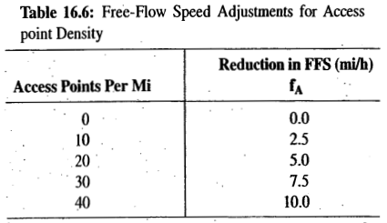

Free-Flow Speed Determination
Lane and Shoulder Adjustment
Lane/shoulder adjustment factor is taken from Table 16.5
    Narrower lanes reduce speed
    Narrower shoulders reduce speed
    reductions can exceed 5 mi/h in poor conditions
Access Point Adjustment
Access point adjustment factor is taken from Table 16.6

Slide 25
Free-Flow Speed Determination
Example-1:
Calculate the estimated free-flow speed of a Class-II 2-lane highway segment if the field-measured mean speed is 56.5 mi/h and the flow rate during the field data collection was 650 vph. Assume all vehicles were passenger vehicles.

Slide 26



Free-Flow Speed Determination
Given:
= 56.5 mi/h, = 650 vph, =1.0 (all passenger cars)
Solution:
Since the measurement taken when the flow is more than 200 vph, we need to adjust it using the equation:
FFS = 56.5 + 0.00776 (650/1) = 61.5mi/h

Slide 27
Free-Flow Speed Determination
Example-2:
Find the free-flow speed of a two-lane rural highway segment in rolling terrain. The lane width is 11.0 ft with 2.0-ft shoulders. Access point density is 30 per mile, and the base free-flow speed may be taken to be 60 mi/h.

Slide 28

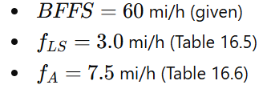

Free-Flow Speed Determination
Solution:
The estimation technique is used. The free-flow speed is determined as follows:
However,

Slide 29

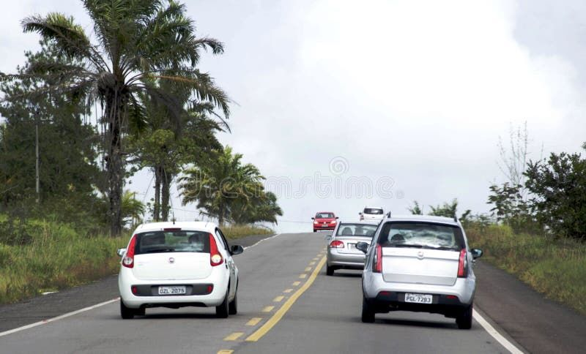
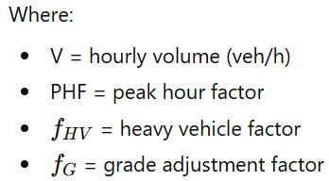
Demand Flow Rate Determination
For two-lane highways, the demand flow rate is computed as:

Slide 30
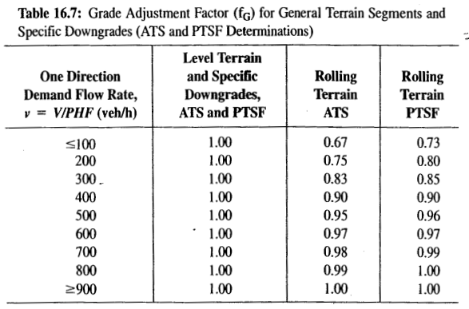
Demand Flow Rate Determination
Grade adjustment factor depends on:
    terrain type (level, rolling, mountainous)
    flow rate
    whether estimating ATS or PTSF
    whether it is a general segment or a specific grade
(refer the reference material “Traffic Engineering” book (page 372-376) for the rest grade adjustment factors table)

Slide 31
Example-3
Determine the demand flow rates for both directions of a Class I two-lane highway on rolling terrain with an FFS of 57.5 mph, and the following characteristics:
    Peak hour volume of 900 vph with 55% of traffic in the peak direction and 250 vehicles arriving in the peak 15 minutes of the peak hour.
    The traffic stream consists of 6% trucks and buses and 0% RVs.
    The segment consists of 50% no-passing zones.

Slide 32

Example-3
Solution:
For a Class I two-lane highway, we need to calculate ATS and PTSF
Step 1: Determine peak hour Factor (PHF)
250 vehicles arrive in the peak 15 minutes of the peak hour.

Slide 33
Example-3
Solution:
Step 2: Determine analysis volumes for each direction
Total two-way peak-hour volume: V=900 veh/h
Directional split:
  Peak direction = > V_{pd} = (900 x 0.55)/0.90= 550vph
  Opposing direction => V_{od} = (900 x 0.45)/0.90= 450vph

Slide 34
Example-3
Solution:
Step 3: Determine the grade adjustment factors (f_{g}) for both directions
      f_{g.d}= 0.96
      f_{g.o}= 0.93
Step 4: Determine E_{T} and E_{R} for both directions
      E_{Td} = 1.7
      E_{To} = 1.9
      E_{Rd}= E_{Ro}=1.1
From Table
From Table

Slide 35


Example-3
Solution:
Step 5: Compute the heavy vehicle adjustment factor
    f_{HV,d}= (1/(1+0.06(1.7-1))= 0.960
    f_{HV,o}= (1/(1+0.06(1.9-1))= 0.949
  Note: RV proportion P_{RV}=0.0

Slide 36
Example-3
Solution:
Step 6: Determine the demand flow rate for both directions
For ATS
    v_{d,ATS}= (900x0.55/(0.9x0.96x0.96))= 597pc/h
    v_{o,ATS}= (900x0.45/(0.9x0.93x0.949))= 510pc/h
For PTSF
    v_{d,PTSF}= 577pc/h
    v_{o,PTSF}= 498pc/h
Follow the same procedure to calculate these values for PTSF

Slide 37
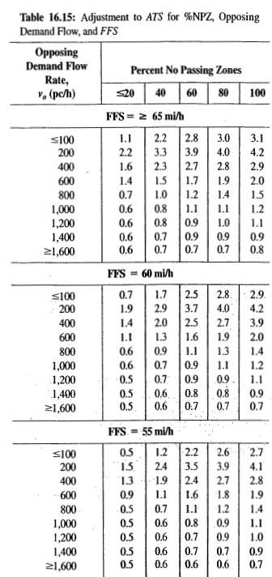

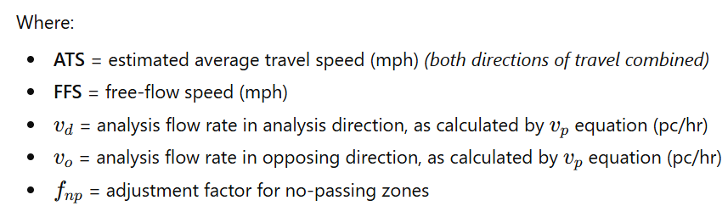
Example-3
Step 7: Calculate the performance measures –Average Travel Speed (ATS)
Determine f_{np} from Table 16.15 by interpolation as = 1.8
Hence,
  ATS_{d} = 57.5 – 0.00776(597+510)-1.8 = 47.1mi/h

Slide 38

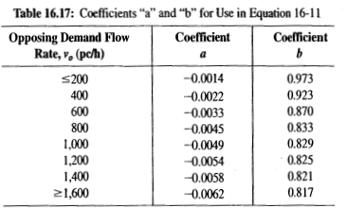
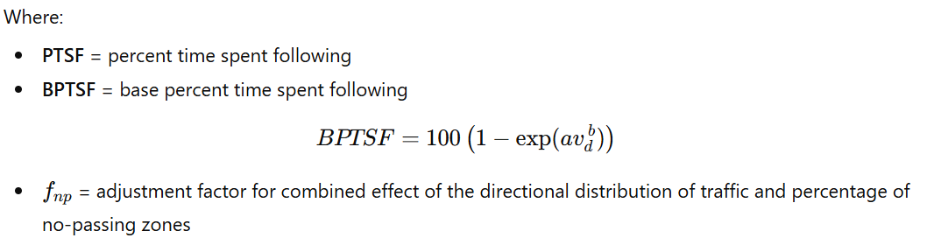
Example-3
Step 8: Calculate the performance measures –Percent Time Spent Following (PTSF)
Interpolating from Table 16.17, a=-0.0027 and b=0.897, then BPTSF= 55.5%
Respective f_{np} interpolated from the table as 32.4
Hence, PTSF 55.5 + 32.4 (577/(577+498))= 72.88%

Slide 39
Example-3
Step 9: Determine LOS based on ATS and PTSF
ATS= 47.1 mi/h
PTSF=72.88%
LOS for ATS= C
LOS for PTSF= D
Hence, the LOS is “D” as it is the worst

Slide 40
Additional references
Transportation Research Board (TRB). Highway Capacity Manual, Washington, DC: The National Academies Press, 2010.
https://www.youtube.com/watch?v=QiaXErgNzc8

