Slide 1
Traffic Engineering
Lecture 4.4: Traffic Signal Design Phasing and Timing

Slide 2
Learning objectives
At the end of this lecture, students should be able to:
Explain why parking studies are important in traffic engineering
Define key parking study terms (volume, accumulation, load, turnover, etc.)
Analyze parking data using space-hour concepts
Apply demand and supply equations for parking analysis
Identify different types of parking facilities

Slide 3
Lecture outline
Introduction
Hierarchy of Intersection Control
Level I: Basic rules of the road
Level II: YIELD or STOP Control
Level III: Traffic Control Signals
Basic reference:
Roger P. Roess; Elena S. Prassas; William R. McShane, Traffic Engineering, 5th edition, Pearson, 2019

Slide 4
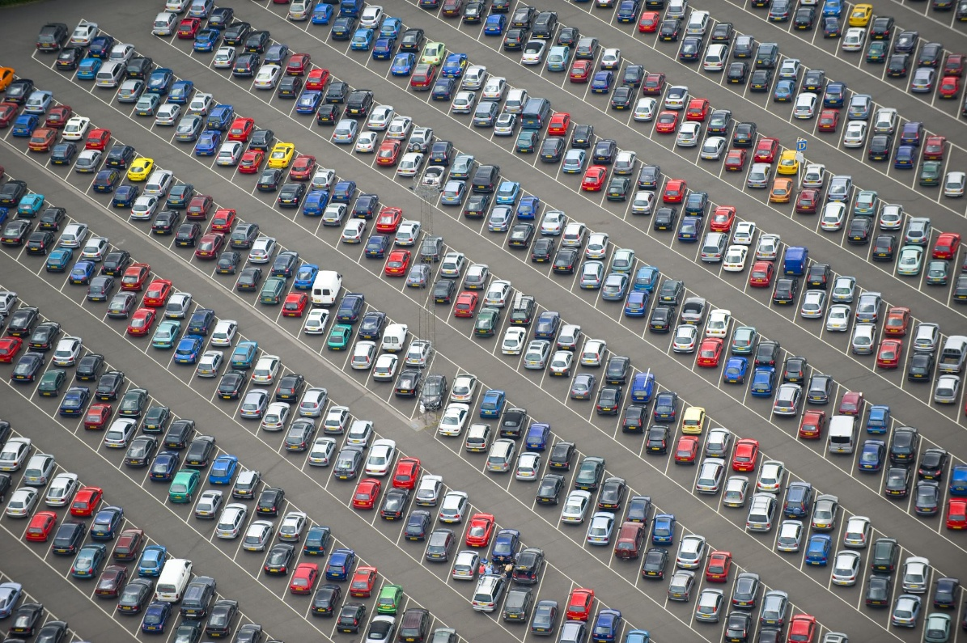
Introduction
  Parking is a major element of transportation systems.
  Every vehicle traveling on a roadway will eventually require parking, either for:
    Short-term activities (shopping, delivery, personal errands)
    Long-term activities (work, residence, overnight parking)
  Because parking demand is high, especially in urban areas, proper planning is required.

Slide 5
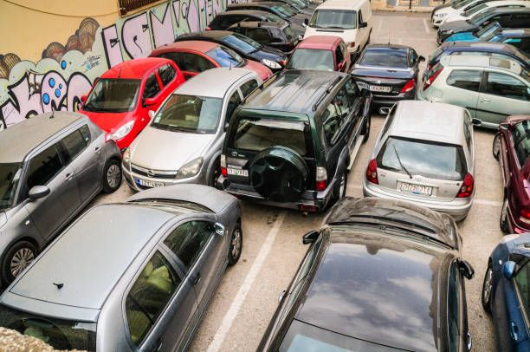
Introduction
  Parking studies are essential because they help to:
    Determine parking demand and supply in a given area
    Reduce congestion caused by parking search traffic
    Support land use and transport planning decisions
    Improve safety by reducing illegal parking
    Improve accessibility in commercial and CBD areas

Slide 6

Introduction
Parking demand is closely linked to:
    Business activities
    Residential density
    Commercial centers
    Institutional land uses (schools, hospitals)
    Transit terminals
In high-density cities, land is expensive, and planners must decide how to allocate space for:
    Traffic movement
    Parking facilities

Slide 7
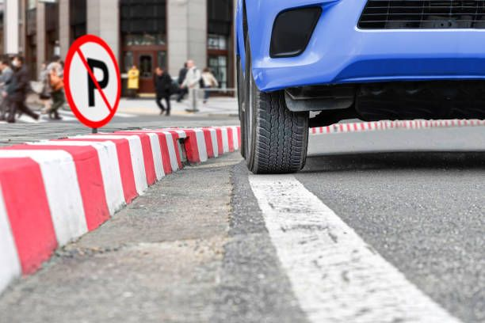
Introduction
Central Business District (CBD) parking issues include:
    High parking demand with limited land supply
    Illegal parking that reduces road capacity
    Increased congestion due to vehicles searching for parking
    Conflicts between parking needs and roadway capacity needs
Parking studies support decisions on whether curb parking should be reduced or expanded.
What is wrong?

Slide 8
Types of Parking Facilities
Parking facilities can be divided into two major groups:
    On-street parking
    Off-street parking
On-street parking is also known as curb parking:
    Characteristics:
      Parking bays are located along the curb
      Can be on one side or both sides of the road
      Reduces roadway width available for moving traffic
      On-street parking can significantly affect road capacity and safety.

Slide 9
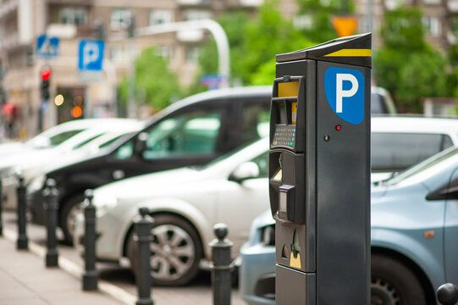
Types of Parking Facilities
Unrestricted Vs Restricted On-Street Parking
Unrestricted parking refers to:
    No time limit on duration
    Often free parking
    Usually occurs in low-demand areas
    Long-term occupation of curb space (problem)
Restricted parking refers to parking with:
    Time limitations (e.g., 30 minutes, 1 hour, 2 hours)
    Specific permitted times of the day
    Possible fees or enforcement rules
    Restricted parking improves turnover and availability in high-demand areas.

Slide 10
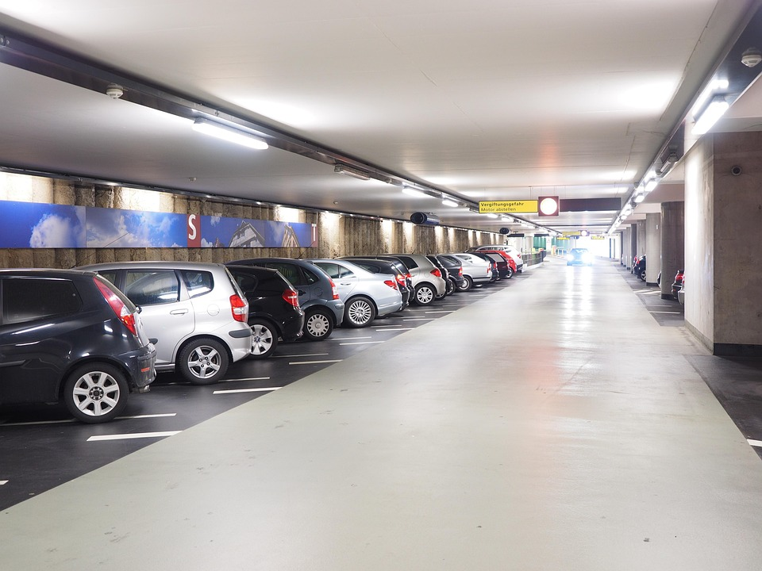
Types of Parking Facilities
Off-Street Parking Facilities include
    Surface parking lots
    Parking garages (multi-level)
    Can be private (shopping malls, offices) or publicly owned (municipal parking lots)
    Off-street parking reduces curbside congestion but requires significant land or investment.
Two major types of garages include:
    Self-parking garages
          Drivers park their own vehicles
          Requires clear layout and guidance
    Attendant-parking garages
          Staff park the vehicles for users
          More efficient space use but higher operational cost

Slide 11
Types of Parking Facilities
Comparison of On-Street vs Off-Street Parking
On-street parking:
    Convenient access
    Reduces roadway capacity
    More conflicts with pedestrians and cyclists
Off-street parking:
    Higher capacity
    Less interference with traffic flow
    Requires construction cost and land availability

Slide 12
Key Parking Study Definitions
To conduct parking studies, traffic engineers use several standard terms, including:
  Space-Hour is defined as:
    The use of one parking space for a period of one hour,
    Space-hours are the foundation for parking demand analysis,
    Example:
      If 1 car parks for 2 hours → 2 space-hours
      If 10 cars park for 1 hour each → 10 space-hours
  Parking Volume is:
    The total number of vehicles that park in a study area during a specified time period (usually one day).
    Parking volume helps identify:
      Total demand intensity
      Daily activity levels in a parking zone

Slide 13
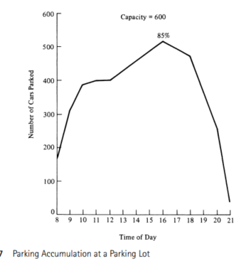
Key Parking Study Definitions
  Parking Accumulation is:
    The number of vehicles parked in a study area at a specific time,
    Parking accumulation varies throughout the day and is often presented as a curve,
    Accumulation is useful for identifying peak parking periods.
  Parking Accumulation Curve shows:
    Time of day on the x-axis and number of parked vehicles on the y-axis,
    Indicates peak accumulation time,
    Duration of high-demand periods,
    Variation patterns across the day
Parking accumulation curve
Source: Traffic and Highway Engineering, 4th Edition

Slide 14
Key Parking Study Definitions
  Parking load is:
    The area under the parking accumulation curve between two times,
    It represents total space-hours used during that time interval
    Parking load is a strong measure of total demand.
  Parking Duration is:
    The length of time a vehicle remains parked in a parking bay,
    Long durations reduce turnover and reduce parking availability
    Average duration indicates
      How frequently spaces become available
      Whether demand is short-term or long-term

Slide 15
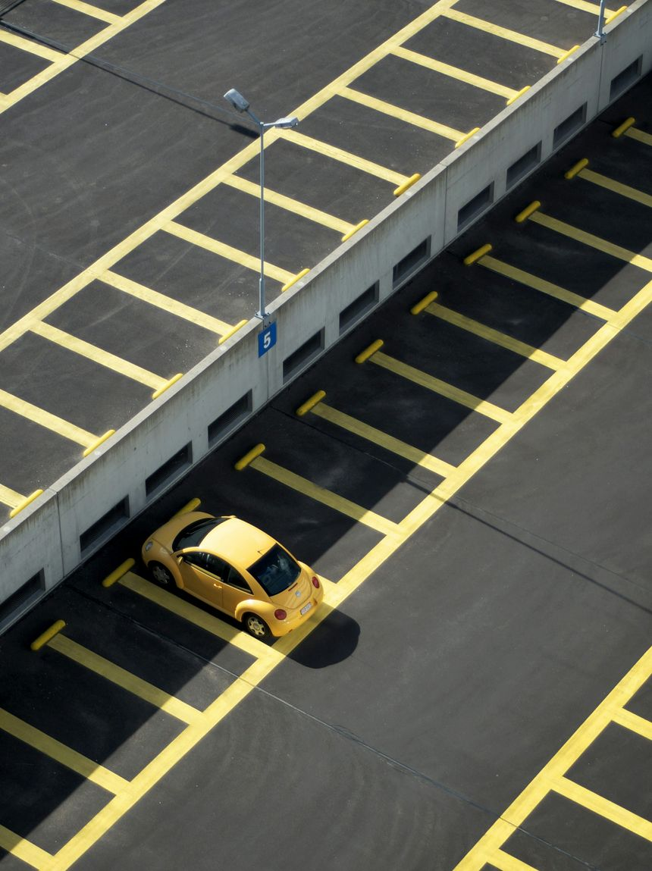
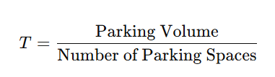
Key Parking Study Definitions
  Parking Turnover is:
    The rate of use of a parking space,
    A higher turnover means:
      Parking spaces are used more frequently
      Demand is more short-term

Slide 16
Methodology of Parking Studies
A comprehensive parking study includes the following major steps:
    Inventory of existing parking facilities
    Collection of parking data (accumulation, turnover, duration)
    Identification of parking generators
    Collection of information on parking demand
Additional information may include:
    Financial issues (willingness to pay)
    Legal and administrative regulations

Slide 17
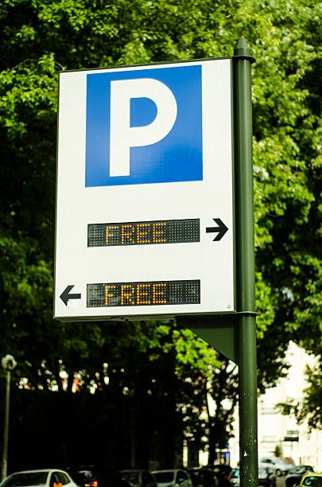
Methodology of Parking Studies
Inventory of Existing Parking facilities includes:
    Type and number of spaces at each facility
    Times of operation and parking duration limits
    Ownership type (public or private)
    Parking fees and collection method
    Restrictions (loading zones, bus stops, taxi ranks)
    Accessibility to the public
    Permanency of facility (temporary or permanent)

Slide 18
Methodology of Parking Studies
Parking accumulation data is obtained by:
    Checking the number of parked vehicles at regular time intervals
    Common intervals at every 1 or 2 hours
    Typical study period from 6:00 AM to 12:00 midnight
    The selected time range depends on land use activity patterns, for instance
          Retail zones may require monitoring until 9:30 PM
          Truck stops may require monitoring around midnight
          Residential areas may require evening and overnight observations
          This ensures peak demand is not missed.

Slide 19
Methodology of Parking Studies
Parking Turnover and Duration are measured by:
    Selecting a sample of parking spaces
    Recording license plates at fixed time intervals
    Example:
          If parking limit is 1 hour → check every 20 minutes
          If the parking limit is 2 hours → check every 30 minutes
In a License Plate Survey:
    Each parking bay is observed at regular intervals
    Changes in plate numbers indicate vehicle replacement
    Duration is estimated based on how long a plate remains
    This method provides accurate data but is labor-intensive

Slide 20
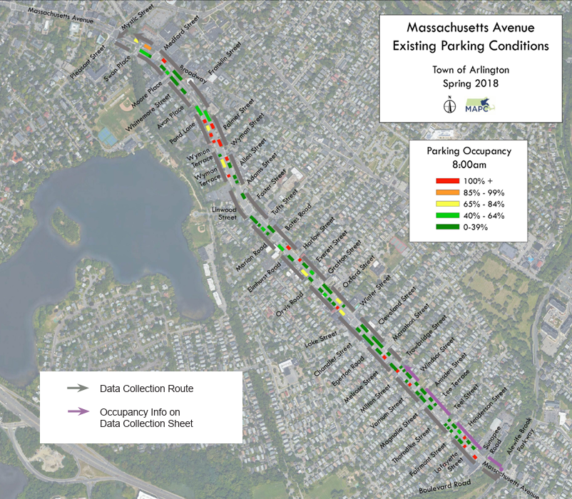
Identification of Parking Generators
Parking generators are land uses that attract high parking demand,
    Shopping centers
    Business offices
    Schools and universities
    Hospitals
    Transit terminals
These generators should be mapped and linked to parking demand patterns
Parking demand data can be collected by interviewing drivers at parking facilities. Including
    Trip origin, trip purpose, destination after parking, arrival, and departure time
https://www.mapc.org/wp-content/uploads/2010/02/HTD_5.pdf

Slide 21
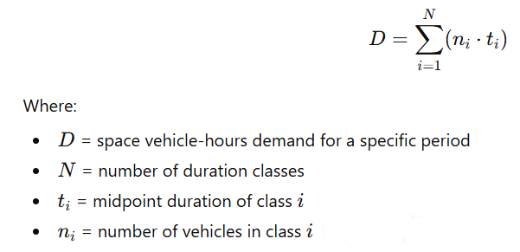
Parking Data Analysis
Parking data analysis involves:
    Summarizing collected data
    Coding and interpreting information
    Generating indicators for decision-making
Key outputs include:
    Number and duration of legally parked vehicles
    Number and duration of illegally parked vehicles
    Parking space-hour demand
    Parking supply
Parking demand in space-hours is computed as:

Slide 22
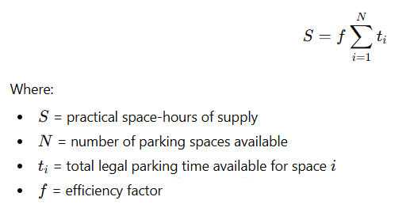
Parking Data Analysis
Space-Hours of Parking Supply is computed as:
The efficiency factor (f) accounts for time lost due to turnover (vehicles leaving and entering spaces).
  Efficiency varies depending on facility type:
    Curb parking: 78% – 96%
    Garages and lots: 75% – 92%
  Typical average values:
    0.90 for curb parking
    0.80 for garages
    0.85 for surface lots

Slide 23
Parking Data Analysis
Interpretation of Demand vs Supply. If
      D > S => parking shortage exists (demand exceeds supply)
      D < S => parking spaces are adequate or underutilized
This comparison supports:
    parking policy decisions
    parking facility expansion planning
    pricing and regulation strategies

Slide 24
Parking Data Analysis
Practical Applications of Parking Studies:
    CBD parking policies
    Meter pricing decisions
    Development approvals (minimum parking requirements)
    Transit-oriented development planning
    Urban congestion reduction strategies
Common challenges in Parking Studies:
    Manual data collection labor cost
    Inaccurate driver interviews
    Low response rate in the postcard technique
    Illegal parking is not always recorded properly
    Rapid changes in land use affecting results

Slide 25
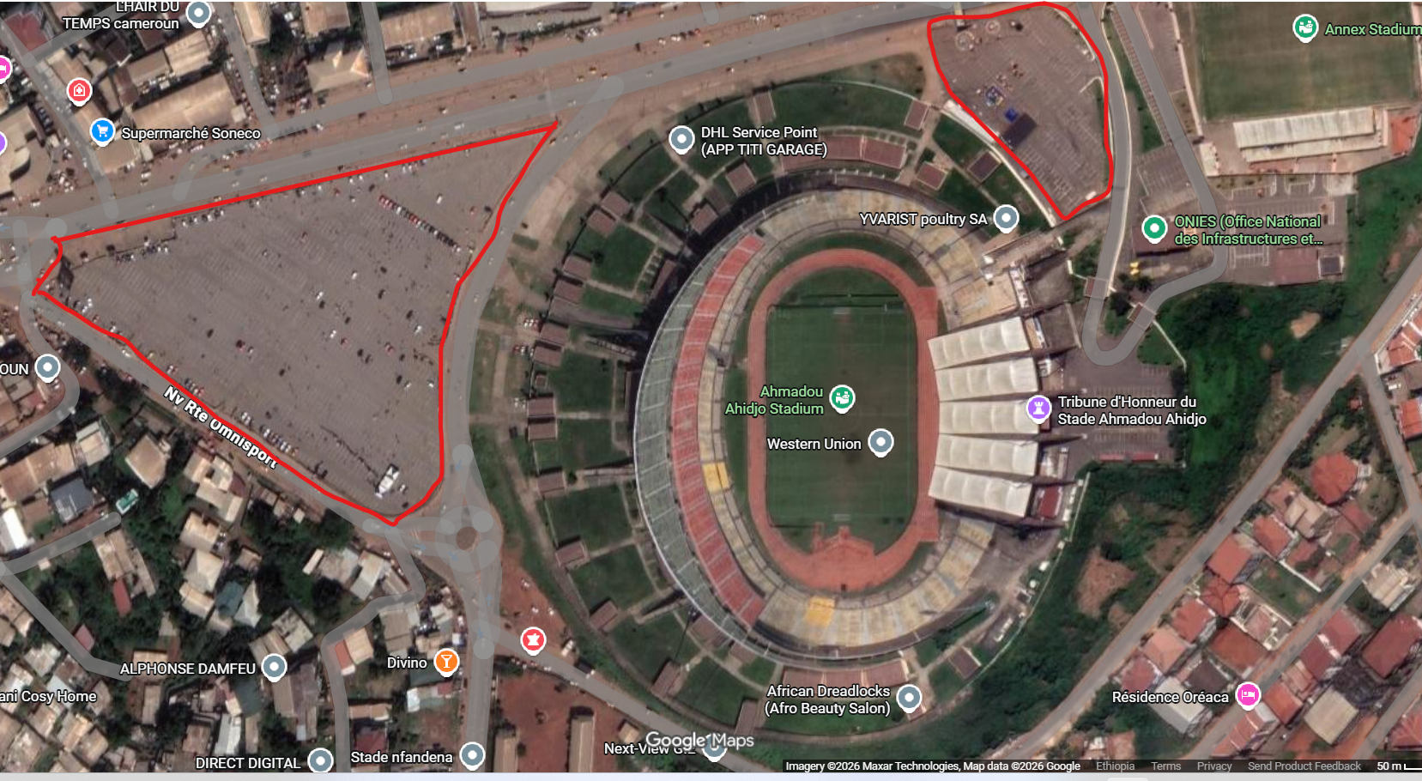

Slide 26
Discussion Questions
How does curb parking reduce street capacity and LOS?
What are the advantages of electronic parking data collection?
How can parking pricing be used to reduce congestion in CBD areas?

