Slide 1
Traffic Engineering
Lecture 3.2: Traffic Volume studies

Slide 2
Learning objectives
Understand traffic volume concepts
Differentiate volume, demand, and capacity
Explain temporal traffic variation patterns
Apply concepts to intersection and network studies

Slide 3
Lecture outline
Why Traffic Volume Studies are Important?
Key Traffic Parameters
Volume vs Demand vs Capacity
Volume Characteristics
Basic reference:
Roger P. Roess; Elena S. Prassas; William R. McShane, Traffic Engineering, 5th edition, Pearson, 2019

Slide 4
Introduction
Traffic volume studies measure the number of vehicles or pedestrians
Include directional movement, occupancy rates, vehicle classification, and pedestrian age.
Counts are taken over a specified time period
Time period varies from 15 minutes to a full year
Fundamental input to traffic engineering decisions
Used in planning, design, and operations

Slide 5
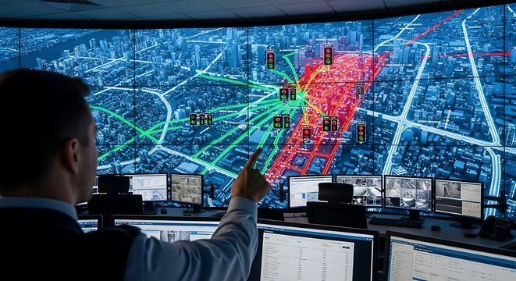
Why Traffic Volume Studies are Important?
Provide foundation for traffic engineering analysis
Support transportation planning and design
Help evaluate safety and operational performance
Enable long-term infrastructure investment decisions

Slide 6
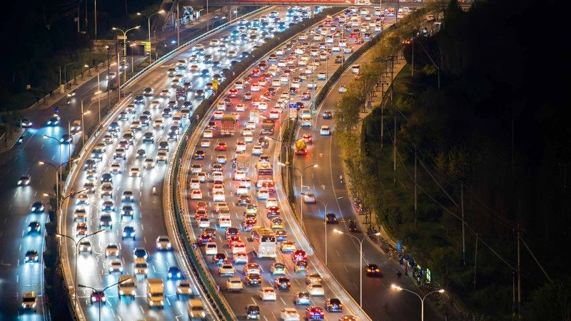
Key Traffic Parameters
Volume
Rate of flow
Demand
Capacity
All expressed in vehicles per unit time

Slide 7
Key Traffic Parameters
Volume
  is the number of vehicles (persons) passing a point during a specified time period.
  Time period can be an hour or a day.
  Cannot exceed roadway capacity
  Different types of volume based on the length of the count period
    Annual average daily Traffic (AADT)
    Average Daily Traffic (ADT)
    Peak Hour Volume (PHV)

Slide 8
Key Traffic Parameters
Flow
  Equivalent hourly rate for short periods
  Expressed in vehicle per hr.
  Important for peak flow analysis
Capacity
  The maximum rate at which vehicles can traverse a point or short segment during a specified time
  It is the characteristics of the roadway
  Estimated using Highway Capacity Manual
  May differ from observed maximum flow

Slide 9
Demand
  The number of vehicles (persons) that DESIRE to pass a point during the specified time, usually an hour.
  May exceed observed volume
  Includes queued, diverted, and suppressed trips
  Not directly observable
  When demand is higher than capacity, CONGESTION will result
Source: Traffic Engineering, 4th Edition,

Slide 10
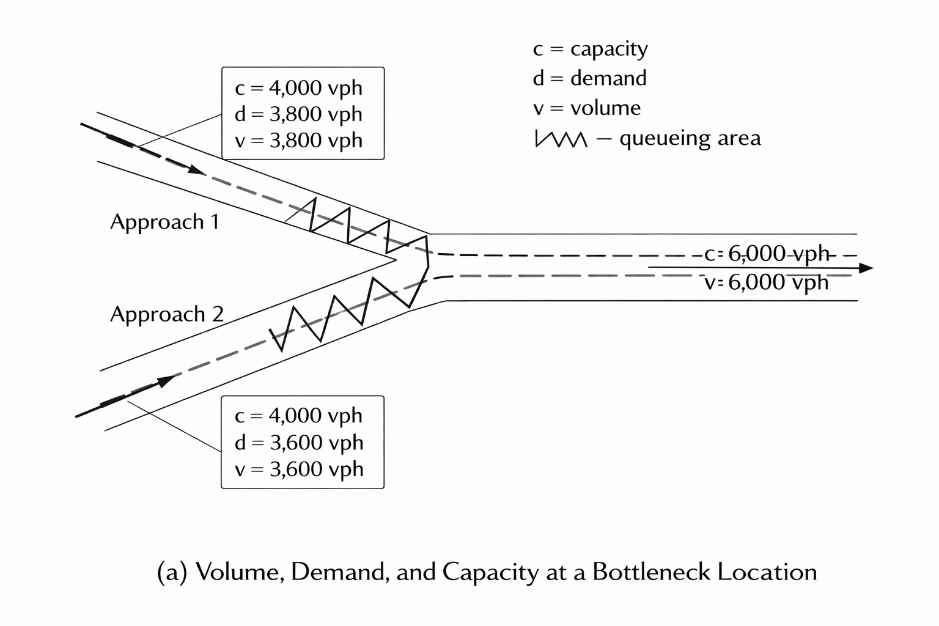
Volume vs Demand vs Capacity
Volume = what is observed
Demand = what users want
Capacity = physical limit
Confusion leads to poor design decisions
Bottleneck Concept
Occurs where demand exceeds capacity
Creates queues and delays
Observed volume capped at capacity
True demand remains hidden
Source: Traffic Engineering, 4th Edition,

Slide 11
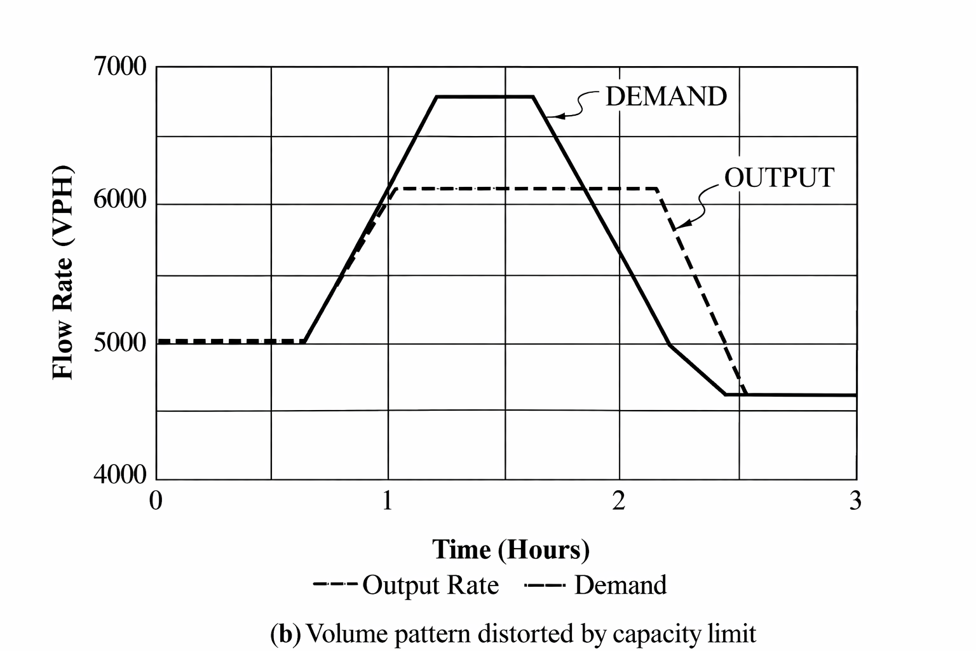
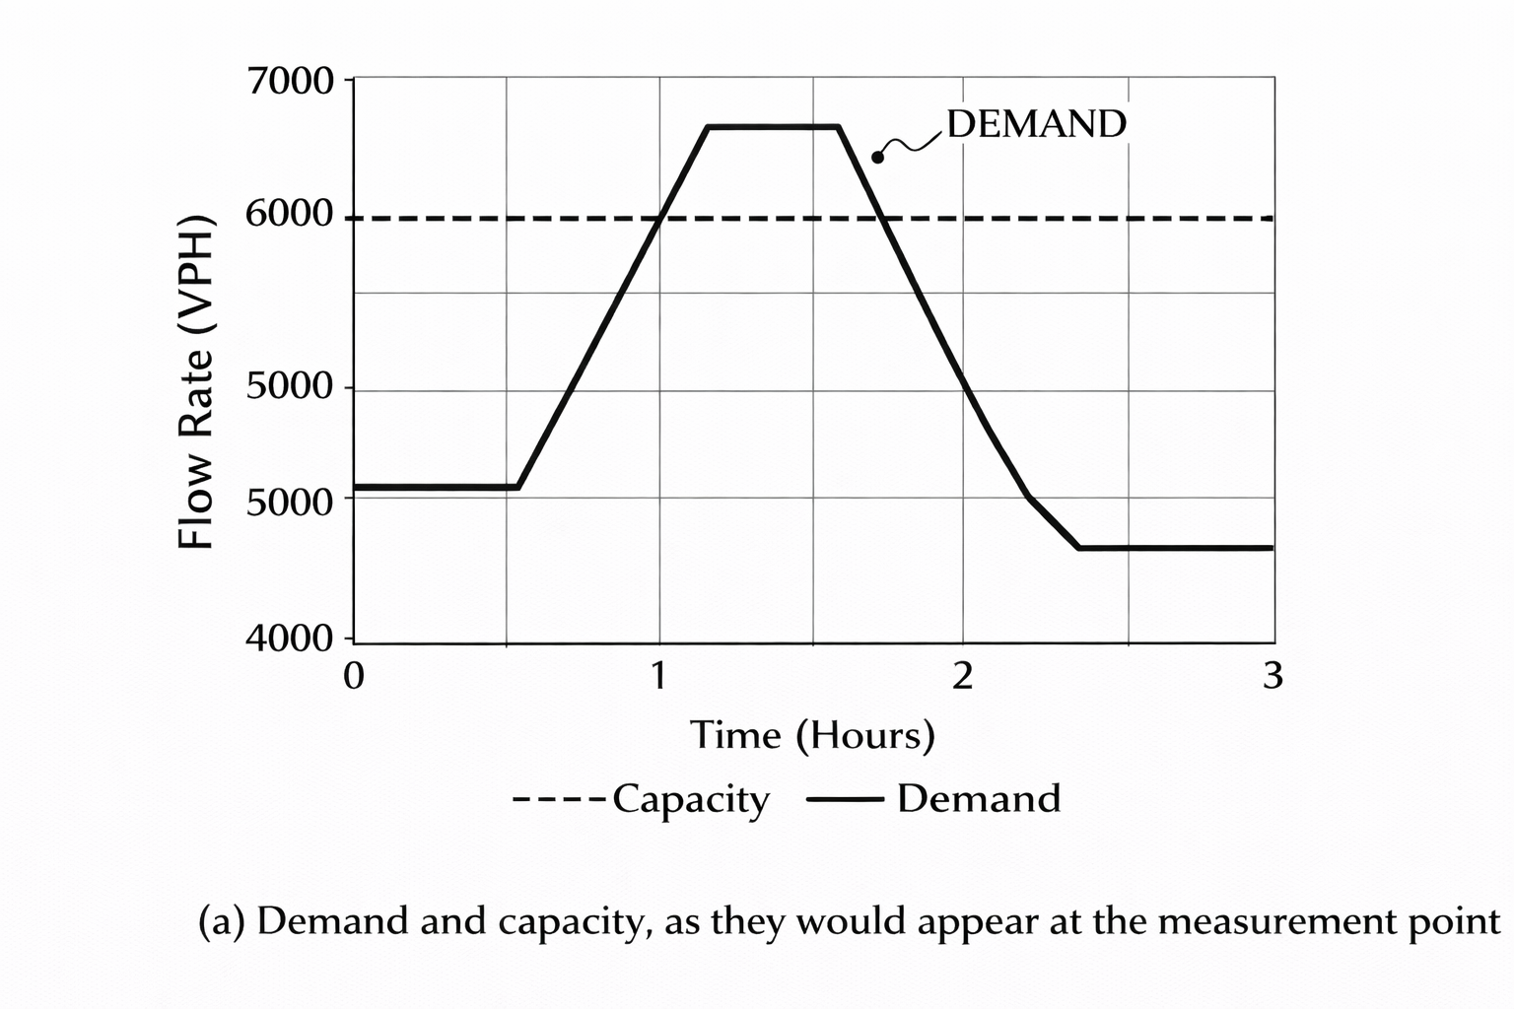
Volume vs Demand vs Capacity
Source: Traffic Engineering, 4th Edition,

Slide 12
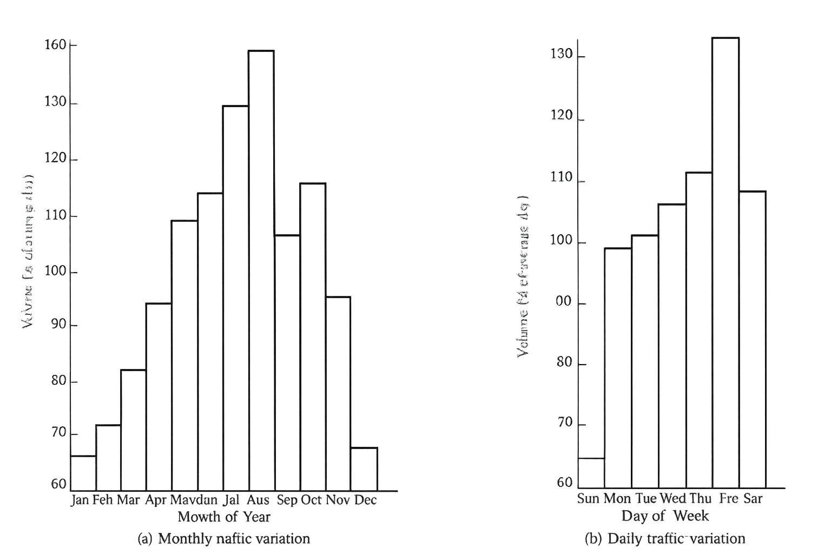
Volume Characteristics
Traffic demand varies over time (by hours of a day, by days of a week, by months of a year)
Facilities are designed for peak conditions
Underutilization occurs off-peak
Accurate data prevents overdesign
Source: Garber, N. J., & Hoel, L. A. (2009). Traffic and Highway Engineering (4th ed., pp. 127)

Slide 13
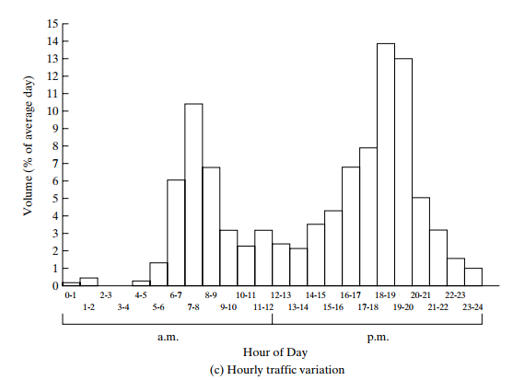
Daily Traffic Variation
Volumes differ by day of the week
Weekdays differ from weekends
Friday is often higher than midweek
Depends on land use and trip purpose
Monthly and Seasonal Variation
Traffic varies by season
Recreational routes peak seasonally
Commuter routes are more stable
Important for AADT estimation

Slide 14
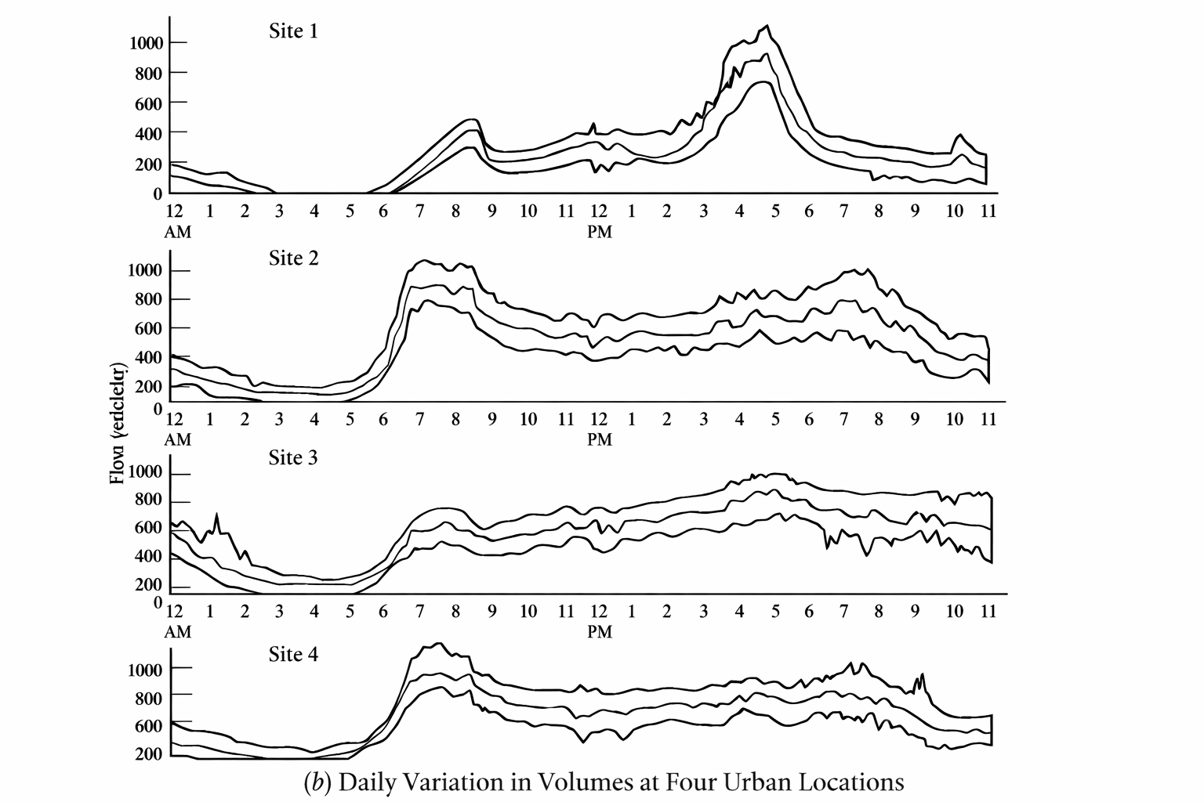
Hourly Traffic Variation
Traffic is not uniform throughout the day
Morning and evening peaks are common
Peaks driven by commuter travel
Pattern varies by facility type
Peak Hour Concept
Highest hourly traffic volume
Typically 9–15% of daily traffic
Key design condition
Varies by location and land use
Source: Traffic Engineering, 4th Edition,

Slide 15
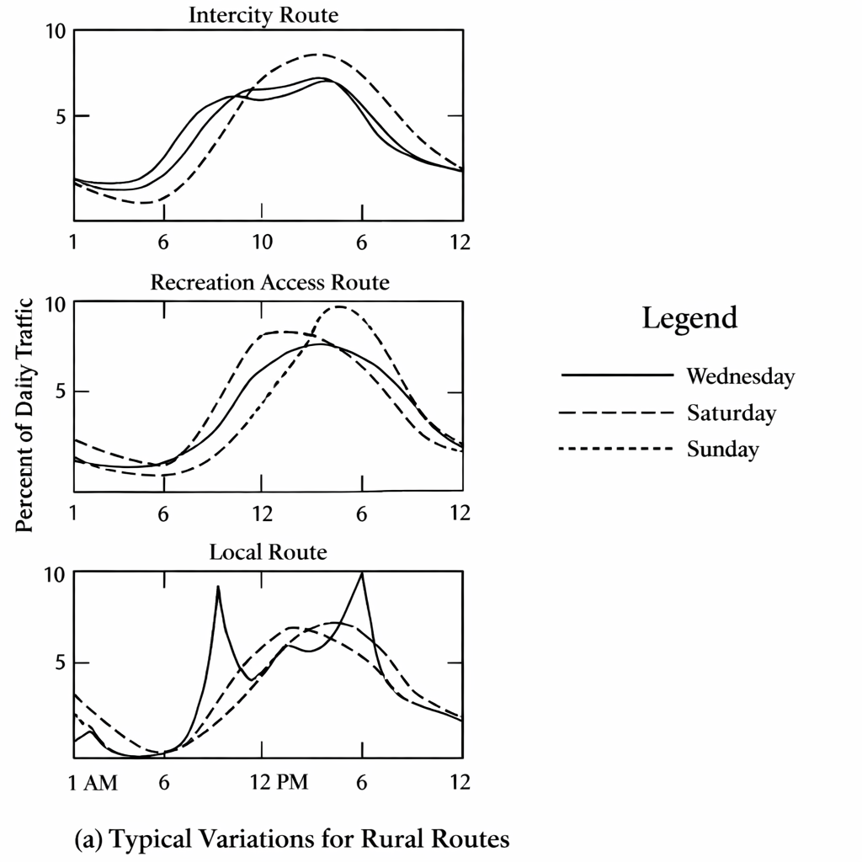
Urban Hourly Patterns
Some facilities show extended peaks
Congestion spreads demand
Off-peak travel increases
Clear AM/PM peaks may disappear
Rural Hourly Patterns
Single broad peak common
Weekend and seasonal effects are strong
Higher variability than urban routes
Driven by non-work trips
Source: Traffic Engineering, 4th Edition,

Slide 16
Peak Hour Factor (PHF)
Ratio of hourly volume to peak flow rate
Indicates demand concentration
Lower PHF means sharper peak
Critical for design decisions

Slide 17
Average Annual Daily Traffic (AADT)
Average 24-hour traffic volume over a year
  Calculated by averaging daily traffic counts for all 365 days
Represents long-term traffic demand
  Smooths out daily, weekly, and seasonal variations
Used in the evaluation of the economic feasibility of highway projects
Essential for highway planning and design
  Basis for functional classification, geometric design, and investment decisions

Slide 18
Average Daily Traffic (ADT)
Average 24-hour volume over several days
  Computed from multiple daily traffic counts within a short period
Collected for periods shorter than one year
  Does not account for full seasonal variation
Used to evaluate current traffic demand
  Reflects existing traffic conditions on a roadway
Can be converted to AADT by multiplying by the seasonal factor.

Slide 19
Vehicle Kilometer of Travel (VKT)
Product of traffic volume and roadway length
Represents total travel demand
Used for funding allocation and maintenance planning
Indicator of system usage

Slide 20
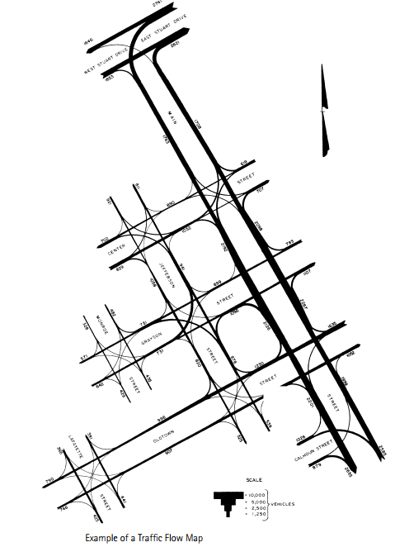
Traffic flow map
Shows traffic volumes on individual routes
Traffic volume is represented by the width of bands drawn on the map
Bandwidth is proportional to the magnitude of traffic flow
Enable quick visual comparison of traffic volumes across routes
Include numerical volume values near bands to improve clarity and accuracy
Source: Garber, N. J., & Hoel, L. A. (2009). Traffic and Highway Engineering (4th ed., pp. 125)

Slide 21
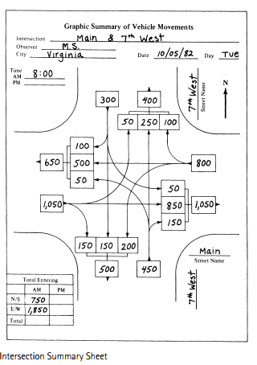
Intersection Volume Studies
Most complex traffic locations
Multiple movements and conflicts
Turning movements critical
Often counted manually
Source: Garber, N. J., & Hoel, L. A. (2009). Traffic and Highway Engineering (4th ed., pp. 126)

Slide 22
Applications of Traffic Volume Studies
Highway and intersection design
Traffic signal timing
Pavement and structural design
Transportation planning and policy
Roadway and intersection design
Traffic control and signal timing
Capacity analysis
Network planning and VMT estimation

