Slide 1
Traffic Engineering
Lecture 4.3: Traffic Signal Design Phasing and Timing

Slide 2
Learning objectives
At the end of this lecture, students should be able to:
Explain key terms used in signalized intersections
Describe signal cycle components and signal phases
Understand discharge headways and saturation flow
Apply critical lane and time budget concepts
Compute intersection capacity and cycle length

Slide 3
Lecture outline
Introduction
Traffic signal system components
Terms and definitions
Types of Signal Operation
Discharge Headways and Saturation Flow
Capacity of Signalized Lane Group
Critical Lane and Time Budget
Basic reference:
Roger P. Roess; Elena S. Prassas; William R. McShane, Traffic Engineering, 5th edition, Pearson, 2019
Additional reference:
https://ops.fhwa.dot.gov/publications/fhwahop08024/fhwa_hop_08_024.pdf
https://www.fgsv-verlag.de/pub/media/pdf/321_E.v.pdf

Slide 4
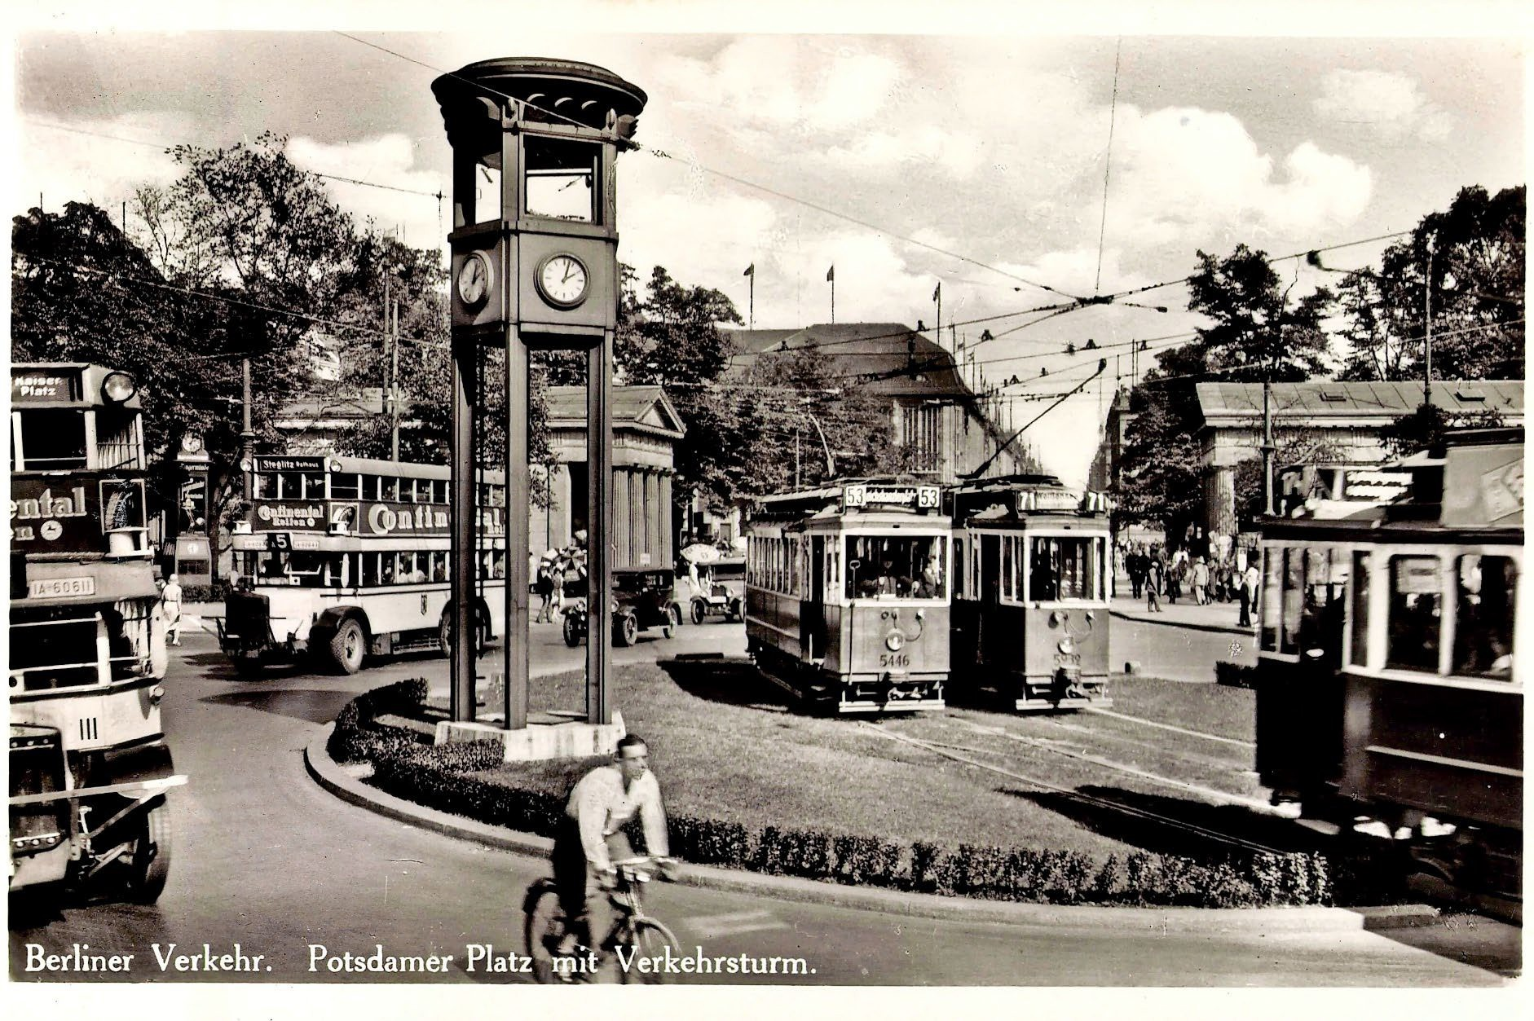
Introduction
Historical Overview:
  First experiments with gas-powered light signals in 1868 in London (Parliament Square)
  Urban electrification and motorization led to the installation of electric traffic signals.
  The first two-colored (red/green) traffic signal was installed in 1914 in Cleveland (OH)
  The first three-color system was introduced in 1920 in Detroit (MI) and New York City (NY)
  In Germany, the first traffic signal was installed in 1924 at Potsdamer Platz in Berlin
Picture: rnd.de
When and where was the first traffic signal installed in Cammeron/ DRC?

Slide 5
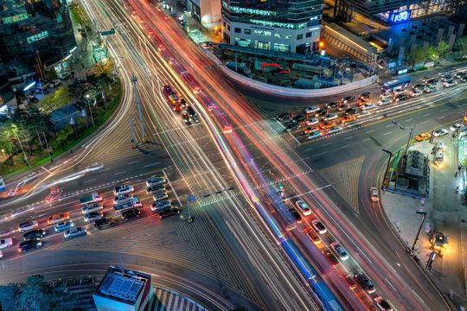
Introduction
Signalized intersections are important because:
  They control the movement of traffic in urban networks
  They affect delay, travel time, and congestion
  Poor timing can cause severe inefficiency
  Good signal timing improves safety and capacity
  Key Focus Areas of Signalized Intersection Operation:
  Discharge headways, saturation flow, and lost times
  Time allocation and the critical lane concept
  Left-turn equivalency
  Delay as a measure of service quality

Slide 6
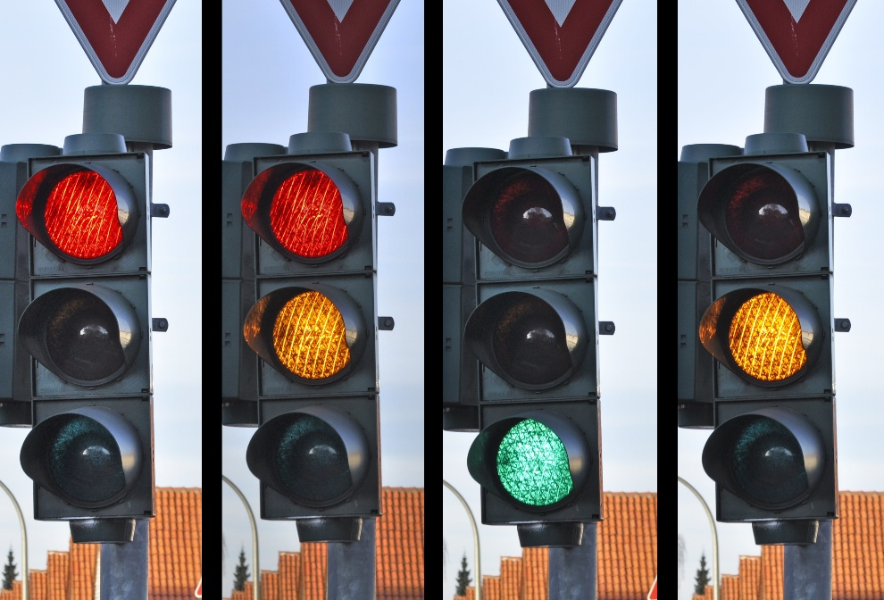
Introduction
Traffic signals are used when:
  Traffic demand becomes high
  Conflicts increase and cause safety problems
  Efficiency and orderly movement are needed
  Driver convenience and pedestrian crossing must be supported
  Signalized intersection operation is complex due to:
  Competing movements (vehicles and pedestrians)
  Turning movements
  Varying traffic demand throughout the day

Slide 7
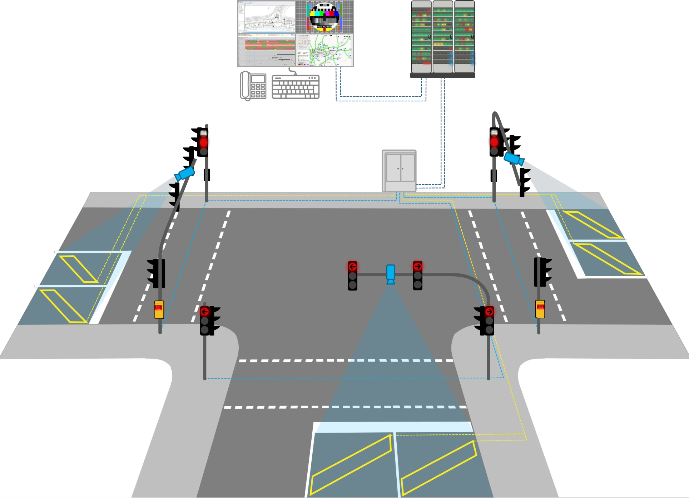
Traffic signal system components
1.
2.
Control unit
Mast (with boom)
Vehicle traffic signal transmitter
Pedestrian traffic signal heads
Detection of vehicle traffic, e.g.
Induction loop
Camera
7
6
4b
3.
1
3b
4.
3a
2
5.
6.
Detection of foot traffic
Traffic computer
Traffic management center
5
7.
Basic equipment for fixed time control (FZS)
Additional components for traffic-dependent control (VAS), coordination, and management
4a

Slide 8
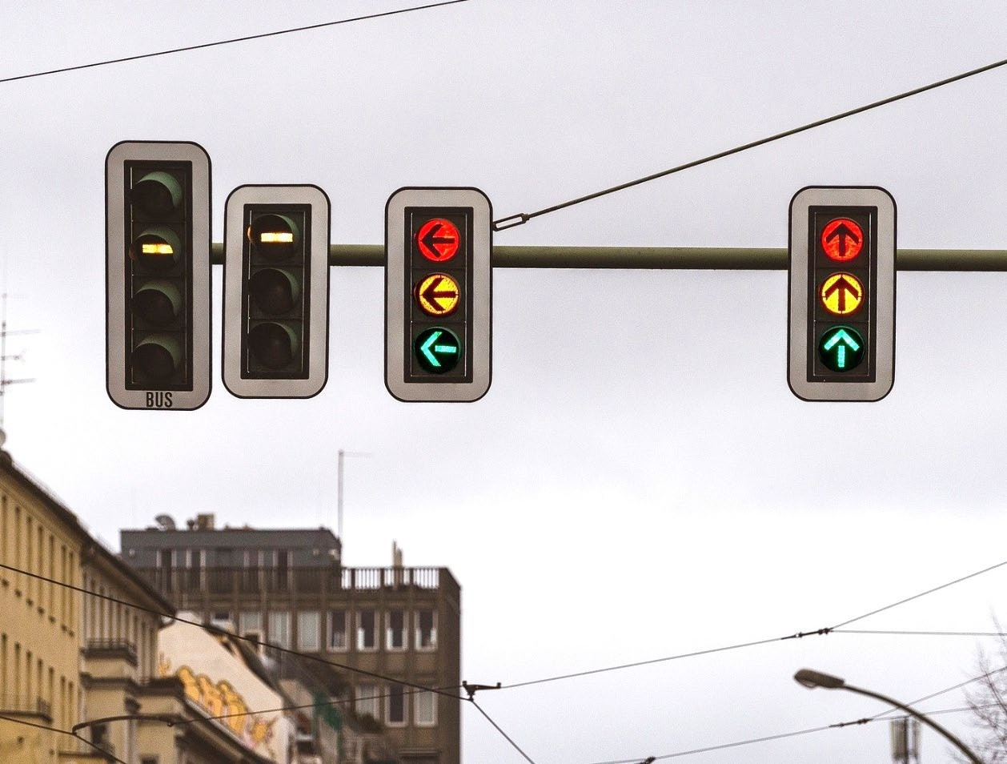
Traffic signal system components
System components - Signal transmitter
Visually transmit control information to road users
Signal transmitter for
  Motor vehicles
  Pedestrian traffic (visual and acoustic)
  Bicycle traffic
  Trams/buses
  Auxiliary signals, speed signals
Light fields in vertical arrangement
  1-, 2-, or 3-field design (for public transport, sometimes also more fields)
  Diameter 200 mm (also 300 mm depending on the situation)
  Contrast aperture with opposing background

Slide 9
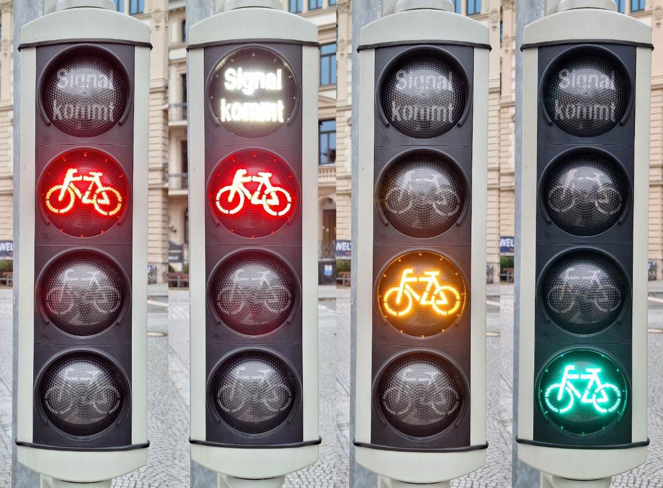
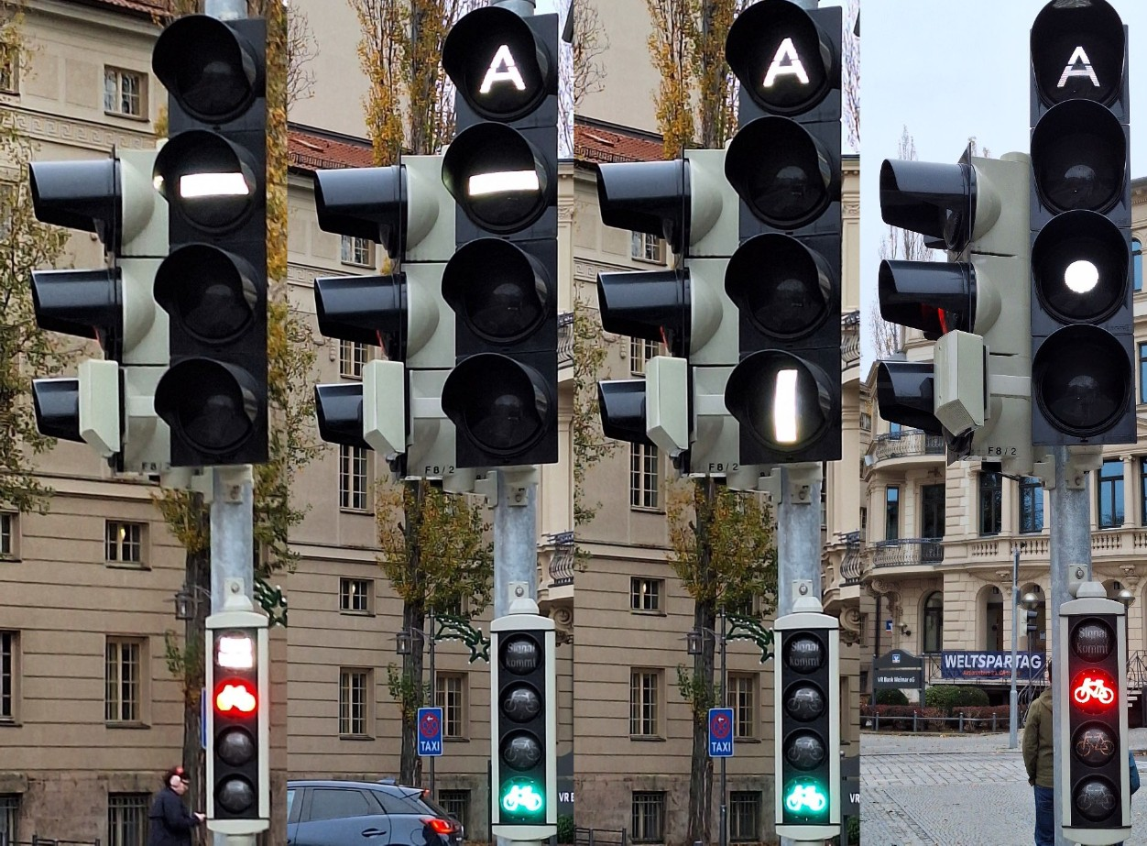
Traffic signal system components

Slide 10
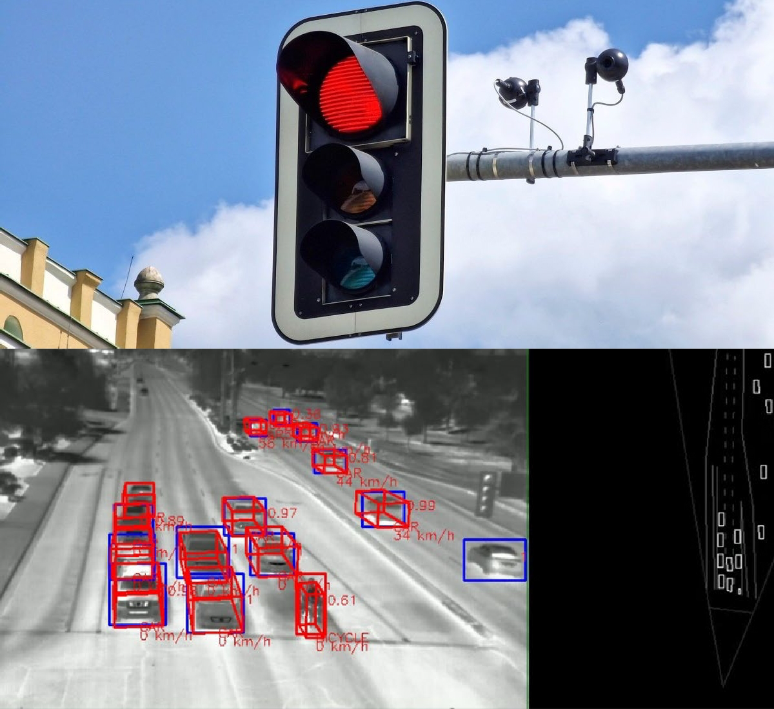
Traffic signal system components
System components - Signal transmitter
Detectors for vehicle traffic
Different sensor types
  Induction loops
  Infrared, thermal image
  Video
  Radar, ultrasound
  Lidar
Use for
  Dimensioning
  Congestion detection
  Counting

Slide 11
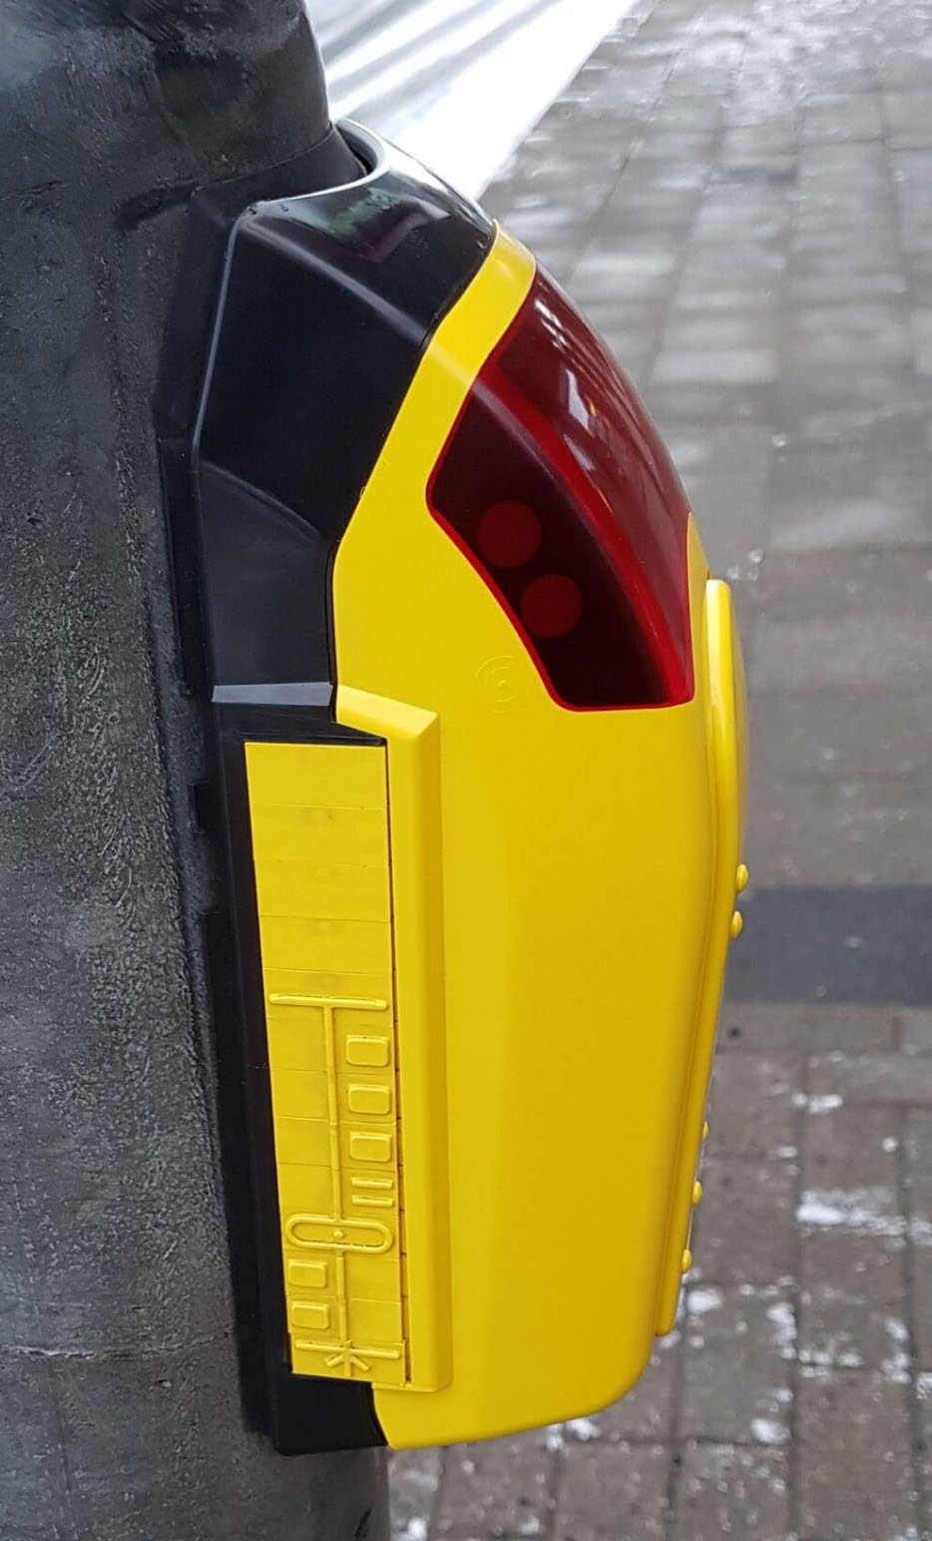
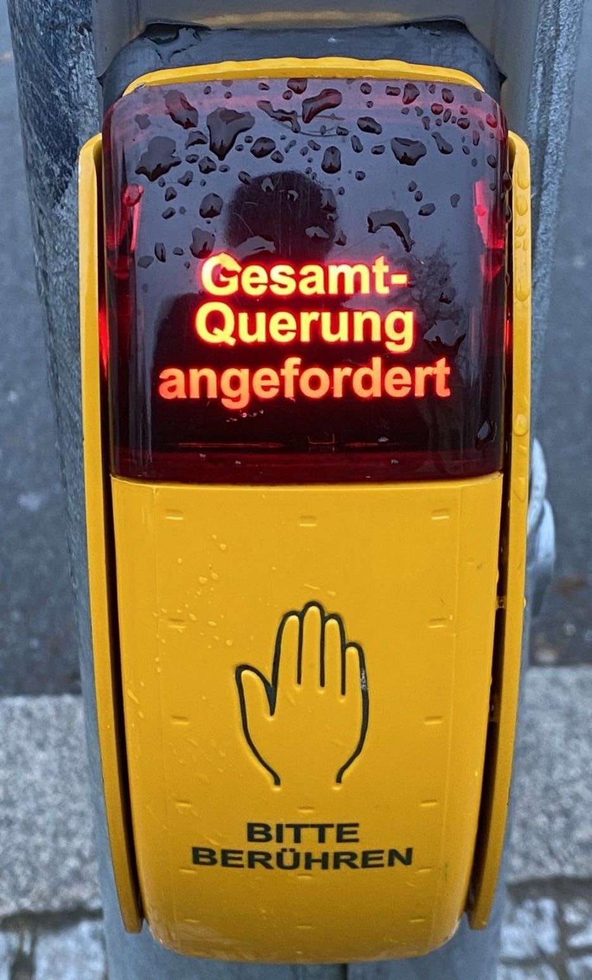
Traffic signal system components
Detector for requesting Pedestrian traffic
Wide range of designs and technologies
  Push-button, touch detector,...
Confirmation display
Support for people with visual impairments
  Additional button for activating acoustic signals ' Vibrating elements
  Tactile elements to indicate the direction of travel
  Tactile elements to describe the crossing (relief symbol)

Slide 12
Signal position plan
Signal position plan
Included information:
Junction geometry (access roads, lanes, Krebs, islands)
Markings
  Stop lines, fords
  Lane markings, guidelines
  Arrow markings
Traffic signs regulating right of way
  Z. 306 for privileged access roads
  Z. 205 or Z. 206 for access roads requiring waiting
• Masts, signal heads, signal groups (SGR)
• Position of detectors and buttons
Image: RiLSA example collection (FGSV 2017)

Slide 13
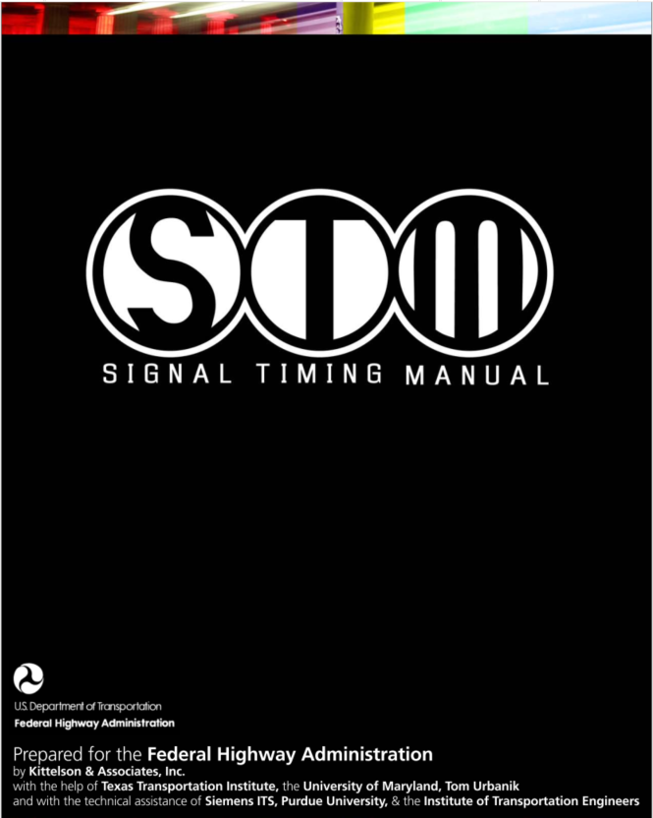
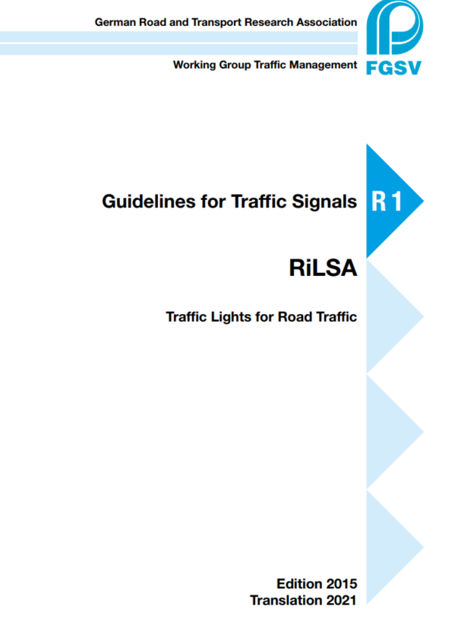
Signal Timing Manuals and Guidelines
https://ops.fhwa.dot.gov/publications/fhwahop08024/fhwa_hop_08_024.pdf
https://www.fgsv-verlag.de/pub/media/pdf/321_E.v.pdf

Slide 14
TERMS AND DEFINITIONS
Components of a Signal Cycle:
Cycle: One complete rotation through all signal indications.
      A cycle includes green, yellow, red, and all-red intervals
      Each legal movement gets a green at least once per cycle,
      Cycle is the basic unit of signal design
Cycle length(C): Total time required to complete one full cycle.
      Measured in seconds
      Typical cycle lengths: 40–120 seconds
      Long cycles increase capacity but also increase delay
Signal Phase: Total time required to complete one full cycle.
      Measured in seconds
      Typical cycle lengths: 40–120 seconds
      Long cycles increase capacity but also increase delay
      Phase (G_{i} + Y_{i} + ar_{i})

Slide 15
TERMS AND DEFINITIONS
Interval: A period during which no signal indication changes.
  Change interval (y_{i}):
    Yellow indication and transition from green to red,
    Allows vehicles that cannot stop safely to enter the intersection legally,
    Prevents sudden braking and collisions,
  Clearance Interval (All-Red Interval), ar_{i}
    Vehicles that entered during the yellow clear the intersection safely
    Avoid conflict between vehicles leaving the intersection and vehicles starting a new phase
  Green interval (G_{i}):
    Movement is permitted to proceed
    Green time is allocated based on traffic demand and priority
  Red interval (R_{i}):
    Movement is prohibited
    Red time includes the time when other movements have green, yellow, or all-red

Slide 16
Types of Signal Operation
Traffic signals operate in different modes depending on detectors and demand:
    Pretimed operation
      Cycle length, phase sequence, and intervals are constant
      Same timing repeats continuously
      Simple, predictable, low cost
      Cannot respond to sudden demand changes
    Semi-actuated operation
      Detectors placed on minor approaches only
      Major road remains green unless a call is detected
      Best for major road carries continuous flow

Slide 17
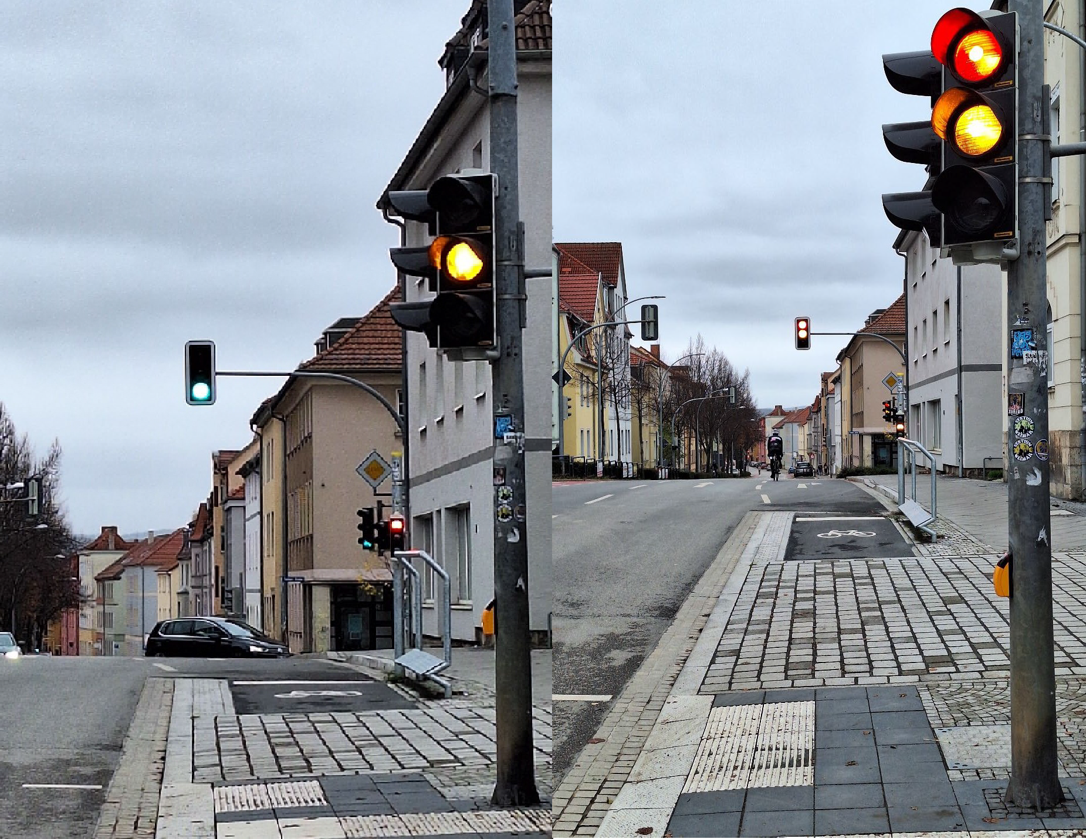
Types of Signal Operation
    Fully actuated operation
      Detectors placed on every lane of every approach
      Signal timings vary from cycle to cycle
      Green times are adjusted based on demand
      Efficient allocation of green time
      Reduced delay under variable demand
    Coordinated operation (system control)
      In urban areas, intersections are close together. Hence, signal coordination aims to:
      Reduce stops along an arterial
      Create smooth traffic progression
      Improve travel time and reduce delay

Slide 18
Discharge Headways and Saturation Flow
When the signal turns green:
    Vehicles stored in a queue start moving
    Vehicles discharge through the stop line
    Headways between vehicles can be measured
As the queue moves, headway measurements can be taken as follows:
    First headway: from green start to first vehicle crossing
    Second headway: between the first and second vehicle front wheel crossing the stop line
    Subsequent headways follow similarly

Slide 19
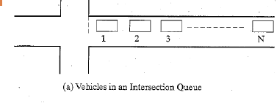
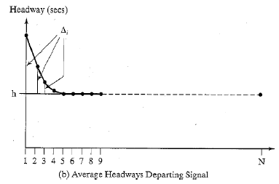
Discharge Headways and Saturation Flow
Headway behavior in a Queue
  First headway is largest (reaction + acceleration)
  Second headway is shorter
  Headways gradually decrease
  Eventually stabilize at a constant value

Slide 20

Discharge Headways and Saturation Flow
Saturation headway (h):
    Constant headway achieved when the average headway level out
    Usually begins after 4th or 5th vehicle
    Measured in seconds per vehicle (s/veh)
Saturation flow rate (s):
    Maximum flow rate possible if green were always available.
    Where:
      s = saturation flow rate (veh/h of green per lane)
      h = saturation headway (s/veh)

Slide 21
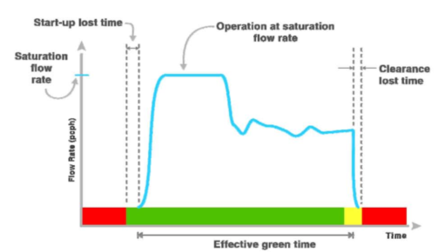
Discharge Headways and Saturation Flow
Saturation flow represents:
    The “ideal capacity” of a lane during continuous green
    The maximum discharge ability under saturated conditions
    However,
    Actual intersection capacity depends on effective green time, and there are lost times
Source: Signal Timing Manual, FHWA

Slide 22

LOST TIMES
Start-Up Lost Time-at the beginning of the green:
  Drivers react and accelerate slowly,
  The first three or four headways are larger than the saturation headway,
  The sum of these extra headways is known as “Start-up Lost time.”
  where:
  = start-up lost time, s/phase
  =incremental headway (above “h” seconds) for vehicle i, s

Slide 23
LOST TIMES
Clearance Lost Time: at the end of the green
  Vehicles may not fully use the remaining green time
  The last vehicle may cross the stop line before the green ends
  This unused time is called “Clearance Lost time (l₂ )”
Total Lost Time at the end of the green:
  Total lost time per phase:
  Total Lost Time per phase (s/phase) = l₁ + l₂

Slide 24

Effective Green Time
The actual signal goes through a series of intervals for each phase: Green, Yellow, All-red, Red
The Yellow and All-red intervals are transitions between Green and Red
In terms of modeling, only two time periods are important
  Effective Green Time: is the actual time vehicles can discharge at saturation flow.
  Effective Red Time: the amount of time that the vehicle is not moving

Slide 25

Capacity of Signalized Lane Group
The Capacity of an Intersection lane or lane group may be computed as:
Where:
c_{i} = capacity of lane or lane group i, (veh/h)
s_{i} = saturation flow rate (veh/hg)
g_{i} = effective green time (s)
C = cycle length (s)

Slide 26
Example-1
Consider a given movement at a signalized intersection with the following known characteristics:
Cycle length, C= 60s
Green time, G=27s
Yellow plus all-red, η=4s,
Saturation headway, h=2.4 s/veh
Start-up lost time, l1= 2.0 s,
Clearance lost time, l2= 2.0 s
What is the capacity per lane for this movement?

Slide 27
Example-1
Solution:
Saturation flow s_{i}= 3600/h = 3600/2.4= 1500 veh/hg/ln
Effective green time = G + Yi – t_{L}
= 27 + 4 – (2 + 2)= 27 s
Capacity, c = 1500 * 27/60 = 675 veh/h/ln

Slide 28
Critical Lane and Time Budget
Time Budget: is the allocation of time to various vehicular and pedestrian movements.
  Time budget allocates:
      effective green time
      lost times
      pedestrian phases
Critical Lane: is the lane that controls signal timing for a phase.
      It is NOT always the lane with the highest volume.
      It is the lane with the highest demand intensity, considering turning movements, heavy vehicles, lane conditions, and pedestrian effects

Slide 29
Critical Lane and Time Budget
General rules for Critical Lane Identification;
Each phase has one critical lane and critical-lane flow
Only one critical lane can be served at a time (excluding overlaps)
Lost time occurs in every phase
Overlapping phases must preserve the “one critical lane moving” rule

Slide 30
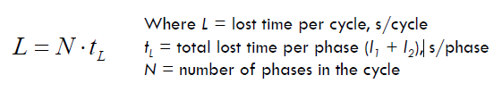
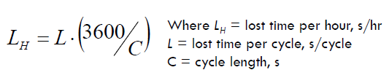
Critical Lane and Time Budget
To determine the Maximum Sum of Critical Lane Volumes:
    Determine the total lost time in the hour
    Divide the remaining time (total effective green time) by saturation headway
Assuming the total lost time per phase (t_{L}) to be constant for all phases, the total lost time per signal cycle is:
The total lost time in an hour depends upon the number of cycles occurring in the hour:

Slide 31



Critical Lane and Time Budget
The remaining time within the hour is devoted to effective green time for the critical lane movements,
where:
    = total effective green time in the hour, s
This time may be used at a rate of one every “h” seconds, where h is the saturation headway:
where:
    = maximum sum of critical lane volumes, veh/hr
    = saturation headway, s/veh

Slide 32
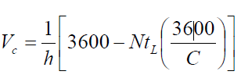
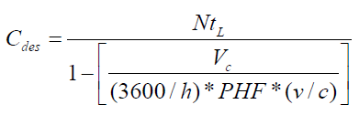
Critical Lane and Time Budget
Critical lane capacity relationship:
Key trends:
    Increasing cycle length increases capacity (less lost time per hour),
    Increasing number of phases reduces capacity (more lost time)
Desirable cycle length (C_{des}), s
    Peak Hour Factor (PHF): to account for the flow rate in the worst 15-minute period of the hour
    v/c (volume to capacity ratio) – to provide some excess capacity to avoid failure of individual cycles or peak periods on a specific day

Slide 33
Discussion Questions
Why does saturation flow vary significantly across intersections?
How do lost times affect capacity and signal efficiency?
Why do more phases reduce intersection capacity?

Slide 34
Exercise Problem
Given:
Cycle length = 80 s
Green = 35 s
Yellow + all-red = 5 s
Start-up lost time = 2 s
Clearance lost time = 3 s
Saturation headway = 2.2 s/veh
Calculate:
Compute saturation flow rate
Compute effective green time
Compute lane capacity

