Slide 1
Traffic Engineering
Lecture 5.3: Capacity and Level of Service (LOS) Analysis –
Freeways & Multilane Highways

Slide 2
Learning objectives
At the end of this lecture, students should be able to:
Identify freeway and multilane highway facility types
Compute LOS using density criteria
Estimate free-flow speed (FFS) for freeway and multilane segments
Adjust flow rates using PHF and heavy vehicle factors
Conduct capacity and LOS analysis using HCM methodology

Slide 3
Lecture outline
Uninterrupted flow facilities
Freeways
Multilane Highways
Base Speed–Flow Curves
LOS Criteria
Service flow rates and capacity
Determining Free-Flow Speed
Basic reference:
Roger P. Roess; Elena S. Prassas; William R. McShane, Traffic Engineering, 5th edition, Pearson, 2019 (Chapter 13, pp 275-284)

Slide 4

Uninterrupted flow facilities:
Traffic movement is not interrupted by traffic signals or stop control.
Vehicles can travel continuously with minimal forced stops.
Maximum access control
Example
    Freeways
    Long multilane highway segments with access control

Slide 5
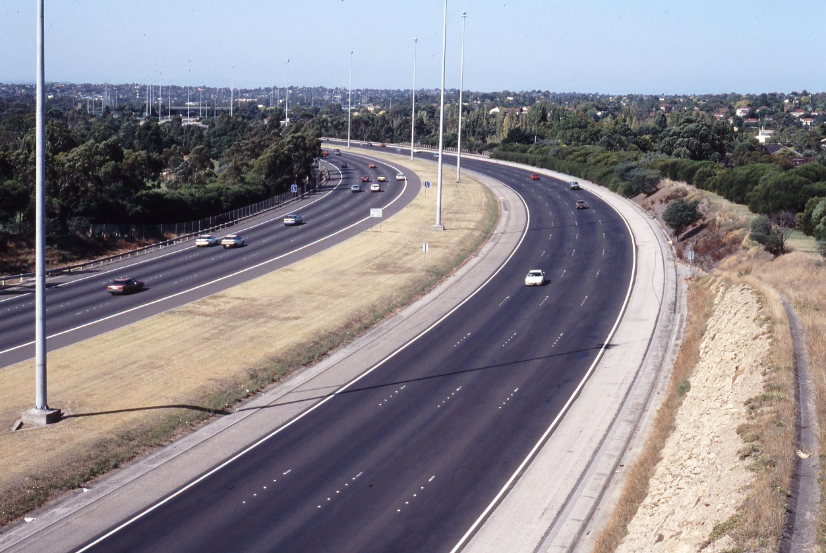
Freeways
Characteristics of Freeways
Is a separated highway with two or more lanes in each direction.
provide pure uninterrupted flow
No at-grade intersections
No driveway access
No parking permitted
Full access control
Entry/exit via ramps only
This Photo by Unknown Author is licensed under CC BY-ND

Slide 6


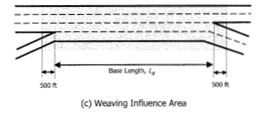
Freeways
Freeways
It includes :
  Basic freeway segment
  Freeway merger/diverge segment
  Freeway weaving segment
Source: Highway Capacity Manual 2010, TRB

Slide 7
Freeways
  Basic freeway segments: Segments of freeway that are outside the influence area of ramps or weaving areas.
  Freeway weaving areas: segments of freeway where two or more vehicle flows must cross each other’s path along a length of the freeway.
      They are usually formed when an on-ramp is followed by an off-ramp, and the two are connected by an auxiliary lane
  Freeway merger/diverge areas: points at which on-and off-ramps join the freeway.
      The junction formed at this point is an area of turbulence because of the concentration of merging or diverging vehicles.

Slide 8
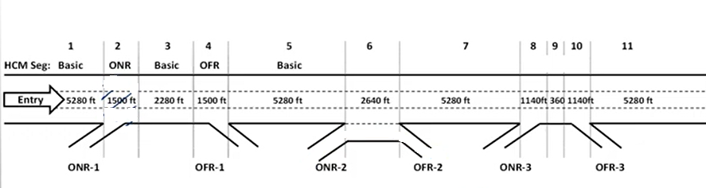
Freeways
Example:
Define the following freeway sections as basic, off-ramp (diverging), on-ramp (merging), or weaving.

Slide 9
Multilane Highways
Multilane highways can be:
    Undivided
    Divided (physical median)
    Two-Way Left Turn Lane (TWLTL)
Median type affects operations:
    Physical median limits midblock turns
    An undivided road allows turning anywhere
    TWLTL allows turning without blocking through flow

Slide 10
LOS Determination Process
Step 1 – Base Conditions
Example: Base Conditions for Freeway Segments include
    12-ft lanes
    6-ft right shoulder lateral clearance
    2-ft median clearance
    Passenger cars only
    More than 5 lanes per direction (urban case)
    2-mile or greater interchange spacing
    Level terrain (≤2% grades)
    Familiar driver population

Slide 11
Base Conditions for Freeway Segments:
Base Conditions for a basic Freeway Segment include:
    12-ft minimum lane width
    6-ft right shoulder lateral clearance
    2-ft median clearance
    Passenger cars only
    More than 5 lanes per direction (urban case)
    2-mile or greater interchange spacing
    Level terrain (≤2% grades)
    Familiar driver population

Slide 12
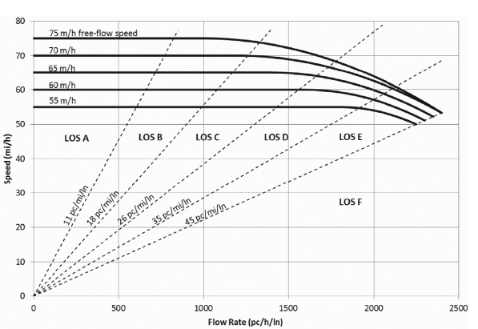
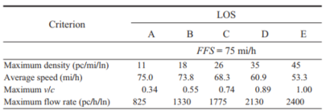
Base Speed–Flow Curves for Freeways
BFFS represents the free-flow speed under ideal conditions.

Slide 13
Service performance measures
The three main service measures for freeways are:
  Density (pc/mi/ln)
  Speed (mi/hr.), and
  Volume-to-capacity (v/c) ratio.
An indication of how well or how poorly traffic flow is being accommodated by the freeway segment.
For freeways/multilane highways:
    Speed remains almost constant over a wide range
    Speed differences between LOS categories are small
    Density changes significantly → better performance measure

Slide 14
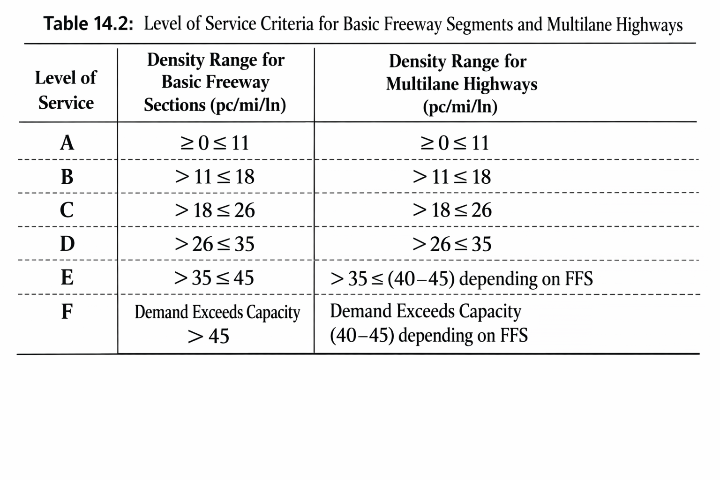
LOS Criteria
Source: Traffic Engineering, 5th edition

Slide 15
LOS Criteria
LOS A represents:
    Free-flow operations
    Little interaction among vehicles
    Lane changing is easy
    Average spacing ≥ 480 ft (~24 car lengths)
LOS B represents:
    Drivers begin responding to other vehicles
    Still near free-flow speed
    Average spacing ≥ 293 ft (~15 car lengths)

Slide 16
LOS Criteria
LOS C represents:
    Reduced maneuverability
    Free-flow speed maintained
    More driver effort needed for lane changes
    Average spacing ≥ 203 ft (~10 car lengths)
LOS D represents:
    Speed begins declining
    Difficult merging/passing
    Average spacing ≥ 151 ft (~7 car lengths)

Slide 17
LOS Criteria
LOS E represents:
    Operation near capacity
    Few usable gaps
    Small disruptions create shockwaves
    Average spacing ≥ 117 ft (~6 car lengths)
LOS F represents:
    Queue operation (breakdown conditions)
    Caused by incidents or demand > capacity
    Stop-and-go flow and unstable conditions
    Equivalent to v/c > 1.00
    Density cannot be predicted reliably

Slide 18
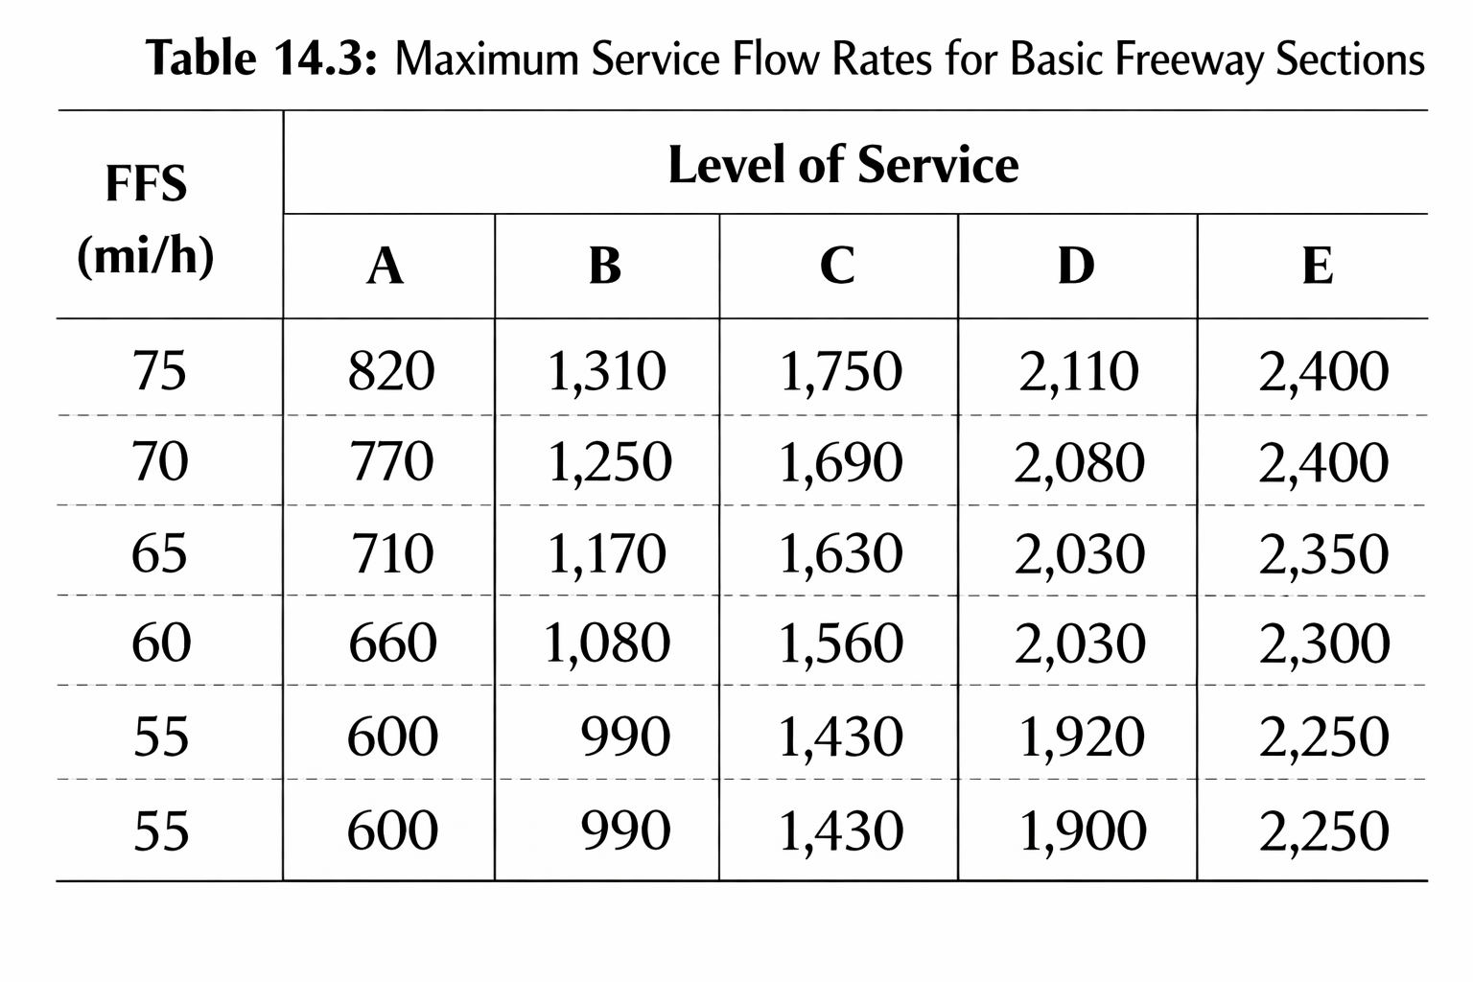
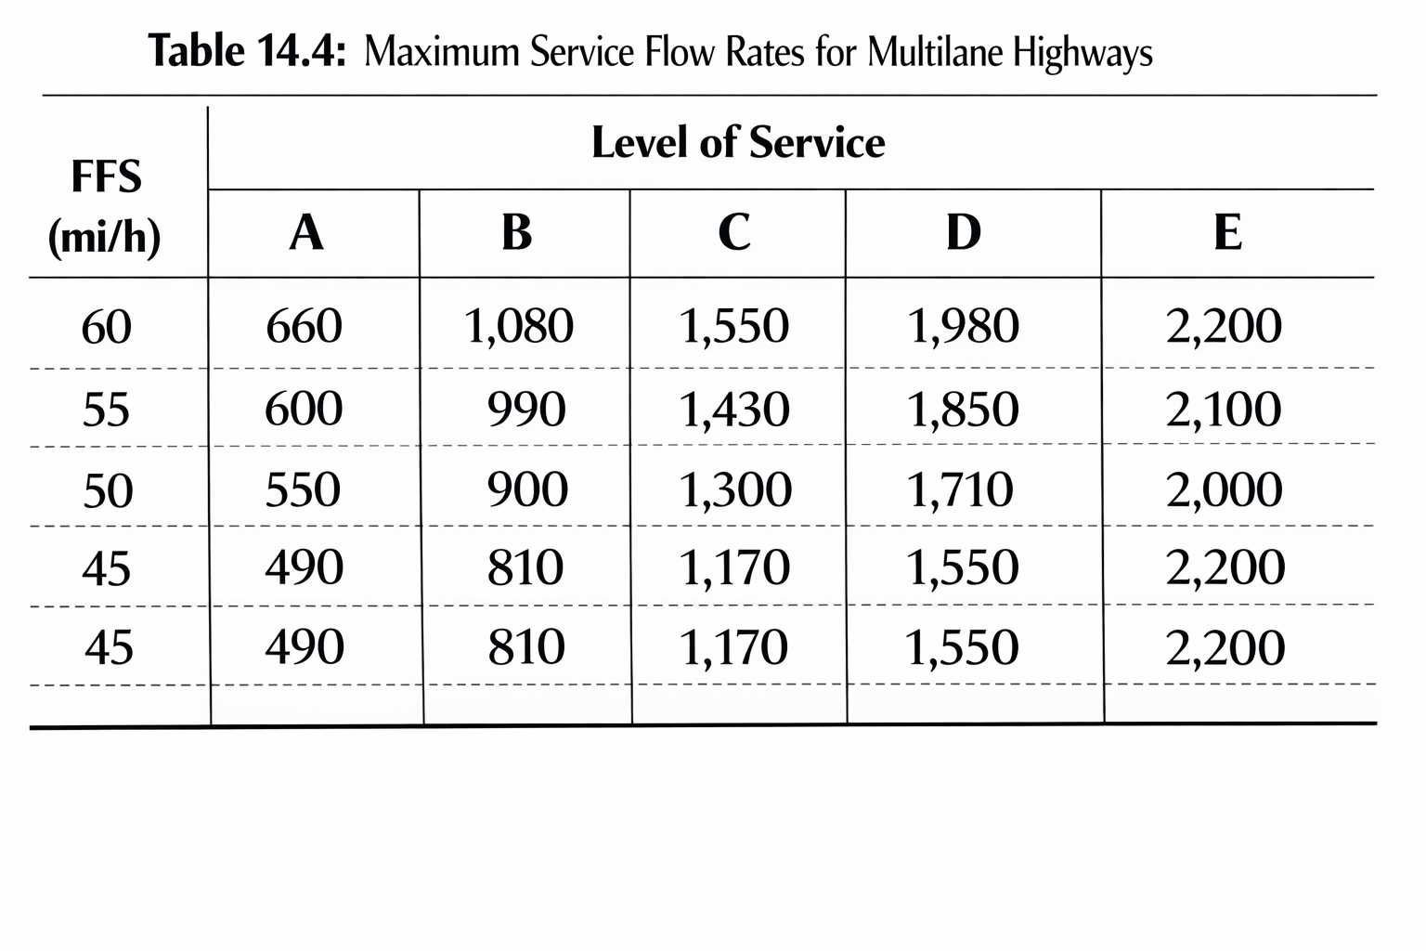
Service flow rates and capacity
Maximum service flow rate (MSF):
    Maximum flow allowed for each LOS
    Derived from speed-flow curves
Source: Traffic Engineering, 5th edition

Slide 19
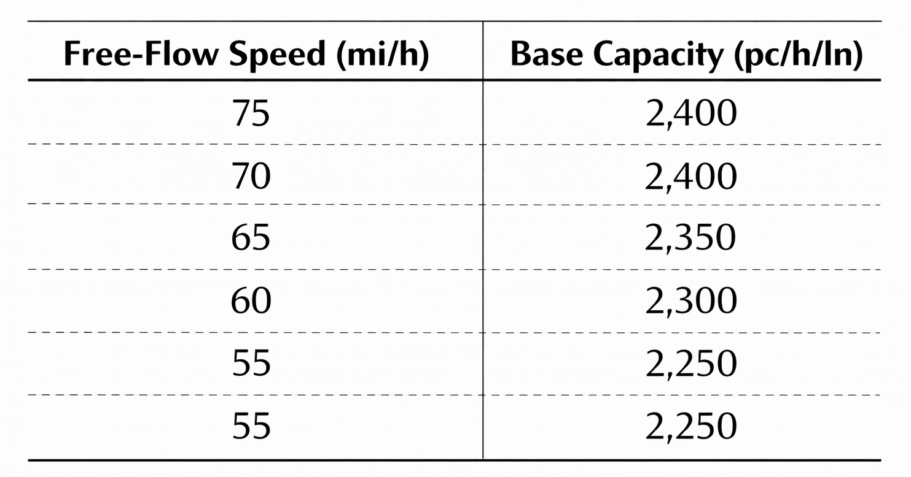
Service flow rates and capacity
Base curves assume ideal conditions.
Real facilities require adjustments due to:
    Lane width
    Lateral clearance
    Ramp/access density
    Heavy vehicles
    Unfamiliar drivers
Source: Traffic Engineering, 5th edition

Slide 20
Types of Analysis
Three types of analysis for basic freeway and multilane highway sections:
    Operational analysis
    Service flow/service volume analysis
    Design analysis

Slide 21
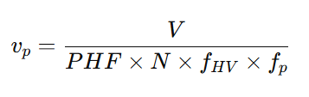
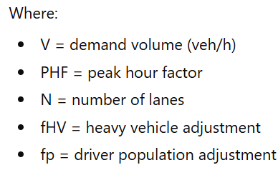
Operational Analysis
The most common form of analysis
All traffic, roadway, and control conditions are defined
Expected speed, density, and LOS determined
Adjusted demand flow rate per lane calculated as:

Slide 22
Operational Analysis
Using Speed–Flow Curves:
Procedure:
  Compute adjusted flow rate v_{p}
  Select appropriate FFS curve
  Read speed from the curve
  Compute density = v_{p} / speed

Slide 23
Operational Analysis
Example: If an adjusted demand flow (vp) of 1800 pc/h/ln is traveling on a freeway segment with a free-flow speed of 65 mi/h, what is the estimated LOS?
Given:
  vp = 1800 pc/h/ln
  FFS = 65 mi/h
Solution
  Speed from curve ≈ 62 mi/h
  Density = 1800 / 62 = 29 pc/mi/ln
  Hence, LOS = D (refer table on slide 15)
1800

Slide 24
Determining Free-Flow Speed
Gather important data, including
  Lane widths
  Right-shoulder lateral clearance between the edge of the travel lane and the nearest obstacle or object influencing traffic
  Percentage and type of vehicles (passenger cars, trucks, etc.)
  Number of on-or off-ramps within 3 miles upstream and down stream of the segment

Slide 25
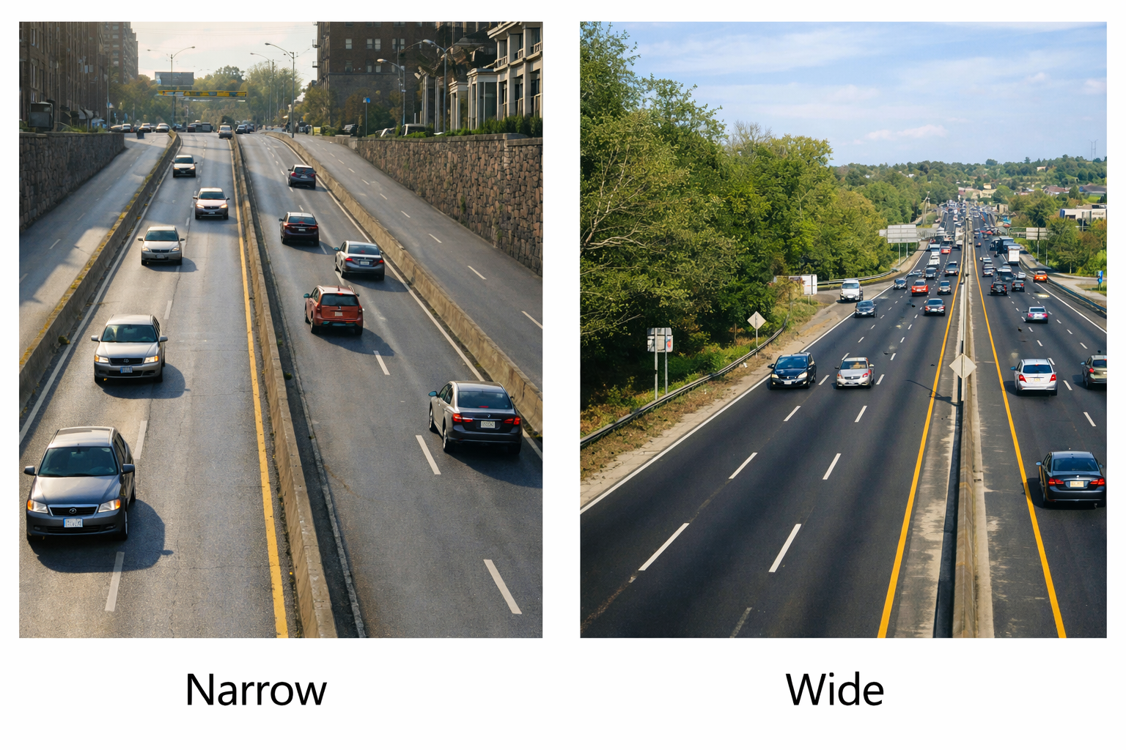
Determining Free-Flow Speed
Gather important data -Lateral clearance
Narrow
Wide

Slide 26
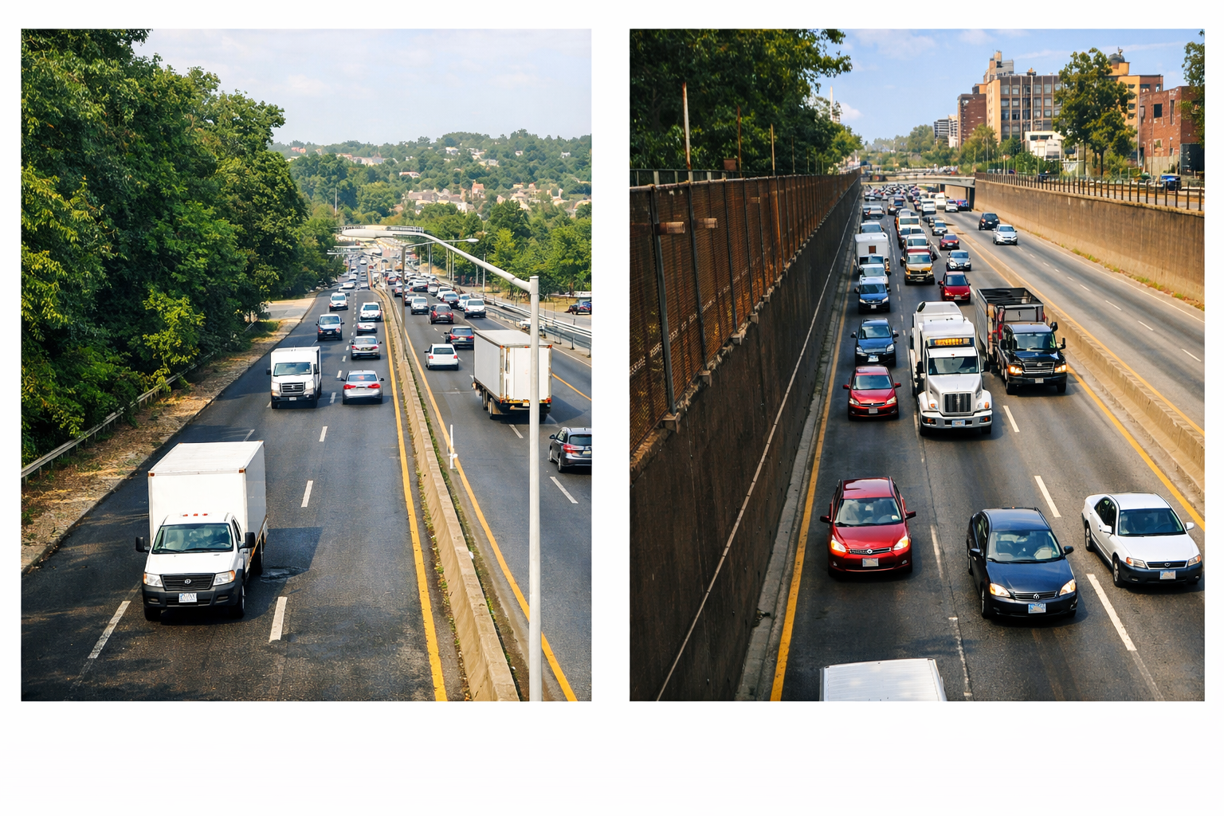
Determining Free-Flow Speed
Gather important data -Heavy vehicles

Slide 27

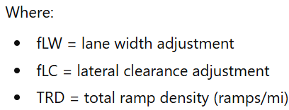
Determining Free-Flow Speed - Freeway
Estimate Free-flow speed if measurement is not possible
    Freeway FFS model:

Slide 28
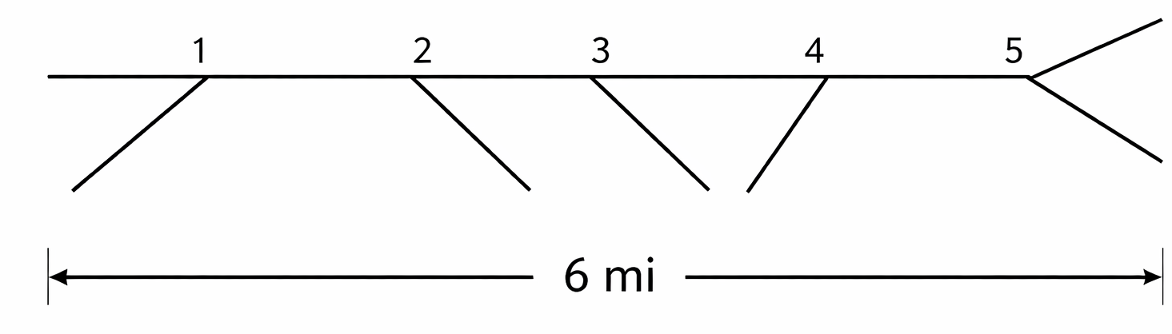
Determining Free-Flow Speed - Freeway
Total Ramp Density (TRD)
TRD is calculated as:
      Total ramps within ±3 miles of segment midpoint
      Divided by 6 miles
Example
    In the figure, there are four ramp terminals and one major diverge point in a 6-mile segment.
    Hence, TRD= 5/6 = 0.83 ramp/mi.
Higher TRD → lower FFS due to turbulence

Slide 29
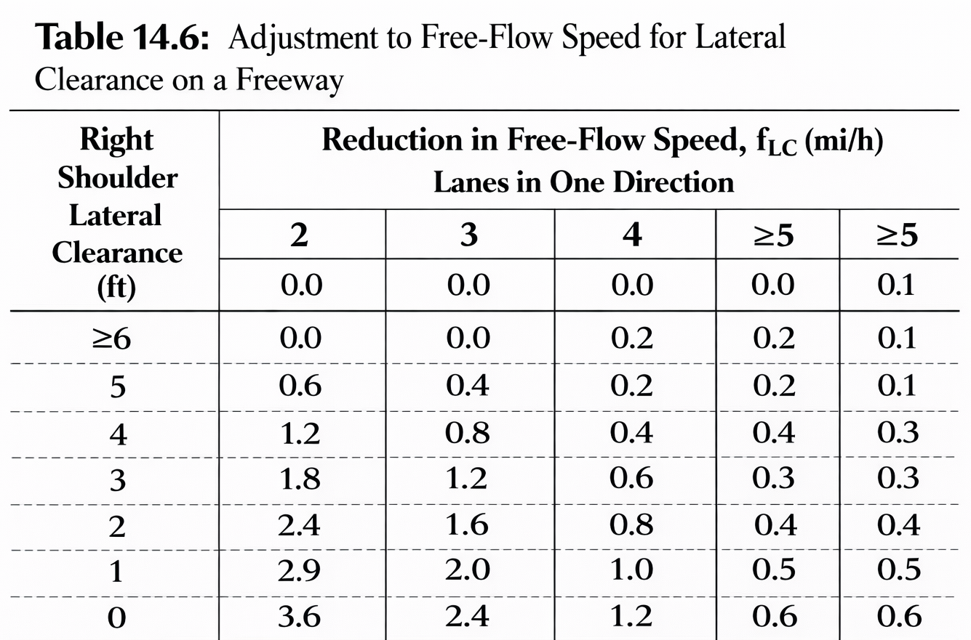
Determining Free-Flow Speed- Freeway
Lane Width Adjustment (Freeway)
    Base lane width = 12 ft; for narrower lanes, the base free-flow speed is reduced by
      > 12 ft → 0.0 mi/h
      11 ft → 1.9 mi/h
      10 ft → 6.6 mi/h
Lateral Clearance Adjustment
    Base right-side clearance = 6 ft
    For a narrower right-side clearance, adjustment is made
    Adjustment depends on the number of lanes
    No adjustment for median,
Source: Traffic Engineering, 5th edition

Slide 30

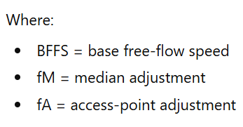
Determining Free-Flow Speed- Multilane
    Multilane highway FFS equation:
    Base Free-Flow Speed (Multilane)
      60 mi/h for rural/suburban multilane highways
      Or based on posted speed limit:
          For 40–45 mi/h → BFFS ≈ limit + 7 mi/h
          For 50–55 mi/h → BFFS ≈ limit + 5 mi/h

Slide 31
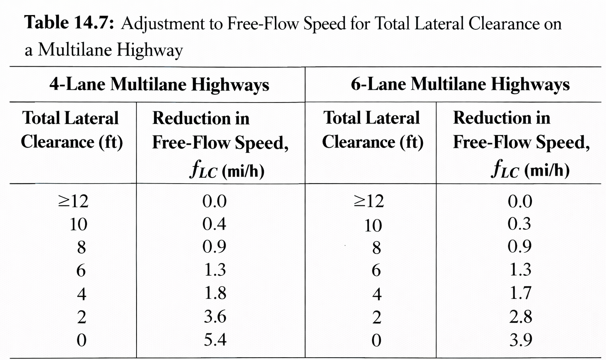
Determining Free-Flow Speed- Multilane
Lane Width Adjustment
    Base lane width = 12 ft; for narrower lanes, the base free-flow speed is reduced by
      > 12 ft → 0.0 mi/h
      11 ft → 1.9 mi/h
      10 ft → 6.6 mi/h
    The same as freeways
Total Clearance Adjustment
    Total lateral clearance = right + left clearance
    Maximum value per side = 6 ft
    Base total = 12 ft
    Undivided highway assumes 6 ft on the left to avoid double-counting
Source: Traffic Engineering, 5th edition

Slide 32
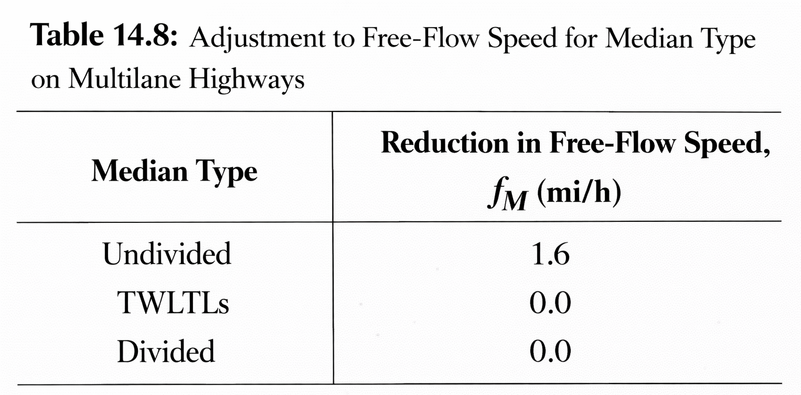
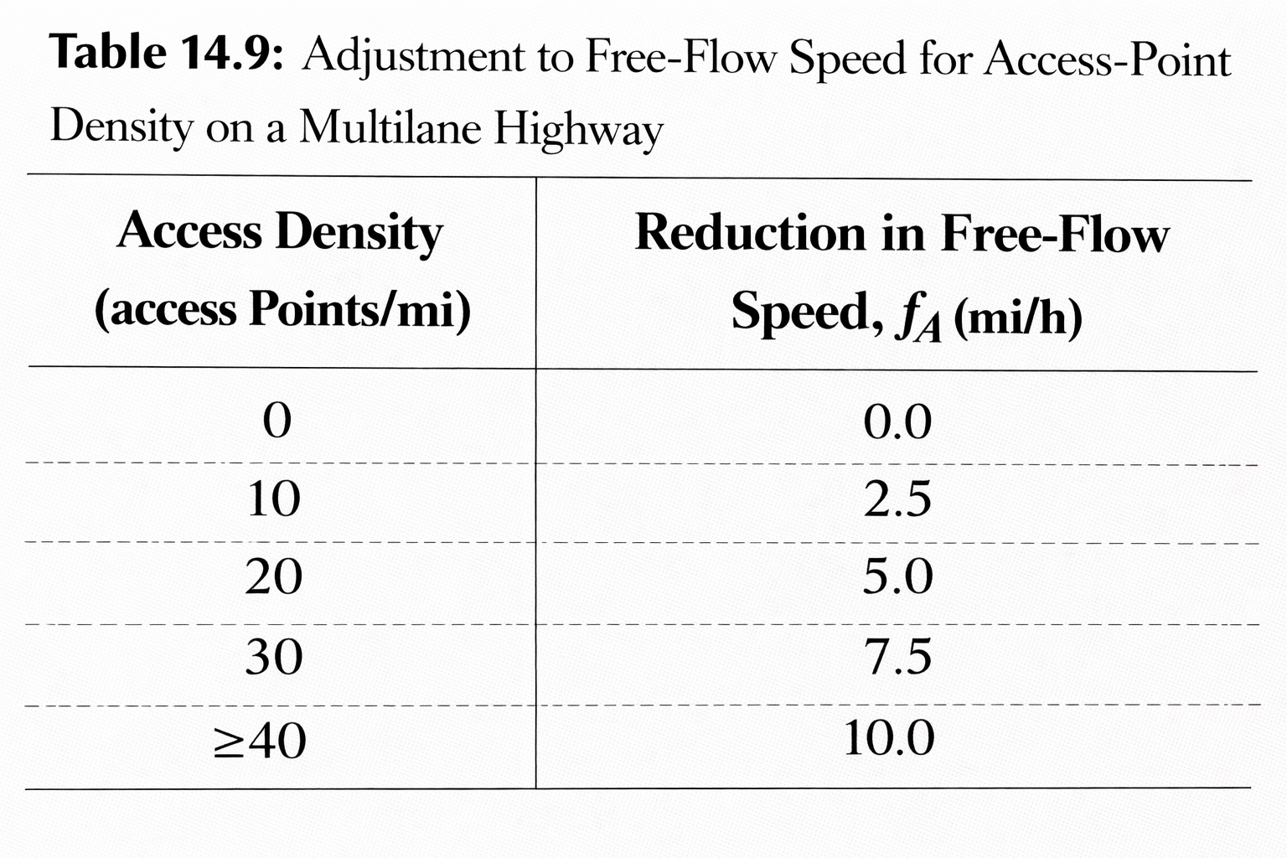
Determining Free-Flow Speed- Multilane
Median Type Adjustment
Access Point Density Adjustment
Source: Traffic Engineering, 5th edition

Slide 33

Example-1
An old 6-lane urban freeway has the following characteristics: 11-foot lanes; frequent roadside obstructions located 2 feet from the right pavement edge; and a total ramp density of 3 ramps/mile.
What is the free-flow speed of this freeway?
Solution:
The free-flow speed of a freeway may be estimated using Equation

Slide 34


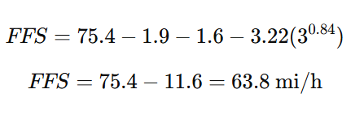
Example-1
Solution:
The following values are used in this computation:
    = 1.9 mi/h ( adjustment for 11-ft lanes, refer to the table on slide 30)
    =1.6 mi/h (2-ft lateral clearance, 3 lanes, refer to the table on slide 30)
    TRD = 3 ramps/mi (Given)
Hence,

Slide 35

Example-2
A four-lane undivided multilane highway in a suburban area has the following characteristics: posted speed limit = 50 mi/h, 11-foot lanes; frequent obstructions located 4 feet from the right pavement edge; 30 access points/mile on the right side of the facility.
What is the free-flow speed for the direction described?
Solution
The free-flow speed for a multilane highway is computed using Equation

Slide 36



Example-2
Solution
The base free-flow speed based on the posted speed limit of 50 mi/h, calculated as: 50+5=55 mi/h
Adjustments to the base free-flow speed are as follows:
    =1.9 mi/h (for 11-ft lanes)
    =0.4 mi/h (total lateral clearance = 10 ft, 4-lane highway)
    =1.6 mi/h (Median adjustment for undivided highway)
    =7.5 mi/h ( Adjustment for 30 access points/mi)
Hence,

Slide 37
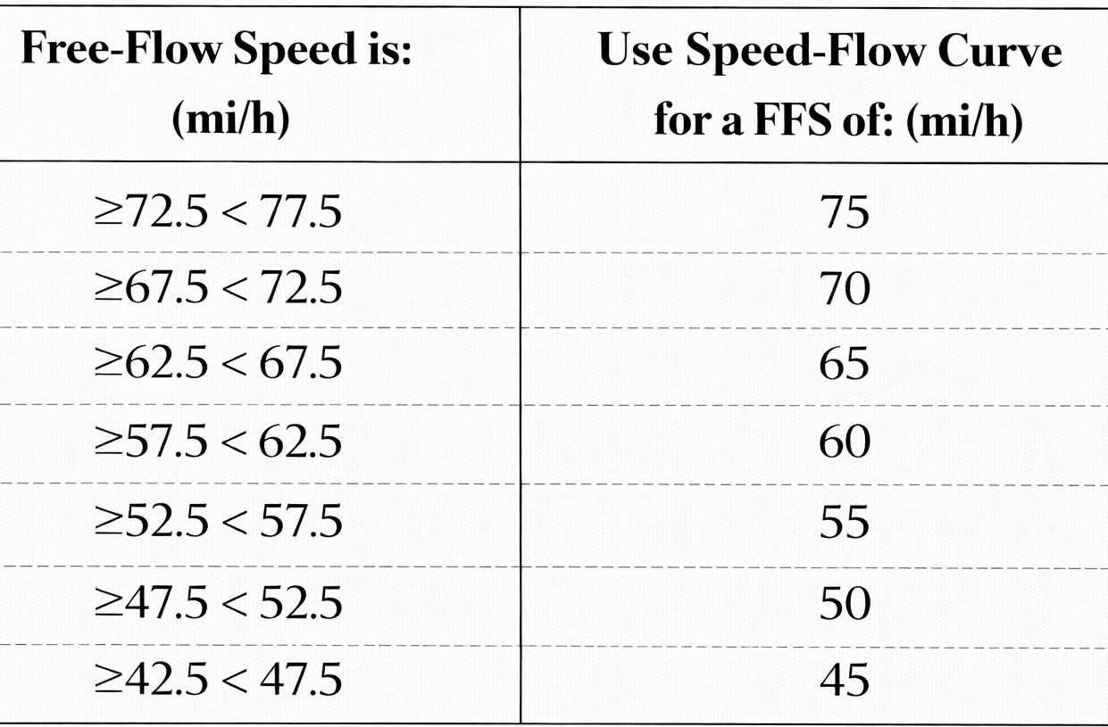
Determining Free-Flow Speed
Choosing the Correct FFS Curve
Do not interpolate curves.
Use the nearest curve as shown in the table.
  Example: In the previous examples, the free-flow speeds were estimated as 63.8 mi/h for the freeways (example 1) and 43.6 mi/h for the multilane highway (example 2). Determine the correct FFS curves.
  For free-flow speed 63.8 mi/h => FFS curve is 65 mi/h
  For free-flow speed 43.6 mi/h => FFS curve is 45 mi/h

Slide 38
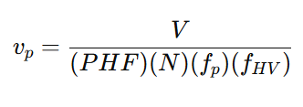
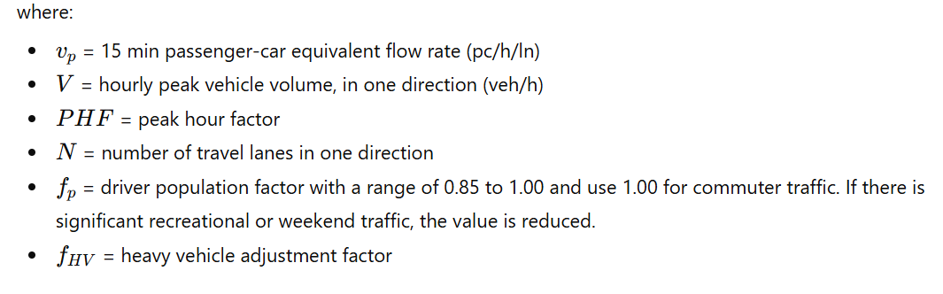
Calculate Analysis Flow Rate
This step includes the following tasks
  Adjust for PHF
  Adjust for vehicle mix
  Adjust for driver population

Slide 39
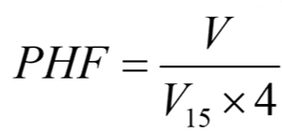
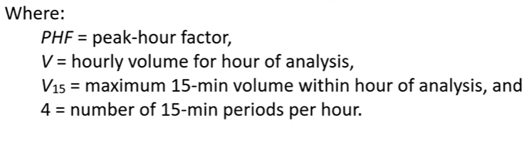

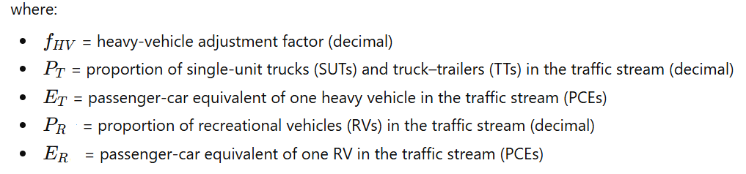
Calculate Analysis Flow Rate
Peak Hour Factor (PHF)
Heavy vehicle adjustment factor (f_{HV}):

Slide 40
Calculate Analysis Flow Rate
Passenger Car Equivalency (PCE) factor
    Two vehicle classes
      Trucks and Buses (T)
      Recreational vehicles (RVs)
    Passenger equivalence values
      1 Trucks = 2.5 passenger car
      1 RV = 2.0 passenger car
    However, for different terrains, the PCE values will be
      Level terrain: ET = 1.5, ER = 1.2
      Rolling terrain: ET = 2.5, ER = 2.0
      Mountainous terrain: ET = 4.5, ER = 4.0
    Detailed values of PCE are also available for different grades

Slide 41
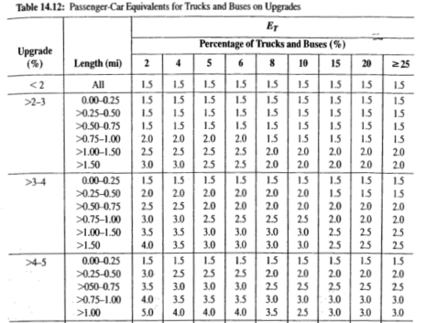
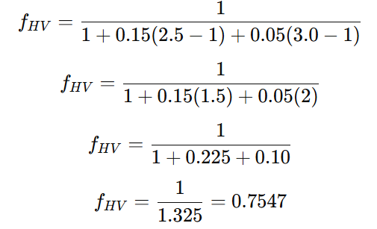
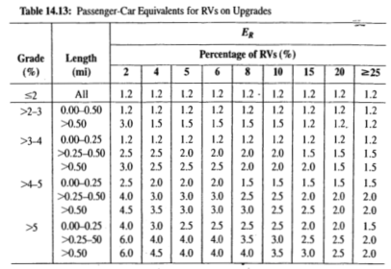
Example-3
Consider the following situation: A volume of 2,500 veh/h traverses a section of freeway and contains 15% trucks and 5% RVs. The section in question is a 5% upgrade, 0.75 miles long. What is the equivalent volume in passenger-car equivalents?
Solution:
first determine E_{T} =2.5 and E_{R} = 3.0 from the tables for 5% grade and a 0.75-mile length
The heavy-vehicle adjustment factor is computed as:

Slide 42

Example-3
Solution:
Hence, the passenger-car equivalent volume is estimated as:
Alternative Method (Direct Application of PCEs)
    The solution can also be found by applying passenger-car equivalents directly:
    Truck PCE: 2500 X 0.15 X2.5 = 938
    RVs PCE : 2500 X 0.05 X 3.0 = 375
    Passenger cars: 2500 X 0.80 X 1.0 = 2000
    Hence, Total PCE = 2000+ 375+ 938= 3,313

Slide 43
Calculate Analysis Flow Rate
Driver Population Factor (f_{p})
    The value for f_{p} ranges from 1.0 to 0.85.
    Consider 1.0 for commuter traffic (i.e., familiar road users)
    Unless there is sufficient evidence available, a value of 1.0 is generally used.
    Where future situations are analyzed, and recreational users dominate, a value of 0.85 is suggested.

Slide 44
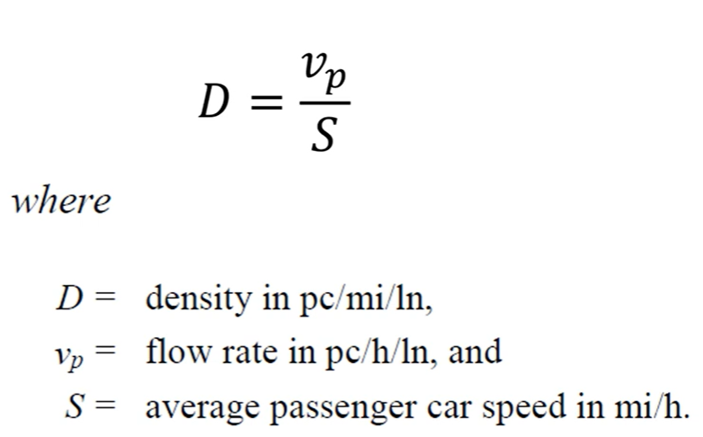
Calculate Density and LOS
Density

Slide 45
Calculate Density and LOS
LOS

Slide 46
Example-4
A six-lane urban freeway (three lanes in each direction) is on rolling terrain with 11-ft lanes, with obstructions 2 ft from the right edge of the traveled pavement, and 9 ramps within 3 miles upstream and 3 miles downstream of the midpoint of the analysis segment. The traffic stream consists primarily of commuters. A directional weekday peak-hour volume of 2300 veh/h is observed, with 700 vehicles arriving in the most congested 15-minute period. If the traffic stream has 15% large trucks and buses and no recreational vehicles, determine the level of service (LOS).

Slide 47
Example-4
Given:
    Lane width = 11 ft
    Right-shoulder lateral clearance=2 ft
    Heavy vehicle percentage = 15%
    No. of ramps within 3-mi upstream and downstream =9
    Terrain type = rolling
    Driver population = frequent commuters or familiar users

Slide 48





Example-4
Solution:
Step 1 — Estimate free-flow speed (FFS)
    For freeway FFS model:
      = 1.9 mi/h ( Lane adjustment for 11-ft)
      = 1.6 mi/h ( Adjustment for Lateral clearance of 2-ft)
      Compute total ramp density (TRD)
          There are 9 ramps within a total length of 3+3=6 miles.
          Hence,
    Accordingly, the appropriate FFS curve is the 65 mi/h curve

Slide 49




Example-4
Solution:
Step 2 — Determine the flow rate ( )
  Compute Peak Hour Factor (PHF)
  Heavy-vehicle adjustment factor ( )
  use equation

Slide 50


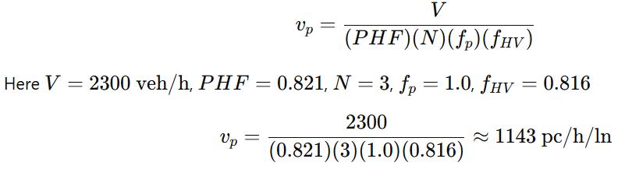
Example-4
Solution:
Step 2 — Determine the flow rate ( )
  Heavy-vehicle adjustment factor ( )
      However, P_{T}= 0.15, P_{RV} = 0
      For rolling terrain basic freeway segment, E_{T} = 2.5
      Hence,
    Driver population factor for commuters:
  Therefore, Passenger-car equivalent flow rate per lane will be:

Slide 51


Example-4
Solution:
Step 3 — Determine the Density and LOS
    For a basic freeway segment, LOS is determined primarily by density:
    At this moderate flow, the average speed is close to the free-flow speed; use S=65 mi/h
    Since D=17.6, the facility operates at: LOS =B
    Level of Service (LOS) = B (stable flow with slight restrictions; speeds near free-flow and moderate density).

Slide 52
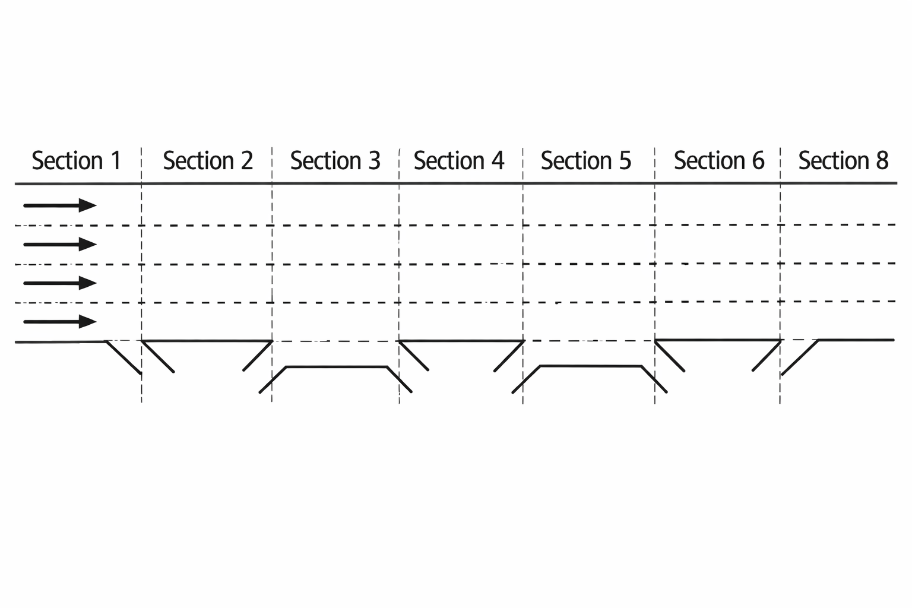
Exercise
Example:
Define the following freeway sections as basic, off-ramp (diverging), on-ramp (merging), or weaving.

Slide 53
Additional references
Transportation Research Board (TRB). Highway Capacity Manual, Washington, DC: The National Academies Press, 2010.
https://www.youtube.com/watch?v=V3bEdLs_8pE&t=385s
https://www.sciencedirect.com/science/article/pii/S2352146516305324

