Slide 1
Ingénierie du trafic
Cours 2.3 : Théories des files d’attente

Slide 2
Objectifs d’apprentissage
Discuter the fundamentals of théorie des files d’attente
Comprendre deterministic and stochastique file analyse
Définir the paramètres required to fully specify a file
Analyser the performance of systèmes in file

Slide 3
Plan du cours
Principes de base de la théorie des files d’attente
Queueing théories: Deterministic analyse
Queueing théories: stochastique analyse
Référence principale :
Garber, N. J., & Hoel, L. A. (2009). Chapter 6: Fondamental Principles of flux de trafic. In Traffic and Route Engineering (4th ed., pp. 253–305).

Slide 4

Principes de base de la théorie des files d’attente
Regarder the following vidéo and résumer the clé principles of théorie des files d’attente.
https://www.youtube.com/watch?v=SqSUJ0UYWMQ

Slide 5

Théories des files d’attente
théorie des files d’attente in ingénierie du trafic involves mathematical modeling to décrire the processes by which traffic les files se forment and dissipate.
On uninterrupted débit, les files se forment behind breakdown points at which arriving demande débit exceeds capacité,
On infrastructures à écoulement interrompu, queueing forms at every intersection à feux.

Slide 6
Théories des files d’attente
It is utilisé to analyser the retard, longueur de file, and service efficacité at goulots d’étranglement such as postes de péage, intersections à feux, and zones de travaux.
théorie des files d’attente is generally divided into two analytical approaches:
  Deterministic (for oversaturated conditions) and,
  stochastique (for random arrivals).

Slide 7

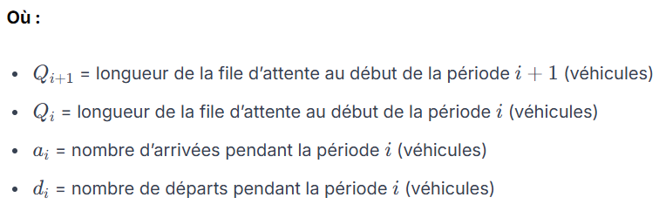
Queuing Théories Deterministic Queueing Analyse
The longueur of the file is the difference between arrivals and departures at a point.

Slide 8
Exemple
Consider a section of a three-lane route with a capacité of 2000 véh/h/ln. If an incident occurs that results in the closure of one voie for 90 minutes. Assume the demande volume is 5000 véh/h throughout the incident période.
  Before the incident, the is NO File because the demande volume is less than the capacité.
  During the incident, the demande volume (arriving véhicules) is higher than the reduced capacité of the route, which results in the formation of a File.
  Once the incident is removed, the File will take some temps to dissipate, and the normal débit will be restored.
  The following Figures show the scenario presented above.

Slide 9
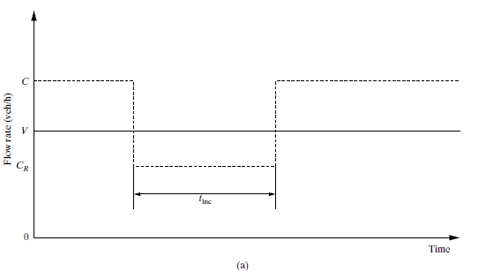
Queuing diagram for an incident situation
Source: Garber, N. J., & Hoel, L. A. (2009). Traffic and Route Engineering (4th ed., pp. 251)

Slide 10
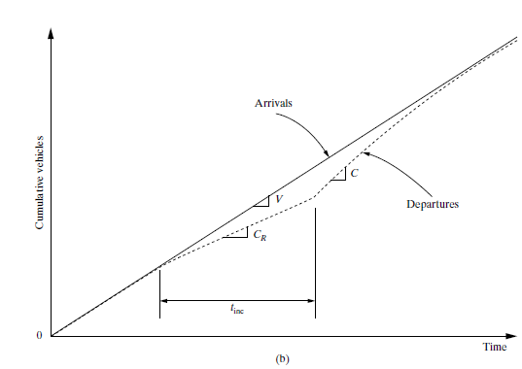
Queuing diagram for an incident situation
Source: Garber, N. J., & Hoel, L. A. (2009). Traffic and Route Engineering (4th ed., pp. 251)

Slide 11
Example (continued..)
The maximum longueur de file is the excess demande rate multiplied by the duration of the incident:
          q max = (demande débit – reduced capacité)* temps of incident
          = (5000véh/h – 2 voie * 2000 véh/h/ln)* 1.5 hr
          = 1500 véhicules
The temps duration of the file is the longueur de file divided by the excess capacité (capacité minus demande rate)
          t q = (demande débit – reduced capacité)* temps of incident
          (capacité – demande débit)
          = (5000véh/h – 2 voie * 2000 véh/h/ln)* 1.5 hr
          (3 voie* 2000 véh/h/ln - 5000 véh/h)
          = 1500 veh
          1000 véh/h
          = 1.5 hours

Slide 12
Queuing Théories stochastique Queueing Analyse
stochastique file analyse is a method utilisé to évaluer traffic scenarios where arrival rates and service times are random rather than deterministic.
This approach is most applicable to light-to-medium traffic conditions, where arrivals follow probabiliste patterns (often modeled by a Poisson distribution).
However, deterministic patterns seen in high-volume congestion

Slide 13
Queuing Théories stochastique Queueing Analyse
Requirements for proper file specification
  distribution des arrivées: How véhicules arrive (e.g., Uniform, Poisson, etc.)
  méthode de service: The order in which véhicules are served (typically First-Come–First-Served, priority, or random)
  longueur de file Caractéristiques: Whether the file is finite (limité waiting space) or infinite (unrestricted space).
  distribution du service: The temps pattern for servicing véhicules (e.g., negative exponential distributions)
  configuration des files: The number of waiting lines (single or multiple)
  Oversaturated (q > Q) and sous-saturé (q< Q) files:

Slide 14
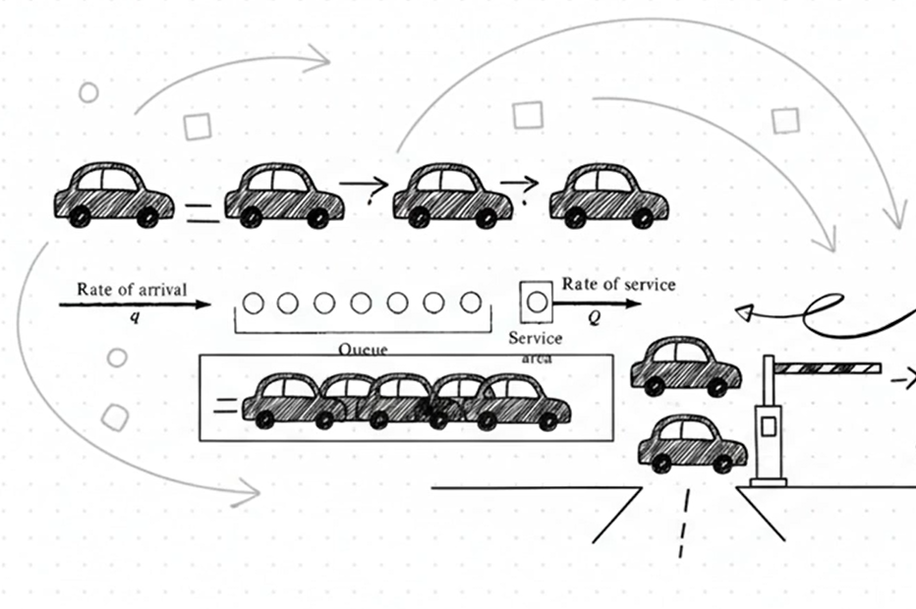
Queuing Théories stochastique Queueing Analyse
Scenario-1: canal unique, sous-saturé, files infinies
Assume an taux d’arrivée of q véh/h and a taux de service of Q véh/h, where Q > q, and both rates of arrival and service are random, the following relation can be established:

Slide 15




Queuing Théories stochastique Queueing Analyse
Scenario-1: canal unique, sous-saturé, files infinies
Probability of “n” véhicules in the system, P(n)
Expected number of véhicules in the system, E(n)
Expected number of véhicules waiting for service (mean longueur de file), E(m)
temps d’attente moyen in file, E(w)

Slide 16
Example: Application of the canal unique, sous-saturé, Infinite File Théorie to a Tollbooth Exploitation
On a given day, 425 Veh/hr. arrive at a toll booth with a canal unique service at a rate of 625 Veh/hr. Déterminer (a) the percentage of temps the operator of the tool booth will be free, (b) the moyen number of véhicules in the system, and (c ) the temps d’attente moyen in the file (Assume Poisson arrival and negative binomial service temps).
Solution :
q=425, and Q=625, hence the condition Q >q is satisfied, and the débit is sous-saturé. For the operator to be free, the number of véhicules in the system must be zero. Hence, P(0) is
      P(0) = 1-q/Q = 1 – (425/625) = 1- 0.68 = 0.32
      Hence, the operator is free for 32% of the temps.
Adapted from: Garber, N. J., & Hoel, L. A. (2009. Traffic and Route Engineering (4th ed., pp. 256).

Slide 17
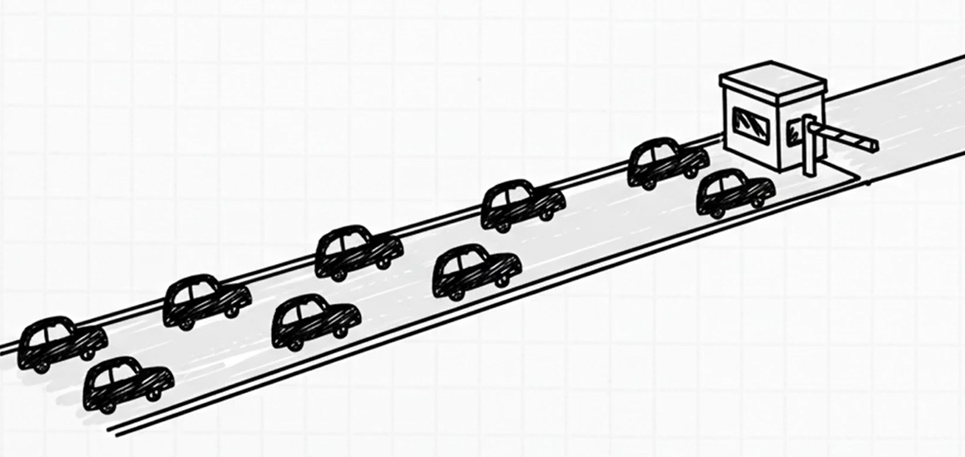
b) The moyen number of véhicules in the system will be
    E(n) = q = 425 = 2 véhicules
    (Q-q) (625-425)
b) The temps d’attente moyen in the file will be
    E(w) = q = 425 = 12 seconds
    Q(Q-q) 625(625-425)

Slide 18
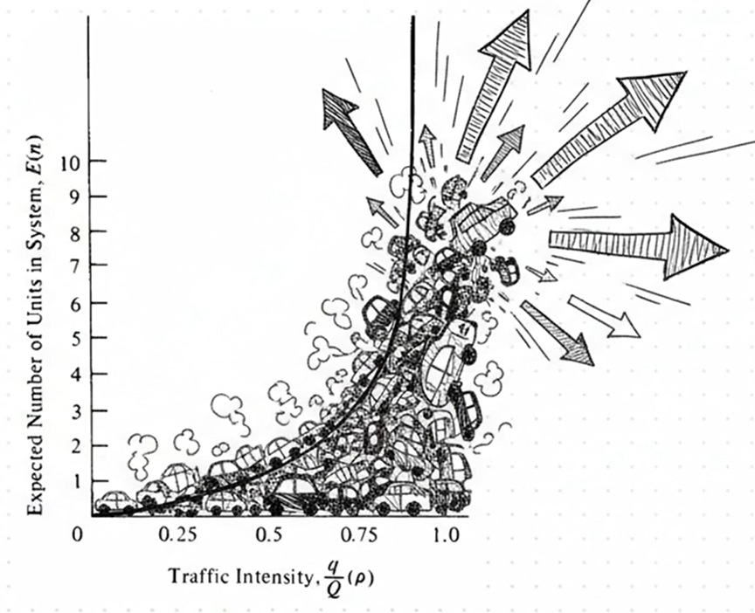
Queuing Théories stochastique Queueing Analyse
As intensité du trafic (q/Q) increases, the expected number of véhicules in the system increases exponentially,
As the intensity tends to approach 1, the expected number of véhicules tends to infinity, and the rupture of the system.
As a rule of thumb, it is useful to keep the ratio below 0.85 and certainly below 0.9.

Slide 19
Questions de discussion
How does the "two-capacité" phenomenon challenge the exactitude of standard deterministic queueing modèles during facility breakdowns, and what are the practical implications for predicting dégagement times?
Traffic engineers often appliquer a rule of thumb to keep the q/Q ratio below 0.85 or 0.90. Why is "wasted" capacité considered a necessary requirement for a high niveau de service, and how does this contradict the goal of maximizing resource utilization?

Slide 20
Ressources complémentaires
https://www.youtube.com/watch?v=d6WC3TPMDuA&list=PLneifN52CCdu_uMCA-R6zHD_1YYxVS0Oe&index=12
https://www.youtube.com/watch?v=EGgTcr6aBFU&list=PLneifN52CCdu_uMCA-R6zHD_1YYxVS0Oe&index=13
Garber, N. J., & Hoel, L. A. (2009). Chapter 6: Fondamental Principles of flux de trafic. In Traffic and Route Engineering (4th ed., pp. 253–305).

