Slide 1
Ingénierie du trafic
Cours 2.4 : Théories des ondes de choc

Slide 2
Objectifs d’apprentissage
Comprendre traffic ondes de choc
Classify shockwave types
Calculer shockwave vitesse
Analyser files at feux and goulots d’étranglement

Slide 3
Plan du cours
Rappel : variables fondamentales du trafic
What is traffic Shockwave?
Types d’ondes de choc
Velocity of ondes de choc
Exemple corrigé – intersection à feux
Référence principale :
Garber, N. J., & Hoel, L. A. (2009). Chapter 6: Fondamental Principles of flux de trafic. In Traffic and Route Engineering (4th ed., pp. 253–305).

Slide 4

Pourquoi les ondes de choc ?
ondes de choc décrire how changements brusques in vitesse, débit, or capacité propagate through a courant de trafic, forming a file mobile.
Essential for exploitation du trafic and contrôle because it explains how congestion forms, grows, and dissipates
Critique for signal conception, zones de travaux, and gestion des incidents
Strong lien to route sécurité and congestion mitigation
Regarder these videos
https://www.youtube.com/watch?v=Suugn-p5C1M
https://www.youtube.com/watch?v=Mh6PNQbKBYo

Slide 5
Rappel : variables fondamentales du trafic
Débit (q)= Rate of véhicules passing a point. Unit: véh/h
Densité (k)= Concentration of V1ehicles over a distance. Unit:
Veh/ km
vitesse (u)= vitesse moyenne spatiale of the stream. Unit: km/h
vitesse moyenne spatiale vs vitesse moyenne temporelle
Fondamental relation: q = k · u

Slide 6
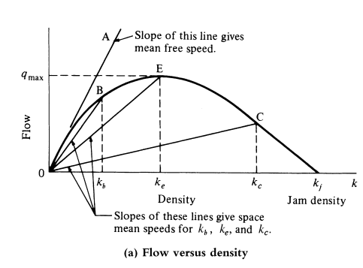
Diagramme fondamental de l’écoulement du trafic
Shows the relation between débit and densité
Defines capacité and densité de saturation
Source: Garber, N. J., & Hoel, L. A. (2009). Traffic and Route Engineering (4th ed., pp. 251)

Slide 7
Qu’est-ce qu’une onde de choc du trafic ?
A moving boundary between two états de trafic with different speeds, flows, and densities.
Represents the propagation of a disturbance, not the motion of individual véhicules.
Can move upstream, downstream, or remain stationary.
Commonly observé as sudden braking or acceleration in traffic streams
Typical at feux, goulots d’étranglement, zones de travaux, and incidents

Slide 8
Types d’ondes de choc
Majeur types:
  Frontal stationary
  Backward forming
  Backward recovery
  Rear stationary
  Forward recovery

Slide 9
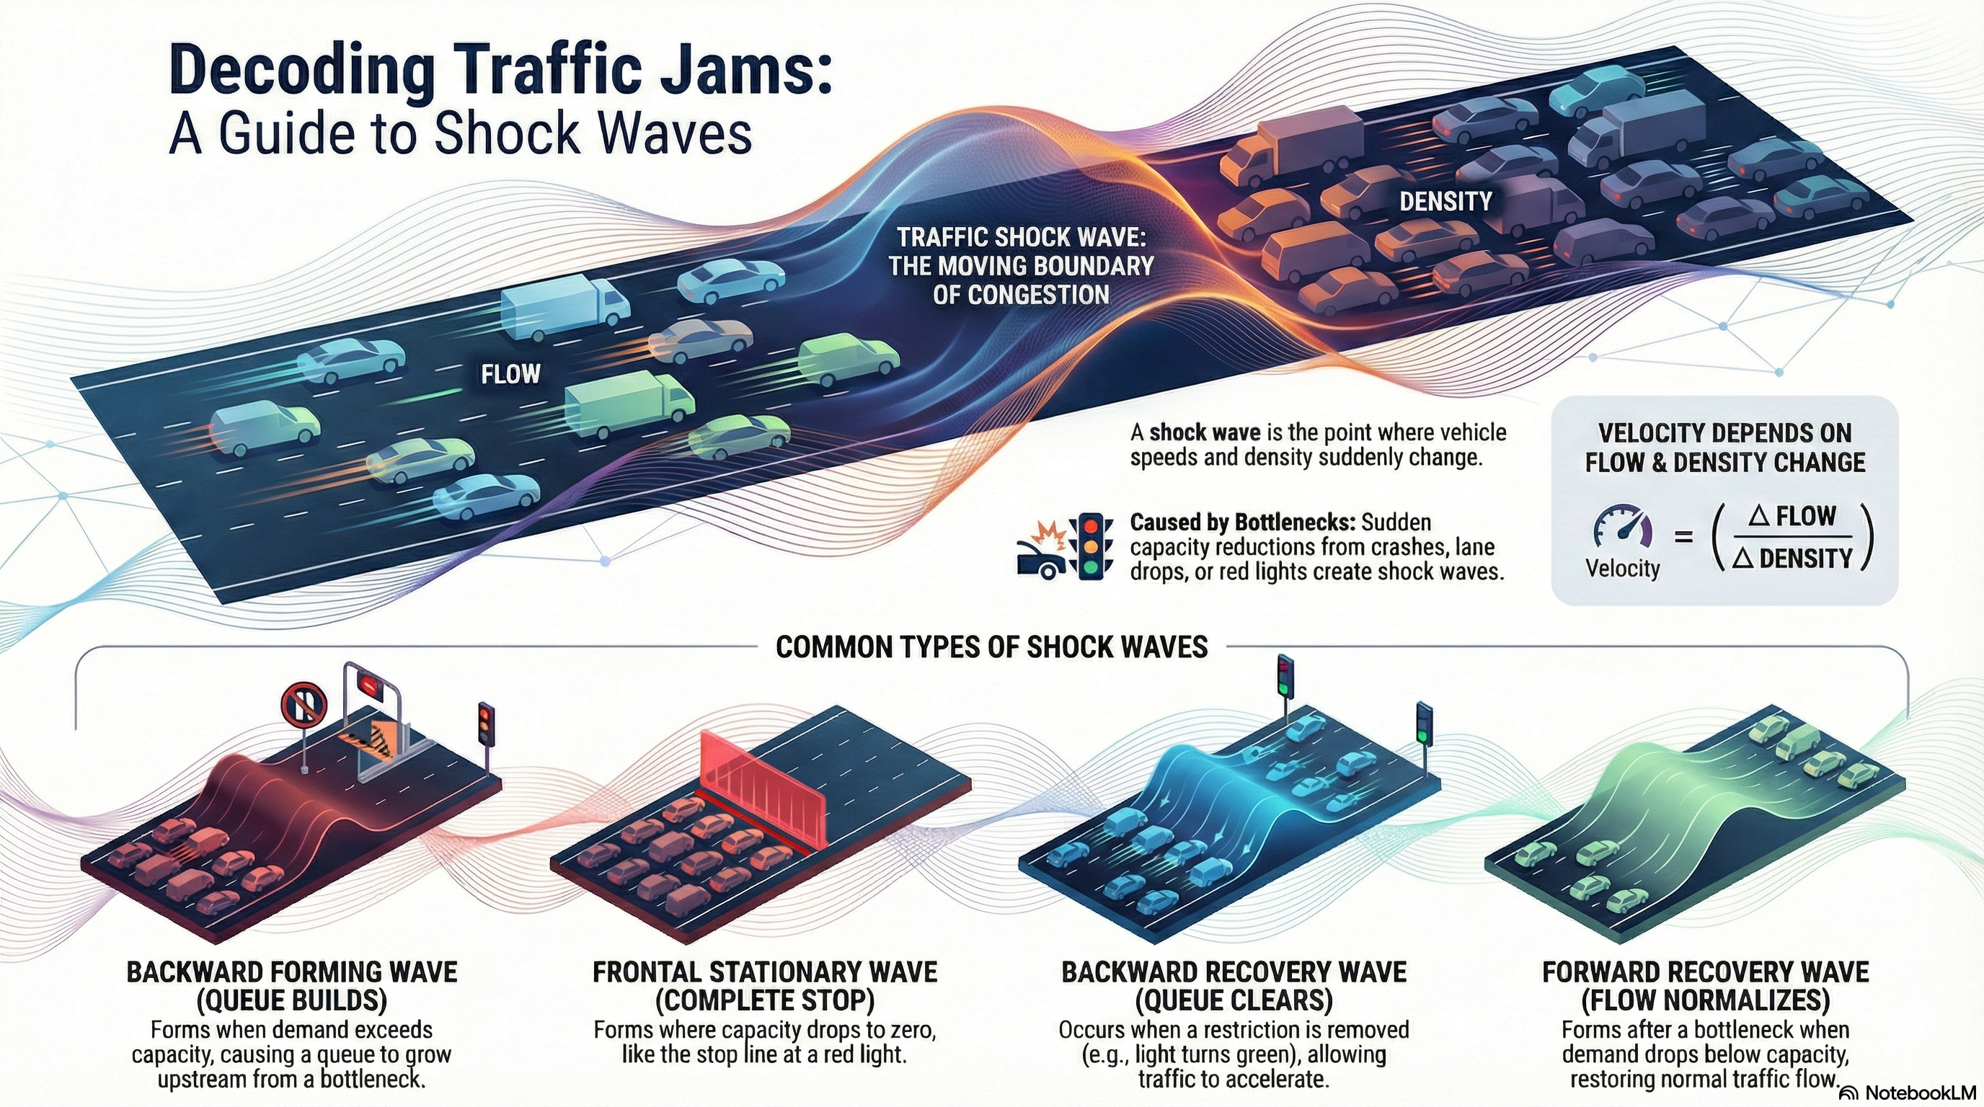

Slide 10
Types d’ondes de choc
Frontal Stationary Shockwave
  Occurs when la capacité tombe à zéro
  Example: feu rouge
  Waves remain fixed in space
onde de choc de formation vers l’amont
  File grows upstream when demande > capacité
  Courant at goulots d’étranglement and red feux
onde de choc de récupération vers l’amont
  File dissipates when demande < capacité
  Moves upstream, releasing véhicules

Slide 11
Types d’ondes de choc
Rear Stationary Shockwave
  demande equals capacité after oversaturation
  File neither grows nor shrinks
  Transitional condition
onde de choc de récupération vers l’aval
  Occurs after congestion clears
  Wave moves downstream
  véhicules accelerate to écoulement libre vitesse

Slide 12
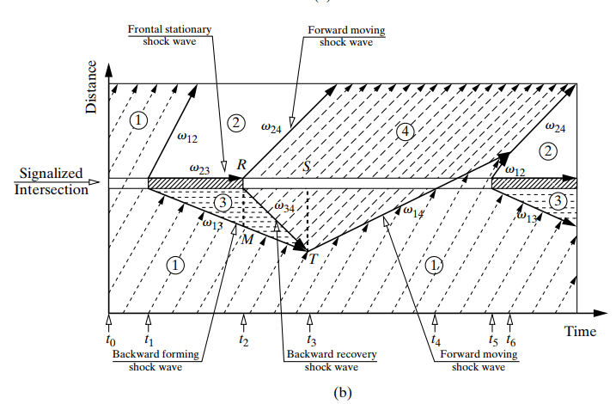
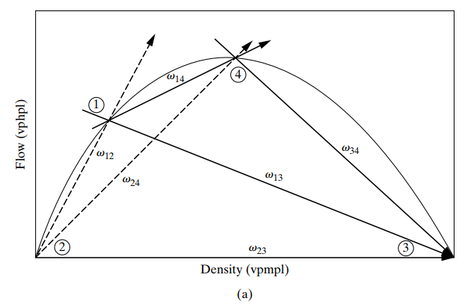
Example: ondes de choc at intersections à feux
Shock Wave at intersection à feux
Source: Garber, N. J., & Hoel, L. A. (2009). Traffic and Route Engineering (4th ed., pp. 232)

Slide 13
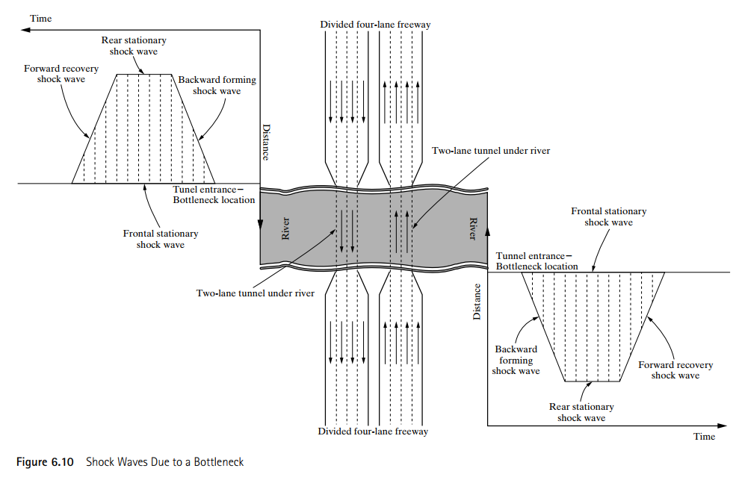
Example: ondes de choc at Bottleneck
Source: Garber, N. J., & Hoel, L. A. (2009). Traffic and Route Engineering (4th ed., pp. 233)

Slide 14
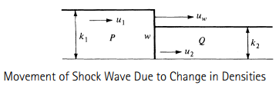
Vitesse des ondes de choc
états de trafic
State 1: (q₁, k₁, u₁)
State 2: (q₂, k₂, u₂)
Shockwave boundary between the two states (w)
Conservation Principle
No véhicule creation or loss across the wave
véhicules entering = véhicules leaving
Basis for shockwave vitesse derivation
Propagation de l’onde de choc due à une variation des densités

Slide 15



Vitesse des ondes de choc
The relative space mean speeds of véhicules in the two états de trafic are
The number of véhicules crossing the line “w” during a temps période t is:
Since the net change is zero—that is, N1 =N2 (conservation)
However,
=>

Slide 16


Vitesse des ondes de choc
Substituting q1 and q2 gives
Hence, the shockwave vitesse will be
Interpretation of Shockwave vitesse
uw < 0: upstream wave
uw > 0: downstream wave
Propagation de l’onde de choc due à une variation de densité
Source: Garber, N. J., & Hoel, L. A. (2009). Traffic and Route Engineering (4th ed., pp. 234)

Slide 17
Exemple corrigé – intersection à feux
The southbound approach of a intersection à feux carries a débit of 1000 véh/h/ln at a velocity of 50 km/h. The feu rouge duration is 15 seconds. If the débit de saturation is 2000 véh/h/ln and the densité is 75 veh/ln, the densité de saturation is 150 véh/km. Déterminer the following:
    The longueur of the file at the end of the red phase
    The maximum longueur de file
    File dissipation temps after the end of the red.
Adapted from: Garber, N. J., & Hoel, L. A. (2009). Traffic and Route Engineering (4th ed., pp. 237)

Slide 18




Exemple corrigé – intersection à feux
Données :
débit de saturation
Densité at saturation
densité de saturation
Solution :
a) Let us first déterminer the vitesse of the backward-forming shock wave when the feux turn to red (w13)

Slide 19




En utilisant the relation fondamentale, déterminer the initial densité (k1)
Since débit stops at the signal during red, q3=0
longueur de file at the end of red:
=

Slide 20
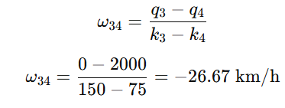

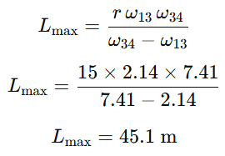
b) Maximum longueur de file
Let us calculer the onde de choc de récupération vers l’amont vitesse
Hence, the maximum longueur de file is given by
=

Slide 21
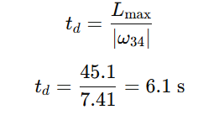

c) File dissipation temps after the end of red
File dissipation temps is given by:

Slide 22
Questions de discussion
At a intersection à feux, why is the dissipation of a file not instantaneous when the light turns green, and how do the "Forward Moving" and "Backward Recovery" waves interact to déterminer the total temps to dégagement?
In the scenario of a slow-moving truck, how can a facility experience both a "backward moving" shockwave and a "forward moving" shockwave simultaneously, and what does this tell us about densité relative to the obstacle?

Slide 23
Ressources complémentaires
https://ocw.tudelft.nl/course-lectures/4-shockwave-theory-s-p-hoogendoorn/
https://ocw.tudelft.nl/course-readings/chapter-8-shock-wave-analysis/
https://open.umn.edu/opentextbooks/textbooks/973
Garber, N. J., & Hoel, L. A. (2009). Chapter 6: Fondamental Principles of flux de trafic. In Traffic and Route Engineering (4th ed., pp. 253–305).

