Slide 1
Ingénierie du trafic
Cours 3.2 : Études des volumes de trafic

Slide 2
Objectifs d’apprentissage
Comprendre volume de trafic concepts
Differentiate volume, demande, and capacité
Expliquer temporal traffic variation patterns
Appliquer concepts to intersection and réseau studies

Slide 3
Plan du cours
Pourquoi les études des volumes de trafic sont-elles importantes ?
Paramètres clés du trafic
Volume vs demande vs capacité
Caractéristiques des volumes
Référence principale :
Roger P. Roess; Elena S. Prassas; William R. Mc Shane, ingénierie du trafic, 5th edition, Pearson, 2019

Slide 4
Introduction
études des volumes de trafic mesurer the number of véhicules or pedestrians
Inclure directional movement, occupancy rates, véhicule classification, and pedestrian age.
Counts are taken over a specified temps période
Temps période varies from 15 minutes to a full year
Fondamental input to ingénierie du trafic decisions
Utilisé in planification, conception, and exploitation

Slide 5
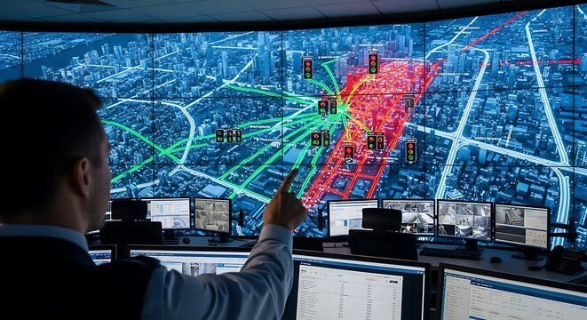
Pourquoi les études des volumes de trafic sont-elles importantes ?
Provide foundation for ingénierie du trafic analyse
Support transportation planification et conception
Help évaluer sécurité and operational performance
Enable long-term infrastructure investment decisions

Slide 6
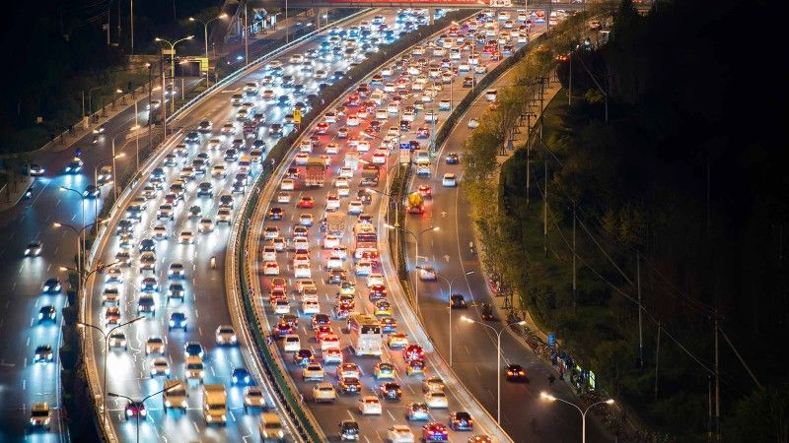
Paramètres clés du trafic
volume
débit
demande
capacité
All expressed in véhicules per unité de temps

Slide 7
Paramètres clés du trafic
volume
  is the number of véhicules (persons) passing a point during a specified temps période.
  Temps période can be an heure or a day.
  Cannot exceed roadway capacité
  Different types of volume fondé on the longueur of the count période
    Annuel trafic journalier moyen (AADT)
    Trafic journalier moyen (ADT)
    volume de l’heure de pointe (PHV)

Slide 8
Paramètres clés du trafic
Débit
  Equivalent horaire rate for short periods
  Expressed in véhicule per hr.
  Important for peak débit analyse
capacité
  The maximum rate at which véhicules can traverse a point or short segment during a specified temps
  It is the caractéristiques of the roadway
  Estimated en utilisant Route capacité Manuel
  May differ from observé maximum débit

Slide 9
demande
  The number of véhicules (persons) that DESIRE to pass a point during the specified temps, usually an heure.
  May exceed volume observé
  Inclut queued, diverted, and suppressed trips
  Not directly observable
  When demande is higher than capacité, congestion will result
Source : Traffic Engineering, 4e édition,

Slide 10
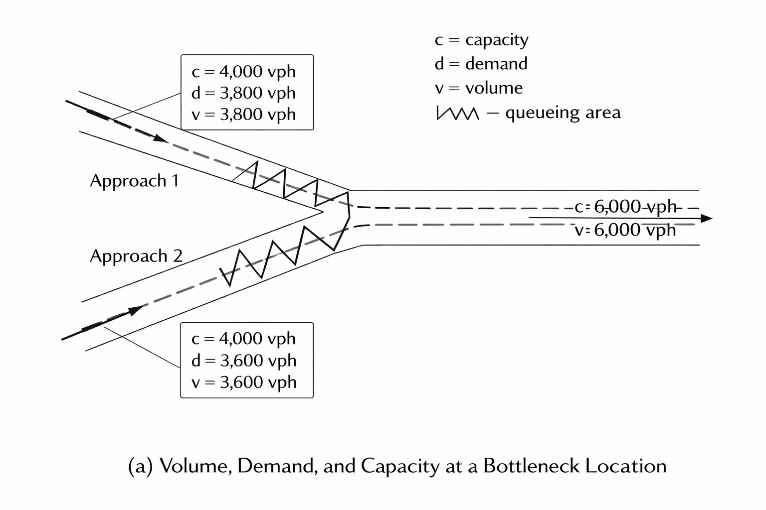
Volume vs demande vs capacité
volume = what is observé
demande = what users want
capacité = physical limit
Confusion leads to poor conception decisions
concept de goulot d’étranglement
Occurs where demande exceeds capacité
Creates files and retards
volume observé capped at capacité
True demande remains hidden
Source : Traffic Engineering, 4e édition,

Slide 11
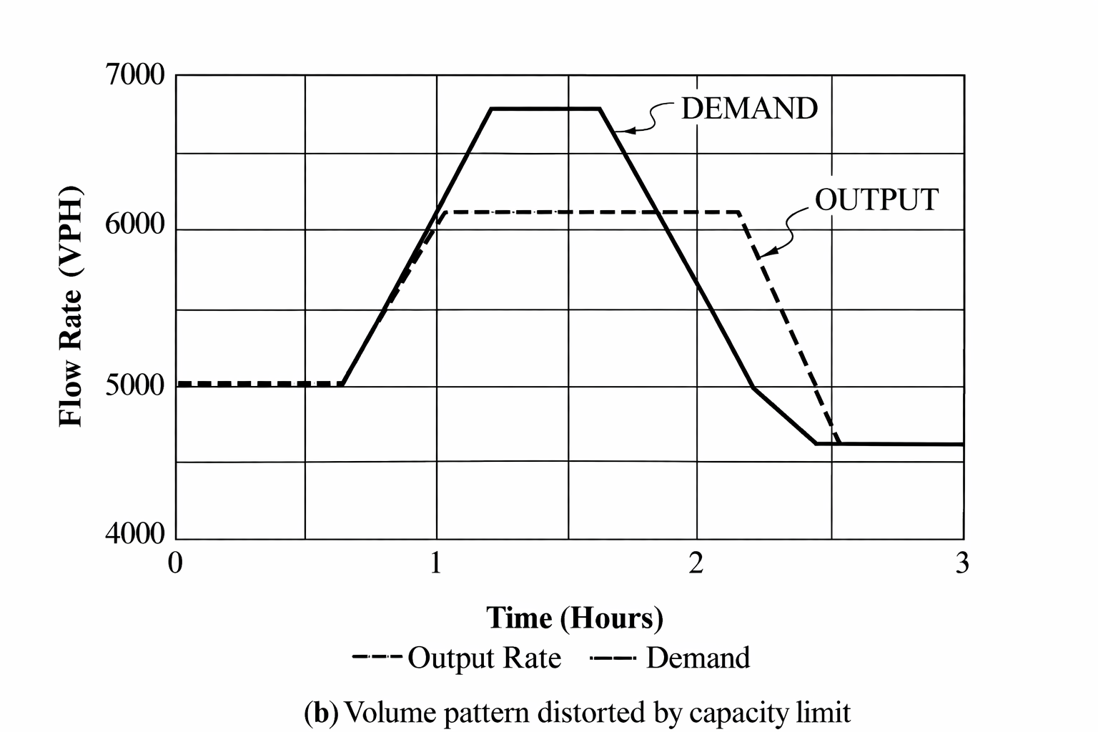
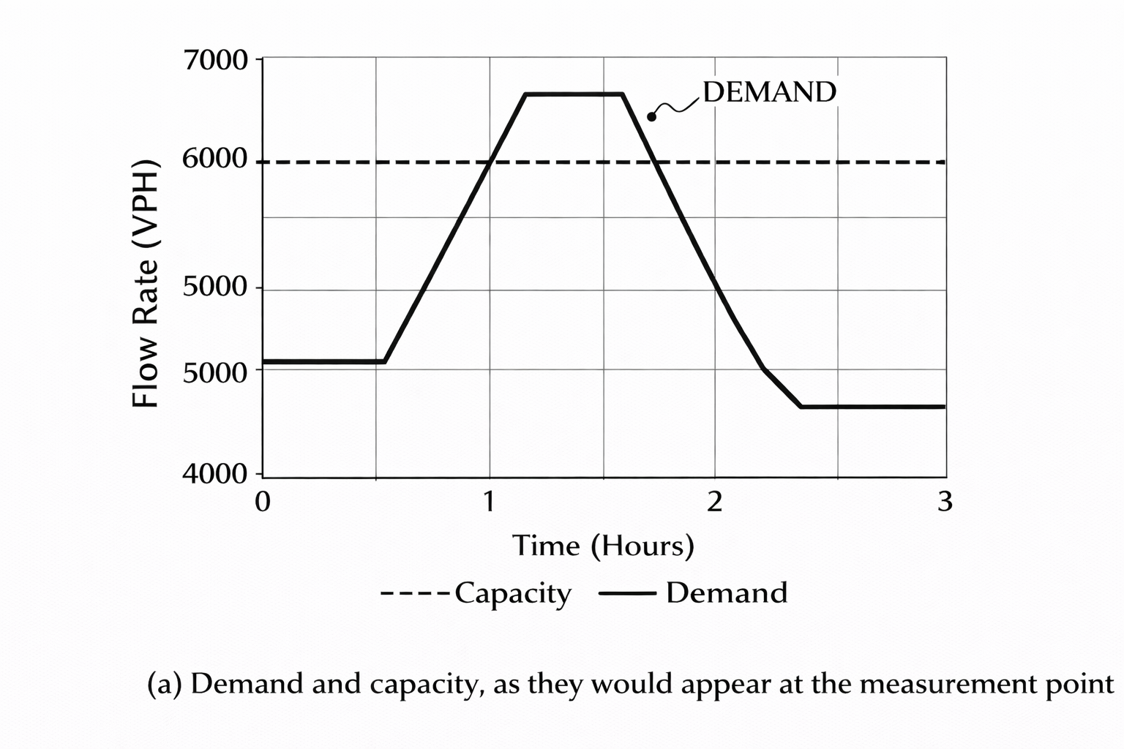
Volume vs demande vs capacité
Source : Traffic Engineering, 4e édition,

Slide 12
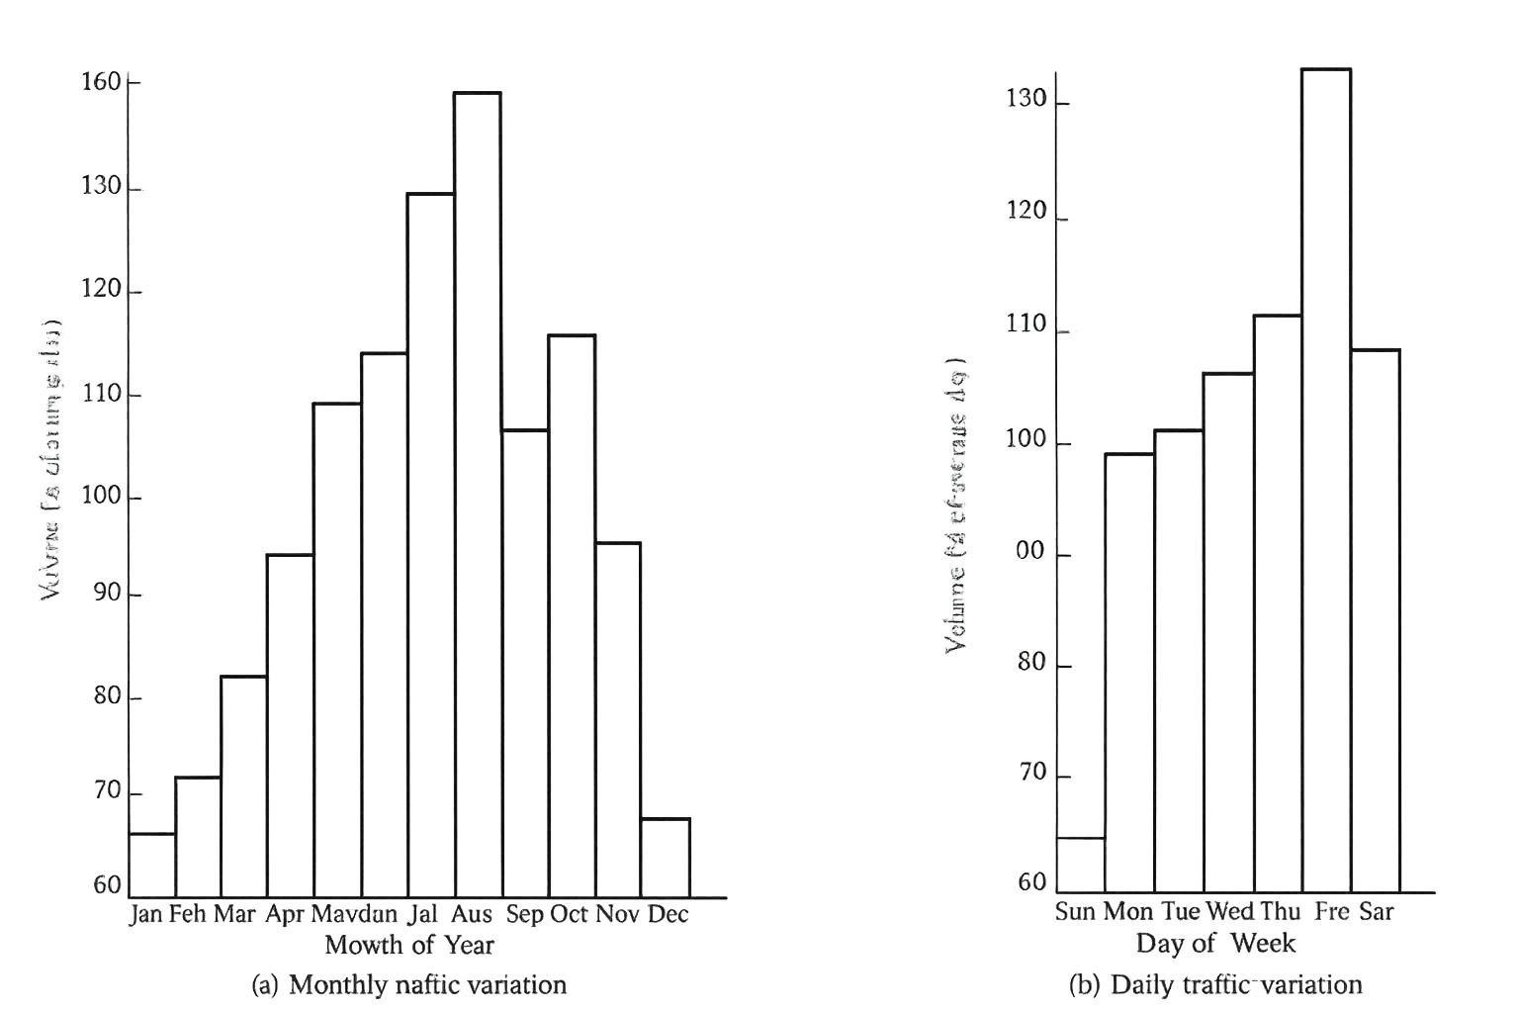
Caractéristiques des volumes
Traffic demande varies over temps (by hours of a day, by days of a week, by months of a year)
Facilities are designed for peak conditions
sous-utilisation occurs off-peak
Accurate données prevents surdimensionnement
Source: Garber, N. J., & Hoel, L. A. (2009). Traffic and Route Engineering (4th ed., pp. 127)

Slide 13
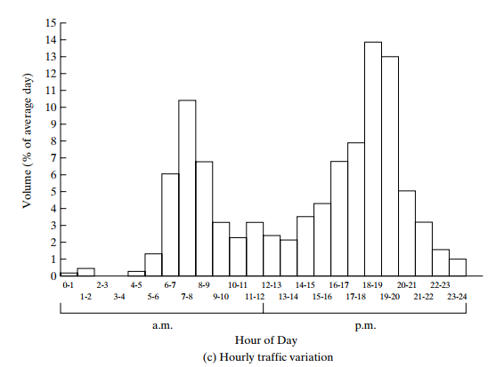
Variation quotidienne du trafic
volumes differ by day of the week
Weekdays differ from weekends
Friday is often higher than midweek
Depends on occupation du sol and trip purpose
Variation mensuelle et saisonnière
Traffic varies by season
itinéraires récréatifs peak seasonally
itinéraires pendulaires are more stable
Important for AADT estimation

Slide 14
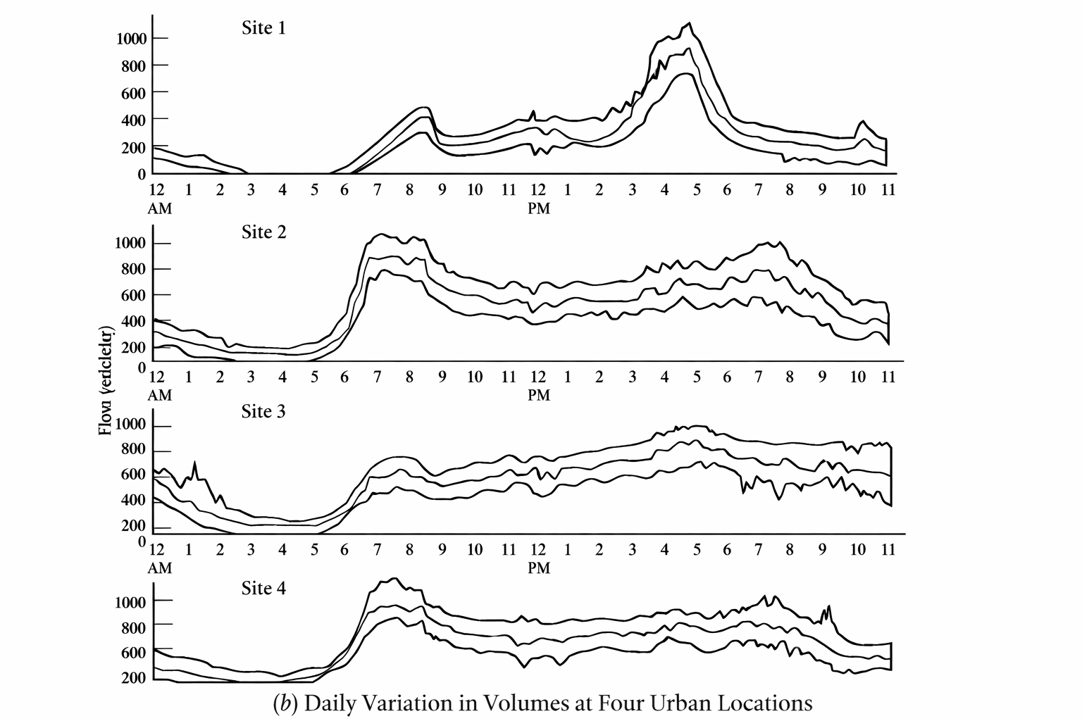
Variation horaire du trafic
Traffic is not uniform throughout the day
pointes du matin et du soir are courant
Peaks driven by déplacements domicile-travail
Pattern varies by type d’infrastructure
Concept d’heure de pointe
Highest horaire volume de trafic
Typically 9–15% of journalier traffic
Clé conception condition
Varies by location and occupation du sol
Source : Traffic Engineering, 4e édition,

Slide 15
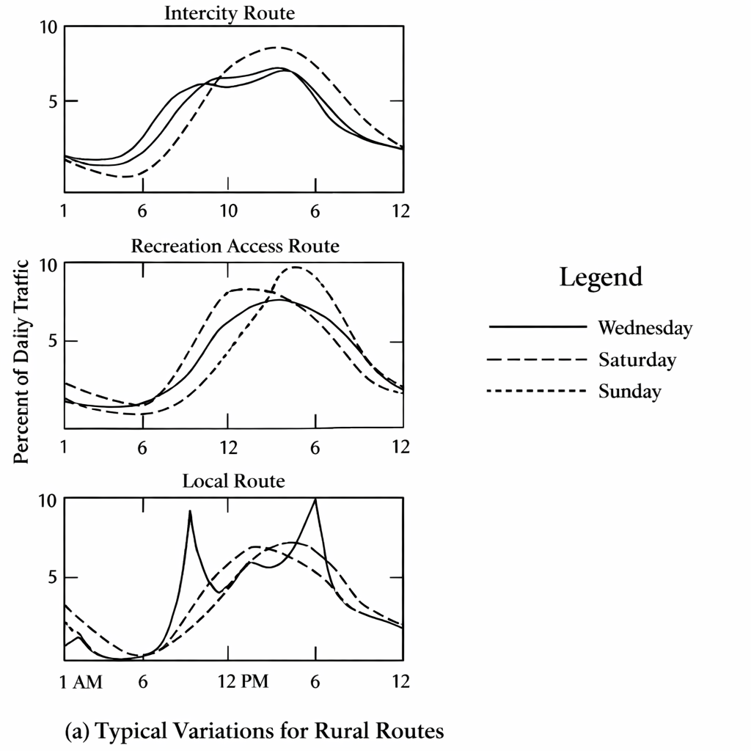
Profils horaires urbains
Some facilities show extended peaks
congestion spreads demande
Off-peak travel increases
Clear AM/PM peaks may disappear
Profils horaires ruraux
Single broad peak courant
Weekend and seasonal effects are strong
Higher variability than urbain itinéraires
Driven by non-work trips
Source : Traffic Engineering, 4e édition,

Slide 16
Facteur d’heure de pointe (PHF)
Ratio of horaire volume to peak débit
Indicates demande concentration
Lower PHF means sharper peak
Critique for conception decisions

Slide 17
Trafic journalier moyen annuel (AADT)
Moyen 24-heure volume de trafic over a year
  Calculated by averaging journalier traffic counts for all 365 days
Represents long-term traffic demande
  Smooths out journalier, weekly, and seasonal variations
Utilisé in the evaluation of the economic feasibility of route projects
Essential for route planification et conception
  Basis for functional classification, conception géométrique, and investment decisions

Slide 18
Trafic journalier moyen (ADT)
Moyen 24-heure volume over several days
  Computed from multiple journalier traffic counts within a short période
Collected for periods shorter than one year
  Does not account for full variation saisonnière
Utilisé to évaluer current traffic demande
  Reflects existing traffic conditions on a roadway
Can be converted to AADT by multiplying by the seasonal factor.

Slide 19
Véhicules-kilomètres parcourus (VKT)
Product of volume de trafic and roadway longueur
Represents total travel demande
Utilisé for allocation des financements and planification de l’entretien
Indicator of system usage

Slide 20
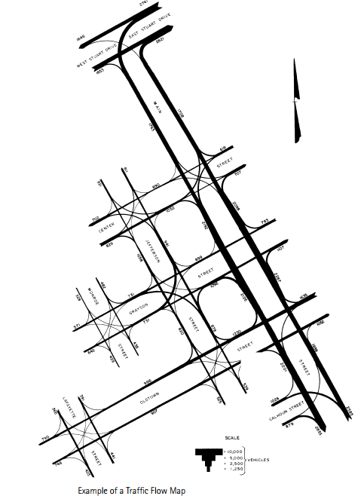
Carte des flux de trafic
Shows traffic volumes on individual itinéraires
volume de trafic is represented by the width of bands drawn on the map
Bandwidth is proportional to the magnitude of flux de trafic
Enable quick visual comparison of traffic volumes across itinéraires
Inclure numerical volume values near bands to improve clarity and exactitude
Source: Garber, N. J., & Hoel, L. A. (2009). Traffic and Route Engineering (4th ed., pp. 125)

Slide 21
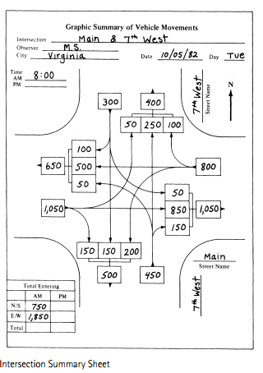
Études des volumes aux intersections
Most complex traffic locations
Multiple movements and conflicts
mouvements tournants critique
Often counted manually
Source: Garber, N. J., & Hoel, L. A. (2009). Traffic and Route Engineering (4th ed., pp. 126)

Slide 22
Applications des études de volumes de trafic
Route and intersection conception
programmation des feux
conception des chaussées et des structures
Transportation planification and policy
Roadway and intersection conception
Traffic contrôle and signal timing
analyse de capacité
planification du réseau and VMT estimation

