Slide 1
Additional material
An Introduction to Geosynthetics
TRB Webinar
Prof. Chungsik Yoo

Slide 2
Road Transportation Systems Engineering Development in the Sub-Saharan Africa – Modern EU Master Programme & Capacity Building

Slide 4
TRB Webinar:An Introduction to Geosynthetics
Introduction to Geosynthetics – Prof. Chungsik Yoo, President of the International Geosynthetics Society (IGS)
This webinar was sponsored by TRB’s Standing Technical Committees on Mechanics and Drainage of Saturated and Unsaturated Geomaterials, Transportation Earthworks, and Geotechnical Instrumentation and Modelling.

Slide 5
TRB Webinar:An Introduction to Geosynthetics
Learning Objectives:
Understand the fundamental concept and definition of geosynthetics
Identify major categories of geosynthetics and their engineering functions
Recognize typical applications of geosynthetics in geotechnical and civil engineering
Understand how geosynthetics contribute to infrastructure performance, durability, and sustainability
Gain introductory knowledge of current developments and practical use of geosynthetic materials

Slide 6
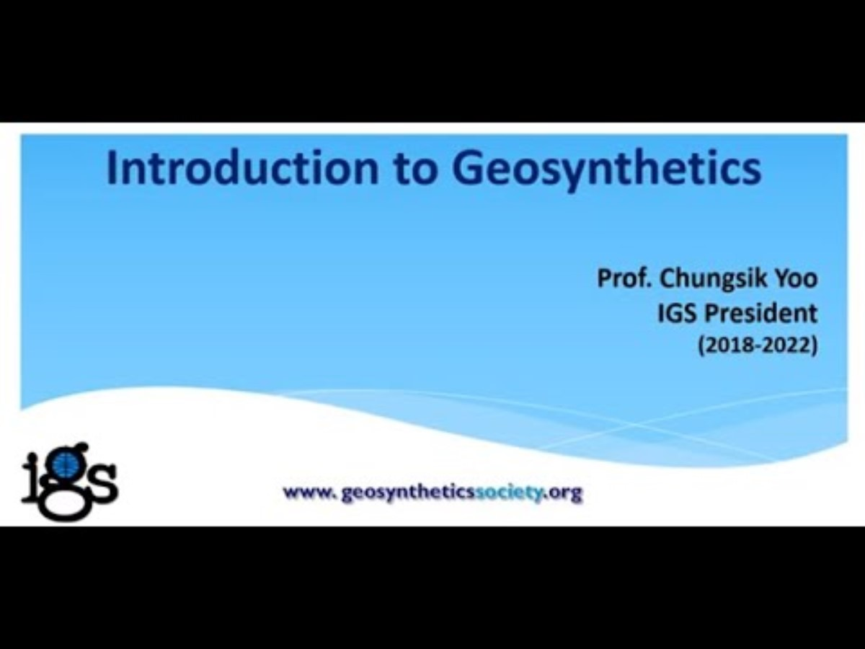
TRB Webinar:An Introduction to Geosynthetics

